Slide 1
Buckling calculation for window design
S. Jin¹, P. Sievers², T. Omori³, J.Gao¹
¹ IHEP; ²CERN; ³KEK;
POSIPOL2016, LAL, Orsay, Sept. 14-16, 2016.

Slide 2
Introduction
Studies on thin Ti-windows are important for the containment of targets and vacuum windows.
In the following a first approach is made, studying the response of thin windows to beam heating by buckling.

Slide 3
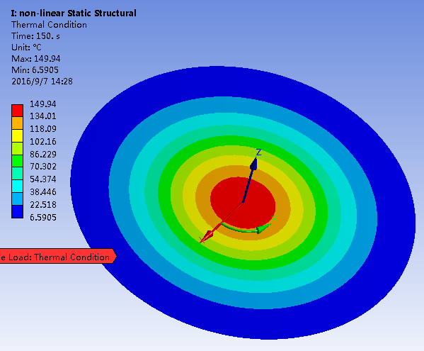
The temperature profile used before was uniform. Now, the Gauss temperature profiles are used. Sigma=4mm.
Thickness of 0.1mm and 0.2mm of the windows are calculated, respectively.
Following temperature is checked:
23.5 C and 47 C for 0.1mm window
47 C and 94 C for 0.2mm window
These values resulted from a study, made by A. Ushakov for the window of the photon beam dump, where however the rms value was smaller, about 1.0 mm.
In the first part we continue, however, with a rms of 4 mm, which gives pessimistic results, as compared to smaller beams with the same peak temperature.
For better understanding, we compare cases with buckling and cases, where buckling is not allowed.
$$T⁢\left(r,z\right)=C∗e^{−\frac{r^{2}}{32}}$$

Slide 4
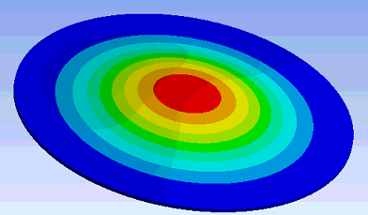
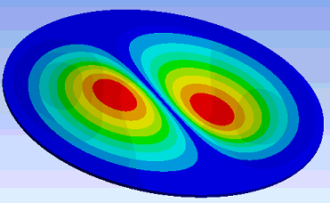
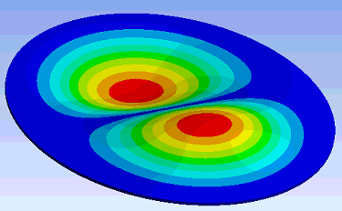
1. Buckling analysis for 0.1mm thickness window with Gauss profile temperature
1st mode
Mode | Critical Peak Temperature (C)
1 | 24.95
2 | 47.02
3 | 47.03
4 | 82.73
5 | 82.90
2nd mode
3rd mode
It shows that for 0.1mm thickness window, it will start to buckle with Gauss temperature profiles at peaks temperature of about 25C and 47C. The schematic of modes shape are shown as above.

Slide 5
Displacement for 1st order and 2nd order mode
v. M. stresses and displacement for 1st and 2nd order of buckling for 0.1mm window
v. M. stress for 1st order and 2nd order mode
We can see that the 1st order buckling will take place earlier than 2nd order buckling mode. The displacement for the 1st order buckling is larger than for the 2nd order and the stresses are not very different for 1. and 2. order, just the shapes are different.

Slide 6
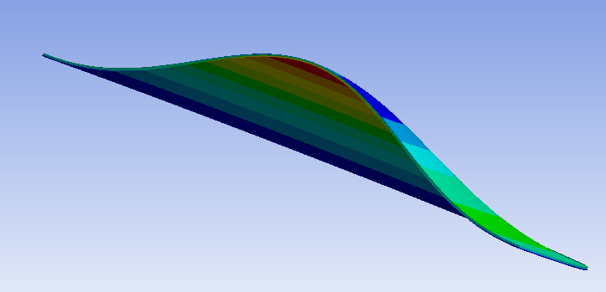
2. Buckling analysis for 0.2mm thickness window with Gauss profile temperature (1)
Mode | Critical Peak Temperature (C)
1 | 99.603
2 | 187.56
3 | 187.6
4 | 329.64
5 | 330.37
It shows that for 0.2mm thickness window, there will not be buckling under the Gauss temperature profile if the peak temperature is below of 99.6C

Slide 7
0.2mm thickness window with Gauss profile temperature (2)
We calculated the displacement and v.M. stress in the center versus temperature. Buckling starts at around 94C and the stress rises sharply from 100 MPa at 110C to 210 MPa at 130C.

Slide 8
3. Buckling and non-buckling results comparison
v. M. stress comparison of buckling and non-buckling results for 0.1mm window
v. M. stress comparison of buckling and non-buckling results for 0.2mm window

Slide 9
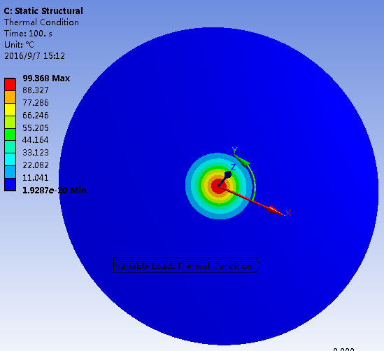
4. Gauss profile temperature with rms of 1mm.
The peak temperatures are 23.5 ºC and 47. for 0.1 and 0.2 mm thickness when rms=4mm.
Considering now a smaller beam with rms = 1mm
$$T⁢\left(r,z\right)=C∗e^{−\frac{r^{2}}{2}}$$

Slide 10
Critical Peak Temperature of buckling with a rms beam of 1.0mm
Mode | Critical Peak Temperature (C)
1 | 196
2 | 469
3 | 469
4 | 531
5 | 884
Mode | Critical Peak Temperature (C)
1 | 785
2 | 1870
3 | 1870
4 | 2107
5 | 3495
0.1mm thickness window. It will buckle at about 196C.
0.2 mm thickness window. There will be no buckling under 720C.
So, we just consider 1st mode for both of 0.1 mm and 0.2 mm window for one beam.

Slide 11
For 0.1 mm thickness window and a rms beam of 1.0 mm

Slide 12
For 0.2 mm thickness window and a rms beam of 1.0 mm
720 C
At the peak temperature of 720 C, the max. v. M. stress is about 373MPa.

Slide 13
Summary
Simulation with different beam sizes, window thicknesses are done. Results on displacements, stresses and temperatures where buckling starts and also displacements and stresses at the expected and assumed temperatures are obtained.
Following is a table to detailed results.
 | thickness | Buckling Mode | Critical Peak Temperature (C) | Max.v. M. Stress in buckling (MPa) | Excepted peak temperatures ( C ) | Max. v. M. Stress at excepted peak temperatures (MPa)
rms=4 | 0.1mm | 1st | 25 | 27 at 25C to 56 at 34C | 23.5 | 21
 |  |  |  |  | 47 | 75
 |  | 2nd/3rd | 47 | 34 at 33C to 78 at 55C | 23.5 | 21
 |  |  |  |  | 47 | 63
 | 0.2mm | 1st | 99.6 | 85 at 99C to 212 at 129C | 47 | 37
 |  |  |  |  | 94 | 78
rms=1 | 0.1mm | 1st | 196 | 108 at 196C to 176 at 240C | 23.5 | 11.7
 |  |  |  |  | 47 | 23.5
 | 0.2mm | 1st | 785 | 435 at 785C to 881 at 1076C | 47 | 23.5
 |  |  |  |  | 94 | 47

