Slide 1
ILC Active sliding contact cooling Target R&D update
Presenters
Project personnel
Wanming Liu
Wei Gai, Manoel Conde, Wanming Liu, Scott Doran, Vic Guarino (UofC), Charles Whiteford, Frank Skrzecz, Allen Zhao, George Fenske (ES), Robert Erck (ES),
Sept 16, 2016
POSIPOL 2016, Orsay, France

Slide 2
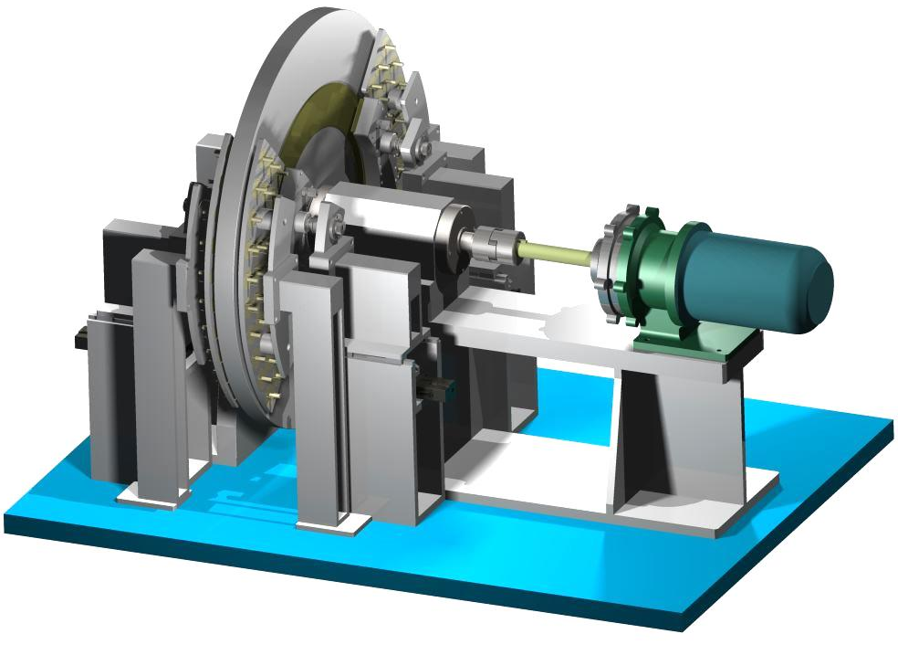
Active Sliding Contact Cooling Demo Conceptual Illustration
Overview
Rotating 1meter diameter Target Wheel at 2000 rpm (100 m/s) while extracting ~10kW by using active sliding contact cooling.
Target wheel is driven by a magnetically coupled drive motor which separates the motor from the vacuum.
Stability of wheel controlled by heavy duty machine spindle.
Temperature of wheel controlled by 4 Active Sliding Contact Cooling Pads.
Cooling Pad’s temperature controlled by water/coolant.
Heat applied to wheel using UHV radiant filament heaters.
Diagnostic feedback: RPM, Temp and Pressure of Cooling Pads, Temp of Target Wheel, Vibration, etc.
1
6
4
3
2
Full Size Target Wheel Ready for Operations in Vacuum

Slide 3
Proposed parameters
The target will be a 1 meter diameter solid disc with a rim of about 2cm wide and 1.4cm thick titanium alloy for positron production.
The disc surface area contacting with cooling pad will be coated with vacuum compatible low friction lubricant.
The cooling pad will be spring loaded and also coated with vacuum compatible low friction lubricant.
The contacting area is assumed to be 300cm^2 with a contact pressure of 1N/cm^2 . Assuming a friction coefficient of 0.1, the heat generated by the friction is estimated to be 3kW when target is rotating at full speed (~2000RPM).
If Tungsten(173 W/m/K) is used for the cooling pads, then the temperature at the surface of target will be roughly estimated at about 38 K above ambient for 20kW total power removal( the highest power deposited in target by photon beams is about 8kW).
The cooling pad will have cooling channel inside and connected with cooling liquid manifolds. As the cooling pad is stationary, a vacuum compatible cooling water manifold should be easily implemented.

Slide 4
Review of results presented @ LCws2015
The initial short test run of phase 1 setup prior to LCWS2015 has showing encouraging results

Slide 5
More test runs were planned and carried out
Test Goals
Operate the target wheel continuously for a period of time longer than the initial test runs prior to LCWS2015 to confirm improvements and stability of system.
The initial test runs were 15-30 minutes long. These test runs will be approximately 3 hours.
Verify machine stability while simultaneously and clearly demonstrating contact cooling and/or contact heating.

Slide 6
More test runs were planned and carried out
Test Approach
Approaches taken
Repeat test from prior to LCWS2015. Cool the wheel from ambient temperature with cooling pads.
Heat the wheel from ambient temperature with cooling pads.
Cool the wheel with cooling pads while external heat source (radiant heater) is applied to wheel. The goal of Phase 1.

Slide 7
More test runs were planned and carried out
Test Set Ups
IR Thermal Sensor
Precision Slides
Laser Tachometer
Load Cells
Computer Controls
Dry Lubrication
Spring Loaded Pads
Magnetic Coupling
Test Set Up #1, 2, & 3
Cooling Pad

Slide 8
More test runs were planned and carried out
Test Set Ups
IR Thermal Sensor
Precision Slides
Laser Tachometer
Load Cells
Computer Controls
Dry Lubrication
Spring Loaded Pads
Magnetic Coupling
Test Set Up #1, 2, & 3
Cooling Pad
Radiant Heater
Test Set Up #3

Slide 9
More test runs were planned and carried out
Test Approach and Operational Stability Results
Approaches taken
Operational stability
Repeat test from prior to LCWS2015. Cool the wheel from ambient temperature with cooling pads.
Heat the wheel from ambient temperature with cooling pads.
Cool the wheel with cooling pads while external heat source (radiant heater) is applied to wheel. The goal of Phase 1.
While we ran each test for several hours, the drive mechanics and controls worked very smoothly. After careful alignment and support of shafts, calibration of controls, lubrication of bearings and slides, and alignment of cooling pads, there were no unplanned events and no audible grinding noise from the internal motor bearings.

Slide 10
More test runs were planned and carried out
Test Results
Approaches taken
Test results
Repeat test from prior to LCWS2015. Cool the wheel from ambient temperature with cooling pads.
Heat the wheel from ambient temperature with cooling pads.
Cool the wheel with cooling pads while external heat source (radiant heater) is applied to wheel. The goal of Phase 1.
Due to low ambient temperature, no cooling was clearly observed.

Slide 11
More test runs were planned and carried out
Test Results
Approaches taken
Test results
Repeat test from prior to LCWS2015. Cool the wheel from ambient temperature with cooling pads.
Heat the wheel from ambient temperature with cooling pads.
Cool the wheel with cooling pads while external heat source (radiant heater) is applied to wheel. The goal of Phase 1.
Due to low ambient temperature, no cooling was noticed.
Due to limited power of the chiller, heating of the wheel with cooling pads was not observed.

Slide 12
More test runs were planned and carried out
Test Results
Approaches taken
Test results
Repeat test from prior to LCWS2015. Cool the wheel from ambient temperature with cooling pads.
Heat the wheel from ambient temperature with cooling pads.
Cool the wheel with cooling pads while external heat source (radiant heater) is applied to wheel. The goal of Phase 1.
Due to low ambient temperature, no cooling was noticed.
Due to limited power of the chiller, heating of the wheel was not observed.
We were able to heat the wheel with a heater and cool the wheel with ASCC while the heater ran continuously.

Slide 13
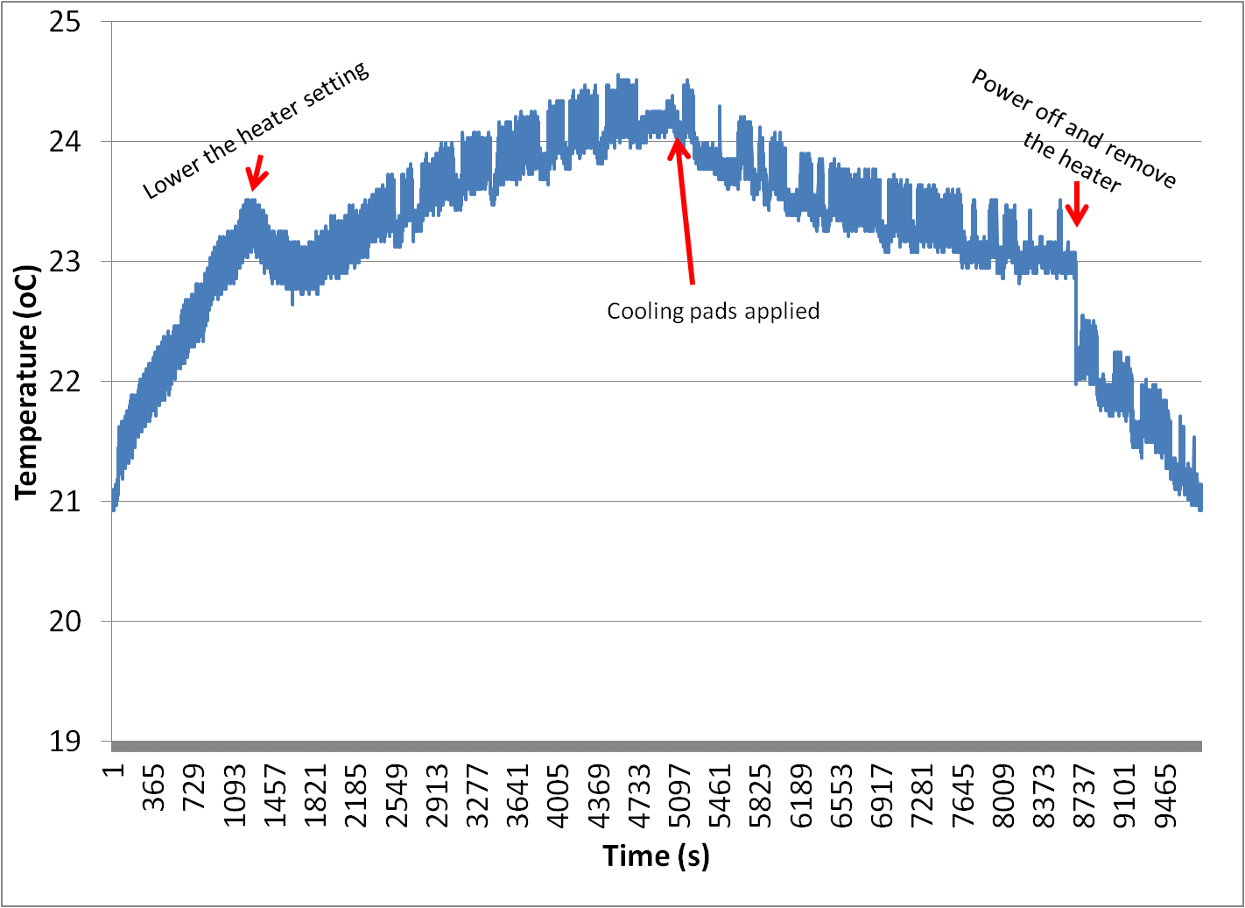
More test runs were planned and carried out
Test #3 Results
Screen shot before shutting down after ~3 hours of continuous running at ~100rpm

Slide 14
More test runs were planned and carried out
Test #3 Results
Screen shot before shutting down after ~3 hours of continuous running at ~100rpm
Phase 1 Success!!!

Slide 15
What’s next?
Iterate phase 1
Install Improved contact system
Run machine with new system
Improve contact surfaces

Slide 16
ILC ascc phase 1 update
Install and Test New Contact System
The new contact system has several improvements.
Improved Bearing System
Easy Access for Alignment
One Installed - Currently Efforting the Second
Improved Contact System is Mounted on a Swivel and Secured by a Shaft and Bearing that Adjusts Itself to the Wheel Face with Four Linear Absorbers
We have already identified some improvements

Slide 17
ILC ascc phase 1 update
Improve Contact Surfaces
While installing the new contact system, we had a chance to inspect the wear on the cooling pad.
The cooling pad was cleaned and little to no wear was visible.
Burnished Vertical Striations in Dry Lube
Faint Vertical Striations on Clean Cooling Pad Surface
Test different contact material.
Test methods of lubrications.
Test embed MoS2 into the contact pads.
Long term testing.
Iterate designs.

Slide 18
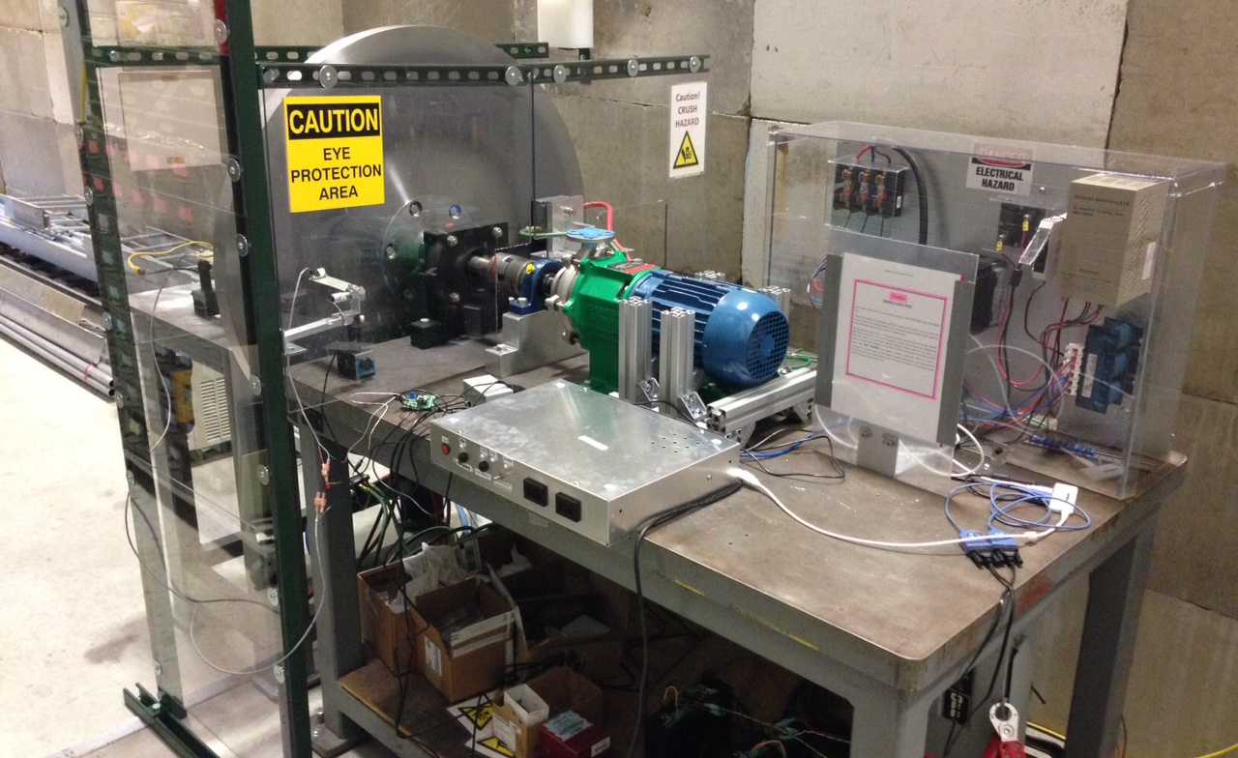
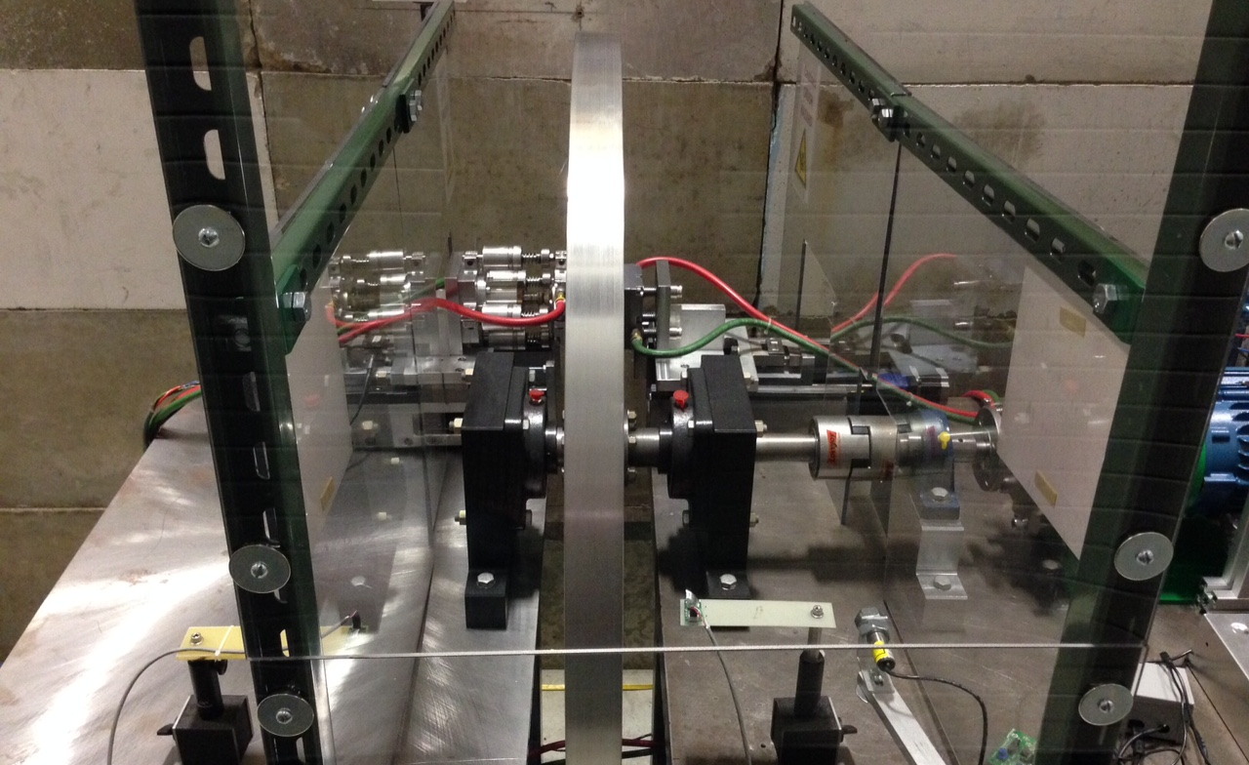
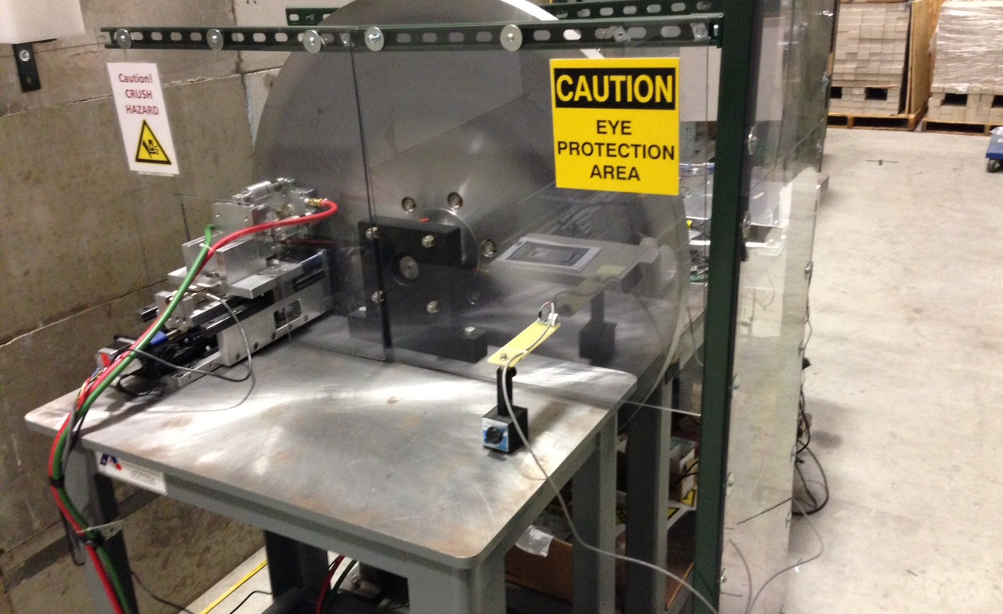
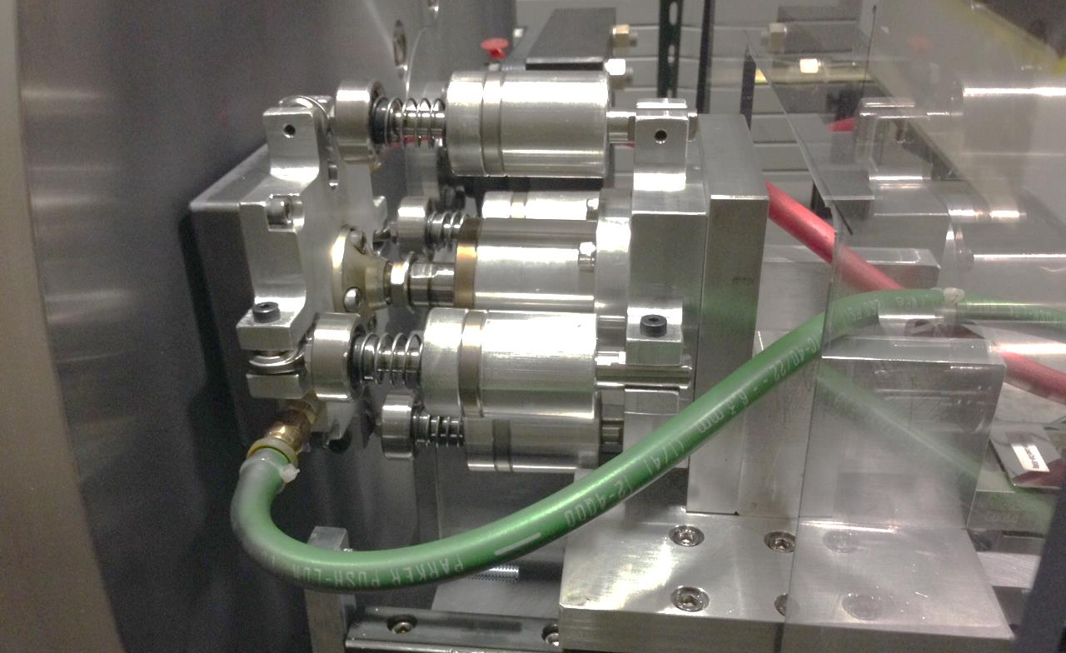
ILC ascc phase 1 update
That Wraps Up Phase 1

Slide 19
Short video showing spinning wheel with cooling and heating

Slide 20
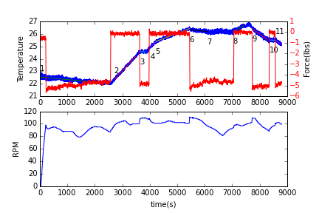
Measured temperature from upstream and downstream IR thermal sensor
stage | heater | Cooling pads | dT/dt (ºc/s) |  | Estimated cooling /heating power (W)
 |  |  | Upstream | Downstream | Upstream | Downstream
1 | Off | Applied, | -2.31e-4 | -2.10e-4 | -22.4 | -20.4
2 | On, high | Removed | 2.49e-3 | 2.38e-3 | 241.5 | 230.8
3 | On, high | Applied | 1.24e-3 | -1.29e-4 | -121.2(equivalent) | -243.3(equivalent)
4 | On, high | Removed | 1.89e-3 | 2.26e-3 | 183.3 | 219.2
5 | On, medium | Removed | 6.58e-4 | 8.37e-4 | 63.8 | 81.2
6 | On, medium | Applied | -5.9e-5 | -2.44e-4 | -69.5(equivalent) | -102.9(equivalent)
7 | On, medium | Applied | 2.88e-5 | -1.22e-4 | -61.0(equivalent) | -93.0(equivalent)
8 | On, high | Removed | 9.58e-4 | 1.24e-3 | 93.0 | 120.2
9 | Off | Applied | -1.44e-3 | -1.58e-3 | -139.6 | -153.2
10 | Off | Removed | 1.58e-4 | -1.46e-4 | 15.3 | -14.2
11 | Off | Applied | -1.21e-3 | -1.65e-3 | -117.3 | -160.0

Slide 21
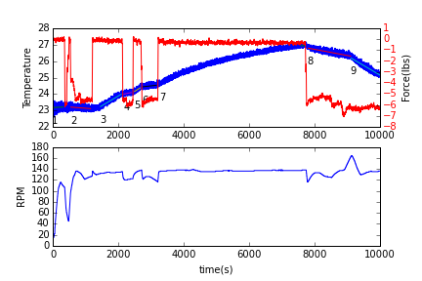
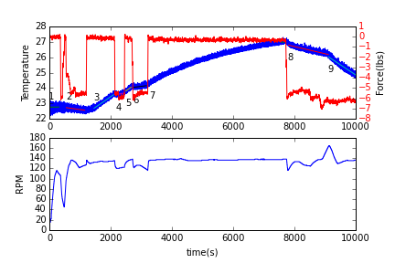
Measured temperature from upstream and downstream sensor(Repeated at different date with different heater settings)
stage | heater | Cooling pads | dT/dt (ºc/s) |  | Estimated cooling /heating power (W)
 |  |  | Upstream | Downstream | Upstream | Downstream
1 | Off | Removed | 9.36E-05 | 2.29E-05 | --- | ---
2 | Off | Applied | -1.51E-04 | -2.83E-04 | -14.6 | -27.4
3 | On, medium | Removed | 1.17E-03 | 1.38E-03 | 113.5 | 133.8
4 | On, medium | Applied | 4.18E-04 | 4.40E-04 | -72.9(equivalent) | -91.2(equivalent)
5 | On, medium | Removed | 1.26E-03 | 1.41E-03 | 122.2 | 136.7
6 | On, medium | Applied | 2.26E-04 | 2.51E-04 | -100.3(equivalent) | -112.4(equivalent)
7 | On, medium | Removed | 1.01E-03 | 1.24E-03 | 97.8 | 120.2
8 | On, medium | Applied | -3.73E-04 | -4.66E-04 | -36.2(net) | -45.2(net)
9 | Off | Applied | -1.16E-03 | -1.32E-03 | -112.5 | -128.0

Slide 22
Summary of phase one
The measured data clearly demonstrated that sliding contact cooling concept.
The data also shows that the newer cooling pad fixture(downstream) is better than the older cooling pad fixture(upstream)
Since the current setup is not capable of isolating the system from the surrounding environments, an accurate calculation of the cooling capacity is impossible.
A rough estimate on the cooling capacity from different measurements is ranging from about 14W to 240W has indicated that we need better mechanical design on the cooling pads support system and there are still rooms for performance improvements on the cooling pads.

Slide 23
Phase 2 :
A fully functional prototype running at full speed over long periods of time in vacuum

Slide 24
ILC ascc phase 2 concept
Conceptual Designs and Phase 2 Needs
Although we have a conceptual design for Phase 2, the reality is that Phase 2 needs funding for engineering and design to be performed in conjunction with safety analysis. Engineering solutions that satisfy the safety requirements will drive the overall design of Phase 2.
Phase 2 will also need significant funding for vacuum components, drive components, controls, chillers, hardware, infrastructure, effort, etc.
While implementing what we have learned from Phase 1, we are confident that Phase 2 will be successful.
Concept Shows AWA Bunker Wall

