Slide 1
Design Options for e- and Undulator driven Positron Targets for the ILC
POSIPOL 2016 at LAL/Paris, 14-16 Sept. 2016
Peter Sievers-CERN

Slide 2
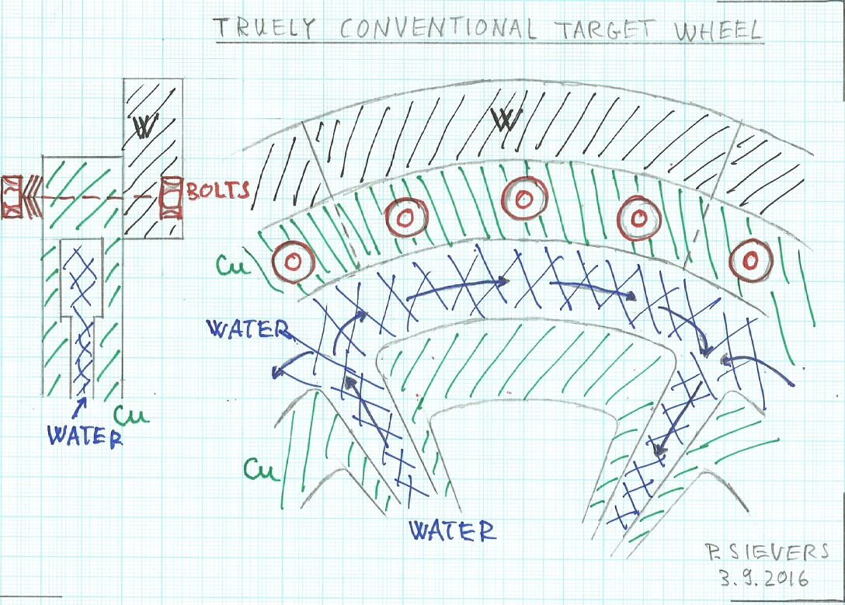
1. e-driven Target Wheel

Slide 3
Design Parameters
300 Hz scheme: 20 bunches, each 1 µs and spaced by 3.3 ms. Rep. rate 5 Hz.
Average heat input of 35 kW into a W-target ring of 20 mm height, 15 mm thickness and a diameter of 500 mm.
Water cooling is arranged with in- and outlets through the rotating axis.
A vacuum tight, radiation resistant, rotating seal is required. Being investigated by KEK.

Slide 4
For optimal uniform occupation of the wheel by the 63 µs pulses of 95 %, a velocity of 4.71 m/s, 180 rpm., is required.
Five sectors around the wheel will be hit in sequence by the pulses.
Each spot on the target will be hit once per second.

Slide 5
The W-target is submitted to thermal shocks, under study by Song Jin-IHEP.
Cyclic thermal heating and thermal quasi static stresses by the pulsed beam and transients, like beam trips, are under study.
The thermal contact between the target and the cooling water is of prime importance.

Slide 6
Bolted Thermal Contact.
Spring loaded bolts provide a robust and about constant thermal contact between the W-sectors and the water cooled Cu-wheel.
This W-Cu-thermal contact is resistant to differential thermal and transient expansions.
The temperature jump across the W-Cu interface can, however, be of the order of 100 oC.
To provide the space for the bolts, the heat path to the water channel is relatively long.
Average temperatures in the W-target can approach 400 oC.
Detailed thermal analysis has still to be done.

Slide 7
1.2 Options
Replace bolted contact by brazing, friction or diffusion bonding,…..Technology, available in industry. Could it be adapted to the specific conditions of the target?
Requires however R+D, to qualify the resistance of alternative joining techniques.
Direct bonding would lead to lower average temperatures.
Check with RIGAKU.
Increasing the diameter of the wheel to 800 mm, would lower the average temperature by 0.63. Keep this option open!

Slide 8
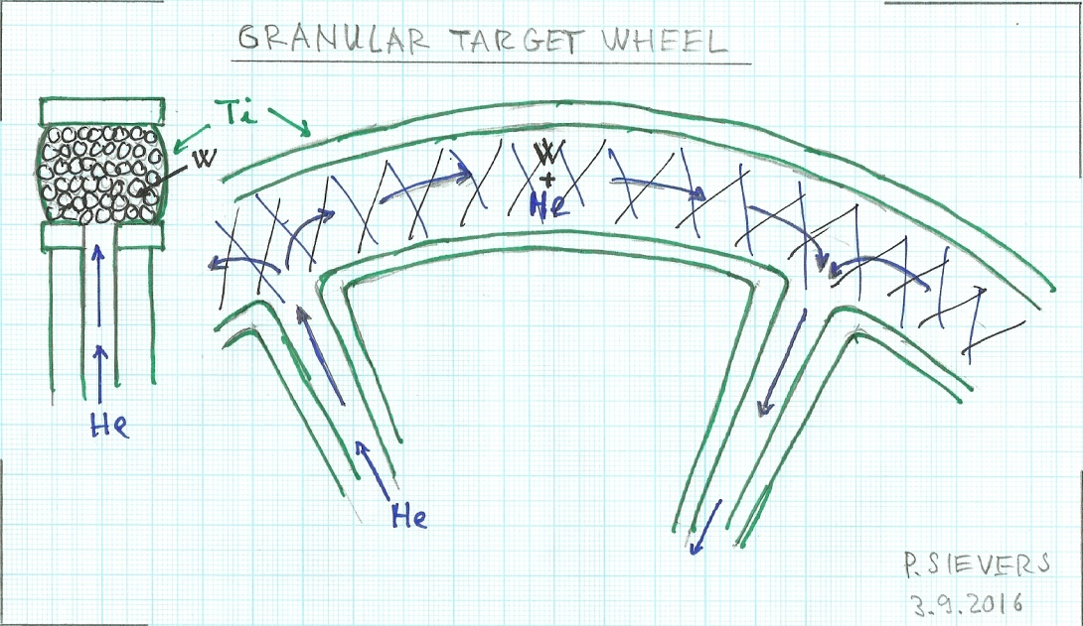
2. He-Cooled Granular Target.

Slide 9
Basic lay out of the wheel as before
Thermal shock in 2 mm W-spheres with 1 µs pulses is much lower than in bulk material, see Song Jin-IHEP.
Dynamic response of spheres is tolerable.
He-leak tight Ti-windows are required: temperature jumps of 70 oC/pulse at 35 J/g.
Cooling of the spheres and the 0.2 mm thick windows by the flowing He is sufficient.
Life time of W-spheres is expected to be longer than W-bulk material.

Slide 10
3. Liquid Metal Target
Inspired by the recent article of A. Mikhailichenkov, Usage of liquid metals in the positron production …..,CLASSE, Ithaca, NY, 14853., Nov. 2015.
Spinning wheels, driven by metal jets and free flowing target jets, Hg, Pb-Bi, In-Ga,… are considered.
Here a liquid Hg-pendulum is considered.

Slide 11
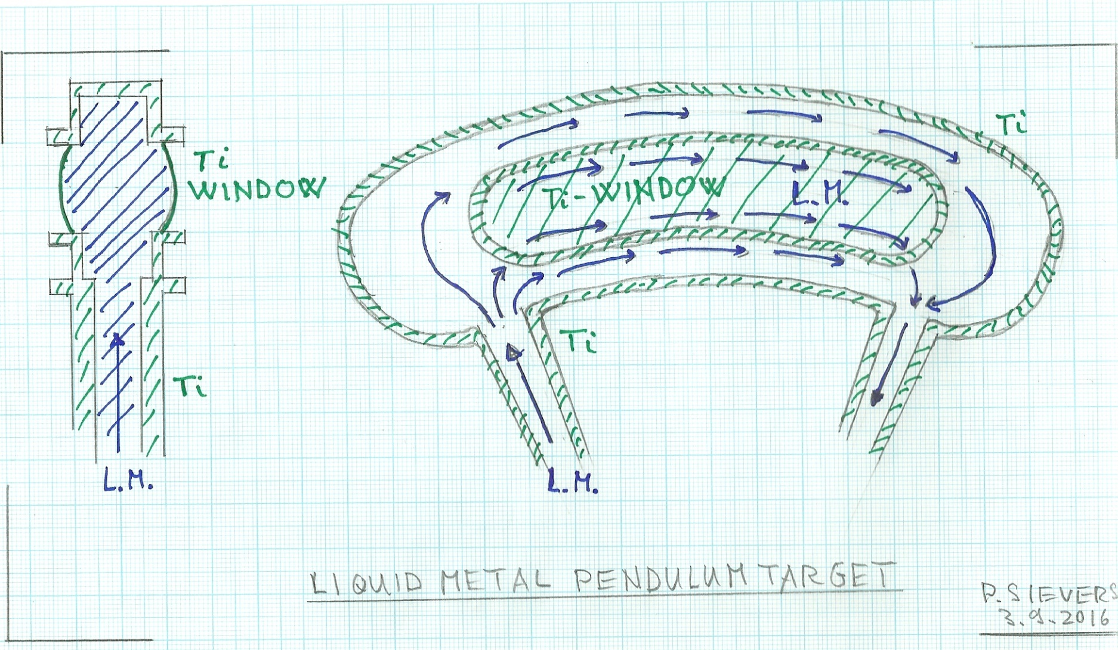
Liquid Metal Pendulum Target

Slide 12
Liquid Metal, Hg-Pendulum
The fluid, Hg, is driven through a container at a velocity of several meters, 5-10 m/s.
This avoids pile up of shock and temperatures in the liquid due to each 1 µs pulse, spaced by 3.3.ms.
Thin Ti-windows can efficiently be cooled by the flowing liquid metal. The cooling time constant is of the order of several ms, i.e. cooling occurs during the time between pulses.
The container can “nearly” be stationary.

Slide 13
However, radiation damage in the container windows will occur.
Therefore, by a slow movement of the pendulum, say 10 cm at 0.5 m/s, the radiation damage can be diluted over a larger surface.
The container window has to be qualified.
But, no rotating seal is required!

Slide 14
However: each 1 µs pulse will create a shock wave in the liquid as well as in the window.
Plenty of liquid metal volume around the actual target volume should be provided to dissipate, dilute the shock energy and to protect thus the container wall.
Severe damage, pitting, in the Hg-container of the JPARK spallation source were experienced.
This was successfully mitigated by injecting He-gas bubbles into the Hg.
This technique could also be adopted to protect the Ti-windows against shocks in the pendulum target.

Slide 15
4.1 Undulator driven Target Wheel
Basic Parameters are still valid: A segmented Ti-ring of 1 m diameter, 2 cm height and 14 mm thickness is mounted onto a Cu-wheel and spinning at a velocity of about 100 m/s.
Cooling of several kW, 4 kW, average power dissipated by heat radiation from Cu-radiators into stationary, water cooled coolers.
Magnetic bearings and drives are placed inside the vacuum.
The weight of the wheel has to be optimised with respect to the surface available for heat radiation.
No vacuum tight rotating seal is required.

Slide 16
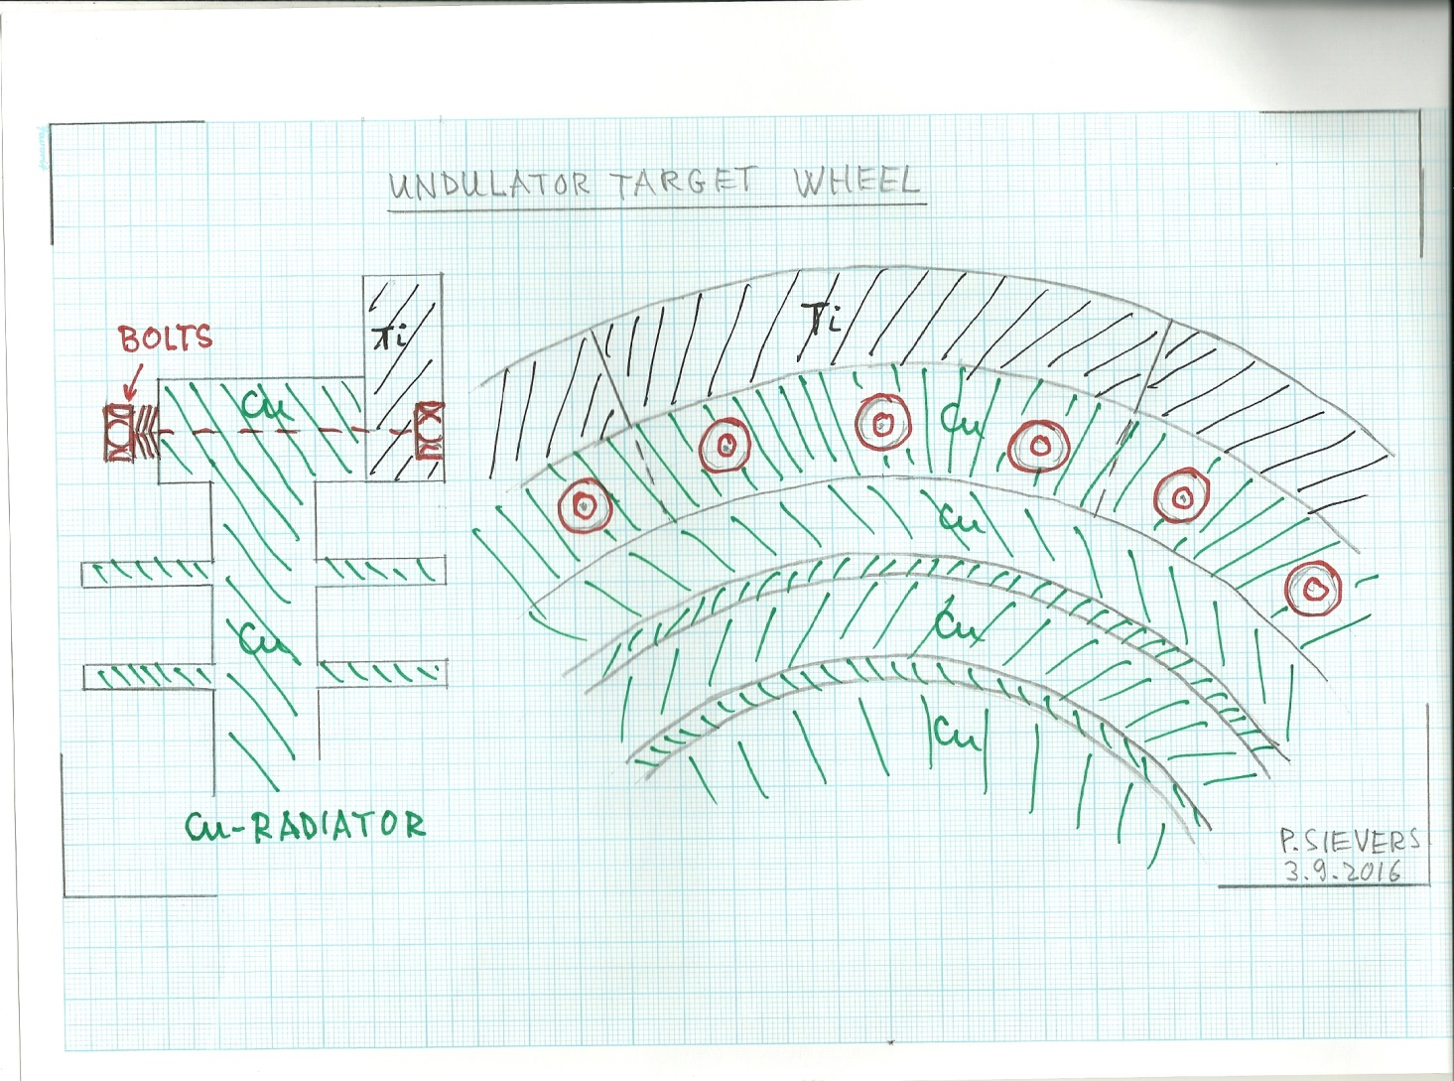

Slide 17
Elevated temperatures are caused, among other things, by the very low thermal conductivity of the Ti-alloy.
The thermal Ti-Cu contact is again an issue. As a pragmatic approach, spring loaded bolts are considered.
These offer a good safety margin against high temperatures, thermal transients, bake out temperatures or accidents.

Slide 18
4.2 What could be improved?
Shorten the heat path from the Ti-target towards the Cu-radiator.
Replace the bolted contact by direct Ti-Cu bonding. This has, however, to be severely qualified under all circumstances.
Find a target material with higher thermal conductivity, like Vanadium??
Reduce the PEDD and the average power by about one half, by using a shorter target of 0.2 Xo. See the study of Andriy. The loss of positron yield is marginal at 150 GeV.
This could be acceptable at least for the wheel of the first generation. Later consolidation programs for further operational options will be readily accepted by the user community!

Slide 19
5. Conclusion
5.1 e-driven target wheel
The proposed principal design, including bolted W-Cu contact, can be realised without major R+D.
Qualification of the rotating seal is well under way. No show stopper appeared (yet).
Temperatures with 35 kW average power input are high. They could be reduced by a bonded W-Cu junction, still to be qualified for the prevailing conditions and by increasing the diameter of the wheel.
Life time of the W-slabs under thermal cyclic load and shock must be studied further.

Slide 20
When the life time of the W-target is the limiting factor, a granular, He-cooled target wheel could be an option.
When the rotating vacuum seal becomes the limiting factor, a liquid metal pendulum target should be studied.

Slide 21
5.2 Undulator driven, radiation cooled wheel.
Mechanical design, including bolted Ti-Cu contact, can be made without major R+D.
Vacuum compatible drive and bearings have to be validated, also in view of rotation stability and weight of the wheel.
To reduce the target temperatures, direct Ti-Cu bondings would have to be devised and qualified.

Slide 22
To evaluate the life time of the Ti target, studies of its resistance to thermal cycles and shocks are under way (DESY).
Proceed with a first generation design (Xo=0.2?) and postpone further upgradings to a consolidation program at a later stage.
Thank you for your attention.

