Slide 1

xxxxxx sub-system for QUBIC
For Technological Demonstrator (T.D.)
And
For Final Instrument (F.I.)

Slide 2
Status of the sub-system : blocking points and schedule
What is the status of the sub-system ?
Design/manufacturing (home made/industry)/assembly/tests ?
When is this phase supposed to be finished ?
If you are still designing the sub-system:
Which inputs / specifications / requirements, needed to finish the detailed design of your sub-systems, are not yet delivered ?
For D.T.
For F.I.
Which other working group should deliver these inputs (see annex 1 for list of main WP) ?
For D.T.
For F.I.
What time is still needed in order to (for D.T.) – assume that the above inputs are provided if needed - :
Finish the whole detailed design of D.T. ?
Manufacture the sub-system ?
Test the sub-system in your premises before delivery to APC / ROMA ?
Idem for F.I.
Do you think you can comply to the target schedule (see annex 2) ?

Slide 3
Interfaces with other sub-systems
List and describe needed interfaces with other systems. Mechanical
Electrical / Signal
Vacuum
Thermal
Etc…
Are these interfaces currently frozen ?

Slide 4
Test, Delivery, Assembly, Calibration Operations
Tests of the sub-system in your premises before delivery at APC or ROMA:
What is the rationale for testing the sub-systems ?
Which specifications will be tested ?
What are the criterion for fail / pass ?
Delivery to APC or ROMA:
Special care needed for the transportation and handling of the goods ?
Assembly Operations in APC or/and ROMA:
Same questions as first point above.
+ which other sub-systems should be integrated before yours? After yours ?
+ Is there any specific material needed for assembly ? (see annex 3 for help)
What are the test sequences needed to be performed during/after integration
+ How many FTE will you send people at APC / ROMA for help during assembly ?
Calibration Operations at APC:
Same questions as for Assembly operations.

Slide 5
ATRIUM and Documentation
List (with reference ATRIUM-xxxxx) the technical documents related to your sub-system already in the ATRIUM repository.
Are these documents definitive ? Should we update the status of the document from “in project” to “validated” ?
Missing documents from other sub-systems ?
Future documents to be downloaded by you ?

Slide 6
Last news, program for late 2016 and 2017 and other useful information

Slide 7
Budget (excluding salaries)for T.D. + F.I.
 | Spendings (type and amount) | Funding (source and amount) | Status of funding (granted / under examination)
2016
2017
2018

Slide 8
Manpower
Name and responsibility | % FTE 2016 | % FTE 2017 | % FTE 2018
TOTAL FTE

Slide 9
Risks analysis
List up to three major risks that can impact performances, schedule, costs for the delivery of your sub-systems.
Describe strategies dedicated to mitigate the probability of occurrence or the consequence of the risks

Slide 10
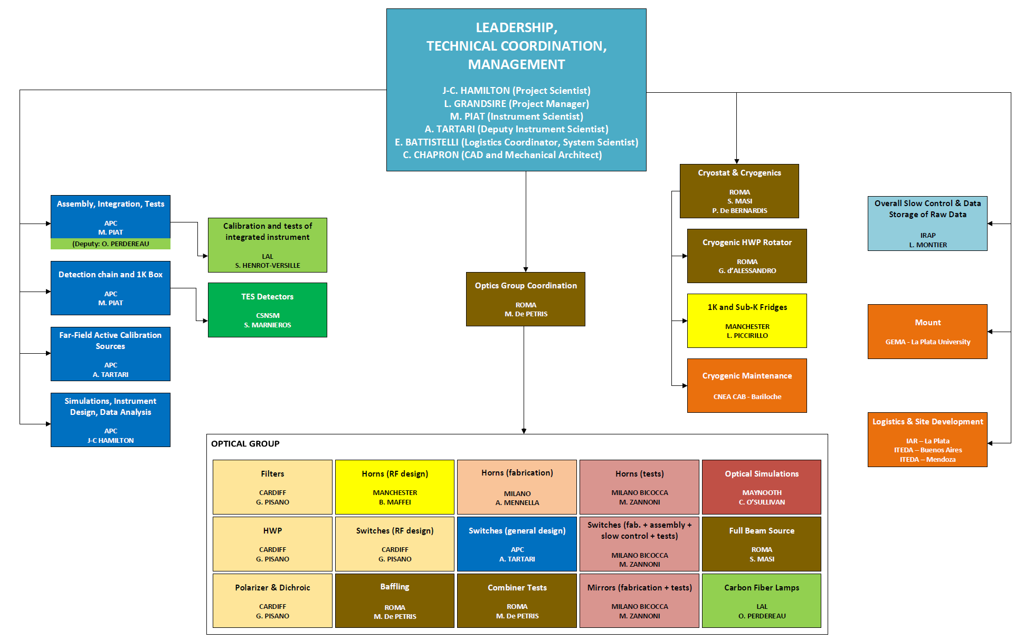
Annex 1: list of main-sub-system and WP leaders

Slide 11
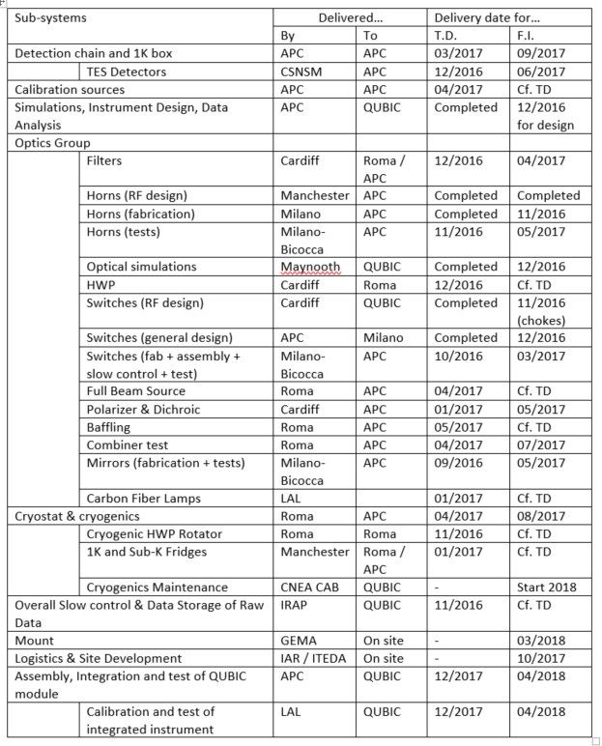
Annex 2 : Target schedule

Slide 12
Annex 3: examples of possibly needed major tools or utilities
High voltage (380 V) power
Cold water
Liquid or gaseous N2 / He
Compressed air
Clean air laminar flow / clean room / conditioned air
Assembly Hall
Mechanical workshop
IT network or Wifi
Chemicals
ESD equipments
Crane or heavy handling systems
Metrology systems (Faro, MMT, Laser…)
VNA
Calibration source
Mount (or fake)
Vacuum systems (including degassing)
Acquisition systems
Computers / data acq. systems
Electrical test with probe station

