Slide 1

Active Calibration Sources

Slide 2
Status
Call for tender almost ready (ask Laurent for the latest news!)
Two or three companies can fill the requirements
basically off-the shelf components => delivery < 6 months after the end of the call

Slide 3
Principle
Synth (5-15 GHz, or 1-20 GHz)
Ampli
Multipliers
(x10, x12…)
mm-waves
Control
Power typ 1 mW
Flatness 3dB
F Coverage: 130-170 GHz and 190-245 GHz at least
Frequency resolution: usually much higher than what we need (< 1 GHz)
CW mode (and modulation possibilities…)
PS: companies are allowed to propose something different, if it fits power level.

Slide 4
Option (to be investigated)
Multipliers
150 GHz
Synth (1-10 GHz, or 1-20 GHz)
Ampli
microwave switch?
Multipliers
220 GHz
Control

Slide 5
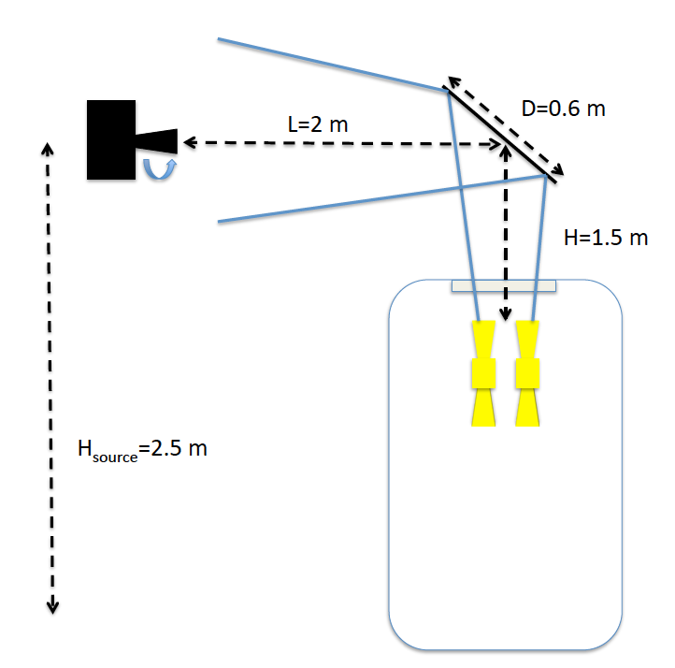
Injection scheme (to be discussed!)
Paraboloidal
mirror for flat wavefront

