Slide 1
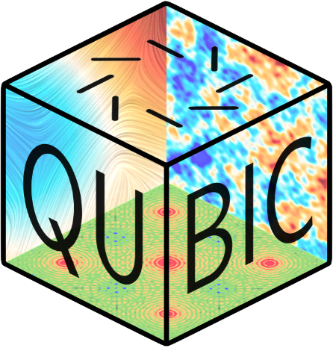

Update on Optical Modelling
Créidhe O’Sullivan, Stephen Scully, Donnacha Gayer, David Burke at Maynooth
Marco De Petris and colleagues at Roma

Slide 2
Outline
Reminder: Optical design of the beam combiner
Optical analysis of the beam combiner performance
methods
instrument PSF
dual-band operation
Next?

Slide 3
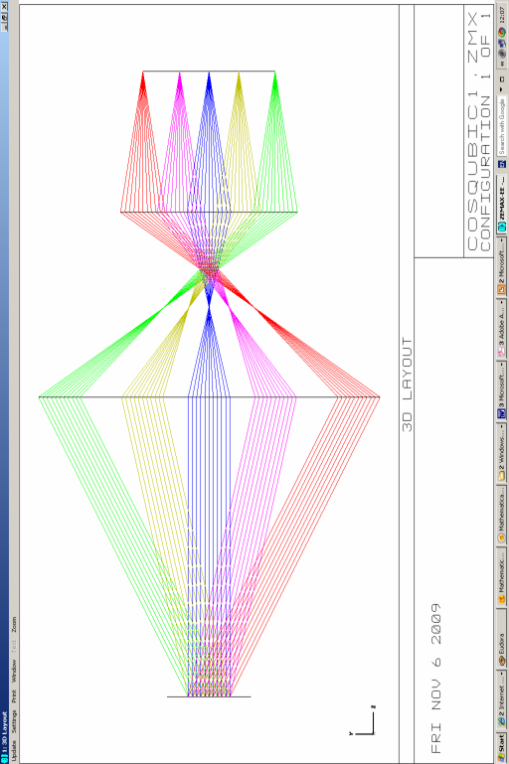
sky
sky horn array
re-emitting horn array
QUBIC operates as a Fizeau interferometer: the beams from an array of back-to-back horns at the entrance aperture are superimposed on a focal plane by the beam combiner.
Each pair of horns produces a fringe pattern on this focal plane (depends on baseline length and direction).
imaging optics
(beam combiner)
beams superimposed on the focal plane

Slide 4
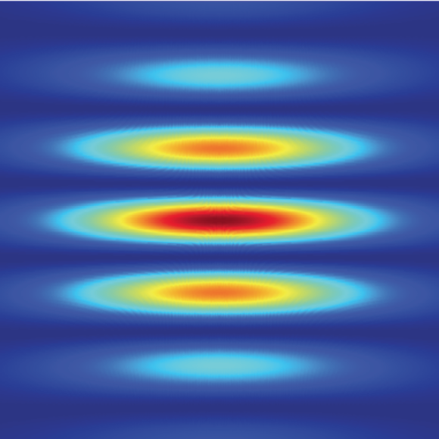
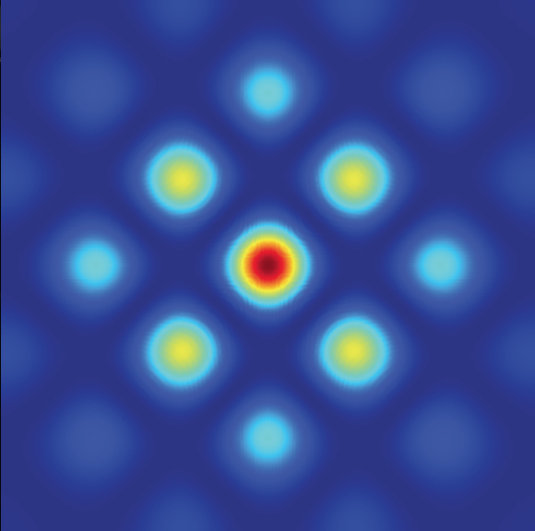
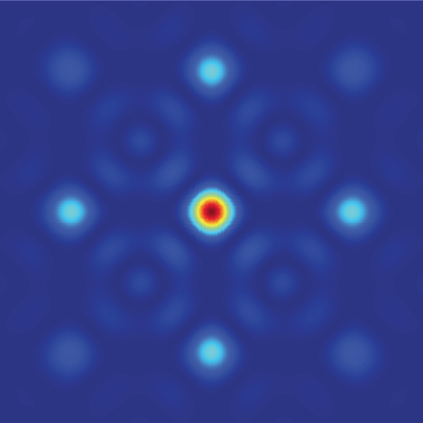
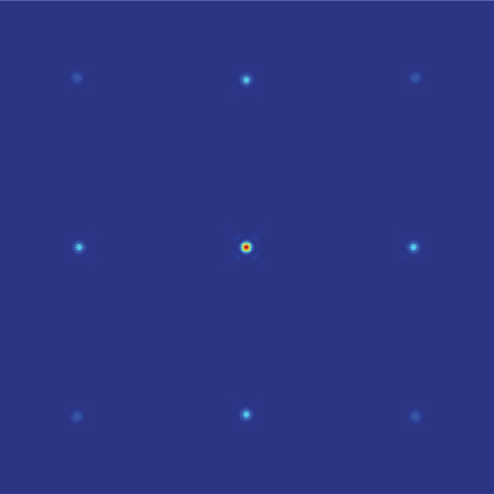
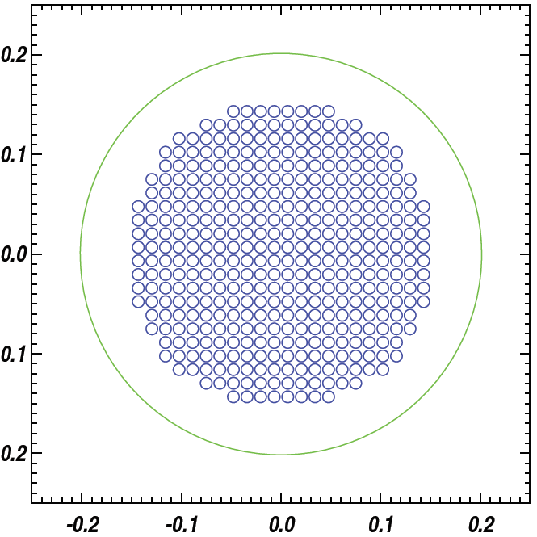
Focal plane image for one baseline (pair of horns)
The combined fringe pattern is simply an image of the sky convolved with the synthesised beam of the instrument.

Slide 5
Optical Design
sky horn array
The combiner must be a focusing system (imager) so that beams from each of the re-emitting horns are superimposed on the focal plane.
In the absence of aberrations, equivalent baselines (same length and direction) produce identical fringe patterns.
This is a very fast optical system with a wide field-of-view.
re-emitting horn array
sky
imaging optics
(beam combiner)
beams superimposed on the focal plane

Slide 6
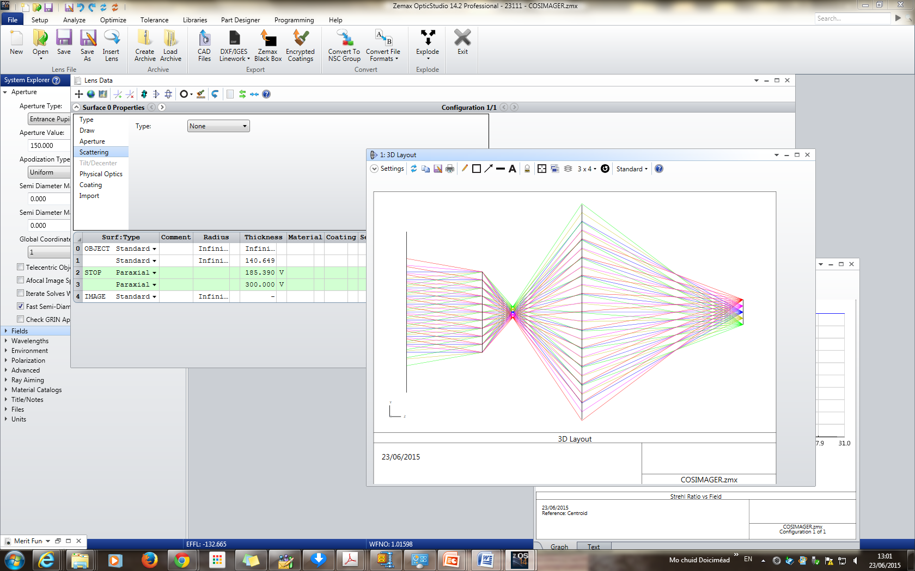
Optical Design
sky horn array
traditional imager
re-emitting horn array
sky
imaging optics
(beam combiner)
beams superimposed on the focal plane

Slide 7
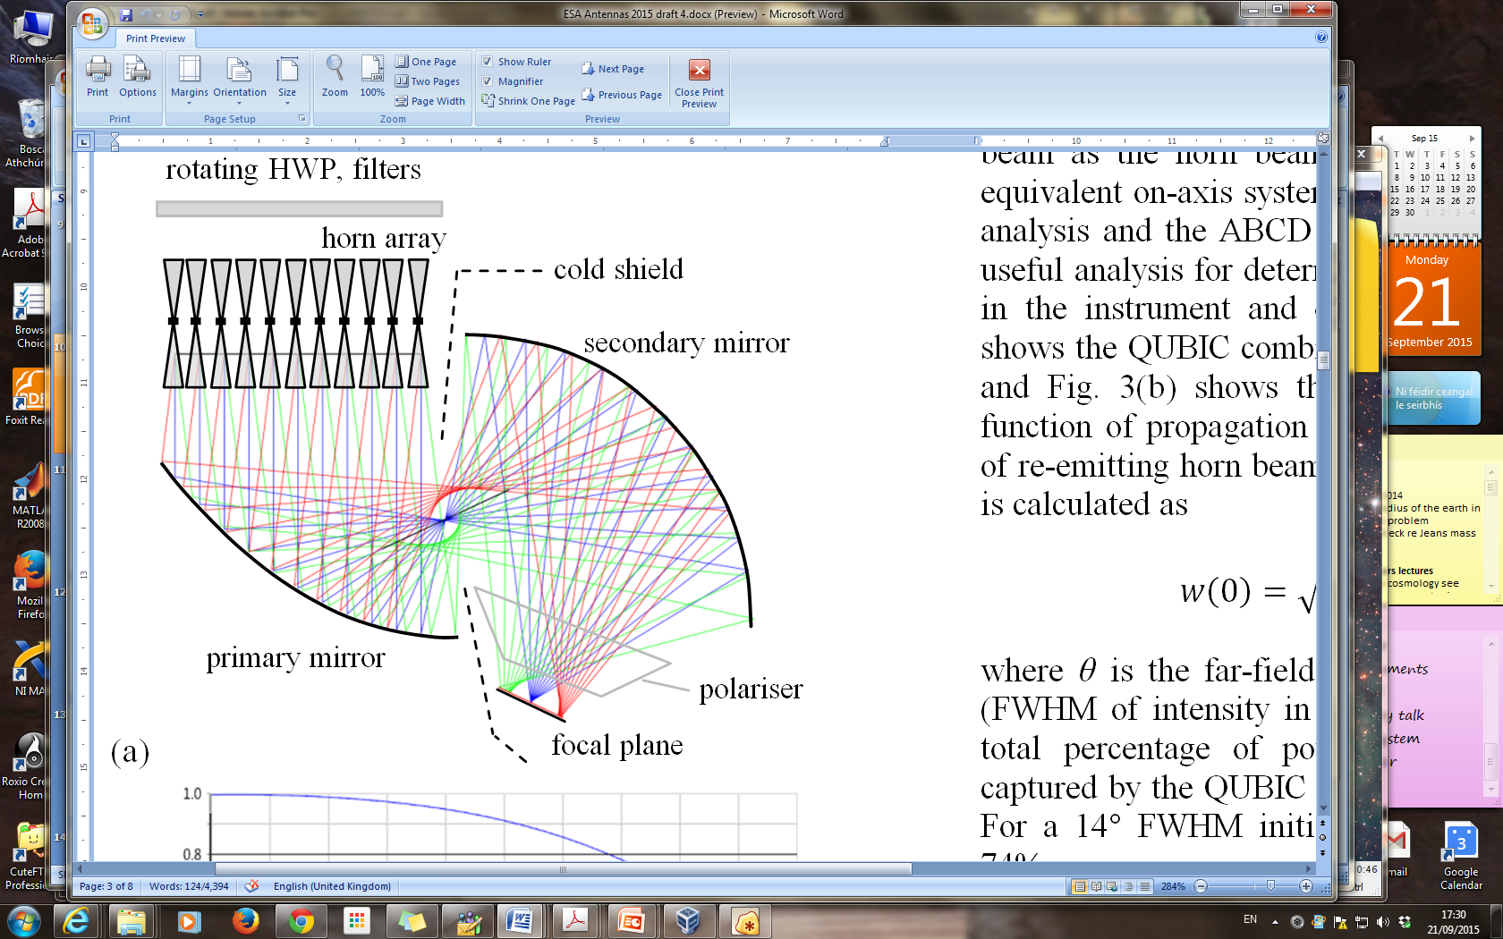
Optical Design
A compensated off-axis Gregorian design was chosen.
A further optimisation of the mirror surfaces was carried out with the aid of commercial ray-tracing.
Aberrations were expected to be an issue.
f = 300 mm

Slide 8
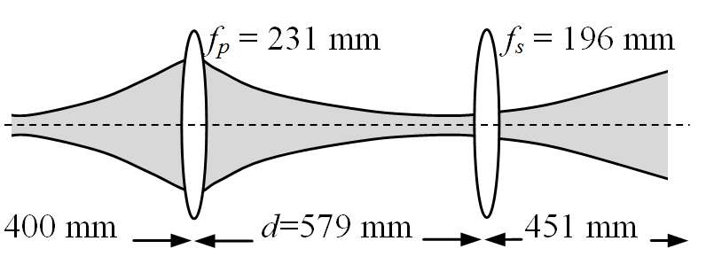
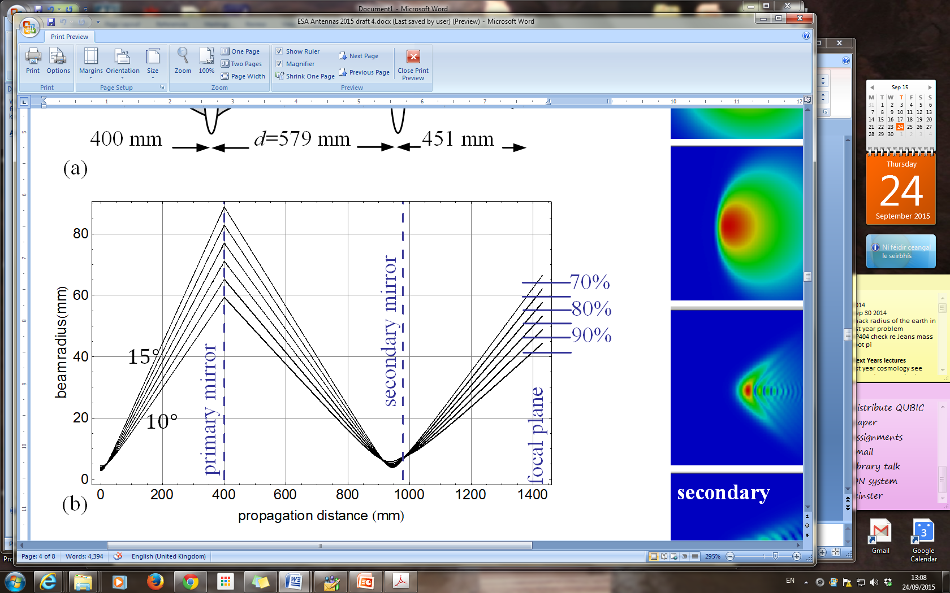
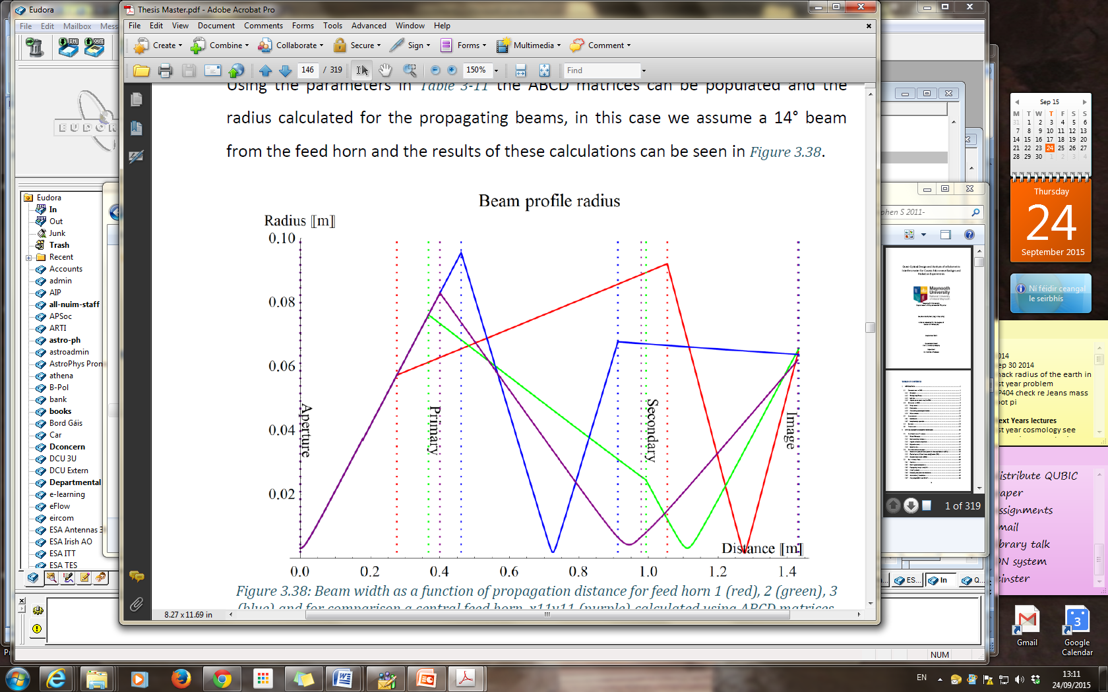
Gaussian Beam Mode Analysis

Slide 9
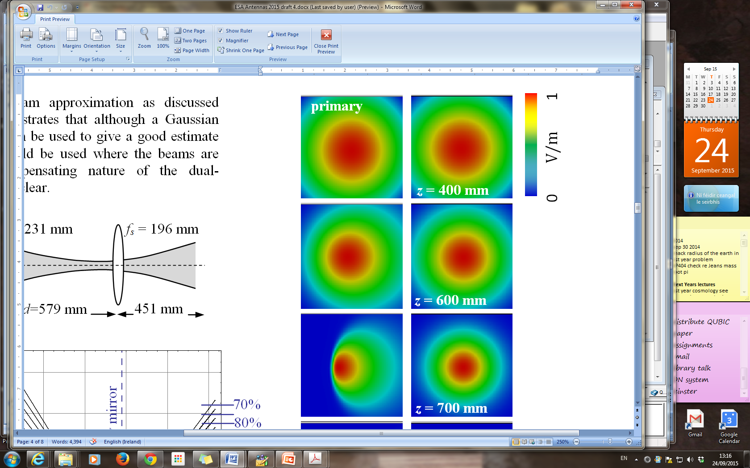
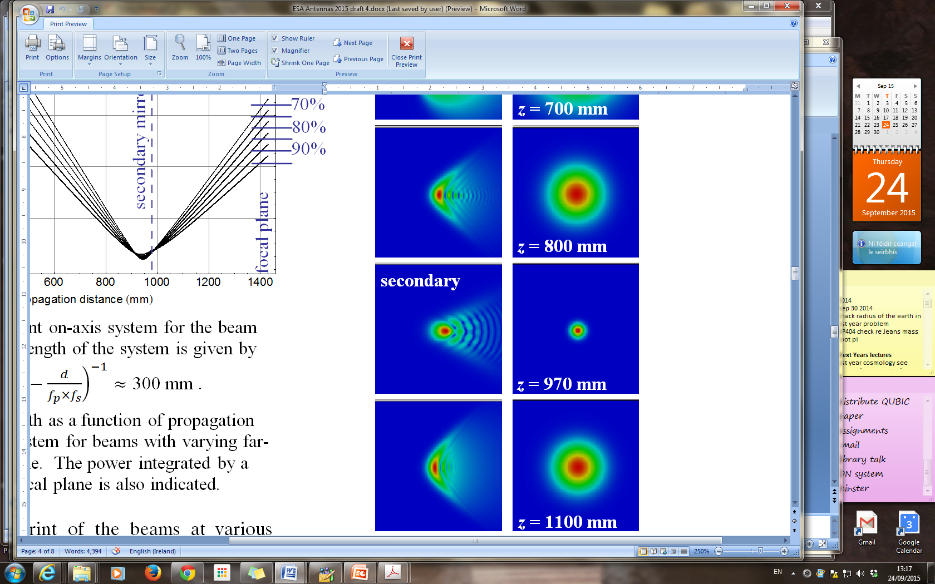
Physical Optics
MODAL (in-house-software tested against GRASP) is used to calculate beam patterns at various planes in the system.
GBM gives a good estimate of beam size but PO is needed, especially where beams are aberrated.

Slide 10
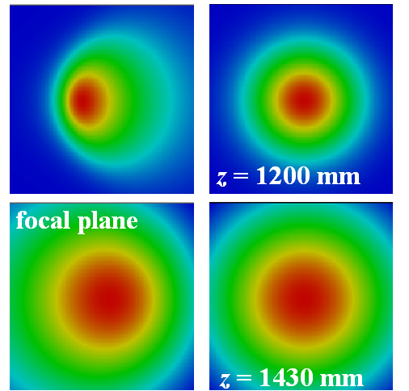

Slide 11
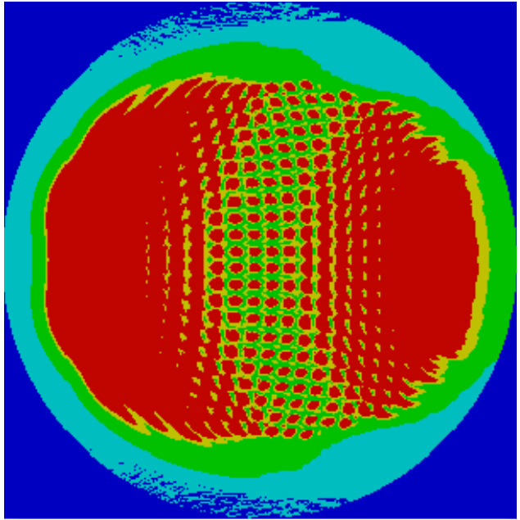
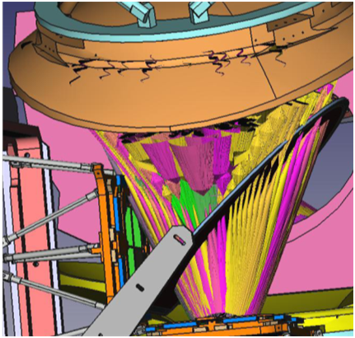
Beam Footprint
r = 2w (99%)
r = 0.8w (72%)
beams
r = w
footprint of 400 antenna beams on the secondary mirror (finite focal plane captures 72% of power)
PO beam ‘edges’ added to CAD model

Slide 12
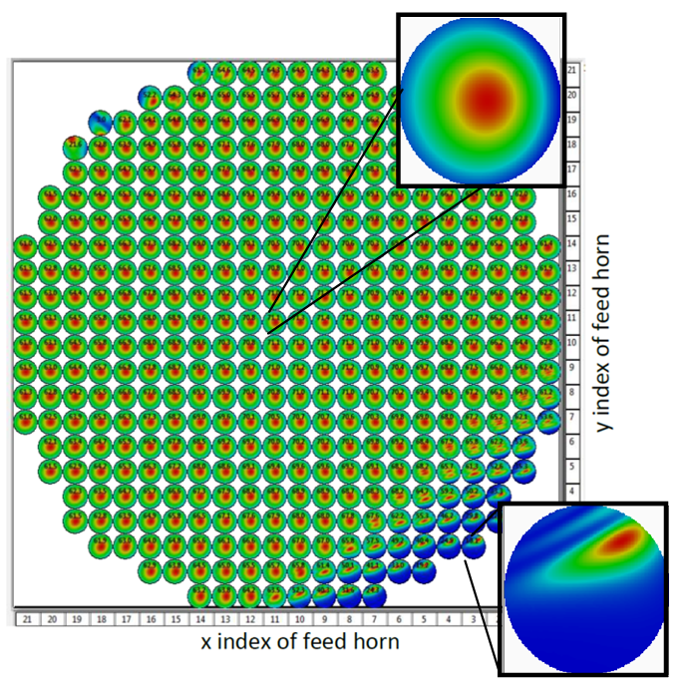
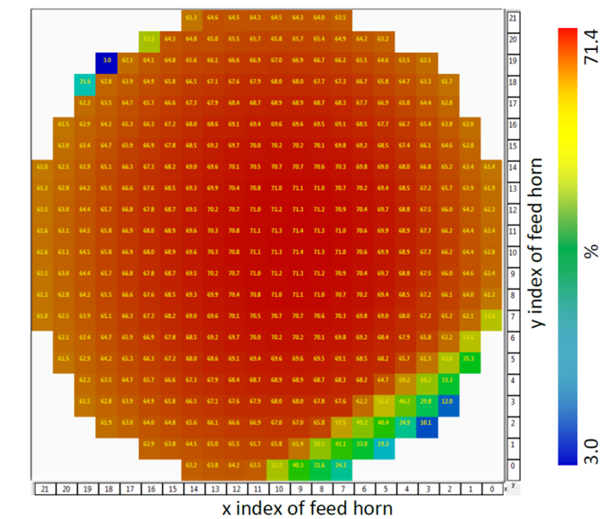
Once all the component sizes and locations are chosen, the 400 antenna beams are propagated through the system to the focal plane.
Maps of the beam pattern from each of 400 input horns on the circular focal plane showing the effect of reducing mirror sizes to <420 mm

Slide 13
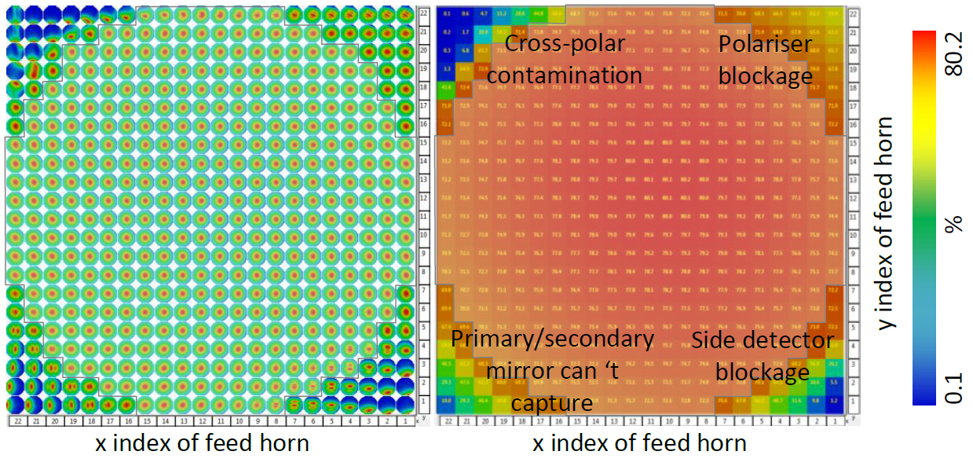

Slide 14
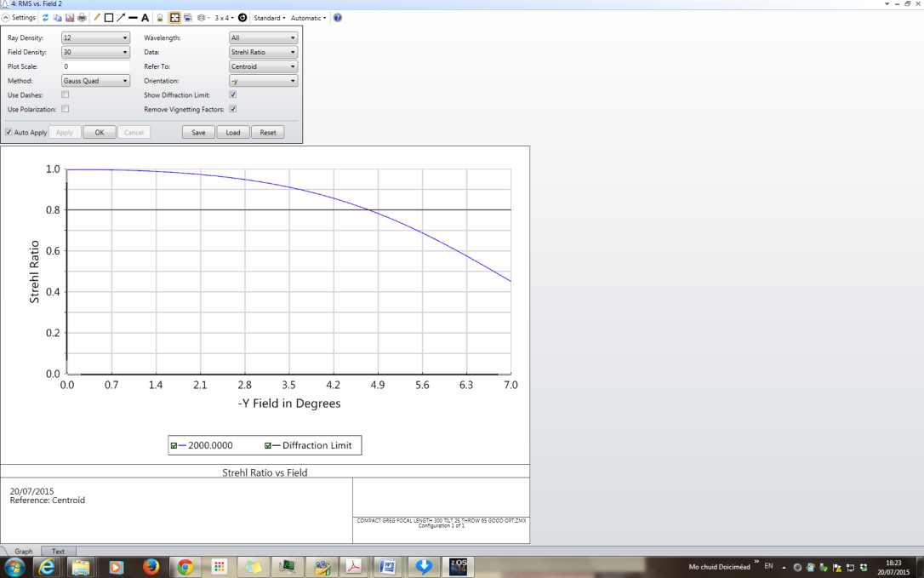
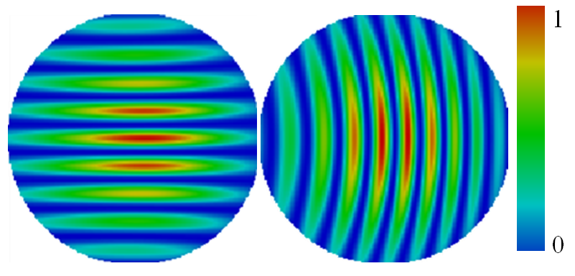
Performance
We would like to produce diffraction-limited images over a 14° (later 12.9°) fov. We could not achieve this in the plane of asymmetry.
fringe patterns generated by two orthogonal 27.5-λ baselines (l≈ 173) along and perpendicular to the plane of symmety

Slide 15
Effect of aberrations is to reduce the fringe visibility
= 50

Slide 16
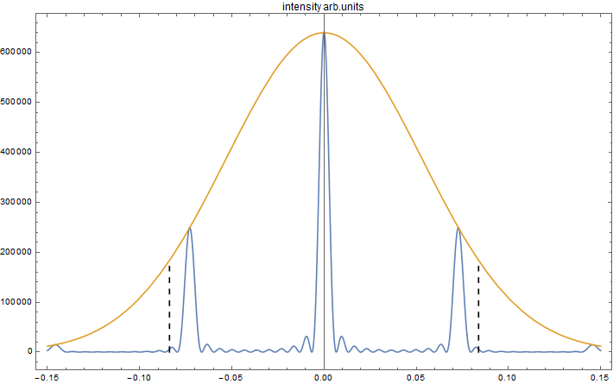
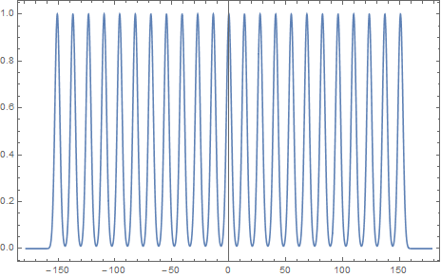
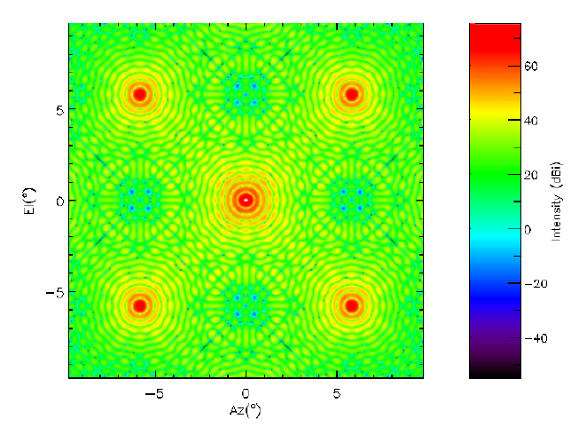
Point Spread Function
FT

Slide 17
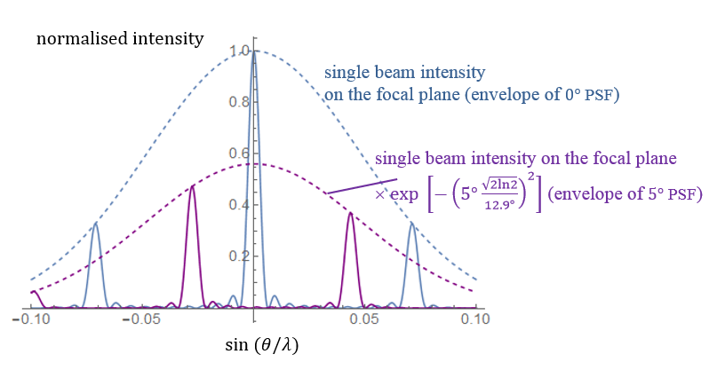
Point Spread Function
on- and off-axis horn
no. of horns
separation of horns

Slide 18
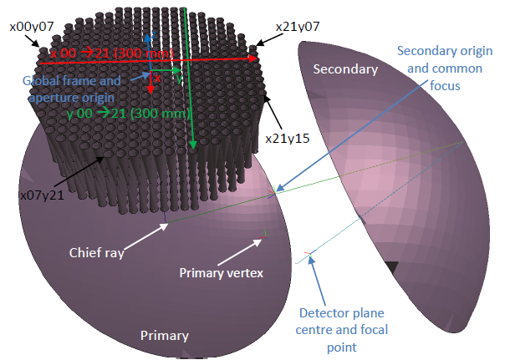
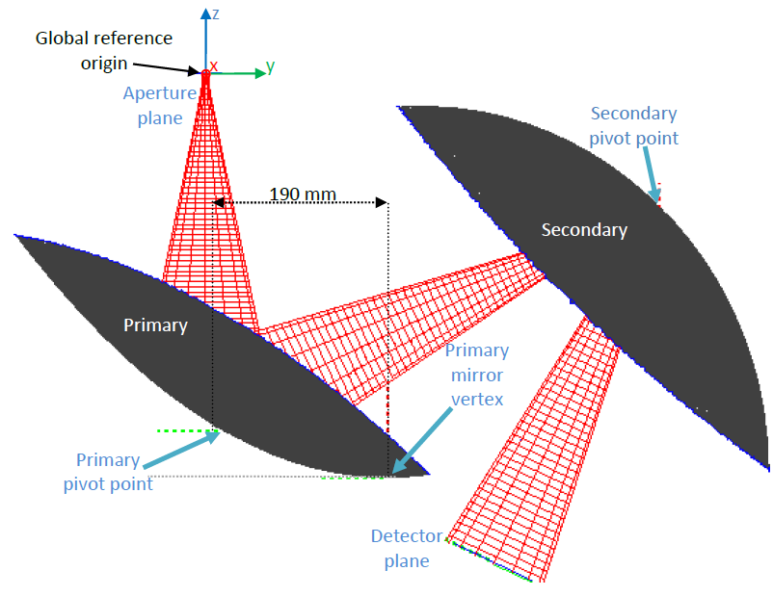
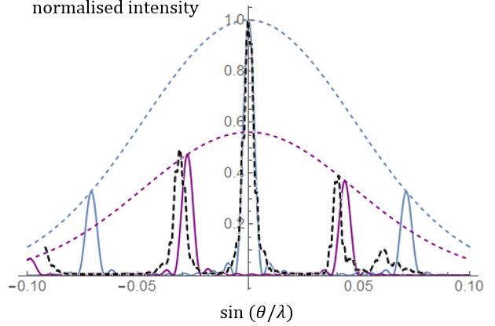
Point Spread Function

Slide 19
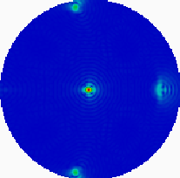
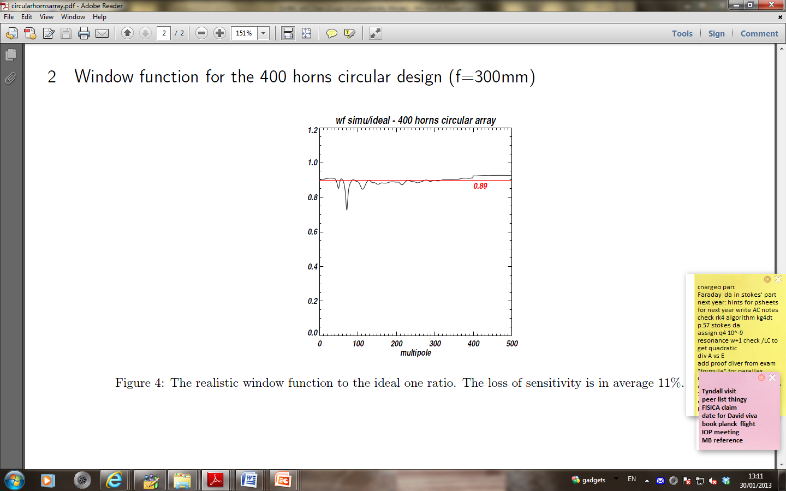
Aberrations in the (14°) beam combiner result in a loss of sensitivity of 10%

Slide 20
Point Spread Function
150 GHz
The slightly smaller beam of the later (12.9 °) design improves the performance of the combiner.

Slide 21
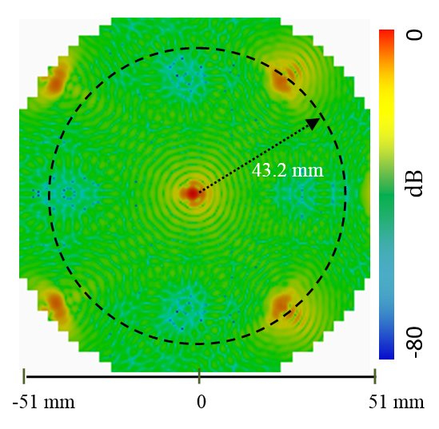
Point Spread Function

Slide 22
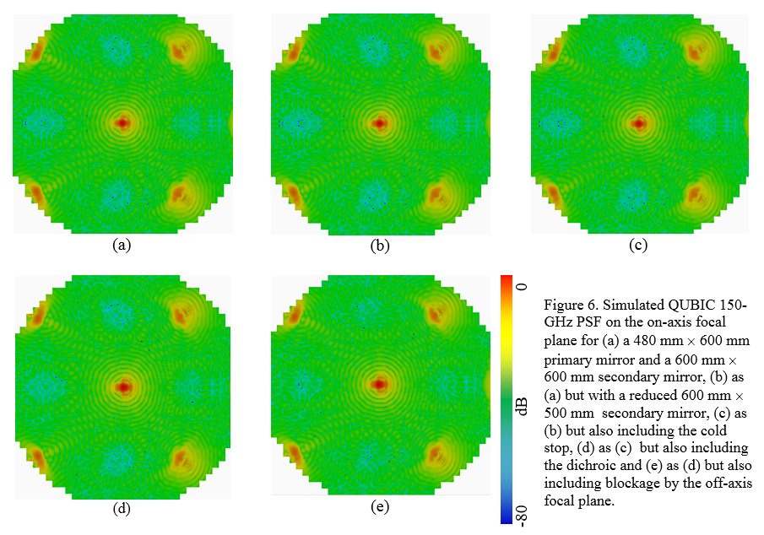
We reduced the size of the secondary mirror and added, in sequence, the cold stop, the dichroic and the blockages cause by the off-axis focal plane and associated electronics.
The addition of the optical components did not degrade the sensitivity of the instrument to any significant extent. The off-axis focal plane, did block power from a small number of horns and reduced the average power that reaches the focal plane by about 1%.

Slide 23
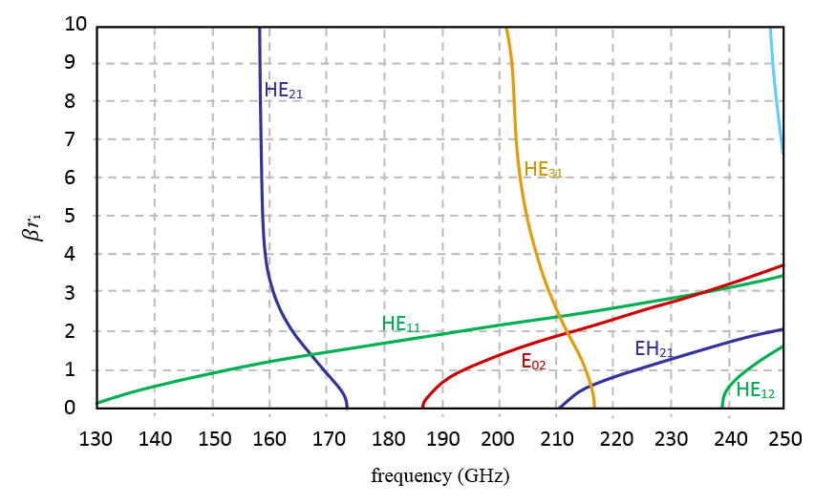
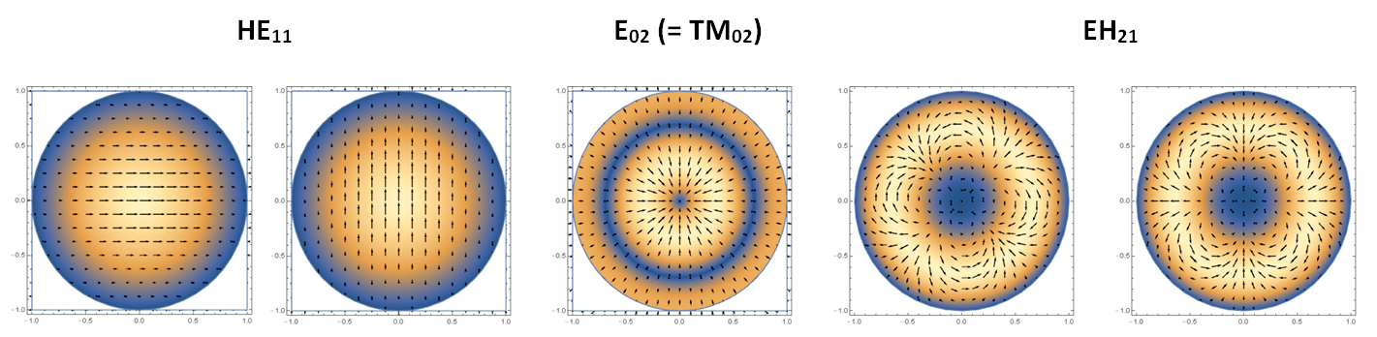
Dual-Band Instrument
The design of the back-to-back horn antennas was changed from the original so that they could operate over 130 – 250 GHz

Slide 24
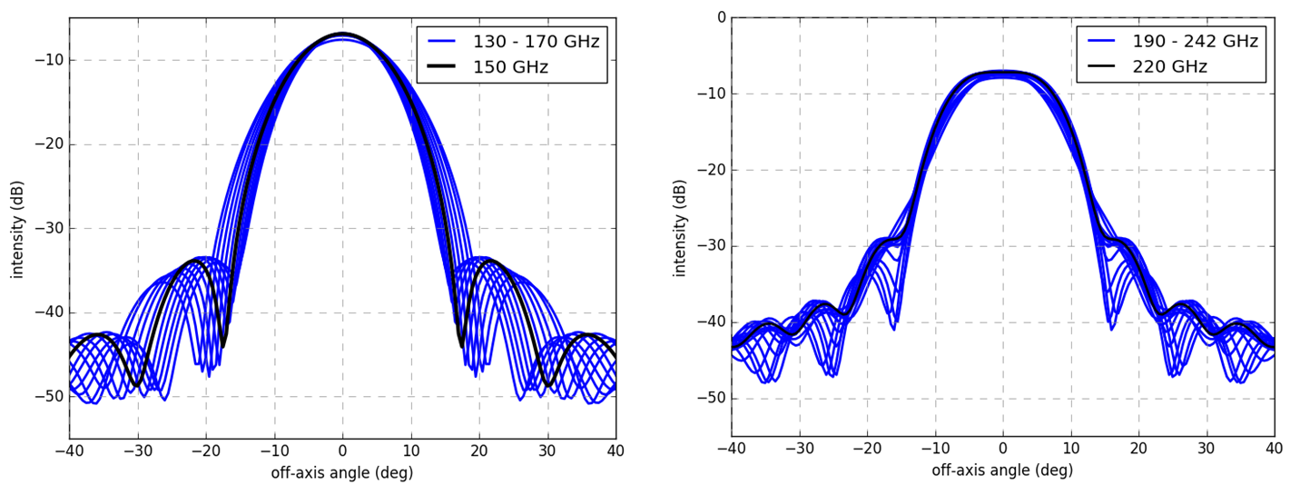
Dual-Band Instrument

Slide 25
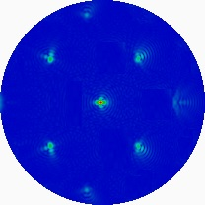
150 GHz single band
150 GHz dual band
220 GHz dual band
The slightly smaller beam of the new design improves the performance of the combiner.

Slide 26
Next
Demonstrator: model warm mirrors (Zemax)
model room temp tests?
tolerance analysis
Multi-mode behaviour, choke
?
Wideband synthesised beam, including aberrations
Effect of near- vs far-field calibration source illumination of horns

