Slide 1

Software / Data Analysis for QUBIC

Slide 2
Many aspects…
Map-making:
Power spectrum Estimation
Self-Calibration:
Scanning Strategy:
Multifrequency mapmaking
Component separation

Slide 3
Map-Making
Well advanced in the “peak approximation” (P. Chanial) including wide band (F. Incardona, G. Dashyan)
Some preliminary works (M. Stolpovskiy) on going beyond the ”peak approximation”
Check of the noise behaviour on maps and in Semi-Analytical formula from Battistelli et al. [J. Kaplan]
Polarization systematics investigated [N. Krachmalnicoff]
Needs to be extensively tested with realistic simulations (1/f noise, real-sized, Atmosphere, …)
[F. Incardona]

Slide 4
Map-Making
Well advanced in the “peak approximation” (P. Chanial) including wide band (F. Incardona, G. Dashyan)
Some preliminary works (M. Stolpovskiy) on going beyond the ”peak approximation”
Check of the noise behaviour on maps and in Semi-Analytical formula from Battistelli et al. [J. Kaplan]
Polarization systematics investigated [N. Krachmalnicoff]
Needs to be extensively tested with realistic simulations (1/f noise, real-sized, Atmosphere, …)

Slide 5
Map-Making
Well advanced in the “peak approximation” (P. Chanial) including wide band (F. Incardona, G. Dashyan)
Some preliminary works (M. Stolpovskiy) on going beyond the ”peak approximation”
Check of the noise behaviour on maps and in Semi-Analytical formula from Battistelli et al. [J. Kaplan]
Polarization systematics investigated [N. Krachmalnicoff]
Needs to be extensively tested with realistic simulations (1/f noise, real-sized, Atmosphere, …)
[M. Stolpovskiy]
Peak Approximation

Slide 6
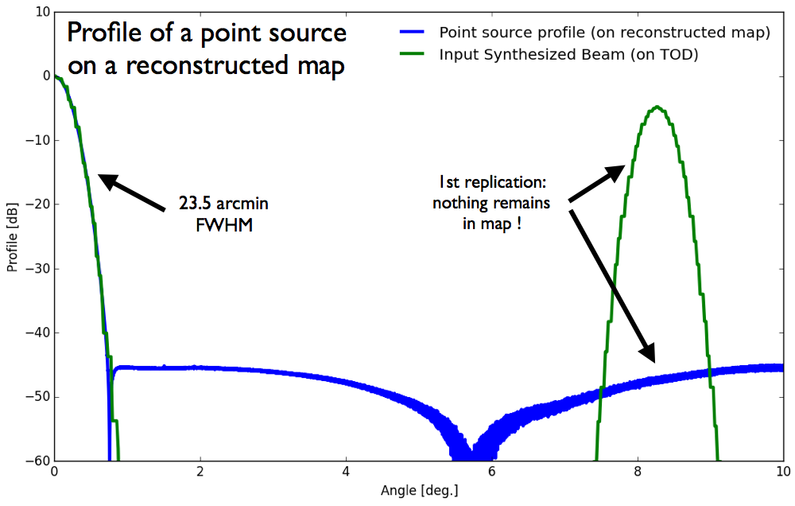
Map-Making
Well advanced in the “peak approximation” (P. Chanial) including wide band (F. Incardona, G. Dashyan)
Some preliminary works (M. Stolpovskiy) on going beyond the ”peak approximation”
Check of the noise behaviour on maps and in Semi-Analytical formula from Battistelli et al. [J. Kaplan]
Polarization systematics investigated [N. Krachmalnicoff]
Needs to be extensively tested with realistic simulations (1/f noise, real-sized, Atmosphere, …)

Slide 7
Map-Making
Well advanced in the “peak approximation” (P. Chanial) including wide band (F. Incardona, G. Dashyan)
Some preliminary works (M. Stolpovskiy) on going beyond the ”peak approximation”
Check of the noise behaviour on maps and in Semi-Analytical formula from Battistelli et al. [J. Kaplan]
Polarization systematics investigated [N. Krachmalnicoff]
Needs to be extensively tested with realistic simulations (1/f noise, real-sized, Atmosphere, …)
[M. Stolpovskiy]
Synthesized beam
Log Scale

Slide 8
Map-Making
1 month QUBIC, 2 ripples
Well advanced in the “peak approximation” (P. Chanial) including wide band (F. Incardona, G. Dashyan)
Some preliminary works (M. Stolpovskiy) on going beyond the ”peak approximation”
Check of the noise behaviour on maps and in Semi-Analytical formula from Battistelli et al. [J. Kaplan]
Polarization systematics investigated [N. Krachmalnicoff]
Needs to be extensively tested with realistic simulations (1/f noise, real-sized, Atmosphere, …)
[M. Stolpovskiy]

Slide 9
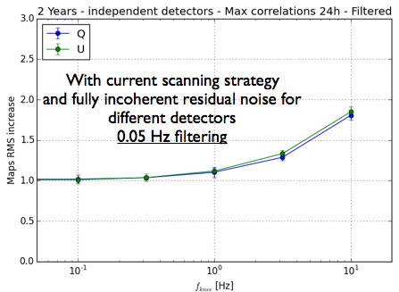
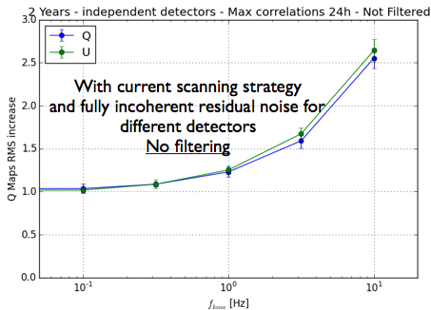
Map-Making
Well advanced in the “peak approximation” (P. Chanial) including wide band (F. Incardona, G. Dashyan)
Some preliminary works (M. Stolpovskiy) on going beyond the ”peak approximation”
Check of the noise behaviour on maps and in Semi-Analytical formula from Battistelli et al. [J. Kaplan]
Polarization systematics investigated [N. Krachmalnicoff]
Needs to be extensively tested with realistic simulations (1/f noise, real-sized, Atmosphere, …)

Slide 10
Power Spectrum
Xpure
Xpol
PolSpice
Xpol, Xpure, PolSpice implemented and compared (M. Stolpovskiy)
Max-Likelihood and CrossLikelihood (M. Tristram + JCH) on the way...
Systematic testing / comparison is needed
[M. Stolpovskiy]

Slide 11
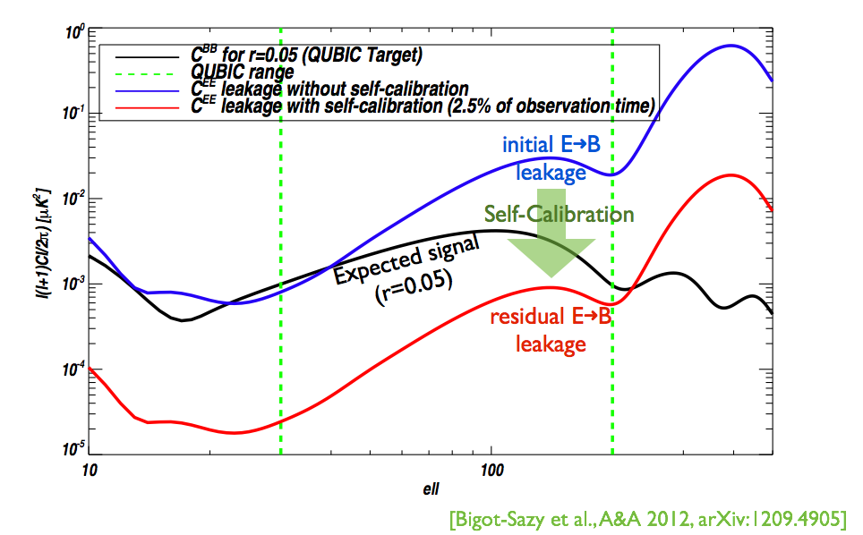
Self-Calibration
Principle validated (M.-A. Bigot-Sazy 2012)
Needs to be implemented on real size and a strategy to be defined
Two-steps need to be considered:
Self-Calibration to be validated with Technological Demonstrator (simplified)
Real-sized self-calibration with extensive systematics modelling

Slide 12
Scanning Strategy
[M. Stolpovskiy]
Almost optimized (M. Stolpovskiy)
More testing needed

Slide 13
Multifrequency mapmaking
See previous meeting (G. Dashyan)
Seems appealing
Optimality to be checked

Slide 14
Multifrequency mapmaking
[G. Dashyan]
See previous meeting (G. Dashyan)
Dust Modelling [N. Krachmalnicoff]
Seems appealing
Optimality to be checked

Slide 15
Multifrequency mapmaking
[G. Dashyan]
See previous meeting (G. Dashyan)
Dust Modelling [N. Krachmalnicoff]
Seems appealing
Optimality to be checked

Slide 16
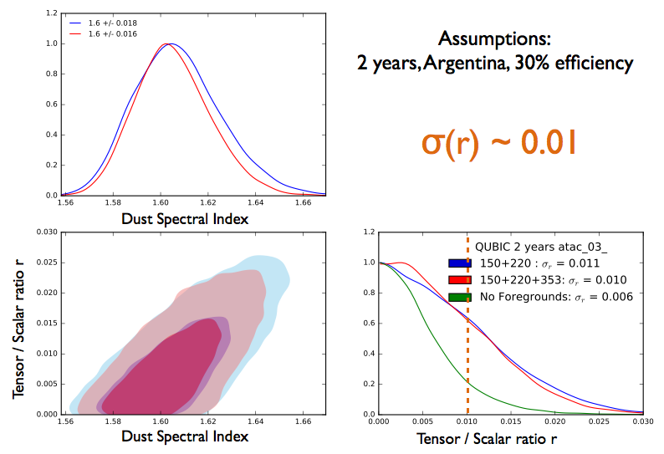
Component Separation
Power-spectrum based Likelihood
Almost everything to be done
Use of multifrequency ?
At map-making stage ? At Power spectrum level ?

Slide 17
QUBIC Software
Relatively easy to install
pip install --ignore-installed --no-deps qubic==4.4.post26
pip install --ignore-installed --no-deps pysimulators==1.1.dev82
pip install --ignore-installed --no-deps pyoperators==0.13.6.post06
Common Machines avalibality:
NERSC
Curie
Milano Cluster
CC-IN2P3 (thanks to Olivier and Sophie)

Slide 18
Take home message
Very little manpower on this set of tasks… a lot of questions remain unanswered...
Interest of boresight angle roation ? During obervations ? Only during Self-Calibration
Pointing accuracy to be checked
Very little actual work done so far outside APC
This is not healthy !
If you plan to work on this:
Please start now !!!!
There is a lot of room for getting some visible work done ! Papers to be written…

