Slide 1

Cryostat sub-system for QUBIC
Silvia Masi, Sapienza University of Rome
Remote presentation, 26 Sept. 2016

Slide 2
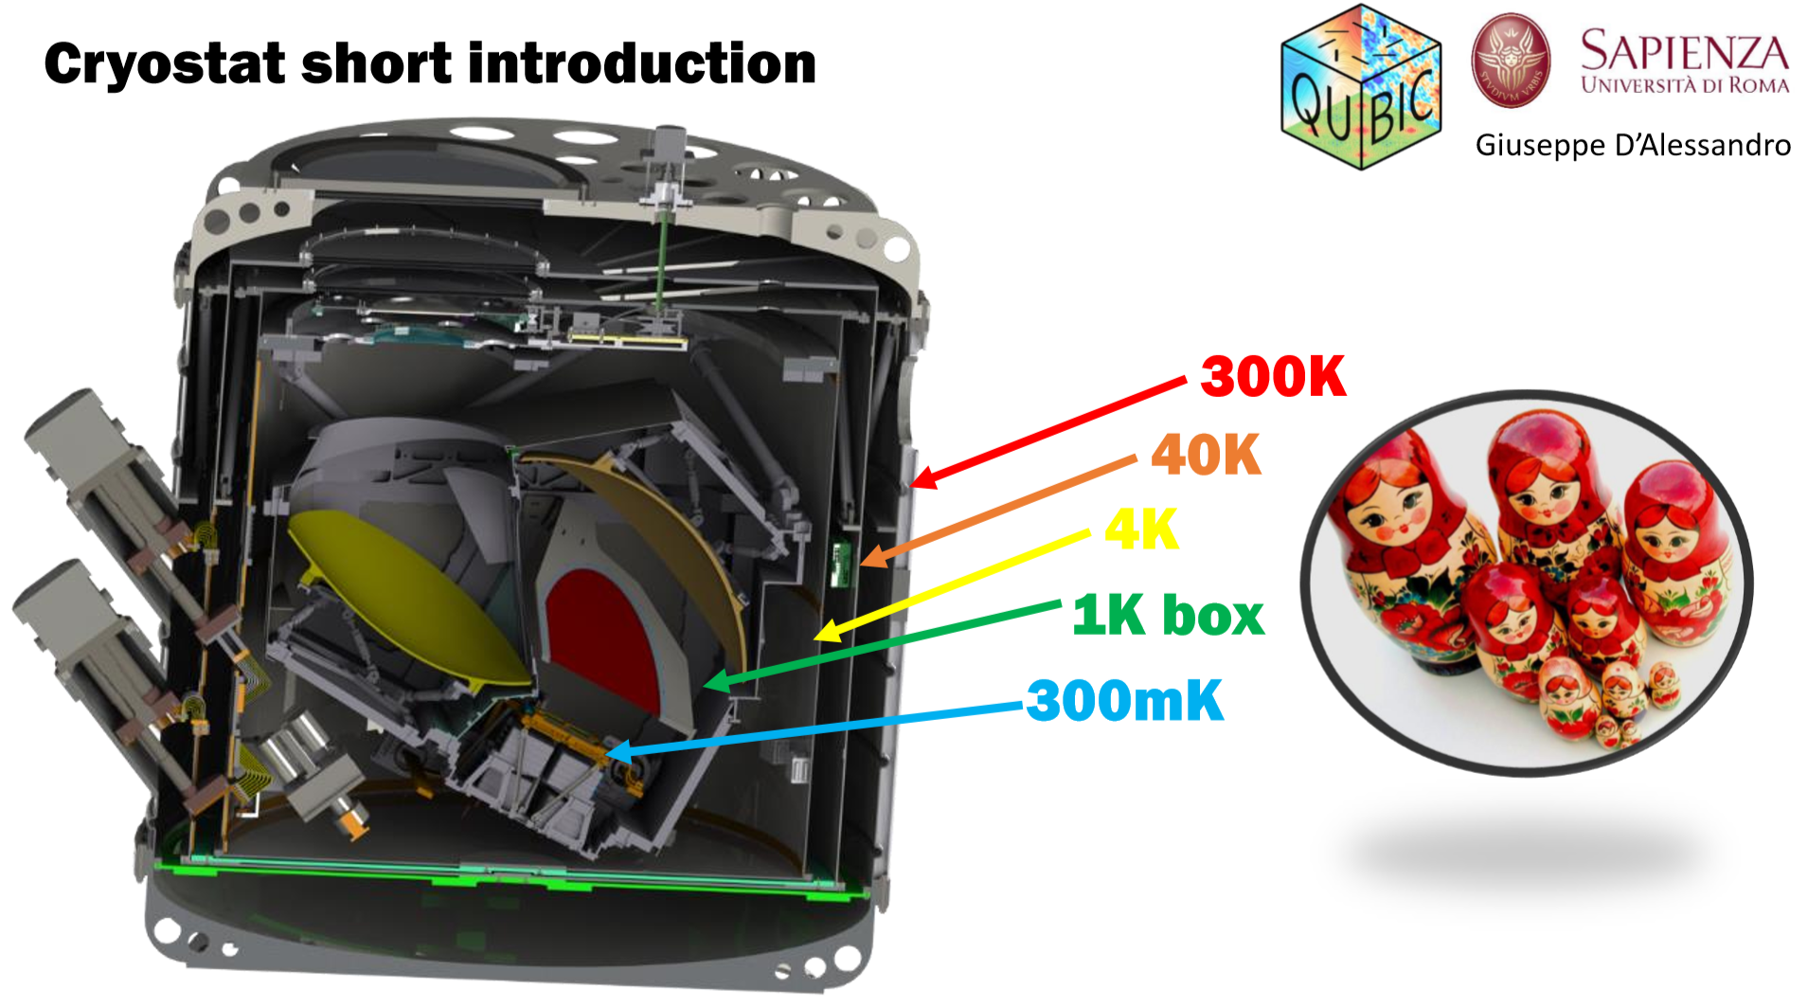
Status of the sub-system : blocking points and schedule
  A large cryostat with large (1m³) cold volume at T<1K.
  Main cryostat (described here) based on pulse tubes and Al shells.
  Sub-K coolers provided by Manchester (see presentation).
3D-Drawing by Giuseppe D’Alessandro
1.4 m

Slide 3

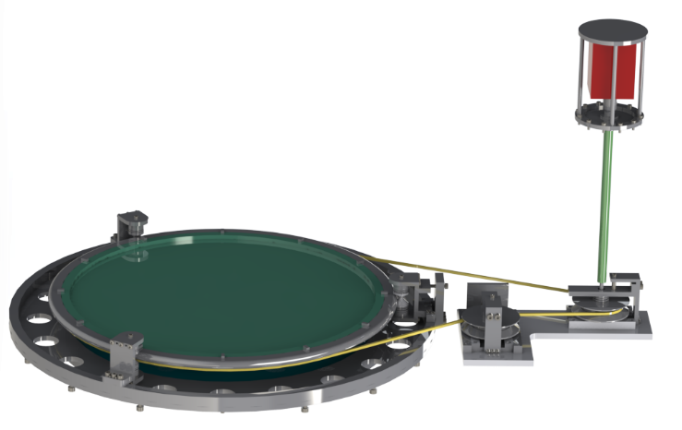
The QUBIC Cryogenic Polarization Modulator
Not shown: fiber-optics and cryogenic optical encoder to read and control positioning.
Parts fabricated and delivered.
Assembly started.
Step motor
Cryostat Vacuum Shell
Magnetic joint
Low-friction bearings
G10 shaft
Kevlar rope
HWP
4K stage
Capstan
4K stage

Slide 4
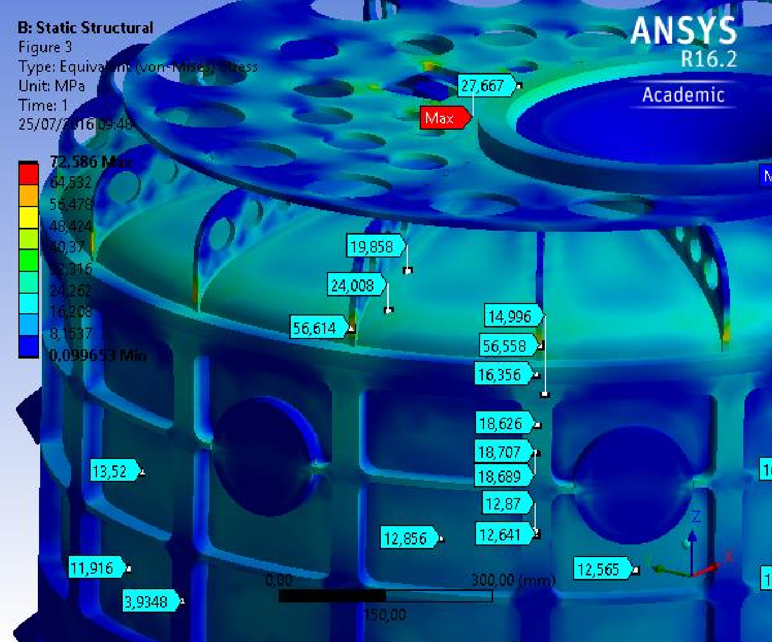
Status of the sub-system : blocking points and schedule
  Mechanical/Structural/Cryogenic Design completed (Masi, D’Alessandro, de Bernardis)
  Blue-prints prepared by company from our 3D drawing
  Detailed structural analysis completed (collaborative effort Sapienza/Company: D’Alessandro/Tarallo)
  Manufacturing of parts started at a precision mechanics company in Rome
  Machining proceeds smoothly. Larger parts (cylinder, top and bottom flanges)
  Delivery of parts still confirmed for the end of this year
  2 Pulse-Tube refrigerators procured and stored in our lab.
  Tests confirmed for first months of 2017
  This manufacturing has been paid with PNRA funds and cannot go to Argentina: expected to go to Dome-C for a CMB polarization measurement.
  Need permission from PNRA to use it for the demonstrator in Paris

Slide 5

Status of the sub-system : blocking points and schedule
  Funds for building a clone of the cryostat for F.I. in Argentina (excluding PTs) requested to INFN – CSN2.
  Funds allocated sub-judice for 2017, pending a discussion between INFN and PNRA. Outcome will be communicated around spring 2017.
  If funds released, we will be ready with the F.I. cryostat at the end of 2017.

Slide 6
Interfaces with other sub-systems
Mechanical:
  Towards 4K structure and 1K box – well defined
  Towards mount – well defined – pending structural verification
Electrical / Signal
  Connectors, cables, readout to be confirmed
Vacuum
  Valve to be procured. Vacuum/leaktest systems for Paris/Argentina to be procured/assured.
Optical
  Vacuum/optical window being procured – ARC to be defined
  Thermal filters: interfaces defined, filters to be produced in Cardiff

Slide 7
Test, Delivery, Assembly, Calibration Operations
Tests of the sub-system in Rome premises before delivery at APC
  Vacuum test for leaks. Pass if leak < 10⁻⁹ mbar l s
  Integrate with temperatures readout, use calibrated thermometers (from?)
  Integrate with instrument cabling (should be removed after demonstration finished and PNRA cryostat is returned to Rome. Is this possible or should we prepare two cablings ?)
  First cryogenic test with blocked windows and filters: pass if T (2nd stage) < 4.2K. Also measure load curve for the two cryo stages.
  Mount 1K and sub-K coolers and cryo test with blocked windows and filters. Pass if T (1K stage) < 1K, T (0.3K stage) < 0.35K
  Test with open window and thermal filters if available (if available). Same pass criterium.
Delivery to APC:
  Need to procure special box for shipment and special vibration damping system

Slide 8
ATRIUM and Documentation
3D drawing available
Future documents to be prepared and downloaded:
  cryostat design report
  cryostat assembly report
  Cryostat operation manual

Slide 9
Man Power
Cognome | Nome | Ruolo | FTE | Attività
Battistelli | Elia | RTDB | 40 | Calibrazioni
Coppolecchia | Alessandro | Ass.Ric. | 20 | Criogenia, Tests
D’Alessandro | Giuseppe | Ass.Ric. | 50 | Polarization modulator, tests
De Bernardis | Paolo | Prof. Ord. | 20 | Polarization modulator
De Petris | Marco | Ric. | 80 | Simulazioni e test ottiche
Lamagna | Luca | RTDA | 30 | Criogenia, tests
Masi | Silvia | Prof. Ass. | 60 | Criogenia, tests, Coord.
Paiella | Alessandro | Dottorando | 40 | Progettazione, Tests
Piacentini | Francesco | Prof. Ass. | 40 | Simulazioni, Analisi
Polenta | Gianluca | Ass. Ric. | 40 | Simulazioni, Analisi

Slide 10
Risks analysis
Risks / solutions:
  Leaks in the vacuum shell welding / Fixable with 1 month delay redoing welds or using stycast as the last resource.
  Leaks in thermal filters / Fixable adding and or modifying filters
  Long cooling time / Fixable reducing mass and or adding additional stage to be defined.

Slide 11
Annex 3: needed major tools or utilities for the cryostat
Three-phase (400 V) power (PT power supply)
Cold water (cooling of PT)
Gaseous He (1 bottle for He leak test)
4He/3He mass spectrometer (leak checking)
A-frame with winch (cryostat integration)
Turbo pump / roughing pump and pressure gauges (cryostat vacuum)
Assembly Hall (cryostat integration)

