Slide 1
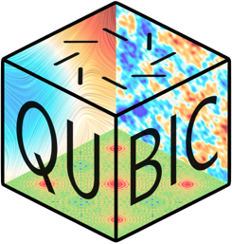







Last news from argentina
M. C. Medina
for the Argentinean Qubic Collaboration

Slide 2
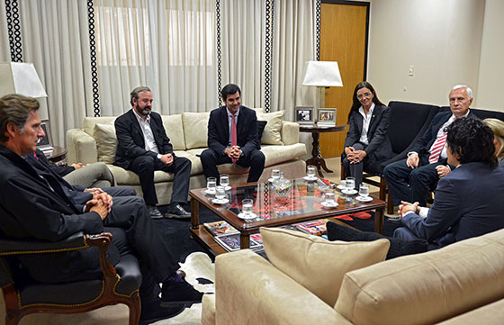
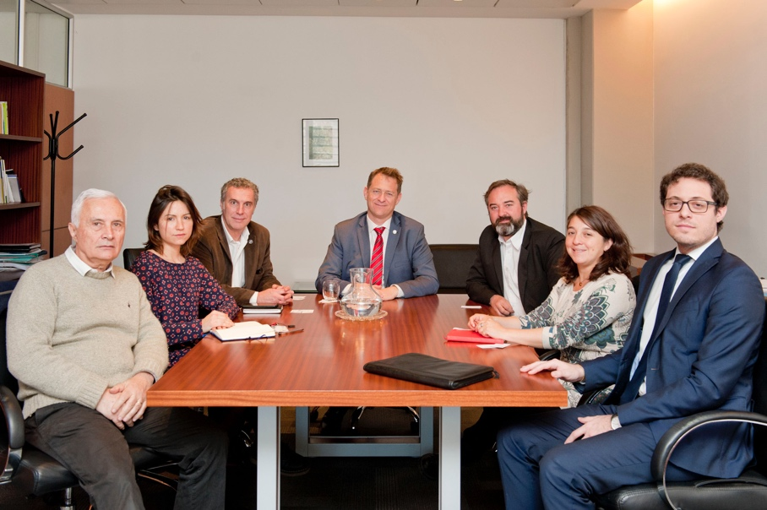
Political News
Several meetings with local authorities expressing their support :
  Governor and Minister of Education Science and Technology of Salta, Dr. Urtubey and Prof. Berruezo Sánchez.
  Director of the Department Of Scientific And Technological Articulation of the MINCyT (National Ministry of Science and Technology), Lic. Campero.
  Actual Vice- president of CNEA (National Commission of Atomic Energy), Dr. Lamagna.

Slide 3
Political News
four-party agreement (5 years) in preparation to be signed by:
    MINCyT (National Minister of Science and technology)
    CNEA (National Commission of Atomic Energy)
    CONICET (National Council of Science and Technology)
    Province of Salta
  Main points:
    Creation of a Council of Representatives advised by a Scientific Council.
    Qubic considered as a strategic scientific project.
    Argentinean commitment to participate on construction and operation of QUBIC and to form local human resources.
    Salta province will provide infrastructure in the site.
    Contributions from different parties to be defined in following acts.

Slide 4
Political news
Creation of an International Joint Laboratory (Laboratoire International Associé) proposal in preparation to be signed by:
    CNRS
    IN2P3
    USPC (Université Sorbonne Paris Cité)
    CONICET
    CNEA
  “virtual” laboratory named “ALFA-AC”:
    The Pierre Auger international Observatory for Ultra High Energy Cosmic Rays.
    The Cosmological Microwave Background Telescope QUBIC in Altos Chorillos, Salta/ArgentinA
    The two underground laboratories: the Laboratoire Souterrain de Modane (LSM) in the Modane tunnel between France and Italy and the planned Agua Negra Deep Experiment Site (ANDES) in the Agua Negra tunnel between Argentina and Chile.

Slide 5
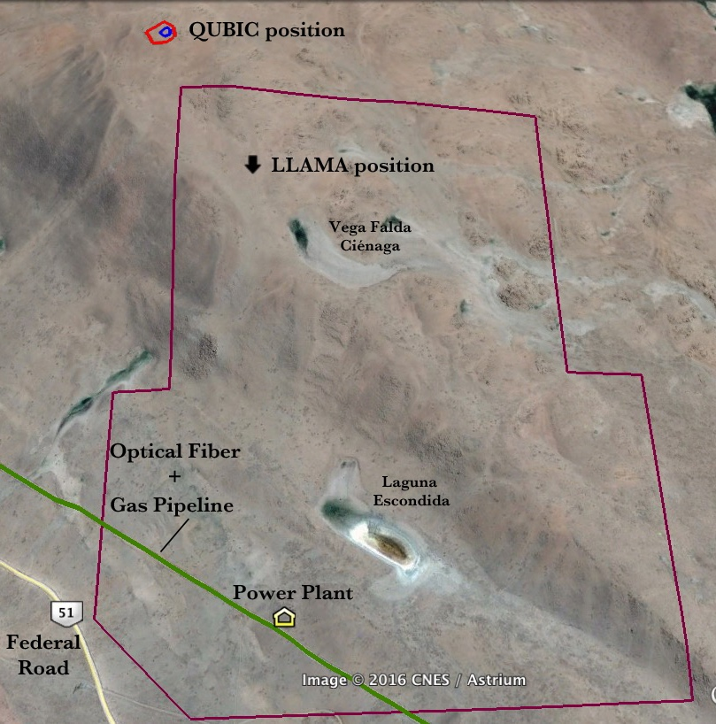
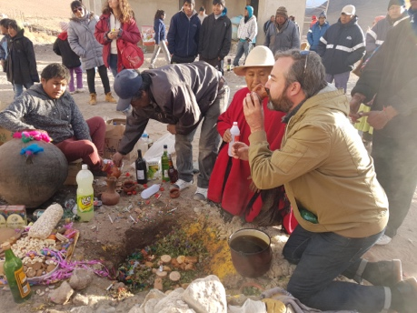
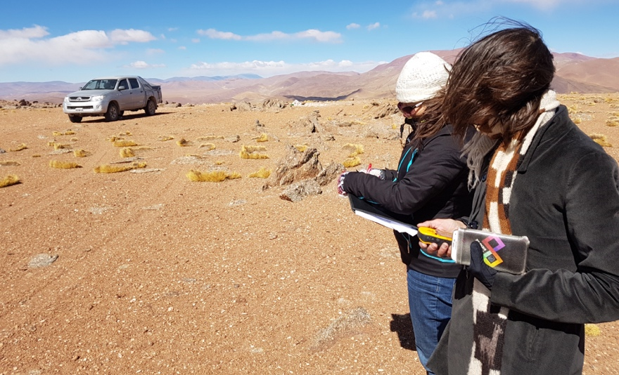
SITE development status
August, 2016: visit to the site (Alto Chorillos)
  Definition of the final position
  Check on Infrastructure progress
  Contact with local community
October 2016:
  Installation of weather station by ITEDA & CNEA.
  Demarcation of the selected area
LLAMA Infrastructure:
  Access Road; Housing + Labs @ San Antonio de los Cobres; power → following the same schedule mentioned on the TDR.
Local Support:
  Available CNEA installations @ Salta City for instrument integration (Lab and hangar). 2 People working for QUBIC.

Slide 6
Argentinean participation
Mount (+ building) design : GEMA (Applied Mechanics Testing Group) of the Department of Aeronautics, School of Engineering of the National University of La Plata, in close collaboration with Roma groups (See dedicated presentation later today).
Data analysis and simulations : Interested people from the Argentinean Institut of Radioastronomy and the Faculty of Astronomy of The National university of la plata. First discussion between Claudia Scoccola, Leonardo Pelliza & Jean Christophe on August.
T.E.S. Development by the Department of Micro and Nanotechnology of CNEA (Atomic center Constituyentes), as a support backup to CSNSM/IEF historical effort given the closing of IEF in mid 2017. In close collaboration with Stefanos Marnieros, Benoit Belier & Michel Piat.
Possible development of MKIDs for future bolometers by the Laboratory of Low Temperatures @ CAB-CNEA.

Slide 7
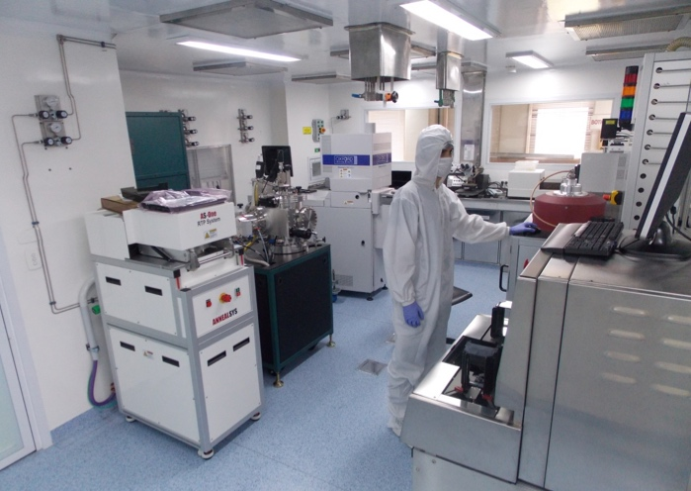
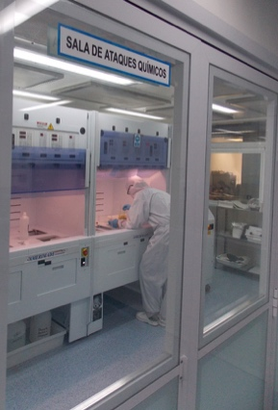
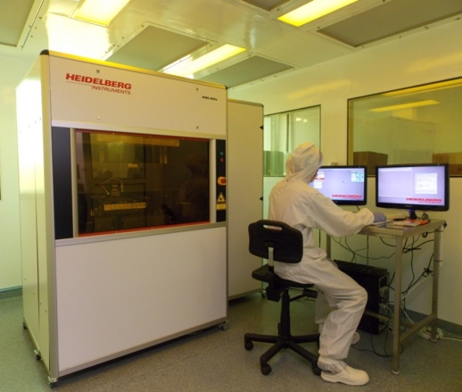
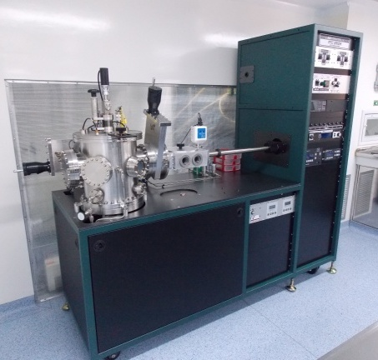
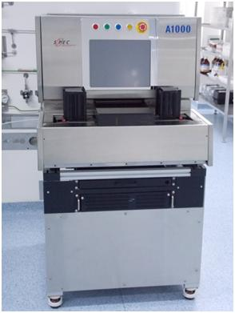
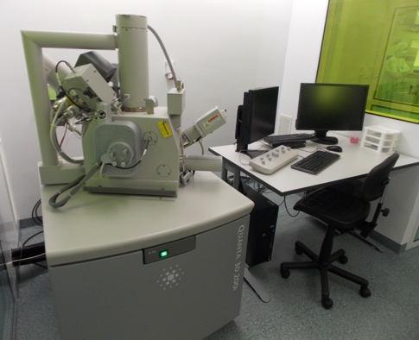
T.E.S. Development
Alejandro Fasciszewski, Juan BONAPARTE
Department of Micro and Nanotechnology of CNEA (DMN-CNEA)
12 people working on microfabrication
  135 m² Clean Room (Class 1.000 & 10.000)
  35 m² Auxiliary services area.
  75 m² Bottom-UP laboratories & electrical characterization.
  Capabilities for doing:
    Lithography
    Deposition
    Chemical Attack
    Metrology
    Laser –Assisted Thin layer growth

Slide 8
T.E.S. Development
Alejandro Fasciszewski, Juan BONAPARTE
Schedule:
  Teleconferences evert Tuesday.
  First tests on micro-fabrication using QUBIC photo-masks.
  Visit of people from CNEA to the IEF for discussing about the details on T.E.S. fabrication.
  Visit of Camille Perbost to DMN-CNEA the first months oF 2017.
  @ the end 2016 → be able to have:
    Results of microfabrication tests
    Acquisition planning for missing equipment.
    Realistic estimation of Fabrication time.

Slide 9
Miscellaneous
Qubic-Argentinean collaboration constitution:
  7 institutions and about 20 people involved.
“Primordial Universe and Cosmology Data Analysis Cosmology” Lectures given by J. C. Hamilton @ Instituto Sabato - University of San Martin (Buenos Aires):
  2 weeks, August 2016.
  more than 25 attendees.
  Big interest from different groups:
    IAFE, University of Buenos Aires, FCAGLP, etc.
Presentation of qubic-Argentina at the Annual Reunion of the Argentinean astronomical society (By B. Garcia).
Paper in preparation for a local review of scientific outreach (Ciencia hoy).

Slide 10
Conclusions i
Argentinean community interest on Qubic has grown quickly in the last months.
Argentinean contribution on
  Site development
  Mount Design
  T.E.S. Backup production
Remarkable progress on political support:
  Very Important parties Commitment with QUBIC: MinCyT, CNEA, CONICET, Province of Salta.
Financial support:
  500 KU$S by MINCyT (already approved but not yet materialized)
  The Province of Salta will provide infrastructure on site.
  Conicet would contribute with human resources (Salaries and scholarships)
  Argentina would finance half of the mount (after agreement signed)

Slide 11
Conclusions Ii
Site development:
  Work in progress.
  We expect a to be more independent of LLAMA, thanks to CNEA-Salta support.
Proposal:
  Next Qubic Collaboration meeting in Argentina?

Slide 12
Thanks!

Slide 13
Backup slides

Slide 14

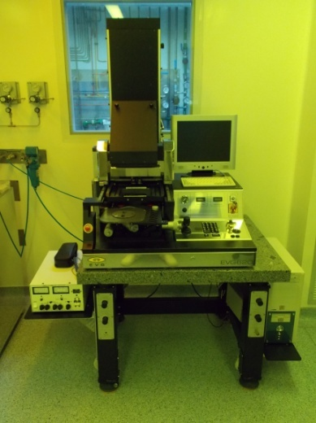
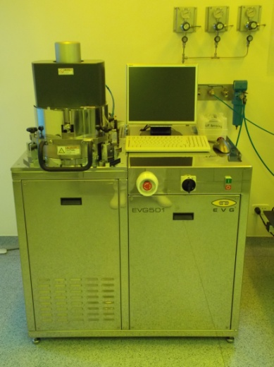
Equipamiento
Litografía
ID | Nombre | Ubicación
L-01 | Alineador de Máscaras EVG 620 | Sala Litografía
L-02 | Soldador de obleas EVG 501 | Sala Litografía
L-03 | Mesada de Litografia | Sala Litografía
L-04 | Generador de Máscaras HEIDELBERG DWL66fs | Sala Masterizador
Generador de Máscaras HEIDELBERG DWL66fs
Alineador de Máscaras EVG 620
Soldador de obleas EVG 501

Slide 15
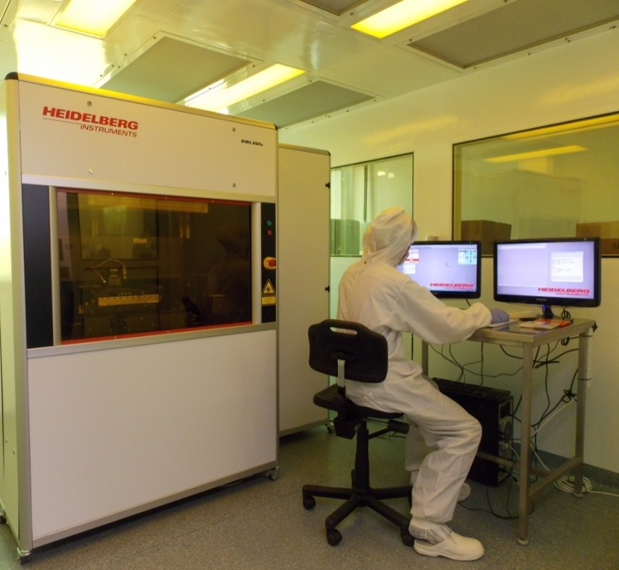
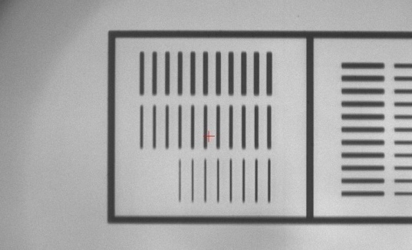
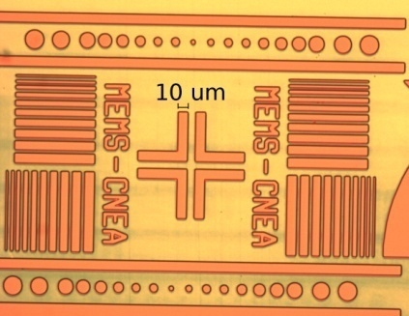
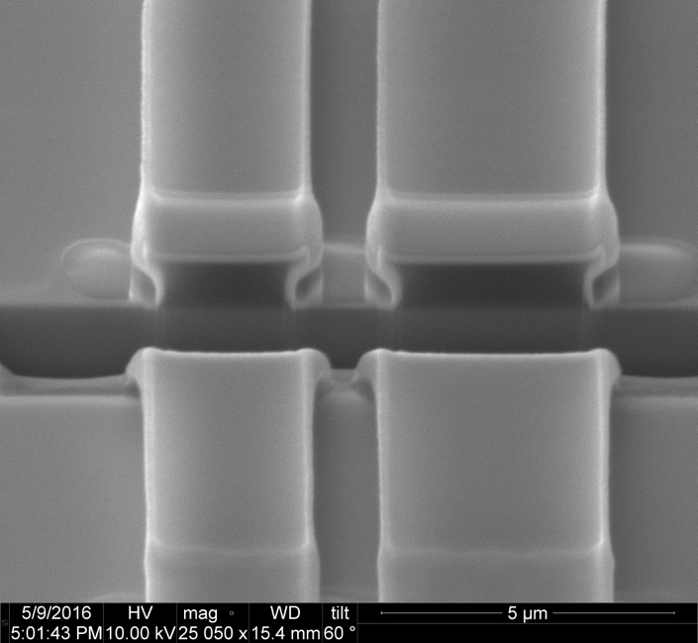
Equipamiento
Generador de Máscaras HEIDELBERG DWL66fs
Laser | Estado Solido, λ=405nm
Resolución mínima | Cabezal de 10mm: >4um Cabezal de 2mm >1um
Velocidad de escritura | Cabezal de 10mm: 119mm²/min Cabezal de 2mm: 8mm²/min
Alineador de Máscaras EVG 620
Lámpara | i-line, λ=365nm
Resolución mínima | CD >1um
Velocidad de escritura | Alineación Front to Front y Front to Back

Slide 16
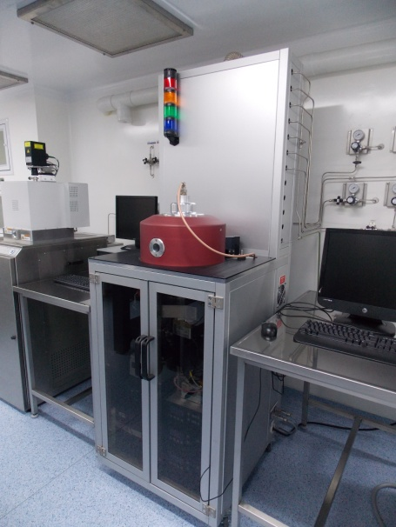
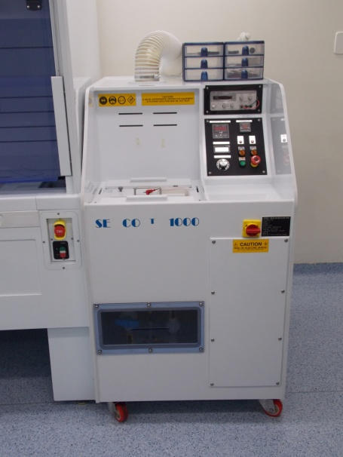
Equipamiento
Deposición
ID | Nombre | Ubicación
D-01 | Sputtering AJA Orion | Sala de Ataques por Plasma
D-02 | PECVD ADVANCED VACUUM VISION 310 | Sala de Ataques por Plasma
D-03 | Celda Electroplating SEMCOM 1000 | Sala Ataques Químicos
Sputtering AJA Orion
PECVD Vision 310
Celda Electroplating
SEMCOM 1000

Slide 17
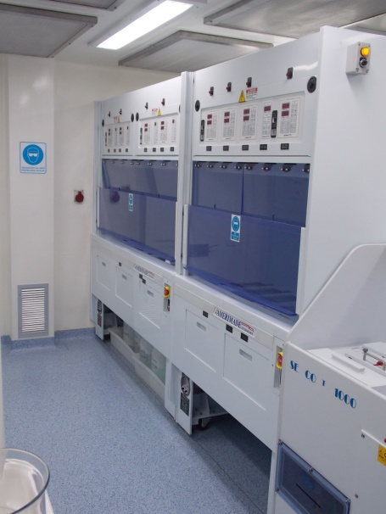
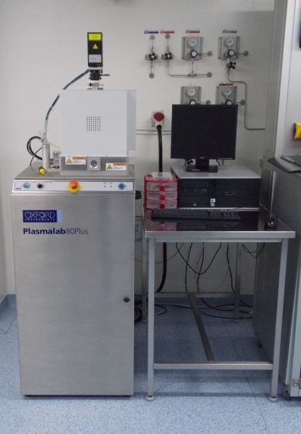
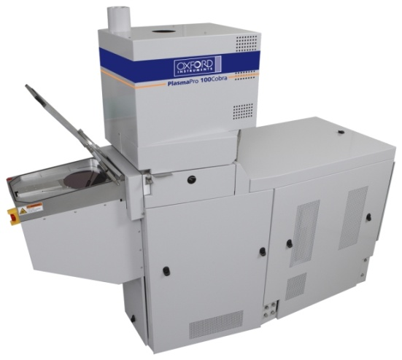
Equipamiento
Ataque
ID | Nombre | Ubicación
A-01 | RIE OXFORD INSTRUMENTS PLASMALAB80+ | Sala de Ataques por Plasma
A-02 | D-RIE OXFORD INSTRUMENTS PLASMAPRO COBRA | Sala de Ataques por Plasma
A-03 | Asher SPEC AURA1000 | Sala de Ataques por Plasma
A-04 | Mesada de ataques químicos AMERIMADE | Sala Ataques Químicos
A-05 | Mesada de Limpieza AMERIMADE | Sala Ataques Químicos

Slide 18
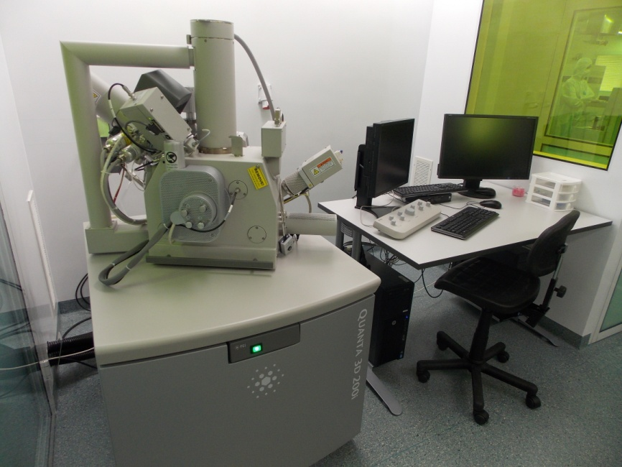
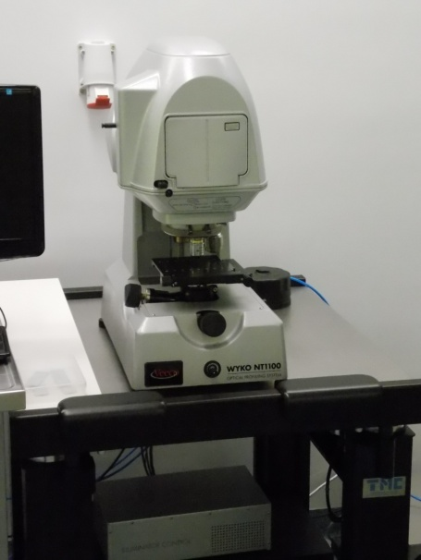
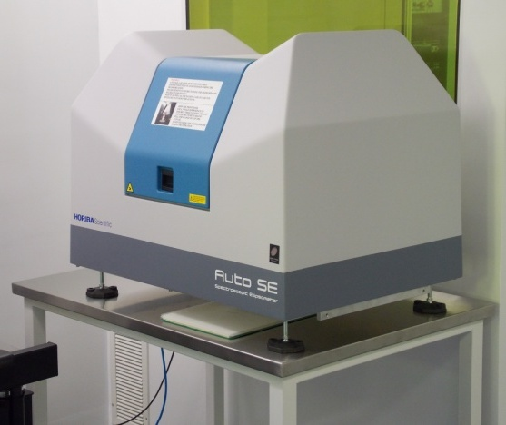
Equipamiento
Metrología
ID | Nombre | Ubicación
M-01 | Microscopio Óptico MITUTOYO FS70 | Sala Litografía
M-02 | Perfilómetro Óptico 3D, Veeco Wyco NT1100 | Sala Metro
M-03 | Perfilómetro por contacto KLA-TENCOR ALPHA STEP D120 | Sala Metro
M-04 | Elipsometro Horiba AUTO-SE | Sala Metro
M-05 | Dual Beam SEM-FIB FEI Quanta 3D 200i | Sala Metro
M-06 | Microscopio óptico LEICA | Sala Ataques por Plasma
SEM-FIB
Perfilómetro óptico 3D
Elipsometro AUTO-SE

Slide 19

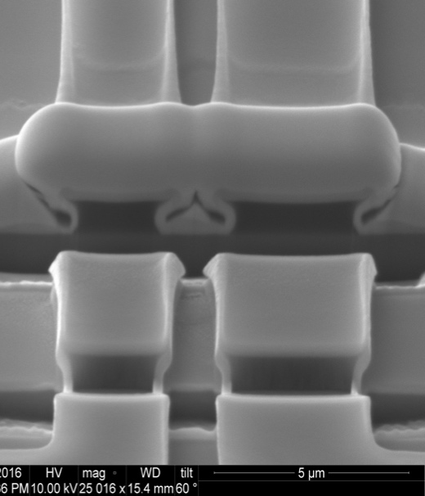
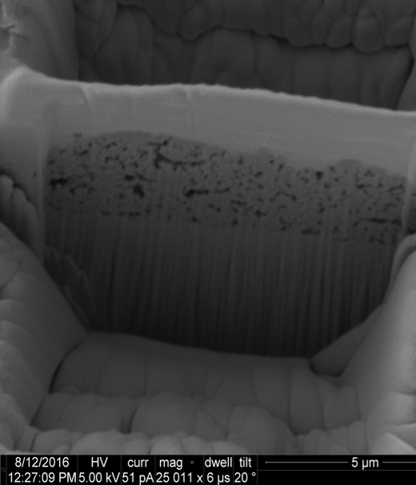
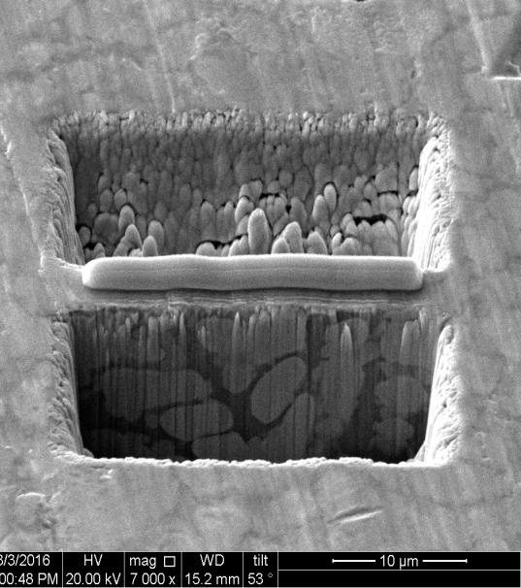
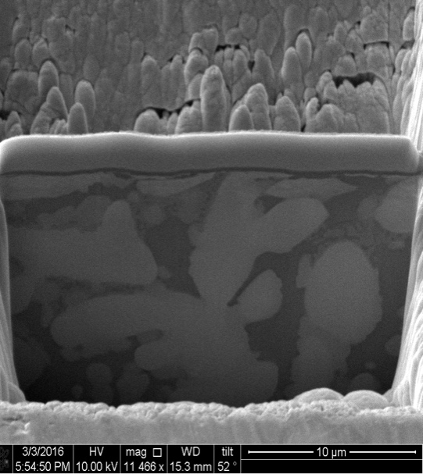
Equipamiento
Dual Beam SEM-FIB FEI Quanta 3D 200i
SEM | FIB
Emisión termoiónica | Columna de Galio de alta corriente con fuente de emisión de metal liquido.
Resolución: – 3.0 nm @ 30 kV | Resolución al punto de coincidencia 9 nm @ 30 kV @ 1 pA
Voltajes de aceleración: 200v a 30Kv | Voltajes de aceleración: 2 a 30Kv
Campo máximo horizontal: 10mm | Campo máximo horizontal: 2.5mm
 | Corriente del haz: 1pA a 65nA
 | 15 tamaños de aperturas

Slide 20
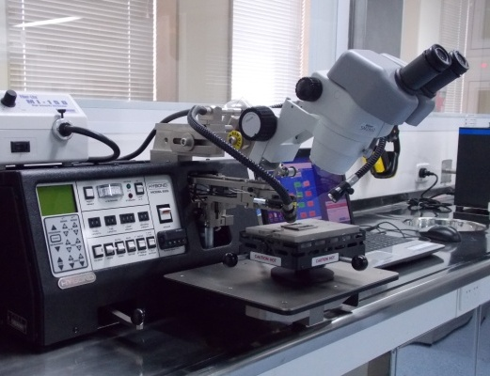
Equipamiento
BackSide
ID | Nombre | Ubicación
DS-01 | Sierra de corte de obleas DISCO DAD3240 | Lab C220
DS-02 | Wire Bonder Hybond 912 | Sala de ataques por plasma
Dicer Disco
Wire bonder

Slide 21
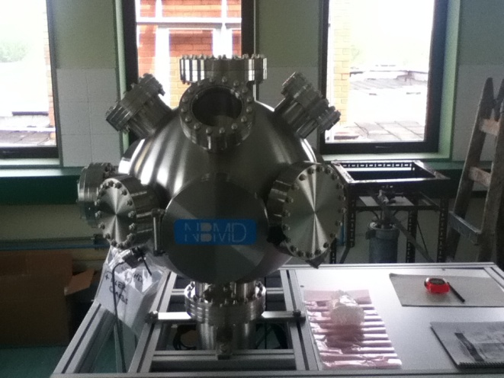
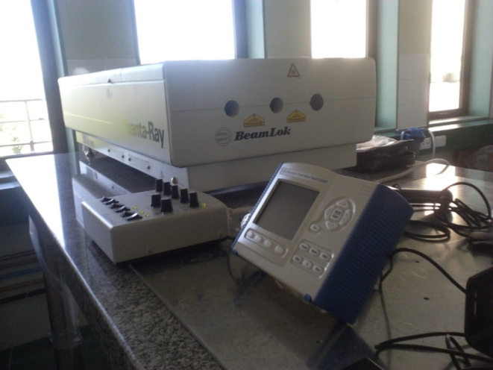
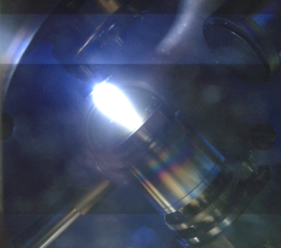
Equipamiento
Crecimiento de films delgados por Ablación Láser asistida por RHEED
Cámara dedicada a óxidos
Crecimiento congruente, aún para óxidos complejos
El RHEED (difracción de electrones) permite monitorear en tiempo real cristalinidad, epitaxia, morfología. mecanismos de crecimiento
Sistema abierto a usuarios INN, que deberán proveer:
Blanco (cerámico sinterizado de 1’’ de diámetro y hasta 4mm de espesor)
Substratos
Responsable de la facilidad:
Diego Rubi
diego.rubi@gmail.com
Ext. 7092

