Slide 1



QUBIC Optics
Baffling & Combiner tests
Marco De Petris
“Sapienza” University , Rome, Italy
Department of Physics

Slide 2


Sub-systems for QUBIC:
Shielding (baffling)
& Combiner tests
QUBIC: Optics
For Technological Demonstrator (T.D.)
And
For Final Instrument (F.I.)

Slide 3
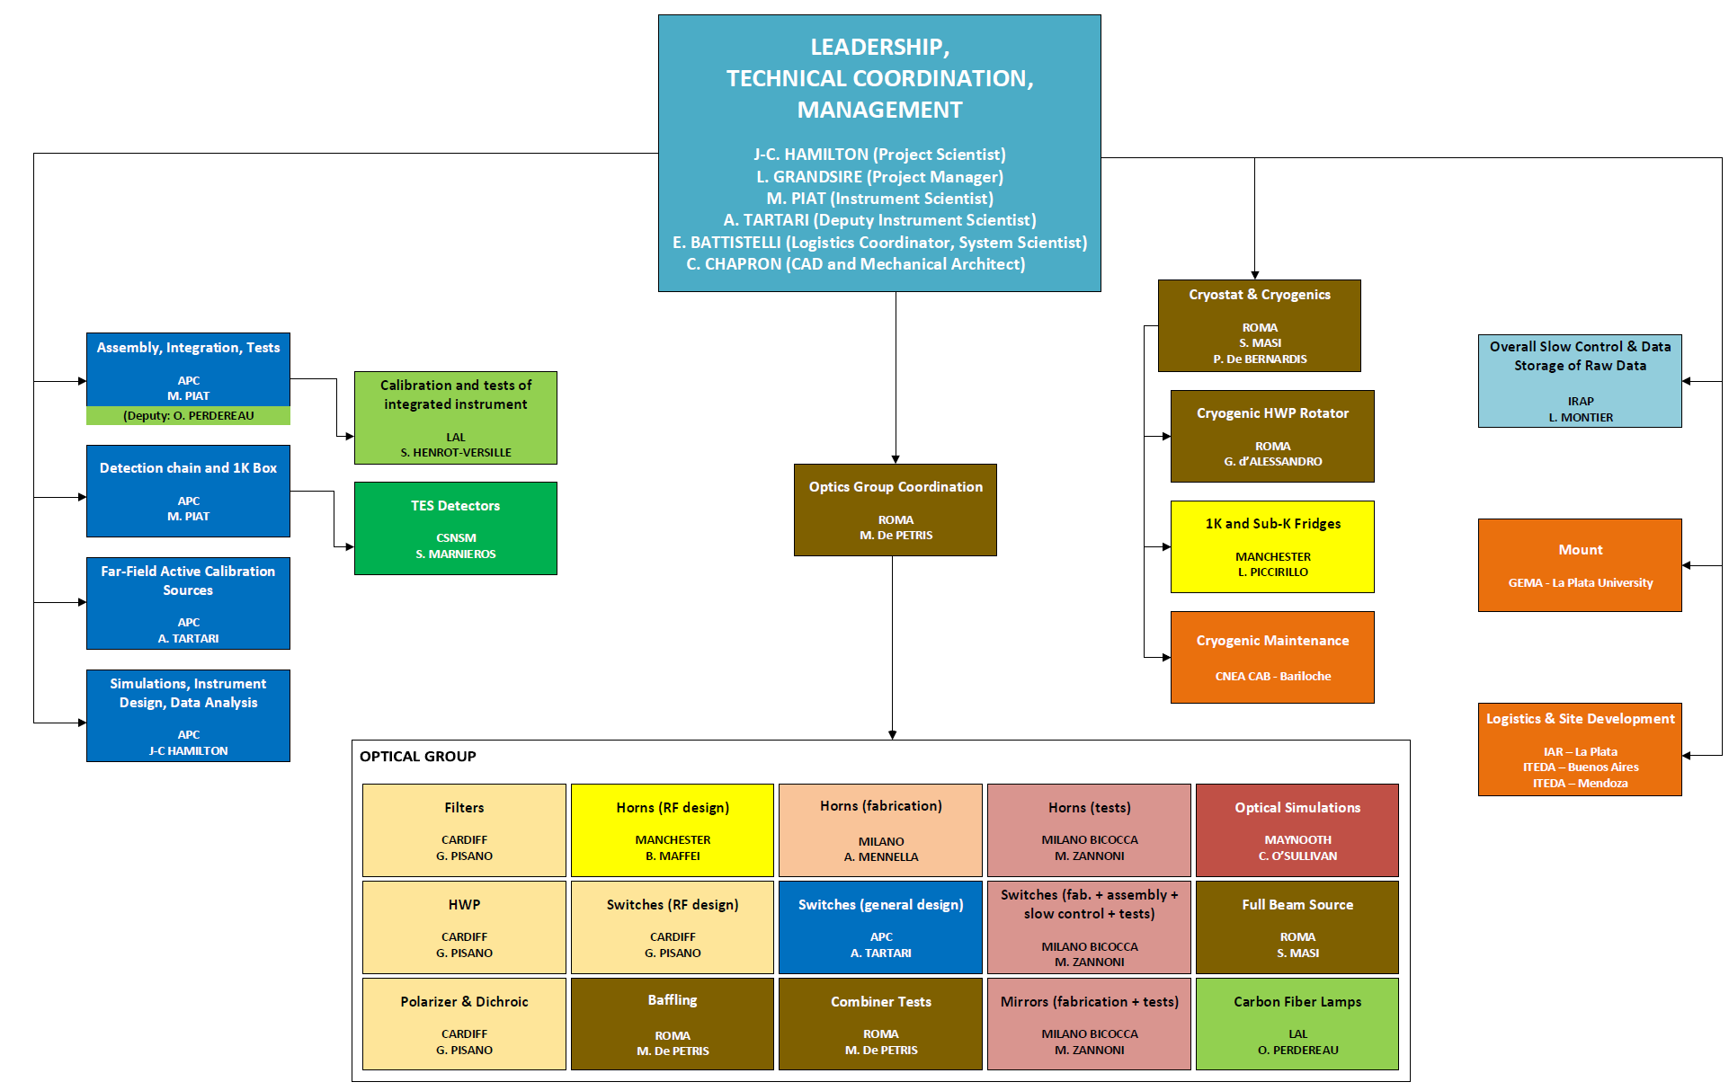
QUBIC: Optics
Annex 1: list of main-sub-system and WP leaders

Slide 4
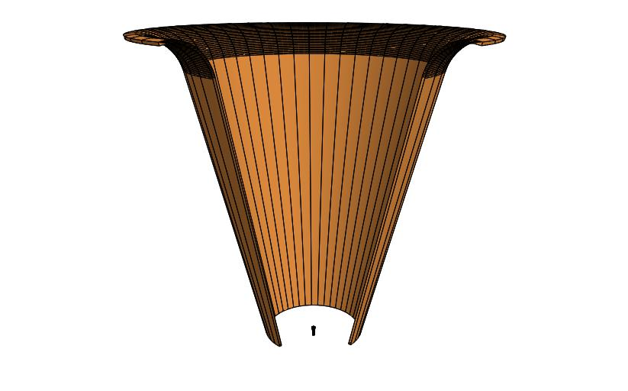
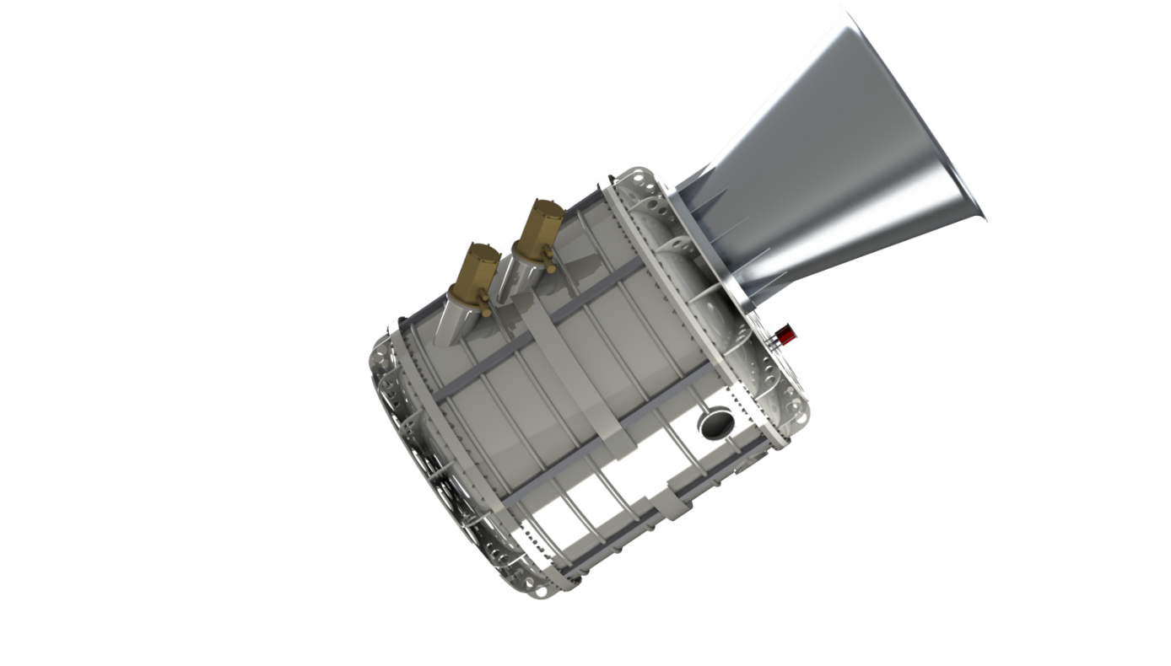
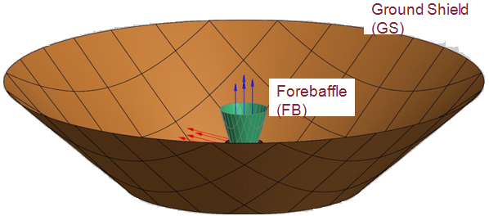
QUBIC: Optics
Shielding
Current shielding baseline
ForeBaffle (FB)
conical shape
1 meter height
aperture angle 14 degrees (FWHM)
flared edge with curvature radius 50mm
base diameter 350 mm
absorbing inner surface
(Acknowledgment
NIKHEF/TNO)
Ground Shield (GS)
G. D’Alessandro
conical shape (TBC, petals?)
aperture angle 45 degrees
flared edge with curvature radius 50mm
base diameter 3 m
(TBC, see cryostat mount and experimental module)
reflecting inner surface

Slide 5
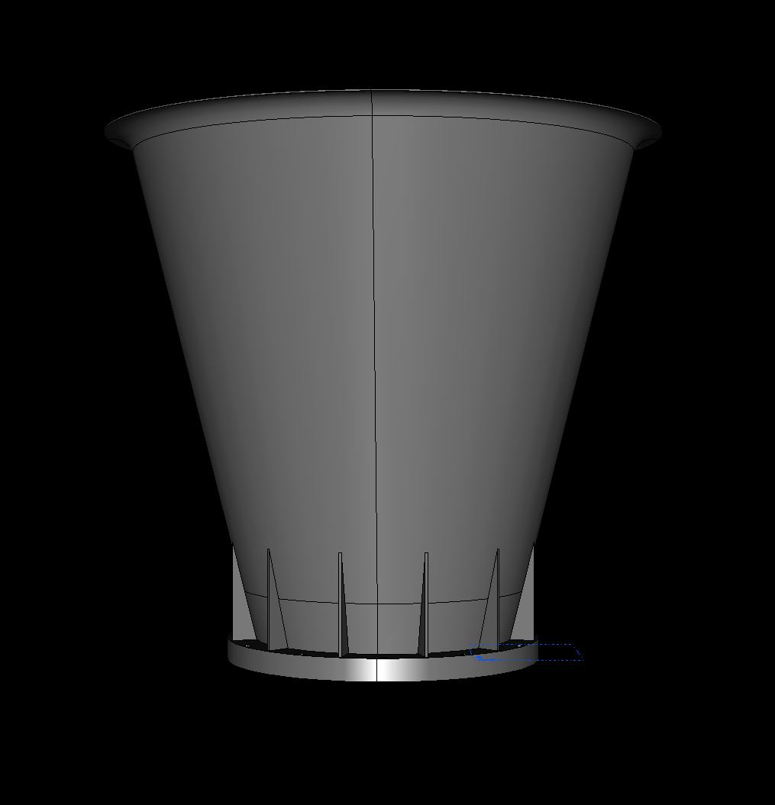
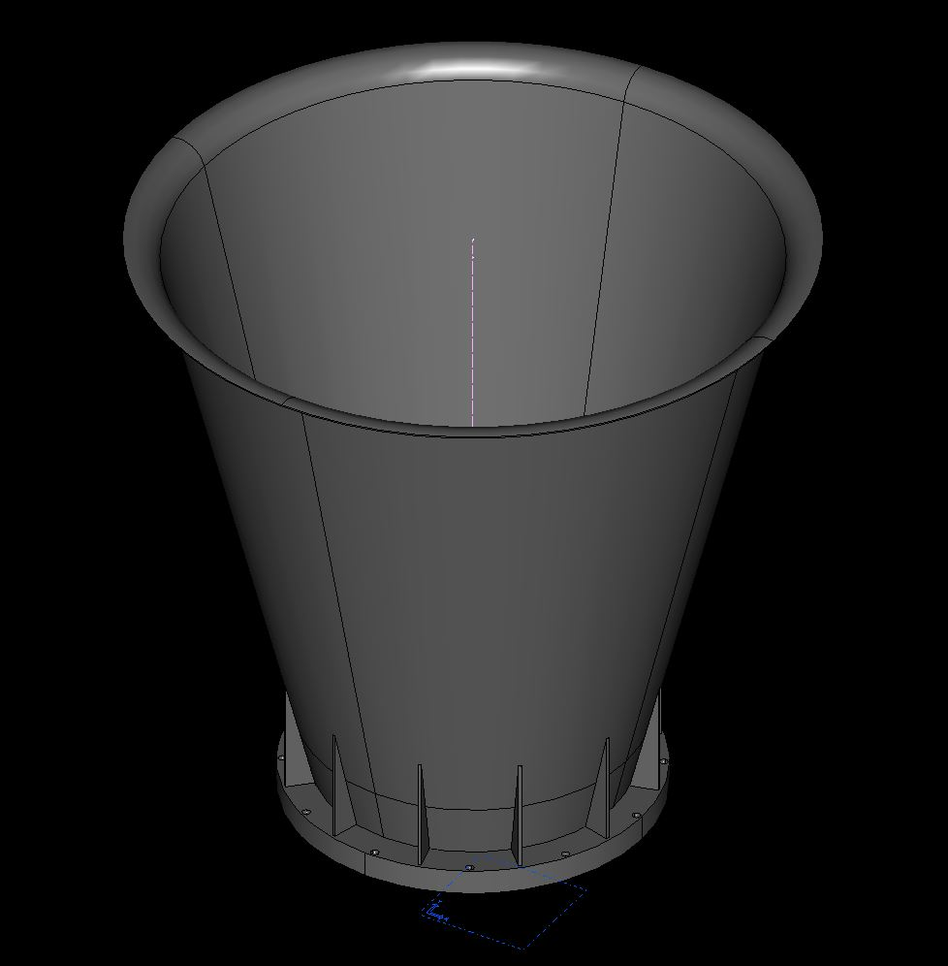
QUBIC: Optics
Shielding
Current Forebaffle: preliminary drawings
Height 1 m
aperture 28 deg
A. Pelosi INFN RM1

Slide 6
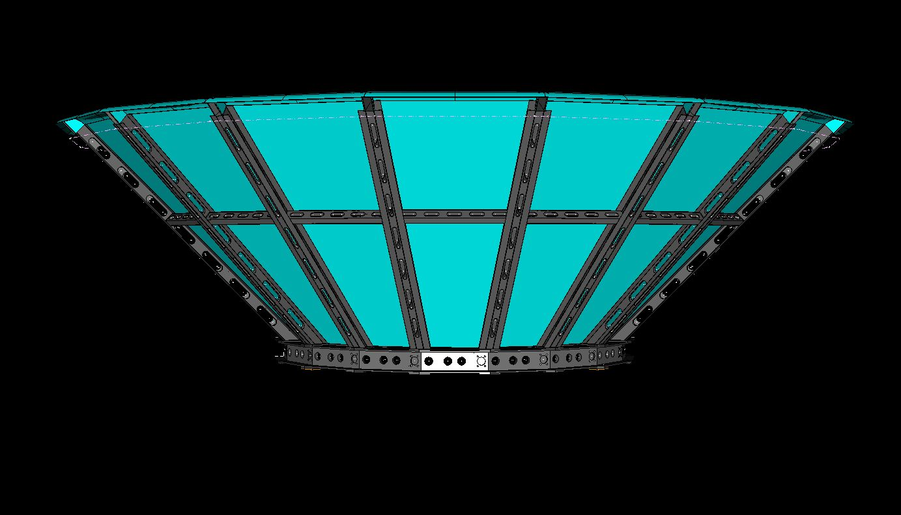

QUBIC: Optics
Shielding
Current Ground Shield: preliminary drawings
6m in
outer dia. 6m
inner dia. 3m
aperture 90 deg
18 petals
A. Pelosi INFN RM1

Slide 7
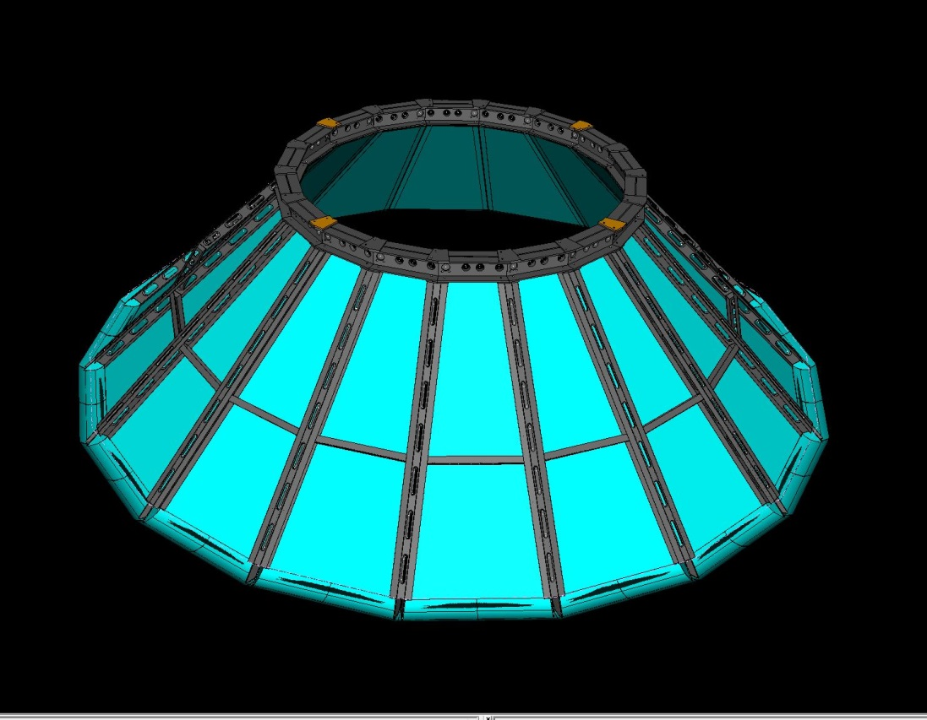
QUBIC: Optics
Shielding
Current Ground Shield: preliminary drawings
4 flanges to install the shield on the ground/roof
TBD ... under discussion with GEMA
A. Pelosi INFN RM1

Slide 8
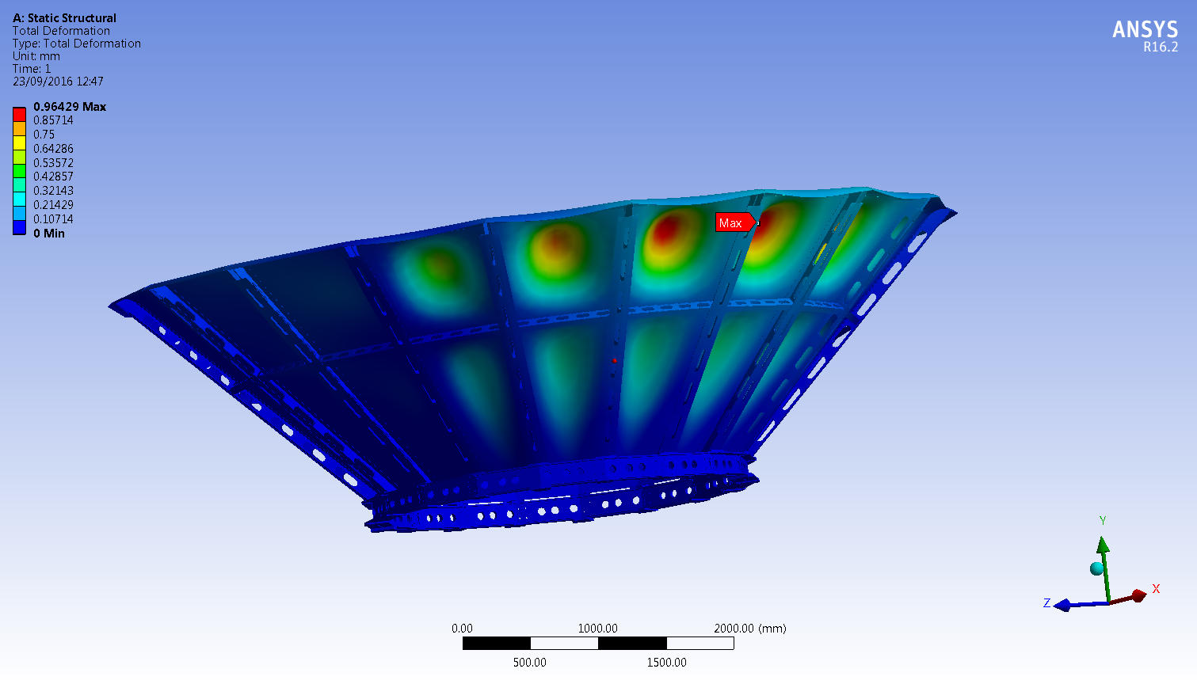
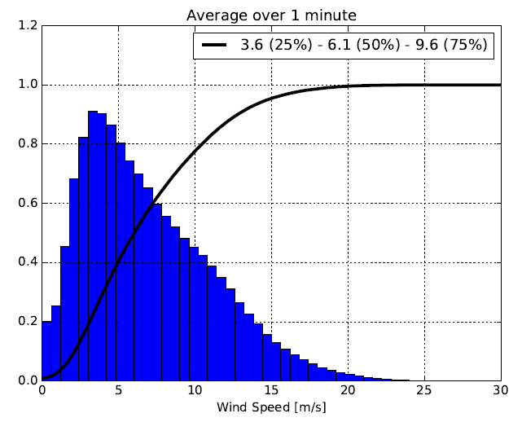
QUBIC: Optics
Shielding
Current Ground Shield: preliminary structural analysis
wind 25 m/s
max total deformation 1mm
max wind velox
@Chorillos
credits C. Medina
A. Zullo INFN RM1

Slide 9
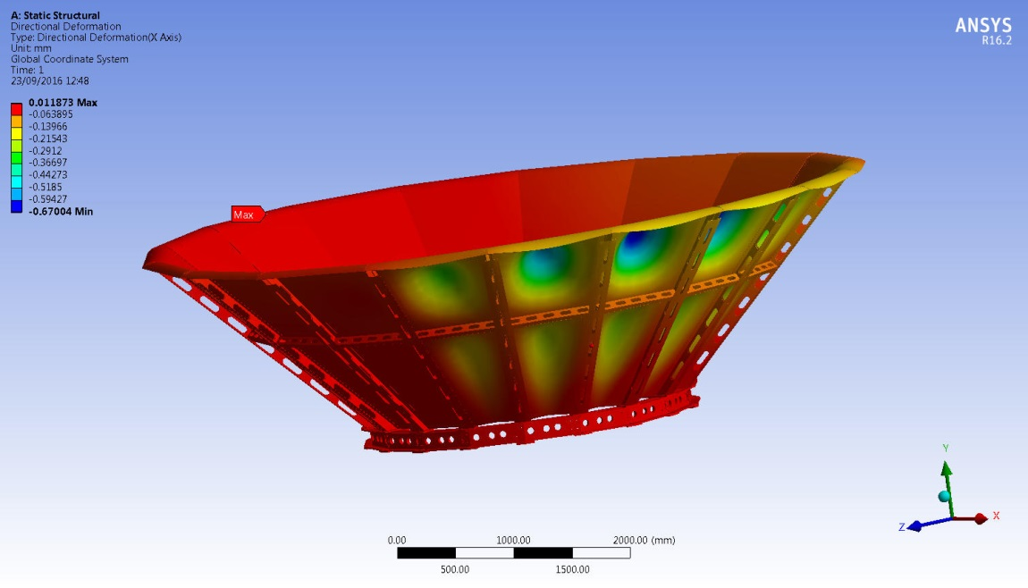
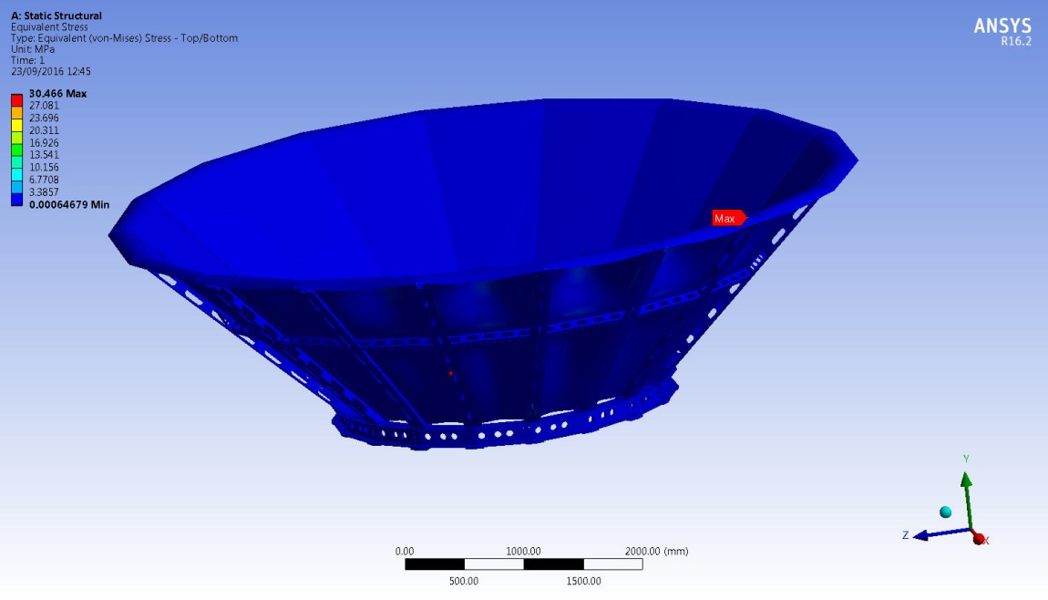
QUBIC: Optics
Shielding
Current Ground Shield: preliminary structural analysis
max x-axis deformation = 0.7mm
max Von-Mises stress = 30 MPa
A. Zullo INFN RM1

Slide 10
QUBIC: Optics
Combiner tests
Current Ground Shield: preliminary structural analysis
After choosing the elevation axis (see GEMA mount/laboratory roof):
  re-model beam pattern with correct FB and GS positions
        [GS geometry could consistently change]
After the change of the observation site (DC -> Chorillos):
  Constraints on the weight, can we relax them? [material (Al) and lightening the ribs]
  Maximum size component limitations for transportation
        [from Basler to container?]
  Some protection on the FB to cover cryostat window in case of necessity or for the whole mount [TBD]

Slide 11
Status of the sub-system Shielding blocking points and schedule
  What is the status of the sub-system ?
    Design and modeling on going/manufacturing by outside firm/assembly and test @outside firm
    When is this phase supposed to be finished ? FB (for T.D. and F.I.) and GS (only for F.I.) drawings 12/2016
                Forebaffle manufacturing 05/2017, to ship to APC
                Ground Shield manufacturing 03/2018, to ship to the site (? or APC)
  If you are still designing the sub-system:
    Which inputs / specifications / requirements, needed to finish the detailed design of your sub-systems, are not yet delivered ?
      For T.D. Forebaffle: geometry frozen (reflective inner surface as first version to test performances)
      For F.I. Ground Shield: geometry to be interfaced with mount/site location and manufacturing cost
    Which other working group should deliver these inputs (see annex 1 for list of main WP) ?
      For T.D. no one
      For F.I. GEMA, IAR, ITEDA, APC
  What time is still needed in order to (for D.T.) – assume that the above inputs are provided if needed - :
    Finish the whole detailed design of D.T. ? FB drawings 12/2016
    Manufacture the sub-system ? Forebaffle manufacturing 05/2017 - Ground Shield manufacturing 03/2018
    Test the sub-system in your premises before delivery to APC / ROMA ? no
  Idem for F.I.
    Finish the whole detailed design of D.T. ? GS drawings 12/2016
    Manufacture the sub-system ? Ground Shield manufacturing 03/2018
    Test the sub-system in your premises before delivery to APC / ROMA ? no
  Do you think you can comply to the target schedule (see annex 2) ? It’s dependent on the (INFN?) funds: scheduled time and total amount
still in preparation …

Slide 12
Interfaces with other sub-systems
Forebaffle
List and describe needed interfaces with other systems.
  Mechanical with cryostat
Are these interfaces currently frozen ? yes
Ground Shield
List and describe needed interfaces with other systems.
  Mechanical with laboratory roof/ground
Are these interfaces currently frozen ? no
still in preparation …

Slide 13
Test, Delivery, Assembly, Calibration Operations
Tests of the sub-system in your premises before delivery at APC or ROMA:
  What is the rationale for testing the sub-systems ?
  Which specifications will be tested ?
  What are the criterion for fail / pass ?
Delivery to APC or ROMA:
  Special care needed for the transportation and handling of the goods ?
Assembly Operations in APC or/and ROMA:
  Same questions as first point above.
  + which other sub-systems should be integrated before yours? After yours ?
  + Is there any specific material needed for assembly ? (see annex 3 for help)
  What are the test sequences needed to be performed during/after integration
  + How many FTE will you send people at APC / ROMA for help during assembly ?
Calibration Operations at APC:
  Same questions as for Assembly operations.
still in preparation …

Slide 14
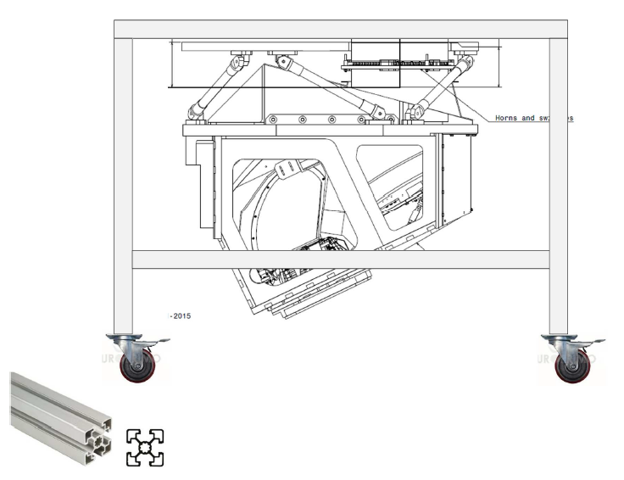
QUBIC: Optics
Combiner tests
Test of combiner alignment by check the «misalignment» @ 300K
Cart to align and to assemble the combiner
X-Y translation stages
on a mount fixed on the top flange of the «1K box»
He-Ne laser
secondary mirror
@300K
primary mirror
@300K
Comparison of full field spot diagrams with Zemax simulations at 300K

Slide 15
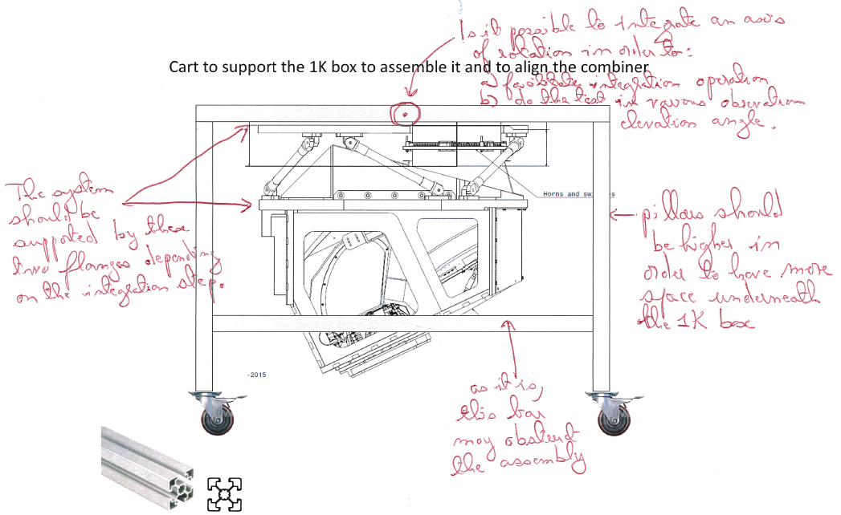
QUBIC: Optics
Combiner tests
Test of combiner alignment by check the «misalignment» @ 300K
Upgrades since first version (following Claude et al.’s suggestions)
Tiltable flange 0°- 60°
  i.e. elevation 90°-30°
  exploring operational configs
Car taller than before
  to work more easily on it
Fully accessible sides
  ditto
… still to find a solution to support
the second flange (the support belt).
1.
4.
2.
3.

Slide 16
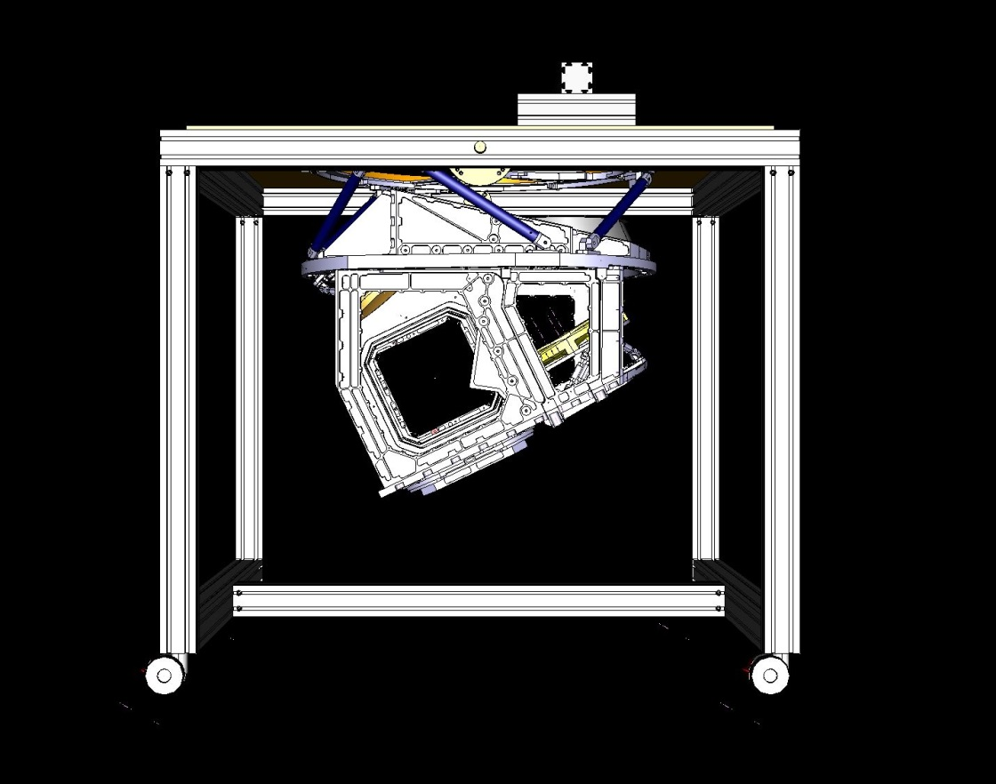
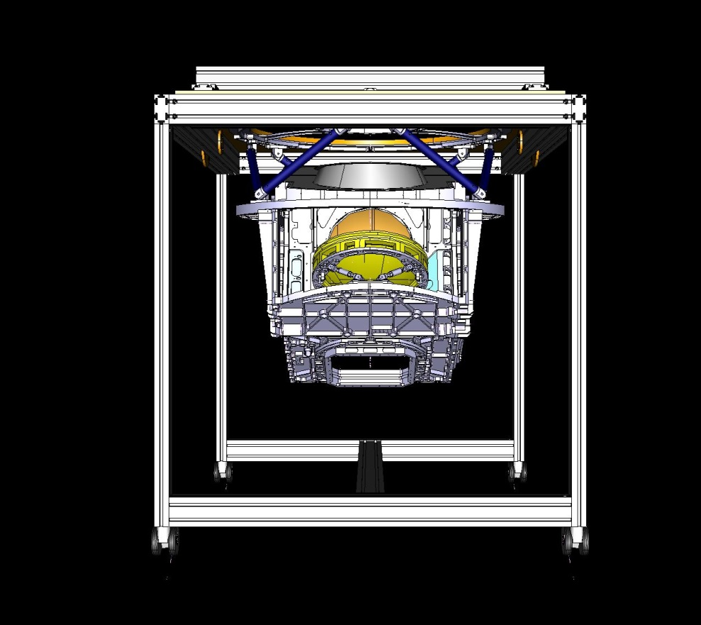
QUBIC: Optics
Combiner tests
Test of combiner alignment by check the «misalignment» @ 300K
A. Pelosi INFN RM1

Slide 17
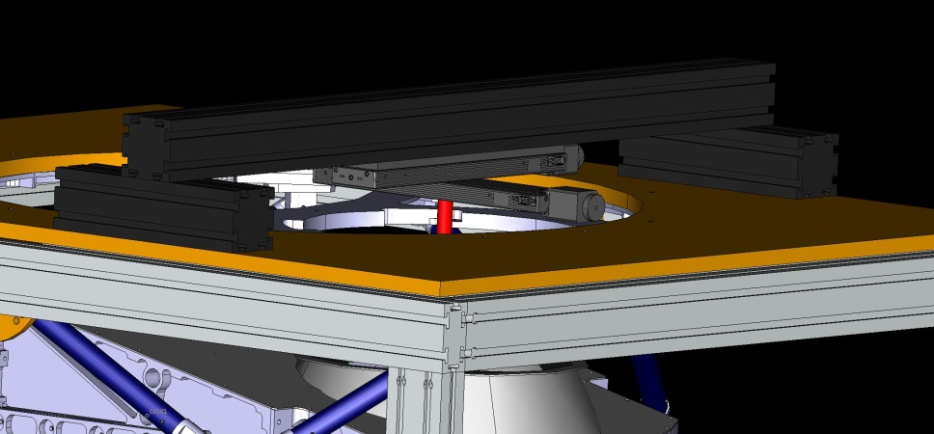
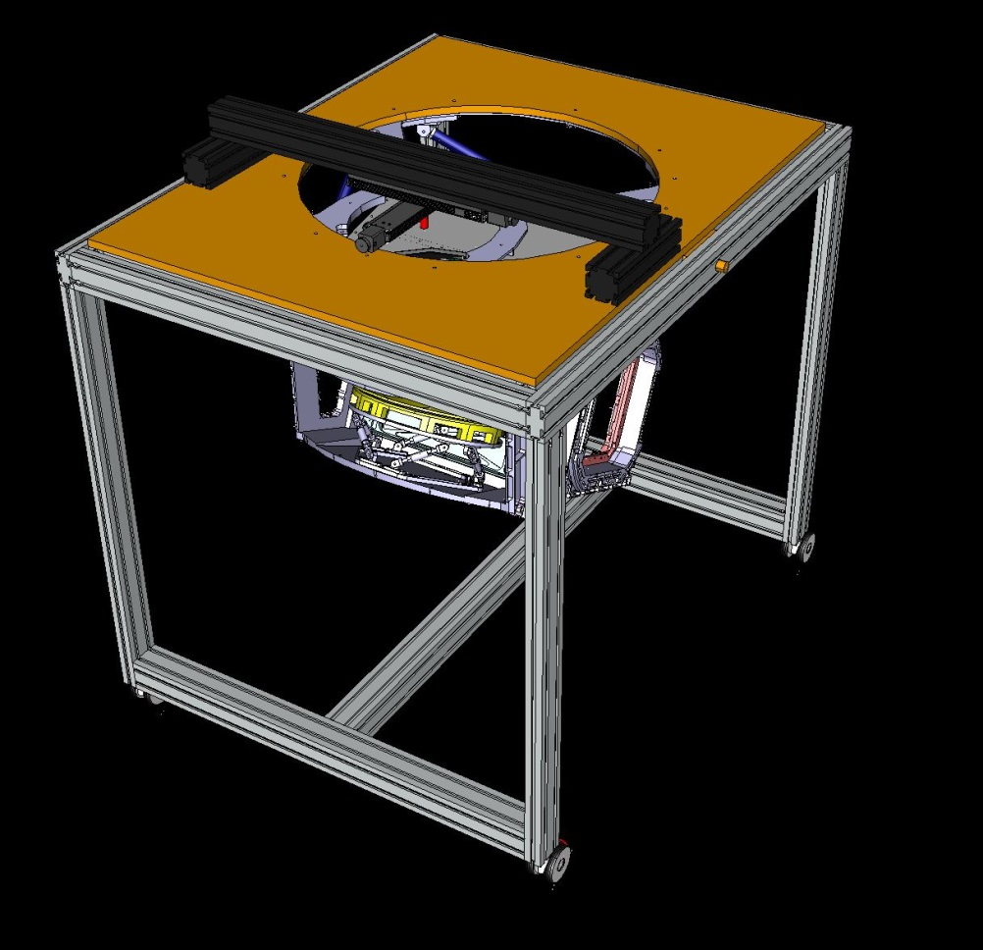
QUBIC: Optics
Combiner tests
Test of combiner alignment by check the «misalignment» @ 300K
2-axes linear stages 300x300 mm range with He-Ne laser
Elev = 90 deg
A. Pelosi INFN RM1

Slide 18
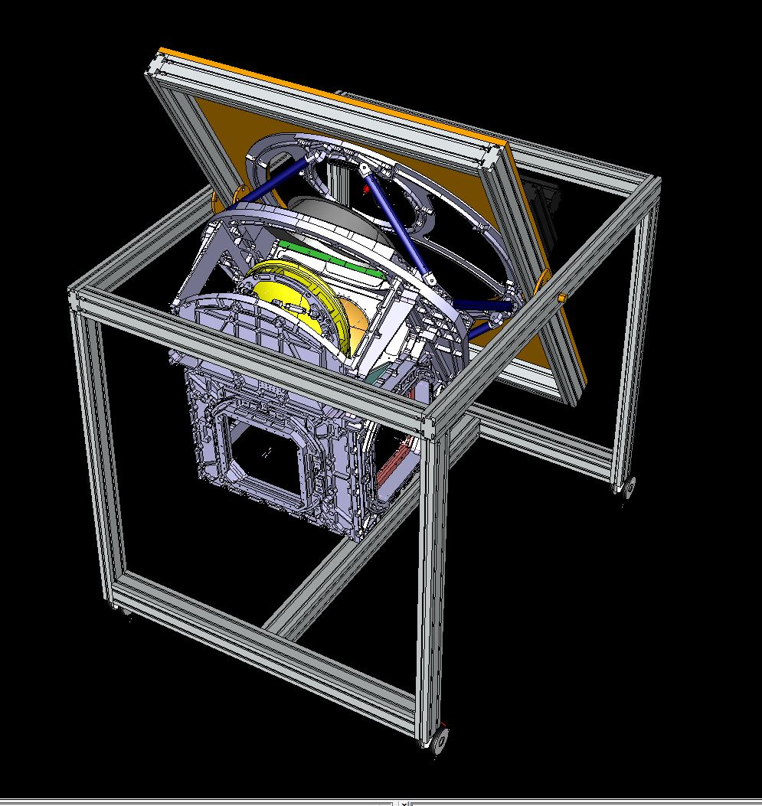
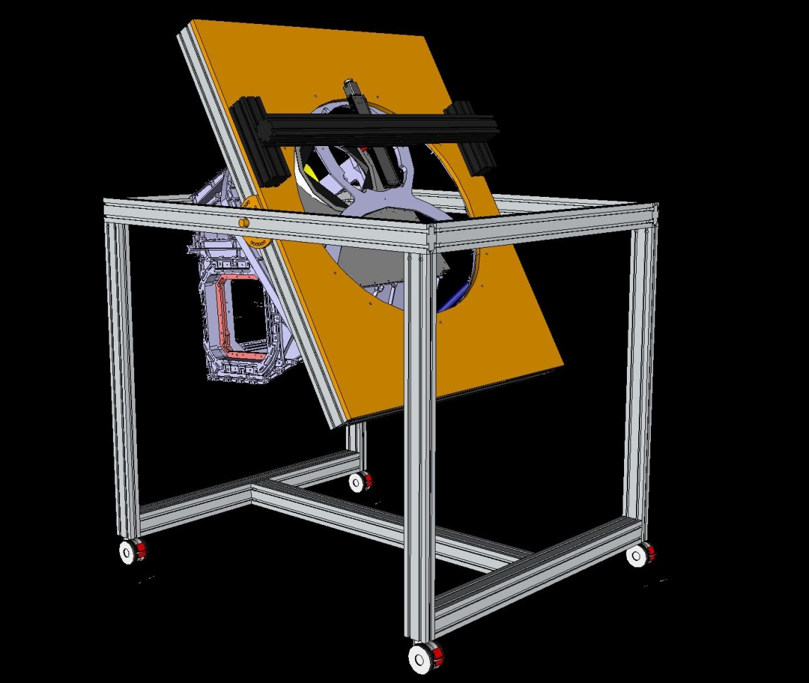
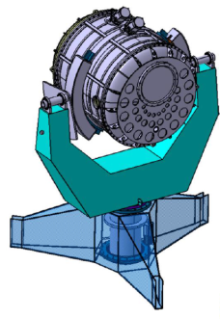
QUBIC: Optics
Combiner tests
Test of combiner alignment by check the «misalignment» @ 300K
Elev = 30 deg
A. Pelosi INFN RM1
UID-GEMA

Slide 19
QUBIC: Optics
Combiner tests
Test of combiner alignment by check the «misalignment» @ 300K
Alignment setup key components
Car to mount the 1K box and to align the combiner (drawings on-going);
2-axes linear stages 300x300 mm range to move He-Ne laser output along secondary horn apertures surface (allocated money from PNRA);
1 screen to be positioned instead of each focal plane array surface (APC?);
1 flat mirror to be installed instead of dichroic also to map the off-axis focal plane (more info needed to draw from Cardiff).

Slide 20
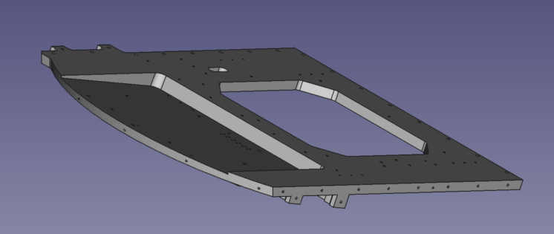
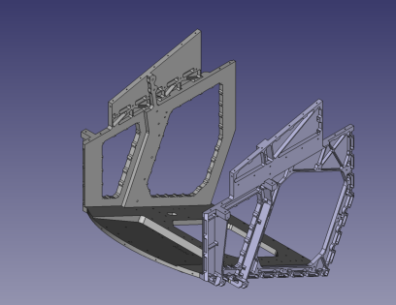
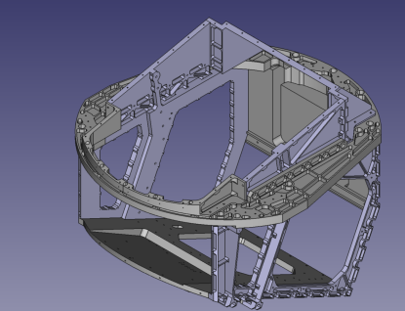
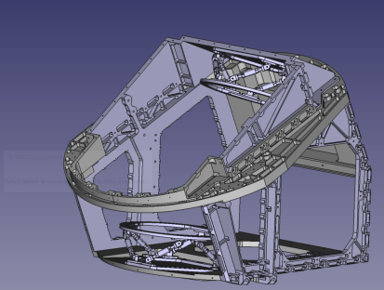
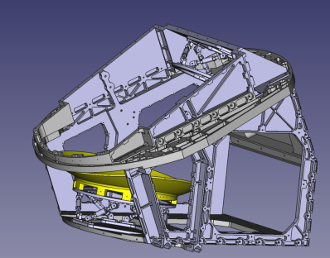
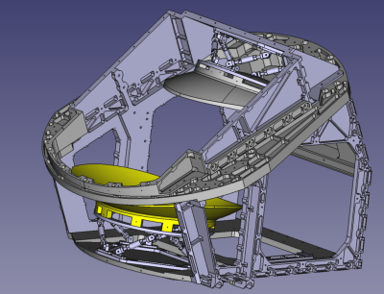
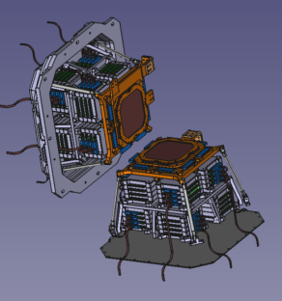
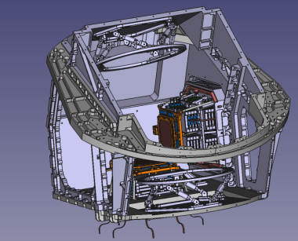
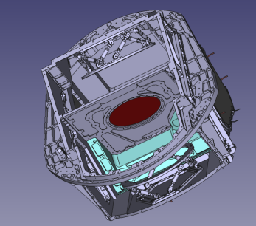
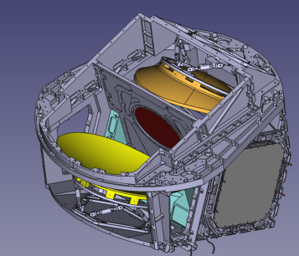
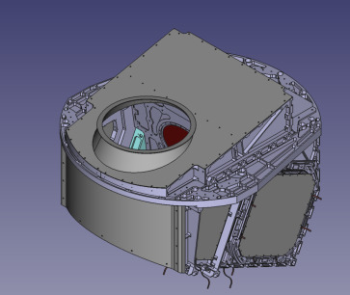
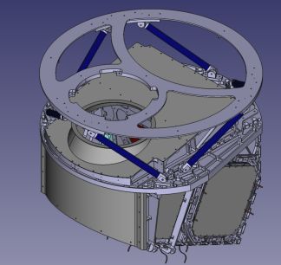
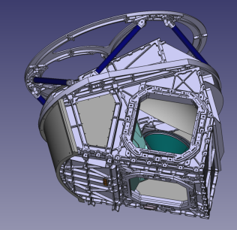
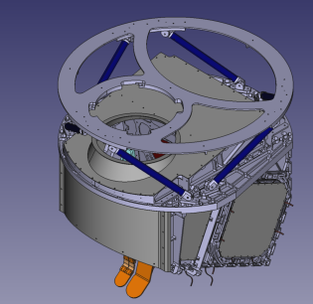

QUBIC: Optics
Combiner tests
Steps to integrate the 1K box (+ combiner) inside the cart
L. Grandsire/C. Chapron

Slide 21

QUBIC: Optics
Combiner tests
Steps to integrate the 1K box (+ combiner) inside the cart
Only at this step the 1K box could be mounted inside the current version of the cart
L. Grandsire/C. Chapron

Slide 22
QUBIC: Optics
Combiner tests
Shall we modify the current version of the cart to start from this flange?
Steps to integrate the 1K box (+ combiner) inside the cart
L. Grandsire/C. Chapron

Slide 23
QUBIC: Optics
Combiner tests
Steps to align the combiner inside the cart
1 STEP: The hexapods, and so the mirrors, have to be tuned to be as near as possible to the nominal positions, before laser alignment procedure (FARO arm or other approaches?)
L. Grandsire/C. Chapron

Slide 24
QUBIC: Optics
Combiner tests
Steps to align the combiner inside the cart
2 STEP: Insert one screen at the nominal position of the on-axis focal plane array;
screen with support
to map focal plane footprint
ONA_FP
L. Grandsire/C. Chapron

Slide 25
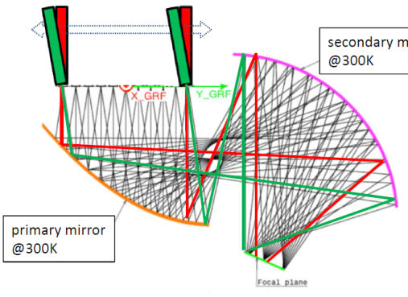
QUBIC: Optics
Combiner tests
Steps to align the combiner inside the cart
3 STEP: Laser scans at several pointing directions
He-Ne laser
300K model of combiner with Zemax
[GRASP mirrors to be converted in Zemax]
Footprints on both focal planes for several incidence angles
.. and different elevation angles
secondary mirror
@300K
primary mirror
@300K

Slide 26
QUBIC: Optics
Combiner tests
Steps to align the combiner inside the cart
4 STEP: Move the screen to the nominal position of the off-axis focal plane array;
Insert the flat mirror instead of dichroic; STEP 3 again
screen with support
to map focal plane footprint
OFA_FP
dichroic
flat mirror
L. Grandsire/C. Chapron

Slide 27
Status of the sub-system Combiner test blocking points and schedule
  What is the status of the sub-system ?
    Design on going/manufacturing (home made, i.e. INFN/Dept machine shop)/assembly (in lab)
    When is this phase supposed to be finished ? 04/2017
  If you are still designing the sub-system:
    Which inputs / specifications / requirements, needed to finish the detailed design of your sub-systems, are not yet delivered ?
      For T.D. and F.I. Zemax model/ Dichroic -> mirror/screens at focal plane/combiner assembly procedure/FARO arm or other metrology sistems
    Which other working group should deliver these inputs (see annex 1 for list of main WP) ?
      For T.D. and F.I. Cardiff/APC/Maynooth/Milano-Bicocca
  What time is still needed in order to (for D.T.) – assume that the above inputs are provided if needed - :
    Finish the whole detailed design of T.D./F.I. ? 12/2016
    Manufacture the sub-system ? 03/2017
    Test the sub-system in your premises before delivery to APC? Yes, to check the laser control
  Idem for F.I. The combiner test setup is the same for T.D. and for F.I.
  Do you think you can comply to the target schedule (see annex 2) ? Yes, with PNRA funds
still in preparation …

Slide 28
Interfaces with other sub-systems
Combiner test
List and describe needed interfaces with other systems.
  Mechanical with 1K box
Are these interfaces currently frozen ?
  Under discussion the possibility to interface the cart with two flanges of 1K box
still in preparation …

Slide 29
Test, Delivery, Assembly, Calibration Operations
Tests of the sub-system in your premises before delivery at APC:
  Assembly the cart and check the laser 2-axes movements control in Rome
Delivery to APC :
  Special care needed for the transportation and handling of the goods ? no
Assembly Operations in APC :
  The cart should be used to assemble the 1K box and to check the consistency of the subsystems to be mounted on it (see focal plane arrays, dichroic, mirrors,..)
  The cart doesn’t need special tools to be assembled.
  The combiner test needs: 1 screen as fake focal plane array and 1 flat mirror as fake dichroic.
  See before
  + How many FTE will you send people at APC / ROMA for help during assembly ?
Calibration Operations at APC:
  Same questions as for Assembly operations.
still in preparation …

Slide 30
QUBIC: Optics
Thank you

Slide 32
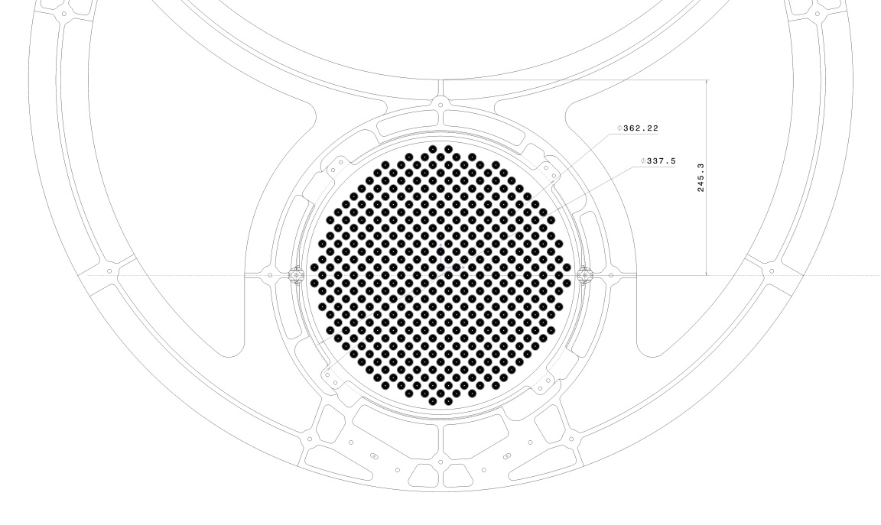
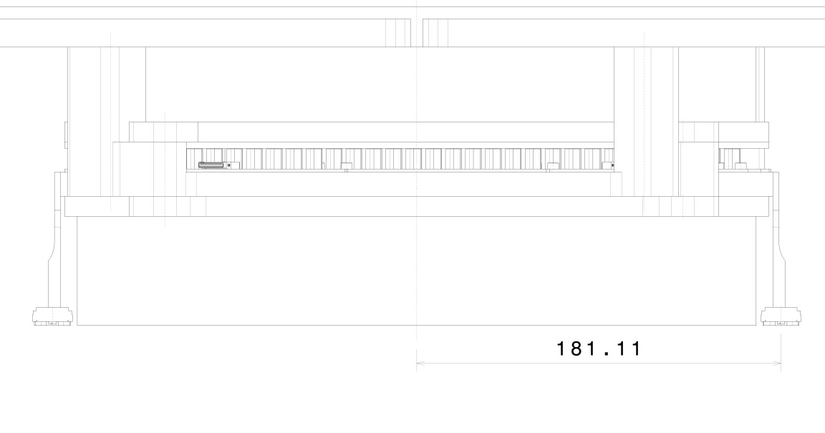
QUBIC: Optics
CalLamp

Slide 33
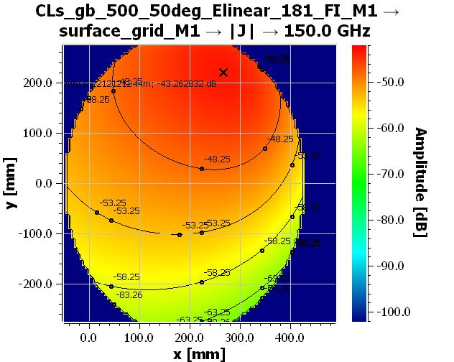
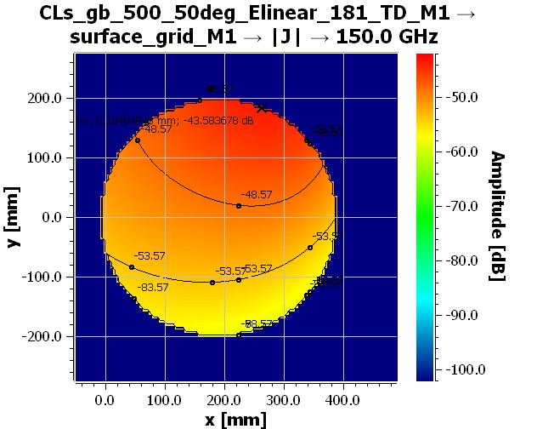
QUBIC: Optics
CalLamp
Working progress…

