Slide 1

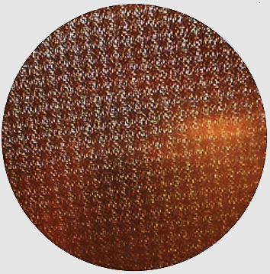
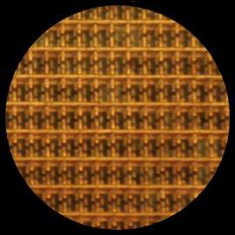
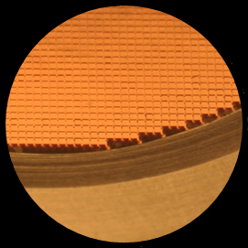
QUBIC
Metal Mesh Quasi-Optical devices
G. Pisano, C. Tucker and P. Ade
Astronomy Instrumentation Group - Cardiff University
QUBIC meeting, Paris, 27th September 2016

Slide 2
Summary
Introduction
Mesh filters, dichroic, polariser
Mesh Half Wave Plate

Slide 3
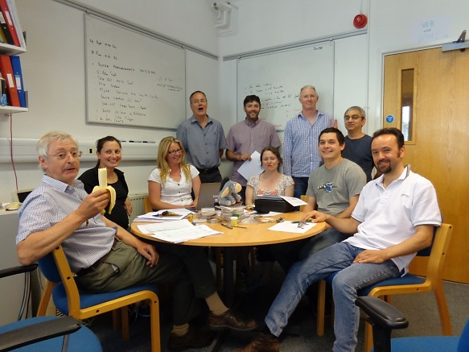
Metamaterial and QO production team
P. Moseley ? M.W. Ng ?
C. Dunscombe
I. Walker
T. Jones
R. Sudiwala
A. Kasperek
P. Ade
C. Tucker
N. Owens
G. Pisano
F. Azman

Slide 4
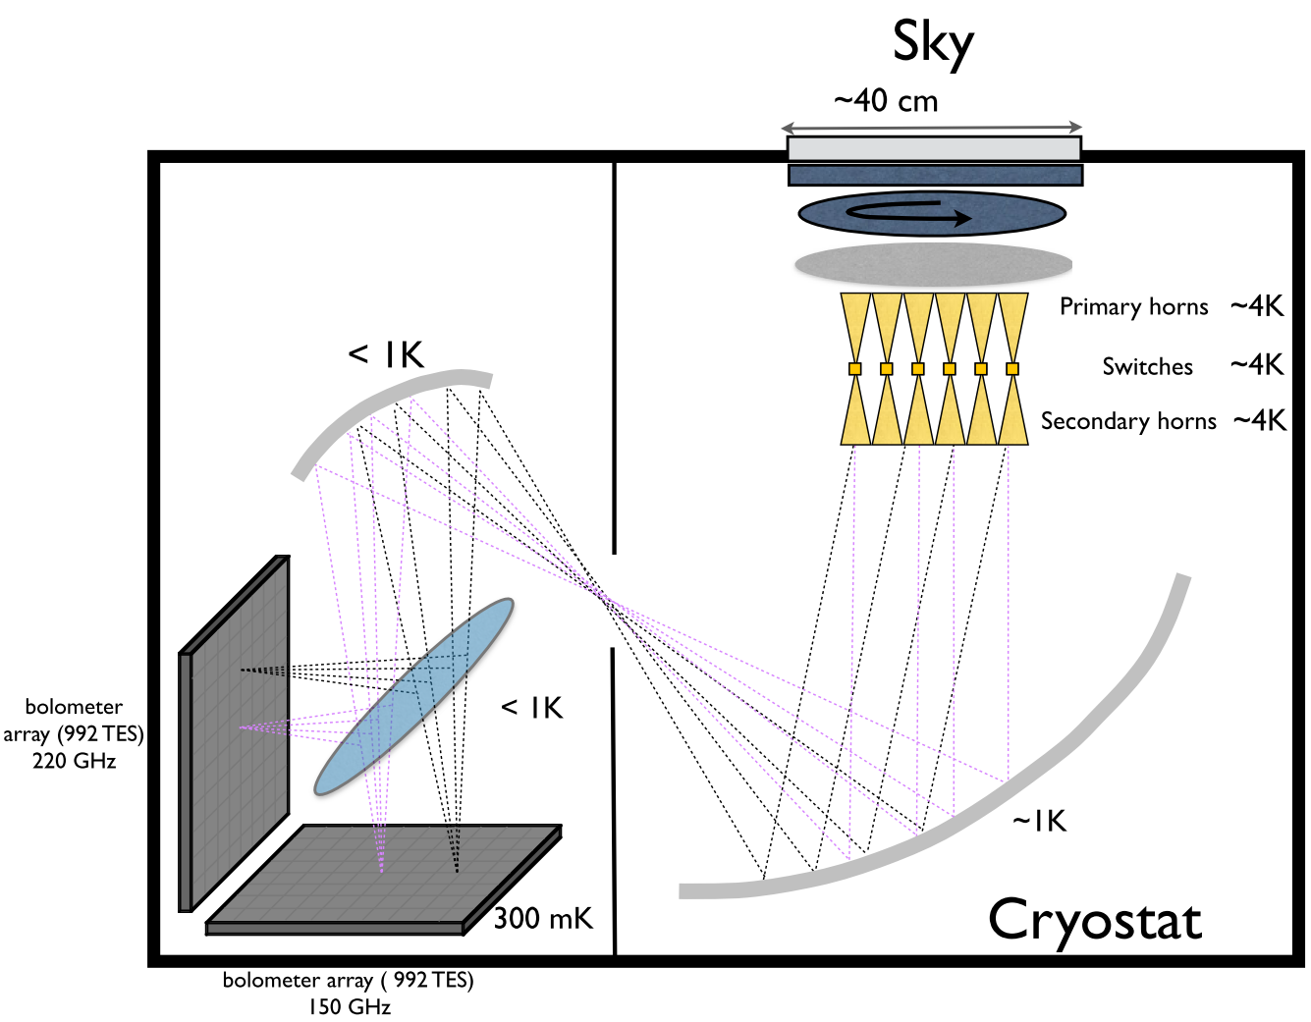
QUBIC: Metal-mesh Quasi-Optical components
Thermal Filters
Rotating HWP
Polariser
Band
defining
Filters
Dichroic
Band defining Filters

Slide 5
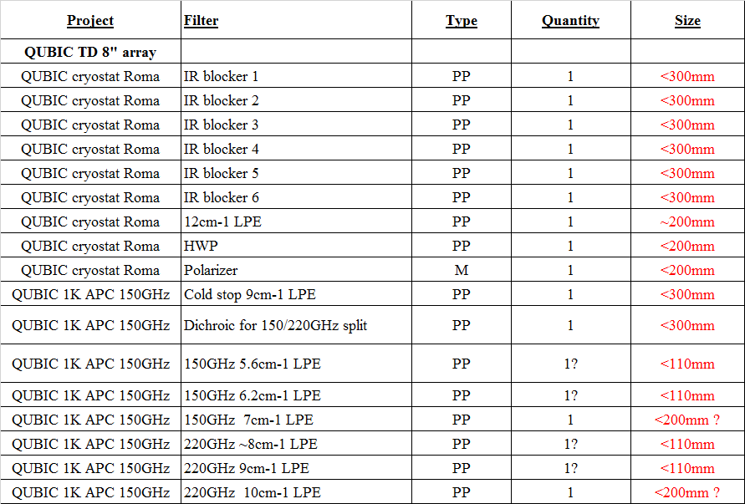
QUBIC: Cardiff deliverables

Slide 6
Summary
Introduction
Mesh filters, dichroic, polariser
Mesh Half Wave Plate

Slide 7
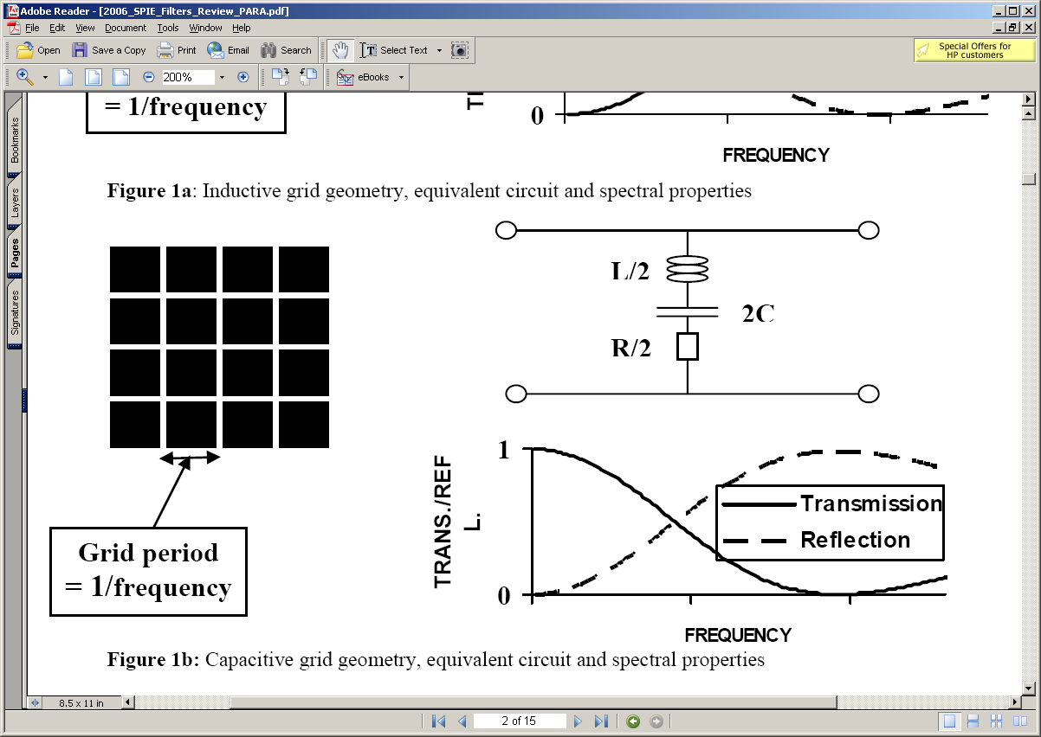
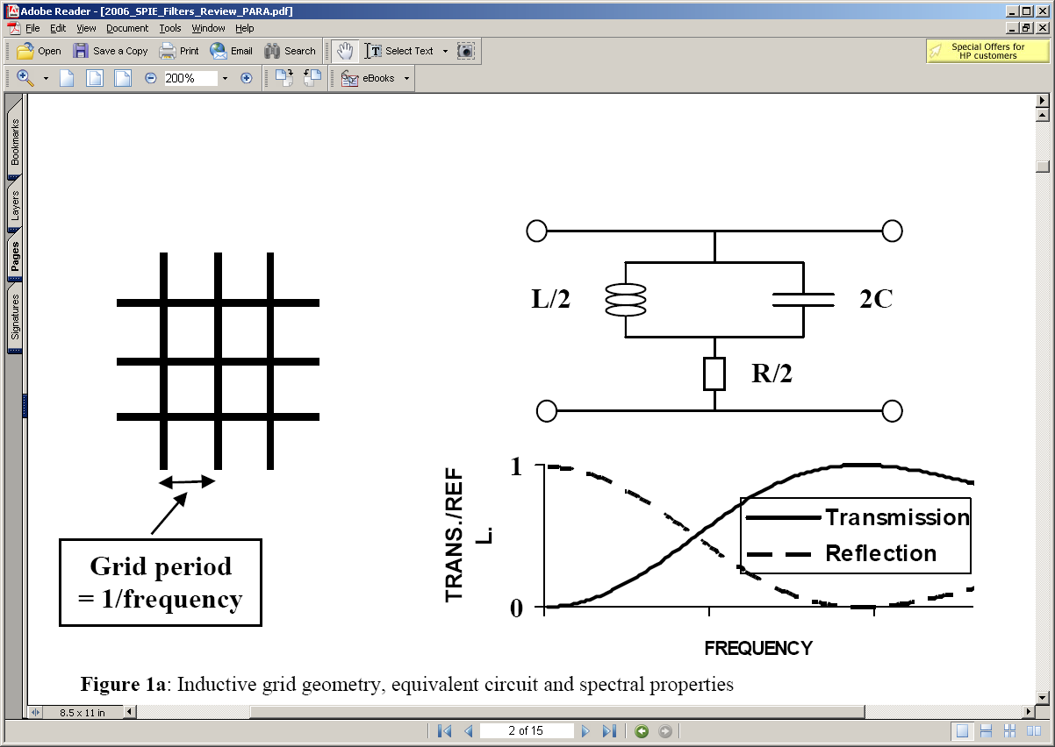
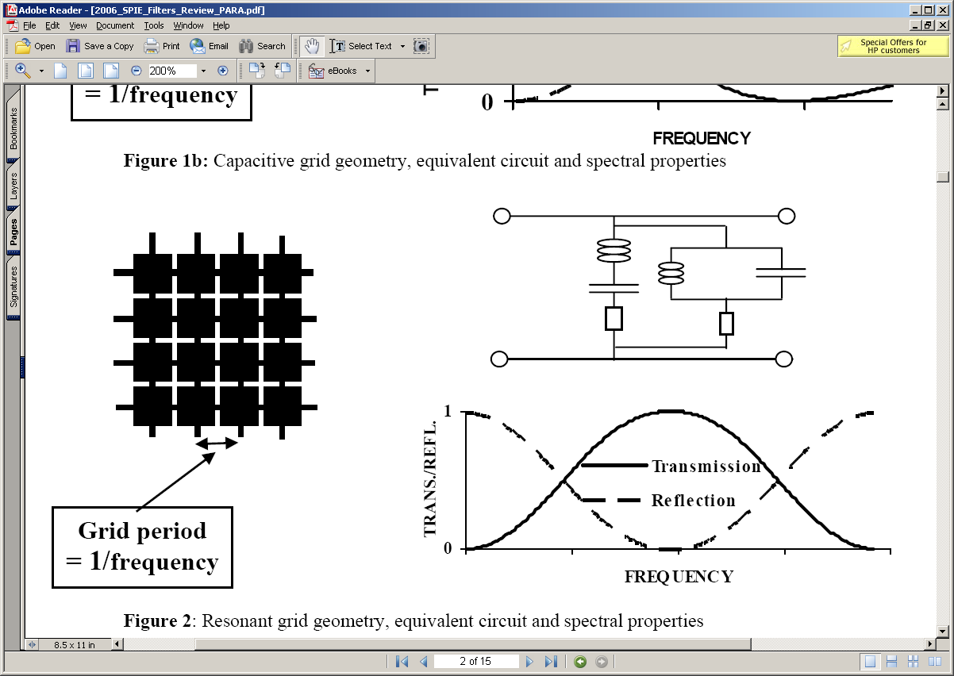
Mesh Technology: Theory
FSSs subgroup
Markuvitz (1951)
Ulrich (1967)
Capacitive Low-Pass Filter
Sub-wavelength periodic structures
Spectral response
Grid Period
< λ
Equivalent Circuit
Inductive High-Pass Filter
Resonant Band-Pass Filter

Slide 8
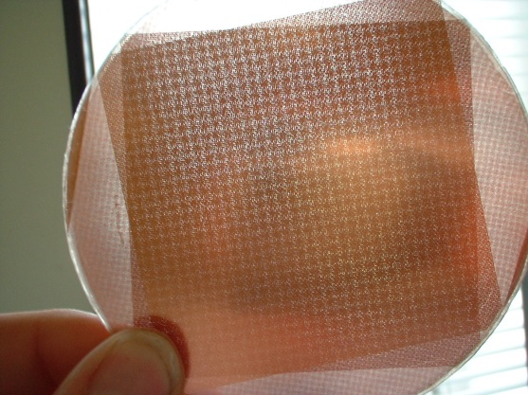
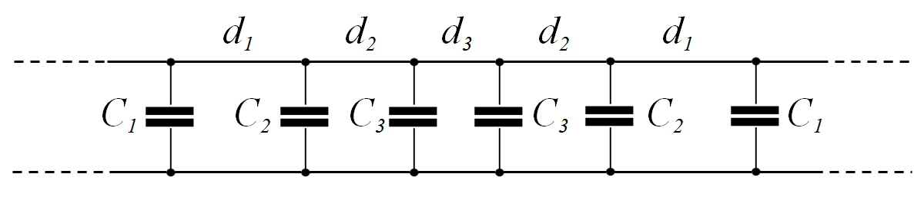
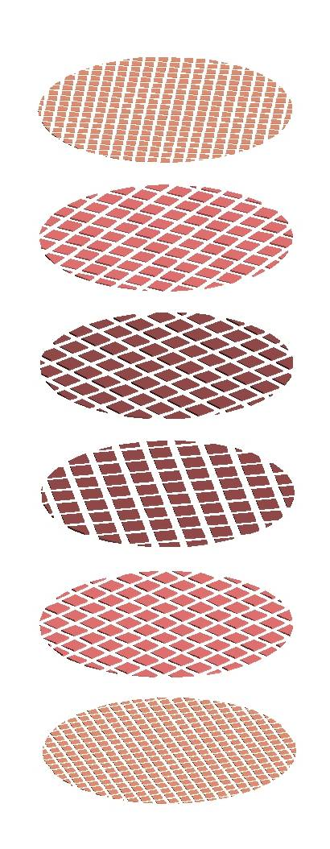
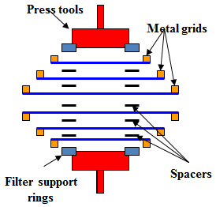
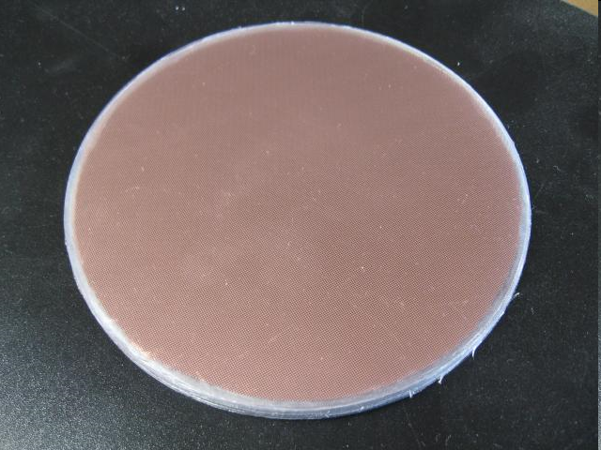

Mesh Technology: Manufacture
Free standing (air-gap) multiple-mesh devices
Dielectrically embedded multi-mesh devices

Slide 9
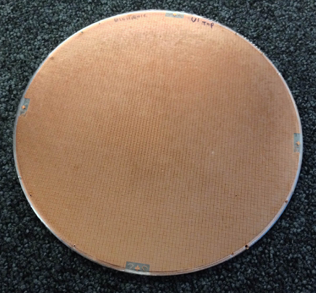
Mesh Filters: Band defining
FSSs
Homogeneous
grids
Low Pass Capacitive Hot Pressed Mesh Filters (10 grids )
- Hot pressed high frequency rejection continues through diffraction region

Slide 10
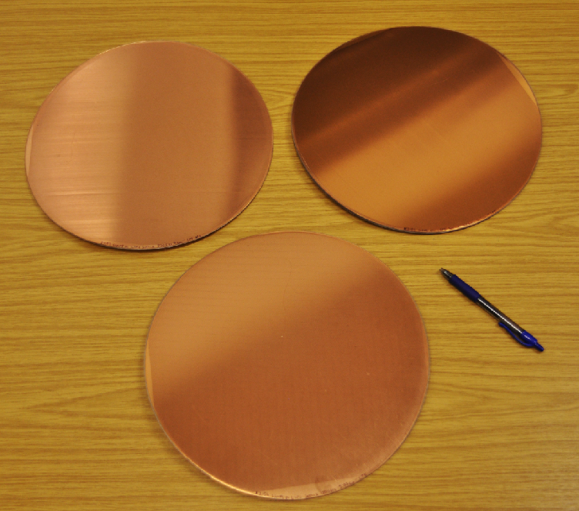
Mesh Filters: Band defining LPE examples
Diameter: 33 cm

Slide 11
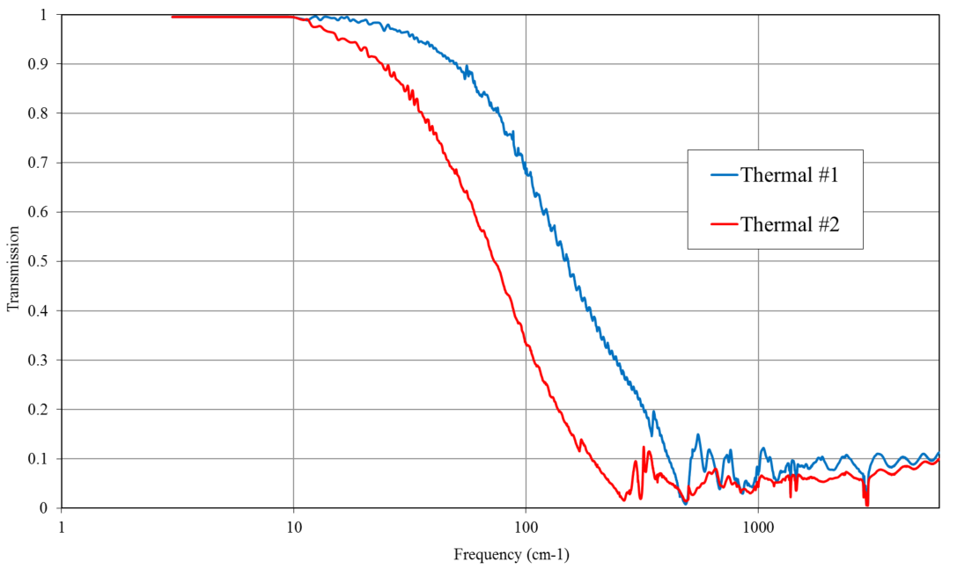
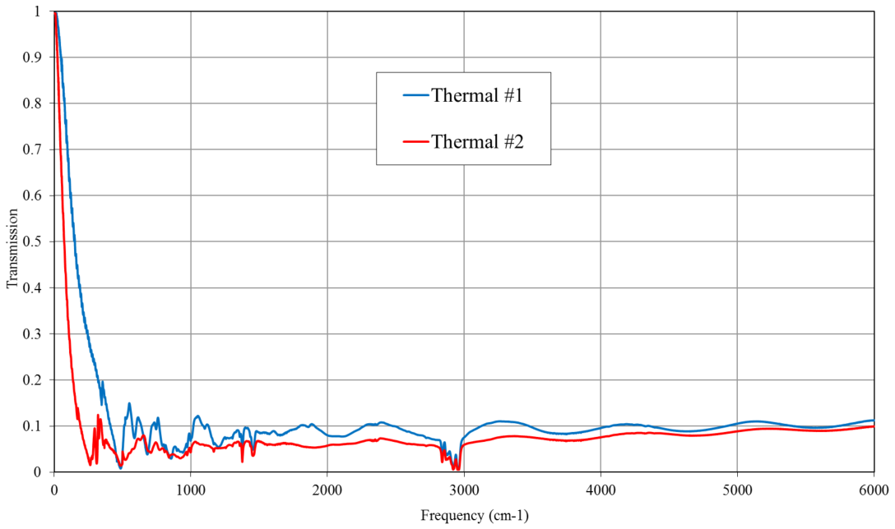
Blocking Filters: Thermal filters
- Used in cryogenic systems to reject optical and near infrared radiation

Slide 12
Mesh Filters Stacks: Blockers + band defining filters
- Multiple filters can be cascaded to achieve rejection of NIR radiation down to ~1:10⁹

Slide 13
Dichroics: Frequency Splitters
Capacitive grid air-gap with f/4 beam at 30deg incidence angle
- Wood’s anomalies increase with off-axis incidence angle and beam convergence

Slide 14
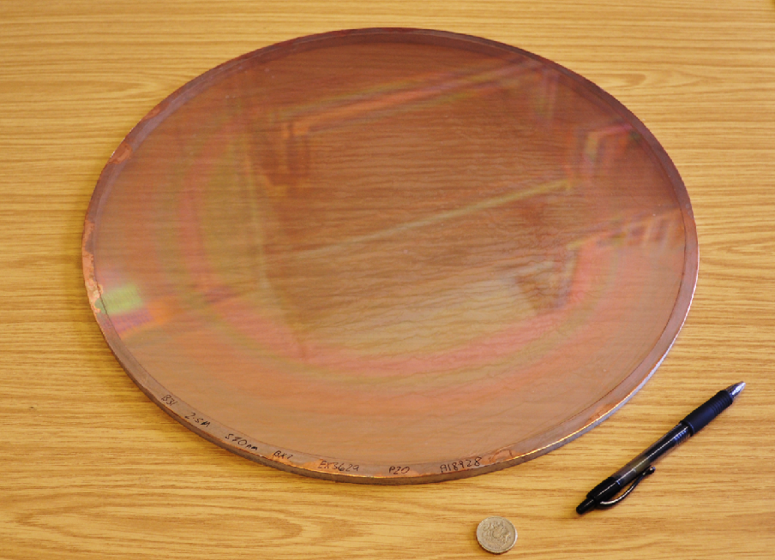
Photolithographic Polariser: Example
Period: 20μm , Diameter: 42 cm

Slide 15
Summary
Introduction
Mesh filters, dichroic, polariser
Mesh Half Wave Plate

Slide 16
Transmissive HWPs: Options
B-HWP
• Birefringent Pancharatnam HWP (BP-HWP):
- Stack of rotated birefringent HWPs
- Limited dimensions, heavy, ARCs
x
y
o
e
M-HWP
y
• Mesh HWP (M-HWP):
- Based on mesh filters technology
- Large diameters achievable
- Bandwidths ~100%
x
L
C

Slide 17
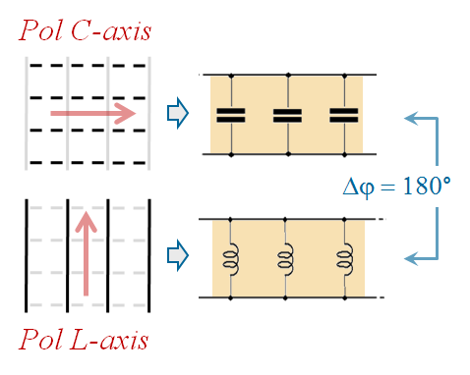
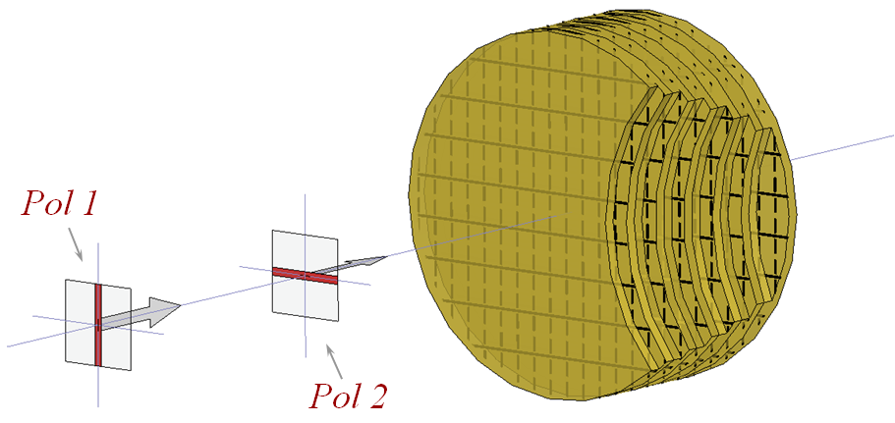
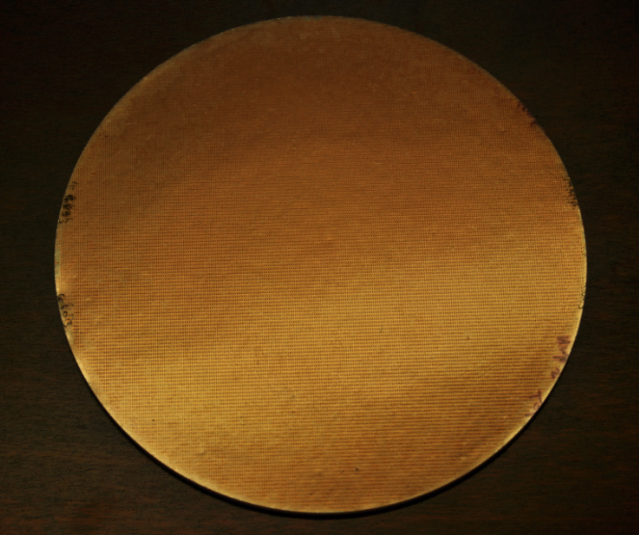
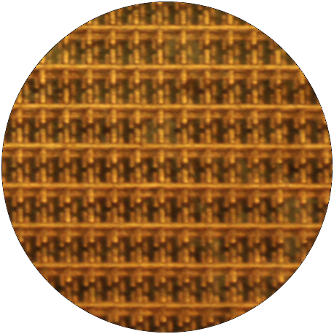
Mesh Half Wave Plates: Embedded design
G. Pisano et al.
PIER M, 25, p101 (2012)
Homogeneous
anisotropic
grids
Lerner geometry
W-Band
Unit cell
Other devices:
QWPs (linear ↔ circular)
TPRs (pol rotation)
∅=20cm

Slide 18
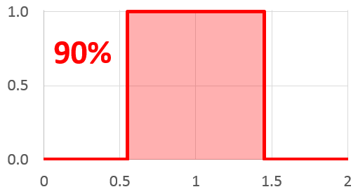
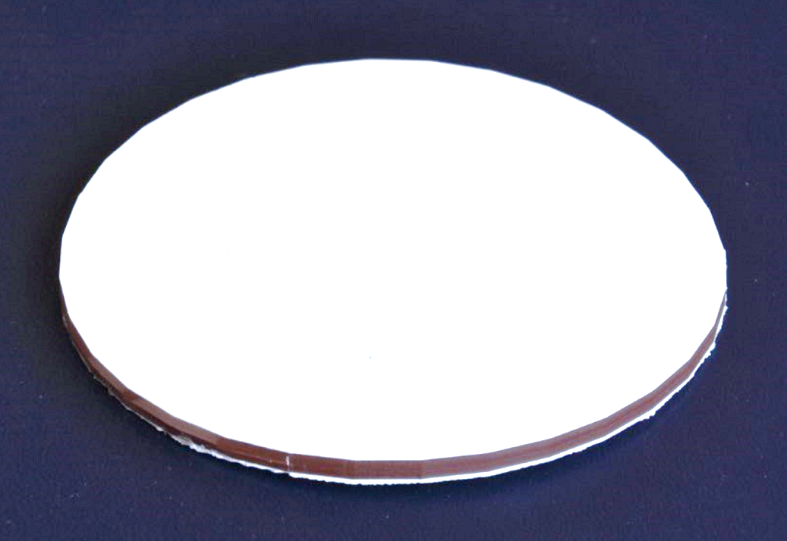
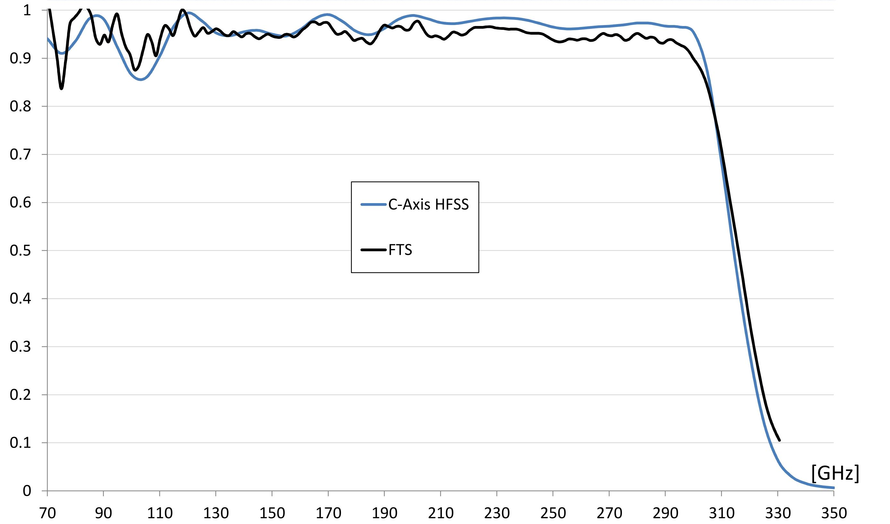
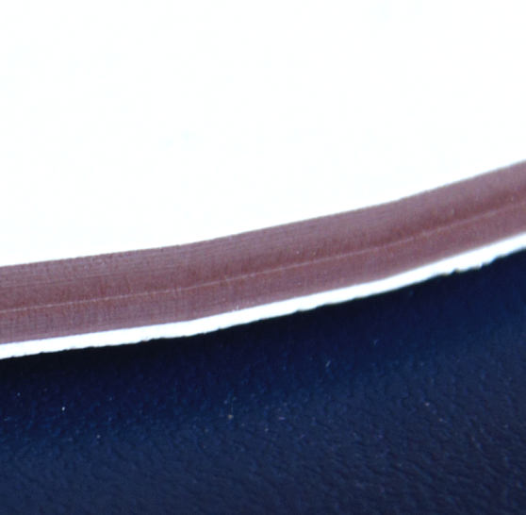
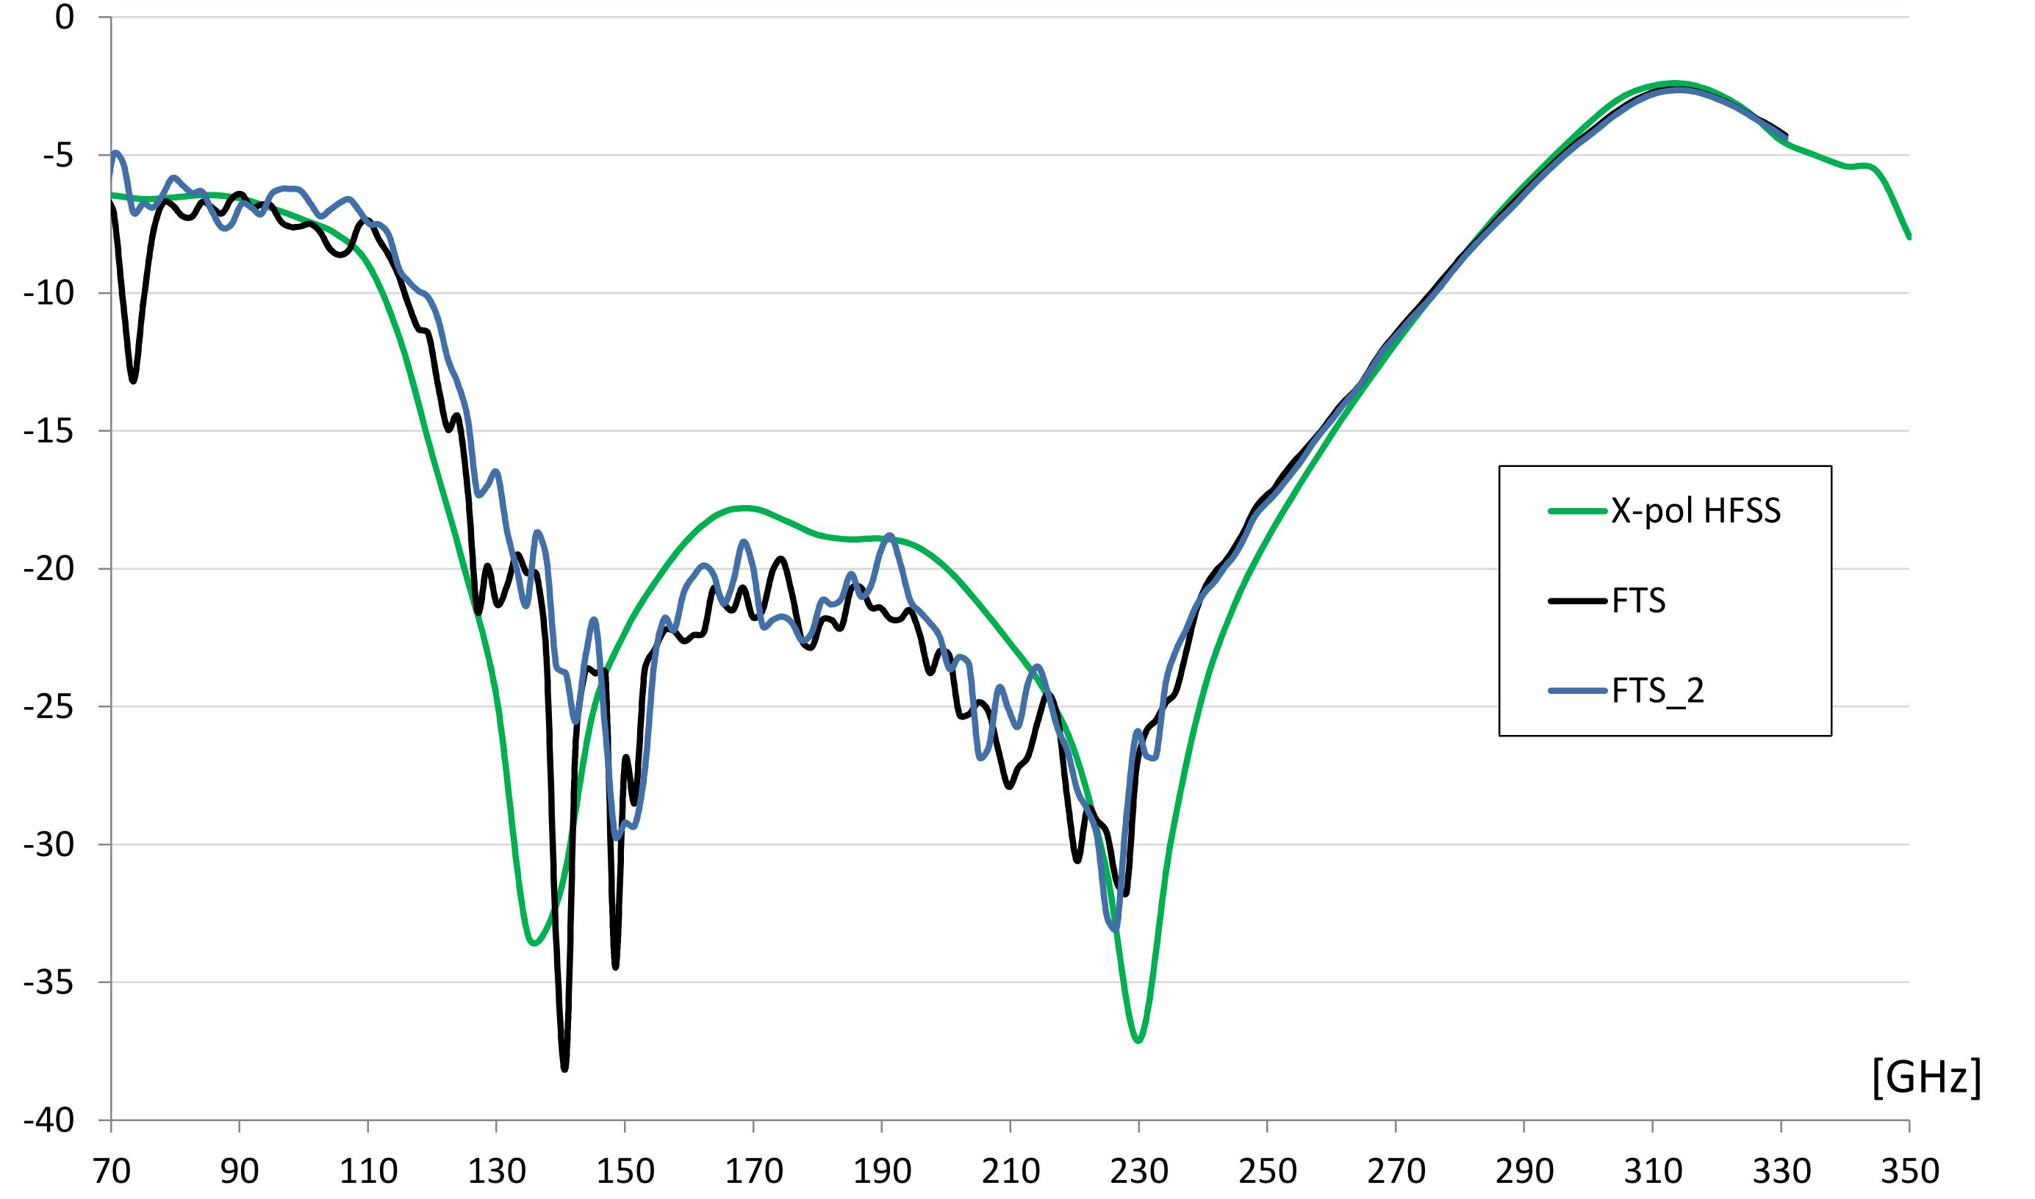
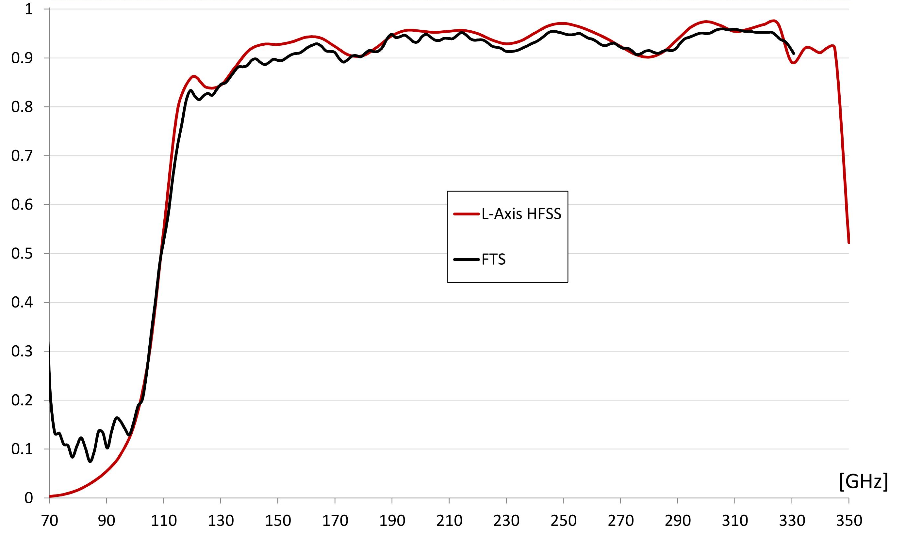
Mesh HWPs: Large bandwidth designs BW~90%
Transmission along C-axis
45° Cross-Polarisation
~90% BW
Transmission along L-axis

Slide 19
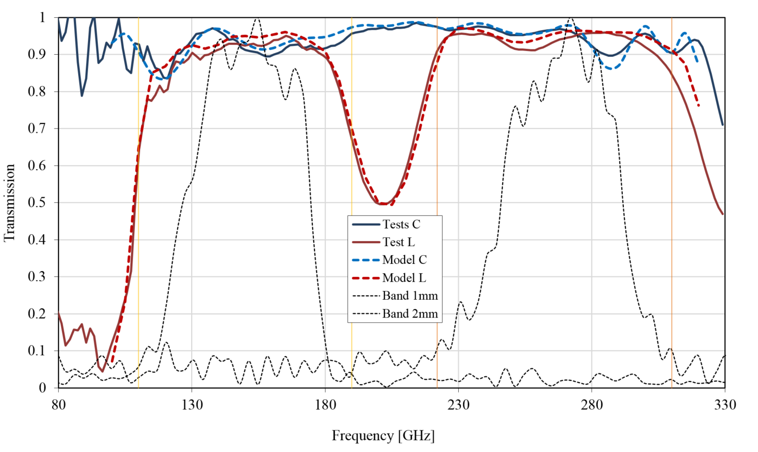
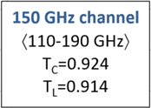
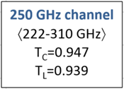
NIKA2 instrument: Dual-band Mesh-HWP
QUBIC | ν₁ | ν₂ | BW
150 GHz | 127 | 171 | 30%
220 GHz | 192 | 272 | 34%
2 bands | 127 | 272 | 73%
20/10/2015

Slide 20
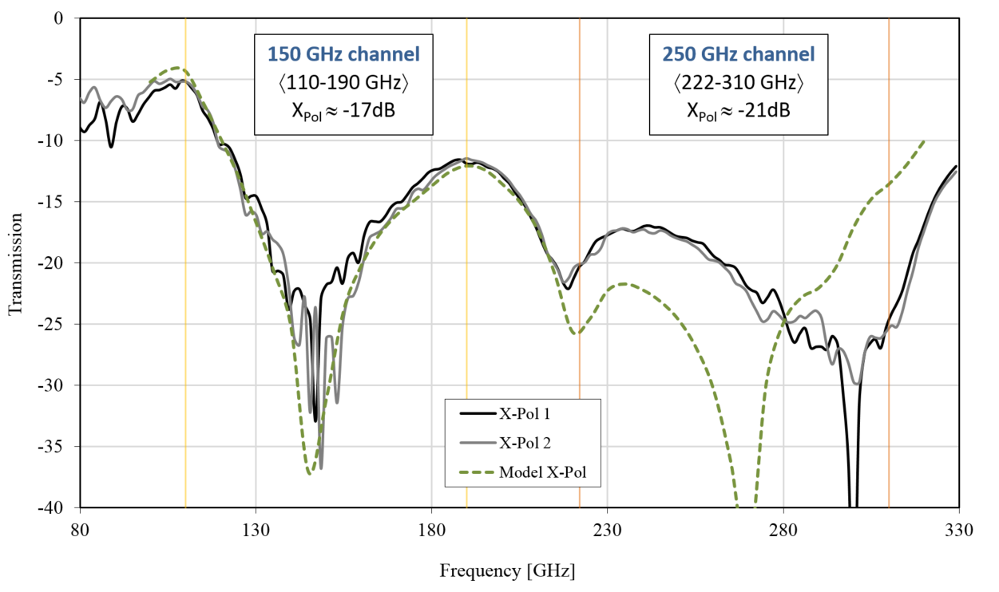
NIKA2 instrument: Dual-band Mesh-HWP
QUBIC | ν₁ | ν₂ | BW
150 GHz | 127 | 171 | 30%
220 GHz | 192 | 272 | 34%
2 bands | 127 | 272 | 73%
20/10/2015

Slide 21
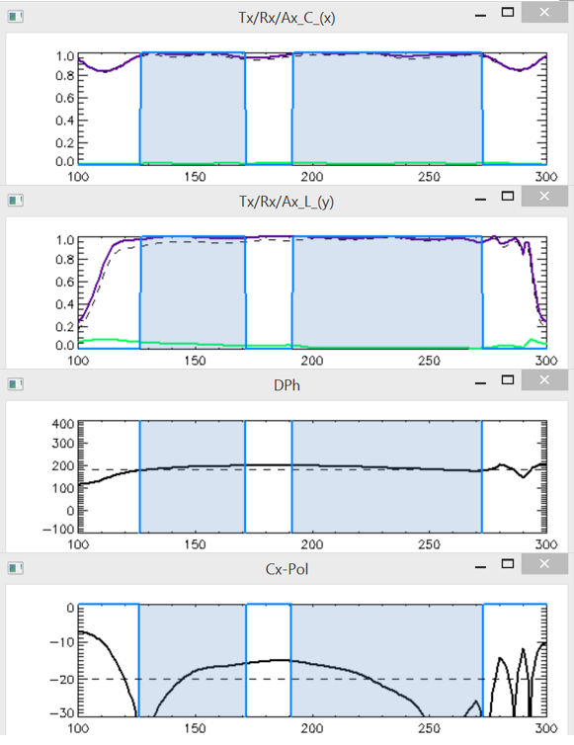
QUBIC: Dual-band Mesh-HWP design BW~73%
24/11/2015
T = 10 K
T_{x} (150) ~ T_{x} (220) ~ 0.95
(Average Transmissions)
T_{y} (150) ~ T_{y} (220) ~ 0.95
Δφ (150) ~ 189±10
Δφ (220) ~ 182±10
(Axes differential phase-shift)
X_{pol} (150) ~ -20dB
X_{pol} (220) ~ -21dB
(Cross-polarisation)
- Calculations averaged across bands: 127-171 GHz & 192-272 GHz

