Slide 1

Horns & Switches: status
Inputs from: APC, NUIM, U Cardiff, U Manchester, UNIMI, UNIMIB

Slide 2
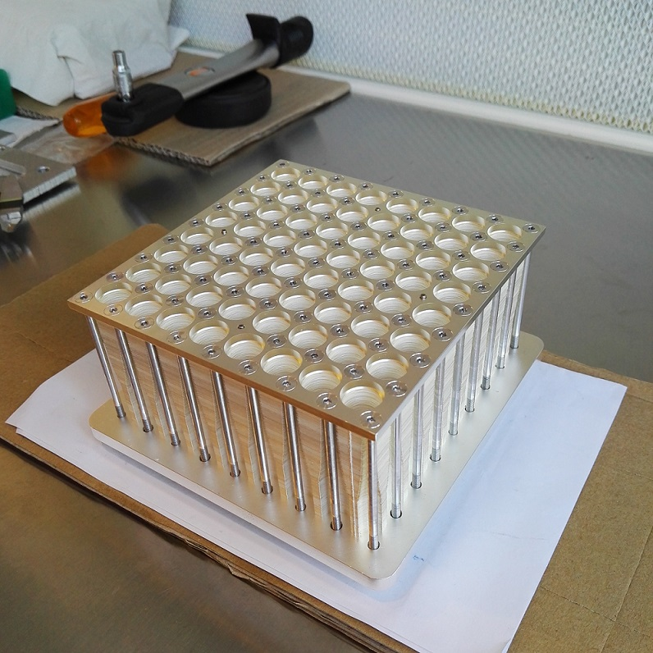
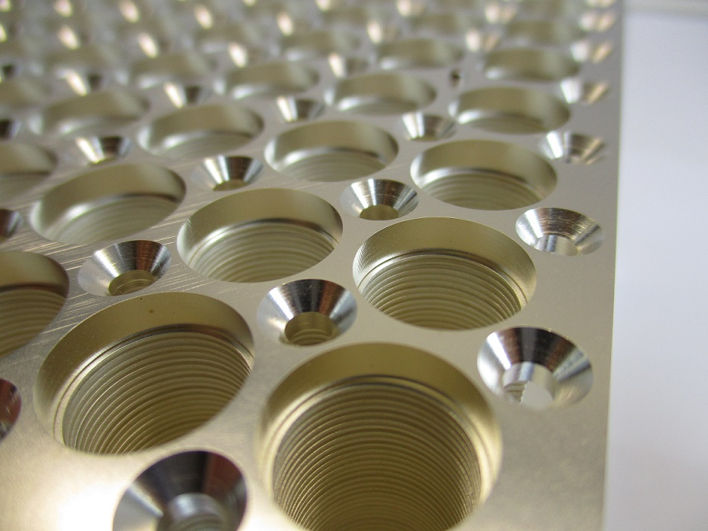
Horns 150/220
UNIMI

Slide 3
Horns 150/220
Characterisation:
VNA test @ 150 GHz of the horns alone is foreseen. An interface flange built on purpose is available.
VNA test @ 220 GHz is possible (UNIMIB), although a very difficult measurement.
Possible test with incoherent detectors and thermal (or active) sources? (to be discussed with B.Maffei).
Use the 8x8 Demonstrator as a test bench.
Philosophy: as long as this activity doesn’t retard/interfere with Demonstrator assembly, let’s try to learn as much as we can!

Slide 4
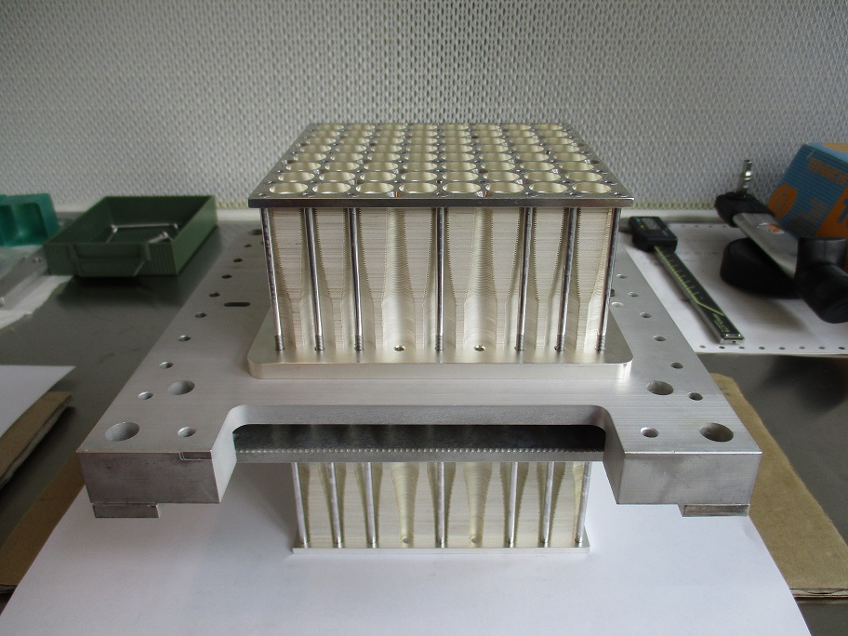
Switch/Horn Assembly: the TD
Assembly of the 64 elements back-to-back
The block will
soon be populated with switches

Slide 5
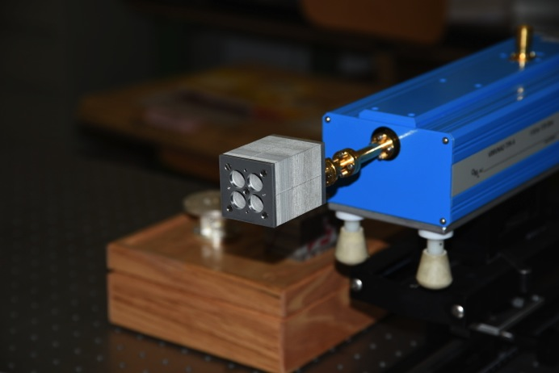
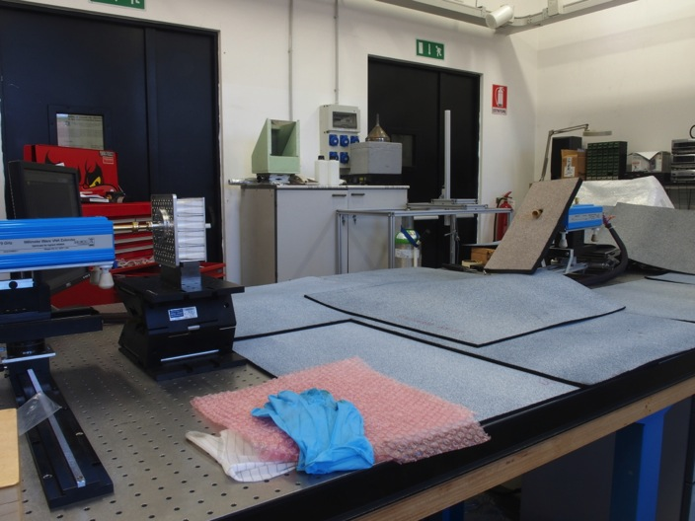
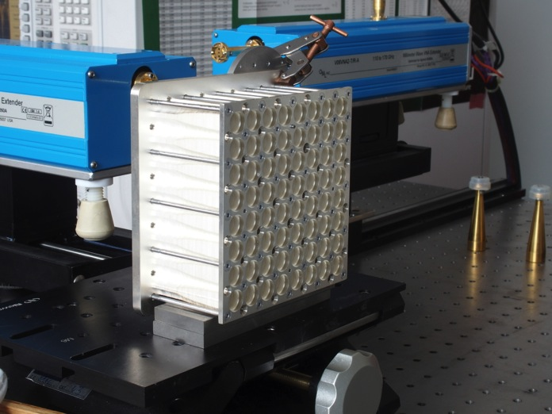
Switch/Horn Assembly: the TD
Horn Test are made at UniMiB lab at room temperature in D band (110-170 GHz) both on 2x2 platelet prototype and 8x8 technological demonstrator manufactured by UniMi

Slide 6
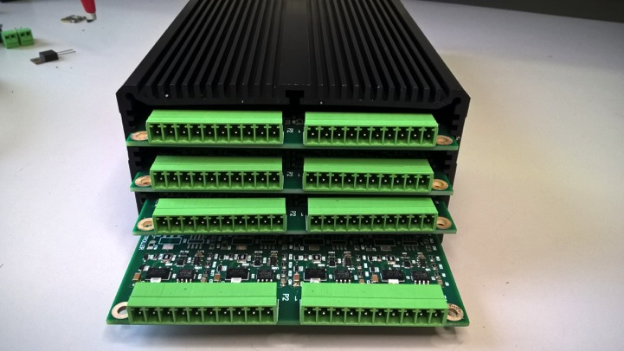
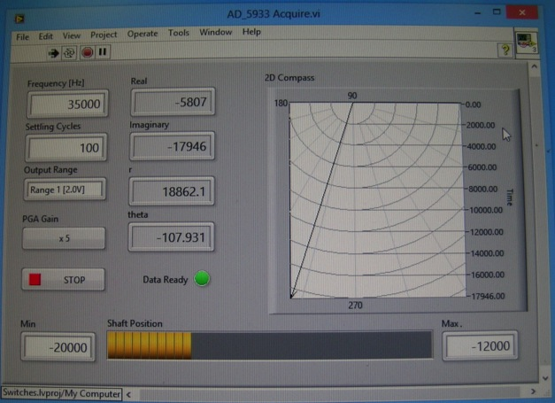
Switch/Horn Assembly: the TD
Control board designed and assembled in-house
Principle of operation: inductive reactance depends on the ferrite position inside the coil.
Real and Imaginary part of impedance is determined by few kHz monitor signal
Spartan-6 FPGA operated
Able to control 16 switches
4 boards for 64 switches
Scalable design
VI interface

Slide 7
Towards the 20x20
The footprint (UniMi)

Slide 8
Towards the 20x20
Platelets ready to be manufactured. Critical point is the horn-switch interfaces (UNIMI).
Planarity requirements of the interface with horns to be defined.
Centering pins? How many? Where?
Simulate misalignement effects at 150 GHz (use these results for tolerancing)
Integration of the system into cryostat should be checked (APC & La Sapienza)
Assembly and wiring of 400 switches may be a tricky task. The current assembly of 8x8 will help define a good strategy

