Slide 1

Readout chain sub-system for QUBIC
For Technological Demonstrator (T.D.)
And
For Final Instrument (F.I.)

Slide 2
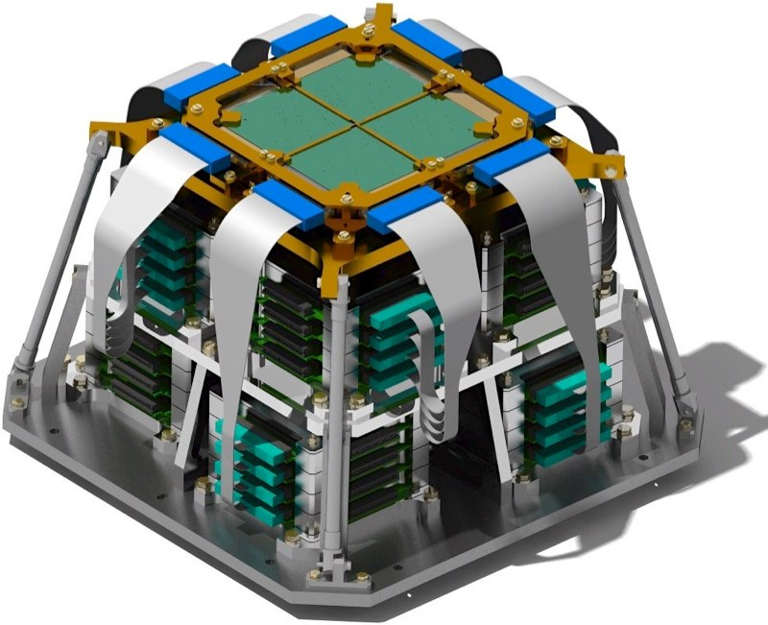
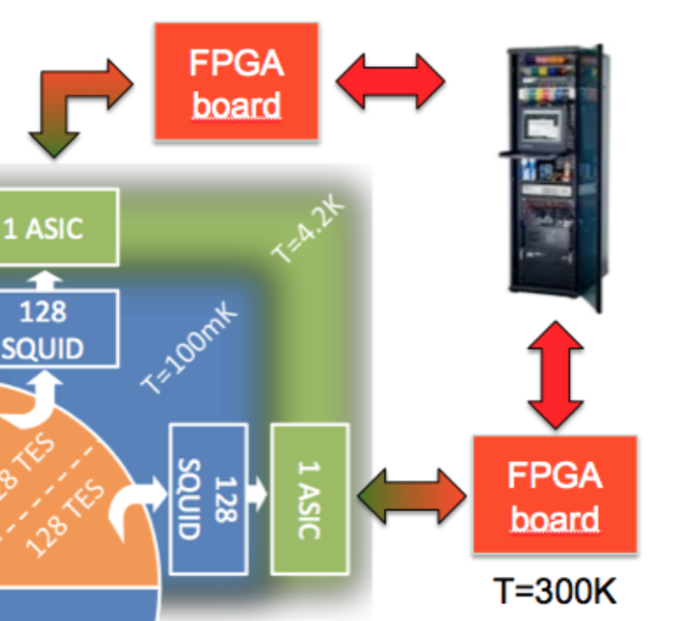
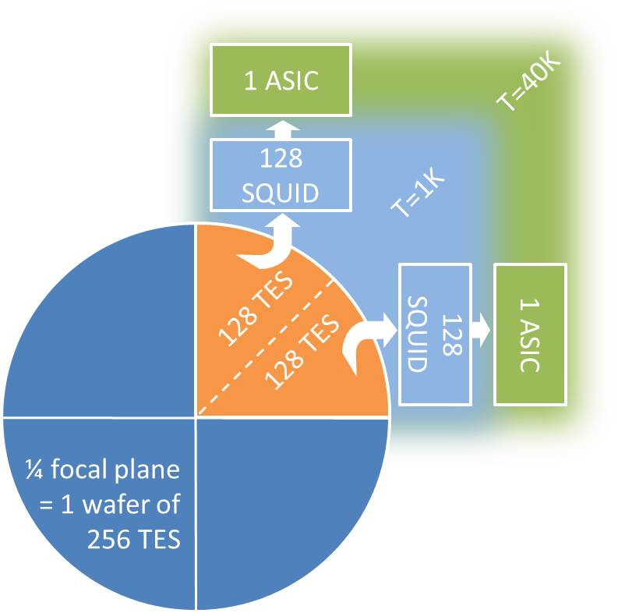
QUBIC detection chain
1 focal plane = 4 wafers of 256 TESs @300mK
Readout: Time Domain Multiplexing 128:1
128 SQUIDs @ 1K + 1 ASIC @ 40 K for ⅛ focal plane
Specifications:
NEP < 5.10⁻¹⁷W.Hz^{-0.5}
τ < 10ms
2 focal planes: 150GHz and 220GHz

Slide 3
Sub-systems
Readout chain
SQUIDs
ASICs
Warm electronics
Wiring
Acquisition software
SQUIDs
PCB
Mechanics
ASICs
PCB
Mechanics
Wires
Inteconnexion box
Interconnexion PCB
Mechanics
Connectors

Slide 4
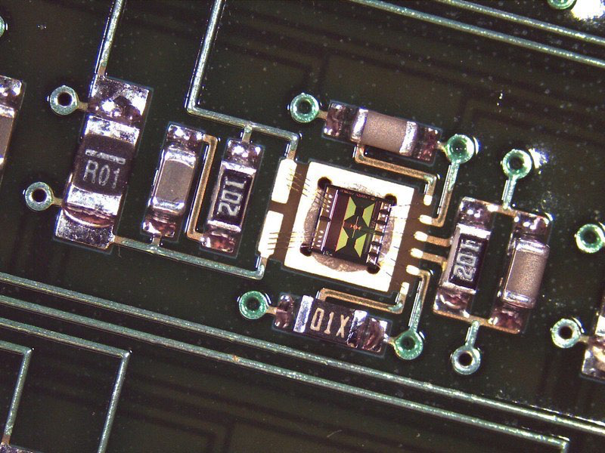
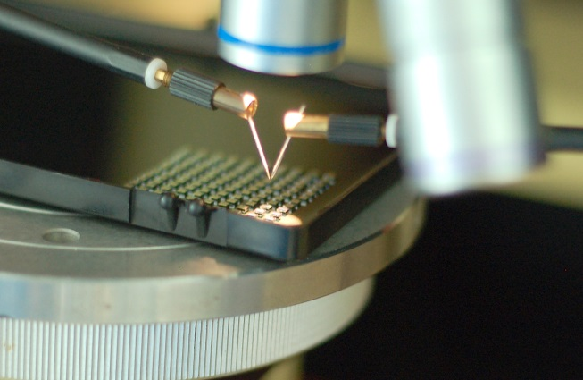
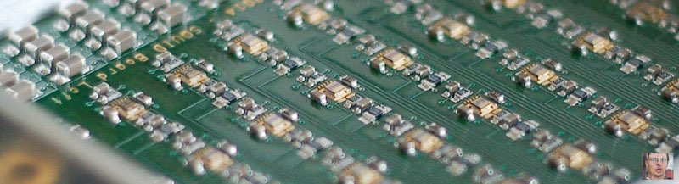
SQUIDs
SQUIDs custom design made by STAR Cryoelectronics
SQ600
Status:
SQUIDS in hand: 2 wafers of 2000 SQUIDs each + 1 new wafer received with improved performances
Warm tests and selection done
PCBs production: received
Defect to be studied

Slide 5
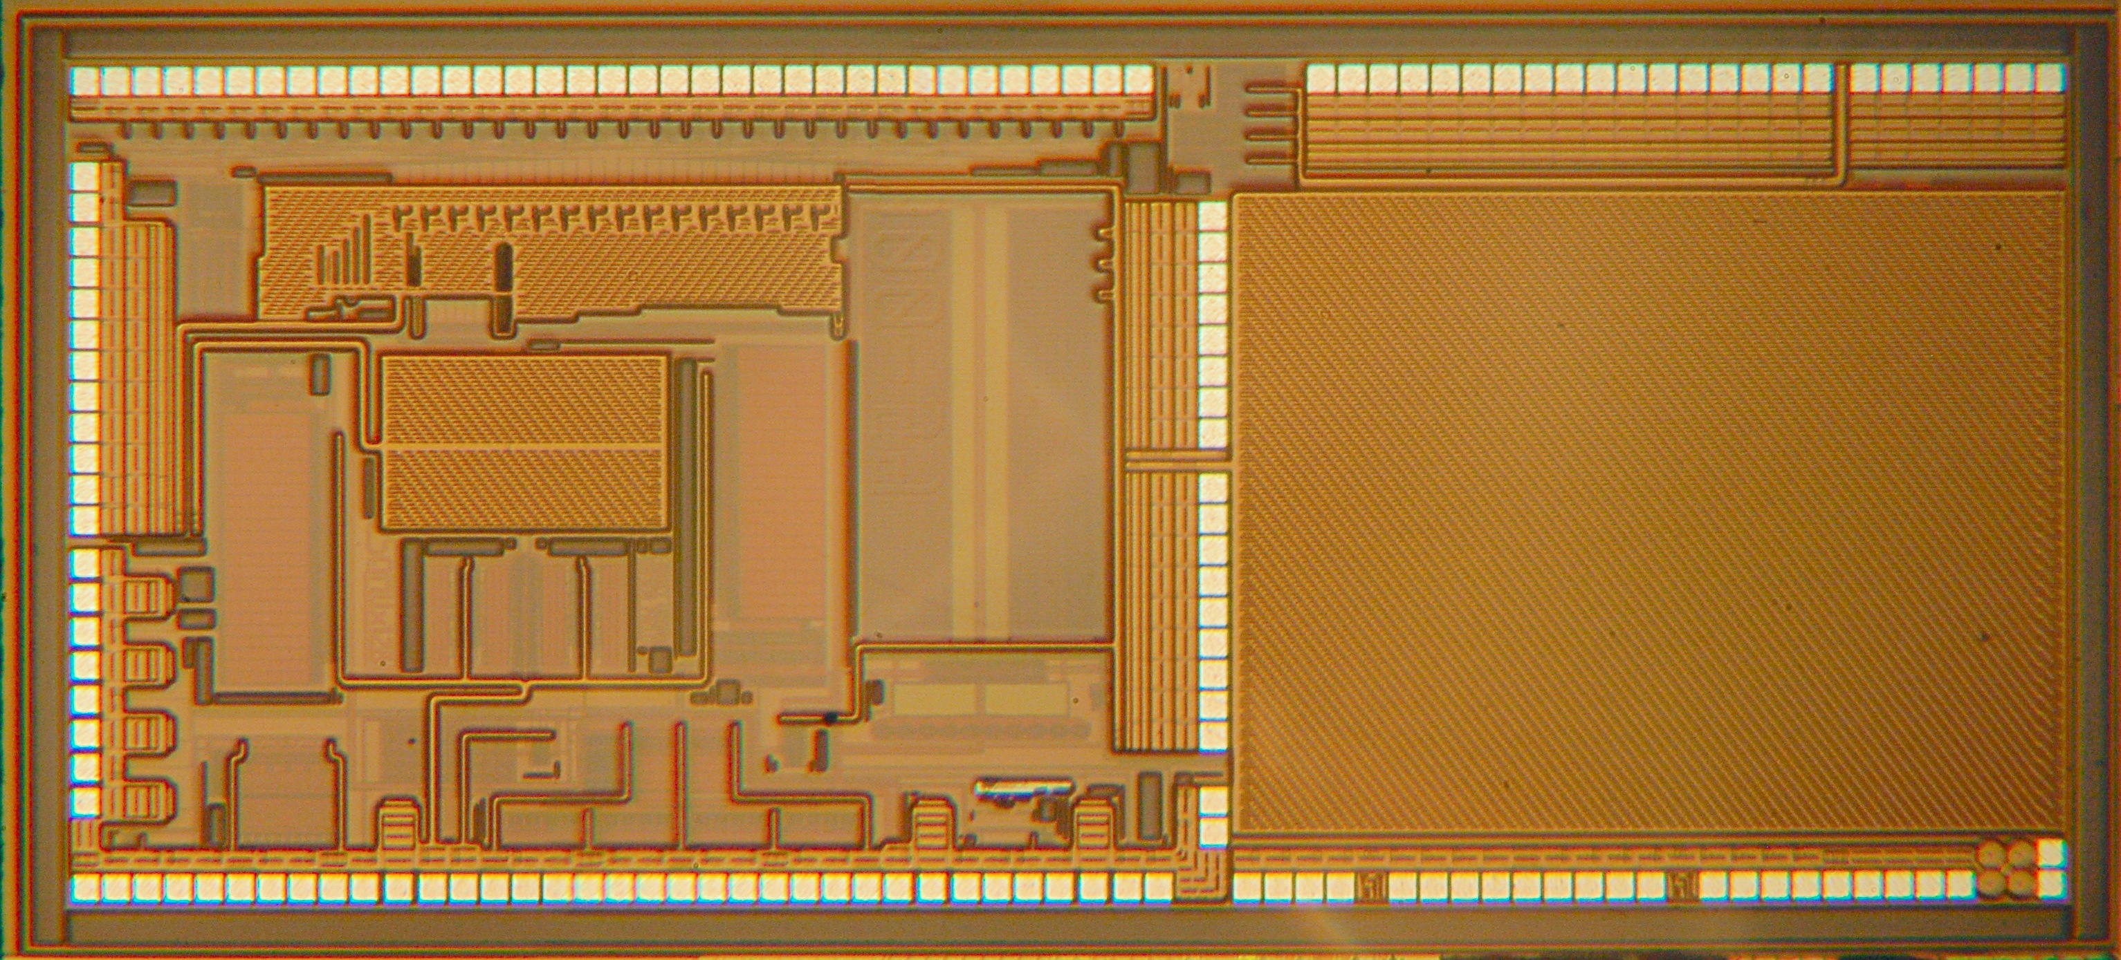
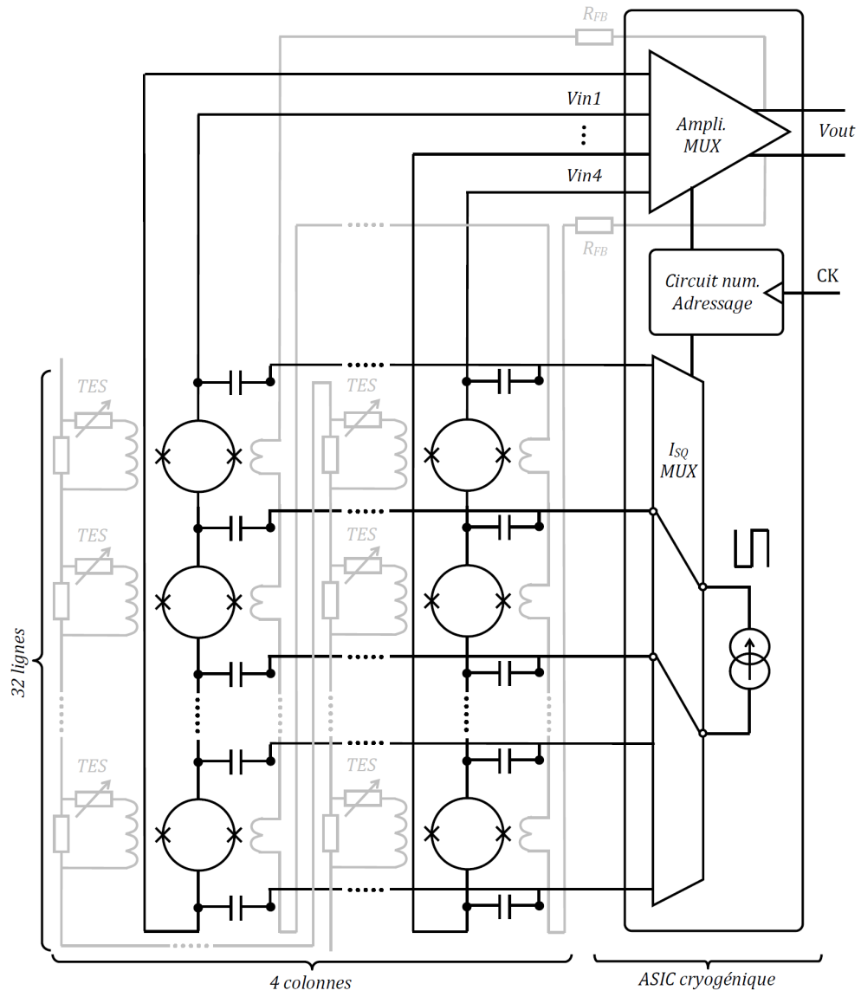
Detection chain: ASIC
ASIC SiGe
First version: fully functionnal
Current source at warm T
Second version: received and tested
Improved performances
Current source in the ASIC
Baseline for TD
PCB being integrated
TESs
SQUIDs (StarCryoelectronics)

Slide 6
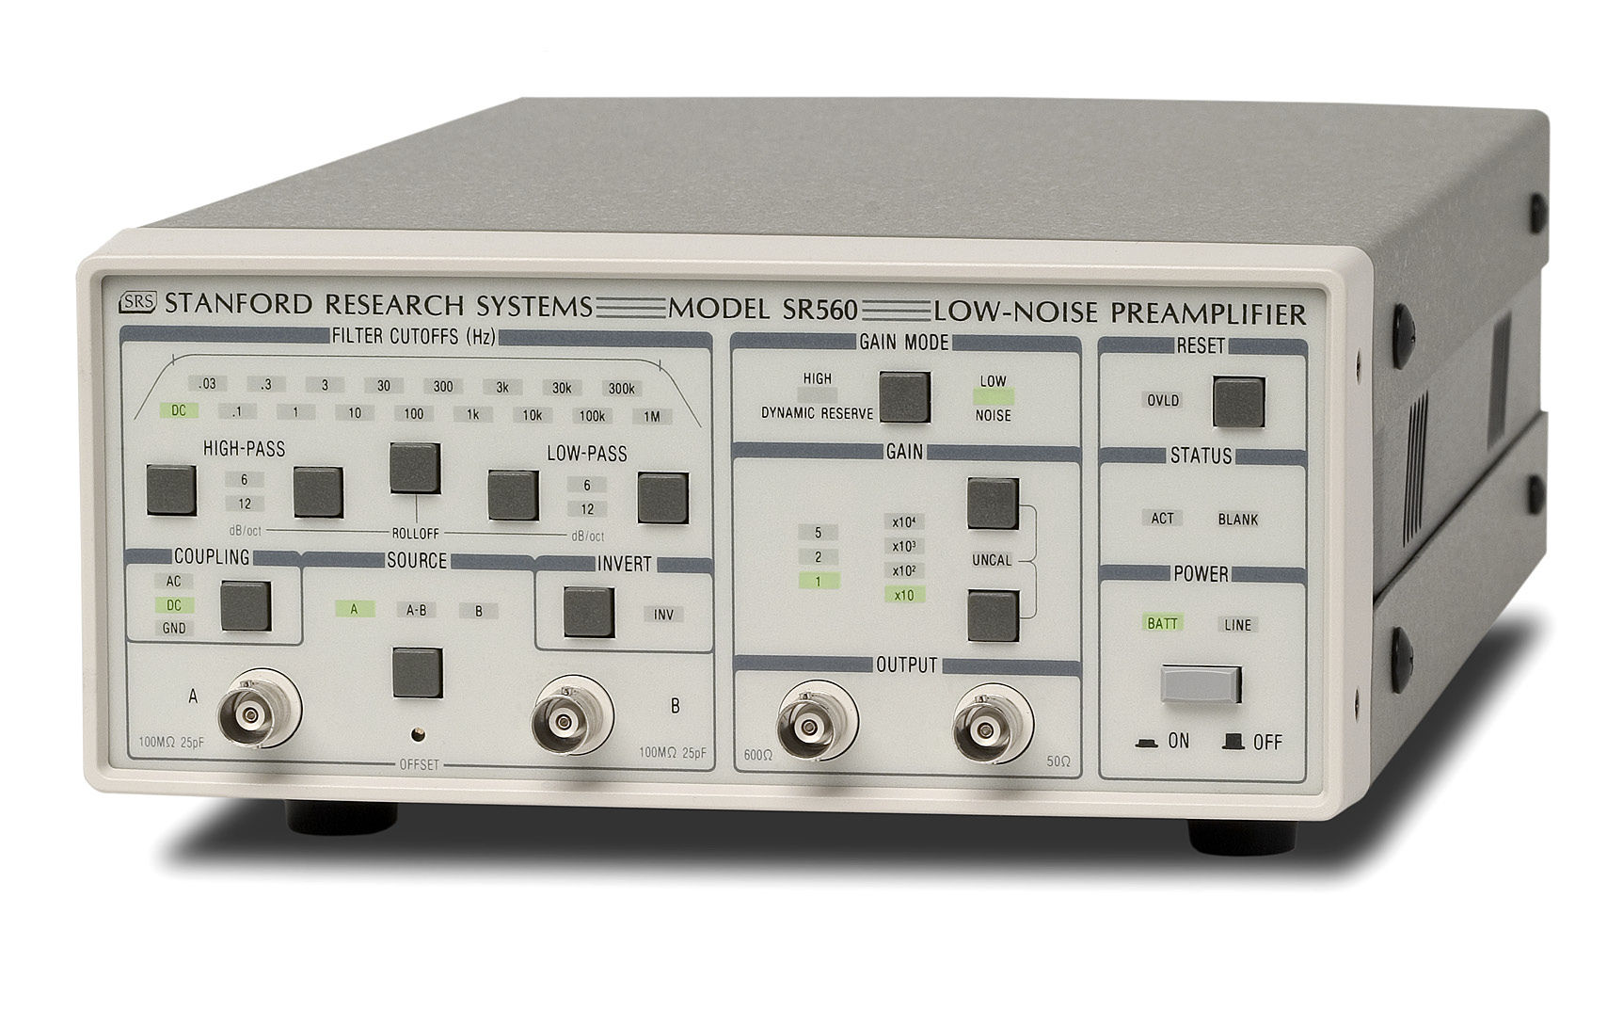
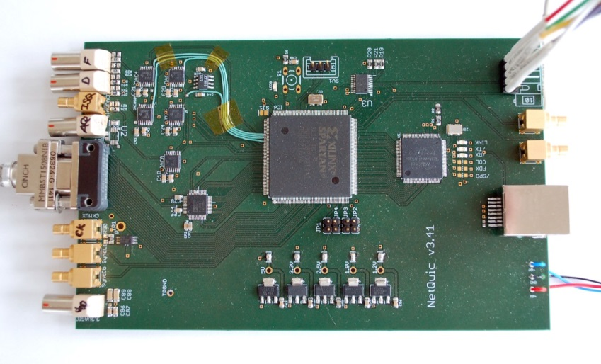
Warm electronics
Amplifier (APC): SR560
Home made amplifier also possible
FPGA board (IRAP)
Status:
2x SR 560 available for TD
Home made amplifier being realised
FPGA board available and functional
With full acquisition speed and FLL in FPGA
Check with IRAP availability of 2nd FPGA board

Slide 7
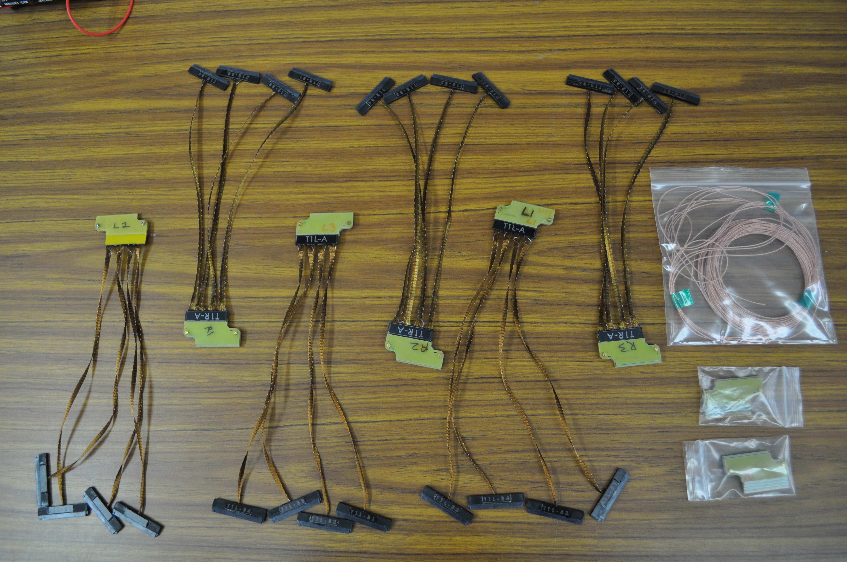
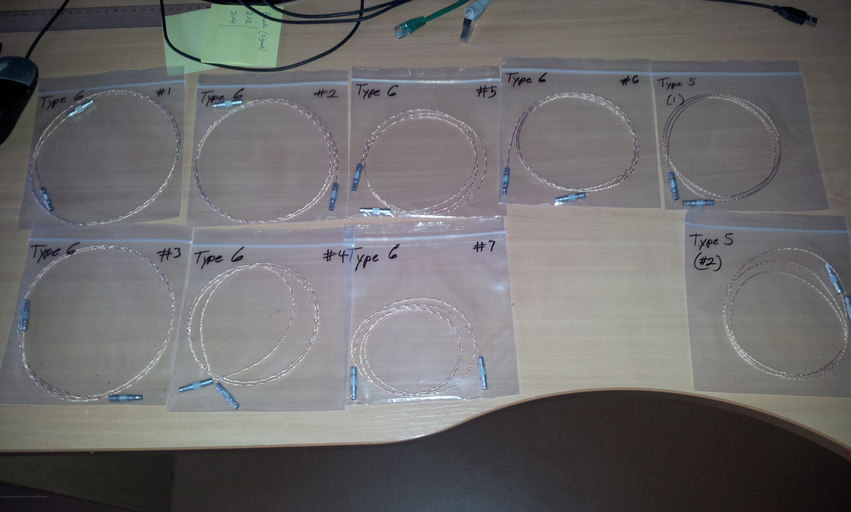
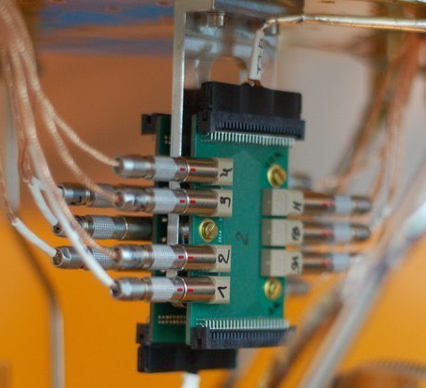
Wiring
Content:
Superconducting NbTi below 4K, Cu or Ph-Br wires above 4K
Inteconnexion PCB
Connectors
Status:
Path defined in the cryostat, length known
Cold interfaces fixed
Interconnexion PCB under integration
Warm interface to be designed (connectors flange)
Detection chain wires: to be ordered to Universal Cryogenics
Connectors to be ordered

Slide 8
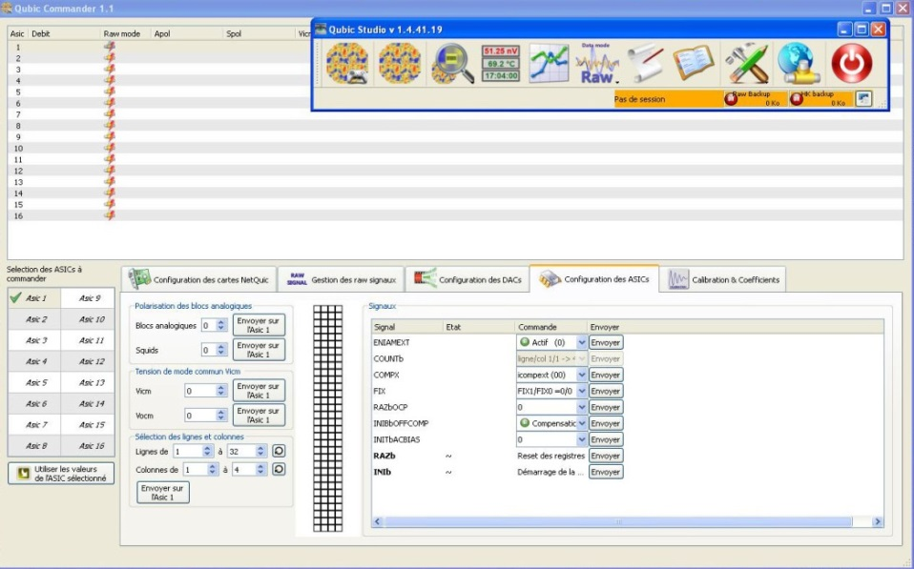
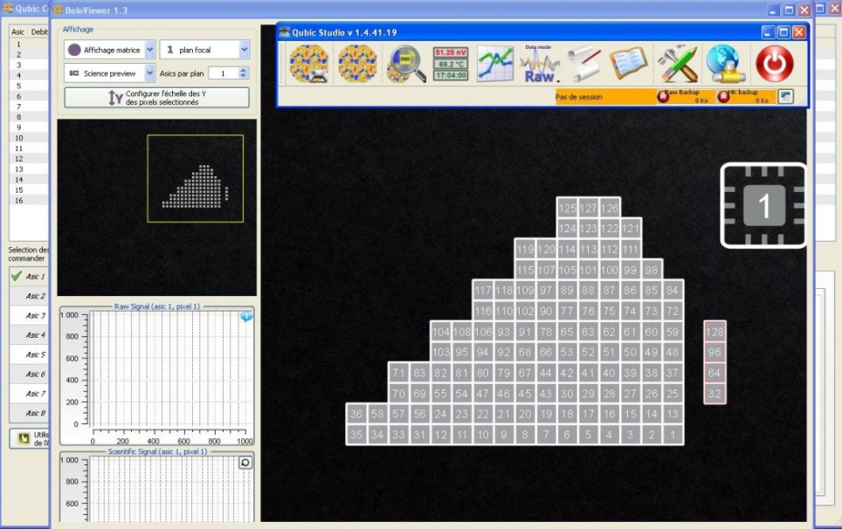

Acquisition software
QUBIC Studio (IRAP):
Overall control of the experiment: TESs, RF switches, PT, thermometers, heaters
Status:
In use for detector characterisation
Connection with other subsystem to be done
ASIC parameterising
Acquisition/Demultiplexing/Visualisation

Slide 9
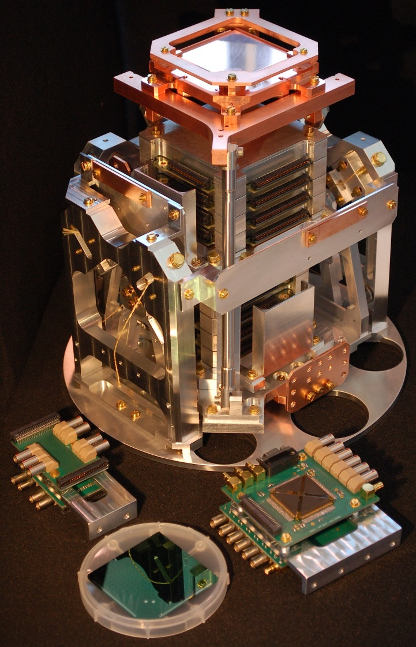
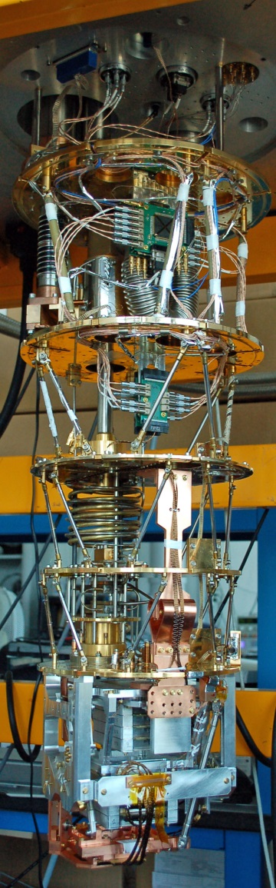
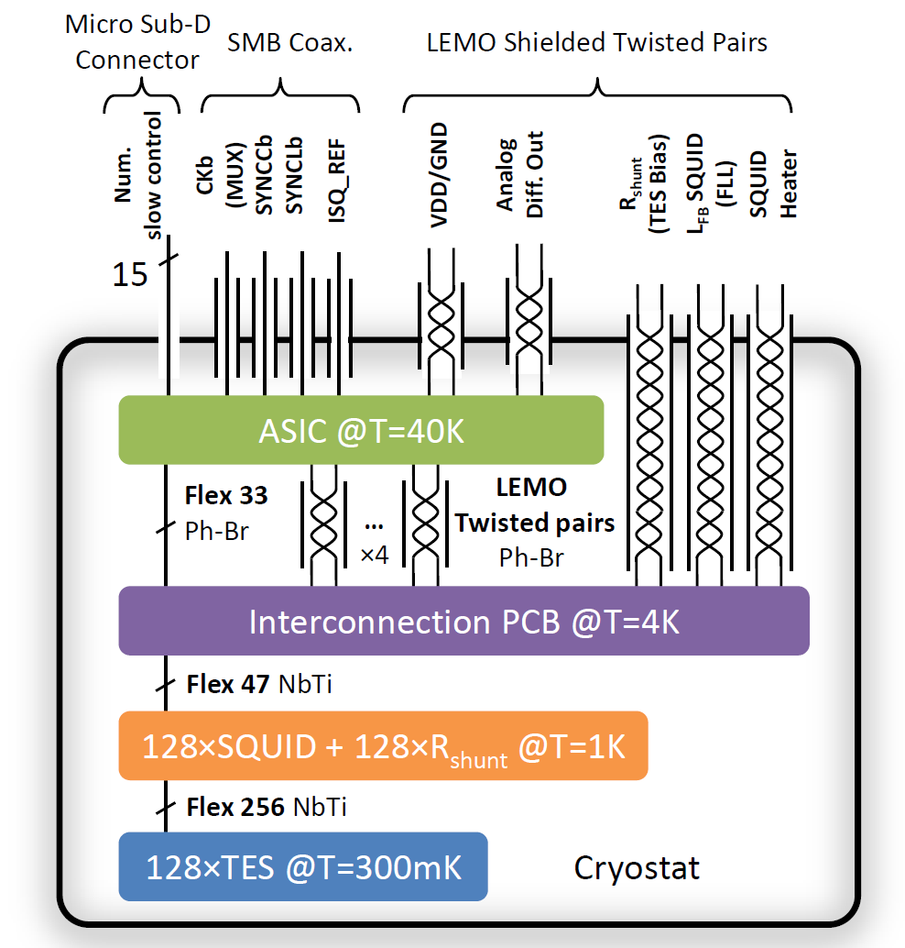
Detection chain: ¼ focal plane integration
Cryostat wiring for 128 TESs readout

Slide 10
P41 characterisation
QUBIC TESs: P41 @ T=350mK
(Camille Perbost)
I-V
P-V
Excellent homogeneity: ±10%

Slide 11
P41 characterisation

Slide 12
P41 characterisation
Preliminary NEP distribution at 350mK:
Requirement: NEP < 5.10⁻¹⁷ W.Hz^{-0.5}

Slide 13
First noise measurements
T=350mK, V_{bias}=1µV
Noise level fully understand
Aliasing
Nyquist inductors to be reduce the aliasing
10⁻¹⁶ W.Hz^{-0.5}

Slide 14

Nyquist inductors
32 Nb inductors (10µH) available from INFN Pisa
Integration on a single SQUID PCB under study
Tests to be done
Quotation available from STAR Cryoelectronics: ~20k€ for 2 wafers, 350 inductors per wafer
Gradiometer version
For TD: no Nyquist inductors will be used at the beginning in order to save money

Slide 15
Interfaces with other sub-systems
Mechanical interfaces:
Wiring inside the cryostat, ASIC and interconnexion boxes frozen
Warm connector part to be designed asap
Localisation of warm electronics and FPGAs to be defined
Other interfaces:
Acquisition software to be interfaced with switches, HWP rotating mechanism, mount

Slide 16
Test, Delivery, Assembly, Calibration Operations
SQUID boards tests before delivery:
In the dilution fridge
Criterion: number of working SQUIDs, ∆V
ASIC boards tests before delivery:
Warm functional test
Criterion: noise level,
Wires tests before delivery:
Tests by Universal Cryogenics
Assembly Operations in APC:
SQUIDs tests: needs T<8K so no tests possible during integration
ASIC functional test could be done after integration at room T

Slide 17
Manpower
Name and responsibility | % FTE 2016 | % FTE 2017 | % FTE 2018
Fabrice Voisin | 60 | 60 | 60
Damien Prêle | 30 | 30 | 30
Tanguy Decourcelle | 30 | 0 | 0
Michel Piat | 20 | 20 | 20
TOTAL FTE | 1.4 | 1.1 | 1.1

Slide 18
Risks analysis
Late delivery of wires or connectors
Possibility to use wires from APC dilution cryostat but in this case we will have no test bed for SQUIDs and TESs
Degraded noise performances
10⁻¹⁶ W.sqrt(Hz) demonstrated, OK for TD

Slide 20
ATRIUM and Documentation
List (with reference ATRIUM-xxxxx) the technical documents related to your sub-system already in the ATRIUM repository.
Are these documents definitive ? Should we update the status of the document from “in project” to “validated” ?
Missing documents from other sub-systems ?
Future documents to be downloaded by you ?

Slide 21
Status of the sub-system : blocking points and schedule
What is the status of the sub-system ?
Design/manufacturing (home made/industry)/assembly/tests ?
When is this phase supposed to be finished ?
If you are still designing the sub-system:
Which inputs / specifications / requirements, needed to finish the detailed design of your sub-systems, are not yet delivered ?
For D.T.
For F.I.
Which other working group should deliver these inputs (see annex 1 for list of main WP) ?
For D.T.
For F.I.
What time is still needed in order to (for D.T.) – assume that the above inputs are provided if needed - :
Finish the whole detailed design of D.T. ?
Manufacture the sub-system ?
Test the sub-system in your premises before delivery to APC / ROMA ?
Idem for F.I.
Do you think you can comply to the target schedule (see annex 2) ?

Slide 22
Status of the sub-system : blocking points and schedule
What is the status of the sub-system ?
Design/manufacturing (home made/industry)/assembly/tests ?
When is this phase supposed to be finished ?
If you are still designing the sub-system:
Which inputs / specifications / requirements, needed to finish the detailed design of your sub-systems, are not yet delivered ?
For D.T.
For F.I.
Which other working group should deliver these inputs (see annex 1 for list of main WP) ?
For D.T.
For F.I.
What time is still needed in order to (for D.T.) – assume that the above inputs are provided if needed - :
Finish the whole detailed design of D.T. ?
Manufacture the sub-system ?
Test the sub-system in your premises before delivery to APC / ROMA ?
Idem for F.I.
Do you think you can comply to the target schedule (see annex 2) ?

Slide 23
Budget (excluding salaries)for T.D. + F.I.
 | Spendings (type and amount) | Funding (source and amount) | Status of funding (granted / under examination)
2016
2017
2018

Slide 24
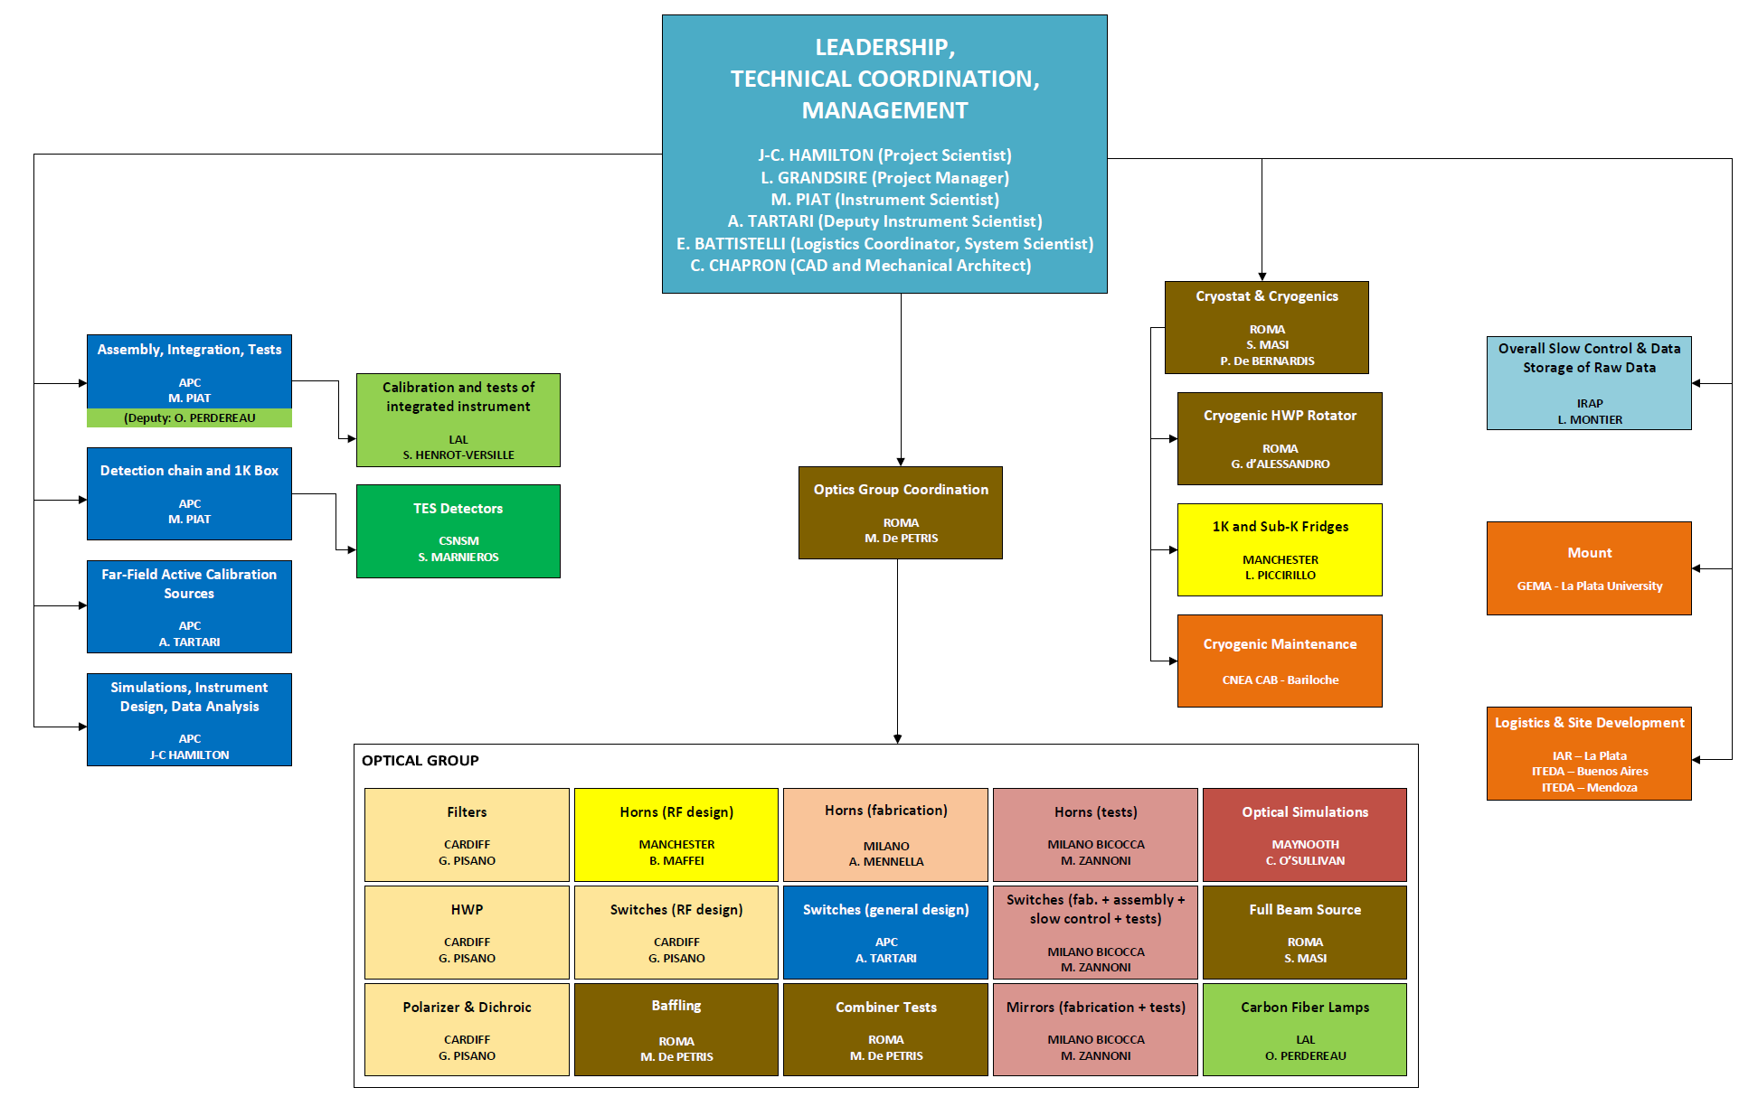
Annex 1: list of main-sub-system and WP leaders

Slide 25
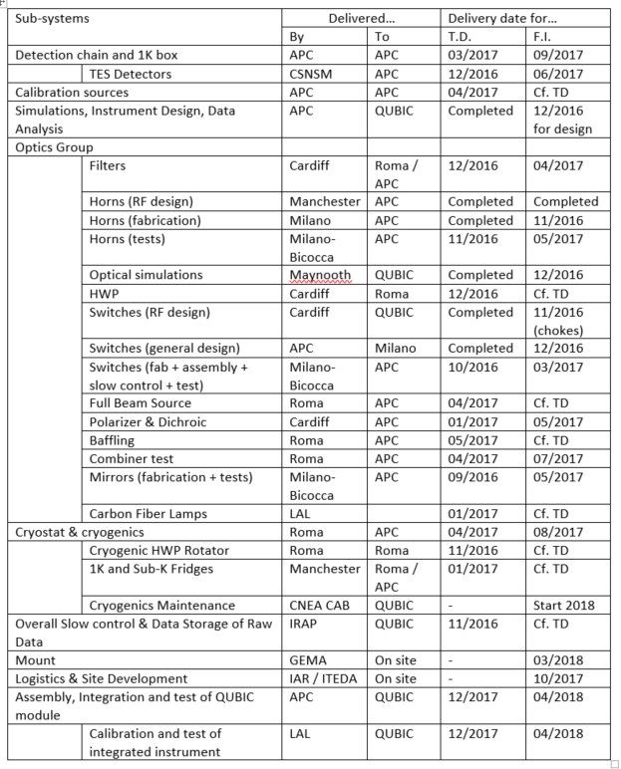
Annex 2 : Target schedule

Slide 26
Annex 3: examples of possibly needed major tools or utilities
High voltage (380 V) power
Cold water
Liquid or gaseous N2 / He
Compressed air
Clean air laminar flow / clean room / conditioned air
Assembly Hall
Mechanical workshop
IT network or Wifi
Chemicals
ESD equipments
Crane or heavy handling systems
Metrology systems (Faro, MMT, Laser…)
VNA
Calibration source
Mount (or fake)
Vacuum systems (including degassing)
Acquisition systems
Computers / data acq. systems
Electrical test with probe station

Slide 27

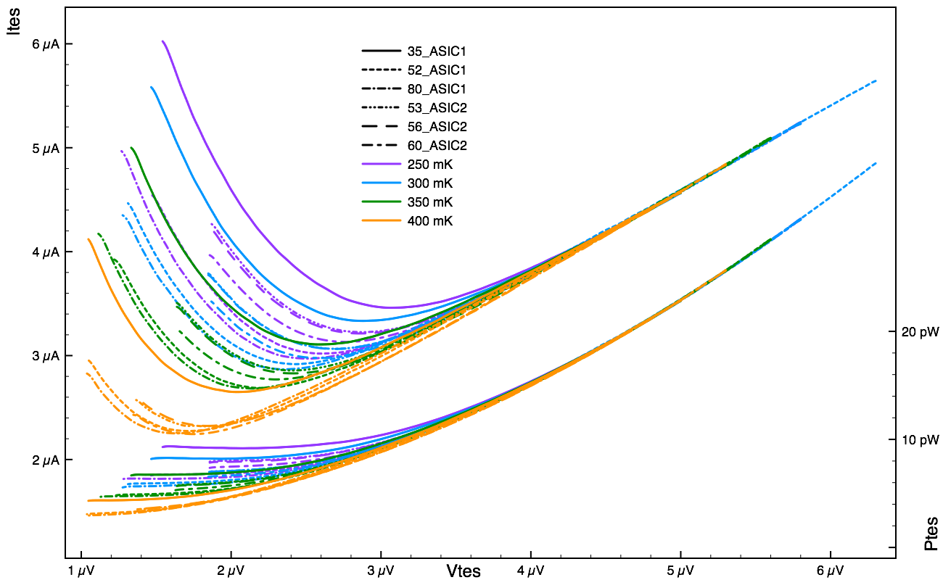
P41 characterisation
Characterisation of TESs: a lots of data!
QUBIC TESs
G~84pW/K
NEP_{phonon}~3.10⁻¹⁷W.Hz^{-0.5}

Slide 28
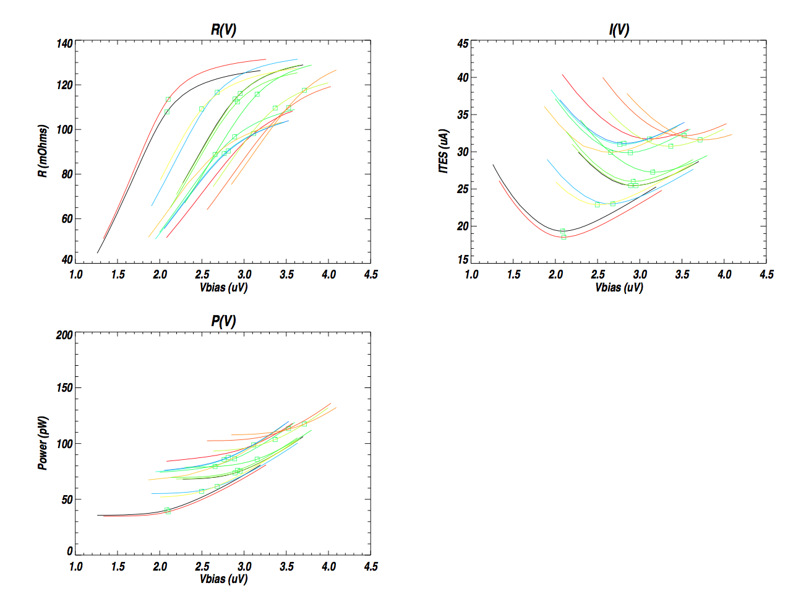
P41 characterisation
QUBIC TESs: P41 @ T=350mK
(Camille Perbost)
23 pixel TESs @ 200mK [Martino 2012]
Excellent homogeneity: ±10%

