Slide 1

Detectors sub-system for QUBIC
For Technological Demonstrator (T.D.)
And
For Final Instrument (F.I.)

Slide 2
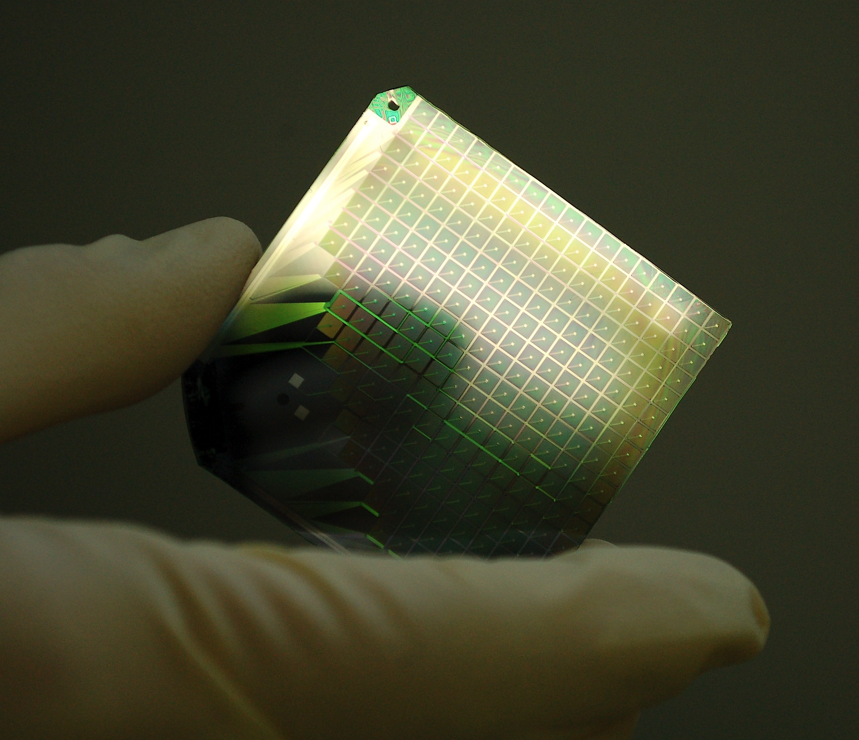
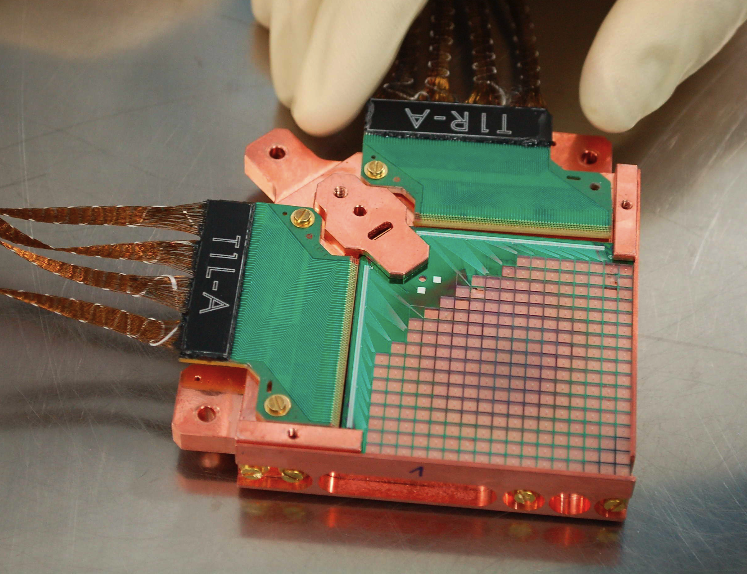
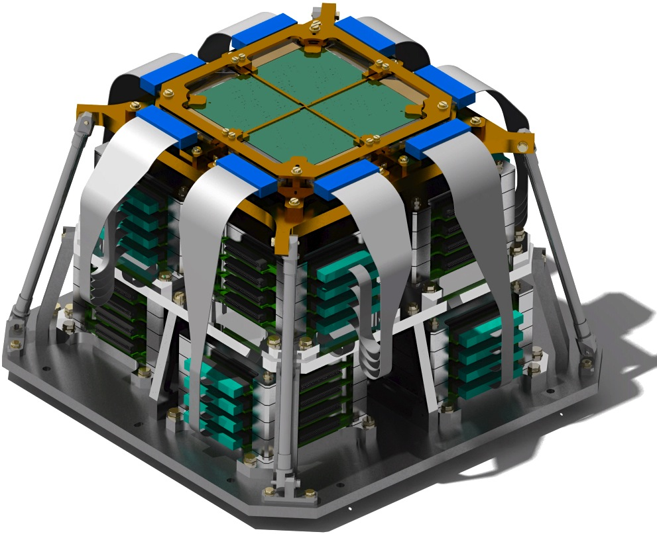
QUBIC detector sub-system :
  Technological Demonstrator : 1 x TES array (248 + 8 TES pixels @ 150 GHz)
  Final Instrument : 8 x TES arrays (150 & 220 GHz)

Slide 3
Status of the sub-system : blocking points and schedule
  What is the status of the sub-system ?
    D.T. phase : Home made manufacturing of TES arrays (CSNSM & CTU IEF-C2N). Room temperature tests (signal rooting) and 300mK electrical calibration tests
    When is this phase supposed to be finished ?
    D.T. 6 arrays end 2016
    F.I. 6 arrays march 2107, 10 arrays end 2017. The best of them will be selected for the F.I.
  If you are still designing the sub-system:
    Which inputs / specifications / requirements, needed to finish the detailed design of your sub-systems, are not yet delivered ?
      For D.T. Fine tuning of the membrane fabrication process is foreseen. Input from 300mK TES tests
      For F.I. Feedback from optical calibration of the D.T. to check absorption efficiency of the grid is recommended.
    Which other working group should deliver these inputs (see annex 1 for list of main WP) ?
      For D.T. Assembly Integration Tests group
      For F.I. Calibration and tests of integrated instrument group
  Do you think you can comply to the target schedule (see annex 2) ?
      D.T. O.K
      F.I. Shifted to 12-2017

Slide 4
Interfaces with other sub-systems
List and describe needed interfaces with other systems. Mechanical
  Electrical / Signal : TES multiplexing read-out
  Vacuum
  Thermal
  Etc…
Are these interfaces currently frozen ? No

Slide 5
Test, Delivery, Assembly, Calibration Operations
Tests of the sub-system in your premises before delivery at APC or ROMA:
  Which specifications will be tested ? Signal routing, TES quality, overall array structure
  What are the criterion for fail / pass ?
  <15% lost pixels, <30 mK Tc spread between pixels, no major visual defaults of the membranes
Delivery to APC or ROMA:
  Special care needed for the transportation and handling of the goods ? Very fragile before integration.
Assembly Operations in APC or/and ROMA:
  Same questions as first point above.
  + which other sub-systems should be integrated before yours? After yours ?
  + Is there any specific material needed for assembly ? (see annex 3 for help)
  What are the test sequences needed to be performed during/after integration
  + How many FTE will you send people at APC / ROMA for help during assembly ?
Calibration Operations at APC:
  Same questions as for Assembly operations.
  Optical calibration, optical and electrical NEP, thermal coupling of membranes and homogeneity

Slide 6
ATRIUM and Documentation
List (with reference ATRIUM-xxxxx) the technical documents related to your sub-system already in the ATRIUM repository.
Are these documents definitive ? Should we update the status of the document from “in project” to “validated” ?
Missing documents from other sub-systems ?
Future documents to be downloaded by you ?
- Fabrication process mask file (GDS file)
- Fabrication process remarks
- Test data (TES R-T curves…)

Slide 7
Last news, program for late 2016 and 2017 and other useful information
6 wafers at stand-by for Deep-RIE (4x 150 GHz, 2x 220 GHz)
6 additional SOI wafers will be processed by march 2017
10 new SOI wafers by end 2017 (optimized membranes for 220 GHz?)
He-free cryostat under construction, will allow quick testing of the TES before Deep-RIE (R-T curves)
Deep-RIE + XeF₂ : fine-tuning and reliability of the process
Optical calibration feed-back from D.T. : photon absorption grid OK?

Slide 8
Fabrication process schedule
 | P_56 | P_57 | P_58 | P_59 | P_60 | P_61 | P_62 to P_67 |  | P_68 to P_78
Wafer Delivery SOI + SiN |  |  |  |  |  |  | 6 SOI wafers |  | 10 SOI wafers
NbSi + Al deposition (e-beam) | 150 GHz | 150 GHz | 150 GHz | 150 GHz | 220 GHz | 220 GHz
Al etching - signal routing (wet)
NbSi etching - TES (XeF₂)
Pd grid deposition & lift-off (e-beam)
Intermediate tests TES + signal routing
SiN membrane etching (RIE)
Deep-RIE (Si + SiO₂ backside)
Si etching – suspended membrane (XeF₂ + resist removal) | end 2016 |  |  |  |  |  | march 2017 |  | end 2017

Slide 9
Budget (excluding salaries)for T.D. + F.I.
 | Spendings (type and amount) | Funding (source and amount) | Status of funding (granted / under examination)
2016
2017 | 30 k€ (mainly clean-room) | IN2P3 | under examination
2018

Slide 10
Manpower
Name and responsibility | % FTE 2016 | % FTE 2017 | % FTE 2018
Stefanos MARNIEROS | 30 | 30
Laurent BERGE | 20 | 20
Louis DUMOULIN | 15 | 15
Benoit Belier (IEF) | 20 | 20
TOTAL FTE | 85 | 85

Slide 11
Risks analysis
List up to three major risks that can impact performances, schedule, costs for the delivery of your sub-systems.
Failure – repair delays of clean room machines used for the fabrication process
2017 IN2P3 funding
Describe strategies dedicated to mitigate the probability of occurrence or the consequence of the risks
alternative fabrication process not using the specific machine
alternative micro-fabrication manufacturing sites
alternative funding??

Slide 12
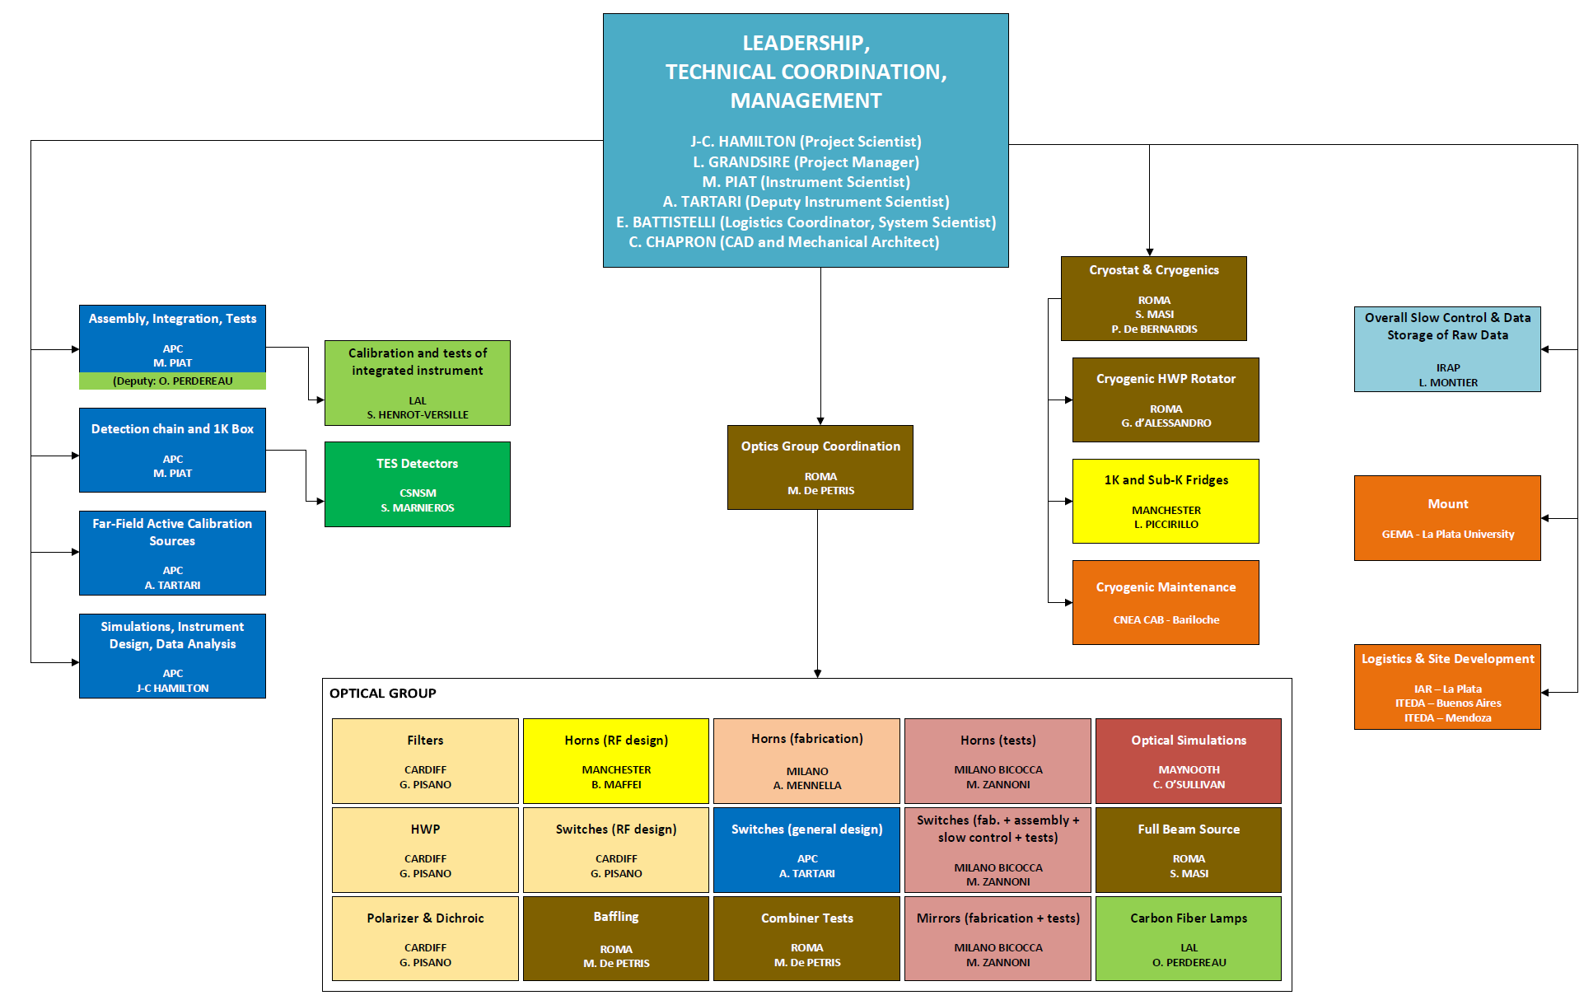
Annex 1: list of main-sub-system and WP leaders

Slide 13
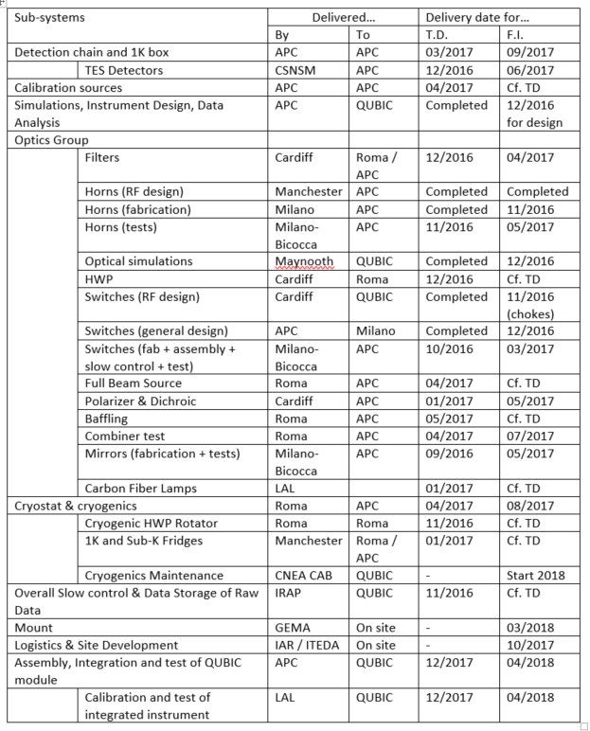
Annex 2 : Target schedule

Slide 14
Annex 3: examples of possibly needed major tools or utilities
High voltage (380 V) power
Cold water
Liquid or gaseous N2 / He
Compressed air
Clean air laminar flow / clean room / conditioned air
Assembly Hall
Mechanical workshop
IT network or Wifi
Chemicals
ESD equipments
Crane or heavy handling systems
Metrology systems (Faro, MMT, Laser…)
VNA
Calibration source
Mount (or fake)
Vacuum systems (including degassing)
Acquisition systems
Computers / data acq. systems
Electrical test with probe station

