Slide 1

Integration Plan for the TD @APC
For Technological Demonstrator (T.D.)
And
For Final Instrument (F.I.)

Slide 2
QUBIC Technological Demonstrator Integration Plan
First draft document distributed by Olivier on 21st September
Content:
  Integration
    Strategy
    Procedure
    Implementation
  Test plan
    At sub-system level
    Before integration
    After integration
  Calibration

Slide 3
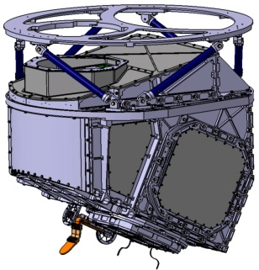
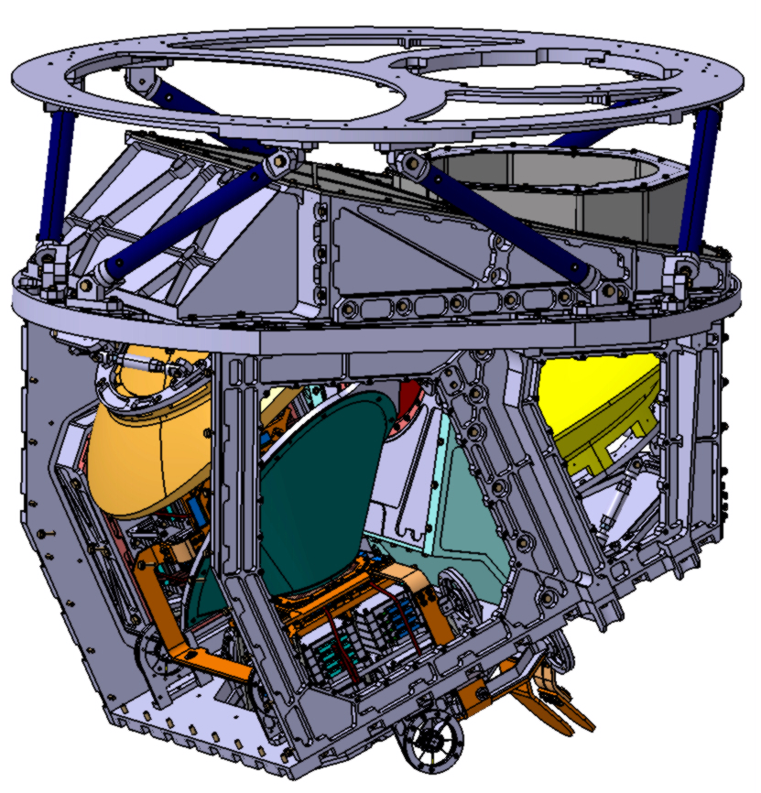
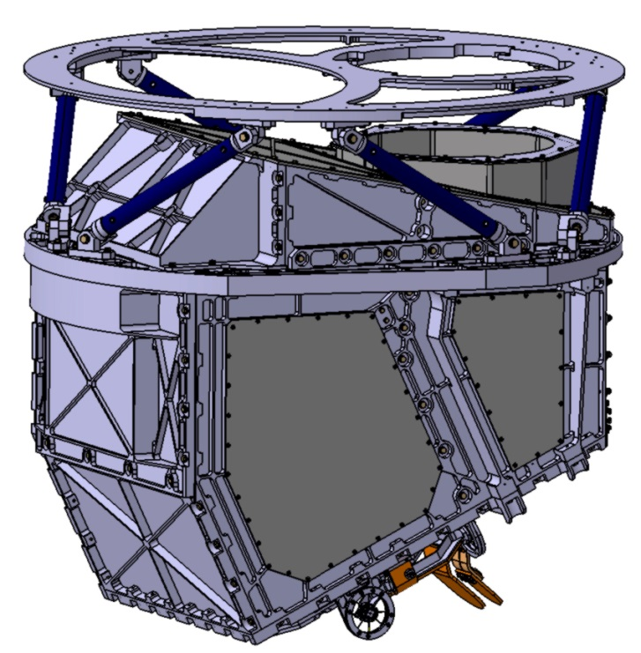
1K box sub-system
Upper support frame
  The mains components of the 1K box are :
    The 2 focal planes and their supports
    The mirrors M1 and M2 and their supports
    The 300mK passageway and links
    The filters : 300mK filters, dichroic filter, cold stop filter.
    And the 1K box itself
1K box
Mirror M2
Mirror M1
OFA focal plane
Dichroic filter
Cold stop filter
300mK passageway
ONA focal plane
1K box equipped

Slide 4
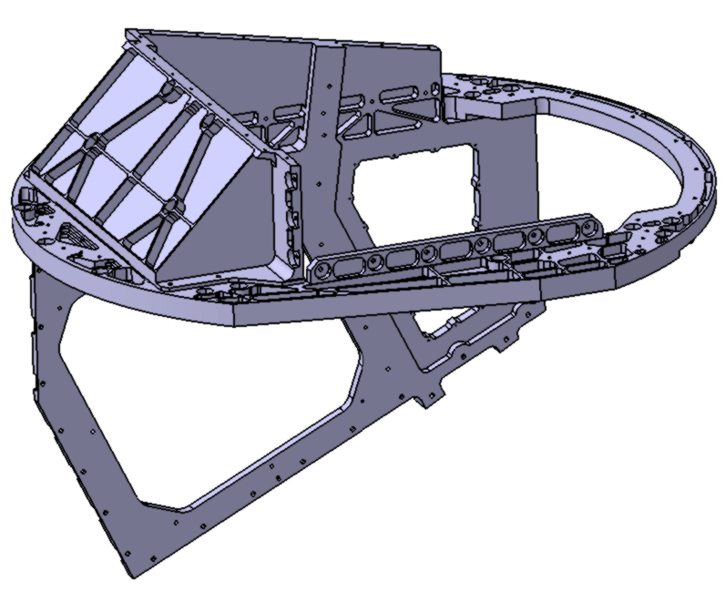
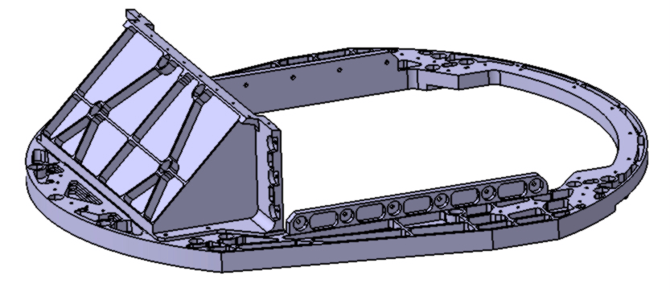
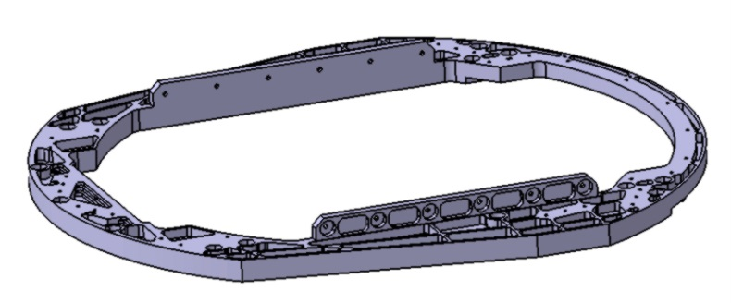
1K box - Assembly Operations
1st step : assembly the 1K box structure
1 – first part : support belt
2 – Mounting of the support plate for M2
3 – Mounting of the Support
side plate for OFA focal plane

Slide 5
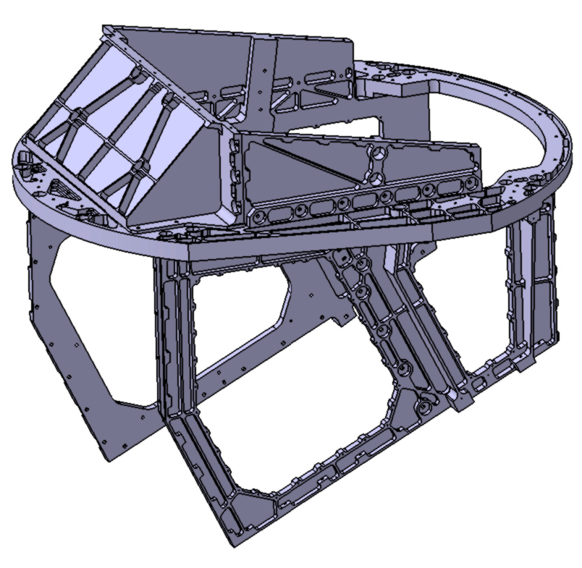
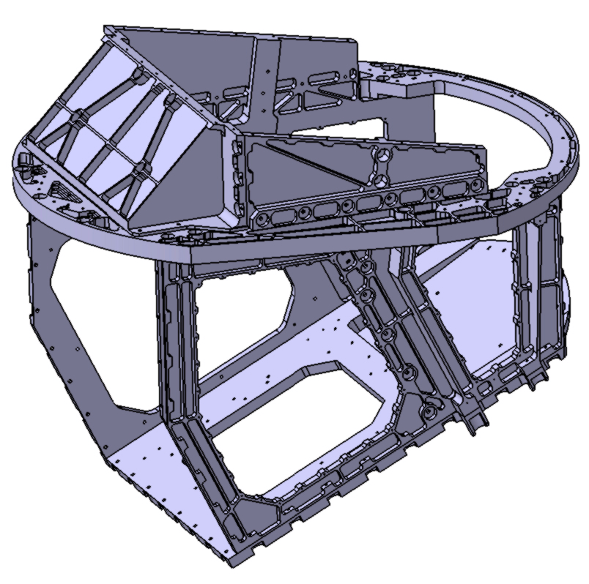
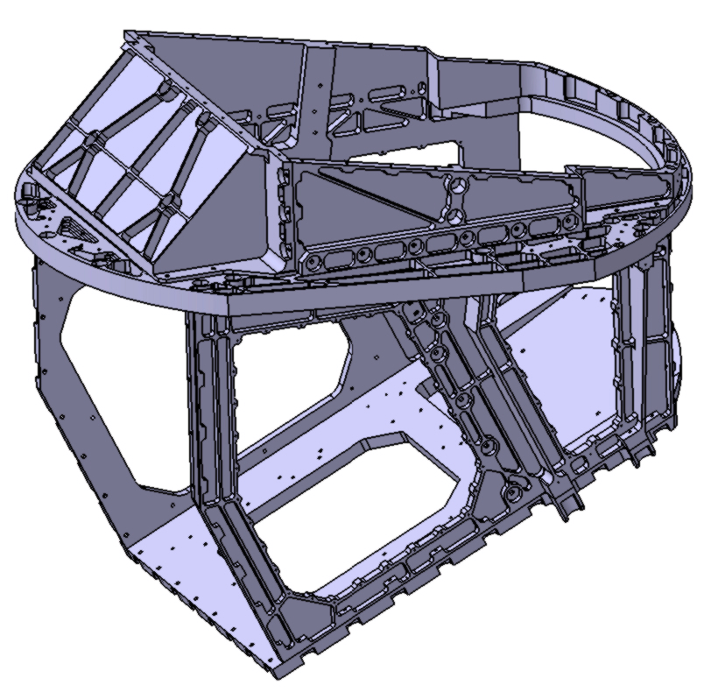
1K box - Assembly Operations
1st step : assembly the 1K box structure
4 – Mounting of the other
support side plate
5 – Mounting of the support
plate ONA-M1
6 – Mounting of the front arch
1K box structure

Slide 6
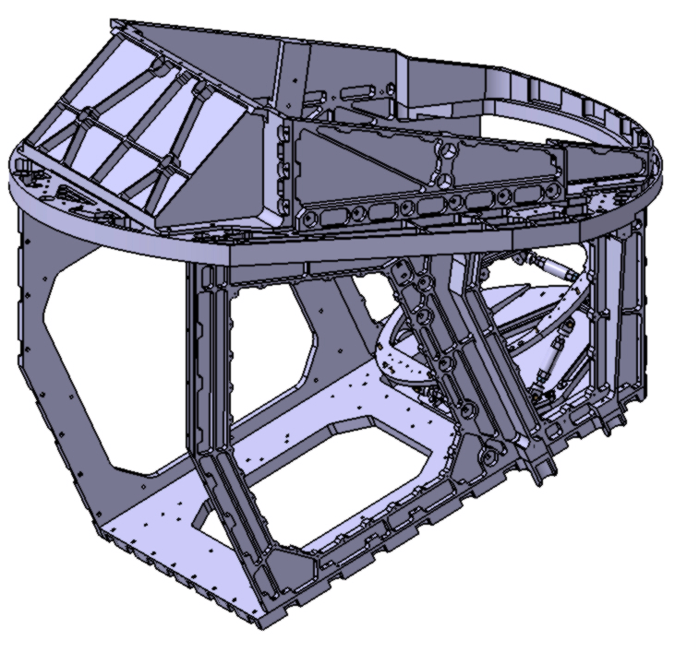
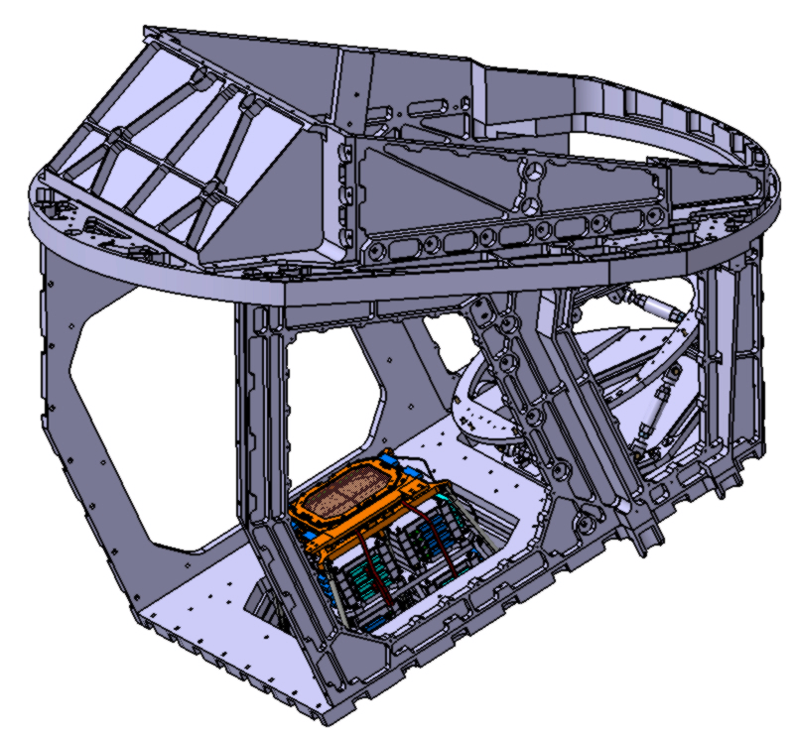
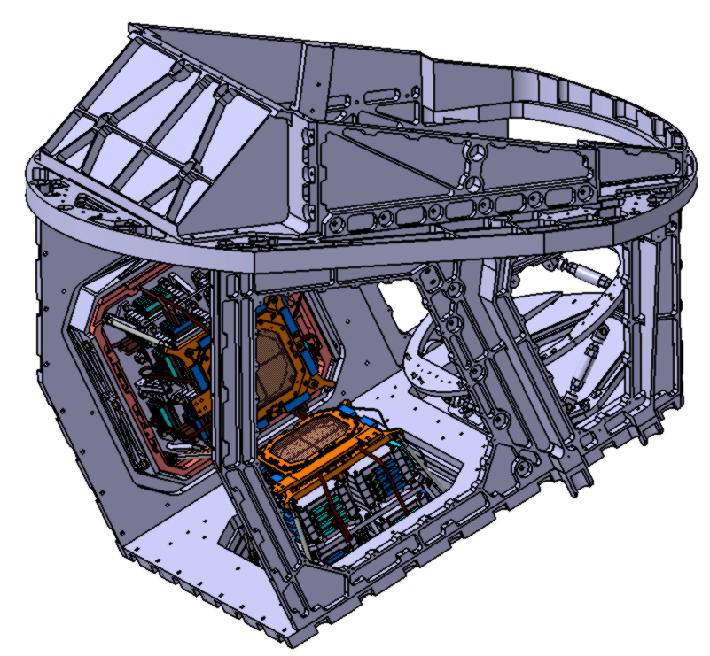
1K box - Assembly Operations
2nd step : mounting and alignment of the focal planes
7 – Mounting of the support of the
mirror M1
The support is assumed to be « aligned »
(with tools – to be defined)
8 – Mounting of the ONA-FP and its support
Alignment of the ONA-FP with mirror M1
(with Tools - to be defined)
9 – Mounting of the OFA-FP and its support
Alignment of the OFA-FP with ONA-FP
(with Tools - to be defined)
ONA-FP : ONA focal plane
OFA-FP : OFA focal plane

Slide 7
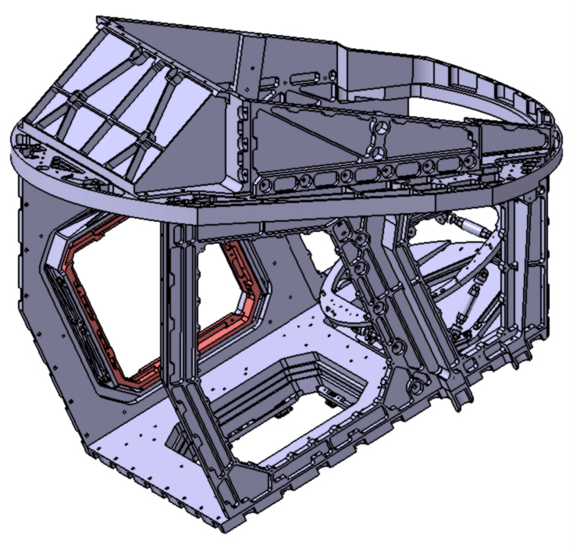
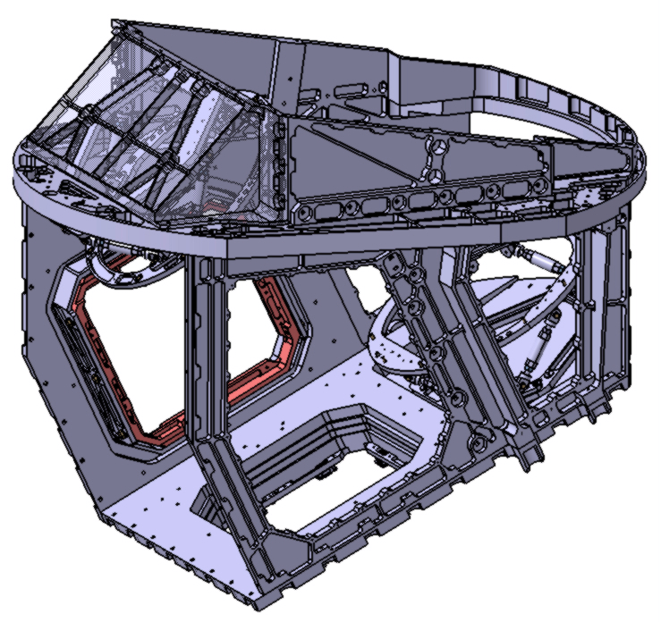
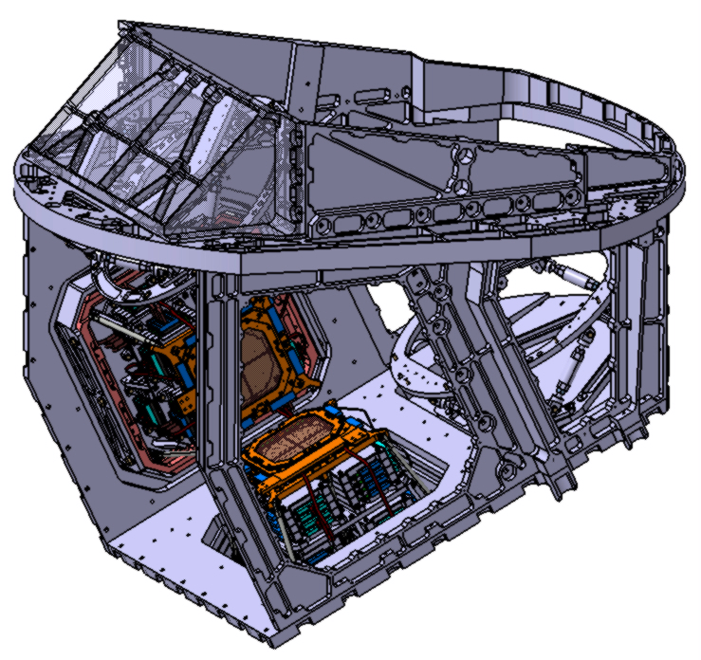
1K box - Assembly Operations
3rd step : mounting and alignment of the mirror M2
10 – Dismounting the ONA-FP
and the OFA-FP
11 – Mounting the support of the mirror M2
Alignment of the mirror M2 with
the mirror M1 (with tools – To be defined)
12 – (Re)Mounting the ONA-FP
and the OFA-FP
ONA-FP : ONA focal plane
OFA-FP : OFA focal plane

Slide 8

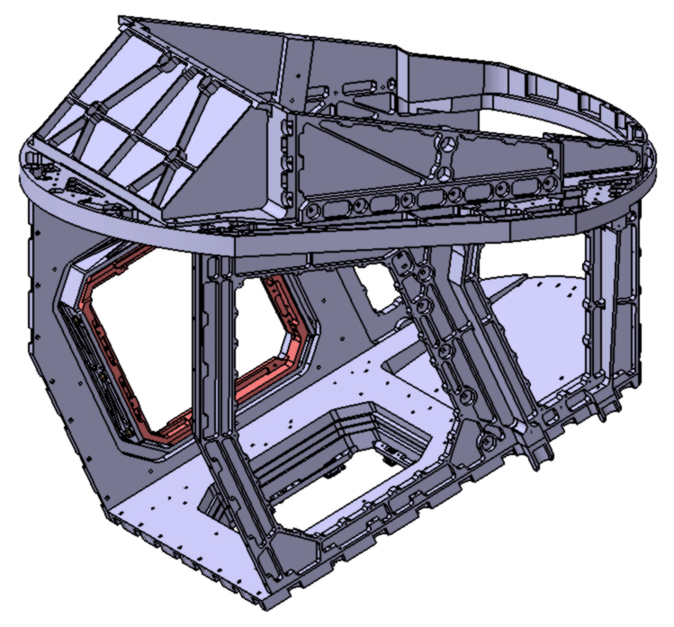
1K box - Assembly Operations
4th step : mounting and alignment of the dichroic filter
13 – Mounting the Dichroic filter
Alignment of its support with
the OFA-FP (with tools – to be defined)
14 – Dismounting the Dichroic filter, the
ONA-FP, the OFA-FP, the mirrors M1
and M2
ONA-FP : ONA focal plane
OFA-FP : OFA focal plane

Slide 9
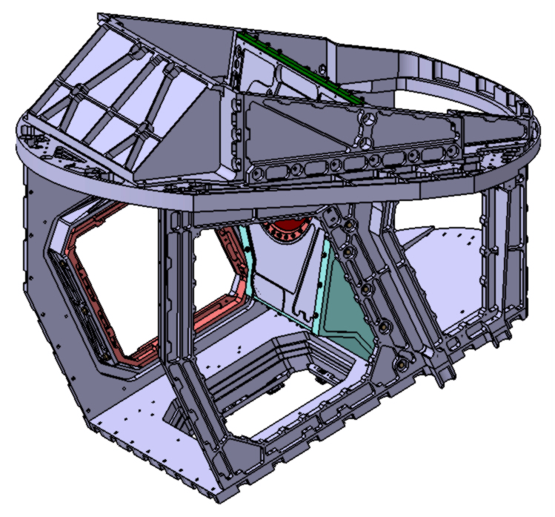
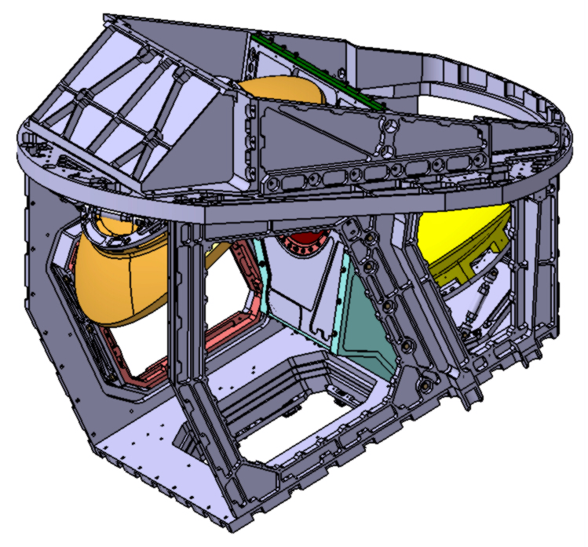
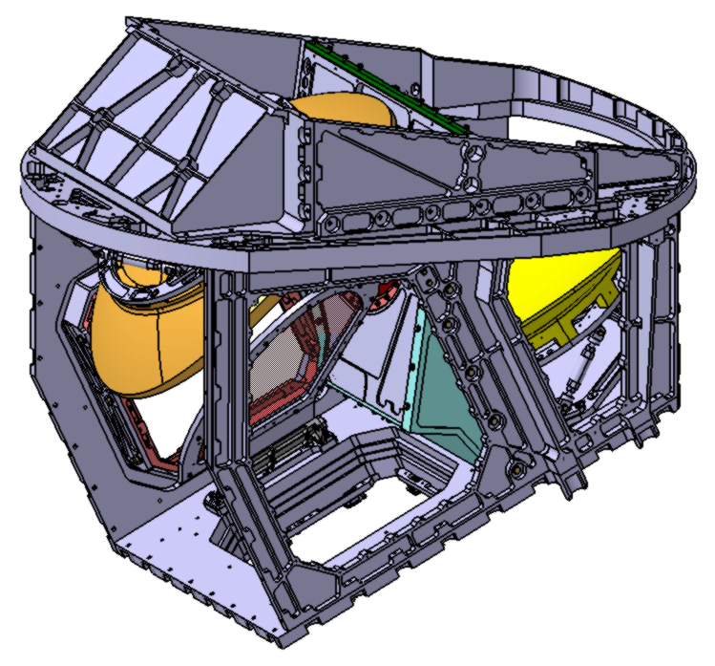
1K box - Assembly Operations
5th step : mounting of the cold stop
15 – Mounting the cold stop
16 – (Re)mounting the mirrors M1 and M2
17 – (Re)mounting the dichroic filter

Slide 10
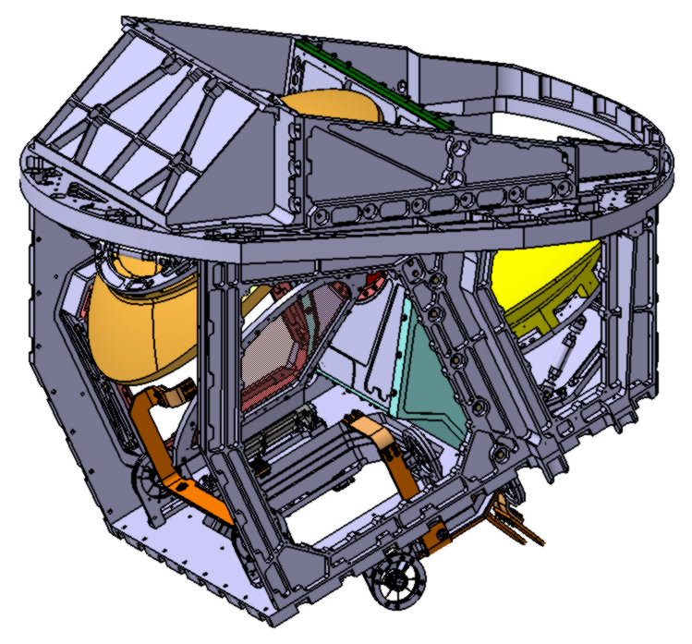
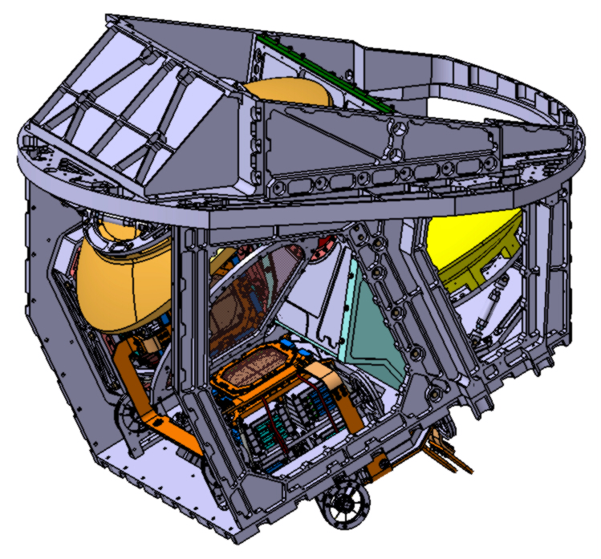
1K box - Assembly Operations
6th step : mounting of the 300mK passageway and
18 – Mounting of the 300mK passageway
19 – (Re)mounting of the ONA-FP and
the OFA-FP
ONA-FP : ONA focal plane
OFA-FP : OFA focal plane

Slide 11
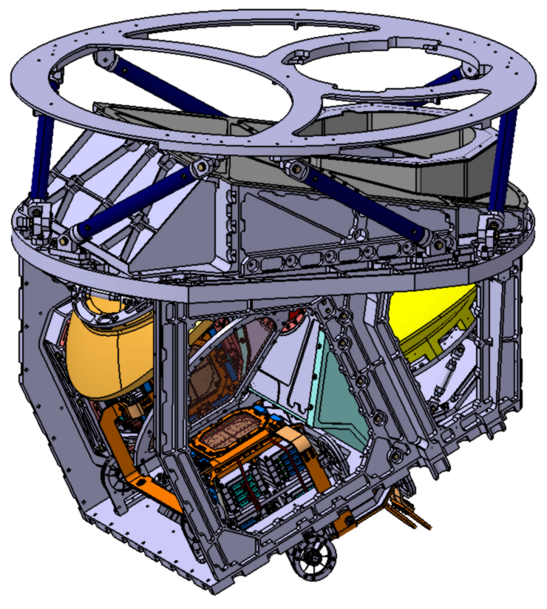
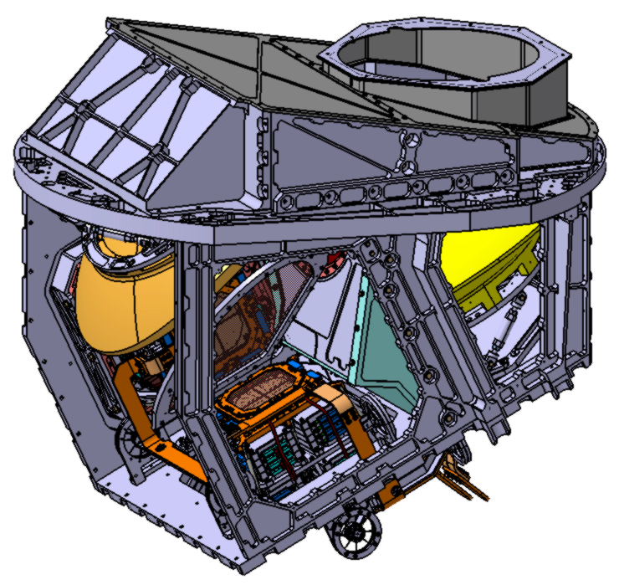
1K box - Assembly Operations
7th step : mounting of the « top lid » and the upper support frame with the 6 pillars
20 – mounting the top lid
21 – Mounting the upper support frame with
the 6 pillars (with tools – to be defined)

Slide 12
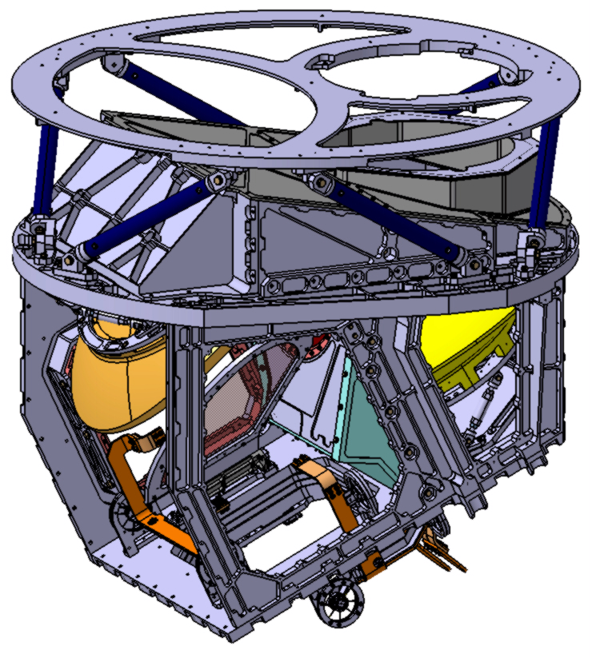

1K box - Assembly Operations
8th step : wiring of the focal plan
22 – Dismounting the ONA-FP and
the OFA-FP for wiring
23 – (Re)mounting the ONA-FP and
the OFA-FP after wiring
ONA-FP : ONA focal plane
OFA-FP : OFA focal plane

Slide 13
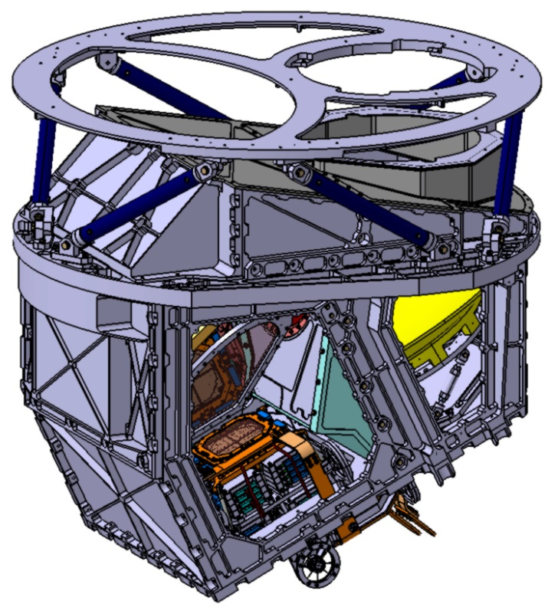
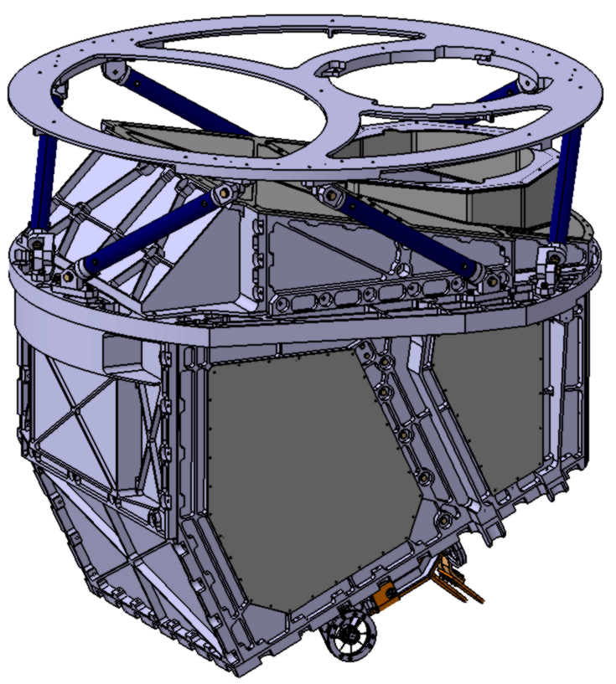
1K box - Assembly Operations
9th step : mounting the lids and the covers
24 – Mounting the rear covers
25 – Mounting the remaining lids
1K box equipped

Slide 14
Comments
1K integration needs to be optimised
  Reduction of mounting/dismounting procedures
  Laser alignement procedure to be added (in configuration 16?)

Slide 15
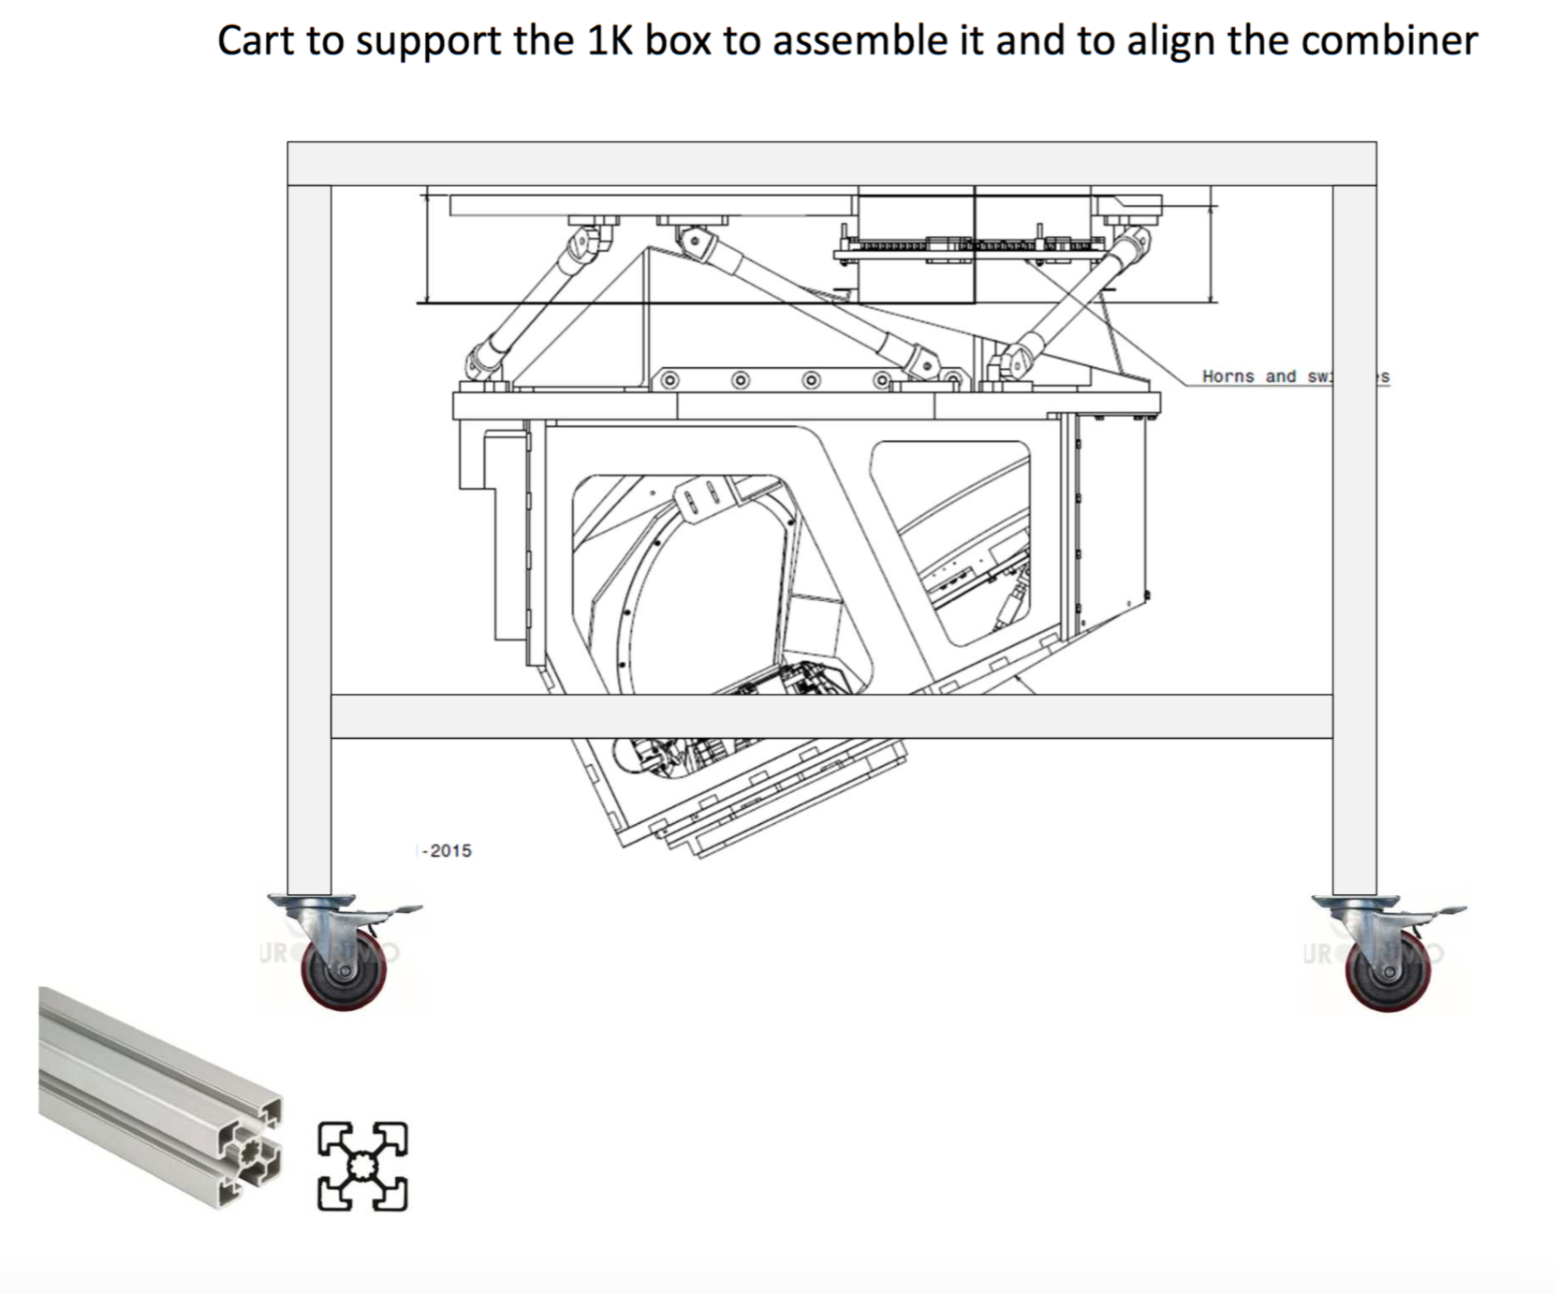
Status of the sub-system : blocking points and schedule
  Status : under definition
    Integration of FP is missing (at APC clean room)
    Intgration of instrument: in the integration hall of APC
  Design:
    Tools needs to be designed (see Claude presentation)
  What time is still needed in order to (for D.T.):
    Finish the whole detailed design of D.T. ?
    Manufacture the sub-system ?
    Test the sub-system in your premises before delivery to APC / ROMA ?
  Idem for F.I.
    Same tools for F.I.!
  Do you think you can comply to the target schedule (see annex 2) ? Under study

Slide 16
Interfaces with other sub-systems
APC integration hall is being prepared to receive QUBIC:
  Closed loop cold water line about to be implemented
  All other needed instrumentation needed (see Silvia’s talk) are available

Slide 17
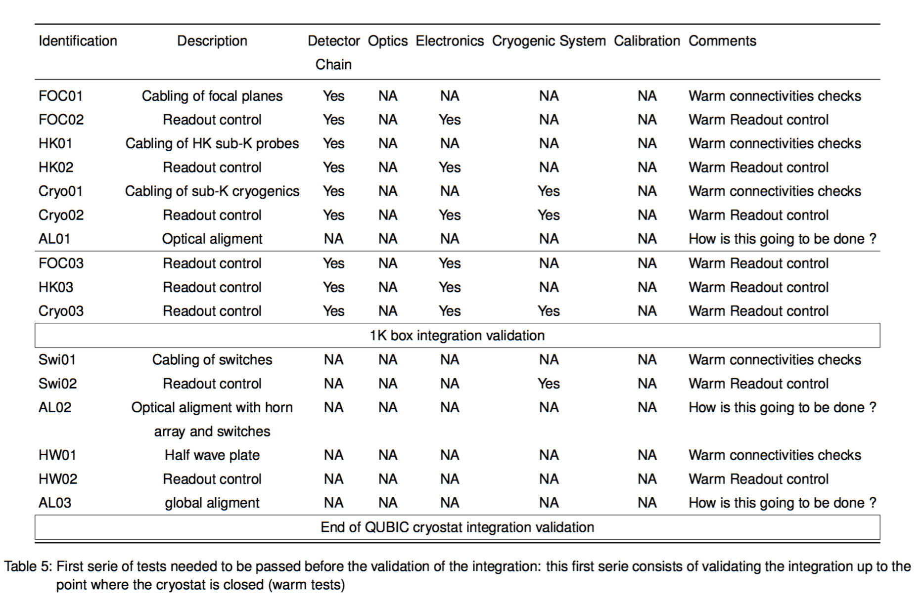
Tests and calibration
See the document : QUBIC Technological Demonstrator Integration Plan

Slide 18
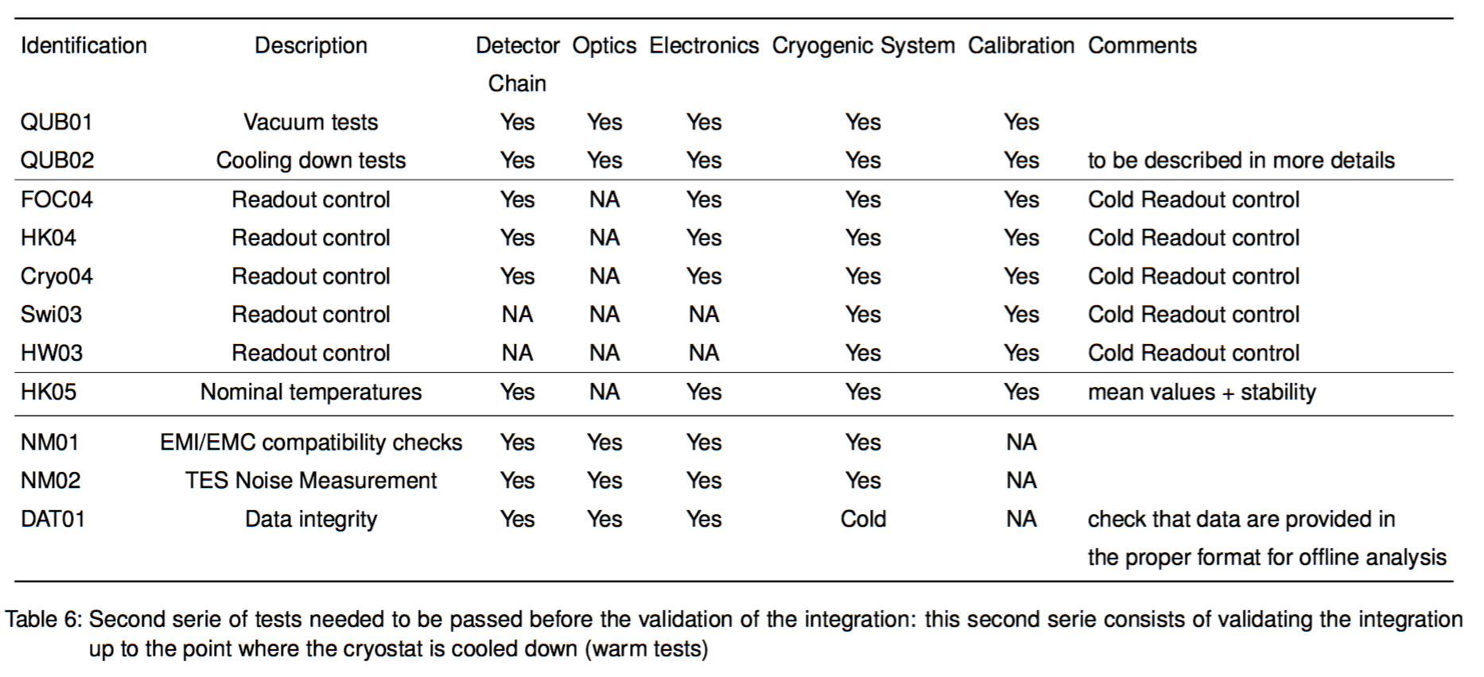
Tests and calibration

Slide 19
Manpower
Name and responsibility | % FTE 2016 | % FTE 2017 | % FTE 2018
Claude Chapron | 50 | 50 | 50
Michel Piat | 10 | 10 | 10
Damien Prêle | 10 | 10 | 10
Fabrice Voisin | 10 | 10 | 10
+LAL, IRAP, Roma, Milano, Maynooth, Manchester…
TOTAL FTE

Slide 21
ATRIUM and Documentation
List (with reference ATRIUM-xxxxx) the technical documents related to your sub-system already in the ATRIUM repository.
Are these documents definitive ? Should we update the status of the document from “in project” to “validated” ?
Missing documents from other sub-systems ?
Future documents to be downloaded by you ?

Slide 22
Last news, program for late 2016 and 2017 and other useful information

Slide 23
Budget (excluding salaries)for T.D. + F.I.
 | Spendings (type and amount) | Funding (source and amount) | Status of funding (granted / under examination)
2016
2017
2018

Slide 24
Risks analysis
List up to three major risks that can impact performances, schedule, costs for the delivery of your sub-systems.
Describe strategies dedicated to mitigate the probability of occurrence or the consequence of the risks

Slide 25
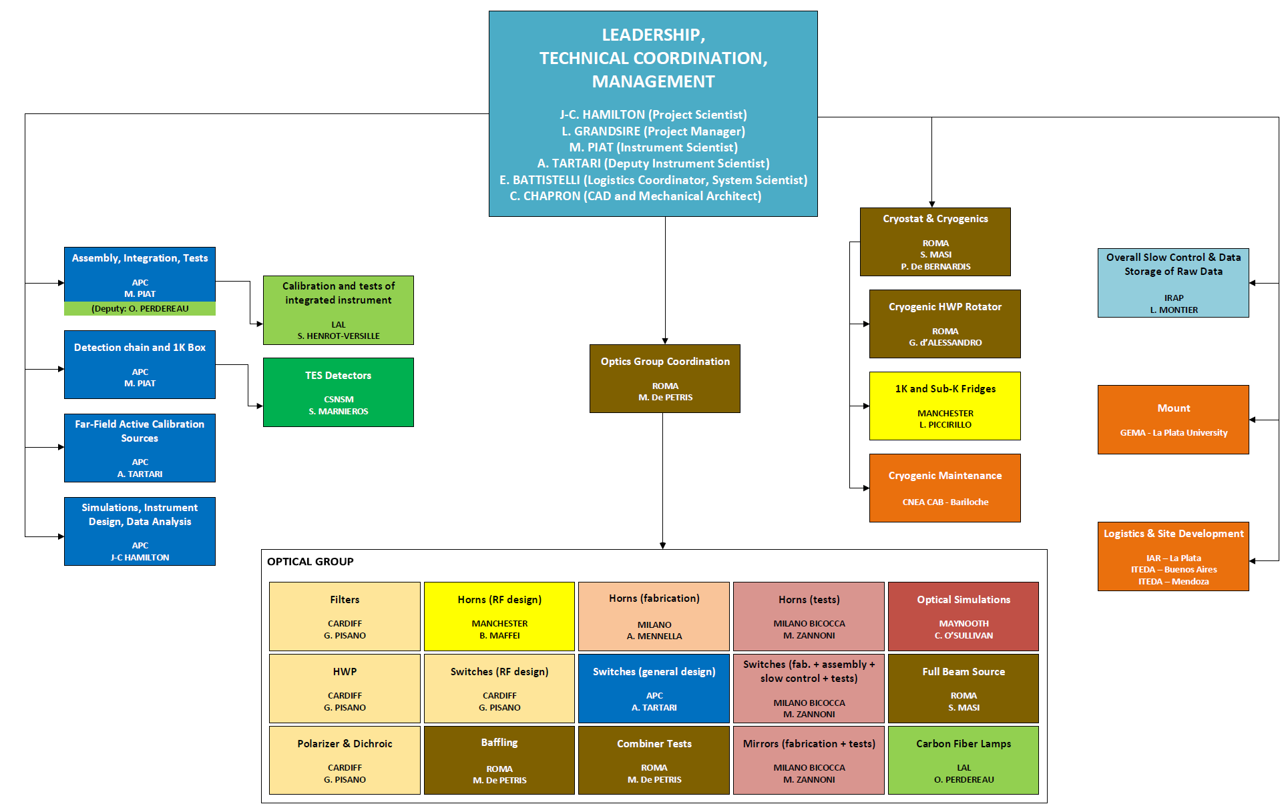
Annex 1: list of main-sub-system and WP leaders

Slide 26
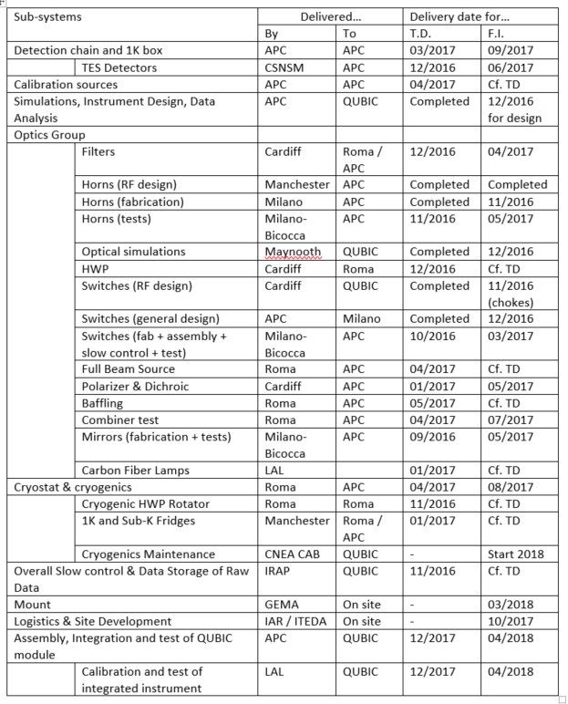
Annex 2 : Target schedule

Slide 27
Annex 3: examples of possibly needed major tools or utilities
High voltage (380 V) power
Cold water
Liquid or gaseous N2 / He
Compressed air
Clean air laminar flow / clean room / conditioned air
Assembly Hall
Mechanical workshop
IT network or Wifi
Chemicals
ESD equipments
Crane or heavy handling systems
Metrology systems (Faro, MMT, Laser…)
VNA
Calibration source
Mount (or fake)
Vacuum systems (including degassing)
Acquisition systems
Computers / data acq. systems
Electrical test with probe station

