Slide 1
PSPA comme je le voudrais
MB
22 Septembre 2016

Slide 2
User’s wishes
Describe any kind of lattice, simply e fast
Upload created lattice as an input readable by all codes
Download an existing file, look into it, correct it, run it
Update input file(s) with run results and run it again
Plots → standard (command as input) or user made (plot window with options)
Upload output file(s) and plots (.ps, .jpg, png) with possibility to change/give name
Run different codes with same input file (user does not need to know differences)
Plot of machine layout from any lattice input, with possibility to select zones (sectors) or zoom
Download files on personal computer
Possibility to easily add any home made code

Slide 3
Server and laptop
Run PSPA on powerful servers (fast, possible to parallelize): big machines, long simulations
Which area data will be stored? Common area (examples) and/or personal area
Possible to provide users with “case study” accelerators (the ones already tested or built)?
Usually users are very possessive with their work...

Slide 4
Codes
The list of codes is close to infinite, since it depends on the study (build a lattice, track particles, compute lifetimes and backgrounds, interact with targets, simulate beam-beam, instabilities, impedances, orbit correction, error minimization, luminosity optimization…)
Codes which are “private” (as Tosca for magnetic fields of HFSS for RF structures) will not be available
Codes with Matlab interface should be considered
User made codes should be easy to implement in future

Slide 5
Codes
Available now:
Parmela for e- source, Linac
Transport for Linac, transfer lines, rings
Beta for transfer lines, rings
MADX for transfer lines, rings
To be implemented:
Elegant for e- source, Linac, transfer lines, rings
SAD for transfer lines, rings
AT + MML + Matlab for transfer lines, rings

Slide 6
Features to be implemented soon
THOMX is implemented for Twiss, matching
Need to implement error correction schemes for commissioning:
magnets misalignments (100 μ foreseen)
BPM errors
gradient errors
Beta-beat, coupling and dispersion correction
IP feedback (e- in FP cavity) ?
Can use procedures built for Low Emittance Rings (ex. ESRF) which use AT + MML

Slide 7
PSPA page
Download/upload files
Build your machine:
from scratch
from file → cut in pieces? load all pieces
Look at your machine: layout
Modify your machine
Pick your “sector”
Pick your code
Pick your commands (Twiss, track, match,…)
RUN
Look at output and plots
Save, modify, re-run

Slide 8
Load from file
Build from scratch
Look/Plot layout/Modify
Pick “sector”
Pick code
Pick commands
RUN
PLOT/Look otput
Save results

Slide 9
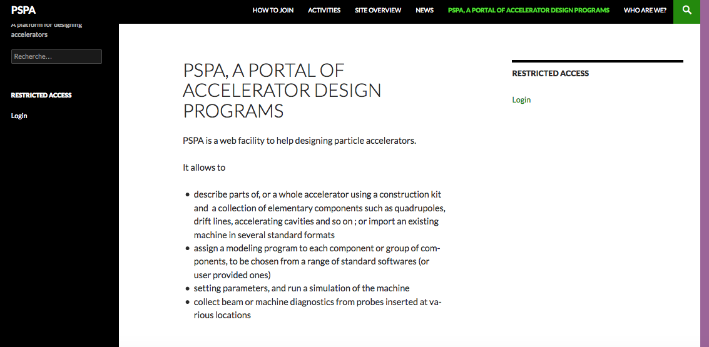
Portal web (CH)
Should be fast to load

Slide 10
Present windows
Description (HOME)
Site overview
How to join
Who are we
News
Activities

Slide 11
Other windows?
Login to “Users” page with
Access to PSPA portal
Documentation
Examples
Users forum (for debugging, new requests, …)
Request to become a User
Short demo page
List of codes implemented
Contact us

