Slide 1
Examples of web lattice design

Slide 2
OPA (Paul Scherrer Institute) https://ados.web.psi.ch/opa/tour/index.html

Slide 3
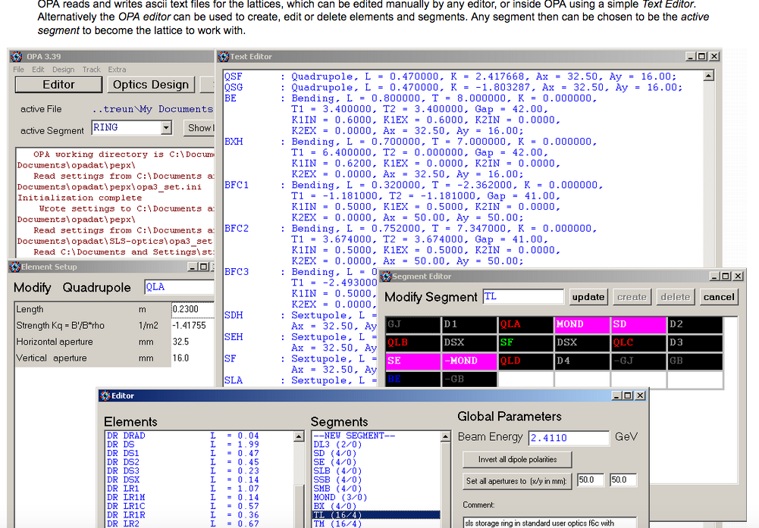
OPA Editor

Slide 4
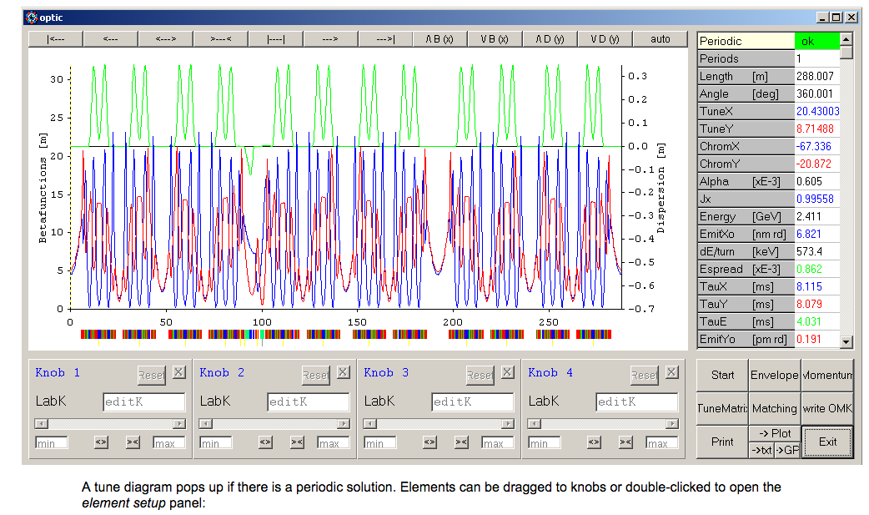
OPA Twiss

Slide 5
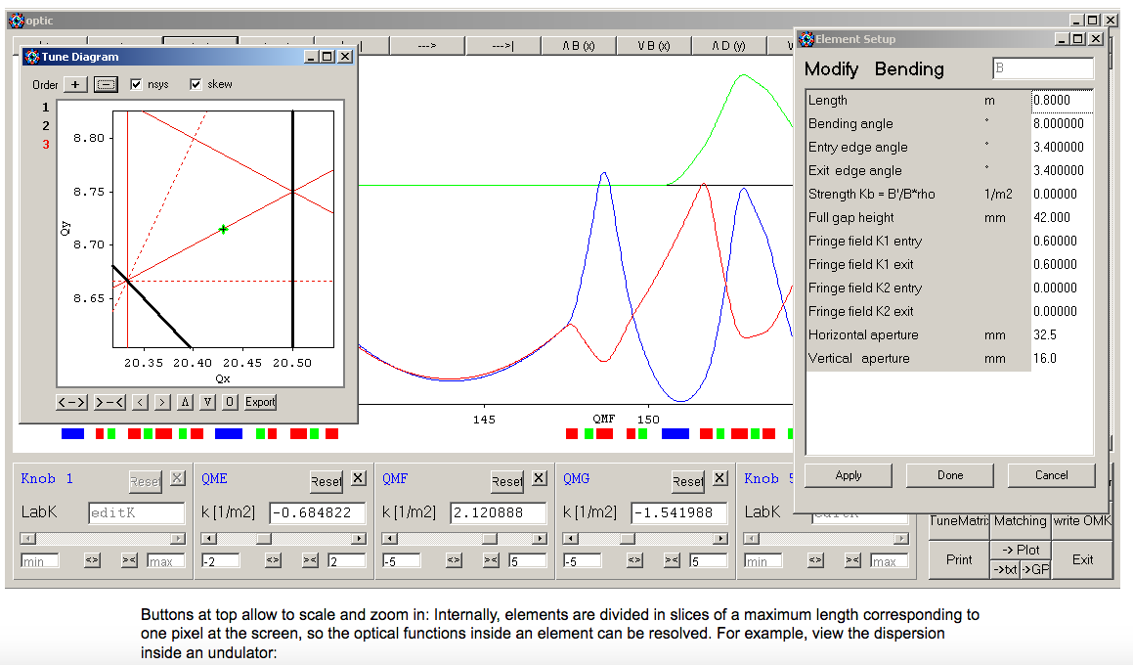
OPA Matching

Slide 6
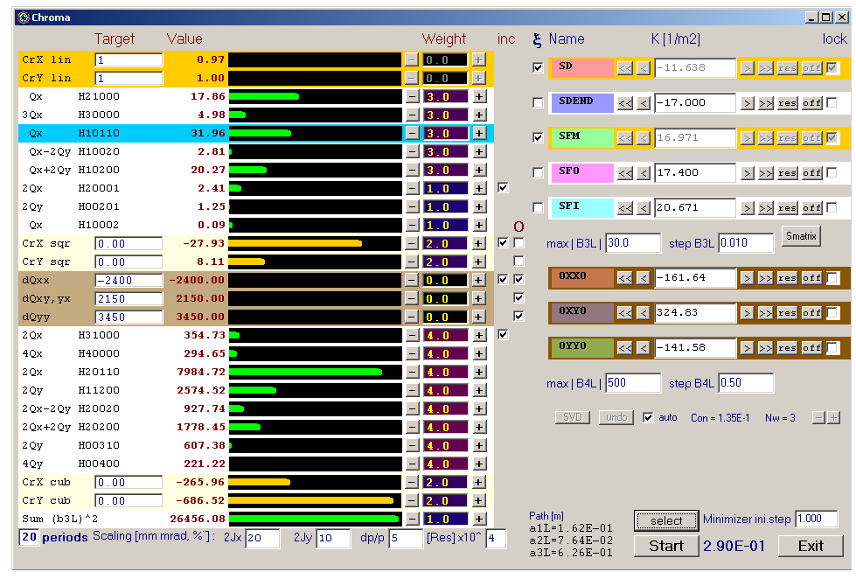
OPA Non linear dynamics

Slide 7
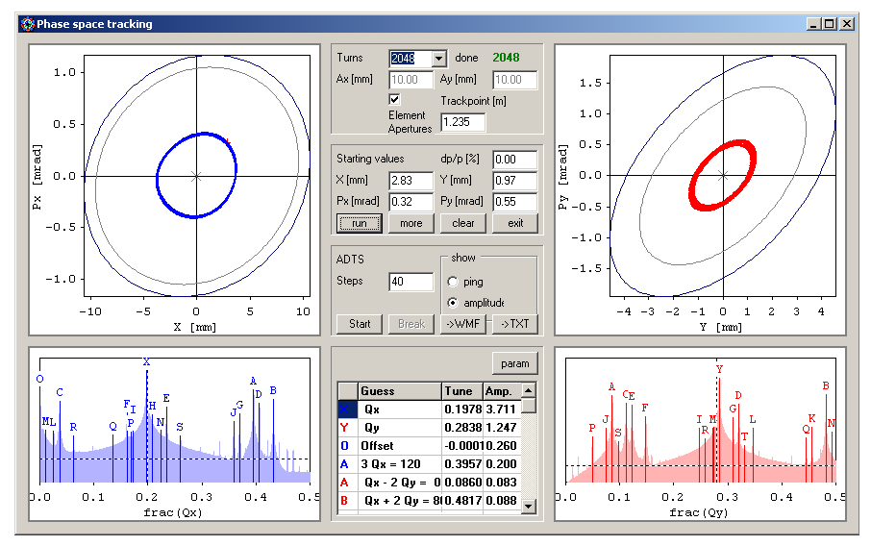
OPA Tracking

Slide 8
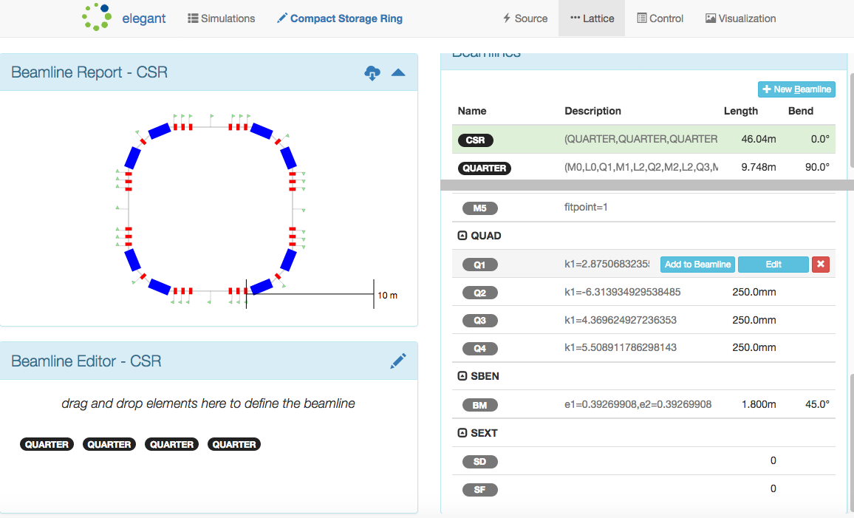
Elegant by Radiabeam https://alpha.sirepo.com/elegant#/simulations

Slide 9
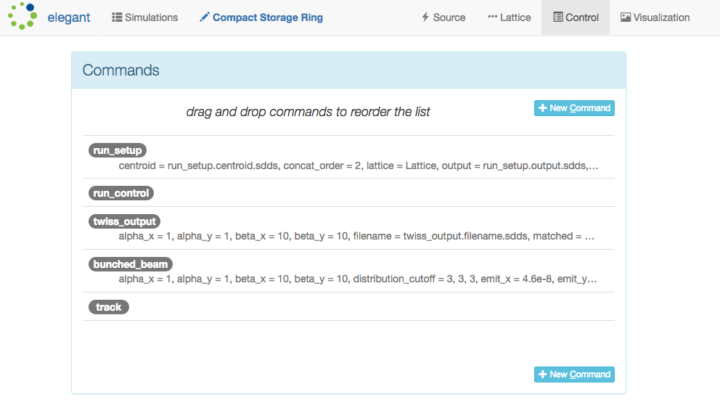
Commands

Slide 10
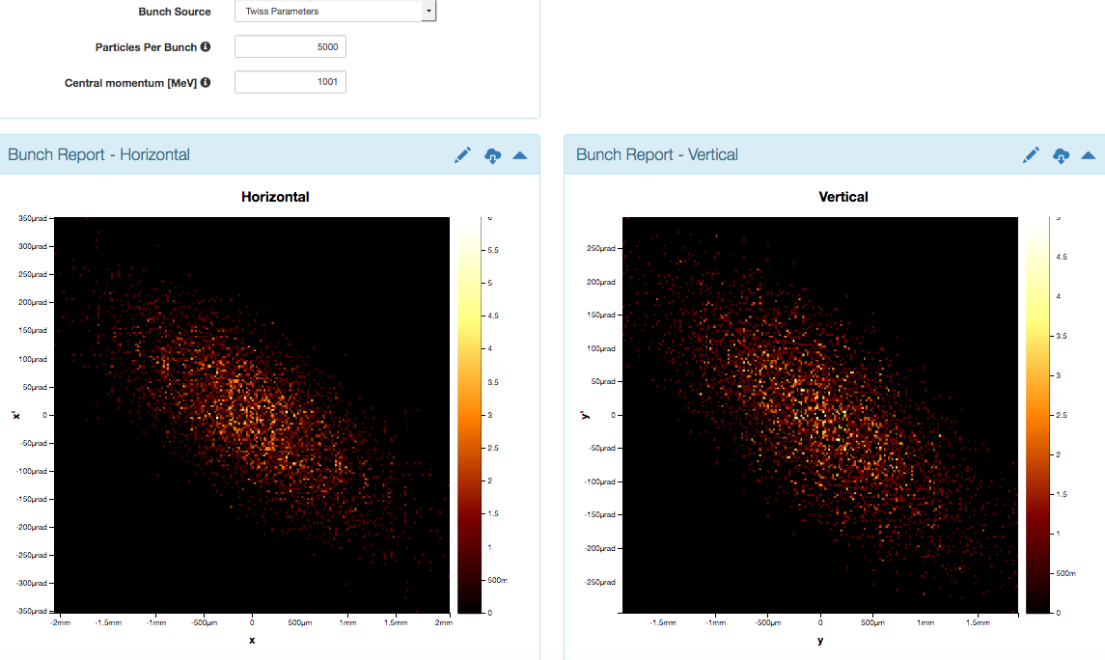
Phase space

Slide 11
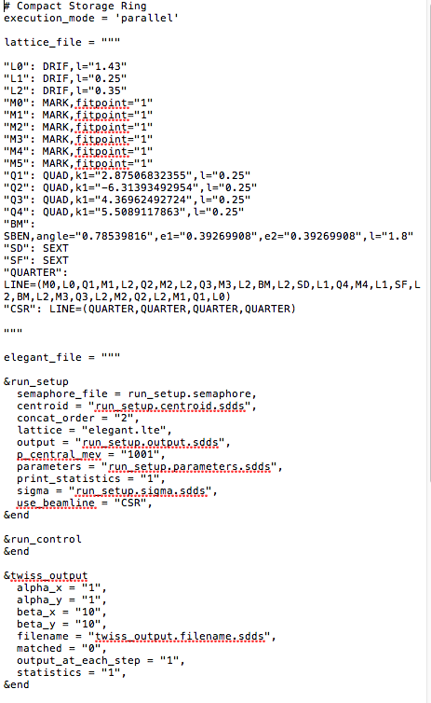
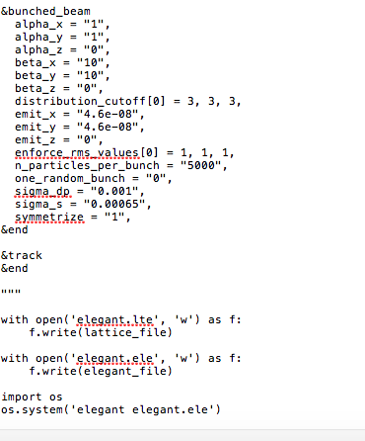
Pyton source

