Slide 1
Study of the nuclear fission process by prompt gamma-ray spectrometry
Michał Rąpała
PHENIICS Fest, Orsay, 30 May 2017

Slide 2
Presentation outline
Motivations
Experimental data
  EXILL experiment
Preliminary results
  Ba – Kr
Conclusions

Slide 3


Motivations

Slide 4
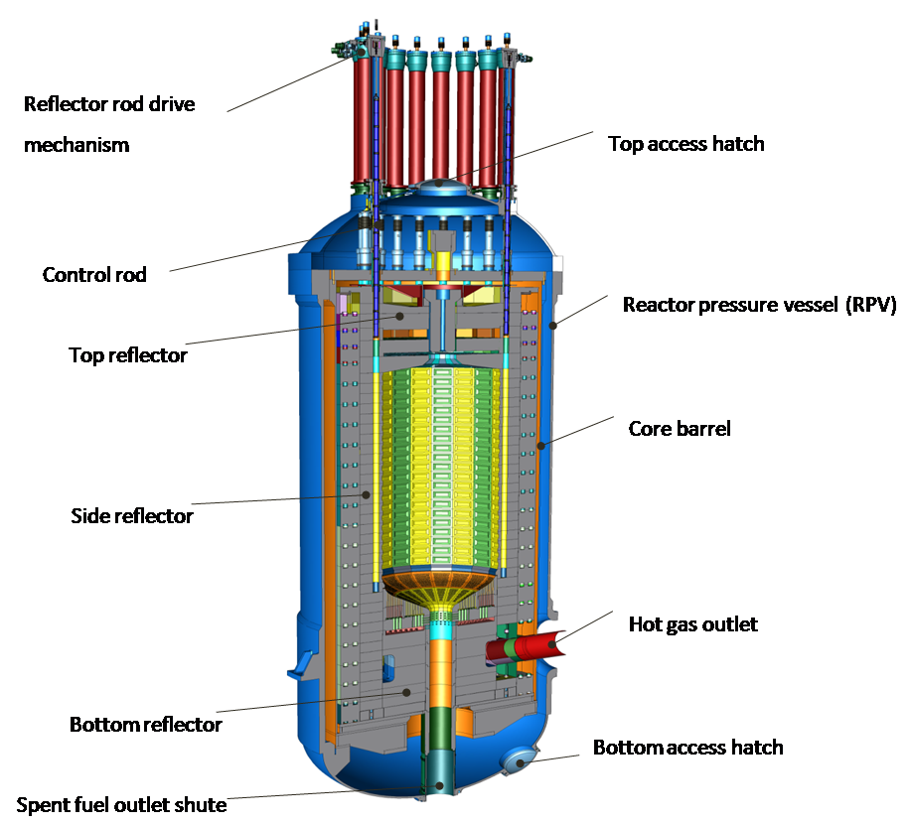
Gamma heating process in a nuclear reactor
Result of gamma-ray energy deposition
HTMR Asia Development Limited,
http://www.htmr-asia.com/en/product.php?id=27 (2014)
Notes:
MTRs are designed to host several irradiation experiments simultaneously in their core and reflector. These experiments help us better understand the complex phenomena occurring during the accelerated aging of materials and the irradiation of nuclear fuels. Gamma heating, i.e. photon-energy deposition, is mainly responsible for temperature rise in non-fuelled zones of nuclear reactors, including MTR internal structures and irradiation devices. As temperature is a key parameter for physical models describing the behavior of material, precise control of temperature, and hence gamma heating, is required in irradiation devices and samples in order to adequately analyze future experimental results. From a broader point of view, MTR global attractivity depends on their ability to monitor experimental parameters with high accuracy, including gamma heating.

Slide 5
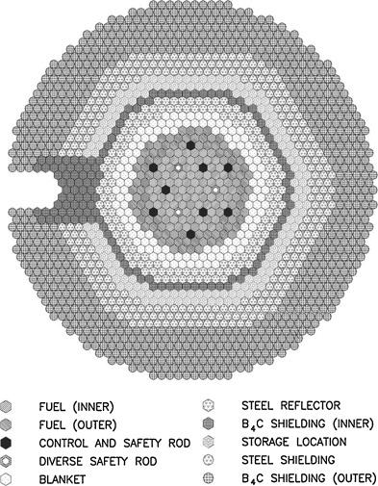
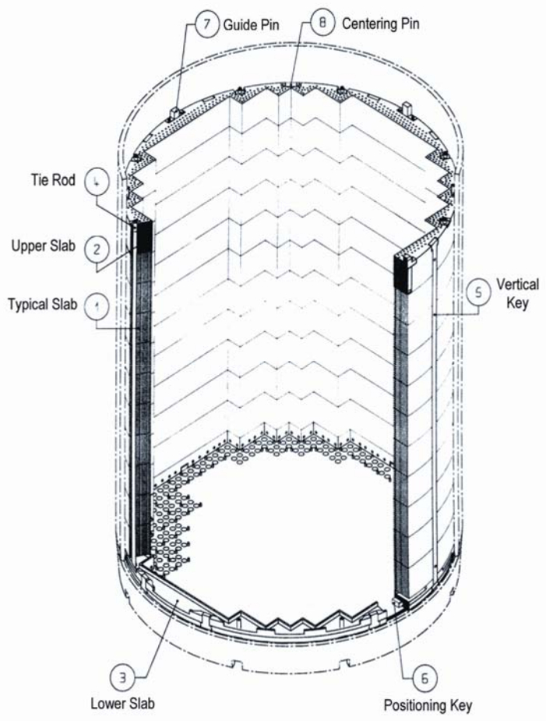
Gamma heating process in a nuclear reactor
Result of gamma-ray energy deposition
HTMR Asia Development Limited,
http://www.htmr-asia.com/en/product.php?id=27 (2014)
Areva , UK-EPR, Fundamental safety overview Vol. 1, Chapter A, Page 63
S. Sen et al., Nuclear Engineering and Design Vol. 293,
Pages 323-329 (2015)

Slide 6
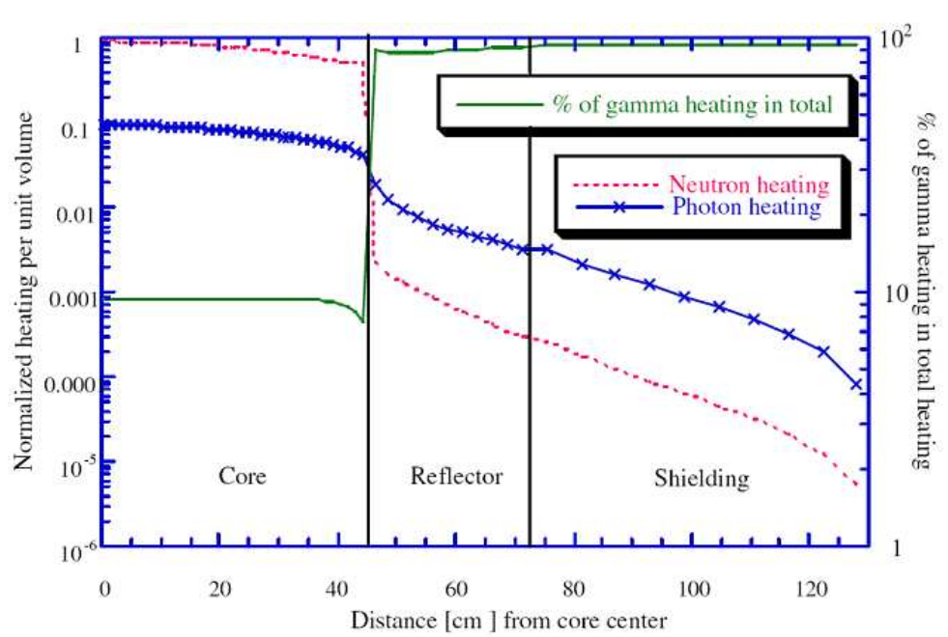
Gamma heating process in a nuclear reactor
Almost 100% of total heating in the reflector
A-C. Colombier et al., EPJ Web of Conferences 42, 04001 (2013)

Slide 7
Context of the study
Generation III+ and IV reactors
More accurate simulation
Higher safety
Gamma heating process
More precise simulation

Slide 8
Context of the study
Generation III+ and IV reactors
More accurate simulation
Higher safety
Gamma heating process
More precise simulation
Fission fragment deexcitation simulation code
Improvement of implemented models
Fission
Prompt gamma-ray cascade

Slide 9
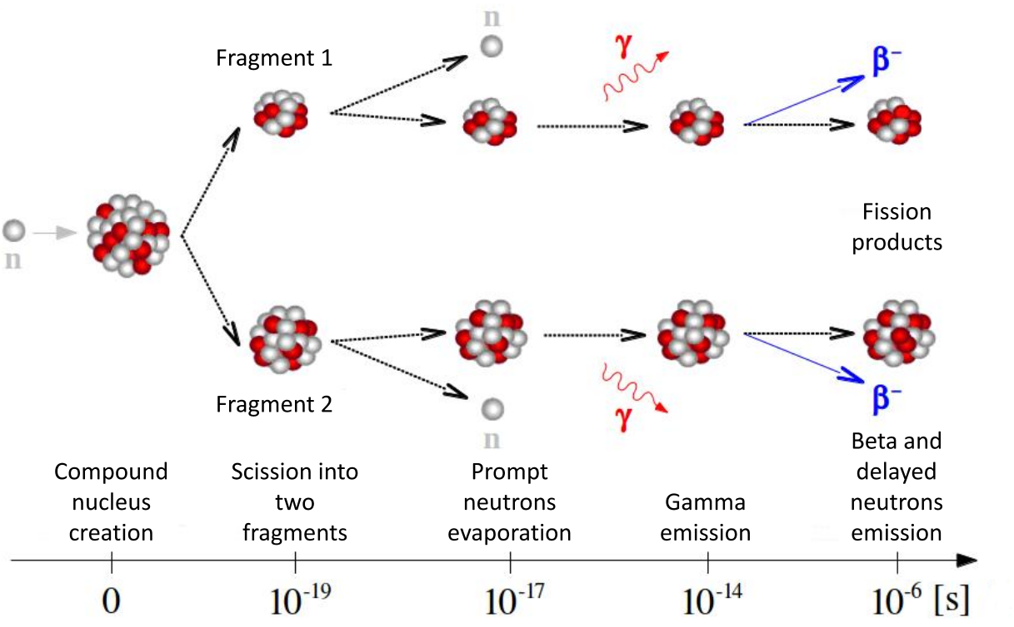
Fission process
What we want to study:
  Fission process
  Prompt gamma-ray cascade in fission fragments
Courtesy of J.F. Lemaître, SPhN, IRFU, DRF, CEA Saclay
Notes:
This session is about fission observables. I made a short list, it is not very long.
Cross-sections, fission yields, kinetic energy of the fragments, neutrons multiplicity and energy distributions
There is one missing observable, that I would like to add this list. It is the cascade of discrete gamma-rays emitted by fission fragments.

Slide 10
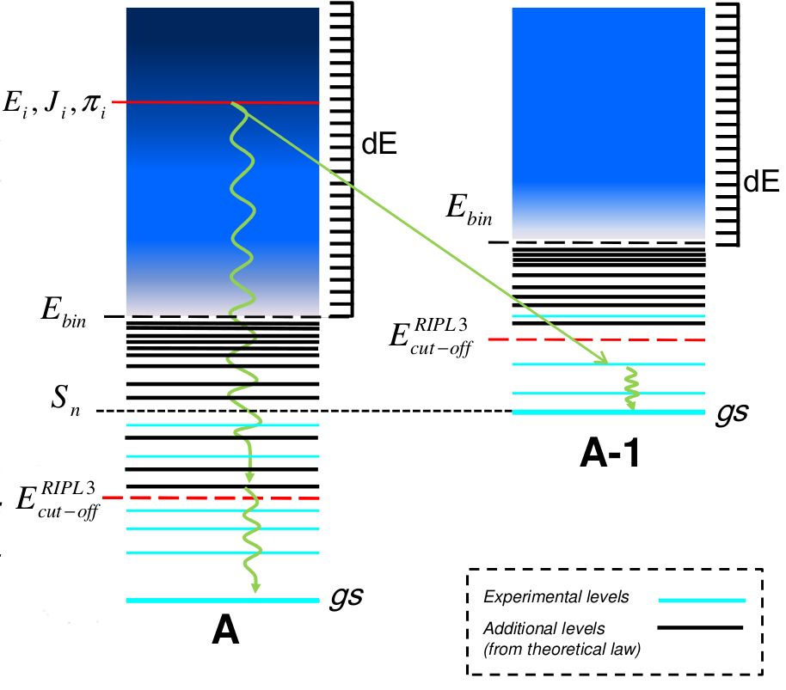
Fission fragment deexcitation
The continuum
The part partially completed from the models
The experimental nuclear levels
O. Litaize et al., ND-2016, Bruges
Notes:
Excitation energy of primary fission fragments 5-20MeV

Slide 11
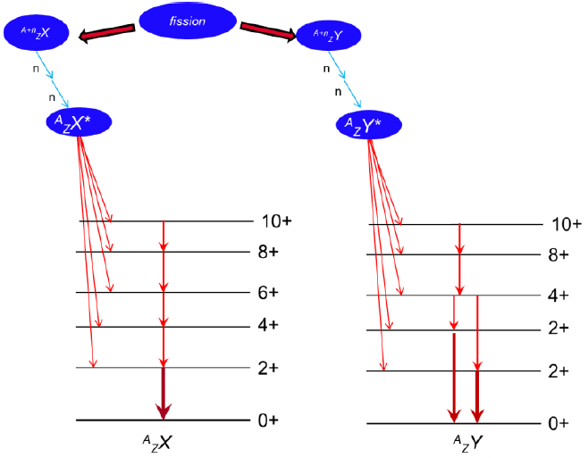
Prompt gamma-ray cascade
Main questions concerning de-excitation process:
What happens after the scission point?
How is the excitation energy shared between the two fragments?
What are the initial spin distributions?
Are they correlated?
What is the process that generates high spin in the fragment?

Slide 12
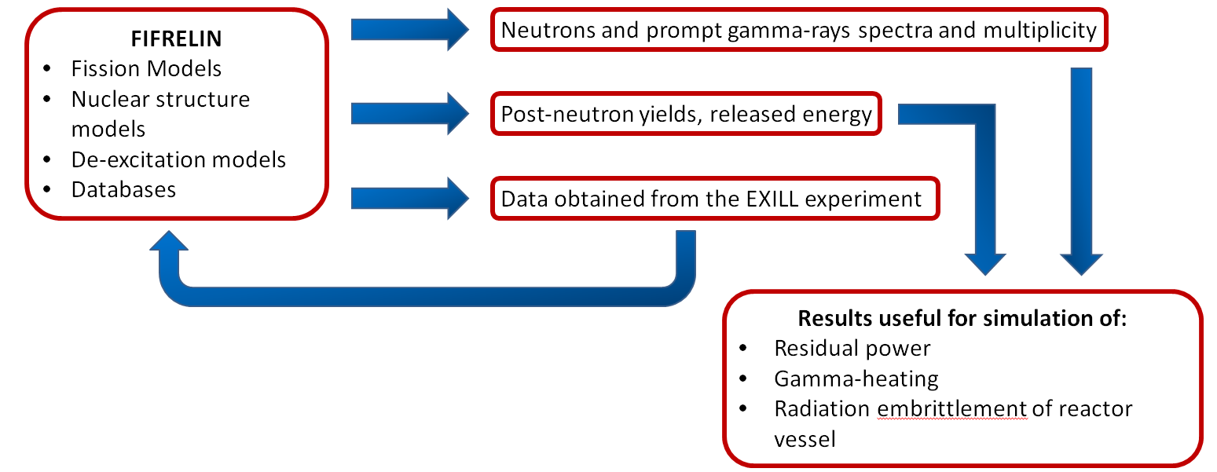
FIFRELIN Monte-Carlo simulation code
Simulates fission fragments de-excitation
Observables
Notes:
The Monte Carlo code FIFRELIN [6] developed at CEA Cadarache simulates the de-excitation of the fission fragments. Output fits already well with integral measurements. First results show a fair agreement when one focuses on a pair of fission fragments. Comparison with the EXILL data will help to improve the models implemented in the FIFRELIN code.
I will say only few words about FIFRELIN. It was already explained this morning by Olivier Serot and there will be a full description by Olivier Litaize tomorrow afternoon
Fifrelin is a Monte Carlo deexcitation code for fission fragments. It is a good mixture of models and database with good choice of fission models, nuclear structure models, deexcitation models. The good point for us is that the FIFRELIN includes and uses discrete level schemes with experimental energies and branching ratios.
Fifrelin produced observables like fission yield and kinetic energy of the fragments, prompt neutron and gamma spectra and multiplicity.
But it can also and of course produce the gamma ray cascade in any fragments.
And I believe that with these data we can better target the models in FIFRELIN

Slide 13
Experimental data

Slide 14
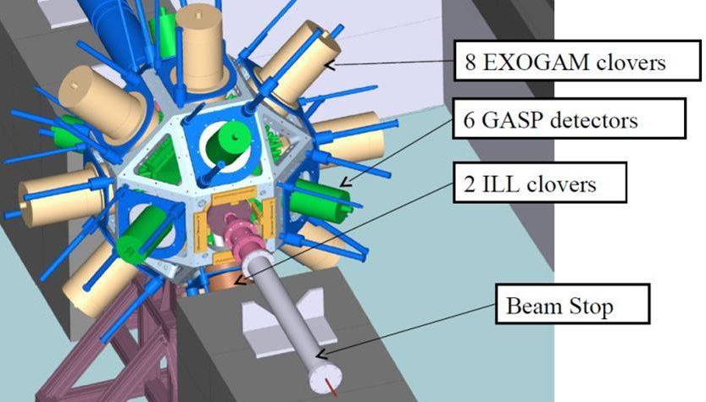
Exogam Experiment at ILL - EXILL
Array of Ge-detectors around a fissile target in a intense cold neutron beam
  15 days with ²³⁵U (575 μg/cm²) + Sn/Zr
  5 days with ²³⁵U (675 μg/cm²) + Be
  15 days with ²⁴¹Pu (300 μg/cm²) + Be
8 EXOGAM clovers + 2 ILL clovers + 6 GASP Ge + BGO shielding
  Without LaBr₃ detectors
Analysis of ²³⁵U data
Notes:
In 2013, as part of a large collaboration including the ILL, GANIL, LPSC, CEA, INFN, the university of Warsaw, of Cologne, we set up and performed a set of experiments at the end of one neutron guide of the ILL. The challenge was to place a large array of germanium detectors around an thin fissile target irradiated by a cold neutron flux. The experiments was called EXILL because the EXOGAM clover detectors were taken from GANIL to the ILL.
We studied 3 targets in this geometry, two thin targets made of U-235 for a total of 20 days and a Pu-241 target for 15 days. With a capture flux of 10^8 n/cm2/s, the rate was about 10^5 fission per sec. There was no particle detector because the fragments were stopped in the target, only germanium detectors with active BGO shielding to reduce Compton background.
Concerning the analysis, there was a rather long preprocessing step, to calibrate all the channels, run after run, and to correct energy and time shifts. From this step, one can build a three-dimensional histogram with the energies of events in triple coincidence ( γγγ cube). This preprocessing step was done in parallel by different institutes and I use the one build by the university of Warsaw.
The main goal of the experiment was not to study fission process. Most of the propositions concerned the nuclear structure of exotic nuclei, far from the valley of stability.

Slide 15
Data Analysis
Analysis software
  Choosing gates
    Selecting fission fragments
  Fitting spectra in triple-γ coincidence
  Calculating relative intensity of the gamma-ray transition and anticipation of the uncertainty propagation
Triple-γ coincidence

Slide 16
Triple-γ coincidence in practice

Slide 17
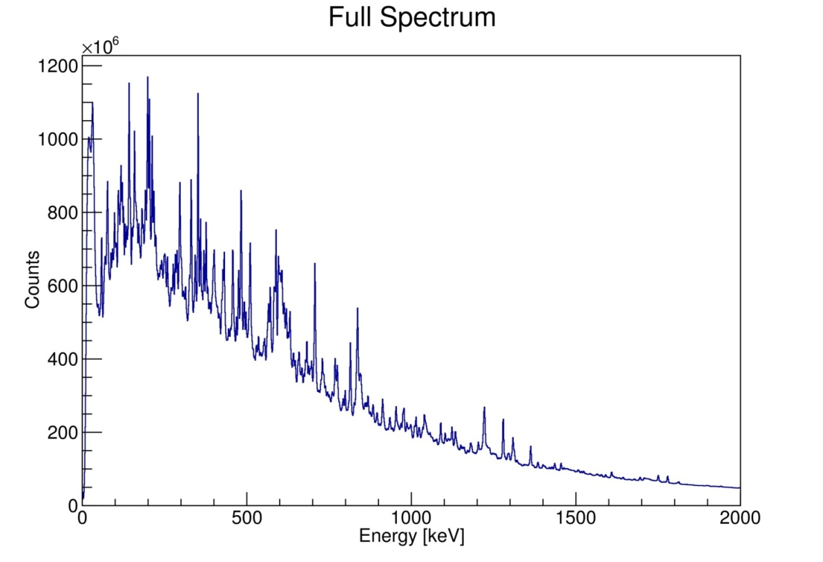
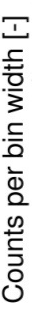
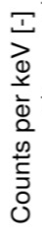
Raw data
Notes:
All other gamma transitions which were measured by the detection system in the exactly same moment

Slide 18
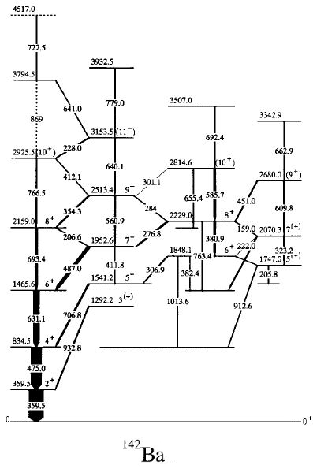
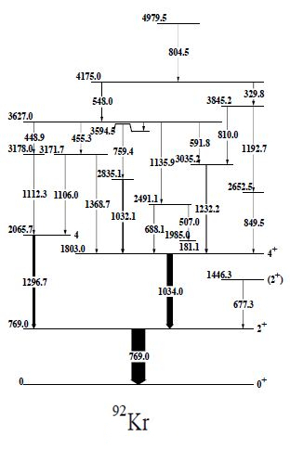
Gates selection
⁹²Kr
¹⁴²Ba
Rząca-Urban et al., Eur. Phys. J. A 9 (2000) 165
Urban et al., Nucl. Phys A 613 (1997) 107

Slide 19
Gates selection
⁹²Kr
¹⁴²Ba
Rząca-Urban et al., Eur. Phys. J. A 9 (2000) 165
Urban et al., Nucl. Phys A 613 (1997) 107

Slide 20

Simple coincidence outcome
Cleaner spectrum
  Still high background and many contaminants
769.0keV
Notes:
All other gamma transitions which were measured by the detection system in the exactly same moment

Slide 21
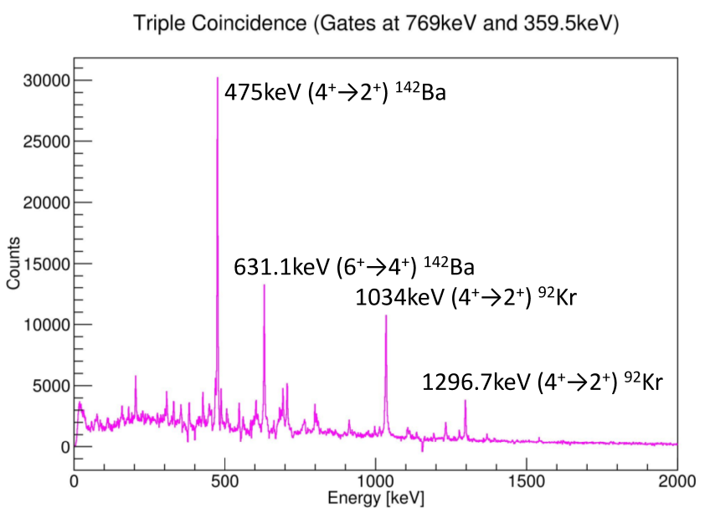
Triple-γ coincidence outcome
Clean spectrum
  Reduced background
  Clearly visible peaks
359.5keV
769.0keV
Notes:
All other gamma transitions which were measured by the detection system in the exactly same moment

Slide 22

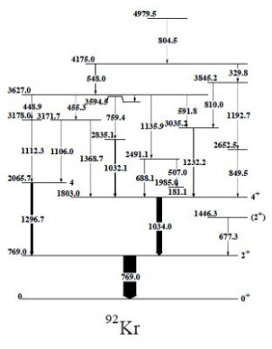
Peak identification
⁹²Kr
¹⁴²Ba
Notes:
All other gamma transitions which were measured by the detection system in the exactly same moment

Slide 23
Preliminary Results

Slide 24
Preliminary Results
Gamma-ray cascade
Gamma-ray cascade in ¹⁴²Ba according to FIFRELIN
T. Materna et al., accepted for publ. In EPJ Web of Conferences (2017)
Notes:
FIFRELIN simulated transition intensities in ¹⁴²Ba
(from ²³⁵U(n_{th},f), as a function of the complementary
fragment ⁸⁹⁻⁹⁴Kr)
The first result I would like to show is 142Ba. This nucleus has a fission yield of 2.8%. According to RIP,L its level scheme is complete up to 1.8 MeV and 38 levels are known, up to 5.2 MeV.
The plot on the right is the cascade simulated by FIFRELIN. In the middle, I put the cascade we measure with EXILL. We did want to measure all the transitions. We only measure the strong one to keep a low uncertainty. Visually, the match is quite good. In fact you should look on the width of the transitions. We choose Ba 142 because this nucleus was also measured in the spontaneous fission of Cm248 with EUROGAM2 at Strasbourg more than 20 years ago.
In good agreement.

Slide 25
Preliminary Results
Gamma-ray cascade
Gamma-ray cascade in ¹⁴²Ba according to FIFRELIN
Gamma-ray cascade in ¹⁴²Ba according to EXILL data
T. Materna et al., accepted for publ. In EPJ Web of Conferences (2017)
T. Materna et al., accepted for publ. In EPJ Web of Conferences (2017)
Notes:
FIFRELIN simulated transition intensities in ¹⁴²Ba
(from ²³⁵U(n_{th},f), as a function of the complementary
fragment ⁸⁹⁻⁹⁴Kr)
The first result I would like to show is 142Ba. This nucleus has a fission yield of 2.8%. According to RIP,L its level scheme is complete up to 1.8 MeV and 38 levels are known, up to 5.2 MeV.
The plot on the right is the cascade simulated by FIFRELIN. In the middle, I put the cascade we measure with EXILL. We did want to measure all the transitions. We only measure the strong one to keep a low uncertainty. Visually, the match is quite good. In fact you should look on the width of the transitions. We choose Ba 142 because this nucleus was also measured in the spontaneous fission of Cm248 with EUROGAM2 at Strasbourg more than 20 years ago.
In good agreement.

Slide 26
Preliminary Results
Gamma-ray cascade
E (keV) | J1→J2 | I_{γ}
 |  | EXILL* | FIFR.** | Ratio(**/* )
359.6 | 2⁺→0⁺ | 100 (3) | 100.0 (1) | 1.00 (3)
475.2 | 4⁺→2⁺ | 80 (2) | 91.4 (2) | 1.14 (3)
631.2 | 6⁺→4⁺ | 42 (2) | 66.3 (1) | 1.58 (8)
693.4 | 8⁺→6⁺ | 12 (1) | 26.0 (1) | 2.2 (2)
766.5 | 10⁺→8⁺ | 2.4 (7) | 3.60 (3) | 1.5 (4)
706.8 | 5⁻→4⁺ | 10 (1) | 10.17 (5) | 1.0 (1)
486.7 | 7⁻→6⁺ | 8 (1) | 15.60 (6) | 1.9 (2)
354.4 | 9⁻→8⁺ | 4.4 (5) | 8.40 (4) | 1.9 (2)
561.1 | 9⁻→7⁻ | 4.0 (5) | 7.52 (4) | 1.9 (2)
640.1 | 11⁻→9⁻ | 2 (1) | 6.22 (3) | 3 (2)
380.9 | 8⁺→6⁺ | 4.0 (6) | 5.06 (3) | 1.3 (2)
585.6 | 10⁺→8⁺ | 4 (1) | 5.66 (3) | 1.4 (4)
Gamma-ray cascade in ¹⁴²Ba according to FIFRELIN
T. Materna et al., accepted for publ. In EPJ Web of Conferences (2017)
Notes:
FIFRELIN simulated transition intensities in ¹⁴²Ba
(from ²³⁵U(n_{th},f), as a function of the complementary
fragment ⁸⁹⁻⁹⁴Kr)
The first result I would like to show is 142Ba. This nucleus has a fission yield of 2.8%. According to RIP,L its level scheme is complete up to 1.8 MeV and 38 levels are known, up to 5.2 MeV.
The plot on the right is the cascade simulated by FIFRELIN. In the middle, I put the cascade we measure with EXILL. We did want to measure all the transitions. We only measure the strong one to keep a low uncertainty. Visually, the match is quite good. In fact you should look on the width of the transitions. We choose Ba 142 because this nucleus was also measured in the spontaneous fission of Cm248 with EUROGAM2 at Strasbourg more than 20 years ago.
In good agreement.

Slide 27
Preliminary Results
Gamma-ray cascade
  Good agreement for low spin transitions
  High spin transitions overestimated by FIFRELIN code
E (keV) | J1→J2 | I_{γ}
 |  | EXILL* | FIFR.** | Ratio(**/* )
359.6 | 2⁺→0⁺ | 100 (3) | 100.0 (1) | 1.00 (3)
475.2 | 4⁺→2⁺ | 80 (2) | 91.4 (2) | 1.14 (3)
631.2 | 6⁺→4⁺ | 42 (2) | 66.3 (1) | 1.58 (8)
693.4 | 8⁺→6⁺ | 12 (1) | 26.0 (1) | 2.2 (2)
766.5 | 10⁺→8⁺ | 2.4 (7) | 3.60 (3) | 1.5 (4)
706.8 | 5⁻→4⁺ | 10 (1) | 10.17 (5) | 1.0 (1)
486.7 | 7⁻→6⁺ | 8 (1) | 15.60 (6) | 1.9 (2)
354.4 | 9⁻→8⁺ | 4.4 (5) | 8.40 (4) | 1.9 (2)
561.1 | 9⁻→7⁻ | 4.0 (5) | 7.52 (4) | 1.9 (2)
640.1 | 11⁻→9⁻ | 2 (1) | 6.22 (3) | 3 (2)
380.9 | 8⁺→6⁺ | 4.0 (6) | 5.06 (3) | 1.3 (2)
585.6 | 10⁺→8⁺ | 4 (1) | 5.66 (3) | 1.4 (4)
Notes:
FIFRELIN simulated transition intensities in ¹⁴²Ba
(from ²³⁵U(n_{th},f), as a function of the complementary
fragment ⁸⁹⁻⁹⁴Kr)
The first result I would like to show is 142Ba. This nucleus has a fission yield of 2.8%. According to RIP,L its level scheme is complete up to 1.8 MeV and 38 levels are known, up to 5.2 MeV.
The plot on the right is the cascade simulated by FIFRELIN. In the middle, I put the cascade we measure with EXILL. We did want to measure all the transitions. We only measure the strong one to keep a low uncertainty. Visually, the match is quite good. In fact you should look on the width of the transitions. We choose Ba 142 because this nucleus was also measured in the spontaneous fission of Cm248 with EUROGAM2 at Strasbourg more than 20 years ago.
In good agreement.

Slide 28
Preliminary Results
Gamma-ray cascade
  Good agreement for low spin transitions
  High spin transitions overestimated by FIFRELIN code
  Probably wrong estimation of a mean value of the fission fragment spin distribution
E (keV) | J1→J2 | I_{γ}
 |  | EXILL* | FIFR.** | Ratio(**/* )
359.6 | 2⁺→0⁺ | 100 (3) | 100.0 (1) | 1.00 (3)
475.2 | 4⁺→2⁺ | 80 (2) | 91.4 (2) | 1.14 (3)
631.2 | 6⁺→4⁺ | 42 (2) | 66.3 (1) | 1.58 (8)
693.4 | 8⁺→6⁺ | 12 (1) | 26.0 (1) | 2.2 (2)
766.5 | 10⁺→8⁺ | 2.4 (7) | 3.60 (3) | 1.5 (4)
706.8 | 5⁻→4⁺ | 10 (1) | 10.17 (5) | 1.0 (1)
486.7 | 7⁻→6⁺ | 8 (1) | 15.60 (6) | 1.9 (2)
354.4 | 9⁻→8⁺ | 4.4 (5) | 8.40 (4) | 1.9 (2)
561.1 | 9⁻→7⁻ | 4.0 (5) | 7.52 (4) | 1.9 (2)
640.1 | 11⁻→9⁻ | 2 (1) | 6.22 (3) | 3 (2)
380.9 | 8⁺→6⁺ | 4.0 (6) | 5.06 (3) | 1.3 (2)
585.6 | 10⁺→8⁺ | 4 (1) | 5.66 (3) | 1.4 (4)
Notes:
FIFRELIN simulated transition intensities in ¹⁴²Ba
(from ²³⁵U(n_{th},f), as a function of the complementary
fragment ⁸⁹⁻⁹⁴Kr)
The first result I would like to show is 142Ba. This nucleus has a fission yield of 2.8%. According to RIP,L its level scheme is complete up to 1.8 MeV and 38 levels are known, up to 5.2 MeV.
The plot on the right is the cascade simulated by FIFRELIN. In the middle, I put the cascade we measure with EXILL. We did want to measure all the transitions. We only measure the strong one to keep a low uncertainty. Visually, the match is quite good. In fact you should look on the width of the transitions. We choose Ba 142 because this nucleus was also measured in the spontaneous fission of Cm248 with EUROGAM2 at Strasbourg more than 20 years ago.
In good agreement.

Slide 29
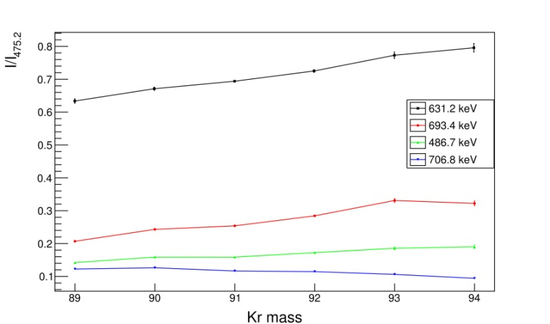
Preliminary Results
Dependence on a complementary fragment (neutron evaporation)
6₁⁺ → 4⁺
8₁⁺ → 6₁⁺
7⁻ → 6₁⁺
5⁻ → 4⁺
FIFRELIN simulated transition intensities in ¹⁴²Ba

Slide 30
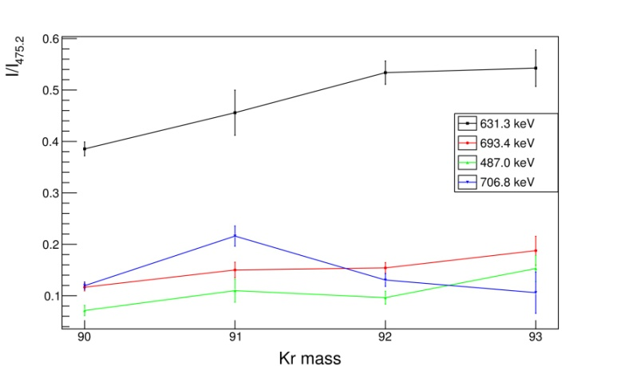
Preliminary Results
Dependence on a complementary fragment (neutron evaporation)
6₁⁺ → 4⁺
6₁⁺ → 4⁺
8₁⁺ → 6₁⁺
5⁻ → 4⁺
8₁⁺ → 6₁⁺
7⁻ → 6₁⁺
5⁻ → 4⁺
7⁻ → 6₁⁺
FIFRELIN simulated transition intensities in ¹⁴²Ba
EXILL data transition intensities in ¹⁴²Ba

Slide 31
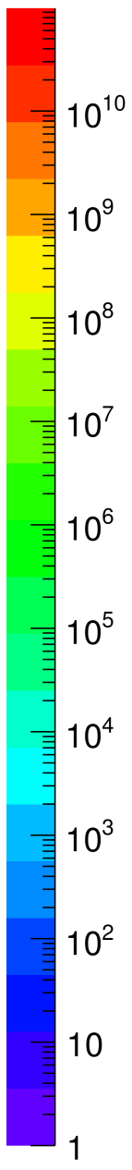
Preliminary Results
4 neutrons
In FIFRELIN initial spin is constant
3 neutrons
E_{ex}
[MeV]
2 neutrons
1 neutron
0 neutrons
J [ħ]
Notes:
Initial spin 10.5 light, 12 heavy

Slide 32
Preliminary Results
4 neutrons
In FIFRELIN initial spin is constant
Neutron evaporation follows the mean value of the level density distribution
3 neutrons
E_{ex}
[MeV]
2 neutrons
1 neutron
0 neutrons
J [ħ]
Notes:
Initial spin 10.5 light, 12 heavy

Slide 33
Preliminary Results
4 neutrons
In FIFRELIN initial spin is constant
Neutron evaporation follows the mean value of the level density distribution
With more evaporated neutrons less high spin transitions are produced
3 neutrons
E_{ex}
[MeV]
2 neutrons
1 neutron
0 neutrons
J [ħ]
Notes:
Initial spin 10.5 light, 12 heavy

Slide 34
Conclusions

Slide 35
Conclusions
Systematic study of the prompt gamma-ray cascades of the fission fragments
  Triple-γ coincidence technique
  Analysis made on a few (the most abundant) fission fragment pairs
  Results will help to improve simulations of gamma heating in nuclear reactors
Benchmarking the MC simulation code FIFRELIN
  Comparison to FIFRELIN simulation results
  Some effects need further investigation

Slide 36
Collaboration
T. Materna¹, A. Letourneau¹, A. Marchix¹, O. Litaize², O. Sérot², D. Regnier², W. Urban³, A. Blanc⁴, M. Jentschel⁴, U. Köster⁴, P. Mutti⁴, T. Soldner⁴, G. Simpson⁵, Călin A. Ur⁶, and G. de France⁷
¹ Irfu, Université Paris-Saclay, Gif-sur-Yvette, France
² CEA, DEN, DER, Cadarache, Saint-Paul-lez-Durance, France
³ Faculty of Physics, University of Warsaw, Warsaw, Poland
⁴ Institut Laue-Langevin, Grenoble, France
⁵ LPSC, CNRS/IN2P3, Grenoble, France
⁶ INFN, Legnaro, Italy
⁷ GANIL, Caen, France

Slide 38
PhD aims
CEA Saclay
  Data analysis technique development
  Data analysis
  Gathering information about gamma-ray cascade
  Comparing experimental data with simulation results
CEA Cadarache
  Comparing experimental data with simulation results
  Testing different parameter setups
  Improving simulation code

Slide 39
Fitting problems
Too high uncertainty
  Too high statistical error
Peak shape too complicated
  Problems with detectors energy resolution and tails
  Our peak looks like triple Gaussian + Compton
  Additional peaks needed to reproduce the correct shape
    Wrong volume of the peaks
  Contaminants included in the gates
Notes:
Systematic error

Slide 40
Detection system calibration
Europium source data used for calibration
¹⁵²Eu ¹⁵²Gd or ¹⁵²Sm
Three types of detectors with different performance
Notes:
Efficiency was calculated with add-back, so EXOGAM clover efficiency is equal to 160%, Lohengrin to 88%
Various properties of different detector groups
Coincidence efficiency calculation
Complicated equation
Problem with error calculation
Complications during further analysis

Slide 41
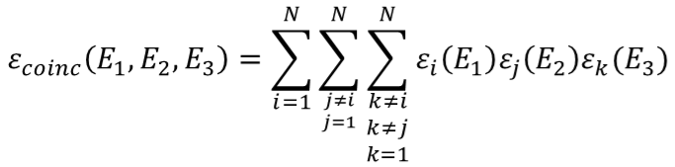
Detection system calibration
Europium source data used for calibration
¹⁵²Eu ¹⁵²Gd or ¹⁵²Sm
Three types of detectors with different performance
Total coincidence efficiency formula simplification
Notes:
Efficiency was calculated with add-back, so EXOGAM clover efficiency is equal to 160%, Lohengrin to 88%
Various properties of different detector groups
Coincidence efficiency calculation
Complicated equation
Problem with error calculation
Complications during further analysis

Slide 42

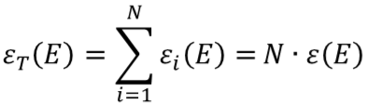
Detection system calibration
Europium source data used for calibration
¹⁵²Eu ¹⁵²Gd or ¹⁵²Sm
Three types of detectors with different performance
Total coincidence efficiency formula simplification
Notes:
Efficiency was calculated with add-back, so EXOGAM clover efficiency is equal to 160%, Lohengrin to 88%
Various properties of different detector groups
Coincidence efficiency calculation
Complicated equation
Problem with error calculation
Complications during further analysis

Slide 43
Detection system calibration
Europium source data used for calibration
¹⁵²Eu ¹⁵²Gd or ¹⁵²Sm
Three types of detectors with different performance
Total coincidence efficiency formula simplification
  Difference lower than 2% in range between 100keV to 1.5MeV
Notes:
Efficiency was calculated with add-back, so EXOGAM clover efficiency is equal to 160%, Lohengrin to 88%
Various properties of different detector groups
Coincidence efficiency calculation
Complicated equation
Problem with error calculation
Complications during further analysis

Slide 44
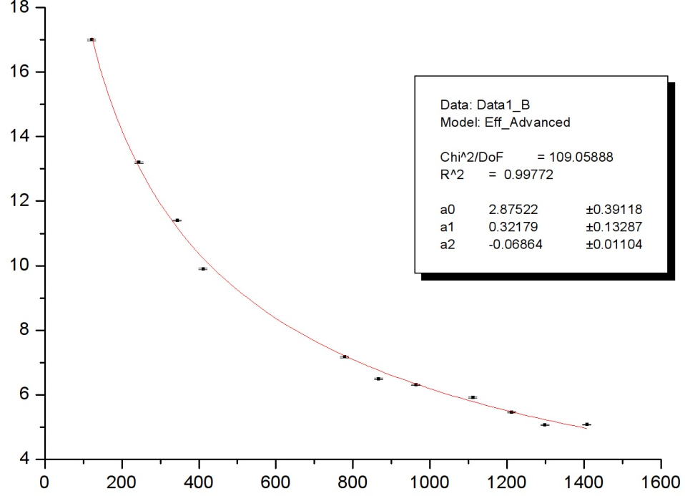
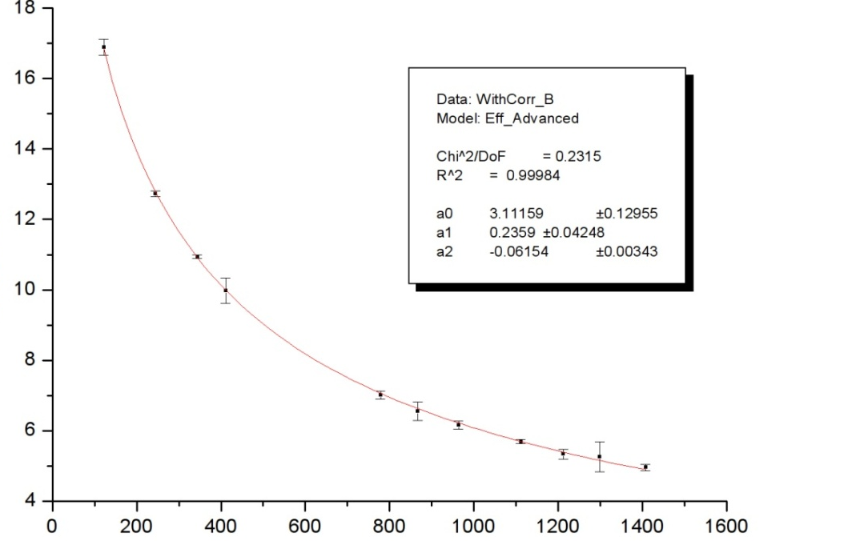
Detection system calibration
Europium source data used for calibration
¹⁵²Eu ¹⁵²Gd or ¹⁵²Sm
Three types of detectors with different performance
Total coincidence efficiency formula simplification
Correction of true coincidence effect
Efficiency [%]
Efficiency [%]
Energy [keV]
Energy [keV]
Notes:
Efficiency was calculated with add-back, so EXOGAM clover efficiency is equal to 160%, Lohengrin to 88%
Various properties of different detector groups
Coincidence efficiency calculation
Complicated equation
Problem with error calculation
Complications during further analysis

Slide 45
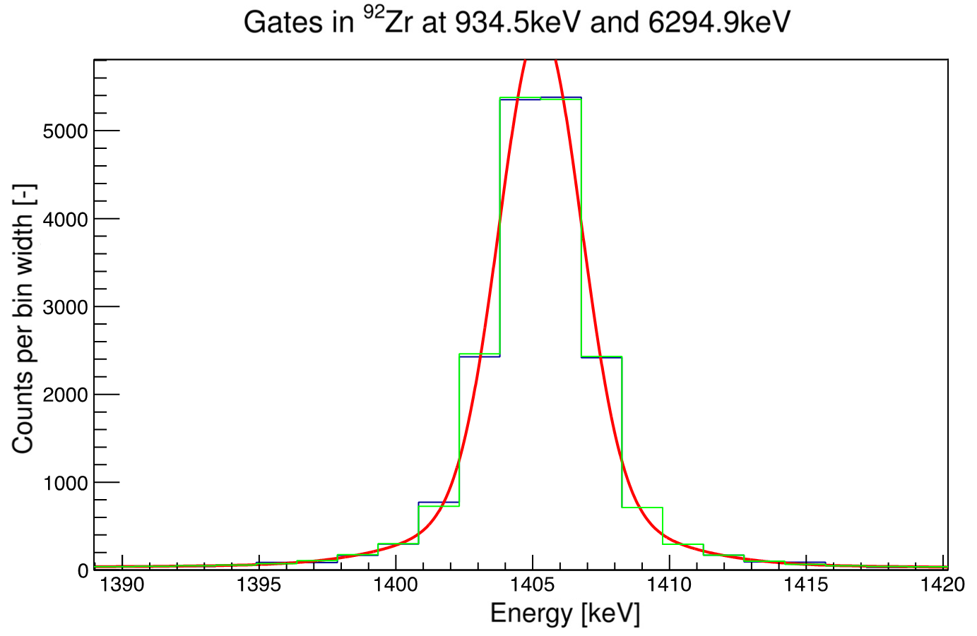
EXILL resolution
⁹¹Zr(n,γ)
  ⁹²Zr peak at 1405 keV
  FWHM equal to 3.7 keV
  Chi²/NDF equal to 1.7
Notes:
Resolution >3.5keV at 1.3 MeV – not very good (two times larger peaks than expected)
Anti-Compton – not good

Slide 46
Spectra fitting problems
Peak shape
  Not a simple Gaussian
Gating with subtracted background
  Choosing correct background
Peak/Background ratio
  Gates width
Contaminants in the gates
  Gates width
Notes:
Systematic error

Slide 47
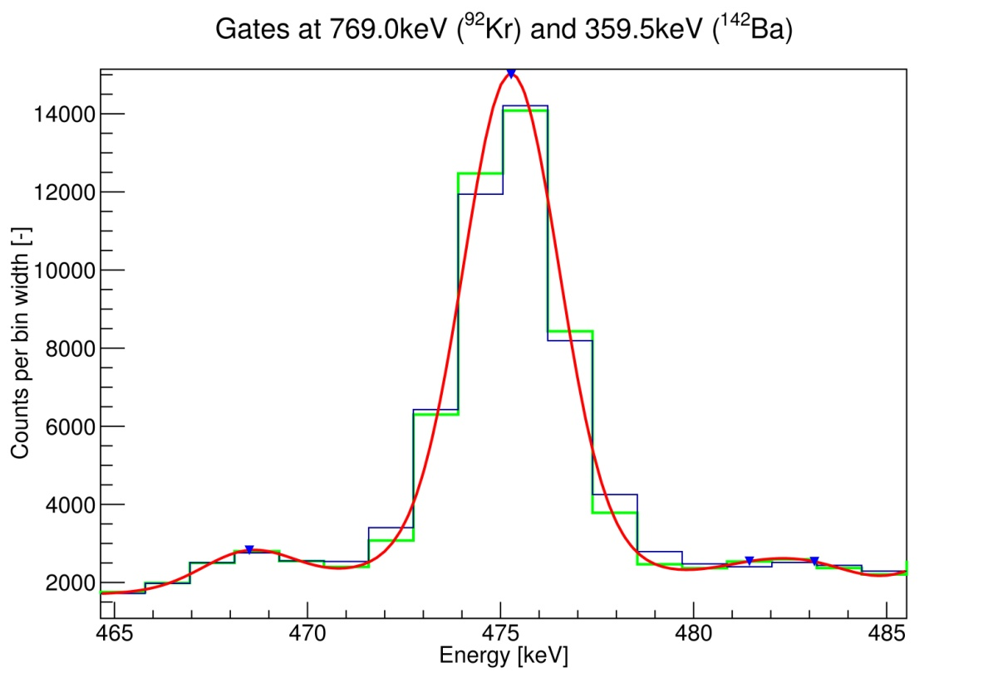
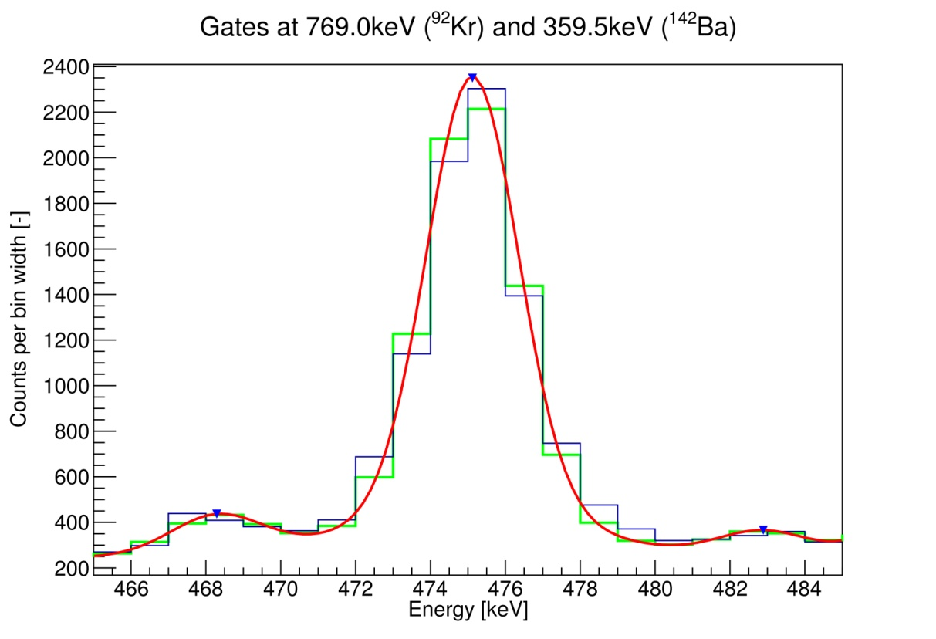
Spectra fitting problems - peak/background
Better value of the peak/background ratio
2 bins gate width
1 bin gate width
Notes:
Background 10 times lower
Peak 6 times lower

Slide 48
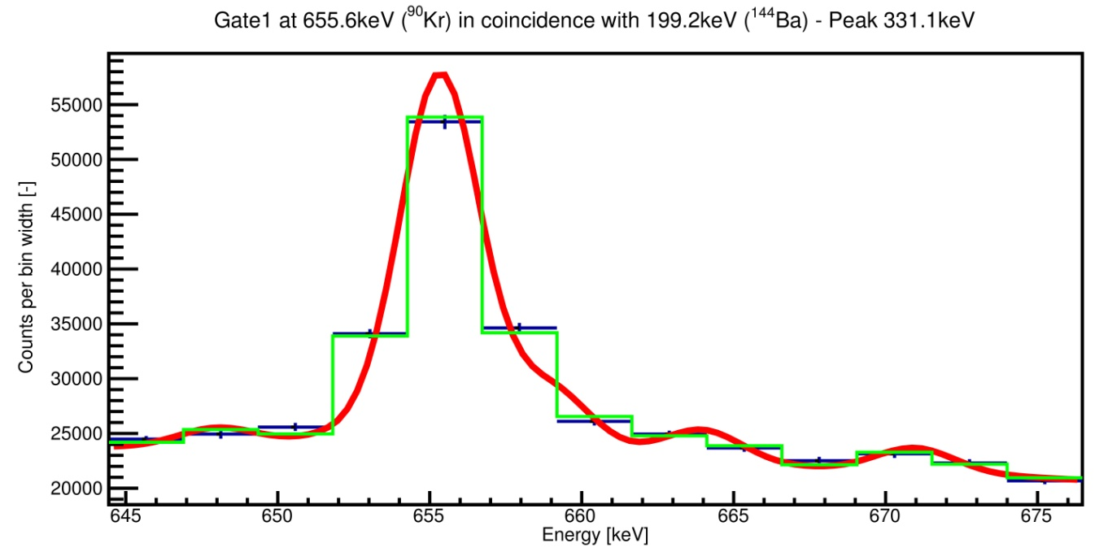
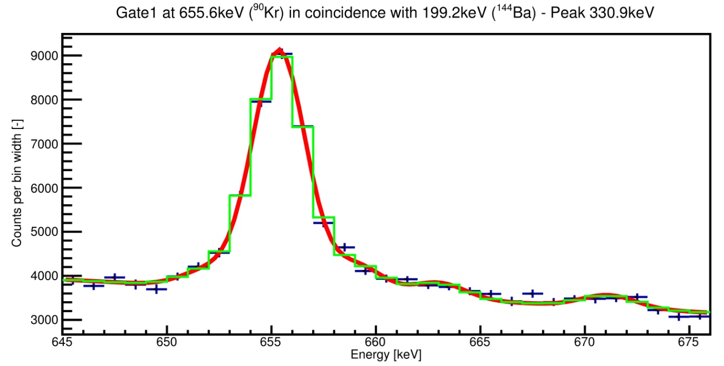
Spectra fitting problems - contamination
Better visibility of contaminants
More precise contamination positioning
More precise results
Lower uncertainty
2 bins gate width
1 bin gate width
Notes:
Background 10 times lower
Peak 6 times lower
Loose 4 times in

Slide 49
Preliminary Results
  Effect caused by dependence between excitation energy and level density
Dependence on a complementary fragment (neutron evaporation)
6₁⁺ → 4⁺
8₁⁺ → 6₁⁺
7⁻ → 6₁⁺
5⁻ → 4⁺
FIFRELIN simulated transition intensities in ¹⁴²Ba

Slide 50
Preliminary Results
  Effect caused by dependence between excitation energy and level density
  More evaporated neutrons
  Lower excitation energy of the fission fragments after neutron evaporation
  Lower probability of high-spin transition production
Dependence on a complementary fragment (neutron evaporation)
6₁⁺ → 4⁺
8₁⁺ → 6₁⁺
7⁻ → 6₁⁺
5⁻ → 4⁺
FIFRELIN simulated transition intensities in ¹⁴²Ba

Slide 51
gates selection
⁹²Kr

Slide 52
gates selection
⁹²Kr

Slide 53
Triple-γ coincidence outcome
359.5keV
769.0keV
Notes:
All other gamma transitions which were measured by the detection system in the exactly same moment

Slide 54
Triple-γ coincidence outcome
Clean spectrum
  Reduced background
  Clearly visible peaks
Notes:
All other gamma transitions which were measured by the detection system in the exactly same moment

Slide 55
Triple-γ coincidence
Three-dimensional histogram → γγγ-cube
Fixed time window
Transitions coming within the time window limit are considered to be in coincidence
Notes:
Concerning the analysis, there was a rather long preprocessing step, to calibrate all the channels, run after run, and to correct energy and time shifts. From this step, one can build a three-dimensional histogram with the energies of events in triple coincidence ( γγγ cube).
Channel = crystal

Slide 56
Analysis scheme
Selection of fission fragments
Gating (with back ground subtraction)
Identification of peaks

Slide 57
Analysis scheme
Selection of fission fragments
Gating (with back ground subtraction)
Identification of peaks
Fitting of the peaks
  Fitting with simple Gaussian
  Fit integration
Calculation of normalized intensities of the peaks
  Normalized to the most intense transition of the particular fission fragment
Comparison to other experimental data and FIFRELIN simulation results

Slide 58
Context of the thesis
Generation III+ and IV reactors
More accurate simulation
Higher safety
Gamma heating process
More precise simulation
CEA, DPhN, IRFU, Saclay
Fission fragment deexcitation simulation code
Improvement of implemented models
Fission
Prompt gamma-ray cascade

Slide 59
Context of the thesis
Generation III+ and IV reactors
More accurate simulation
Higher safety
CEA, DEN, DER, Cadarache
Gamma heating process
More precise simulation
CEA, DPhN, IRFU, Saclay
Fission fragment deexcitation simulation code
Improvement of implemented models
Fission
Prompt gamma-ray cascade

Slide 60
FIFRELIN Monte-Carlo simulation code
Simulates fission fragments de-excitation
Observables
Data obtained from the EXILL experiment
Notes:
The Monte Carlo code FIFRELIN [6] developed at CEA Cadarache simulates the de-excitation of the fission fragments. Output fits already well with integral measurements. First results show a fair agreement when one focuses on a pair of fission fragments. Comparison with the EXILL data will help to improve the models implemented in the FIFRELIN code.
I will say only few words about FIFRELIN. It was already explained this morning by Olivier Serot and there will be a full description by Olivier Litaize tomorrow afternoon
Fifrelin is a Monte Carlo deexcitation code for fission fragments. It is a good mixture of models and database with good choice of fission models, nuclear structure models, deexcitation models. The good point for us is that the FIFRELIN includes and uses discrete level schemes with experimental energies and branching ratios.
Fifrelin produced observables like fission yield and kinetic energy of the fragments, prompt neutron and gamma spectra and multiplicity.
But it can also and of course produce the gamma ray cascade in any fragments.
And I believe that with these data we can better target the models in FIFRELIN

Slide 61
Problems with analysis and solutions

Slide 62
Spectra fitting problems
Peak shape
  Not a simple Gaussian
Notes:
Systematic error

Slide 63
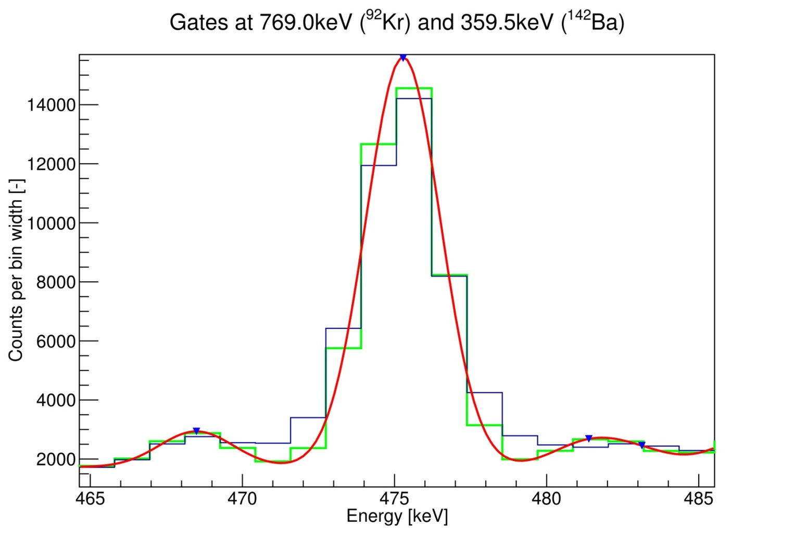
Spectra fitting problems - peak shape
Simple Gaussian
fit function
fit function
integrated over
the bin
data

Slide 64
Spectra fitting problems - peak shape
Simple Gaussian
Bad resolution
  Sum of all detectors
  Sum of all runs
  Compton – tails
fit function
fit function
integrated over
the bin
data

Slide 65
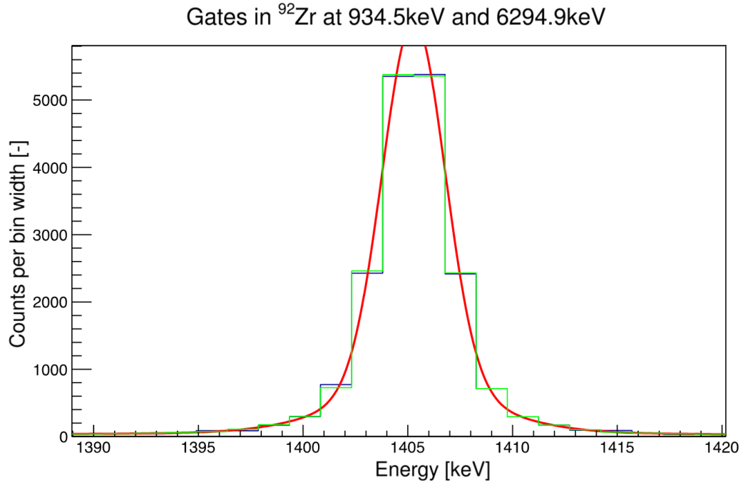


EXILL resolution
⁹¹Zr(n,γ), ⁹²Zr(n,γ)
  Adjusted on ⁹²Zr and ⁹³Zr clean peaks
Fit function
  Sum of 3 Gaussians
    Same center
  Compton – tails
Notes:
Bad resolution
Addback
Sum of all detectors
Sum of all runs
tails

Slide 66
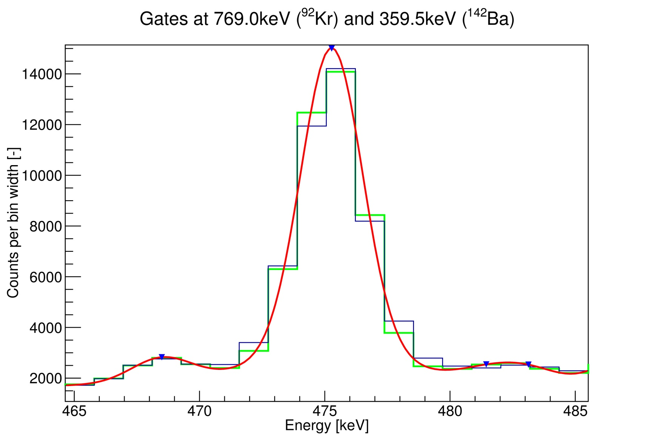
Spectra fitting problems - peak shape
Triple Gaussian + Compton tails

Slide 67
Spectra fitting problems
Peak shape
  Not a simple Gaussian
Gating with subtracted background
  Choosing correct background
Notes:
Systematic error

Slide 68
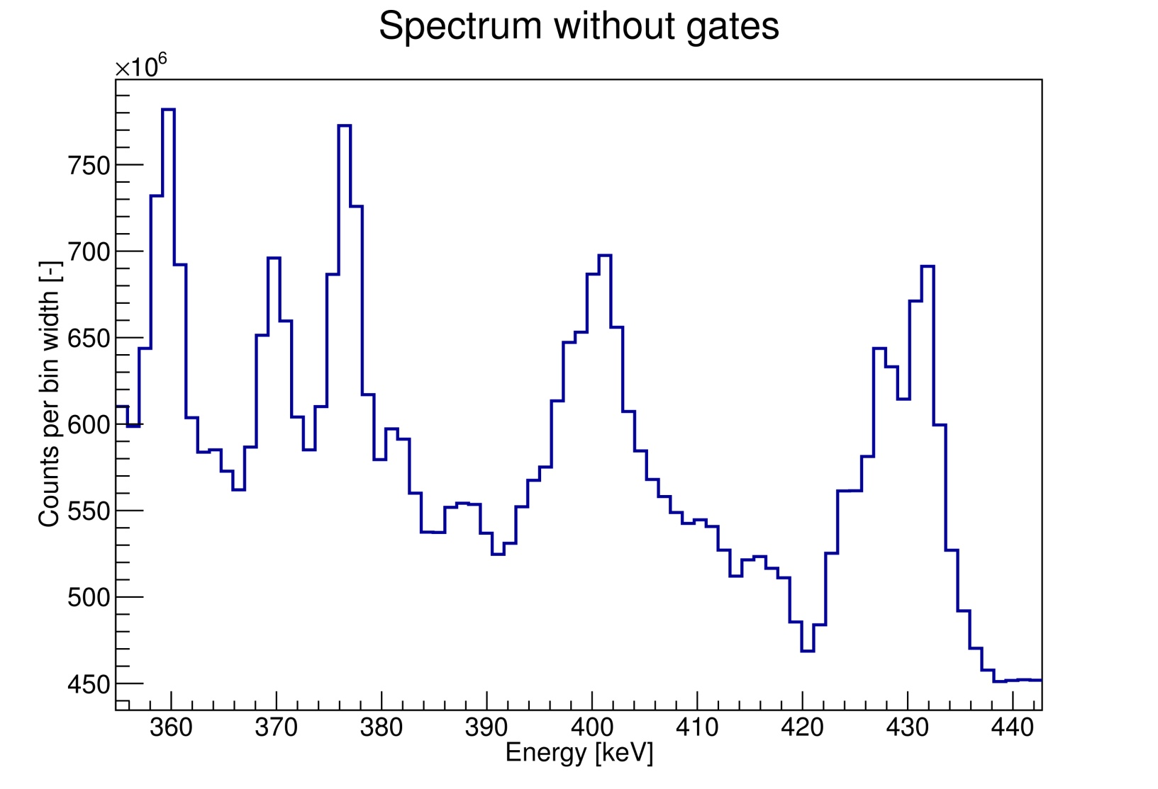
Spectra fitting problems - background
Gating with subtracted background
  Gate background close to the peak
401.6keV
Gate 1
Background
Notes:
Systematic error

Slide 69
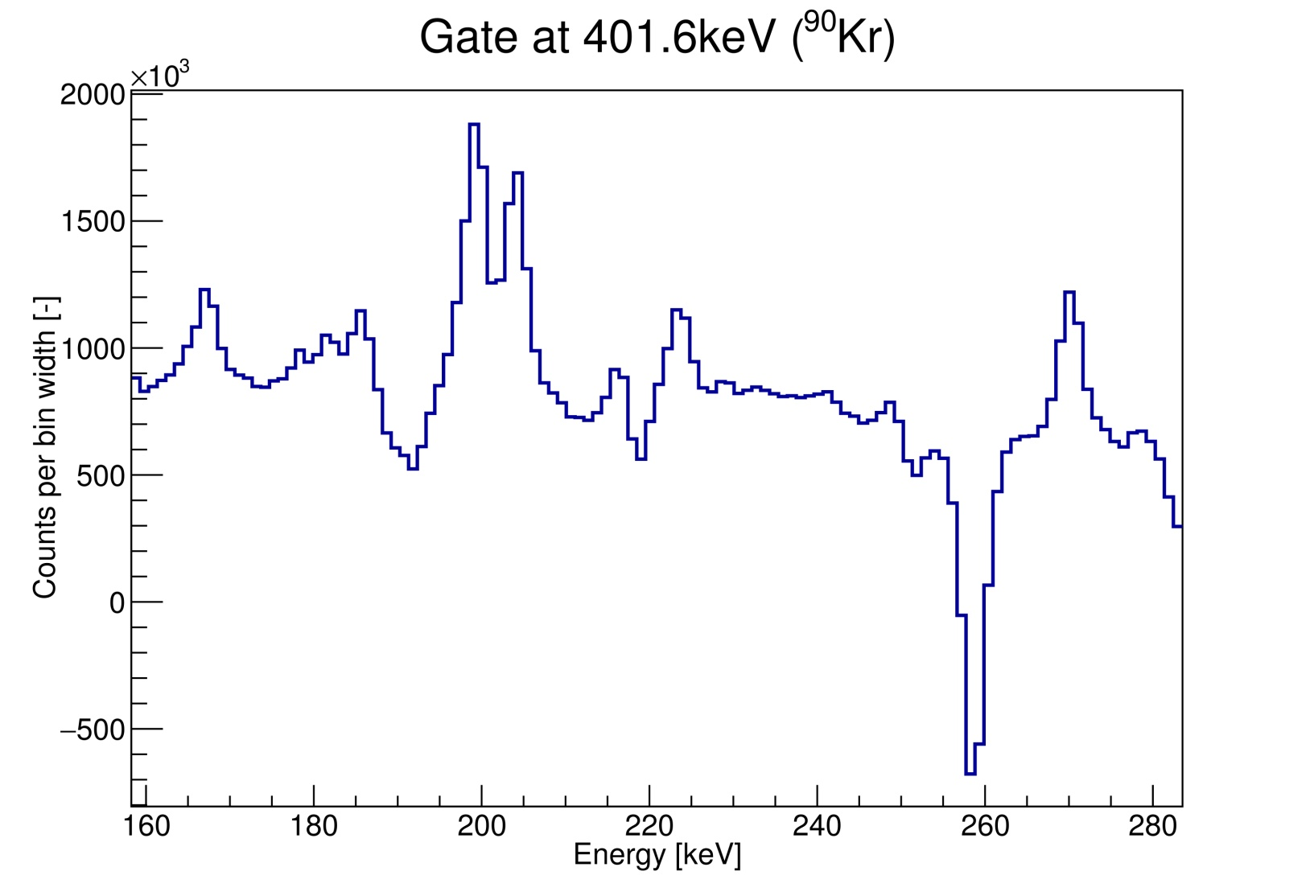
Spectra fitting problems - background
Gating with subtracted background
  Gate background close to the peak
199.2keV
Gate 2
Background
Notes:
Systematic error

Slide 70
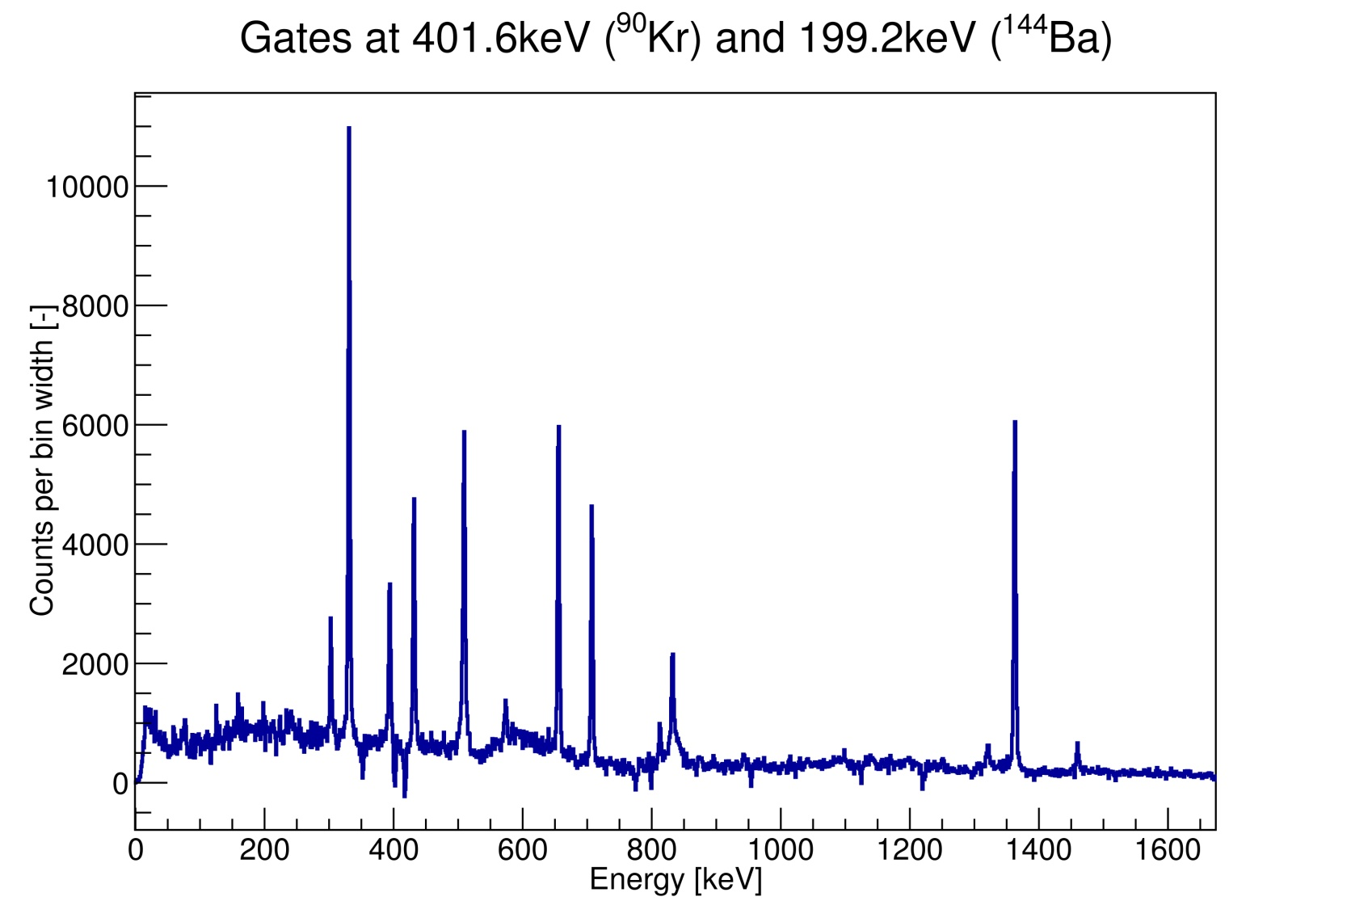
Spectra fitting problems - background
Gating with subtracted background
  Choosing correct background
Notes:
Systematic error

Slide 71
Spectra fitting problems - background
Gating with subtracted background
  Choosing correct background
330.7keV
Notes:
Systematic error

Slide 72
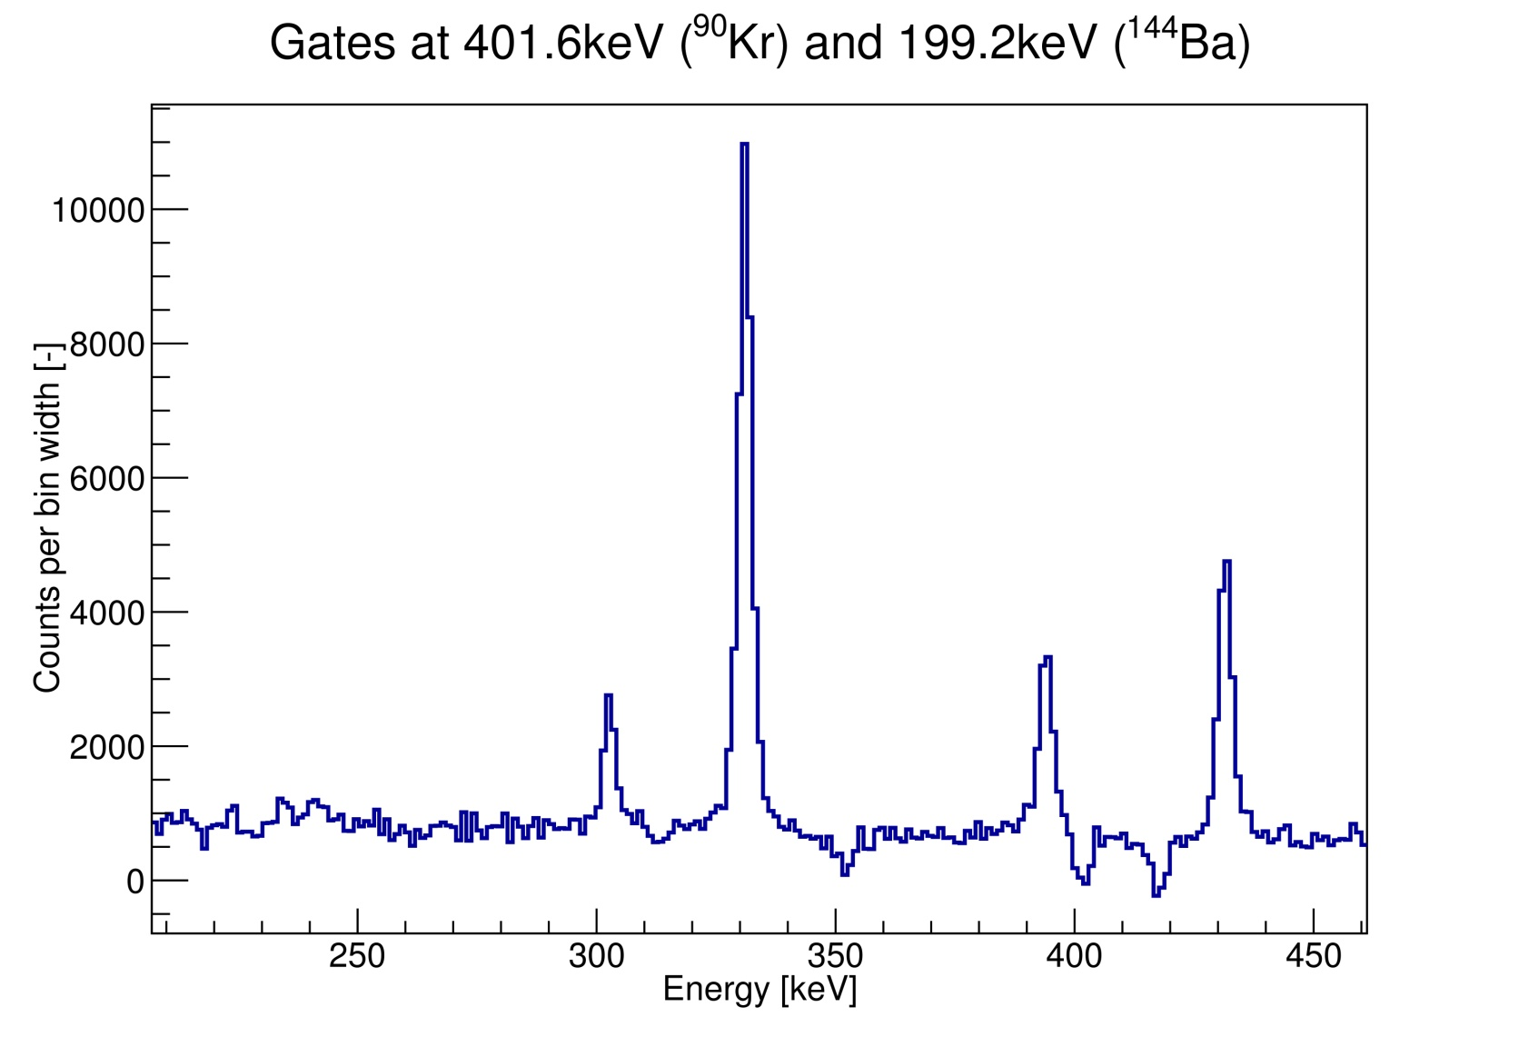
Spectra fitting problems - background
Baseline depends on the placing the background
  Up to 10% difference depending on the background choice
330.7keV
Notes:
Systematic error
Problem with reproducing the results

Slide 73
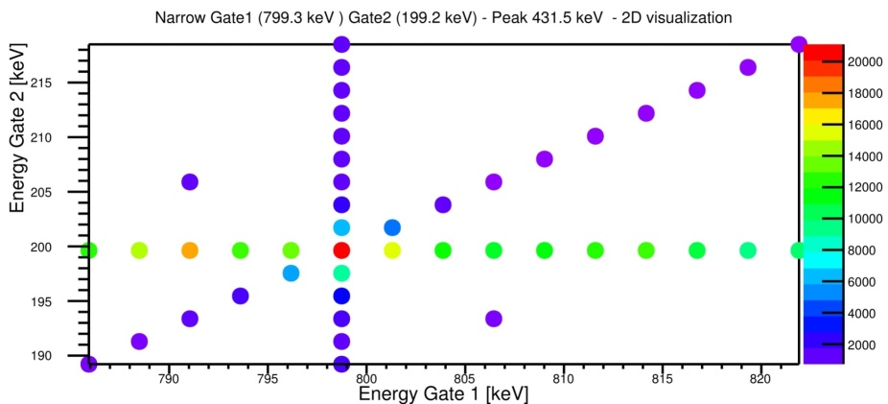
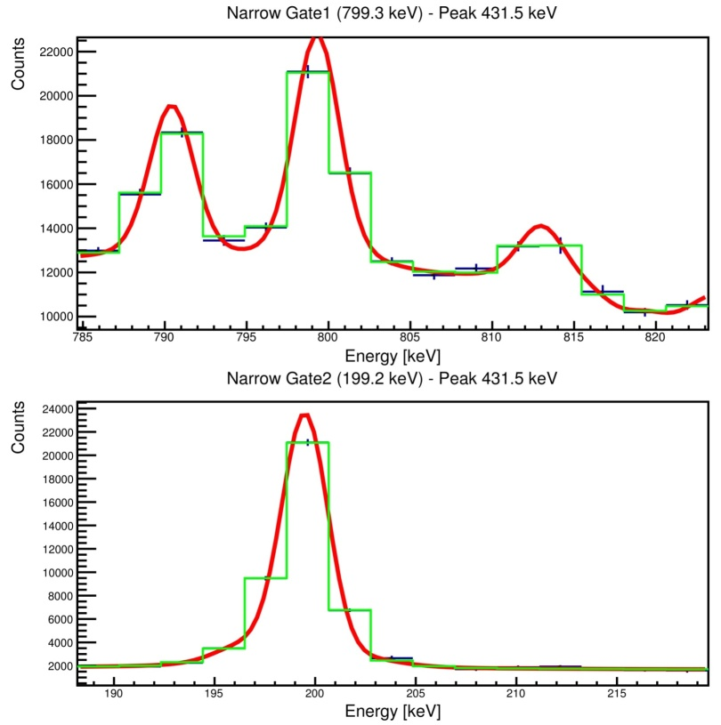
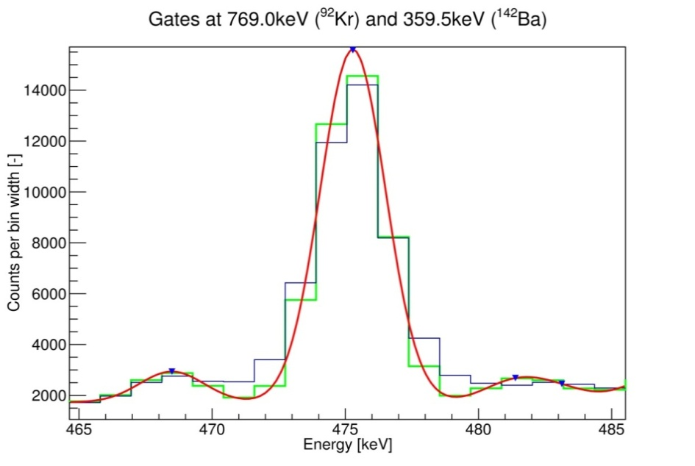
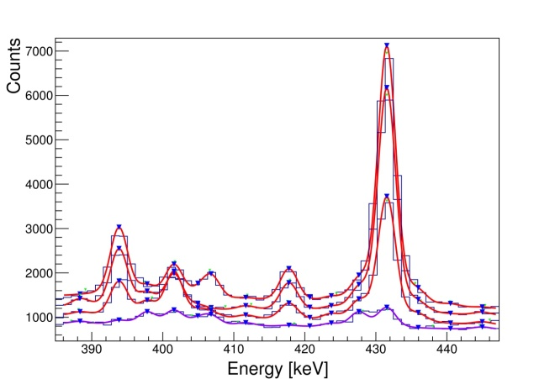
analysis procedure
Redefinition of background treatment
  No background subtraction → gate scanning needed
2D gate scan
Semi-automatic spectra fitting
Gate fitting
Notes:
Generating spectra with Ana
No background subtraction
Gates of the same size
No region overlapping
No gaps between gates
All regions values and fitting option send to a server
Alignment of peaks positions
One list of peaks for all spectra
Prefitted spectra verification
Peak position verification
Additional peaks removal
Not perfect peak shape model
Optimization
Different gate sizes
Final size 2 bins
Different number of spectra
9 → 45
Diagonal backgrounds treatment

Slide 74
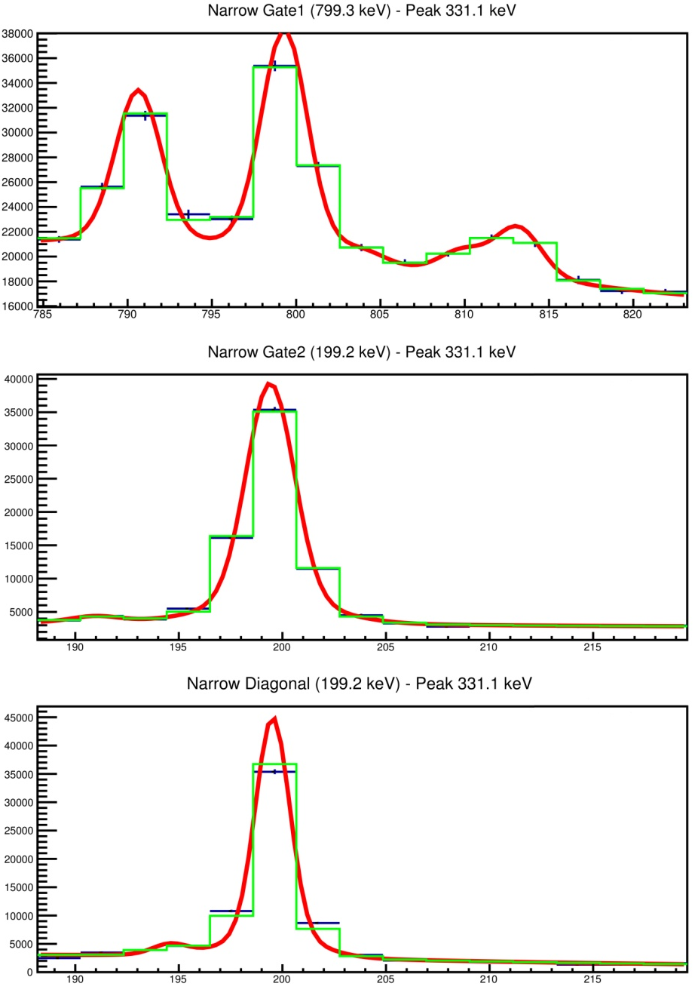
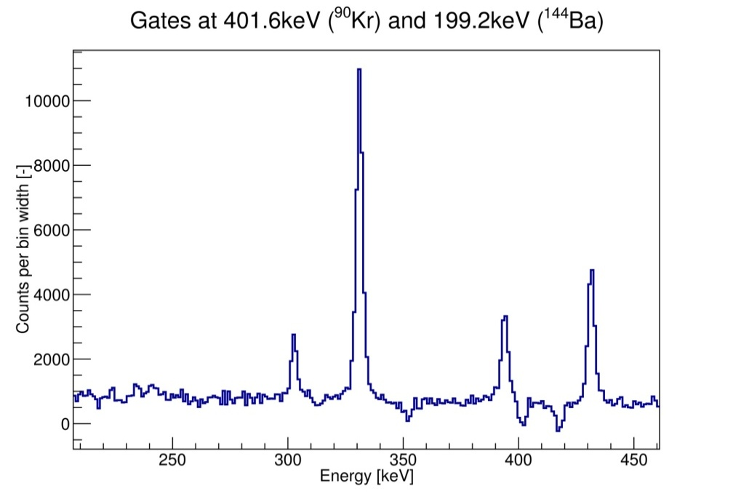
analysis procedure
Diagonal Gates
Vertical Gates
Horizontal Gates
Fitted background
No contamination
  N = N_{m} - B_{H} - B_{V} + B_{D}
Contamination only in horizontal gate
  N = N_{H} - B_{V} + B_{D}
Notes:
Projection
N_{m} purely statistical error – measured value

Slide 75
Data preprocessing - Triple-γ coincidence
Three-dimensional histogram → γγγ-cube
Time shift correction for all Ge crystals
Energy calibration of all Ge crystals (run after run)
Coincidence time window
  Fixed to 200ns
Cube created in Poland at Warsaw University
  Time needed: 6 to 12 months

Slide 76
Data preprocessing - Triple-γ coincidence
Three-dimensional histogram → γγγ-cube
Time shift correction for all Ge crystals
Energy calibration of all Ge crystals (run after run)
Coincidence time window
  Fixed to 200ns
Cube created in Poland at Warsaw University
  Time needed: 6 to 12 months
Dedicated analysis software
  Choosing gates
  Fitting spectra in triple-γ coincidence
  No access to the source code

Slide 77
Preliminary Results
Gamma-ray cascade
Gamma-ray cascade in ¹⁴²Ba according to ²⁴⁸Cm data
Gamma-ray cascade in ¹⁴²Ba according to EXILL data
Urban et al., Nucl. Phys A 613 (1997) 107
T. Materna et al., accepted for publ. In EPJ Web of Conferences (2017)
Notes:
FIFRELIN simulated transition intensities in ¹⁴²Ba
(from ²³⁵U(n_{th},f), as a function of the complementary
fragment ⁸⁹⁻⁹⁴Kr)
The first result I would like to show is 142Ba. This nucleus has a fission yield of 2.8%. According to RIP,L its level scheme is complete up to 1.8 MeV and 38 levels are known, up to 5.2 MeV.
The plot on the right is the cascade simulated by FIFRELIN. In the middle, I put the cascade we measure with EXILL. We did want to measure all the transitions. We only measure the strong one to keep a low uncertainty. Visually, the match is quite good. In fact you should look on the width of the transitions. We choose Ba 142 because this nucleus was also measured in the spontaneous fission of Cm248 with EUROGAM2 at Strasbourg more than 20 years ago.
In good agreement.

Slide 78
Preliminary Results
Gamma-ray cascade
  Transition intensity values very close especially in ground state band
E (keV) | J1→J2 | I_{γ}
 |  | EXILL* | ²⁴⁸Cm** | Ratio(**/* )
359.6 | 2⁺→0⁺ | 100 (3) | 100 (5) | 1.00 (6)
475.2 | 4⁺→2⁺ | 80 (2) | 85 (5) | 1.06 (7)
631.2 | 6⁺→4⁺ | 42 (2) | 40 (3) | 0.95 (8)
693.4 | 8⁺→6⁺ | 12 (1) | 13 (2) | 1.1 (2)
766.5 | 10⁺→8⁺ | 2.4 (7) | 2.3 (3) | 0.9 (3)
706.8 | 5⁻→4⁺ | 10 (1) | 6.0 (6) | 0.60 (8)
486.7 | 7⁻→6⁺ | 8 (1) | 18 (2) | 2.2 (4)
354.4 | 9⁻→8⁺ | 4.4 (5) | 5.1 (4) | 1.2 (2)
561.1 | 9⁻→7⁻ | 4.0 (5) | 4.5 (4) | 1.1 (2)
640.1 | 11⁻→9⁻ | 2 (1) | 5 (1) | 2 (1)
380.9 | 8⁺→6⁺ | 4.0 (6) | 6.5 (8) | 1.6 (3)
585.6 | 10⁺→8⁺ | 4 (1) | 5.5 (5) | 1.4 (4)
Notes:
FIFRELIN simulated transition intensities in ¹⁴²Ba
(from ²³⁵U(n_{th},f), as a function of the complementary
fragment ⁸⁹⁻⁹⁴Kr)
The first result I would like to show is 142Ba. This nucleus has a fission yield of 2.8%. According to RIP,L its level scheme is complete up to 1.8 MeV and 38 levels are known, up to 5.2 MeV.
The plot on the right is the cascade simulated by FIFRELIN. In the middle, I put the cascade we measure with EXILL. We did want to measure all the transitions. We only measure the strong one to keep a low uncertainty. Visually, the match is quite good. In fact you should look on the width of the transitions. We choose Ba 142 because this nucleus was also measured in the spontaneous fission of Cm248 with EUROGAM2 at Strasbourg more than 20 years ago.
In good agreement.

Slide 79
Preliminary Results
Gamma-ray cascade
  Transition intensity values very close especially in ground state band
  Probably initial spins of the primary fission fragments in both systems are similar
E (keV) | J1→J2 | I_{γ}
 |  | EXILL* | ²⁴⁸Cm** | Ratio(**/* )
359.6 | 2⁺→0⁺ | 100 (3) | 100 (5) | 1.00 (6)
475.2 | 4⁺→2⁺ | 80 (2) | 85 (5) | 1.06 (7)
631.2 | 6⁺→4⁺ | 42 (2) | 40 (3) | 0.95 (8)
693.4 | 8⁺→6⁺ | 12 (1) | 13 (2) | 1.1 (2)
766.5 | 10⁺→8⁺ | 2.4 (7) | 2.3 (3) | 0.9 (3)
706.8 | 5⁻→4⁺ | 10 (1) | 6.0 (6) | 0.60 (8)
486.7 | 7⁻→6⁺ | 8 (1) | 18 (2) | 2.2 (4)
354.4 | 9⁻→8⁺ | 4.4 (5) | 5.1 (4) | 1.2 (2)
561.1 | 9⁻→7⁻ | 4.0 (5) | 4.5 (4) | 1.1 (2)
640.1 | 11⁻→9⁻ | 2 (1) | 5 (1) | 2 (1)
380.9 | 8⁺→6⁺ | 4.0 (6) | 6.5 (8) | 1.6 (3)
585.6 | 10⁺→8⁺ | 4 (1) | 5.5 (5) | 1.4 (4)
Notes:
FIFRELIN simulated transition intensities in ¹⁴²Ba
(from ²³⁵U(n_{th},f), as a function of the complementary
fragment ⁸⁹⁻⁹⁴Kr)
The first result I would like to show is 142Ba. This nucleus has a fission yield of 2.8%. According to RIP,L its level scheme is complete up to 1.8 MeV and 38 levels are known, up to 5.2 MeV.
The plot on the right is the cascade simulated by FIFRELIN. In the middle, I put the cascade we measure with EXILL. We did want to measure all the transitions. We only measure the strong one to keep a low uncertainty. Visually, the match is quite good. In fact you should look on the width of the transitions. We choose Ba 142 because this nucleus was also measured in the spontaneous fission of Cm248 with EUROGAM2 at Strasbourg more than 20 years ago.
In good agreement.

Slide 80
Preliminary Results
Gamma-ray cascade in ⁹²Kr according to EXILL data
(in coincidence with ¹⁴²Ba)
T. Materna et al., accepted for publ. In EPJ Web of Conferences (2017)

Slide 81
Preliminary Results
Gamma-ray cascade in ⁹²Kr according to EXILL data
(in coincidence with ¹⁴²Ba)
Gamma-ray cascade in ⁹²Kr according to FIFRELIN
(old RIPL-3 version, without low intensity transitions, in coincidence with ¹⁴²Ba)
T. Materna et al., accepted for publ. In EPJ Web of Conferences (2017)

Slide 82
Preliminary Results
RIPL-3 update
Strong dependence of the FIFRELIN simulation output on spin values
Gamma-ray cascade in ⁹²Kr according to EXILL data
(in coincidence with ¹⁴²Ba)
Gamma-ray cascade in ⁹²Kr according to FIFRELIN
(new RIPL-3 version, without low intensity transitions,
in coincidence with ¹⁴²Ba)
T. Materna et al., accepted for publ. In EPJ Web of Conferences (2017)
T. Materna et al., accepted for publ. In EPJ Web of Conferences (2017)

Slide 83
PhD outlook
CEA Saclay:
Analysis of other fission fragment pairs
  Comparison to ²⁴⁸Cm and ²⁵²Cf experimental data
  Comparison to FIFRELIN simulation results

Slide 84
PhD outlook
CEA Saclay:
Analysis of other fission fragment pairs
  Comparison to ²⁴⁸Cm and ²⁵²Cf experimental data
  Comparison to FIFRELIN simulation results
CEA Cadarache:
Comparison of gathered experimental data results to FIFRELIN simulation results
Evaluation and improvement of the models implemented in the code

Slide 85
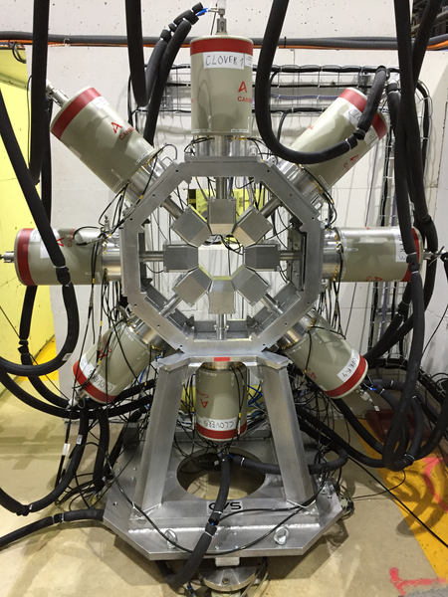
outlook
FIPPS experiment
  At ILL in Grenoble (the same beamline as EXILL)
  Phase I started operation in January 2017
  HPGe array – 8 detectors
Institut Laue-Langevin,
https://www.ill.eu/instruments-support/instruments-groups/instruments/fipps/description/fipps-hpge-array/ (2017)

Slide 86
outlook
FIPPS experiment
  At ILL in Grenoble (the same beamline as EXILL)
  Phase I started operation in January 2017
  HPGe array – 8 detectors
Plans:
  Active target (fission trigger)
  Anti-Compton shield
Outcomes:
  Lower background
  Less contaminants
  Better energy resolution
Institut Laue-Langevin,
https://www.ill.eu/instruments-support/instruments-groups/instruments/fipps/description/fipps-hpge-array/ (2017)

