Slide 1


A METHOD FOR COMPUTATION of radiation EMITTED BY ELECTRONS AND POSITRONS in straight and bent crystals
L. Bandiera
INFN Section of Ferrara – Italy
bandiera@fe.infn.it
Laboratoire de l'accélérateur linéaire
Orsay, January 19, 2017
1

Slide 2
Outlook
Introduction of radiation processes in crystals;
Development of an algorithm to compute the radiation generation in oriented crystals based on the Baier and Katkov method;
Comparison with experiments at intermediate energies (1 GeV e±);
Comparison with experiments at ultra-high energies (100 GeV e±);
Conclusions.

Slide 3


Enhancement of bremsstrahlung radiation in aligned crystals
Coherent Bremsstrahlung (1950s) Ter-Mikaelian, Ferretti, Dyson-Uberall
$$\frac{1}{γ}$$
Laboratori Nazionali di Frascati, 1960
$$lc=\frac{2γ^{2}}{ω}$$
Enhancement
bremsstrahlung
e±
θ<<1
x = ω/E
Notes:
3

Slide 4
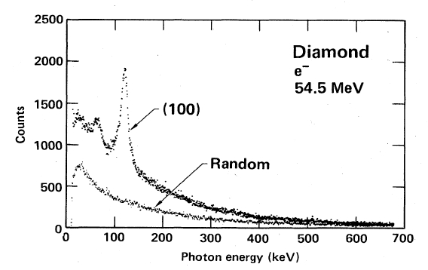
Enhancement of radiation in aligned crystals
Coherent Bremsstrahlung (1950s) Ter-Mikaelian, Ferretti, Dyson-Uberall
$$\frac{1}{γ}$$
Laboratori Nazionali di Frascati, 1960
$$lc=\frac{2γ^{2}}{ω}$$
Enhancement
bremsstrahlung
e±
θ<<1
x = ω/E
HE
HE e⁻
LE e⁻
Channeling radiation ( Kumakhov)
M. Kumakhov, Physics Letters A 57, 17 (1976).
Notes:
4

Slide 5
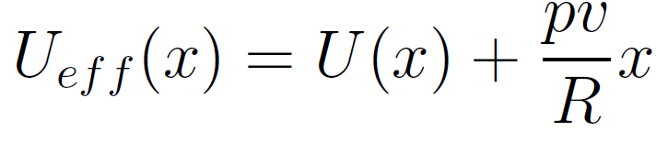
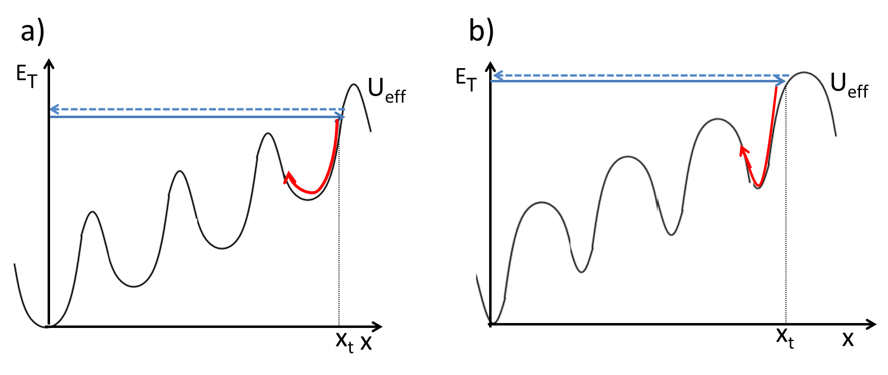

Channeling and related effects in a bent crystal
Tsyganov (1976): channeling in bent crystals;
Taratin and Vorobiov (1987): Volume Reflection of over-barrier particles.
2θ_{C}
5

Slide 6
Channeling and related effects in a bent crystal
Tsyganov (1976): channeling in bent crystals;
Taratin and Vorobiov (1987): Volume Reflection of over-barrier particles.
Under VR the angle between the particle trajectory and crystalline planes changes during the motion
Need of a general method for radiation computation
2θ_{C}
6

Slide 7
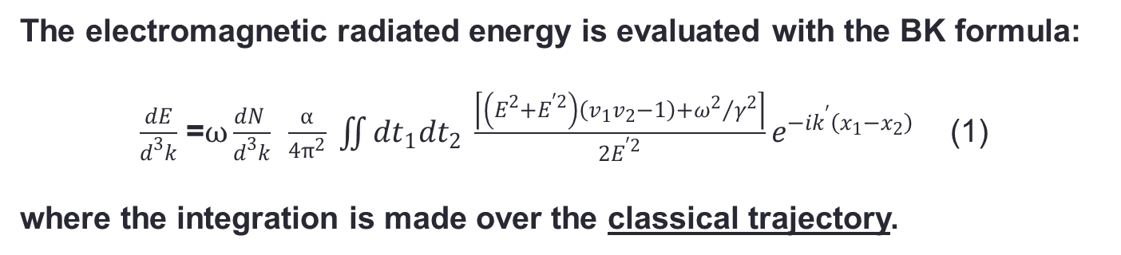
Baier-Katkov quasiclassical operator method (1967-1968)
General method for calculation of radiation generated by e± in an external field
The electromagnetic radiated energy is evaluated with the BK formula:
$\frac{dE}{d^{3}k}$ =$ω\frac{dN }{d^{3}k}$ $\frac{α}{4π^{2}} \iint{{dt}_{1}{dt}_{2} \frac{\left\lceil \left(E^{2}+E^{′2}\right)\left(v_{1}v_{2}−1\right)+{ω^{2}}/{γ^{2}}\right\rceil }{2E^{′2}}e^{−ik^{′}\left(x_{1}−x_{2}\right)}}$ (1)
where the integration is made over the classical trajectory.
The generality of the Baier-Katkov operator method permits to simulate the electromagnetic radiation emitted by e± in very different cases, e. g., straight, bent and periodically bent crystals, and for different beam energy range, from sub-GeV to TeV.
Notes:
This method has the advantage to be applicable in the whole photon energy range, except for the extreme limit where ℏω ∼ ε.
Aggiungi parte sulla formula.

Slide 8
Baier-Katkov quasiclassical operator method (1967-1968)
General method for calculation of radiation generated by e± in an external field
The electromagnetic radiated energy is evaluated with the BK formula:
$\frac{dE}{d^{3}k}$ =$ω\frac{dN }{d^{3}k}$ $\frac{α}{4π^{2}} \iint{{dt}_{1}{dt}_{2} \frac{\left\lceil \left(E^{2}+E^{′2}\right)\left(v_{1}v_{2}−1\right)+{ω^{2}}/{γ^{2}}\right\rceil }{2E^{′2}}e^{−ik^{′}\left(x_{1}−x_{2}\right)}}$ (1)
where the integration is made over the classical trajectory.
Why classical trajectory?
2 types of quantum effects :
the quantization of particle motion ~ℏω₀/E
In crystals: negligible for electron/positron energy >10-100 MeV
the quantum recoil of the particle when it radiates a photon with energy ℏω~E NOT negligible for electron/positron energy >50 GeV
Notes:
This method has the advantage to be applicable in the whole photon energy range, except for the extreme limit where ℏω ∼ ε.
Aggiungi parte sulla formula.

Slide 9
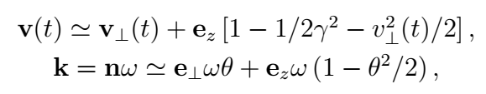

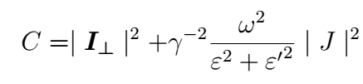
An algorithm for radiation in crystals
Integration of the BK formula
SMALL ANGLE APPROXIMATION: Since the angle between particle trajectories and crystal planes or axes is small and at ultrarelativistic energies the radiation angle 1/γ is much smaller than unity the particle velocity v and photon momentum k can be
represented in the form :
where the angle θ ≪ 1 represents the radiation angle. The formula (1) can be rewritten as:
(2)
where (3)
V. Guidi, L. Bandiera, V. Tikhomirov, Phys. Rev. A 86 (2012) 042903]
L. Bandiera, et al., Nucl. Instrum. Methods Phys. Res., Sect. B 355, 44 (2015).

Slide 10



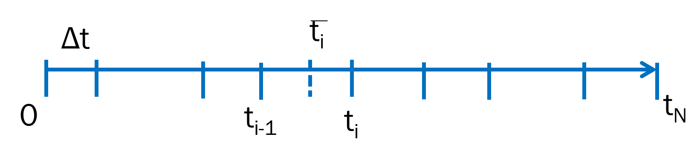

An algorithm for radiation in crystals
Integration of the BK formula
SMALL ANGLE APPROXIMATION: the integrals of eq. (1) can be represented as follows:
(4)
being and
ACCOUNT OF INCOHERENT SCATTERING:
The particle trajectory is then divided in N small steps, within which the particle trajectory is calculated through the integration of equation of motion in the continuous potential. At the end of each step the scattering by nuclei and electrons is sampled and the transverse velocity for the i-step becomes
Incoherent scattering with atoms

Slide 11
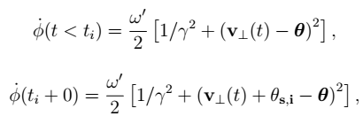

An algorithm for radiation in crystals
Integration of the BK formula
Incoherent scattering with atoms
In order to improve the convergence of its integration over t and θ (photon emission angle), the integrals of eq. 4 are computed as follows after an integration by parts:
The contributions of the trajectory ends are not taken into account, thus neglecting the soft contribution of transition radiation.
The integration over θ leads to the radiation spectral intensity, ωdN/dω.
If incoherent scattering is switched off, it is go to zero.

Slide 12
COMPARISON WITH EXPERIMENTS
GeV and sub-GeV energy range:
No quantum correction;
Thin crystals -> single photon emission.

Slide 13
RADCHARM++
The algorithm for direct integration of the BK formula has been included in the RADCHARM++ routine [1] , which is an expansion of the DYNECHARM++ code [2] (see E. Bagli talk)
The electrical characteristic of the crystal are evaluated by using the atomic form factors from x-ray diffraction data;
Numerical integration of the classical equation of motion of particle trajectories under the continuum potential approximation;
At the end of each step the multiple and single scattering by nuclei and electrons is sampled.
DYNECHARM++ has already been implemented in Geant4 [3].
The RADCHARM++ routine can also be implemented to include the bremsstrhalung radiation enhancement in crystals.
[1] L. Bandiera, et al., Nucl. Instrum. Methods Phys. Res., Sect. B 355, 44 (2015).
[2] E. Bagli, V. Guidi, Nucl. Instr. and Meth. in Phys. Res. Section B 309 (2013) 124
[3] E. Bagli, M. Asai, D. Brandt, et al. Eur. Phys. J. C (2014) 74: 2996.

Slide 14
Comparison with previous experiments:
Simulation of e.m. radiation emitted by ultrarelativistic electrons in the field of any crystal plane
Comparison with past experiments performed at the Mainzer Mikrotron with 855 MeV electrons interacting with a 175 µm straight Si crystal
H. Backe et al., NIMB 2008
RADCHARM++
Courtesy of H. Backe
L. Bandiera, et al., Nucl. Instrum. Methods Phys. Res., Sect. B 355, 44 (2015).

Slide 15
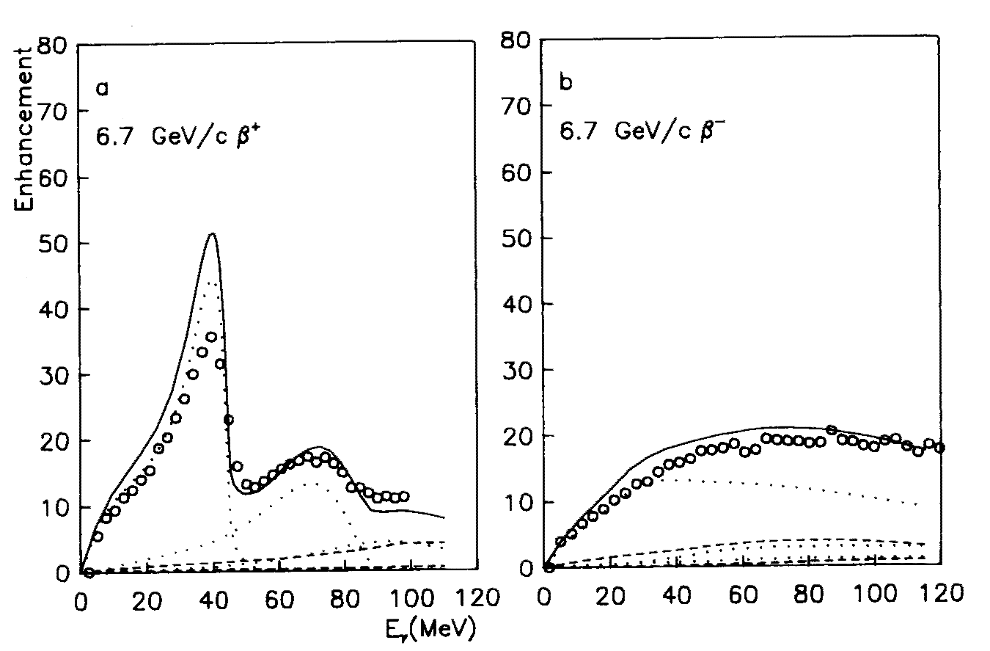
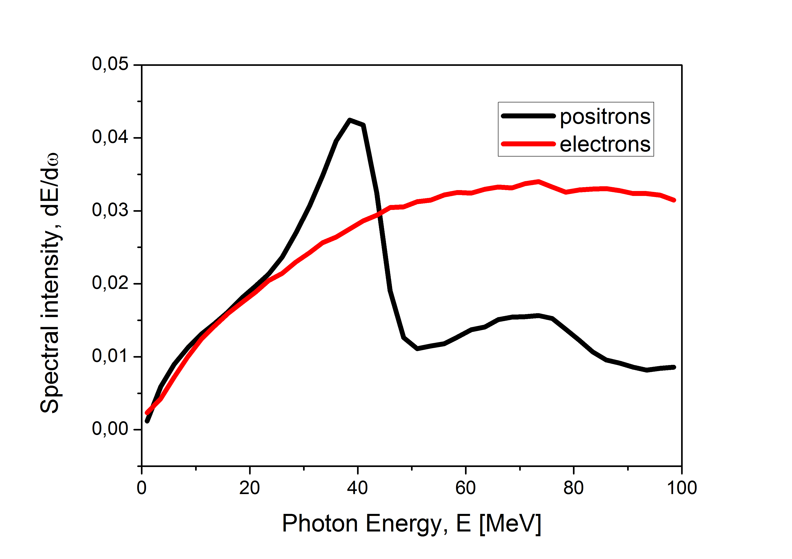
Comparison with previous experiments:
Simulation of e.m. radiation emitted by both positive and negative particles
Comparison with past experiments at CERN: 6.7 GeV positrons/electrons channeling in a 0.1 mm thick Si (110)
Enhancement with respect to random
J. Bak et al.,
Nucl.Phys. B254(1985)491.
Spectral Intensity,
dE/dω= ωdN/dω
(ideal case)
very preliminary

Slide 16
Experiment with bent crystals:
Motivations
16
A lot of attention is devoted to channeling effects of electron around GeV :
  Interest for alternatives x-ray sources
  Relatively large availability accelerators
  Study of the influence of the curvature on Channeling Radiation (CR) and Coherent Bremsstrahlung (CB). This experimental knowledge may be exploited to determine with more accuracy the CR contribution in crystalline undulators;
  Steering of sub-GeV electron trajectories through channeling in bent crystals was not possible before due to the lack of thin-enough bent crystals.

Slide 17

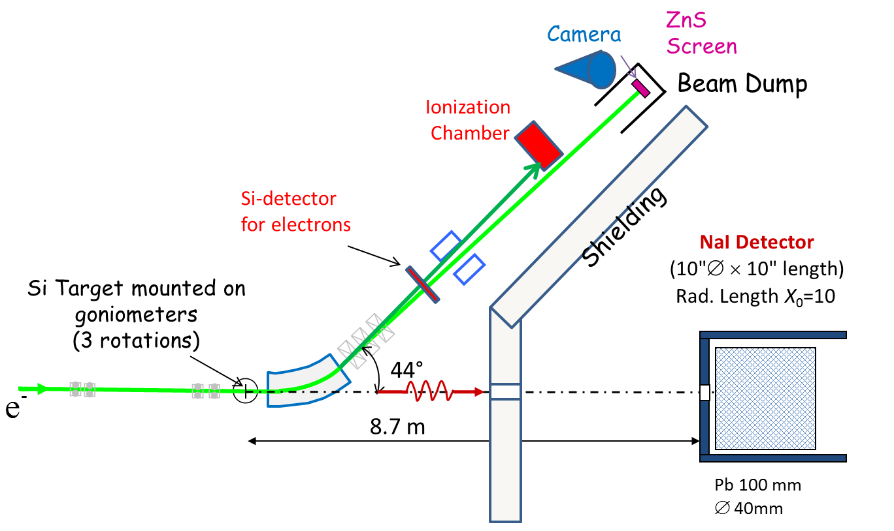
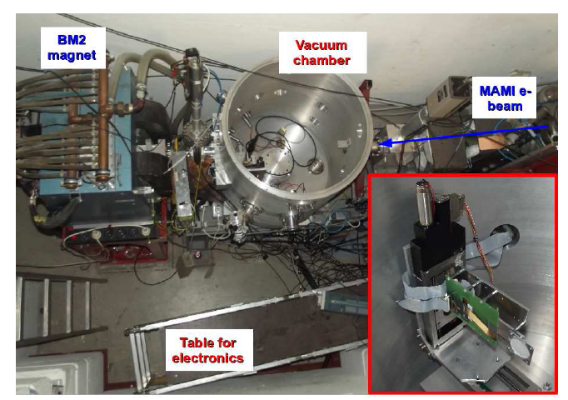
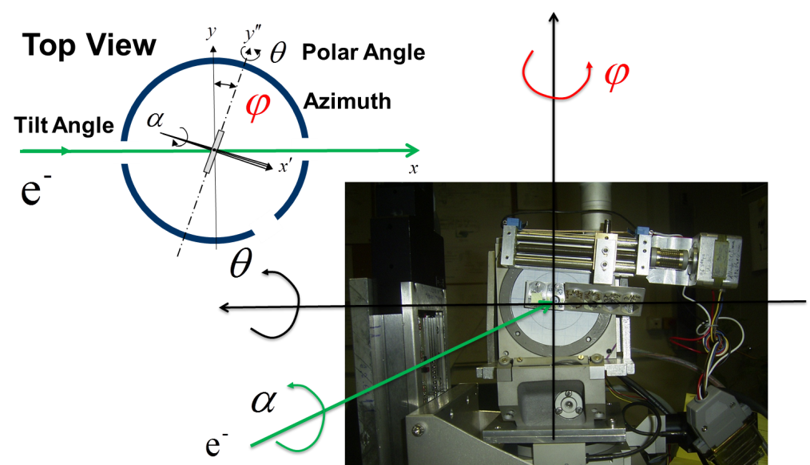
Experimental setup at the MAinzer MIkrotron
855 MeV electron beam characteristics:
Beam-Spot size σ_{hor} = 200 µm,
Beam Divergence σ'_{hor} = 70 µrad
Beam-Spot size σ_{vert} = 70 µm,
Beam Divergence σ'_{vert} = 30 µrad

Slide 18
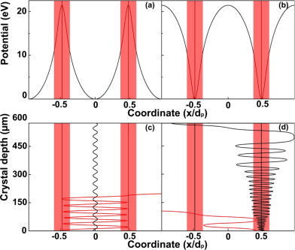
Dechanneling of positive and negative particles
Positive vs Negative
Channeled negative particles are dechanneled faster than positive ones due to higher probability to suffer nucler incoherent scattering;
Ultra thin bent crystals are required for efficient deflection of negative particles
To determine how thin, one has to know the dechanneling length for negative particles!
N.B. L_{d} decrease with energy, being some tens of microns for 1 GeV electrons in Si [1].
[1] W. Lauth, H. Backe, P. Kunz, A. Rueda, Int. Journal of Modern Physics A, 25, 1 136-143 (2010)

Slide 19

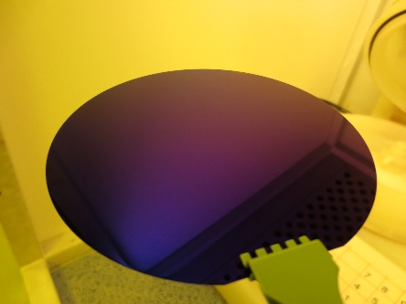
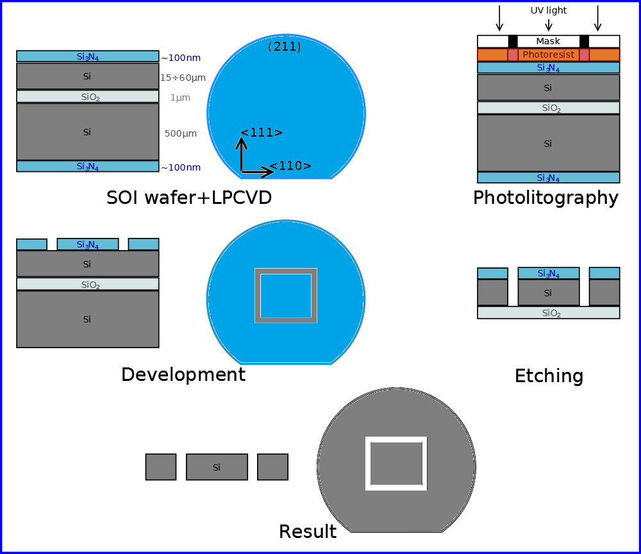
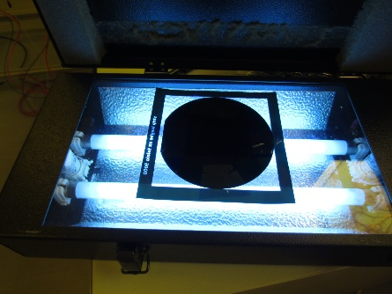
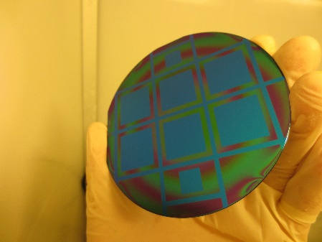
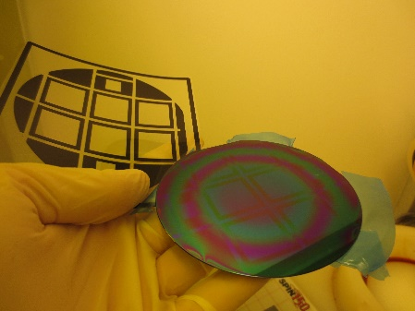
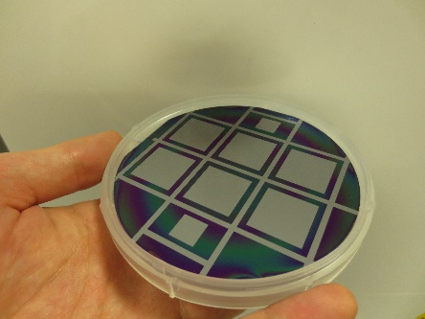
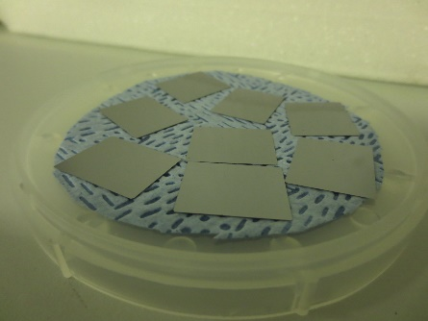
Thin crystals manufacturing
G. Germogli, A.Mazzolari et al., Nucl. Instr. Meth. B 355 (2015)

Slide 20
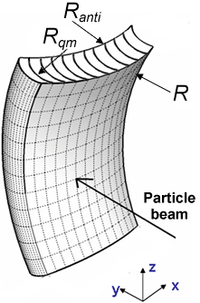
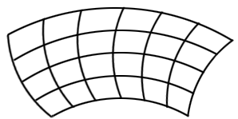
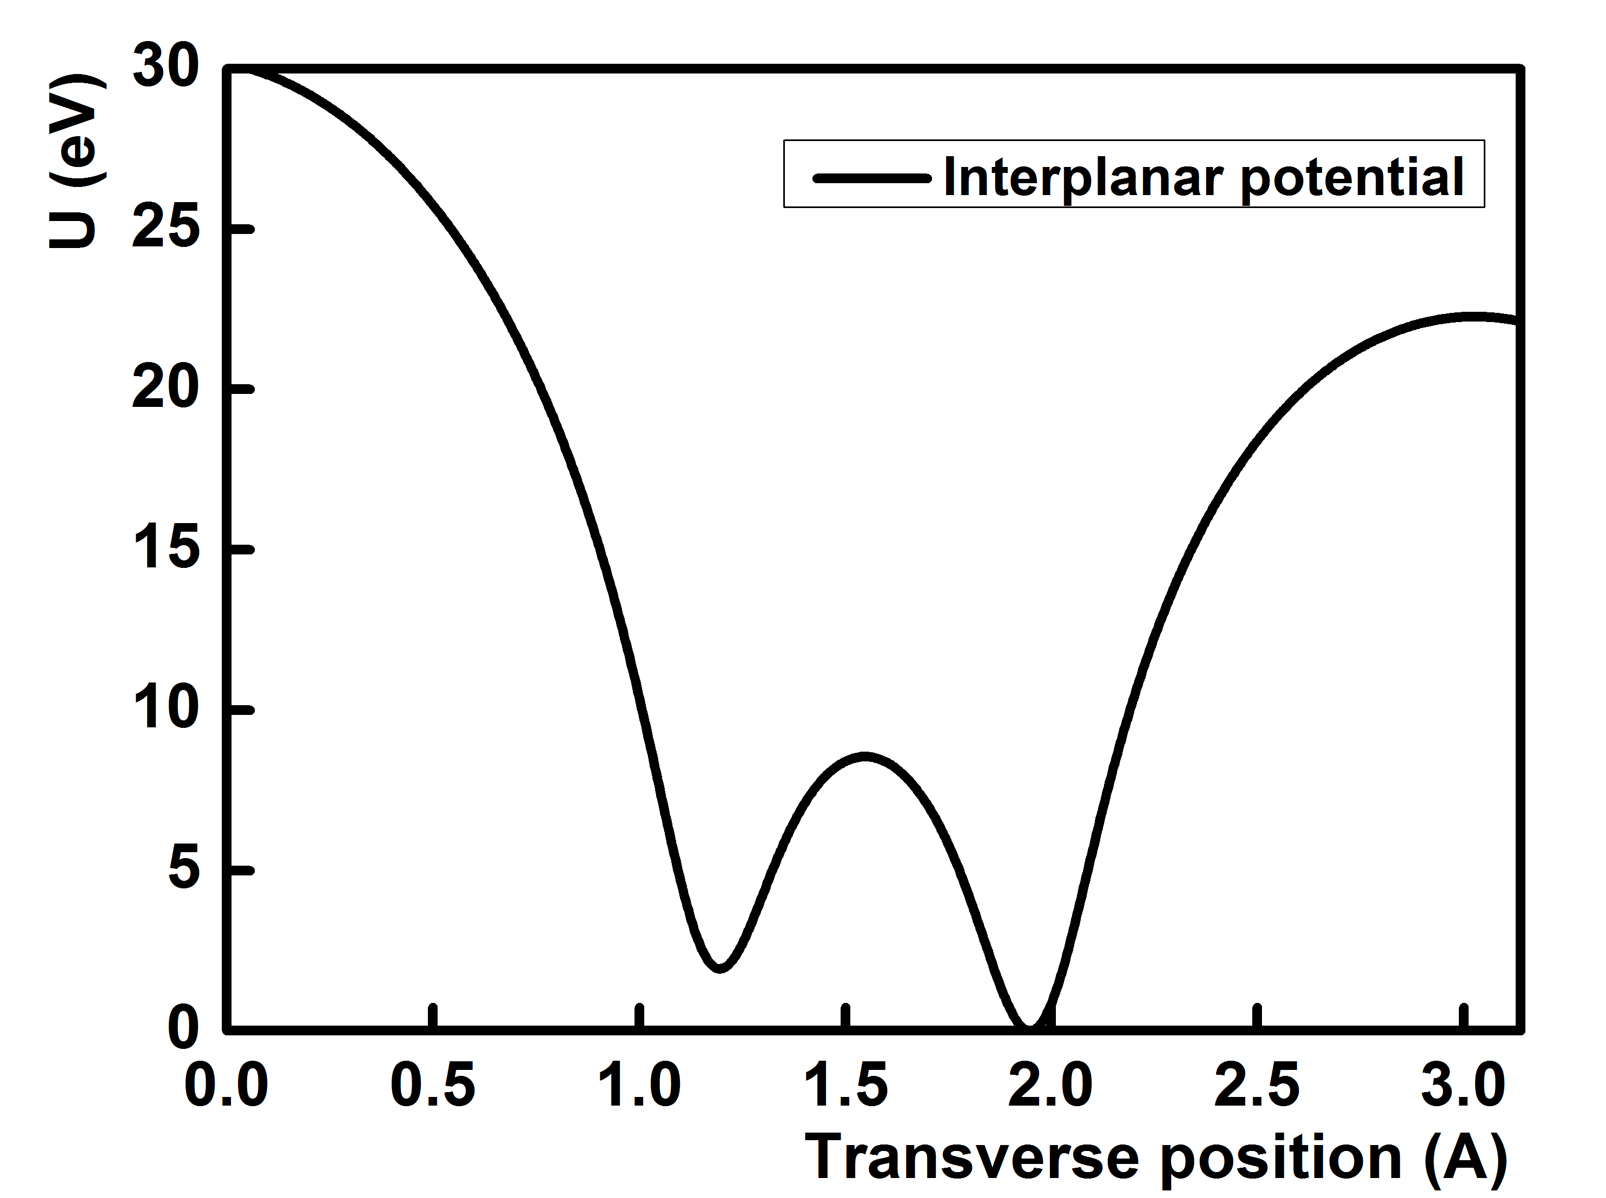
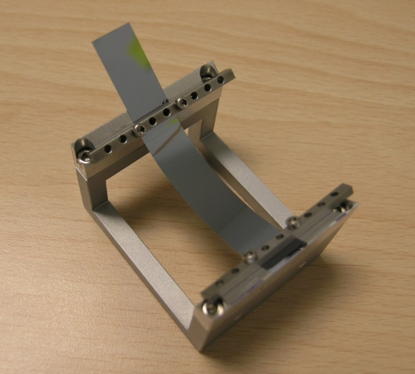
Crystal bending
<211>
Sketch of the quasi-mosaic [1] crystal highlighting the crystal crystallographic orientations. Anticlastic deformation absent due to strong bending along primary direction.
<111>
Crystal parameters
T = 30.5 µm
R_{qm} = 33.5 mm
(111) Bent planes
U₀= 23 eV
θc= 220 µrad
20
[1] Y. M. Ivanov, A. A. Petrunin, and V. V. Skorobogatov, Jetp Letters 81,99 (2005).
Notes:
The technology for bent crystal fabrication was pushed to its extreme limit, starting from the ~ mm bent crystals for CERN (100 GeV) to arrive at the 30 µm bent crystal used in MAMI (0.855 MeV).

Slide 21
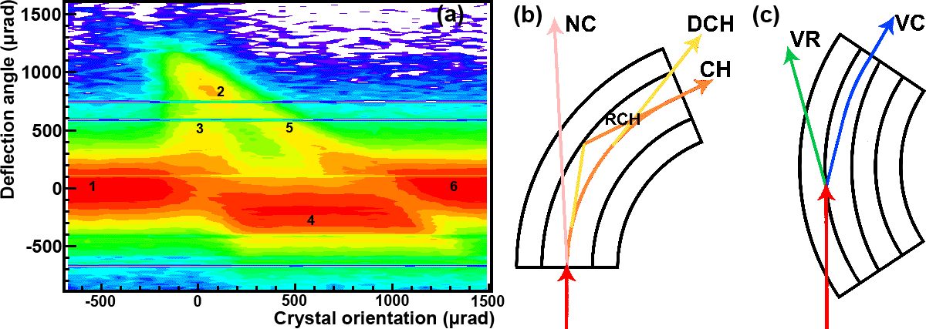
Experimental results on beam steering
Angular scan for deflected beam distribution: (1) and (6) nonchanneling regime; (2) channeling; (3) dechanneling; (4) volume reflection; and (5) volume capture.
A. Mazzolari et al., Phys. Rev. Lett. 112 (2014) 135503
21

Slide 22
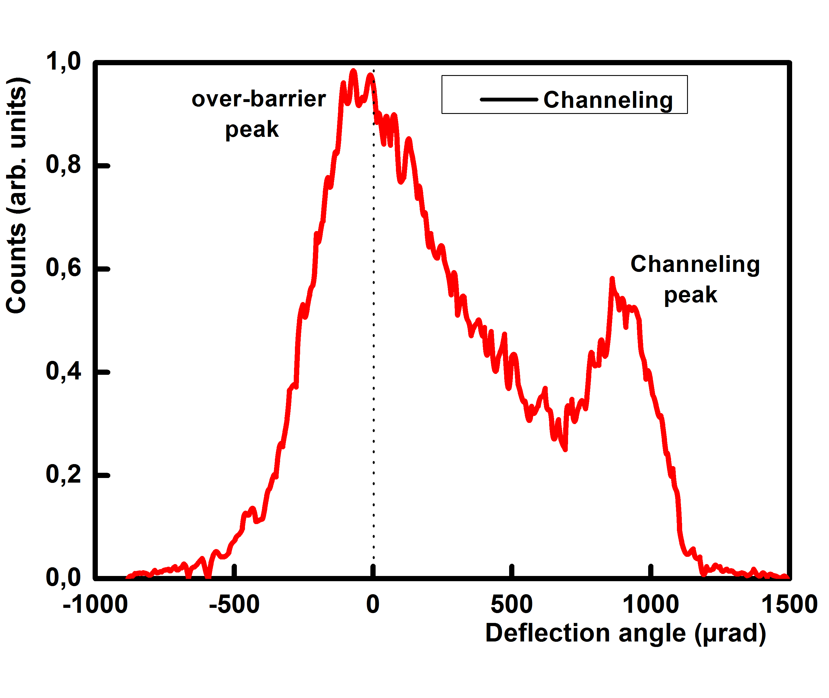
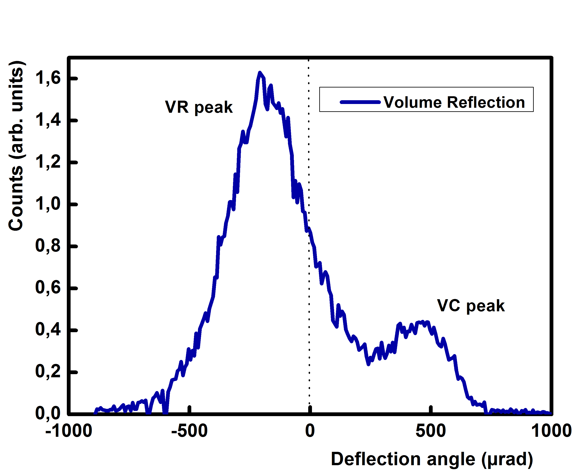
Experimental results on beam steering
CHANNELING
VOLUME REFLECTION
Θinc ~ 0 µrad Deflection = 910±5 µrad
Fraction of channeled is 20.1±1.2%
Θinc~450 µrad Deflection =191±10 µrad Fraction of reflected is 76.7±1.1%
First experimental observation of channeling and VR of negative particles in the sub-GeV energy range

Slide 23
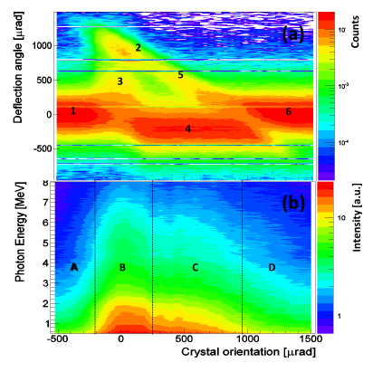
Experimental results on radiation emission
Observation: in VR orientation, emitted radiation seems to remain soft and intense as for channeling
L. Bandiera et al. Phys. Rev. Lett. 115, (2015) 025504.

Slide 24
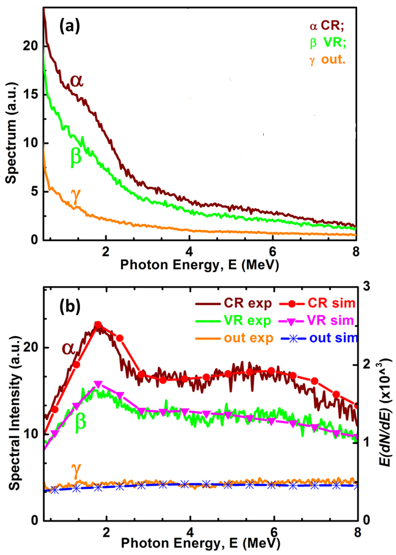
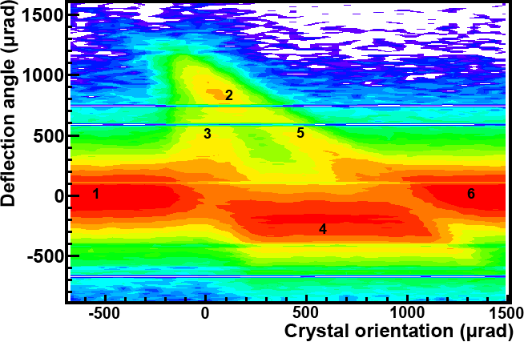
Simulation of e.m. radiation emitted by ultrarelativistic electrons in a bent crystal
Comparison with experiment performed at the Mainzer Mikrotron with 855 MeV electrons interacting with a 30.5 µm bent Si crystal along the (111) planes
-
RADCHARM++
Channeling at <zero> position
Volume reflection at +490 µrad
OUT: not aligned at 8 mrad
Channeling peak at E_{γ}~ 1.8 MeV
for 855 MeV electrons
in (111) Si bent planes
L. Bandiera et al., Phys. Rev. Lett. 115 (2015) 025504.

Slide 25
Simulation of the contribution to radiation of incoherent scattering
Simulation of the contribution of the scattering with nuclei and electrons to radiation spectral intensity [E(dN/dE)].
L. Bandiera et al., Phys. Rev. Lett. 115 (2015) 025504.

Slide 26
Incoherent scattering contribution to radiation accompanying VR
.
32% of volume-captured and 68% of pure volume-reflected electrons.
The contribution of VC particles maintains the electromagnetic radiation accompanying VR close in intensity to that for CR over the whole angular acceptance
L. Bandiera et al., Phys. Rev. Lett. 115 (2015) 025504.

Slide 27
COMPARISON WITH EXPERIMENTS
100 GeV energy range:
Quantum correction;
Multiple photon emission.

Slide 28
Multi photon emission
In principle, the BK formula should be integrated along the whole particle trajectory.
At very-high energy, the total probability of radiation may exceed unity -> multiple photon emission!
Separation of particle trajectory in intermediate lenghts > coherence length and << typical distance between two sequential photon emission points. Total probability of radiation on such trajectory part does not exceed 0.1.
The trajectory-part ends are neglected as the interference between them.
V. Guidi, L. Bandiera, V. Tikhomirov, Phys. Rev. A 86 (2012) 042903.
Notes:
The presented approach to the integration of the BK formula, is similar to the one
implemented by Artru [77], who was the first that treated both multiple coherent and
incoherent radiation. From the spectral intensity, one calculates its maximum and total probabilities of radiation. This two values are then used to determine the energy of the emitted photon through the acceptance-rejection method. If a photon is emitted, its energy is then subtracted from the particle energy and simulation proceeds in the same way for a new ”intermediate length” starting from the emission point until the particle had left the crystal.
In (3.4), "e_perp v_perp" should be only e_perp
In (3.13) the big square brakets are not well placed.
Page 52 : I understand that the photon emission is simulated by the Monte-Carlo method. How are chosen the energy and angle of a "candidate" photon ? Is there an a priori cut-off in theta ?

Slide 29
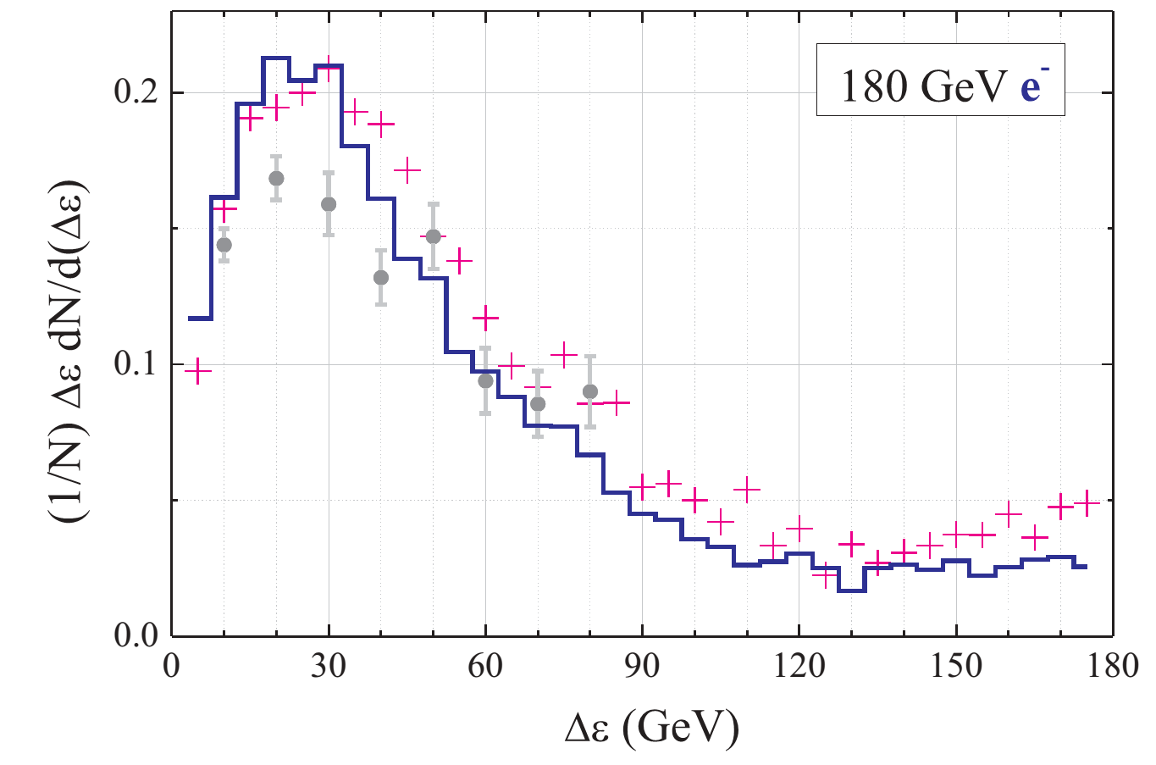
Simulation of PLANAR volume reflection
Si Crystal parameters:
Length = 0.84 mm;
Bending radius = 12 m;
Plane (111)
Beam divergence:
σ_{x} = 25 µrad and σ_{y} = 46 µrad
Incidence angle:
Θ_{X0} = 40 µrad
Photon energy ≥ 1 GeV has been selected.
Energy loss spectral intensities: (dn/dE)*E
of 180 GeV/c volume reflected electrons
Experiment: W. Scandale, et al.,Phys.Rev.A79, 012903 (2009).
Simulation: V. Guidi, L. Bandiera, V. Tikhomirov, Phys. Rev. A 86 (2012) 042903
Notes:
The stronger intensity of MVROC radiation than for Volume Reflection (VR) in the hard region is due to the contribution of the [111] axes, which generates stronger e.m. fields. Integration in angle in +-6 1/gamma

Slide 30

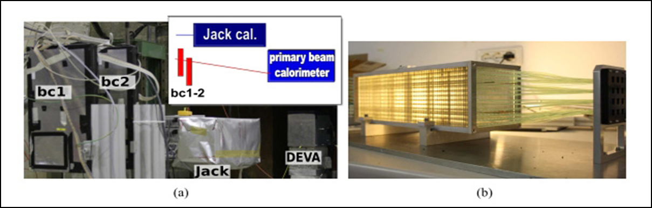
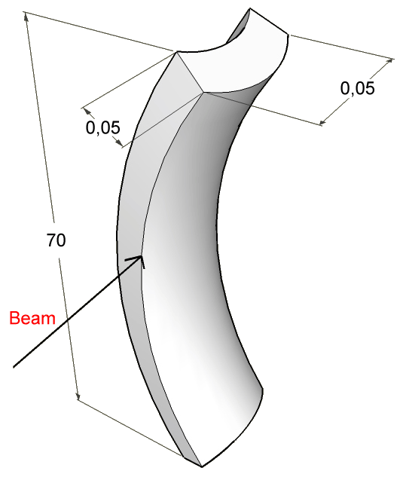
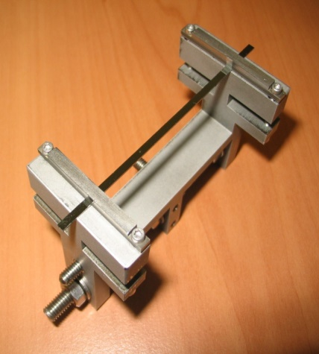
Interaction of 120 GeV/c electrons with a 2 mm long bent Si crystal
H4 extracted line from CERN SPS
γ-beam shashlik calorimeter for a total of 19 X0 to measure the emitted photons
Double sided silicon detectors SDi (300μm)
[5-μm spatial resolution]
Beam
2
A bending magnet (BM) and a pair of two single sided silicon beam chambers, BCi, form the SPECTROMETER to measure the particle momentum
(110) Bent Si planes

Slide 31
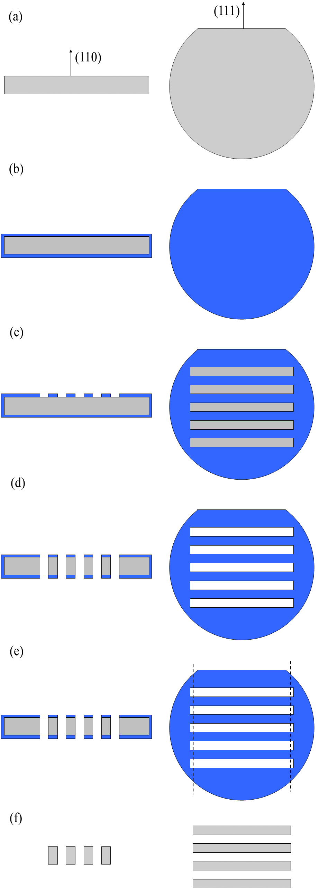
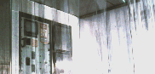
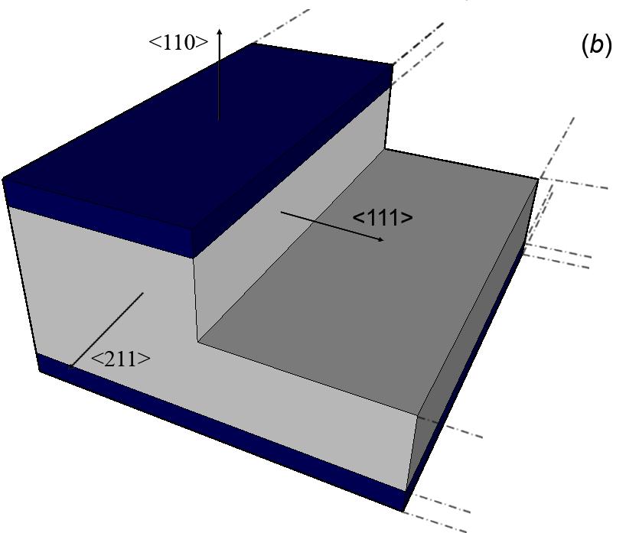
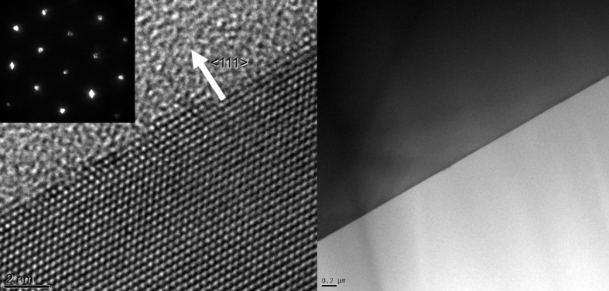
Silicon Crystal Fabrication
LPCVD deposition of silicon nitride thin layer
Anisotropic etching:
Etching rate on different silicon planes for KOH 20% at 40 °C
Silicon nitride patterning
Crystalline surfaces
S. Baricordi et al., Journal of Physics D: Applied Physics 41 (24), 245501
S. Baricordi et al., Applied Physics Letters 91 (6), 061908

Slide 32

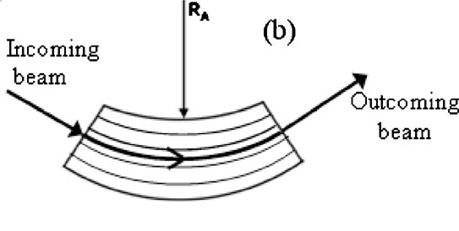
Bent Si crystal
beam
Ra = 2.71m
A primary curvature is imparted by mechanical external forces, which result in a secondary (anticlastic) curvature;
The mechanical holder used to impart the primary strain can set far apart from the particles and hence it reduces any wanted interaction with the beam.
JAP 107 (2010) 113534

Slide 33
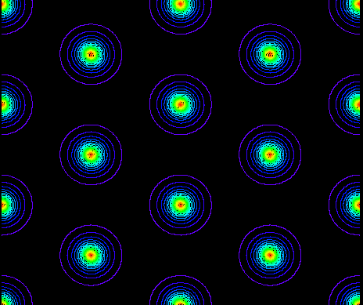
Single vs Multiple Volume Reflection in One bent Crystal
Single VR results in a small deflection angle, which decreases while increasing the particle energy.
Possible solution to increase the VR deflection angle: Multi VR from different planes of a bent crystal becomes possible when particles move at a small angle with respect to a crystal axis.
Deflection distribution
Multi VR -40 µrad
Single VR -11 µrad
Potential along a Si crystal [111] direction
V. Tikhomirov Phys. Lett. B 655 (2007) 5,

Slide 34
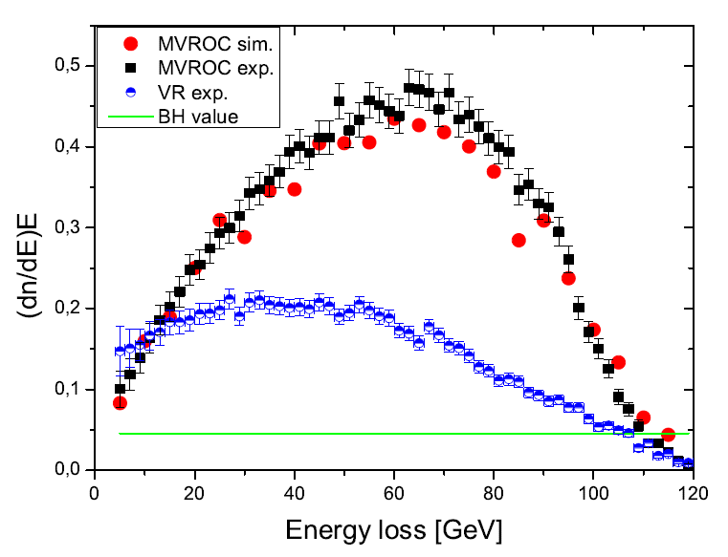
Simulation of AXIAL multi-volume reflection
Si Crystal parameters:
Length = 2mm;
Bending radius = 2.7 m;
Plane (110)
Axis <111>
Beam divergence:
σ_{x} = 50 µrad and σ_{y} = 65 µrad
Incidence angle:
Θ_{X0} = 365 µrad ≈ half bending
Θ_{Y0} misaligned for planar VR
= 205 µrad for axial MVROC
Axial MVROC
Planar VR
amorphous
Photon energy ≥ 1 GeV has been selected.
Energy loss spectral intensities: (dn/dE)*E
of 120 GeV/c single and multi-reflected electrons
L. Bandiera et al., Phys. Rev. Lett. 111(2013) 255502
Notes:
The stronger intensity of MVROC radiation than for Volume Reflection (VR) in the hard region is due to the contribution of the [111] axes, which generates stronger e.m. fields.
Few dozens of trajectory parts. Due to the finite resolution of the calorimeter used in the experiment, a cut-off at photon energy ≥ 1 GeV has been selected.

Slide 35
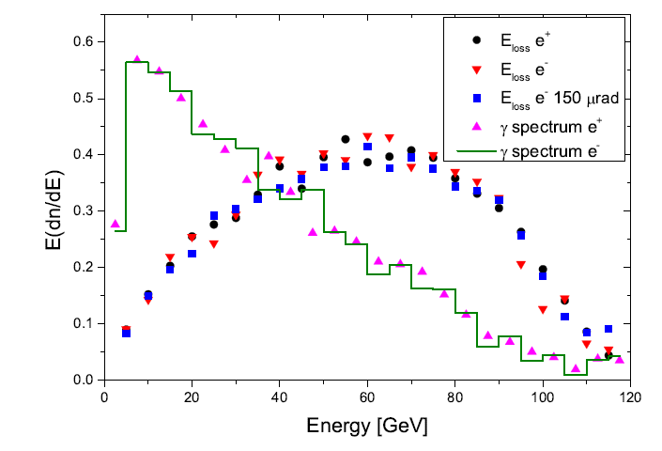
Radiation features: single photon spectra
Single photon spectrum for 120 GeV/c positrons
Single photon spectrum for 120 GeV/c electrons
A mean number of photons emitted by each particles (multiplicity factor) equal to 2.2/e⁻ for ℏω > 1 GeV.
L. Bandiera et al., Phys. Rev. Lett. 111(2013) 255502

Slide 36
Possible application
Some opportunities in the collimation system of future linear electron/positron colliders, such as ILC
Bent crystal instead of a spoiler
BM
absorber
The insertion of a short Si crystal (0.02-0.05 X₀) instead of a long spoiler (0.5-1 X₀) to clean the halo particles would diminish the perturbations on the beam.
The deflection of particles under single and multiple VR and the increase in energy loss (more than 30% in 0.02 X₀) may increase the discrimination of halo particles, which are deflected more in the bending magnets placed downstream after the collimator.
Seryi, Nucl. Instrum. Methods Phys. Res., Sect. A 623, 23 (2010)
L. Bandiera et al., et al., Journal of Physics: Conference Series 517 (2014) 012043
36
Notes:
Check radiation resistance of material. Some test already done at LHC…

Slide 37
Summarizing
An algorithm to compute of radiation emitted by relativistic e± in crystals based on the Baier-Katkov method has been presented;
Such algorithm has already been implemented in existing Monte Carlo codes for simulation of particle trajectories in crystals;
Comparison with experiments show a very good agreement in a wide energy range (from 1 GeV to 100 GeV);
Such a method can be inserted in the most general toolkits for the simulation of the passage of particles through matter, such as Geant 4, as an implementation of the radiation processes in oriented crystalline structures.

