Slide 1


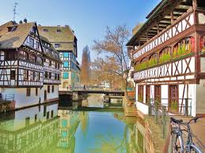
TYL-FJPPL: A_RD_07
Suppression of magnetic flux trapping to achieve high-Q of SRF cavities
Juliette Plouin, Enrico Cenni, Olivier Napoly (CEA)
Kensei Umemori, Mika Masuzawa, Kiyosumi Tsuchiya, Takayuki Kubo (KEK)
2017 Joint Workshop of the FKPPL and FJPPL
11 mai 2017
Strasbourg, France

Slide 2
Flux trapping
During supraconducting transition of a niobium cavity, some of the ambient magnetic field is trapped
⇨ Surface resistance is improved ☹
⇨ degradation of the Q₀
T> Tc
T< Tc
Magnetic probe
Bapplied
Total expulsion
ZOOM
Partial expulsion
B applied x 1.8
Total expulsion
Objective : limit flux trapping
Reduce ambient field
Improve flux expulsion during transition
Magnetic probe signal
ΔB
Partial expulsion
ΔB₁
B applied
T
Superconducting transition

Slide 3
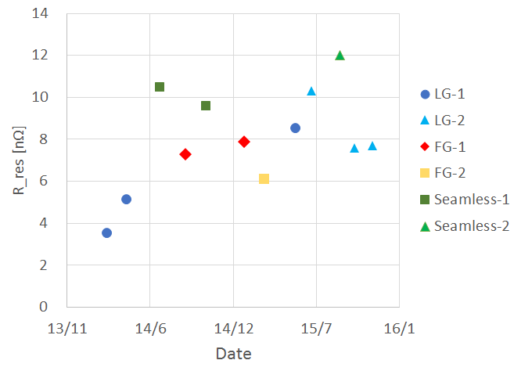
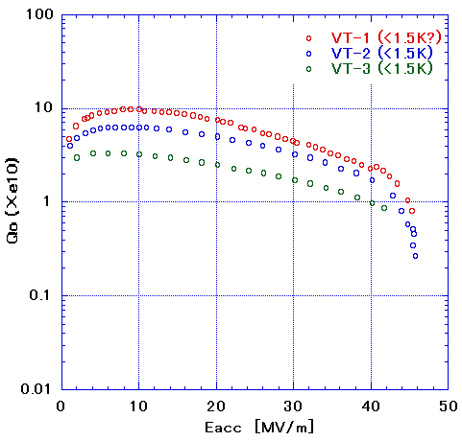
Residual resistance history of single-cell cavity vertical tests
LG-1 cavity (<1.5 K)
・R_res gradually increase?
・Q-values of large grain (LG) cavity were gradually decrease.

Slide 4
First stage of flux expulsion experiments at KEK-STF
(2016/March ～ June)
Heater
Example
Temperature [K]
Magnetic flux [mG]
Si temp. sensor
Flux gate(FG)
Some strange behaviors were observed during flux expulsion experiments.
  Asymmetric magnetic field
  Negative expulsion(?)
  Significant horizontal magnetic field
E. Cenni & J. Plouin (CEA) participated to those tests in March 2017, in the frame of FJPPL

Slide 5
Degradation of R_res?
Strange magnetic flux behavior?
Check magnetization for most of all the components of vertical test

Slide 6
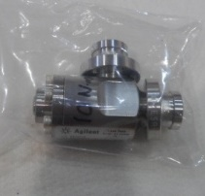
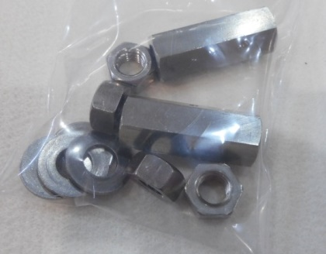
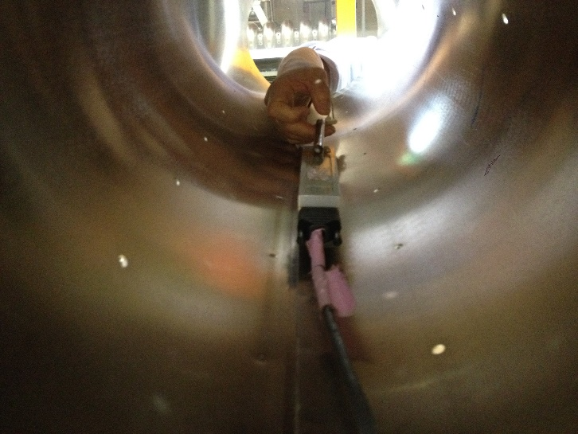
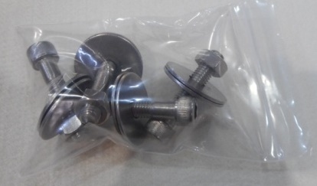
Study on magnetized components (example)
No. | name | Magnetic field [mG]
14 | Φ034 metal valve ① | 430
15 | Φ034 metal valve (which observed vacuum leak) | 80
19 | Φ034 metal valve ② | 59
25 | Volts and washers for support of input coupler shaft | 140
28 | Nuts and washers for hanging cavity | 110
29 | Stat-volts, nuts and washers for hanging cavity | 300
⑭
㉙
㉕
Measure inside magnetic shield by using 3-axis flux gate sensor.

Slide 7
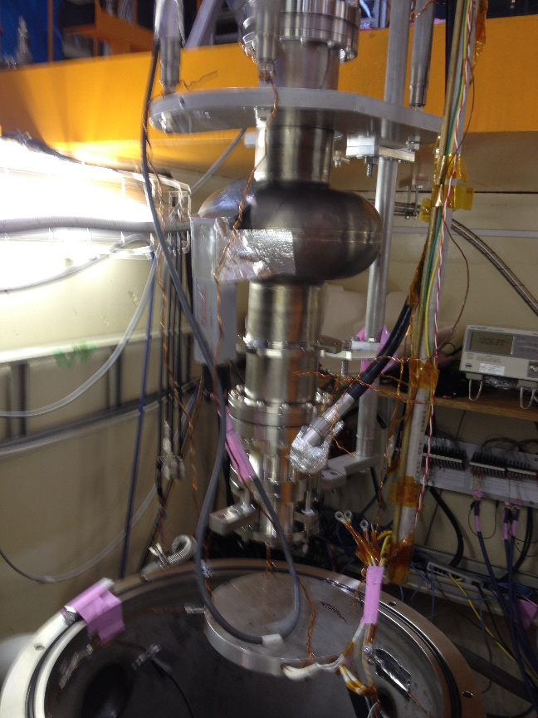
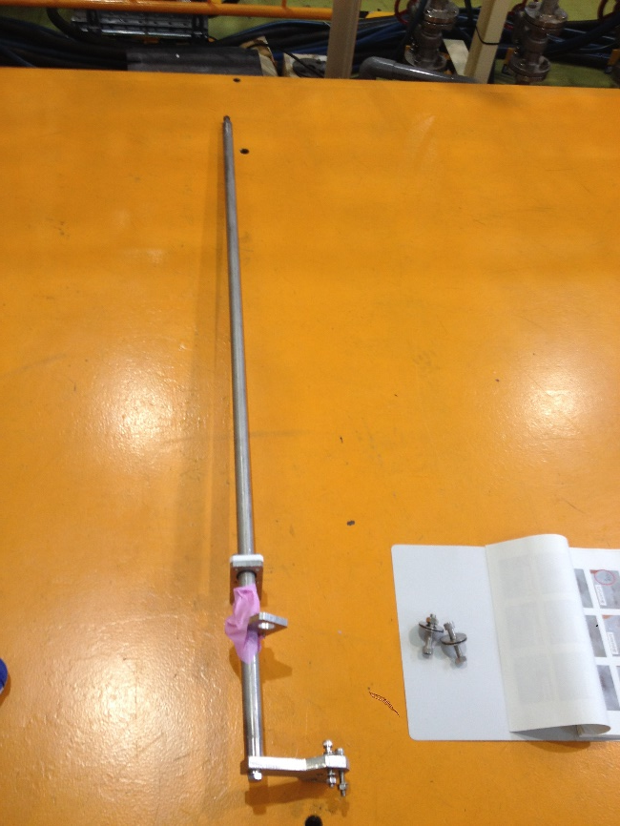
Effects of SUS shafts
SUS shafts for variable coupler were highly magnetized.
More than 1 G!!
Magnetic field with shafts inside vertical test dewar
Angle | Bx [mG] | By[mG] | Bz[mG] | B[mG]
0 | -7 | -11 | -6 | 15
90 | -6 | 2 | -9 | 11
180 | 6 | -11 | -7 | 15
270 | 8 | 130 | -49 | 139
If both shafts were removed B ≦ 2mG for any positions.

Slide 8
Then…
Exchange SUS shafts to Ti
Exchange or remove SUS components as much as possible
Exchange metal valve to less magnetized one
And vertical tests were carried out.

Slide 9
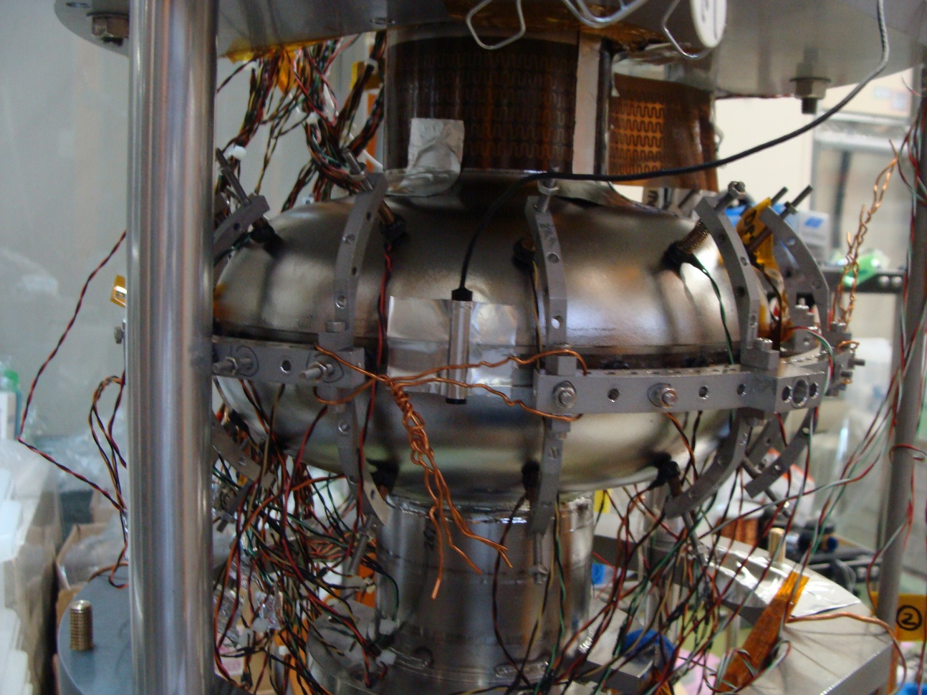
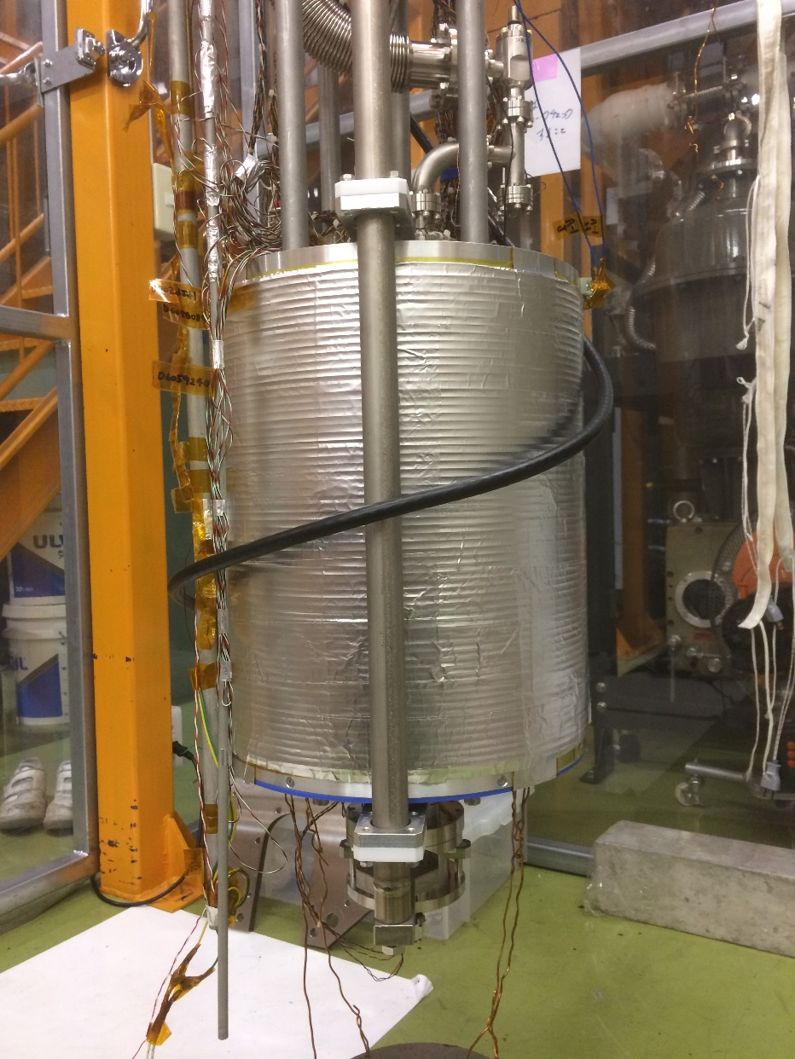
Vertical test setup
Heater
Solenoid coil
Flux gate sensor
Si temperature sensor
(Equator and beamtube)
Flux gate sensor, Si temperature sensor, heater and solenoid coil were used.

Slide 10
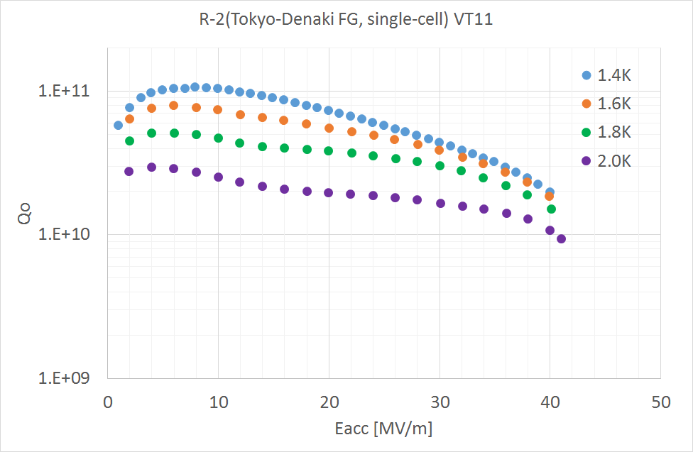
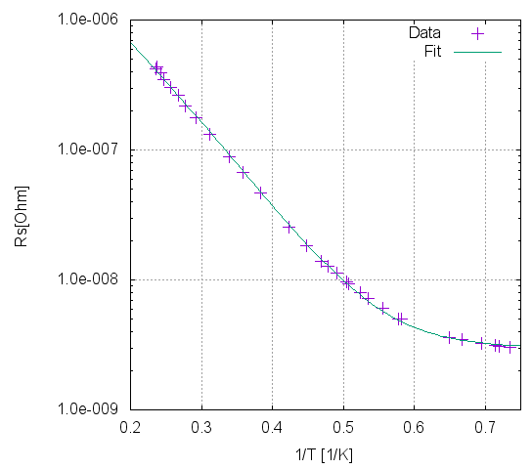
Vertical test results
Rres = 3.0nΩ
FG single-cell cavity (Tokyo-Denkai)
Nominal recipe (Not N-doping)
With cancelling coil
With thermal gradient by heater
Very high-Q was observed after the effort for demagnetization

Slide 11
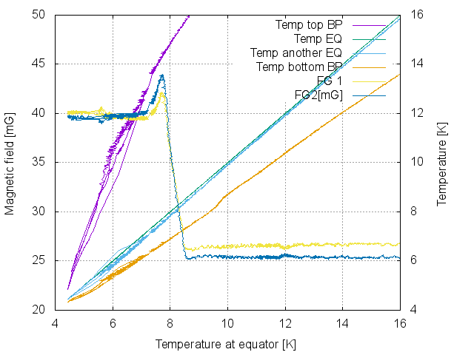
Flux expulsion during cool-down(add 16mG with coil)
Upper beampipe temperature
FG single-cell cavity (ULVAC)
Nominal recipe (Not N-doping)
900 degree heat treatment applied
Add +16mG with coil (Total 9 + 16 = 25mG)
With thermal gradient by heater
Equator temperature
Lower beampipe iris
Clear flux expulsion(~90%) can be observed.
Temperature gradient of more than 1 degree between equator and lower beampipe iris.

Slide 12
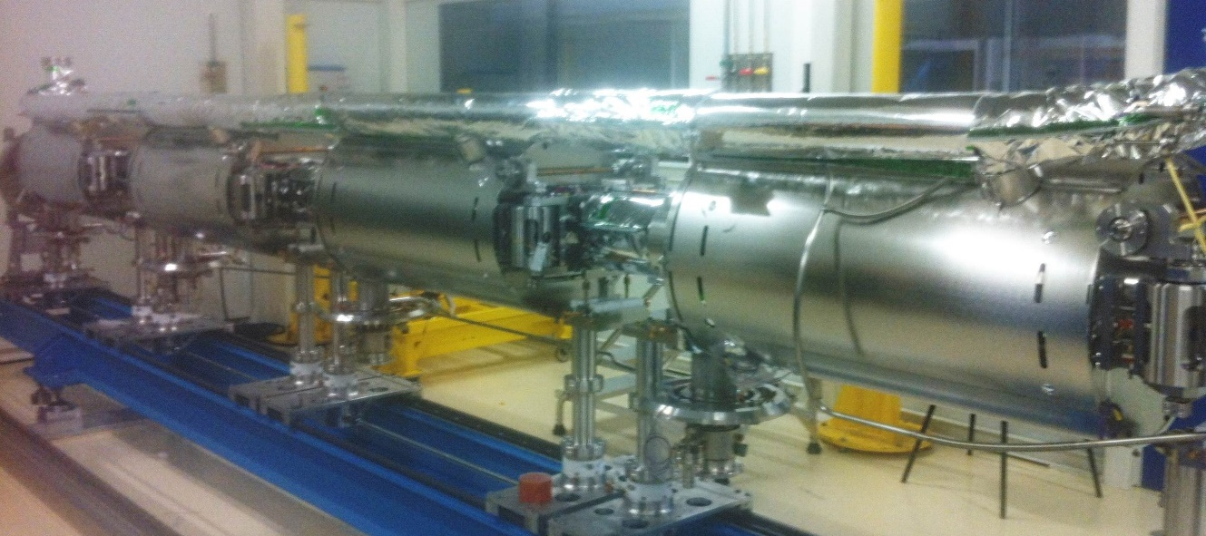
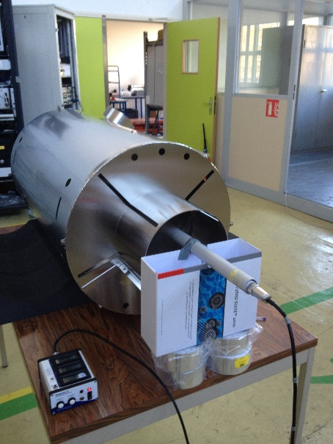
Magnetic shields characterization : ESS
ESS magnetic shield
Cryophy, 2 mm
Diam 0,5 m, L = 1 m
B_{inside} < 0,5 μT
(meas. at room temperature, meas. in LHe are foreseen)

Slide 13
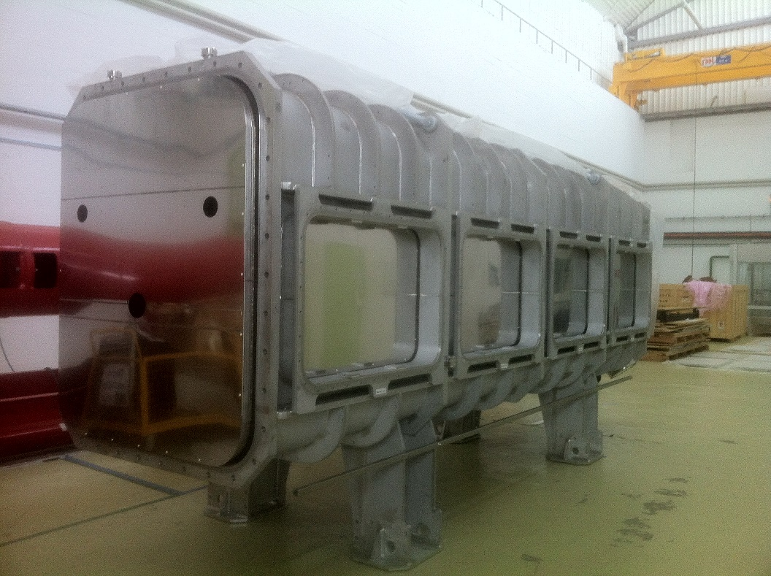
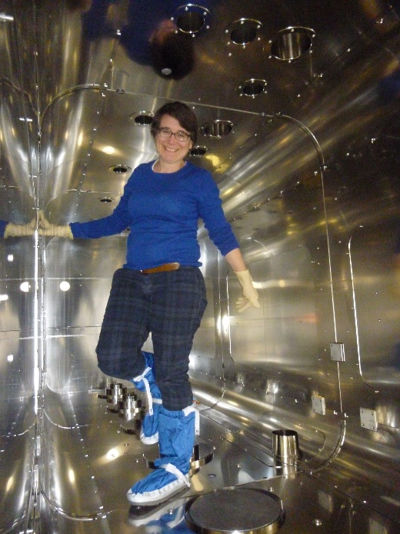
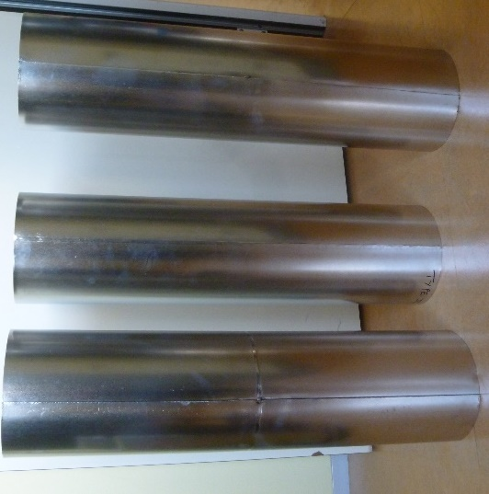
Magnetic shields characterization : IFMIF
IFMIFmagnetic shield
mumetal, 2 mm
l~2 m, L = 6 m
Binside < 0,5 μT
(meas. at room temperature)
IFMIF samples
mumetal, 2 mm
Diam 0,15 m, L = 0,6 m
Binside < 0,05 μT

Slide 14
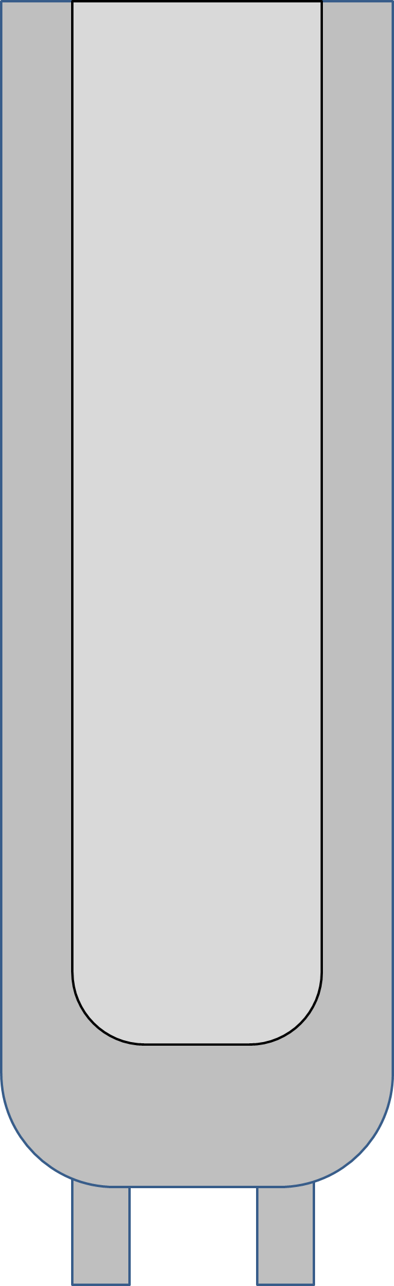
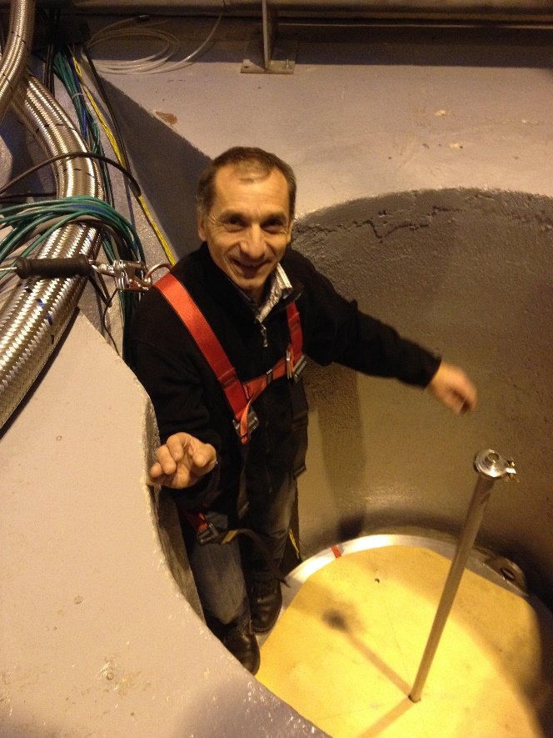
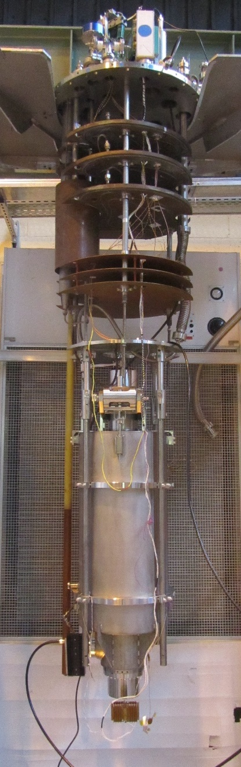
Improvement of the magnetic shield of Vertical Cryostat CV2
cryostat
LHe
Existing magnetic shield (mumetal)
coil
B up to 10 μT
B ≈1 μT
cavity
Extra magnetic shield (Cryophy)
Measurement of B field inside the cryostat

Slide 15
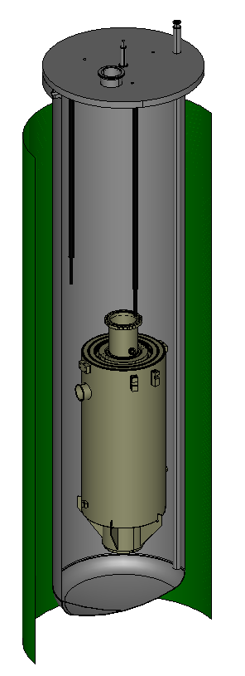
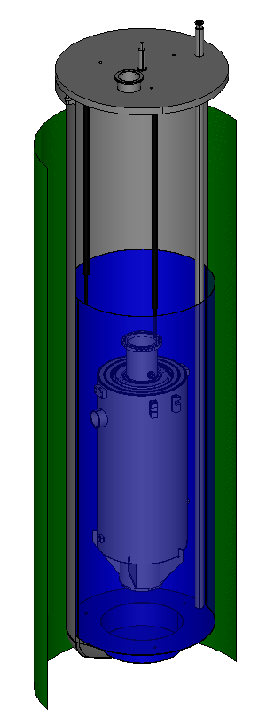
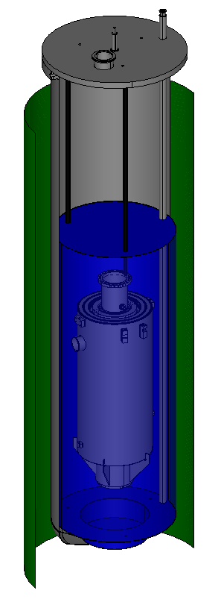
Design of the extra magnetic shield
w/o extra shield
B up to 10 μT
B ≈1 μT
w/o top plate
Fabrication of this new magnetic shield is planned during 2017
w top plate

Slide 16
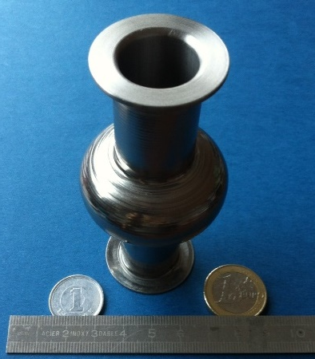
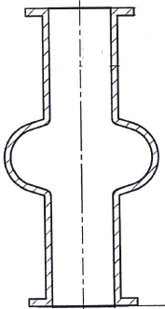
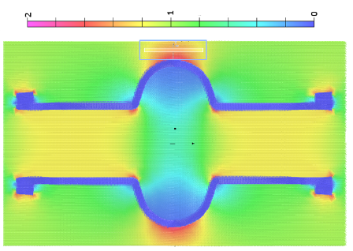
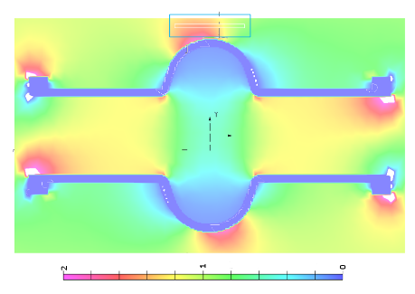
Flux expulsion during cool-down on 6 GHz cavity
Flux expulsion tests planned at Saclay
Monitoring of magnetic field and temperature
We have received a 6 GHz cavity (bulk Nb)
cernox
fluxgate
Flux expulsion calculation
Applied field :
// cavity axis
45°to cavity axis
Cryocooler : better control of gradient and cooldown rate
Cryostat :cavity in a vacuum vessel placed in a cryostat

Slide 17
Summary
At KEK
Effort has been achieved to eliminate magnetized elements in the vertical test cryostat
  High Q could be measured on a cavity
  Clear flux expulsion signal could be observed
New magnetic shields have been designed, fabricated and tested
  ⇨ field around cavities < 0.5 μT
Improvement of the magnetic shield of the vertical test cryostat is planned
Flux expulsion on 6 GHz cavity is foreseen
At CEA
KEK and CEA collaborate together within the international effort to high Q superconducting cavities

