Slide 1
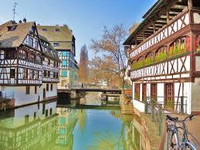
A_RD_8: Fast luminosity monitoring and background measurements at SuperKEKB
Presented by P. Bambade, LAL-Orsay, Univ. Paris-Sud, IN2P3/CNRS
on behalf of A_RD_8 collaboration
Joint TYL/FJPPL-FKPPL Workshop
Strasbourg, 10-12 may 2017

Slide 2
A_RD_08: Fast luminosity monitoring and background measurements at SuperKEKB
LAL-Orsay
Cécile Rimbault – DEPACC, LAL
Philip Bambade – DEPACC, LAL
Viacheslav Kubytskyi – DEPACC, LAL (end 2017/09)
Didier Jehanno – SERDI, LAL
Yann Peinaud – SDTM, LAL
Dima El Kechen – PhD stud. (end 2016/12)
Pang Chengguo – PhD stud. (begin 2016/9)
Salvatore Di Carlo- PostDoc (begin 2017/06)
KEK
Sadaharu Uehara – INPS, KEK
Yoshihiro Funakoshi – ACCL, KEK
Mika Masuzawa – ACCL, KEK
Toshiyuki Oki – ACCL, KEK
Takashi Kawamoto – ACCL, KEK
Collaboration with Isabelle Ripp-Baudot et al. (IPHC-Strasbourg) :
TYL-FJPPL / FLAV_01: Characterization of the SuperKEKB beam induced background during the BEAST II commissioning of the Belle II experiment
→ LAL is joining the recently established Multi-National Partnership Project “R&D for high luminosity colliders”, led by KEK, with CERN SLAC, INFN, (+IHEP)
→ Application for Belle-II membership now underway at LAL and IPHC…

Slide 3
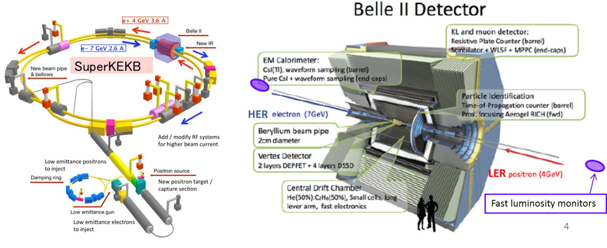
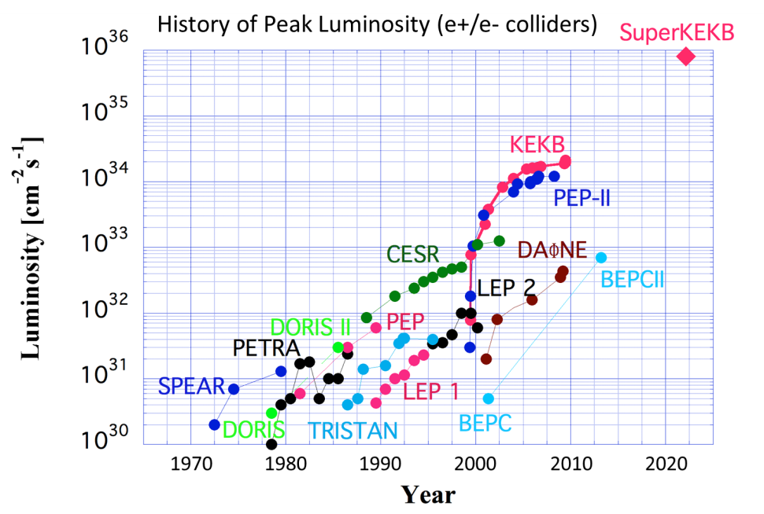
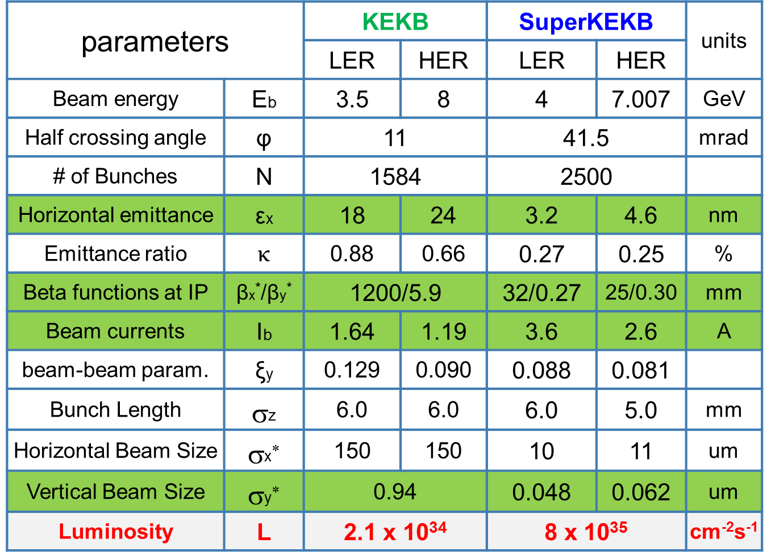
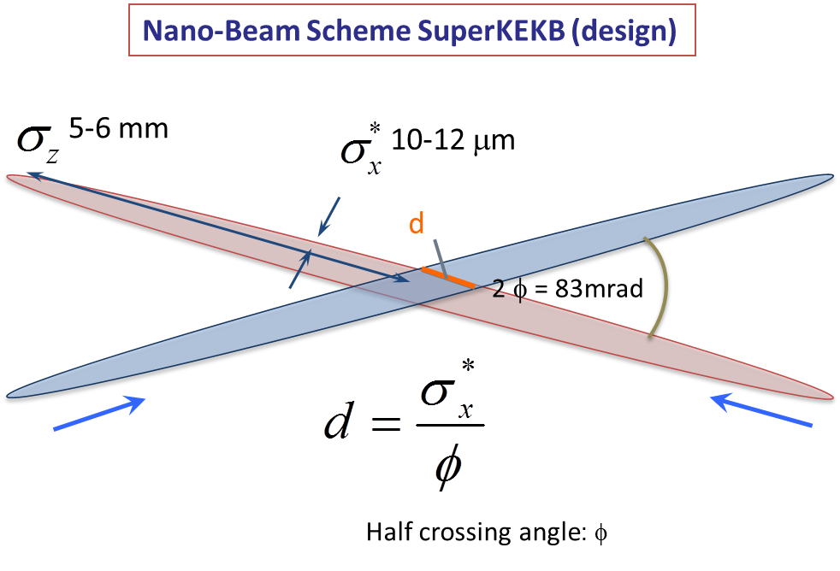
SuperKEKB and Belle-II
Luminosity monitoring & tuning
Control beam induced backgrounds
e⁺e⁻ collider for Belle II experiment
Υ(4s) 10.6 GeV cms (E₊ = 4 GeV, E₋ = 7 GeV)
L = 8 10³⁵ cm⁻²s⁻¹:
nano-beam scheme
tiny beam sizes ( σ_{y} = 60 nm)
large crossing angle (83 mrad)
high currents
2500 bunches
4 ns bunch spacing
1) Phase 1 : 2016/Feb. → Jun.
- single beam commissioning, vac. scrubbing
- no luminosity (no final focus), no detector
2) Phase 2 : 2018/Jan. → Jun.
- colliding beam commissioning, no vertex detector
3) Phase 3 : from 2018/end
- full luminosity for physics running
β_{y} = 300 μm
d ∼ 300 μm
→ Lumi × 40
→ mitigates beam-beam and hour-glass effects…

Slide 4
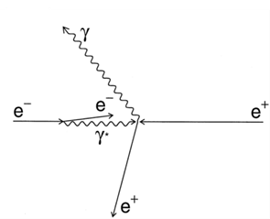
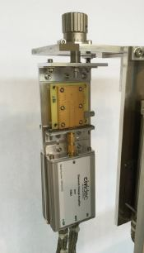
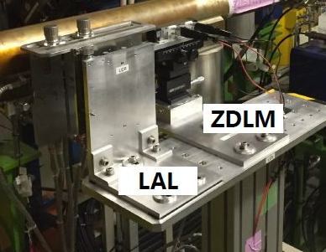
Fast Luminosity Monitoring at LAL ↔ KEK
Goal: Realization of a fast luminosity monitor based on radiative Bhabha scattering measurements for SuperKEKB luminosity feedback, tuning and backgrounds studies (BEAST).
  Aimed precision for Train Integrated Luminosity (TIL): δL/L ∼ 10 ⁻² to 10⁻³ in 1 to 10ms
  Fast signal from each bunch crossing for Bunch Integrated Luminosity (BIL),
  2500 bunches/train, collisions every 4 ns
Measure the radiative Bhabha process at vanishing photon scattering angle
  Rate proportional to Luminosity
  Large cross section ∼ 0.2 barn
Two complementary techniques developed at LAL and KEK:
  ∼ 5x5x0.5 mm³ single crystal CVD diamond sensors (CVD DS) pairs coupled to fast charge / current amplifiers (LAL)
  Cerenkov detector + scintillator (ZDLM group @ KEK)
positioned together outside of the beam pipe
Two optimized locations fixed in 2014 and 2015:
- In High Energy Electron Ring : 30m downstream the Interaction Point for Bhabha photon detection
- In Low Energy Positron Ring : 11.9m from IP for Bhabha scattered positron detection

Slide 5
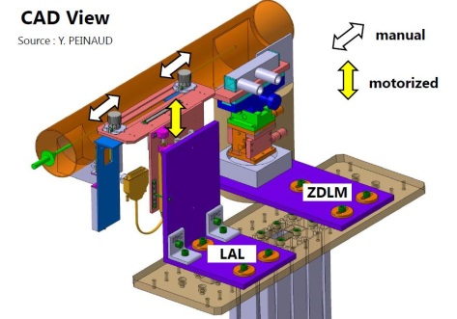
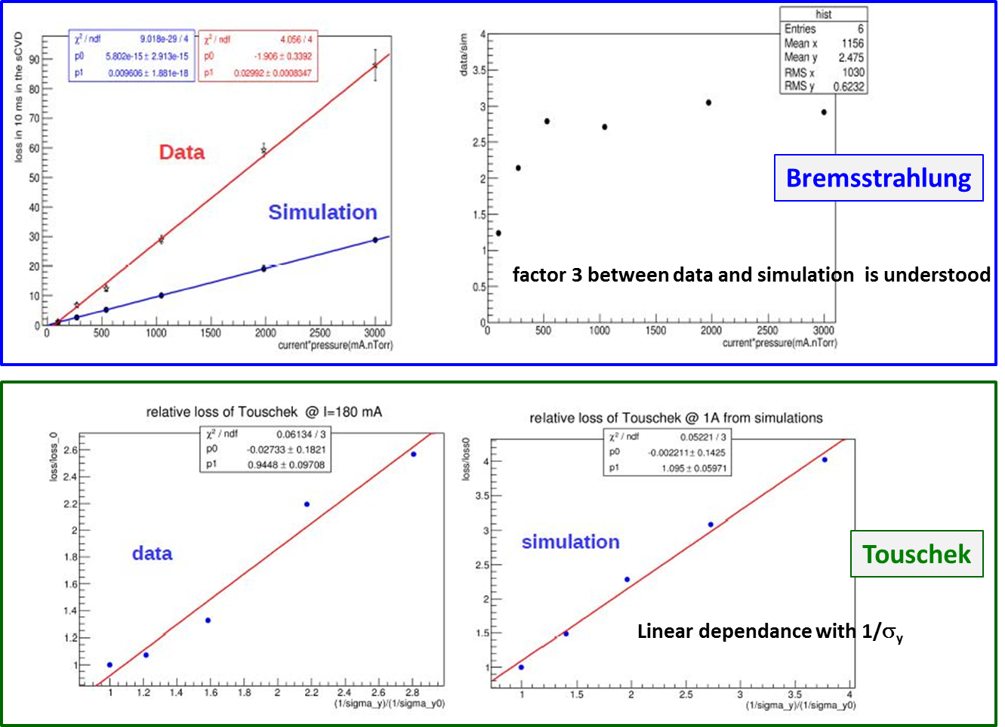
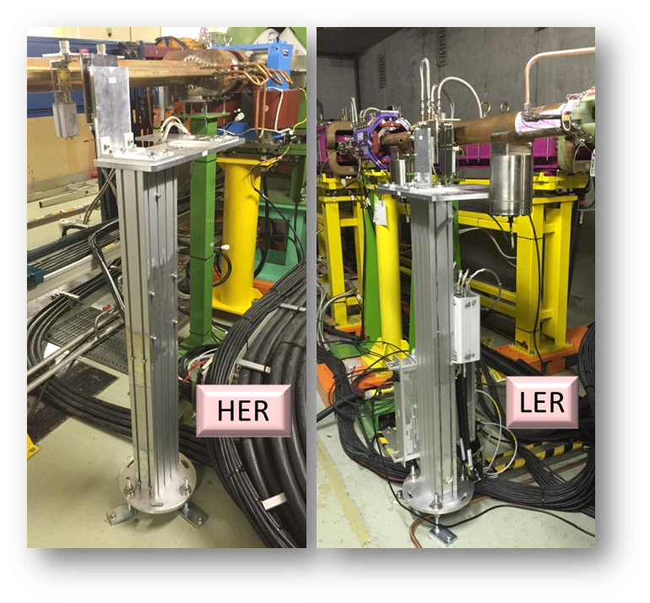
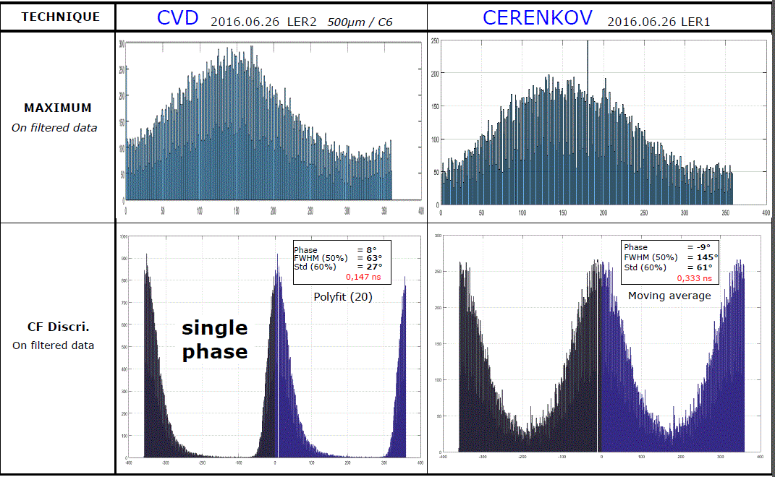
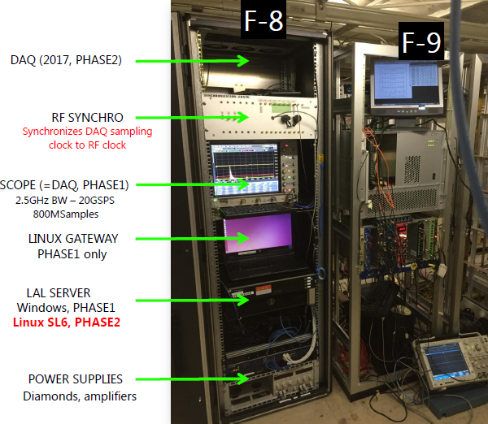
Fast Luminosity Monitoring: Commissioning phase 1
End 2015: Joint installation of 2 X 2 sets of diamond sensors and ZDLM detector @ SuperKEKB
February 2016 ➔ June 2016: Phase 1 of SuperKEKB commissioning
  Single beam background measurements (bremsstrahlung + Touschek): 5 TB of data collected
  Scripts and GUI for continuous data taking and processing/post processing analysis (→ phases II and III)
  Comparison between CIVIDEC / LAL sensors and charge/ voltage amplifiers
  LER background analysis as function of current, pressure and beam sizes → compare with simulations:
  - Separation of losses from Touschek / Bremstrahlung processes
  - good agreement with simulation → validate prediction for luminosity measurements. S/B ∼ 100
  Diamond signal / RF clock synchronization check
  Diamond sig
0,147ns
0,333ns

Slide 6
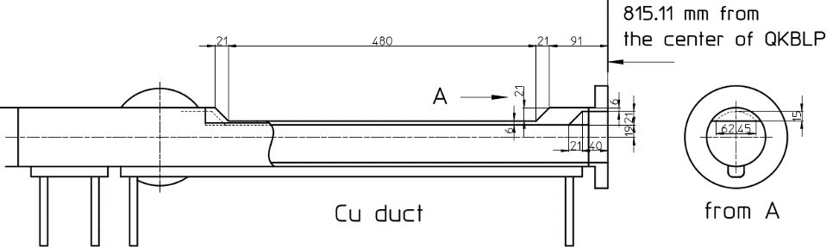
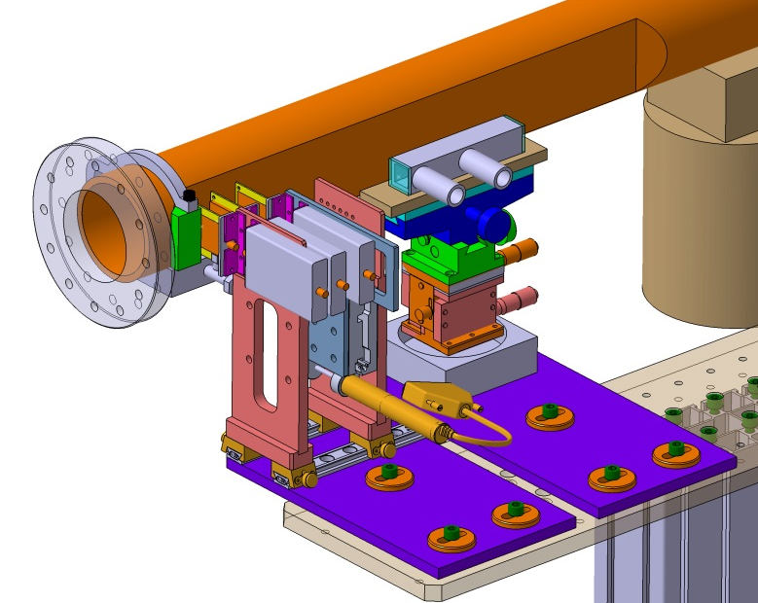

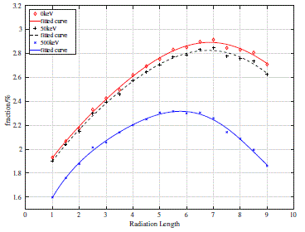

July 2016 → December 2017 : Prepare phase 2 commissioning (1)
Development of FPGA based DAQ for the phase II :
  ➔Luminosity firmware development:
  signal pulse reconstruction algorithm: A1-A4
  ➔test on Train Integrated Lumi (TIL) & Bunch
  Integrated Lumi (BIL) reconstruction: almost validated
Installation of a window in LER (confirmed for spring 2017)
➔ Adaptation of existing pillar for phase 2
➔ radiator design study: trapezoid shape Tungsten radiator
with thickness of 6*RL will be used.
Fraction of detected Bhabha which can be achieved in 140$μm$ DS with different thickness radiator

Slide 7
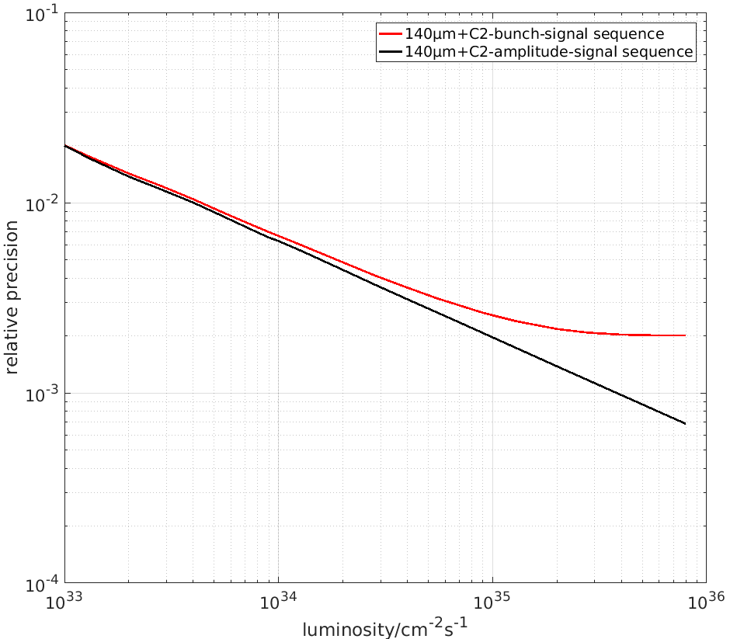
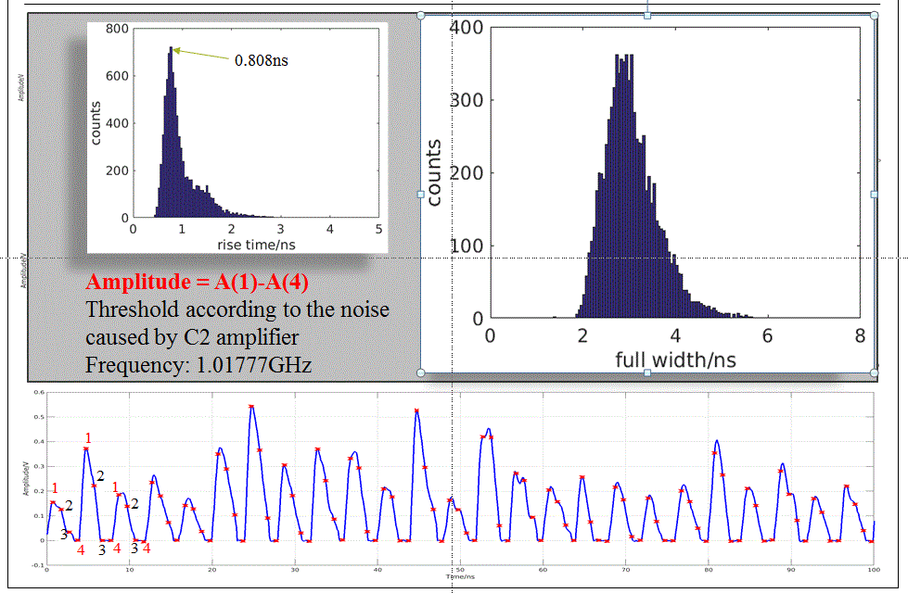
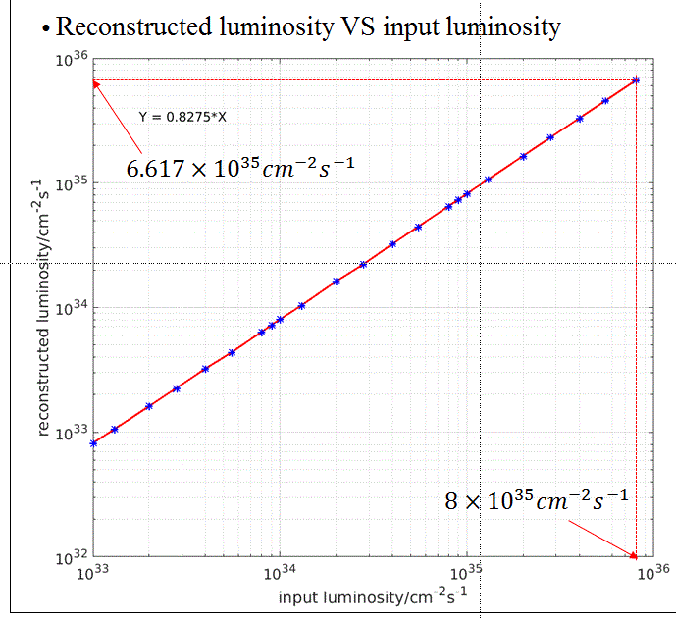


July 2016 → December 2017 : Prepare phase 2 commissioning (2)
Development of FPGA based DAQ for the phase II :
  ➔Luminosity firmware development:
  signal pulse reconstruction algorithm: A1-A4
  ➔test on Train Integrated Lumi (TIL) & Bunch
  Integrated Lumi (BIL) reconstruction: almost validated
Installation of a window in LER (confirmed for spring 2017)
➔ Adaptation of existing pillar for phase 2
➔ radiator design study: trapezoid shape Tungsten radiator
with thickness of 6*RL will be used.
New thin diamond + broadband amplifier signal study:
Good timing performance of the signal of 140𝜇𝑚 DS coupled with
C2 current amplifier → expect to achieve specified relative precision !
$$2.0037×{10}^{−3}$$
$$6.8725×{10}^{−4}$$
some
pile-up ?

Slide 8
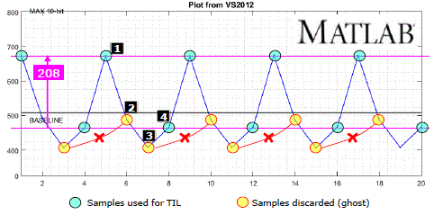
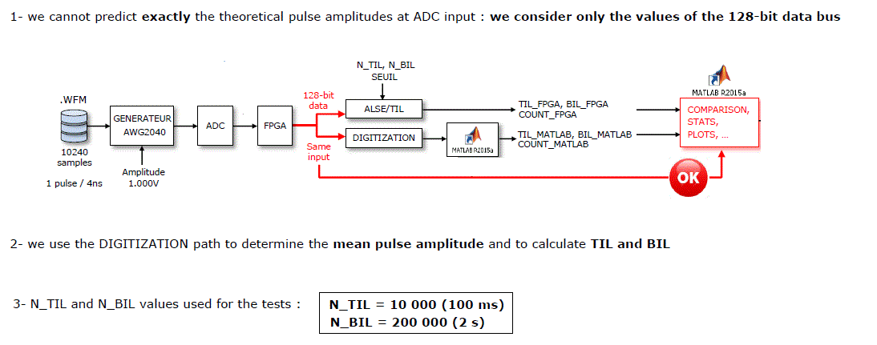
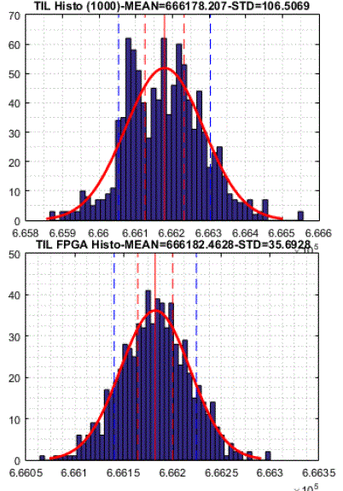
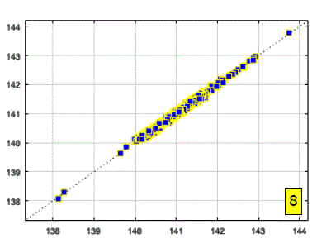
July 2016 → December 2017 : Prepare phase 2 commissioning (3)
Development of FPGA based DAQ for the phase II :
  ➔Luminosity firmware development:
  signal pulse reconstruction algorithm: A1-A4
  ➔test on Train Integrated Lumi (TIL) & Bunch Integrated Lumi (BIL) reconstruction: almost validated
Matlab BIL reconstruction vs FPGA BIL reconstruction
Matlab TIL reconstruction
Same mean value
FPGA TIL reconstruction

Slide 9
July 2016 → December 2017 : Prepare phase 2 commissioning (4)
Development of FPGA based DAQ for the phase II :
  ➔Luminosity firmware development:
  signal pulse reconstruction algorithm: A1-A4
  ➔test on Train Integrated Lumi (TIL) & Bunch
  Integrated Lumi (BIL) reconstruction: almost validated
Installation of a window in LER (confirmed for spring 2017)
➔ Adaptation of existing pillar for phase 2
➔ radiator design study: trapezoid shape Tungsten radiator
with thickness of 6*RL will be used.
New thin diamond + broadband amplifier signal study:
Good timing performance of the signal of 140𝜇𝑚 DS coupled with
C2 current amplifier → expect to achieve specified relative precision !
New simulations of phase 2 backgrounds
More detailed HER evaluation (phase 1→ 2/3)
Software developments (DAQ GUI, EPICS integration, hardware control coding (power supply…))

Slide 10
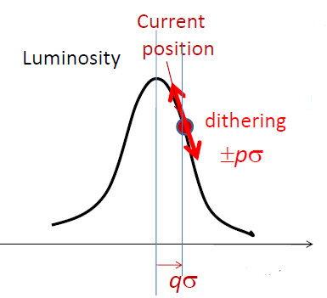
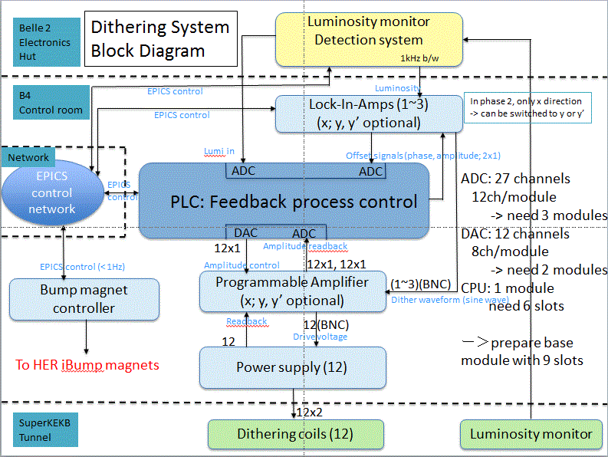

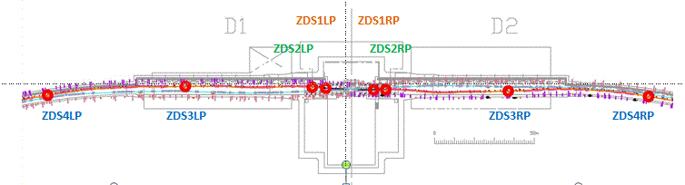
Fast luminosity monitoring - Plan for 2018 (and beyond... ) (1)
01/2018-06/2018: tests during phase II of SuperKEKB commissioning
- Bhabha acquisition and first luminosity measurement tests
- Single beam background characterization
- Luminosity DAQ output provided to the SuperKEKB monitoring system and dithering system tests:
8 locations for the dithering coils in LER around IP.

Slide 11
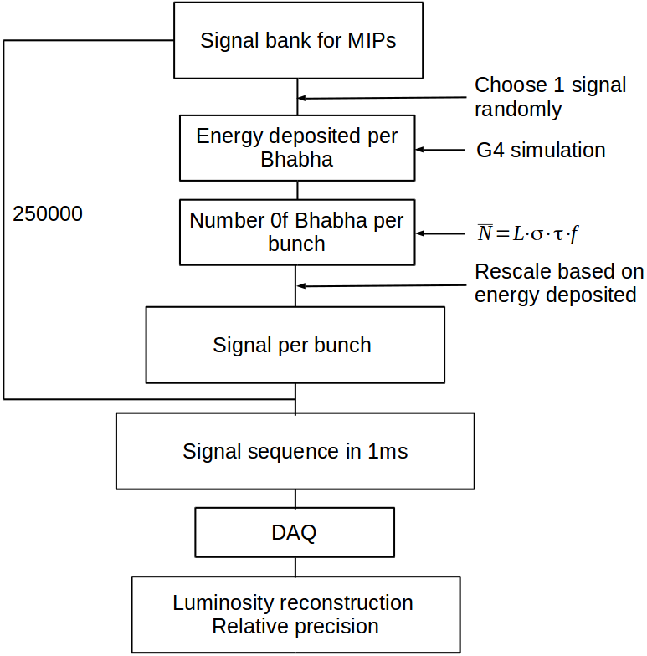
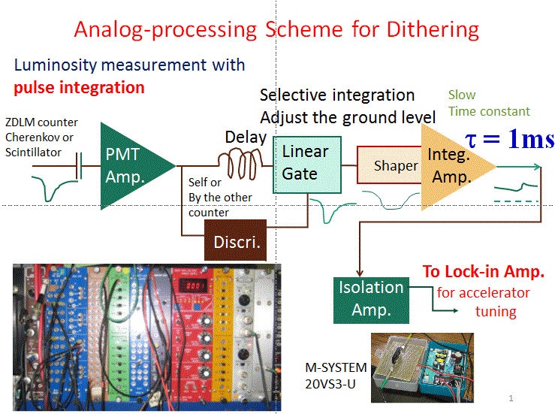
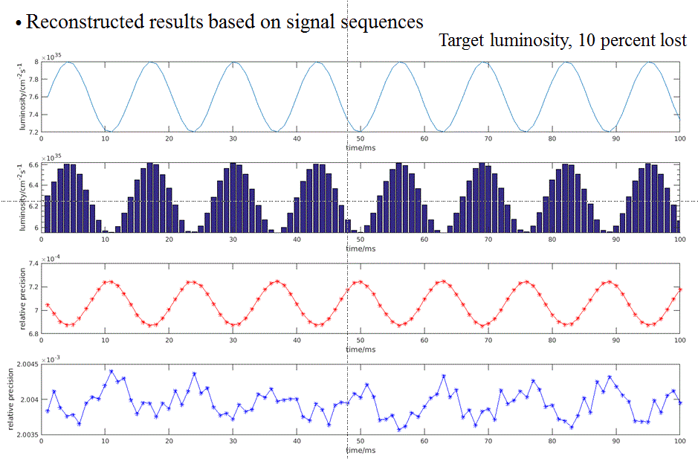
Fast luminosity monitoring - Plan for 2018 (and beyond… ) (2)
01/2018-06/2018: tests during phase II of SuperKEKB commissioning
- Luminosity DAQ output provided to the SuperKEKB monitoring system and dithering system tests:
Dithering simulation
(diamond sensors)
Pseudo-pulse dithering test (ZDLM)
Pseudo-pulses generated by Arbitrary Wave Generator;
F = ∼ 400kHz modulated by ±3% by the Dithering Frequency 77Hz (test INPUT to the circuit)
Pseudo-signal of the lumi change oscillating by the dithering freq. with a ±3% variation (the resulting-in OUTPUT from the circuit)
100 ms
100 ns

Slide 12
Fast luminosity monitoring - Plan for 2018 (and beyond… ) (3)
01/2018-06/2018: tests during phase II of SuperKEKB commissioning
- Bhabha acquisition and first luminosity measurement tests
- Single beam background characterization → BEAST
- Luminosity DAQ output provided to the SuperKEKB monitoring system dithering system tests
End of 2018 and from 2019 : Phase III = first Belle-II runs and after
- New single beam and beam-beam background characterization
- Operating fast lumi monitoring system for SuperKEKB monitoring and feedback
- Probe non linear QED from strong beam-beam interactions with nanometre beam size
- Evaluation of machine-detector interface (BEAST)
- Belle-II perspective
Belle II and Electronics-Hut Rolled In
for the Collision Point on 12 April 2017

Slide 13
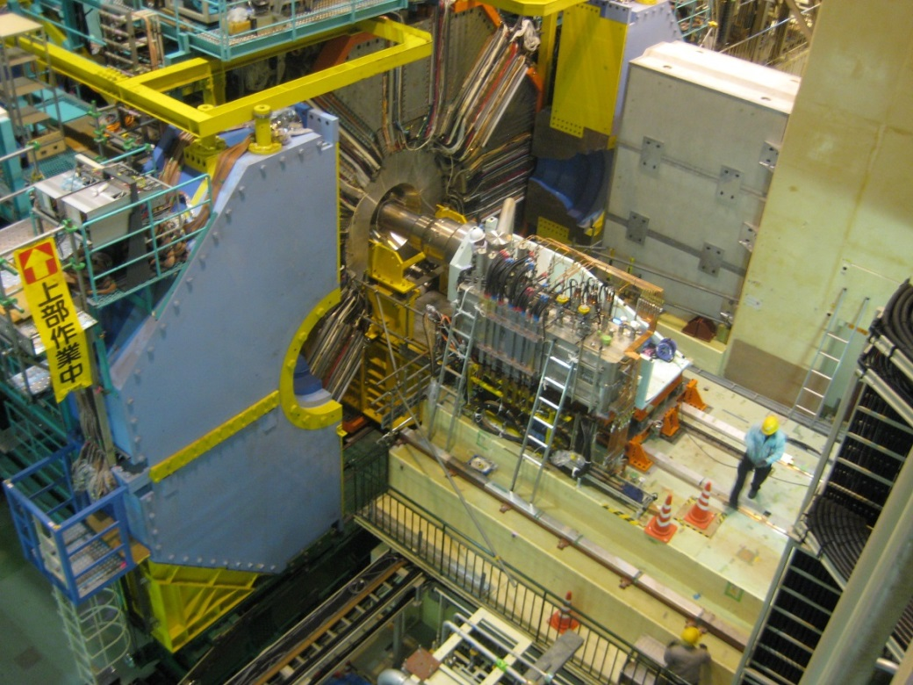
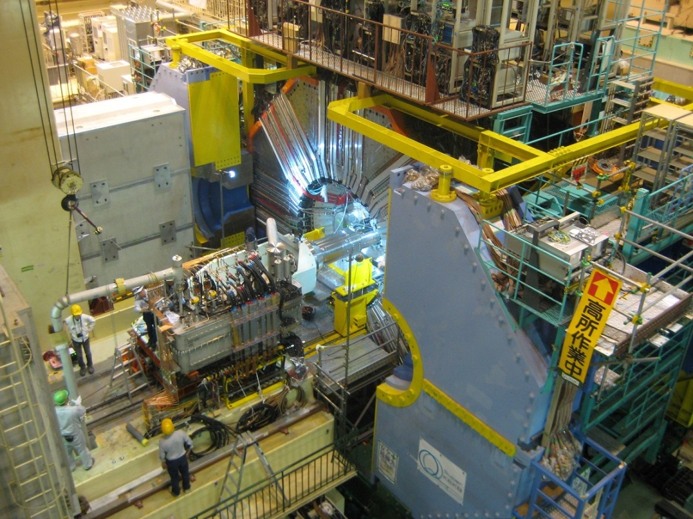
QCS Magnets for the World-Highest Luminosity
QCSR: Positron’s upstream
QCSL: Electron’s upstream

Slide 14
Back-up

Slide 15
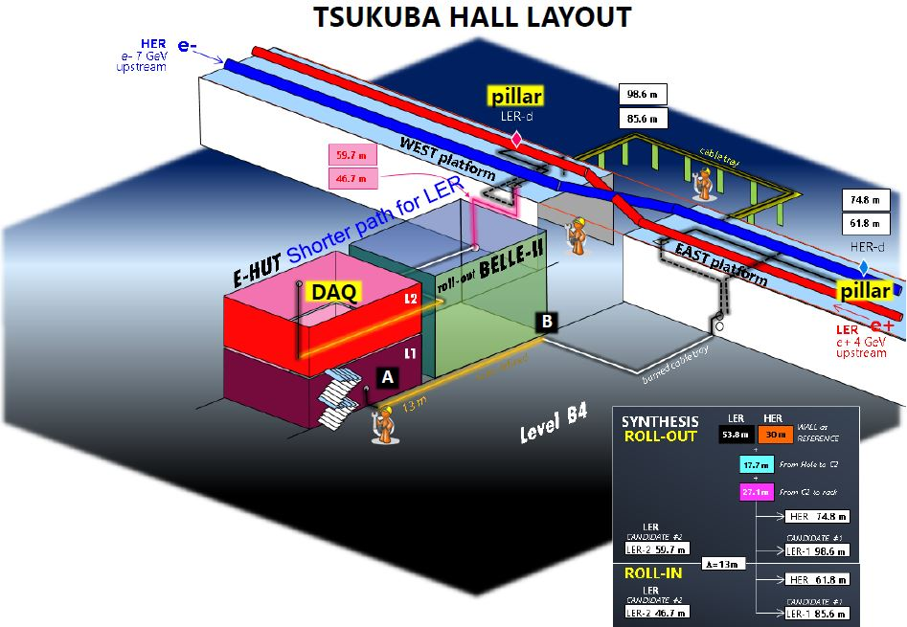

Slide 16
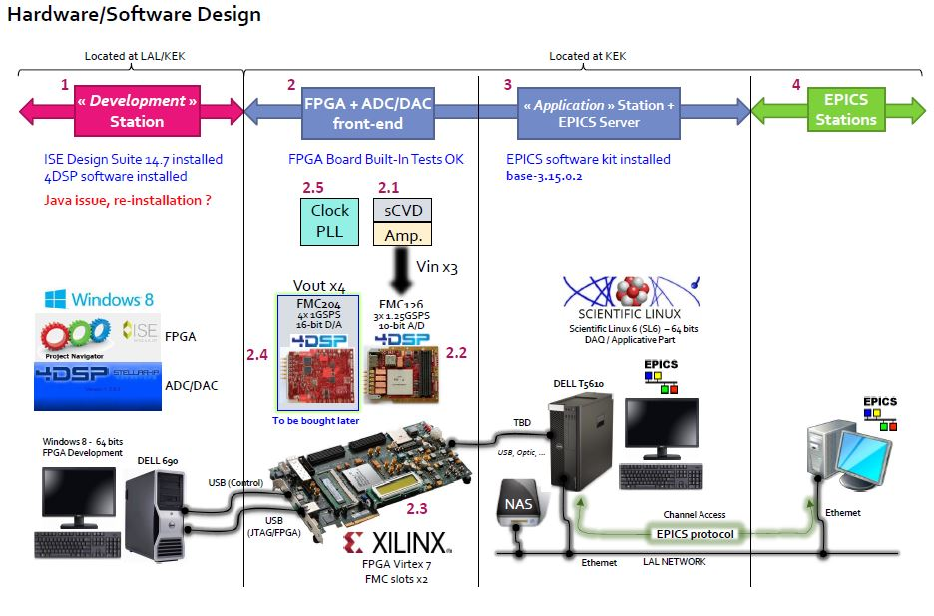
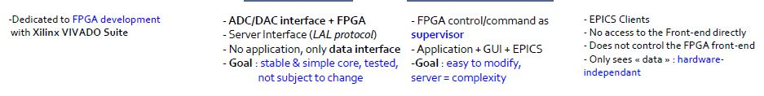
READOUT

