Slide 1
JSPS Programs for Japan-France Collaboration
Japan Society for the Promotion of Science
Hiroyuki MIYAMOTO
Director
JSPS Strasbourg Office
May 10, 2017

Slide 2
Introduction of JSPS
The Japanese largest funding agency
Established through an endowment by Emperor Showa in 1932.
Rooster:
Harbinger of new knowledge that promises a brilliant future for humankind.
Photo of JSPS steering meeting
in May 1937.
The first funding began in 1939.

Slide 3
Funding Agency for « Science »
JSPS policy: Supporting curiosity-driven researches in natural/social sciences, engineering and humanities. No priority field.
JSPS funds:
Grant to research projects: (Grant-in-Aid, “KAKENHI”: €2,000,000,000 / 70,000 projects)
For researchers at Japanese Institutions, regardless of their nationality.
Fellowships: 6,000 Japanese pre-/post-docs.
International collaborations: Bi- & multi-lateral etc.

Slide 4
Four Major Missions
Support for research initiatives
Competitive research funding: Grants-in-Aid
Fostering the next generation of researchers
Research fellowships for young scientists
Support for university reform
Joint programs with MEXT
International collaborations
Collaborations with overseas partners
｀｀｀｀｀｀｀｀｀
Mobility by International programmes (per year): 10,000 researchers from pre-docs to professors

Slide 5
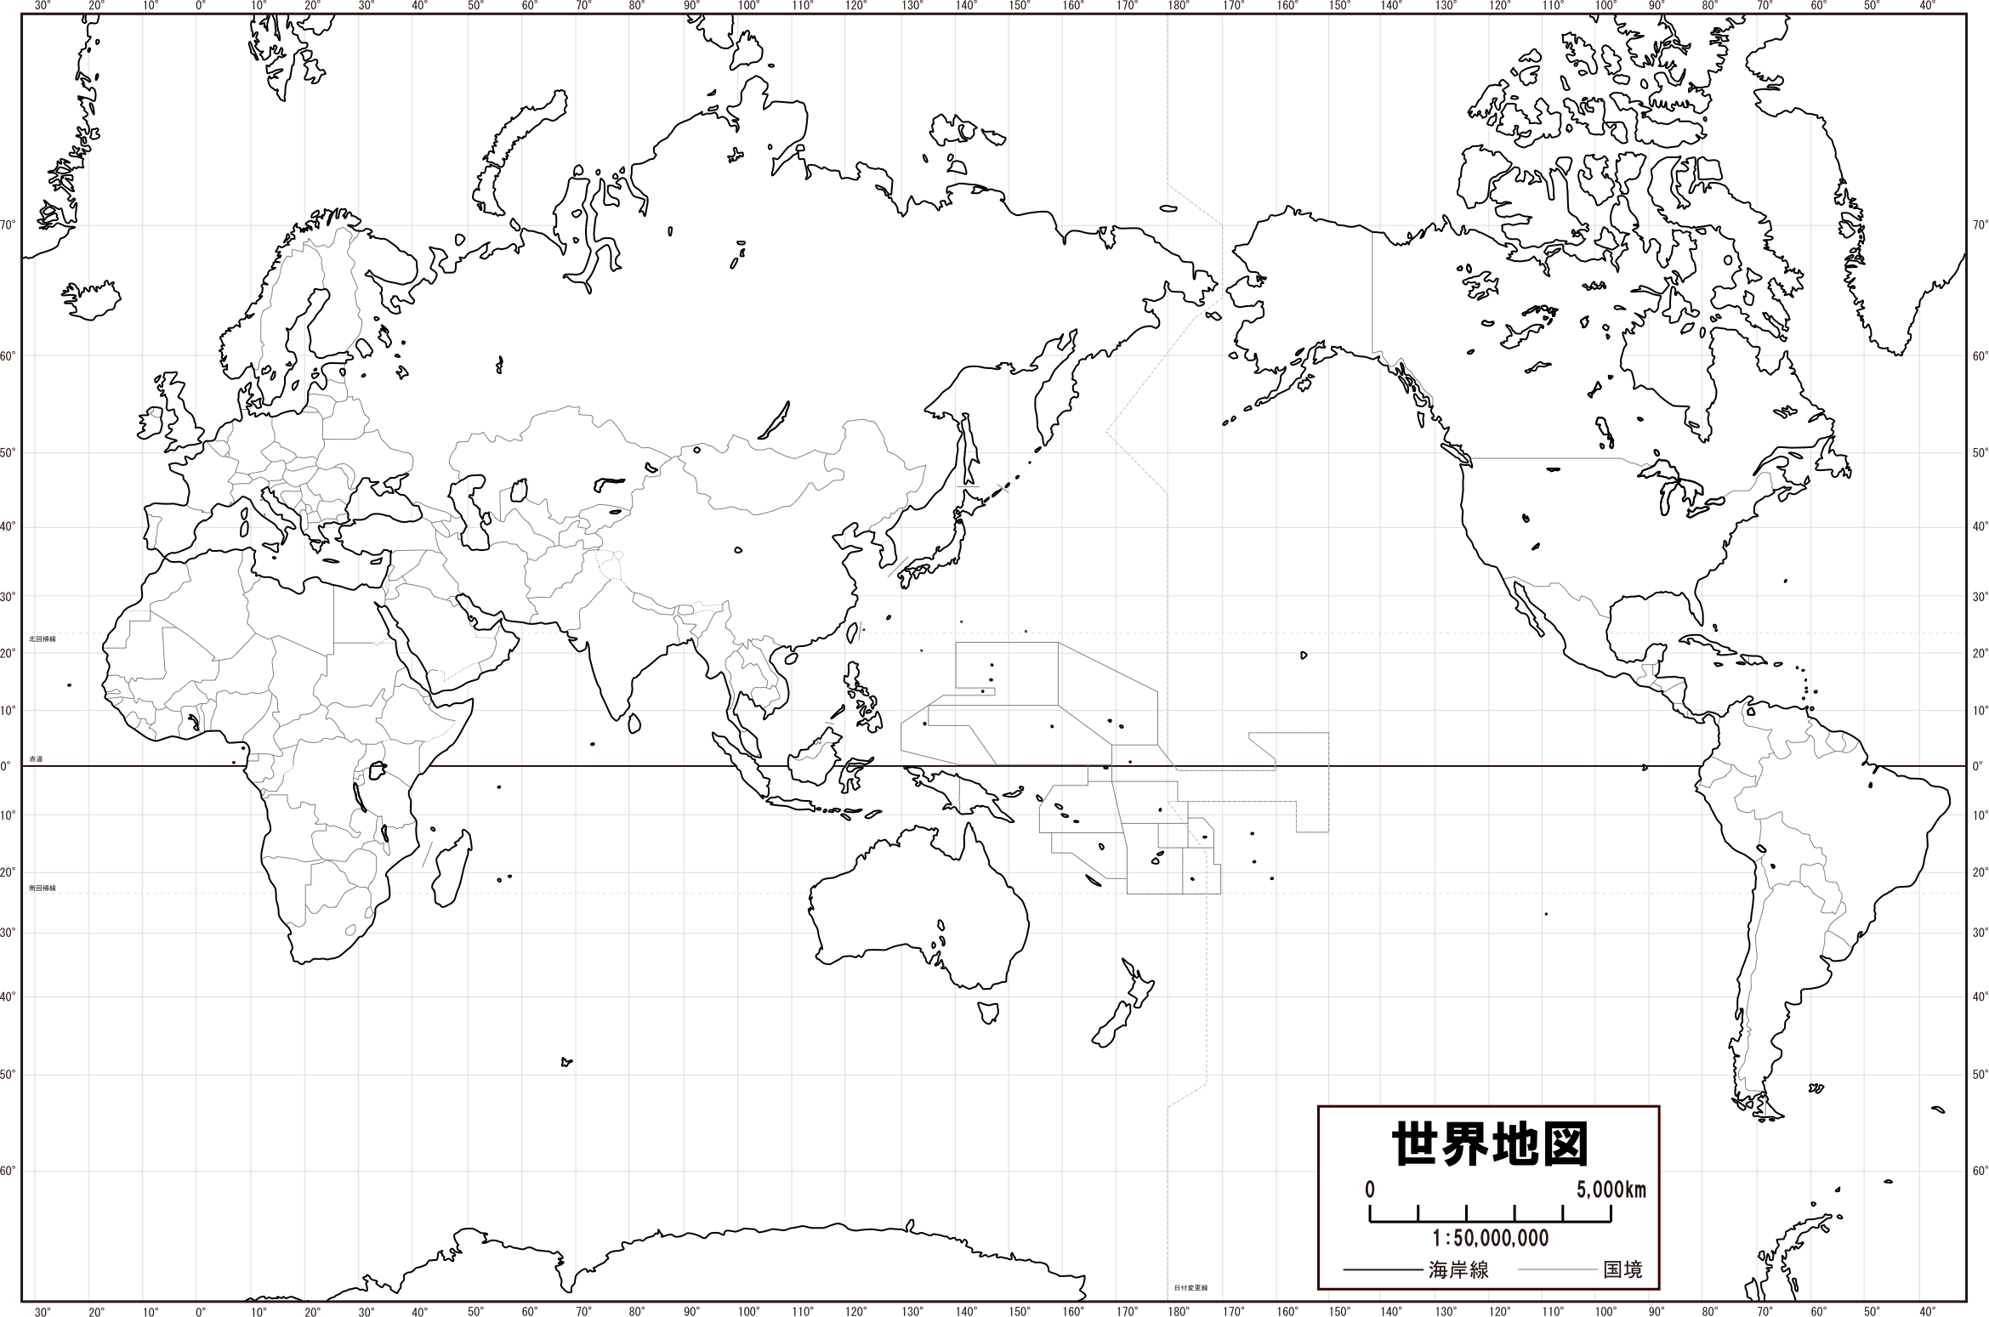
Four Offices in Europe, 10 in the World
JSPS Stockholm Office
JSPS London Office
JSPS Bonn Office
JSPS Tokyo
JSPS Strasbourg Office
JSPS Beijing Office
JSPS San Francisco Office
JSPS Washington Office
JSPS Cairo Research Station
JSPS Bangkok Office
JSPS Nairobi Research Station
JSPS
Around the World

Slide 6
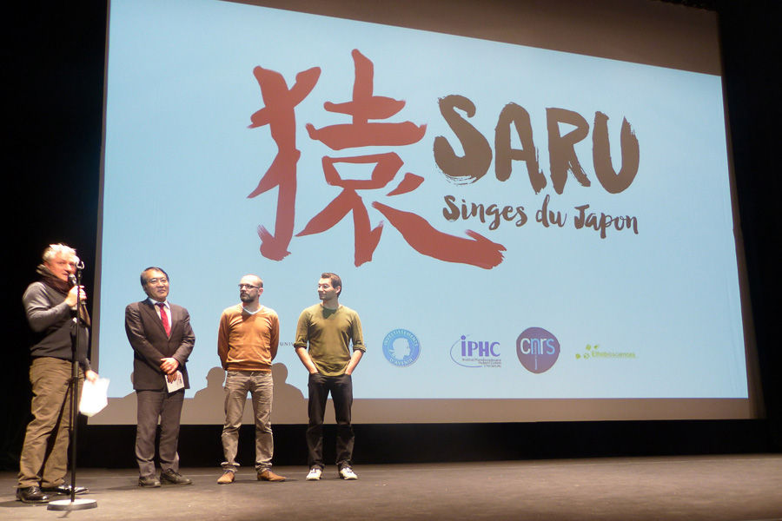
JSPS works with IHPC

Slide 7
International Collaboration Programs
{
Multilateral
Institution
Core-to-Core Programs
{
Bilateral
Group
Based on MoUs
Open Partnership Joint Projects/Seminars
{
France → Japan
Individual
Postdoctoral Fellowships
Invitation Fellowships
Japan → France
Postdoctoral Fellowships for Research Abroad
Research Fellowships for Young Scientists
Overseas Challenge Program for Young Researchers

Slide 8
Core-to-Core Programs, Bilateral Programs & Fellowships
Researcher
Host
Visiting researchers are encouraged
to do collaborative works in host rsearchers’s labs.
Host
Researcher

Slide 9
International Collaboration Programs
{
Multilateral
Institution
Core-to-Core Programs
{
Bilateral
Group
Based on MoUs
Open Partnership Joint Projects/Seminars
{
France → Japan
Individual
Postdoctoral Fellowships
Invitation Fellowships
Japan → France
Postdoctoral Fellowships for Research Abroad
Research Fellowships for Young Scientists
Overseas Challenge Program for Young Researchers

Slide 10
France → Japan
Postdoctoral Fellowships & Invitation Fellowships
Postdoctoral
(within 6 years
after PhD)
Distinguished
Professor
Master
PhD
Mid Career
Professor
(M2 recherche)
Postdoctoral Fellowships
Invitation Fellowships
Standard
1 to 2 years
Long-term Short-term Short-term S
61 days- 14 - 60 days 7 - 30 days
10 months
Short-term
1 to 12 months
Support all research fields
More than 300 researchers from
France each year
Summer Program
(2 months)

Slide 11
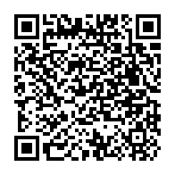
France → Japan
Postdoctoral Fellowships & Invitation Fellowships
Eligibility, Duration of stay, etc.
CNRS : Major partner in France
http://www.jsps.go.jp/english/programs/index.html

Slide 12
International Collaboration Programs
{
Multilateral
Institution
Core-to-Core Programs
{
Bilateral
Group
Based on MoUs
Open Partnership Joint Projects/Seminars
{
France → Japan
Individual
Postdoctoral Fellowships
Invitation Fellowships
Japan → France
Postdoctoral Fellowships for Research Abroad
Research Fellowships for Young Scientists
Overseas Challenge Program for Young Researchers

Slide 13
Bilateral Program based on MoU
MoU
Funding Agencies* etc.
JSPS
Support
Support
Joint projects
Seminars
20,000€/year
for 2 years
Proposal
Proposal
French Researcher group
Japanese Researcher group
*CNRS, Inria, Inserm,
MAEDI, IHES
56 projects in FY 2016
(52 joint projects, 3 seminars

Slide 14
Bilateral Program without MoU
Funding Agencies etc.
JSPS
Open Partnership
Support
Support
Joint projects
Seminars
20,000€/year
for 2 years
8 projects in FY 2016
Proposal
French Researcher group
Japanese Researcher group

Slide 15
International Collaboration Programs
{
Multilateral
Institution
Core-to-Core Programs
{
Bilateral
Group
Based on MoUs
Open Partnership Joint Projects/Seminars
{
France → Japan
Individual
Postdoctoral Fellowships
Invitation Fellowships
Japan → France
Postdoctoral Fellowships for Research Abroad
Research Fellowships for Young Scientists
Overseas Challenge Program for Young Researchers

Slide 16
Core-to-Core Program
Promote International collaboration in cutting-edge fields by creating world-class research hubs,
Foster new generations of talented young researchers in Japan and other countries.
Japan
JSPS
150,000€/year
for 5 years
Core Institution
Cooperating
Institution
Cooperating
Institution
Partner Country A
Partner Country B
Funding Agency
Joint
Research Seminar
Funding Agency
Core Institution*
Core Institution*
Cooperating
Institution
Cooperating
Institution
Cooperating
Institution
Cooperating
Institution
* Their own fund required
Nineteen programs are running with France in FY 2017

Slide 17
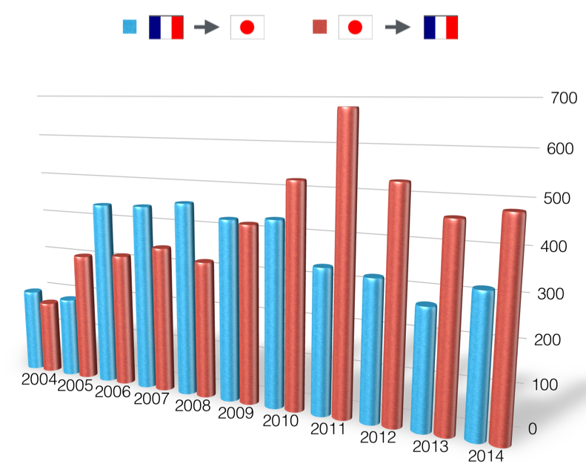
Numbers of Exchanged Researchers
between Japan and France

Slide 18
French Alumni Association of JSPS
628
Maintain and develop linkages with Japan
long-lasting collaboration, not « one time visit. »
Exclusive programs for the members
« BRIDGE fellowship »
Symposiums & Networking events
Honorary President : Prof. Jean-Marie Lehn

Slide 19
French Alumni Association of JSPS
10th Anniversary of foundation
April 17, 2015 at the Residence of Ambassador of Japan in Paris
Conference by Prof. Jean-Marie Lehn, JSPS Fellow, Nobel Chemistry Laureate in 1987
Honorary President : Jean-Marie Lehn

Slide 20
Merci de votre attention

