Slide 1
Injector, RF Power & Frequency Variation
Erk Jensen, CERN

Slide 2
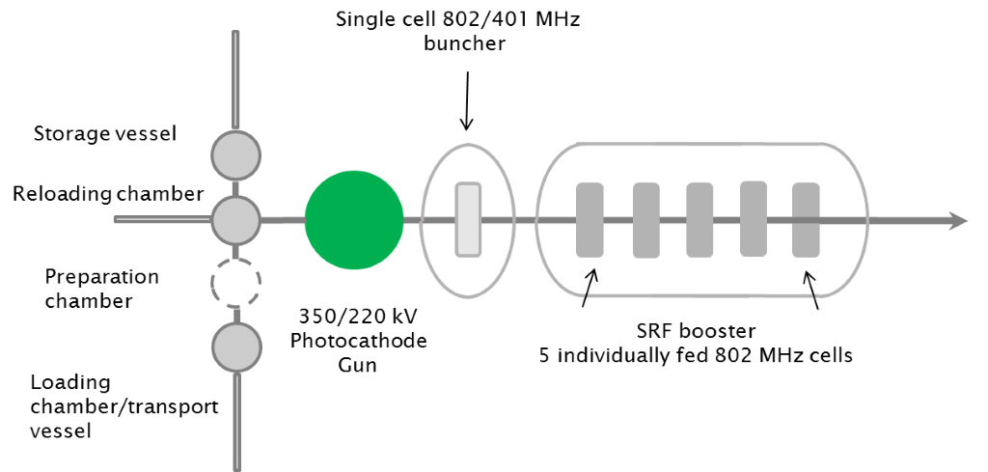

Injector
Preferred concept: Photocathode, DC gun with SRF accelerator (buncher & booster)
LASER allows flexible bunching sequence!
Nominal repetition rate: $40.1 MHz$(20th subharmonic of $802 MHz$)
Nominal bunch charge: $2∙{10}^{9}e=320 pC$ ($320 pC∙40 MHz=12.8 mA$)

Slide 3
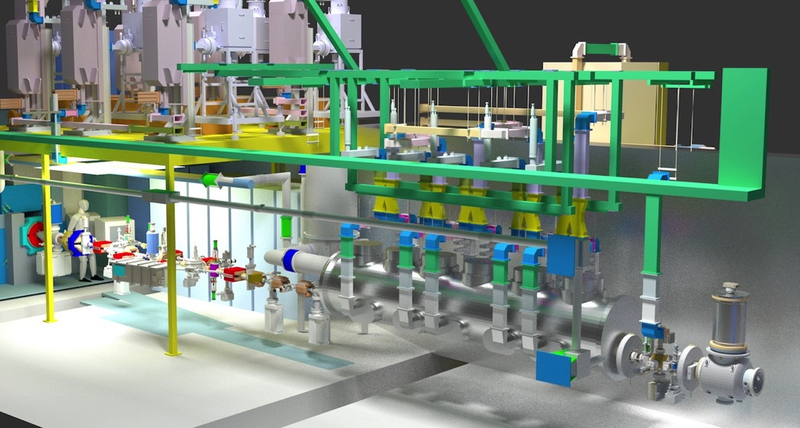
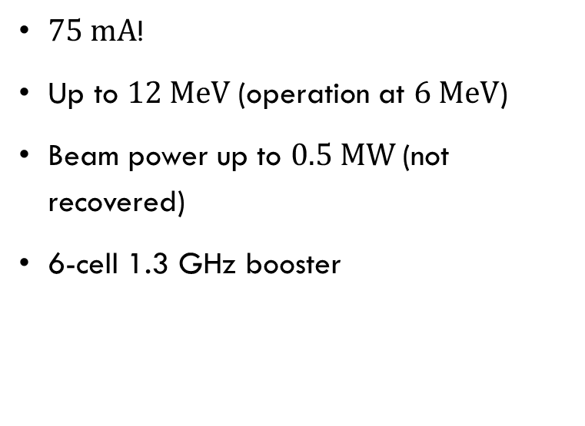
Example: CBETA injector
$75 mA$!
Up to $12 MeV$(operation at $6 MeV$)
Beam power up to $0.5 MW$(not recovered)
6-cell 1.3 GHz booster
Georg Hoffstaetter

Slide 4
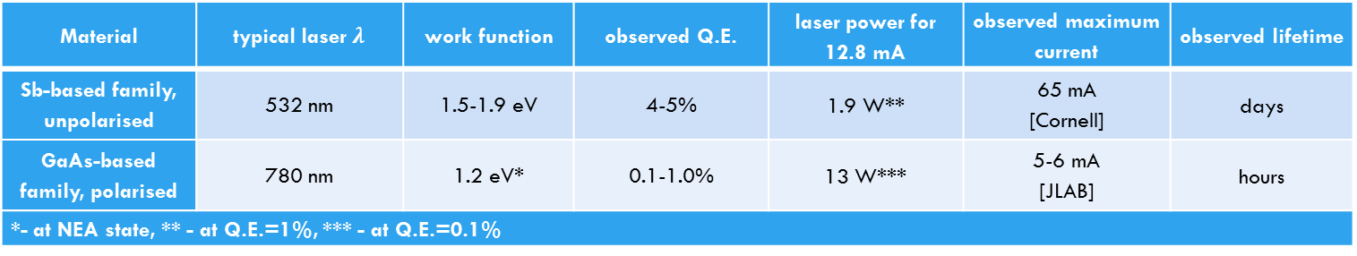
DC gun with photocathode:
Considered photo-cathode materials:
Material | typical laser $λ$ | work function | observed Q.E. | laser power for 12.8 mA | observed maximum current | observed lifetime
Sb-based family, unpolarised | 532 nm | 1.5-1.9 eV | 4-5% | 1.9 W** | 65 mA [Cornell] | days
GaAs-based family, polarised | 780 nm | 1.2 eV* | 0.1-1.0% | 13 W*** | 5-6 mA [JLAB] | hours
*- at NEA state, ** - at Q.E.=1%, *** - at Q.E.=0.1%
Boris Militsyn

Slide 5
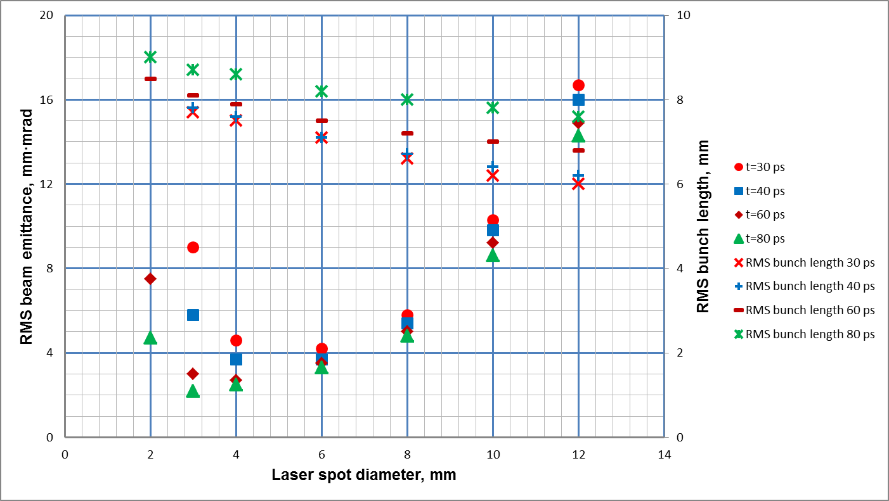
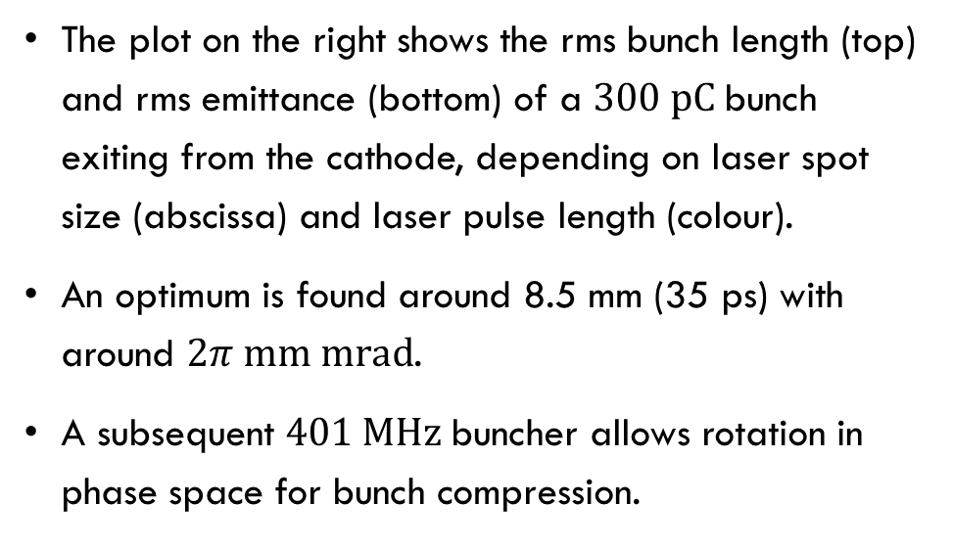
Buncher
The plot on the right shows the rms bunch length (top) and rms emittance (bottom) of a $300 pC$bunch exiting from the cathode, depending on laser spot size (abscissa) and laser pulse length (colour).
An optimum is found around 8.5 mm (35 ps) with around $2π mm mrad$.
A subsequent $401 MHz$buncher allows rotation in phase space for bunch compression.
Boris Militsyn

Slide 6
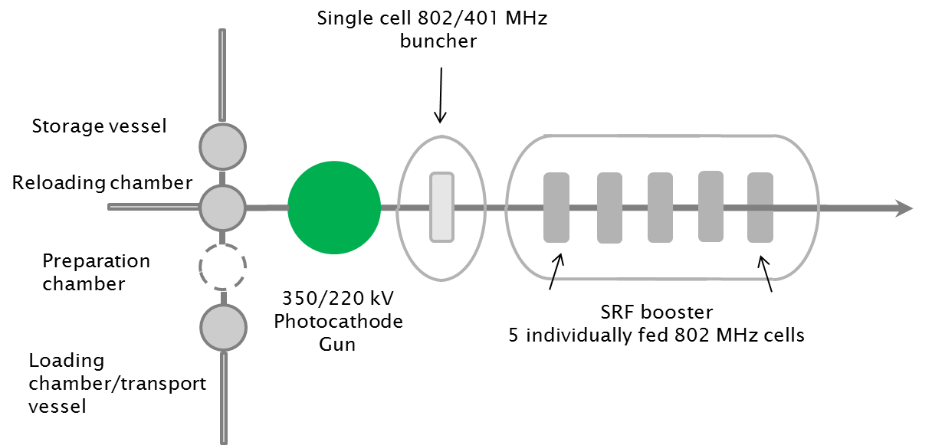
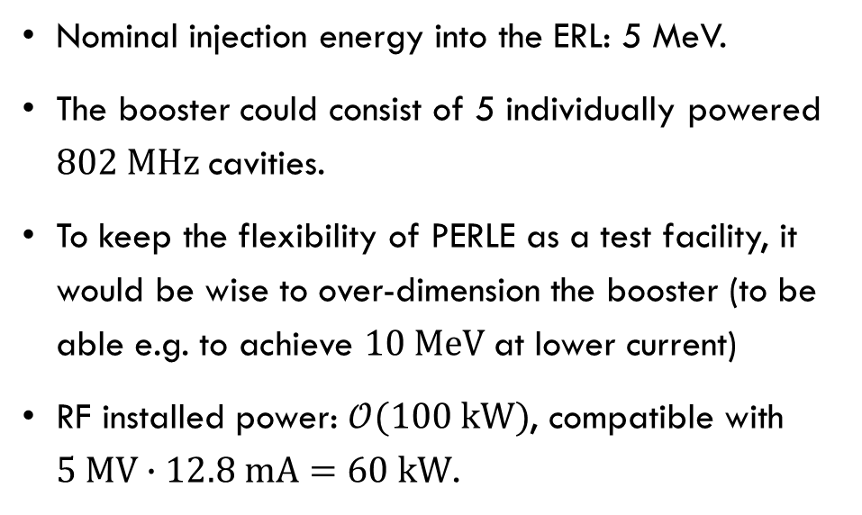
Booster
Nominal injection energy into the ERL: 5 MeV.
The booster could consist of 5 individually powered $802 MHz$cavities.
To keep the flexibility of PERLE as a test facility, it would be wise to over-dimension the booster (to be able e.g. to achieve $10 MeV$at lower current)
RF installed power: $𝒪(100 kW)$, compatible with
$5 MV∙12.8 mA=60 kW$.
Boris Militsyn

Slide 7
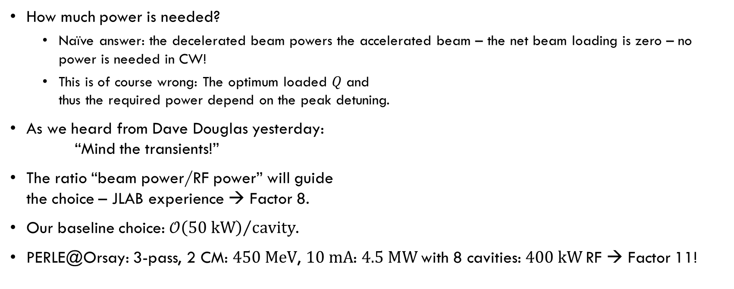
RF Power
How much power is needed?
  Naïve answer: the decelerated beam powers the accelerated beam – the net beam loading is zero – no power is needed in CW!
  This is of course wrong: The optimum loaded $Q$ and
  thus the required power depend on the peak detuning.
As we heard from Dave Douglas yesterday:
“Mind the transients!”
The ratio “beam power/RF power” will guide
the choice – JLAB experience → Factor 8.
Our baseline choice: ${𝒪\left(50 kW\right)}/{cavity}$.
PERLE@Orsay: 3-pass, 2 CM: $450 MeV$, $10 mA$: $4.5 MW$with 8 cavities: $400 kW$RF → Factor 11!
Rama Calaga

Slide 8
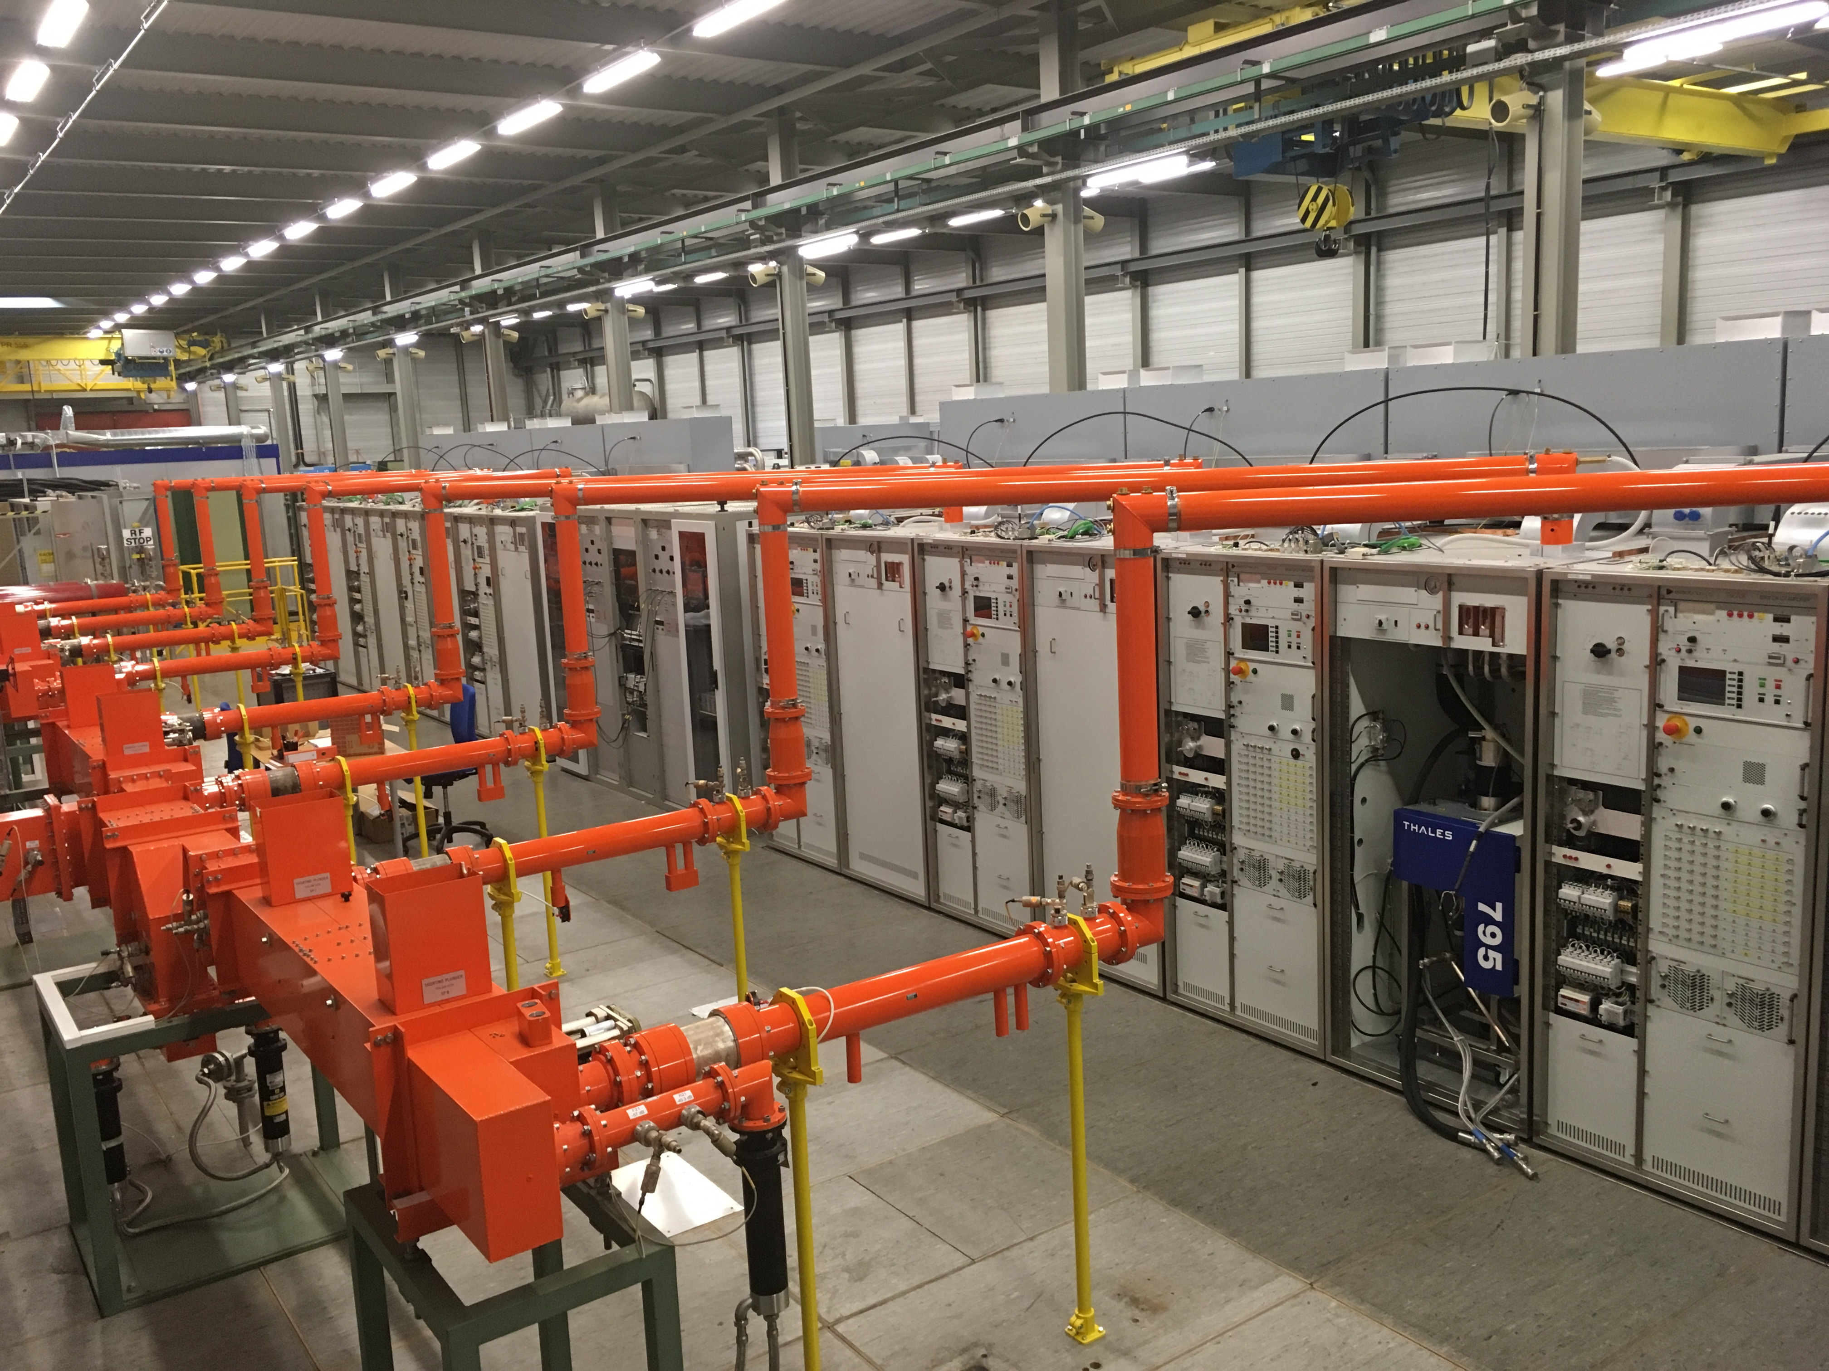
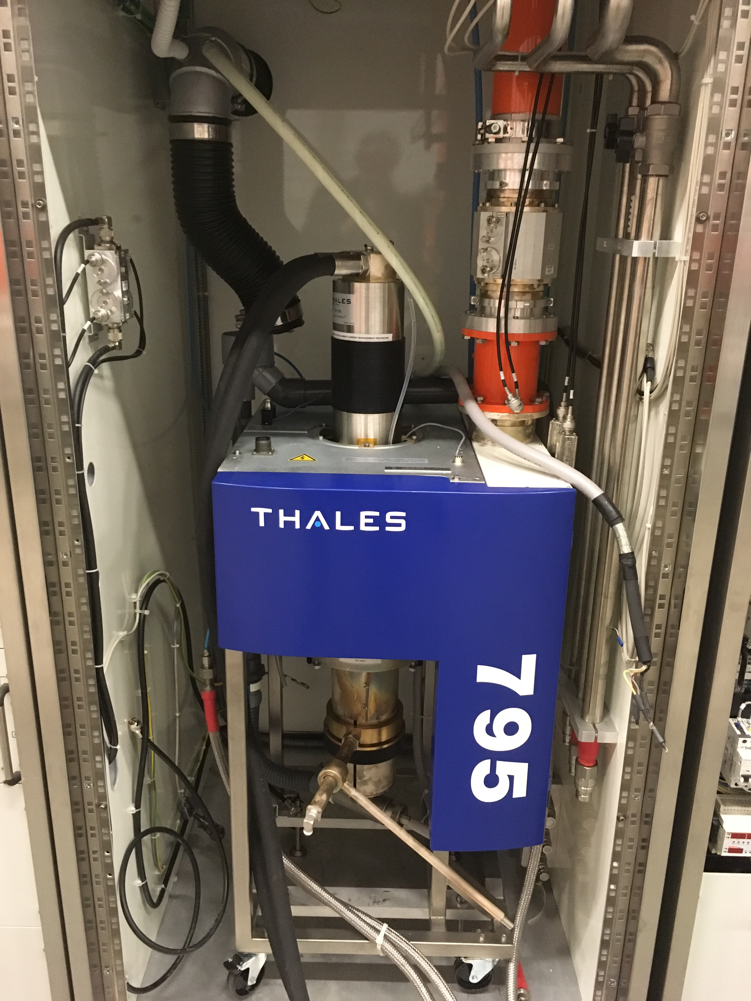
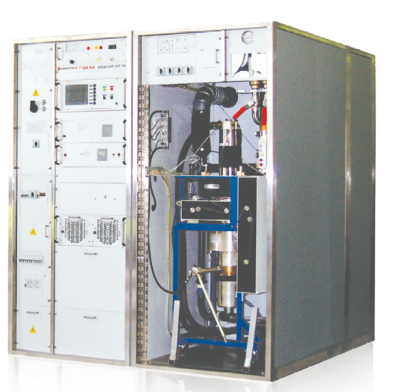
CERN 800 MHz RF system @ SPS
CERN 802 MHz, 60 kW CW IOT TX
Eric Montesinos

Slide 9
How to adapt PERLE to test cavities at different frequencies?
One purpose of PERLE is to “test SRF Cavities/cryomodules with beam” – it would be good to make this possible at more frequencies than just one!
… without changing the entire set-up!
This can be made possible thanks to the flexibility of a laser pulse driven photocathode.

Slide 10
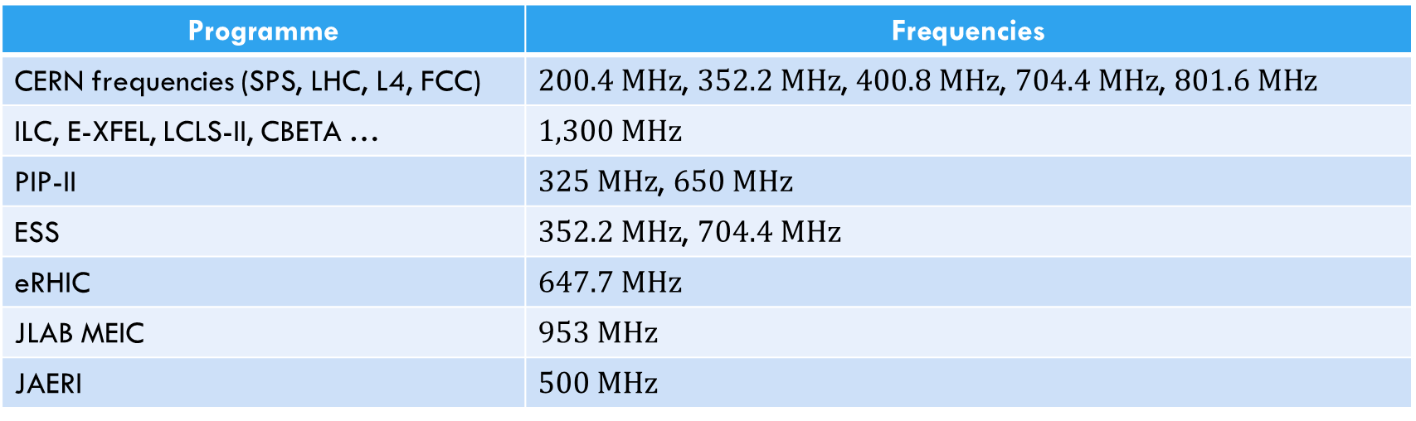
Frequencies of interest …
Programme | Frequencies
CERN frequencies (SPS, LHC, L4, FCC) | $200.4 MHz$, $352.2 MHz$, $400.8 MHz$, $704.4 MHz$, $801.6 MHz$
ILC, E-XFEL, LCLS-II, CBETA … | $1,300 MHz$
PIP-II | $325 MHz$, $650 MHz$
ESS | $352.2 MHz$, $704.4 MHz$
eRHIC | $647.7 MHz$
JLAB MEIC | $953 MHz$
JAERI | $500 MHz$

Slide 11
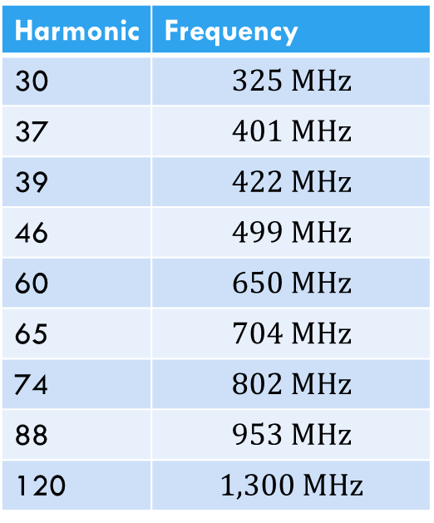

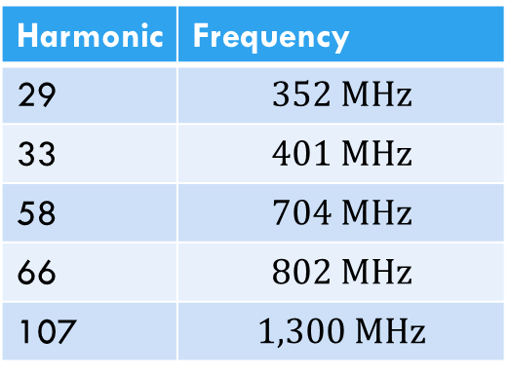

… are there common sub-harmonics?
… I found 2 common (approximate) interesting sub-harmonics:
$f_{0}=10.835 MHz$:
Harmonic | Frequency
30 | $$325 MHz$$
37 | $$401 MHz$$
39 | $$422 MHz$$
46 | $$499 MHz$$
60 | $$650 MHz$$
65 | $$704 MHz$$
74 | $$802 MHz$$
88 | $$953 MHz$$
120 | $$1,300 MHz$$
$f_{0}=12.146 MHz$:
Harmonic | Frequency
29 | $$352 MHz$$
33 | $$401 MHz$$
58 | $$704 MHz$$
66 | $$802 MHz$$
107 | $$1,300 MHz$$

Slide 12
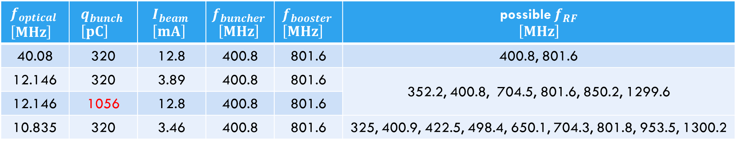
Options Table
$$f_{optical} \\ \left[MHz\right]$$ | $$q_{bunch} \\ \left[pC\right]$$ | $$I_{beam} \\ \left[mA\right]$$ | $$f_{buncher} \\ \left[MHz\right]$$ | $$f_{booster} \\ \left[MHz\right]$$ | possible $f_{RF}$ $$\left[MHz\right]$$
40.08 | 320 | 12.8 | 400.8 | 801.6 | 400.8, 801.6
12.146 | 320 | 3.89 | 400.8 | 801.6 | 352.2, 400.8, 704.5, 801.6, 850.2, 1299.6
12.146 | 1056 | 12.8 | 400.8 | 801.6
10.835 | 320 | 3.46 | 400.8 | 801.6 | 325, 400.9, 422.5, 498.4, 650.1, 704.3, 801.8, 953.5, 1300.2

Slide 13

… but
You have to place the bunches in the correct buckets – both for acceleration and deceleration!
$f_{1}$, harmonic 33 of the bunch repetition frequency:
$f_{2}$, e.g. harmonic 20 of the bunch repetition frequency:
In the worst case, this may require path length adjustment by approx. $λ/2$ of the lowest test frequency (for $325 MHz$, this would be $46 cm$).

Slide 14

Thank you!

