Slide 1
Main magnets for PERLE Test Facility
Pierre-Alexandre THONET
24 Feb. 2017

Slide 2
Overview
New layout and magnet inventory proposed by A. Bogacz with an energy of 450 MeV
Horizontal bending magnets
  As proposed in the new magnet inventory
  Alternative solution in order to reduce the number of magnets
Quadrupoles

Slide 3
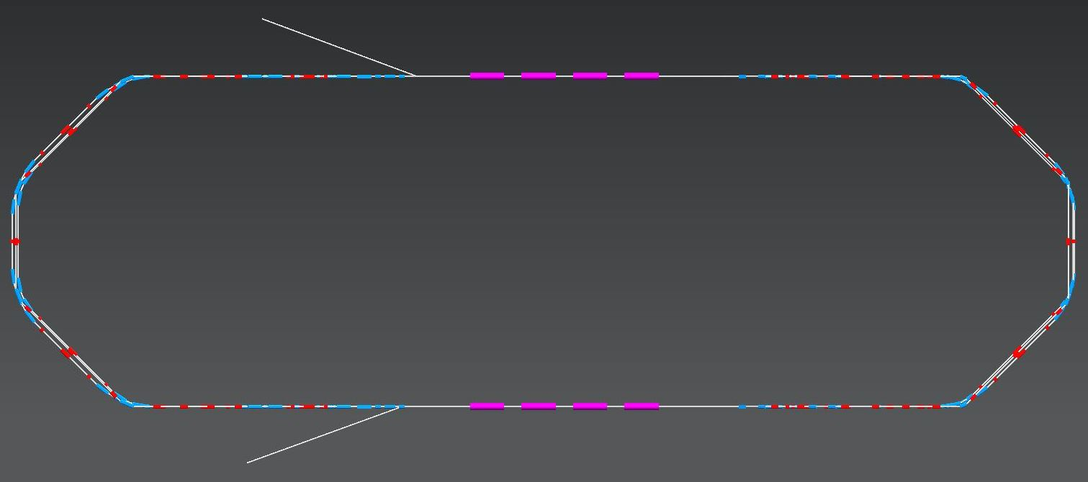
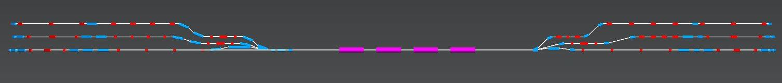
Layout Perle@Orsay 450 MeV
Top view
6 m
24 m
2 : 4 : 6
Side view
1 : 3 : 5
0.3 m + 0.3 m
Courtesy A. Bogacz

Slide 4
Magnet inventory
Courtesy A. Bogacz

Slide 5
Horizontal bending magnets

Slide 6
Bending magnets as in the magnet inventory
All magnets work with the same magnetic field (the same power supply could be used to power all of the magnets at the same time)
Operation in DC
Magnet aperture of +/- 20 mm
2 magnet types with same cross section (yoke length of 0.15 and 0.3 m)
The deflection angle changes function of the energy: straight magnet solution required
H design in order to reduce the height of the magnet for stacking
The required integrated field for each bend is obtained thanks to a combination of the 2 magnet types

Slide 7
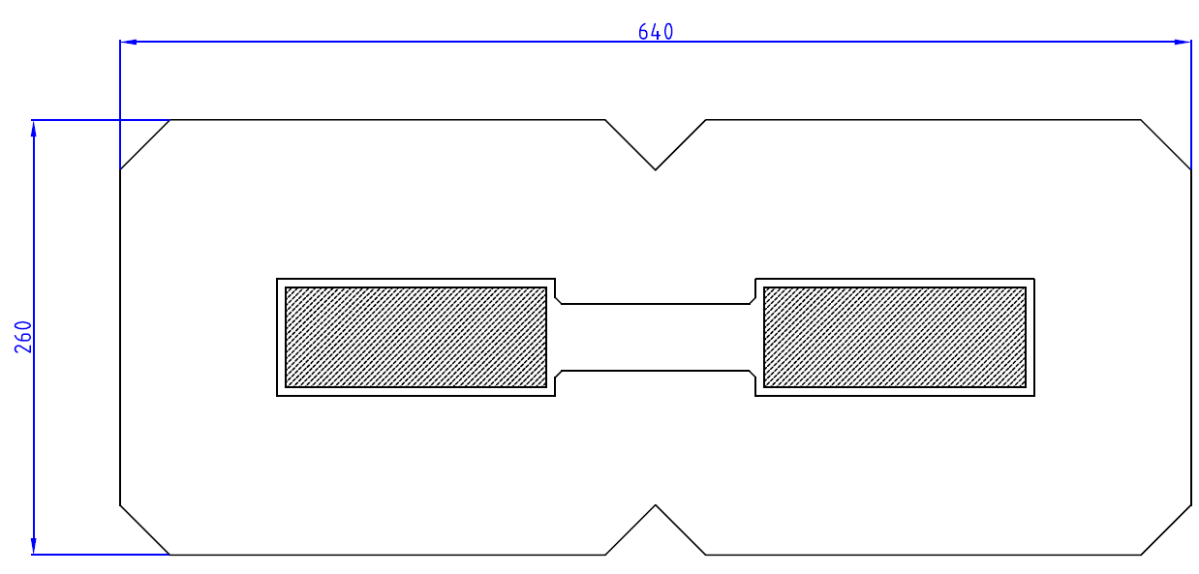
Cross section
Central field: 1.4 T
Aperture width: +/- 55 mm
water cooled coils (the shaded area corresponds to 6-7 A/mm²)
Relatively large cross section of the magnet compared to the aperture size
Due to its width, the same magnet cannot be used for horizontal and vertical deflection

Slide 8
Alternative solution
Longer and curved bending magnets
2 different magnet types with same cross section (only the length changes)
Only 1 magnet per bend with a deflection of 45°
Reduction of magnet number (24 compared to 48), could help to reduce cost
Arc | Energy [MeV] | Count | angle [deg] | B [T] | L [mm] | Curv. radius [mm] | Pole gap [mm] | GFR width [mm]
#1 | 80 | 4 | 45 | 0.45 | 456 | 596 | ±20 | ±20 | MBA
#2 | 155 | 4 | 45 | 0.87 | 456 | 596 | ±20 | ±20
#3 | 230 | 4 | 45 | 1.29 | 456 | 596 | ±20 | ±20
#4 | 305 | 4 | 45 | 0.85 | 912 | 1191 | ±20 | ±20 | MBB
#5 | 380 | 4 | 45 | 1.06 | 912 | 1191 | ±20 | ±20
#6 | 455 | 4 | 45 | 1.27 | 912 | 1191 | ±20 | ±20

Slide 9
Alternative solution
initial part of combiner not considered
initial part of spreader not considered

Slide 10
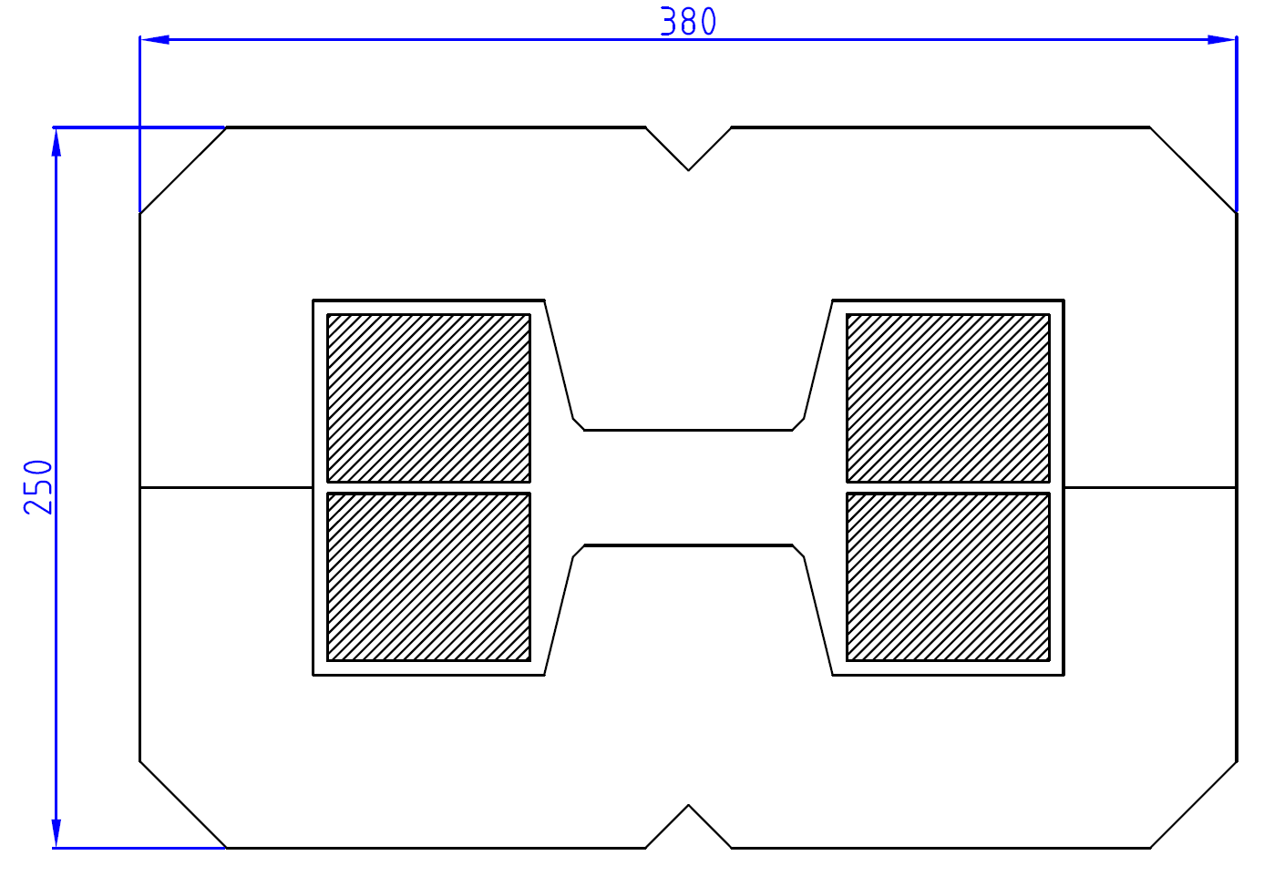
Solution 1: independent power supplies
1 power convertor for each arc
Central field: 0.45 to 1.29 T
The use of the same magnet for horizontal and vertical deflection seems possible
Water cooled coils (the shaded area corresponds to 6-7 A/mm²)
Yokes possibly machined

Slide 11
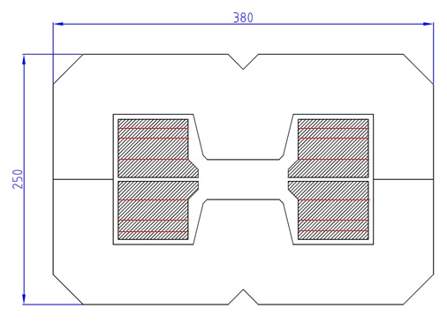
Solution 2: single power supply
1 power convertor for all horizontal magnets
The magnetic field is settled by changing the number of conductor layers (i.e. number of turns) in the coils
2 turns are added in order to compensate the non linearity of the magnetic field for the different arcs due to the injection energy (5 MeV)
arc | B [T] | L [mm] | Number of layers for each coil | Int. field Bdl [T.m]
#1 | 0.45 | 456 | 2 | 0.21
#2 | 0.87 | 456 | 4 | 0.40
#3 | 1.29 | 456 | 6 | 0.59
#4 | 0.85 | 912 | 4 | 0.77
#5 | 1.06 | 912 | 5 | 0.97
#6 | 1.27 | 912 | 6 | 1.16

Slide 12
Quadrupoles

Slide 13
Quadrupoles
In total 118 quadrupoles are required
Same aperture diameter of 40 mm for all arcs
2 magnetic lengths, 100 mm and 200 mm
Maximum gradient: 30 T/m
Operation in DC

Slide 14
Quadrupoles: cross-section
water cooled coils, to be designed as part of overall optimization including yoke height, power converters, magnet manufacturing cost and operational scenario (the shaded area corresponds to 7-8 A/mm² at max field)

Slide 15
Conclusion

Slide 16
Conclusions
The last inventory of the magnets of Perle@Orsay Test Facility lists:
  92 bending magnets (vertical and horizontal field)
  118 quadrupole magnets
Conventional iron-dominated resistive magnets can be used
Grouping the magnets in families – has to be analysed to possibly reduce the number of magnets (for example with longer and curved dipoles)
  The spreader and combiner regions need to be studied in detail since space is rather tight.
  The need for dipole correctors has to be evaluated. They could possibly be added to some quadrupoles.

Slide 17
Many thanks to Alessandra Valloni and Alex Bogacz.
Thank you.

