Slide 1
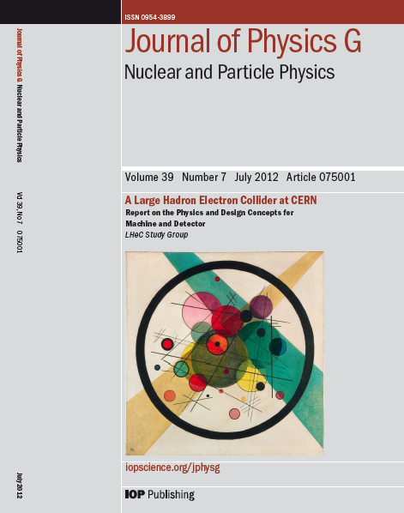
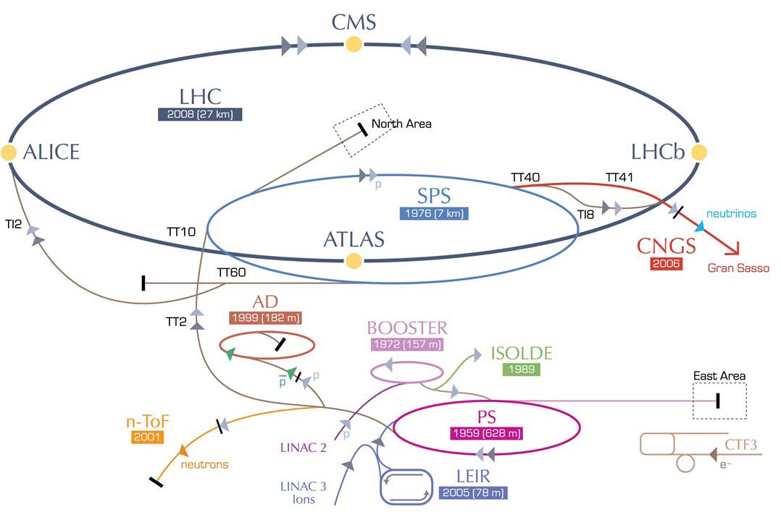
CDR Options for LHeC Infrastructure:
CDR Study assumptions:
-Assume parallel operation to HL-LHC
-TeV Scale collision energy
➔ 50-150 GeV Beam Energy
-Limit power consumption to 100 MW
➔ (beam & SR power < 70 MW)
➔ 60 GeV beam energy
-Int. Luminosity > 100 * HERA
-Peak Luminosity > 10³³ cm⁻²s⁻¹
Higgs @ 125GeV➔ > 10³⁴ cm⁻²s⁻¹
F. Zimmermann
RR LHeC:
new ring in
LHC tunnel,
with bypasses
around
existing
experiments
RR LHeC
e-/e+ injector
10 GeV,
10 min. filling time
LR LHeC:
recirculating
linac with
energy
recovery,
or straight
linac

Slide 2

CDR Choices:
Linac-Ring Design based on ERL:
-Installation largely decoupled from LHC operation ✔
-can accept larger beam-beam ➔ larger bunch current ✔
Recirculating Linac with Energy Recovery Mode (ERL) ✔
  energy efficiency and luminosity reach!
New accelerator concept & SRF technology (Q₀, HOM damping)
  New operation mode on a large scale facility
      requires demonstration of parameter reach!

Slide 3
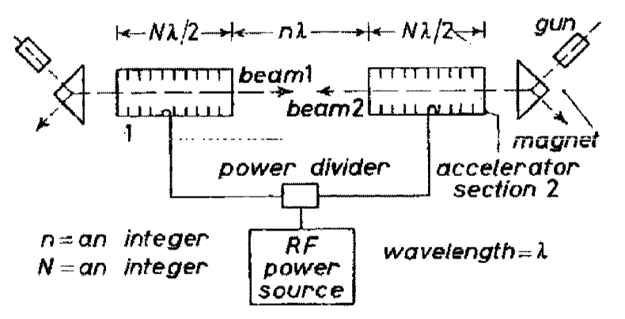
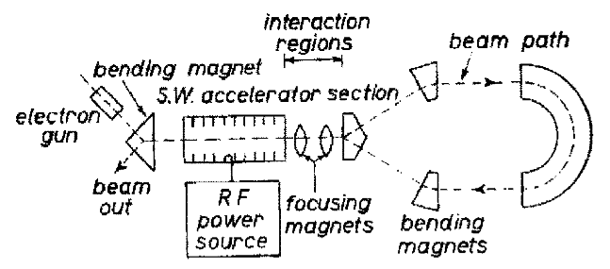
Motivation: Accelerator Technology Development
Energy Recovery Linac concept: First proposal 50 years ago
M. Tigner: “A Possible Apparatus for Electron Clashing-Beam Experiments”,
Il Nuovo Cimento Series 10, Vol. 37, issue 3, pp 1228-1231,1 Giugno 1965
Concept became only viable with recent advances in SC RF technology
(e.g. high gradient structures with high Q₀)
Many interesting potential applications
(e.g. coherent e-cooling and eRHIC)
➔ World wide need for a variety of demonstrator facilities!
First Tests: Done at SCA @ Stanford in 1986
Interesting concept for FELs and Compton photon light sources,
and high current electron cooler concepts and colliders ➔ SRF!!!

Slide 4
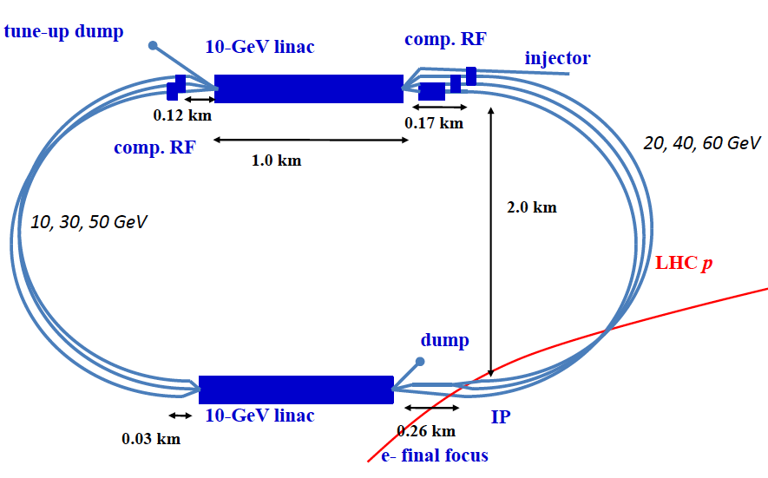
LHeC: Baseline Linac-Ring Option
Super Conducting Linac with Energy Recovery
& high current (> 6mA)
Two 1 km long SC
linacs in CW operation (Q > 10¹⁰)
requires Cryogenic
system comparable
to LHC system!
10³³ cm⁻² s⁻¹ Luminosity reach | PROTONS | ELECTRONS
Beam Energy [GeV] | 7000 | 60
Luminosity [10³³cm⁻²s⁻¹] | 1 | 1
Normalized emittance γε_{x,y} [μm] | 3.75 | 50
Beta Funtion β∗_{x,y} [m] | 0.1 | 0.12
rms Beam size σ∗_{x,y} [μm] | 7 | 7
rms Beam divergence σ’∗_{x,y} [μrad] | 70 | 58
Beam Current [mA] | 430 (860) | 6.6 (3.3)
Bunch Spacing [ns] | 25 (50) | 25 (50)
Bunch Population | 1.7*10¹¹ | (1*10⁹) 2*10⁹
Bunch charge [nC] | 27 | (0.16) 0.32
10³⁴ cm⁻² s⁻¹ Luminosity reach | PROTONS | ELECTRONS
Beam Energy [GeV] | 7000 | 60
Luminosity [10³³cm⁻²s⁻¹] | 16 | 16
Normalized emittance γε_{x,y} [μm] | 2.5 | 20
Beta Funtion β∗_{x,y} [m] | 0.05 | 0.10
rms Beam size σ∗_{x,y} [μm] | 4 | 4
rms Beam divergence σ’∗_{x,y} [μrad] | 80 | 40
Beam Current [mA] | 1112 | 25
Bunch Spacing [ns] | 25 | 25
Bunch Population | 2.2*10¹¹ | 4*10⁹
Bunch charge [nC] | 35 | 0.64
Relatively large return arcs
ca. 9 km underground tunnel installation
total of 19 km bending arcs
same magnet design as for RR option: > 4500 magnets

Slide 5
Post CDR Studies: RF Frequency
Review of the SC RF frequency:
-HL-LHC bunch spacing requires bunch spacing with multiples of
25ns (40.079 MHz)
Frequency choice: h * 40.079 MHz
h=18: 721 MHz or h=33: 1.323GHz
SPL & ESS: 704.42 MHz; ILC & XFEL: 1.3 GHz
Existing technologies do not quite match that requirement (20MHz)!

Slide 6
Post CDR Studies: ERL Beam Dynamics
Beam-Beam effects:
➔ Optimum choice for LHeC RF frequency?
Daniel Schulte @ LHeC Seminar 12. March 2013
N=3 10⁹
Beam-beam effect included
as linear kick
Result depends on seed for frequency spread
“worst” of ten seed shown
F_{rms}=1.135 for ILC cavity
F_{rms}=1.002 for SPL cavity
Beam is stable but very small margin with 1.3GHz cavity ➔ lower frequency

Slide 7
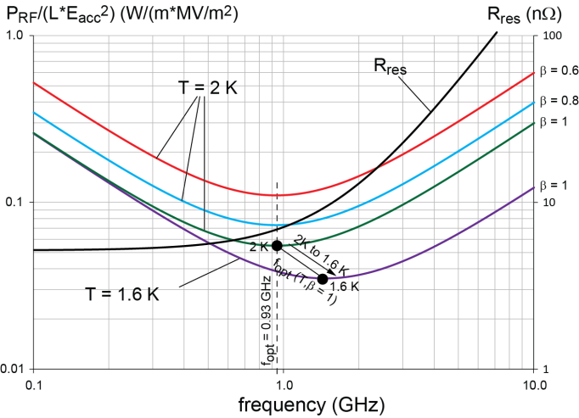
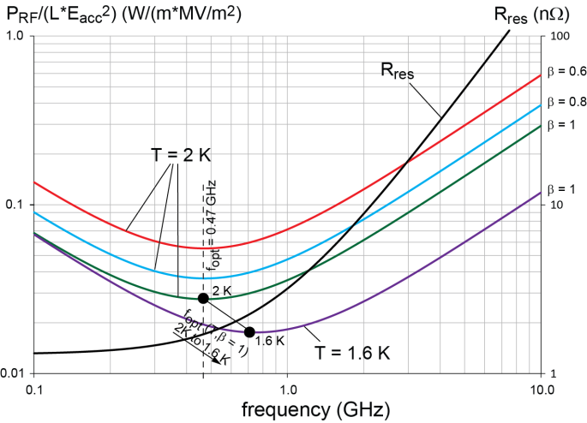
Optimum RF Frequency: Power Considerations
Results from F. Marhauser
Optimum frequency between 700MHz and 800MHz
(large and small grain Nb and 1.6K and 2K)
Chose 801MHz for bucket matching in the LHC
and for
synergies with FCC
Started discussions with JLab for Cavity construction in Washington 2015
➔ collaboration active under the FCC umbrella
Small-grain (normal) Nb:
Optimum frequency at 2K between 700 MHz and 1050 MHz
Lower T shift optimum f upwards
Large-grain Nb:
Optimum frequency at 2K between 300 MHz and 800 MHz
Lower T shift optimum f upwards

Slide 8
CDR Choices: Technology Choices and Design:
Super Conducting RF:
-Requirements imposed by LHC beam structure (n * 40 MHz)
-Existing technologies world wide (e.g. ILC, ESS)
-Beam stability considerations (Beam-Beam & Beam Breakup)
-RF Power considerations
-Synergies with other projects (e.g. FCC)
Daresbury meeting in 2013
  800MHz SRF in synergy with FCC-eh and FCC-ee
  Further beam dynamic studies with 802MHz choice

Slide 9
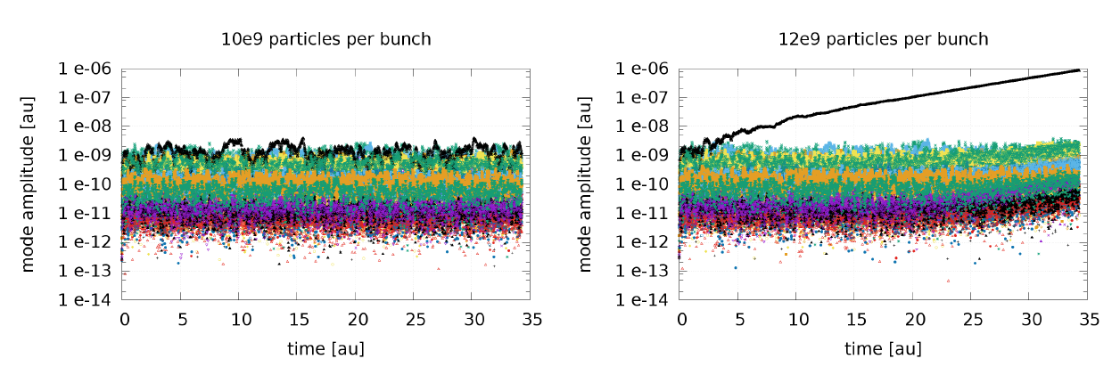
Beam Breakup Instability:
Evolution of the amplitudes of the dipole modes for two different charges per bunch
D. Pellegrini (EPFL/CERN) Draft Perle CDR

Slide 10
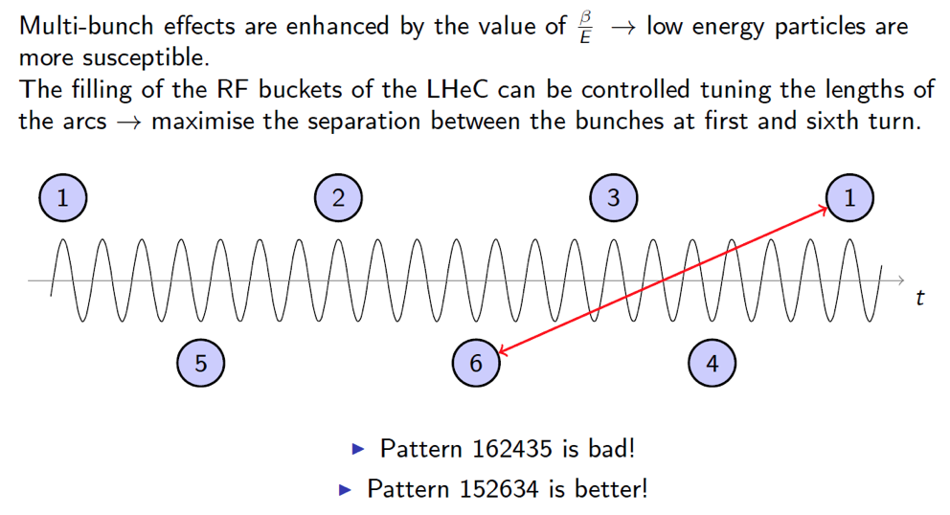
Instabilities and Recombination pattern:
D. Pellegrini (EPFL/CERN) @ ERL’15

Slide 11
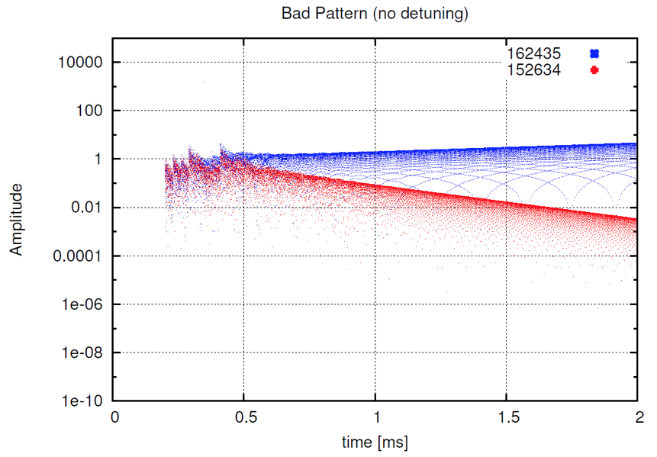
Instabilities and Recombination pattern:
➔ Need for demonstrator and test facilities!
D. Pellegrini (EPFL/CERN) @ ERL’15

Slide 12
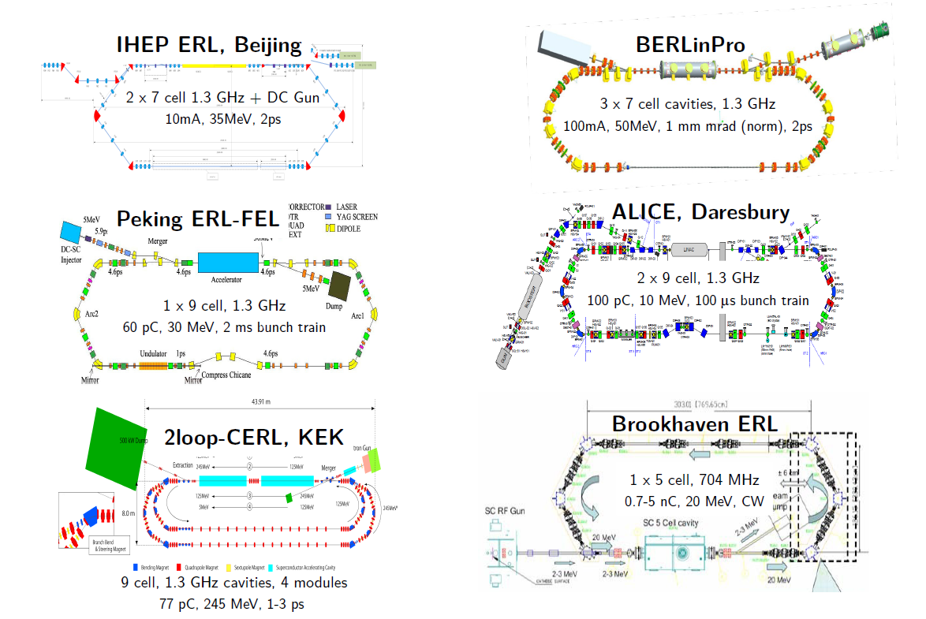
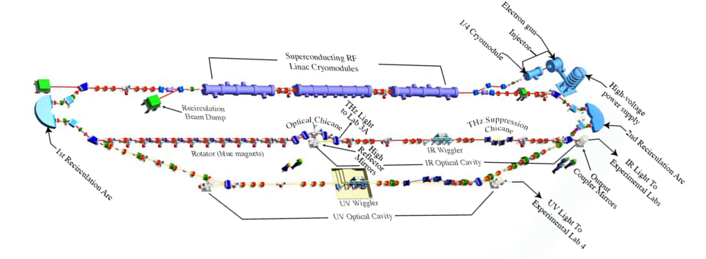
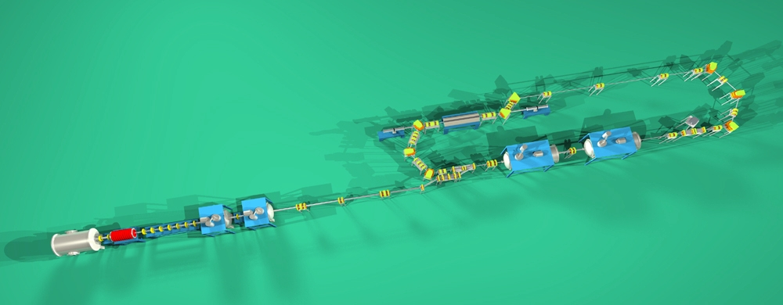
ERL Facilities around the World
Rama Calaga
RFTech 2013, Annecy Mar 25-26, 2013
Low Energy (< 100MeV), Single turn Facilities:
JLAB, FEL, 160 MeV, 1.5 GHz
Bunch: 7.7ns; 60pC
77pC
All single turn !!!
Only 2 with high bunch charge
500 MHz + DC Gun
5 mA, 17 MeV, 12 ps
10mA-40mA
400pC
JAERI, Tokai
12

Slide 13
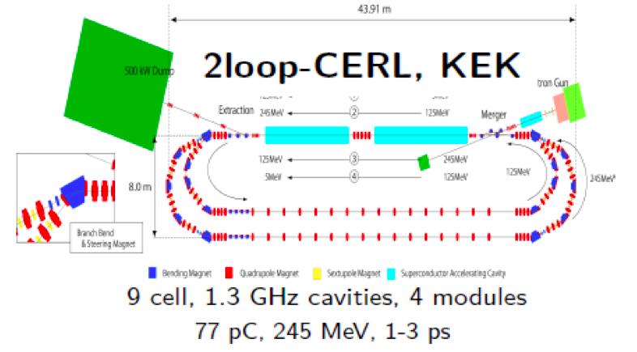
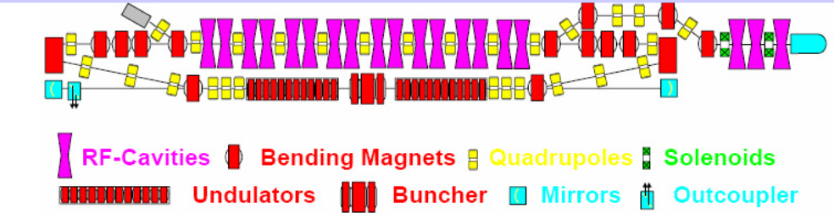
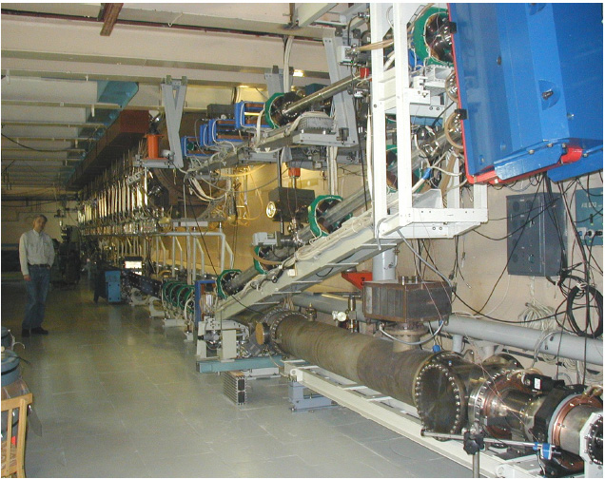
ERL Facilities around the World
Multi Turn Test Facilities and Installations:
Normal Conducting 180 MHz + DC Gun
30 mA, 11 MeV, 70-100 ps
BINP, Novosibirsk
➔Only BINP achieves bunch charges comparable to LHeC (900-1500pC)!
But it is normal conducting!
-At the moment only single loop operation
-Severe limitations in beam current
due to injector
-3-4 turn ERL
-Normal conducting RF
13

Slide 14
LHeC ERL Test Facility:
Validation of key LHeC Design Choices:
Three re-circulations with high beam current:
➔ Coherent Beam stability due to ions, and wake-fields when triggering
transverse perturbations (a la beam-beam) (Beam Breakup instability)
➔ Pulse stability and reproducibility of beam parameters (intensity, position
and size)
➔ Energy spread and beam parameter stability at end of deceleration process
➔ Study of transient ERL dynamics during current ramp-up
➔ Study of failure scenarios (e.g. cavity quench during ERL operation etc)
SC RF Design validation via operation with beam
  SC RF behavior with beam
  Coupler validation
  HOM tolerances and required HOM damping
  Beam loading and implied RF controls (LLRF!!!)
14

Slide 15
ERL Demonstrator for LHeC:
Fundamental Goals and Motivation:
Build up expertise in the design and operation for a facility with a fundamentally new operation mode:
➔ ERLs are circular machines with tolerances and timing requirements
similar to linear accelerators (no ‘automatic’ longitudinal phase stability
etc.)
Proof validity of fundamental design choices:
  Multi-turn recirculation
  Implications of high current operation (6 * [6mA – 25mA] ➔ 150mA!!)
Verify and test machine and operation tolerances before designing a large scale facility
  Tolerances in terms of field quality and alignment of the arc magnets
  Required RF phase stability (RF power) and LLRF requirements
15

Slide 16
LHeC ERL Test Facility:
Validation and tests of auxiliary ERL components:
Injector and gun
  Choice of electron sources (Superconducting RF, DC High Voltage etc)
  Injection energy and beam transfer, emittance requirements and preservation, etc.
Injection line and beam dump tests
  Momentum acceptance requirements
  Beam extraction at different beam energies and machine protection aspects; beam halo formation etc
Required beam diagnostics (CTF closure at end of 2016):
➔ Pulse by pulse diagnostics
➔ Single pass beam size measurements etc.
16

Slide 17
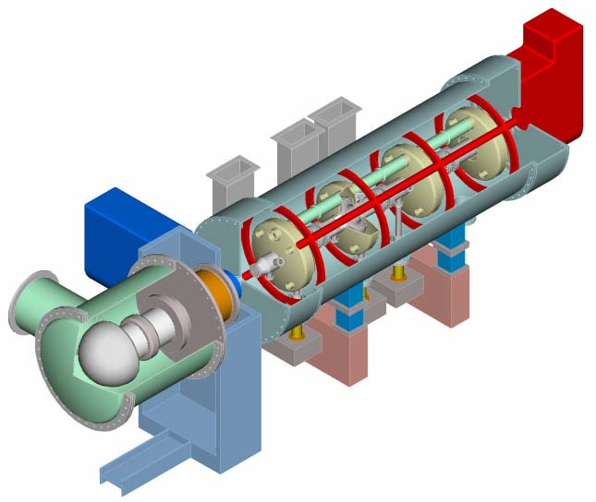
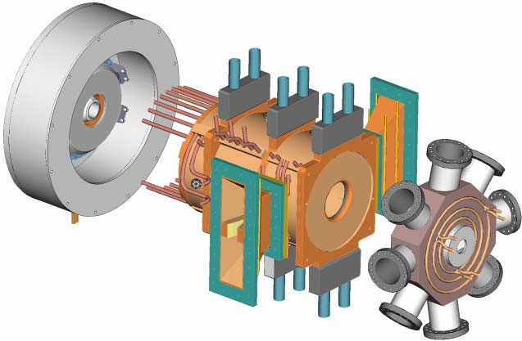
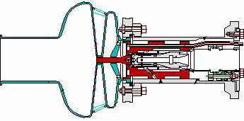
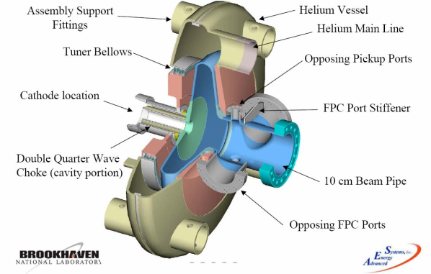
Injector & injector R&D
Erk Jensen and
F. Loehl @ IPAC’10
NC Gun (LANL-AES)
SRF Gun (FZR-AES-BNL)
DC Gun + SRF CM (JLAB-AES) /
Cornell DC gun
Preferred options
 | DC+SRF-CM | Cornell | NC | SRF
Energy | 2-5 MeV | 10 MeV | ? | 2 MeV
Current | 100 mA | 100 mA | 100 mA | 500 mA
Bunch charge |  | 77pC | 3000pC | 700pC
Bunch spacing |  | 0.7ns
Long. Emit | 45 keV-ps | 10-60 keV-ps | 200 keV-ps | -
Trans. Emit | 1.2 µm | 0.3-1.6 µm | 7 µm | 1.4-5 µm
SRF Gun (BNL-AES)

Slide 18
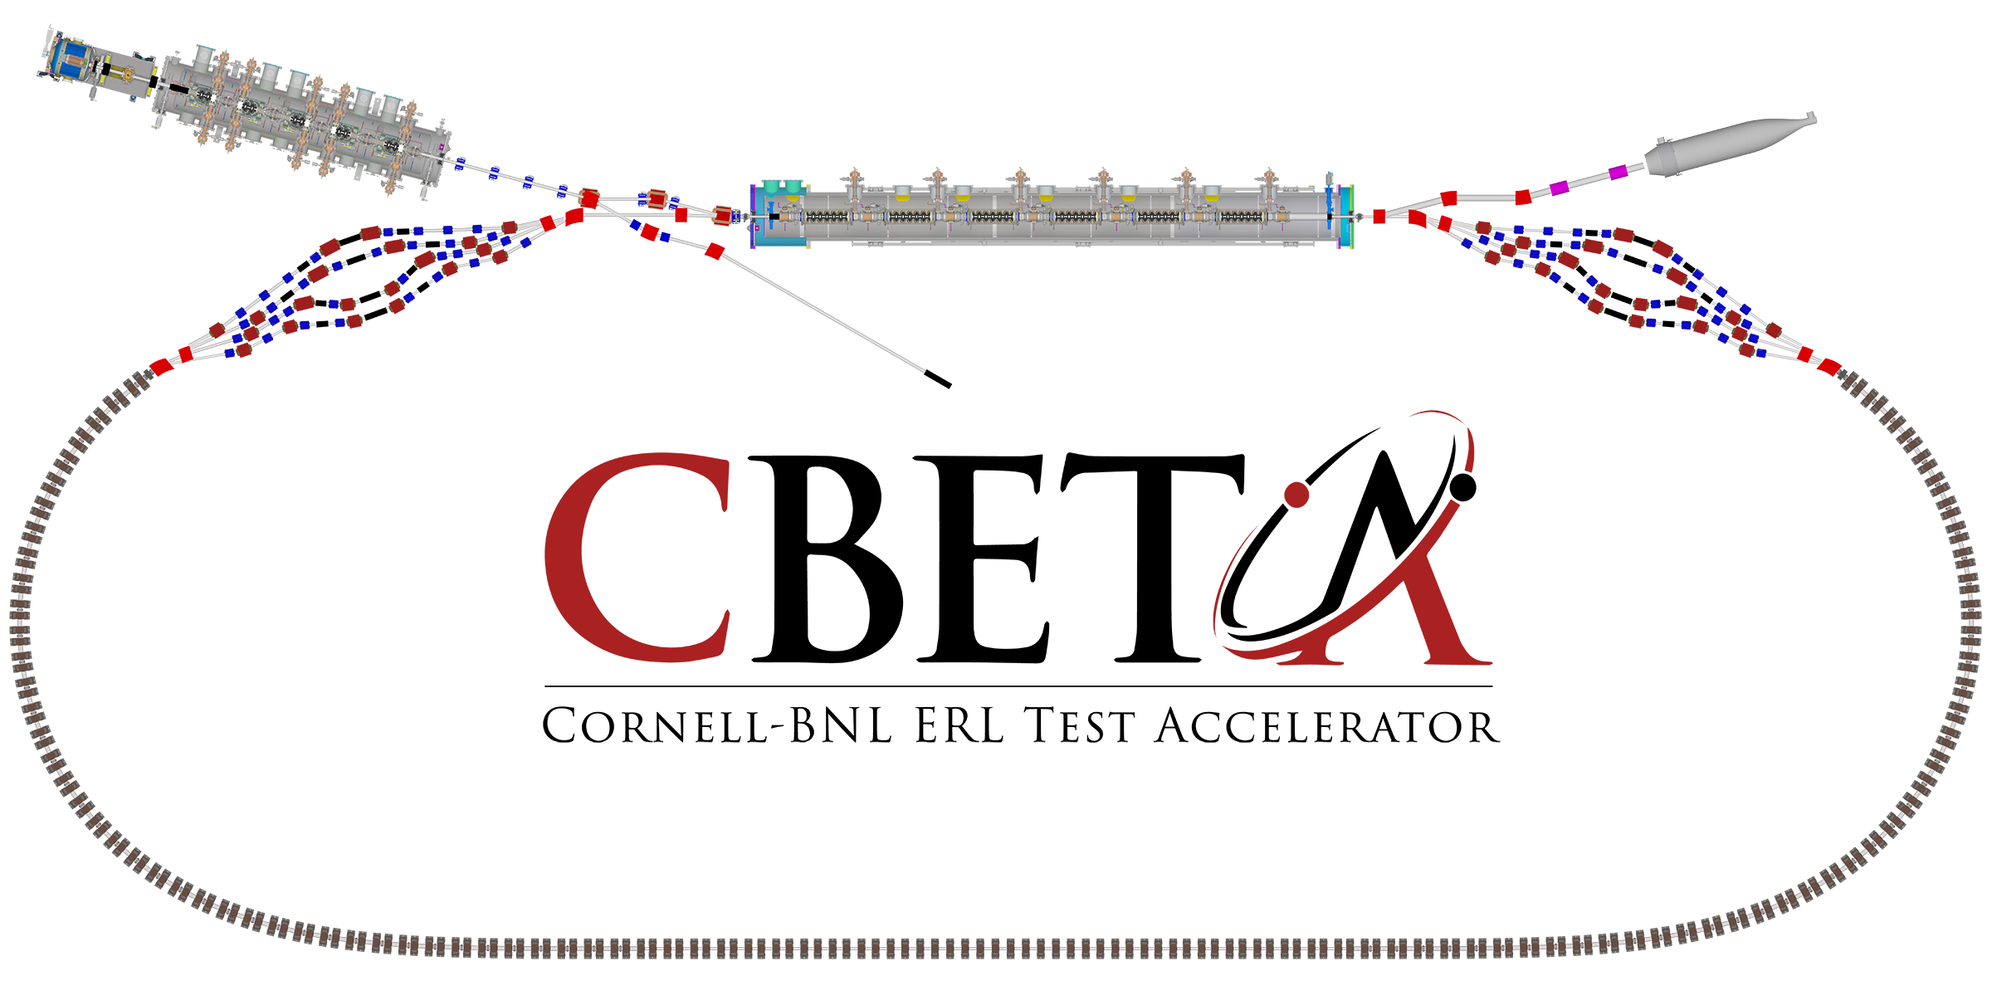
The test ERL in Cornell’s hall LOE
Cornell DC gun
100mA, 6MeV SRF injector (ICM)
600kW beam dump
100mA, 6-cavity SRF CW Linac (MLC)
Existing components at Cornell
6 MeV
6 MeV
+/- 36 MeV
Electron Current up to 320mA in the linac
Bunch charge Q of up to 2nC
Bunch repetition rate 1.3GHz/N
Beams of 100mA for 1 turn and 40mA for 4 turns
42, 78, 114, 150 MeV

Slide 19
Key Performance Parameters and
Ultimate Performance Parameters
Parameter | Unit | KPP | UPP (Stretch)
Electron beam energy | MeV |  | 150
Electron bunch charge | pC |  | 123
Gun current | mA | 1 | 40
Bunch repetition rate (gun) | MHz |  | 325
RF frequency | MHz | 1300 | 1300
Injector energy | MeV |  | 6
RF operation mode |  |  | CW
Number of ERL turns |  | 1 | 4
Energy aperture of arc |  | 2 | 4
➔Some of these items can be addressed @ CBETA.
But: Main focus is the demonstration of FFAG arcs!!
Different frequency; bunch spacing and HOM spectrum as for LHeC
➔ But strong synergies for collaboration with an LHeC ERL demonstrator!!!

Slide 20
PERLE ERL Facility: PCDR 2015
Potential applications beyond an LHeC ERL Test Facility:
Magnet and cable quench facility:
➔ Vital for development of new cables and future high field SC
magnets (e.g. FCC hh) ➔ energy density in recirculating linac mode
Test facility for SC RF with beam
  Very interesting for development of new SC RF components
  e.g. Crab Cavities, SC RF for FCC ee, etc.
  Unique installation world wide!!! (SPS CC installation for protons)
Test beam for detector component developments
  Beam lines with beam energies higher than 100 MeV/c [Peter Kostka]
Dedicated Physics Facility ➔ N. Pietralla at 2015 LHeC
20

Slide 21
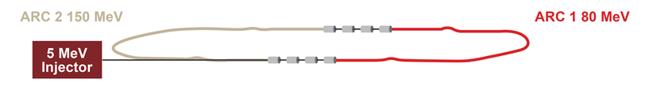
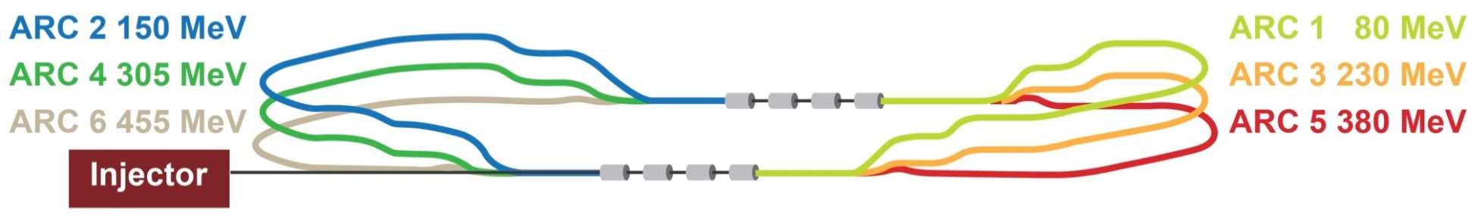
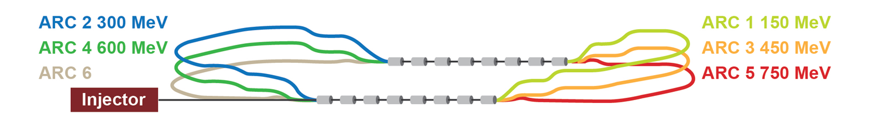
Staged Installation
Stage 1 – 2 CMs, test installation – injector, cavities, beam dump.
ARC 2 155 MeV
Stage 2 – 2 CMs, set up for energy recovery, 2…3 passes
Stage 3 – 4 CMs, set up arcs for higher energies – reach up to 905 MeV
ARC 2 305 MeV
ARC 4 605 MeV
ARC 6 905 MeV
ARC 1 155 MeV
ARC 3 455 MeV
ARC 5 755 MeV

Slide 22
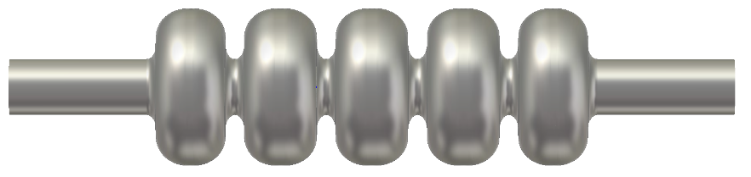
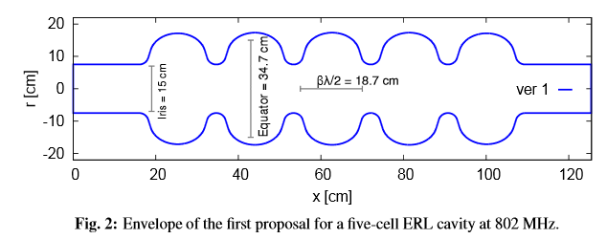
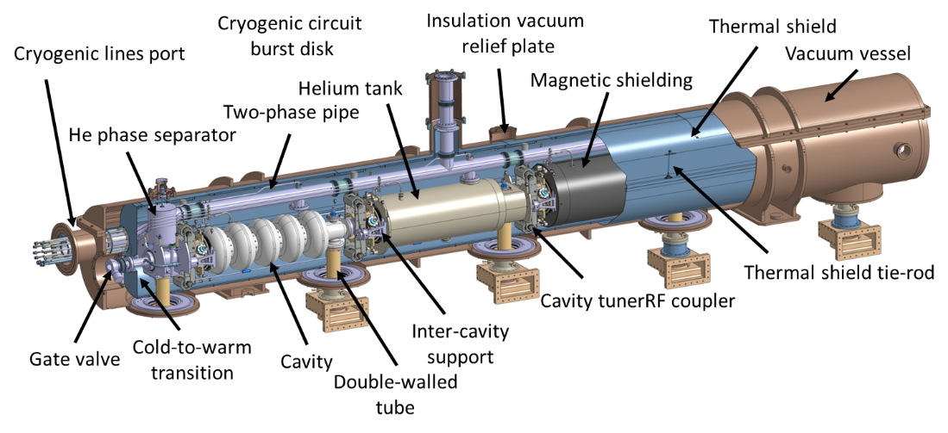
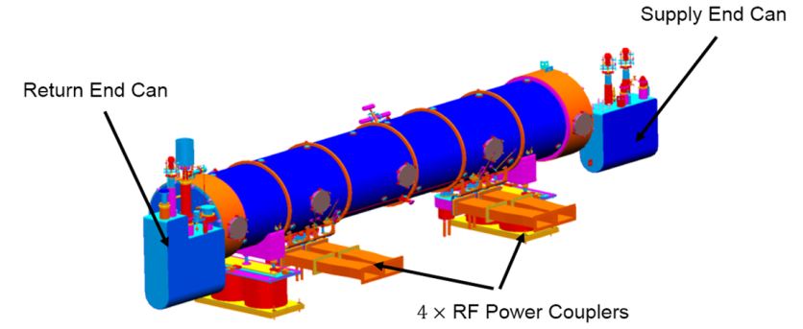

Cavity and Cryomodule Design
E. Jensen
LHeC Workshop 2015
Collaboration with JLAB established – work has started. Cavity designs exist with different apertures ($115 mm$… $160 mm$), optimization ongoing
The cavity prototypes will be fabricated
for PERLE by JLAB in the framework of
our collaboration agreement.
JLAB equally helps us with the design of
the cryomodule (alternative to the SPL
design).
R. Calaga, M. Karppinen, K. Schirm, R. Torres-Sanchez (CERN)
F. Marhauser, R. Rimmer (JLAB)
JLAB design (based on SNS 805 MHz)
CERN design (based on SPL 704 MHz)

Slide 23
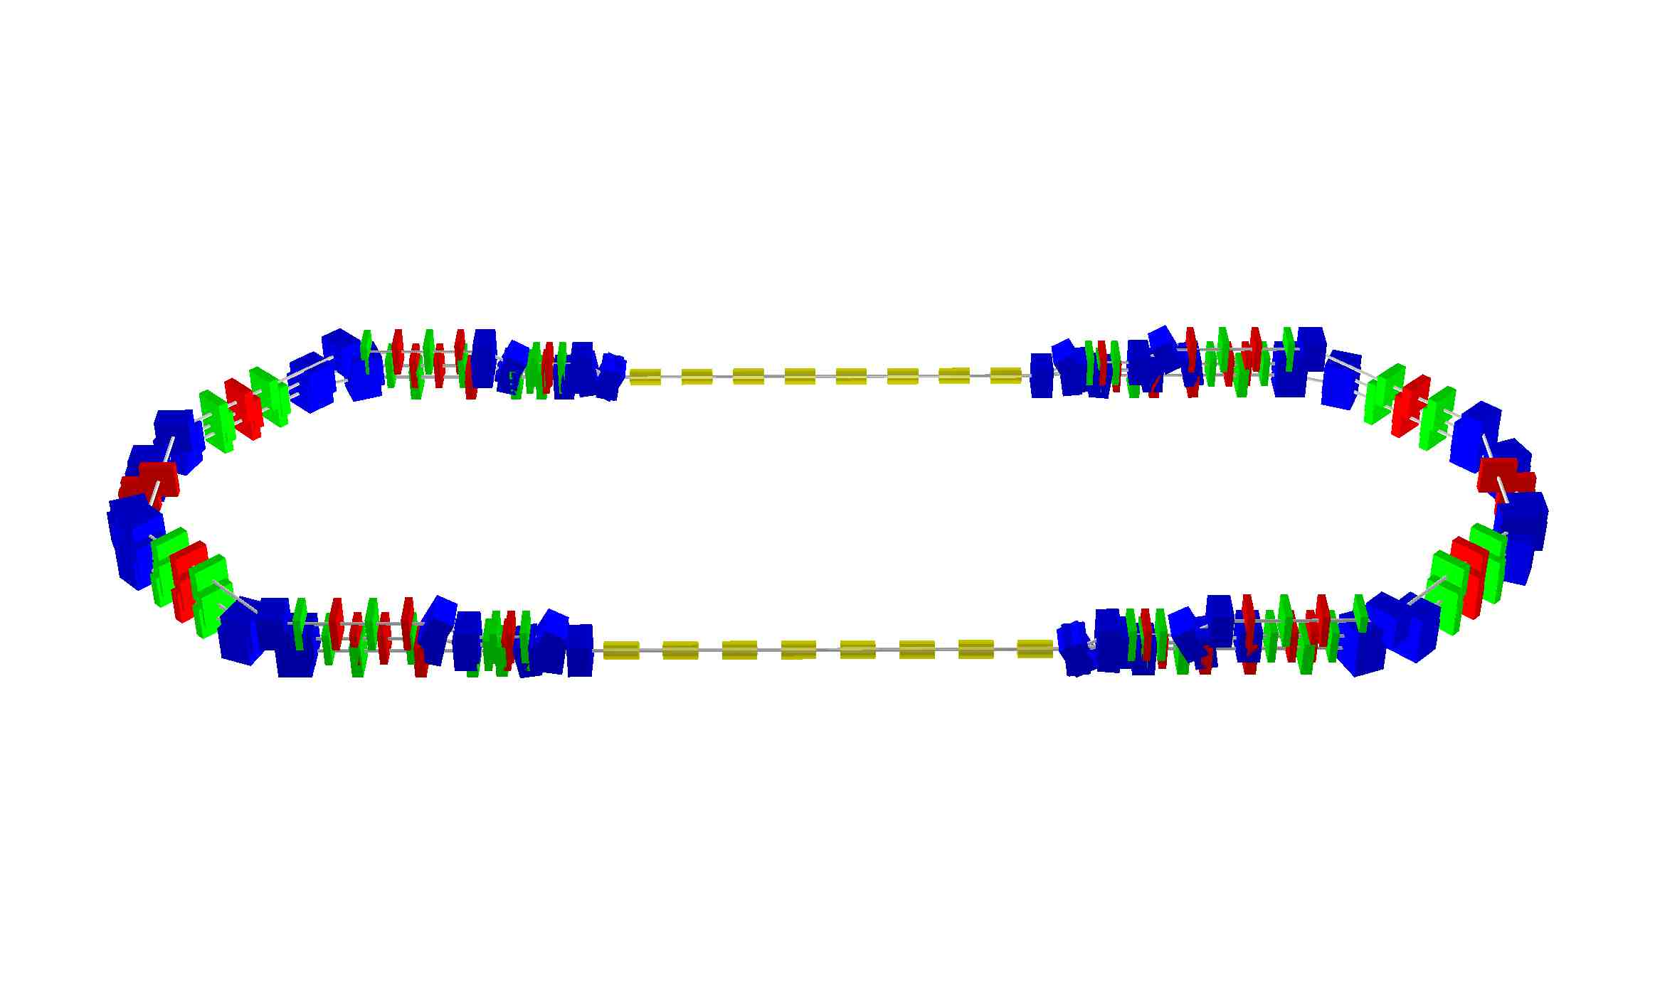
PERLE Footprint:
A.Valloni 2/16
98.5 cm
14.22 m
42.8 cm
13.66 m
6.8 cm
13.66
42.46 m

Slide 24
PERLE Parameters: PCDR 2015
Parameter | Value
injection energy | 5MeV
RF frequency | 801MHz
acc. voltage per cavity | 15MV
# cells per cavity | 5
total cavity length | ca. 1m
# cavities per cryomodule (CM) | 4
RF power per cryomodule (CM)
# cryomodules | 2-4
max. acceleration per CM pass | 75MV
bunch repetition | 25ns
injected beam current | 10-30mA
nominal bunch charge | 0.7 nC
number of passes | 1 | 3
top energy | 155-305Gev | 455-905GeV
duty factor | CW

Slide 25
ERL Demonstrator for LHeC:
International Advisory Committee outcome 2015:
-Develop a Conceptual Design Report for a minimal test
facility @ CERN ➔ demonstrate LHeC needs without
additional applications
Footprint, required infrastructure and parameter specification
Reduced version of PERLE Stage 2 (1 cryo module only)
Stage 2 – 2 CMs, set up for energy recovery, 2…3 passes

Slide 26
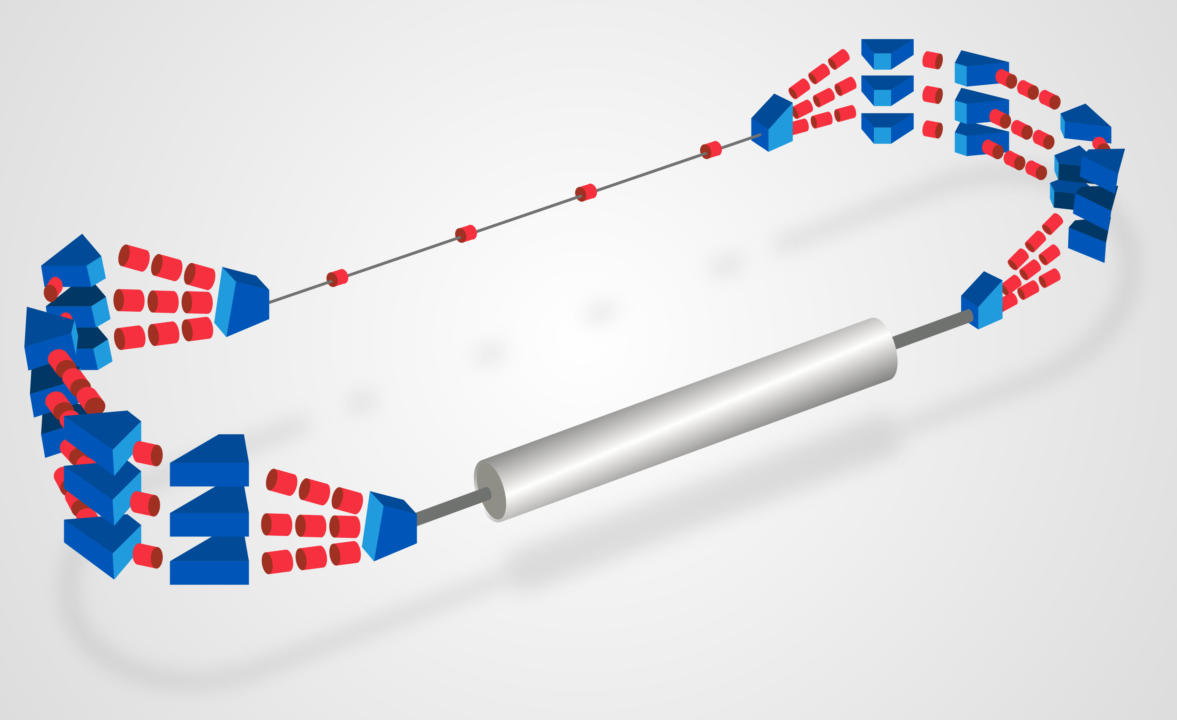
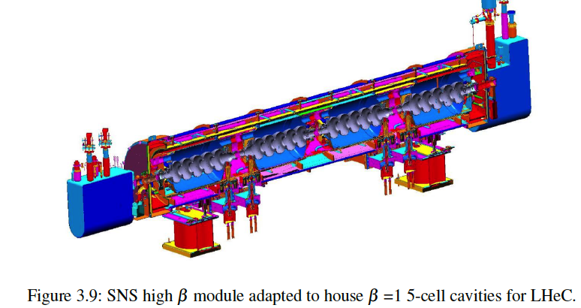
ERL Demonstrator
Demonstration of high current
(25mA), multi(3)turn ERL
Test and development of 802MHz
SCRF technology
(65-75MV / CM & 4 5-Cell cavities/CM)
E_{e} = 200 (400) MeV with 1(2) CMs
A.Valloni 2/16
Parameter | Value
Dipoles per arc Dipole length Max B Field | 3/4 50 cm 1.1 T
Quadrupoles per arc Quadrupoles in straight lines | 5 4
Dipoles in Spreader/Combiner Quads in Spreader/Combiner | 1-3 3
Dipoles for Injection-Extraction | 6
A.Valloni 2/16

Slide 27
Mini PERLE Parameters:
Parameter | Value
injection energy | 5MeV
RF frequency | 801MHz
acc. voltage per cavity | 15MV
# cells per cavity | 5
total cavity length | ca. 1m
# cavities per cryomodule | 4
RF power per cryomodule
# cryomodules | 1 / 2
max. acceleration per module pass | 75MV
bunch repetition | 25ns
injected beam current | 10-30mA
nominal bunch charge | 0.7 nC
number of passes | 3 | 3
top energy | 230Gev | 455GeV
duty factor | CW

Slide 28
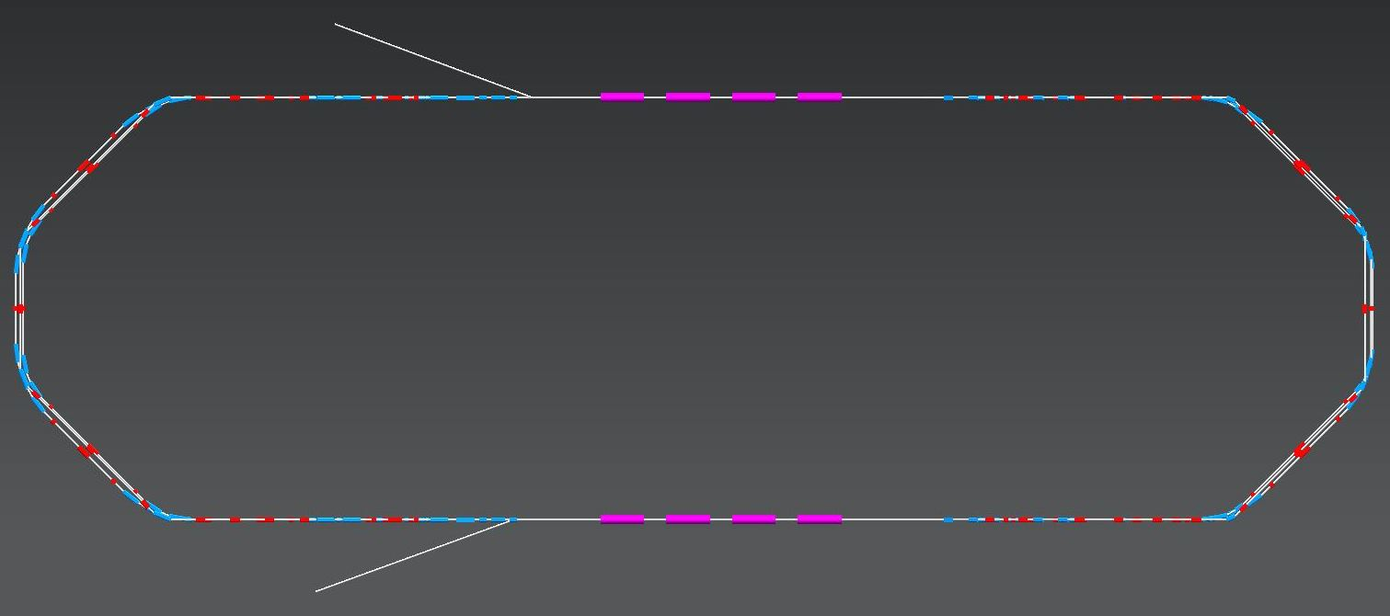
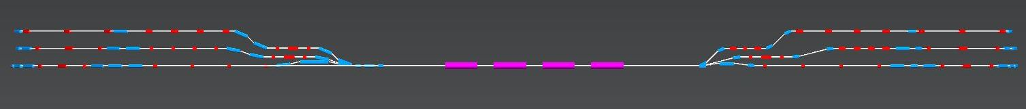
Mini PERLE Footprint:
A.Bogazs 2/17
6m
24 m
92 dipole [1.4T] and 118 quadrupole magnets

Slide 29
ERL Demontrator
Technical Mission Summary for LHeC:
-high current (25mA / 0.7nC) multi-turn (3) ERL operation
-Energy recovery efficiency
-SRF LLRF feedback and control
-Failure scenarios and transients in multi turn ERL operation
-Beam stability (Beam Breakup and filling schemes)
-Demonstration / specification of required HOM damping
-Transverse / longitudinal stability for bunch passage @ high energy
-Beam halo formation and dump-line acceptance
-Beam instrumentation (minimum requirements)
-Build up operational experience
-Source and injector validation

Slide 30
Reserve Transparencies

Slide 31
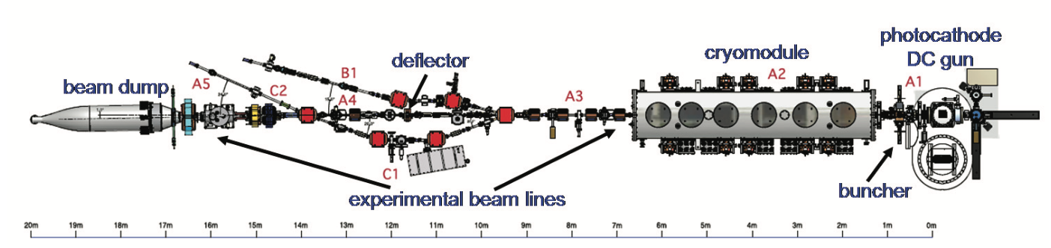
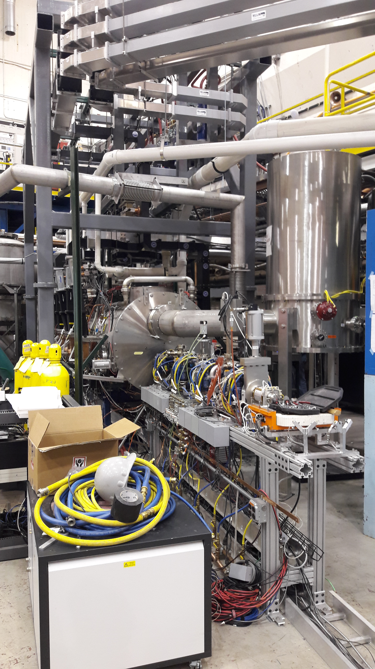
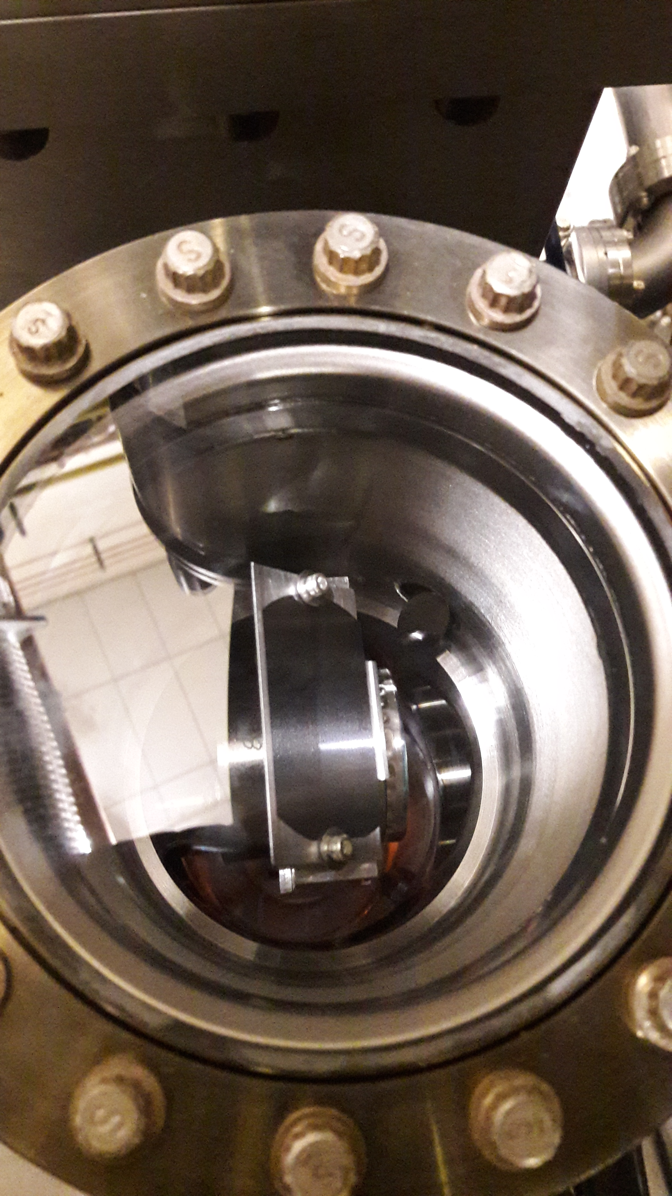
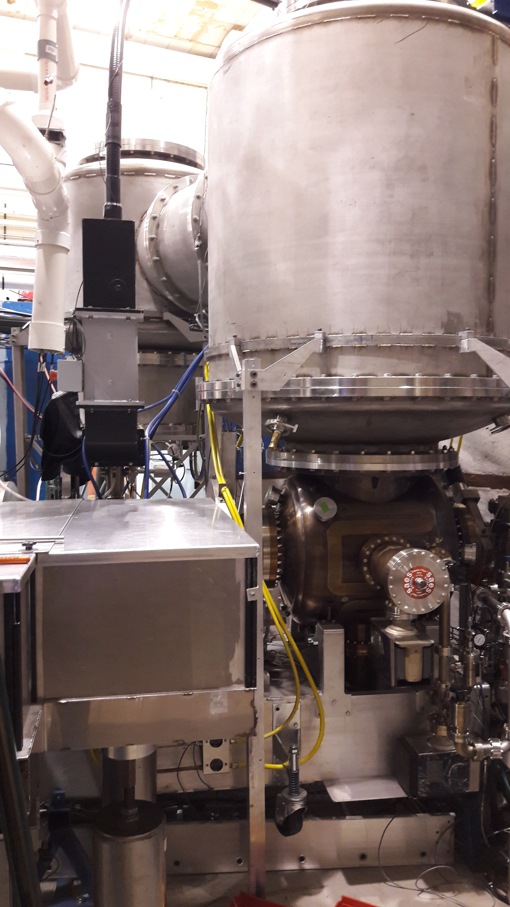
Cornell High Current Injector
F. Loehl @ IPAC’10

Slide 32
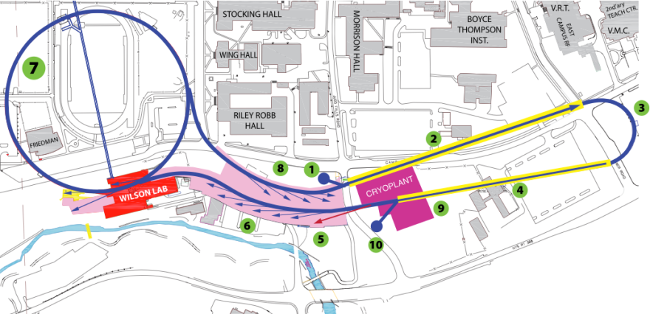
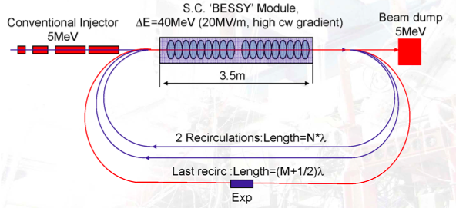
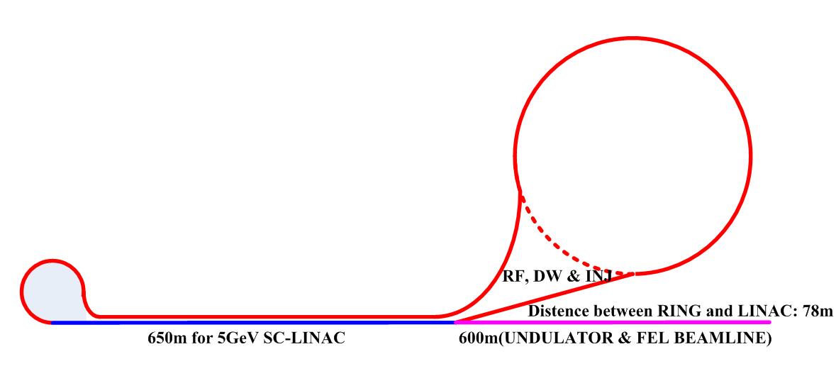
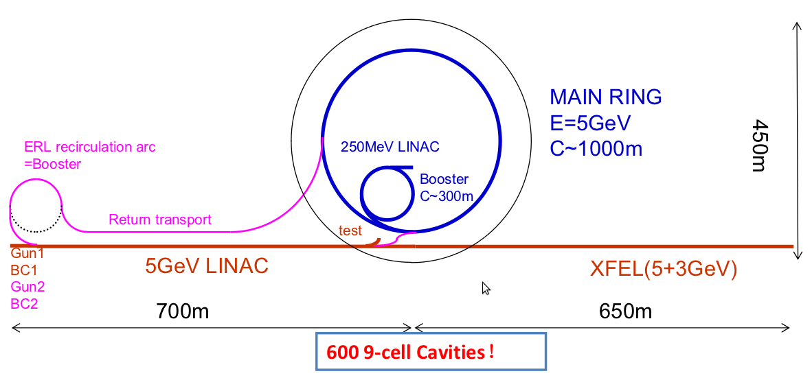
ERL Facilities around the World
High Energy (> 100MeV), planned, (single turn) Facilities:
JLAB, FEL, 160 MeV, 1.5 GHz
Cornell ERL Light Source, 5 GeV, 1.3 GHz
10mA
1.3GHz
5-125 MeV
MESA
APS-ERL Upgrade
5 GeV, 1-2 passes
1.4 GHz
APS
Beijing Advanced
Photon Complex
1.3 GHz

Slide 33
CDR Choices: Technology and Design
Optics:
-SRF Linac with quadrupoles between the cryo modules
-Flexible Momentum Compaction [FMC] arc optics

Slide 34
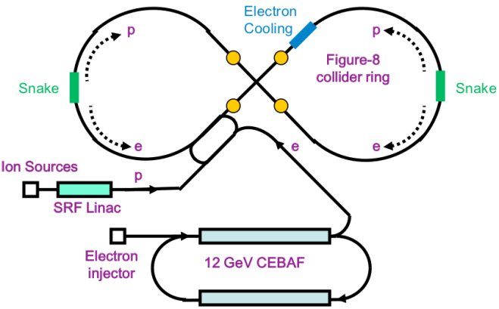
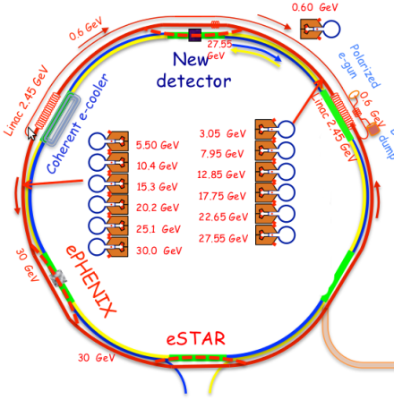
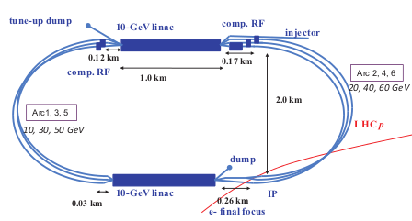
HE ERL’s, EIC’s (election-ion) - Studies
JLAB, MEIC
BNL, eRHIC
JLab MEIC | BNL eRHIC | CERN LHeC
5-10 GeV | 20 GeV | 60 GeV
750 MHz 5 passes | 704 MHz 16 passes | 704 MHz 3-passes
3 A -> 30mA | 50 mA -> 1.6A | 15 mA -> 90mA
4 nC | 3.5 nC | 0.3 nC
7.5 mm | 2 mm | 0.3 mm
Planned | Planned | Planned
Frequency choice!
Number of Recirculation turns!
Beam intensity / Beam current
Need for complementary ERL Facilities!
CERN, LHeC

Slide 35
Existing Demonstrator Proposals:
C-BETA: funded
Combined proposal by BNL and Cornell University
Funded by the state of New York and being build at Cornell
Main characteristics: FFAG arcs, 1.3 GHz TESLA module, 1 linac,
150 MeV, 6Mev inj;
4 turns and FFAG arcs; 4*2*40mA; 125pC; 203ns
ER@CEBAF: Not yet funded
Combined proposal by BNL and JLab
Main characteristics: 1.5 GHz CEBAF modules, 0.1mA,
2 linacs, 5 re-circulations, 1 GeV
PERLE: Main characteristics:
800MHz, 3 turns, 25mA, 650pC, 2 linacs, 1 GeV

Slide 36
LHeC Infrastructure Baseline:
F. Zimmermann
LR LHeC:
recirculating
linac with
energy
recovery,
or straight
linac

Slide 37
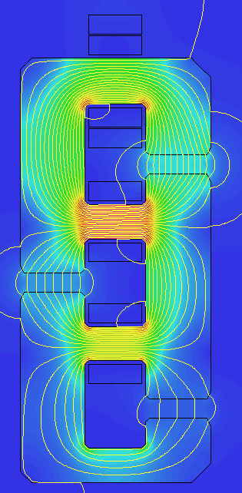
Post CDR: Return Arc Dipoles optimization
∙
Attilio Milanese
∙
Alternative coil arrangement
keep the idea of recycling Ampere-turns
stack the apertures vertically but offset them also transversally
same vertical gap, 25 mm
simple coils / bus-bars, same powering circuit
as before, trim coils can be added for two of the apertures, to give some tuning
×
0.264 T
60 GeV
×
∙
0.176 T
40 GeV
∙
×
0.088 T
20 GeV

Slide 38
Linac 1 and 2 − Multi-pass ER Optics
A. Bogacz (JLab) @ ERL2015, Stony Brook University, June 9, 2015

Slide 39
Vertical Separation of the Three Arcs
A. Bogacz (JLab) @ ERL2015, Stony Brook University, June 9, 2015
Arc 1 (10 GeV)
Arc 3 (30 GeV)
Arc 5 (50 GeV)

Slide 40
Arc Optics: Emittance preserving FMC cells
Emittance dilution due to quantum excitations:
[Flexible Momentum Compaction]
A. Bogacz (JLab) @ ERL2015, Stony Brook University, June 9, 2015
Arc 1 , Arc2
Arc 3, Arc 4
Arc5, Arc 6
500
Imaginary γ_{t} Optics
0.5
500
DBA-like Optics
0.5
500
TME-like Optics
0.5
[Double Bend Achromat]
[Theoretical Minimum Emittance]
BETA_X&Y[m]
DISP_X&Y[m]
BETA_X&Y[m]
BETA_X&Y[m]
DISP_X&Y[m]
DISP_X&Y[m]
0
-0.5
0
-0.5
0
-0.5
0
BETA_X
BETA_Y
DISP_X
52.3599
DISP_Y
0
BETA_X
BETA_Y
DISP_X
DISP_Y
0
BETA_X
BETA_Y
DISP_X
52.3599
52.3599
DISP_Y
factor of 20 smaller than FODO
total emittance increase in Arc 1- 5: Δε_{x}^{N} = 4.9 μm rad

Slide 41
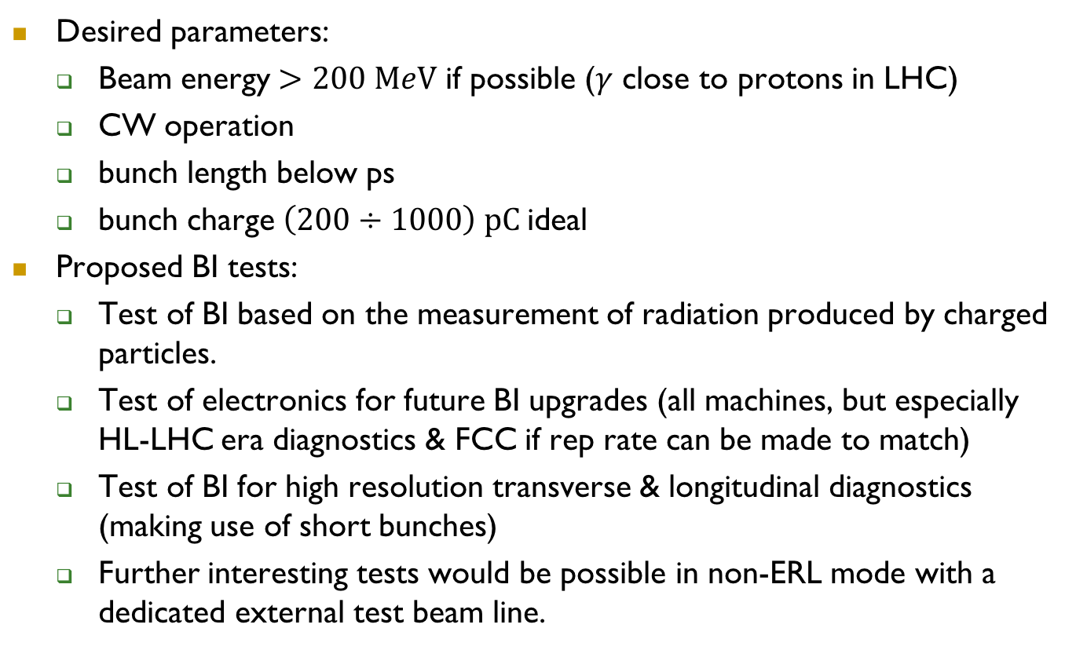
Beam diagnostics application
E. Jensen
LHeC Workshop 2015
Desired parameters:
  Beam energy $>200 MeV$ if possible ($γ$ close to protons in LHC)
  CW operation
  bunch length below ps
  bunch charge $\left(200÷1000\right) pC$ideal
Proposed BI tests:
  Test of BI based on the measurement of radiation produced by charged particles.
  Test of electronics for future BI upgrades (all machines, but especially HL-LHC era diagnostics & FCC if rep rate can be made to match)
  Test of BI for high resolution transverse & longitudinal diagnostics (making use of short bunches)
  Further interesting tests would be possible in non-ERL mode with a dedicated external test beam line.

Slide 42
Low Energy ERL’s and ERL test facilities (contd.)
IHEP ERL-TF | HZB BERLinPro | BINP | Peking FEL | BNL ERL-TF | KEK cERL | Daresbury ALICE | JAERI
35 MeV | 100 MeV | 11-40 MeV | 30 MeV | 20 MeV | 245 MeV | 10 MeV | 17 MeV
1.3 GHz 9 cell | 1.3 GHz | 180 MHz | 1.3 GHz 9-cell | 704 MHz 5-cell | 1.3 GHz 9-cell | 1.3 GHz 9-cell | 500 MHz
10 mA | 100 mA | 30 mA | 50 mA | 50-500 mA | 10-100 mA | 13 µA | 5-40 mA
60 pC | 10-77 pC | 0.9-2.2 nC | 60 pC | 0.5-5 nC | 77 pC | 80 pC | 400 pC
2-6 ps | 2 ps | 70-100ps | 1-2 ps | 18-31 ps | 1-3 ps | ~10 ps | 12 ps
1 pass | 1-2 pass | 4 passes | 1 pass | 1 pass | 2-passes | 1-pass | 1-pass
Under construction | Planned / construction | operating |  | Under construction | Under construction | No longer operating | operating
Rama Calaga, RFTech 2013, Mar 25-26, 2013

Slide 43
High Energy ERL’s, EIC’s (election-ion)
JLAB, MEIC
BNL, eRHIC
JLab MEIC | BNL eRHIC | CERN LHeC
5-10 GeV | 20 GeV | 60 GeV
750 MHz ? passes | 704 MHz 6 passes | 800 MHz 3-passes
3 A | 50 mA | 25 mA
4 nC | 3.5 nC | 0.64 nC
7.5 mm | 2 mm | 0.3 mm
Study | Study | Study
CERN, LHeC
Rama Calaga, RFTech 2013, Mar 25-26, 2013

Slide 44
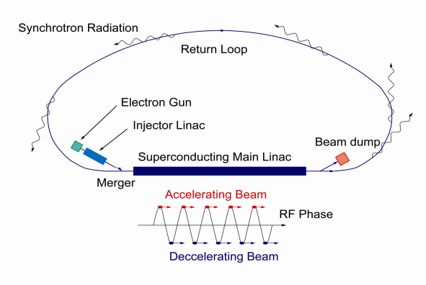
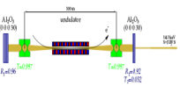
High Energy ERL’s, Light sources, FEL
Cornell ERL Light Source, 5 GeV
JLAB, FEL, 160 MeV
KEK-JAEA
XFEL-O 2nd Phase
7GeV
Double Acc.
3GeV ERL
First Stage
APS-ERL Upgrade
5 GeV, 1-2 passes
APS
Beijing Advanced
Photon Complex
Rama Calaga, RFTech 2013, Mar 25-26, 2013

Slide 45
High Energy ERL’s, Light sources, FEL’s
Rama Calaga, RFTech 2013, Mar 25-26, 2013
JLab FEL (IR, UV) | Argonne Light Source | Cornell Light source | Mainz, MESA ERL | KEK-JAEA Light Source | Beijing Photon Source
160 GeV | 7 GeV | 5 GeV | 100-200 MeV | 3 GeV | 5 GeV
1.5 GHz | 1.4 GHz 1-2 passes | 1.3 GHz | ? 2 passes | 1.3 GHz | 1.3 GHz 9 cell
10 mA | 25-100 mA | 100 mA | 0.15-10 mA | 0.01-100 mA | 10 mA
135 pC | 77 pC | 77pC | 7.7 pC | 7.7-77 pC | 77 pC
0.045-0.15 mm |  | 0.6 mm | - ps | 2 ps | 2 ps
Operating | Planned | Planned | ? | Planned | Planned
CEBAF not in the list since it is not normally operated in ER mode.
(Is this so? – Please correct me if wrong! – and help fill my other blanks!)

