Slide 1
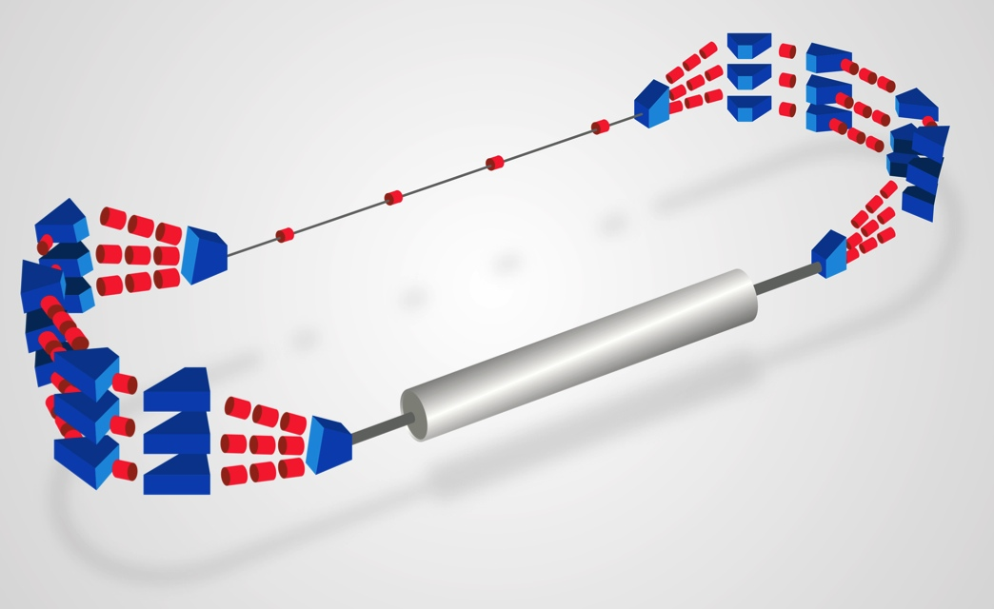
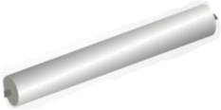
Workshop PERLE@Orsay
Hosting PERLE @ Orsay Walid KAABI
February 23rd 2017
Notes:
How to edit the title slide
Upper area: Title of your talk, max. 2 rows of the defined size (55 pt)
Lower area (subtitle): Conference/meeting/workshop, location, date, your name and affiliation, max. 4 rows of the defined size (32 pt)
Change the partner logos or add others in the last row.

Slide 2
Introduction:
Why an ERL:
A clever concept: Accelerate electrons to high energy, use the beam, decelerate and recover the beam energy for machine operation.
Saving energy is a key word for future machine construction.
Compact accelerator with high performances, smaller infrastructures (site area, cryogenic plant…)
Why @ Orsay:
Develop and acquire expertise in design and operation of ERL.
Involvement of local accelerator experts with complementary expertise around an ambitious project.
Opportunity to host the first superconductive R&D test facility.

Slide 3
Introduction:
Why PERLE:
The opportunity to work within an international collaboration with expert in ERL design and operation.
Technical challenges imposed by the machine design:
Multi-pass energy recovery,
High current operation,
SR cavities test with beam,
beam stability (intensity, position and size) in acceleration and deceleration phases,
Injector versatility,
To prepare technology for the future machine.
Compact but powerful machine that could allow many applications: (controlled quench tests in SC cables and magnet, Beam diagnostics development, injector studies, test facility for cryomodules, detector development and test).

Slide 4
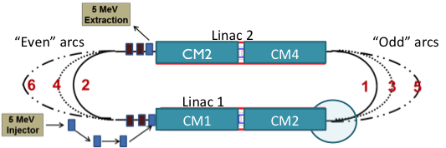
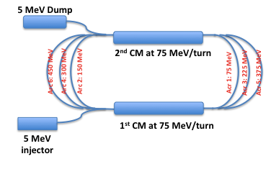
Hosting PERLE@Orsay:
PERLE:
PERLE@Orsay:
Target Parameter Values:
Injection Energy: 5 MeV
RF Frequency: 802 MHz.
CW mode.
Beam current: 6-15 mA.
4 CMs: 4 cavities (5 Cells) @ 15-20 MeV
→ ≈ 300 MeV/tour.
3 passes → ≈ 900 MeV.
Target Parameter Values:
Injection Energy: 5 MeV
RF Frequency: 802 MHz.
CW mode.
Beam current: 6-15 mA.
2 CMs: 4 cavities (5 Cells) @ 15-20 MeV
→ ≈150 MeV/tour.
3 passes → ≈ 450 MeV.

Slide 5
Hosting PERLE@Orsay:
Staged construction:
Phase 1 (2 CMs, single tour): test of injector, cryomodules and beam dump.
Phase 2 (2 CMs, 2-3 tours): installation of arcs for higher energies, spreaders and combiners. Installation of feed-back and diagnostics for test in Energy Recovery Mode.

Slide 6
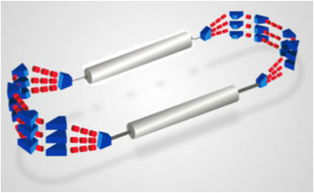
Hosting PERLE@Orsay:
Footprint:
5 m
16 m
The double of the area of the accelerator itself is required to accommodate all services (RF source, cryogenic plant, power converters for magnets, septa and kickers, injector, Dump, beam extraction…) ≈ 150 m².

Slide 7
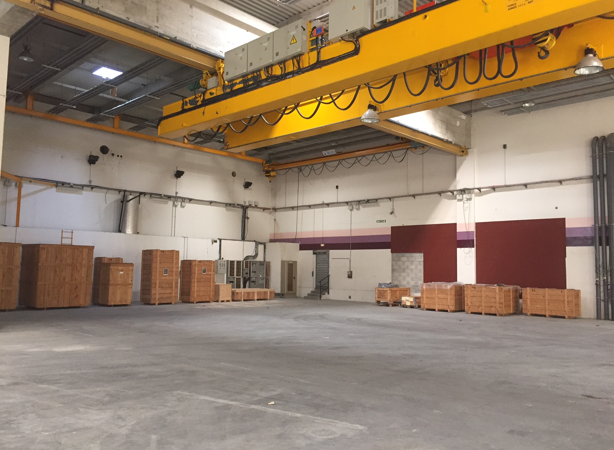
Hosting PERLE@Orsay:

Slide 8
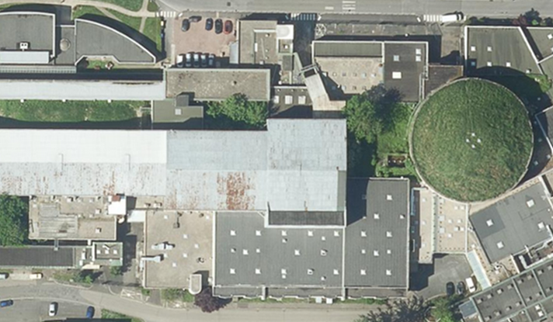
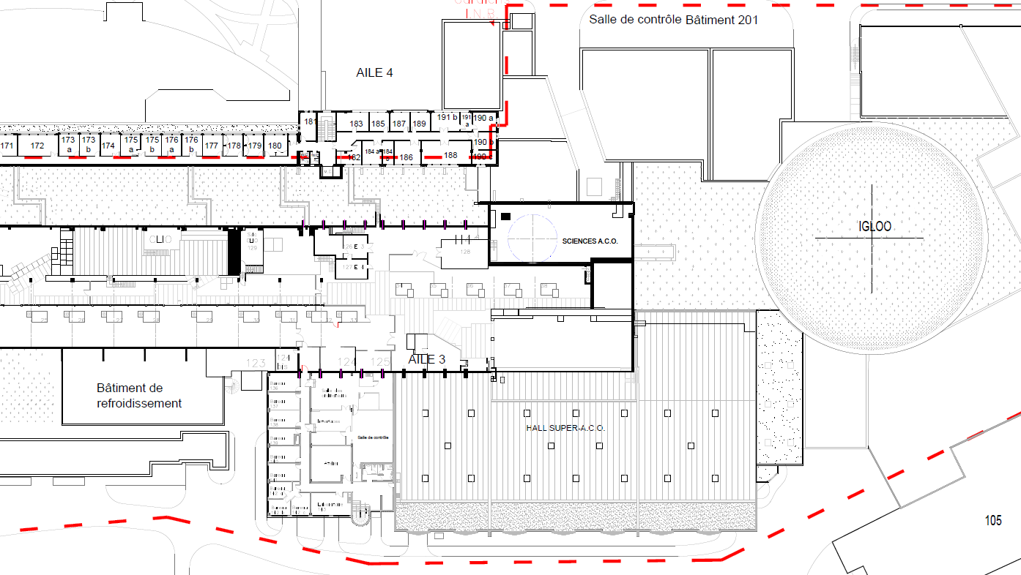
Hosting PERLE@Orsay:
IGLEX: Thomx + Andromede
PRAE
(1)
22.3 X 11.5
= 255 m²
(2)
19.6 X 12.9
= 253 m²
Hall Super ACO
(1850 m²)
Possible use of a 2nd levels for RF source installation
2 possible locations to install Perle@Orsay

Slide 9
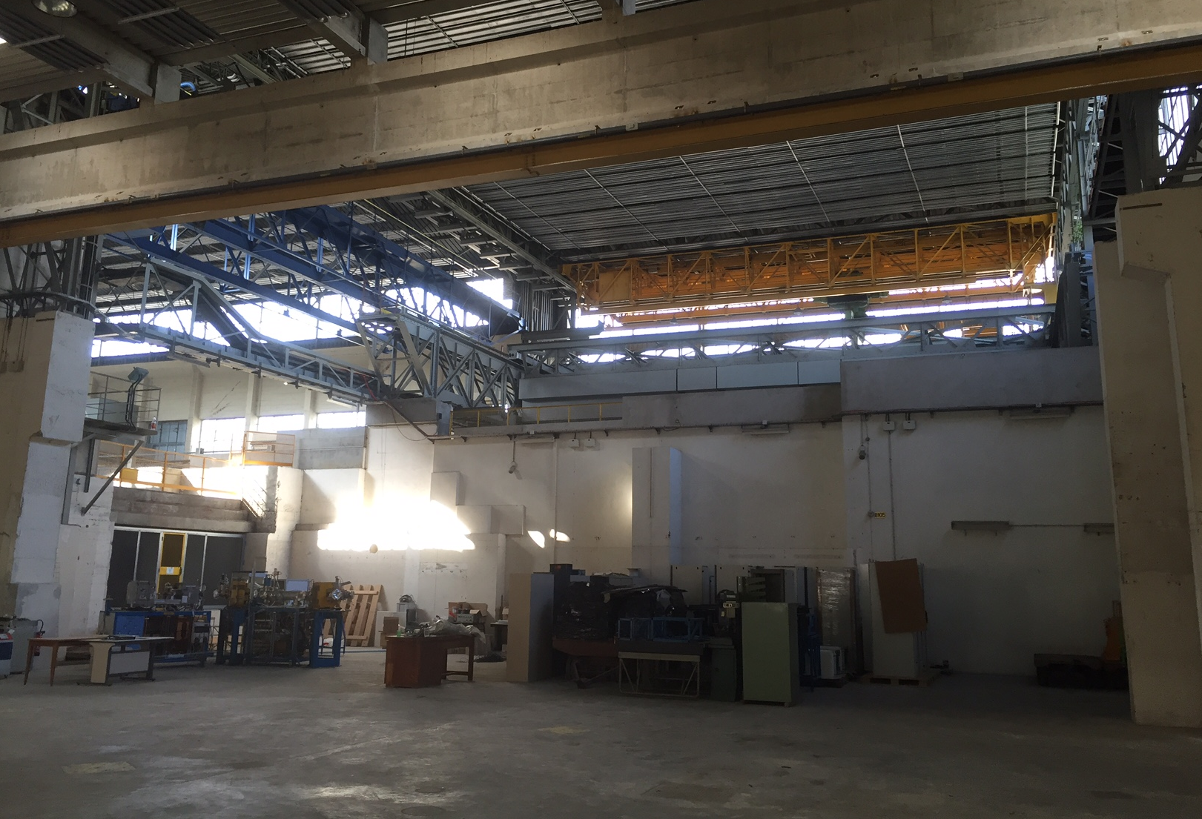
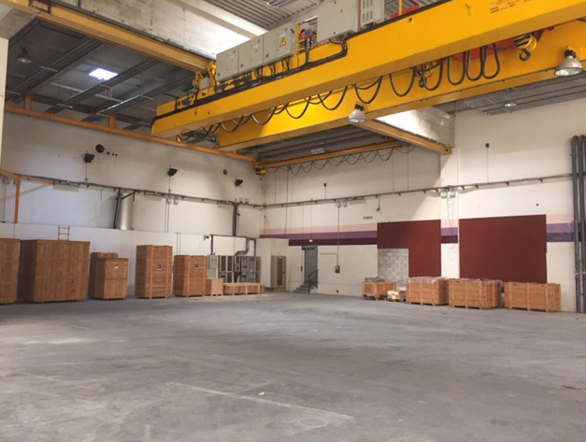
Hosting PERLE@Orsay:
(1)
(2)

Slide 10
Hosting PERLE@Orsay:
Site description:
The experimental hall is equipped with crane, electricity and partially shielded
Water cooling circuit could be shared with other machines nearby.
Possibility to install the RF source and power supplies in a different level than the accelerator
A large area of ground have the required resistance to allow installation of PERLE.
A control room that overlooks the hall could be used for PERLE.
No Cryogenic plant around, has to be built.
Space available for experiments.
Support for the infrastructure is fully assured.

Slide 11
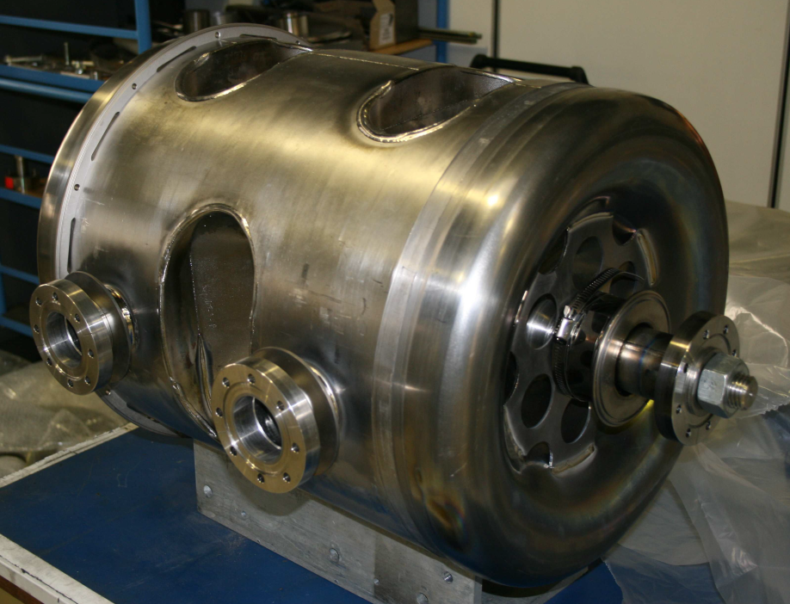
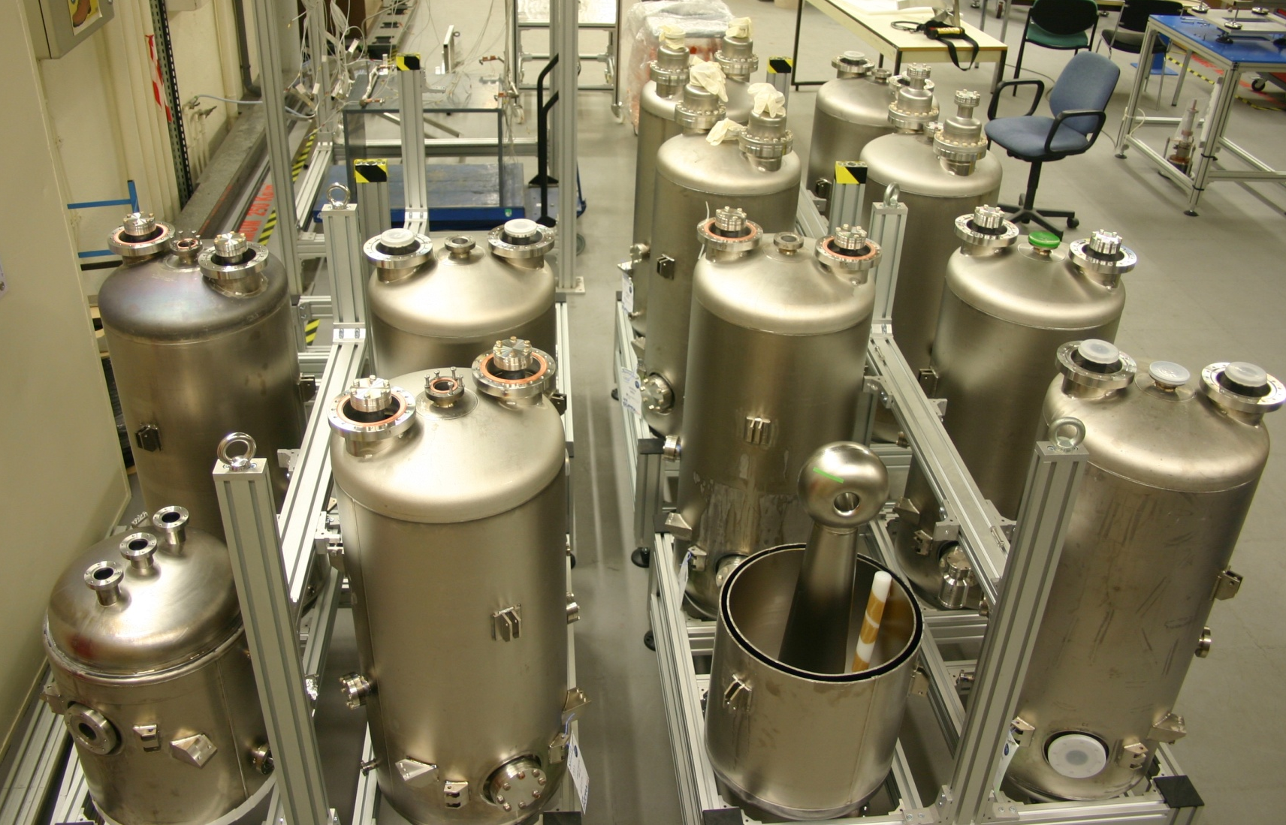
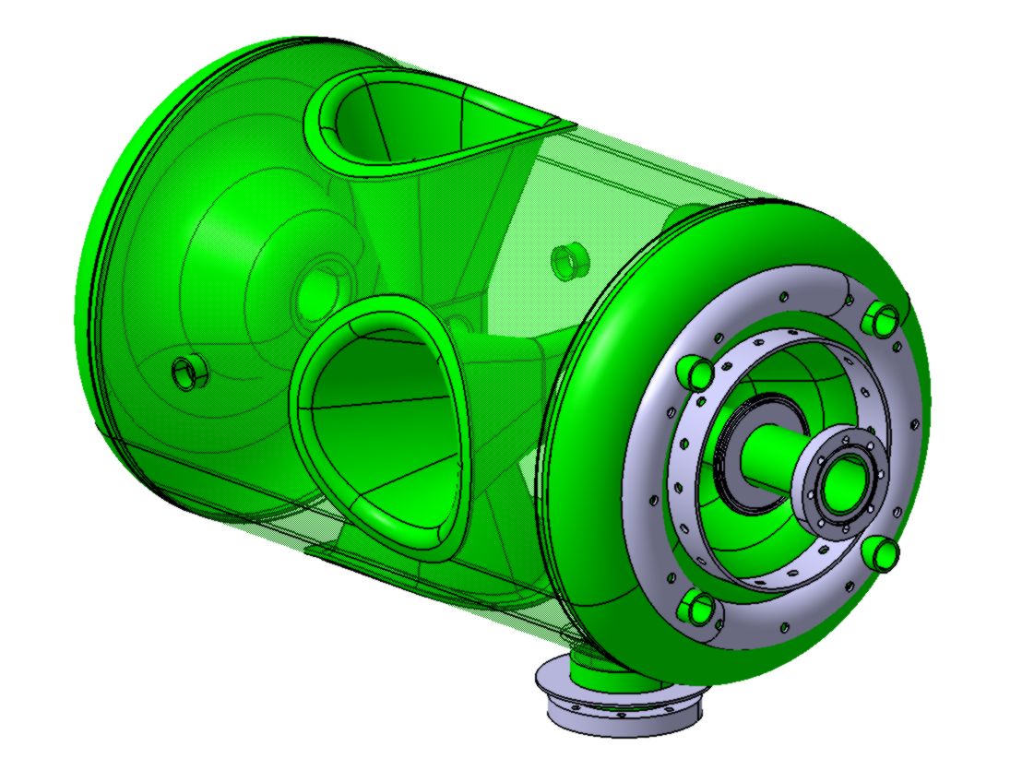
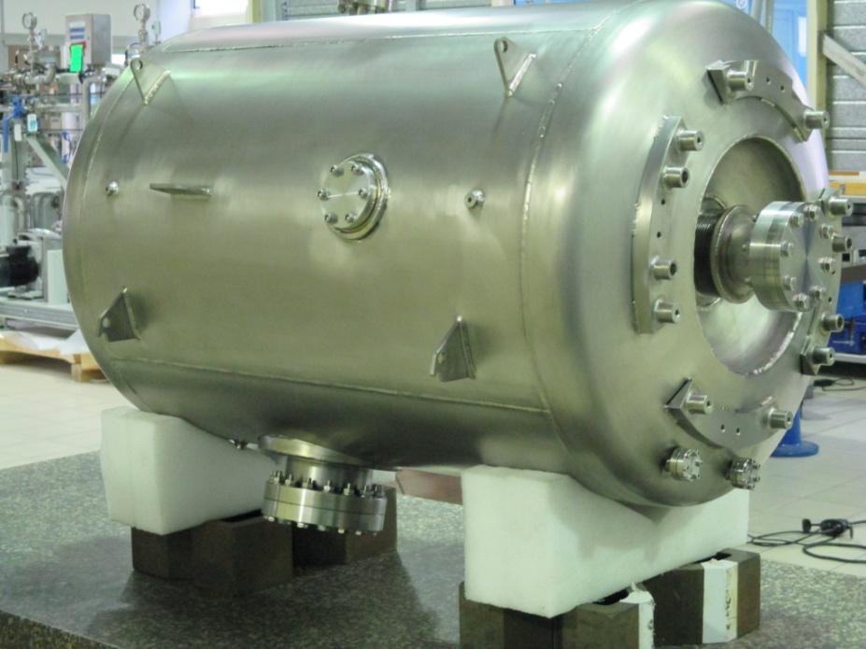
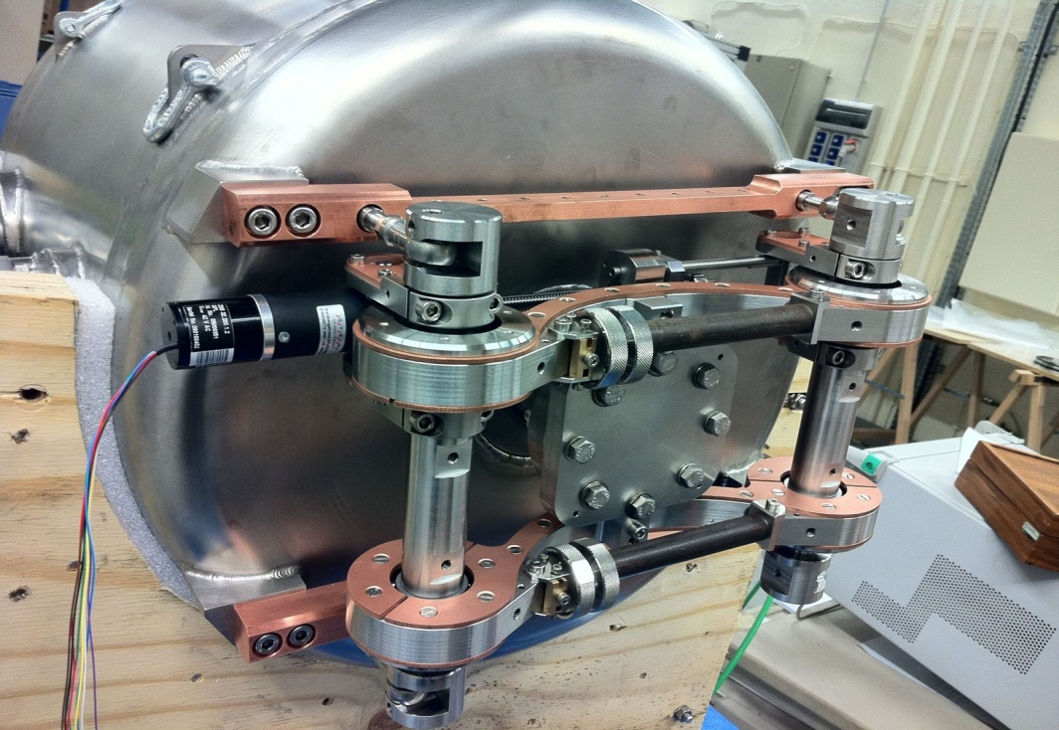
Hosting PERLE@Orsay:
IPN-Orsay is developing since 20 years the heart of future accelerators: superconducting cavities of different types.
ForSPIRAL-2
For Eurisol
Cold tuning systems: to generate mechanical deformation of a few µm, under vacuum and at cryogenic T°
For ESS and MYRRHA

Slide 12
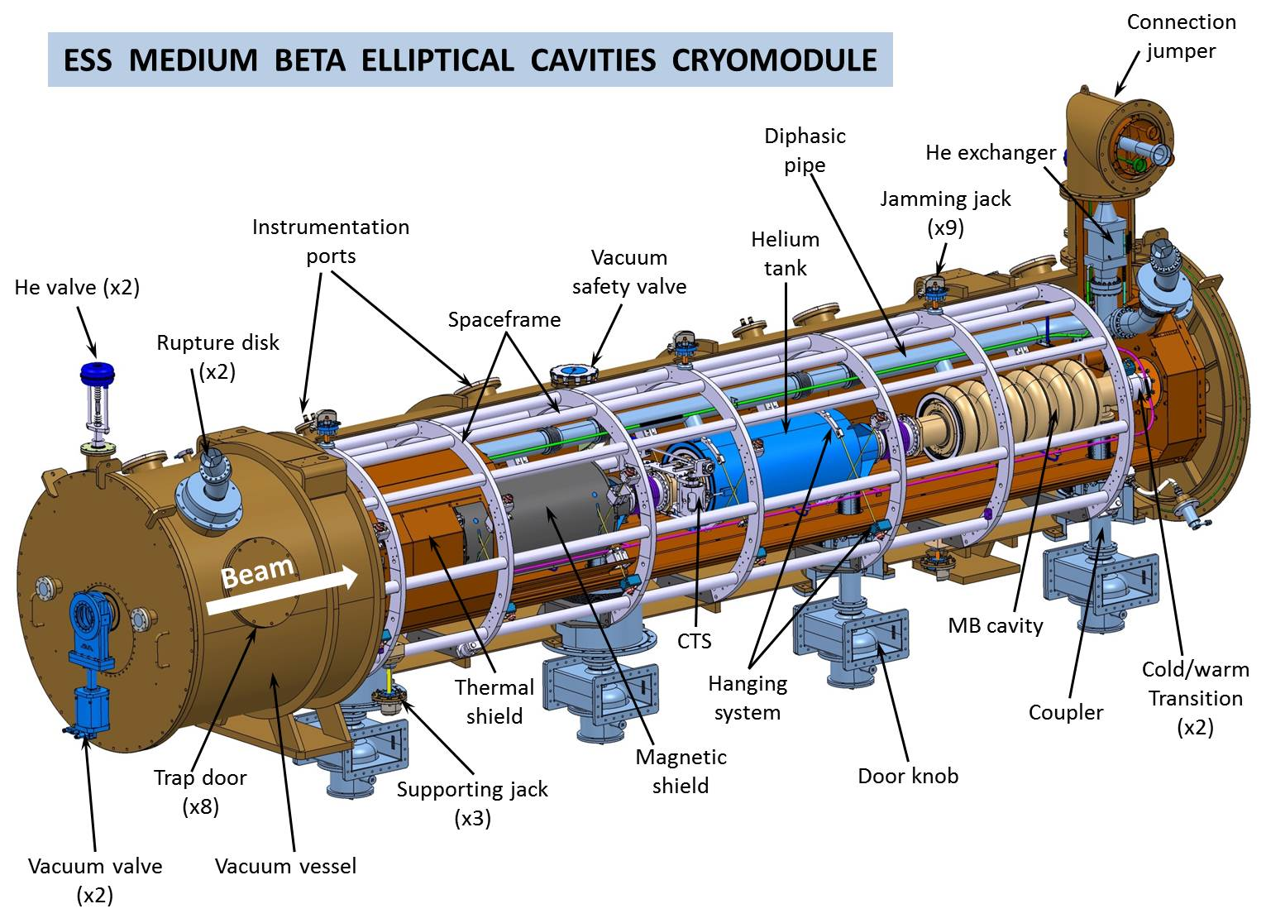
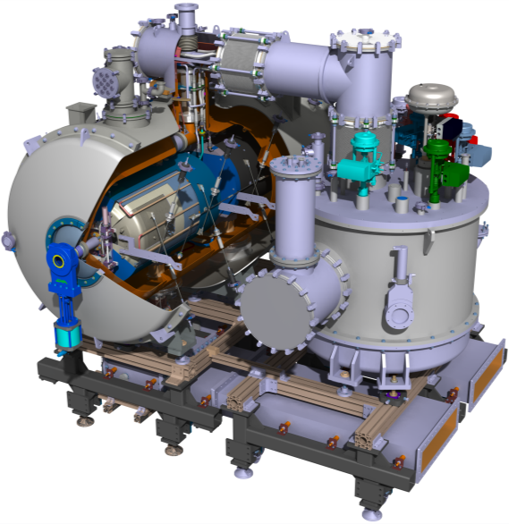
Hosting PERLE@Orsay:
For ESS (Lund, Sweden): accelerating cryomodules: spoke type (13 units) and elliptical (30 units, collaboration with CEA/IRFU).
Elliptical cryomodules
VALVE BOX (VB)
For SPL (CERN): prototype cryomodule
SPOKE CRYOMODULE (CM)
Spoke cryomodule

Slide 13
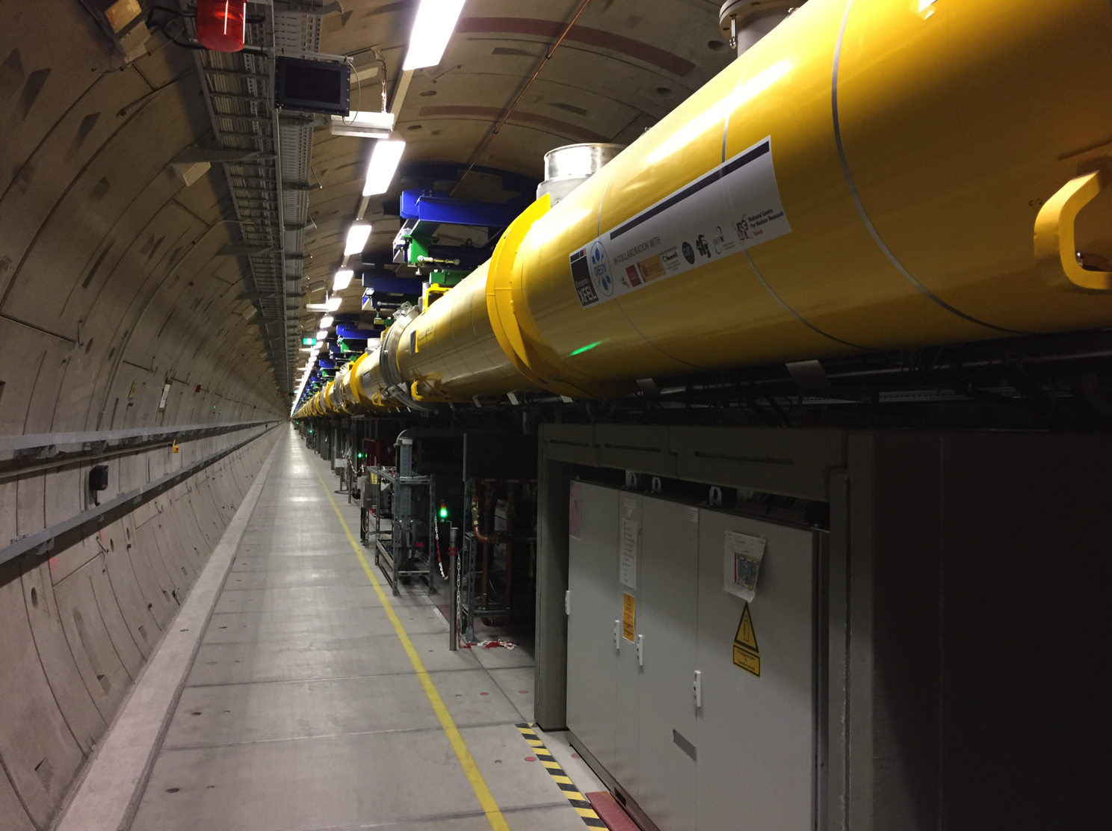
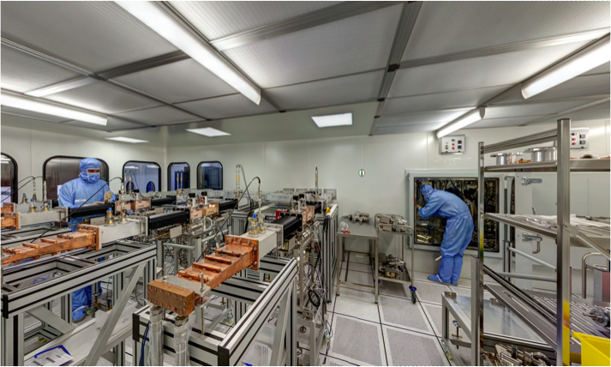
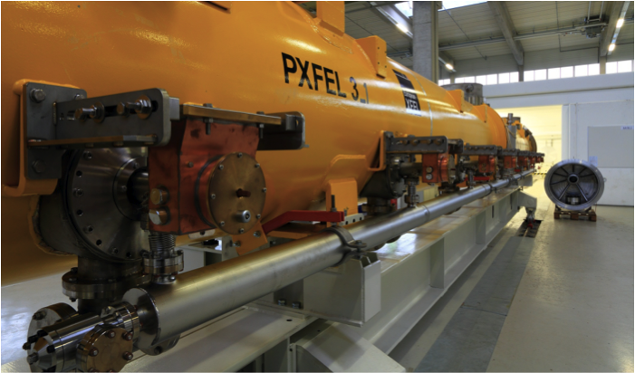
Hosting PERLE@Orsay:
800 power couplers for European XFEL

