Slide 1
ERL at Novosibirsk
G.N. Kulipanov and NovoFEL team
Budker INP, Novosibirsk, Russia
February 23 - 24, 2017
Kickoff Meeting at Orsay for the Technical Design of PERLE

Slide 2
NovoFEL Team
N.A. Vinokurov, V.S.Arbuzov, K.N.Chernov, I.V. Davidyuk, E.N.Dementyev, B.A.Dovzhenko, Ya.V.Getmanov, B.A.Knyazev, E.I.Kolobanov, A.A.Kondakov, V.R.Kozak, E.V.Kozyrev, V.V.Kubarev, G.N.Kulipanov, E.A.Kuper, I.V.Kuptsov, G.Ya.Kurkin, S.V.Motygin, V.N.Osipov, V.M.Petrov, L.E.Medvedev, V.K.Ovchar, A.M.Pilan, V.M.Popik, V.V.Repkov, T.V.Salikova, M.A.Scheglov, I.K.Sedlyarov, S.S.Serednyakov, O.A.Shevchenko, A.N.Skrinsky, S.V.Tararyshkin, V.G.Tcheskidov, A.G. Tribendis, P.D.Vobly, V.N. Volkov.

Slide 3
1.Introduction.
History of ERL activity in Novosibirsk
The Energy Recovery Linac concept for the FEL was proposed at Budker INP by N. Vinokurov and A. Skrinsky (Preprint BINP 78-88, Novosibirsk, 1978; Preprint BINP 78-91, Novosibirsk, 1978; Proceedings of the 6th Soviet Union Accelerator Conference, Dubna, 11-13 October 1978, V II, p.233-236).
The first project of the race-track microtron-recuperator for the free electron laser NovoFEL was proposed at FEL’90 Conference, which took place in Paris (September 1990).
Gavrilov N.G., Gorniker E.I., Kulipanov G.N., …, Vinokurov N.A., NIM A304 (1991), P.228-229

Slide 4
Later the project was modified, the base lines kept:
A four-turn normal conductance linac with energy recovery;
Low RF cavities (180 MHz)
A grid-controlled DC gun with Q~ 1nQ, τ=1nsec, and f_{rep}=10kHz÷50 MHz;
The ERL can operate in three modes, providing an electron beam for the three different FELs, from 300 µm up to 5 µm
Advantages of the low frequency (180 MHz) RF system
High threshold currents for instabilities
Operation with long electron bunches (for narrow FEL linewidth)
Large longitudinal acceptance (good for operation with large energy spread of used beam)
Relaxed tolerances for orbit lengths and longitudinal dispersion

Slide 5
Construction and commissioning four track ERL was divided on three stages;
The first stage of Novosibirsk high power free electron laser (NovoFEL) working in spectral range (90 ÷ 240) μm, based on one track energy recovery linac (ERL) with energy 12 MeV, was commissioned in 2003.
The second stage of NovoFEL working in spectral range (35 ÷ 80) μm, based on two track energy recovery linac with energy 22 MeV, was commissioned in 2009.
The third stage of NovoFEL working in spectral range (8 ÷ 15) μm, based on four track energy recovery linac with energy 42 MeV, was commissioned in 2015.

Slide 6
2. First stage of energy recovery linac
τ = 100 ps
Q = 1.5 nQ
E = 2 MeV
Gun
τ = 1 ns
Q = 1.5 nQ
E = 300 keV
E = 2 MeV
E = 2 MeV
Main acceleration structure
ΔE = 10 ÷ 12 MeV
Buncher
0.5 kW
Electron beam from the gun passes through the buncher (a bunching RF cavity), drift section, 2 MeV accelerating cavities, the main accelerating structure and the undulator, where a fraction of its energy is converted to radiation.
After that, the beam returns to the main accelerating structure in a decelerating RF phase, decreases its energy to its injection value (2 MeV) and is absorbed in the beam dump.
6

Slide 7
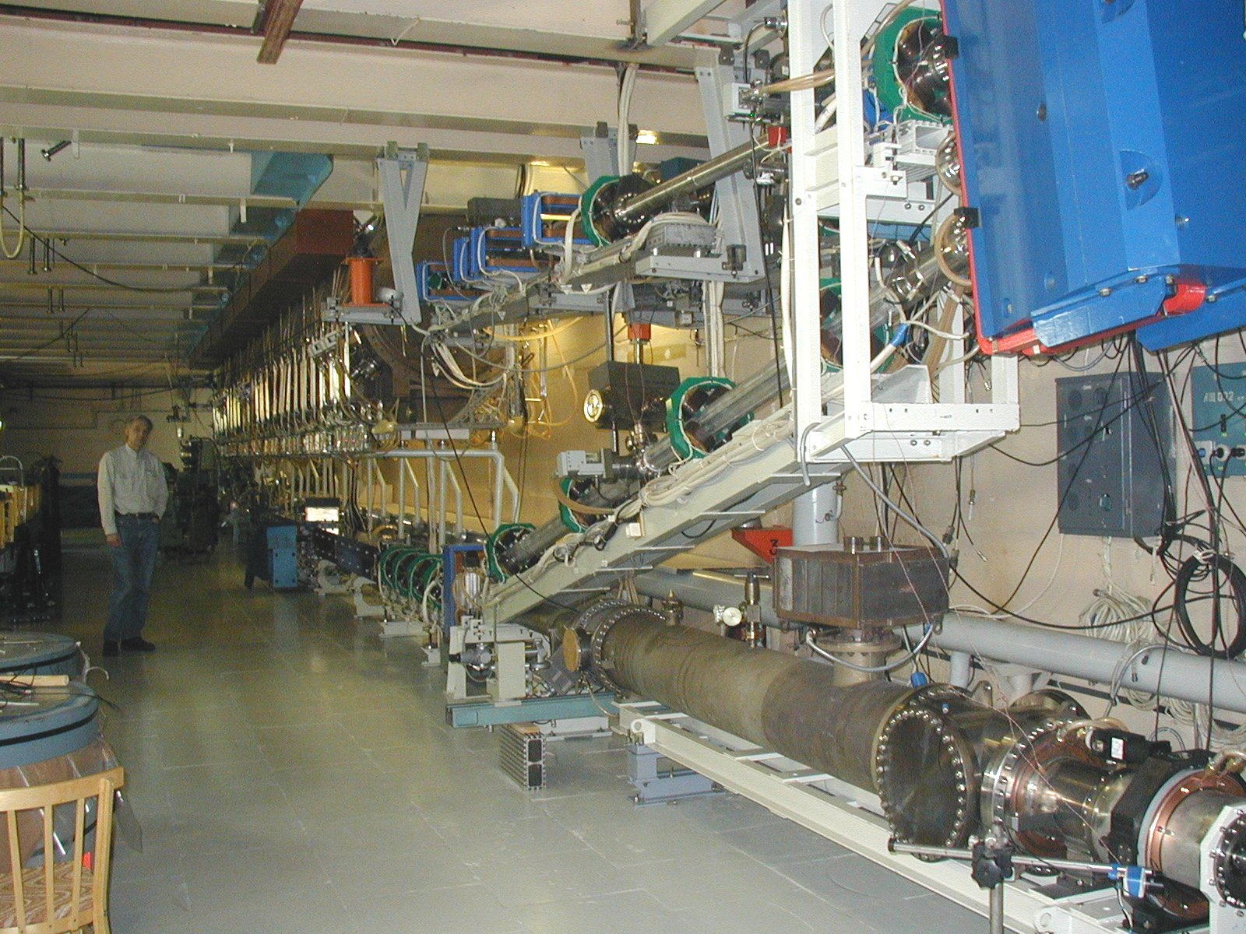
7

Slide 8
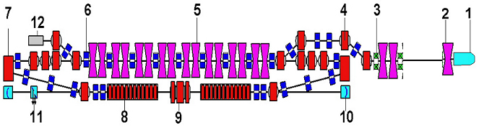
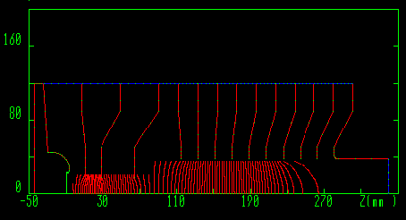
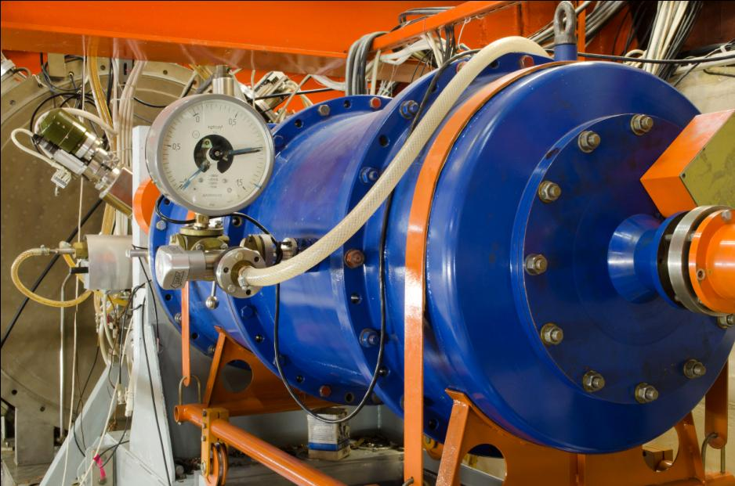
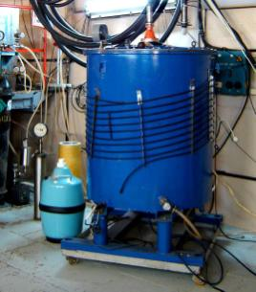
Electrostatic gun
Power supply:
U_{max} = 300 kV
I_{max} = 50 mA
8

Slide 9
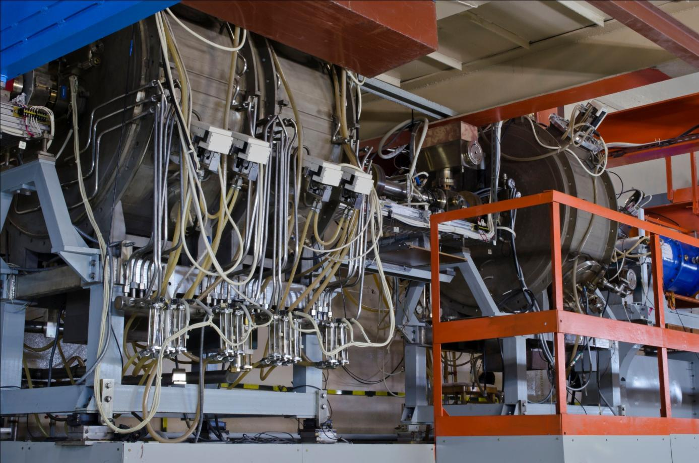
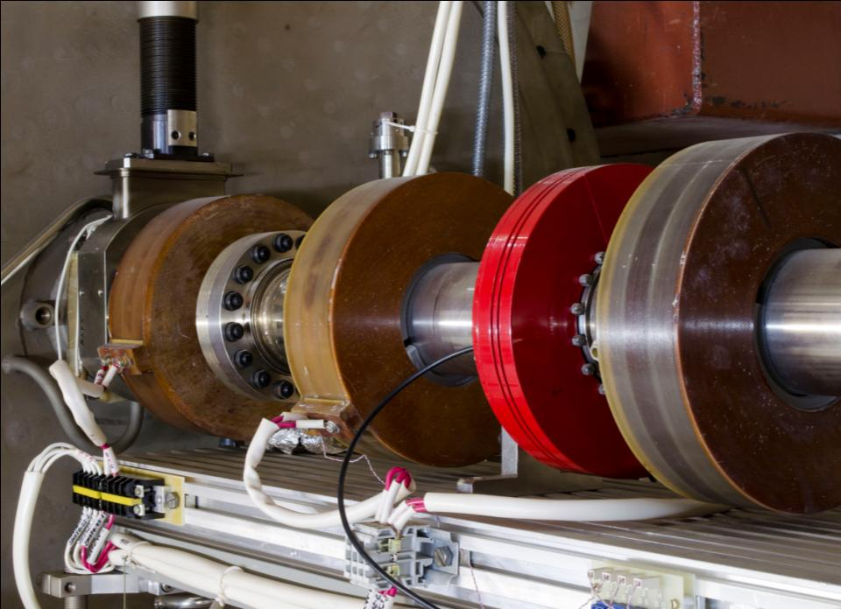
Injector
9

Slide 10
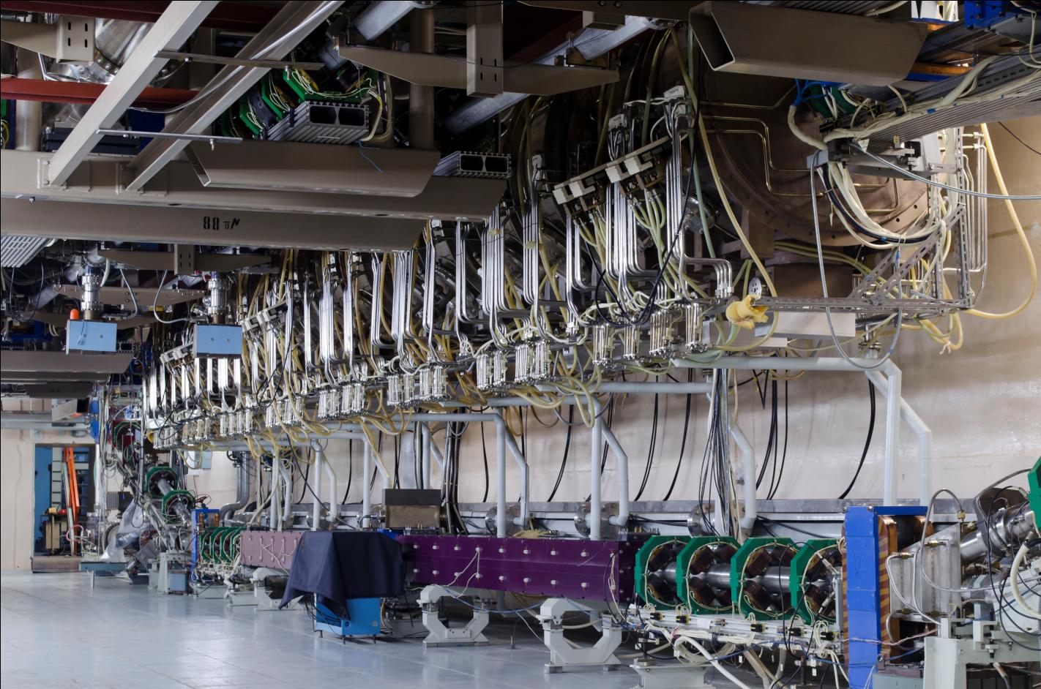
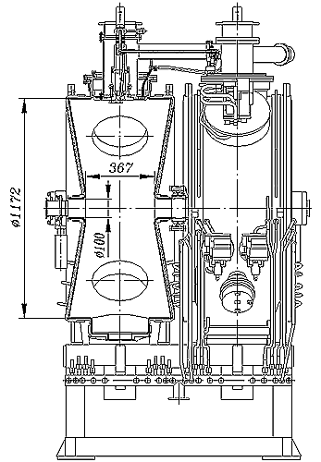
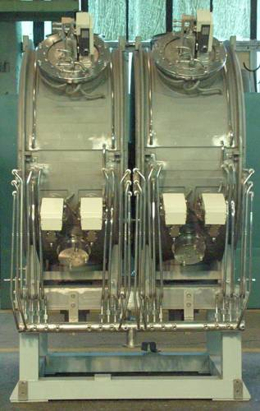
Main linac
10

Slide 11
Resonator parameters
Resonant frequency | f₀ | 180,4 | MHz
Frequency tuning range (by 2 movable tuners) | Δf₀ | 320 | kHz
Unloaded quality factor | Q₀ | 40 000
Transit time factor (for v / c = 1) | T | 0,9
Shunt impedance | R | 5,3 | MOhm
Effective shunt impedance | R_{eff} = RT² | 4,3 | MOhm
Characteristic impedance | ρ = R/Q₀ | 133,5 | Ohm
Effective characteristic impedance | ρ_{eff} = ρT² | 108,1 | Ohm
Max operating gap voltage (ampl.) | U | 950 | kV
Max operating accelerating voltage (ampl.) | U_{eff} = UT | 850 | kV
Power dissipation in the cavity @ U = 950 kV | P = U²/2R | 85 | kW
Max power density @ U = 950 kV | dP/dS (max) | 2 | W/cm²

Slide 12
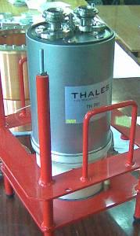
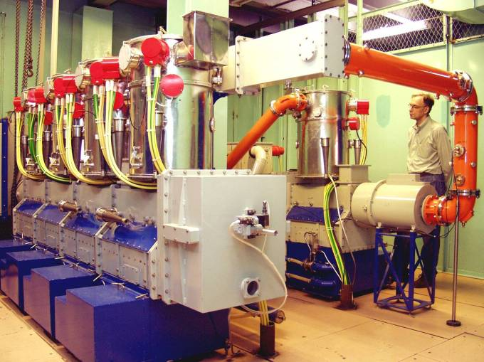
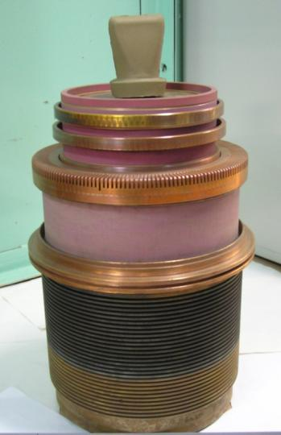
RF power supply
Frequency, MHz | 180.4
Power, MW | 2 x 0.6
12

Slide 13
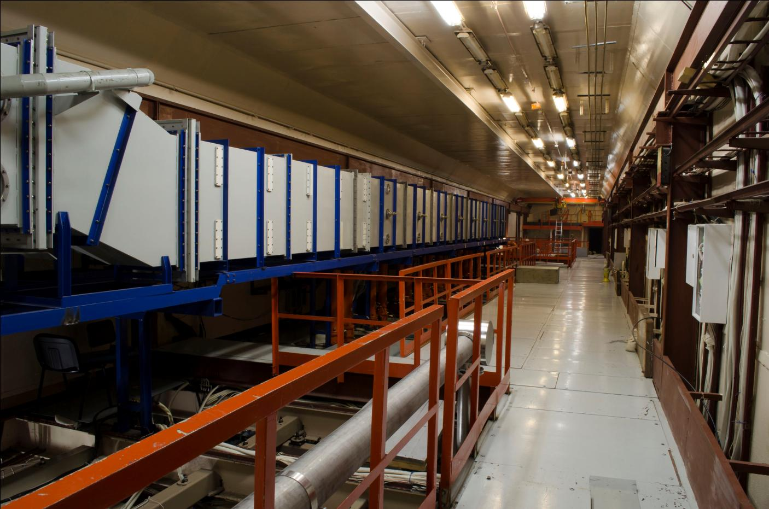
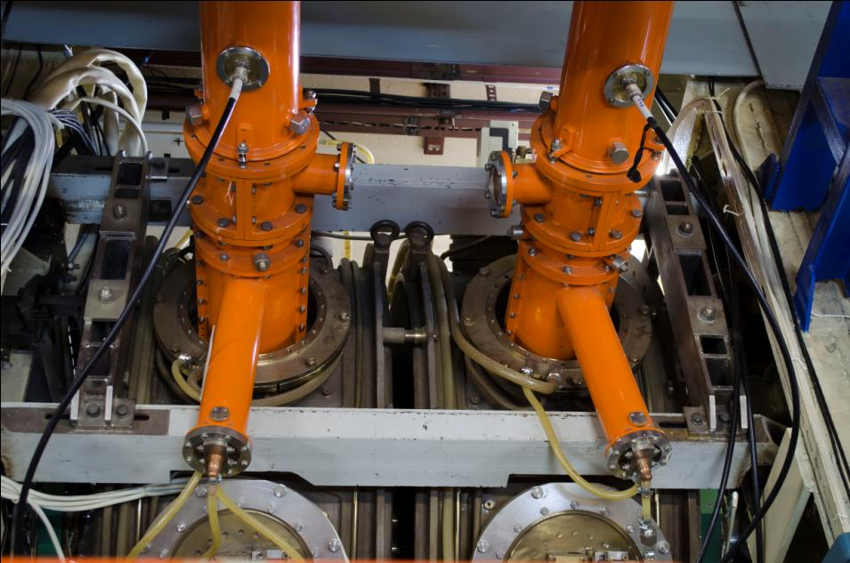
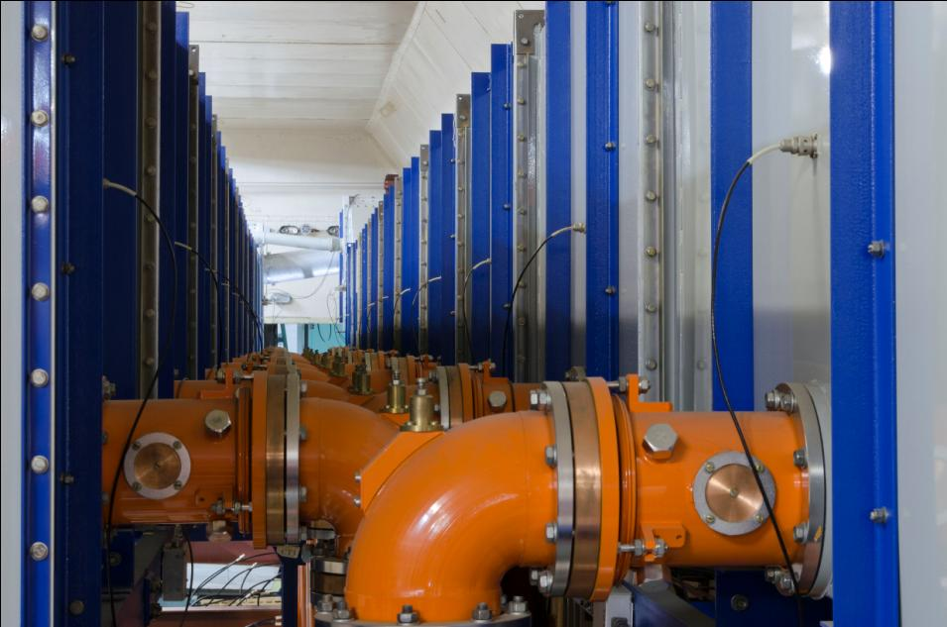
RF waveguides and feeders
13

Slide 14
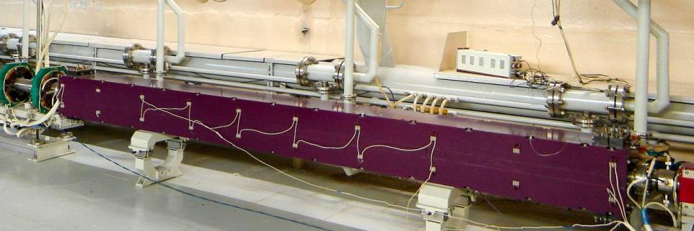
1st stage Undulator
Period, cm | 12
Maximum current, kA | 2.4
Maximum K | 1.2
14

Slide 15
Scheme of optical cavity
(10⁻⁹ – 10⁻¹⁰ Тор)
Parameters of every of 2 sections of 1st stage undulator

Slide 16
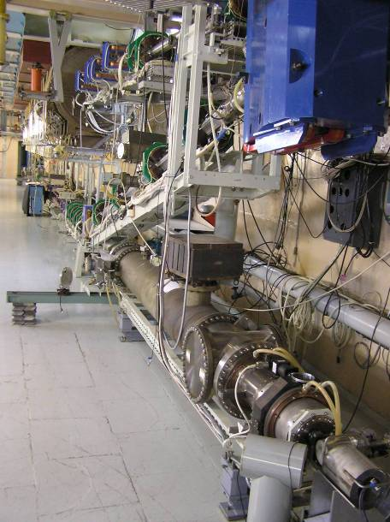
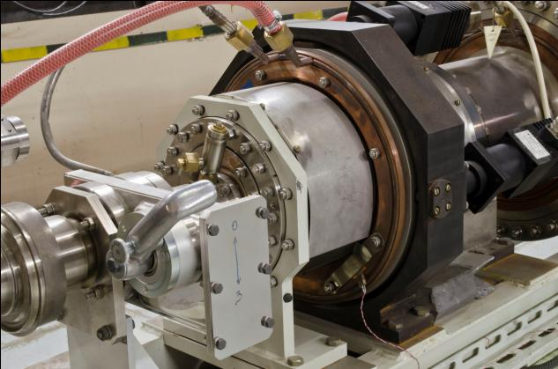
Optical cavity
16

Slide 17
The 1st stage FEL radiation parameters
Radiation wavelength, 5 µm | 90÷240
Pulse duration, ps | 70
Repetition rate, MHz | 5.6; 11.2; 22.4;
Maximum average power, kW | 0.3 _{(for 5.6 MHz)} 0.5_{(for 11.2 MHz)} 1.0 _{(for 22.4 MHz)}
Minimum relative linewidth (FWHM) | 3.10⁻³
Peak power, MW | 1
The obtained radiation parameters are still the world record in terahertz region.

Slide 18
3. Second and third stages of NovoFEL design and commissioning
Novosibirsk energy recovery linac has rather complicated magnetic system. First stage of NovoFEL with 12-MeV electron energy lies in vertical plane.
Other four orbits lie in the horizontal plane.
The beam is directed to these orbits by switching on of two round magnets. In this case electrons pass four times through acceleration RF cavities, obtaining 43-MeV energy. Than, (at the fourth orbit) the beam is used in FEL and decelerated four times.
18

Slide 19
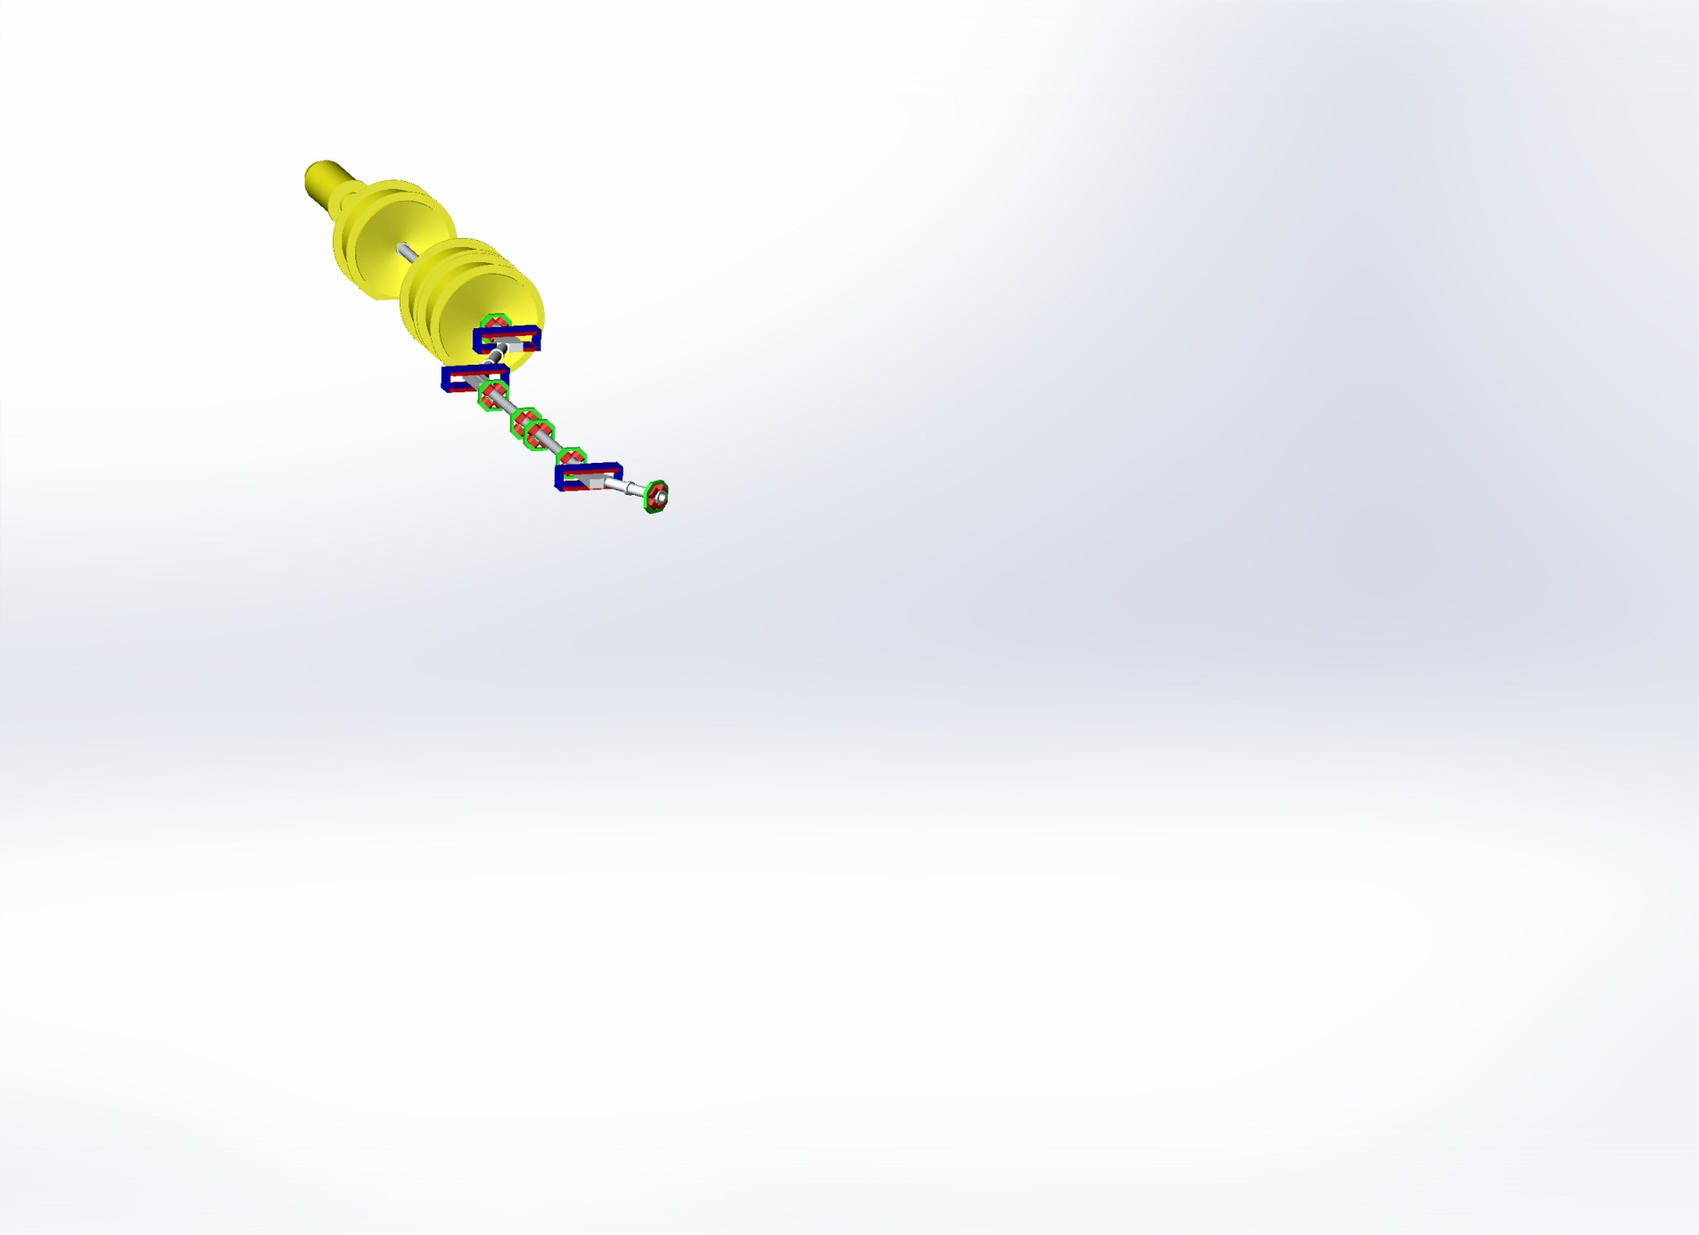
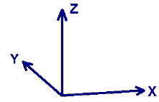

NovoFEL Accelerator Design and status
Gun
Injector

Slide 20
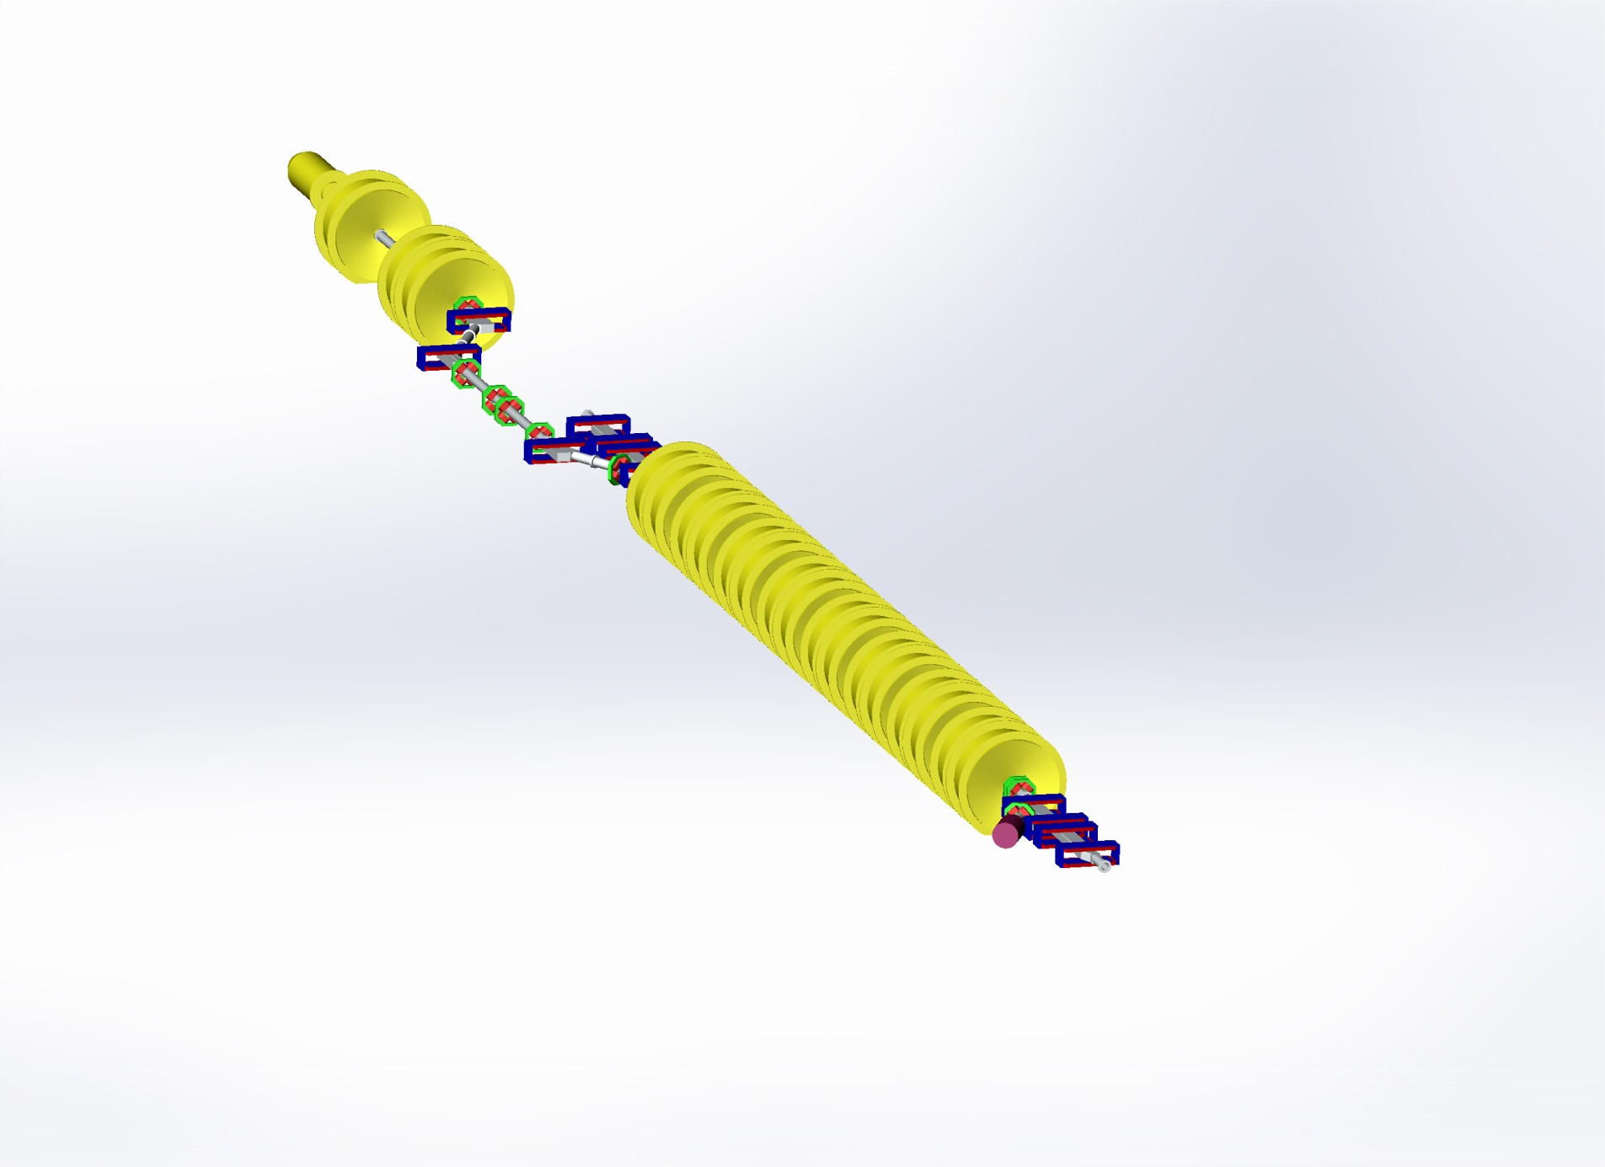
NovoFEL Accelerator Design and status
Gun
Injector
Main linac
Dump

Slide 21
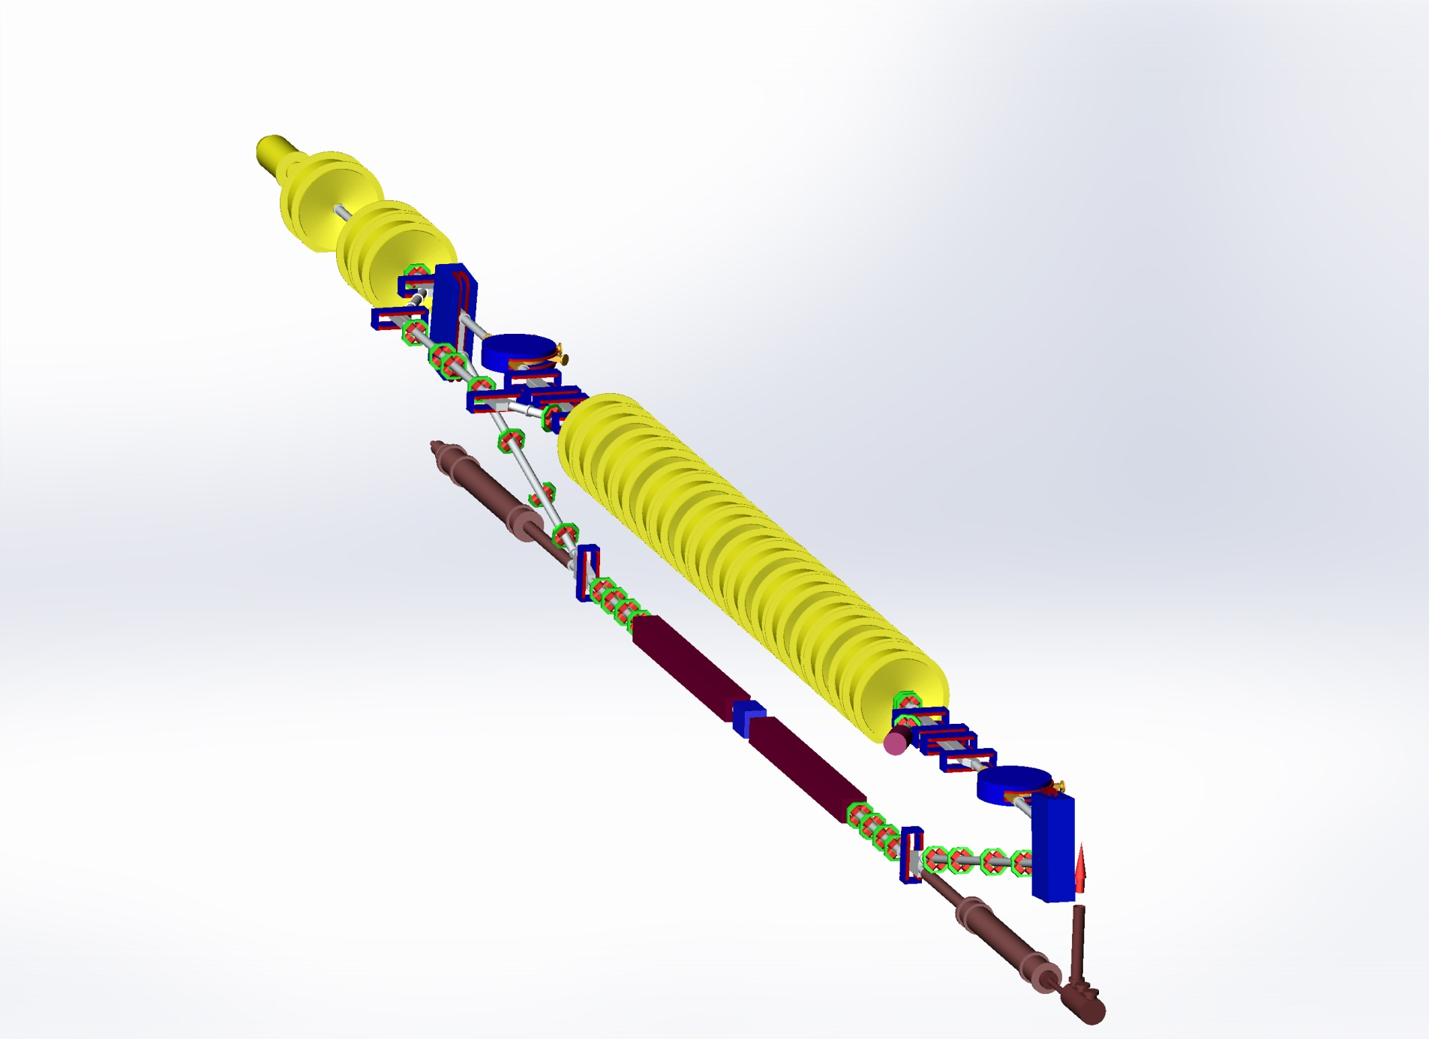
NovoFEL Accelerator Design and status
Gun
Injector
Main linac
The first THz FEL
undulator sections
Dump

Slide 22
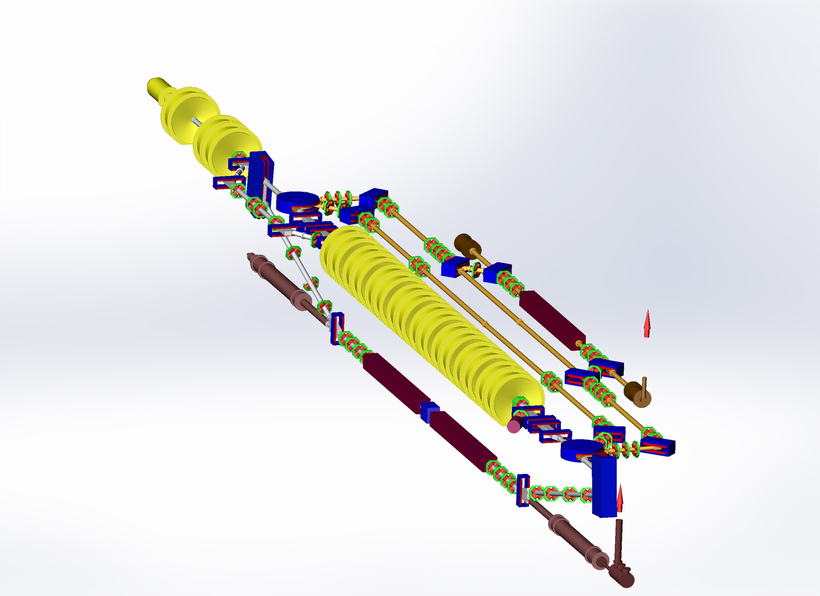
NovoFEL Accelerator Design and status
Gun
The second FEL
undulator
Injector
Main linac
The first THz FEL
undulator sections
Dump

Slide 23
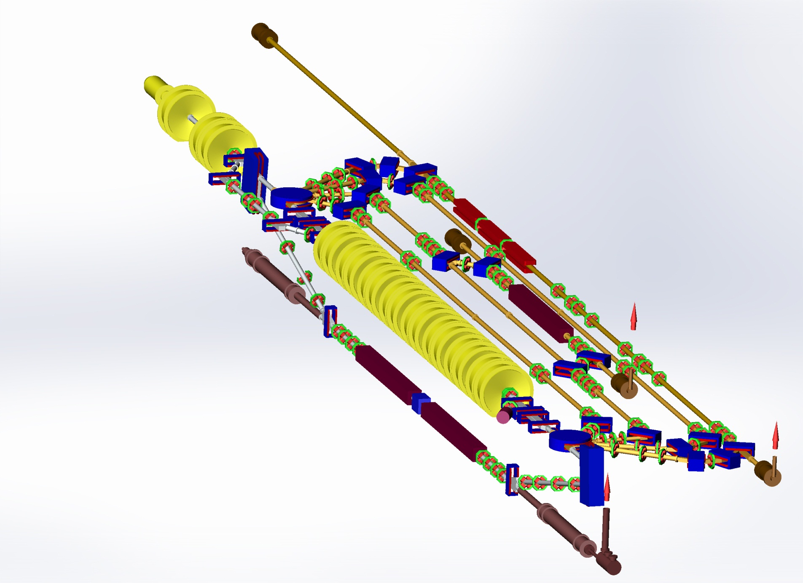
NovoFEL Accelerator Design and status
Gun
The third IR FEL
undulator sections
The second FEL
undulator
Injector
Main linac
The first THz FEL
undulator sections
Dump

Slide 24
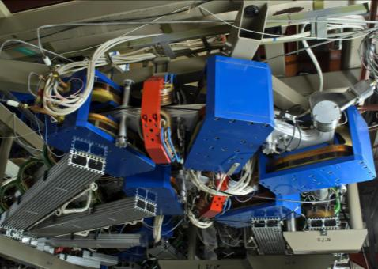
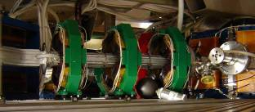
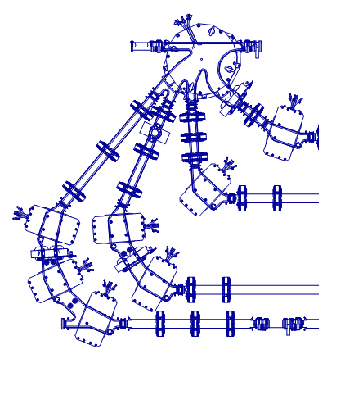
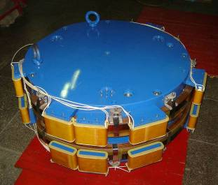
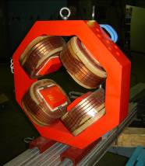
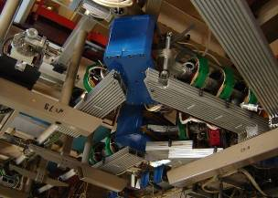
Magnets and vacuum chamber of bends

Slide 25
Second and third stages beamlines
12 MeV
22 MeV
32 MeV
42 MeV
(horizontal plane)
25

Slide 26
At the second orbit (20 MeV) we have bypass with second FEL. When magnet of bypass are switched on, the beam passes through this FEL. The length of bypass is chosen to provide the delay, which necessary to have the deceleration instead acceleration at the third passage through acceleration cavities. The first lasing of the FEL at bypass was achieved in 2009. The radiation wavelength range now is 40-90 micron.
Now all four horizontal orbits are assembled and commissioned. The electron beam was accelerated four times and then decelerated down to low injection energy. First in the world multi-orbit ERL operation was demonstrated successfully, first lasing was obtained in July 2015.
26

Slide 27
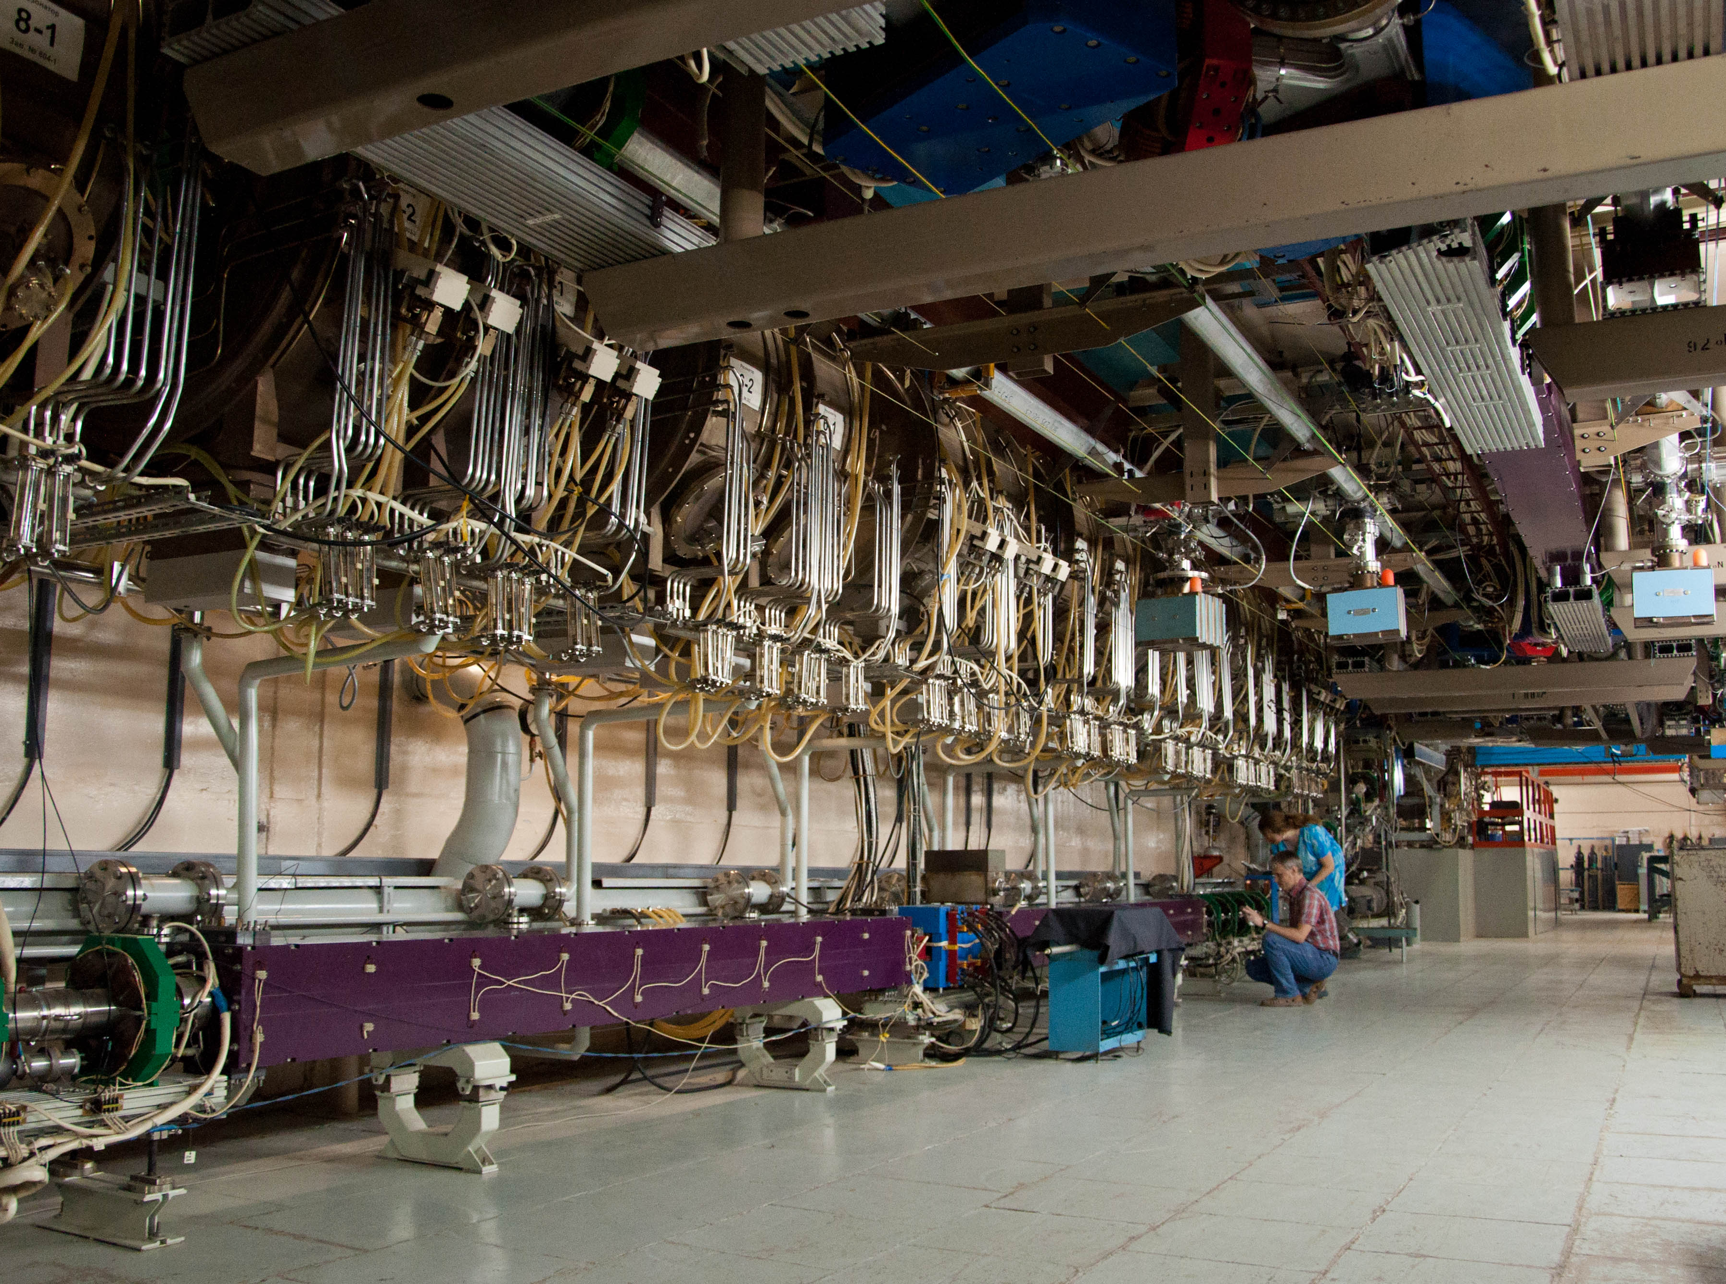
Horizontal tracks
1st stage FEL
undulator
2nd stage FEL
undulator
Main linac

Slide 28
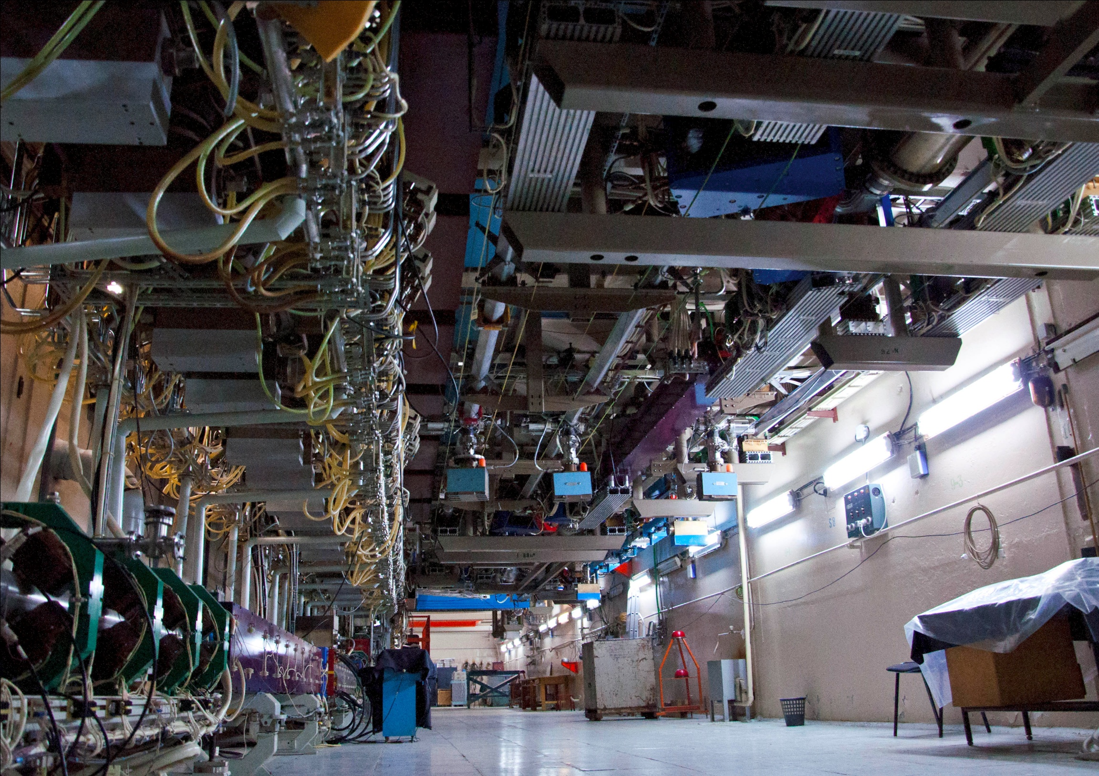
3rd stage FEL
undulator

Slide 29
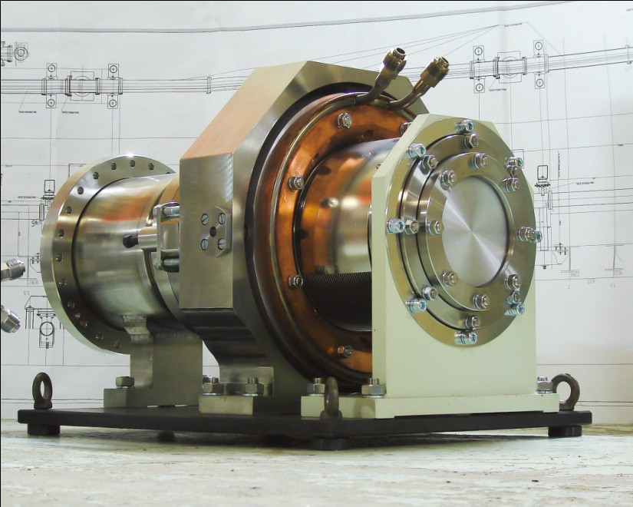
The third stage FEL
FEL radiation
~ 40 m
Electron outcoupling scheme may be used here
29

Slide 30
Electron beam and radiation parameters
 | 1st | 2nd | 3^{d}
Energy, MeV | 12 | 22 | 42 | 46
Current, mA | 30 | 7.5 | 5 | 50
Wavelength, μm | 90-240 | 40-90 | 8-11 | 5-20
Radiation power, kW | 0.5 | 0.5 | 0.1 | 5
Electron efficiency, % | 0.6 | 0.3 | 0.2 | 0.5

Slide 31
 | 1st |  |  | 2nd |  | 3^{d}
 | lasing | working | max | lasing | max | lasing | max
Current, mA | 5.5 | 11 | 30 | 7.0 | 7.5 | 3.0 | 5
Rep. rate, MHz | 5.6 | 11.2 | 22.4 | 7.52 | 7.52 | 3.76 | 5.64
Q nQ | 1 | 1 | 1.4 | 0.9 |  | 0.8
P W | 300 | 500 | 1000 | 500 |  | 100

Slide 32
Nearest and far future plans
Optical (SR) diagnostics of electron beam parameters
Decrease beam losses and increase average current
Increase DC gun voltage and improve beam quality in injector
Optimize electron efficiency of FEL
Install undulator with variation of period
Improve x-ray and neutron radiation shielding
Install RF gun
τ

Slide 33
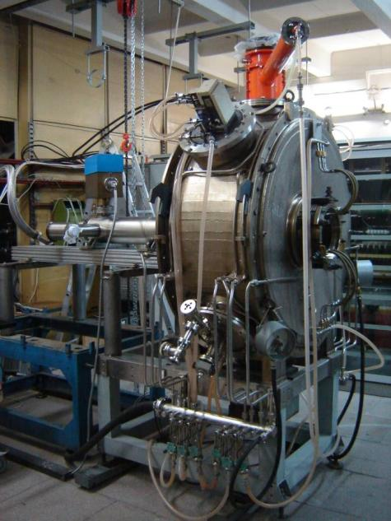
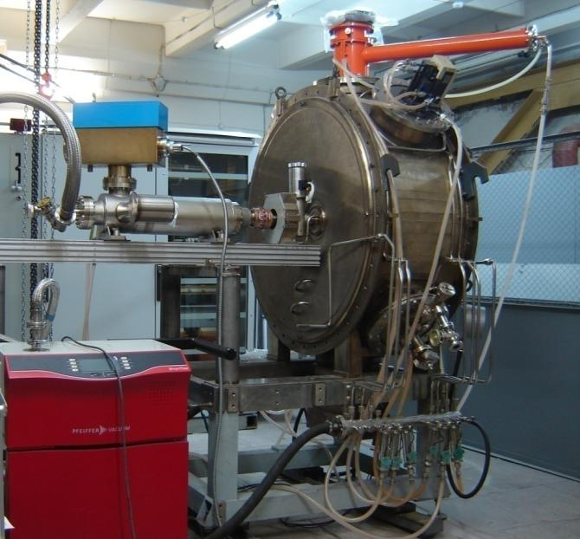
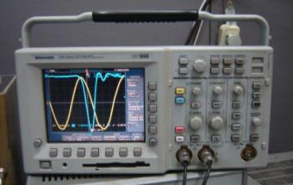
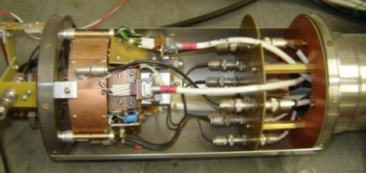
90 MHz RF gun test setup
E_{e} = 300 kV I_{e}max = 100 mA τ = 1 ns Q_{pulse} = 1 nQ f_{rep} = 10 kHz ÷ 90 MHz
modulator
33

Slide 34
One of the main FEL
advantages is the ability to
adjust the wavelength
Variation of magnetic field
Electromagnetic
undulator
Variable gap
undulator
K ~ 0…1.5
K ~ 0.4…2.5
E1 ~ 10…13 MeV
E2 ~ 20…24 MeV
E3 ~ 40…46 MeV
Variation of beam energy
Variable period
undulator
Variation of undulator period
(N. Vinokurov)
K ~ 0.42…1.79

Slide 35
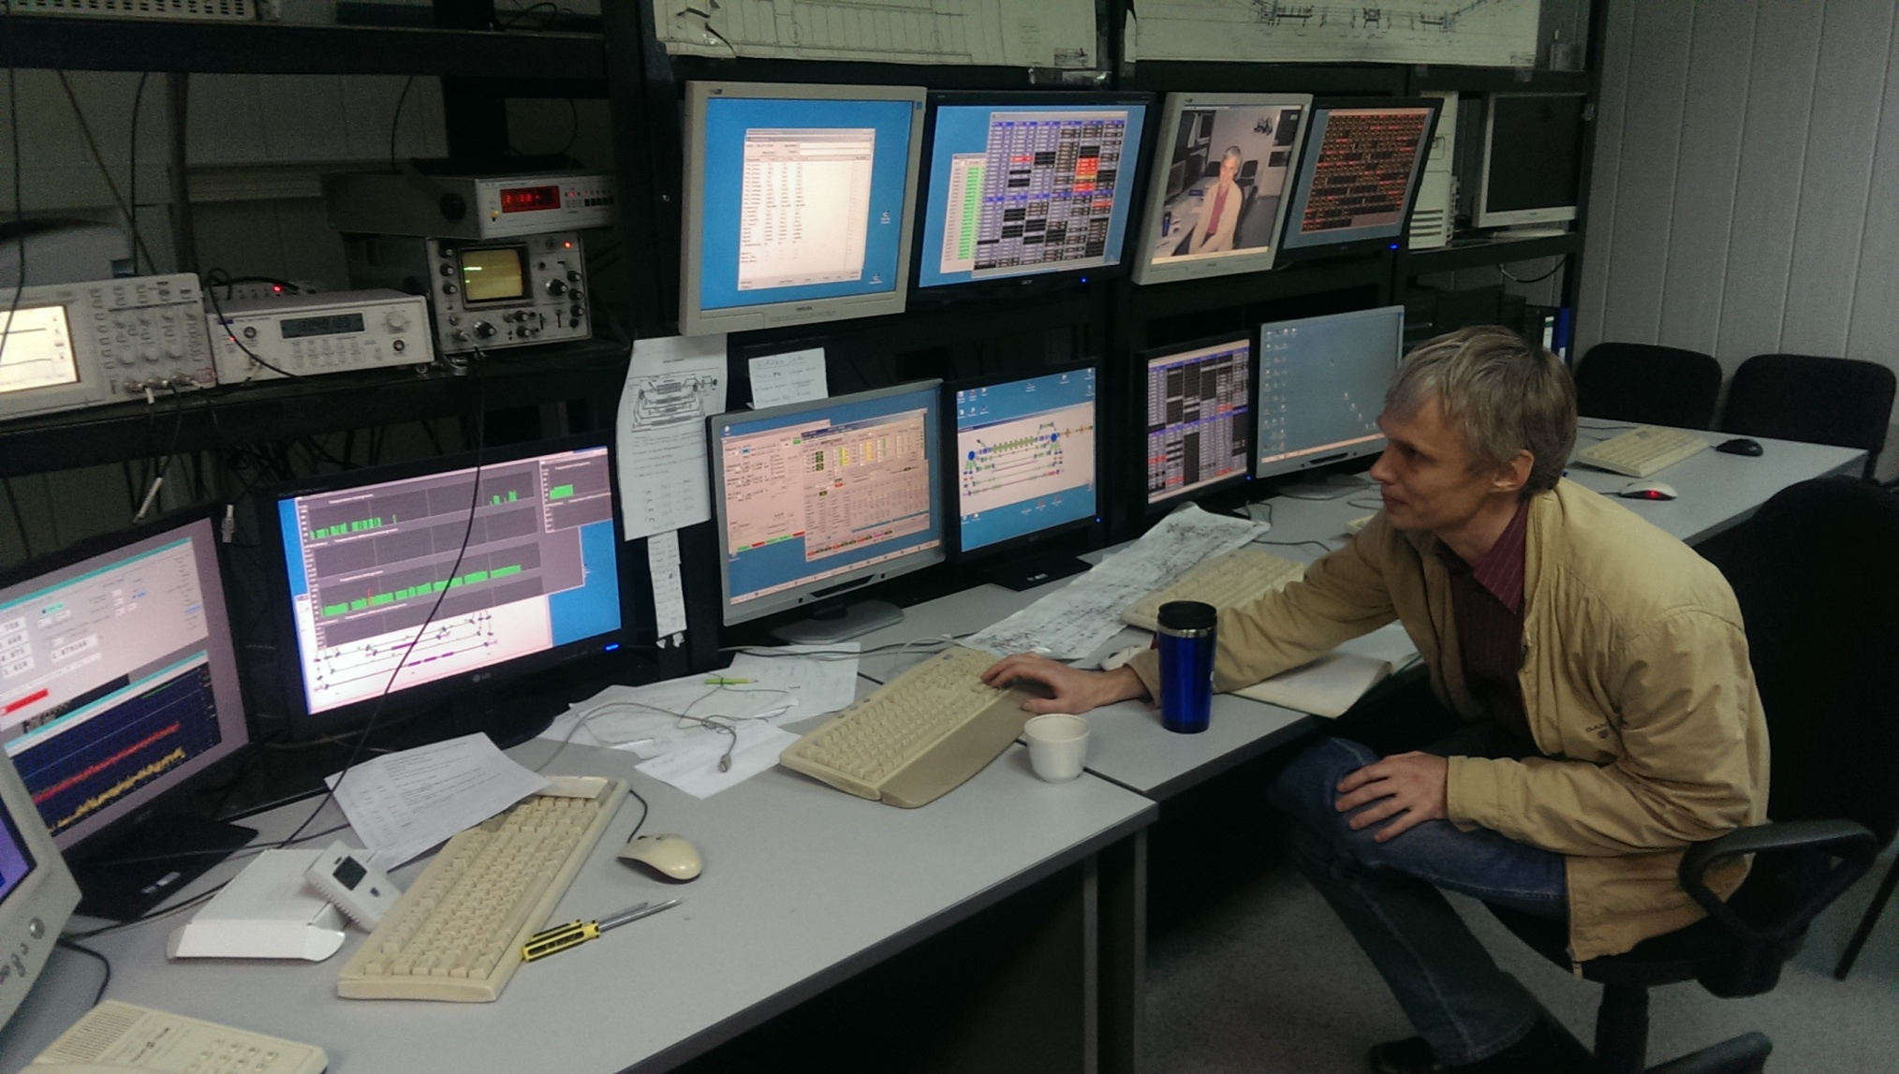
Третий ЛСЭ заработал на пользователей в 2016 г.
35

Slide 36
Thank you for your attention!

Slide 37
At SRI-97 conference for realization of a fully spatially coherent X-ray source was proposed by Kulipanov G., Skrinsky A., Vinokurov N. using of accelerators-recirculators with energy recuperation (SRI-97)
See: [1] MARS - recirculator-based diffraction limited X-ray source. // Budker
INP preprint No 97-103 (1997);
[2] Kulipanov G., Skrinsky A., Vinokurov N. Synchorton light sources and
recent development of accelerator technology. // J. of Synchrotron
Radiation –1998 V.5 pt.3 P.176).
MARS, a recuperator-based diffraction-limited X-ray source, was presented and discussed at the ICFA workshop on future light sources (ANL, USA, July 1999) and SRI-2000 (Berlin), “ERLSYN-2002” (Erlangen, Germany, 2002), “SR-2004” (Novosibirsk, Russia, 2004); “RUPAC-2005” (Dubna, Russia, 2005); “Nano-Beam 2005” (Kyoto, Japan, 2005).
After SRI-2000, the idea of using the accelerators-recuperators for creation of 4th generation of SR sources has been actively discussed at Jefferson Lab, Cornell Uni., KEK, BNL, LBL, Erlangen Uni., Daresbury Lab.
37

Slide 38
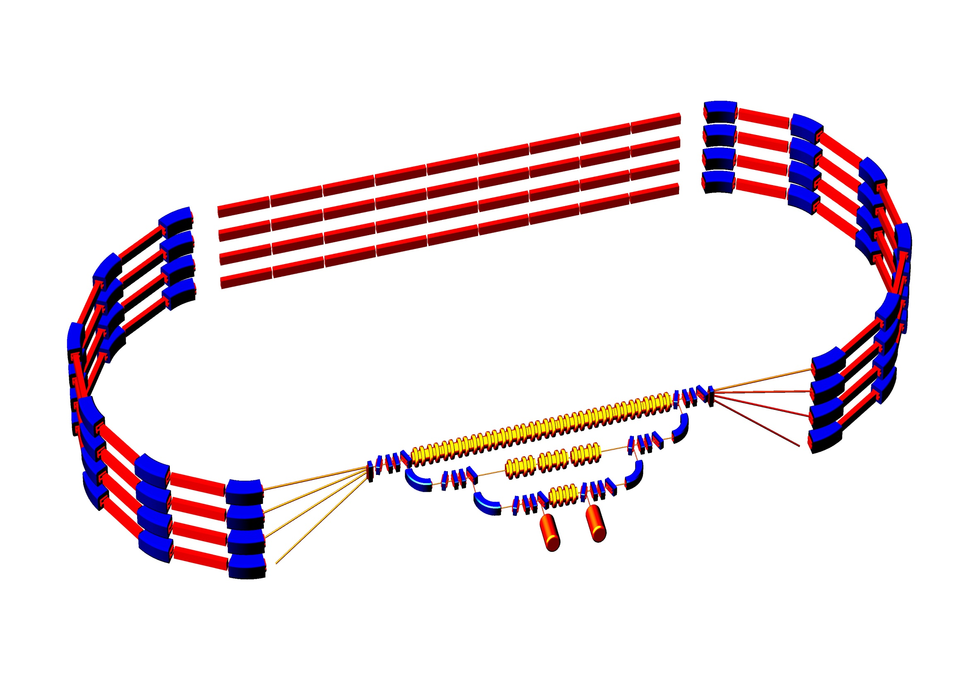
Layout of 5.7 GeV four-pass accelerator-recuperator
Basic overall dimensions of ERL and MARS (E_{max} = 6 GeV)
λ~1Å
5.76 GeV
λ~12Å
1.8 GeV 3.12 GeV 4.44 GeV 5.76 GeV
ΔE = 1.32 GeV, L_{acc} = 144 m
ΔE = 440 MeV
ΔE = 40 MeV
Injector
5-8 MeV
Beam
dump
R=100 m
38

Slide 39
ERL with separated tracks for accelerated and decelerated beams
It was suggested at ERL-2011 (G. Kulipanov, Ya. Getmanov, O. Shevchenko, A. Skrinsky, A. Tribendis, N. Vinokurov,
V. Volkov, “Multiturn ERL X-ray Source(MARS) Feasibility study,” ERL-2011, October 2011, KEK) to turn to an accelerator-recuperator scheme with two acceleration sections, similar to the scheme of the US accelerator CEBAF. Such schemes are considered below.
39

Slide 40
The simplest scheme of ERL (for understanding) with separated tracks
0.7 GeV
350 MeV
8 MeV
42 MeV
8 MeV
6
1
1.9 GeV
1 – injector, 2 – preliminary accelerating system, 3 – main accelerating RF structure, 4 – magnets, 5 – undulator, 6 – dump.
red arrows – accelerating bunch
black arrows – used decelerating bunch
40

Slide 41
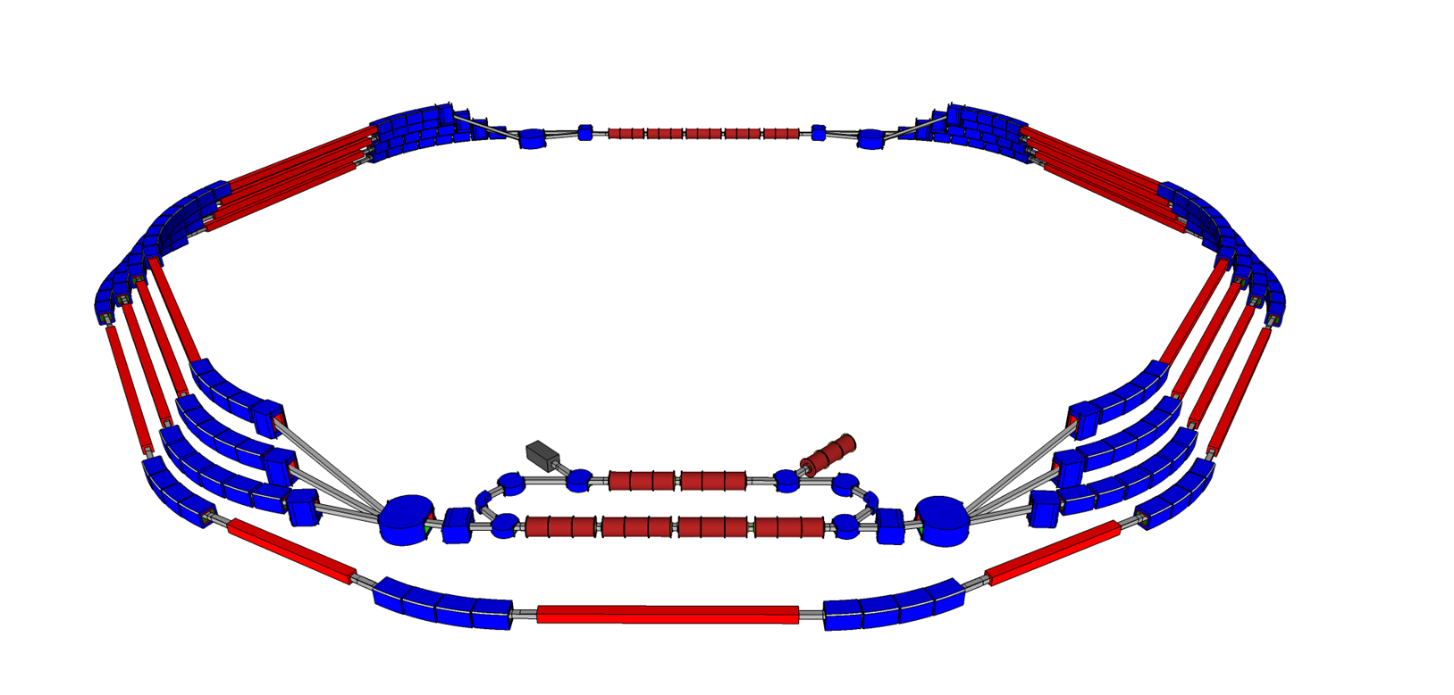
Multy-pass Accelerator-Recuperator Source (MARS) ERL-2011
Energy range 5.6, 3.8, 3, 1.2 GeV
7 undulators for 5.6 GeV
4 undulators for 3.8 GeV
4 undulators for 3 GeV
4 undulators for 1.2 GeV
Emittance:
Bunch Charge:

Slide 42
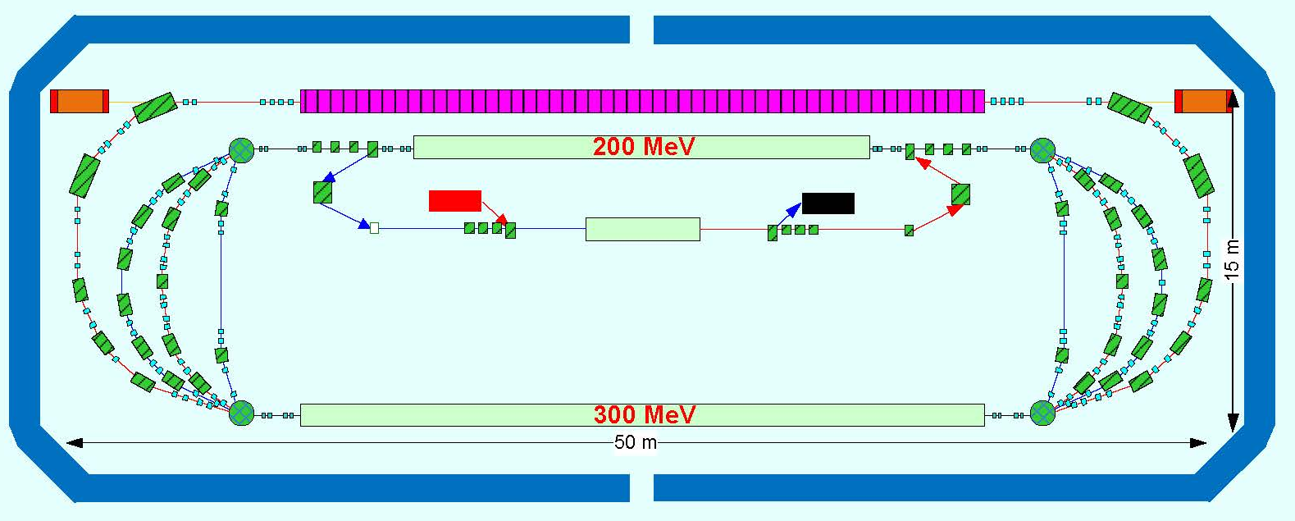
Project FEL for EUV Lithography
(compact 13.5-nm free-electron laser for extreme ultraviolet lithography,
Y. Socol, G.N. Kulipanov, A.N. Matveenko, O.A. Shevchenko, and N.A. Vinokurov,
Phys. Rev. ST AB, Vol. 14, No 4. – 040702-1 – 040702-7, 2011).
Undulator
10 МэВ
10 МэВ
30 МэВ
λ | 13.5 нм
E_{e} | 1 ГэВ
P_{av} | 10 кВт
I | 10-20 мА
λ_{u} | 3 см
accelerated beam
decelerated beam

