Slide 1

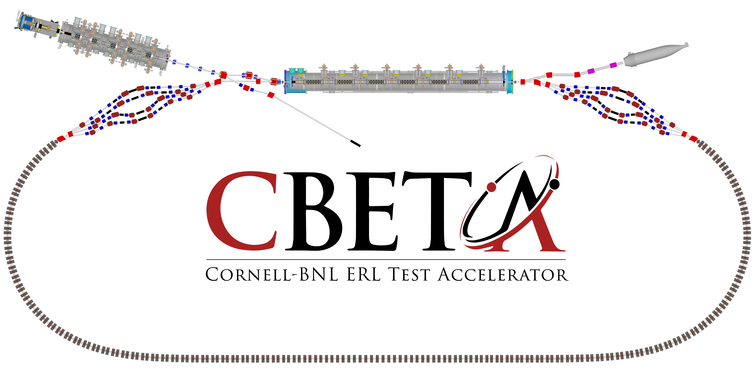




The Cornell/BNL FFAG-ERL Test Accelerator: CBETA
KPP and UPP strategy
Goals for the first 42 months
Georg Hoffstaetter (Cornell)

Slide 2
The test ERL in Cornell’s hall LOE
Cornell DC gun
100mA, 6MeV SRF injector (ICM)
600kW beam dump
100mA, 6-cavity SRF CW Linac (MLC)
Existing components at Cornell
6 MeV
6 MeV
+/- 36 MeV
Electron Current up to 320mA in the linac
Bunch charge Q of up to 2nC
Bunch repetition rate 1.3GHz/N
Beams of 100mA for 1 turn and 40mA for 4 turns
42, 78, 114, 150 MeV

Slide 3
The test ERL in Cornell’s hall LOE
Cornell DC gun
100mA, 6MeV SRF injector (ICM)
600kW beam dump
100mA, 6-cavity SRF CW Linac (MLC)
Existing components at Cornell
6 MeV
6 MeV
Positive funding decision by NYSERDA
+/- 36 MeV
Electron Current up to 320mA in the linac
Bunch charge Q of up to 2nC
Bunch repetition rate 1.3GHz/N
Beams of 100mA for 1 turn and 40mA for 4 turns
42, 78, 114, 150 MeV

Slide 4
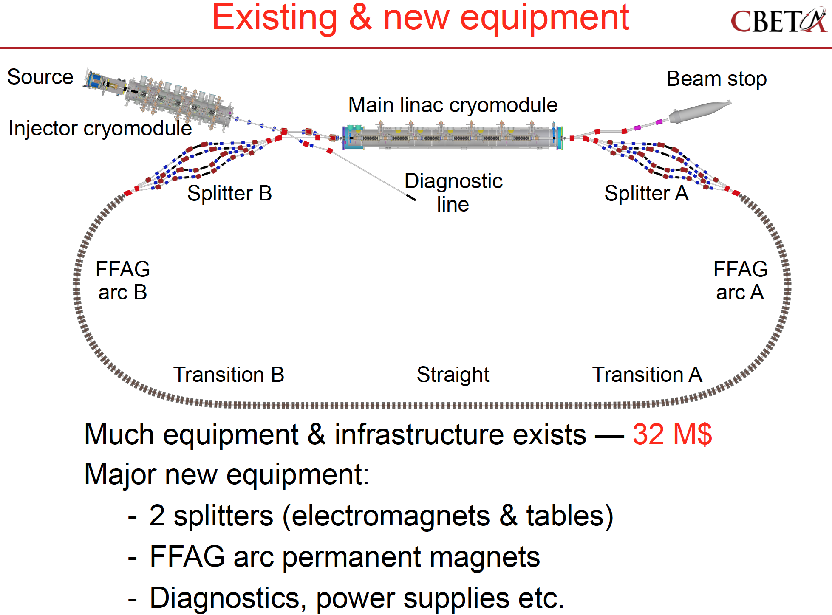

Slide 5
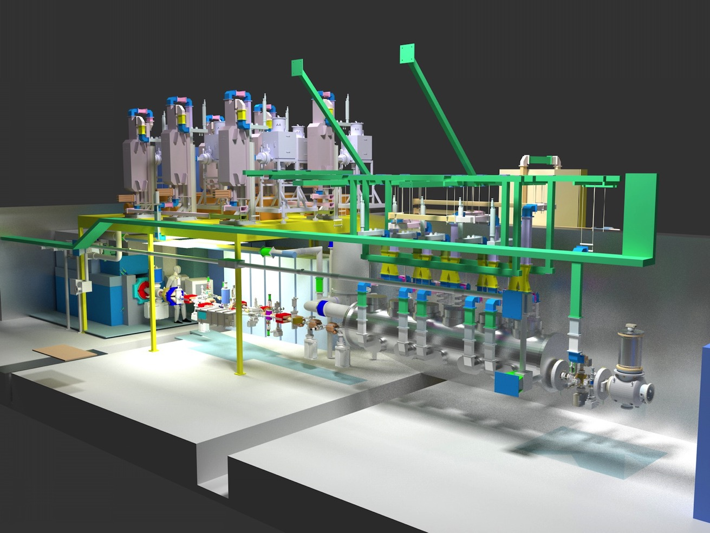
Cornell ERL injector prototype
DC photo-emitter electron source with highest current (75mA)
SRF injector linac with up to 0.5MW, 12MeV, larges bunch brightness for high current
Full 6-D beam diagnostics for low-emittance studies.
SC injector
Dump
Diagnostics
Cavities, couplers,
HOM absorbers
Gun

Slide 6
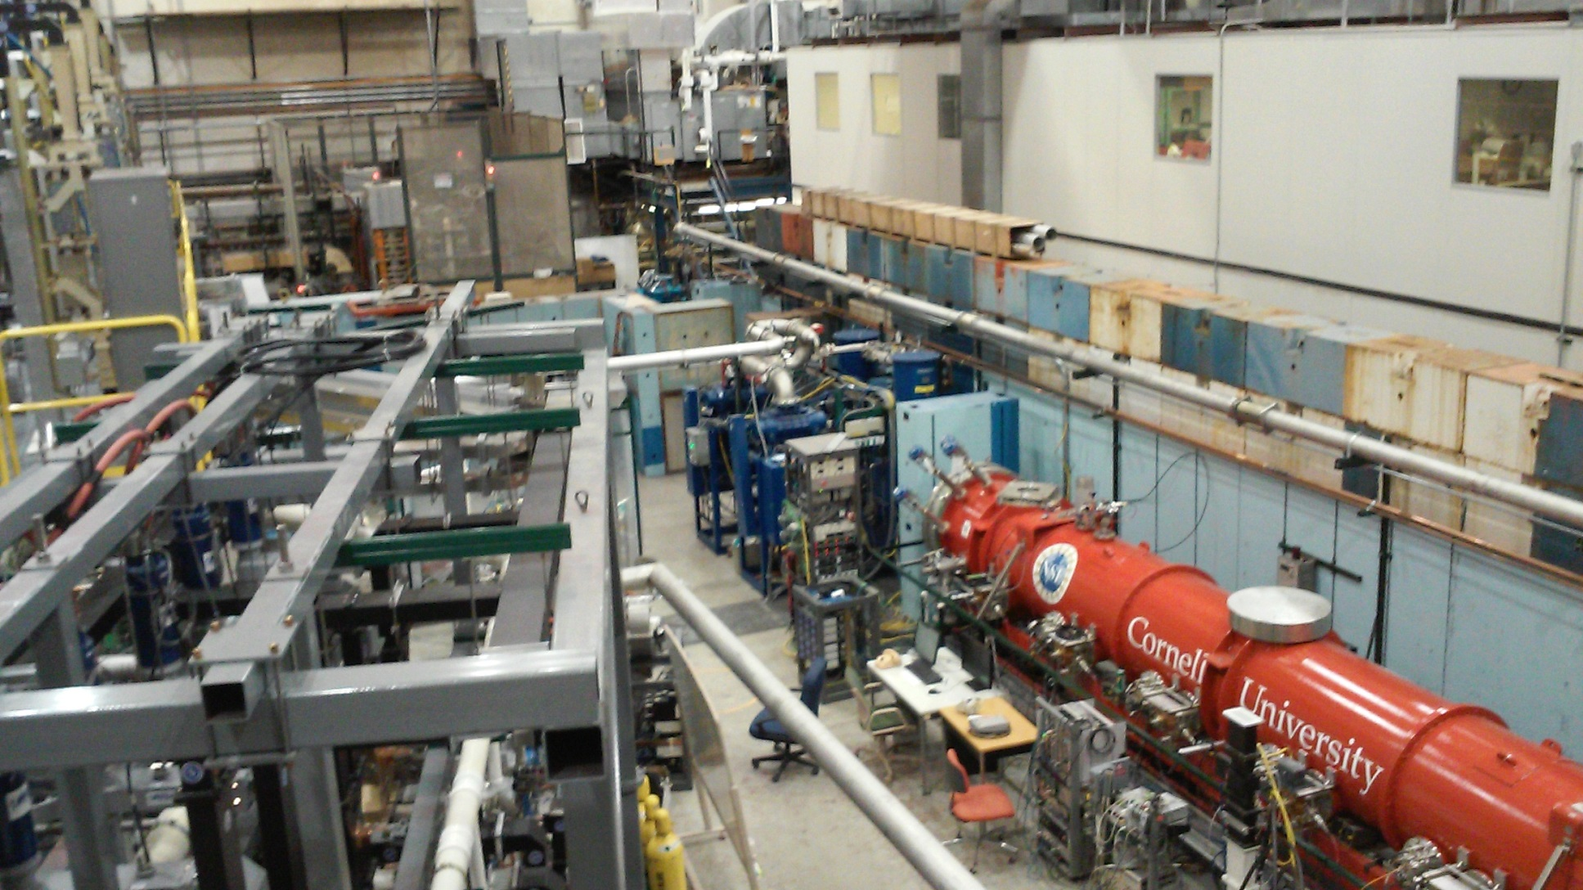
MLC construction at Cornell
1.3GHz, 6 cavities, 7 cells, a SiC beampipe HOM absorber next to each cavity.
5 kW solid-state amplifiers for each coupler (capable of 10kW)

Slide 7
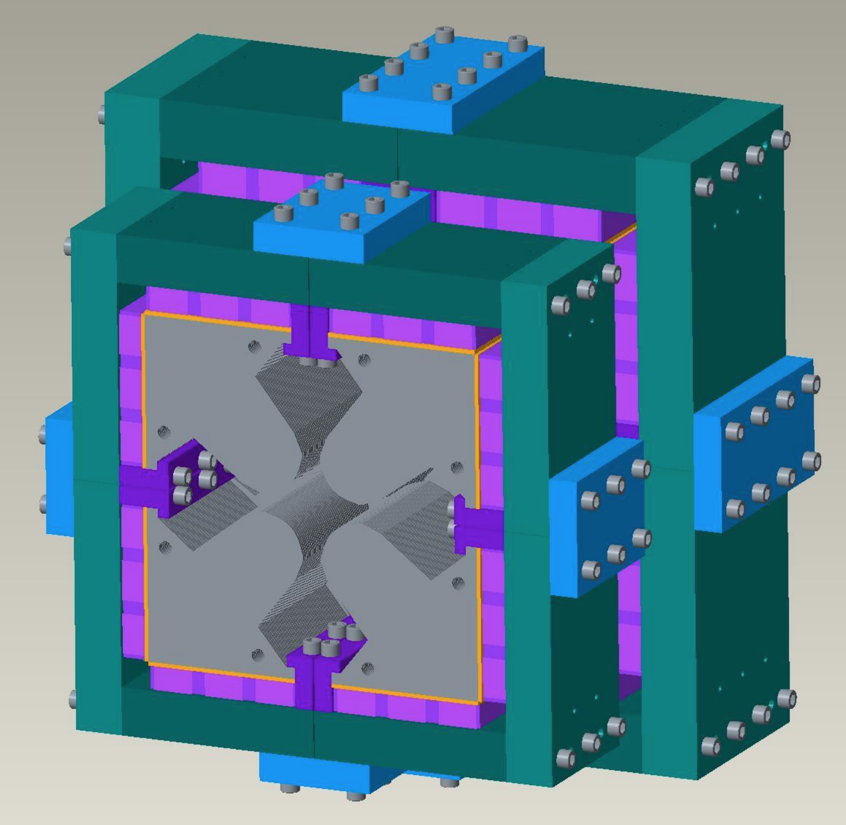
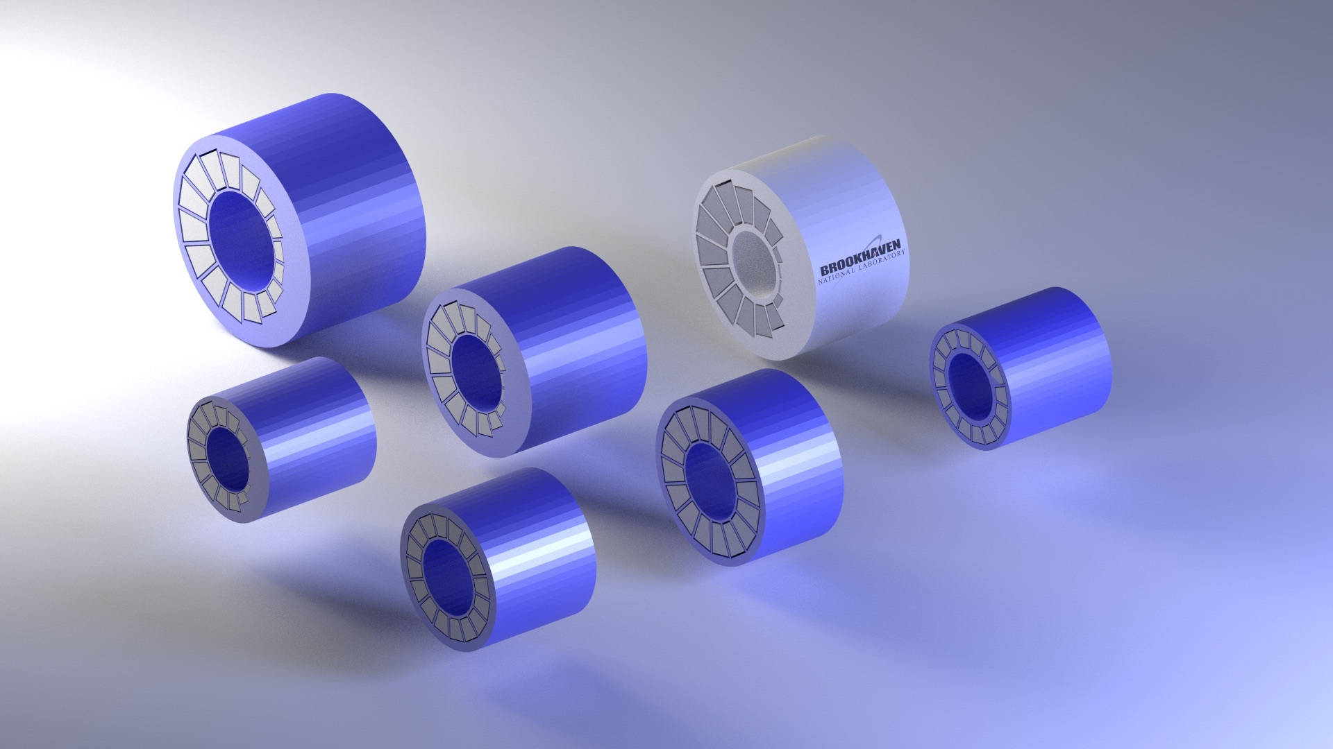
Permanent FFAG magnets
Temperature stabilized using NiFe cross hatches or bars: a few 10⁻⁴ between 20 and 30⁰C.
Comfortable field strengths
Well controlled cross talk
Budgetary estimates obtained from 1-year delivery from Radiabeam.
OR: Halbach Magnets
Quadrupoles
Combined function Quad/Dipoles

Slide 8
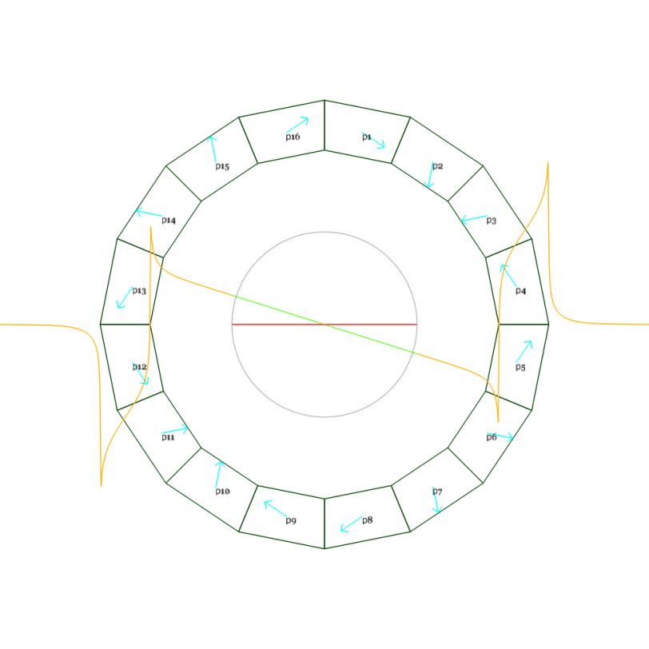
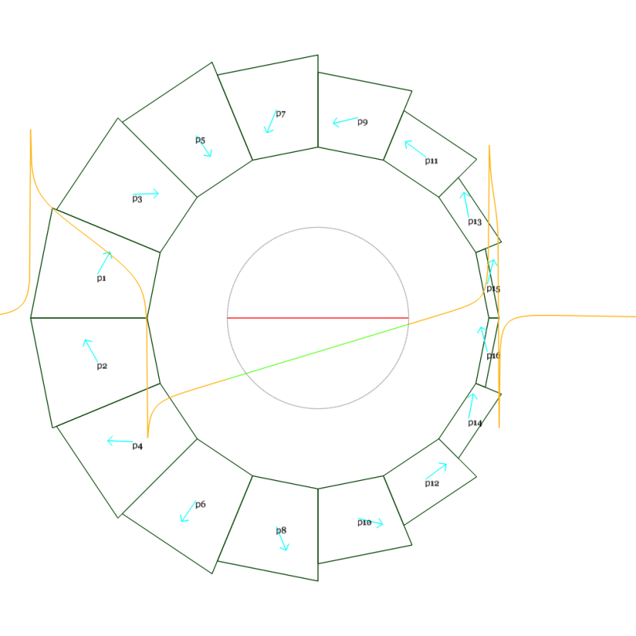
Magnetic Design
CBETA note #1
DR3.1.2
DR2.6.1
DR = Design Report
BP = Baseline Parameters
Magnet name | Length (mm) | Dipole at centre (T) | Quadrupole (T/m) | Radius to magnet pieces (mm) | Radius incl. shim holder (mm)
QF | 133.3 | 0 | -11.5 | 42.5 | 39.4
BD | 121.7 | -0.311 | 11 | 42.5 | 39.4
BP1.5

Slide 9
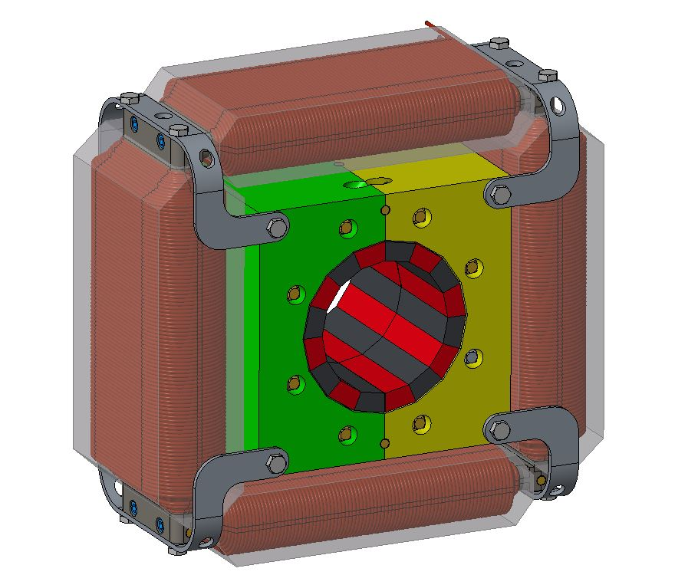
Halbach Magnet Frame Design
Final frame models/drawings with alignment pins
Quadrupole / Horizontal OR Vertical dipole correctors
Permanent Halbach wedges glued in place to defined shimmed location on an aluminum frame
Alignment pins for repeatable assembly of Halbach magnet
Corrector assembly disassembles to allow for vertical Halbach split
Alignment pins for repeatable assembly of Halbach magnet

Slide 10
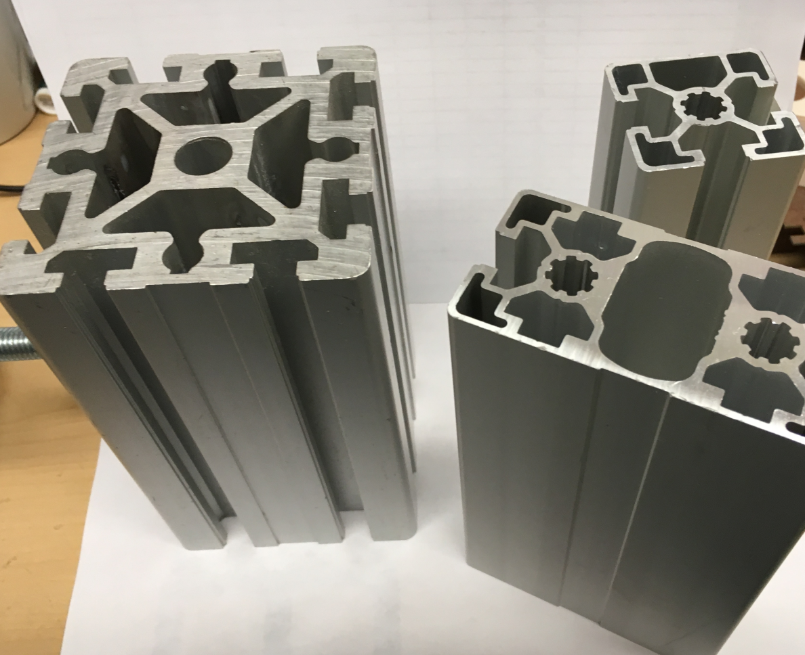
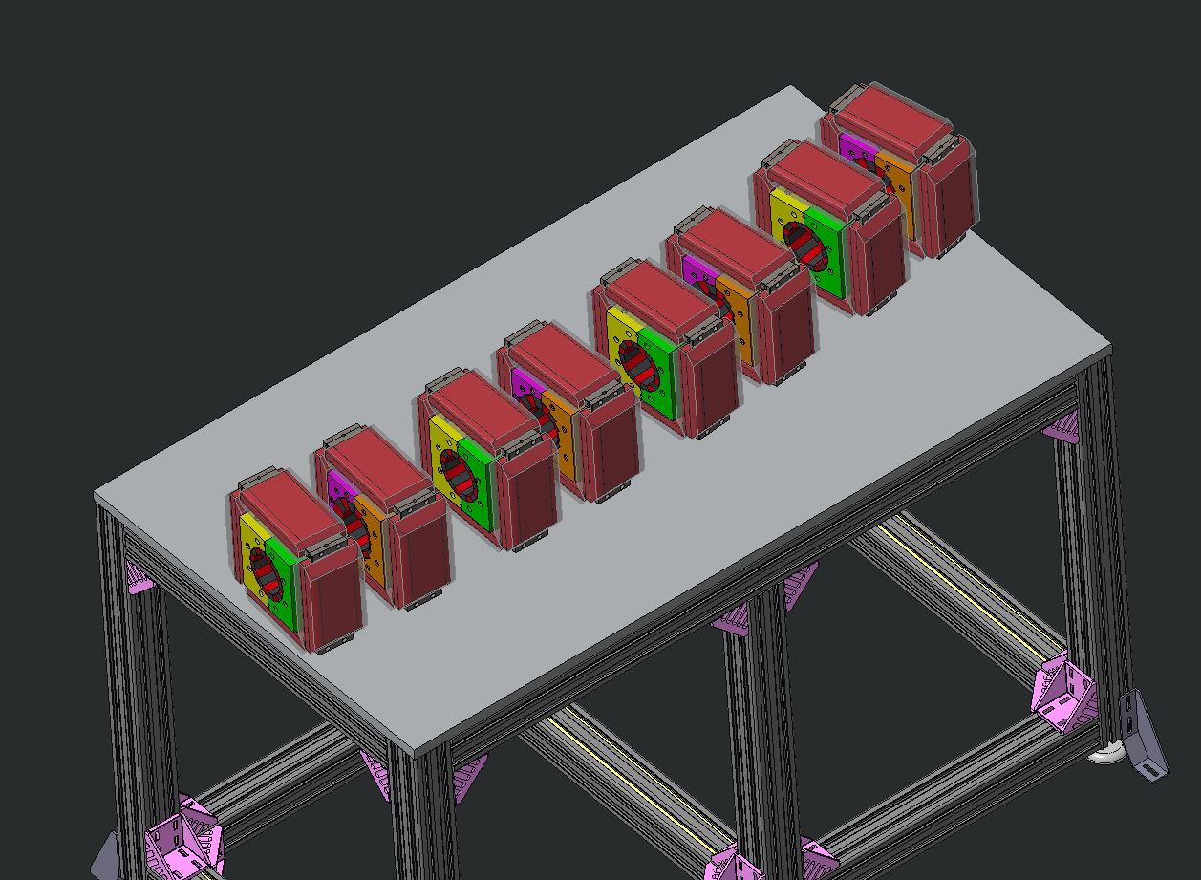
Girder Types and Positions
Integrated H2O manifold
Flexible component mounting
Cable tray

Slide 11
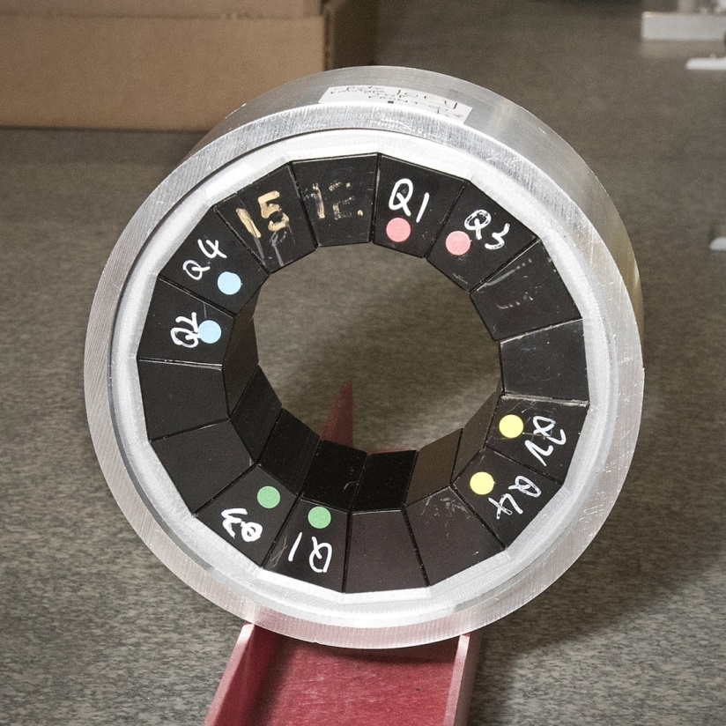
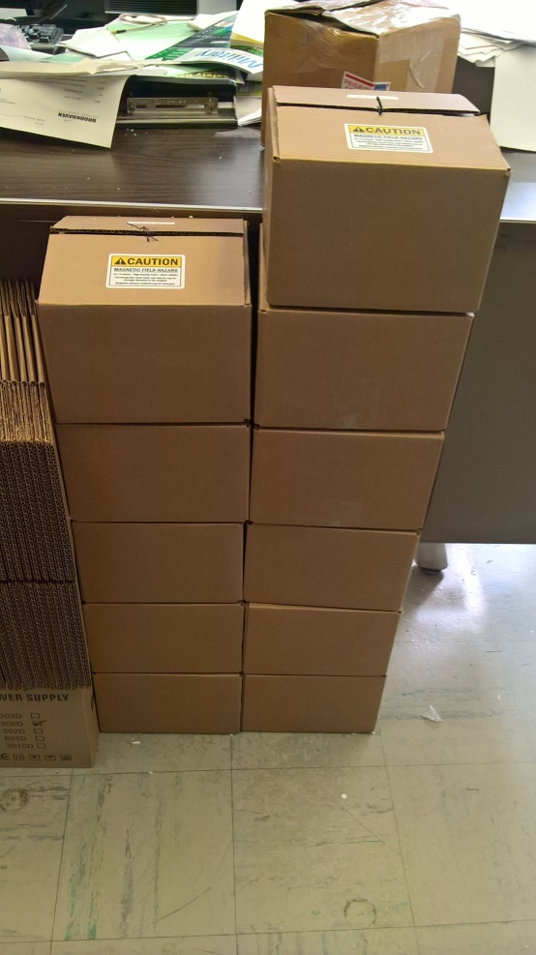
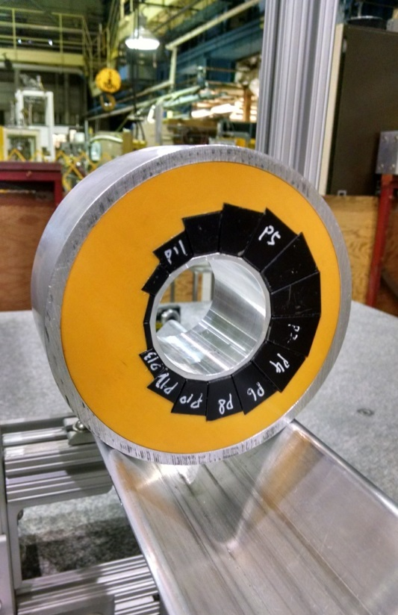
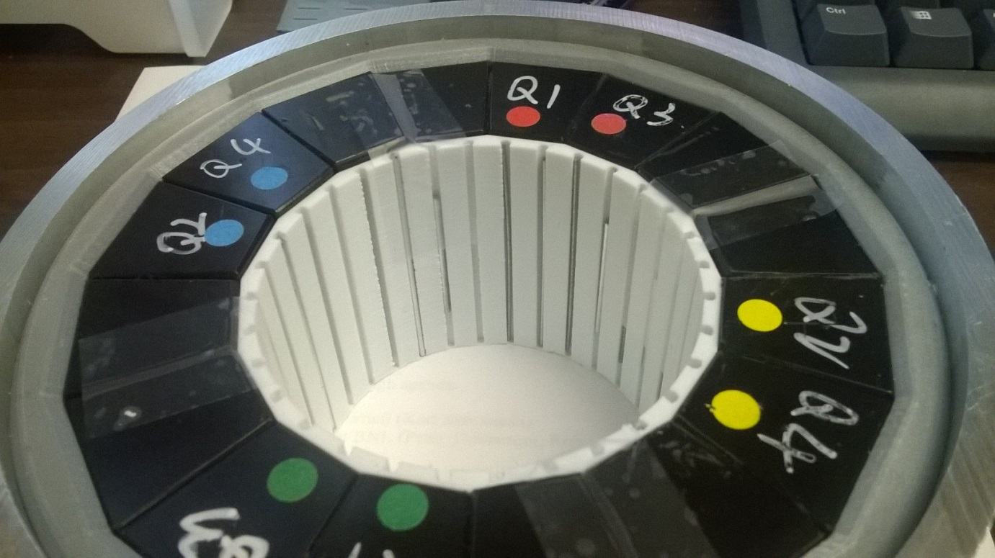
PoP QF
12 proof-of-principle magnets (6 QF, 6 BD) have been built as part of CBETA R&D.
Iron wire shimming has been done on 3 QFs and 6 BDs with good results.
PoP BD
PoP magnet series
Iron wire shims

Slide 12
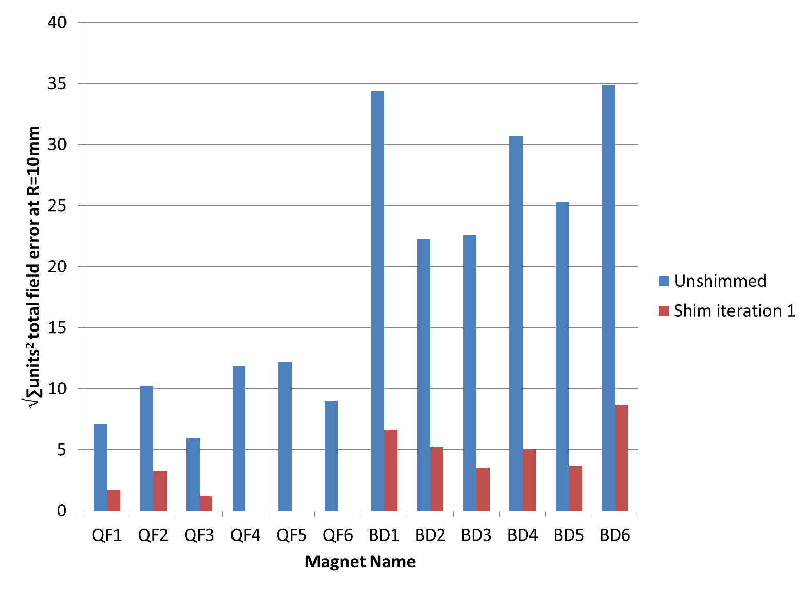
Iron Wire Shimming Improvement
DR3.1.4
Factor of ~4 reduction regardless of starting value
2nd iteration improved further in previous R&D:
29.62 → 6.69 → 1.94

Slide 13
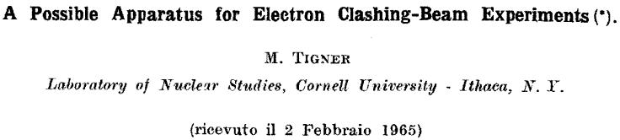
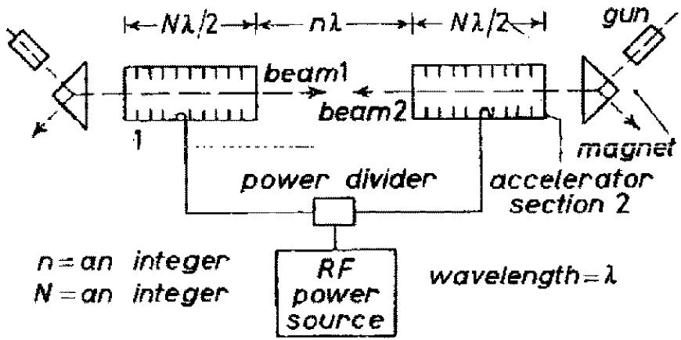
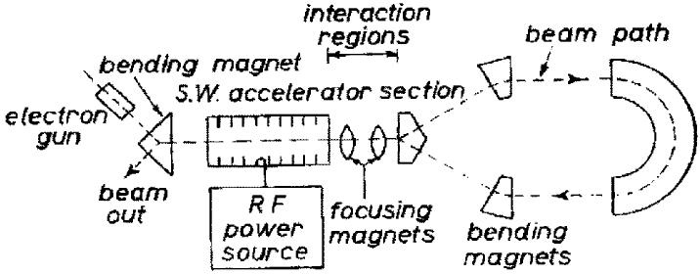
First Energy Recovery Linac idea
Energy recovery needs continuously fields in the RF structure
Normal conducting high field cavities can get too hot.
Superconducting cavities used to have too low fields.

Slide 14
ERL – a new type of accelerator
Synchrotron: Repetitive acceleration to high energy, low repetition rate and therefore low current.
Fixed target experiments, high energy, low current, relatively large beam size.
Storage rings: Rare filling at high energy and storage for millions of turns, high current, requires very low loss rates.
➔ Internal target experiments, high energy, high current, relatively large beam size.
Linacs: Linear acceleration to moderately high energies that are limited by the available length. Current*Energy is limited by the available power.
➔ Fixed target experiments, moderately high energies, low current, small beam size.
ERLs: Linear acceleration and deceleration to capture the energy of spent beam, like a linac but without the power limit on beam current, as spent beam provides the power. Loss rates have to be limited.
Dense internal targets, moderately high energies, high currents, small beam size.
ERLs provide a new niche of beam parameters: What physics can they be used for?

Slide 15
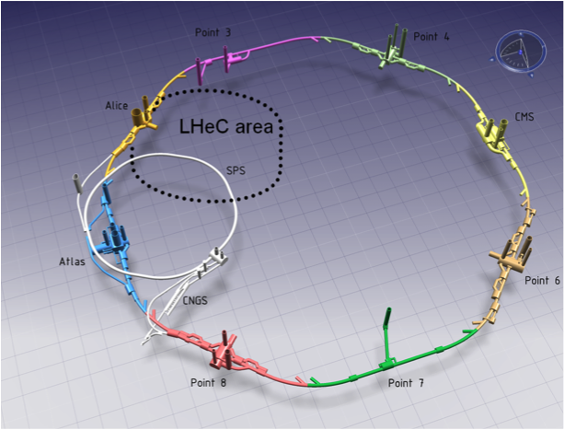
LHeC– Electron for the LHC
60 GeV electrons for electron-ion collisions.
courtesy Oliver Bruening

Slide 16
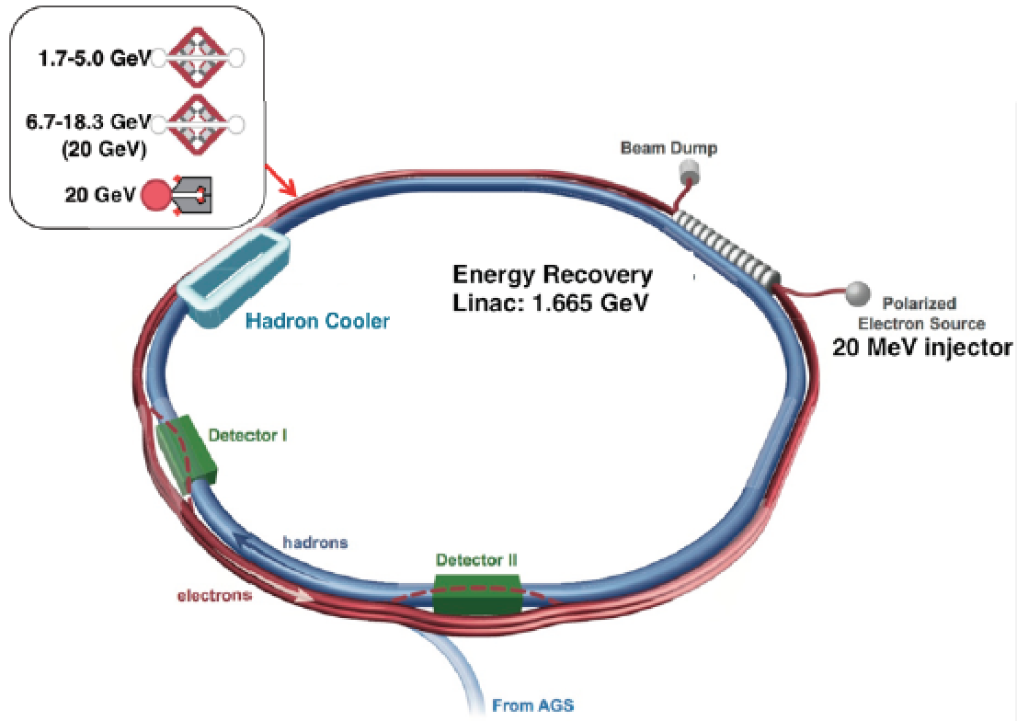
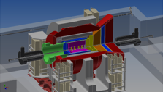
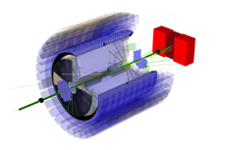
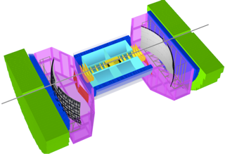
eRHIC Design – requires an ERL !
ePHENIX
eSTAR
BeAST
1.7 × 10³³ cm⁻² s⁻¹ for √s = 127 GeV (15.9 GeV e↑on 255 GeV p↑)
× 10 luminosity with modest improvements (coating of RHIC vacuum chamber)
× 100 luminosity with shorter bunch spacing (ultimate capability)
courtesy Thomas Roser

Slide 17
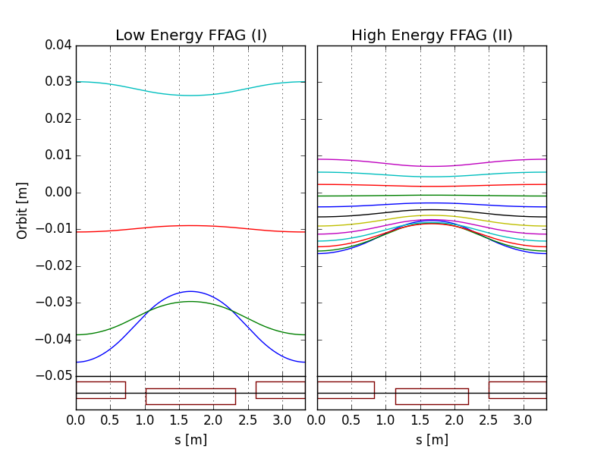
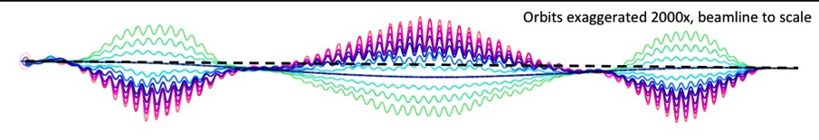
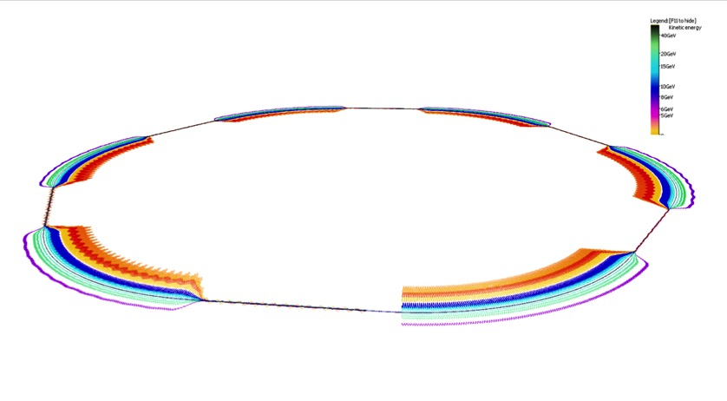
Topics of eRHIC to be studied in CBETA
eRHIC uses two FFAG beamlines to do multiple recirculations.
(FFAG-I: 1.7-5.0 GeV, FFAG-II: 6.7-18.3 GeV, 20 GeV)
All sections of a FFAG beamline is formed using a same FODO cell. Required bending in different sections is arranged by proper selection of the offsets between cell magnets (or, alternatively, with dipole field correctors).
Permanent magnets can be used for the FFAG beamline magnets (no need for power supplies/cables and cooling).
E=5.0 GeV
E=18.3 GeV
E=6.7 GeV
E=1.7 GeV
BD
QF
@S.Brooks, D.Trbojevic
Orbits in Detector bypass section
Quad offsets evolve adiabatically
Orbits in Transition section
Each of two eRHIC FFAGs contain 1066 FFAG cells

Slide 18
CBETA topics to support eRHIC
CBETA study topics important for eRHIC:
FFAG loops with a factor of 4 in momentum aperture.
  Precision, reproducibility, alignment during magnet and girder production.
  Stability of magnetic fields in a radiation environment.
  Matching and correction of multiple simultaneous orbits.
  Matching and correction of multiple simultaneous optics.
  Path length control for all orbits.
Multi-turn ERL operation with a large number of turns.
  HOM damping.
  BBU limits.
  LLRF control and microphonics.
  ERL startup from low-power beam.

Slide 19
The test ERL in Cornell’s hall LOE
Cornell DC gun
100mA, 6MeV SRF injector (ICM)
600kW beam dump
100mA, 6-cavity SRF CW Linac (MLC)
Existing components at Cornell
6 MeV
6 MeV
+/- 36 MeV
Electron Current up to 320mA in the linac
Bunch charge Q of up to 2nC
Bunch repetition rate 1.3GHz/N
Beams of 100mA for 1 turn and 40mA for 4 turns
42, 78, 114, 150 MeV

Slide 20
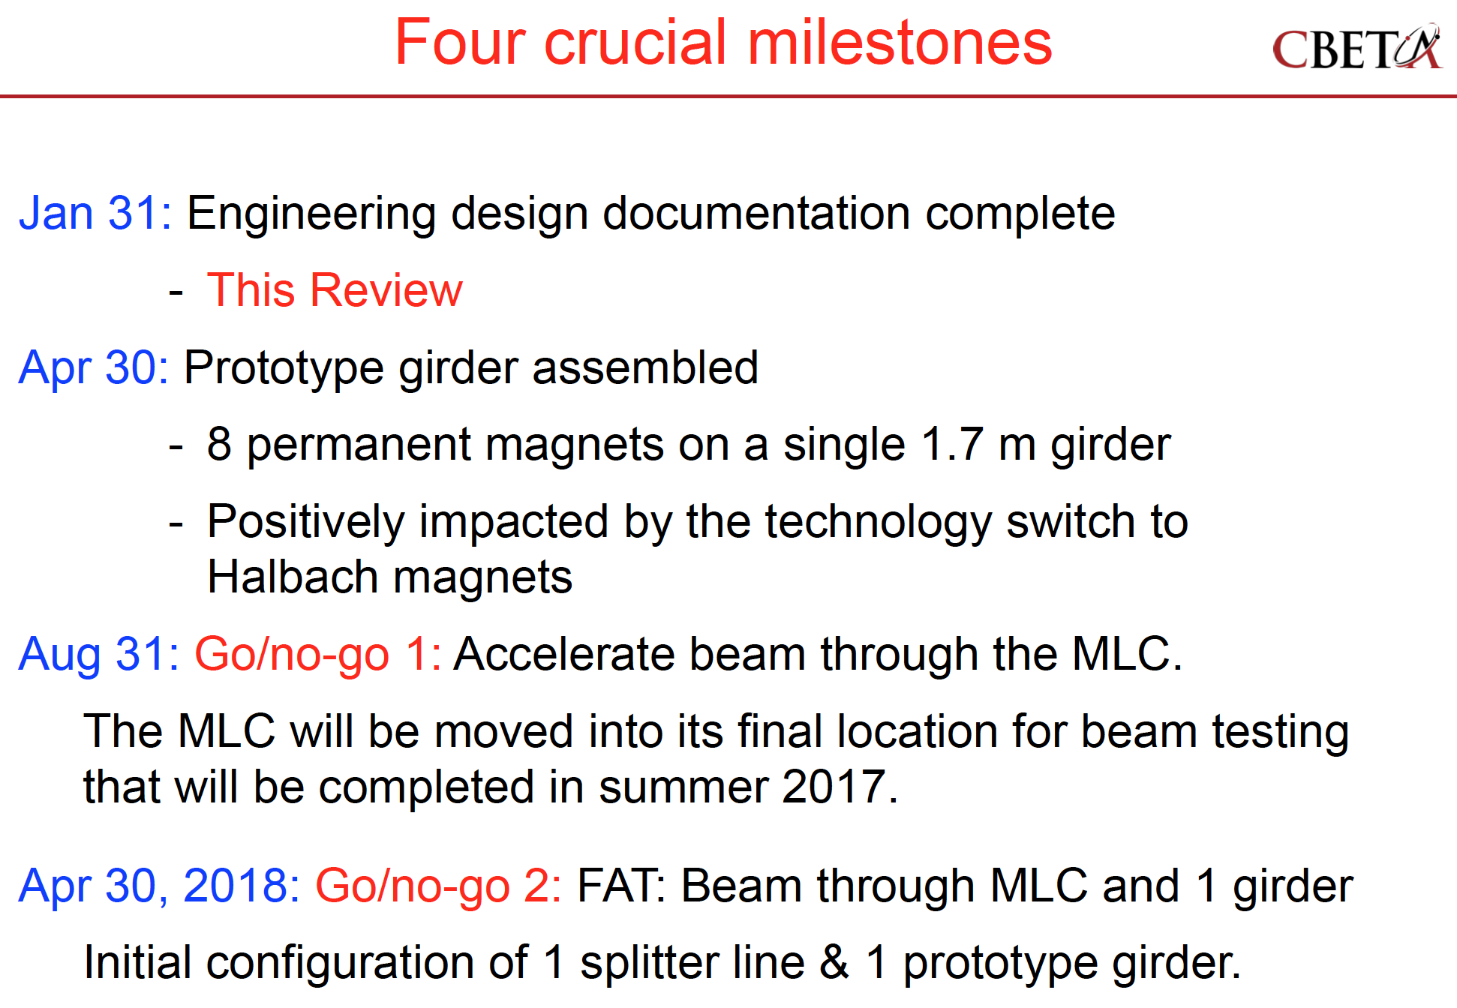

Slide 21
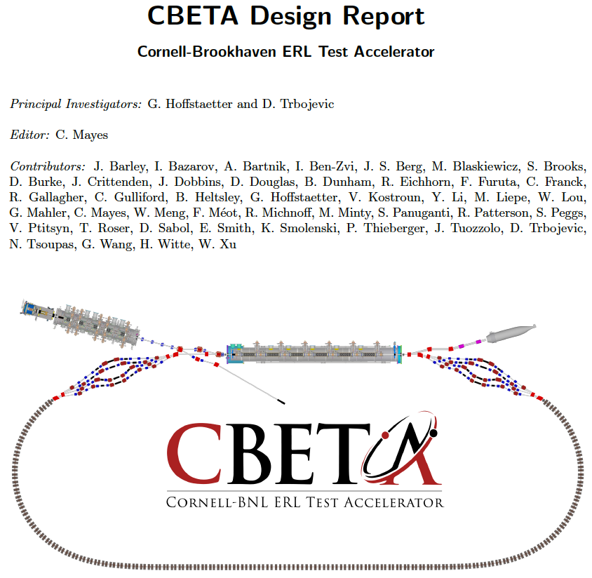
The CBETA CDR
The CBETA Collaboration
Background for CDR
Wrote PDDR for hard X-ray ERL at Cornell in 2012.
Start of CBETA July 2014 White paper December 2014
Defined CBETA in a white paper in December 2014.
CDR for CBETA in with Hybrid permanent magnets in July 2016.
Secured NYSERDA funding October 2016
DR for CBETA with Halbach magnets in February 2017
Past first technical (Jan 31st) and financial (Feb 6) review!

Slide 22
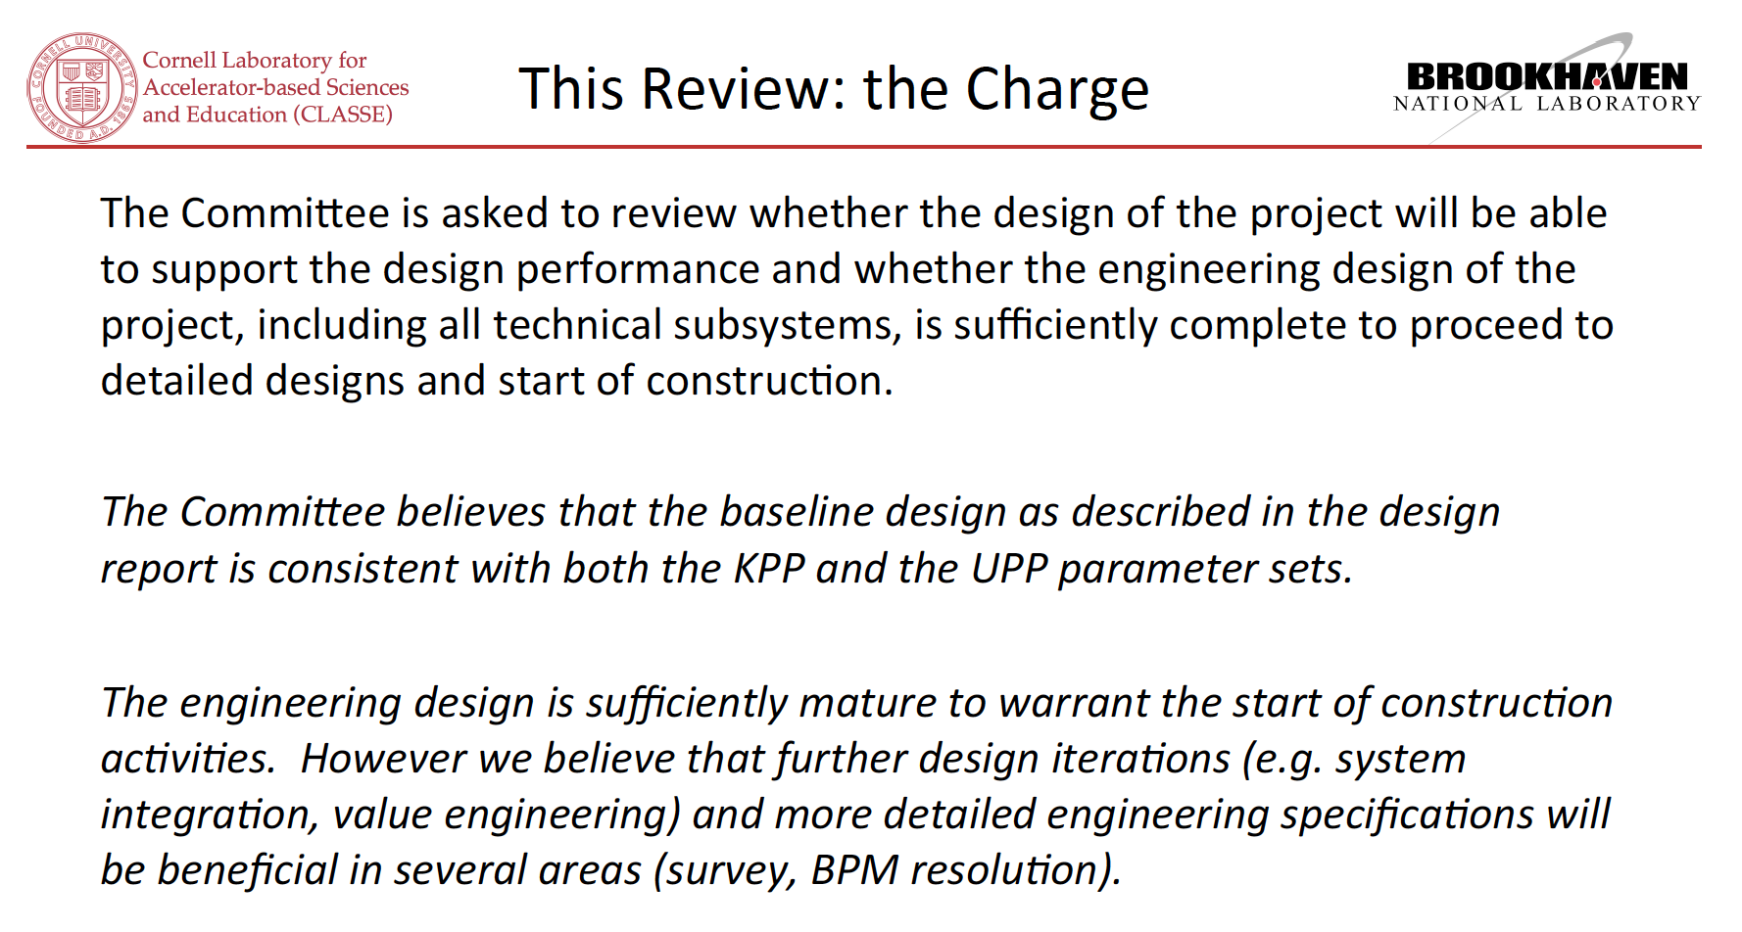
The CBETA CDR
Past first technical (Jan 31st) and financial (Feb 6) review!

Slide 23
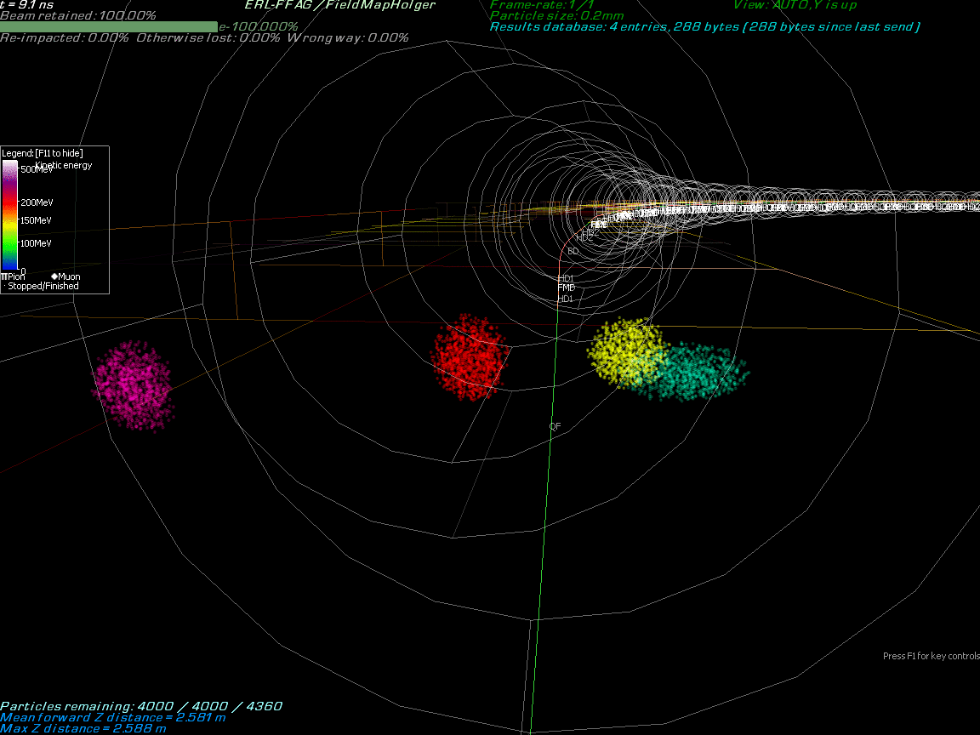
Bunche dynamics in 3D field maps

Slide 24
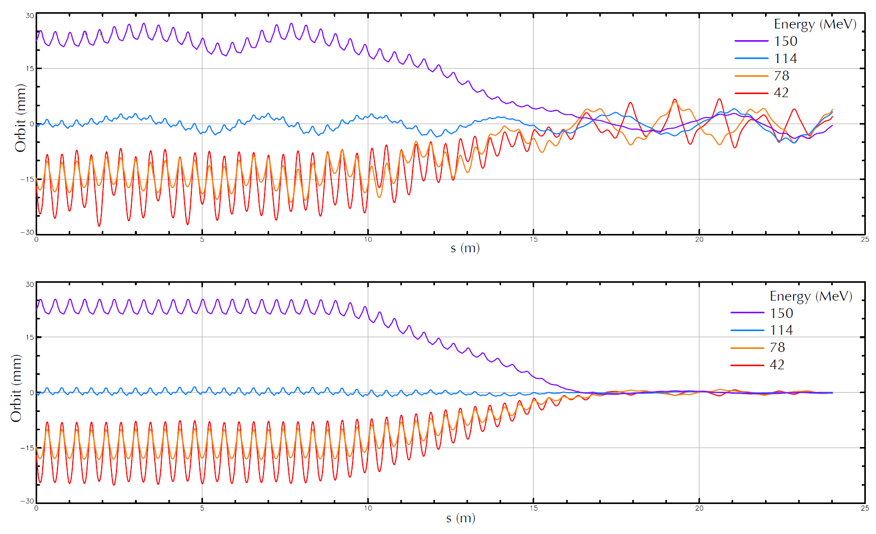
Orbit Correction of 4 Beams
DR2.13

Slide 25
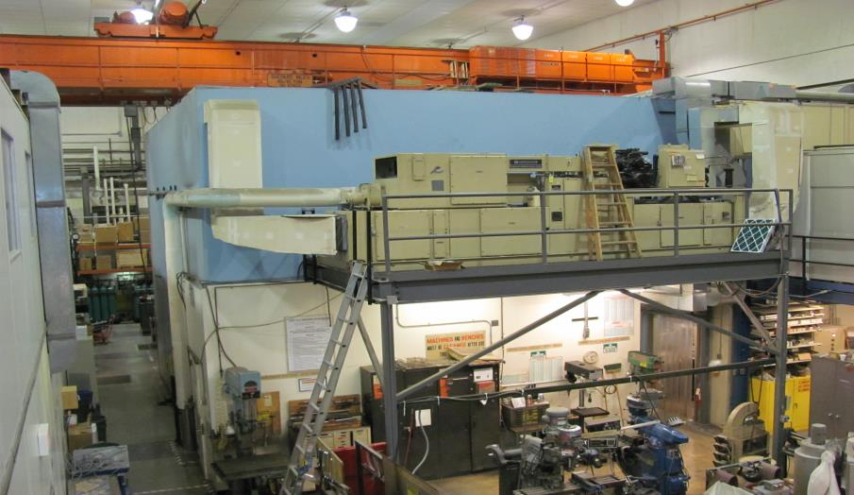
Hall L0E before CBETA
L0E contained approximately 7,000 square feet of Lab and Shop space

Slide 26
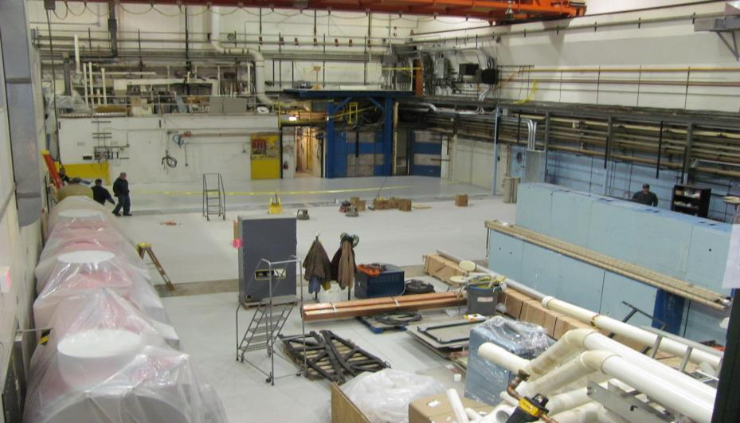
Spring 2015
70% of the existing technical-use space was removed for the initial phase

Slide 27
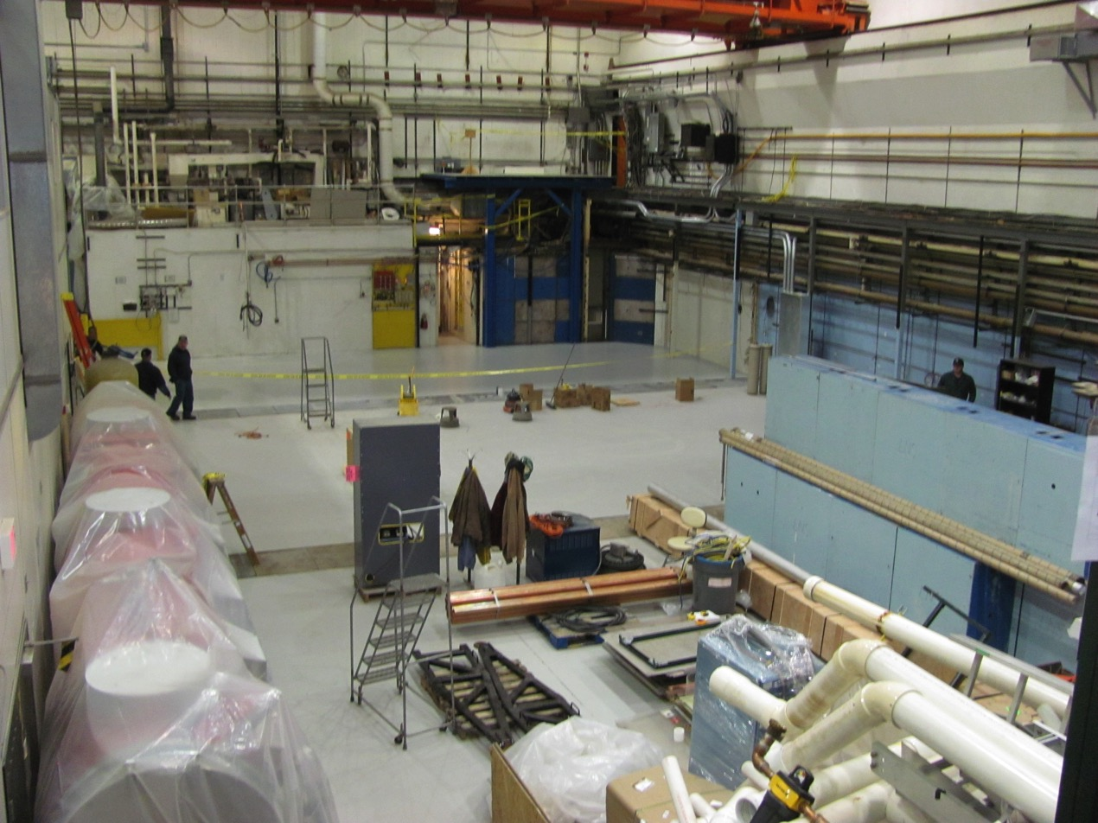
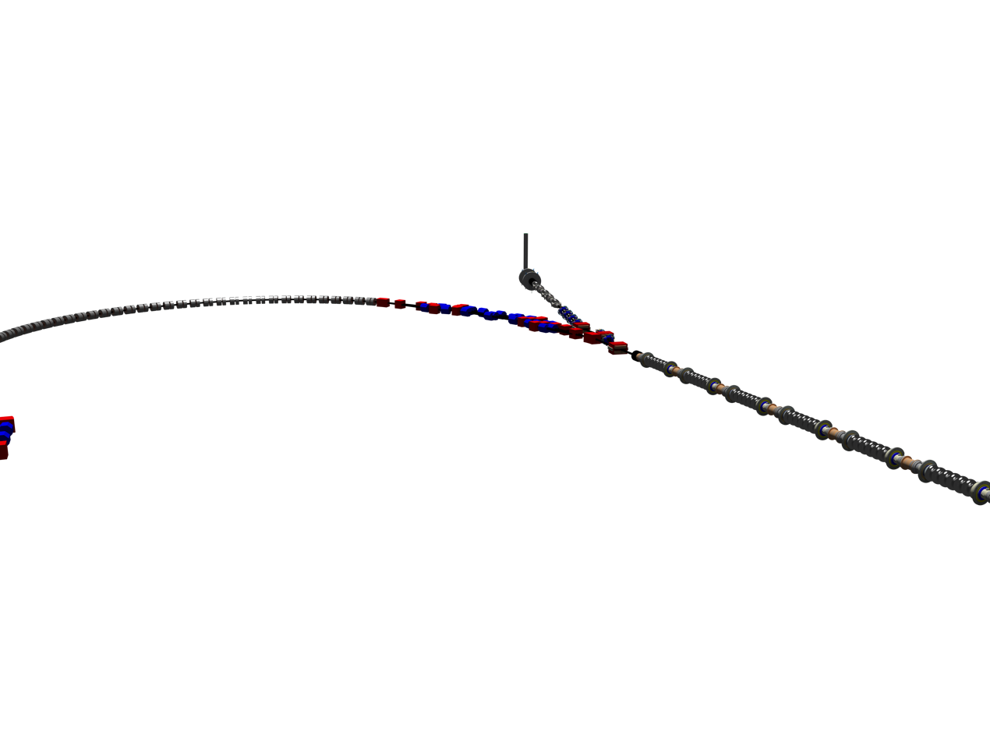
L0E cleaned with CBETA

Slide 28
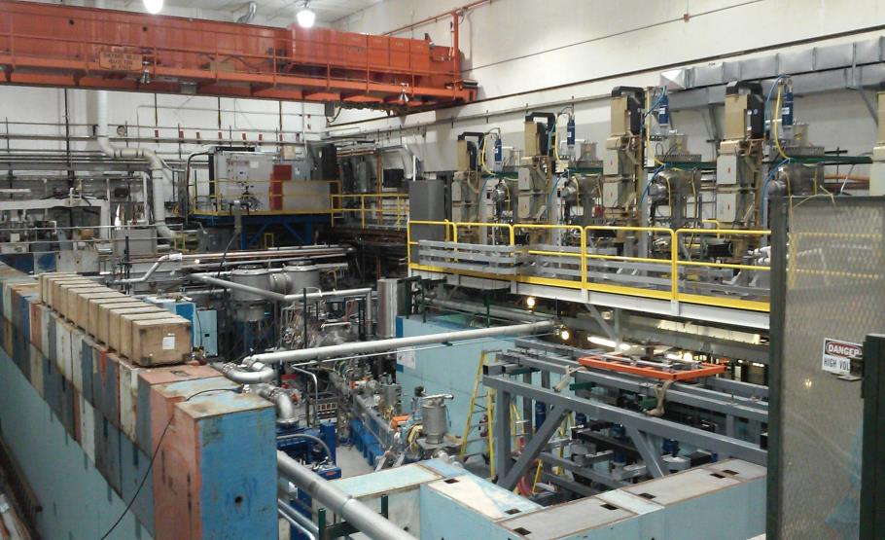
Before this week’s MLC move
The gun and ICM were tested with beam

Slide 29
January 2017: 3 Major Move Actions

Slide 30
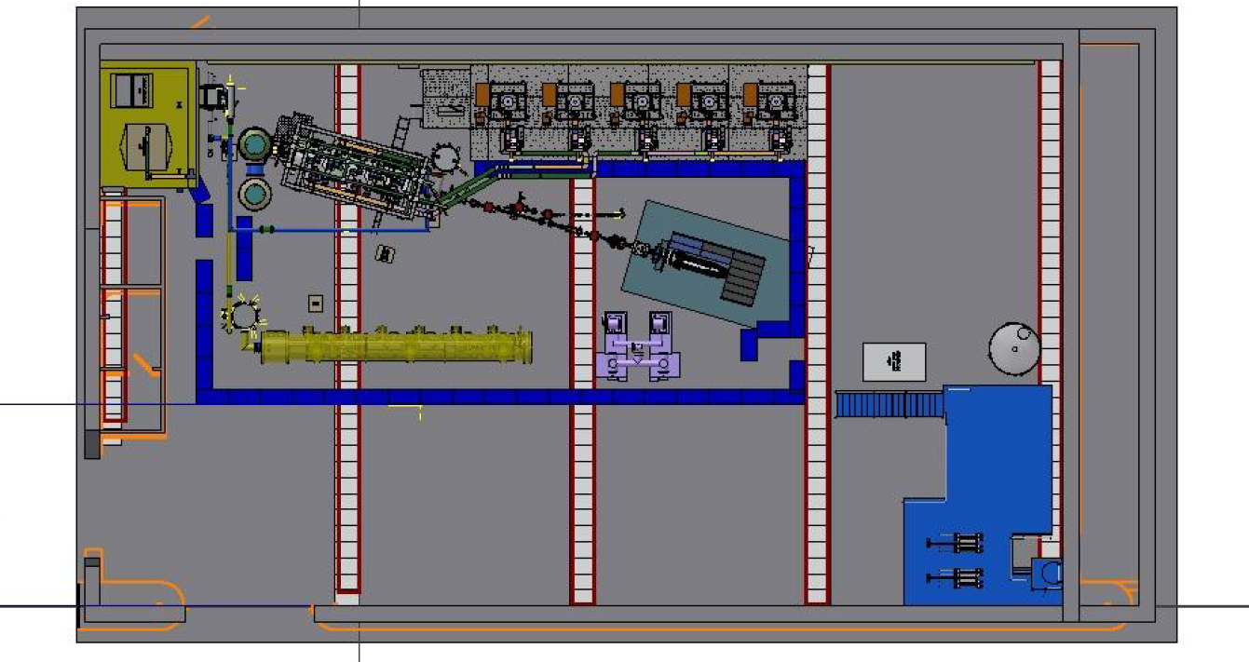
January 2017 Layout

Slide 31
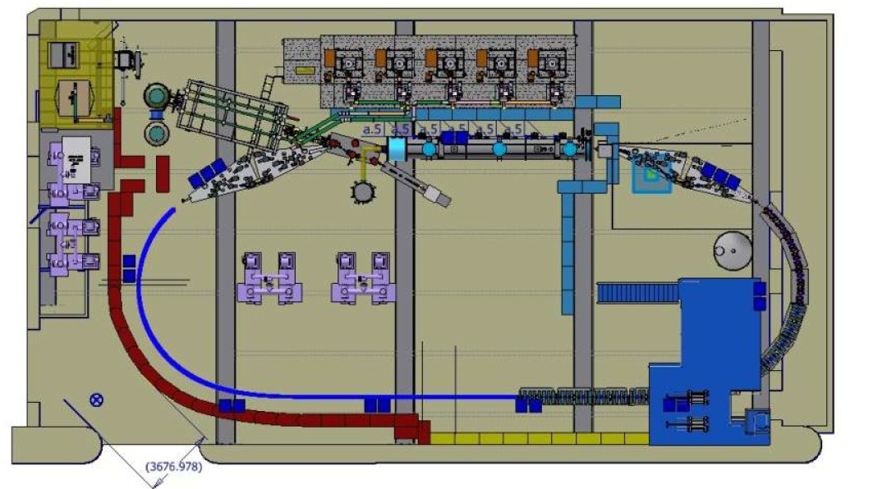
2019 Layout

Slide 32
Key Performance Parameters and
Ultimate Performance Parameters
Parameter | Unit | KPP | UPP (Stretch)
Electron beam energy | MeV |  | 150
Electron bunch charge | pC |  | 123
Gun current | mA | 1 | 40
Bunch repetition rate (gun) | MHz |  | 325
RF frequency | MHz | 1300 | 1300
Injector energy | MeV |  | 6
RF operation mode |  |  | CW
Number of ERL turns |  | 1 | 4
Energy aperture of arc |  | 2 | 4

Slide 33
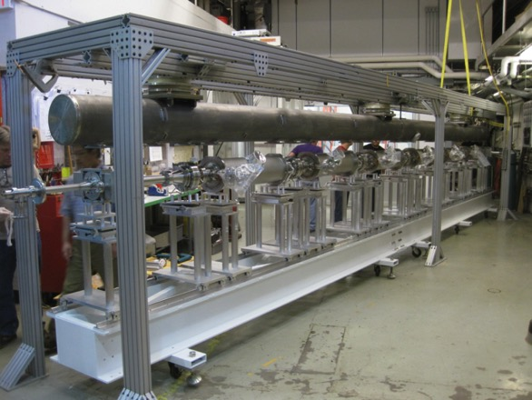
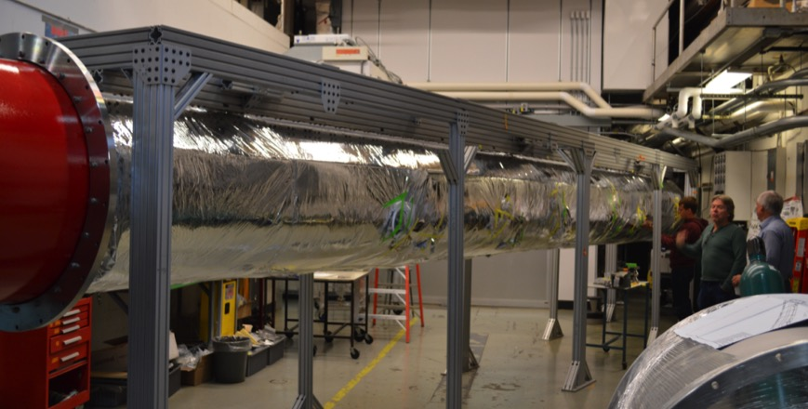
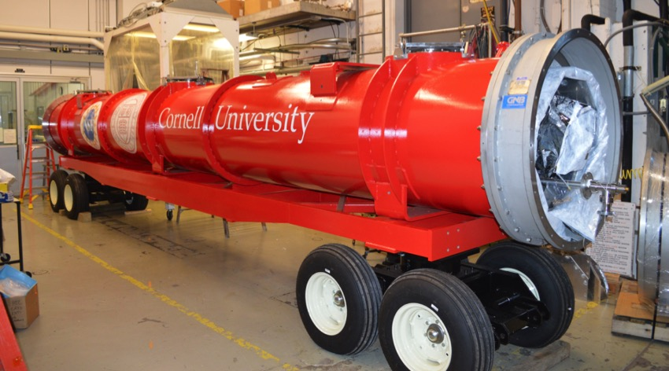
RF sourses
MLC assembly was completed
Cooled down fall 2015, field, Q, and microphonics tested.
Further cold studies will start August 2016

Slide 34
Main linac cryomodule (MLC) achieved accelerating gradients
Limit.
Admin.
Admin.
Admin.
Quench
Admin.
FE
*FE processed out.
5 of 6 cavities had achieved design gradient of 16.2MV/m at 1.8K in MLC.
Cavity#4 is limited by quench so far, no detectable radiation during test.
Enough Voltage for 76MeV per ERL turn (where 36MeV are needed)

Slide 35
Main linac cryomodule (MLC) achieved surface losses (Q0)
*Q₀ at 14MV/m, FE started.
Target Qo 2.0e10 at 1.8K
*Q₀ after FE processed out.
*Q₀ at 16.2MV/m with severe FE.
*Q₀ after many quench.
1.8K
4 of 6 cavities had achieved design Q₀ of 2.0E+10 at 1.8K.
Q₀ of Cavity#6 had severe FE at 16MV/m.
Enough cooling for 73MV per ERL turn (where 36MeV are needed)

Slide 36
Required Peak Power (Q_{L}=2·10 ⁷)
60
7
8
9
10
4
5
6
Required power [kW]
50
7
8
9
10
40
3
4
5
6
peak detuning [Hz]
30
8
9
10
2
7
3
4
5
6
20
7
2
4
5
6
1
3
10
2
3
1
2
1
0
10
15
20
25
gradient [MV/m]
5 kW RF power gives sufficient overhead for 8MV/m cavity operation with up to 90 Hz peak detuning (50 Hz if Q_{L} is not adjusted)

Slide 37
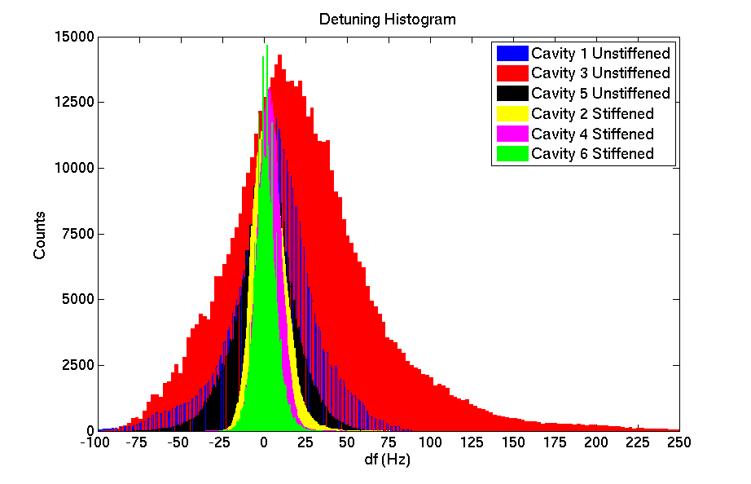
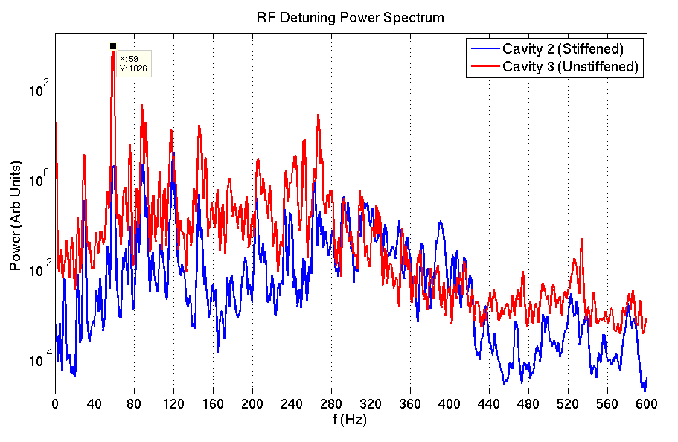
RF Detuning Measurements
Preliminary results:
Stiffened cavities have ~30Hz detuning, Un-stiffened cavities have ~150Hz detuning.
Design specs are ~20Hz.
Detuning spectrum showed large peaks at 60 Hz, 120 Hz.
Enough Voltage for about 50MeV per ERL turn, if microphonics is not reduced (where 36MeV are needed)

Slide 38
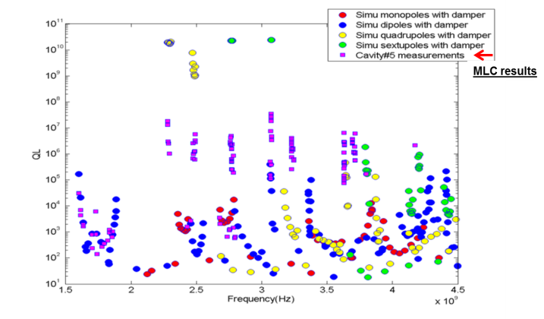
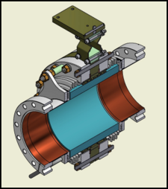
Current limits from HOMs
Dipole HOMs on MLC were strongly damped below Q~10⁴.
Consistent with HTC and simulation results.
HTC results were:
HOM heating: currents are limited to < 40mA in CBETA
BBU no HOM limits BBU to below 100mA in one turn

Slide 39
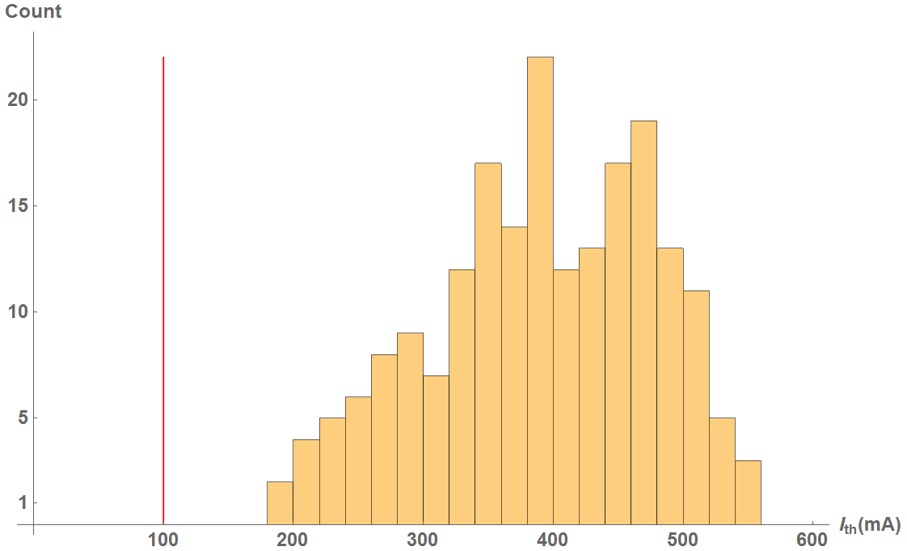

BBU for 1 pass in CBETA
CBETA 1-pass
Cavity shape error: 125 μm
100% of simulations have > 100mA

Slide 40
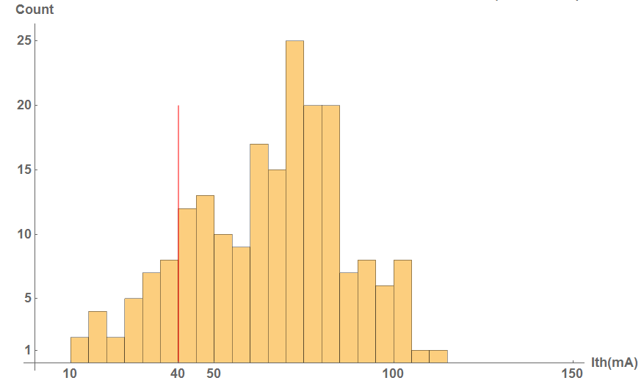
BBU for 4 passes in CBETA
CBETA 4-pass
Cavity shape error: 125 μm
x/y coupling is simulated to increase the threshold significantly
100% of simulations have > 100mA
86% of simulations have > 40mA

Slide 41
Congratulations: Path is free for CBETA
# | NYSERDA milestone (at the end of months) | Baseline | Actual
 | NYSERDA funding start date |  | Oct-16
1 | Engineering design documentation complete | Jan-17
2 | Prototype girder assembled | Apr-17
3 | Magnet production approved | Jun-17
4 | Beam through Main Linac Cryomodule | Aug-17
5 | First production hybrid magnet tested | Dec-17
6 | Fractional Arc Test: beam through MLC & girder | Apr-18
7 | Girder production run complete | Nov-18
8 | Final assembly & pre-beam commissioning complete | Feb-19
9 | Single pass beam with factor of 2 energy scan | Jun-19
10 | Single pass beam with energy recovery | Oct-19
11 | Four pass beam with energy recovery (low current) | Dec-19
12 | Project complete | Apr-20

Slide 42
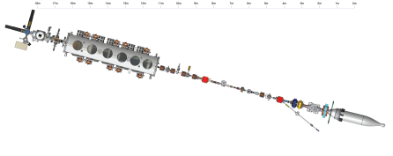
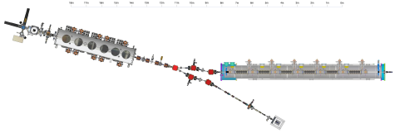



Beam Commissioning
Last beam run
August 2017
April 2018
August 2019
Push toward 4-tunr ERL thereafter (April 2020)

Slide 43
Path length: 1-pass ERL
Page Headline
Harmonic:

Slide 44
Path length: 2-pass ERL
Page Headline
Harmonics:

Slide 45
Path length: 3-pass ERL
Page Headline
Harmonics:

Slide 46
Path length: 4-pass ERL
Page Headline
Harmonics:

Slide 47

RX Merge and Mirror Merger

Slide 48

Splitter render
Page Headline

Slide 49


Harlbach magnets for the FFAG
Page Headline

Slide 50
Things to learn with KPP+ approach
CBETA study topics important for eRHIC:
FFAG loops with a factor of 4 in momentum aperture.
  Precision, reproducibility, alignment during magnet and girder production.
  Stability of magnetic fields in a radiation environment.
  Matching and correction of multiple simultaneous orbits.
  Matching and correction of multiple simultaneous optics.
  Path length control for all orbits.
Multi-turn ERL operation with a large number of turns.
  HOM damping.
  BBU limits.
  LLRF control and microphonics.
  ERL startup from low-power beam.

Slide 51
CBETA use after NYSERDA phase
Ideas for the use of CBETA after the goals for the NYSERDA funding are currently being developed. Decisions have not been made.
Accelerator physics studies for ERL physics
  Post-mortem beam studies for particle-loss scenarios.
  BBU studies
  Halo-development studies
Component tests with beam
  Beam studies with a 650MHz eRHIC test cavity
  Discussions are going on with industry for medical isotope production to test 650MHz cavities with beam.

Slide 52
Compact ERL Hard x-ray Source
Anticipated Performance of a CBeta based Laser Compton Backscattering Source
(Analysis by Carl Franck, Cornell/Physics)
Extrapolating from the recent demonstration of an ERL-based laser Compton source by T. Akagi et al., Phy. Rev. Accelerators and Beams 19, 114701 (2016).
Assuming the same laser source and photon pulse – electron bunch collider
Expected maximum X-ray energy: 412 keV with 0.4% bandwidth, 0.14 mrad divergence
Anticipated flux on sample of 2x10¹⁰ photons/ sec
Compared to the flux of 1x10¹¹ photons/ sec at 80 keV, 0.25% bandwidth , a considerably lower energy, available at a modern undulator enabled synchrotron radiation source, CHESS’s F2 line
CBeta could power an extraordinarily bright source of highly penetrating X-rays for materials science and atomic physics

Slide 53
Targets for ERL beams
ERLs: Linear acceleration and deceleration to capture the energy of spent beam, like a linac but without the power limit on beam current, as spent beam provides the power. Loss rates have to be limited.
Dense internal targets, moderately high energies, high currents, small beam size.
ERLs provide a new niche of beam parameters: What physics can they be used for?
Lost beam power has to be available from power sources.
Target has length L, nuclei with charge Z.
Coulomb scattering and particle optics determine beam loss (at an aperture a with a maximal optical beta function)
ERL Target and luminosity limits:
Courtesy Chris Mayes

Slide 54
Towards CBETA
Collaboration Opportunities!
Questions?

