Slide 1
Institut national de physique nucléaire et de physique des particules
IN2P3 : introduction
Journée Belle-II
March 22nd, 2017

Slide 2
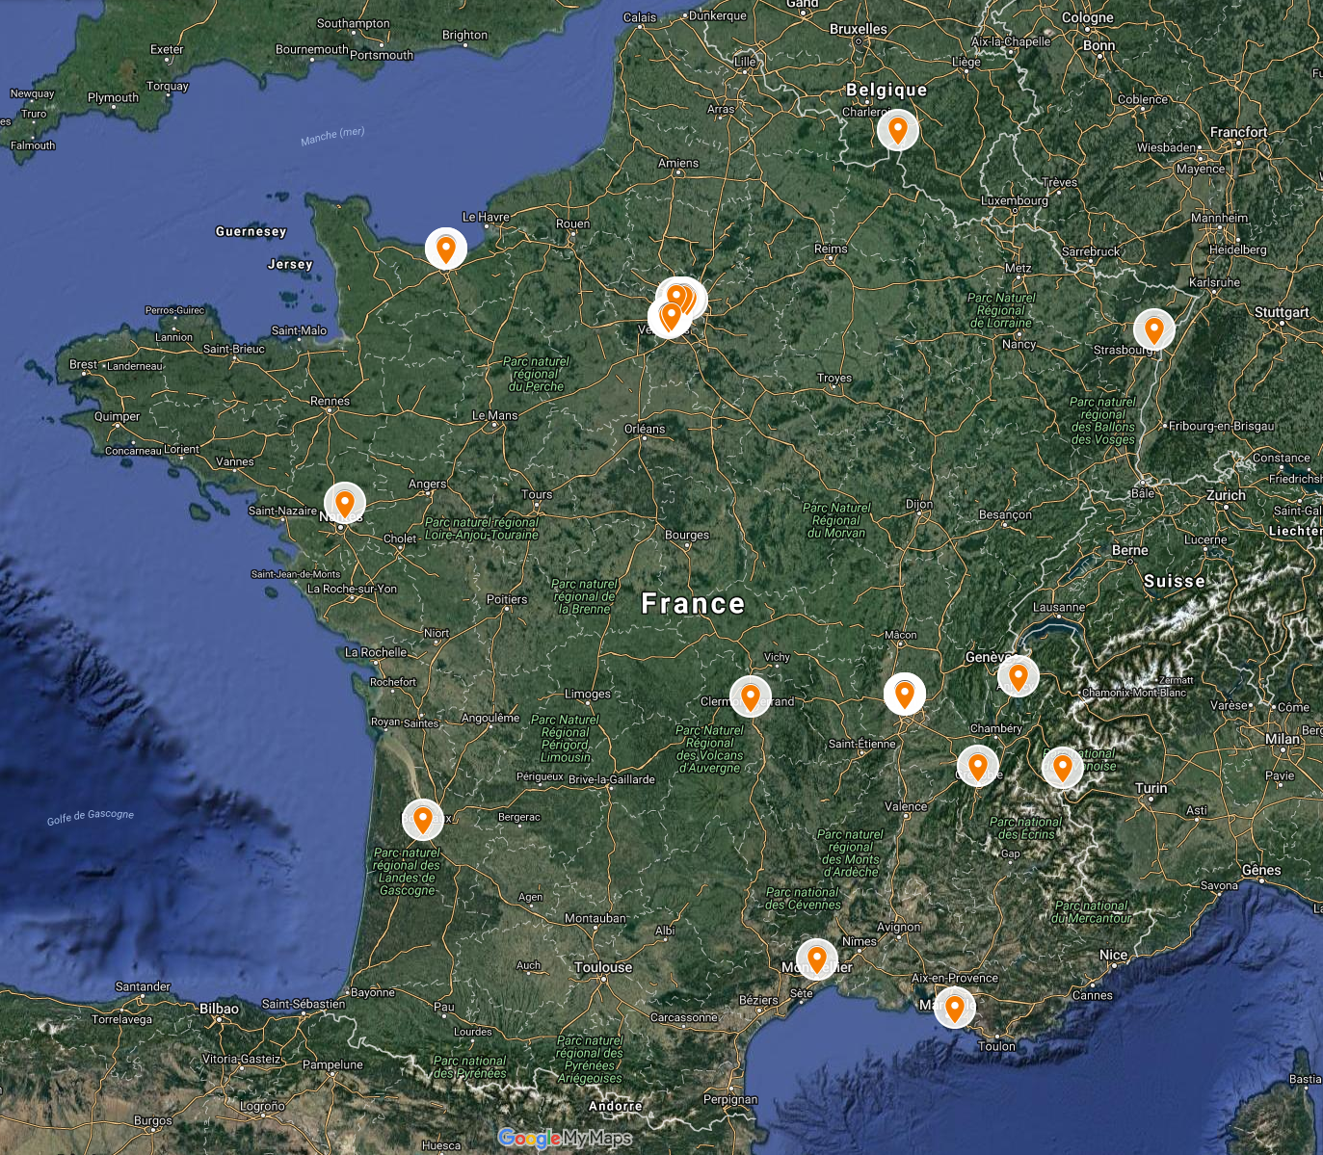
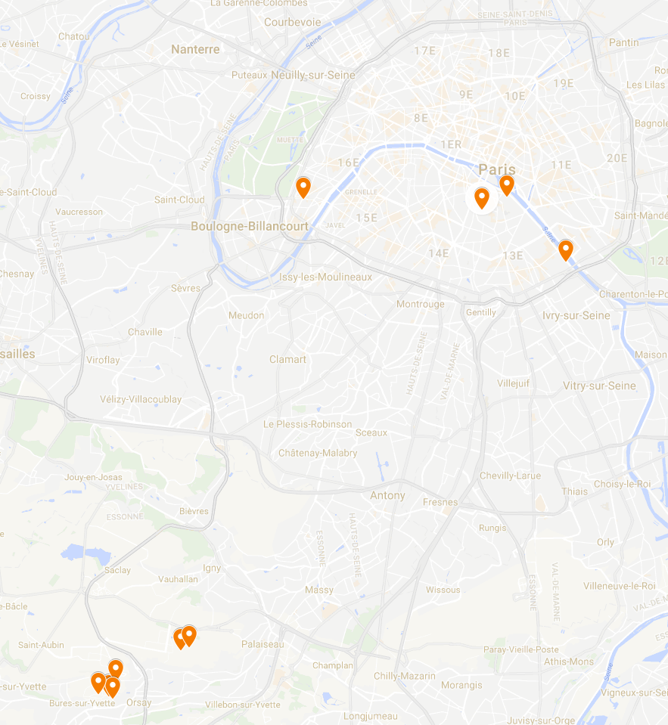
LNCA
LPC Caen
CNRS/IN2P3
LPNHE
APC
IPHC
Musée Curie
SUBATECH
IN2P3 :
25 labs in France
3300 employees
525 CNRS researchers
360 faculties
1200 engineers
400 technicians/administratives
400 non-permanents
420 PhD students
LAPP
LPC
IPNL
OMEGA
LMA
IMNC
LPSC
LSM
LLR
CCIN2P3
CENBG
LAL
IPNO
CSNSM
LUPM
CPPM

Slide 3
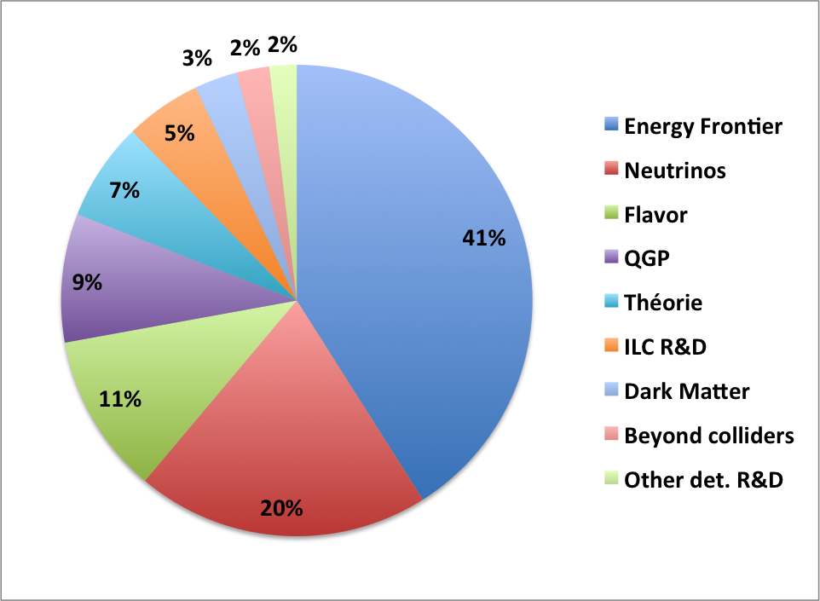
Particle physics at IN2P3
Energy Frontier physic:
ATLAS, CMS
Flavor physic:
LHCb, interest for Belle-2
Hadronic physic:
ALICE, J-Lab
Beyond Colliders:
nEDM, GRANIT, AEgIS, Gbar,
COMET-g-2/EDM
Neutrinos:
T2K/Super-K, DUNE-WA105
Double-Chooz, JUNO, SOLID, STEREO
Super-Nemo, Antares/Km3net
Dark Matter:
Edelweiss, Xenon-1 T, DarkSide, DAMIC R&D
ILC R&D

Slide 4
Flavor Physics at CNRS
Experimental flavor physics@ IN2P3/CNRS
CPPM Marseille
IPHC Strasbourg
LAPP Annecy
LAL Orsay
LLR Palaiseau
LPC Clermont-Ferrand
LPNHE Paris
Theoretical flavor physics @ IN2P3/CNRS
APC Paris
LAL Orsay
LPC Clermont-Ferrand
IPN Lyon
IPN Orsay
LPSC Grenoble
LUPM Montpellier
Theoretical flavor physics @ INP/CNRS
CPT Marseille
L2C Montpellier
LAPTH Annecy
LPT Orsay
LPTHE Paris
IPhT Saclay (CEA/CNRS)
Forum/WG on flavor physics for experimentalists and theoreticians:
- « Groupement De Recherche » (GDR) Intensity Frontier created in January 2017
gdr-intensityfrontier-l@in2p3.fr
- Coordinated by Francesco Polci & Aoife Bharucha
- First meeting next week (29-31/03) in Paris:
https://indico.in2p3.fr/event/14159/

Slide 5
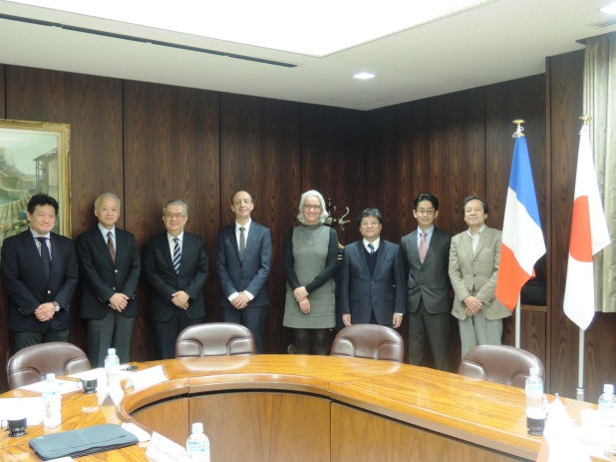
Japan-French collaborations in particle physics
International Associated Laboratory (LIA):
French Japan Particle Physics Laboratory /Toshiko Yuasa Laboratory
Created in 2006 to promote collaboration between French and Japanese teams of researchers working in subatomic physics and related areas
To encourage and facilitate valuable exchanges of personnel, as well as joint training initiatives for junior staff and students. It is also a convenient setting for initiating, promoting and developing new projects and ideas in our community.
Annual Workshops : Strasbourg, May 10-12, 2017
Strong support from IN2P3 :
to develop further Japan-France collaborations
In particular with KEK
Official visit of IN2P3 director at KEK and J-Parc
in November 2016

Slide 6
IN2P3 and Belle-II
Strong scientific interest and expertise in flavor physics at IN2P3
A group of physicists from IPHC and LAL express their scientific interests to join the Belle-II collaboration
This initiative :
is supported by IN2P3 direction
will be examined by IN2P3 scientific council : 22nd-23rd June 2017
This is still time to join this proposal

