Slide 1
Diagnostics for ThomX
N. HUBERT, M. LABAT, M. EL-AJJOURI, D. PEDEAU, Synchrotron SOLEIL
I. CHAIKOVSKA, N. DELERUE, N. EL-KAMCHI LAL

Slide 2
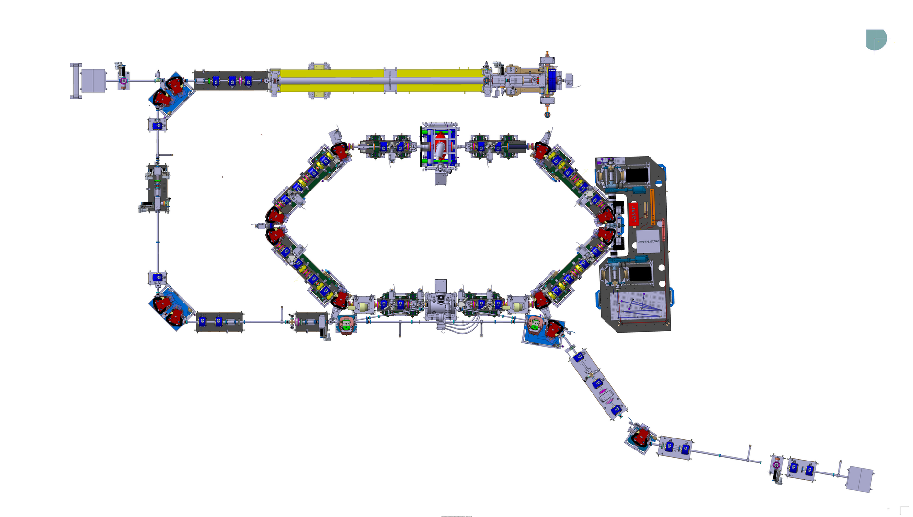
Diagnostics for ThomX (outline)
Charge
Position
Diagnostic stations
Length
Stripline for transverse feedback
Losses

Slide 3

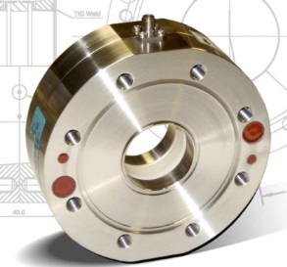
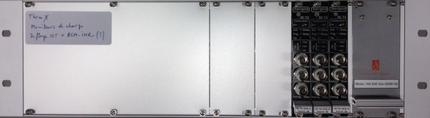
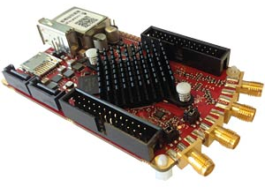
Charge measurement (Typ. 1 nC @ 50 Hz)
3 integrated current transformer (ICT)
  Location:
    @ LINAC entrance
    @ Linac exit (before first TL bending magnet)
    @ Transfer Line (between the 2 bending magnets)
  Type:
    In-flange integrating current transformer from Bergoz
    Dedicated electronics BCM-IHR provides analog voltage proportional to the beam charge
    Acquisition to be integrated in the control system (Red Pitaya, 14 bits).
  Expected resolution <1 pC
Bergoz in-flange ICT & Electronics
14 bits Red Pitaya acquisition board

Slide 4
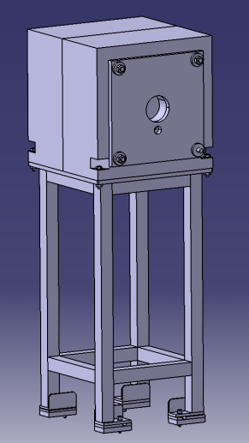
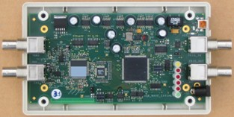
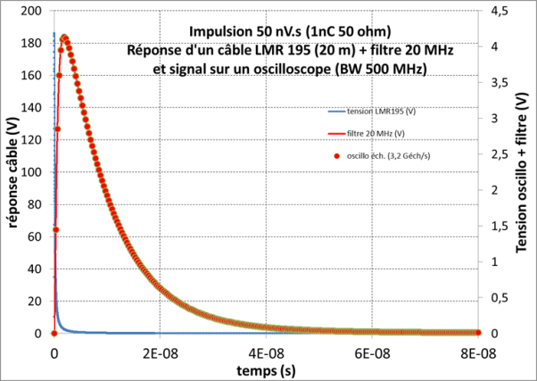
Charge measurement (Typ. 1 nC @ 50 Hz)
2 Faraday cups (FC)
  Location: in the beam dumps
    @ the end of Linac (behind first TL bending magnet)
    @ the end of extraction line
  Acquisition:
    Few tens of ns pulse to be acquired synchronously to injection or extraction trigger
    Use of Low Pass filtering and acquisition with the Wavecatcher board ( BW 500 MHz; 3.2 GS/s, 12 bits)
    Tango device ready
Beam dump
Low-pass filtered signal
Wavecatcher

Slide 5
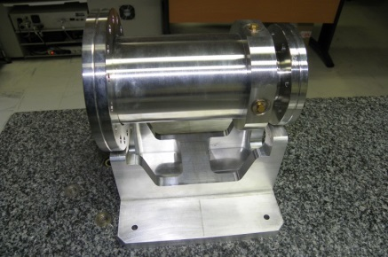
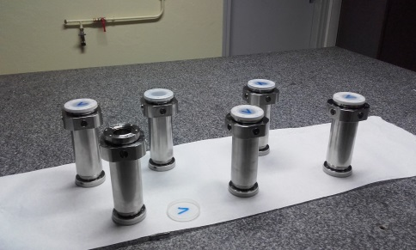
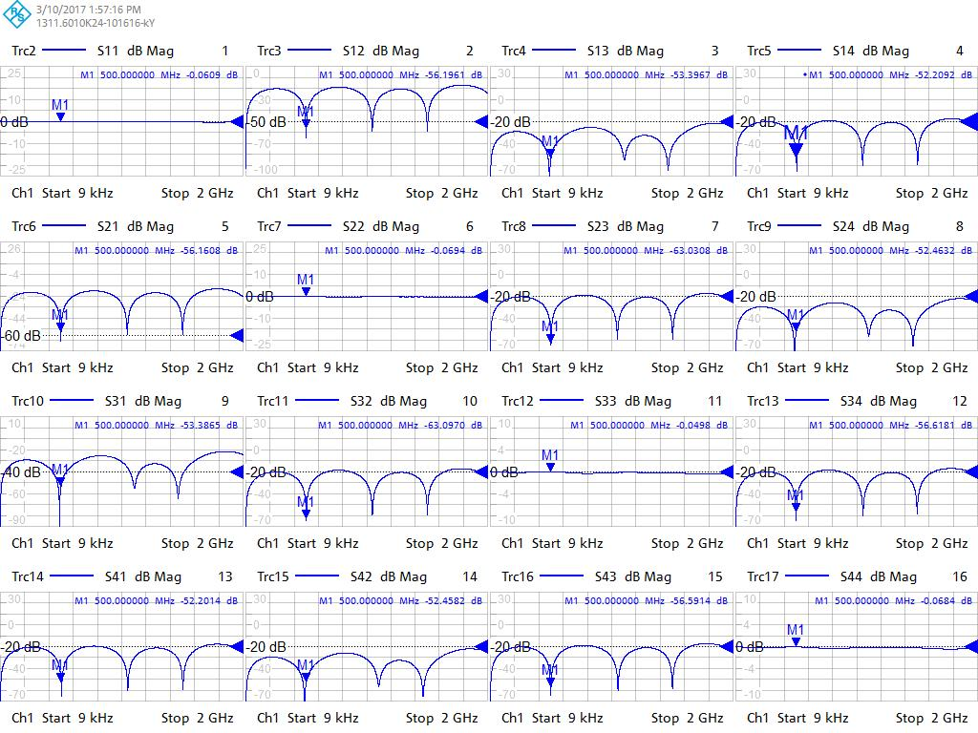
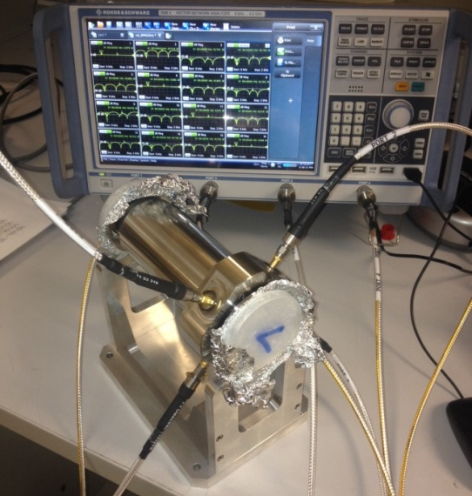
Position measurement (BPM)
Mechanics
6 Striplines
  1 stripline on the LINAC
  4 striplines on the transfer line
  1 stripline on the extraction line
  λ/4 @ 500 MHz -> Electrode length = 150 mm
  Resolution requirements: < 100 µm for 1 nC
  4 electrodes @ 90° covering ~2/3 of circumference
  Linac stripline has different design due to larger vacuum chamber diameter
  Mechanics and soldering (feedthroughs) are done at LAL
  Electrical tests and calibration done at SOLEIL
LINAC
LT
Calibration based on “Lambertson” method using a logic network analyzer

Slide 6
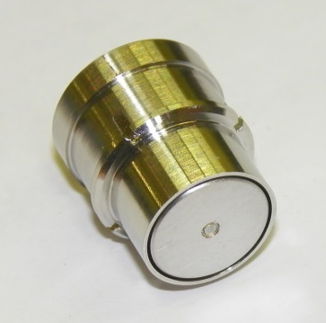
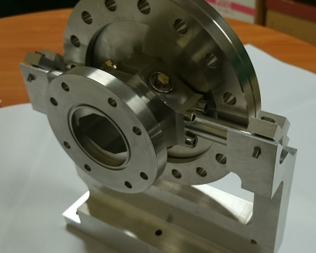
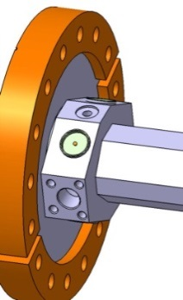
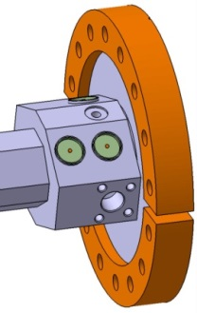
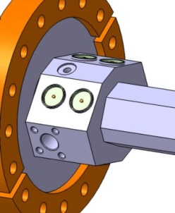
Position measurement (BPM)
Mechanics
12 button BPMs for the storage ring
  Resolution ~1 µm @ 10 Hz
  Prototype done at LAL
  Mechanics and soldering are done by RIAL Vacuum, to be delivered in spring
  Additional electrodes on double BPM for:
    Transverse and longitudinal bunch by bunch feedbacks
    Polarization for ion cleaning
ESRF (old) type
10 mm button
Design
Prototyping
Manufacturing
Feedthrough welding
Electrical test
4, 6 and 8 buttons BPMS
BPM prototype

Slide 7
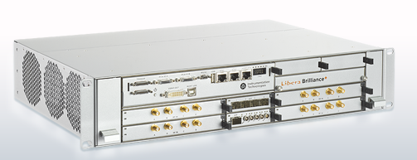
Position measurement (BPM)
Electronics
Libera Brilliance+ (Instrumentation Technologies)
  4 BPM boards per crate
  Data Flow:
    Single Pass for Linac and Transfer Line
    @ 8,33 MHz (half rev. freq.) ~turn by turn data for storage ring
    @10 Hz slow acquisition data for storage ring
  Automatic gain control
  Post-mortem and interlock possibilities
  Tango device available and fully configurable embedded on the ARM processor
Libera Brilliance +
Design (adaptation)
Manufacturing
Reception tests (more than one year…)

Slide 8
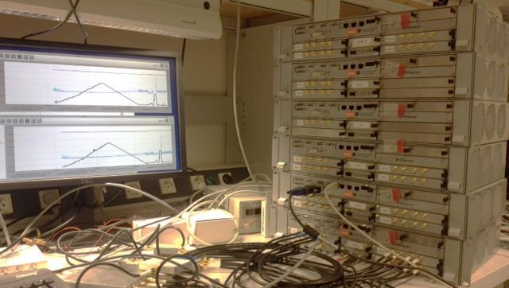
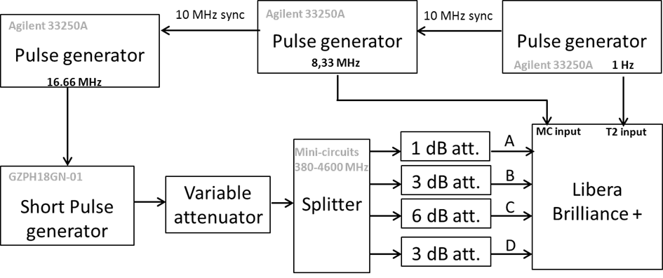
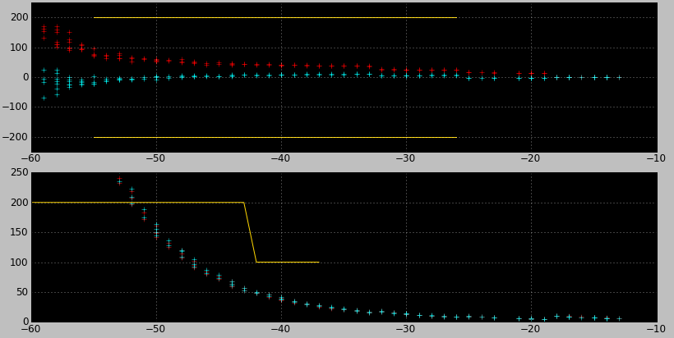
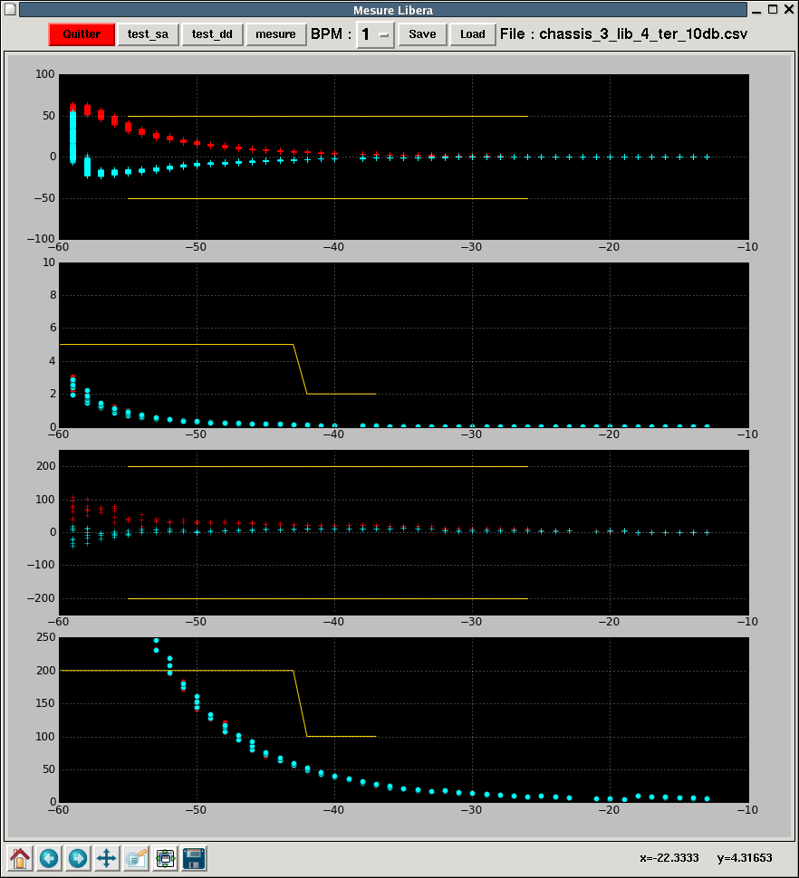
Position measurement (BPM)
Electronics
Acceptance tests: Turn by Turn (8.33 MHz) and Slow Acquisition data (10 Hz)
Turn by Turn Data
Test bench for acceptance test
Slow Acquisition Data
Beam current dependence
µm
Specification
Beam current dependence
µm
ThomX working point
Standard deviation
(10 ksamples)
ThomX working point
Standard deviation
(100 samples)
µm
µm
Input level (dBm)
Input level (dBm)

Slide 9
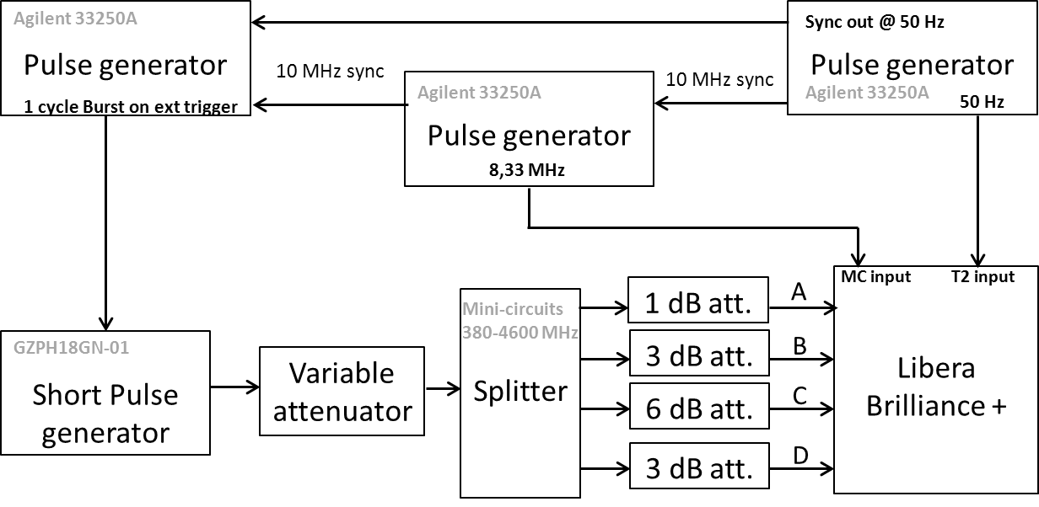
Position measurement (BPM)
Electronics
Acceptance tests: Single Pass Data
Beam current dependence
Specification
Standard deviation (10 ksamples)
Specification
Test bench for acceptance test

Slide 10
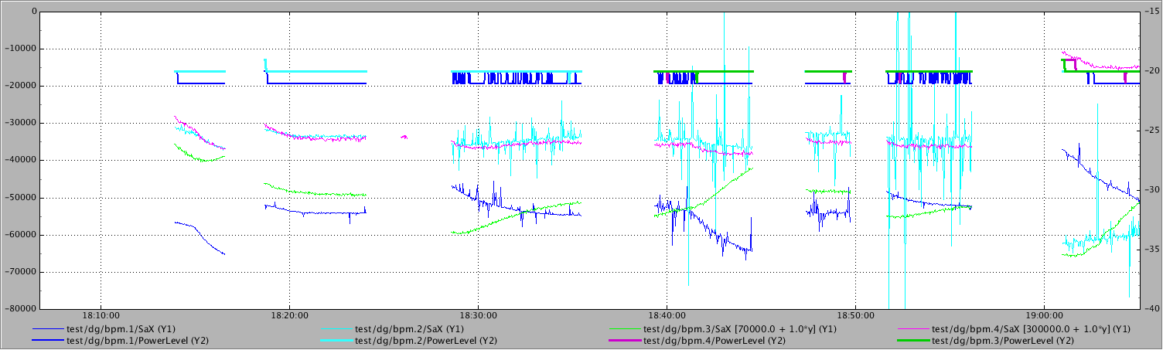
Position measurement (BPM)
Electronics
Reliability issues during Libera Brilliance+ acceptance tests
  First unit delivered in January 2015
    Acceptance test validated in march 2015
      Performances (beam current dependence, resolution…) are ok
      Reliability issues pointed out (boot, data availability, Tango device server)
  5 other modules delivered in september 2015
    Acceptance test not yet validated
      Performances (beam current dependence, resolution…) are ok.
      Still reliability issues
        Software upgrade: november 2015
        1 module back to I-Tech during 6 month
        Software upgrade: november 2016
        Hardware patch: november 2016
        FPGA upgrade: January 2017
        OS upgrade: March 2017
Libera Brilliance +
Spikes issues with boot dependance

Slide 11
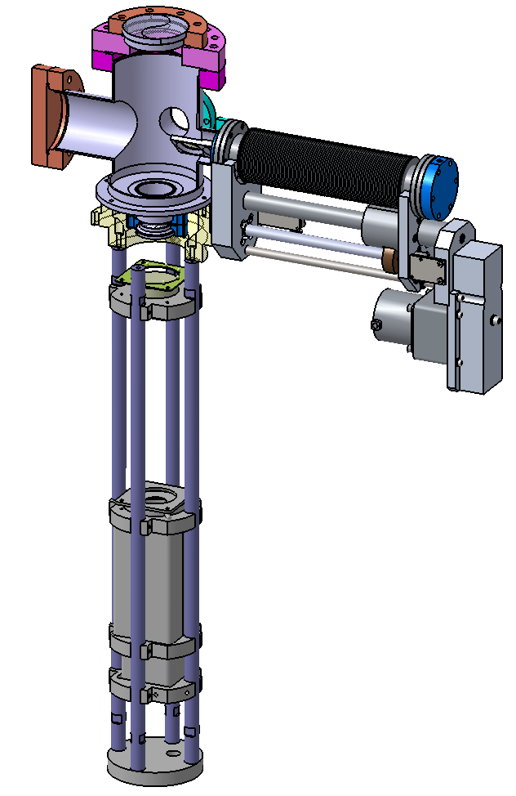
Diagnostic stations
Location
  5 Stations on Linac and transfer lines
Purpose:
  Beam size, emittance and energy measurement
Principle:
  Screen translation stage
    Calibration plate
    YAG (Ce): 25 mm diameter, 100 µm thick
    OTR : 25 mm diameter, 100 µm aluminised silicon wafer
    Sapphire screen (station 2 @ end of Linac)
  View port: Fused Silica DN 60 CF
  Imaging system
  Gigabit Ethernet trigged CCD
Design
Screens are delivered
1 translation stage is ready, the others to be ordered
Screen translation stage

Slide 12
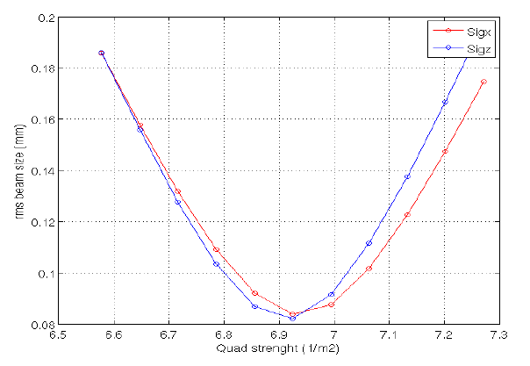
Diagnostic stations
Transverse size measurement
Emittance measurement
  Using Quadrupole scan method
    Measure beam size vs Qpole strength
    Required resolution: 10 pixels/sigma
    Devices: 1 quadrupole + screen + CCD
    Location:
      @ Diag stations 2 and 3
Energy measurement:
  Passing through dipole magnet → dispersion
    <x> → E = energy
    dx → dE = energy spread
  Device:
    Dipole + screen + CCD
  Location:
    @ middle of transfer line (Diag Station 3)
    @ dump 2 (Diag station 5)

Slide 13
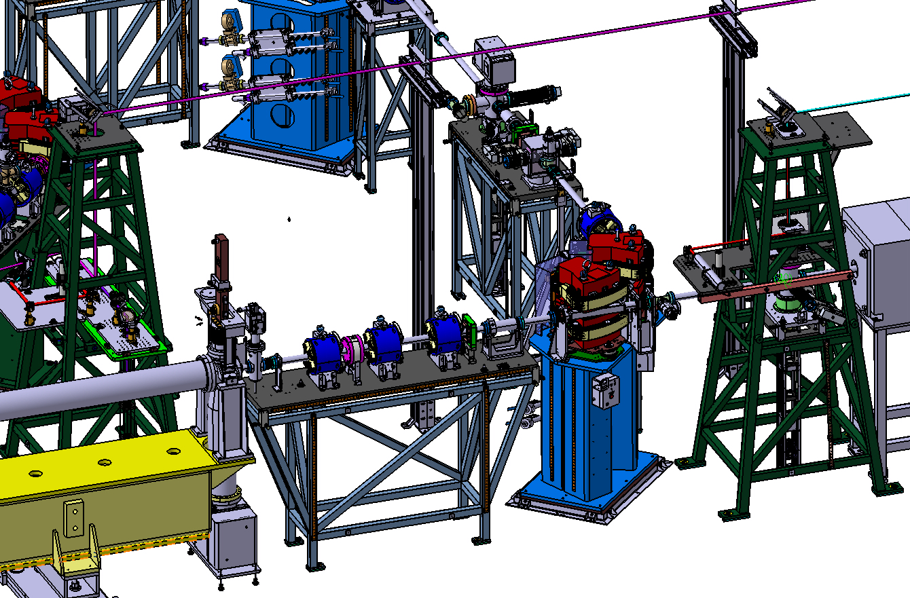
Bunch length measurement
End of Linac (4.3 ps expected):
  Cherenkov radiation produced when the electron beam passes through the sapphire screen
  Sapphire window to extract light
  Transport the radiation to a streak camera to measure the photon pulse length.
Storage Ring (5 to 20 ps expected):
  Synchrotron radiation produced when the electron beam changes its trajectory in the bending magnet
  Sapphire window to extract light
  Transport the radiation to a streak camera to measure the photon pulse length.
SR extraction port

Slide 14
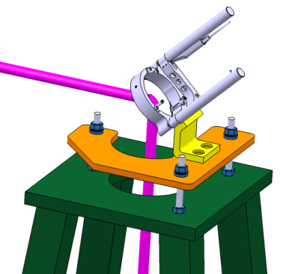
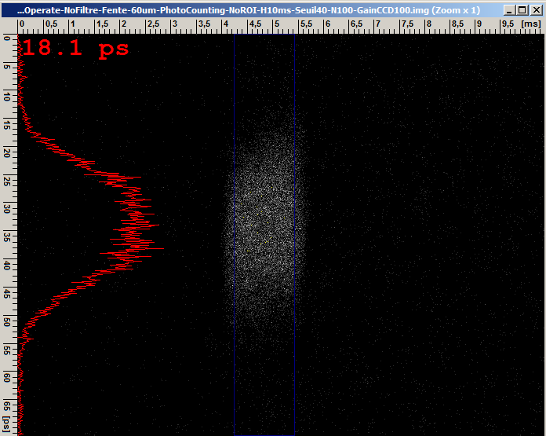
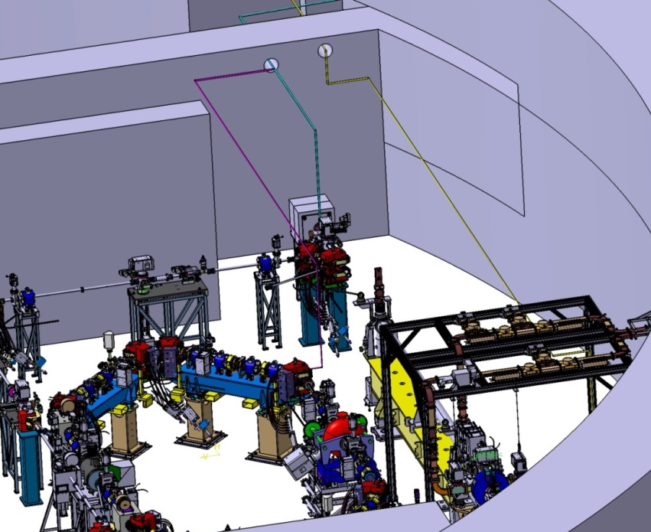
Bunch length measurement
Complex transport path to the streak camera
  Streak camera installed inside laser hutch
  Mirror support at 2.3 meter high
Hammamatsu streak camera
  Double sweep and UV tube
Mirror support
Cerenkov radiation longitudinal measurement on PHIL with ThomX streak camera (photon counting mode)

Slide 15
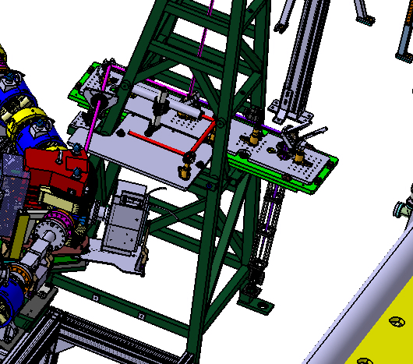
Synchrotron Light Monitor
Visualization of the beam on the storage ring in transverse plane

Slide 16
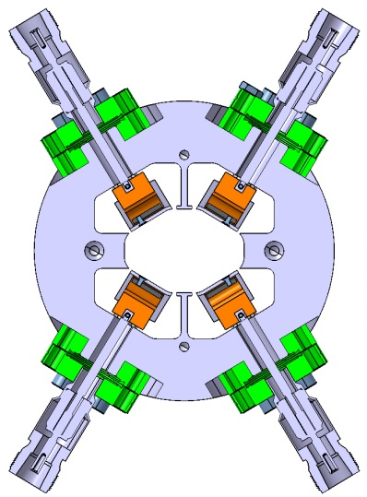
Transverse feedback
Detector:
  One set of additional button from BPM
Actuator
  Stripline (kicker)
    Electrode length: 300 mm (λ/2 @500 MHz)
    4 electrodes for acting in H and V planes
    Rise time < 1 ns
Design main steps:
  Characteristic impedance
    Geometric factor
    S parameters
  Shunt impedance
    Efficiency
  Wakefield/Beam longitudinal impedance
  Thermic studies
Simulations and design
Drawings
Consultation
Manufacturing
Reception tests
FBT stripline

Slide 17
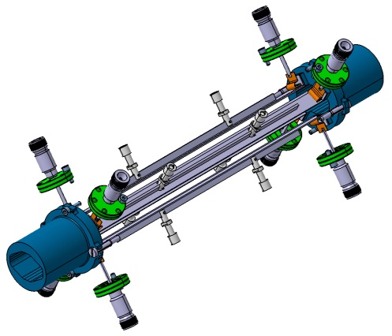
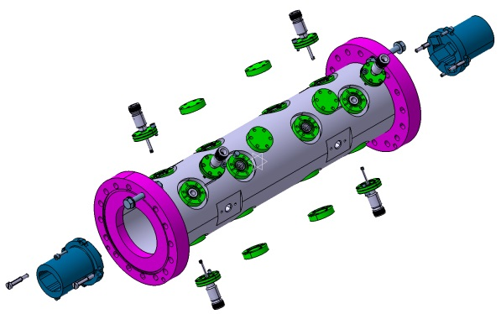
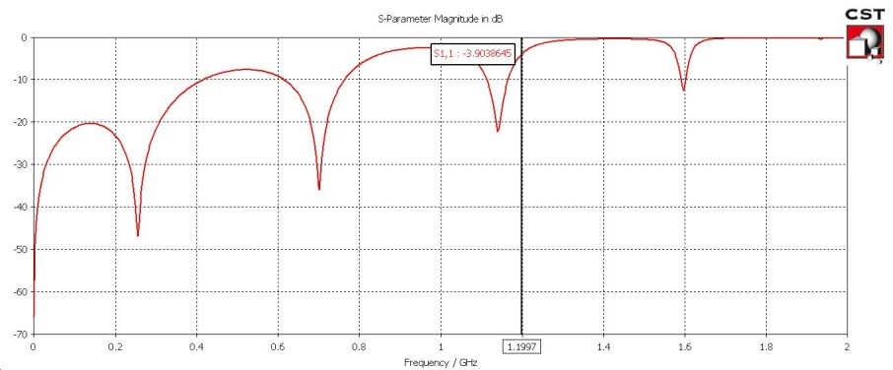
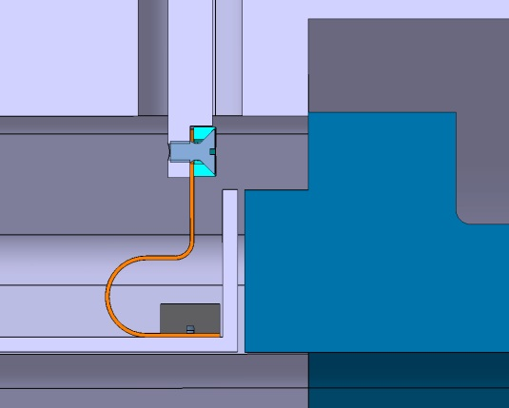
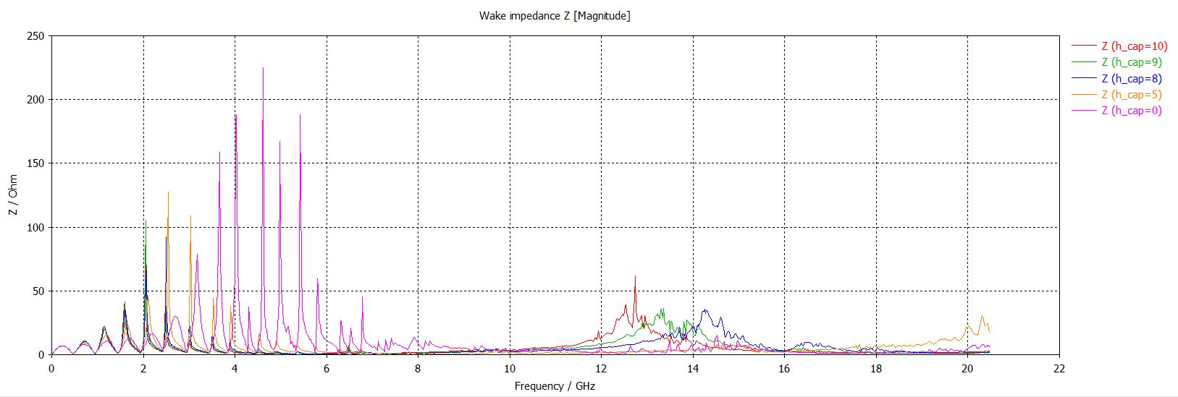
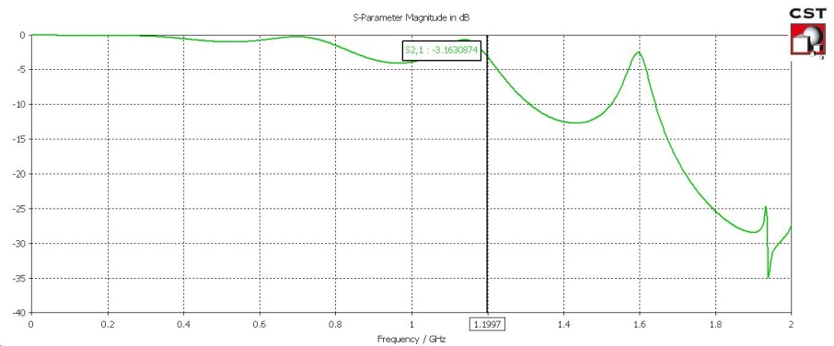
Transverse feedback
Stripline
Reflexion
Transmission
Longitudinal impedance minimization
Stripline Adaptation (Characteristic impedance)

Slide 18

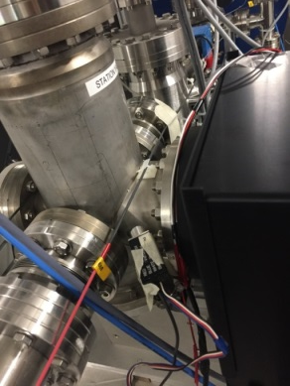
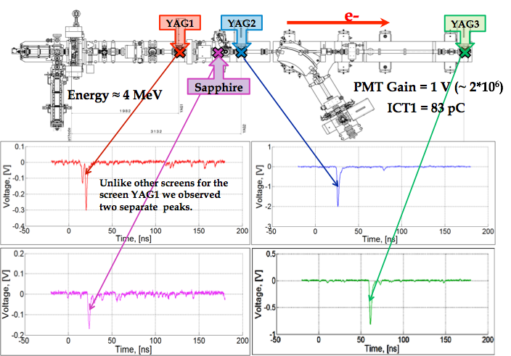
Beam Loss Monitors
Fiber Beam Loss Monitor (FBLM)
  Principle:
    Particle loss → passes through the fiber → generates Cherenkov light pulse in the fiber.
    Pulse propagates to photomultiplier
    Time at witch the loss pulse arrives with respect to the trigger (reference) gives the location of the loss
  1 fiber for the LINAC, 1 for the TL, 4 for the SR and 1 for the EL.
  The choice of the fibers and PMTs are made, the order to be passed at beginning of 2017. The controller for the DAC to control remotely the PMT gain: the order to be passed at the beginning of 2017.
  DAQ: Wavecatcher + Scope for the SR (to be ordered at the beginning of 2017)
  Beam test @ PHIL: Wavecatcher and its Tango DS have been successfully tested with the FBLM.
@PHIL
Fiber BLM tests on PHIL

Slide 19
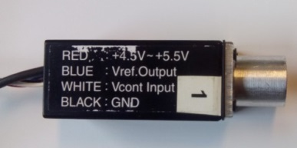
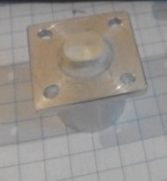
Beam Loss Monitors
Scintillators coupled to the PMT to monitor the local losses (e.g. @injection)
  Scintillator: Thalium activated Cesium Iodide CsI(Tl)
  More sensitive than fibers
  Positioned at specific locations and to be used during the commissioning and operation.
  Scintillator is available, PMT and controller for the DAC will be ordered at the same time as for the FBLM.
  DAQ: RedPitaya card (Tango DS is ready) is under the test => inside crate Diag 5 and 6.
  The assembly has been tested using the scope with the radioactive sources and with the beam @ PHIL.
Red Pitaya
CsI(Tl) + PMT

