Slide 1


Heavy Ion Physics with LHCb
Patrick Robbe, LAL Orsay, 8 November 2017

Slide 2
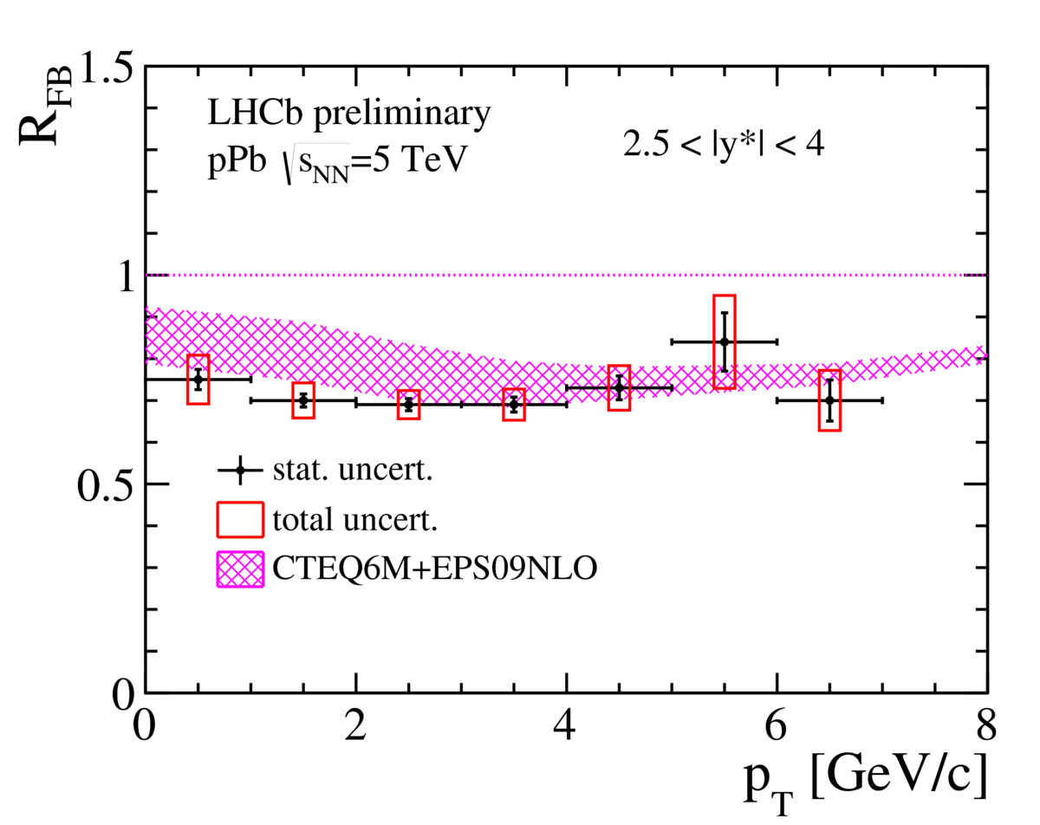
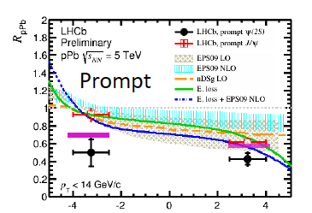
LHCb and Heavy Ions
LHCb joined the LHC Heavy Ion program in 2013: pPb (1.1 nb⁻¹) + Pbp (0.5 nb⁻¹) collisions at 5 TeV, and performed several measurements from these data:
  J/ψ [JHEP 02 (2014) 72], ψ(2S) [JHEP 03 (2016) 133] and Y(nS) [JHEP 07 (2014) 094]
  Z [JHEP 09 (2014) 030], D⁰ [LHCb-CONF-2016-003], particle correlations [PLB 762C (2016) 473]
The program continued in the Run 2 of the LHC and new collision data recorded:
  PbPb in 2015, for the first time
  pPb + Pbp in 2016, with 10 times more statistics
In parallel, development of a fixed target program

Slide 3
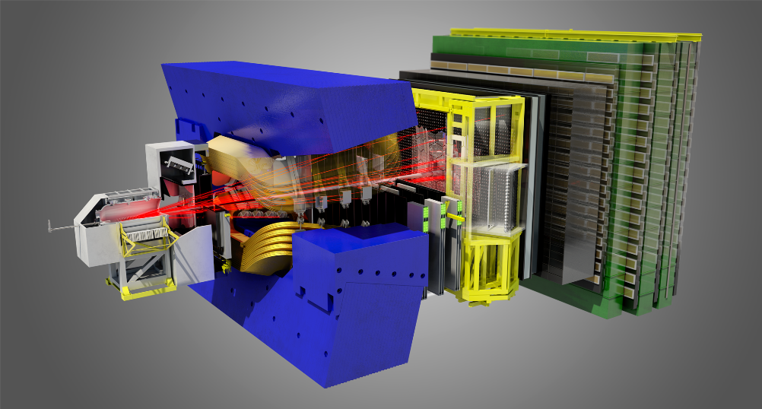
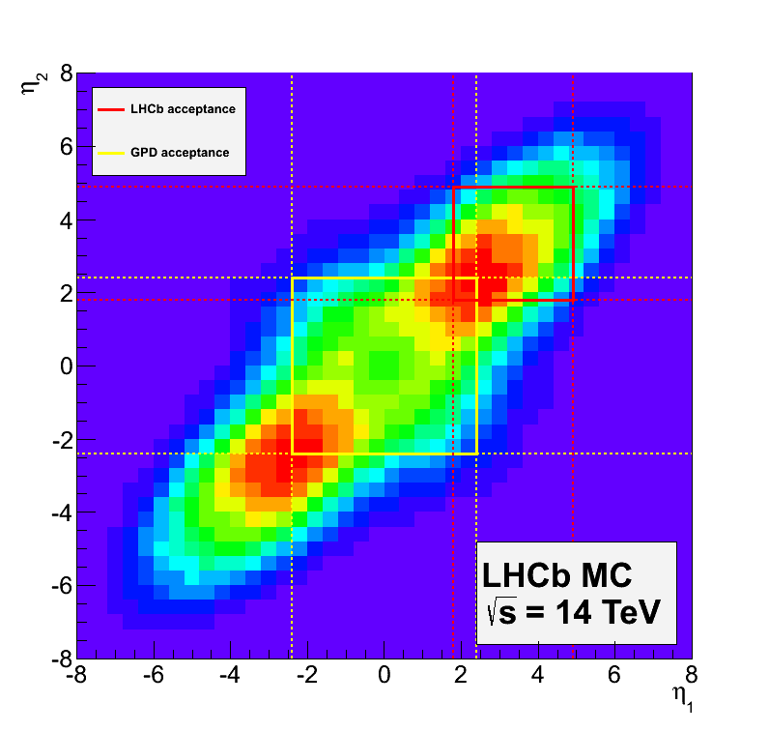

The LHCb experiment
[IJMPA 30 (2015) 1530022]
[JINST 3 (2008) S08005]
Muon system
μ identification ε(μ→μ) ~ 97 %,
mis-ID ε(π→μ) ~ 1-3 %
RICH detectors
K/π/p separation
ε(K→K) ~ 95 %,
mis-ID ε(π→K) ~ 5 %
10-250mrad
Vertex Detector
reconstruct vertices
decay time resolution: 45 fs
IP resolution: 20 μm
~12m
~20m
10-300mrad
b$\overline{b}$ acceptance
Tracking system: TT and OT
momentum resolution
Δp/p = 0.5%–1.0%
(5 GeV/c – 100 GeV/c)
Calorimeters (ECAL, HCAL)
energy measurement
e/γ identification
ΔE/E = 1 % ⨁10 %/√E (GeV)
Dipole Magnet
bending power: 4 Tm

Slide 4
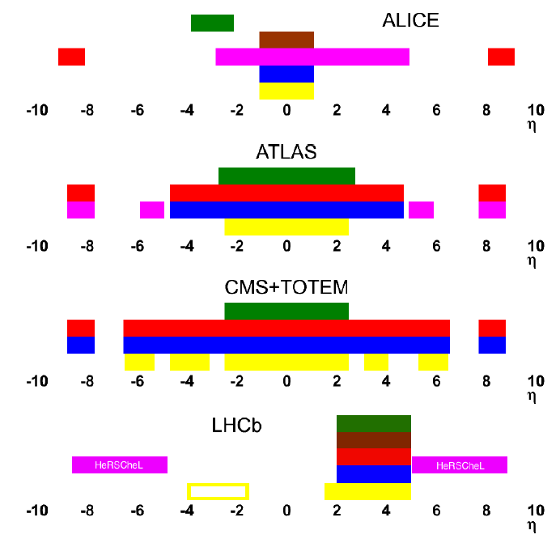
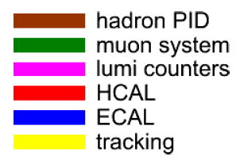
LHCb and Heavy Ions
LHCb is specialised in heavy flavour precision physics, beauty and charm:
  Optimised for low pile-up collisions (ie low multiplicity):
    Precise reconstruction of production and decay vertices: time dependent CP violation
    Correlations between particles: flavour tagging
Some characteristics of the experiment make it attractive for measurements in Heavy ion physics too:
  Instruments fully the forward region: 2<η<5
  Precise vertexing: separation of prompt production from B decay products
  Precise tracking: reconstruction down to p_{T}=0
  Particle identification: reconstruction of hadronic decays

Slide 5
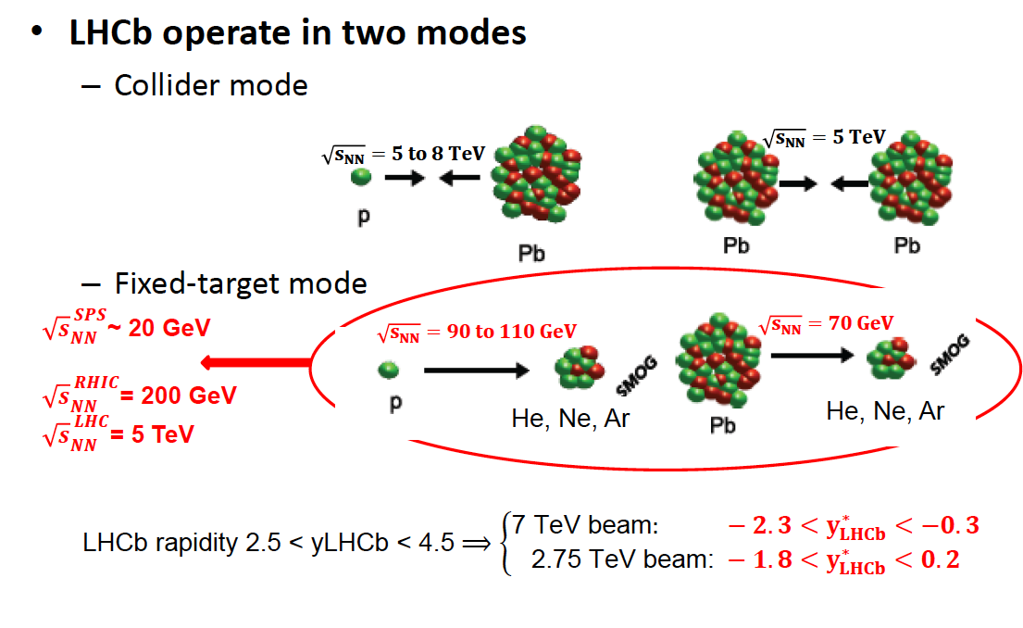
LHCb operates in two modes
Unique to LHCb
Unique energies

Slide 6
Heavy Flavours and Heavy Ions
Most of the analyses (for heavy flavour) consist in measuring the ratio of production in pA collisions to pp collisions: R_{pA} with A = nucleus
pp collisions: hard process cross-section
pA collisions: hard process + « cold » nuclear matter effects
  Shadowing and anti-shadowing: parton density functions of protons and neutrons are modified when they are in a nucleus compared to a single proton
  Energy loss: heavy quarks loose energy in the medium of the collision before forming hadrons
AA collisions: hard process + « cold » nuclear matter effects + « hot » nuclear matter effects (due to Quark Gluon Plasma, free quarks during a short time after the collision):
  Recombination: a lot of other heavy quarks are present in the medium and enhance the production of quarkonium (heavy quark bound states)
  Dissociation: quarkonium melt in the medium
pA collisions allow to understand the « background » mechanisms to the ones due to QGP in AA collisions, and are also interesting in their own rights.

Slide 7
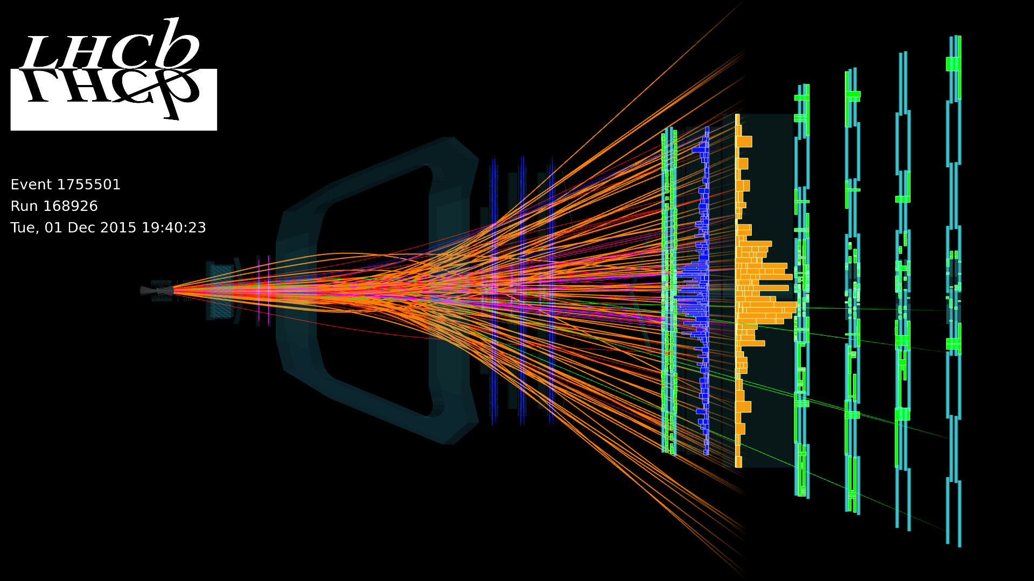
Collider mode: PbPb collisions (2015)
LHCb took part for the first time to a LHC PbPb run end of 2015, with emphasis on low multiplicity events.
Up to 54 colliding bunches, ie 10% of the luminosity provided to the other LHC experiments, and a total of 3-5 μb⁻¹ integrated luminosity recorded with the detector running in standard conditions (same as with proton-proton collisions)
Centrality reach: up to 50%, where measurements of J/ψ, D⁰, K_{s}⁰, Λ, … production can be done
Analysis still ongoing, but difficult because of high multiplicity events, limiting tracking efficiency with the current detector.
D⁰ ➝ K⁻ π⁺
K⁰_{S} ➝ π⁻ π⁺

Slide 8
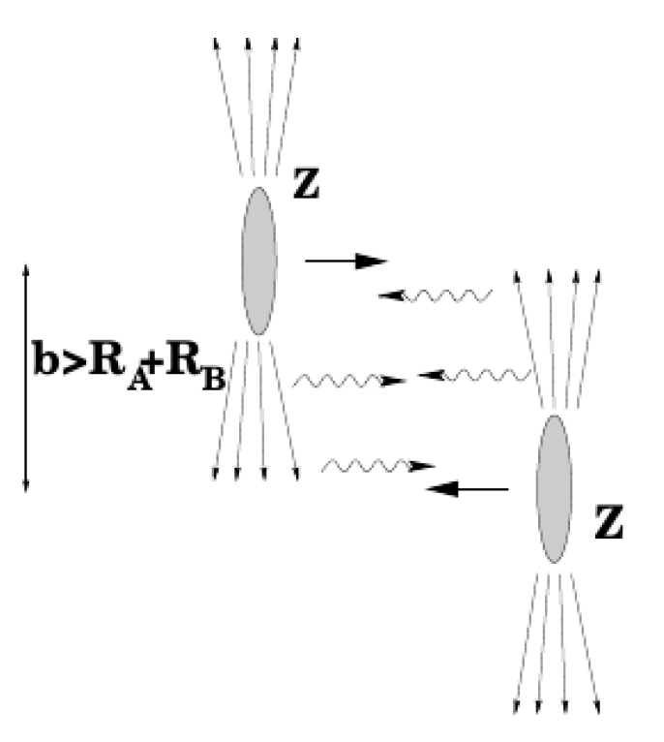
Collider mode: PbPb collisions (2015)
However in low multiplicity collisions, LHCb performances are good
Measurement of J/ψ photo-production in Ultra Peripheral PbPb Collisions (UPC): ): cross-section boosted compared to pp because of high photon flux by factor Z_{Pb}²
Very clean sample in events with only 2 muons

Slide 9
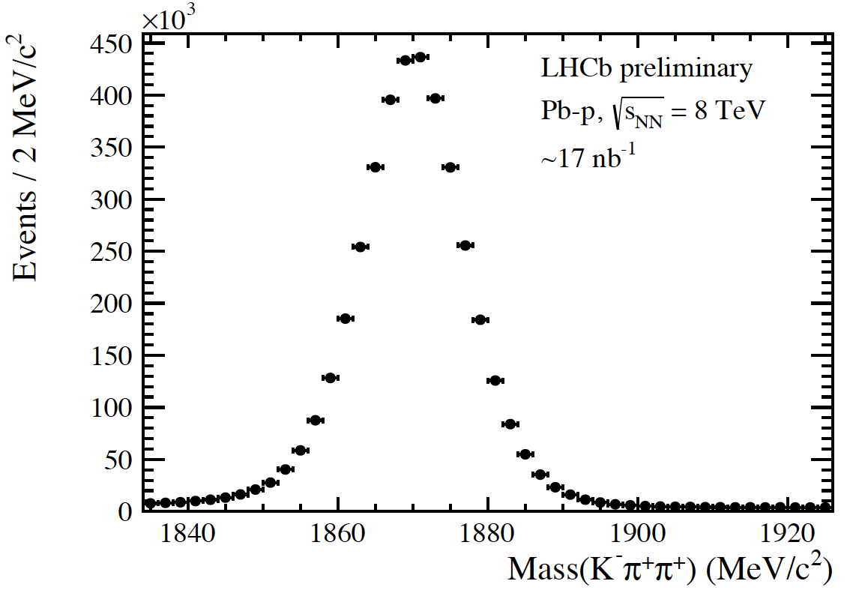
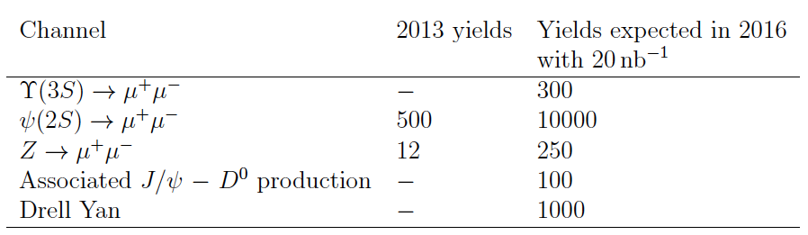
Collider mode: pPb collisions (2016)
pPb collisions at 5 TeV: « small » sample collected (~50% of the 2013 sample)
pPb (~13nb⁻¹) and Pbp (~17nb⁻¹) collisions at 8.2 TeV: more than 10 times the 2013 statistics. Possibility to perform many new or improved measurements [LHCb-PUB-2016-011]
D⁺ ➝ K⁻ π⁺ π⁺

Slide 10
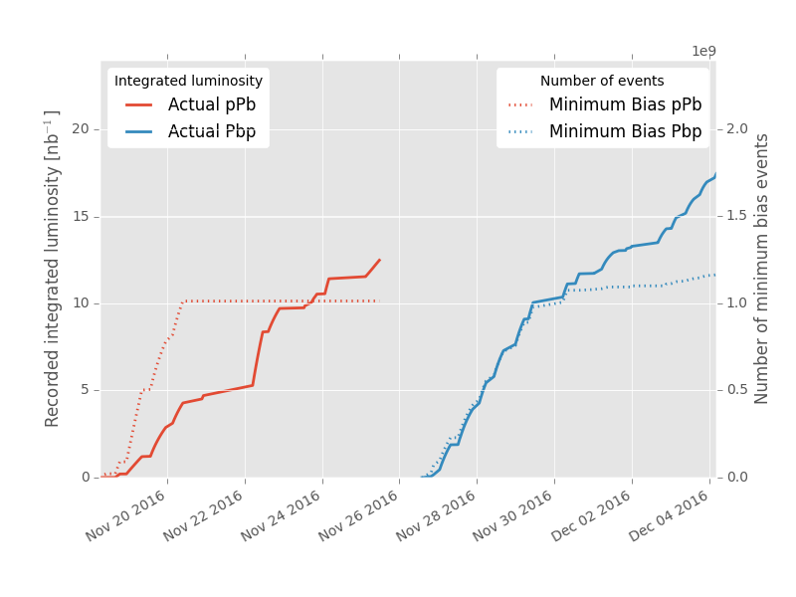
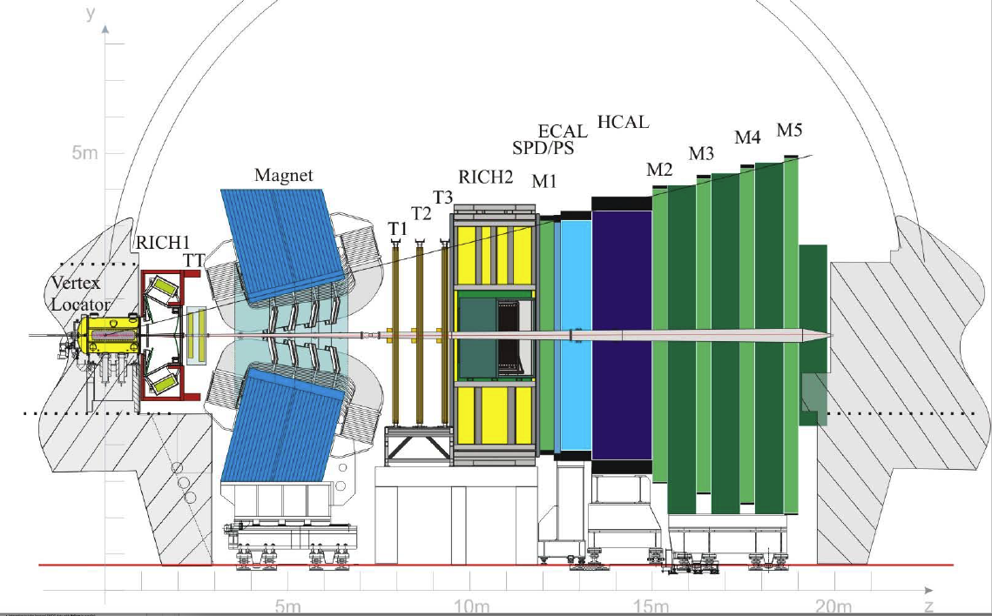
Collider mode: pPb collisions (2013, 2016)
Due to geometry of detector: when reverting beams, two different coverages: statistics accumulated in both configurations in 2013 and 2016
2016
pPb
« forward »
1.5 < y* < 4.5
p
Pb
Pbp
« backward »
Measurement of Forward-Backward ratios in a common range (2<|y*|<4.5)
y* = center of mass rapidity
-5.5 < y* < -2.5
Pb
p

Slide 11
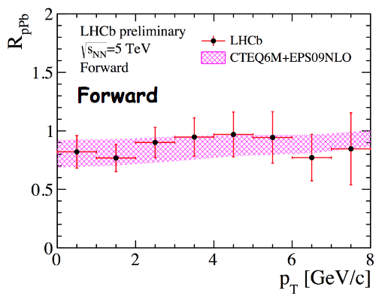



D⁰ production in pPb collisions at 5 TeV
[LHCb-PAPER-2017-015]
Update of previous preliminary results (LHCb-CONF-2016-003) with 10 times more statistics
Measurement of prompt double differential cross-section as a function of:
  p_{T}, transverse momentum, in the range 0 to 10 GeV/c, in bins of 1 GeV/c
  y*, centre of mass rapidity in the ranges, in bins of 0.5 rapidity unit:
    1.5 < y* < 4.0 for pPb
    -5 < y* < -2.5 for Pbp,
From them and the pp cross-section at the same energy, extract nuclear modification factor R_{pPb} (with A=208)
And the Forward-Backward asymmetry comparing pPb and Pbp:
[LHCb-CONF-2016-003]
pPb

Slide 12
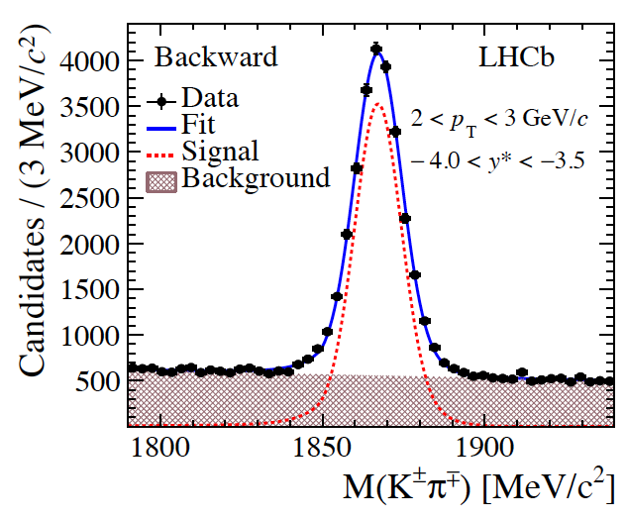
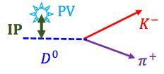
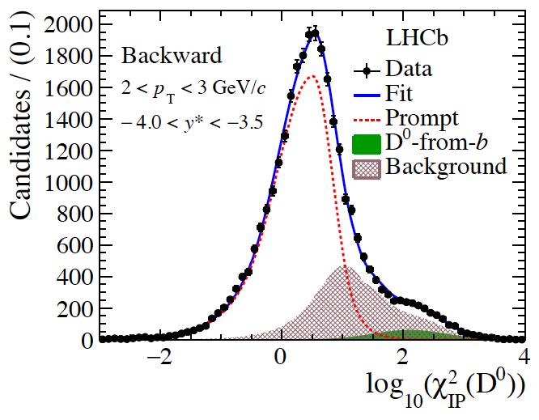
D⁰ production: Signal selection
[LHCb-PAPER-2017-015]
Low instantaneous luminosity: 5x10²⁷ cm⁻² s⁻¹, a minimum activity trigger is used to record all events
Use tight particle identification requirements from RICH detectors
Separate prompt D⁰ from D⁰ from B decays using the D⁰ Impact Parameter to PV:
The number of inclusive candidates is extracted from a fit to the mass distribution, then the number of prompt D⁰ from the log(χ_{IP}²) distribution [χ_{IP}² is the difference in the PV vertex fit χ² with and without the D⁰ tracks]
Efficiencies are computed from pp collision simulations, correcting for the differences in detector occupancies
Pbp

Slide 13
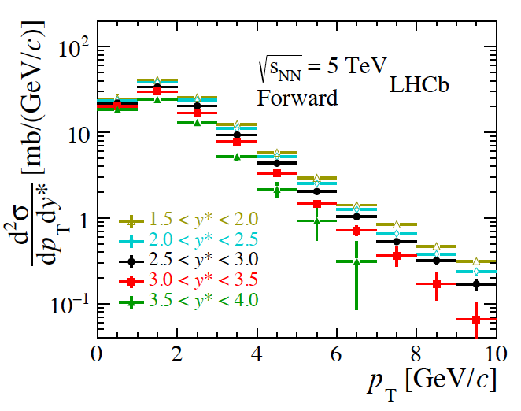
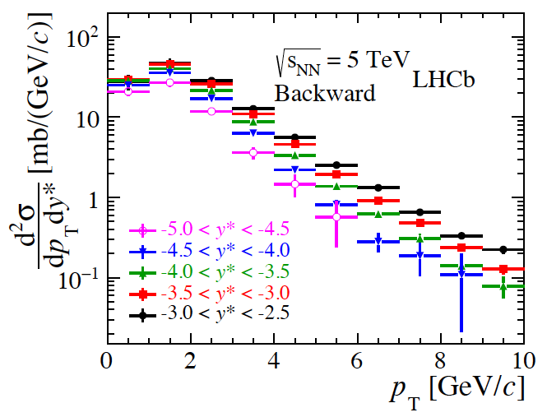
D⁰ production: Absolute cross-sections
[LHCb-PAPER-2017-015]
Integrated luminosity obtained from van der Meer scan and beam gas imaging techniques [JINST 7 (2012) P01010]
  L_{pPb} = 1.06±0.02 nb⁻¹
  L_{Pbp} = 0.52±0.01 nb⁻¹
Systematic uncertainties vary from 5% to 20%, dominated by particle identification
pPb
Pbp

Slide 14
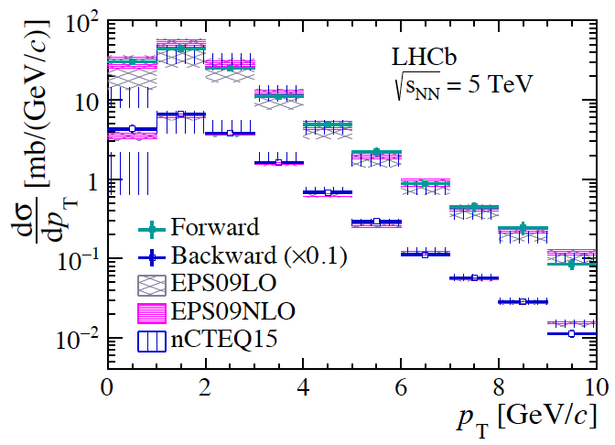
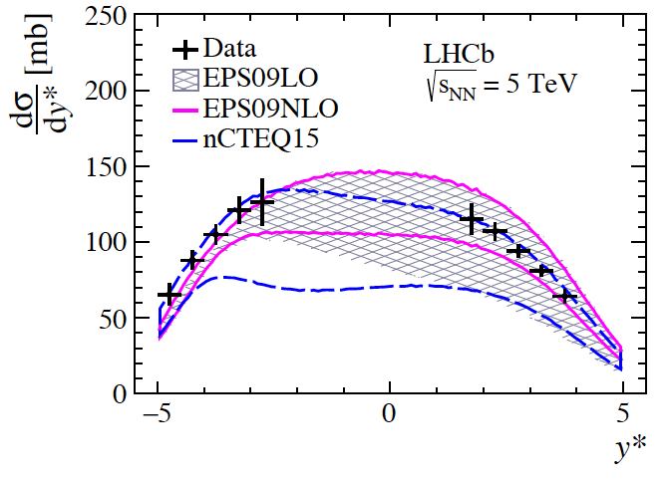
D⁰ production: Integrated cross-sections
[LHCb-PAPER-2017-015]
Integrating over the full range:
Integrating over one dimension:
Compared with HELAC-Onia [J.-P. Lansberg, H.-S. Shao, EPJC77(2017)1] (tuned to reproduce pp data with the PDF set CT10NLO [H.-L. Lai et al, PRD82 (2010) 074024]) using nuclear PDFs:
  EPS09LO or EPS09NLO [K.J. Eskola, H. Paukkunen, C.A. Salgado, JHEP04 (2009) 065]
  nCTEQ15 [K. Kovarik et al, PRD93 (2016) 085037]

Slide 15
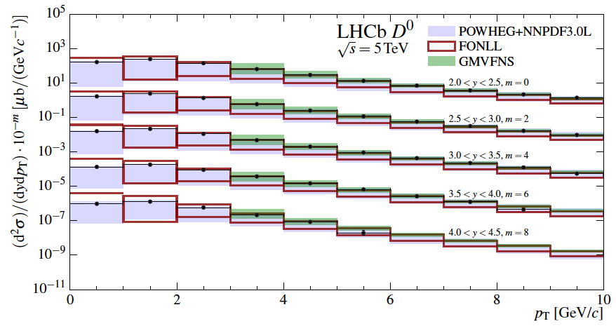
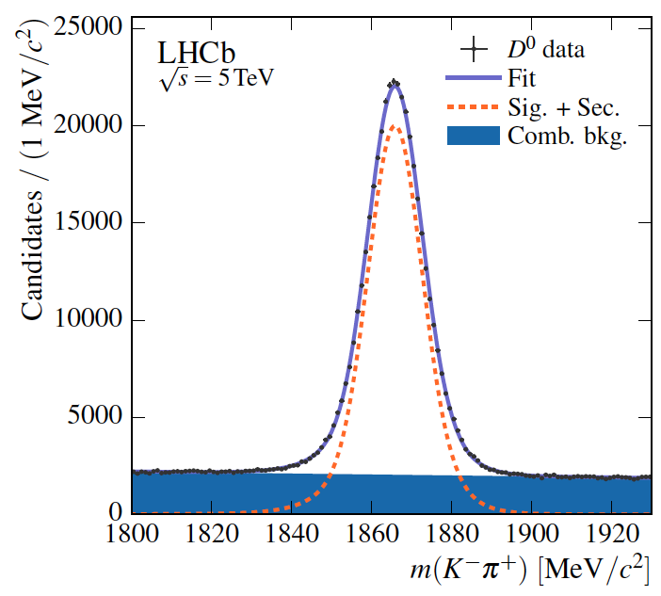
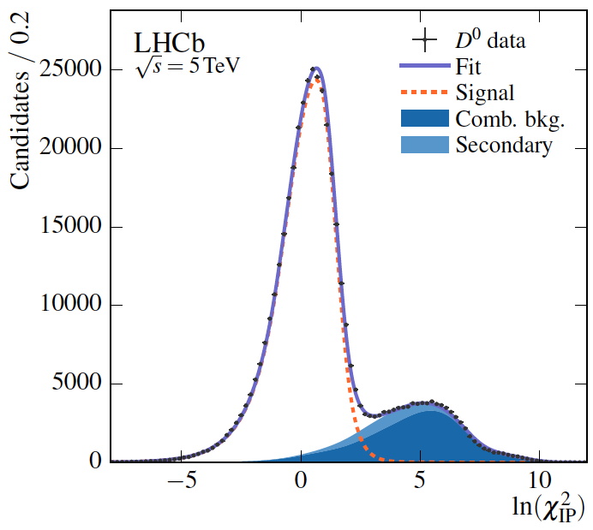
D⁰ production: Reference pp cross-section
[LHCb-PAPER-2016-042, arXiv:1610.02230]
Measured with data accumulated during 5 TeV LHC reference run in 2015, using 8.60±0.33 pb⁻¹ luminosity and the same analysis techniques.
Compared with
  POWHEG+NNPDF3L [R. Gauld, J. Rojo, L. Rottoli, J. Talbert, JHEP11 (2015) 009]
  FONLL [M. Cacciari, M.L. Mangano, P. Nason, EPJC75 (2015) 610]
  GMVFNS [B.A. Kniehl, G. Kramer, I. Schienbein, H. Spiesberger EPJC72 (2012) 2082]

Slide 16
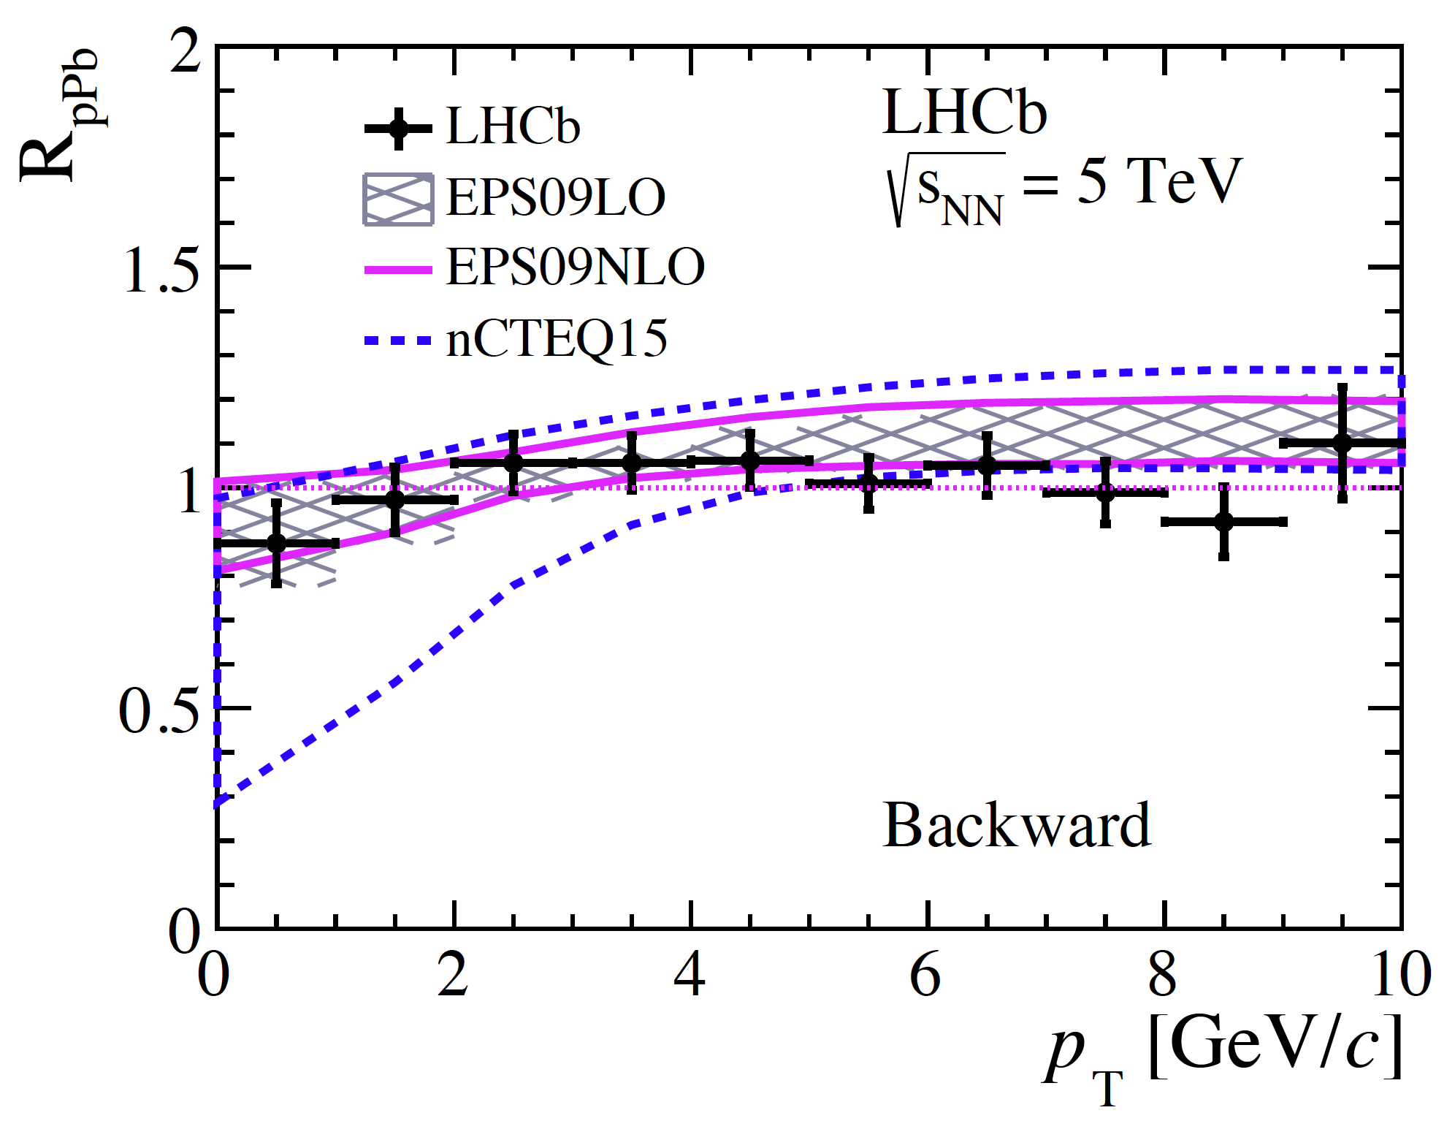
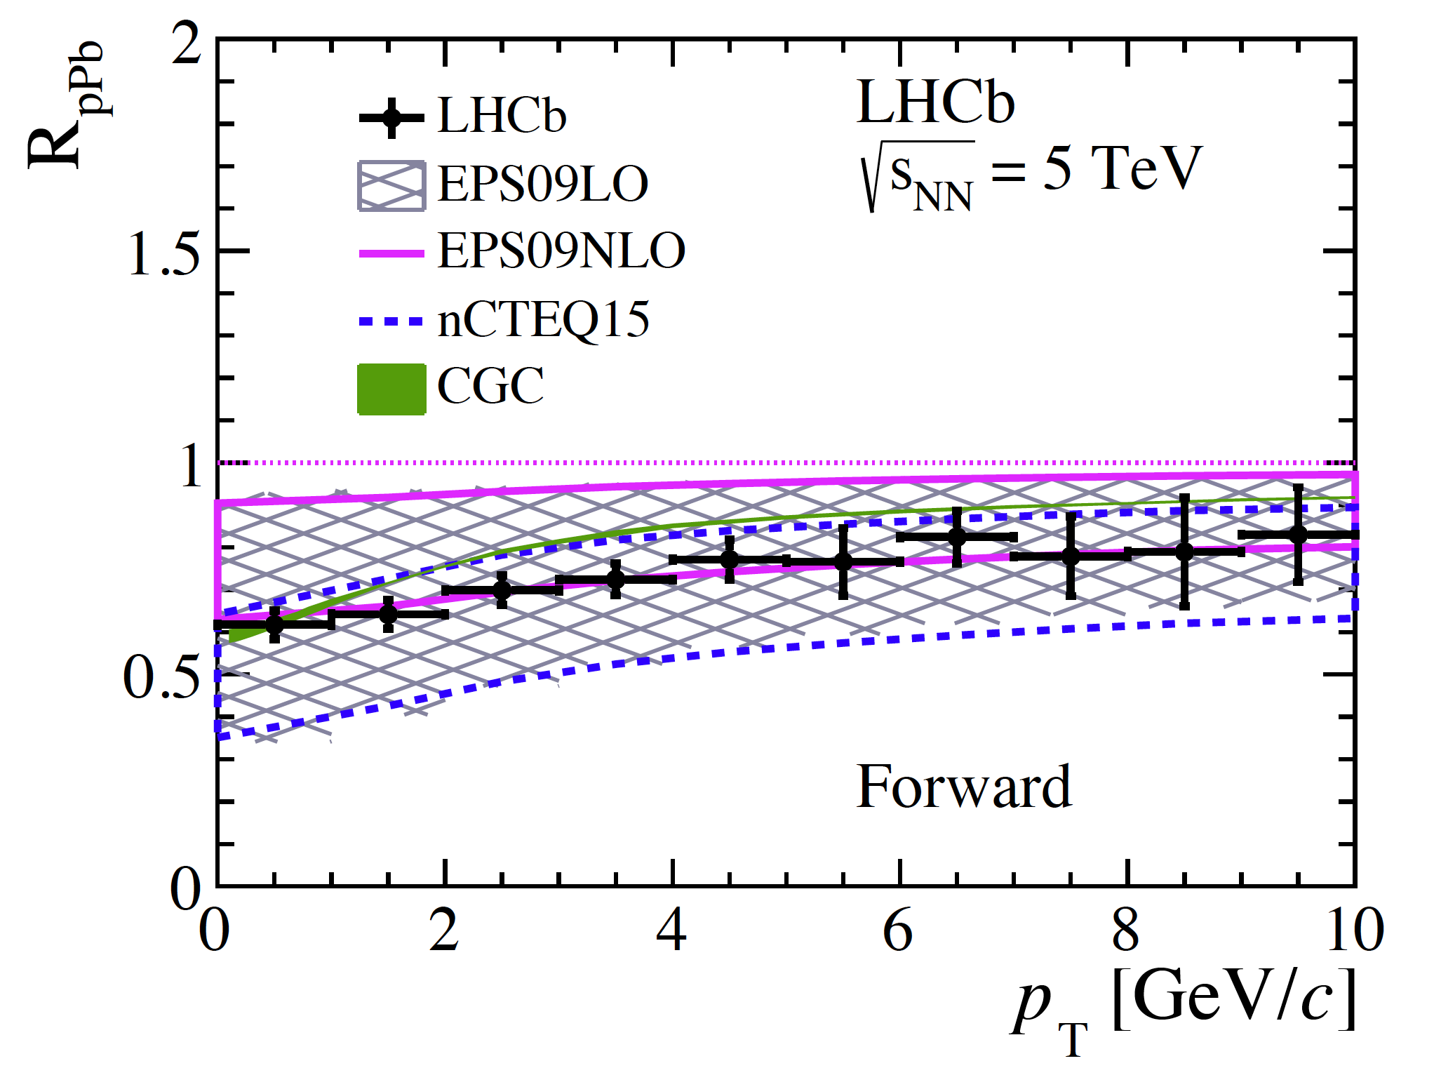
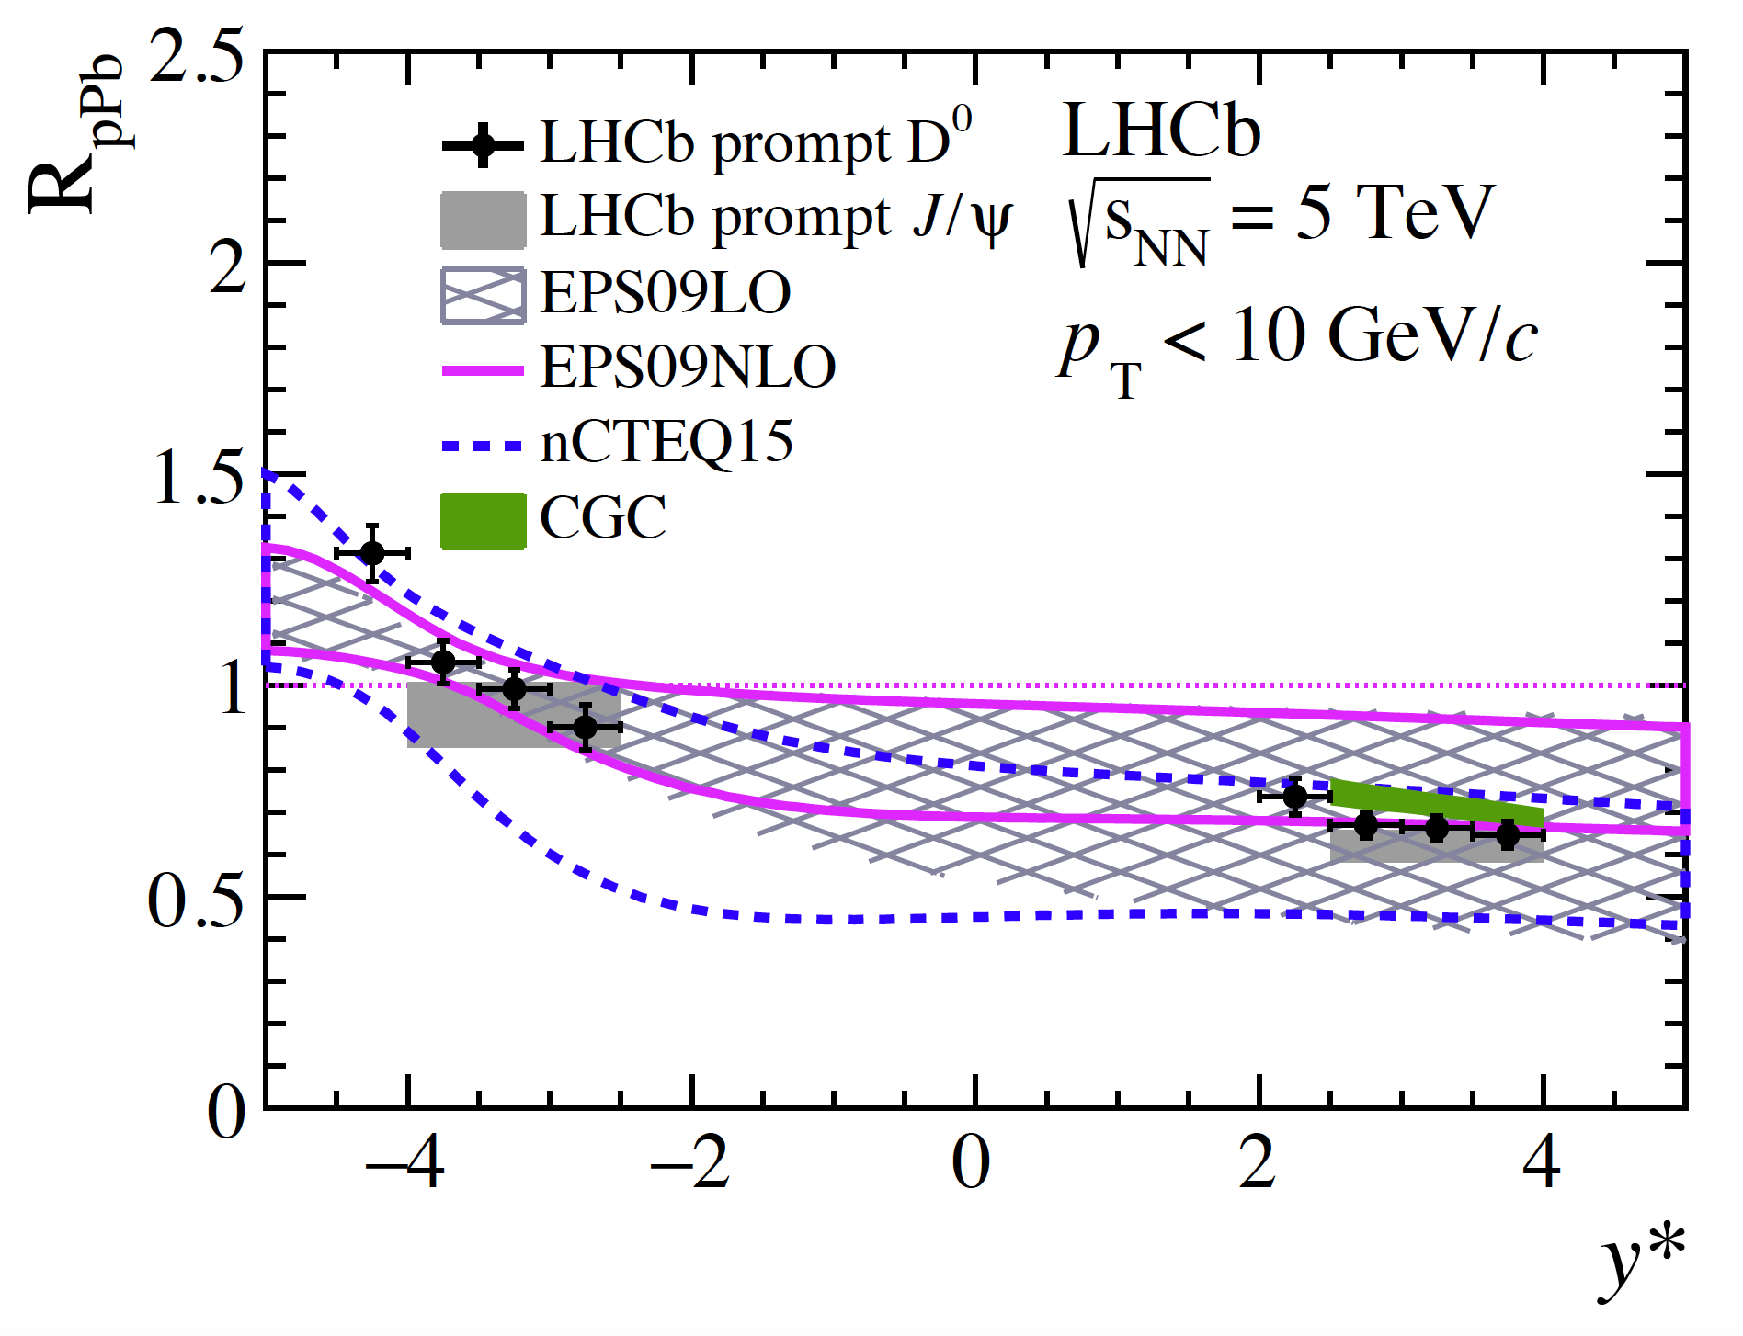
D⁰ production: R_{pPb}
[LHCb-PAPER-2017-015]
Computed in the kinematic range common to pPb and pp or Pbp and pp, integrated over 1 dimension
Compared with:
  HELAC-Onia as for the integrated cross-section
  CGC, Color Glass Condensate [B. Ducloué, T. Lappi, H. Mäntysaari, PRD91 (2015) 114005]
  Prompt J/ψ R_{pPb} measured at 5 TeV in LHCb [JHEP02 (2014) 072]

Slide 17
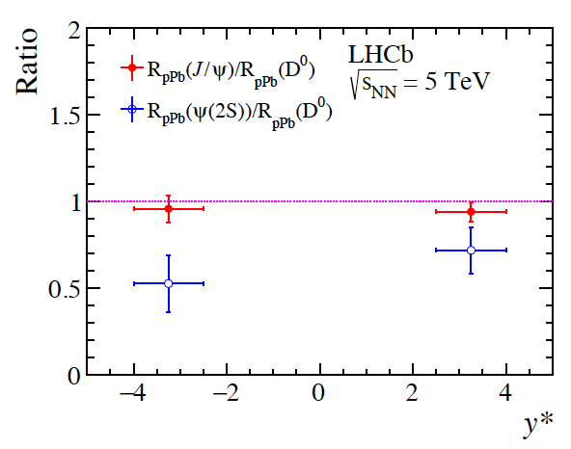
D⁰ production: R_{pPb}
[LHCb-PAPER-2017-015]
  The D⁰ suppression is compared with the one measured by LHCb for J/ψ [JHEP02 (2014) 072] and ψ(2S) [JHEP03 (2016) 133]

Slide 18
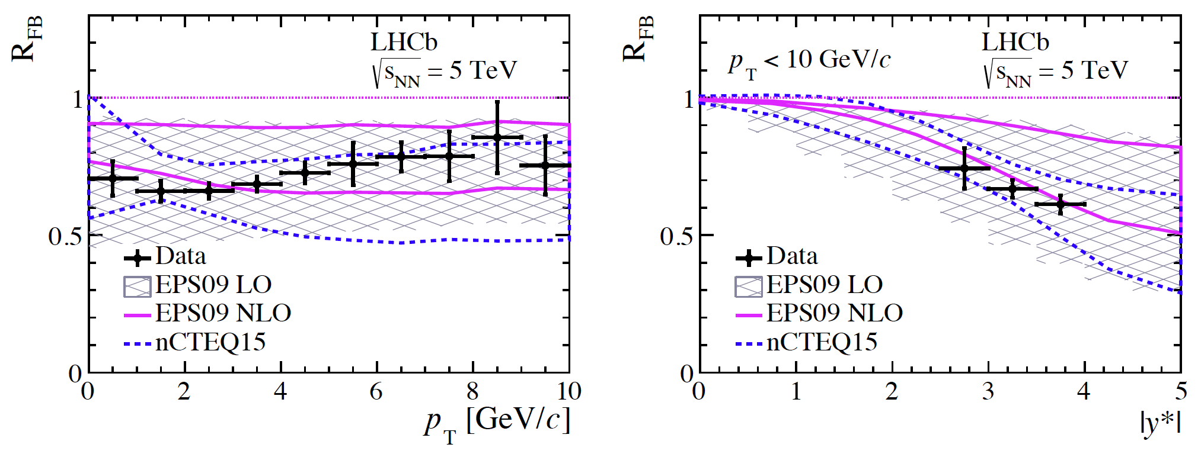
D⁰ production: R_{FB}
[LHCb-PAPER-2017-015]
  Forward to backward suppression ratios are measured in the common acceptance between pPb and Pbp, integrating over 1 dimension
Compared with:
  HELAC-Onia as for the integrated cross-section

Slide 19
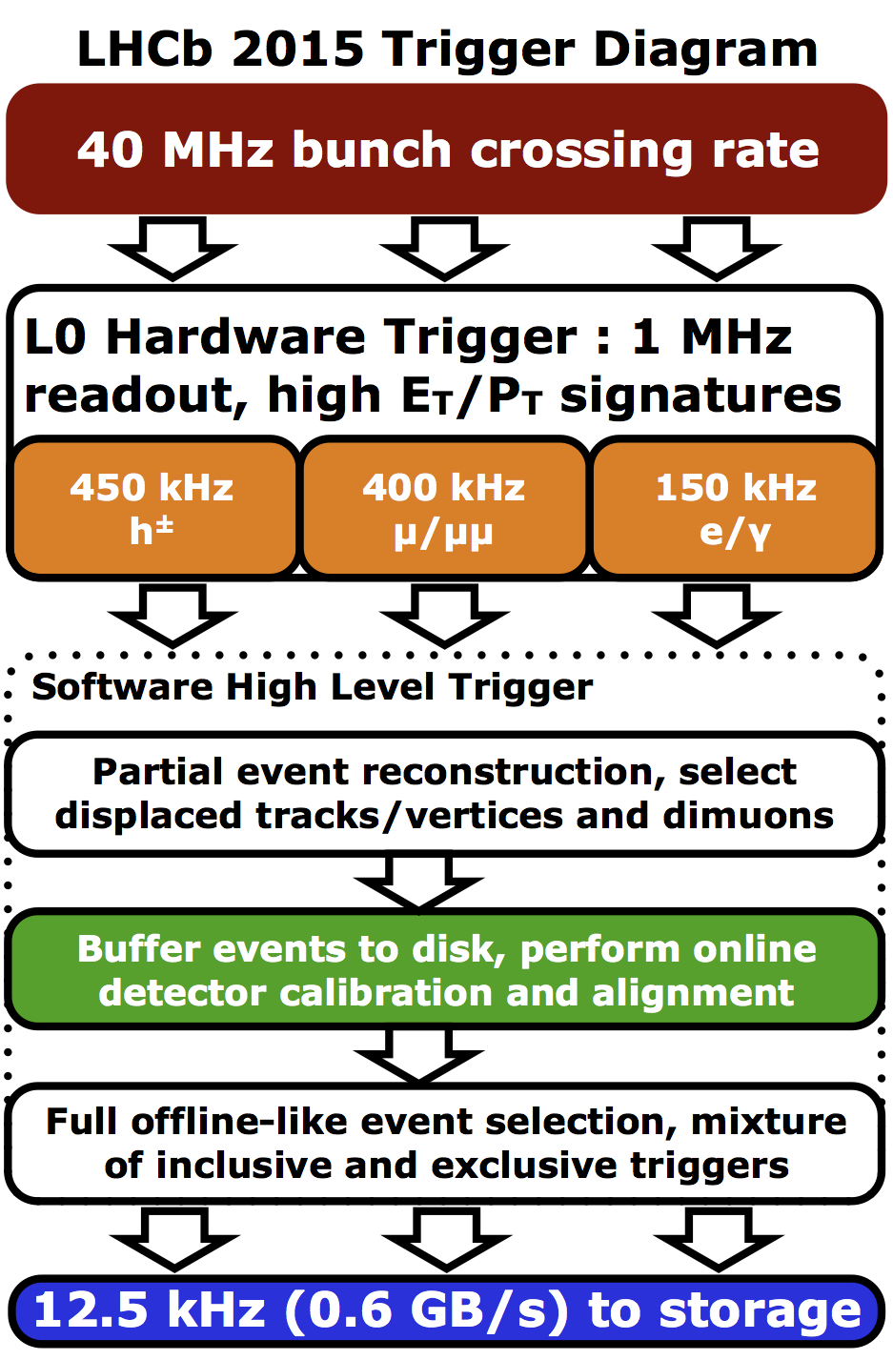
Collider mode: pPb collisions (2016)
For the first time for heavy ion collisions, we used the trigger scheme introduced in Run 2 in LHCb for pp collisions.
This scheme gives at the output of the trigger, fully reconstructed and selected signal candidates (J/ψ, ψ(2S), D⁰, ….) using full detector information (PID, …) and with optimal alignment and calibration: no further reconstruction required.
This allows fast processing of the data and quick results
J/ψ➝μ⁺μ⁻

Slide 20
J/ψ production in pPb at 8 TeV (1)
Fraction from B decays
J/ψ production is the first publication (of all LHC experiments) in this sample, using trigger candidates with no extra reconstruction
Precise double differential cross-section of prompt and J/ψ from b accepted Phys. Lett. B. [LHCb-PAPER-2017-014]

Slide 21
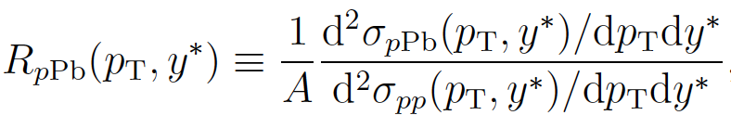
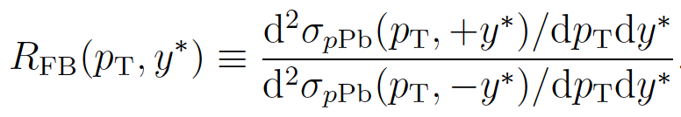
J/ψ production in pPb at 8 TeV (2)
Nuclear effects are seen in the comparison with pp collisions and in the comparison of pPb with Pbp:
and
Modification of production is expected due to the well established modification of the parton density functions in the Pb ion (smaller at low x = shadowing and larger at high x = anti-shadowing).
Shown with HELAC-Onia generator: J/ψ are produced as in pp but using nuclear PDFs (EPS09, nCTEQ15)
In addition:
CGC: color glass condensate, saturation of gluon density at low x
Energy Loss: scattering of the colliding gluon in nuclear matter

Slide 22
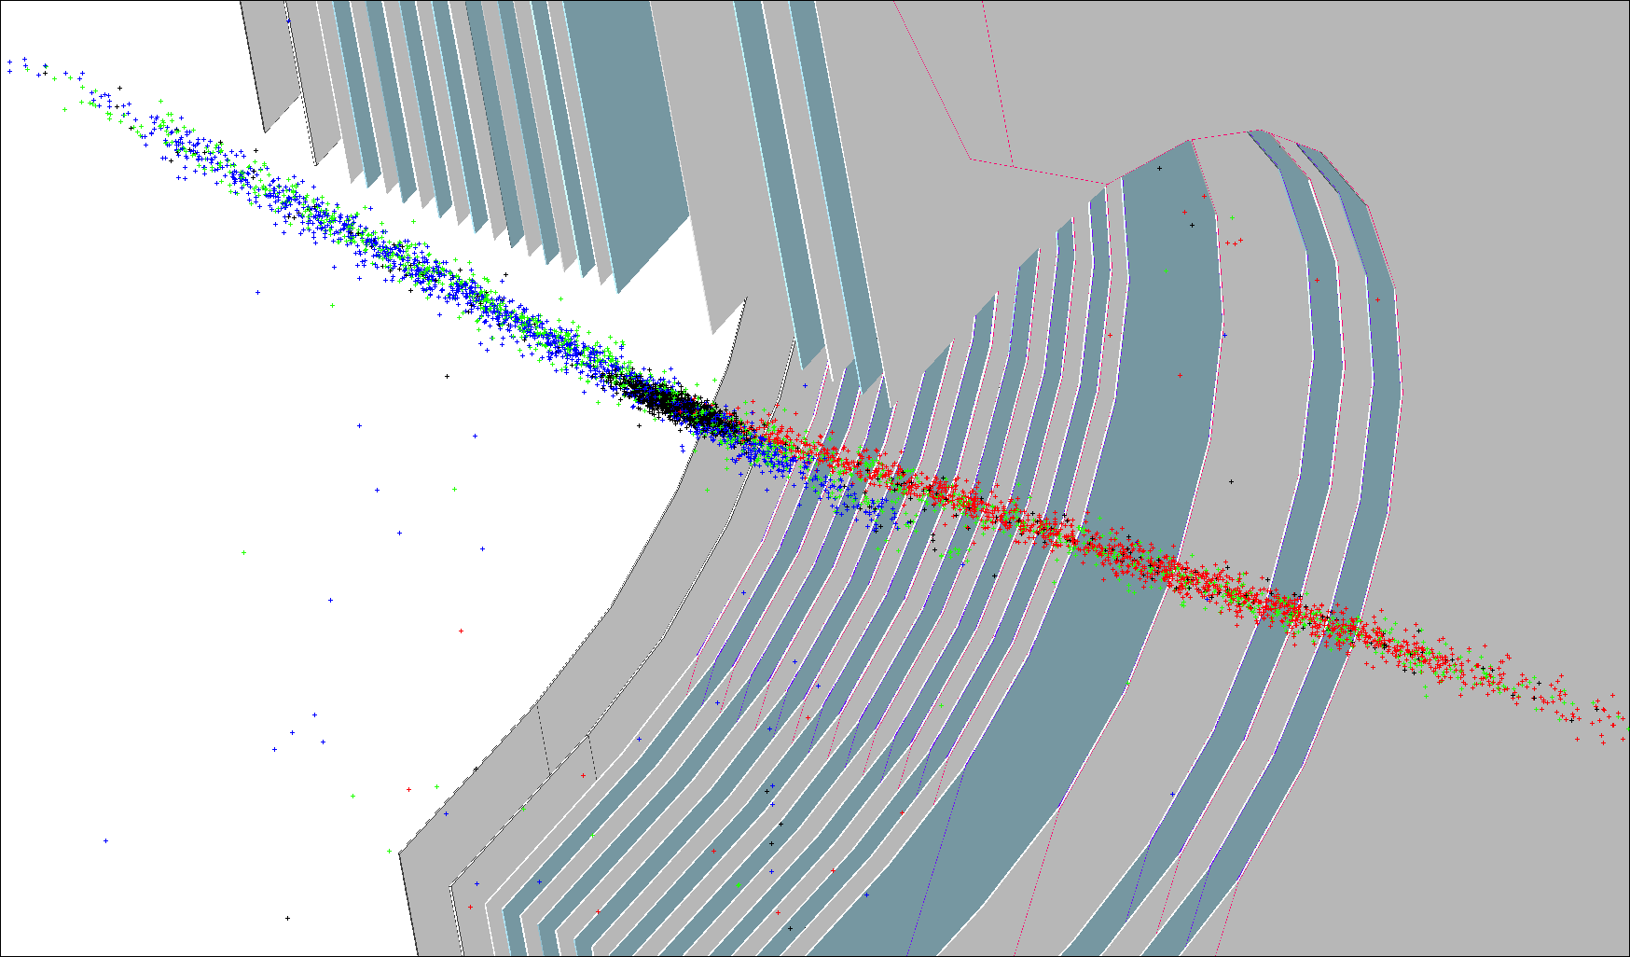
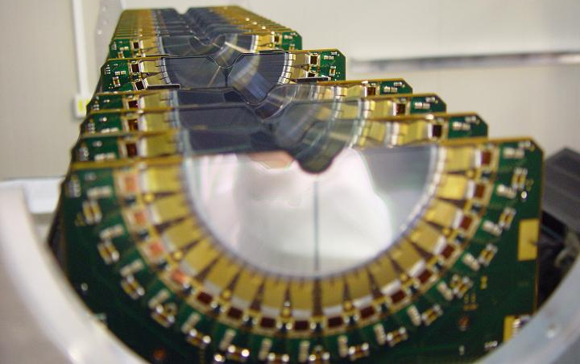
Fixed Target Physics With LHCb
Gas can be injected inside the LHC vacuum, in the VELO detector.
Used to determine the luminosity but since 2015 is used to also collect physics data. [JINST 7 (2012) P01010]
Originally use Neon gas
Other non-getterable noble gases can be used: in 2015, 2016 and 2017, we used also Ar and He
The gas spreads in the beam pipe around LHCb: collision vertices over a range of ~1m (usable range)
Physics events are collected by the LHCb detector, operated in standard configuration

Slide 23
Fixed Target Physics With LHCb
The pressure in the LHC when the gas is injected is ~2x10⁻⁷ mbar (instead of 10⁻⁹ mbar with no injection), between 1 day to 2 weeks.
The pressure is so low that it does not interfere with the running of the LHC and data can be collected also in parallel with pp collisions by LHCb.
Data samples collected:

Slide 24
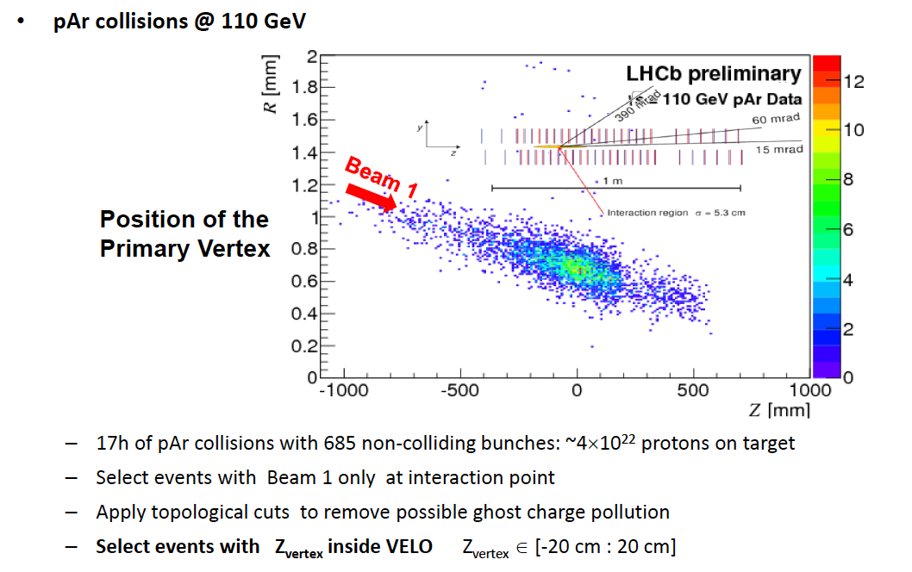
D⁰ and J/ψ production in pAr collisions at 110 GeV: data sample

Slide 25
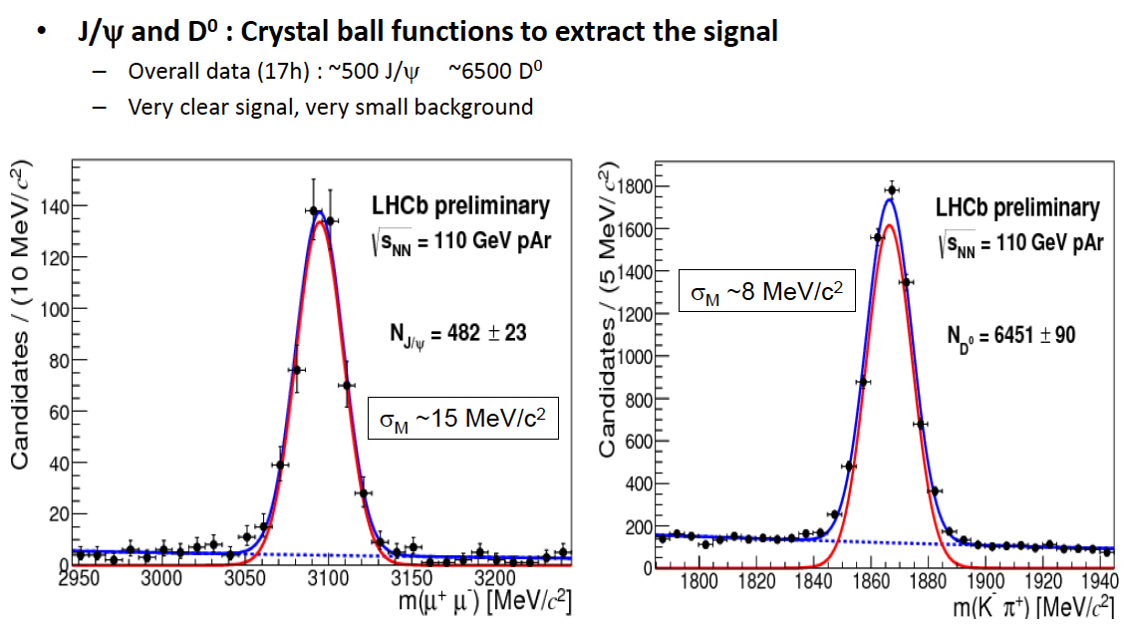
D⁰ and J/ψ production in pAr collisions at 110 GeV: signal extraction

Slide 26
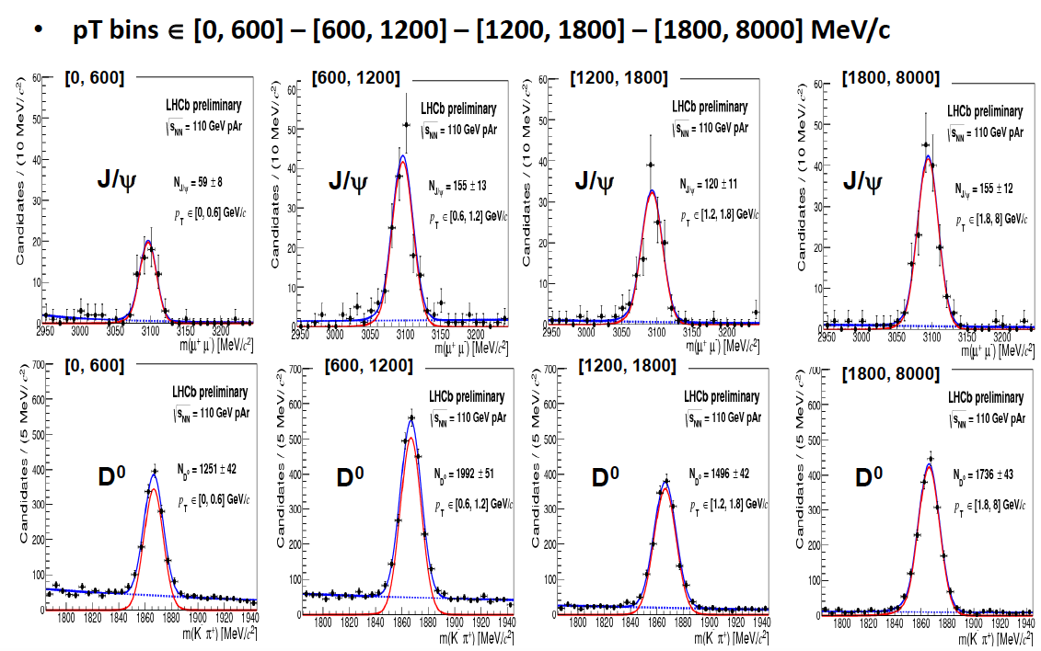
D⁰ and J/ψ production in pAr collisions at 110 GeV: differential production

Slide 27
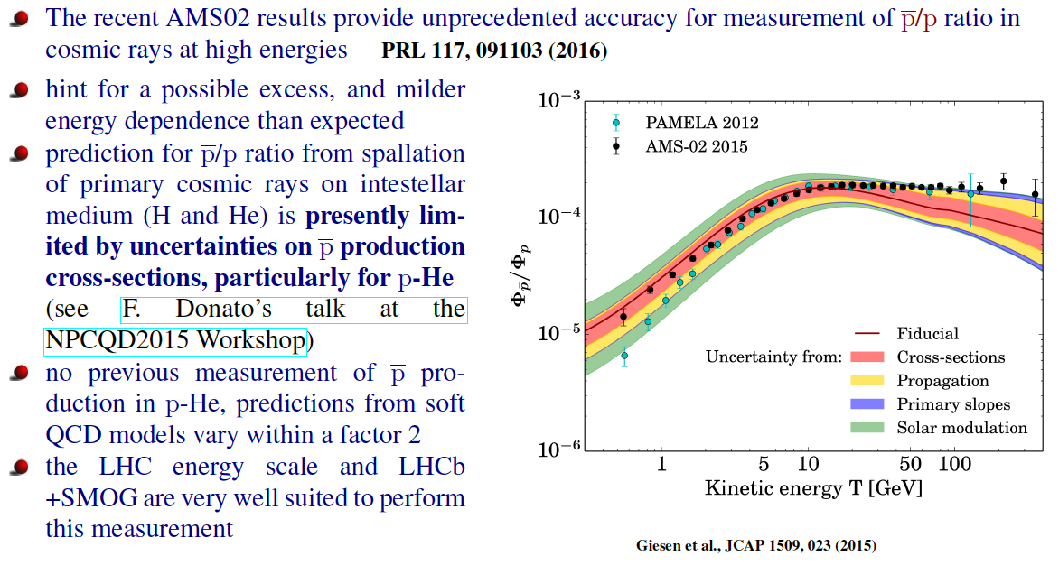
pHe collisions at 110 GeV: Cosmic anti-protons

Slide 28
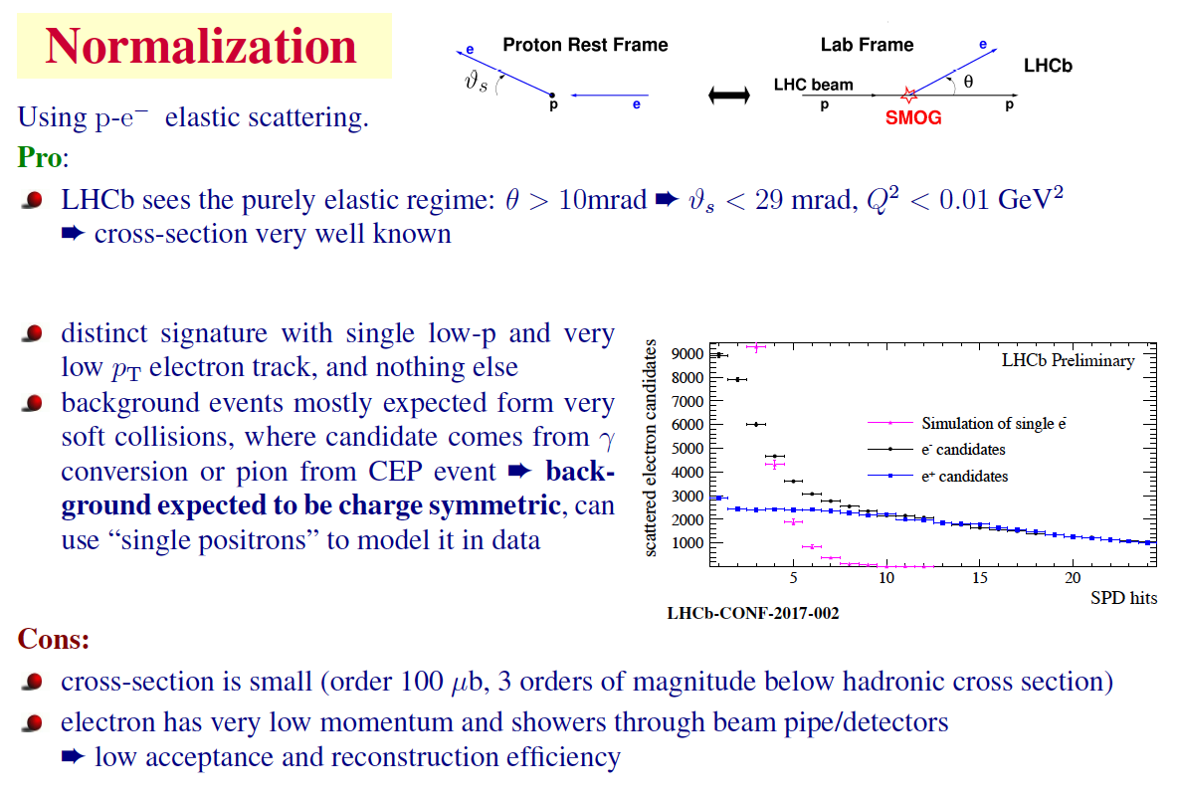

Slide 29
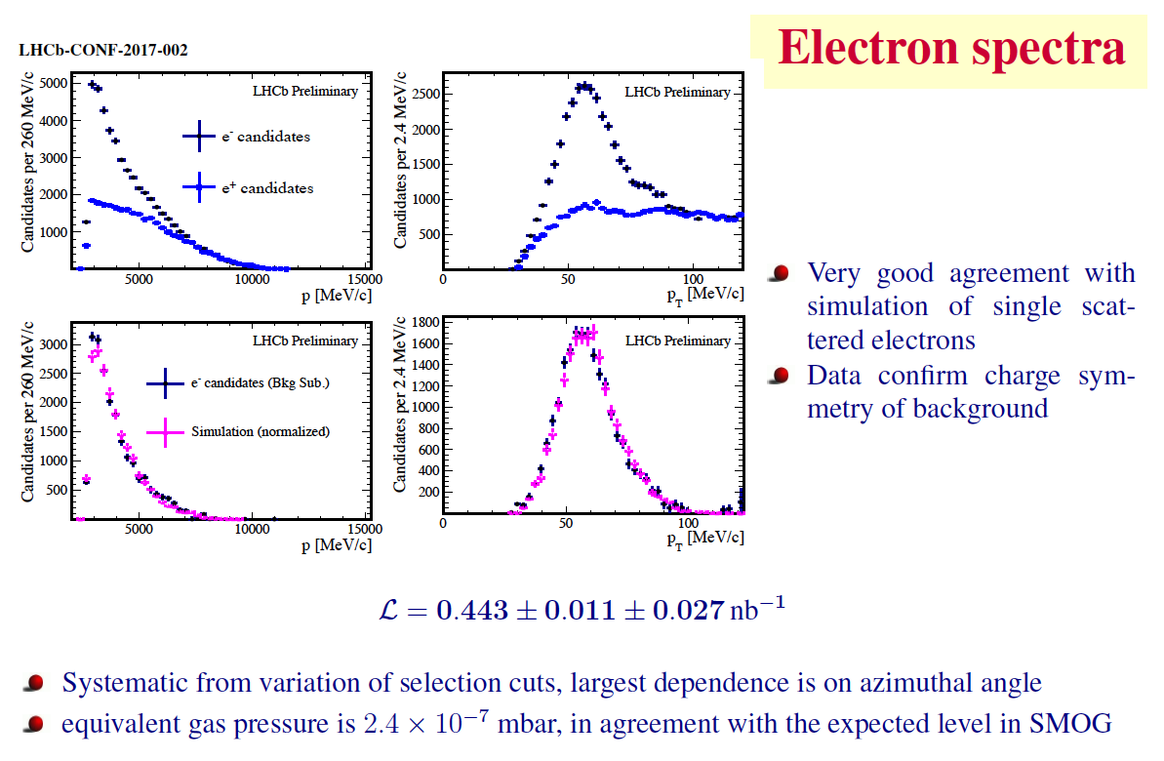

Slide 30
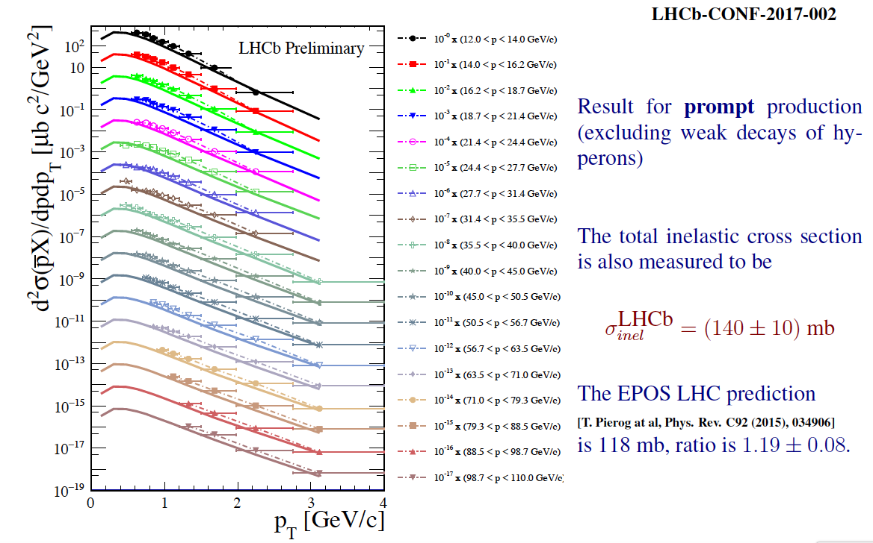
Results
pHe collisions at 110 GeV: result

Slide 31
Conclusions
Active program of study of heavy ion collisions at LHCb:
  Proton-Lead collisions
  Fixed target program
Improvements foreseen after detector upgrade for PbPb, where the granularity and high multiplicity reach will be improved
Success of fixed target program triggered new ideas: bent crystals, wire targets, improved gas injection system that are under study
A large fraction of the activities I presented are done at LAL: we welcome collaborations on these subjects !

