Slide 1

Development and characterization of the Detectorized Phantom for research in the field of spatial fractionated radiation therapy.
D. Ramazanov, V. Pugatch, et al.
Institute for Nuclear Research NAS of Ukraine, Kyiv

Slide 2
Introduction
Therapeutic centers in the world are developing several methods for treating tumors using bundles of charged hadrons for which gamma-quantum gambling is not effective.
Among that methods are the subject of this work: MRT (microbeam radiation therapy) and MBRT (minibeam radiation therapy).
These techniques can deliver a high dose to the tumor while providing a tolerable dose for healthy tissue.
A significant factor in improving the effectiveness of radiation therapy is the spatial fractionation of the dose in the irradiation of tumors. This is due to high local doses and the provision of low doses in the area of healthy tissues.

Slide 3
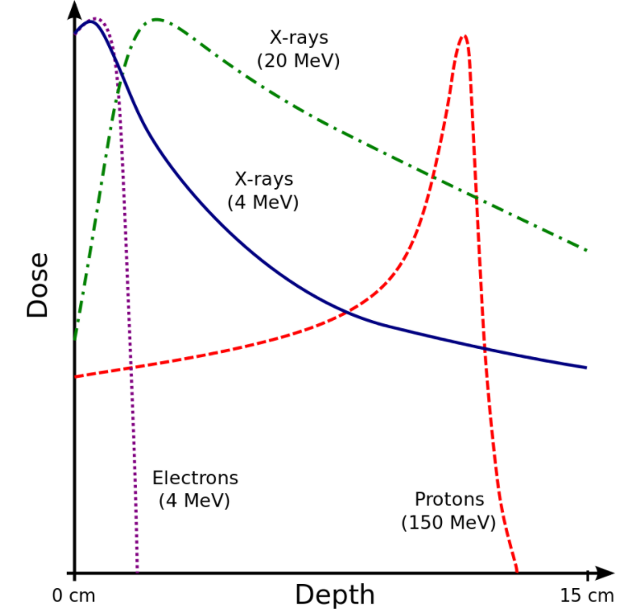
The idea of proton multi-beam therapy
Fig. 1: Bregg peaks for different types of irradiation.
Fig. 2: PVDR(peak to valley dose
ratio) .

Slide 4
The purpose of the work
The development of a detectorized phantom which contains radiation-resistant detectors for research in the field of spatially fractionated therapy.
Characteristic investigations of detectorized phantom prototypes on available sources of ionized radiation.
Evaluate the possibility of using this phantom by Monte Carlo simulations.

Slide 5
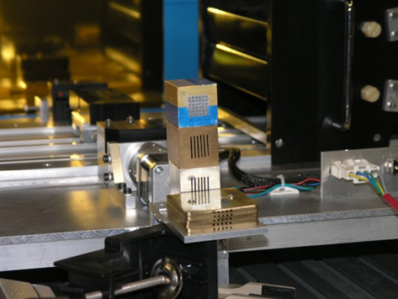
Prototypes of collimators for the formation of multi-beam structures
Fig. 3: Photo of collimators. From top to bottom: yellow and blue - aluminum matrix collimator 6 x 6 holes 1 mm in diameter, 2.5 mm pitch; Yellow color - slit collimator made of brass, width of six cracks - 1 mm, step 2.5 mm; Bright color - slit collimator made of aluminum, width of six cracks - 1 mm, step 2.5 mm; Yellow color - matrix collimator made of brass, 5 x 5 holes 1 x 1 mm2, step 3.0 mm.

Slide 6
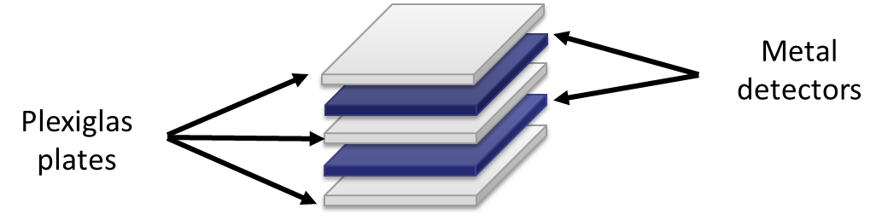
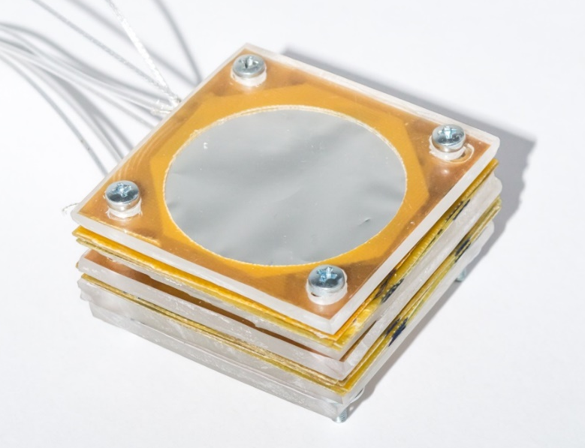
Detectorized phantom development
Fig. 4: Prototype of a multi-layer detector phantom based on MFD. Phantom consists layers of plexiglas and metal foil detectors. Phantom has a modular structure that allows to change the thickness of the working body (Plexiglas) and the amount of detectors.

Slide 7
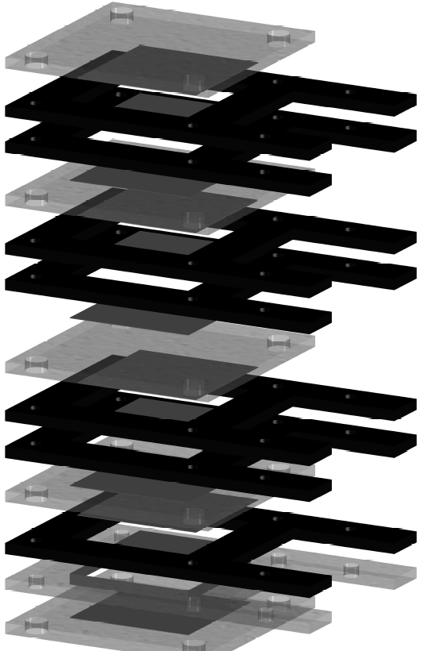
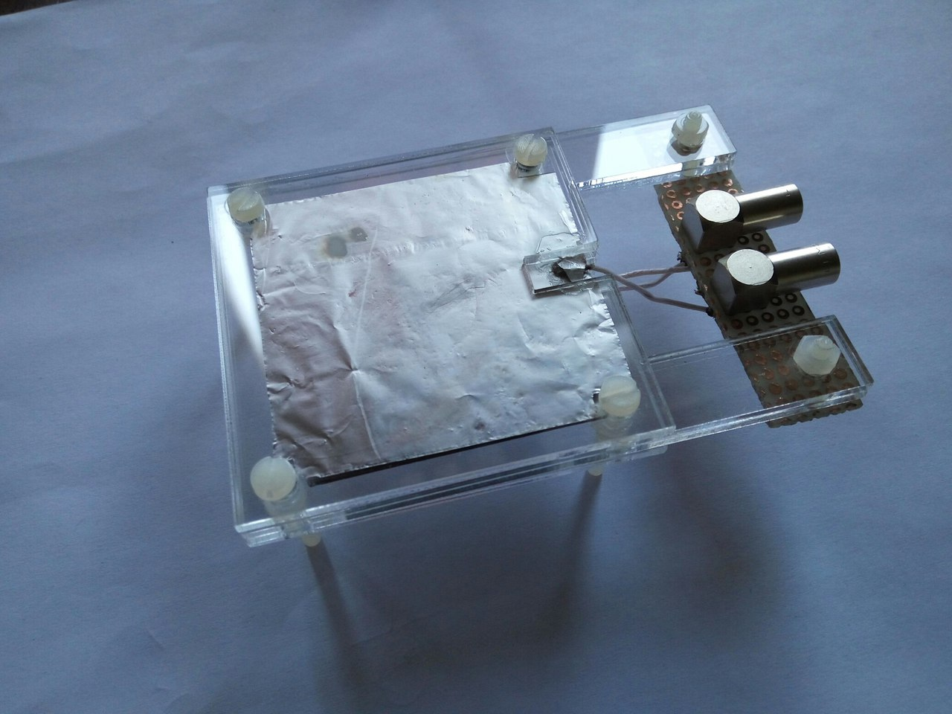
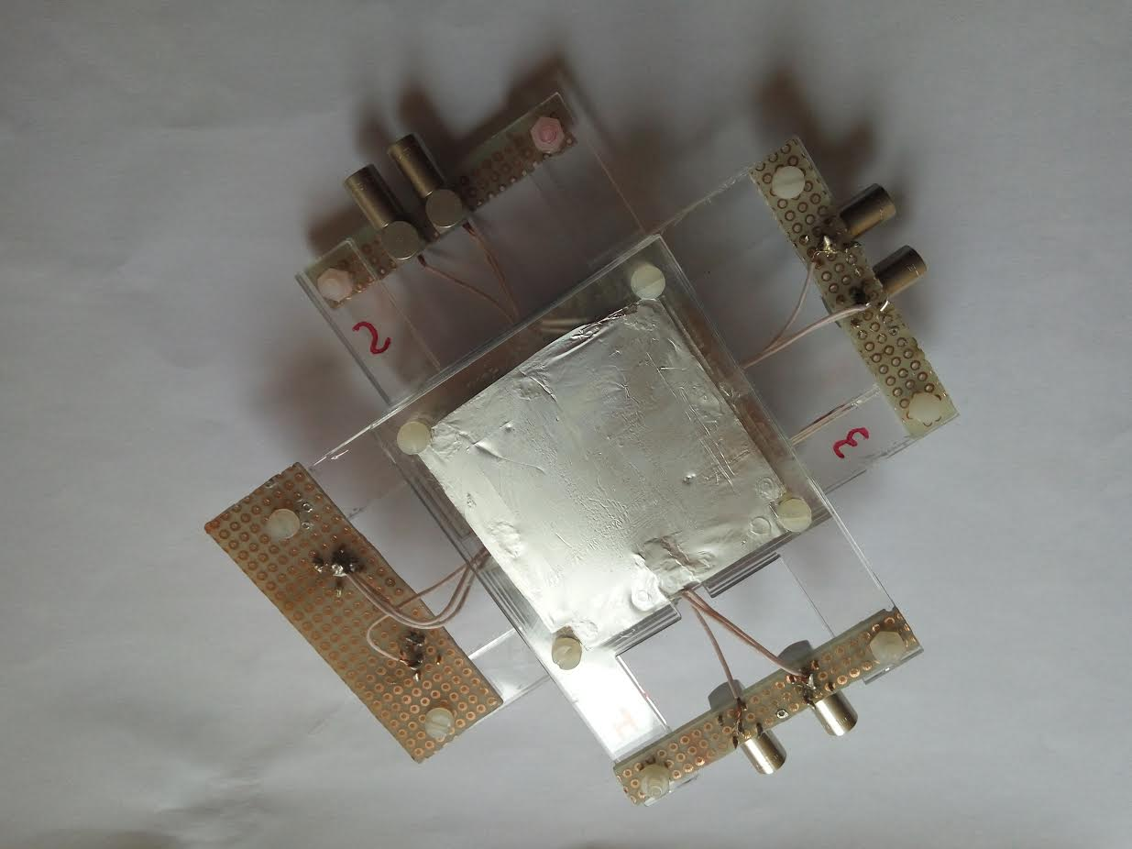
The phantom structure
Fig. 5: The final prototype of еру detectorized phantom made of organic glass and aluminum.
Fig. 6: Detectorized phantom.
Fig. 7: Model of detectorized phantom.

Slide 8
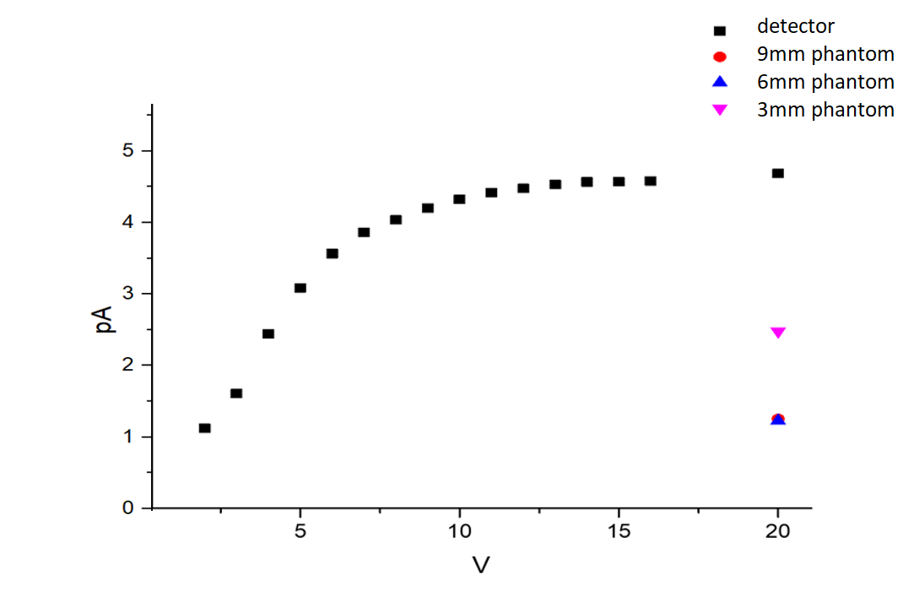
Feedback of metal-foil detector prototype (β – particles, Sr-90)
Fig. 8: volt-ampere characteristic of detector under irradiation by electrons with energy 2 MeV

Slide 9
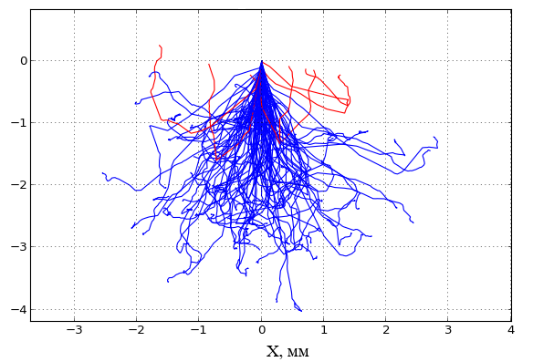
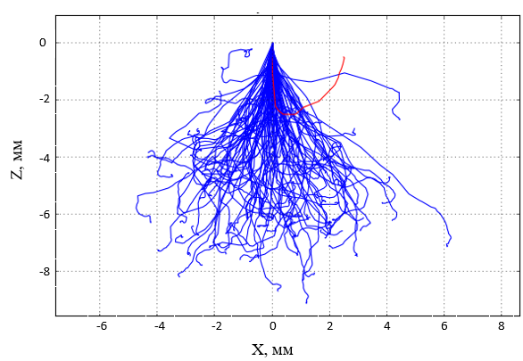
Fig. 9: The path of electrons with energies of 1 and 2 MeV passing through plexiglass.

Slide 10
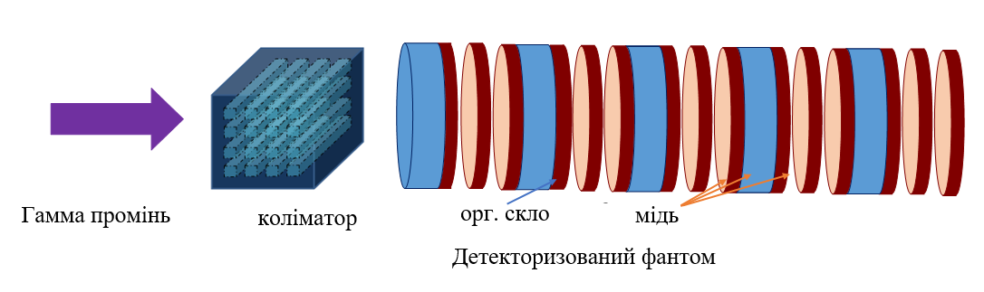
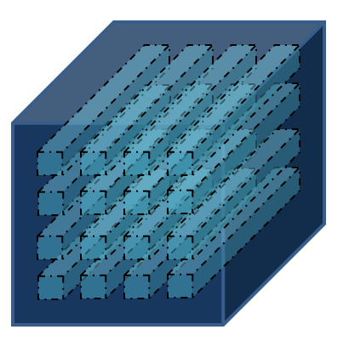
simulations irradiation by gamma quanta with energy 6 MeV, quantity 10⁶
gamma beam
collimator
Organic glass
copper
Fig. 10: detectorized phantom
A layer of organic glass:
Thickness – 3.2 mm
Diameter – 3.4 mm
Copper foil:
Thickness – 100 microns
Diameter – 3.4 mm
Air layer between foils with thickness – 1.5 mm
Fig.11 matrix brass collimator thickness of 5 cm, 2x2 mm mesh size, distance between holes 2 mm
Distance from the source to the surface is 100 cm

Slide 11
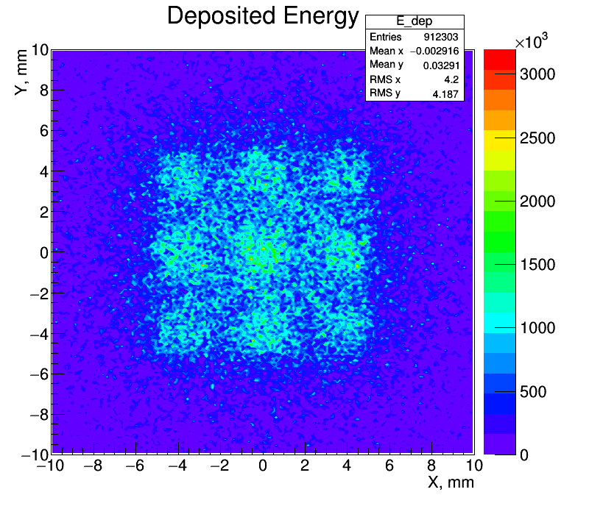
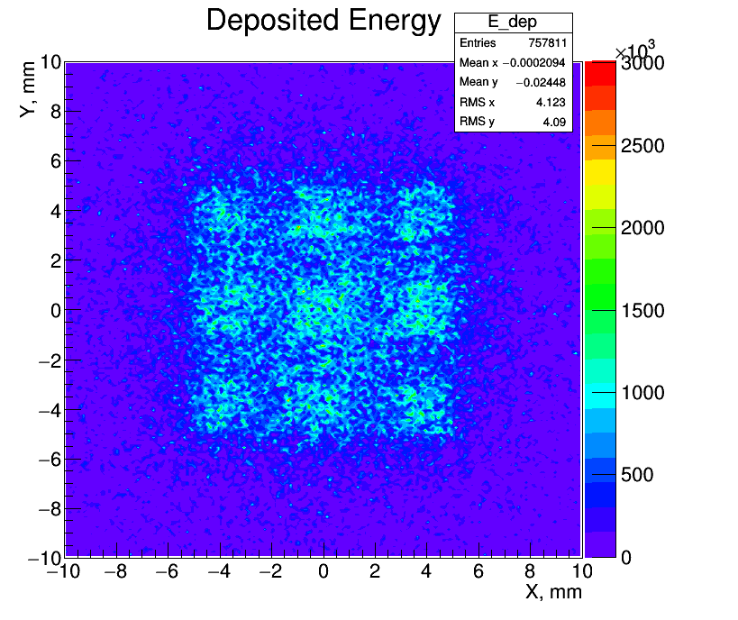
Fig. 12 Distribution of energy that is delivered to the detector 1 and 2

Slide 12
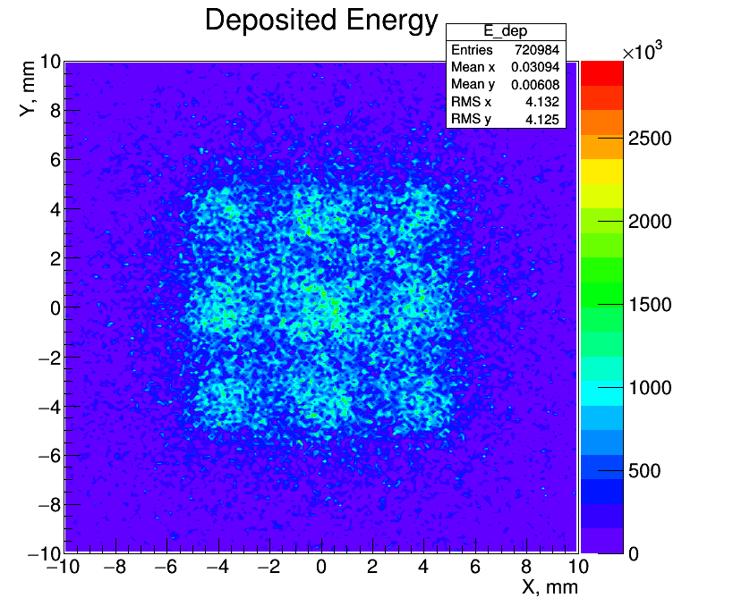
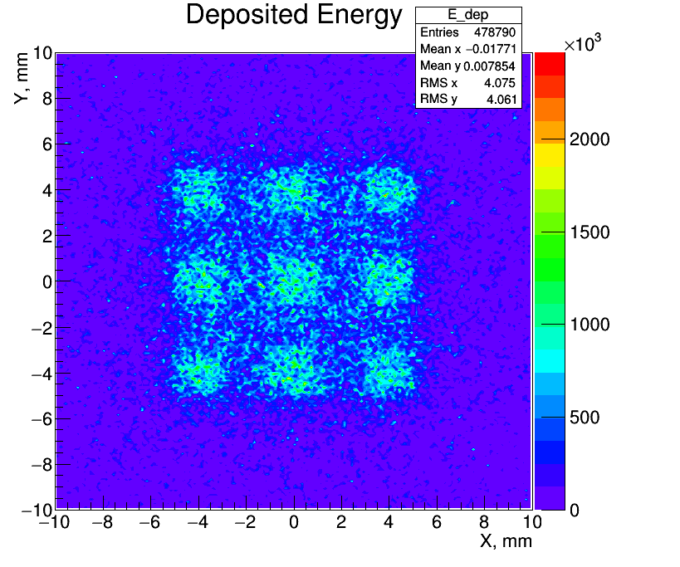
Fig. 13 Distribution of energy that is delivered to the detectors 3 and 4

Slide 13
Conclusions
A prototype of the detected phantom for research in the field of spatially fractionated radiotherapy has been developed and manufactured.
The detectorized phantom prototype was created on the basis of metallic foil detectors with organic glass as a material of phantom and aluminum foil as metal detector sensors.
Measurements of the volt-ampere characteristics of the detector were irradiated by a source of ionizing radiation. The yield on the mode detecting occurs at 10 volts which indicates the proper functioning of the detector.
The research of the work of the detectorized phantom was performed on a source of strontium-90 using high-sensitivity charge integrators for reading data from metal detectors. The obtained results, within the limits of errors, correspond to the calculations using the Monte Carlo simulations, and therefore confirm the possibility of using the created prototype of the detectorized phantom for research and the development of the physical and technical principles of spatially fractionated radiation therapy.

Slide 14
Thank you for attention

