Slide 1
Introduction
J.Maalmi, on behalf of the organizing committee

Slide 2
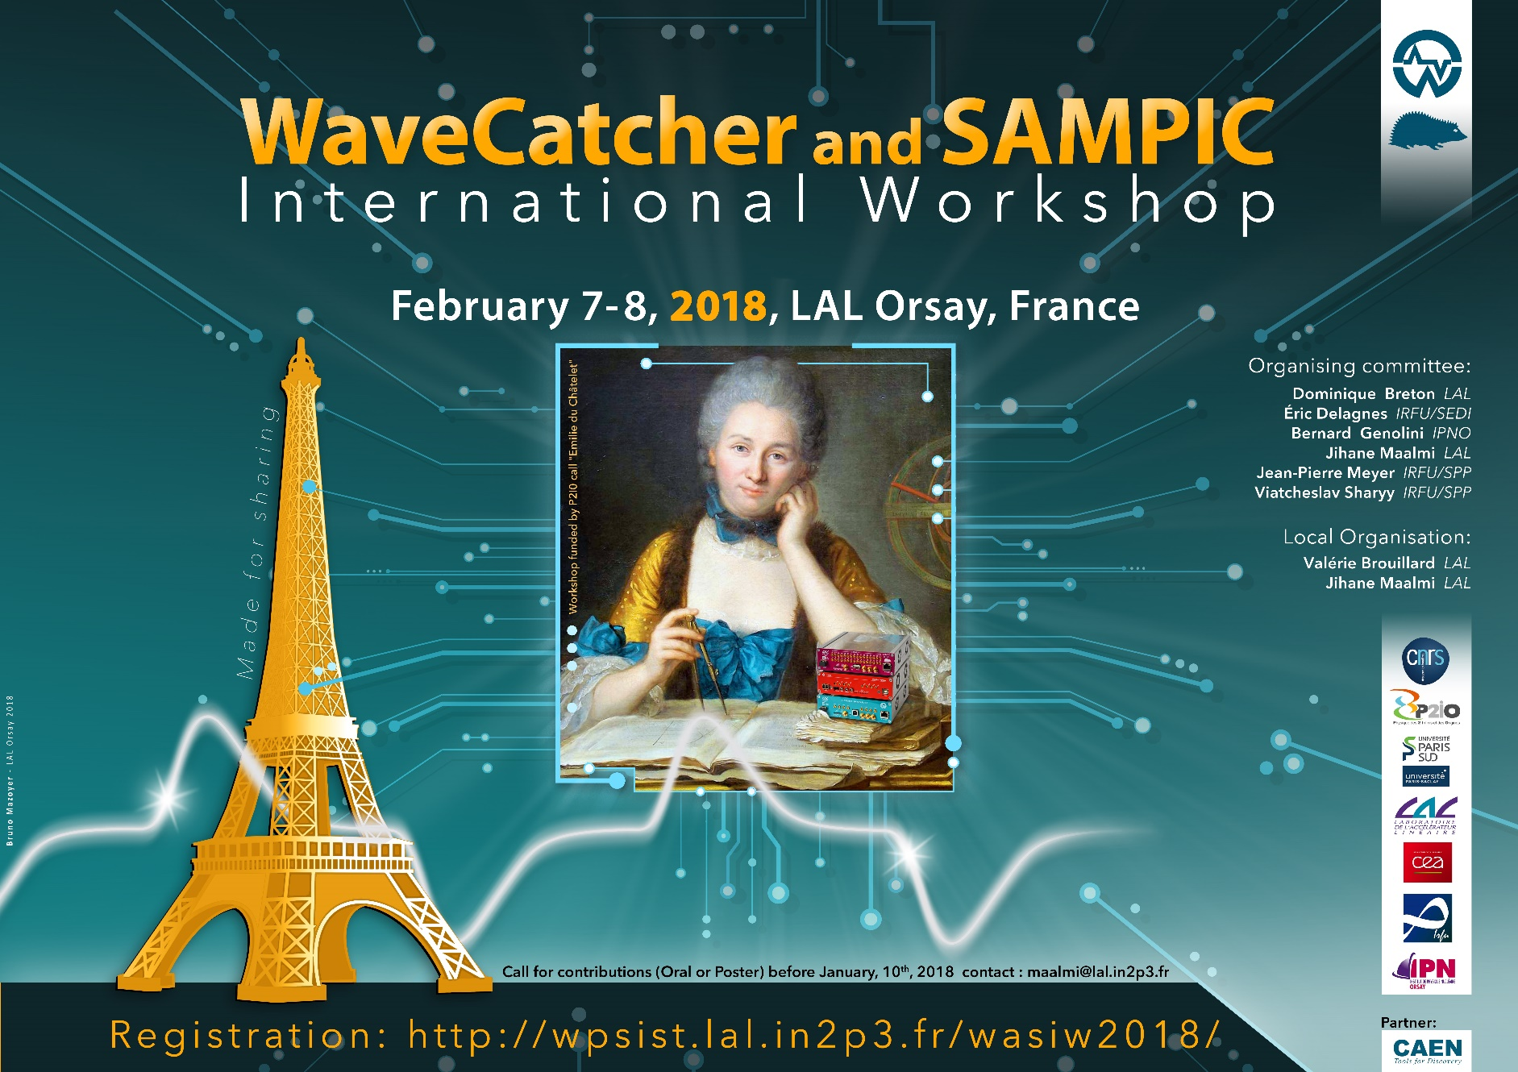
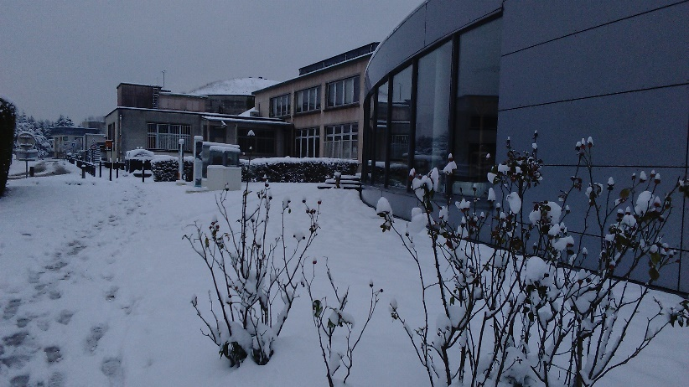
Welcome!
Thanks to brave men and women who managed to come this morning!
Thanks to P2IO for funding this workshop!
Thanks to all the participants for their contributions (oral and poster)

Slide 3
Goals of the workshop
The development of the WaveCatcher (almost 10 years!) and more recently SAMPIC modules Firmware/Software and Libraries has always been enriched by your experience and feedback, and we are grateful for that!
First of all, this workshop gives us a great opportunity to understand better the scientific or technical goals of your applications.
Our main goals:
to share experience between users and the system designers
to present experience feedback
to describe future needs
to think about evolutions of the hardware/firmware/software
to think about development sharing
We hope that it will be an enriching experience for all of us!

Slide 4
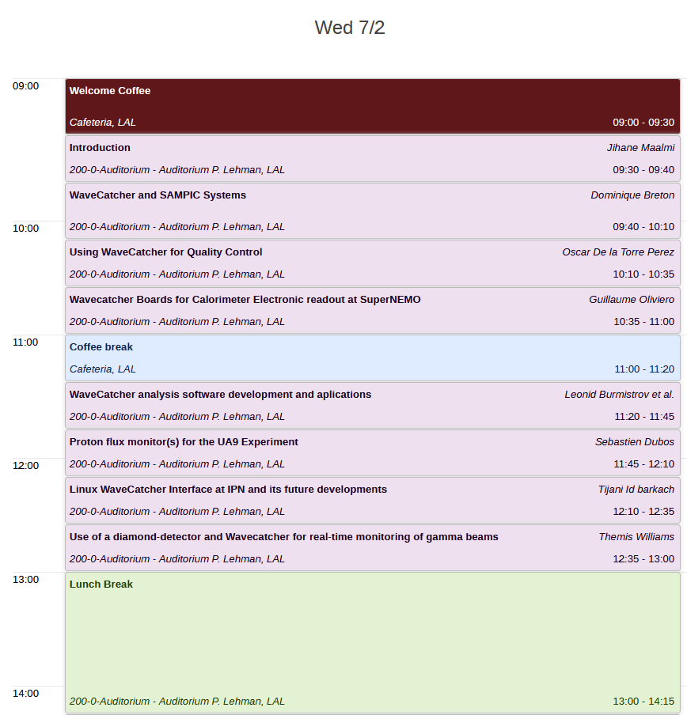
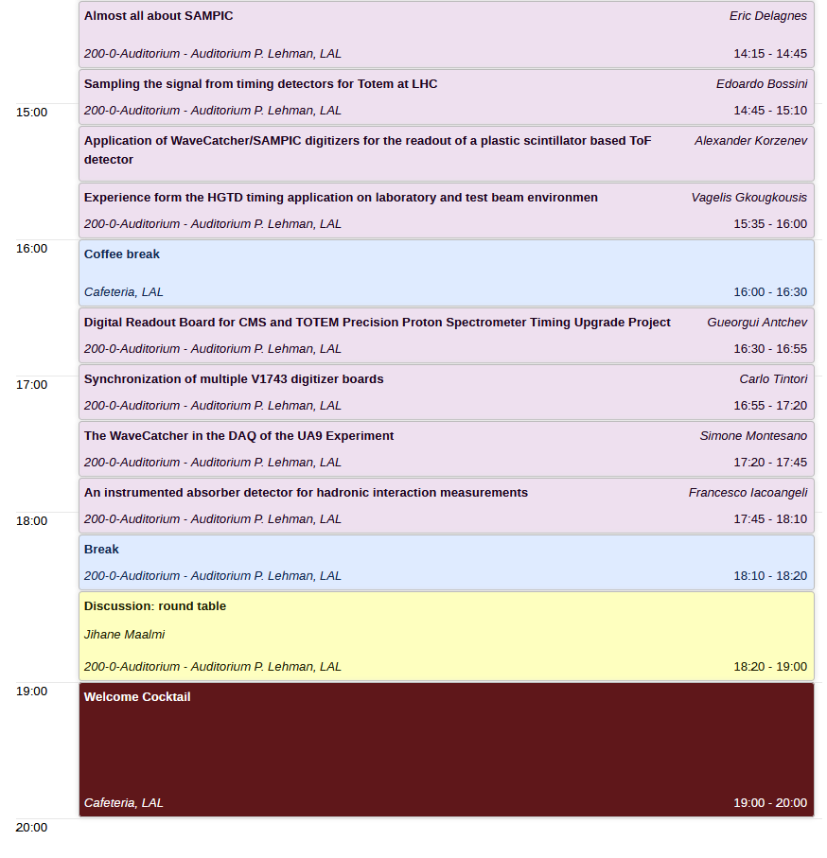
Agenda Today

Slide 5
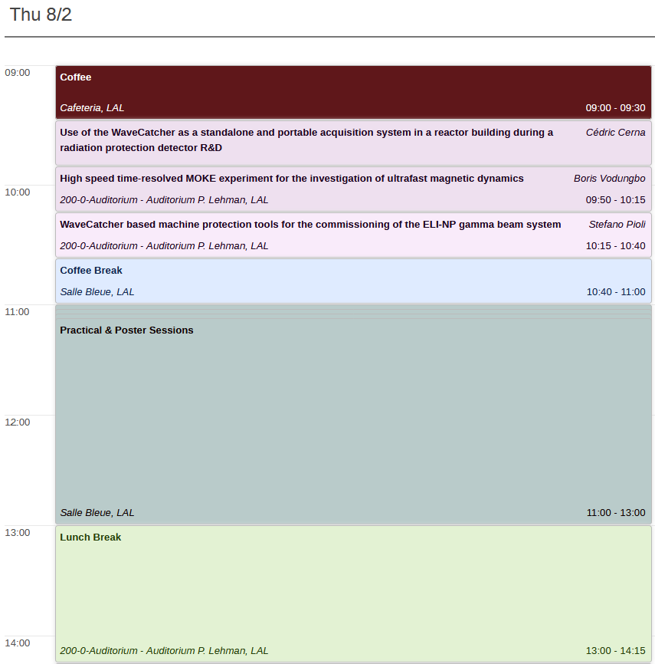
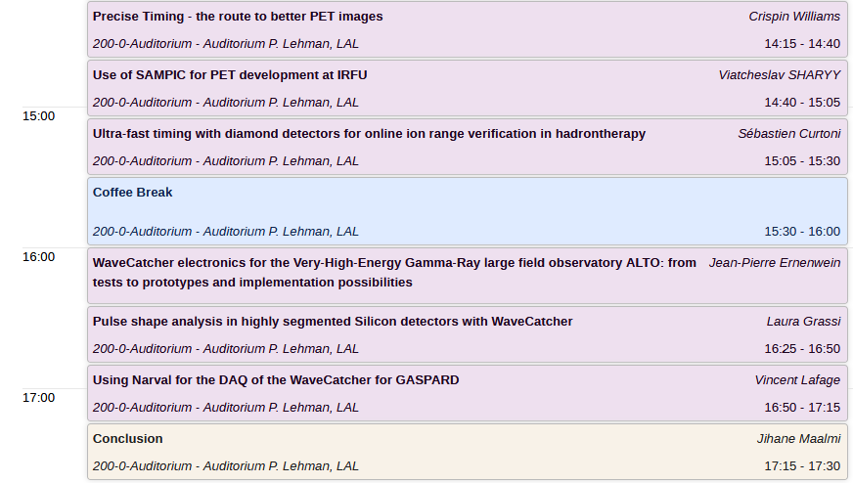
Agenda Tomorrow

Slide 6
Round Table discussion
Discussions ideas:
Issues, difficulties using WaveCatcher or SAMPIC
Future needs : guide us for new technical evolutions/developments
Development sharing: Software analysis…
Website, WaveCatcher and SAMPIC users groups …
…

Slide 7
Practical and Poster session
We will have 4 stands:
Viatcheslav Sharyy: SiPM + laser + SAMPIC
Leonid Burmistrov, Andrii Natochii: scintillator + PMT? + WaveCatcher
Y.Lemiere, G.Oliviero: Muoscope + WaveCatcher
C.Tintori, G.di Maio: Educational kit + DT5743
J.Maalmi, D.Breton: the “Guitar chords setup” WaveCatcher 2ch + SAMPIC
Posters are in the main hall.

Slide 8
Thank you for your attention!

