Slide 1
The CLIC Accelerator Project Status and Plans
Higgs Hunting, Paris, July 2018
Daniel Schulte
For the CLIC collaboration

Slide 2
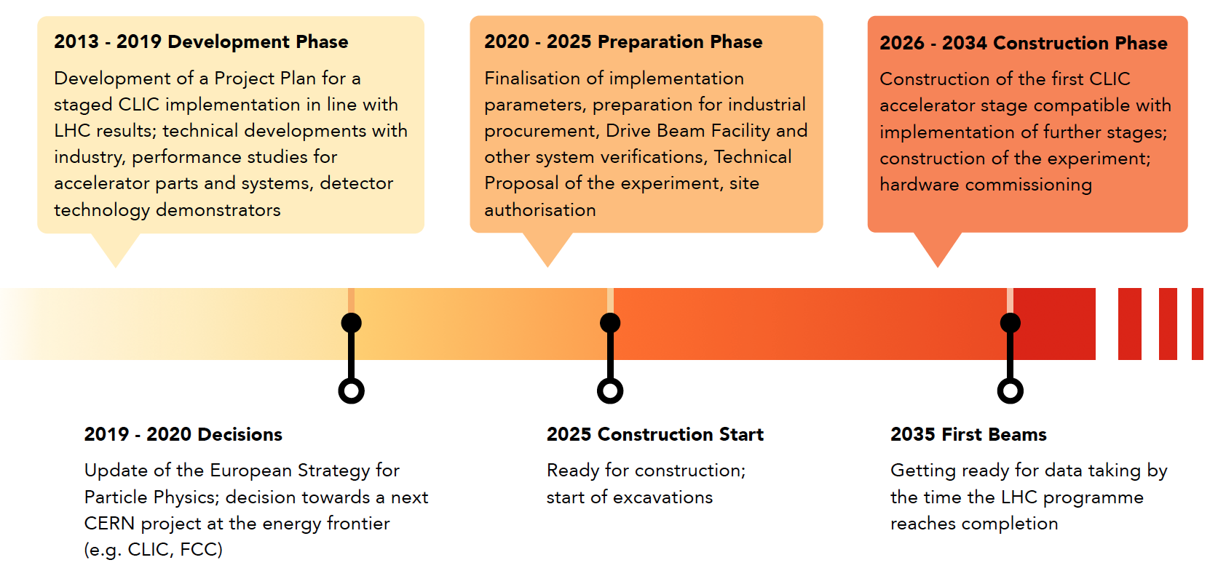
CLIC Introduction
CLIC: Compact LInear Collider
CLIC aims to provide multi-TeV electron-positron collisions with high luminosity at affordable cost and power consumption
2012 CDR:
Shows feasibility of 3 TeV design

Slide 3
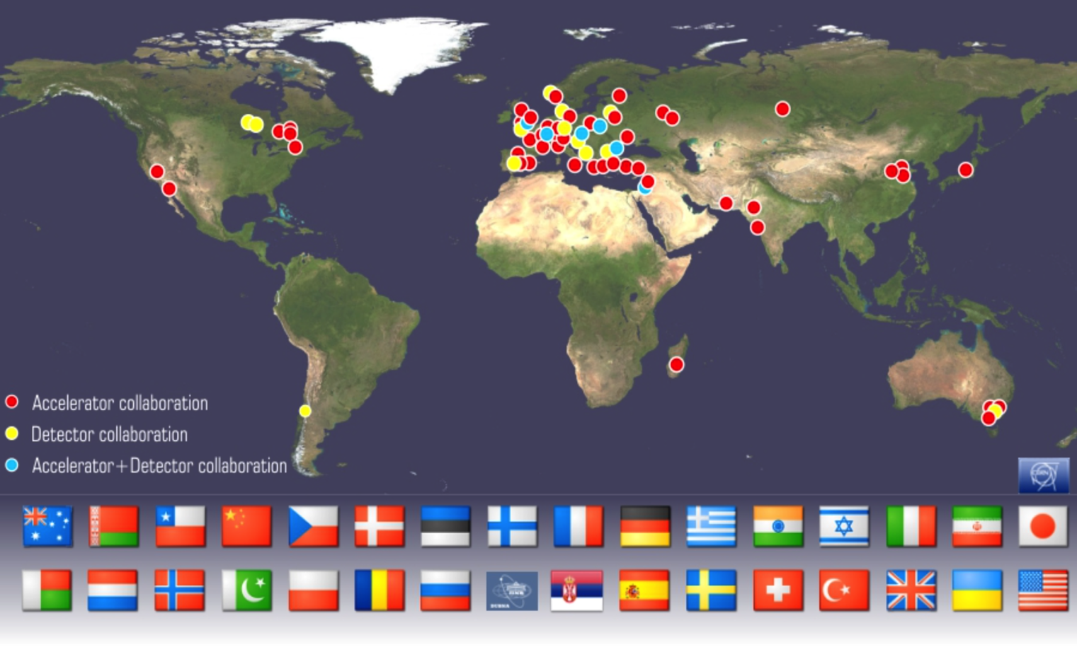
CLIC Collaboration

Slide 4
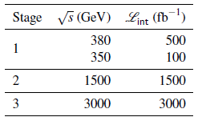
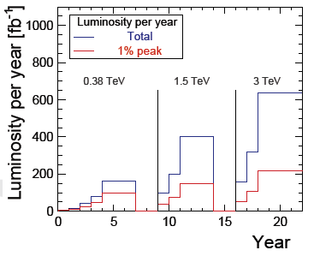
CLIC Staged Scenario
Plenty of physics at low centre-of-mass energies
Energy and luminosity targets from Physics Study Group
Top above threshold
Higgs via Zh and WW fusion
Study top at threshold
To be updated with more input from LHC and stage 1
Implementation in stages

Slide 5
CLIC Staged Scenario
Plenty of physics at low centre-of-mass energies
Energy and luminosity targets from Physics Study Group
Top above threshold
Higgs via Zh and WW fusion
This is being reviewed
Review of effective operation time for luminosity per year showed increase from 1.08 x 10⁷ s to 1.2 x 10⁷
Consider some extra years at full luminosity
  Likely increases integrated luminosities
  Could further improve physics results
Study top at threshold
To be updated with more input from LHC and stage 1
Implementation in stages

Slide 6
CLIC at 380 GeV
Developed optimised first energy stage
Upgrade to higher energies included

Slide 7
Key Parameters
Gradient is optimised for luminosity and cost
Installed modules can be reused at higher energies

Slide 8
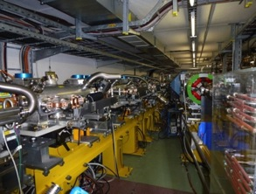
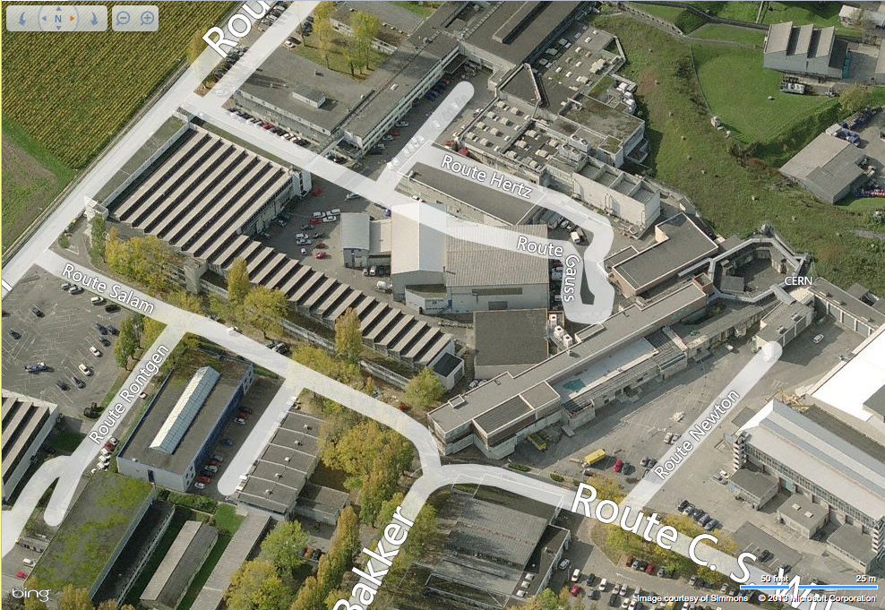
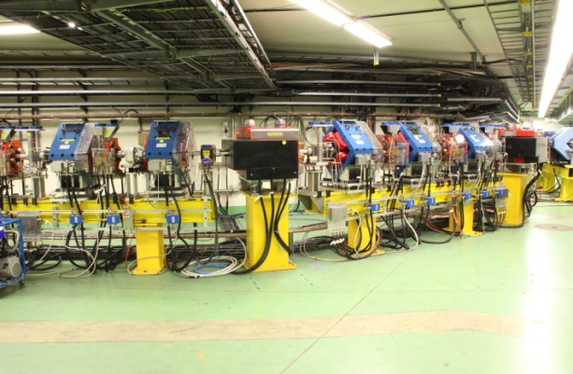
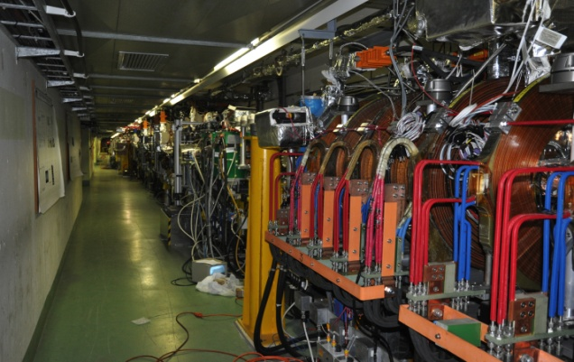
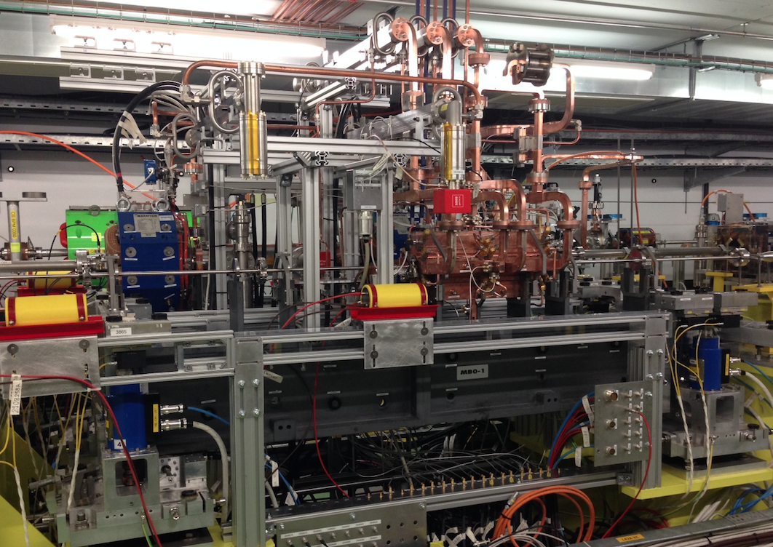
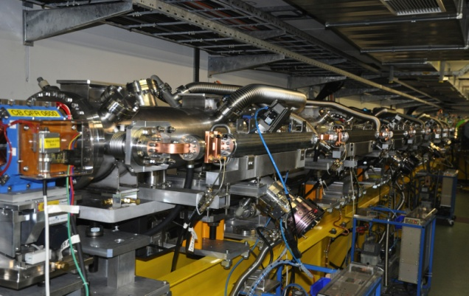
CTF3 programme 2013-2016
Reminder: CLIC Test Facility (CTF3)
Delay loop
Combiner ring
CLEX
Drive beam linac
Two Beam Module
TBL

Slide 9
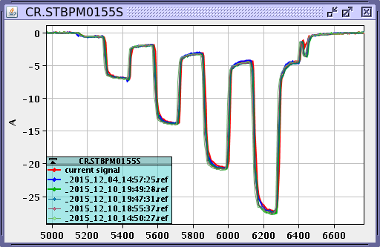
Reminder: Drive Beam Scheme Performance
CTF3 measurements:
RF to drive beam efficiency > 95%
Current multiplication factor 8
Most of beam quality
145 MV/m X-band acceleration
Measured 145 MV/m gradient
Detailed simulations of drive beam performance in CLIC
Arrival time with feedback
Current stability affected by very low CTF3 energy, 3 x larger beam
and delay loop design different from CLIC
Parameter | CLIC goal | CTF3 measured
Arrival time | 50 fs | 50 fs
Current after linac | 0.75 x 10⁻³ | 0.2-0.4 x 10⁻³
Energy | 1.0 x 10⁻³ | 0.7 x 10⁻³

Slide 10
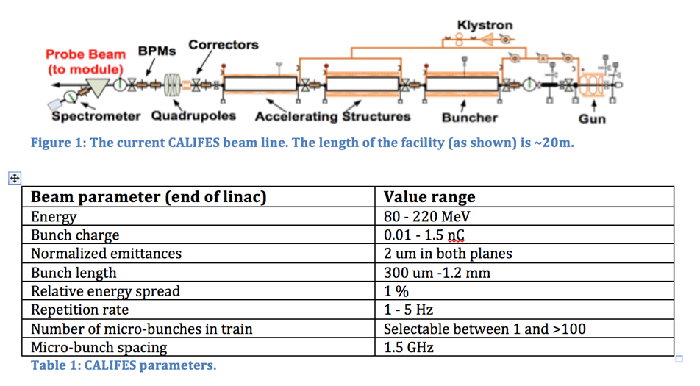
Reminder: Drive Beam Scheme Performance
CTF3 measurements:
RF to drive beam efficiency > 95%
Current multiplication factor 8
Most of beam quality
145 MV/m X-band acceleration
Measured 145 MV/m gradient
CTF 3 stopped operation
New facility is online: CLEAR
CERN Linear Electron Accelerator for Research
Detailed simulations of drive beam performance in CLIC
Arrival time with feedback
Current stability affected by very low CTF3 energy, 3 x larger beam
and delay loop design different from CLIC
Parameter | CLIC goal | CTF3 measured
Arrival time | 50 fs | 50 fs
Current after linac | 0.75 x 10⁻³ | 0.2-0.4 x 10⁻³
Energy | 1.0 x 10⁻³ | 0.7 x 10⁻³

Slide 11
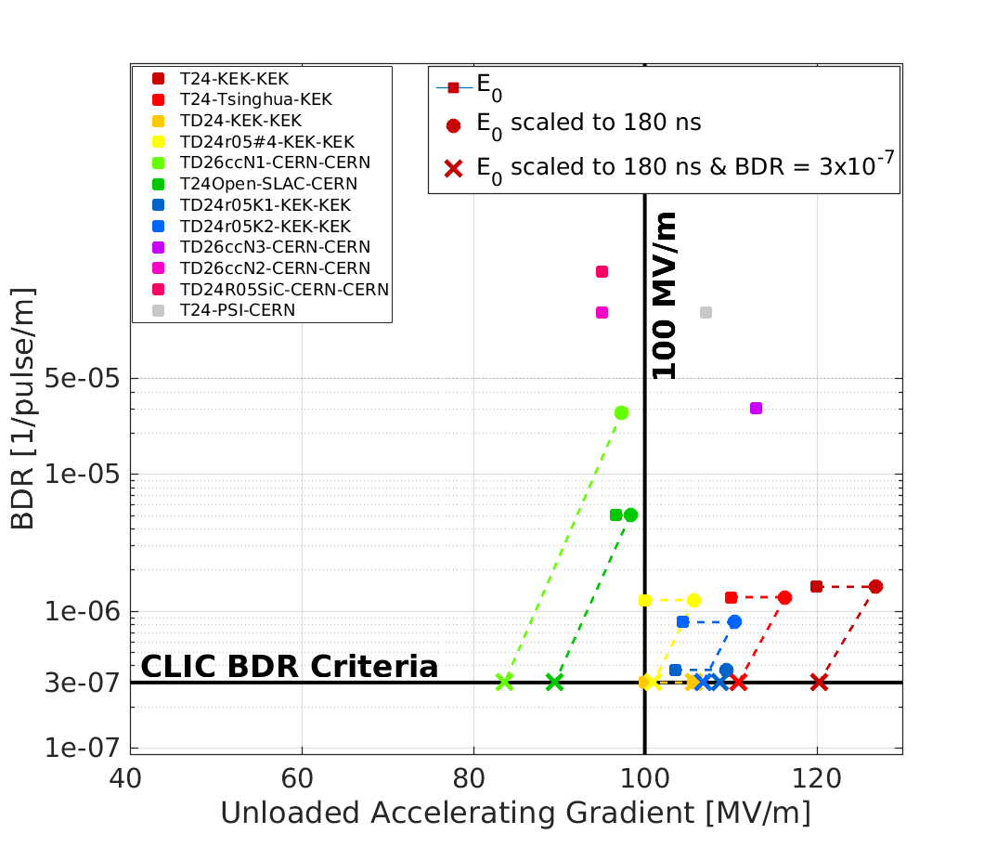
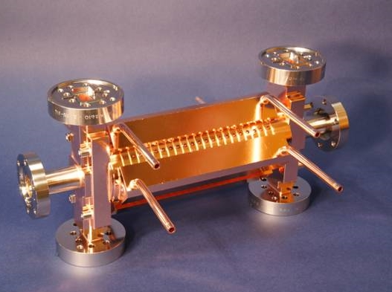
CLIC Structure Development
Several klystron-based test stands exist that test structures (X-boxes)
Structure performance is reproducible
40 G [MV/m] 80 100 120
Further optimisation ongoing of structure production for industrialisation

Slide 12
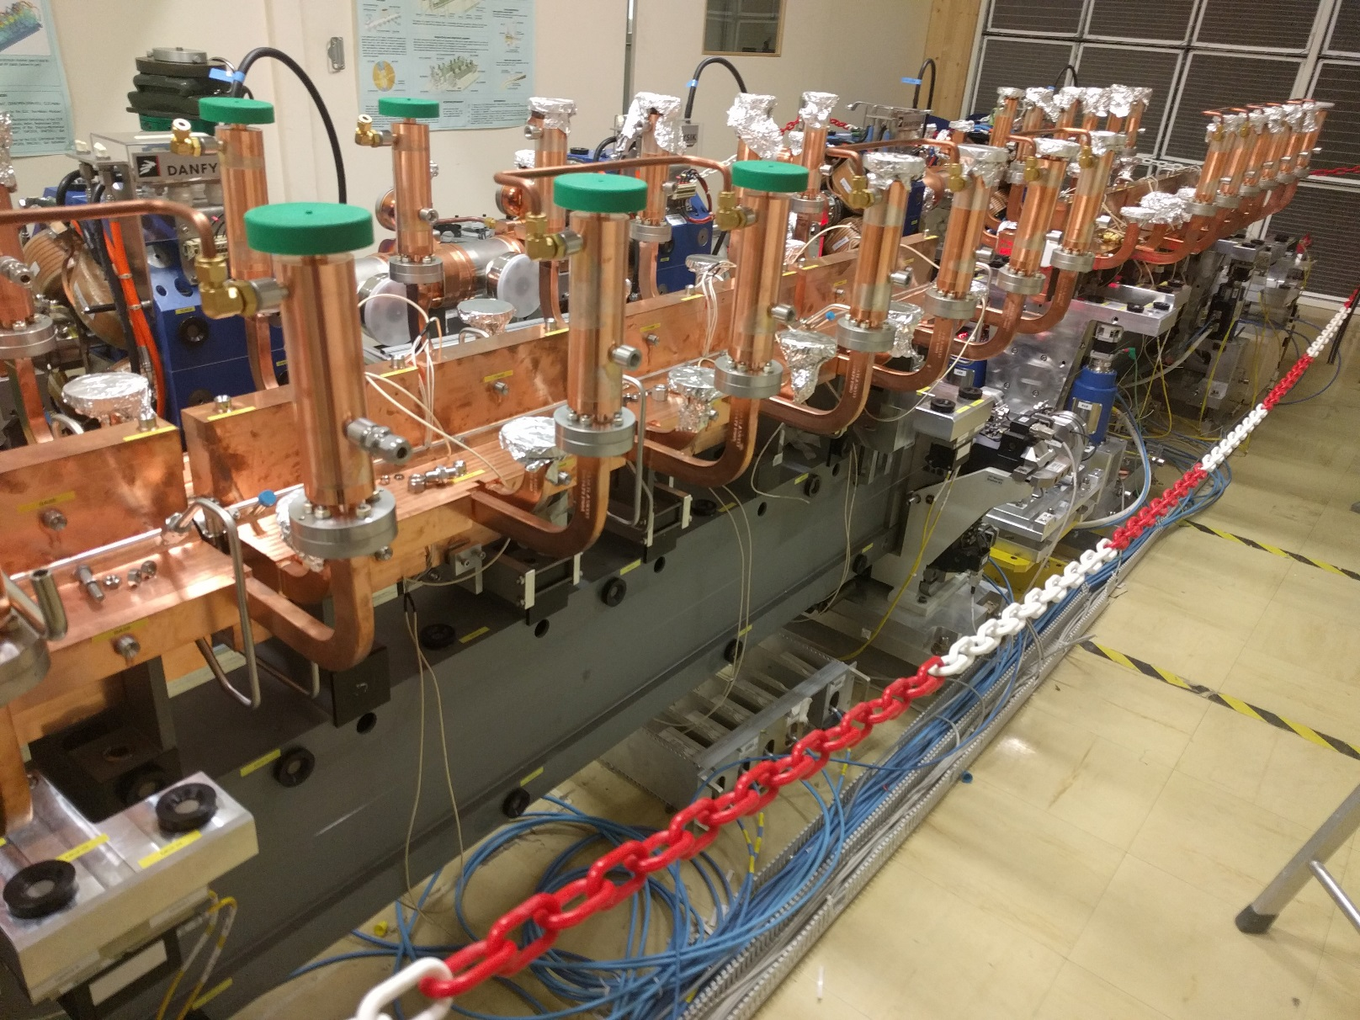
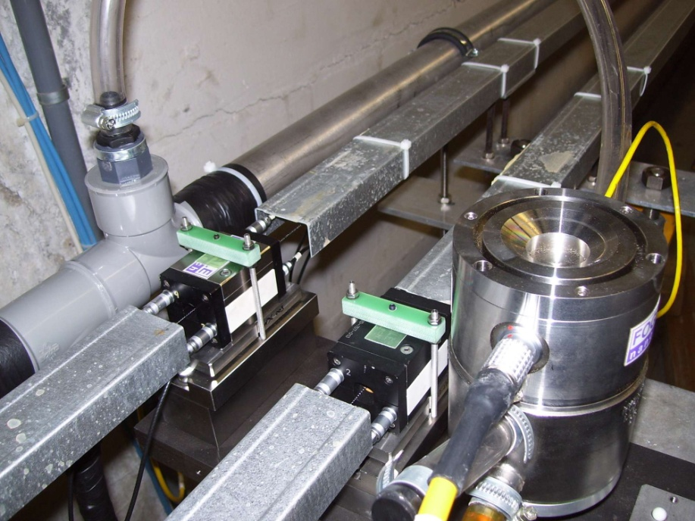
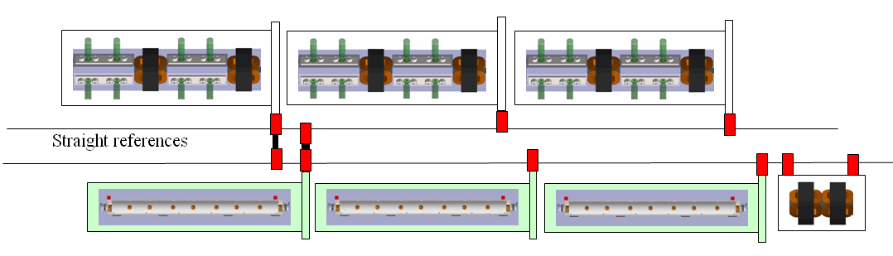
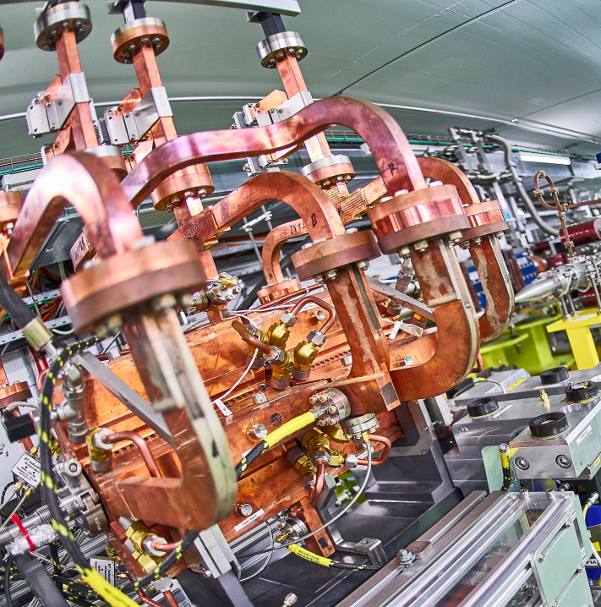
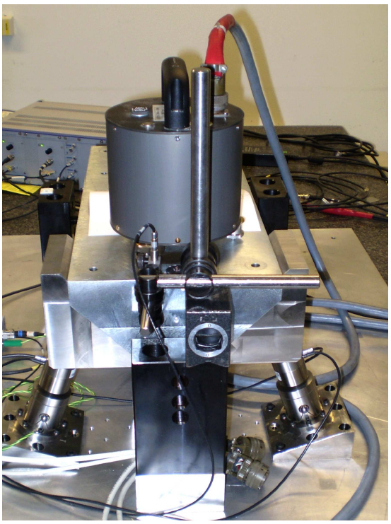
Main Linac Module and Imperfection Mitigation
Overlapping wires provide accurate position information
Components are mounted accurately on movable girders
Magnets are stabilised mechanically to nm against ground motion and vibrations
Wake monitors in each structure measure beam offset (3.5 μm)
In addition to high accuracy optimisation for cost

Slide 13
Klystron-based Alternative
Develop klystron-based alternative
Expect comparable cost for first energy stage
But increases faster for high energies
Novel high efficiency klystrons
Novel pulse compressors
Novel distribution system
8
Optimised structure
8

Slide 14
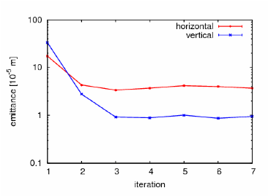
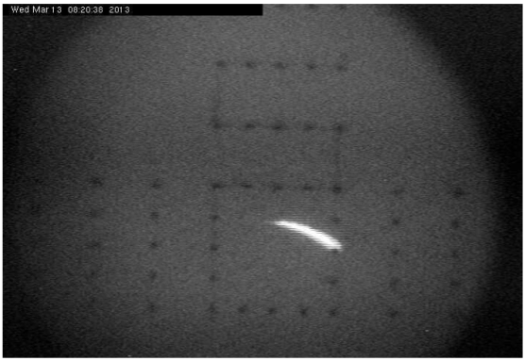
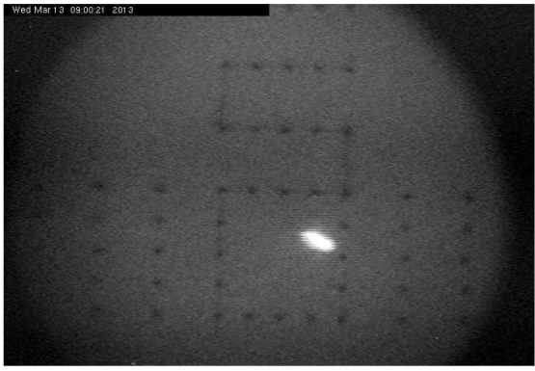
Beam Quality for Luminosity
Production of low-emittance beams in damping ring
  Similar to existing light sources
Dispersion Free Steering Test at FACET (SLAC)
Quality preservation in transport
  Minimisation of imperfections
  Optimised lattice design
  Sophisticated beam-based tuning
Emittance [10⁻⁵ m ]
Focusing of beam in beam delivery system
  Advanced lattice design
  Advanced tuning
  Test at FFTB and ATF2
ATF2 at KEK
Beam size (41 nm) is close to target (37nm)
iteration
Initial beam
3 iterations

Slide 15
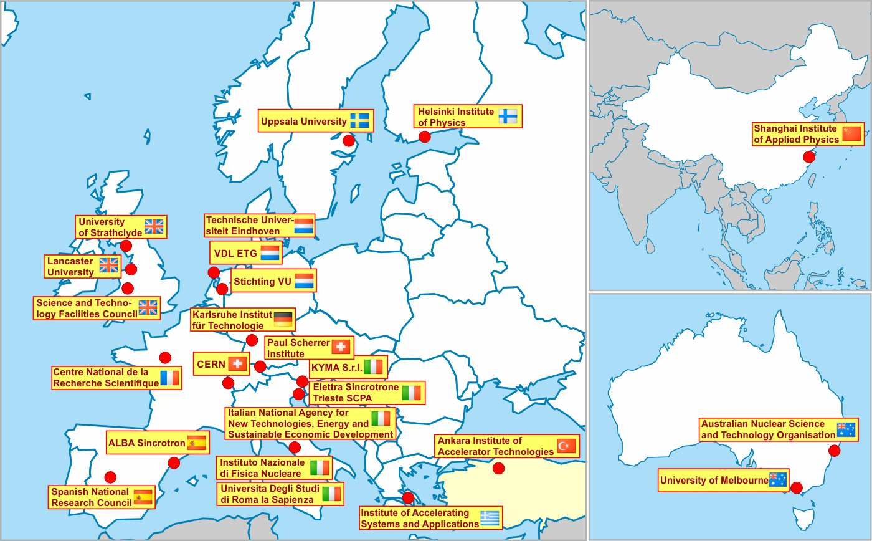
CLIC Technology Development and Applications
CLIC technology for CLIC and different applications
Recent EU co-funded FEL design study
SPARC at INFN-LF
Electrons to SPS for dark matter searches?
…

Slide 16
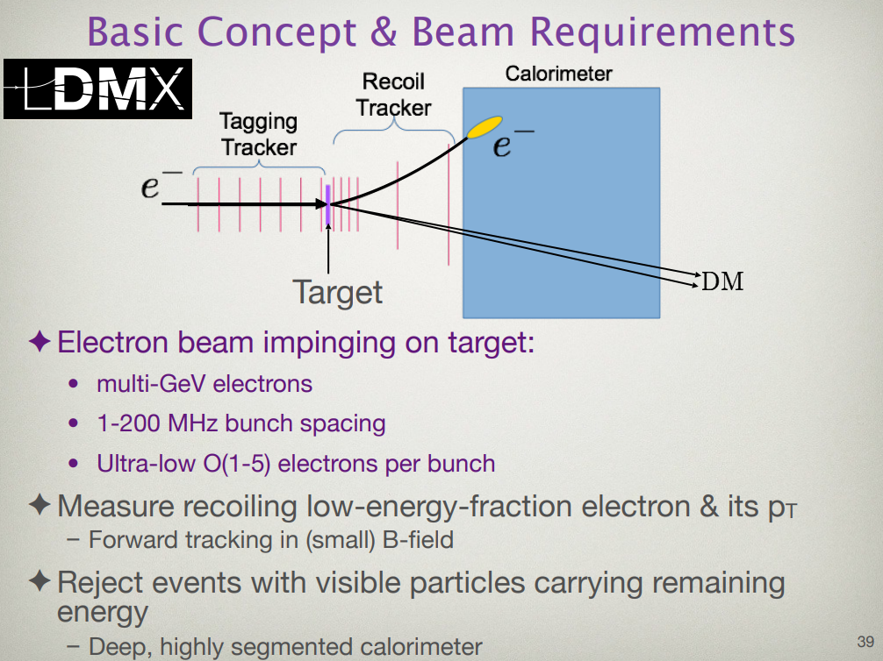
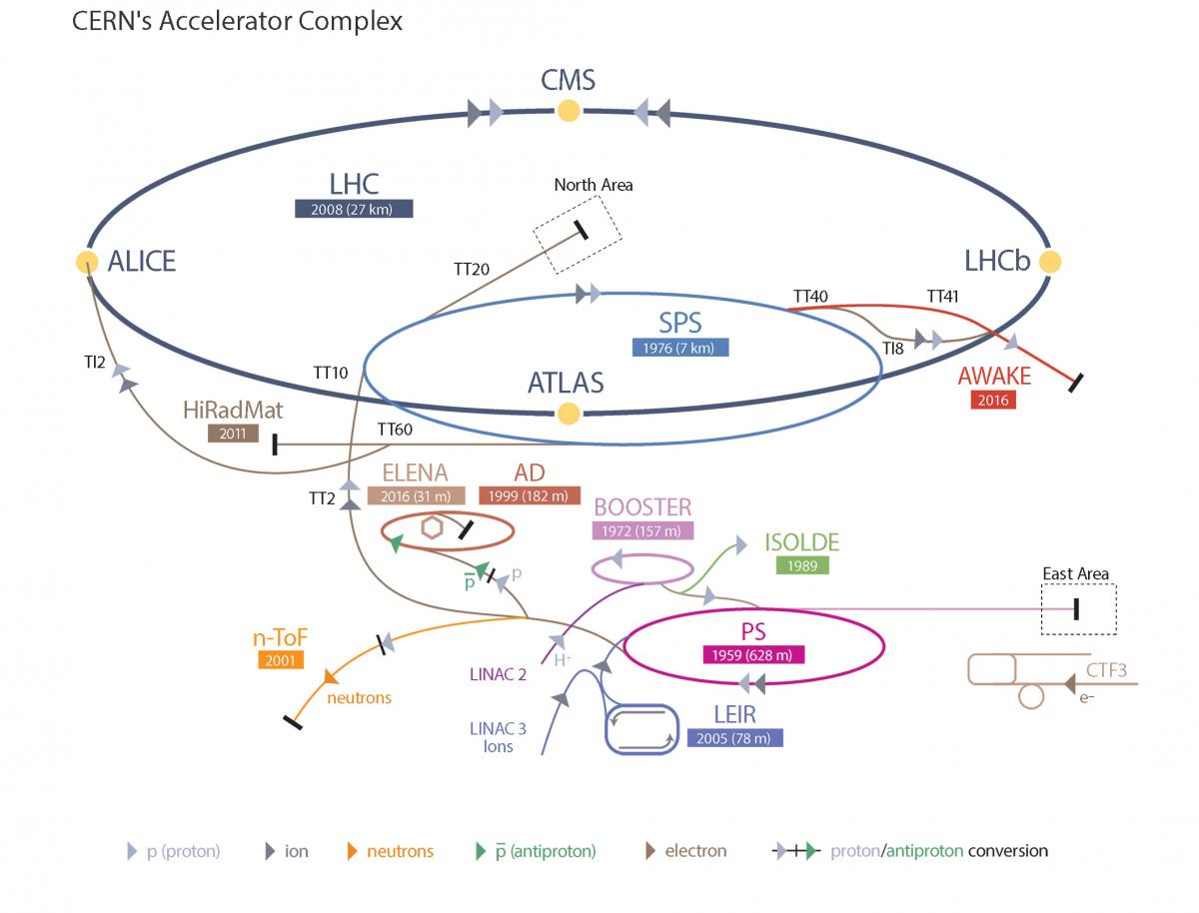
Note: Dark Matter Searches
3.5 GeV Linac
12 GHz CLIC technology
Transfer to SPS
Acceleration to about 16 GeV in SPS
Extraction
Basically all tunnels and infrastructure exist
Need 3.5 GeV linac with CLIC technology

Slide 17
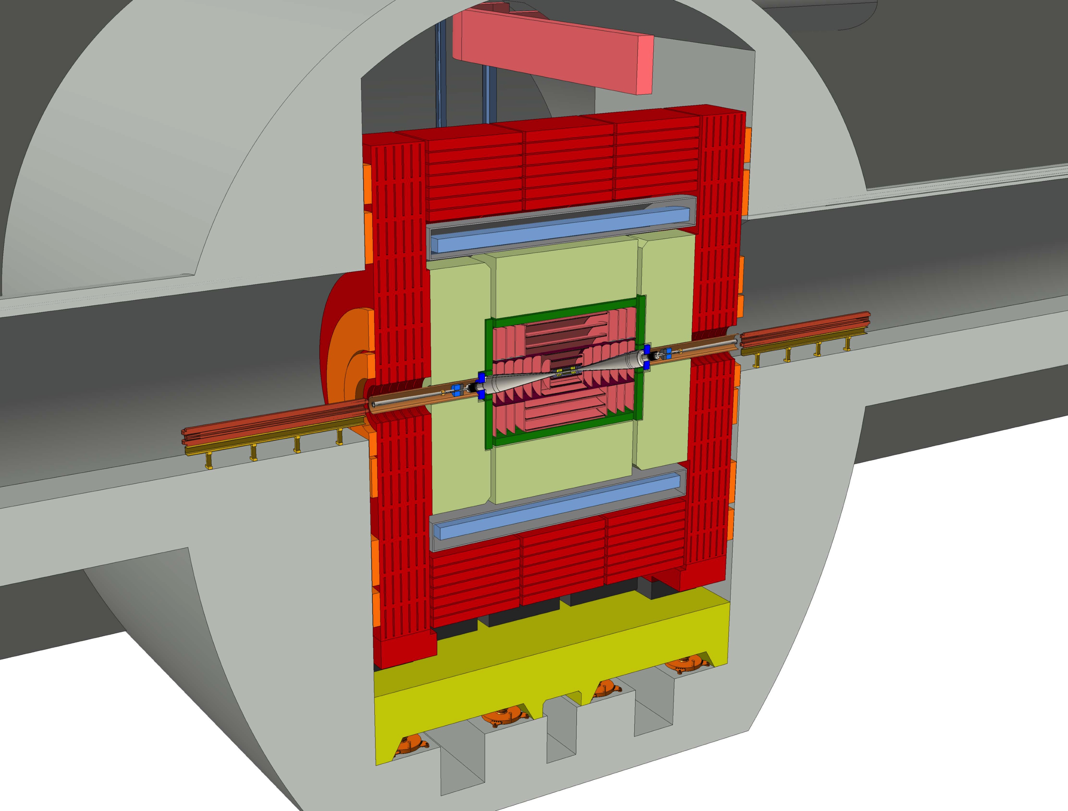
Comment: Increased L* for Detectors
Detailed studies show great experimental conditions
Background acceptable
Luminosity spectrum useful
New BDs design increases L* from 3.5 to 6 m
Focusing magnets now outside of detector
Better angular coverage

Slide 18
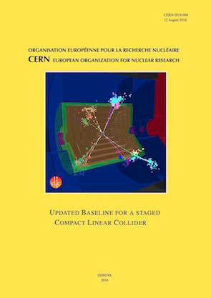
Cost and Power
Goals bring cost and power consumption down:
“reasonable cost”: O(6 GCHF)
Reasonable power < O(200 MW)
Initial value for 380 GeV
(MCHF of Dec 2010)
Main beam production | 1245
Drive beam production | 974
Two-beam accelerator | 2038
Interaction region | 132
Civil engineering etc. | 2112
Control & operation | 216
TOTAL | 6690
Intial Estimate 252 MW
Improvement of cost and power is ongoing
Detailed bottom up estimate
Already savings, seems we meet goal

Slide 19
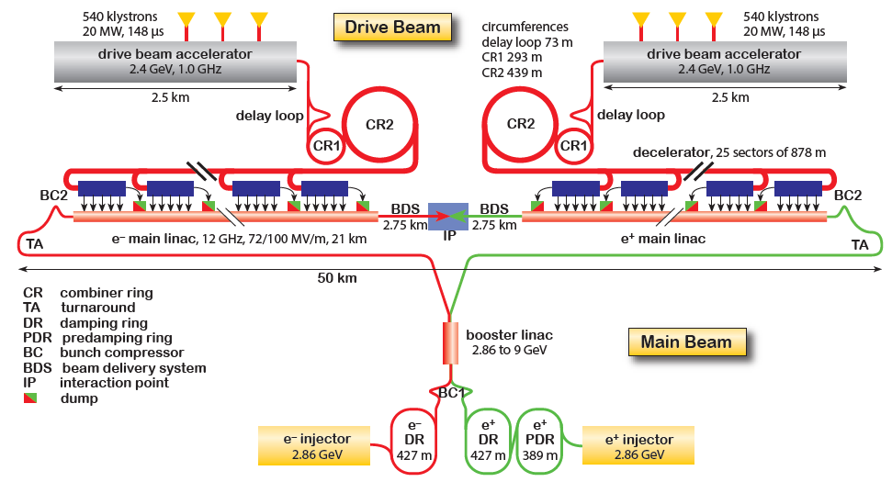
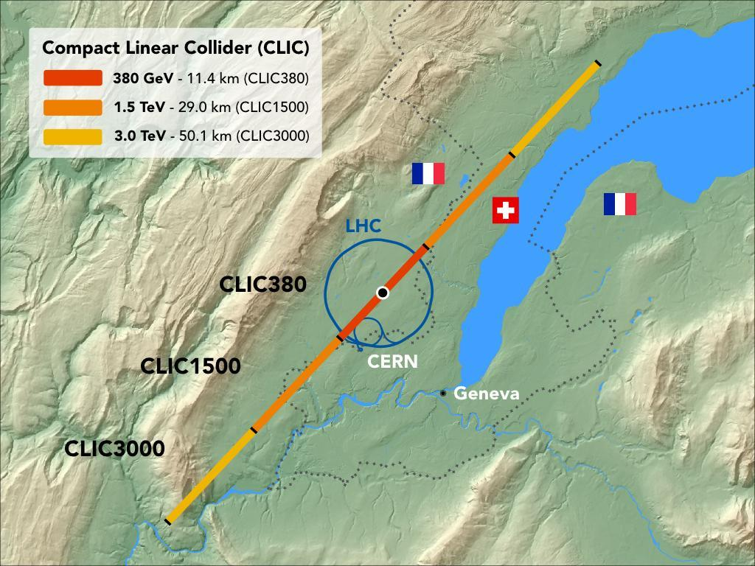
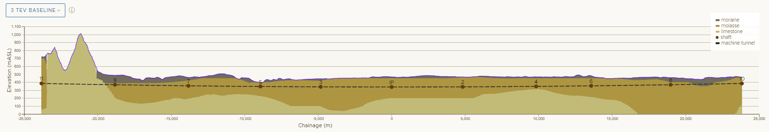
CLIC Site and Upgrade to 3 TeV
Can re-use previous systems and components
Just add more linac and drive beam pulse length
At 3 TeV add one drive beam
Drive Beam Generation Complex
Main Beam Generation Complex
50km

Slide 20
Conclusion
Important progress toward the EU strategy
Much improved technical maturity
Light sources are prototypes of damping rings
Normal conducting FELs are prototypes, e.g. Swiss FEL
Further optimising 380 GeV first energy stage
Work on further stages, including considerations of novel technologies
Writing of Project Implementation Plan is well advancing, ready by end of 2018
Many thanks to L. Evans, S. Stapnes, W. Wuensch, Ph. Burrows, I. Syratchev and the CLIC team

Slide 21
Reserve

Slide 22
Main Linac Imperfection Mitigation
Components are mounted accurately on movable girders
Overlapping wires provide accurate position information
Wake monitors in each structure measure beam offset (3.5 μm)
Magnets are stabilised mechnically to nm against ground motion and vibrations
Optimised lattice design
Sophisticated beam-based alignment, e.g. dispersion free steering (i.e. different energy beams)

Slide 23
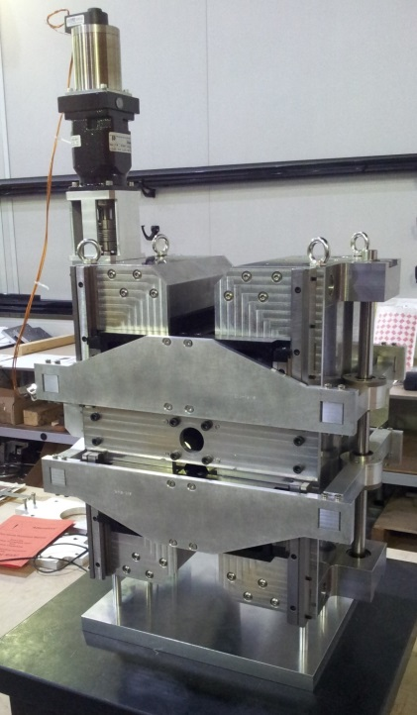
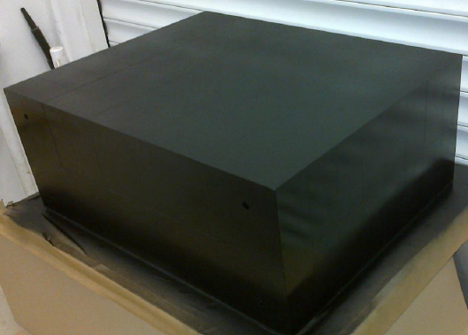
Other CLIC Technology Development
Redesign CLIC modulators and klystrons
Aim: increase efficiency from 62% to 90%
Less power consumption
Also important cost saving
Shorter tubes, no oil in modulator, …
Important cost saving
Permanent magnets
Use tunable permanent magnets where possible
Drive beam quadruoles
Strongest permanent magnet developed in UK
New module design
Reduce cost of mechanical system and control
Main beam injector
e.g. halved power for positron production

