Slide 1
ILC Accelerator overview
S. Michizono and A. Yamamoto
(LCC/ILC/KEK)
Higgs Hunting 2018, Paris
2018-7-25

Slide 2
Outline
Introduction
ILC-250 overview
Key technologies advanced
Progress in cost-reduction R&D
Project Status
Summary

Slide 3

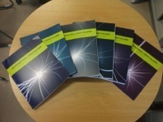
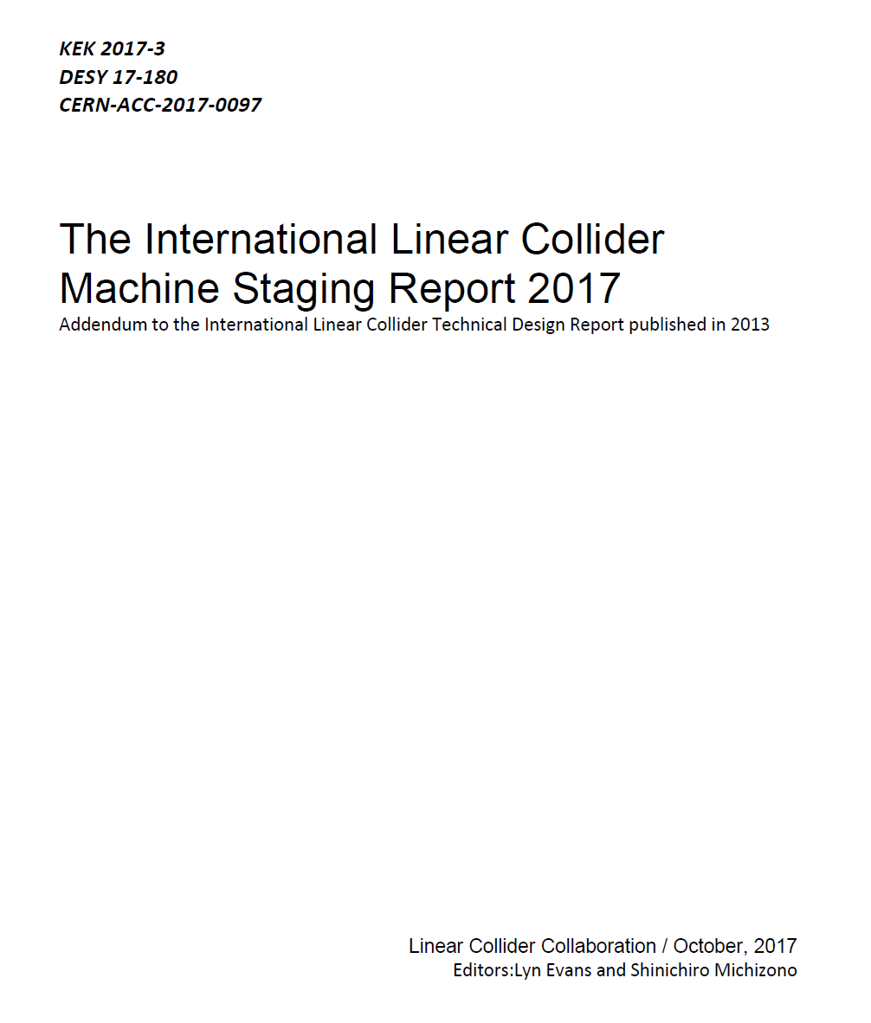
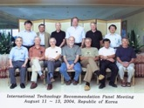
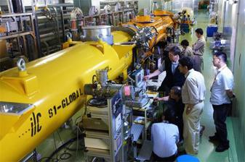
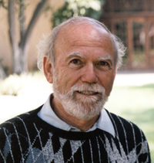
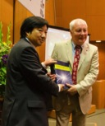
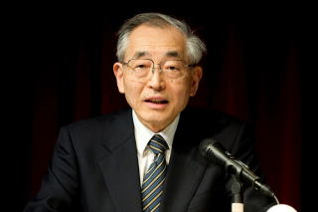
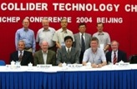
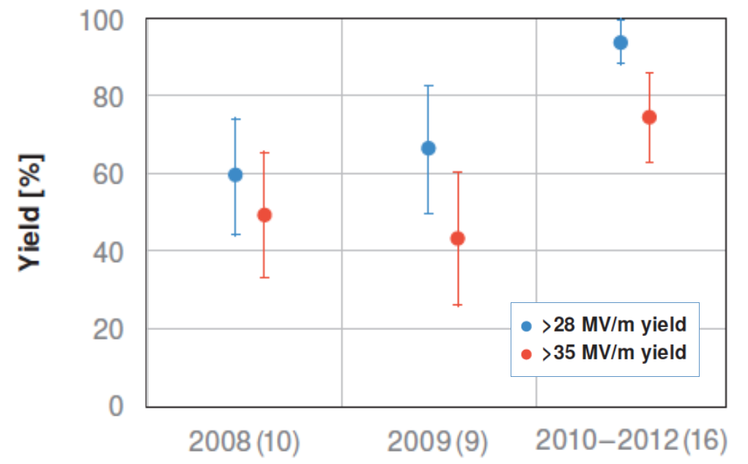
ILC500 to ILC250
1980’ ~ : Basic Study
2004
2006
‘07
‘08
‘09
‘10
‘11
‘12
‘13
‘14
‘15
‘16
’17,18
ILC-GDE
TDR
LCC
RDR)
TDR
Technical Design Phase
ILC-250
LHC
SC Technology
selected
European XFEL
Progressing →
LCLS-II

Slide 4
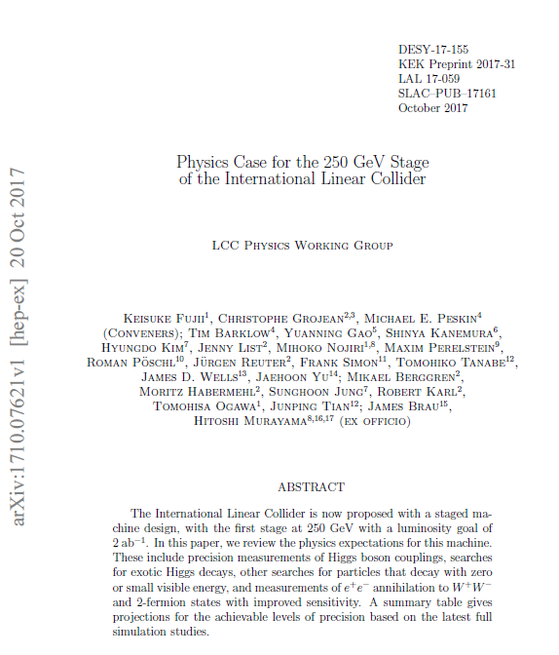
Machine/Physics report (October 2017)
https://arxiv.org/abs/1711.00568
https://arxiv.org/abs/1710.07621

Slide 5
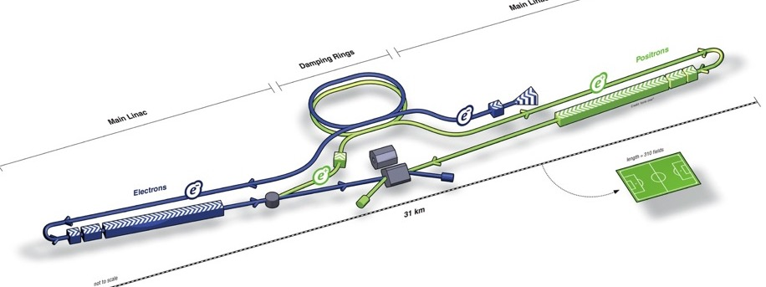
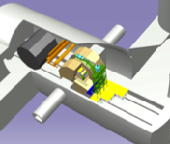
ILC250 Acc. Design Overview
Damping Ring
e- Source
e+ Main Liinac
Physics Detectors
Item | Parameters
C.M. Energy | 250 GeV
Length | 20.5 km
Luminosity* | 1.35 x10³⁴ cm⁻²s⁻¹
Repetition | 5 Hz
Beam Pulse Period | 0.73 ms
Beam Current | 5.8 mA (in pulse)
Beam size (y) at FF | 7.7 nm
SRF Cavity G. Q₀ | 31.5~35 MV/m Q₀ = 1 ~ 1.6x10 ¹⁰
AC Power | 120 ~ 130 MW
Enable to be higher (discussed in ALCW2018)
e+ Source
e- Main Linac
Key Technologies
Nano-beam Technology
SRF Accelerating Technology

Slide 6
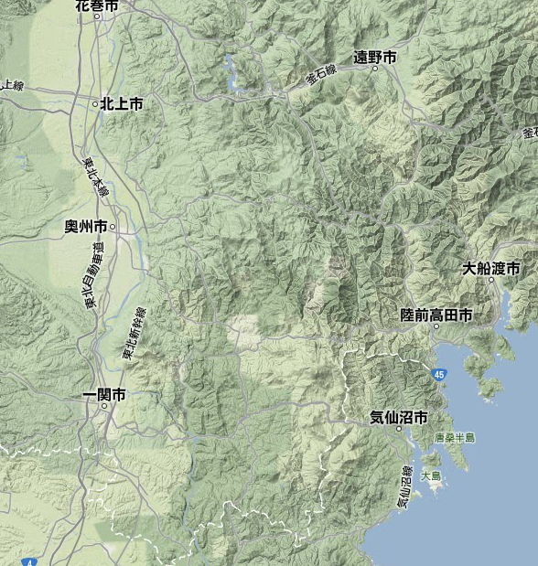
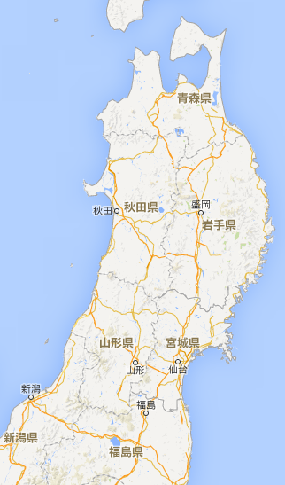
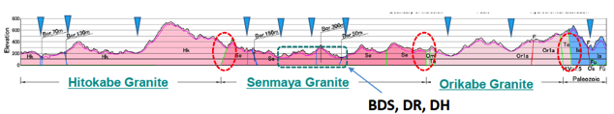
ILC Site Candidate Location in Japan: Kitakami
Preferred site selected by JHEP community,
Endorsed by LCC, in 2013
High-way
Extendability (≥ 50 km)
Oshu
ILC-250n(20.5 km)
Express-
Rail
Ofunato
Kesen-numa
Sendai
Ichinoseki
IP Region

Slide 7
Courtesy: S. Kanemura
ALCW2018, Fukuoka
Further references for ILC250 Physics; :
”The potential of the ILC dor Discovering New Particles”, arXiv:1798.089012
“Physics Case for the 250 GeV Stage of the ILC”, arXiv:1710.07621
“The Role of Positron Polarization for the Initial 250 GeV stage of the ILC”, arXiv:1801.02840

Slide 8
Courtesy: S. Komamiya
ALCW-2018. Fukuoka
Ref: “Physics Case for the 250 GeV Stage of the ILC”, arXiv:1710.07621

Slide 9
ILC-250 Status -- Highlighted
Science:
Scientific significance of the precise measurements of the Higgs Boson increasing,
ILC redefined as a Higgs Factory at the maximum HZ cross section at E_{cm}=250 GeV, and
Energy extend-ability in future science.
Technology:
SRF technology matured: European XFEL SRF accelerator successfully built, with functioning as the prototype for the ILC.
Nano-beam technology matured: ATF demonstrating the FF beam size (41 nm) equivalent to that (7 nm) required at the ILC.
Cost reduced down to 2/3 or less, at a half E_{cm} and further advances in SRF technology.
Toward Project Decision:
Progress: JP/MEXT, ILC Advisory Panel finalizing the report. Science Council (JP) to provide the recommendation to MEXT-Government to finalize the decision.
Int’l discussions in progress: ICFA/LCB, US-JP, France-JP, Germany-JP, CERN, EU, EJADE, and …
The due-date of the input for the European Strategy, Dec. 2018, well informed.

Slide 10
Outline
Introduction
ILC-250 overview
Key technologies advanced
Progress in cost-reduction R&D
Project Status
Summary

Slide 11
Technical Status in 2018
Key Technologies advanced!
Nano-beam Technology：
    KEK-ATF2: FF beam size (v): 41 nm at 1.3 GeV (equiv. to 7 nm at ILC）
SRF Technology ：
    European XFEL completed: <G = ~ 30 MV/m> achieved with 800 cavities
    and accelerator operation reaches the design energy.
    LCLS-II: construction in progress
    H-FEL (Shanghai): approved
    US-Japan: Cost Reduction R&Ds in progress, focusing on Nb-material and
    “N-Infusion” process for High-Q and -G
  General design updated:
  ILC 250 GeV proposal authorized by ICFA/LCB, 2017

Slide 12
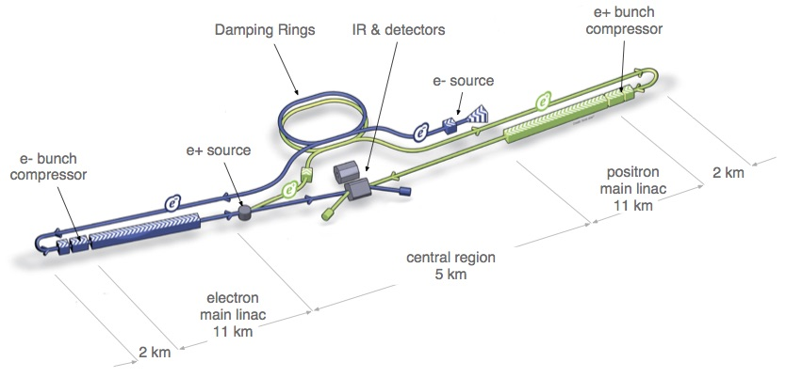
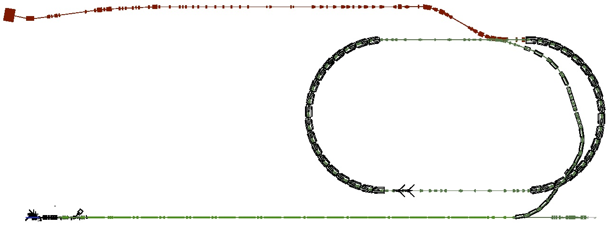
ATF/ATF2: Accelerator Test Facility
Develop the nanometer beam technologies for ILC
Key of the luminosity maintenance
7.7 nm beam at IP (ILC250)
Layout of ILC
ATF2: Final Focus Test Beamline
  Goal 1:Establish the technique for
  small beam
  Goal 2: Stabilize beam position
Damping Ring (~140m)
Low emittance electron beam
 | Vertical | Horizontal
ILC500 | 5.9 nm | 474 nm
ILC250 | 7.7 nm | 516 nm
1.3 GeV S-band Electron LINAC (~70m)

Slide 13
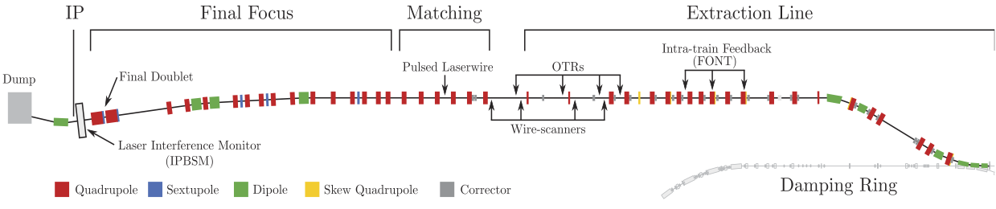
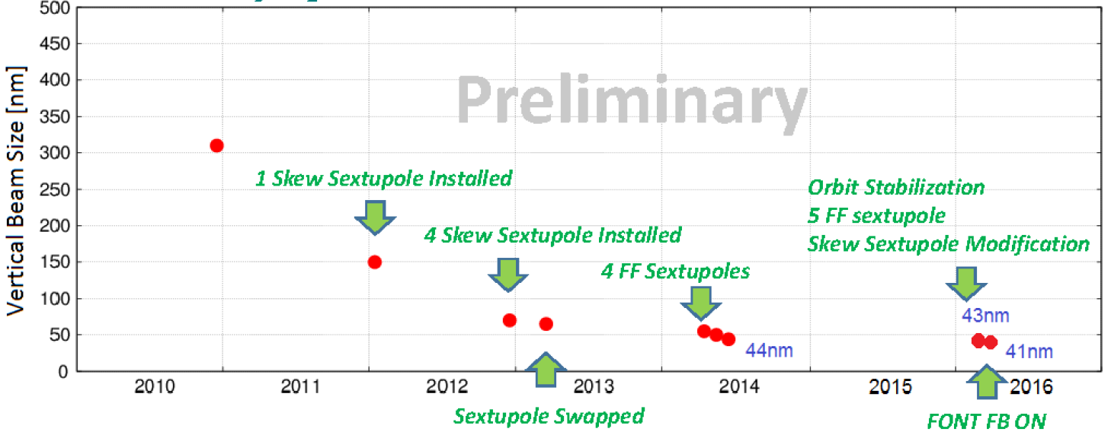
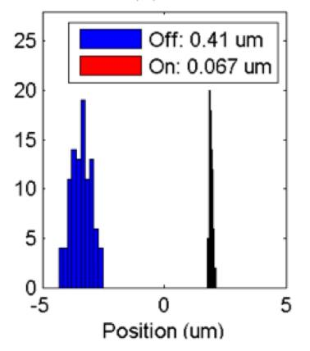
Progress in FF Beam Size and Stability at ATF2
Goal 1: Establish the ILC final focus method with same optics and comparable beamline tolerances
ATF2 Goal : 37 nm → 6nm @ILC500GeV 7.7nm@ILC250GeV
  Achieved 41 nm (2016)
Goal 2: Develop a few nm position stabilization for the ILC collision
FB latency 133 nsec achieved
(target: < 300 nsec)
positon jitter at IP: 410 → 67 nm (2015) (limited by the BPM resolution)
Nano-meter stabilization at IP
Efforts continued.
History of ATF2 small beam

Slide 14





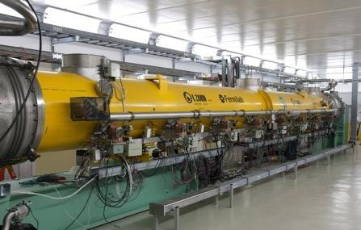
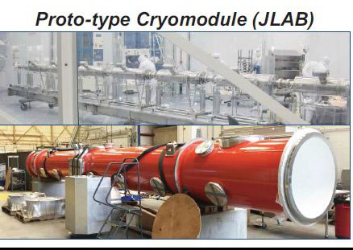
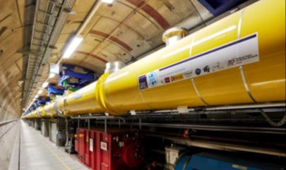
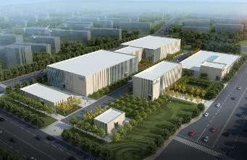
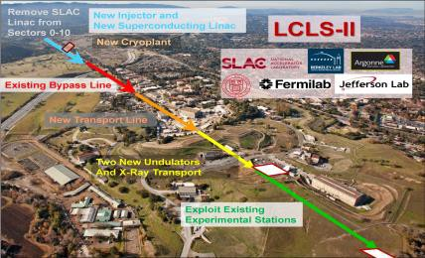
Worldwide SRF Collaboration
CERN, DESY
FNAL/ANL
MSU
IHEP, PKU
TRIUMF
Cornell
JLAB
CEA, CNS-LAL
INFN
KEK
SLAC, LCLS-II
European XFEL
IUAC, RRCAT
Americas, LCLS-II
ILC-SRF technology
Asia,
PAPS@IHEP CFF/STF@KEK

Slide 15
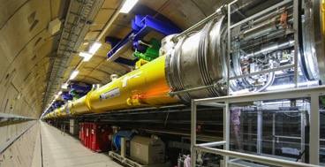

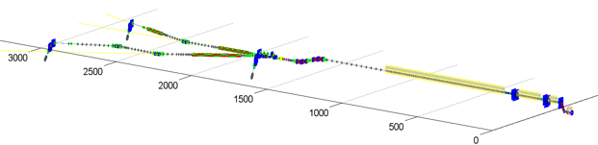
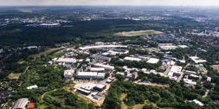

European XFEL, SRF Linac Completed
Courtesy, H. Weise
Progress:
2013: Construction started
…
2016: E- XFEL Linac completion
2017: E-XFEL beam start
1.3 GHz / 23.6 MV/m
800+4 SRF acc. Cavities
100+3 Cryo-Modules (CM)
: ~ 1/10 scale to ILC-ML
1 km SRF Linac
XFEL site
DESY

Slide 16
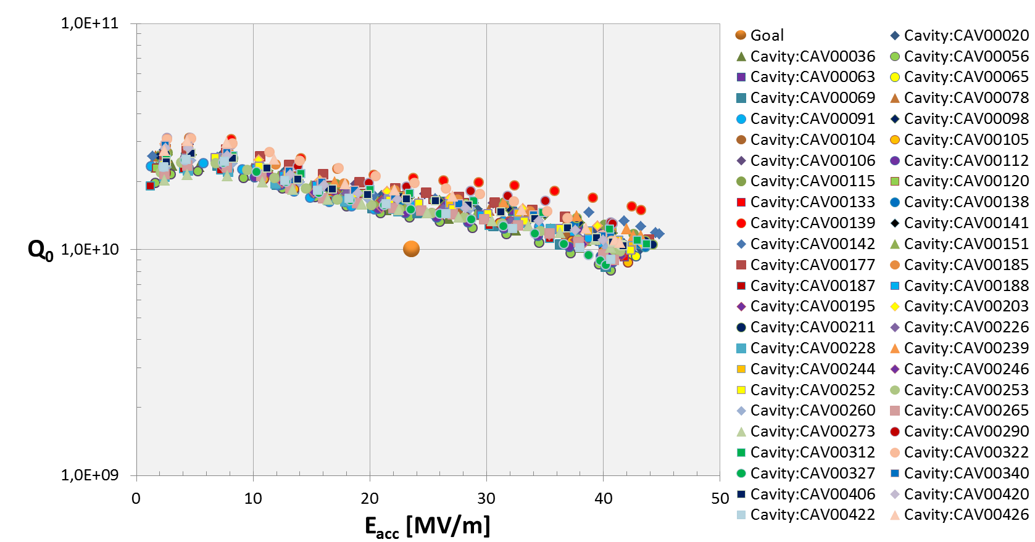
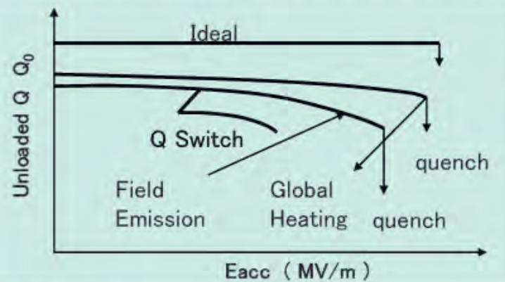
European XFEL: SRF Cavity Performance
Courtesy, D. Reschke , N. Walker, C. Pagani
>10 % (47/420, RI) cavities
exceeding 40 MV/m
After Retreatment:
E-usable: 29.8 ± 5.1 [MV/m]
(RI): E usable 31.2 ± 5.2 [MV/m]), w/ 2nd EP
(EZ): E usable 28.6 ± 4.8 [MV/m]) , w/ BCP ( instead of 2nd EP)

Slide 17
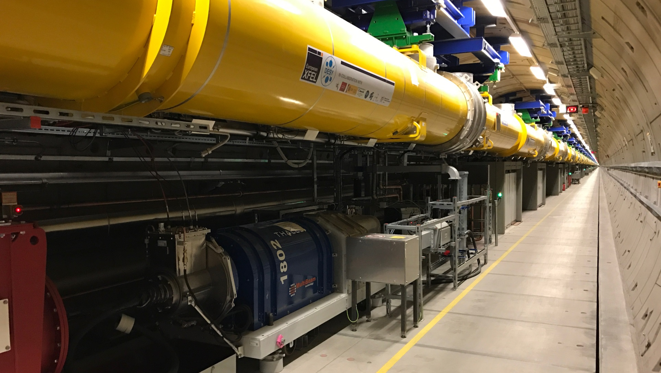
European XFEL reaches its Design Energy
Courtesy, M. Omet
17.5 GeV
17.07.18

Slide 18
Outline
Introduction
ILC-250 overview
Key technologies advanced
Progress in cost-reduction R&D
Project Status
Summary

Slide 19
US-Japan Discussion Group on ILC
First meeting on May 25, 2016 at Washington D.C
  Attended by Deputy Director-General, Research Promotion Bureau, MEXT, and Director, Office of Science, DOE.
  Agreed on item of discussion
Second meeting on October 18, 2016 by video
  Attended by Deputy Director-General, Research Promotion Bureau, MEXT, and Director, Office of Science, DOE.
  Agreed to begin the joint R&D from April 2017.
R&D program started in 2017

Slide 20
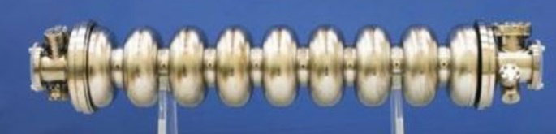
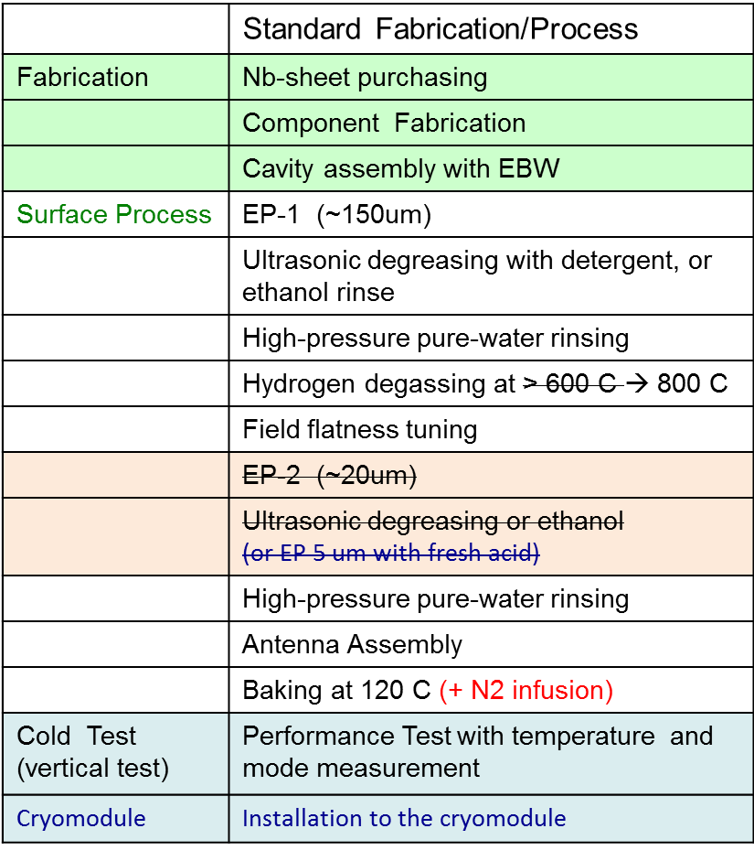
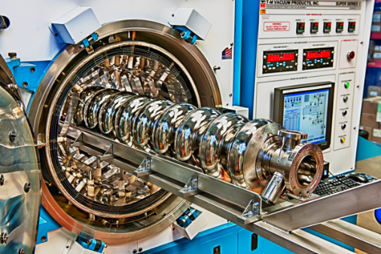
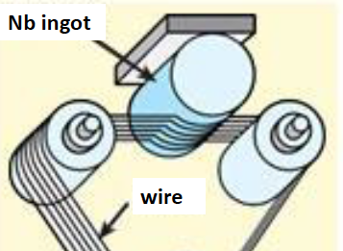
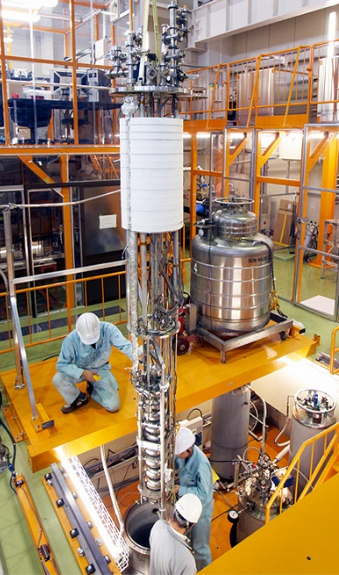
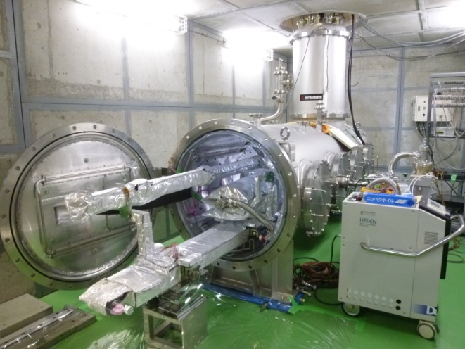
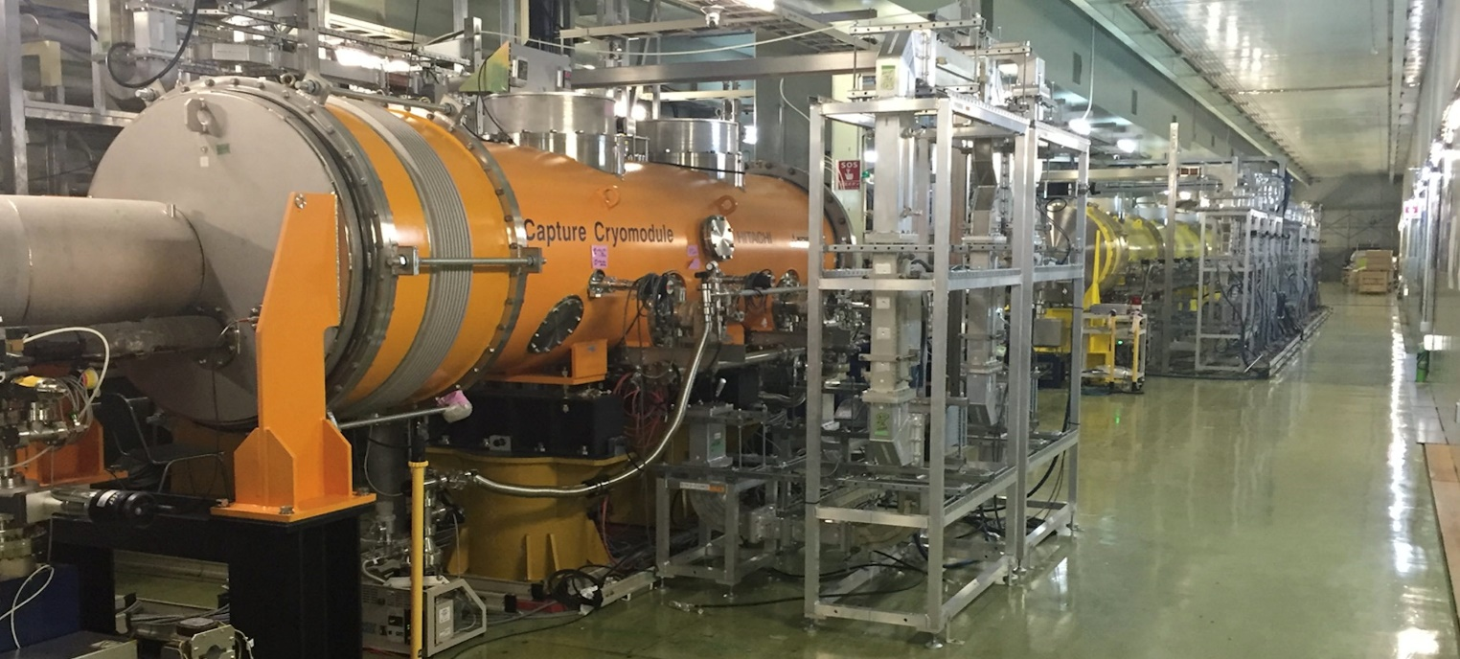
US-Japan cost reduction R&D
Evaluate the cavity performance from vertical test to horizontal test
New Nb material/process
Cavity fabrication
Heat treatment
N-Infusion
Vertical test
Degradation-free environment
Stand-alone horizontal test
Module (including tuner, jacket)
Horizontal test
Module test at stF-2

Slide 21
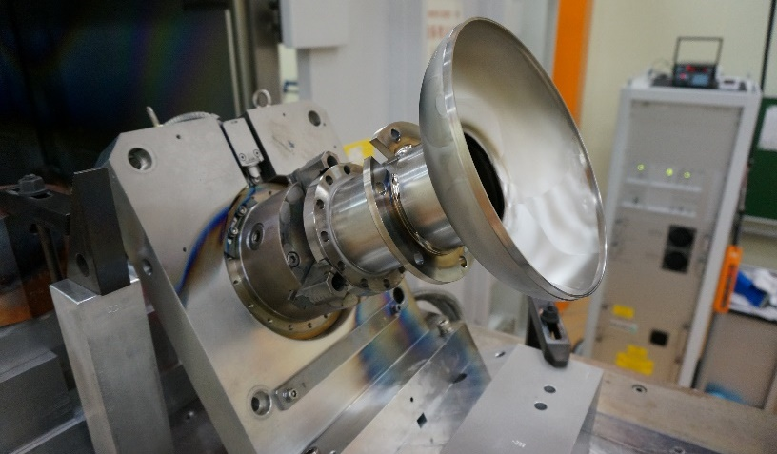
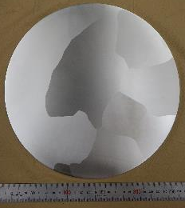
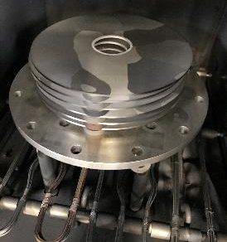
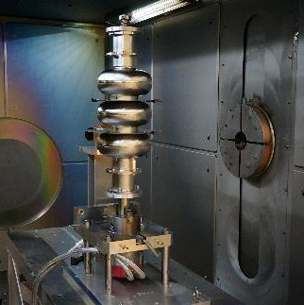
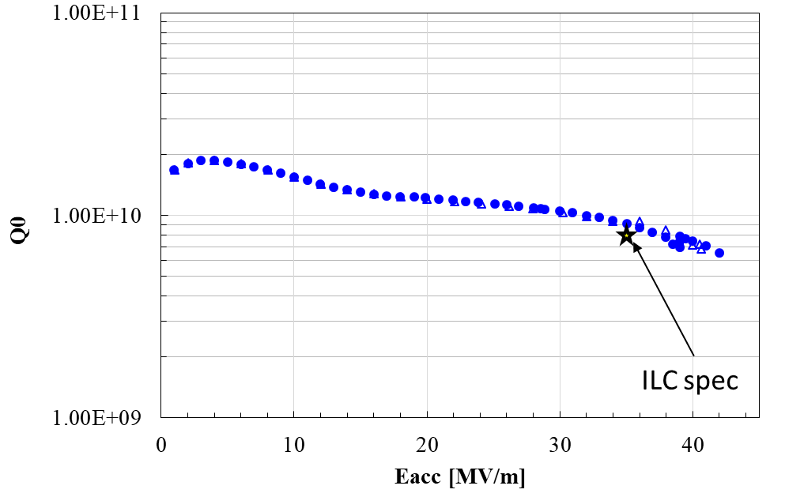
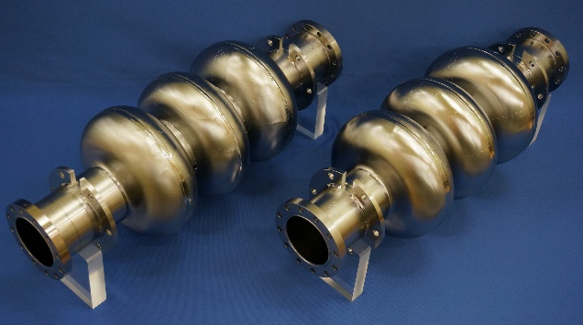
Direct sliced Nb material performance at KEK
Made from large grain Nb disks;
medium RRR Nb with high Ta content (CBMM)
Electron beam welding of end-cell
Annealed for 800℃×3hrs
to remove stresses.
Preliminary
Electron beam welding of the cavity
- The 3-cell cavity achieved very high gradient (~42 MVm) and satisfies ILC spec.

Slide 22
Cavity performance progress at FNAL:
“standard” vs “N infused” cavity surface treatment
A. Grassellino
FNAL recently demonstrated a new treatment, which utilizes “nitrogen infusion”, achieving
    45.6 MV/m → 194 mT
    with Q ~ 2x10¹⁰
Systematic effect observed on several single cell cavities
FNAL has now successfully applied it on three nine cell cavities
Jlab, KEK have reproduced similar results on single cell cavities with Q >2e10 at 35 MV/m
R&D work towards:
  Best recipe for higher Q at high G
  Robustness of process
Increase in Q by > a factor of two
Increase in gradient ~15%
A Grassellino et al 2017 Supercond. Sci. Technol. 30 094004

Slide 23
Outline
Introduction
ILC-250 overview
Key technologies advanced
Progress in cost-reduction R&D
Project Status
Summary

Slide 24
ILC Study Coordination by MEXT
SCJ
2013 →2018
SCJ, MEXT
WGs
MEXT
Commissioned Survey
by NRI (2014-17)
ILC Adv. Panel
IAP
WW Research trend (FY14)
Technology issues (FY15)
Large Int’l projects (FY16)
Risk/safety issues (FY17)
2014 ~ 2018
Physics
WG
TDR Valid.
WG
Human Res. WG
Organization & Manage.WG
2014-15 & 2018
2014-15 & 2018
2015 -16
2017
Physics WG, and TDR Validation WG
re-organized to evaluate ILC-250GeV.

Slide 25
Official Discussions Progress in Japan
47 IAPs/WGs held in 2014~2018 (CY)
We are here
 | 2013 | 2014 | 2015 | 2016 | 2017 | 2018
LCC/ILC | TDR published
SCJ - MEXT | MEXT→SCJ→MEXT |  |  |  |  | MEXT→SCJ
MEXT-IAP |  | 1st ~ 2nd | 3rd ~ 4th | 5th | 6th ~ 8th | 9th ~ 11th
- Science WG |  | 1st ~ 5th | 6th ~ 8th |  |  | (250): 1st ~ 5th
- TDR WG |  | 1st ~ 4th | 5th ~ 6th |  |  | (250): 1st ~ 5th
- HR WG |  |  |  | 1st ~ 3rd | 4th ~ 6th
- Manage. WG |  |  |  |  | 1st ~ 6th
* Comm. Survey (w/ NRI) |  | WW Research | ILC Tech. & Issues | Int’l Project | Risk/Safety Issues
ILC Plan, Update | ILC-500 (TDR) |  |  |  |  | ILC-250

Slide 26
Courtesy: M. Titov

Slide 27
ILC-500 to ILC-250
Turnaround &
Bunch compressors
TDR update:
Damping Rings
250 GeV e+
250 GeV e-
Opt. A, A’: 250 GeV
125GeV e-
125GeV e+
 | Collision E. [GeV] | Tunnel Space [GeV] | Value Total (MILCU) | Value Ratio
TDR | 250/250 | 500 | 7,980 | 1
TDR update | 250/250 | 500 | 7,950 | 0.96
Option A | 125/125 | 250 | 5,260 | 0.66
Option A’ (w/ R&D) | 125/125 | 250 | 4,780 w/ R&D success | 0.60

Slide 28
Official Discussions progressed in IAP
Interim Report for ILC-500 (TDR) in 2015
Share the cost internationally, and Find a clear science vision on BSM, the discovery potential of new particles.
Monitor/analyze the development of the LHC, and mitigate cost-risk.
  {Homework→ Revisit the physics case after LHC Run-II, and Control the cost }
Obtain general understanding by the public & science communities.
Discussions reached, for ILC-250, in 2018 (w/ my understanding)
Science justification and Technical advances well recognized,
Understanding by wide, academic/public communities to be justified. It shall be discussed in SCJ (w/ wider communities).

Slide 29
Discussions at ICFA Meeting
Courtesy: P. Bhat
ICHEP-2018

Slide 30
Courtesy: P. Bhat
ICHEP-2018

Slide 31
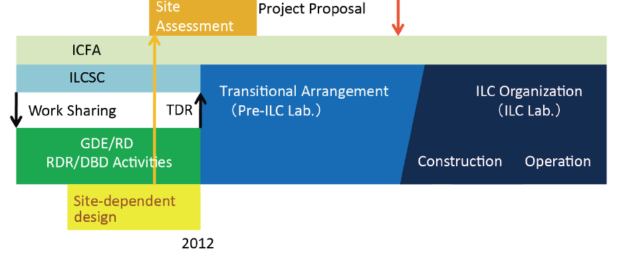
Status and Prospect for ILC
Pre-Preparation and
Preparation Phase
Assuming (~2+) 4 year
(9 year)
We are here,
In 2018
ILC Progress and Prospect

Slide 32
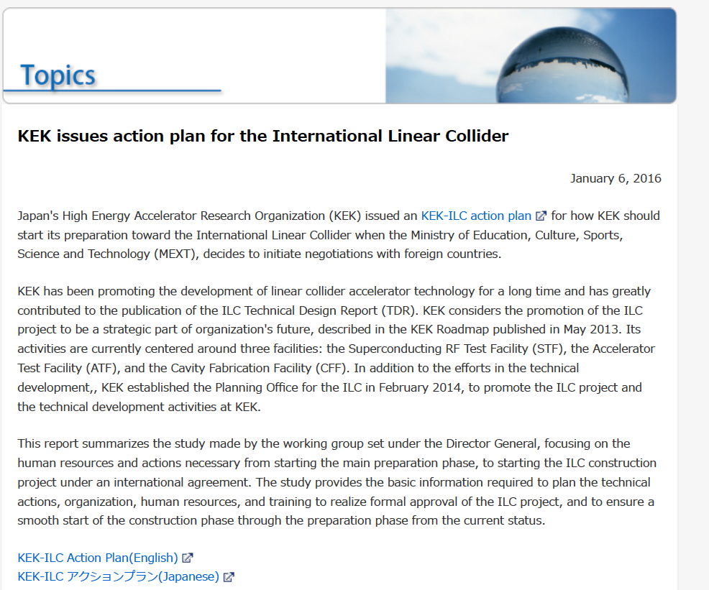
KEK-ILC Action Plan Issued, Jan. 2016 https://www.kek.jp/en/NewsRoom/Release/20160106140000/
 | Pre-Preparation Stage | Main Preparation Stage
 | present (we are here) | P1 | P2 | P3 | P4
ADI | Establish main parameters | Verify parameters w/ simulations
SRF | Beam acc. with SRF cavity string, Cost Reduction R&D (proposed) | Demonstrate mass-production technology, stability, hub-lab functioning, and global sharing
Nano-beam | Achieve the ILC beam-size goal | Demonstrate the nanobeam size and stabilize the beam position
e+ | Demonstrate technological feasibility | Demonstrate both the undulator and e-driven e+ sources
CFS | Pre-survey and basic design | Geology survey, engineering design, specification, and drawings
ILC Progress and Prospect

Slide 33
European ILC Prep. Plan, published in 2018
Note: European Industry to be a key partner, based on its European XFEL experiences

Slide 34



Courtesy: S. Yamashita
ICFA-2018, Souel
Discussions with Europe:
1st Japanese Delegation to Europe
(Parliament, Ministries, Industry, Region, Researchers)
Visited Paris and Berlin (2018.1.9～1.11), and
Visited CERN, 2018.1.08 and 1.12
Germany / France side
Politicians: Hon. Becht (France), Hon. Kaufmann (Germany),
and
Hon. Trautmann (EU/Strasbourg)
Researchers: Marc Winter, Maxim Titov (France)
Rolf Heuer, Joachim Mnich (Germany),
Anticipated EU-JP cooperation sharing the cost discussed

Slide 35
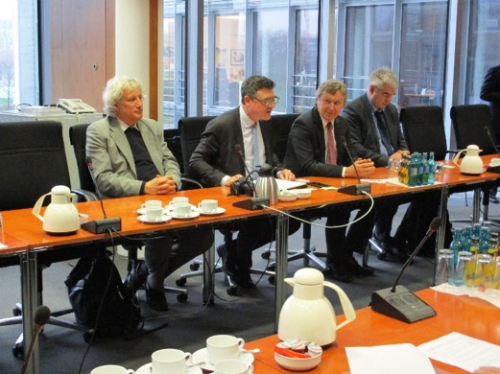
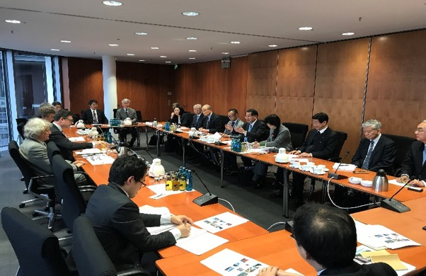
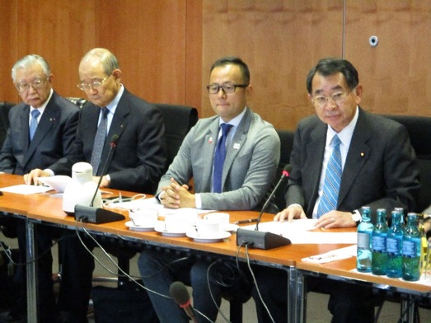
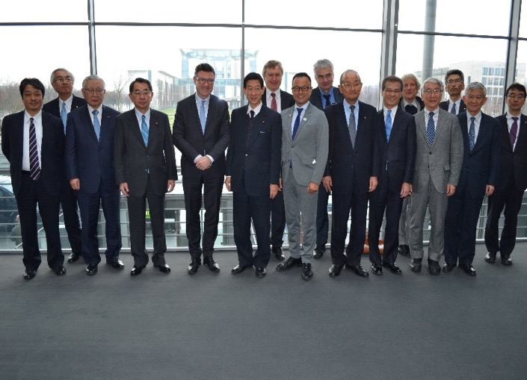




Courtesy: S. Yamashita
ICHEP/ICFA-2018, Souel
Counterparts between Germany and Japan established at four levels:
Bundestag and Diet
Ministries
F. A. / Laboratories
Researchers
BMBF, Germany
Hon. Kaufmann
Dr. Schuette

Slide 36



Courtesy: S. Yamashita
ICHEP/ICFA-2018, Souel
Hon. Olivier BECHT visit Japan in May, 2018
May 16 @ TOHOKU with Governor of Iwate prefecture, Mayors, Economy bodies
May 17 @ TOKYO with Diet members, opinion leaders, industry, researchers
May 23 @ TOKYO (MHI) with Chair of Advanced Accelerator Association (AAA)
Gave BIG and WONDERFUL IMPRESSION to Japanese VIP’s
+
Facilitate clear recognition of Urgency and Necessity of Japanese Gov’s
Clear signal in time in 2018
+
Hints on protocol and processes to realize the signal in time from Japan.

Slide 37


Courtesy: S. Yamashita
ICHEP/ICFA-2018, Souel
July 5th, 2018
JP Cabinet, Diet, AAA Members:
Discussed ILC with Prime Minister Abe
- Prime Minister Abe
- Deputy Chief Cabinet Secretary Nishimura
- Deputy Chief Cabinet Secretary Nogami
- Kawamura (Diet Budget committee chair)
- Shionoya (LDP election chair)
- Suzuki (Minister of Olympic)
- Onodera (Minister of Defense)
- Nishioka (AAA chair, MHI former CEO)
- Takahashi (Tohoku, Tohoku electric former CEO)
- Yamashita

Slide 38
Outline
Introduction
ILC-250 overview
Nano-beam and SRF technologies advanced
Progress in cost-reduction R&D
Summary

Slide 39
Summary
Science:
Scientific significance of the precise measurements of the Higgs Boson increasing,
ILC redefined as a Higgs Factory at the maximum HZ cross section at E_{cm}=250 GeV, and
Energy extend-ability in future science.
Technology:
SRF technology matured: European XFEL SRF accelerator successfully built, with functioning as the prototype for the ILC.
Nano-beam technology matured: ATF demonstrating the FF beam size (41 nm) equivalent to that (7 nm) required at the ILC.
Cost reduced down to 2/3 or less, at a half E_{cm} and further advances in SRF technology.
Toward Project Decision:
Progress: JP/MEXT, ILC Advisory Panel finalizing the report. JP Science Council to provide the recommendation to MEXT-Government to finalize the decision.
Int’l discussions in progress: ICFA/LCB, US-JP, France-JP, Germany-JP, CERN, EU, EJADE, and …
The due-date of the input for the European Strategy, Dec. 2018, well informed.

Slide 40
Backup

Slide 41

(２０１８～)
Chair: G. Taylor

Slide 42
https://arxiv.org/abs/1711.00568

Slide 43
ILC Parameters, demonstrated, by 2016
Characteristics | Parameter | Unit | Demonstrated
Nano-bam:
ILC-FF beam size (y) KEK-ATF-FF equiv. beam size (y) | 5.9 37 (reaching 41 ) | nm nm | KEK-ATF
SRF:
Average accelerating gradient | 31.5 (±20%) | MV/m | DESY, FNAL, JLab, Cornell, KEK,
Cavity Q₀ | 10¹⁰
(Cavity qualification gradient | 35 (±20%) | MV/m)
Beam current | 5.8 | mA | DESY-FLASH), KEK-STF
Number of bunches per pulse | 1312 |  | DESY
Charge per bunch | 3.2 | nC
Bunch spacing | 554 | ns
Beam pulse length | 730 | ms | DESY, KEK
RF pulse length (incl. fill time) | 1.65 | ms | DESY, KEK, FNAL
Efficiency (RF→beam) | 0.44
Pulse repetition rate | 5 | Hz | DESY, KEK

Slide 44

A plan for ILC Cost-Reduction R&D in Japan and US focusing on SRF Technology, in 2~3 years
S. Michizono, S. Belomestnykh
Based on recent advances in technologies;
  Nb material preparation
  - w/ optimum RRR and clean surface
  SRF cavity fabrication for high-Q and high-G
  -w/ a new baking recipe provided by Fermilab
  Power input coupler fabrication
  - w/ new (low SEE) ceramic without coating
  Cavity chemical process
  - w/ vertical EP and new chemical (non HF) solution
  Others

Slide 45

1DE3 – the first 49 MV/m cavity
Cavity (fine grain) from DESY colleagues was prepared for baseline test before infusion, EP 60 microns + regular 120C bake (no nitrogen, low T oven)
Results were pretty surprising/puzzling
A. Grassellino et al, https://arxiv.org/abs/1806.09824

Slide 46
Repeated on second cavity TE1AES009 (fine grain, AES, WC)
EP+ 75C 4 hrs+ 120C 48 hours
Regular 120C
A. Grassellino et al, https://arxiv.org/abs/1806.09824

Slide 47
KEK-ILC Action Plan announced, Jan. 6, 2016
https://www.kek.jp/en/NewsRoom/Release/20160106140000/
KEK issued an KEK-ILC action plan for how KEK should start its preparation toward the International Linear Collider when the Ministry of Education, Culture, Sports, Science and Technology (MEXT), decides to initiate negotiations with foreign countries. ,,,
The study provides the basic information required to plan the technical actions, organization, human resources, and training to realize formal approval of the ILC project, and to ensure a smooth start of the construction phase through the preparation phase from the current status.

Slide 48

KEK-ILC-Action Plan

Slide 49
European ILC Preparation Plan, 2018

Slide 51




Washington DC, May 1-3, 2017

Slide 52



September 25, 2017
General Meeting, Federation of Diet Members for ILC

Slide 53



The second step
France-Japan Meeting on ILC
(Tokyo, 2017 Nov 29）
Japan:
Hon. Kawamura, Hon. Shionoya, Hon. Hirano, Hon. Ito, Hon. Otsuka, Hon. Fujiwara
MEXT: Mr. Itakura et al
Members of AAA, Tohoku Economy Federation
Researchers
France:
Hon. Olivier Becht
Mr. Jean-Christophe AUFFRAY （French Embassy)
Mr. Aurelien ANTHONY（Alsace Japan Agency)
etc.

