Slide 1
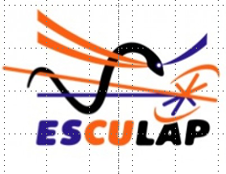
Phil LaseriX Heterodyne Synchronisation
For Drum & Esculap Projects

Slide 2
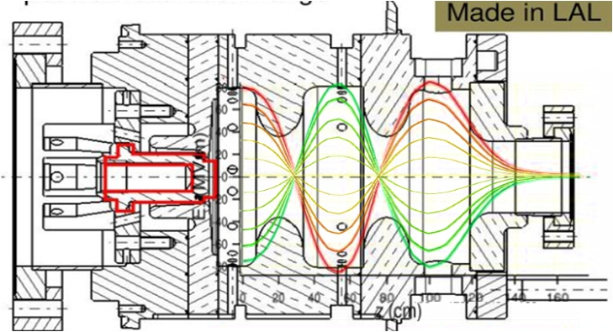
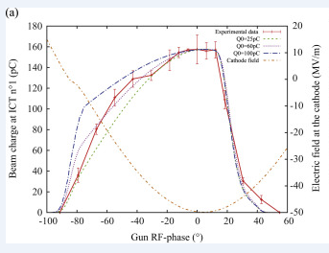
Introduction: What’s an RF electron GUN (a very very fast overview)
RF field @ Z=0 on the cathode
Laser Pulse
RF field
(AU)
Laser Pulse
0°
180°
0°
Time
phase
Laser Pulse
Gun RF phase (°)
RF power in the GUN (5Hz repetition rate)
The relative phase between Laser Pulse and RF in the Gun must be @ a chosen fixed point to extract electrons from the cathode.

Slide 3
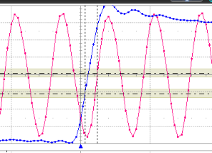
As a reference we measured the jitter on the PHIL machine with his own laser
Pilote PHIL
Cavity RF
Quartz PHIL
75MHz
ϕ
Amplifier
Divider
RF power Amplifier
3GHz MWatt RF (5Hz)
RF GUN
PHIL experiment with his own laser : The laser oscillator is locked in phase with the Phil Quartz wich also provide the 3GHz.
PLL *40
Cathode
PHIL
Timing generator (5Hz)
75MHz ref
CH2
Oscilator
Laser
Ampli
laser
Laser pulse 50µJ (5Hz)
Phil Laser
CH3
Fast photodiode
CH2
CH3
100s jitter delay 1.1ps RMS
with
1100fs displayed on Laser phase
loop control software
Oscilloscope 6GHz 40GS/s

Slide 4
Requirement for ESCULAP & DRUM experiments
The goal of those experiments is to create and study sub-picosecond electron bunch dynamic and to develop Laser Plasma Wakefield Accelerator.
That’s require a high stability electron beam (Energy charge..). The first parameter is the phase stability between the Radio Frequency Field in the RF gun and the Laser pulse which creates the electron beam.
The requirement for ESCULAP & DRUM experiments is around 1degree 3GHz rms (equivalent to 1ps rms).
What is usually done to achieve a such stability is to use One reference RF source and to phase lock all the other oscillators to the Quartz. (PHIL example) That synchronizes directly the laser pulse to the 3GHz RF signal.
As LaseriX oscillator was not designed to be externally phase locked, we unsuccessfully tried to use LaseriX oscillator as the PHIL reference in place of the Quartz.
To run the two asynchronous machines in the same time, we have developed a method the Heterodyne Synchronization.

Slide 5
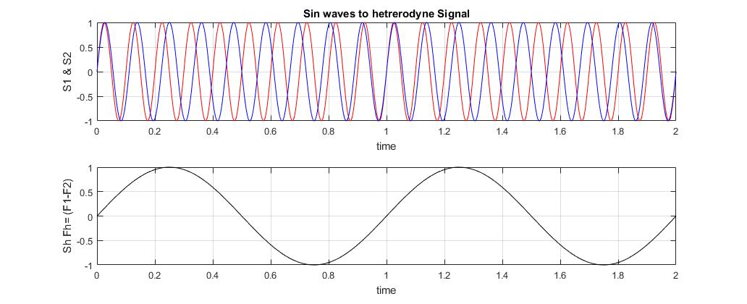
Heterodyne principle:
To create the Heterodyne signal we « just » have to multiply the two input signals:
And to filter high frequency signal with a Low Pass Filter:
Example S1 = sin(2π*10*t) S2 = sin(2π*9*t)
The heterodyne signal gives the relative phase between the two inputs signals in function of the time. If a chosen amplitude (ie. 0 crossing) is detected, the detection time solve the equation.
Theses equations give the dependency for the time/phase detection accuracy versus:
- amplitude noise
- time noise detection.
Conclusion:
- To reduce noise dependency, the Input signal frequency (f₀) and the amplitude (AB) of the heterodyne signal must be higher as possible.
Time/Phase relation is transposed from input signals to heterodyne signal:
360° phase shift between V1 &V2 input signals correspond to 360° for heterodyne signal.

Slide 6
PHIL – LaseriX Heterodyne synchronization global scheme
Pilote PHIL
75MHz
3GHz 5Hz MWatt RF
RF GUN
3GHz
Quartz PHIL
75MHz
PLL *40
ϕ
Amplifier
Divider
switch
RF power Amplifier
δF 4KHz
Cathode
Cavity RF
10HZ
Laser/RF Phase shifter
20HZ
5HZ
5HZ
F_{G}
δF=4KHz
Timing PHIL
Femto sec pulse
Low & High
pass filter
1KHz to 5KHz
Phase control
Comparator
Masterclock
Ext Clock
F_{m}
PLL *40
Hétérodyne Synchro
10HZ
Timing
LaseriX
Ext Clock
F_{OL}
LaseriX must be triggered @ 10Hz repetition rate
PHIL is triggered @ 5 Hz repetition rate
Oscilator
LaseriX
Ampli
laser
10HZ 100fs 80µJ UV laser Pulse
Hétérodyne Synchronisation
Freq Quartz phil : F_{Q} =74 963 950 Hz
Freq Gun: F_{G} =40* F_{Q} = 2998.55MHz
Freq synchro: F_{m} =(40* F_{OL} )+ 4KHz
Freq osc Laser: F_{OL} = F_{Q} + 4KHz/40
δF=4KHz = F_{G} - F_{m}
F_{OL} is frequency locked using δF as reference
δF triggers Phil and LaseriX timings at 5Hz and 10Hz when F_{G} et F_{m} are at the same phase.
Hétérodyne Synchronisation
Mixing the frequency allows to reduce time sensitivity
1°_{3GHz} 1.09ps
1°_{4KHz} = 694ns
PC
Frequency meter
LaseriX

Slide 7
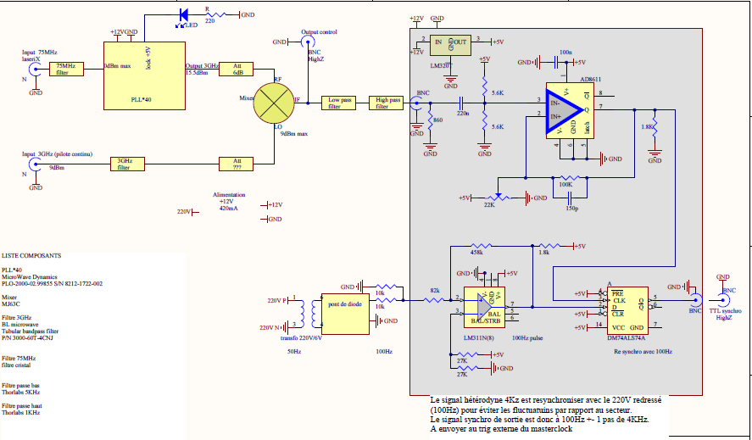
Electronic scheme for heterodyne frequency generation and the low frequency timing
Heterodyne Frequency
4KHz to frequency control of the laser oscillator
From LaseriX oscillator
heterodyne frequency generation
From 3GHz PHIL pilote
100Hz
To masterclock
50Hz line synchronization

Slide 8
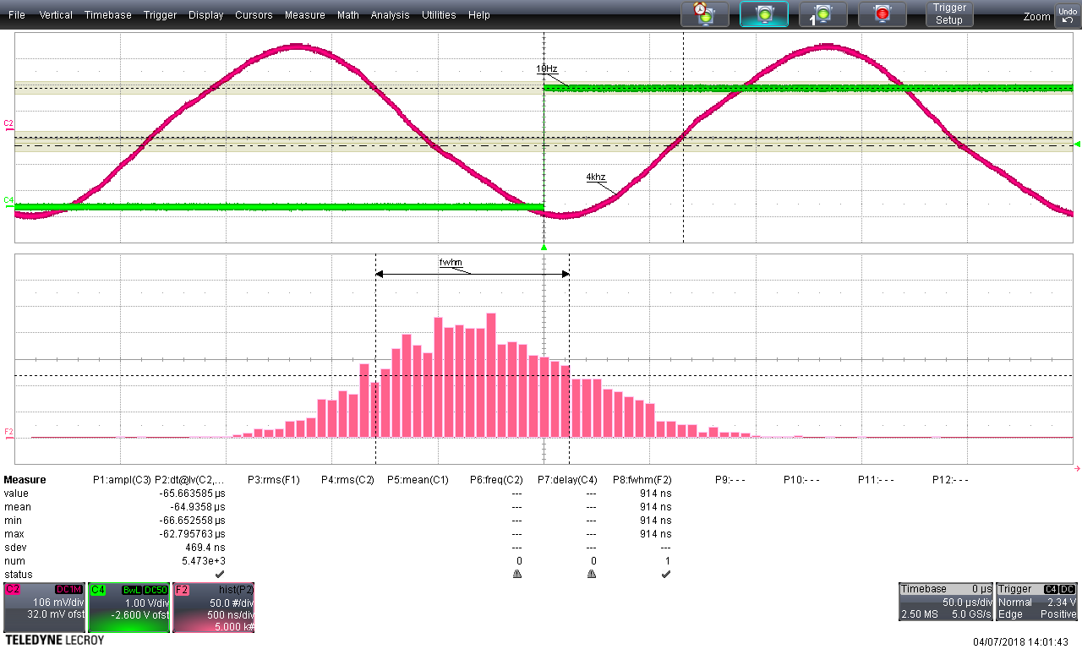
PHIL High Power RF requirement & Synchronization electronic performance
The synchronization signal must be re-synchronized with de 50Hz line due to the sensitivity of the RF power generation to 50Hz line phase.
The frequency error of the repetition rate for LaseriX is about 2.5%. (under specification)
Heterodyne Signa l (4Kz)
T=205µs
Line 100Hz
T=10ms
Re synsynchronized
T=10ms +- 250µs
Electronics Jitter measurement:
From the output of the mixer (4KHz) to the timing generator (10Hz) (Masterclock)
469ns rms @ 4KHz correspond à 0.6° @ 3GHz.
That’s below the requirement of 1° @ 3GHz.

Slide 9
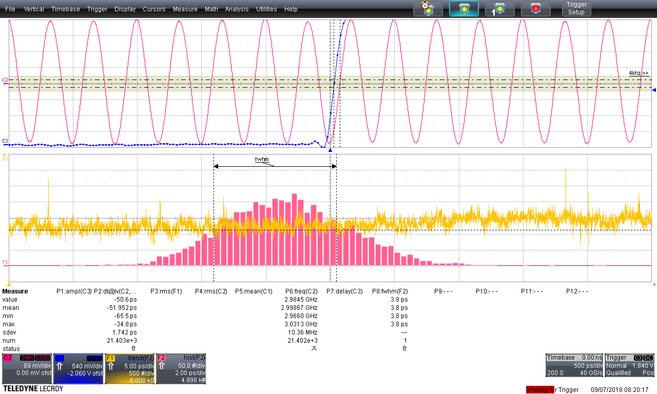
Phil laseriX global jitter between 3GHz RF and Laser Pulse @10Hz
Phil LaseriX Jitter (15mn): 3.8ps FWHM (1.7ps RMS)
The 1.7ps RMS are partly due to the photodiode limitation measurement (rise time of the photodiode 160ps).

Slide 10
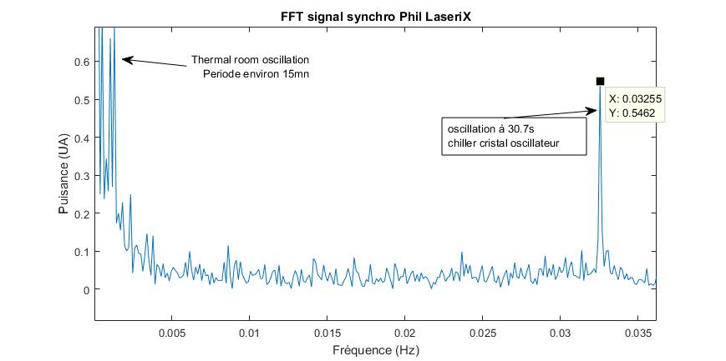
Phil laseriX global jitter between 3GHz RF and Laser Pulse @10Hz
ZOOM
Residual noise’s source assumption:
Thermal noise :
Laser Room temperature regulation (T~15mn)
Chiller cristal oscillator (T~30s)
PHIL machine room temp (T~Hours)

Slide 11
PHIL – LaseriX Heterodyne synchronisation & phase loop scheme
Pilote PHIL
75MHz
3GHz 5Hz MWatt RF
RF GUN
3GHz
Quartz PHIL
75MHz
PLL *40
ϕ
Amplifier
Divider
Switch
RF power Amplifier
δF 4KHz
Cathode
Cavity RF
10HZ
Phase error correction
20HZ
5HZ
5HZ
F_{G}
δF=4KHz
Timing PHIL
Femto sec pulse
Low & High
pass filter
1KHz to 5KHz
Phase error correction
Comparator
Masterclock
Ext Clock
Ext Clock
F_{m}
RF/Laser phase setting
PC
Labview
Phase loop
PLL *40
Hétérodyne Synchro
Optical delay line
Phase error
10HZ
Timing
LaseriX
Ext Clock
40ps rise time
Photodiode
3GHz
Bandpass filter
Wavecatcher
F_{OL}
Oscilator
LaseriX
Phase loop System
Ampli
laser
10HZ 100fs 80µJ UV laser Pulse
Hétérodyne Synchronisation
Freq Quartz phil : F_{Q} =74 963 950 Hz
Freq Gun: F_{G} =40* F_{Q} = 2998.55MHz
Freq synchro: F_{m} =(40* F_{OL} )+ 4KHz
Freq osc Laser: F_{OL} = F_{Q} + 4KHz/40
δF=4KHz = F_{G} - F_{m}
F_{OL} is frequency locked using δF as reference
δF triggers Phil and LaseriX timings at 5Hz and 10Hz when F_{G} et F_{m} are at the same phase.
Phase loop System
Phase error is measured comparing the laser pulse (3GHz filtered) with the 3GHz signal from the gun loop
The phase error(5Hz repetition time) is acquired by a wavecatcher.
a labview software processes the signal
The phase shifter of pilote PHIL is driven to keep the phase error null
The optical delay line (off the loop) stalls the RF/laser phase in the gun.
PC
Frequency meter
LaseriX

Slide 12
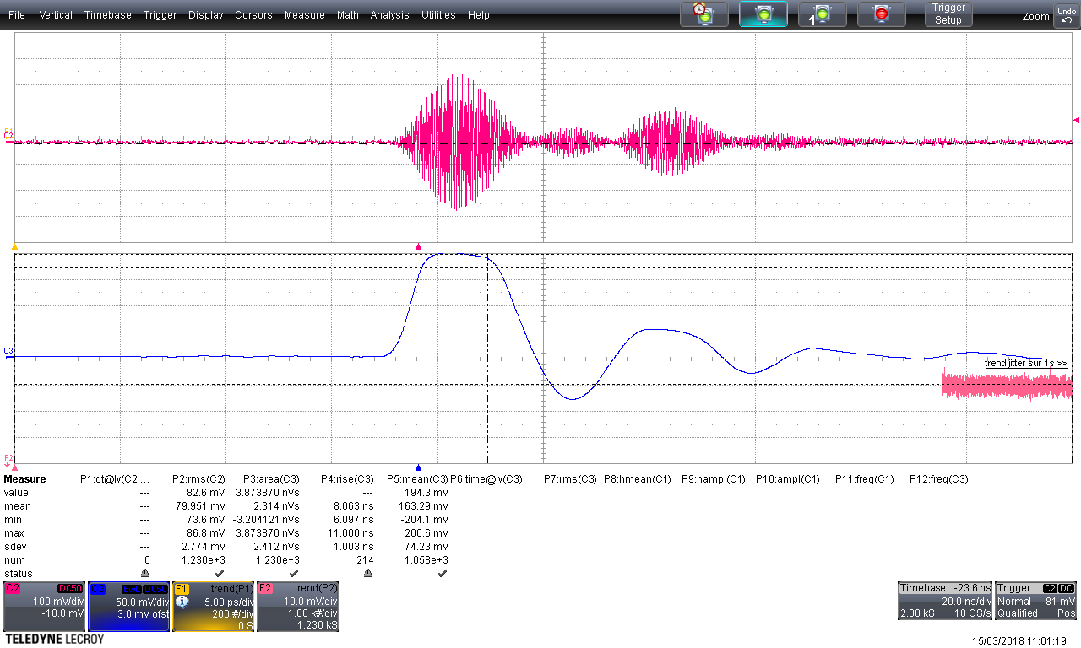
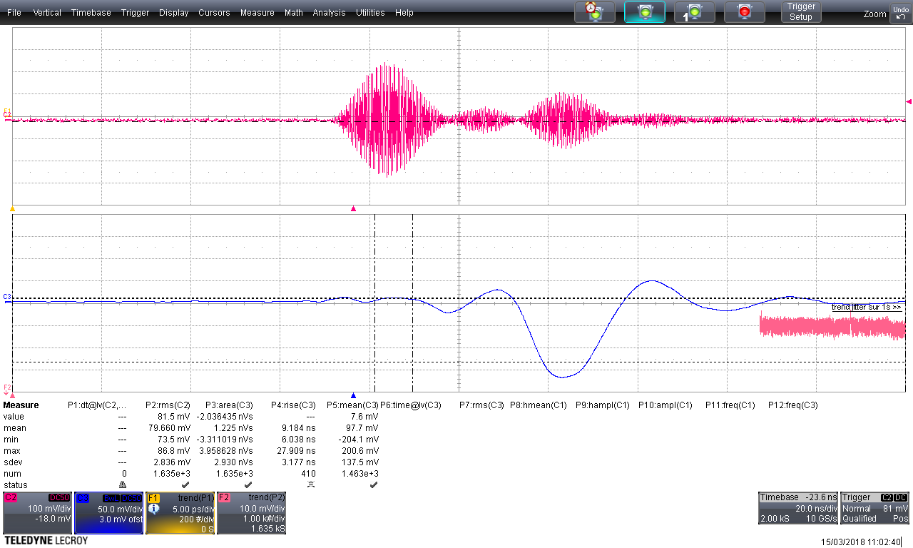
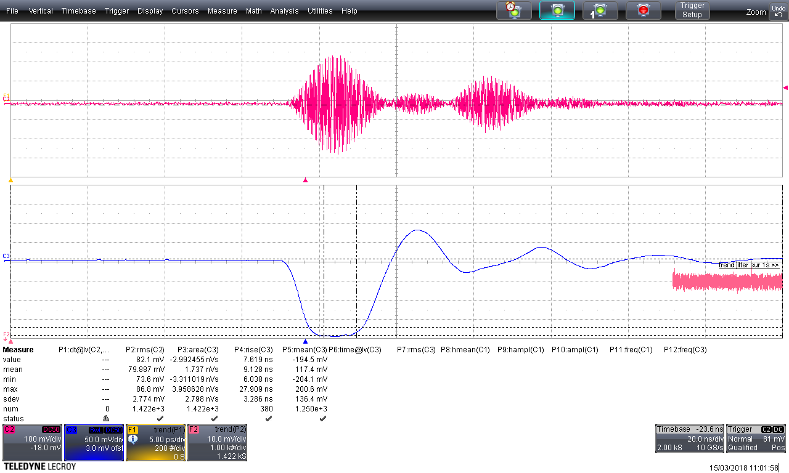
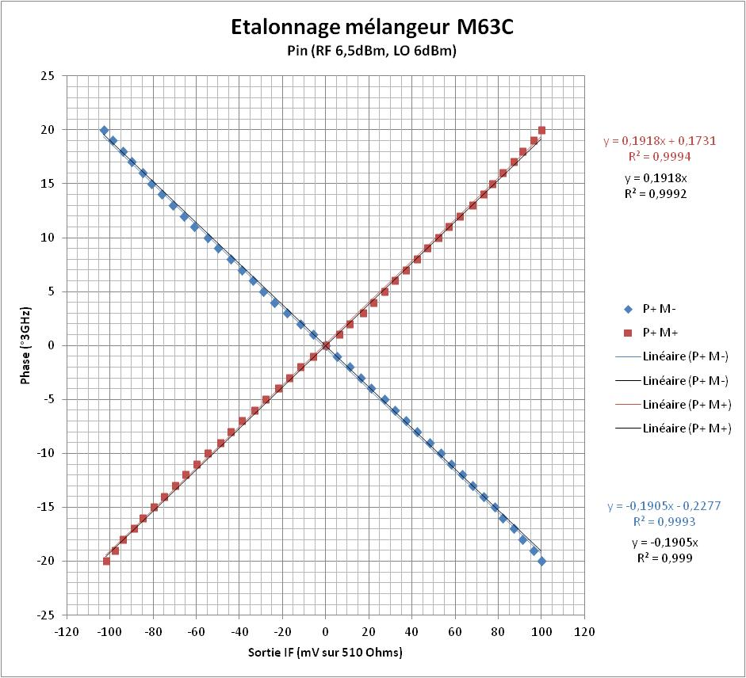
Laser fast diode signal filtered by a 3Ghz bandwidth filter
Output of the mixer for 3 phases
between 3GHz RF (3µs length) and LaseriX pulse
-90°
0°
+90°
Sampling time
Max 5ns
Output mixer linearity versus Input signals relative phase (we assume that linearity is granted beween -20° to20°)
Output value of the mixer must be trigger with a ns time resolution.
We use a wavecatcher to acquire the value

Slide 13
Phase loop acquisition scheme
Photodiode
synchro
Laser
40ps rise time
Photodiode
10V crete
3GHz
Bandpass filter
-21dBm
amplifier
ZHL42
+30dB
9dBm
Wavecatcher
PCLabview
Phase loop
140ps rise time
Photodiode
3V crete
Oscillo
40GS/s
RF
Mixer M63C
IF
CH2
CH1
usb
LO
3dBm
CH0
Pilote PA
5Hz
13dBm
Coupler (10db)
11dBm
RF
P Gun-loop
5Hz
Timing PHIL
Laser 5Hz
Attenuator
MAX 1Volt
Due to 14ns jitter between laser pulse and Phil timing (counting frequency 75MHz), the wavecatcher must be triggered with a coincidence between a photodiode (10Hz repetition rate) and the Phil timing (5Hz)

Slide 14
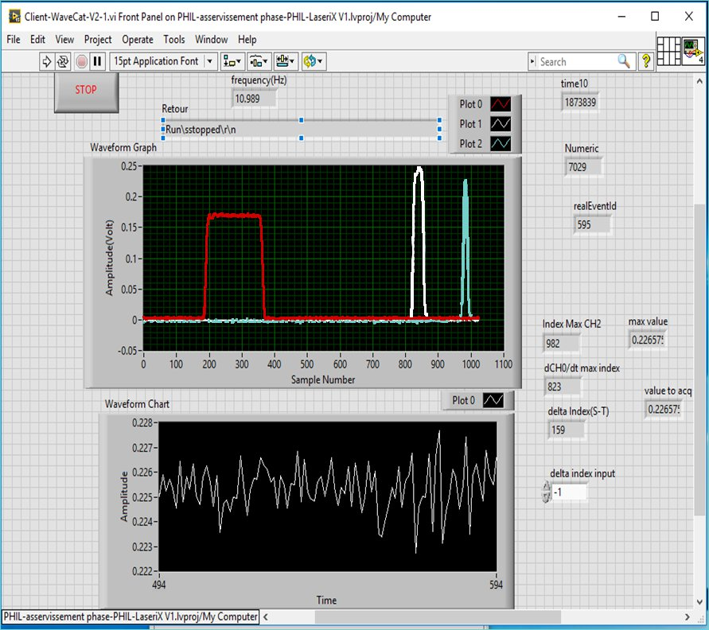
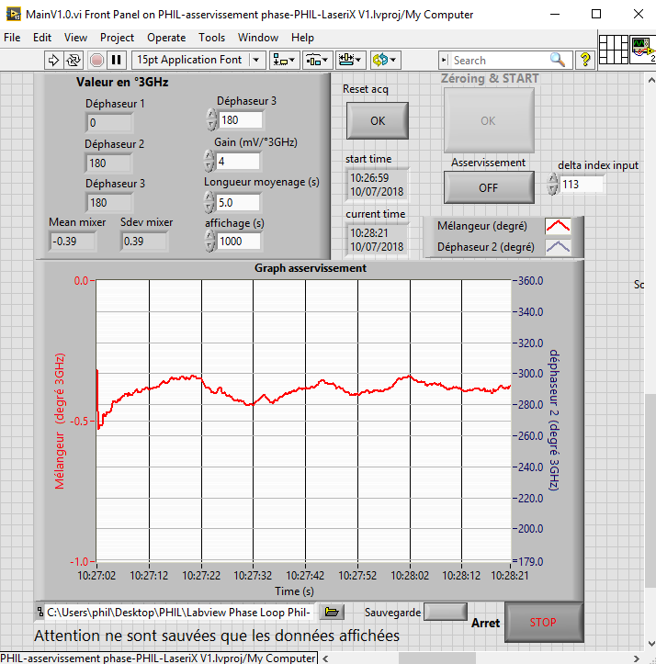
Acquisition system:
Wavecatcher board
driven toward a python server
Read with a Labview client
The Labview software computes the phase correction to send via Phil network and Panorama slowcontrol to a phase shifter in the pilote
Labview H.M.I.
Red => 5HZ PHIL timing
White=> 10Hz synchronization diode
Blue => mixer output 5Hz
Labview H.M.I.
Mixer voltage output value(5s averaged) sampled à 5Hz converted in 3GHz degree

Slide 15
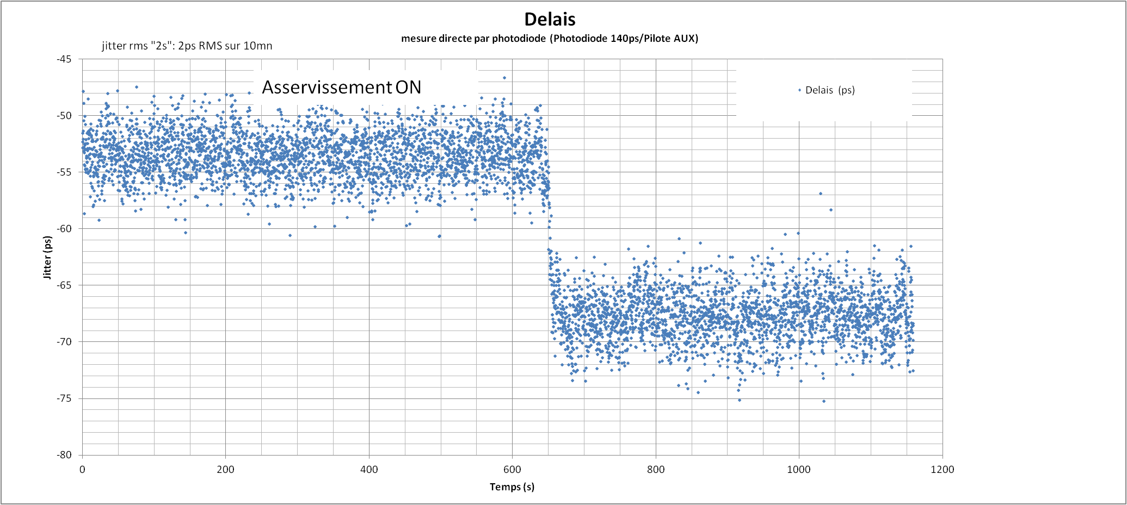
Results for the phaseloop feedback (5Hz repetition rate, 1200s )
Direct Jitter measurement
Laser pulse / 3GHz RF
Phase measurement from the mixer
Phase correction to Pilote phase shifter
Beam Video on Yag4
measuring baricenter beam position

Slide 16
Vidéos: Beam position after dipole on YAG4
Phase experimental result from Christelle & Harsh:
From scans Beam Energy / Phase :
They extract a better than 1ps RMS phase stability value
Futur:
electonic integration
software developpement
Hopes :
better reproductivity
user friendly interface for operator

Slide 17
THE END

Slide 18
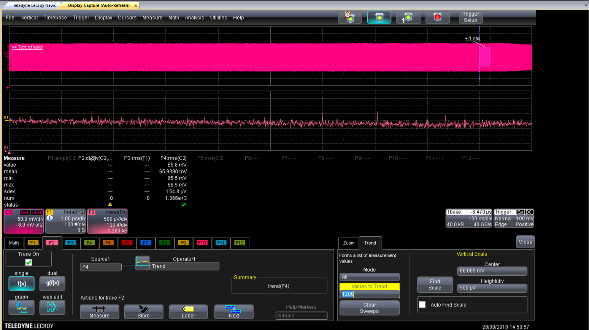
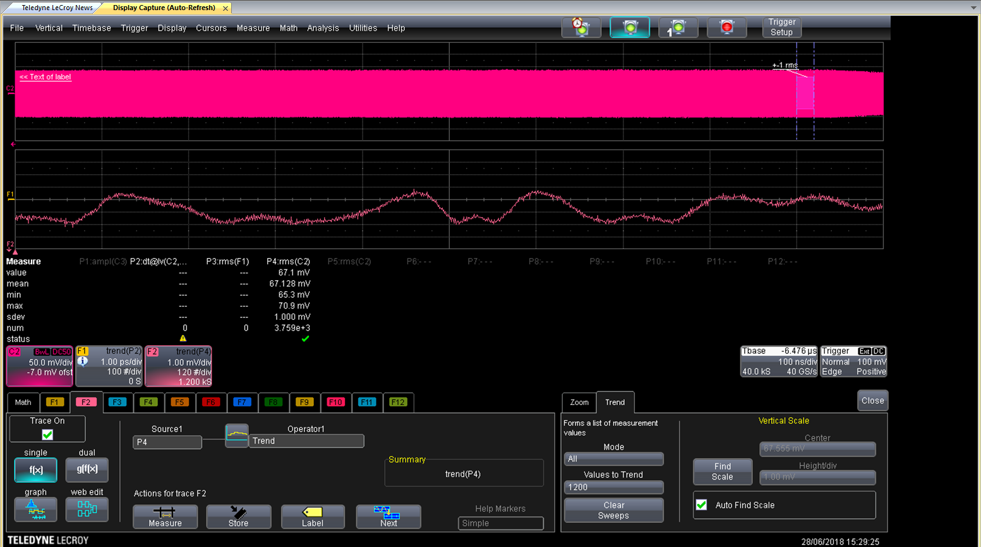
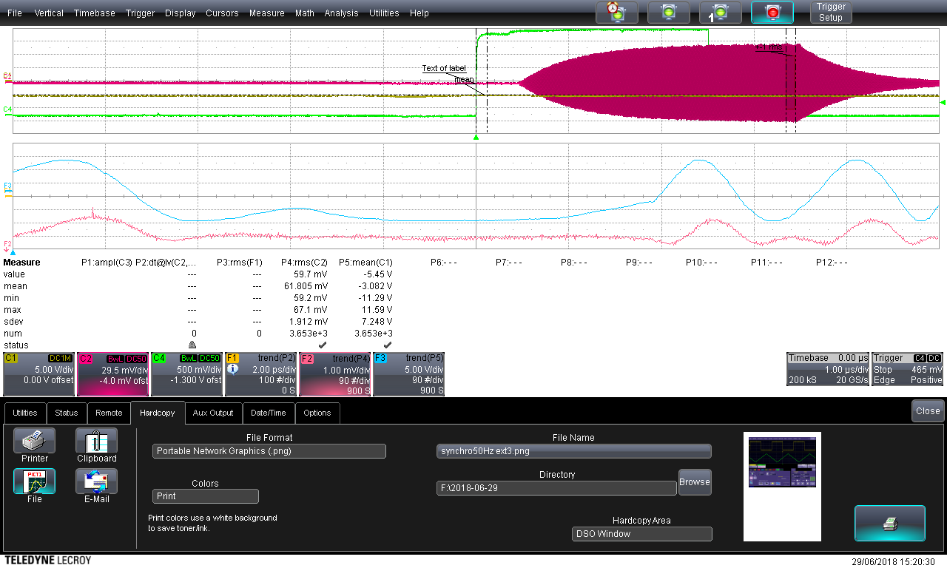
Timing synchro interne mesure PIC
Timing synchro Externe mesure PIC
L’oscilloscope est synchronisé sur le 5Hz de PHIL,
Le trend bleu est la mesure de l’amplitude du 50Hz secteur au moment du tir.
Le trend rouge est la mesure de l’amplitude du P boucle au moment du tir.
On observe une corrélation forte entre les deux trends
Timing synchro Externe mesure Pboucle cavité

Slide 19
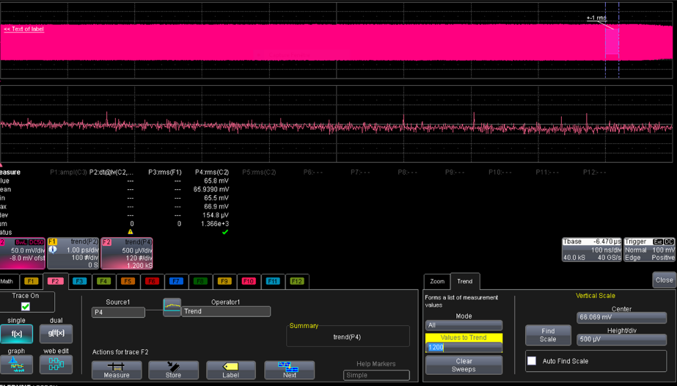
Puissance dans la cavité après re-synchronisation avec le 50Hz secteur
(enregistrement 4mn)

