Slide 1
THOMX linac and transfer line beam dynamics
Harsh PURWAR
Post-doctoral researcher, LAL
On behalf of the Beam Dynamics group

Slide 2
Emittance optimization by changing solenoid position
B1
B3
GUN
ThomX TDR
B1
23 cm
B3
GUN
Lower beta function & emittance
New ThomX
Focusing at the entrance of the section according to invariant envelope condition.

Slide 3
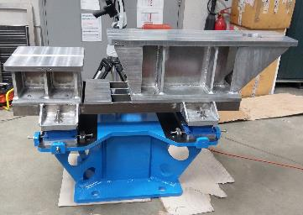
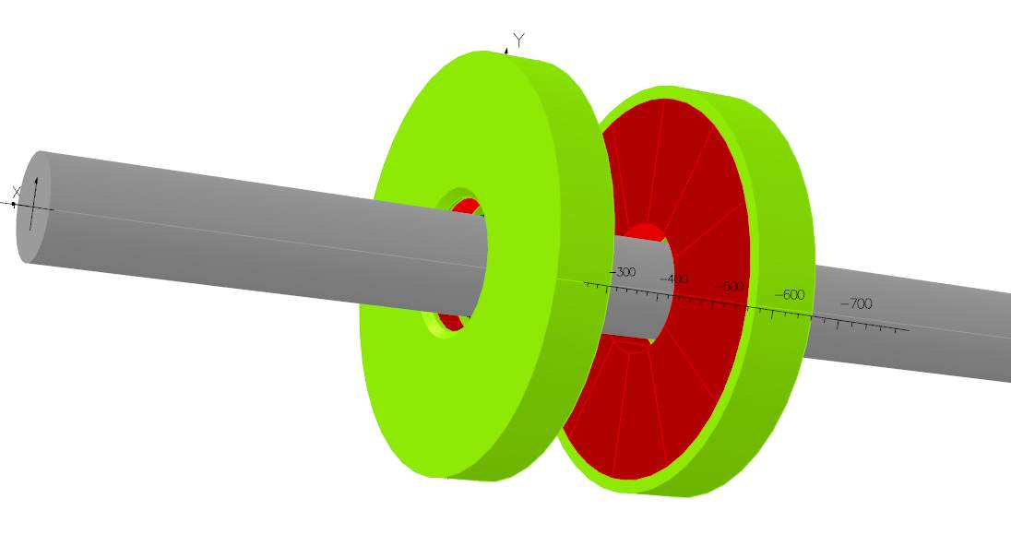
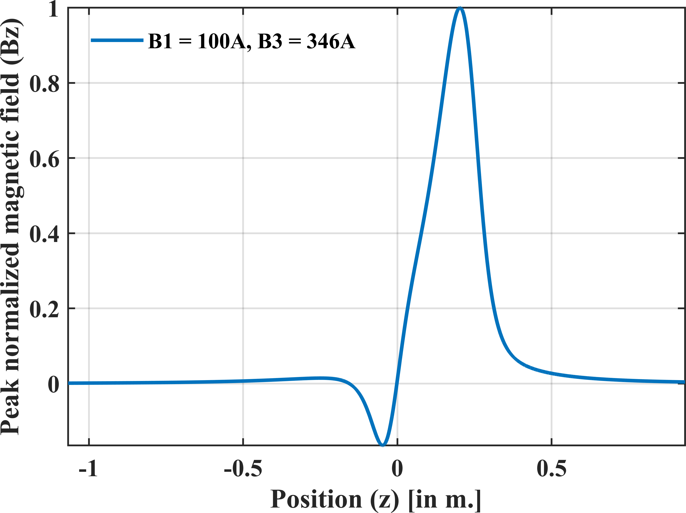
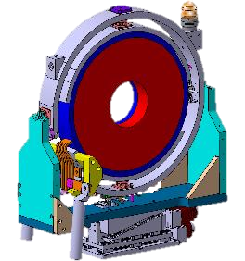
Magnetic calculation, new girder, motorized alignment of the solenoid

Slide 4
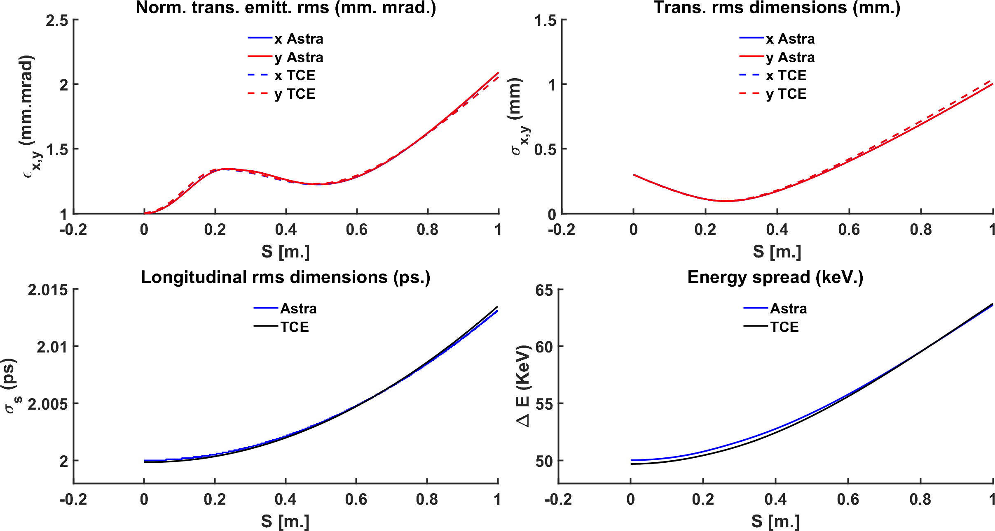
Space charge Astra/CODAL (in house code) for tracking in TL and ring

Slide 5
Linac sensitivity towards misalignment errors and jitters
Study conducted with ASTRA for 1000 machine configurations each with 10k macro-particles.

Slide 6
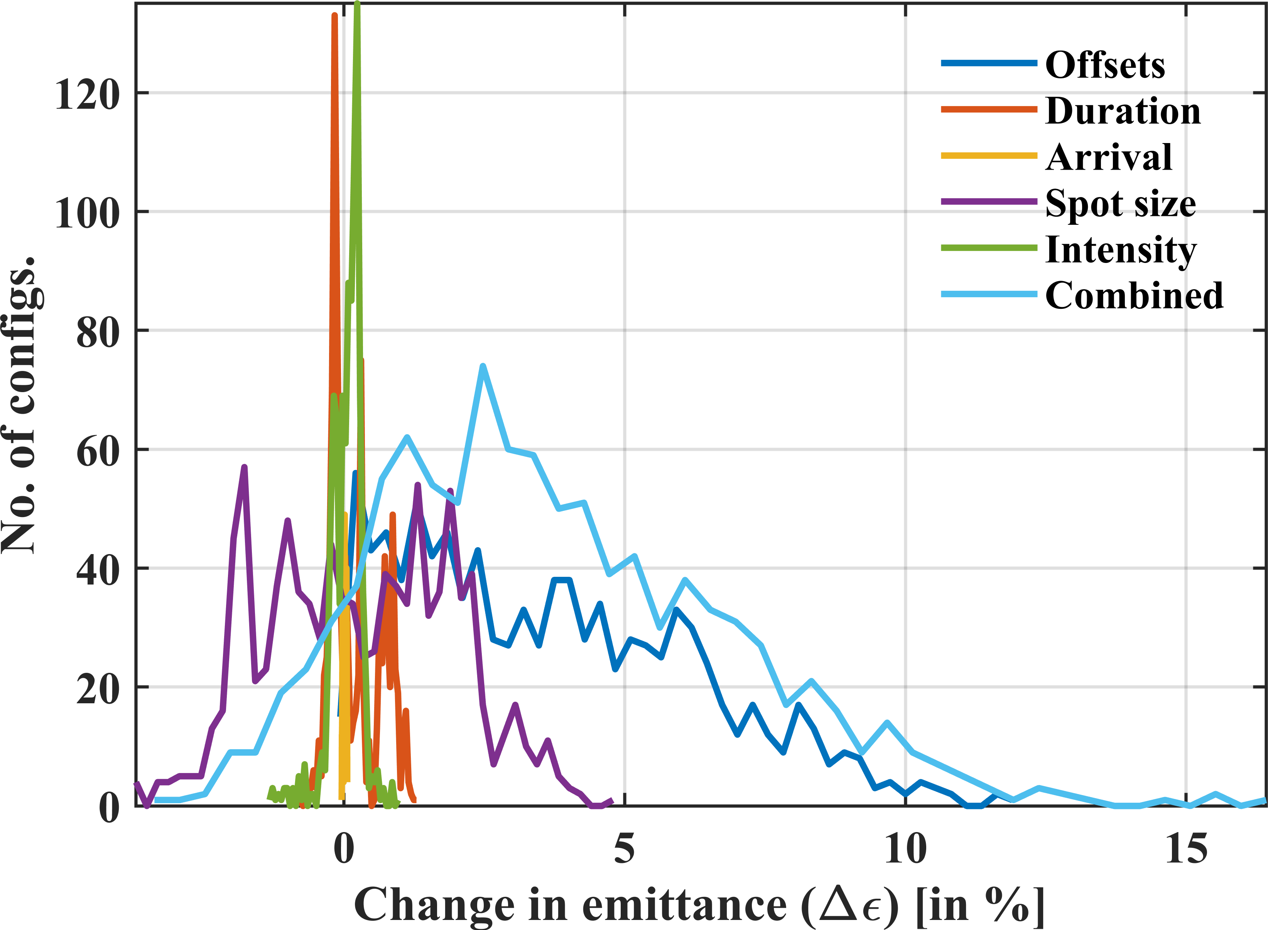
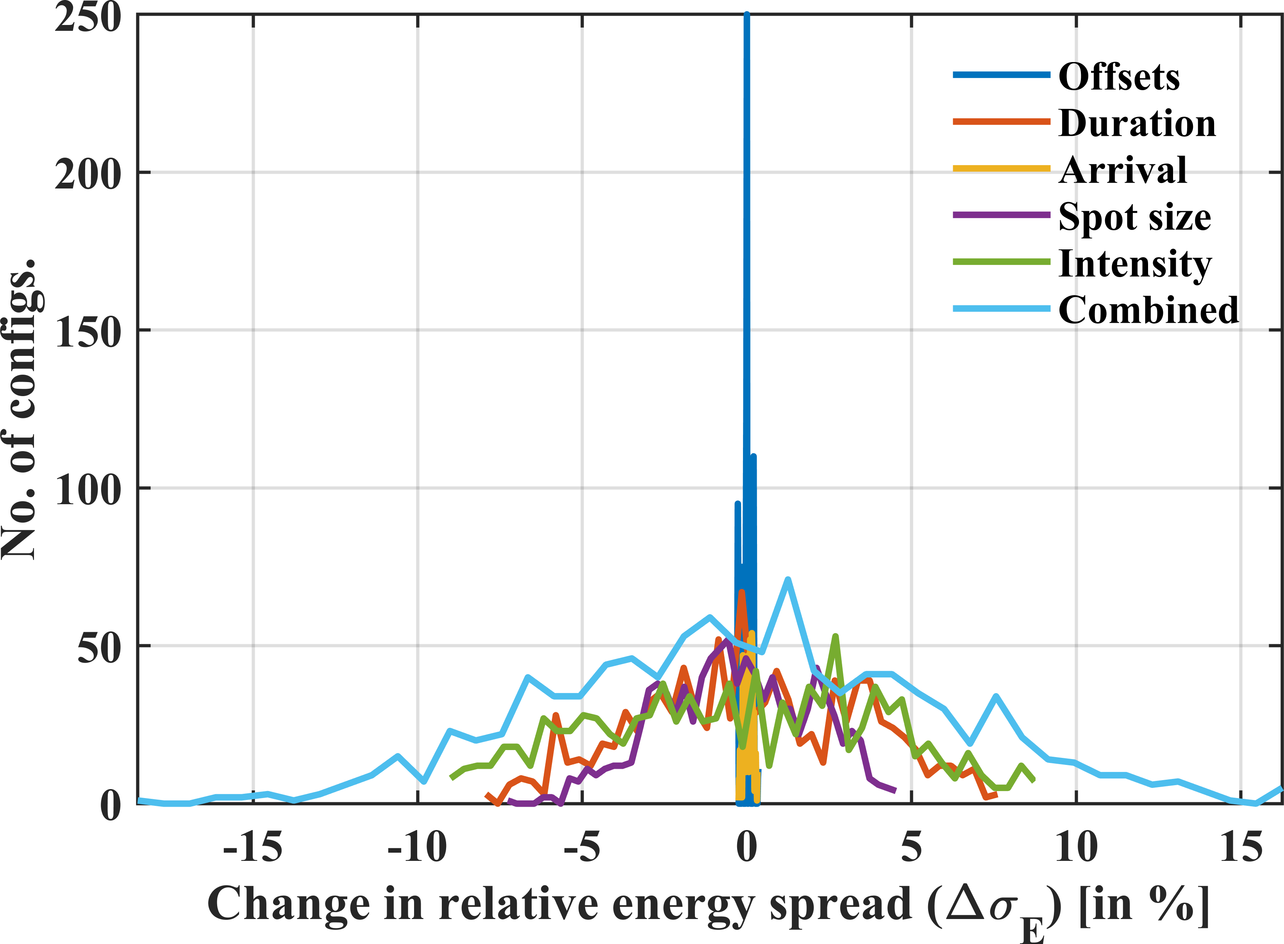
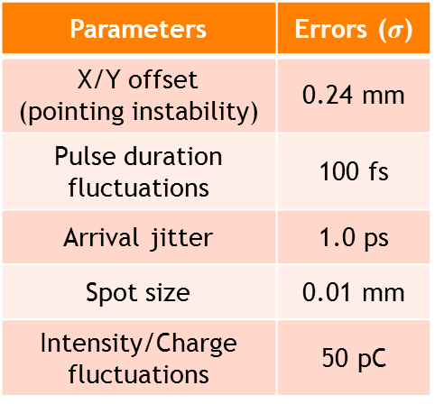
LASER instabilities and jitters
Number of random machines considered: 1000
Number of macro-particles: 10,000
Parameters | Errors ($σ$)
X/Y offset (pointing instability) | 0.24 mm
Pulse duration fluctuations | 100 fs
Arrival jitter | 1.0 ps
Spot size | 0.01 mm
Intensity/Charge fluctuations | 50 pC

Slide 7
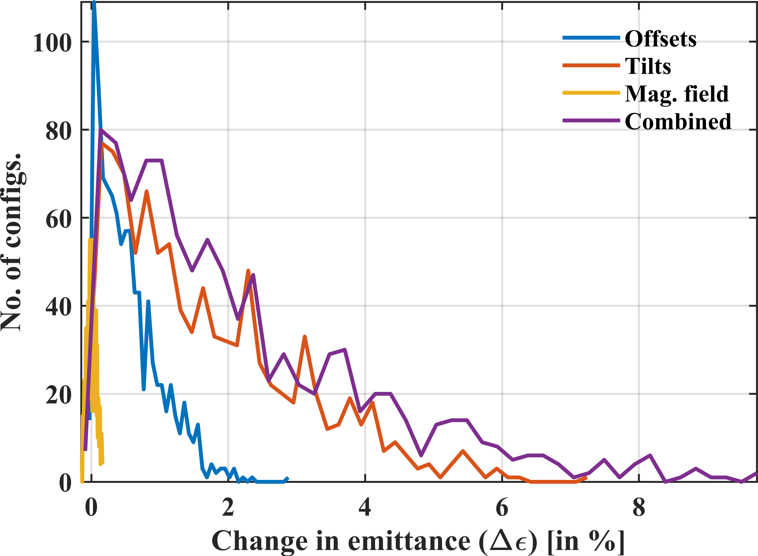
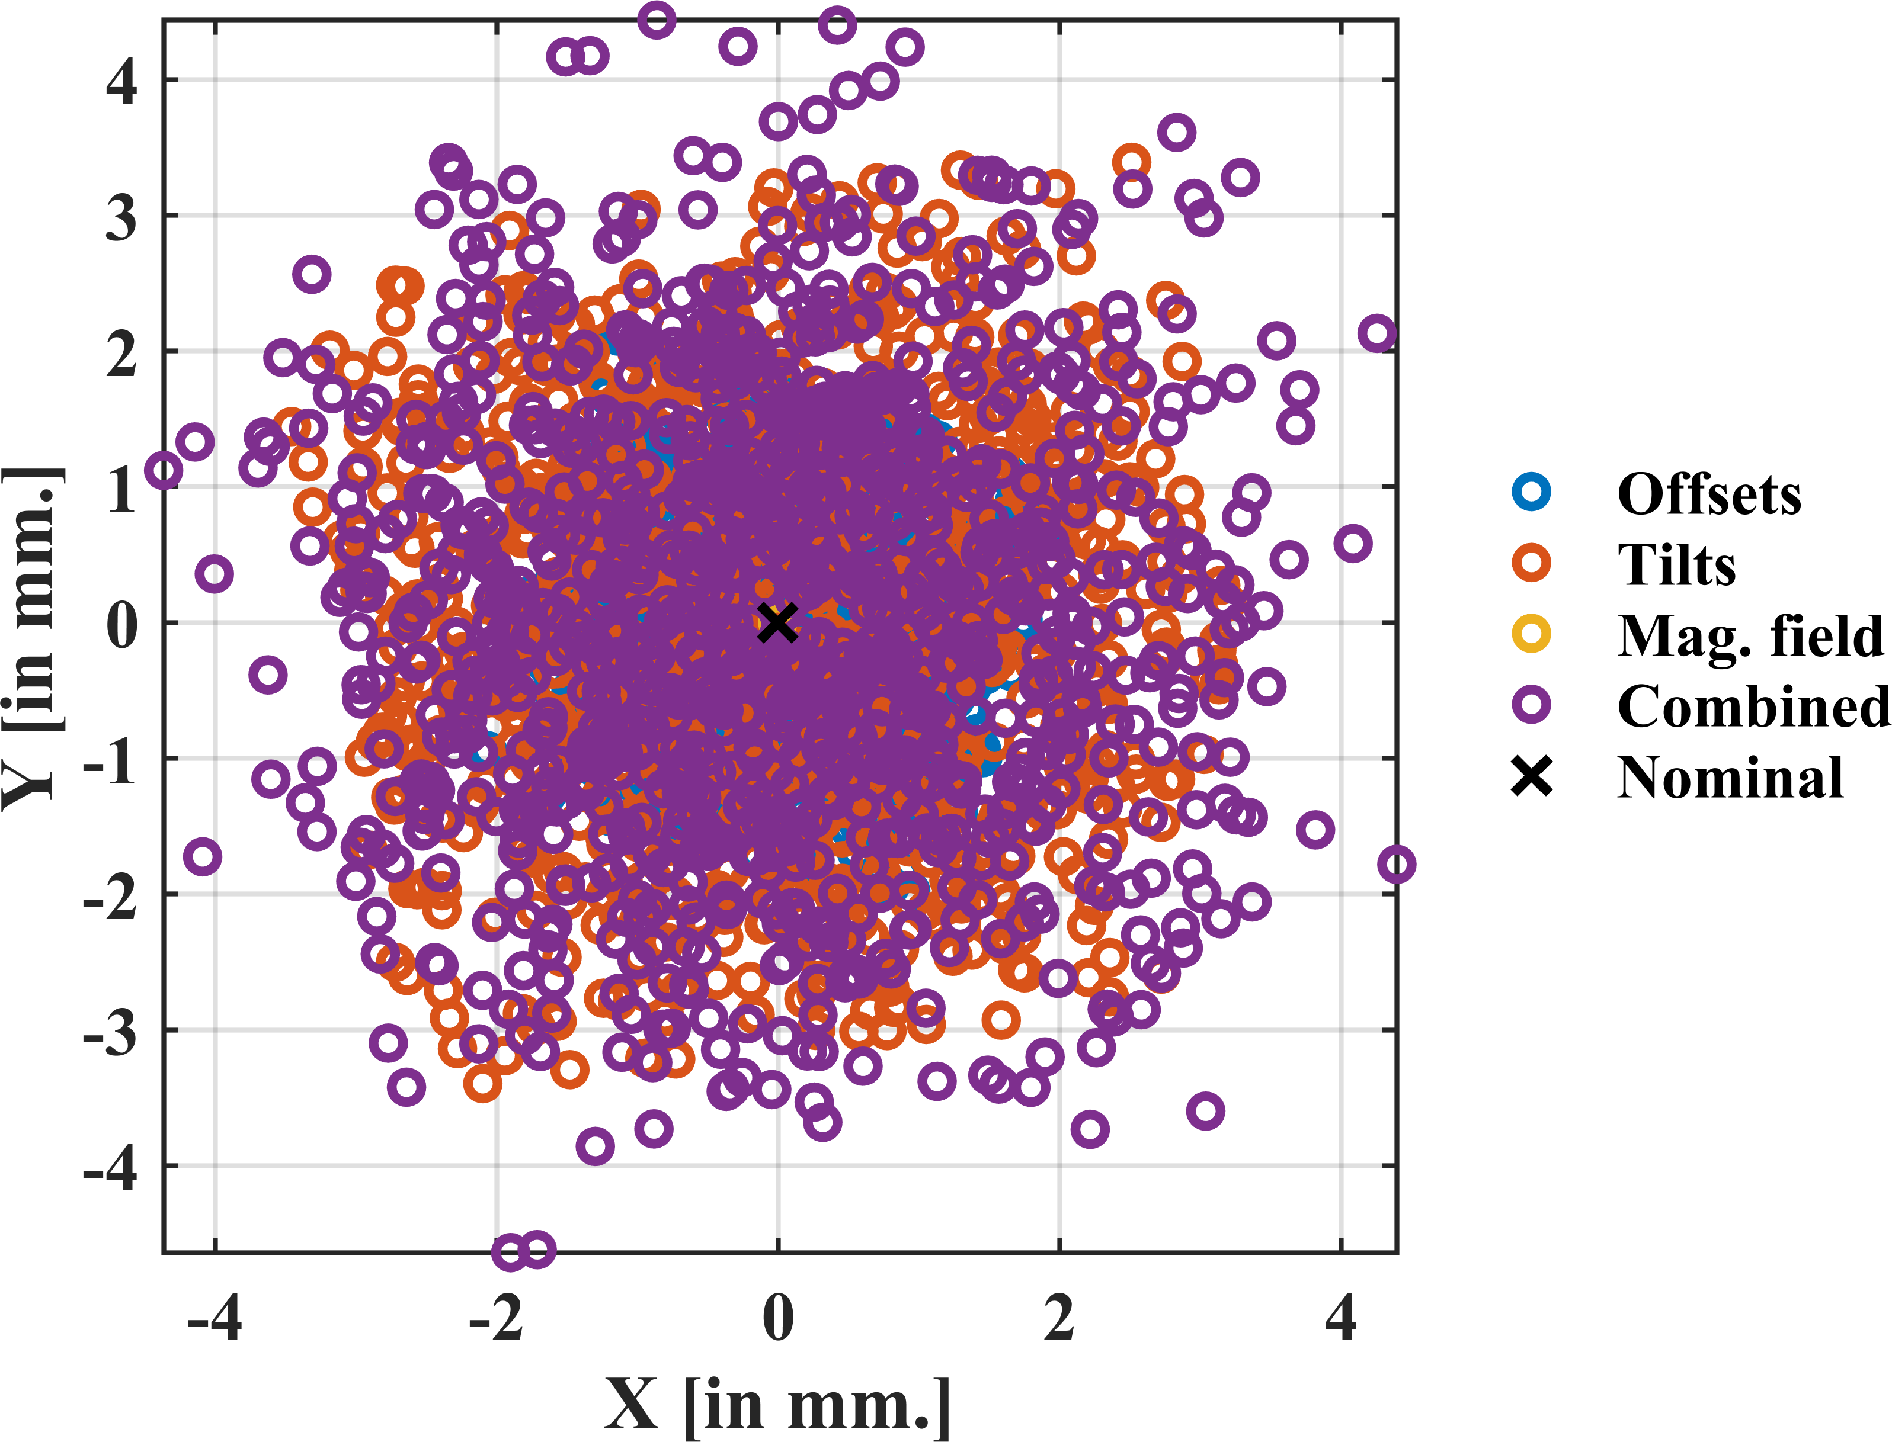
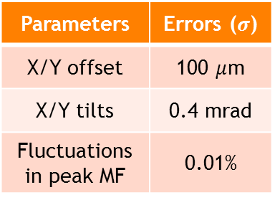
Solenoid misalignments
Parameters | Errors ($σ$)
X/Y offset | 100 $μ$m
X/Y tilts | 0.4 mrad
Fluctuations in peak MF | 0.01%

Slide 8
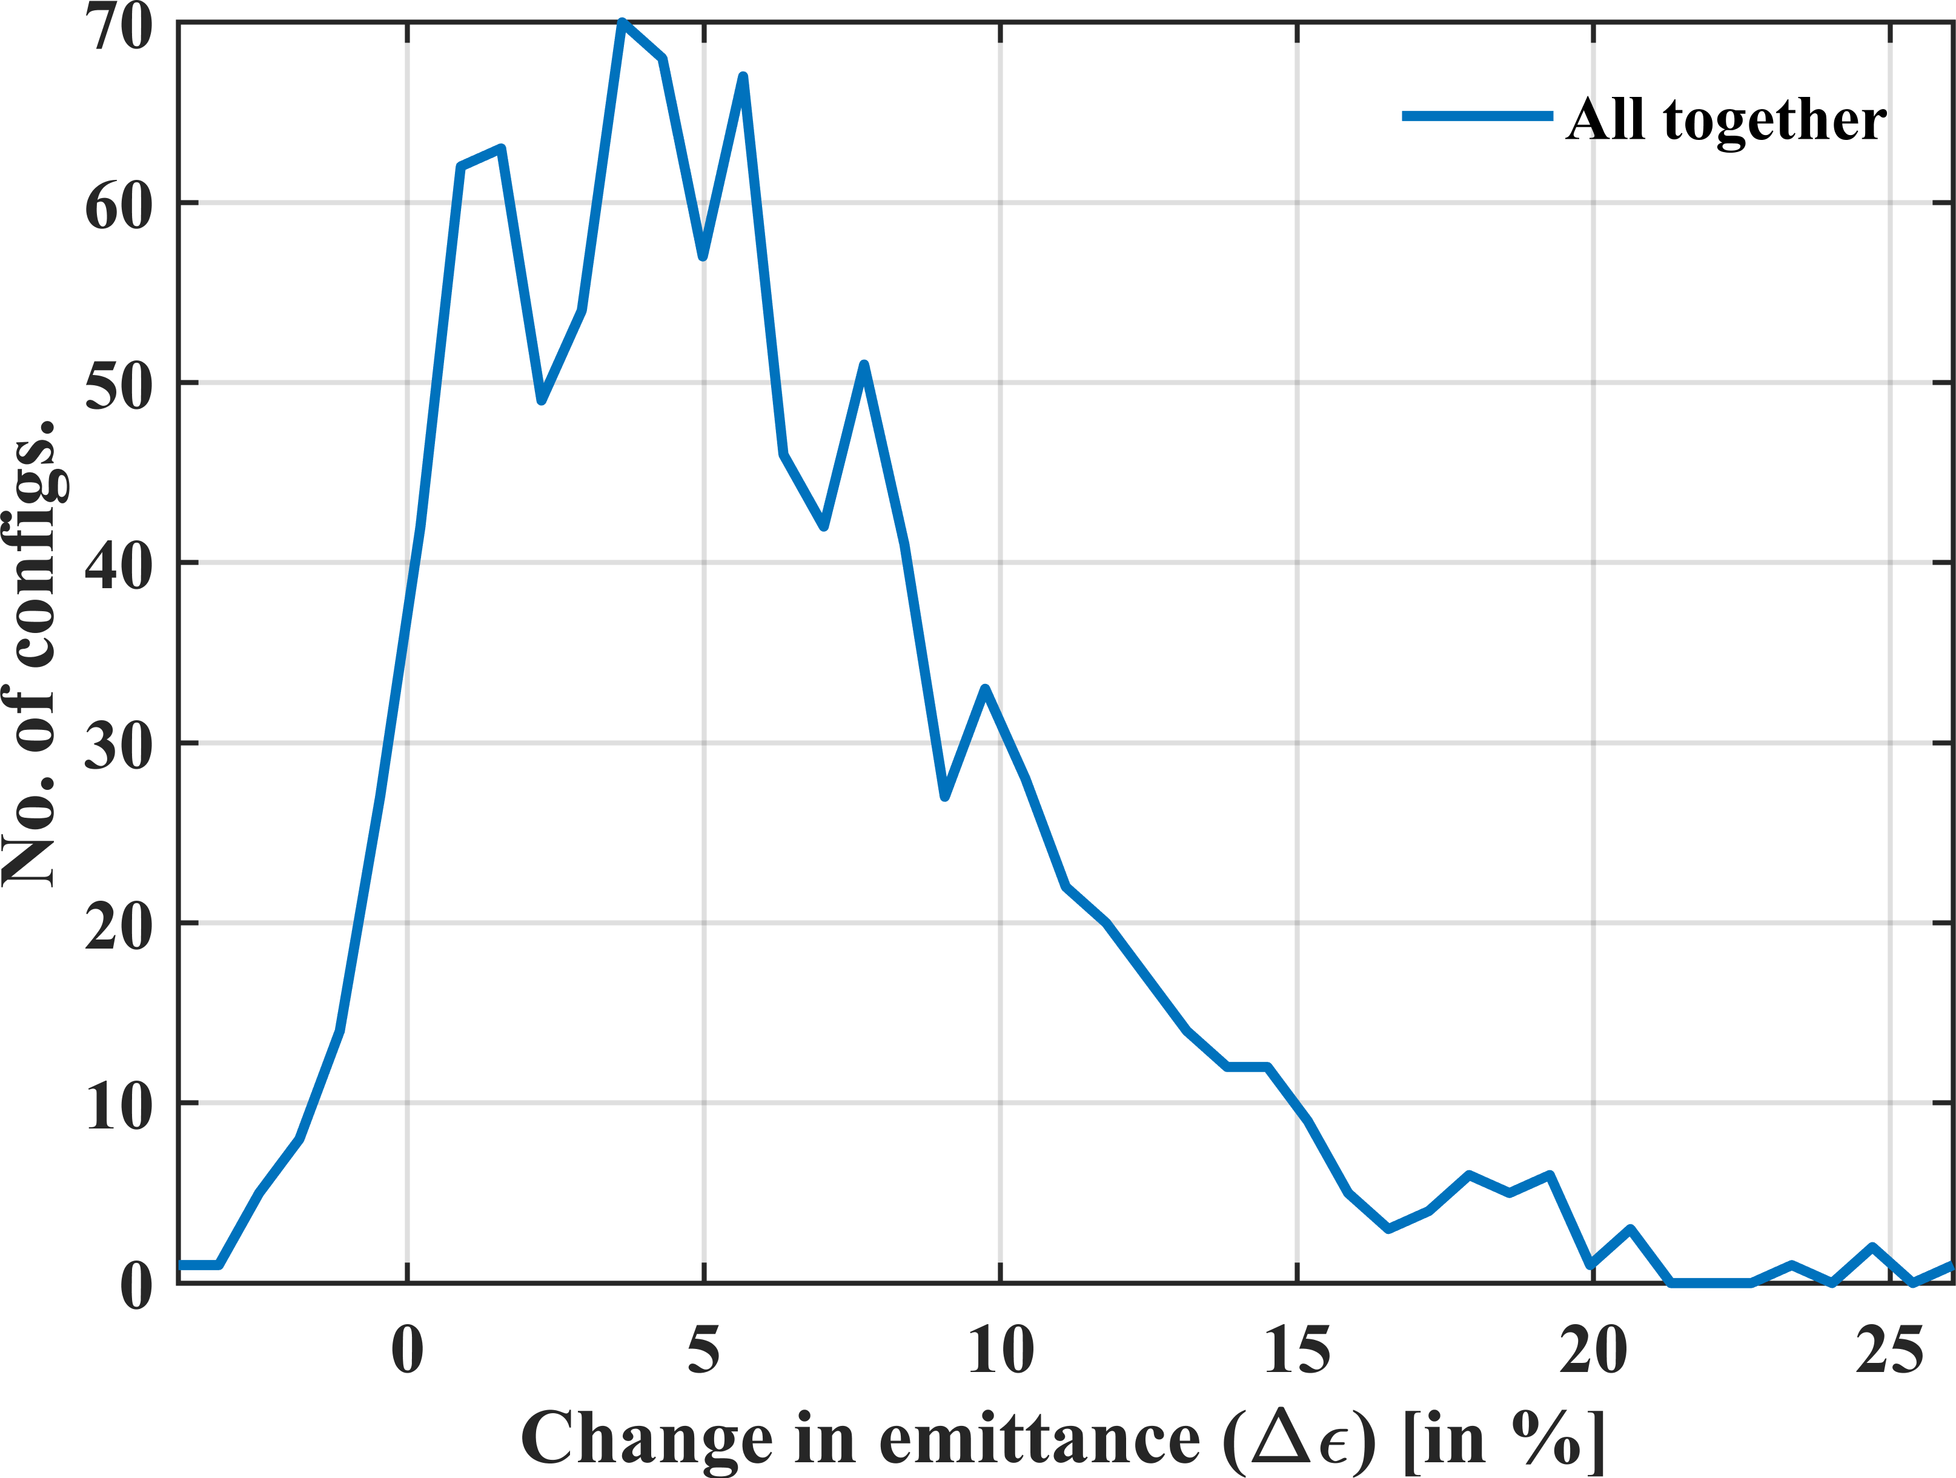
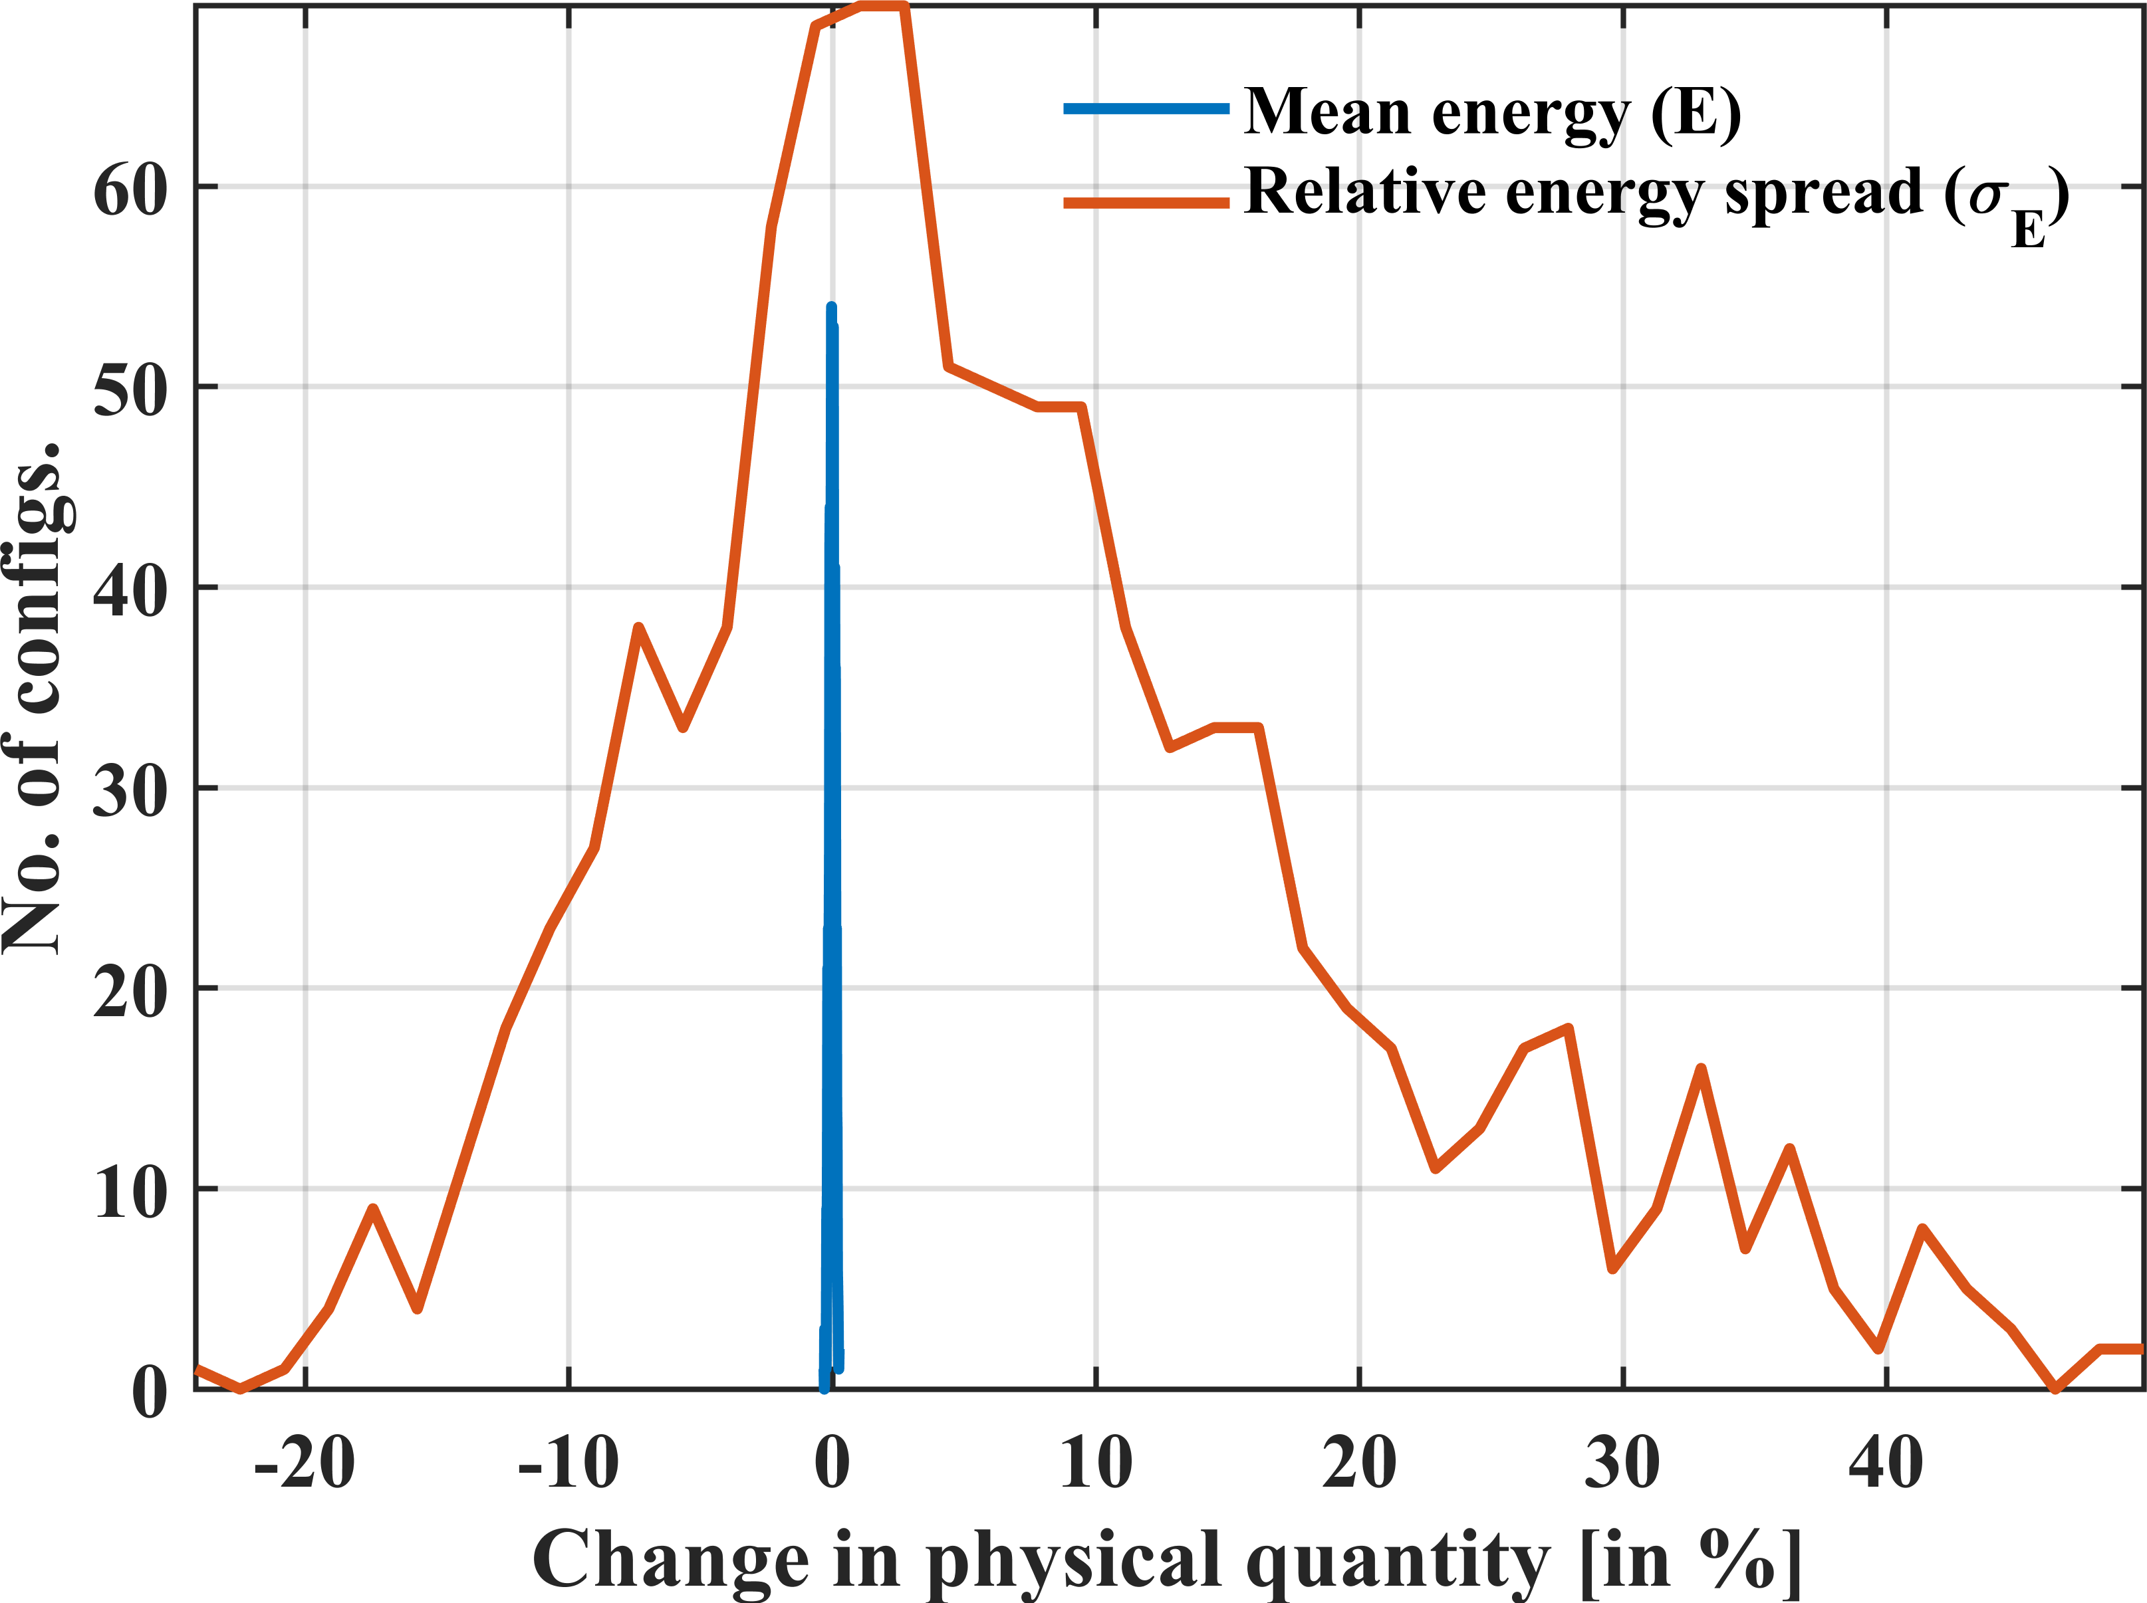
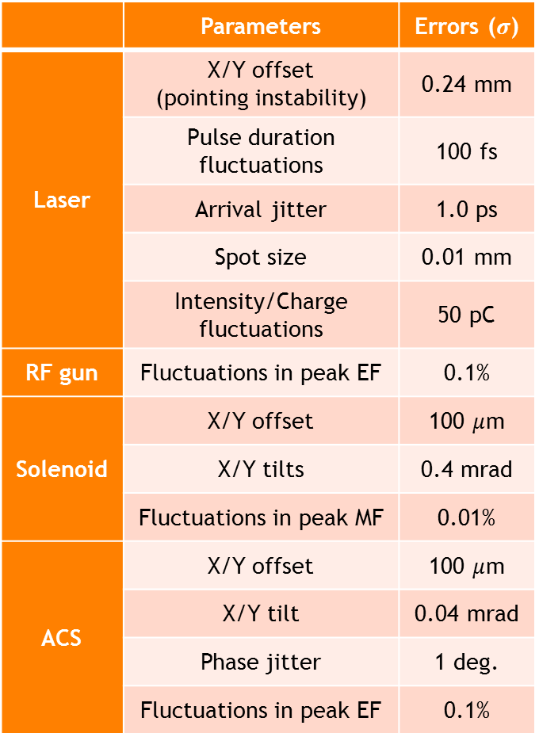
Resulting emittance & errors for the linac
 | Parameters | Errors ($σ$)
Laser | X/Y offset (pointing instability) | 0.24 mm
 | Pulse duration fluctuations | 100 fs
 | Arrival jitter | 1.0 ps
 | Spot size | 0.01 mm
 | Intensity/Charge fluctuations | 50 pC
RF gun | Fluctuations in peak EF | 0.1%
Solenoid | X/Y offset | 100 $μ$m
 | X/Y tilts | 0.4 mrad
 | Fluctuations in peak MF | 0.01%
ACS | X/Y offset | 100 $μ$m
 | X/Y tilt | 0.04 mrad
 | Phase jitter | 1 deg.
 | Fluctuations in peak EF | 0.1%
Dominated by:
laser X/Y offsets
solenoid tilts
Dominated by:
ACS phase jitter

Slide 9
Different working points for ThomX
To meet the requirements of various X-ray users

Slide 10
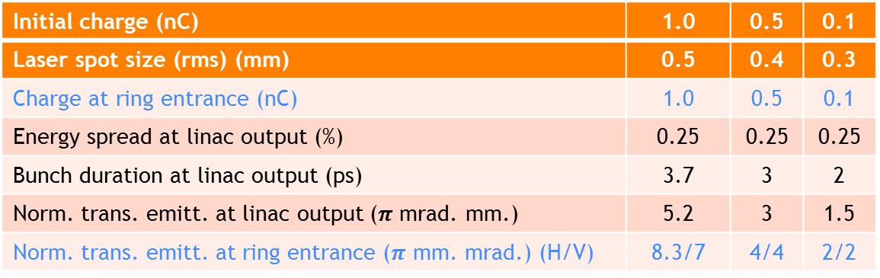
Different working points (charge)
Initial charge (nC) | 1.0 | 0.5 | 0.1
Laser spot size (rms) (mm) | 0.5 | 0.4 | 0.3
Charge at ring entrance (nC) | 1.0 | 0.5 | 0.1
Energy spread at linac output (%) | 0.25 | 0.25 | 0.25
Bunch duration at linac output (ps) | 3.7 | 3 | 2
Norm. trans. emitt. at linac output ($π$ mrad. mm.) | 5.2 | 3 | 1.5
Norm. trans. emitt. at ring entrance ($π$ mm. mrad.) (H/V) | 8.3/7 | 4/4 | 2/2
Commissioning start with copper cathode → charge limited to ~100 pC.
Different charge should be possible to meet the requirement with different X-ray users.
Laser spot size should be adjusted for different charge to optimize emittance.

Slide 11
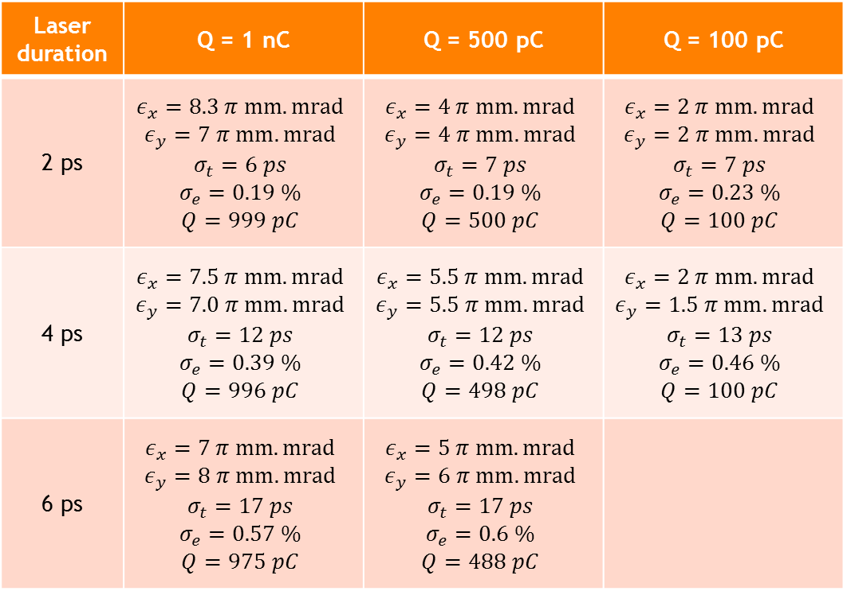
Different working points at ring entrance (laser duration, charge)
Laser duration | Q = 1 nC | Q = 500 pC | Q = 100 pC
2 ps | $$ε_{x}=8.3 π mm.mrad$$ $$ε_{y}=7 π mm.mrad$$ $$σ_{t}=6 ps$$ $$σ_{e}=0.19 \%$$ $$Q=999 pC$$ | $$ε_{x}=4 π mm.mrad$$ $$ε_{y}=4 π mm.mrad$$ $$σ_{t}=7 ps$$ $$σ_{e}=0.19 \%$$ $$Q=500 pC$$ | $$ε_{x}=2 π mm.mrad$$ $$ε_{y}=2 π mm.mrad$$ $$σ_{t}=7 ps$$ $$σ_{e}=0.23 \%$$ $$Q=100 pC$$
4 ps | $$ε_{x}=7.5 π mm.mrad$$ $$ε_{y}=7.0 π mm.mrad$$ $$σ_{t}=12 ps$$ $$σ_{e}=0.39 \%$$ $$Q=996 pC$$ | $$ε_{x}=5.5 π mm.mrad$$ $$ε_{y}=5.5 π mm.mrad$$ $$σ_{t}=12 ps$$ $$σ_{e}=0.42 \%$$ $$Q=498 pC$$ | $$ε_{x}=2 π mm.mrad$$ $$ε_{y}=1.5 π mm.mrad$$ $$σ_{t}=13 ps$$ $$σ_{e}=0.46 \%$$ $$Q=100 pC$$
6 ps | $$ε_{x}=7 π mm.mrad$$ $$ε_{y}=8 π mm.mrad$$ $$σ_{t}=17 ps$$ $$σ_{e}=0.57 \%$$ $$Q=975 pC$$ | $$ε_{x}=5 π mm.mrad$$ $$ε_{y}=6 π mm.mrad$$ $$σ_{t}=17 ps$$ $$σ_{e}=0.6 \%$$ $$Q=488 pC$$

Slide 12
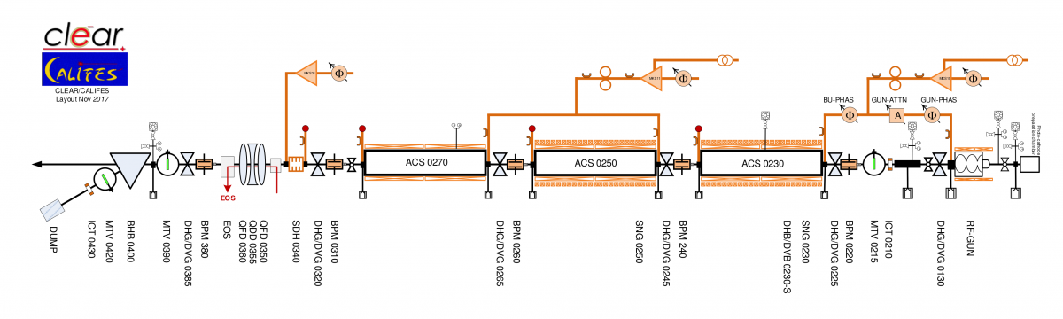
Experiment on CLEAR at CERN
Beam optimization and characterization

Slide 13
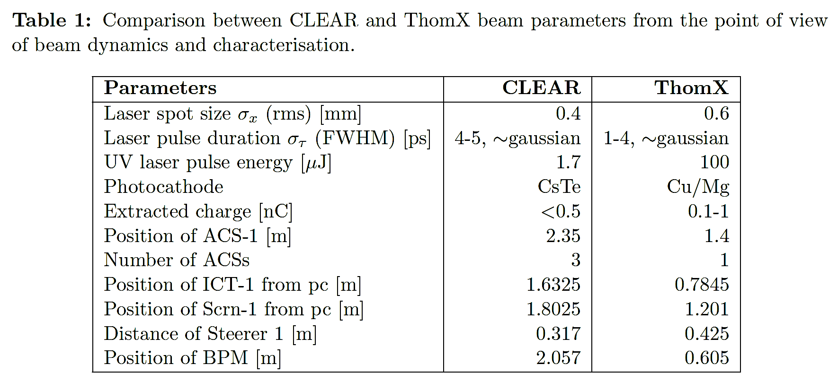
Preliminary experiment on CLEAR
Same gun as ThomX, configuration with joined solenoids.
4-12, ~gaussian

Slide 14
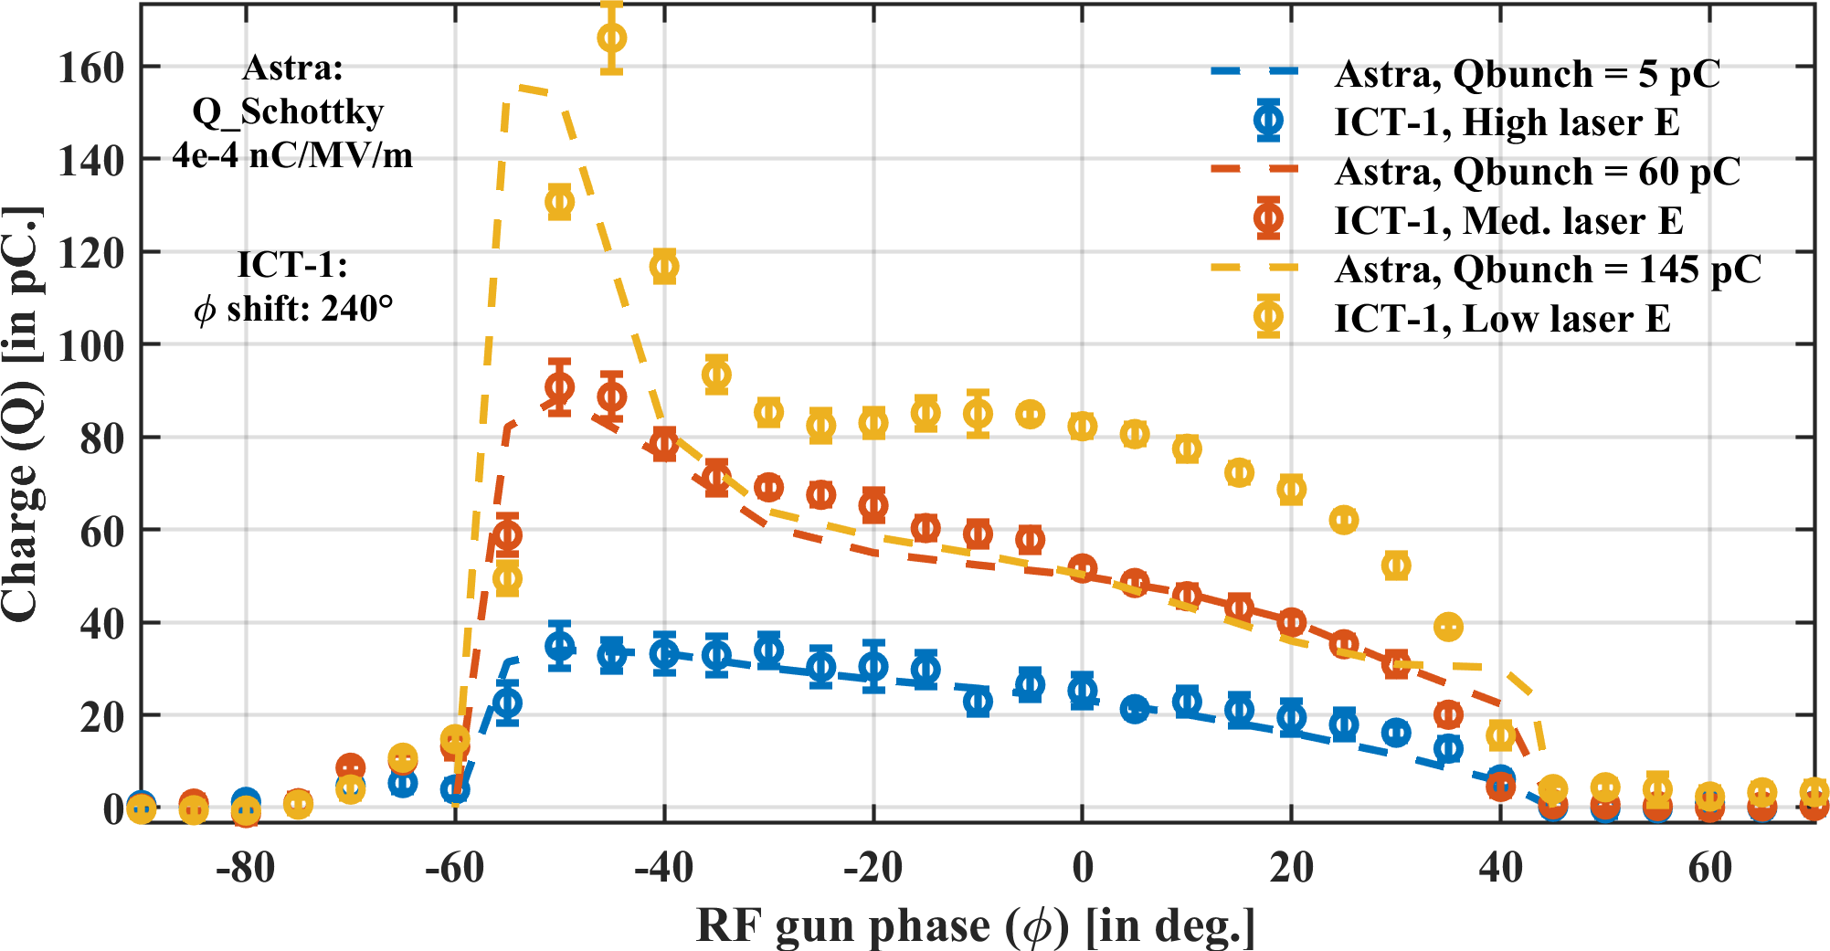
RF model and beam pipe apertures – CLEAR
Measurement tool is what we call “charge phase scan”
Such a measurement relates the beam dynamics inside the RF gun with the photoemission process.
The absence of solenoid magnetic fields allows us to differentiate the beam dynamics due to magnetism and electric field of the gun.
Shape of Schottky dominated effects
Significant losses due to RF dynamics

Slide 15
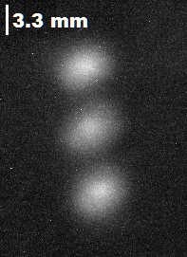
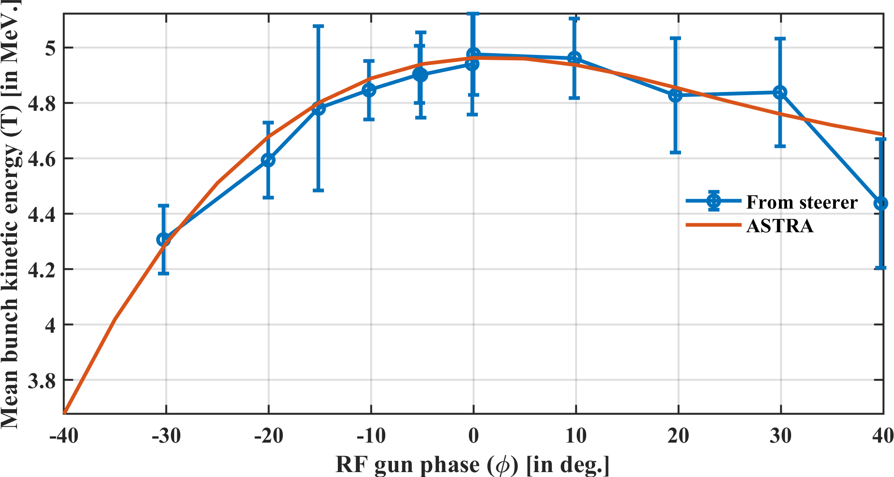
Estimation of the RF gradient – CLEAR
A simple measurement of energy of the beam near the photoinjector.
Steerers can be used as small dipoles.
The energy can be extracted for the transverse position measurement with a screen or a BPM.
Good agreement between Astra simulations and measurements for 74 MV/m.

Slide 16
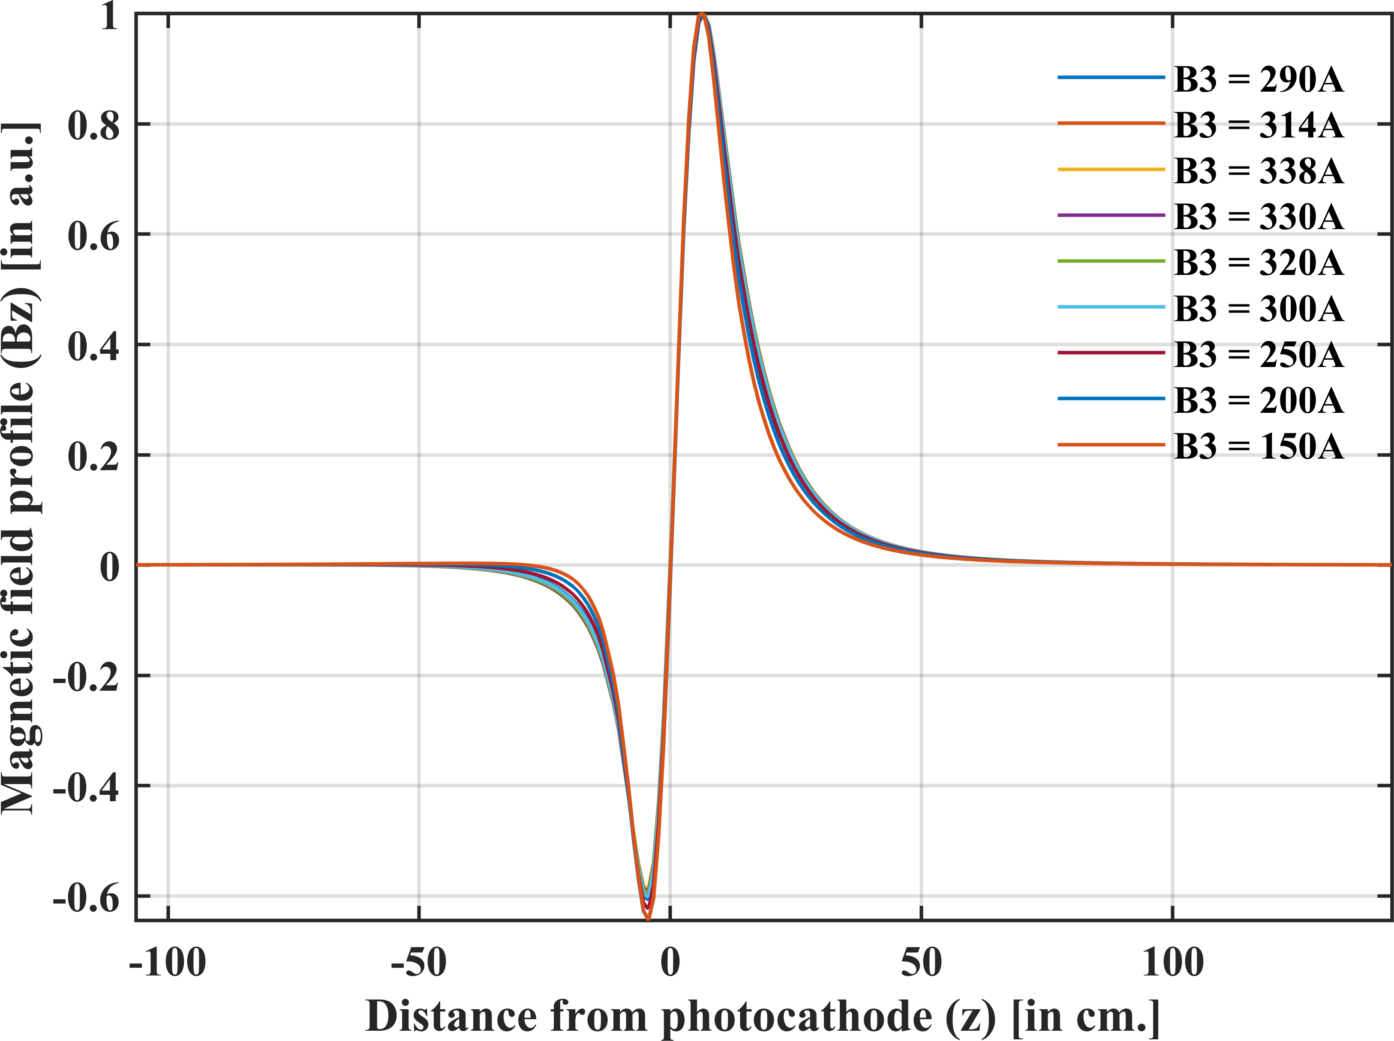
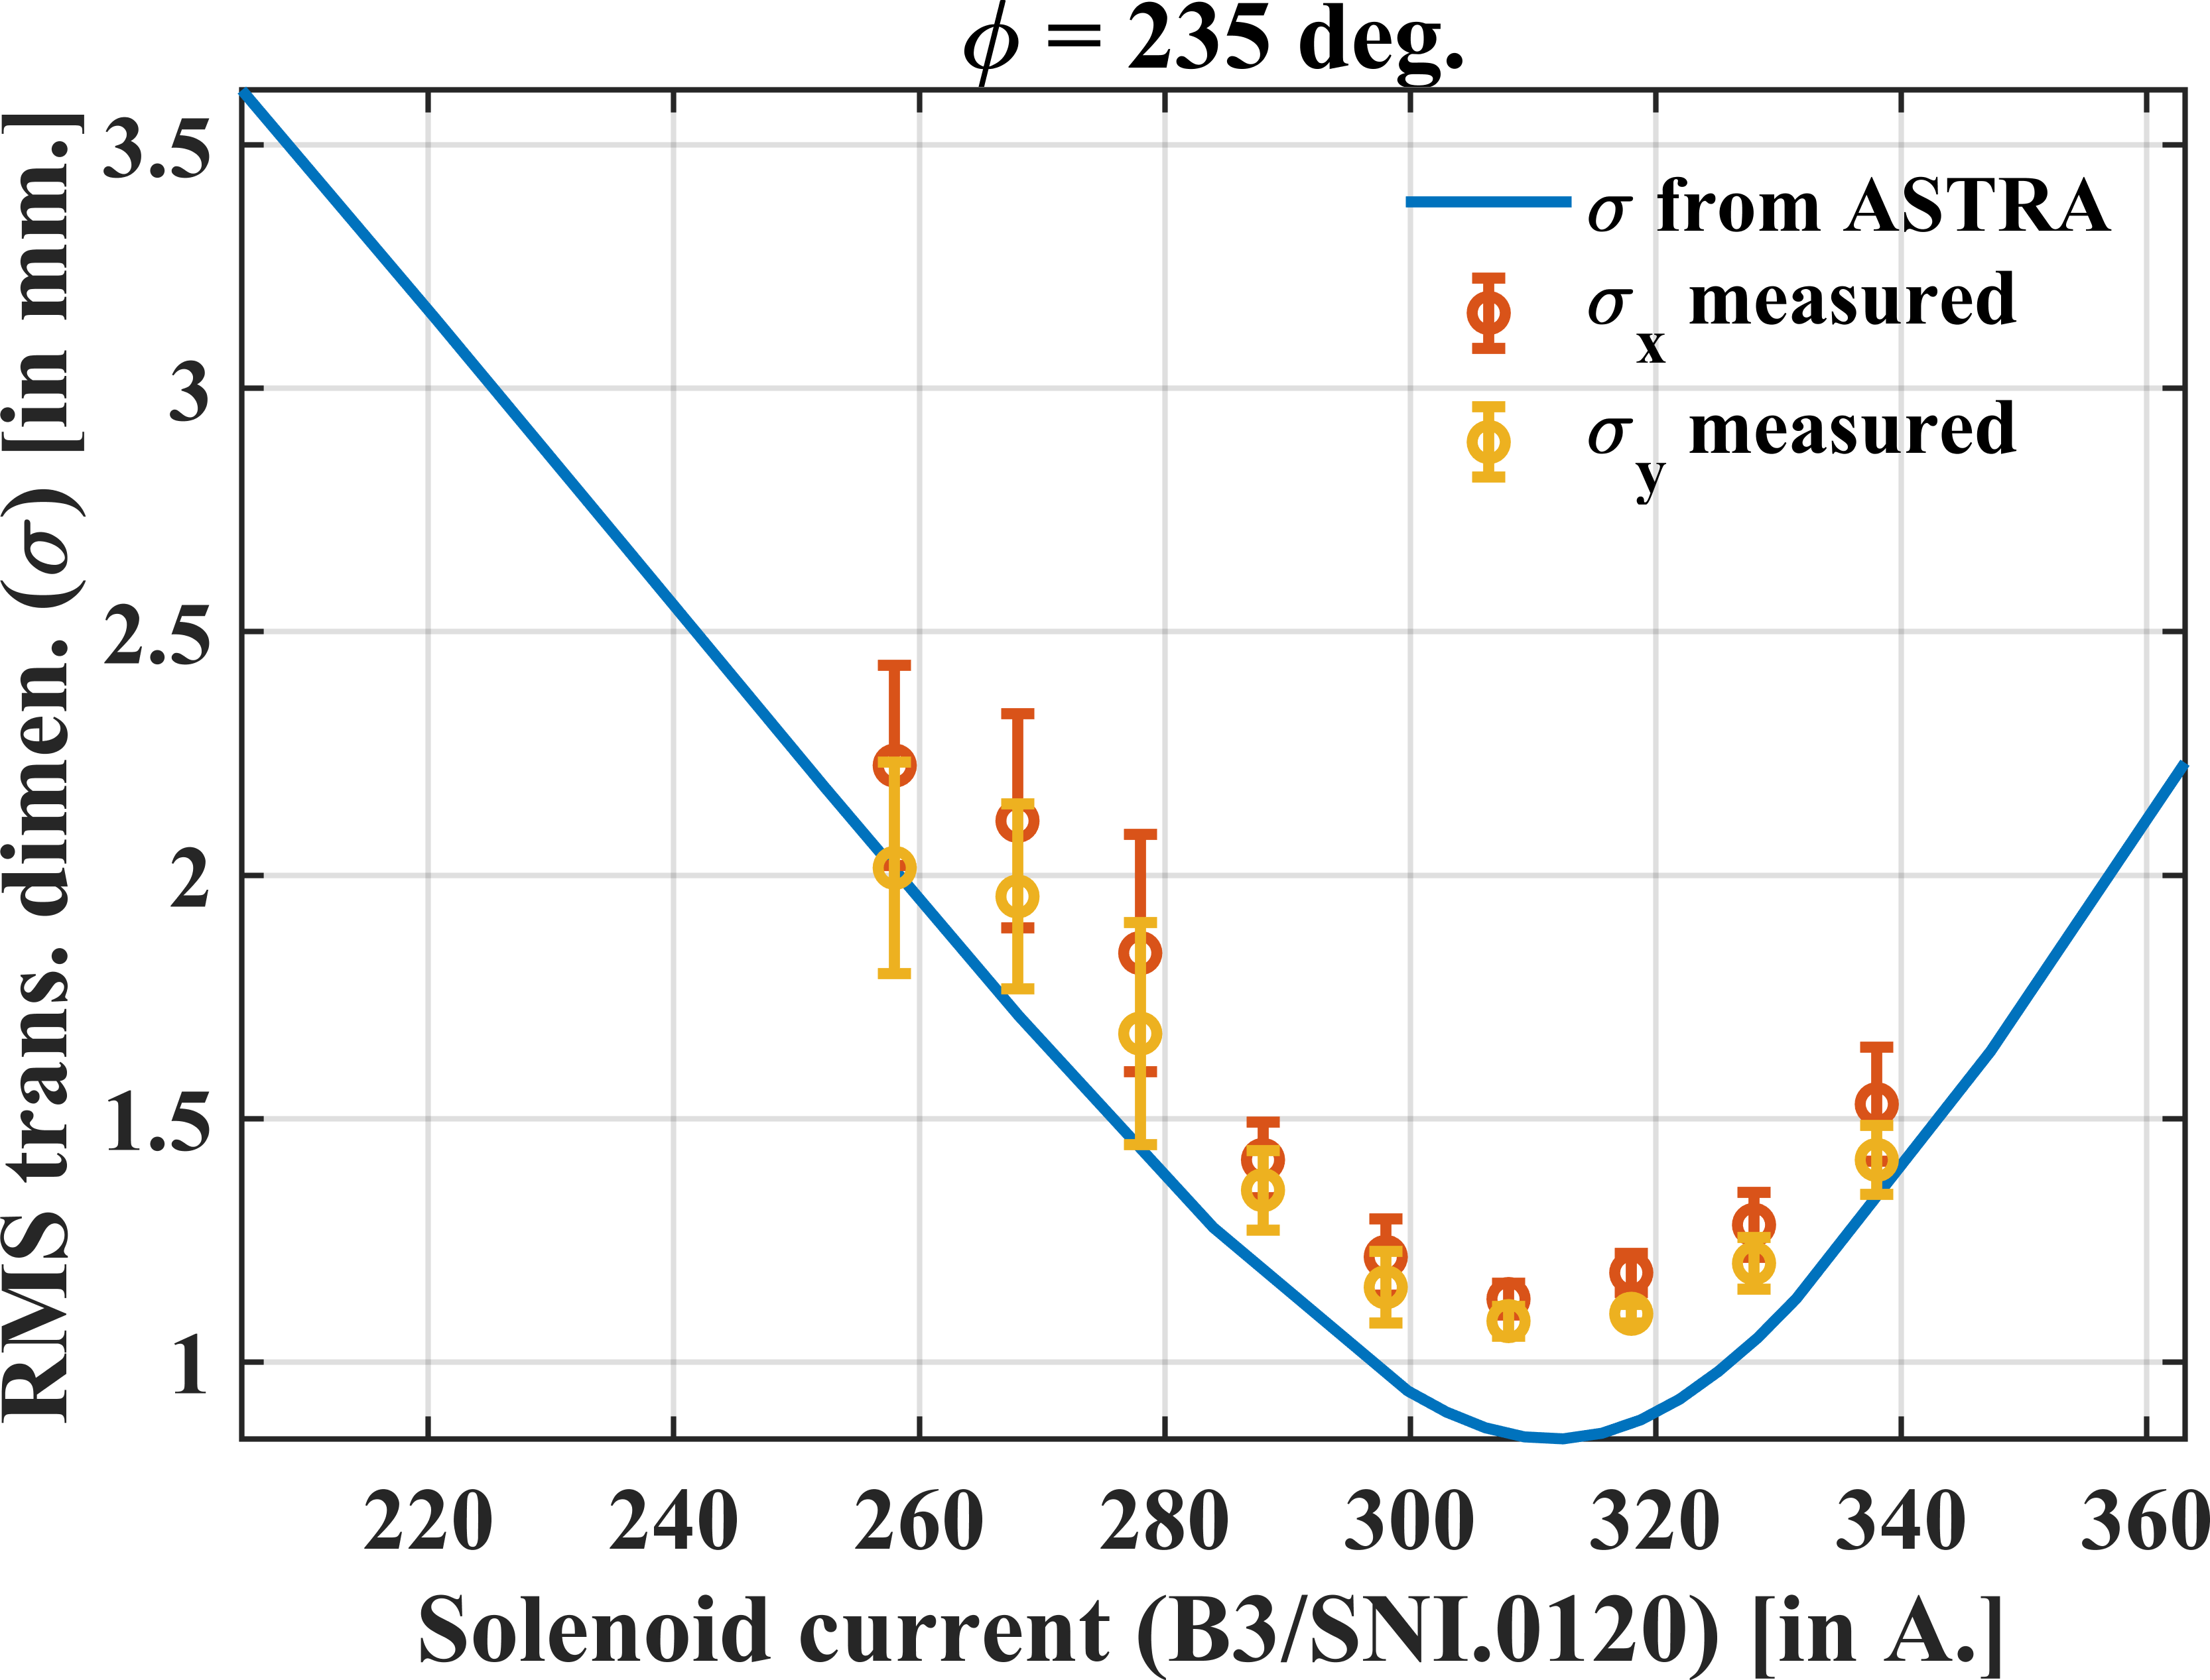
Test of the solenoid model – CLEAR
With the joined solenoids the focusing point can not be at the section entrance for ThomX.
We expect to achieve this with the new solenoids configuration.

Slide 17
Conclusions
A new solenoids configuration had been studied, modelled and implemented with improved focusing at ACS and lower emittances at the linac exit.
CODAL had been benchmarked for space charge calculations with ASTRA and it works well.
Misalignment/jitter studies for ThomX conclude that laser offsets and solenoid tilt are more sensitive parameters for emittance whereas energy spread is most affected by the phase jitter in the ACS.
Different working points for ThomX had been established.
ThomX commissioning procedure had been validated at CLEAR and PHIL. Several scripts & utilities have been developed from scratch for data acquisition & analysis.

Slide 18
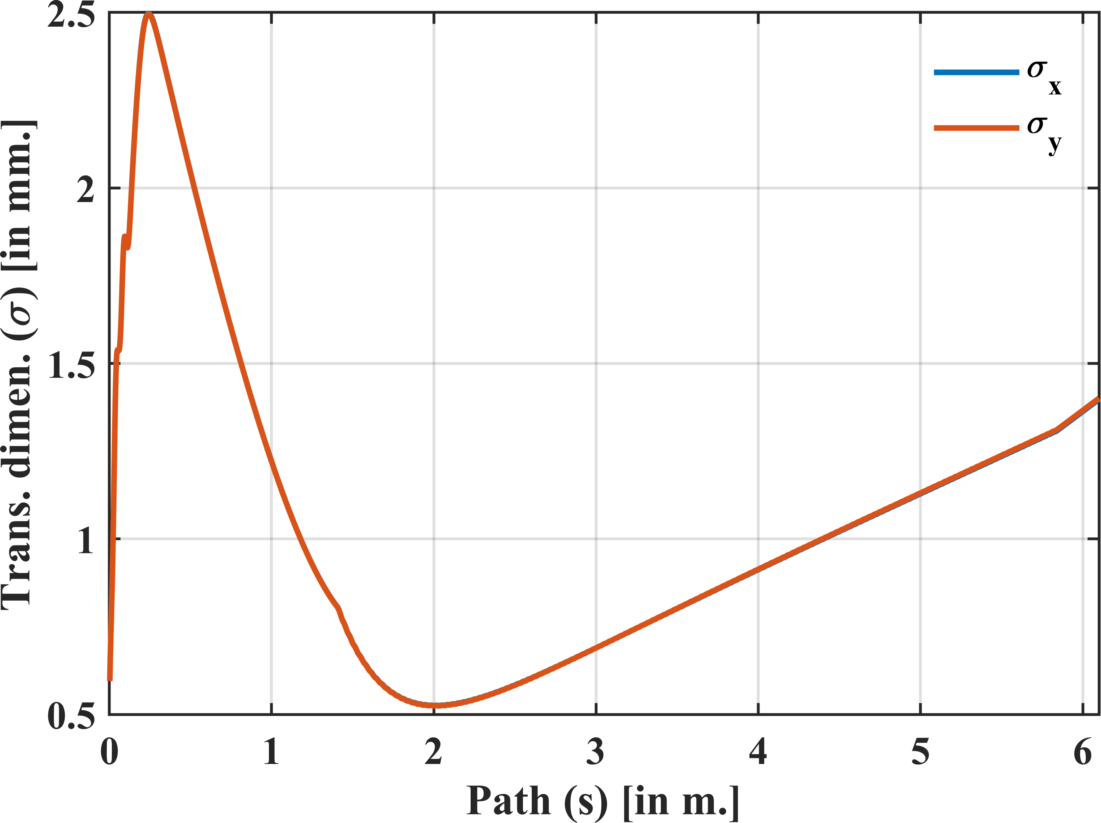
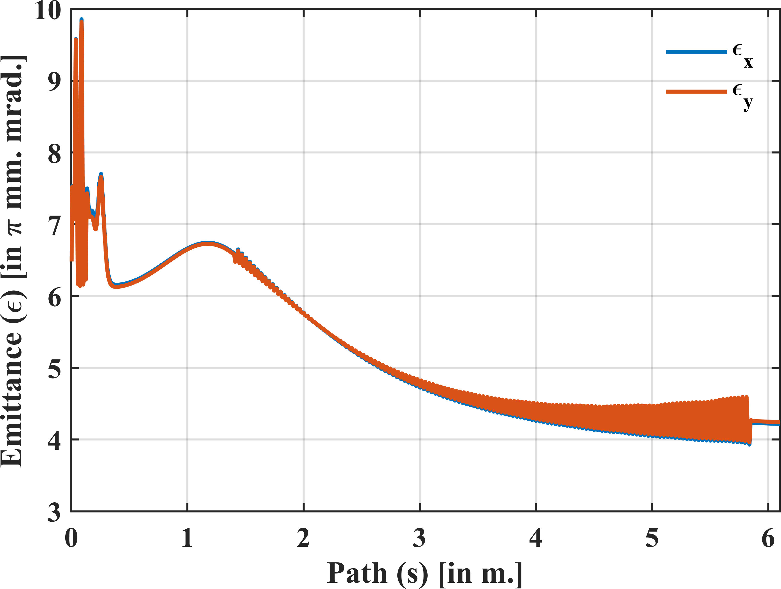
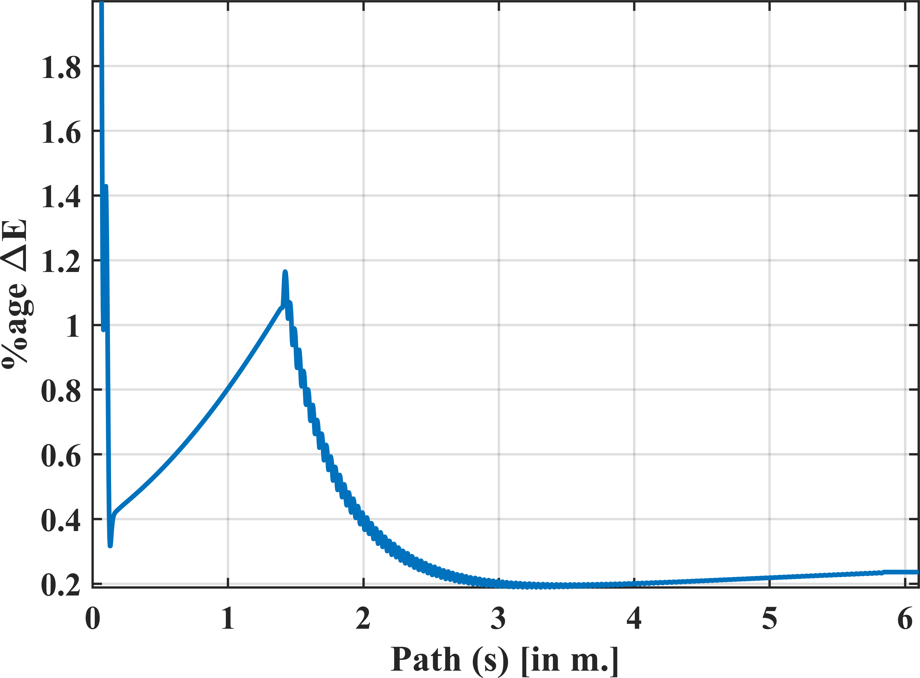

Slide 19
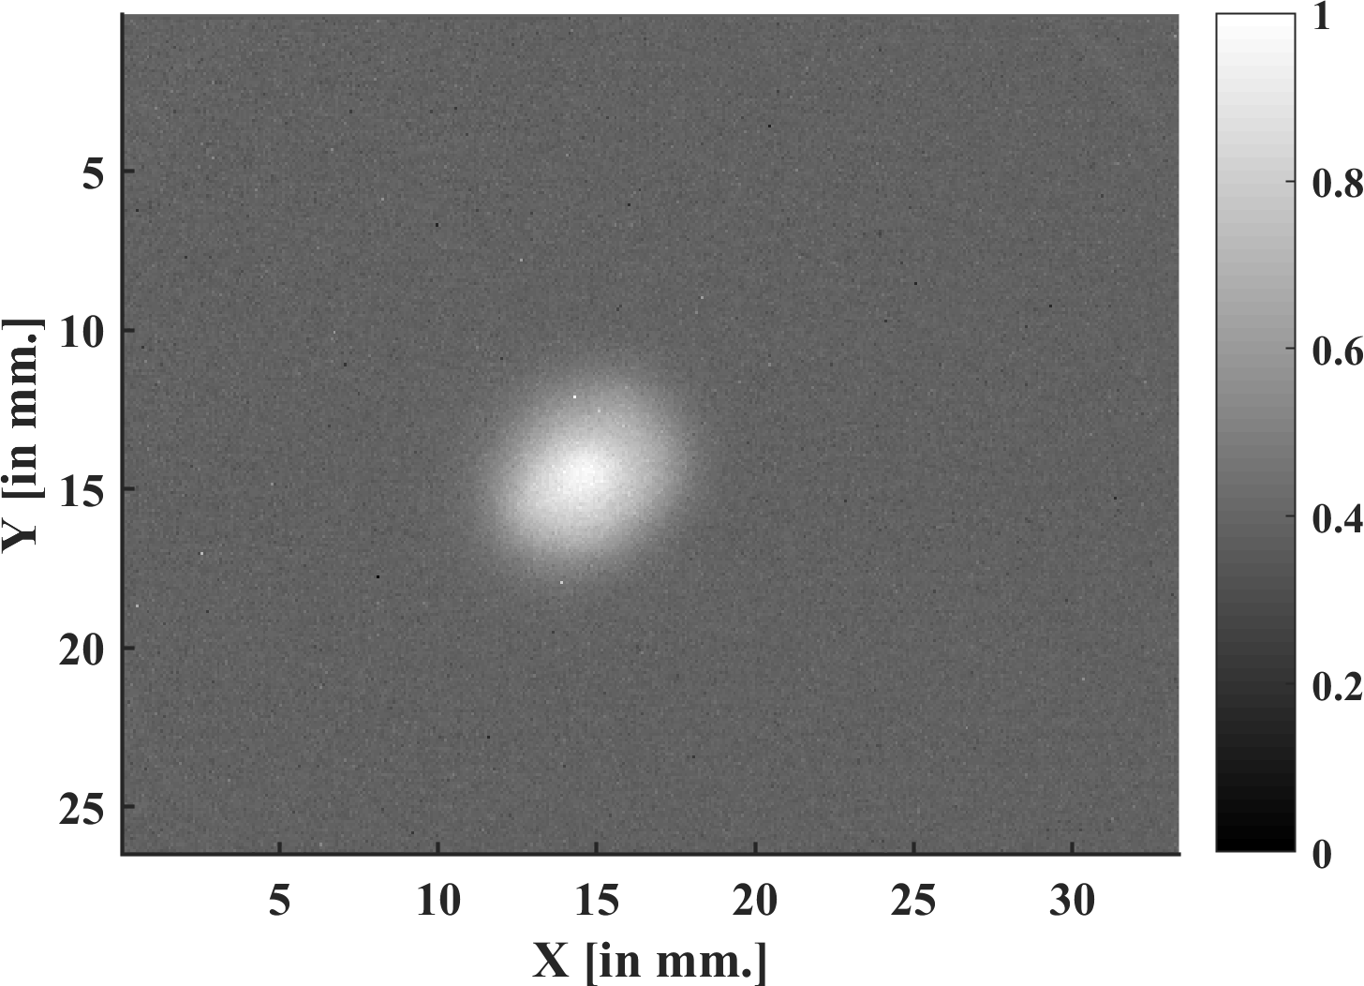
Laser alignment – CLEAR
First step was to check the alignment of the laser on the cathode, and the solenoid relative to the electromagnetic axis of the RF gun.
If all is well alignment, no displacement of the beam occurs either with the phase (relative RF/laser) or the solenoid field amplitude.
To align, we suppose that almost all the current is emitted on the electromagnetic axis. We move the remote control of the mirror keeping the electron beam at the center of the first screen, while decreasing the solenoid current.
We check that after correction, the solenoids were well aligned because there were no coupling relation the first time, second time a coupling remained.

Slide 20
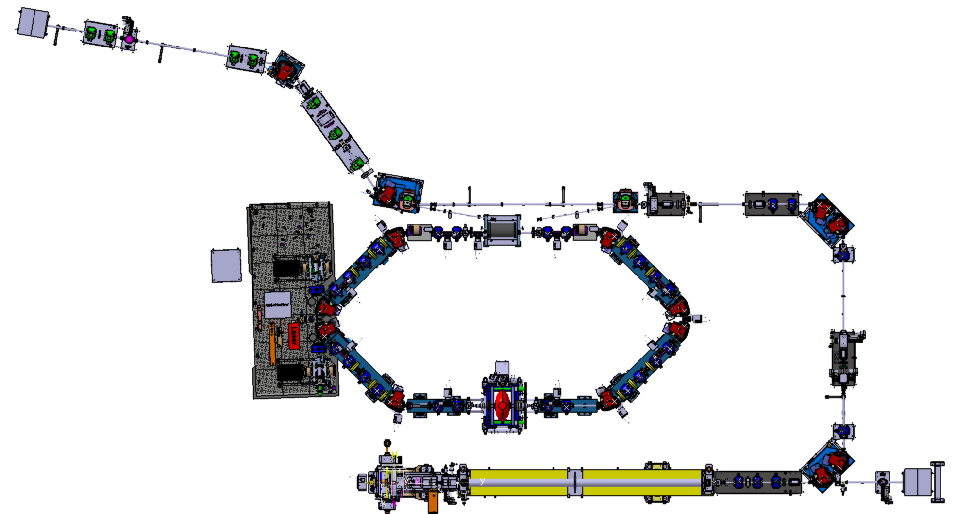

Slide 21
