Slide 1
Vacuum status
Frédéric LETELLIER (on behalf of the vacuum group)
LAL

Slide 2
Summary
Vacuum challenges
Stock on the vacuum material
Ultrathin polyimide-stainless steel heater
Bellow vacuum tests
Still to do
Security
Control-command and Human Machine Interface
Notes:
Sommaire

Slide 3
Vacuum challenges
Storage ring: collision with the residual gas, ion trapping ~ 10⁻¹⁰ mbar
Optical Cavity
Decreasing of degassed flow
Ring
Optimizing the pumping distribution
Injector : lifetime of photocathodes in CsTe UHV ~ 10⁻¹⁰ mbar
Notes:
Les enjeux du vide
La photocathode peut être en Tellure de Césium, ou en magnésium ou en cuivre.
il faut diminuer le flux dégasé par la cavité laser (étuvage)
Pour l’anneau, il faut optimiser la répartition du pompage

Slide 4
Stock on the vacuum material
All the material has been received
31 ion pumps (16 triodes and 15 diodes) + power supplies
5 pumping systems turbomolecular + alimentations
35 Penning gauges and 15 Pirani gauges + supplies
7 mass spectrometers for Residual Gas Analysis (RGA) with 3 electronics
12 inline valves (4 HF on the ring)
24 angle valves
1 leak detector He
1 baking system
Manufacture of the electron gun
Notes:
Faire le point sur le matériel de vide
Dire que tout le matériel a été reçu depuis longtemps
Vanne droite avec court-circuit HF et vanne d’équerre
Jauge magnétron inversé (de type Penning) – jauge à ionisation

Slide 5
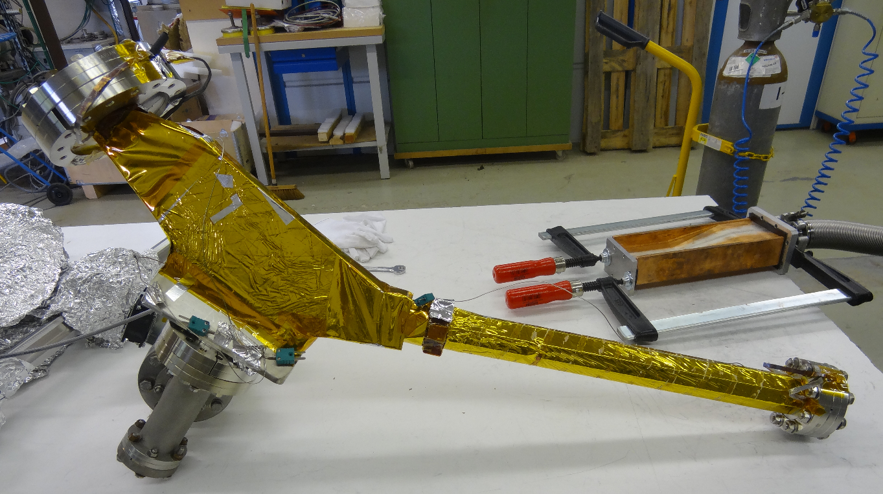
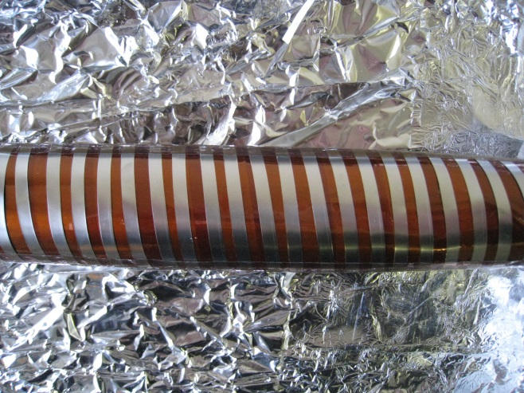
Ultrathin polyimide-stainless steel heater
Use in magnets (elsewhere, it will be a classic baking: heating cables)
4 layers for a total thickness of 0.4mm
Baking temperature between 150 and 200 °C
Baking for about a week
ThomX chamber with thin heater
electrical isolate layer
heated stainless steel band
Notes:
Chambre de liaison coudée

Slide 6
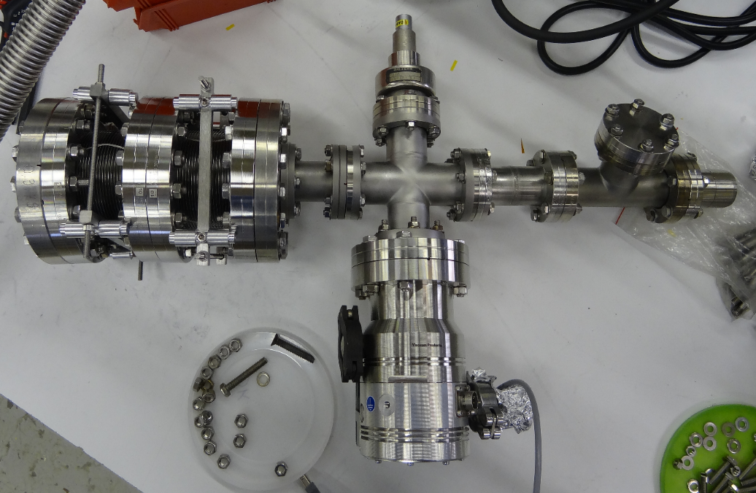
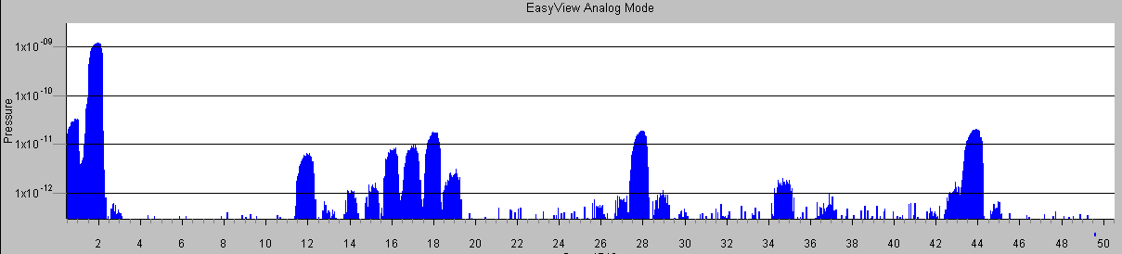
Bellows vacuum test
Limit vacuum after baking
No pollution at the RGA
Vacuum validation
End baking
Start RGA
Start baking 200°C
After baking, pressure =3.10⁻¹¹ mbar
Notes:
Contrôle des soufflets
Soufflets validés pour le vide

Slide 7
Still to do
Heat treatment
Ultrathin polyimide-stainless steel heater
Limit vacuum test
Notes:
Traitement thermique
Étuvage mince
Test du vide limite

Slide 8
« vacuum » security on ThomX
The “vacuum" security commands are carried out from the control contacts of the ion pumps power supplies and the position contacts of the partition valves.
Pressure ok
Valve order authorization
Beam authorization
Vacuum level and hardware protection in ThomX
Bad pressure
Stopping the beams
Closing the valves
Notes:
Ne pas détériorer tout le vide de la machine en cas de problème grâce à l’isolation des vannes
Protection du niveau de vide et du matériel
On regarde la configuration du tir
Mauvais vide = seuil 10-7 mbar (réglable)
Très mauvais vide = arrêt de la pompe, environ 10-5 mbar si « protect » activé
Contact d’asservissement
Stratégie générale du vide

Slide 9
« vacuum » security on ThomX
The security of inline valves
Compressed air
Local/remote
Authorization of the remote valve command
PI thresholds upstream
valve control box
Closed valve
PI thresholds downstream
Open valve
Closing the valve if compressed air pressure is too low and / or if a PI threshold is exceeded
In case of a significant increase in pressure
PI thresholds
Stopping the beams
Off Triggers modulator
Laser Interaction Stop
Closing the valves

Slide 10
« vacuum » security on ThomX
Several operating configurations
LINAC, direct beam
LINAC + Extraction line
Ring with beam and without laser interaction (isolated optical cavity)
Ring with beam and laser in optical cavity
Only optical cavity (laser alone)
Notes:
Chaîne de sécurité déclenche modulateur
Utilisation d’un automate programmable qui récupère tous les contacts

Slide 11
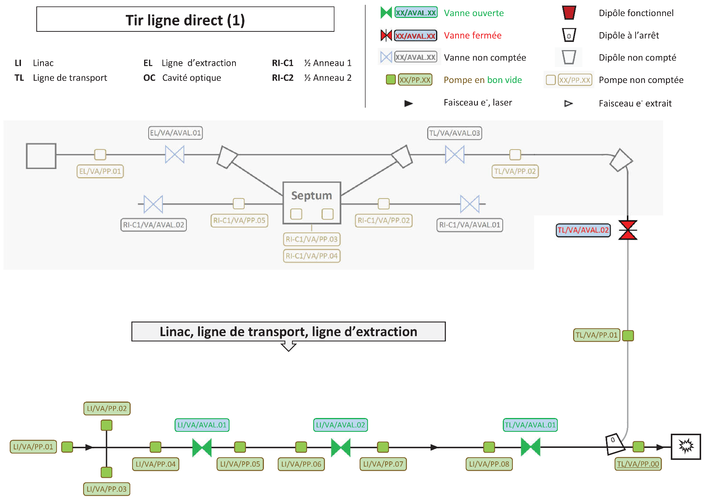
LINAC, direct beam
Picture by
É. Mistretta
Beam dump

Slide 12
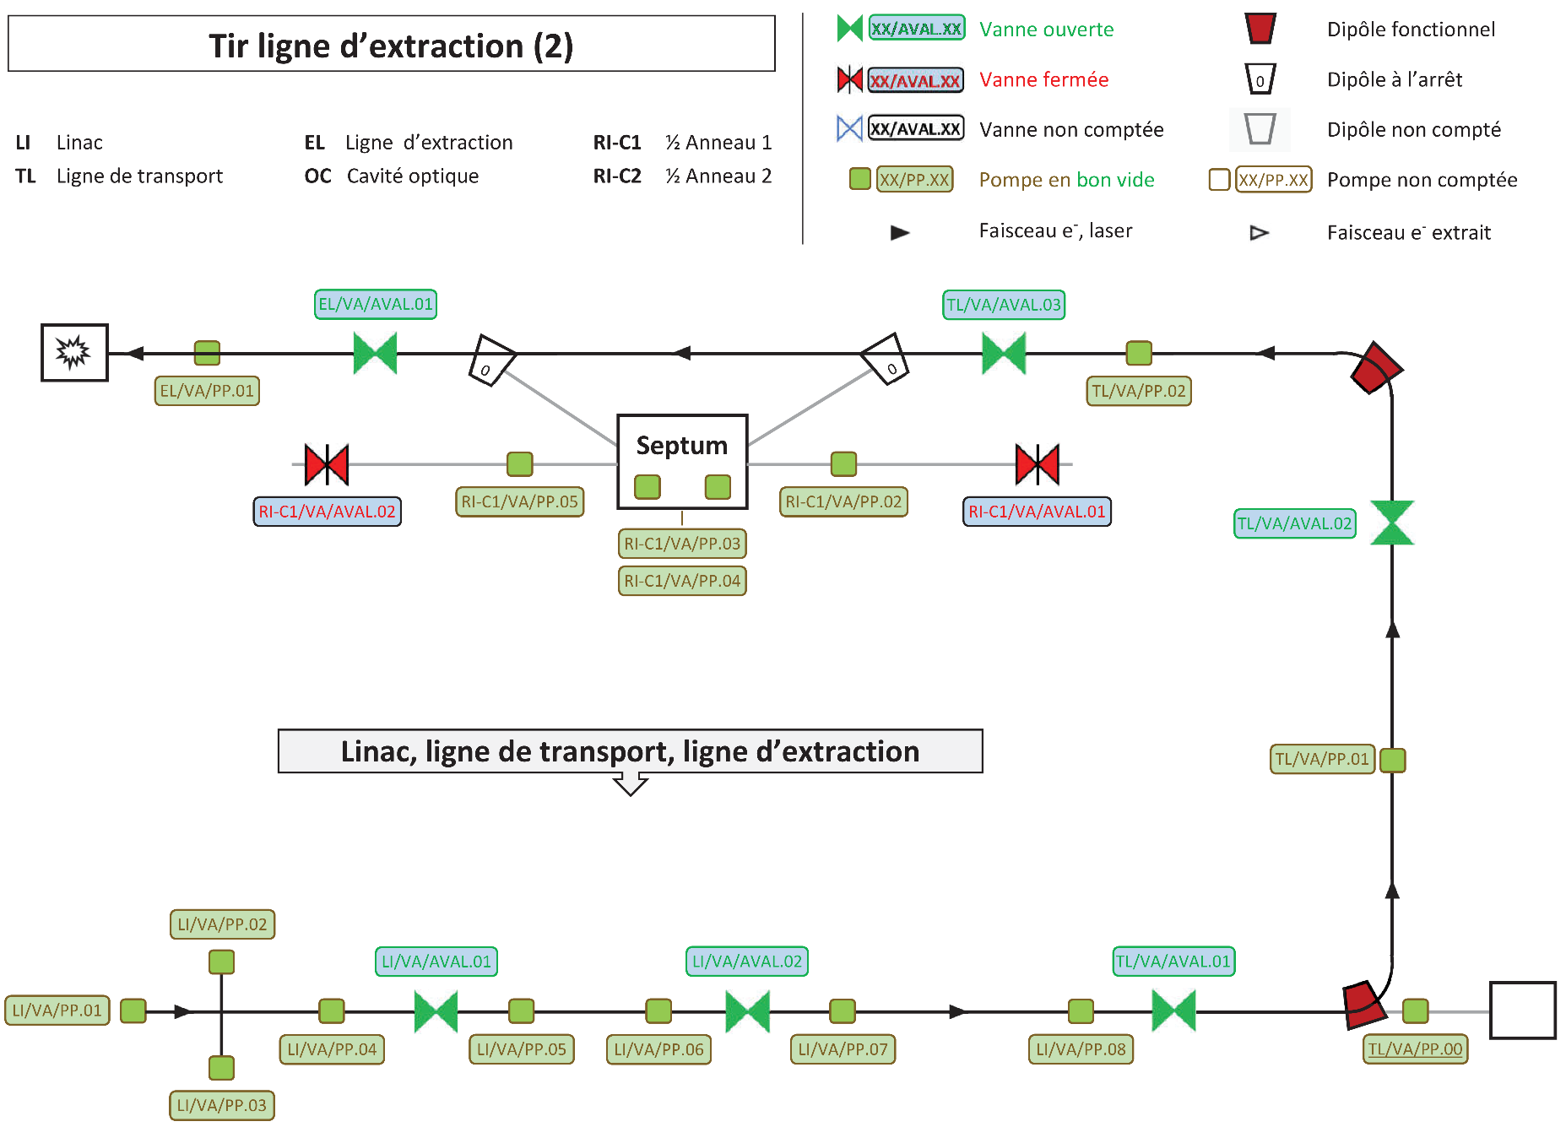
LINAC + extraction line
Beam dump
Picture by
É. Mistretta

Slide 13
e- beam ring with laser / e- beam ring without laser / laser without e- beam
Picture by
É. Mistretta
Thresholds PI LINAC and EL
Thresholds PI Ring
Open valves (except OC valves)
Beam authorization (all contacts closed)
Stop the modulator (one contact open)
Thresholds PI
½ Ring
Thresholds PI
Optic Cavity
Open valves
Laser authorization (all contacts closed)
Close the Shutter of the interaction Laser (one contact open)

Slide 14
control-command and Human Machine Interface
General informations
31 pressure gauges (PENNING + PIRANI)
12 valves
31 ion pumps
Labview Interface
Tango database ➔ archiving and online consultation with a web browser

Slide 15
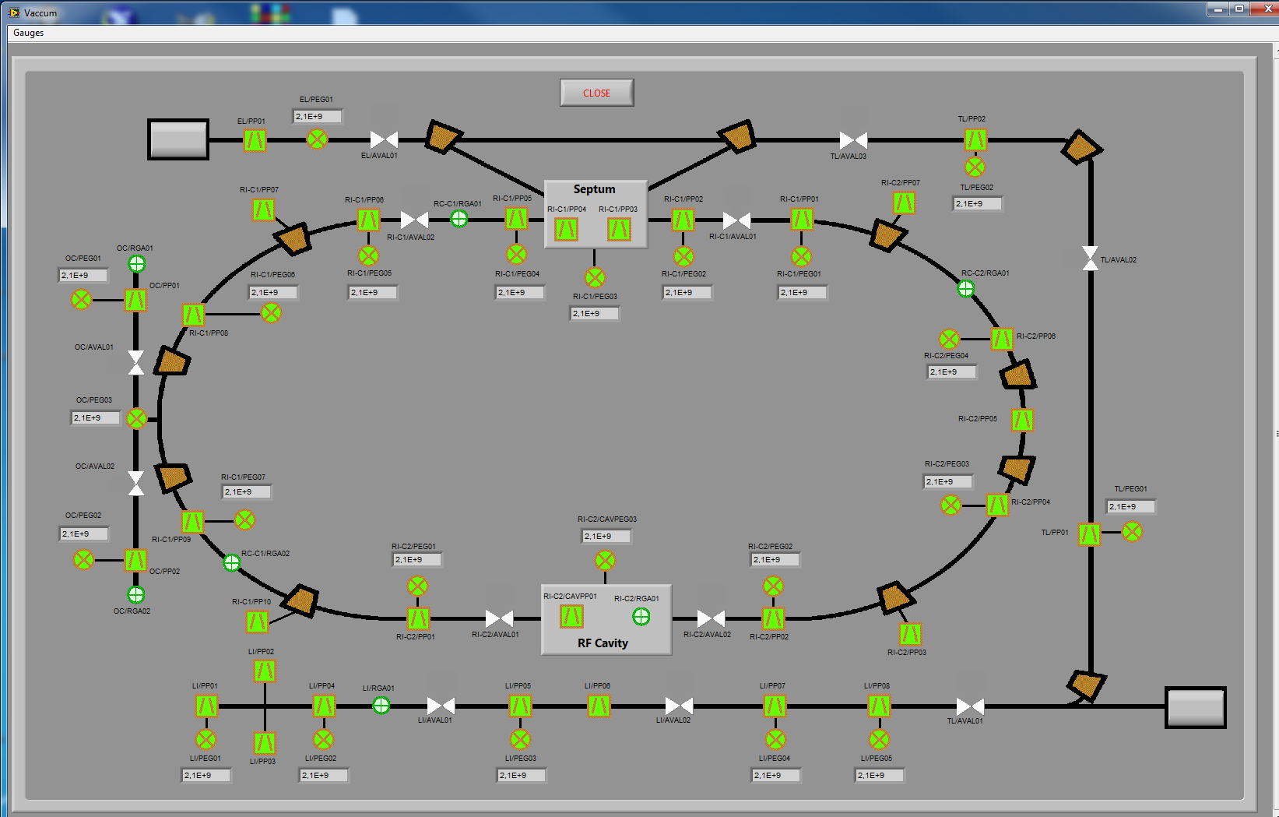
control-command and Human Machine Interface
Picture of
general synopsis by
Olivier Dalifard
Notes:
Cela se commande depuis la salle de contrôle de ThomX

Slide 16
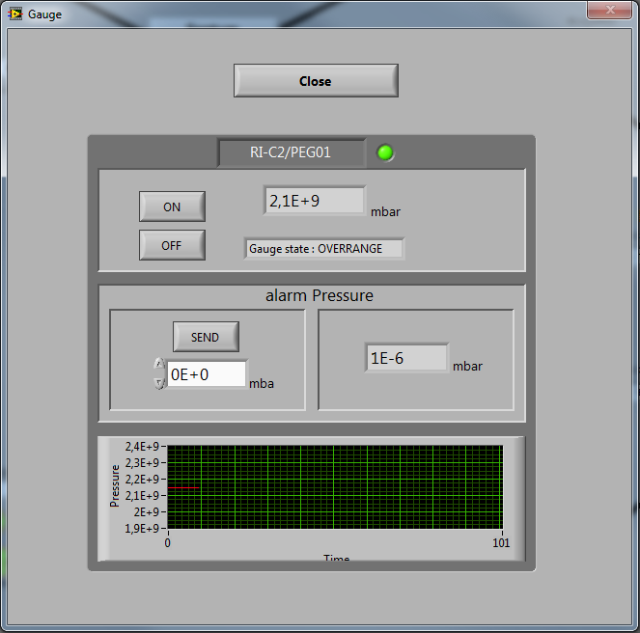
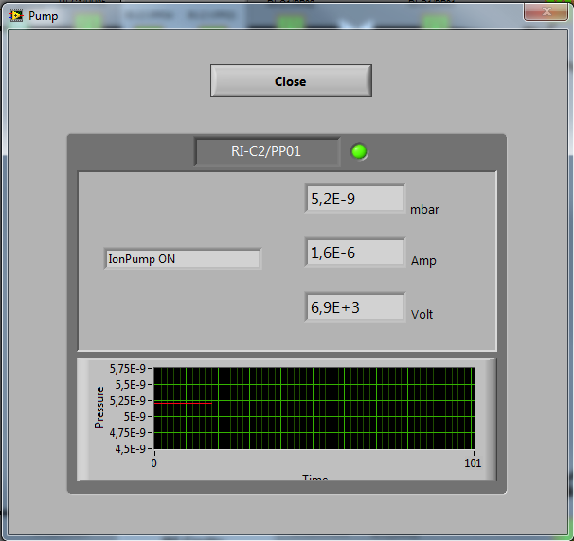
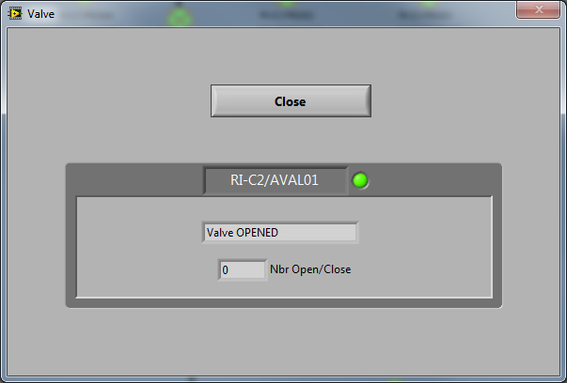
control-command and Human Machine Interface
View of ion pump parameters (voltage, current, pressure, threshold state).
View of the state of an inline valve and number of cycles. Possible control by the operator (with a hardware security).
View of gauge pressure.
Pictures of General synopsis by Olivier Dalifard
Notes:
1000 ouvertures/fermetures pour la vanne (nombre de cycles)
Il faut que les 2 volumes autour de la vanne indiquent un bon vide (seuil) pour qu’on puisse l’ouvrir
Après re-pompage d’un secteur remis à l’azote, demande au groupe vide l’autorisation d’ouvrir les vannes

Slide 17
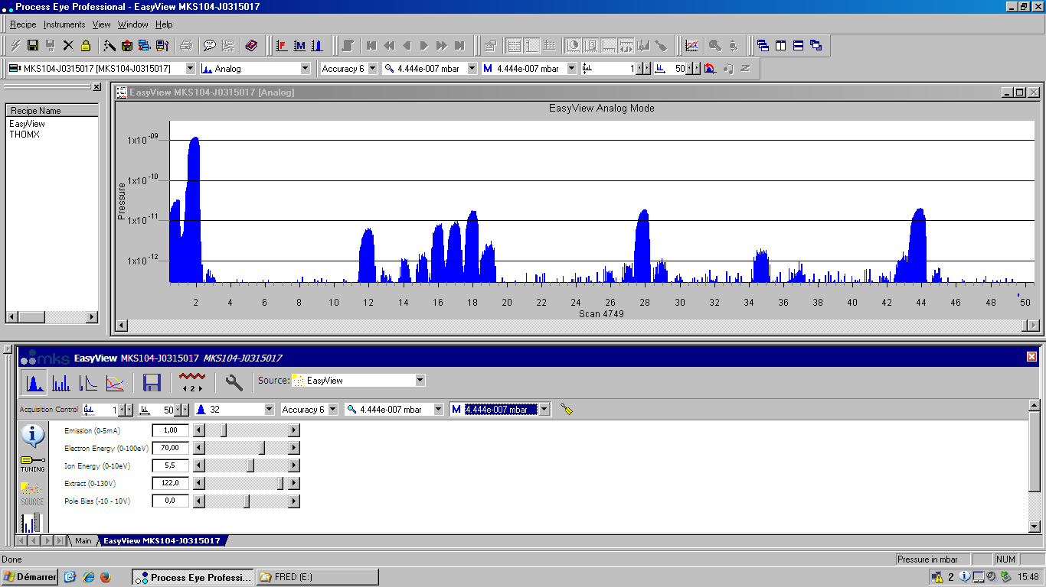
control-command and Human Machine Interface
Mass spectrometry is done with specific software and is practiced by the “vacuum technologies and surface” team

Slide 18
Thank you for your time and attention.

