Slide 1
High Level applications development status
H. Guler for the ThomX commissioning group

Slide 2
Some rules
Interfaces to be implemented into MML (MATLAB) and / or directly using Taurus (Python)
High level interfaces design should be done by machine experts and could evolve
Periods of training and development is necessary
Easy installation, versioning, and user manuals are needed
General single common scripts for raw signal analysis :
Beam charge extraction (from Wavecatcher)
YAG : Spot analysis tool (extract size, position, … )
BPMs …
High level variables (Calibrations, Twiss parameters, …) coming from calculation should be included in Tango
No differences for same variable should appear in different IHM
Single programing language is not mandatory (MATLAB, Python)
TANGO binding should prevent any incompatibility

Slide 3
High level applications are done with MML
MML : communication with TANGO and a Simulation tool (Accelerator Toolbox)
Binding MATLAB / TANGO done
Tested on multi-platform (Windows, MacOS, and Linux)
MML : At platform used to develop and test high level interfaces
MML : simulation tool used for the Transfer lines and the Ring
And Linac beam dynamics analysis
Next need :
Connect MML to simulation TANGO variables
Simulation TANGO variable will be very useful also during commissioning to test newly developed tools before using them on
Connect MML to final TANGO variables

Slide 4
MML/AT current status
Control applications for commissioning and operation are under development using the Matlab Middle Layer (MML).
MML status:
Installation of the MML and AT software together with other applications. New version of AT (v 2.0) is tested. Next step: test a new realease of MML (from G. Portmann /May 2018).
Test version of the master files (thomxinit, TLinit, setoperationalmode, updateatindex, magnetcoefficient...) for the machine (TL and SR) is ready. Next step: put appropriate tango names/variables (collection is ongoing) + many many tests with Tango.
Eventually switch from « personal PC/working locally » style to the dedicated ThomX/MML server (as it will be during the operation, more easy to maintain and track changes/modifications).

Slide 5
High level applications with MML
There are already a lot of functions for accelerator control and measurements but mainly for the damped SR.
In the ThomX SR the e- beam is stored only for 20 ms => can be a difficulty for some type of measurements => specificities to be addressed in the case of the ThomX SR
The work now is focused on the applications for the Day-ONE:
Save/Restore the machine configuration
BPM GUI/test programs
Orbit/signal-sum measurements
First turns applications (orbit correction, tune/chromaticity measurements)
Done (version 0):
Orbit correction (global)
Beta function measurement
Lattice symmetry restoration (LOCO)
Display (plotfamily)
Injection matching
Emittance measurement
Ongoing:
Orbit correction (local)
Dispersion measurement
RM measurements (orbit, tune, chromaticity)
Quadrupole centering (BBA)
…
To be addressed:
Tune display and control
Beam diagnostics (beam size, bunch length...)
Analysis of nonlinearities
Analysis of the collective effects
…

Slide 6
Need for trend plots : easy to compute and very useful

Slide 7
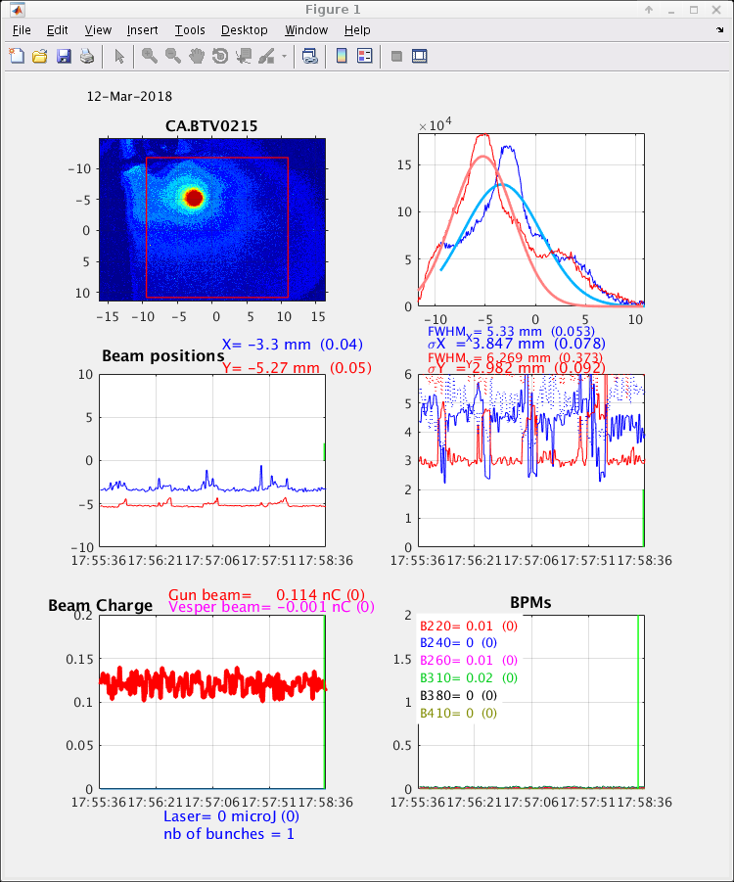
Interfaces needed for beam tuning for single pass (Linac-TL-EL)
Example of interface @CLEAR
Choose screen
Measure beam spot size, position
Plots trends
Get beam charge / position at different locations
Plot trends
During the Linac + TL + EL commissioning
To help the beam tuning
Useful for beam alignment
Follow trends for ICT, BPMs
For example Trend of the beam charge / position
Example of interface used at PHIL
Plan for a synoptic with screen diagnostics locations

Slide 8
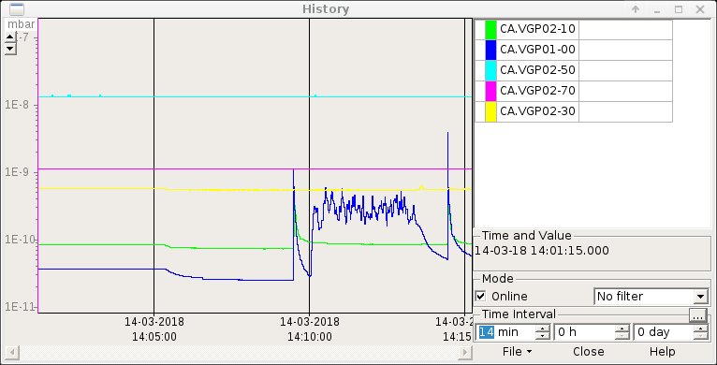
Trend plots for vacuum
During RF conditioning for RF-Gun or Linac Section.
Very useful for conditioning

Slide 9
Scan measurements : To be adapted for ThomX

Slide 10
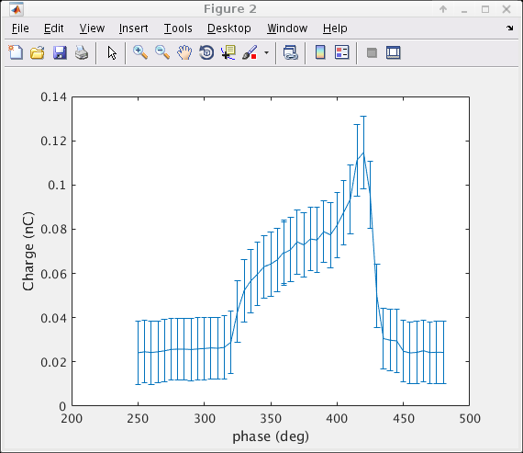
Example of Scan interfaces to be included in MML Charge phase scan (from CLEAR)
Script to adapt for ThomX (could be done in MML or Taurus )

Slide 11
Example scan for energie steerer

Slide 12
Example of solenoide scan

Slide 13
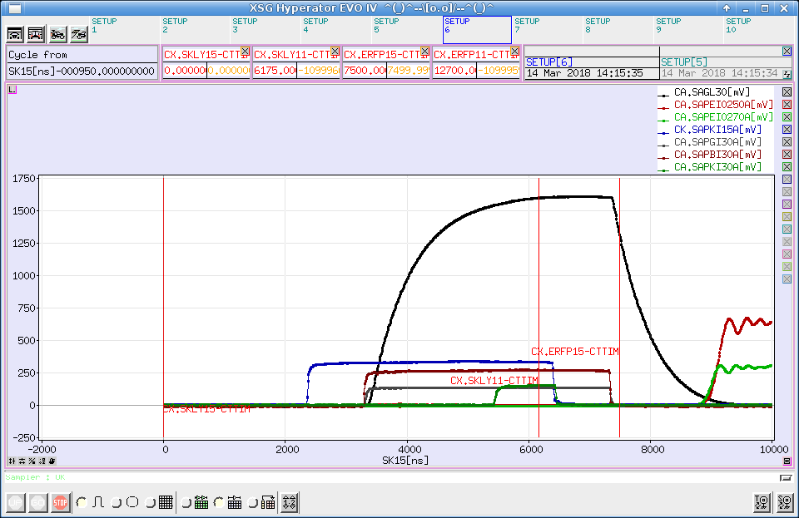
Interface with RF-Signals
Could be very useful to understand the Timing status
Need to keep the possibility to access the analog signals (scope)

Slide 14
Interfaces roadmap (< 6 months)
Upgrade MML test-version to add operating points :
Linac-TL-EL, Linac-TL-Ring-EL, and Linac
Already existing Lattices (MadX and Beta)
Trends :
For vacuum
For beam charge, position …
Diagnostics
General interface :
Diag stations (Yag)
ICTs
BPMs
Automatic measurements
Charge:Phase, Energy steerer, Solenoid scan, energy dispersion
Alignment, orbit correction

