Slide 1
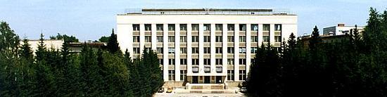
BINP
Novosibirsk SCT vacuum system
Alexander Krasnov, Sergey Pivovarov
Budker Institute of Nuclear Physics (BINP), Novosibirsk, Russia
E-mail address: a.a.krasnov@inp.nsk.su
a.a.krasnov@inp.nsk.su

Slide 2
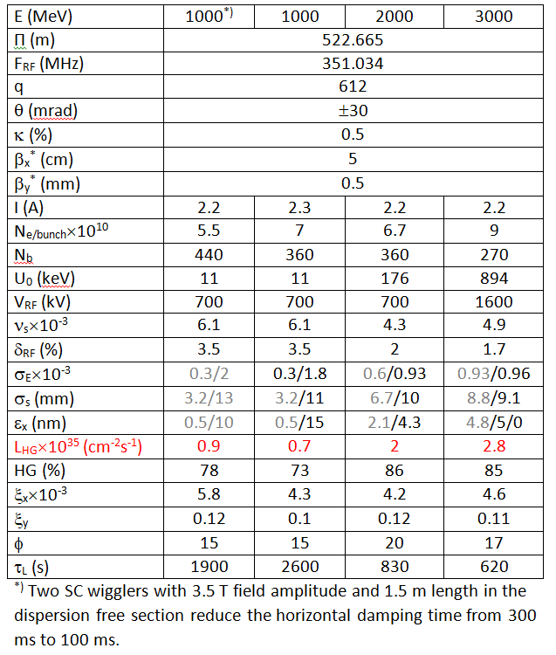
Lattice and parameters
Ѓ ≈ 1E19 ph/m, P_{SR} up to 4 kW/m
Density of photo-electrons is higher than
threshold ~ 3E5 cm⁻³ (SuperKEKB)
of e⁺ beam instability due to
interaction with electron cloud
Low beam pipe impedance:
the Al or Cu is allowed only.
In case of a functional coating:
skin depth must be several times less than
thickness for frequencies up to c/σ_{s}

Slide 3
BINP
General requirements / inputs
Vacuum tightness!
Mechanical stability against external pressure and quenching
Power absorption: SR
Dynamic pressure level: 3E-9 – 1E-8 Torr (vacuum beam lifetime). What is requirement around detector (background due to in-elastic scattering)?
Low SEY & PEY for e⁺ ring: Electron Clouds (EC) problems – beam instability
Impedance: HF: TMI (anti- EC coatings or other surface treatment ?)
Beam pipe must be as smooth as possible (wakes and HOM). Simple round tube – is best case. Number of bellows must be minimized.
Un-baked system more preferable (3 – 4 times less of bellows!)
Design of Collimators, HOM absorbers, bellows: learn PEP-II, KEKB, DAFNA solutions

Slide 4
BINP
Surface
Metallic surface contains 10 ÷ 100 ML (1 ML ≈ 10¹⁵ cm⁻² ) of
Chemically bound: MxOy, Mx(OH)y, Mx(HOC₃)y, carbon clusters
Physically adsorbed: H₂O, organics
Example: Surface of a tube with D=5 cm contains on 10⁷ ÷ 10⁸ times more molecules than ones inside the tube in gas phase at density 10⁹ cm⁻³ or pressure 3E-8 Torr!
Radiation can provoke dissociation of the molecules which causes desorption of:
H₂ , CO, CO₂ defines beam vacuum lifetime at RT (can be critical at 50-80K due to recycling)
Saturated hydrocarbons CxHy (due to catalytic reactions on surface)
- fluxes of photons, electrons and ions correspondingly
- primary desorption yields at irradiation by photons, electrons and ions correspondingly
Range of η = 1Е-2 ÷ 1Е-6, β ~ 10 ÷ 100 times of η and Ψ = 1 ÷ 1Е5 !)

Slide 5
Conditioning
Photon stimulated desorption at RT
Electron stimulated desorption 10 – 100 times higher
BINP
-1
10
-2
10
-3
10
Desorption yield molecule/ph
-4
10
-5
10
-6
10
-7
10
18
19
20
21
22
23
24
25
26
10
10
10
10
10
10
10
10
10
Dose [ph/m]
~2000 A*h
Taking into account conditioning, ~ 6 months

Slide 6
Gas density profile
BINP
z_{p-1}
z_{p}
z_{p+1}
z
S_{p-1}
S_{p}
S_{p+1}
< 30 l/s
Limited by u_{i}
100 - 500 l/s
10000 l/s
Distributed pump
“surface” pump
Lumped pumps
Cryogenic or getter pump

Slide 7
Beam pipe with lumped pumps
BINP
z_{p-1}
z_{p}
z_{p+1}
z
S_{p-1}
S_{p}
S_{p+1}
< 30 l/s
Limited by u_{i}
100 l/s
10000 l/s
Example: Equidistant pump (200 l/s) placement with 5 m period
ID = 6 cm,
at η = 10⁻⁶ molecule/ph
P ≈ 5E-9 Torr
After 2000 A*h
Total number of the pumps is about 100p per ring: combined pump NEG cartridge + IGP

Slide 8
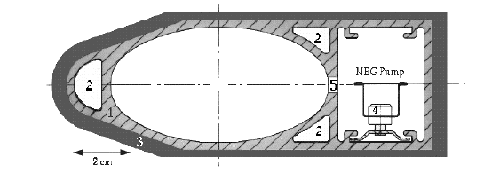
NEG distributed pump
BINP
z_{p-1}
z_{p}
z_{p+1}
z
S_{p-1}
S_{p}
S_{p+1}
Cross section of the LEP vacuum chamber
PEP-II, KEKB, PETRA III
Limited by u_{i}
100 l/s
10000 l/s
Complicity to install into dipole chamber with small radius,
Additional surface, insulators (ceramics), high current feedthrough…
Potential problem with metal dust

Slide 9
NEG
a.a.krasnov@inp.nsk.su
BINP
z_{p-1}
z_{p}
z_{p+1}
z
S_{p-1}
S_{p}
S_{p+1}
NEG coating!
Limited by u_{i}
100 l/s
10000 l/s
re-cycling
Sorption capacity 1 ML. Lifetime ?
Most popular NEG composition is TiZrV – low activation temperature 180 °C
Advantages: low and low SEY, high pumping speed
Disadvantages: Needs baking, low sorption capacity (lifetime ?) –
Good solution MAX IV: lift up and bake (required 1 week). But needs sectorisation

Slide 10
BINP
Investigation of TiZrV.
Effect of activation. Photon flax 4Е16 ph/m/s

Slide 11
Experiment with saturated NEG
a.a.krasnov@inp.nsk.su
BINP
P_{end}
P_{c}
P_{end}
L=150 cm, d=2.5 cm
CO
CO
-L/2
0
L/2
σ=0, s=s_{m}
SR stimulates diffusion of molecules into NEG film!
– prolongation of lifetime!
- No re-cycling!

Slide 12
BINP
Electron clouds
Surface conditioning
SEY measurements at CERN for copper samples:
Pure copper: δ = 1.35

Slide 13
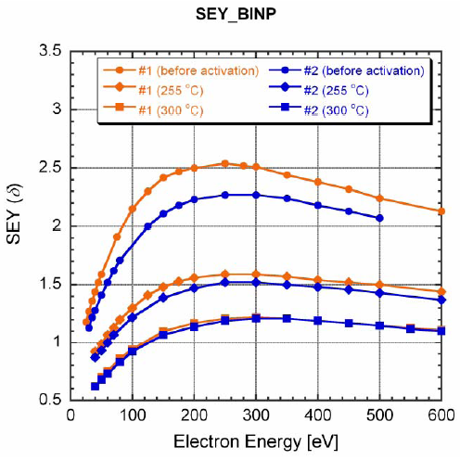
Electron cloud
BINP
Phenomenologically, neglecting space charge, electron density can be estimated as:
The problem is solved if s <0,02,
and < 0,95 for example
α-С coating
Coating is developed at CERN
High quality NEG (TiZrV)
Or just Ti but deposited in-situ
< 3E5 cm⁻³

Slide 14
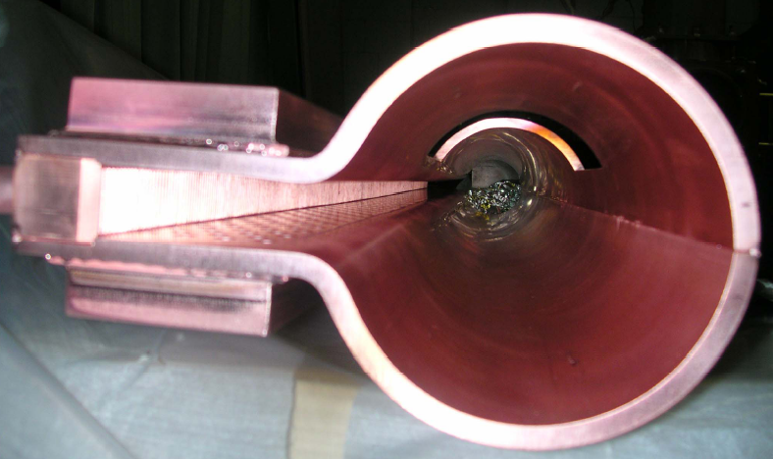
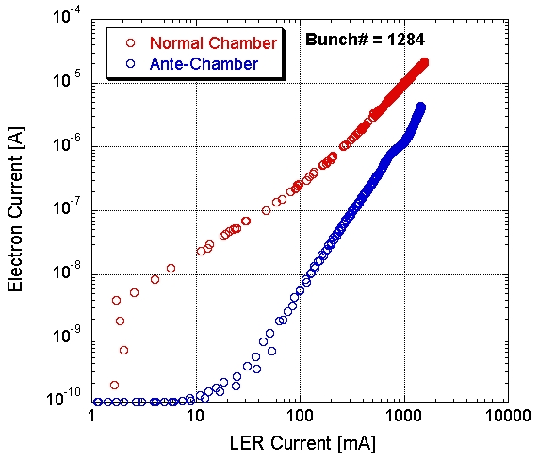
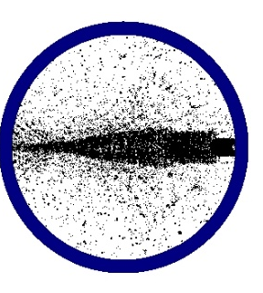
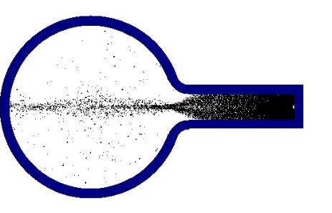
BINP
LER (KEK)
How to mitigate photo-electrons?
Ante-chamber:
СИ

Slide 15
Standard beam pipes of SuperKEKB
BINP produced:
Type-Q 318 chambers
Type-B 108 chamber
Type-S 276 chambers
in total 702 vacuum chambers during 21 months

Slide 16
First concept of CT beam pipe
BINP
cooling
Inners surface
1. Amorphous carbon film
(+ lump pumps)
2. NEG (activation with lifting up)
3. Ti in-situ deposition
SR
Photon flux in beam space must be less than 2% of direct SR photon flux
Effective SEY <=0,9
Film should not influence on HF surface impedance

Slide 17
Options consideration
BINP
 | Carbon + lumped pumps | NEG | Ti in-situ
Conditioning | 2000 A*h | - | -
Re-activation/ Deposition/conditioning | One week | One week | One week
Disassembly of magnets for the “Re-“ | - | Yes | -
Pressure level | 5E-9 Torr | < 1E-9 Torr | < 1E-9 Torr
Sectorization | 50 m and more | < 30 m | 30…50 m (?)
Technology | Exists | Exists* | Semi-exists* Must be developed
Price | High
* degradation at high photon dose?

Slide 18
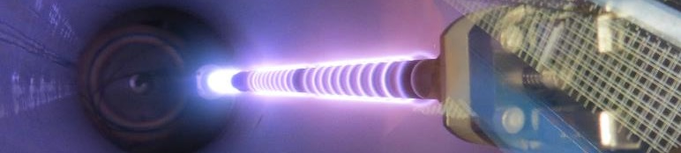
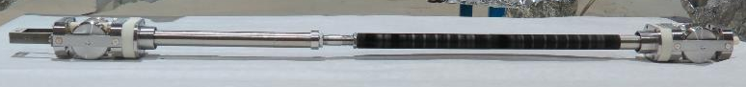
4 – a-C coatings for the LHC
1 spool for mechanical
cable
How to do it?
1 spool for mechanical cable
+
2 spools for electrical cables
Cold bore + beam screen
Ar injection
Turbo molecular
pump
titanium
carbon
8th HL-LHC Collaboration Meeting, 15-18 October 2018 CERN, Geneva

Slide 19

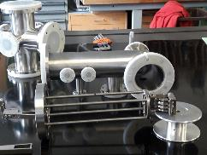
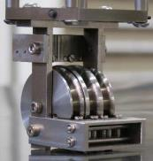
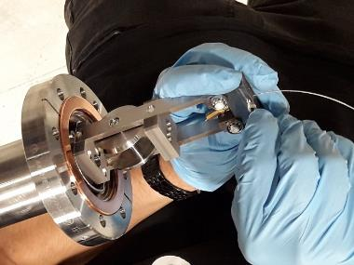
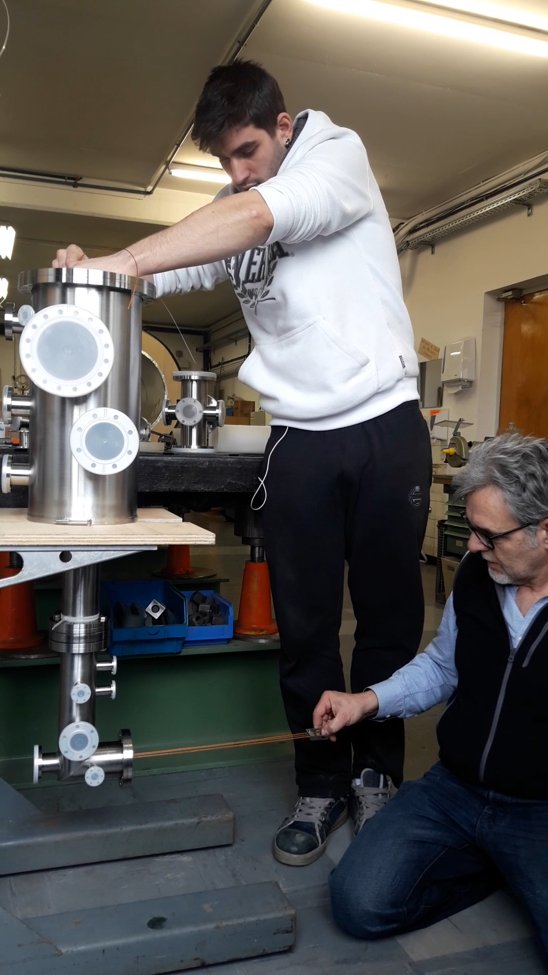


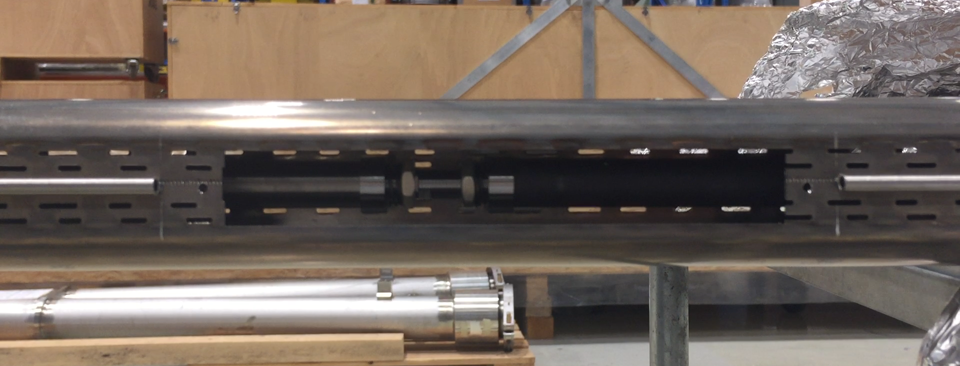

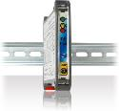
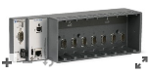
From presentation of P. Costa Pinto (CERN)
2 – Preparation for the LS2
Construction of the coating setups for production (Q5 & Q6)
Vacuum and mechanics for displacement
Sputtering sources for all BS: ready
1st coating system for production is ready.
2nd system presently under construction.
Monitor & control system
(EN-SMM)
First unit to be delivered in December 2018.

Slide 20
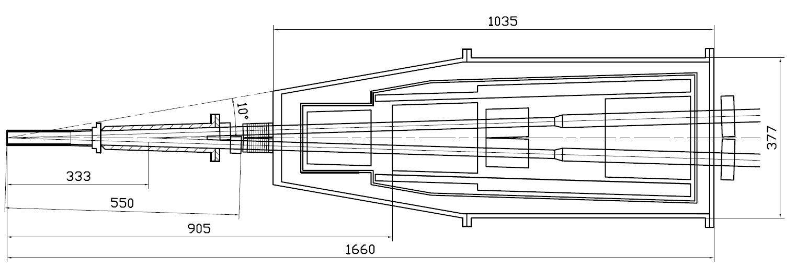
Machine-detector interface
Compensating solenoid
Gradients for 3 GeV
Be-tube ±150 mm,
∅30 mm, cooled
QD0, 200 mm
–100 Т/m
QF1, 200 mm
70 Т/m
Corr. coils
Screening solenoid
BPMs
Y-chamber,
cooled
BPMs
e+
IP
e-
L* =
FF vacuum chamber
Cryostate with FF magnets
Maximum power load on vacuum beam pipe with ID=30mm due to resistivity losses (assuming Cu) and HOM absorption is 50….100 W/m. Therefore the pipe needs an active cooling.

Slide 21
Conceptual design of RT or 77K beam pipe inside cryogenic magnets
Inner stainless steel tube, 0.7 mm thickness with inner Cu coating
Gap 0.7 mm with water flow and wire spacers
Stainless steel tube 0.7 mm thickness with outer Au coating
Vacuum gap 0.9 mm with a HRR (?) spacers with low thermal conductivity
Outer stainless tube, thickness 1 mm, with inner Cu coating, T=4.2K
Correction coil
If ID=30 mm, the OD is 38 mm
Maximum power load on vacuum beam pipe with ID=30mm due to resistivity losses (assuming Cu) and HOM absorption is 50….100 W/m. Therefore the pipe needs an active cooling.

Slide 22
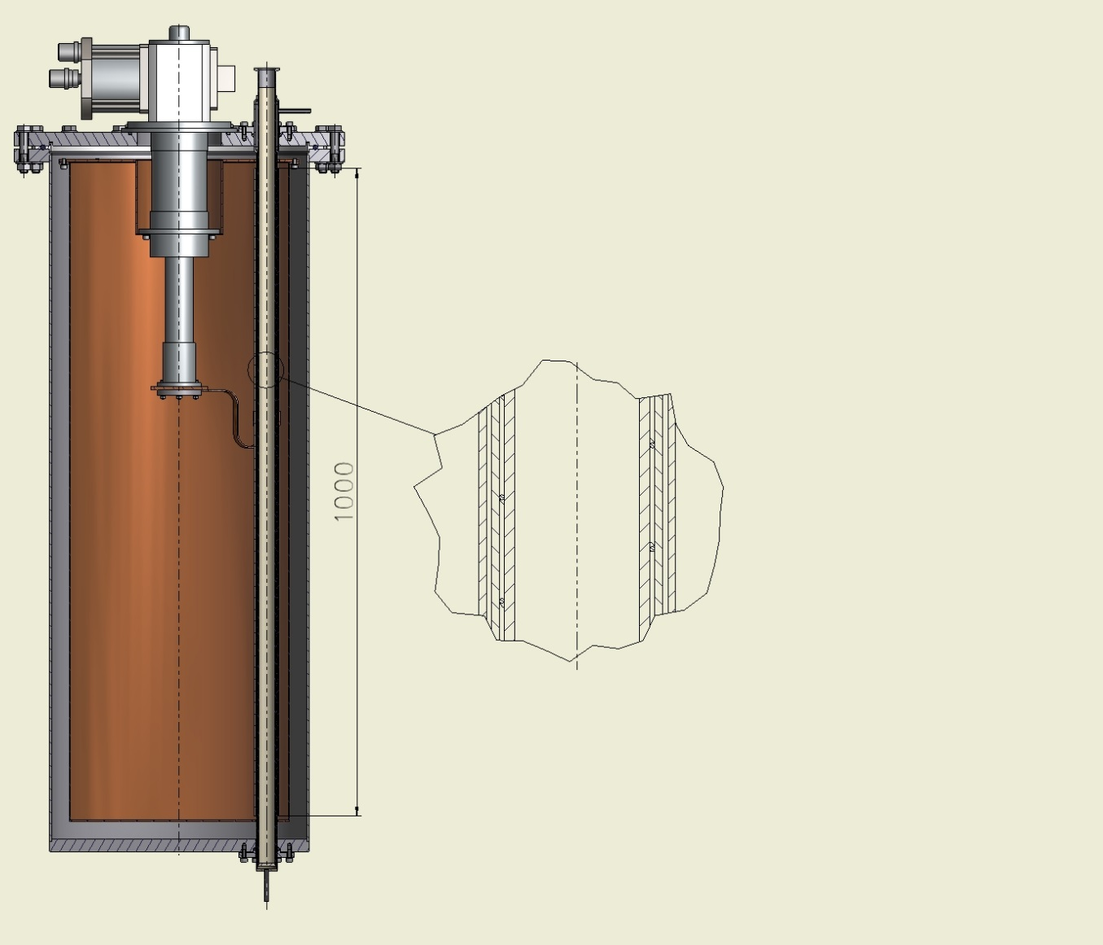
Stand for testing the vacuum chamber.
Cryo-cooler SRDK-415 1st – 50K, 2st – 10K
liquid cooling
Calibrated thermal “bridge”
3 layers Vacuum Chamber
Vacuum
Water
Shield 50K
100W
10K
Cryostat
liquid cooling
Power load will be measured with the use calibrated thermal “bridge” and difference of temperature between cooling liquid inlet-outlet

Slide 23
List to do
Developing of a device for in-situ Ti deposition (a magnetron sputtering)
Investigation of thin getter film evolution/degradation at high SR photon dose
the use existing at BINP: TOF SIMS and EDX (electron microscope) for element analysis with depth profiling, SR beam line from BEP synchrotron
Measurements of HF surface impedance with thin film coatings.
Organization of SEY and PEY (under SR) measurements
MDI:
Experiments with proposed design of beam pipe inside cryogenic elements
Simulation of backgrounds due to Touschek, SR and non-elastic scattering
A coating of IP beam pipe? Learning of Super KEKB results.
Optimization of collimators and HOM absorbers design (placement ?). : learn PEP-II, KEKB, DAFNA solutions
…?
BINP

Slide 24
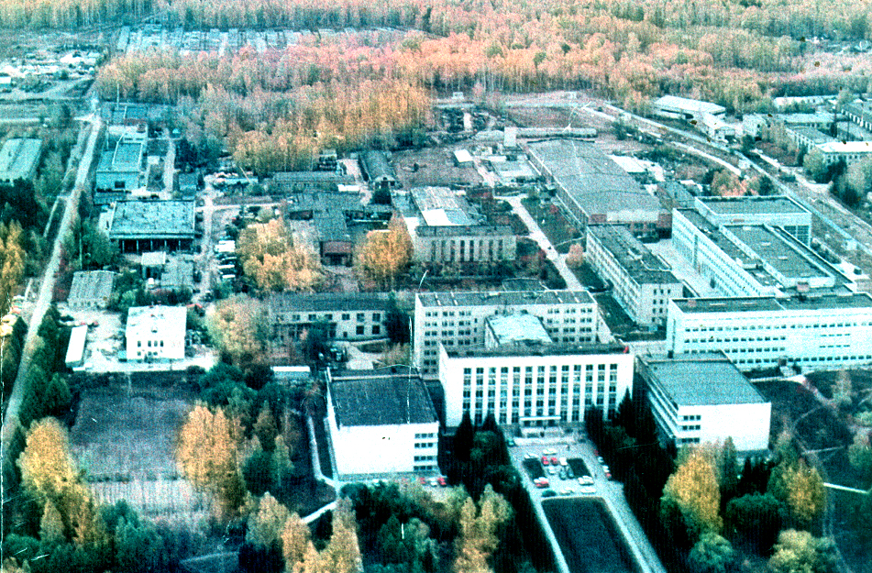
Thanks for your attention

Slide 25
Equations for residual dynamic gas density prediction
a.a.krasnov@inp.nsk.su
BINP
z_{p-1}
z_{p}
z_{p+1}
z
S_{p-1}
S_{p}
S_{p+1}
Limited by u_{i}
100 l/s
10000 l/s
re-cycling
a_{i} - surface density of phisisorbed molecules
l – perimeter of the beam pipe cross-section
- Sticking probability
- Ultimate density
- fluxes of photons, electrons and ions correspondingly
- primary desorption yields at irradiation by photons, electrons and ions correspondingly
- secondary desorption yield (re-cycling)

