Slide 1
Ways to choose the most suitable AM technique for particle accelerators components
Significance in R&D on Additive manufacturing applied on Particle Accelerators
Prof. Toms Torims, CERN/ RTU
PhD Student Adrián Morales Casas, RTU/ UPV

Slide 2
Contend
Overview of AM in industry and science
Description of technologies
Comparison of technologies
Future avenues and conclusions
Current research front

Slide 3
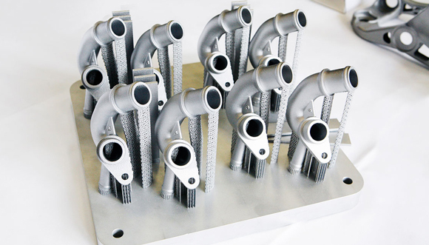
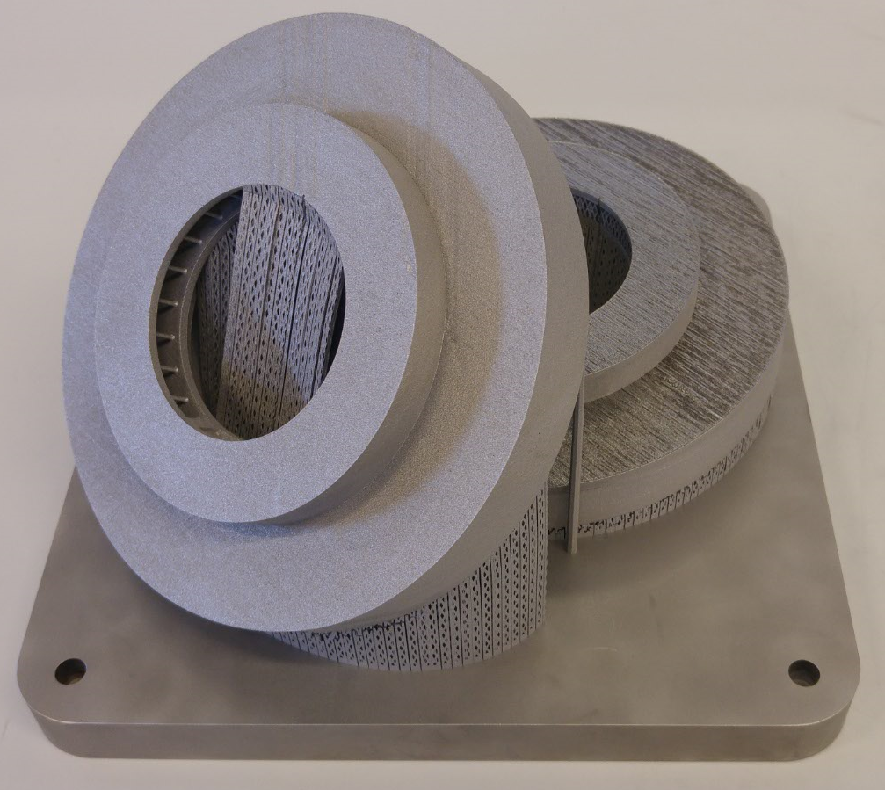
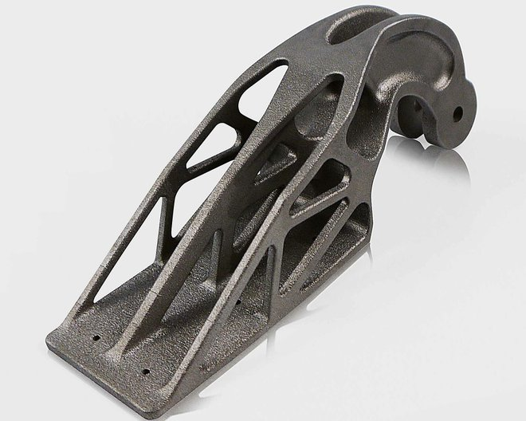
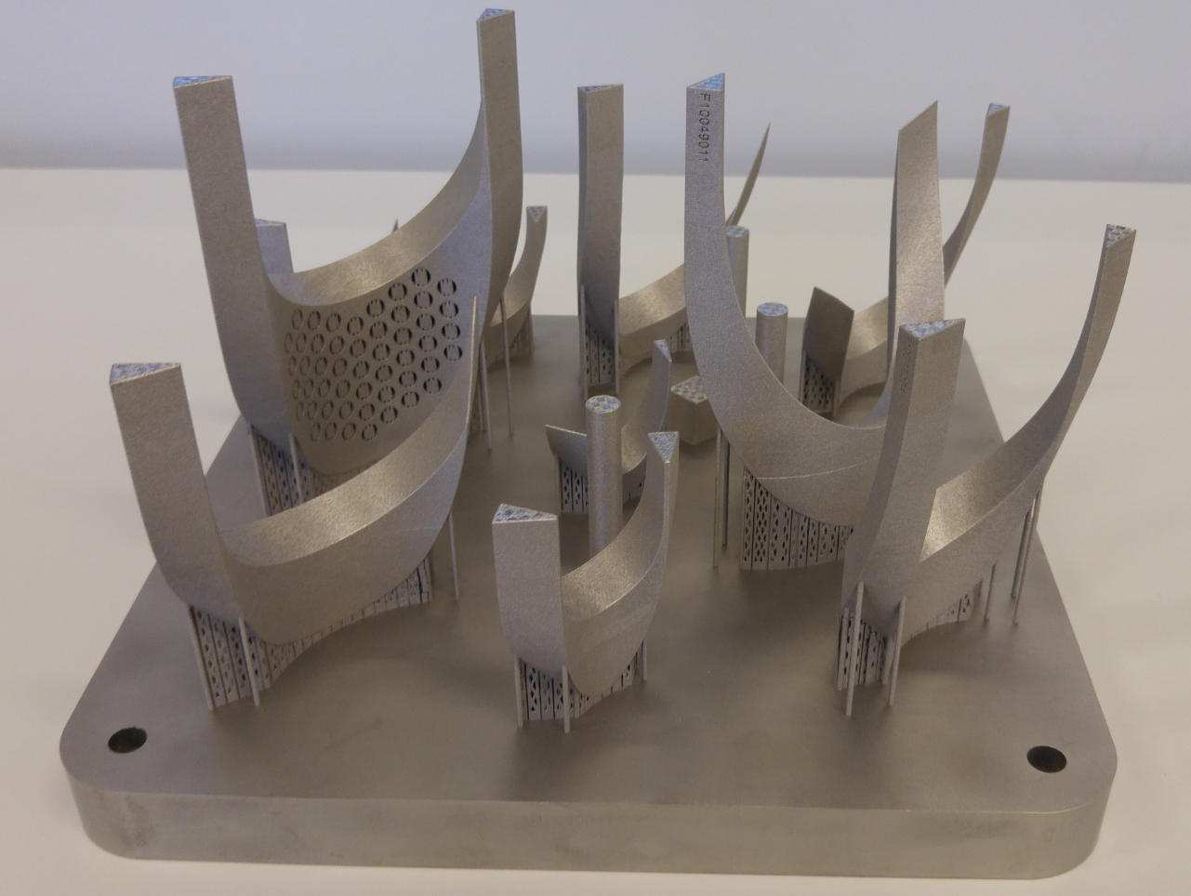
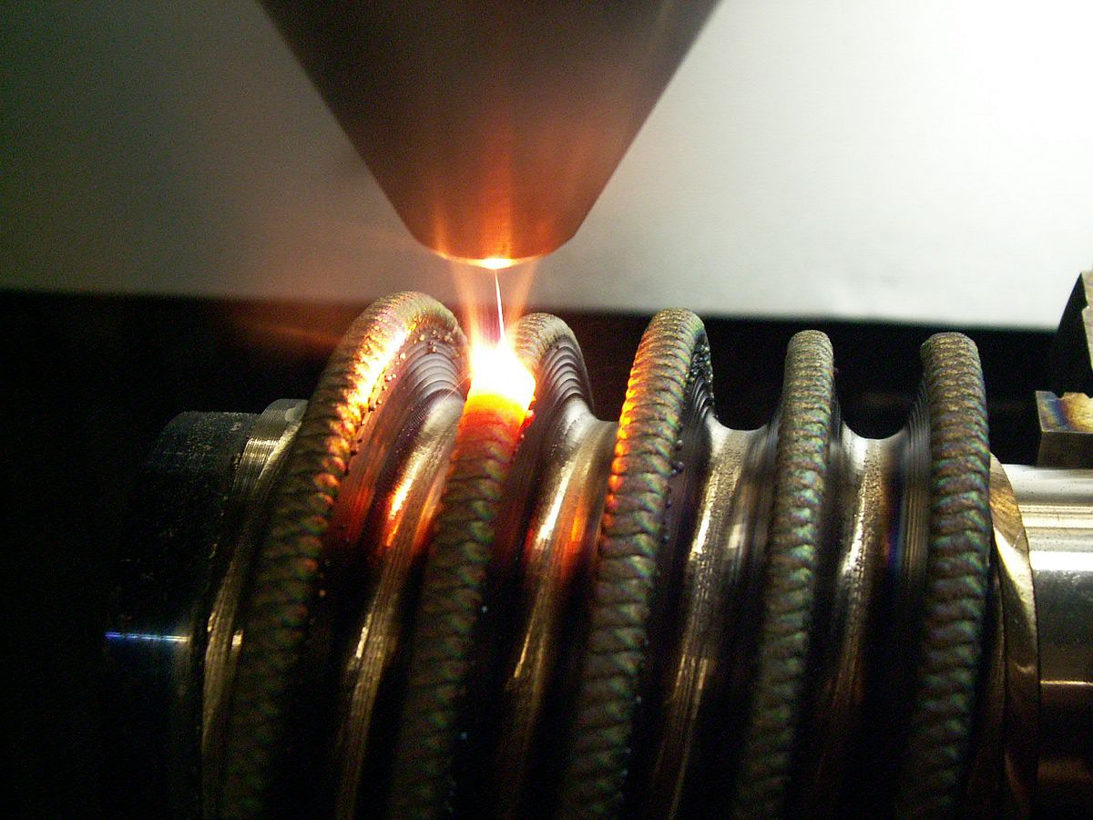
Overview of AD in Industry and Science
Automotive industry
Aircraft Industry
Aerospace Industry
Service Industry
CERN
DESY
LAL
KEK
ANL
FNAL

Slide 4
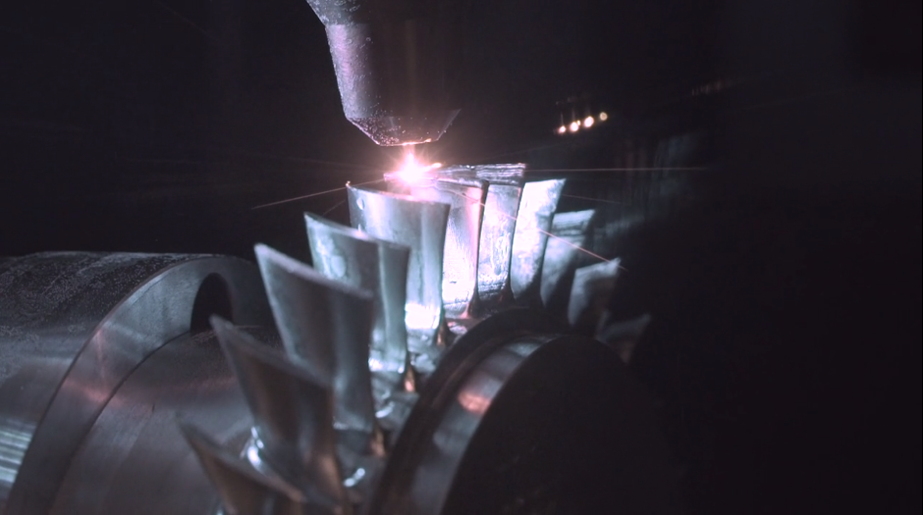
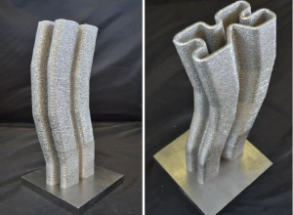
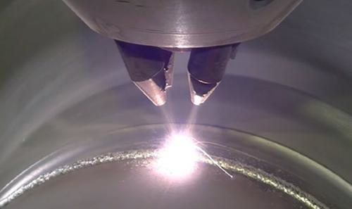
Description of Technologies
Additive Manufacturing
Cladding technique
3D printing technique
Cover
Repair
Free forming build-up welding

Slide 5
Description of Technologies
Additive Manufacturing
Cladding technique
3D printing technique
Cover
Repair
Free forming build-up welding

Slide 6
Description of Technologies
AM 3D printing techniques
-SLS
- SLM
- DMLS
- EBM
-MJF
- LENS
- EBAM
- DMT
- DMD
- BJ
- DOD
- MJ
- NPJ

Slide 7
Comparison of techniques
AD manufacturing techniques:
Traditional methods
Powder bath fusion
Direct energy deposition
Metal Jetting
Binder Jetting
Turning
Milling
Casting

Slide 8
Comparison of techniques
Crucial advantages in the production of
Particle Accelerator components
Capability to combine different materials that are difficult to process.
Control over construction direction, filling shape and microstructure.
Complex designs and sets endowed with mobility can created.

Slide 9
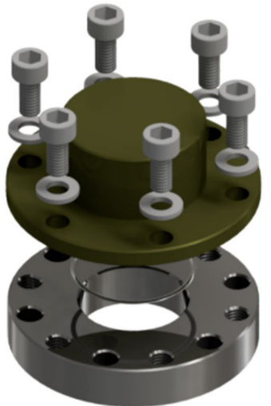
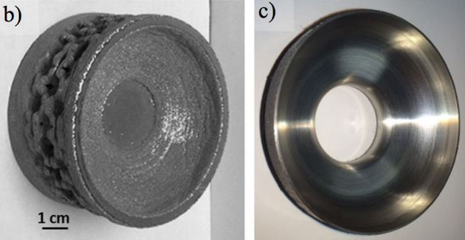
Comparison of techniques
Particle Accelerator simples manufactured so far:
Quantum sensor parts:
Magnet shielding
Vacuum chamber parts
Superconductive radiofrequency cavities prototypes (SRF)
Beam Position Monitoris (BPM)

Slide 10
Comparison of techniques
 | EBM | SLS
Working chamber | Under vacuum around 13 mbar and powder preheated up to 1100ºC | Inert gas environment (Argon) and powder preheated bellow 300ºC
Selective melting source | Electron beam | Laser beam
Scanning speed | 170-160 mm/s | 960-1500 mm/s
Energy density | - | 27-100 J/mm³
Beam current | 20-18 mA | -
Tensile ductility of the outcome | 1012-1011 MPa | 1058-978 MPa
Fatigue strength of the outcome | 350-550 MPa fatigue limit | 350-550 MPa fatigue limit
The hardness of the outcome | 35-15 Rockwell hardness | 35-27 Rockwell hardness
Mechanical properties of the outcome | Low ductility. The outcomes show comparable tensile ductility, fatigue strength, and hardness to SLS. | Higher yield and tensile strength (more ductility)
Process parameters influence | Any significant deviation from optimum process parameters result in relatively large defects and poor mechanic properties | Excessive energy inputs affecting less the mechanical properties than those caused by insufficient energy input

Slide 11
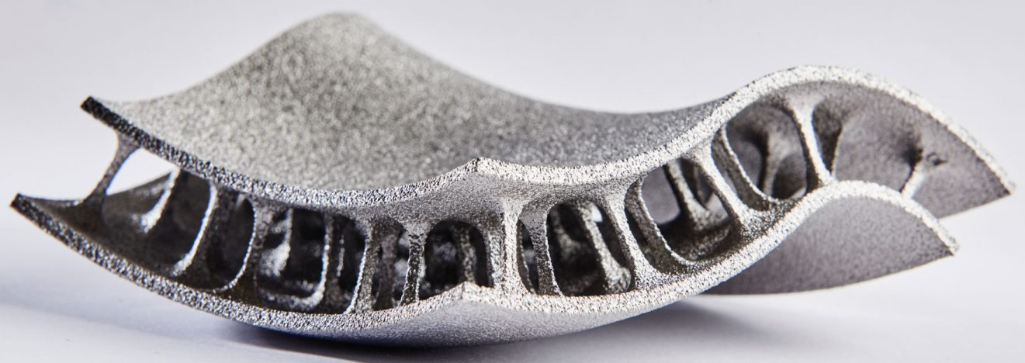
Future avenues and conclusions
SLS and EBM have both evidenced their suitability.
The resulting components are getting closer to wrought manufactured materials.
Re-education of engineer and designer.
Additive Manufacturing

Slide 12
Current research front
Additive manufacturing application in particle accelerator
Study the suitability of AM technology facing to conventional methods
Research advances on additive manufacturing applied on particle accelerator components
Identification of problems and possible solution in the use of AM to manufacture PA components

