Slide 1


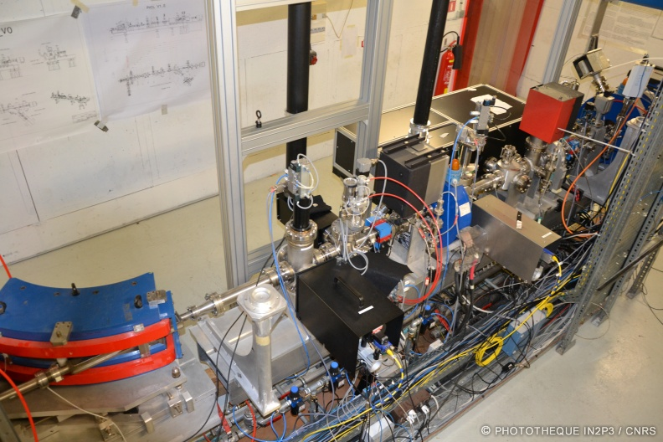
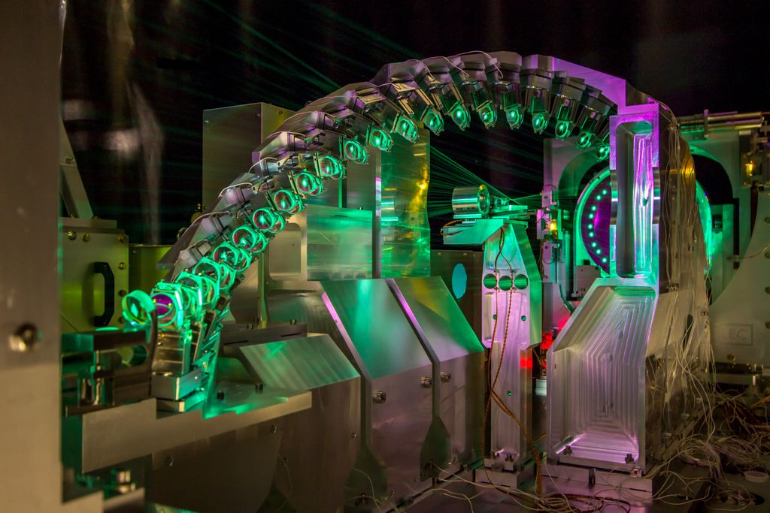
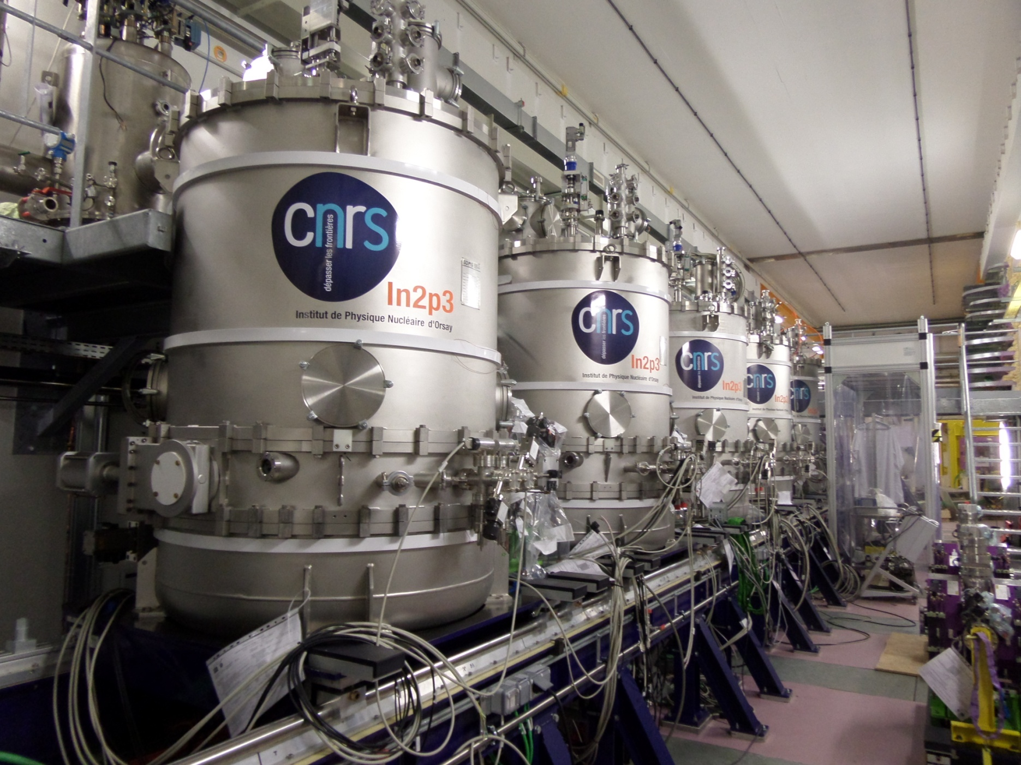
HCERES evaluation of
Laboratoires de la vallée d’ rsay
CSNSM
IMNC
IPNO
LAL
LPT
Accelerator Physics
Speaker : S. Bousson, on behalf of the Accelerator Teams
14-17 january 2019

Slide 2


Accelerators Physics
The Accelerator Physics landscape in the Orsay Valley
Accelerator Physics and Engineering in mainly 2 laboratories, LAL and IPNO, but also some specific expertise in CSNSM
6 area of research activities in the field of Accelerator Physics with high international visibility
  Beam physics and instrumentation
  Accelerator design and simulations, beam dynamics, beam monitoring and control, beam instrumentation, high power beams, nano-beams
  Superconducting and conventional RF acceleration
  Conventional and superconducting RF structure design and operation, RF sources, new SRF concept and material
  Laser-plasma acceleration
  High power laser, photoinjectors, ultra-short beams, diagnostics, external injection
  Laser – electrons interaction
  Compton sources for X-γ ray production, optics,
  Radioactive ion beams production
  Ion-source physics and technology, UCx target developments,
  Physics of vacuum and surfaces (a nascent thematic)
  Vacuum physics, thin films/layers in accelerator application (anti-multipacting, SRF,…), photocathodes,…
Many accelerators projects of various sizes (budget, allocated FTEs) but also framework (from local to international)
Strengthened by world-class technological platforms providing easy access to high tech equipment
Construction and operation of local accelerators

Slide 3
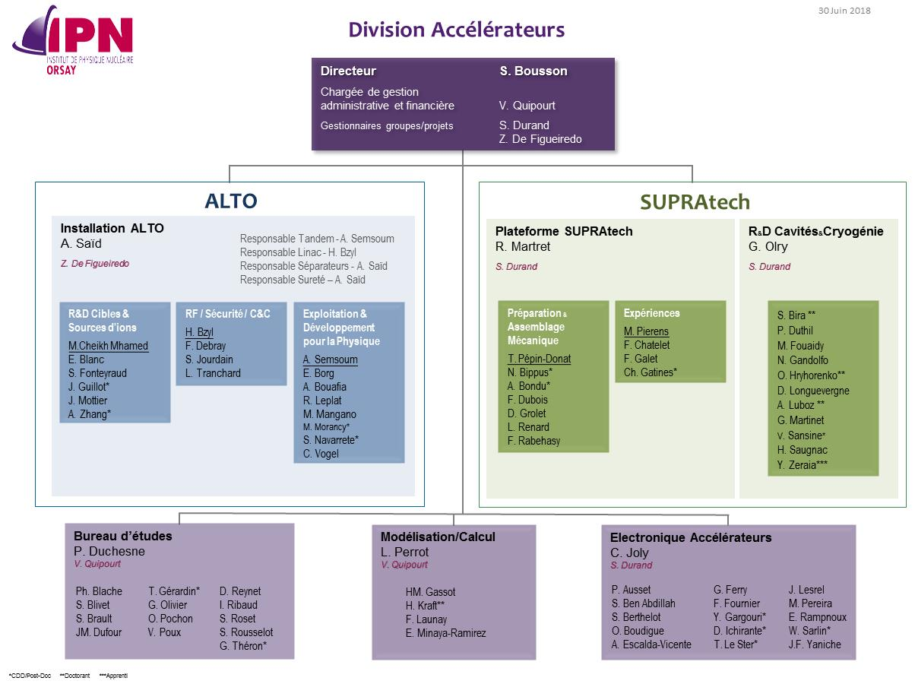
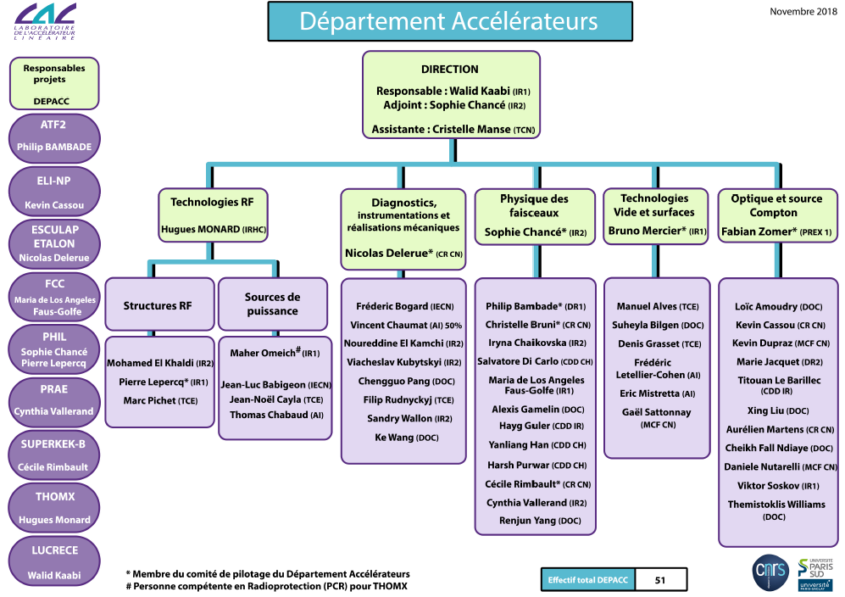
Accelerator Human Resources
Accelerator Human Resources
At present (permanent + temporary): LAL Accelerator Department : 42 and IPNO Accelerator Division: 72
Among which the Accelerator Research Taskforce is about 40 persons

Slide 4
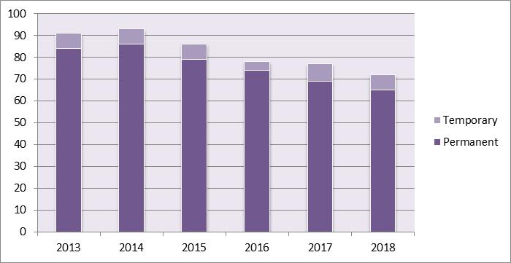
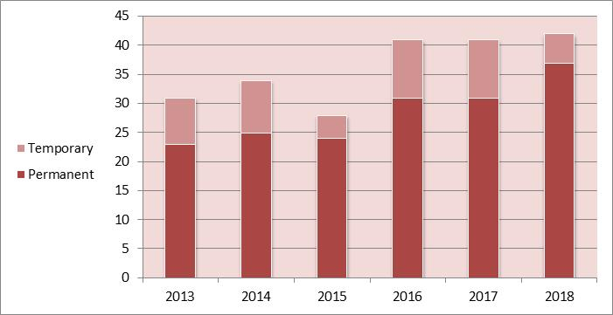
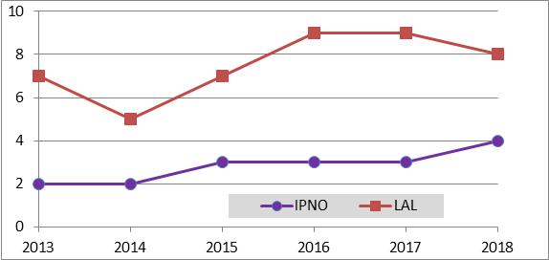
Accelerator Human Resources
Accelerator Human Resources* evolution over the past 5 years
Situation different in IPNO and LAL, but organization is also very different
Differences also in accelerator researcher position: in 2018, 10 in LAL and 2 in IPNO
Ph-D students
* population of IPNO and LAL present accelerator departments, which is not the full account of FTEs spent on accelerator activities

Slide 5
Teaching activities
  Both researchers and Engineers are contributing to numerous teaching activities, at different level. For instance (non exhaustive):
  Several accelerator courses at M2 level (M2 Grand instruments, NPAC)
  Several accelerator courses at PhD school level (ED PHENIICS)
  Several contributions to courses at IN2P3 national school
  Several courses on thermodynamics, sensor engineering, cryogenic at IUT/DUT in Paris-Saclay
  Course in the European Joint University Accelerator School (JUAS)
  Coordination of an online course about particle accelerator as part of the European project ARIES
  Contribution to the MOOC “Voyages de l'infiniment grand à l'infiniment petit »
  Also Outreach activities (Accelerator museum Sciences ACO, conferences about accelerator to the general public, talks in high schools,…)

Slide 6
Scientific achievements
(2013 - 2018)

Slide 7
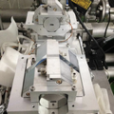
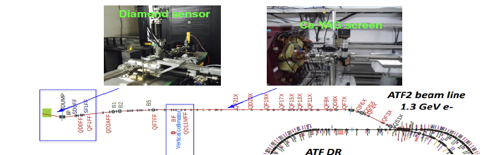
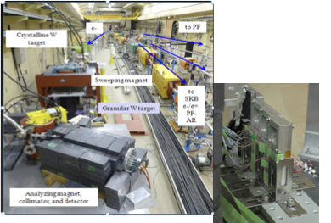
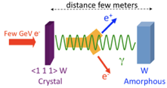
Beam Physics & Instrumentation : ATF2 activities
Scientific Objective
In the framework of the Linear Collider Collaboration (LCC) and specifically in the Accelerator Test Facility (ATF) at KEK the LAL team has played a central role in achieving nanobeam sizes and nanometer beam stabilization at the ILC test facility ATF2 . Besides these activities, the LAL team is also involved in the R&D on high intensity positron sources.
Nanobeam sizes and nanometer alignment technique
  Beam tuning and control techniques; beam instrumentation; origin, control and measurement of the halo
Positron sources
  Development of ILC R&D positron production system
43 nm achieved in June 2014
Main achievements:
The FFS ILC-type on the local chromaticity-correction scheme was successfully validated at ATF2 for the first time. Vertical beam sizes of 43 nm at 10⁹ electrons per bunch have been obtained. A feedback system has also been successfully developed to reduce the orbit jitter, both at the entrance to the final focusing section of ATF2 and at the IP.
Development of unpolarised positron sources more specifically the so-called hybrid positron source, based on channeling radiation. New series of experimental data taking has started recently in SuperKEKB to test this new technique
IPBPM support
Hybrid scheme for e+ production
Granular targets for experiments
FINANCIAL SUPPORT and FTE
PhDs and Postdocs
Granular target-converter can provide better heat dissipation associated with the ratio Surface/Volume of the spheres and the better resistance to the shocks.
IN2P3, ∼ 3 FTE / year on average
LIA FJJPL
H2020 / RISE / E-JADE co-funding
4 PhD defended at UPSud
2 PhD ongoing at UPSud
1 Postdoc

Slide 8
Beam Physics & Instrumentation: SuperKEKB
Scientific Objective
The SuperKEKB asymmetric e⁺e⁻ collider (KEK, Japan) is designed to provide very high luminosity (8x10³⁵ cm⁻²s⁻¹ ) for the Belle II experiment. LumiBelle2 is a fast luminosity monitor using diamond sensors to measure the rate of the radiative Bhabha process at vanishing scattering angle with high precision and with very high dynamic range. It provides:
  Train integrated luminosity at 1 kHz with ∼1% relative precision → one of two main inputs to a dithering feedback system to maintain an optimum horizontal overlap between the two colliding beams at the IP
  Train integrated luminosity at 1 Hz with ∼1% relative precision at very low (few mA) beam currents → for IP beam size optics tuning without beam blowup from beam-beam effects which would mask improvements
  Bunch integrated luminosities at 1 Hz with ∼1% relative precision
Main achievements
  Two successful tests of dithering feedback response with LumiBelle2 input in May and July 2018
  First luminosity measurements in April 2018 and successful delivery of continuous on-line monitoring during Phase 2 SuperKEKB commissioning
LumiBelle2 luminosity monitor setup on SuperKEKB Low Energy Ring
Outlook
  Commitment of LAL team to SuperKEKB to provide continuous luminosity monitoring for beam tuning during the life of the SuperKEKB & Belle II projects (∼10 years). Important to limit accumulated radiation dose on our diamonds to extend their lifes (for 2% relative precision at 1 kHz → ∼1 Mgy / year at 50% op. efficiency)
  After intense R&D phase, LumiBelle2 is evolving into an operation project, part of the LAL contribution to the Belle II experiment
Human & financial resources in past 5 years: 3.3 FTE/year, 2 PhD students, 2 Post-docs, ∼250 k€ (globally) + H2020 funding

Slide 9
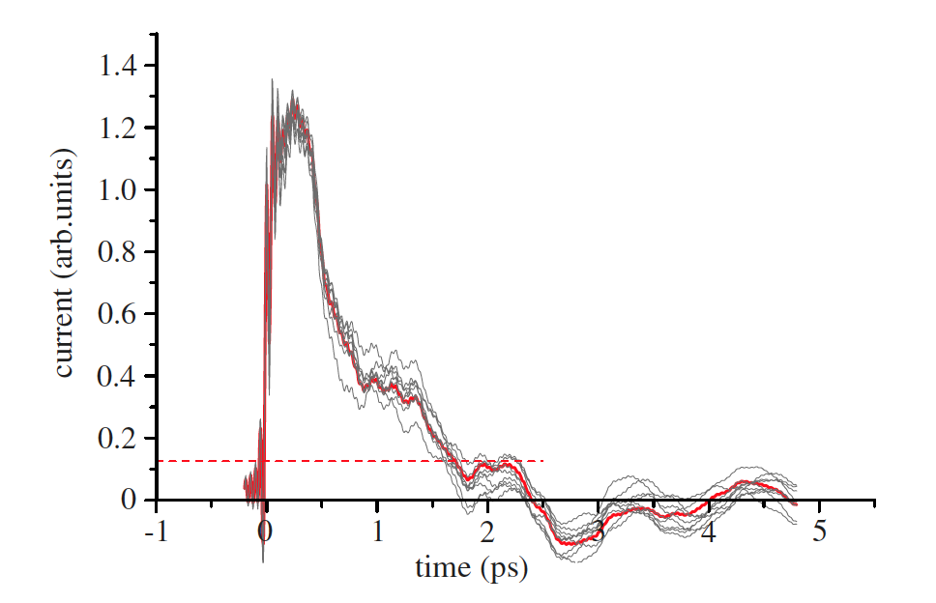
Beam Physics & Instrumentation: ETALON
Scientific Objective
Performing single shot longitudinal bunch profile measurement for ps and sub-ps bunches (important in conventional accelerators and laser plasma accelerators) using coherent Smith-Purcell radiation (CSPR) detectors
Main achievements:
2 experiments recently concluded (FACET@SLAC and SOLEIL) and 2 in progress (CLIO@LCP Orsay and SPARC@LN Frascati).
Demonstration of sub-ps bunches measurement ; Study of background noise identification and removal; Study of bunch profile reconstruction method
Human resources: strong variation from 3,2 FTE/year (1 researcher, 1 post-doc, 1 PhD, 1 engineer) to >1 FTE/year (1 researcher, 2 engineer, all part-time) + mechanical workshop.
Financial resources: ~500k€ over 5 year (mostly from ANR but also IN2P3 and Univ. Paris-Sud)
Main collaborations: University of Oxford, LCP Orsay, LN Frascati, SOLEIL, SLAC
Member of the EuPraxia collaboration (work package leader)
5 years outlook: Use 2 experiments in progress to compare with other diagnostics and demonstrate regular integrated operations at an accelerator; demonstrate single shot operation; find an accelerator to install it as a routine diagnostic

Slide 10

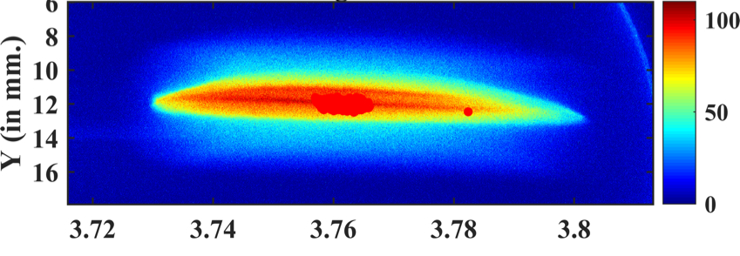

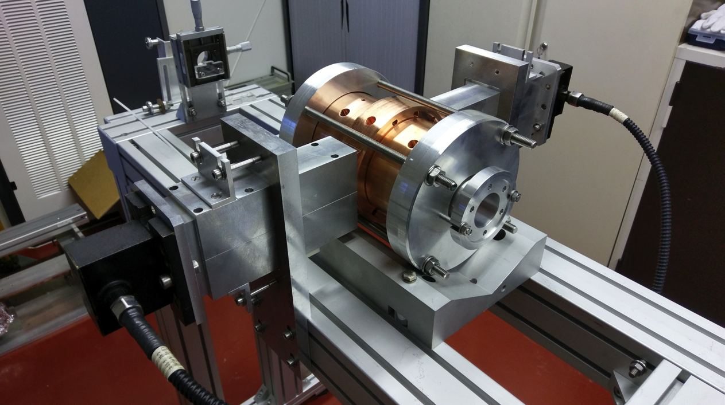
Beam Physics & Instrumentation: DRUM
Scientific Objective
Goals of DRUM project based on the EXALT installation: femtosecond laser (LASERIX) coupled to a photoinjector R&D line (PHIL)
  Produce short electron beams
  Perform bunch duration reconstruction from energy spread measurement and analytical models and improve it with a booster cavity
  Beam dynamics with linear space charge expansion (high charge density)
Main achievements:
Recent experimental results concerning electron bunch measurement at the cathode until 180 fs rms @10 pC, 60 MV/m
  RF tuning in progress for the booster accelerating section done at LAL
  Bunch duration reconstruction tested on different installations (PITZ, SOLEIL, CLEAR)
  Human resource: 1 PhD student, 1 P2IO post-doc, 2 FTE/year (from EXALT team)
Funding: mainly P2IO R&D funding 66 kEuros
Main collaborations LASERIX (LPGP, CLUPS), CEA/Lydil, Desy, CERN

Slide 11
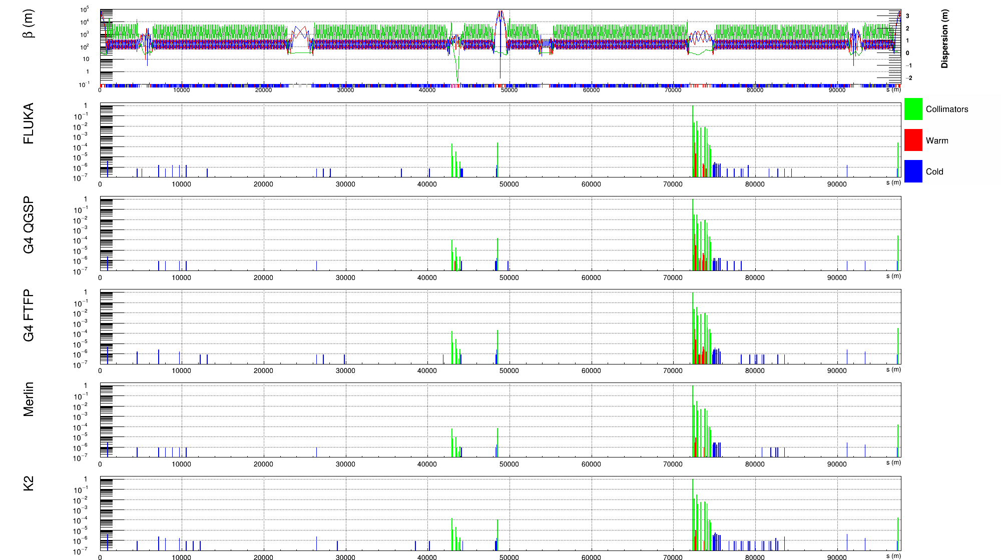
Future Circular Collider (FCC)
Scientific Objective
Contribution to the design of the CERN FCC options:
pp-collider (FCC-hh) → main emphasis, defining infrastructure requirements
(~100 km tunnel infrastructure in Geneva area)
e⁺e⁻ collider (FCC-ee), as potential first step
p-e collider (FCC-he) option, integration one IP, e from ERL
HE-LHC with FCC-hh technology
Collimation insertion design and performance evaluation including imperfections for FCC-hh (further simulation and design for FCC-hh and HE-LHC design under consideration)
Study of beam-surface interactions and dynamic pressure generated by e- clouds and ions in FCC-hh (thesis ongoing started in June 2017)
Design and Performance evaluation of FCC-ee positron system and injection (target optimisation, studies of two modalities of positron production classical and hybrid schemes…
Main achievements:
FCC-hh: Development of the tools for tracking and loss maps; FCChh CDR
FCC-ee:
  FCC-ee can employ the conventional/hybrid positron source. No showstopper identified.
  Target optimization and simulation of the primary capture for conventional e+ production scheme. Parametrization studies for the hybrid scheme. Test of the hybrid source with the granular converter at KEK. Granular targets and photon detector realized at LAL.
  FCCee CDR
FCC loss map
FINANCIAL SUPPORT and FTEs
EuroCircol EU project (2015-2019)
IN2P3 master project, FTE: 3,5
TYL-FJJPL, FCPPL
PhDs
1 UPSud, ongoing

Slide 12
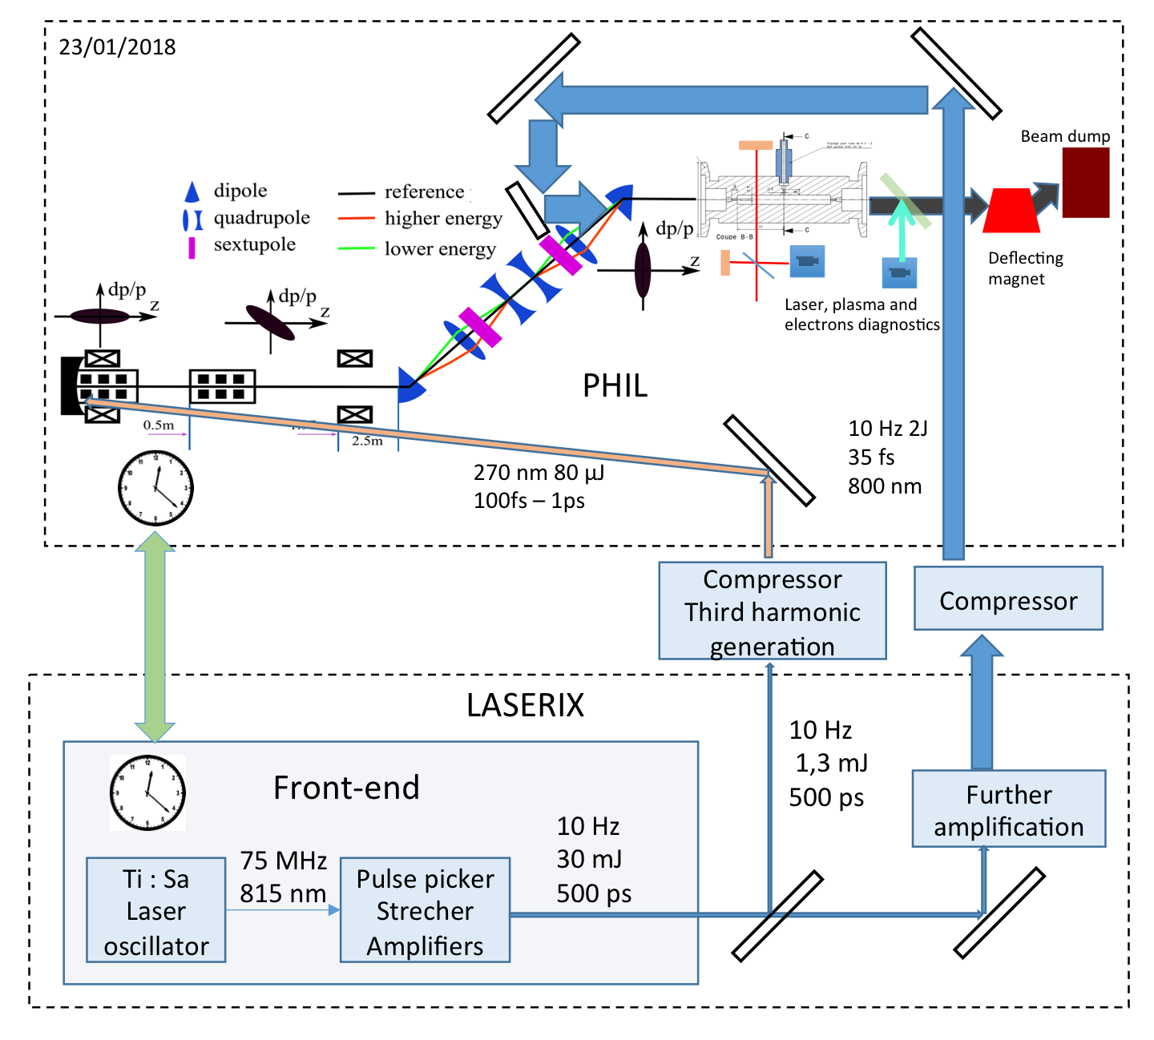
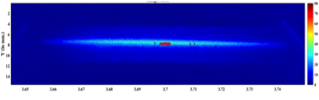
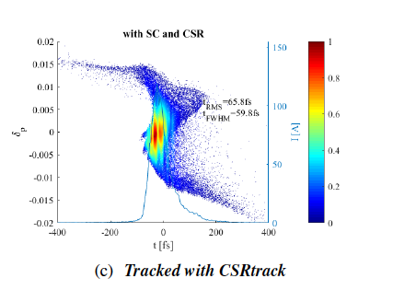
Laser-plasma Acceleration (1)
Scientific Objective
Laser-plasma acceleration uses high power laser (10ths of TW … PW) to accelerate electrons to high energy (100s MeV).
The main purpose is to explore how externally injected electrons can be accelerated. We are a unique place to perform such studies as we combine in the same location a photoinjector (PHIL) and a high power (TW/PW) laser (Laserix).
We also contribute to experiments on the APOLLON PW laser.
Human resources: ~6 researchers (CR+MCF) (~1,5 FTE/year), ~6 engineers (0,7 FTE/year), ~4 technicians (0,4FTE/year), 1.5 post-docs (0,3 FTE/year – one funded by P2IO), 1 PhD student (full time – funded by CSC) + mechanical workshop
Financial resources: about 150k€ integrated over 5 years (IN2P3 and lab resources, 3 P2IO grants) – Not including running and maintenance costs of the two machines.
Main achievements:
  Synchronization of the two machines with ps resolution
  Simulation of the expected performances of the experiment
  Bunch compression scheme for external injection

Slide 13
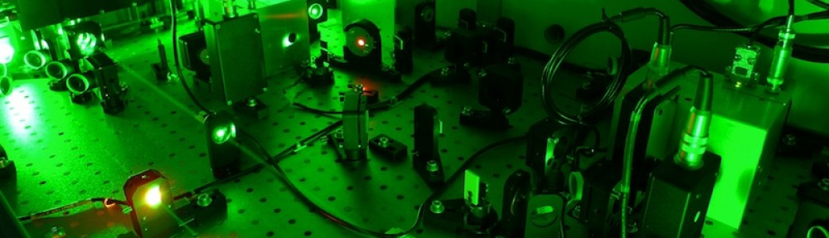
Laser-plasma Acceleration (2)
Collaborations:
  Local: The team collaborates with several laboratories from Paris-Saclay (LPGP, LCP, LLR, CEA/Lydil, LOA, Lumat, LULI, CEA/IRFU, SOLEIL,…) both on the local external injection project and on the APOLLON experiments.
  National: Member of the National Research Group (GdR) APPEL (Plasma accelerator pumped by lasers), one national coordinator and one task leader.
  International: Member of the European collaboration EuPraxia, one work package leader.
5 years outlook:
  Make a preliminary experiment (LUCELX) to demonstrate the operation of both machines together (no acceleration). New ambition with the Laserix group joining LAL !
  Upgrade PHIL to increase bunch energy to 10 MeV and demonstrate bunch compression to 100fs x 100um²
  Perform external injection experiments
  Contribute to electron diagnostics of the APOLLON facility

Slide 14
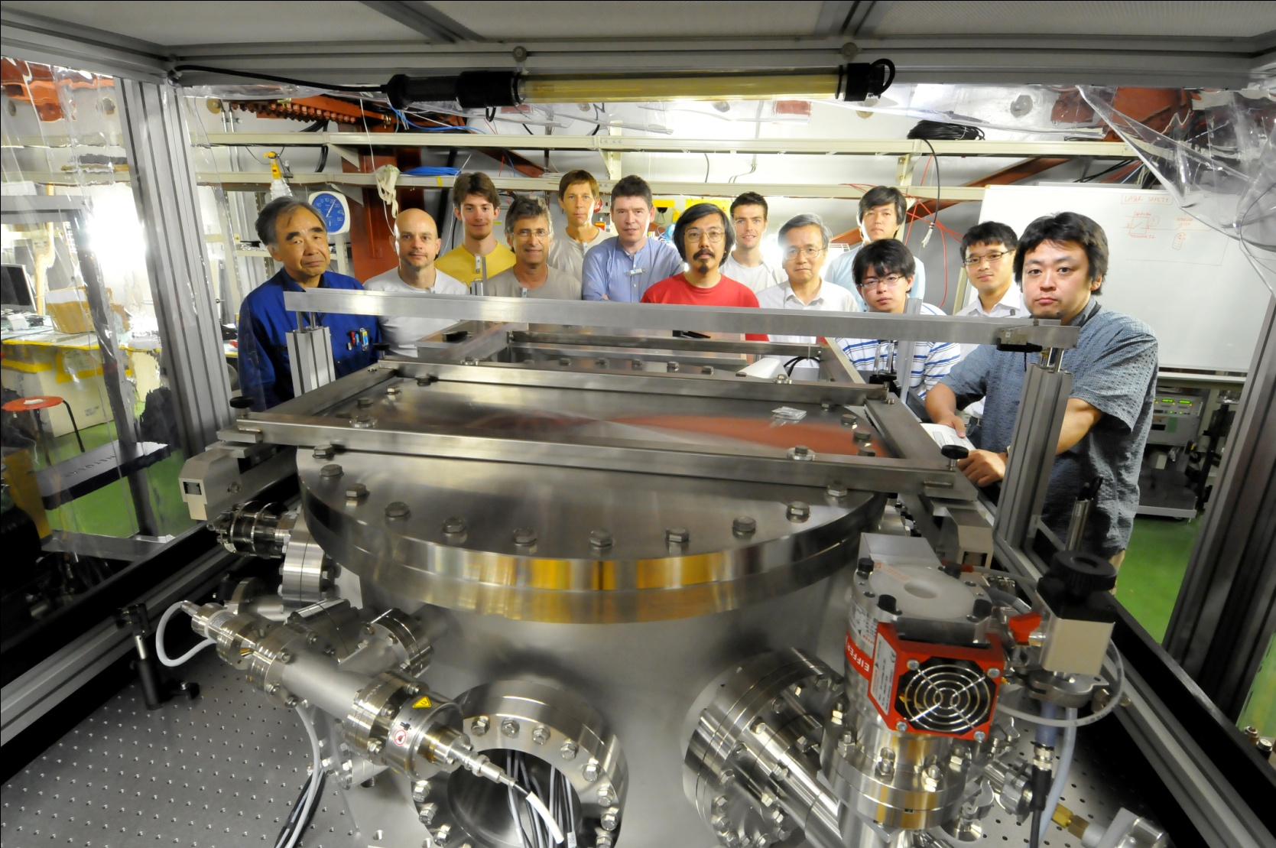
Electron – Laser Interaction (1)
Scientific Objective
  Application of laser interaction with electron and ion beams. R&D on related dedicated optical systems:
    X-ray production with high finesse optical resonator with ~1MW average power & picosecond pulses → ThomX (LAL)
    X/gamma ray production by photonic excitation of stripped ion beam (CERN)
    X-ray production: Burst mode resonators for electron LINACS (Valorisation)
    Diagnostic: High laser power & electron beams high precision polarization measurements (ILC, LHeC projects)
~5 FTE (including 2 PhD/year)
  Y. You, X. Liu, H. Wang(on going) 3 theses cotutelle with Tsinghua University Beijing (Eiffel fundings)
  P. Favier, L. Amoudry (on going) 2 theses Paris-Saclay
Fundings/5 years
  ANR Hellix 140k€, ASTRE: Essonne Department 60k€, IN2P3~125k€ ➔~325 k€
Main achievements:
  Highest rate of gamma rays → ATF / KEK (ANR MightyLaser)
  400kW average power in optical cavity with highest finesse→ LAL (ThomX)
  1 GHz optical cavity / 1 GHz laser oscillator → start LAL/Amplitude

Slide 15
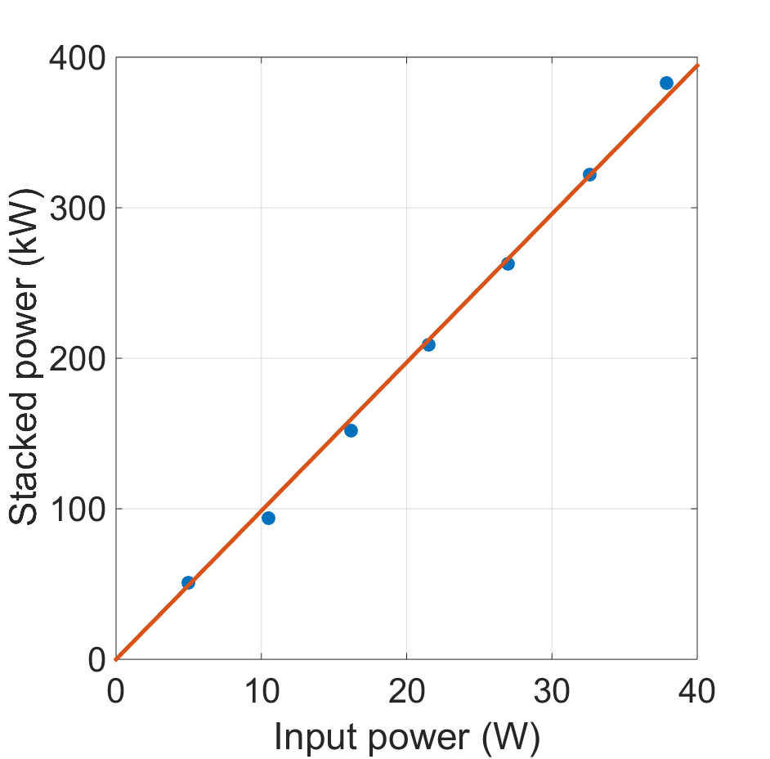
Electron – Laser Interaction (2)
Collaborations
  IOGS/Palaiseau (ANR Hellix), LMA/Lyon (ANR MightyLaser&ThomX), CELIA/Bordeaux (ANR MightyLaser&ThomX) since ~2006
  KEK/Japan (since 2006), Tsinghua Univ./China (since 2011), INFN/Milano (since 2012), INFN/Frascati (since 2012), CERN (Gamma factory since 2017), DESY (ILC since 2018) , Eindhoven Univ. Netherlands (since 2018).
5 years outlook
  ThomX optical cavity upgrades (from 200kW_now to 1MW_futur)
  burst mode cavity (Lab. Com. with Amplitude)
  Gamma Factory (SPS CERN)
  Polarimetry ILC & high field QED effects @ ILC
Finesse 24000

Slide 16
ELI-NP (1)
Scientific Objective
The ELINP Project : Delivering a Gamma beam source for the Romanian Nuclear physics pillar in Romania.
European Consortium EuroGammaS including labs and industries (INFN, CNRS, Scandinova, Amplitude Laser, Alsyom, Comeb) successfully delivered the first part of the machine.
Full budget : 5.7M€. Since the beginning of the contract
Human resources (average since 2014): 4.93 FTE / year
LAL contributions and achievements:
LAL drives design of the interaction point, optics and lasers
Technical coordination of the laser and optics of the GBS machine for the European consortium.
UV laser beam transport line for the photocathode laser with full control system and diagnostics (10/2015)
Low energy IP laser beam transport line with outstanding performances in terms of error in the output wave front (< 50nm PtV) and beam pointing stability (<4urad RMS) - low power laser commissioning at LAL delivered on site (10/2017)
All instruments for the Low energy IP module (M09) and C&C of the full interaction point at ALSYOM, (07/2017)
fast Gamma beam detector based on diamond sensor developed and tested.
LAL team leads and actively participates to the low power commissioning of the laser beam circulator (LBC) from 07/2017-07/2018 with successful results : final phase of the contract laser beam circulator gain demonstrated.
The contract with EuroGammaS has been terminated by IFIN-HH. EU commissioner give the 09/01/19 an ultimatum to Romanian to solve the issue.

Slide 17
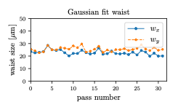
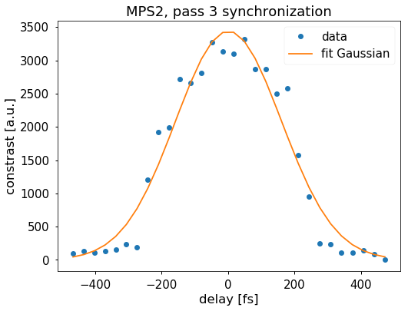
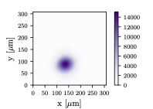
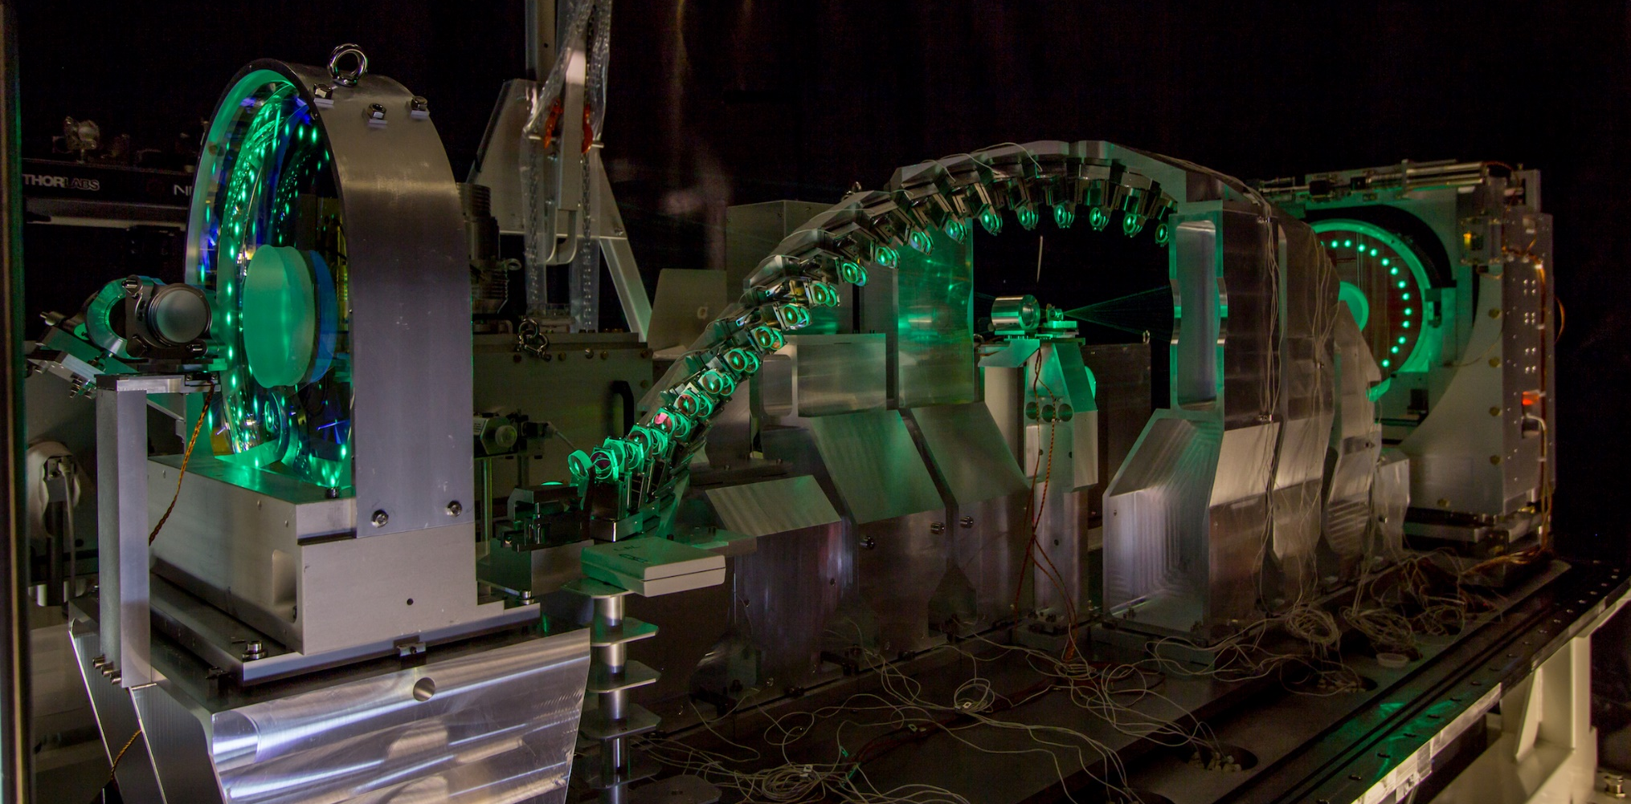
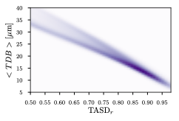
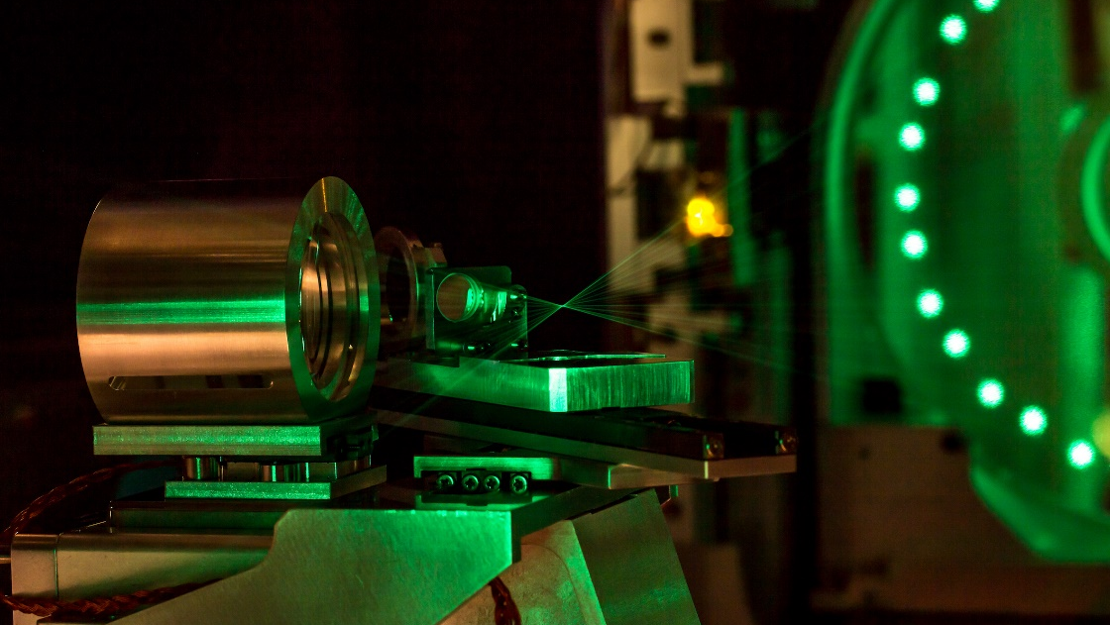
ELI-NP (2)
LBC Performances for Low energy IP (0.2-3.5MeV)
Overlap 32 normalized laser spot at the IP
Observable for spatial alignment performance : Transverse Distance to Barycenter measured down to <TDB> = 8.1um, (routinely between 8-18um)

Slide 18
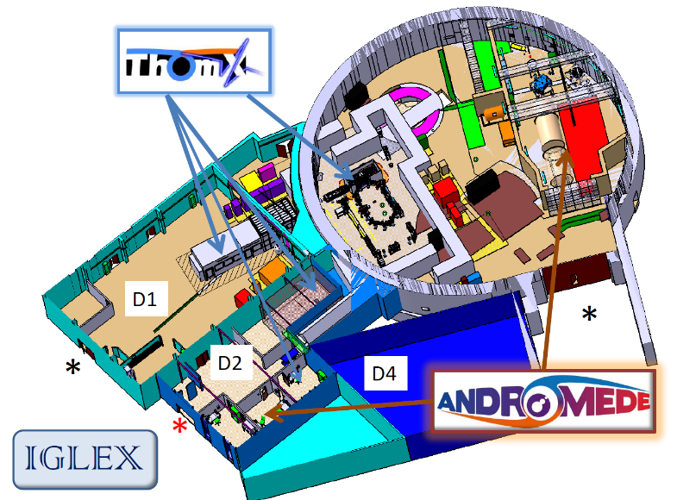
THOMX: Compact X-Ray Source
Demonstrator : compact X ray source installed in lab, museum, hospital, …
RX : ε = 45 à 90 keV
flux : 10¹³ ph/s
BW < 1%
- Key words : compton interaction, linac + ring, laser amplification (Fabry-Perot cavity), x ray users
Budget : PIA -> ANR /Equipex + In2p3 + Sesame+UPS + CPER (building): 2 M€
10 M€ Equipment T1 + 2 M€ functionning T2 :: end T1, T2 = 2021
8 partners (french) : LAL, Soleil, ESRF, CELIA, LAMS, NEEL, GIN,Thalès ~ 30 ETP
building rehabilitation : 2016 – 2017 machine installation start : april 2017
Publications : CDR, TDR, proceedings (eg LINAC, EPAC,..) ~ 10/year
PhD : 3 running (2 FP cavity + 1 Accelerator – ring)
Programme Investissements d’avenir de l’Etat ANR-10-EQPX-51. Financé également par la Région Ile-de-France. Program « Investing in the future » ANR-10-EQOX-51.
Work also supported by grants from Région Ile-de-France.

Slide 19
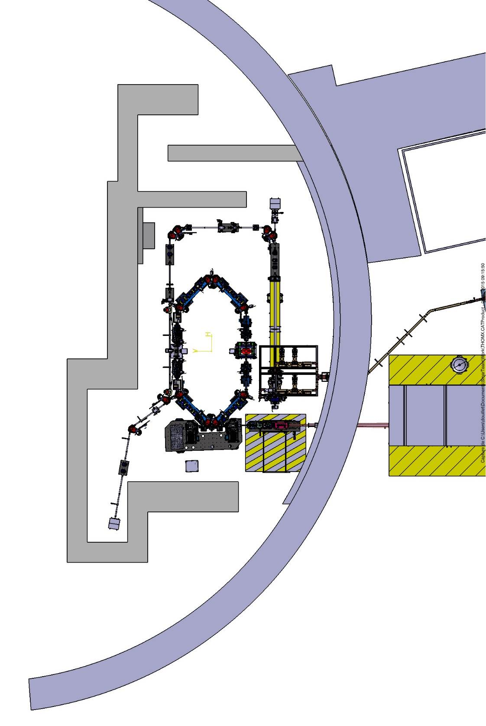
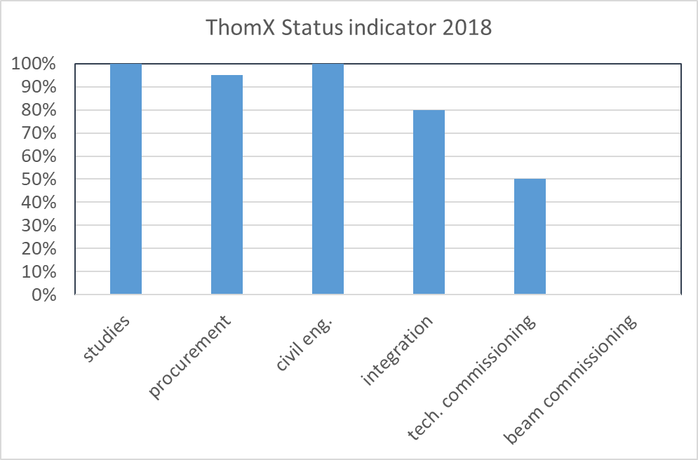
THOMX: Compact X-Ray Source
High priority given to ThomX completion and commissioning
Global Planning
LINAC start : may 2019
1st X ray (45 keV) : january 2020
Flux Optimisation : end 2020
Valorization : SATT, market study : radiotherapy ?
THX future : platform R&D accele + users
Financial model to be defined
Tech Achievement : 200 kW laser stored in FP cavity for ½ h (prototype)
Tech. Commissioning of: photocathode laser, magnets, klystron, modulator, …

Slide 20
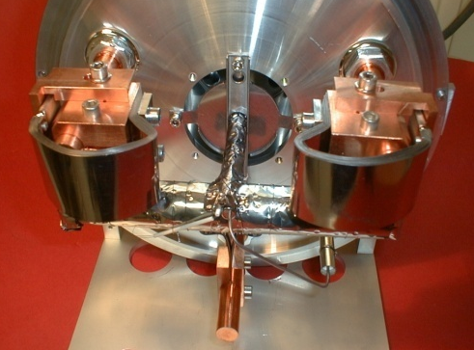
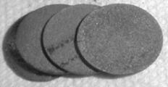
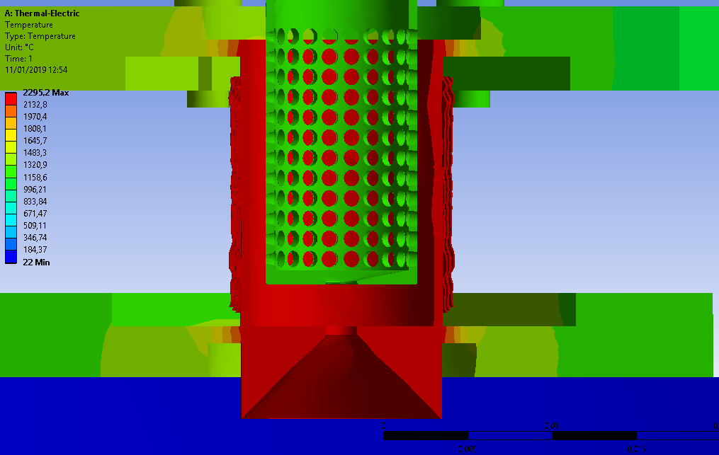
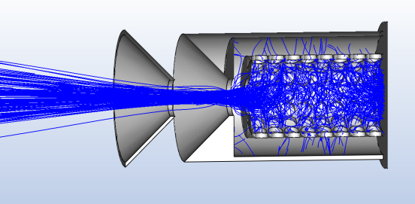
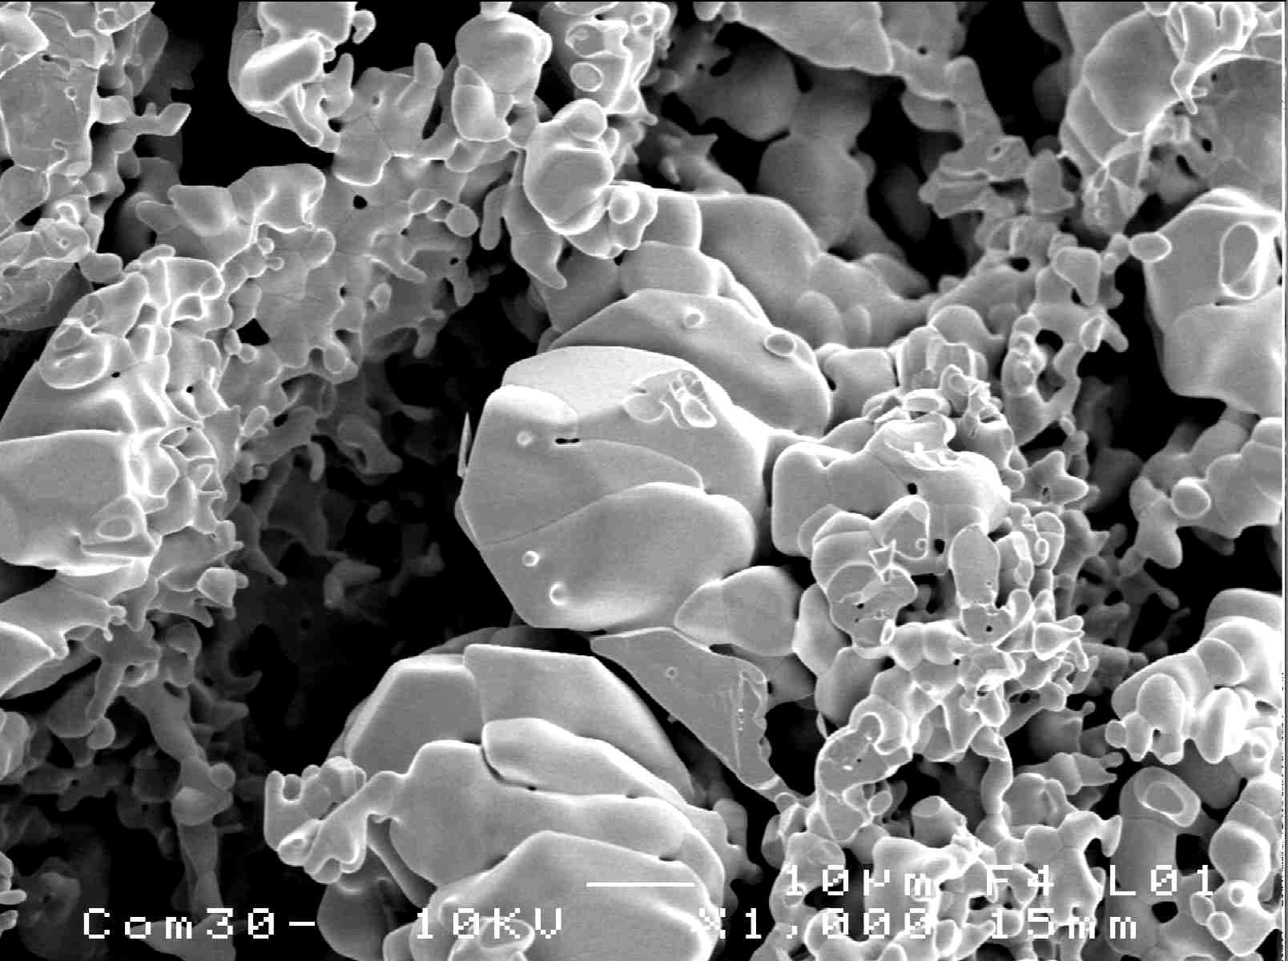

R&D on Radioactive Ion Beams production
Scientific Objective
Production of radioactive ion beams (RIB) of interest for nuclear physicists. The research activities has 4 topics:
To develop new beams @ ALTO
To increase RIB productions
To enhance beam purification
To increase reliability of the target-ion source system
Increase of yield:
Increasing density with controlling porosity, molecular beams, ionization efficiency
Main R&D axes
Stability of release:
Controlling microstructure
The variety of the physics program at ALTO strongly depends on RIB availability, intensity and purity i.e. on global target/ion source system performances
Purification from isobars
Laser ionization
Chemical purification
Main achievements
Design of a new prototype of the FEBIAD-type IRENA ion source
Design of new UCx material structure for ISOL Targets
New mass marker system for ion sources operation and mass separator tuning
Successful stable lanthanides beams production by fluorination process
All requested beams are delivered for ISOL experiments
Collaborations : GANIL, CERN-ISOLDE, INFN-LNL, IFJ-PAN
Human resources: 1 research engineer, 1.5 post-docs (1 ENSAR2 and 0.5 IN2P3), 1 technician (0.3 FTE/year)
5 year outlook:
New beams by Fusion-Evaporation process (ANR TULIP)
Reoxydation of irradiated UCx ISOL targets (nuclear waste management plan)
More reliable Target-Ion source systems
New FEBIAD cavities for Laser ionization
ASPHODEL JRA collaboration (future ERINS)

Slide 21
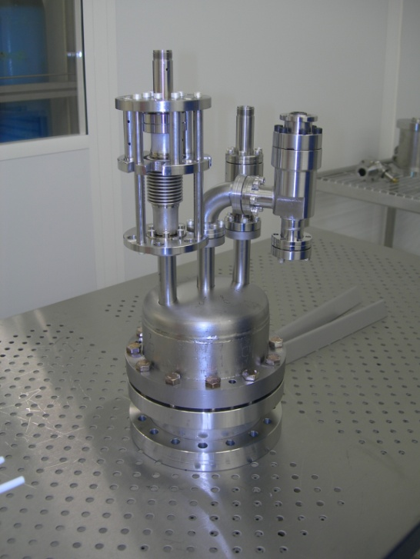
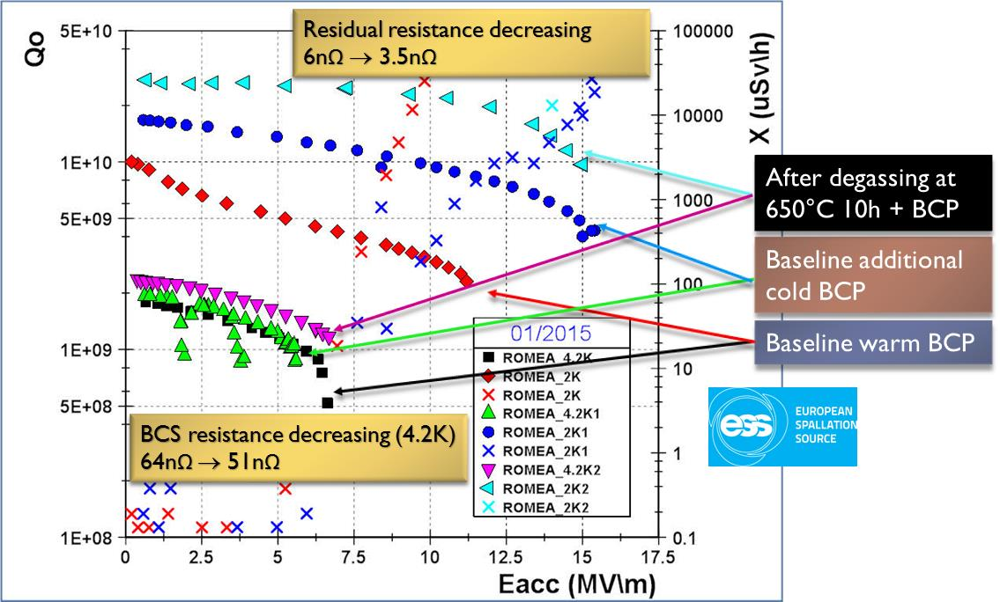
Superconducting RF Acceleration (1)
Scientific Objective
SRF Research Activities are oriented towards 3 main goals:
Push performances of SRF cavities to higher gradients and quality factors with bulk niobium
Increase reliability of actual SRF technology
Beyond bulk Niobium: multilayers SRF thin films for magnetic screening
Nb, Pb
High Tc superconductor:
NbN, Nb₃Sn, etc
Main achievements:
R&D on superconducting thin films (ECOMI program)
A TE011 test cavity resonating at 3.87 GHz and made of bulk niobium has been developed and then used to test superconducting sample for RF applications. Niobium onto copper samples and Aluminum nitride samples have been characterized with this new device.
A promising deposition technique to produce these thin films is the Molecular Beam Epitaxy (MBE). To measure and characterize the tiny samples produced by MBE, a half wave resonator superconducting cavity is being developed.
R&D on surface treatments for SRF cavities (HELOISE program)
This R&D program is aiming at pushing the performances of bulk niobium cavities using two methods: heat treatments under high vacuum at about 600 to 800C and/or nitrogen doping of cavity surfaces.
A new vacuum furnace is installed and commissioned in the SupraTech platform.
Excellent and promising results have already been obtained with a successful treatment of a spoke cavity without the need of a post-treatment process
Isolating layer

Slide 22
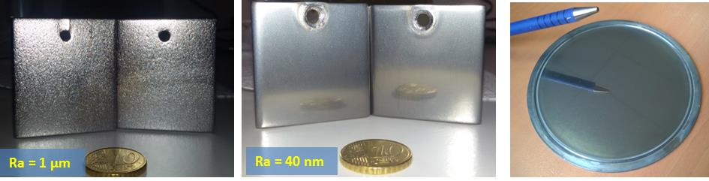
Superconducting RF Acceleration (2)
Main achievements:
R&D on reliability for SRF cavities (CAVSUP): Achieving reliable and reproducible performances on SC cavities .
A successful development of a diagnostic systems for cavities was achieved: a quench detection and localization devices based on second sound wave in superfluid helium.
a dedicated test cryostat for long duration tests on cold tuning system in order to assess their operability and lifetime over a typical 40 years of operation in an accelerator. The cryostat is now fabricated and the first long duration test of the piezoelectric actuators that will be used for ESS will soon take place.
R&D on surface preparation for SRF cavities (PICASU): SC cavities performances are strongly depending on the surface state (physical and chemical) of the niobium. An alternative to niobium chemical etching is to perform a mechanical grinding (centrifugal barrel polishing).
Recently, samples have been produced with centrifugal barrel polishing and the same treatment was applied to a niobium disk
Work is now going on alternated media such as Magnetorheological fluids.
Collaborations : CEA, CERN and soon DESY and Fermilab
Human resources:
~ 4 FTEs + support of SupraTech
1 to 2 PhD per year
Yearly budget :
~80 k€ in average + P2IO and Sesame “Axe SRF” (2018)
Also financial support from projects like ESS and MYRRHA
Niobium samples obtained with standard chemical etching (left) and barrel centrifugal polishing (center and right)

Slide 23
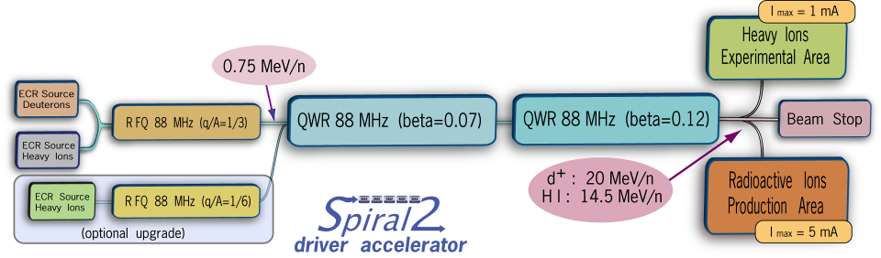
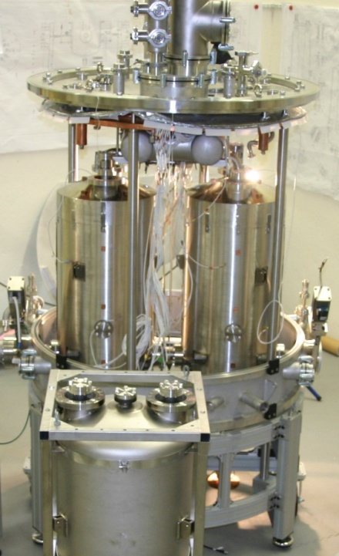
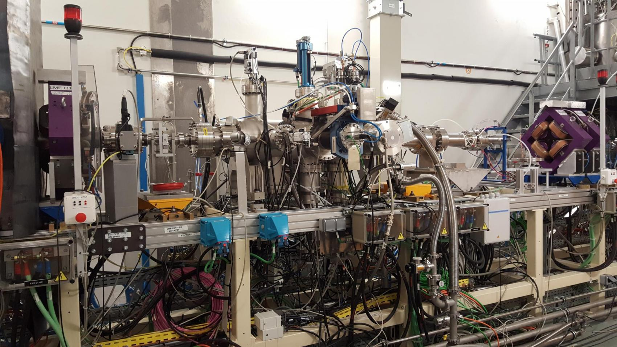
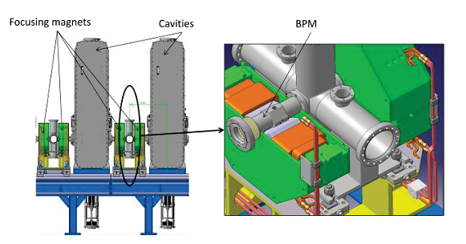
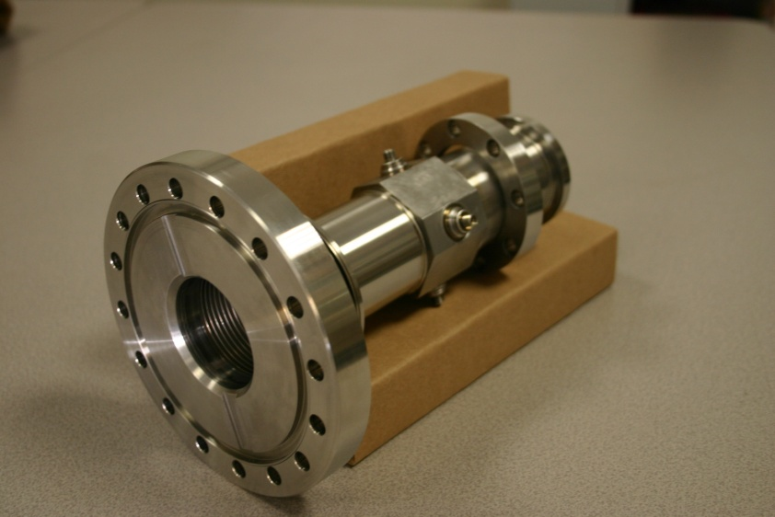
SPIRAL-2
Contribution to the construction of SPIRAL-2
All cryomodules delivered to Ganil, after preparation, assembly and test at IPNO. All cryomodules installed and successfully cooled-down at 4K.
All BPMs (Beam Position Monitor) fabricated, characterized and delivered to GANIL
BPM 1
BPM 2

Slide 24
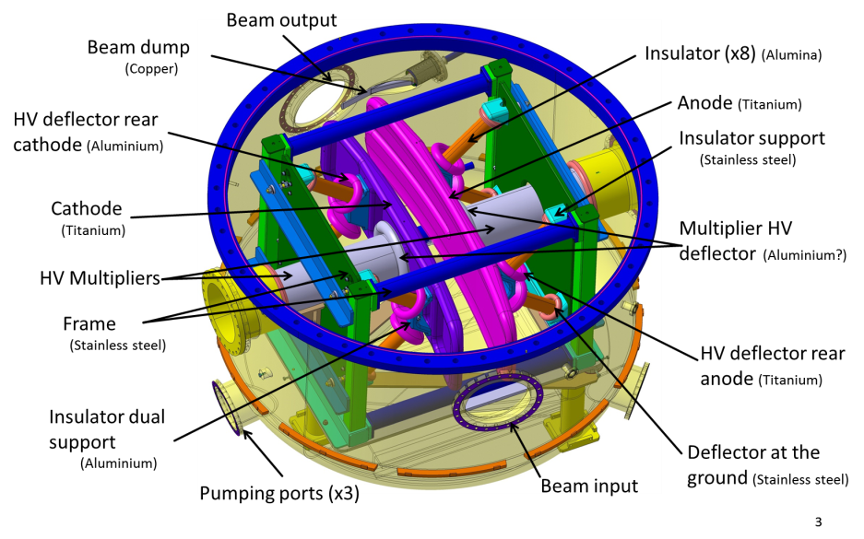
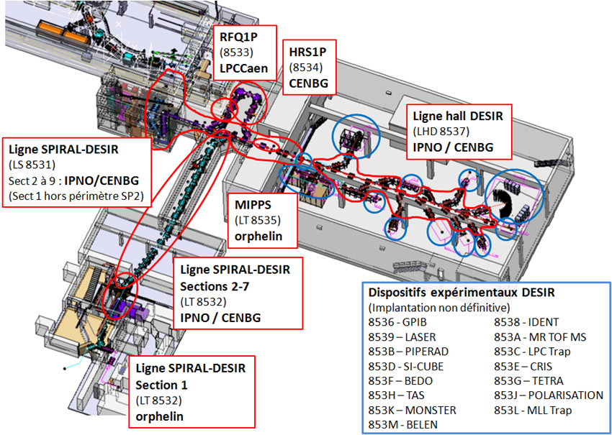
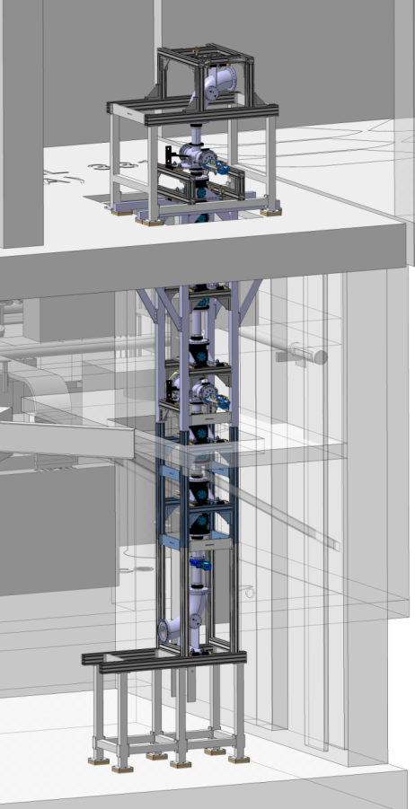
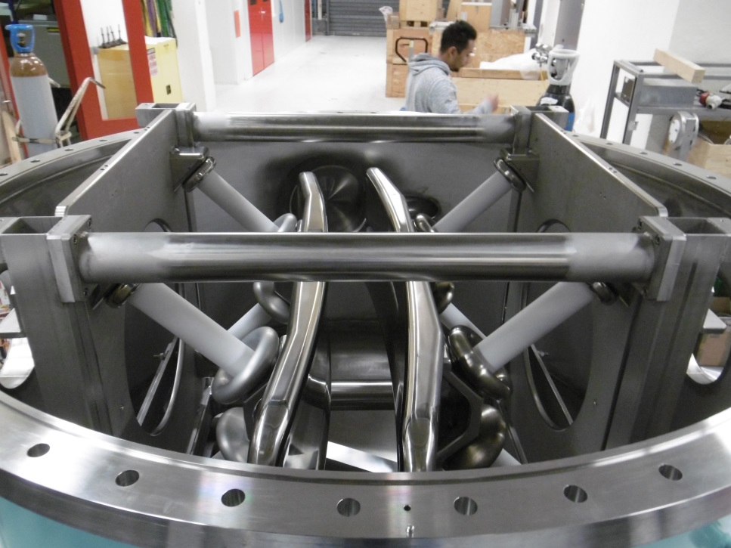
SPIRAL-2
Contribution to S3 and DESIR
In DESIR project IPNO is in charge of the development of the beam transport sections connecting different experimental areas (S3 and the existing GANIL) to and inside the experimental hall DESIR.
An electrostatic quadrupole and steerer triplet section have been built and successfully operated at the test bench PIPERADE at CENBG.
Qualitative version of the transfer line based on the ALTO design has been integrated between the production hall of SPIRAL2 and the injection into the DESIR hall. Full integration of the beam transfer line have been used as inputs for the civil engineering study

Slide 25
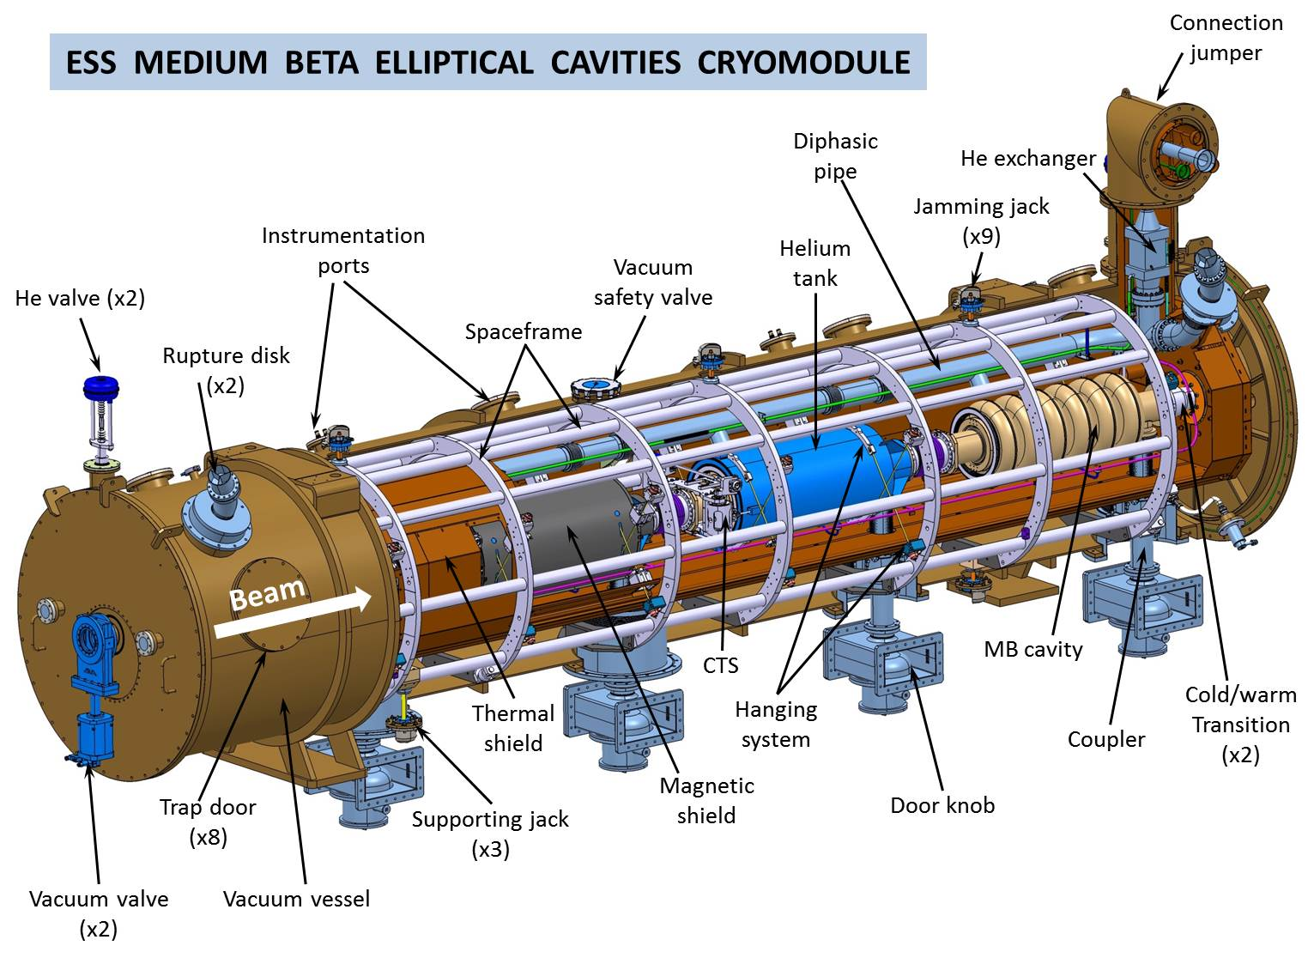
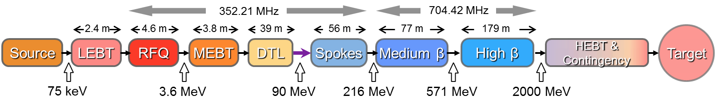



European Spallation Source (ESS)
Scientific Objective
ESS is the future European Neutron Source under construction in Lund (Sw). France is contributing thru In-Kind Contributions on the accelerator and neutron detectors. CNRS (IPNO) contributes to the ESS accelerator on the superconducting sections:
Design, construction, preparation, assembly and test of the 13 spoke cryomodules
Design, construction, installation and test of the Spoke cryogenic distribution system (inc. the 13 cryogenic valve boxes)
In collaboration with CEA-Saclay, design and fabrication follow-up of the elliptical cryostat
Warm linac
SCRF linac (T=2K)
Elliptical cryomodule
ESS activities first covered with the Fr/Sw collaboration agreement (2011-2016) dedicated to prototyping (~5 M€)
Now activity covered by the French IKC to ESS (2015-2021)
Spoke section considered as the most innovative development of the ESS accelerator and thus the most challenging -> huge synergies with previous developments (Eurisol, R&D programs, MYRRHA…)
Spoke section

Slide 26






European Spallation Source (ESS)
Main achievements
All system prototypes (cavity, couplers, frequency tuners) designed, constructed, tested and they all meet specifications
Mass production started for all sub-components, and first elements received
Resources
Expenses covered by the french in-kind contribution to ESS (147 M€ total): 21 M€ for the CNRS (IPNO) contribution to the accelerator
46 FTEs for series production phase (2016-2020)
Next milestones
1st series cryomodule to be completed by May 2019
Last one (#13) in October 2020
Spoke cryogenic distribution system installation completed in Oct. 2019

Slide 27






MYRRHA
Scientific Objective
MYRRHA (Multi-purpose hYbrid Research Reactor for High-tech Applications) is a demonstrator of an Accelerator Driven System (ADS) for nuclear waste transmutation
Could also produce radioisotopes for health applications
Main achievements
Contract signed with SCK-CEN for a TDR phase (2017-2020) to develop beam instruments and spoke cryomodule prototype : 18 FTEs (IPNO+LAL) total
A digital LLRF system for the RFQ has been produced and is being tested
BPMs developed and calibrated for the injector
Experimental program on single spoke cavities
Detailed study of the spoke cryomodule
Beam dynamics simulation for the 100 MeV version
RF board for S.E.L.
Single spoke

Slide 28

XFEL and SRF couplers (1)
Scientific Objective
In the framework of the French in-kind contribution to the European XFEL project, LAL had in charge the delivery of 800 power couplers needed to equip the 100 cryomodules of the superconductive accelerator.
Allocated budget of 20 M€: Coupler purchase (670 units), infrastructure (clean room), equipment (RF source, ovens, tools…)
Man-power: 9.5 FTE/year were involved in the project (an average for the total project duration: 2010-2016).
Close collaboration with DESY and also with the companies Thales Electron Devices (France), Research Instruments (Germany) and CPI (USA).
Main achievements
2013 to mid-2016: LAL insured the production monitoring and the quality control at the production sites, in addition to the RF conditioning at Orsay of all the produced couplers and their delivery for assembly on cryomodule at a rate of 8 couplers/week. These tasks were accomplished with respect of the global project agenda, within the allocated budget.
LAL owns a Technical Infrastructure (clean room, equipment, power source...) adapted to coupler mass production. Even if it was built for Eu-XFEL construction, it is currently part of an European Technical Infrastructure network (AMICI) that aims at participating to the construction of future Research Infrastructures (such as ILC).

Slide 29


XFEL and SRF couplers (2)
From XFEL experience to…:
LCLS2 (2016-2017, SLAC-LAL Agreement ): Production monitoring and quality control of the couplers production in Europe (140 units)
LUCRECE (2016-2020, Regional funding): Design and production and RF conditioning of 2 coupler prototypes (1.3 GHz @ 14kW CW) for Lunex5 accelerator at Soleil.
MYRRHA (2017-2020, CNRS-SCK CEN Belgium collaboration): Preparation and RF conditioning of 4 couplers (352 MHz @20kW CW) for a low beta cryomodule prototype for the Belgium ADS.
Power Coupler R&D:
  Optimisation of TiN thin layers as Multipactor suppressor on coupler ceramic window
  Development of an RF coaxial resonator for multipactor investigating

Slide 30









Platform for Research and Applications with Electrons
PRAE: multi-disciplinary site based on electron beam with energy of 70 MeV (140 MeV PRAE upgrade) at Orsay.
Infrastructure and PRAE design already allows an upgrade to 140 MeV
Program: Nuclear physics/nucleon structure; new approaches in Radiobiology; Instrumentation
Re-use of unique site of the former Linear Accelerator and its infrastructure
Start of the operation foreseen in 2021
Ultimate objectives:
  Crucial measurement in relation with the proton charge radius puzzle
  Development and validation of novel Very High-Energy electron (VHEE) therapy : Mini Beam and FLASH operation modes; Versatile open Radiobiology platform including in vivo studies, internships and training
  Local Test Beam instrumentation platform for HEP and Nuclear detector development programs
  Synergy with industrial applications
  Strong educational component
See talk C.O. Bacri
See talk L. Massacrier
=> Measure at 0.1% of the electric form factor of the proton GE(Q2) at very low four-momentum transfer Q2
Preserve
healthy
tissues
=> FLASH therapy : very high dose rate > 40 Gy/s (conventional 0,03 Gy/s)
=> Mini Beam : combine advantages of VHEE beams with spatial fractionation
=> Measure the time, charge and imaging performance of particle detectors :
Timing reference, < 10 ps bunch length, Charge accuracy, RMS < 2×10-3, Low straggling (energy >> 1 MeV)
See talk L. Ménard
30

Slide 31














Platform for Research and Applications with Electrons
Funding : Projet Emblématique : 514 000,00 € + Programme SESAME : 1 070 000,00 € + LAL/IPNO : 100 000,00 €
Main achievements :
- Accelerator : First beam optics design and simulation, purchase of main components,
contract with IRSD for radioprotection calculations and ASN document
- Nuclear Physics : Detector developments and construction, studies of beam energy
measurement methods
- Instrumentation : Manufacturing of the irradiation platform
- Radiobiology : Flash and mini simulations
- Infrastructure : Building construction financed by IdF region
Choice of architect
- 1st PRAE international workshop
2 post-doc P2IO (M. Hoballah - Y Han) and 2 PhD (1 UPSay – CCS-IHEP (B. Bai)
for accelerator et 1 PHENICS (L. Causse) for beam energy measurements for nuclear
Perspectives 2019-2023 :
Commissioning and delivery of first beam for users - Upgrade of PRAE at 140 MeV
Main publications:
- A new platform for research and applications with electrons: the PRAE project. EPJ Web Conf. 2017;138:1012. doi:10.1051/epjconf/201713801012.
- First Optics Design And Beam Performance Simulation of PRAE: Platform For Research And Applications With Electrons At Orsay, IPAC 2017
- First Performance calculations for very high energy electron radiation therapy experiment at PRAE, Proceedings IPAC 2018
Collaborations:
New collaborations in discussions :
KINR (Instrumented Phantom),
University of KieV (Profiler and its feedback with IA for the Scanning dipole tuning),
CEA/DOSEO (dosimetry),
ACS and SB TEchnologies (Use of IA in accelerators)
31

Slide 32
Project
(2018 – 2023 and longer term future)

Slide 33
General considerations for the future
Merging the five laboratories is a unique opportunity
To develop our capacity to perform high level accelerator research
To optimize our accelerator human resources and gain efficiency thanks to an integrated and coordinated management
To broaden our area of intervention to a wide range of accelerator technology
To strengthen some of our expertise/knowhow which were in danger (subcritical) when separated
To gain visibility and impact at national and international levels
We have defined several guidelines to plan our future:
Reinforce accelerator research in several key area, selected for their strategic importance and our capacity to have an important and visible impact.
Increase our capacity to build accelerators : a clear strategy to have important contributions to international projects, allowing us to take part in the definition of large equipment roadmaps and thus to facilitate the positioning of our research teams
Insure efficient operation of our local accelerators: a key to keep accelerators expertise, training capabilities, and insure visibility and attractiveness
Several projects for the near future are considered, based on this new capacity and in accordance with the defined strategy

Slide 34



DUNE / PIP-II
Scientific Objective
PIP-II (Fermilab) will deliver the world’s most intense beam of neutrinos to the international LBNF/DUNE project, and enable a broad physics research program, powering new discoveries for decades to come.
Deliver 1.2 MW of proton beam power from the Main Injector over the energy range 60 – 120 GeV, at the start of LBNF
A modern SRF cw-compatible H- linac: 1.6 MW at 800 MeV, upgradable energy
Main Injector and Booster upgrades allowing for 1.2 MW and multi-MW beam power in the future

Slide 35











DUNE / PIP-II
Potential contribution:
Mainly on the SSR2 cryomodules: prototypes and series of spoke cavities, power couplers and frequency tuners
Prototype phase: 2019-2021
Series: 2021-2025
~ 30 FTEs and 20 M€ budget
Subjected to approval of France In-Kind contribution to DUNE/LBNF
HWR X 1
SSR1 X 2
SSR2 X 7
LB650 X 11
Why contributing to PIP-II ?
A challenging accelerator, at the forefront of SRF Technology
Worldwide recognize expertize of our teams in spoke cavities and power couplers technology
A neutrino facility, in the heart of the lab’s scientific field
HB650 X 4

Slide 36




MYRRHA
SPOKE
352MHz
Double SPOKE
352MHz
Elliptique
704MHz
Potential contribution:
Could be almost on any sub-systems : prototypes and series of spoke cavities, power couplers and frequency tuners
Why contributing to MYRRHA ?
An SRF accelerator, bringing new challenges with the required extreme reliability
Fructify gained experienced on Spiral-2, ESS, XFEL…
Application to Energy, in the heart of the lab’s scientific field

Slide 37

Potential for ILC
Potential ILC contributions
Adding the expertise and knowhow, the new lab could be an important contributor to ILC in several domains.
Important experience on final focus in electron colliders gained with the participation to ATF2 experiments
SRF experience in cryomodule design and construction (LHC, ESS, …)
Power coupler design, construction and conditioning thanks to experience gained with XFEL
Expertise in laser/electron interaction for polarized positrons compton source and polarization measurements

Slide 38



Contribution to CERN / FCC
Reinforce our contributions to CERN
Contributions to CERN (FCC or other projects) or collaboration with CERN in accelerator research activities is a clear objective, in order to gain visibility and to play a important role in the Accelerator European Strategy
Many contributions in the past: LHC, SPL, CLIC, ISOLDE…
Not currently involved in HiLumi LHC or HE LHC, and not enough in some H2020 R&D programs led by CERN
Several possibilities:
  Increase our contribution to FCC
  Have closer research collaborations with CERN (SRF research activities, 3D printing, Perle…)

Slide 39


PERLE
Scientific Objective
PERLE @ Orsay is a demonstrator of an Energy Recovery Linac (ERL) facility
500 MeV, 20 mA (Pvirtual ~10 MW !!!)
3 turns of recirculation
2 superconducting linac
A unique project of a ERL demonstrator, high current, with recirculation
A collaboration is being set between CERN, Jlab, Daresbury, Novosibirsk, Liverpool University…
D. Douglas
The ERL Landscape: The State of the Art
Courtesy to A. Bogacz
The ERL Landscape: The State of the Art

Slide 40


PERLE
Why PERLE is so interesting ?
A unique opportunity to build “at home” a 10 MW (virtual power) demonstrator of an ERL
Would be a world premiere
Motivated by several reasons:
  New accelerator concept: challenging and promising
  Related to several envisaged large scale facilities: LHeC (CERN) mainly, but also EIC (USA)
  Local potentialities in nuclear physics: electron scattering off RIBs experiments -
  Maybe also Gamma-ray production applications…

Slide 41
SWOT analysis for Accelerator Physics
STRENGTHS
High visibility of the team due to our recent and successful contributions to international projects
Design, construction and operation of local accelerators thanks to high skilled staff in several domains required in particle accelerator
Activities balanced between accelerator research programs and facility construction
World-class technological platforms to support projects and research programs
Involvement in conventional and innovated technics of acceleration
International collaborations with accelerator labs worldwide
WEAKNESSES
Human resources decrease since several years despite numerous solicitations to contribute to many projects.
Scientific contributions to accelerator physics and technology not enough disseminated (low publication rate mainly due to lack of time)
Important turn-over in human resources in specific area (C&C, facility operators)
Lack of resources (available manpower and funding) for technology development. Resources are mostly involved in projects
Non balanced staff, with more engineers than technicians
Difficulties to sustain some technological platform
OPPORTUNITIES
Several promising new large international collaborations (DUNE, EIC, ILC) but also strong collaborations on important research programs are set
Joining with laserix team to develop laser plasma acceleration research
A important activity on accelerator development for local use. This is based on existing platforms (ALTO, ANDROMEDE, PHIL) but also on facilities under construction (THomX, PRAE) or projects (PERLE)
Merging the five Orsay Valley laboratories is a fantastic opportunity to reach higher efficiency (team fragmentation reduction), to avoid being under critical mass in some areas, to increase our capacity to take large commitments in international projects, and finally to have an overall increase of expertise and skills by reinforcing attractivity.
THREATS
Several high level expertise relies on few persons (magnetism, RF power source, …) which is a very fragile and risky situation
Difficulties to hire skilled people, specially at technicians or engineer assistant levels (due to the high living costs in Paris area, the low wages compared to industry)
Temptation to put the main effort on construction projects and allocating less resources to R&D programs: this is an important threat for the long term, as it may result in the decrease of expertise or a difficulty to stay at the forefront of the science and technology in particle accelerators

