Slide 1


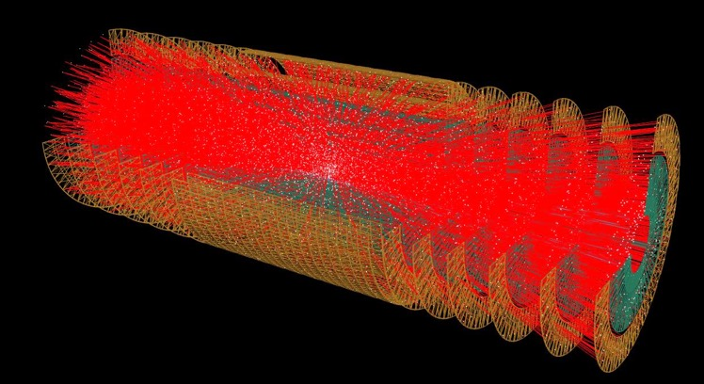
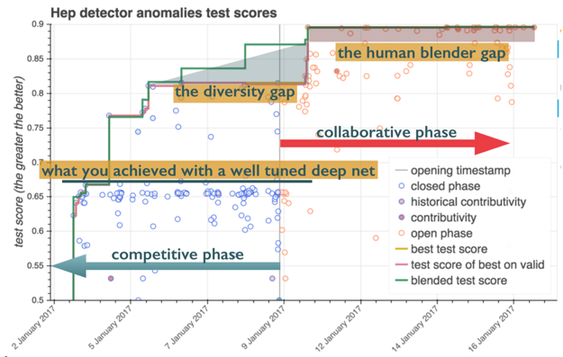
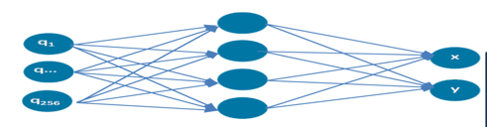
HCERES evaluation of
Laboratoires de la vallée d’ rsay
CSNSM
IMNC
IPNO
LAL
LPT
Data Science
Speaker : D. Rousseau on behalf of people involved
14-17 january 2019

Slide 2
Context
Data Science in la Vallée 2013-2018:
  kernel AppStat group at LAL, created by B. Kégl Data Scientist recruited at LAL in 2006, leaving in Jan 2019
  HEP and ML activities spawned (or not) by this group
Appstat group at LAL 2013-2018: 1 permanent CNRS/IN2P3, 1-2 postdoc (ANR or IN2P3), 1-2 PhD
Financial support for AppStat
  ANR Siminole 2011-2014 160k€/year
  ANR DirtyData 2017-2020 80k€/year
  IN2P3 project CompStat since 2016 : ~15k€/year
  Some stopgap Lab support
  MRM Paris-Sud : 20k€/year computing resources

Slide 3
Teaching activities
2013-2018:
Yearly participation in M2 on CS:“Machine Learning and Optimization”
Organisation of 2014 2016 2018 … IN2P3 School of Statistics. 2018 : ramp down root/TMVA ramp up ML with Sci-kit learn, keras, tensorflow
Future:
Continue participation to IN2P3 School of Statistics May 2018, bi-yearly
Centralesupelec Stat and ML course for 1st year physics « major » (100 students)

Slide 4
Scientific achievements
(2013 - 2018)

Slide 5
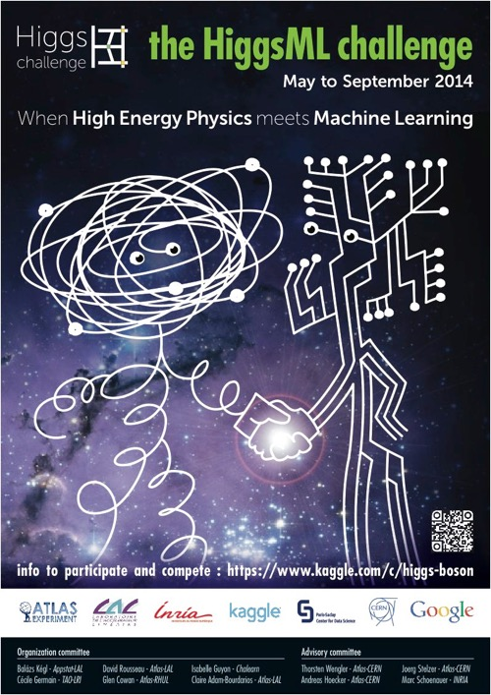
HiggsML Challenge
An ATLAS Higgs signal vs background classification competition, optimising statistical significance
Ran in summer 2014 : at the time few physicists knew what “Machine Learning” was, even if many where familiar with MVA analysis with Boosted Decision Trees
2000 participants (largest on Kaggle at that time)
Outcome
  Best significance 20% than with Root-TMVA
  (gradient) BDT algorithm of choice in this case where number variables and number of training events limited (NN very slightly better but much more difficult to tune)
  XGBoost written for HiggsML, now best BDT on the market
  Wealth of ideas, documented in JMLR proceedings v42
  Raised awareness about ML in HEP
Followed by world wide explosion of HEP ML workshops, papers…

Slide 6
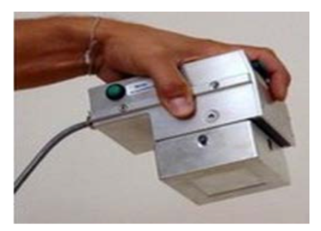
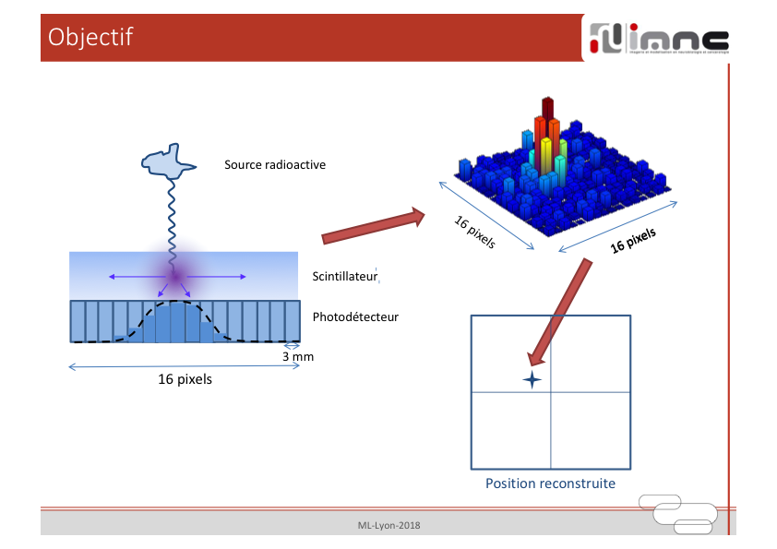

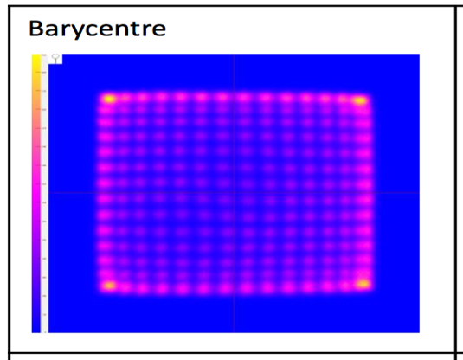
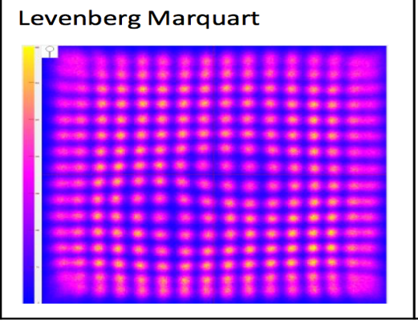
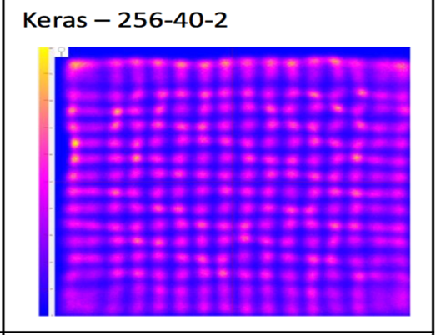
Other ML Application: β,γ camera for medical application (IMNC)
Inaccurate & fast
accurate & slow
accurate & fast

Slide 7
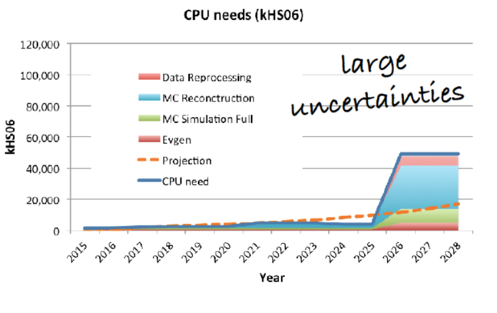

TrackML challenge
Pitch : HL-LHC tracking becoming difficult due to pile-up reaching 200. TrackML https://sites.google.com/site/trackmlparticle/ is a competition to expose new algorithms for pattern recognition. We give 3D points, participants should connect the dots.
First “Accuracy” phase (no CPU constraint) has run on Kaggle platform May to August 2018. 653 participants.➔dedicated 1H15 session at NeurIPS 2018 in Montréal
  icecube #1 92.2 % (master student) : combinatorial approach, with a bit of ML
  outrunner #2 90.3% Deep Learning approach (but very slow)
  Sergey Gorbunov #3 89.4% demelian #4 87.1% : HEP tracking trigger experts
  Yuval & Trian #7 80.4% : innovative clustering
  CPMP #9 80.1% : DBSCAN unsupervised clustering algorithm
  Finnies #12 74.8% : use LSTM
Second phase “Throughput” September to March 2019 : participant submit software on Codalab platform, which evaluates both Accuracy and CPU time
Spin-off : collaboration with Tobias Isenberg (LRI) (and PhD Xiyao Wang) on scientific data visualisation

Slide 8
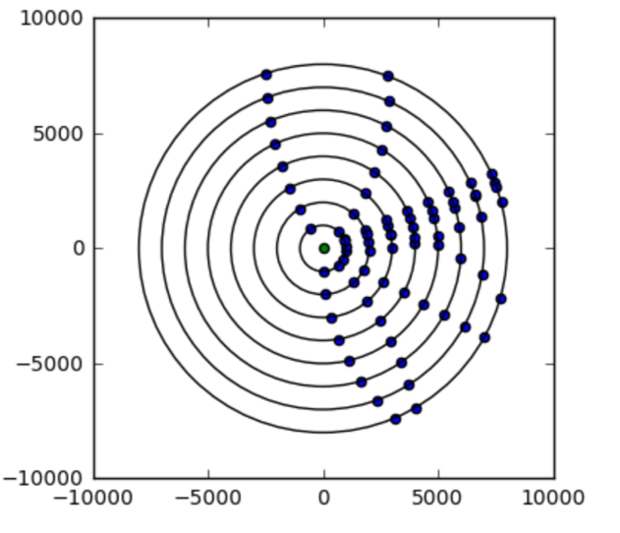
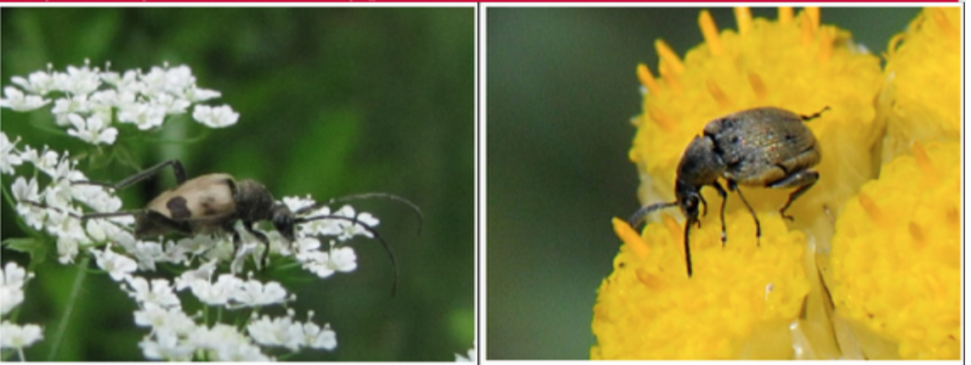

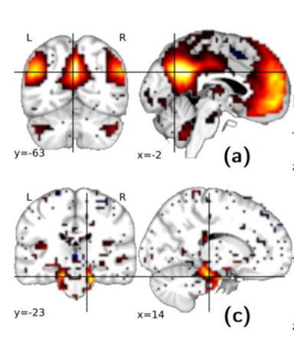
RAMP platform
TrackML2D prefiguration of full TrackML challenge
http://www.ramp.studio A prototyping tool for collaborative development of data science workflows
Support Kaggle-like challenges but allow/favour cooperation in addition to competition
In the frame of Center for Data Science Paris-Saclay
… a few examples
HEP Anomaly detection
Predicting autism from
brain scan (with Neurospin)
Identifying pollinating insects
(with Museum Histoire Naturelle)

Slide 9
Project
(2019 – 2023 and longer term future)

Slide 10
Machine Learning playground
Generators
Detector
Simulation
data
Single trigger
optimisation
Particle ID
optimisation
papers
Analysis statistical
optimisation
Energy regression
Overall trigger
optimisation
Analysis stat+syst
optimisation
Data Quality
Monitoring

Slide 11
Physics - ML collaborations
Foster ML in Laboratoires Vallée d’Orsay
Identified opportunities:
ML in HEP analysis
ML in HEP simulation
ML in biomedical
ML in accelerator
R&D on large scale ML training (Spark…)
ML teaching/training: should always have a kernel of ML savy (sci-kit learn, keras, tensorflow,pyTorch…) PhD students in the laboratoires
More workshops:
Successfully bid for 3 Institut Pascal Workshops (Kavli style 2-weeks workshops with ~35 world experts in new Paris-Saclay building)
  Advanced trigger end Jul 2019
  Advanced Pattern Recognition end October 2019
  Hammers and Nails July 2020 (impact of IA on science)

Slide 12
Link with local/national/international communities
IN2P3 project CompStat continuing
  Foster HEP and ML collaborations in IN2P3 laboratories : identified so far LPC Clermont LAPP Annecy, CPPM Marseille
    =>not just LAL/LRI anymore, good ! But resources ~15k€ to be shared
  Foster exchanges on experience with ML
  Foster training (but manpower?)
Strong links to Laboratoire Recherche Informatique LRI-Orsay (Cécile Germain, Isabelle Guyon, Cyril Furtlehner, Tobias Isenberg)
co-coordination Interexperiment Machine Learning group at CERN, also participation to organising committee Connecting The Dots (advanced tracking), Data Science @ HEP

Slide 13
SWOT analysis
Strengths : established expertise (in particular through challenges)
Weaknesses : no more dedicated embedded data-scientist, no dedicated manpower
    While ML/AI is a very fast evolving field
    ➔hire a replacement ? HEP PhD with very strong ML expertise ?
Opportunity : foster more ML and HEP research in the Vallée and beyond
Threats : well funded HEP sw project (with strong ML component) abroad (e.g. IRIS-HEP US/NSF project 25M$/5 years)

