Slide 1
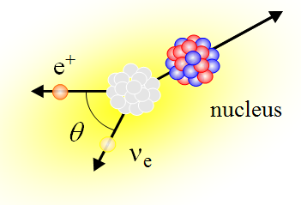
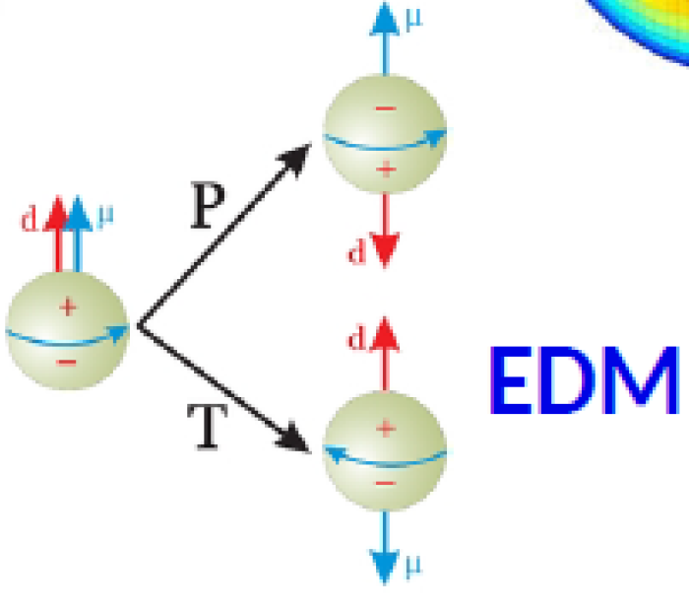
JENAS Meeting
Orsay, 14-16 Oct. 2019
Beyond
Standard Symmetries
Nathal Severijns
KU Leuven, Belgium

Slide 2
Outline
- neutron and nuclear beta decay
- V_{ud} and CKM-unitarity
- searches for exotic S and T currents
- searches for Time Reversal Violation
- EDM experiments in search for CP-violation
- testing CPT with anti-matter

Slide 3
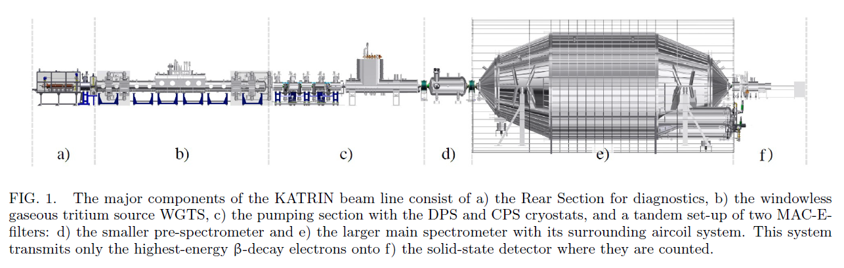
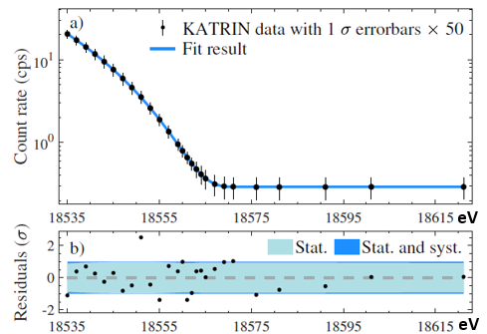
electron (anti-)neutrino mass < 1.1 eV
(90 % C.L.; 4 weeks of data)
best direct determination of the
electron (anti-)neutrino mass ever !
CONGRATULATIONS
arXiv:1909.0604

Slide 4
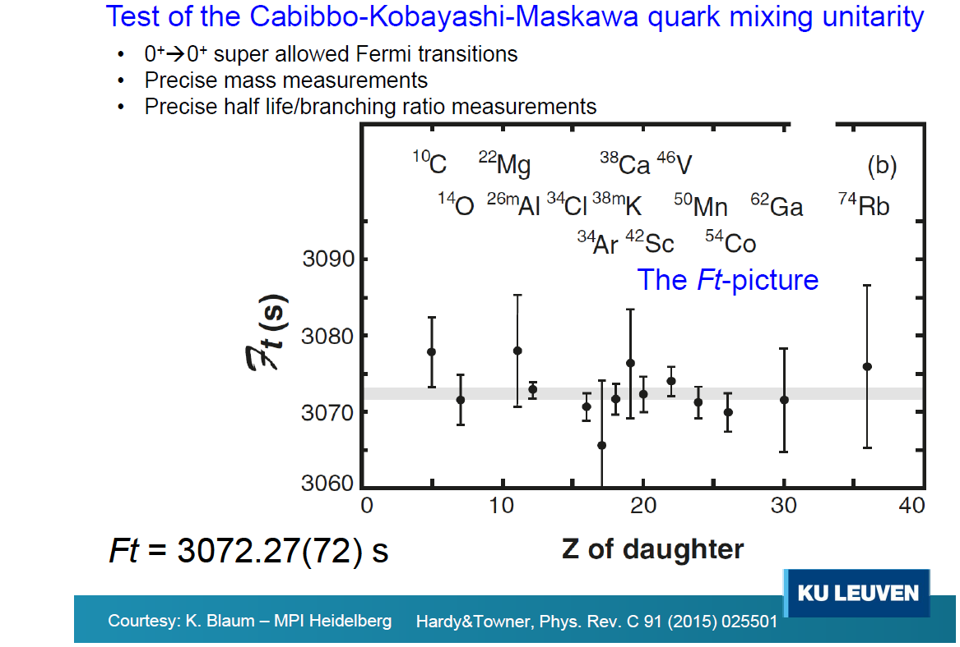
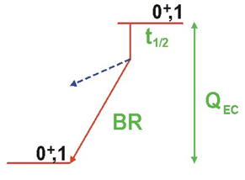
(Penning traps)
ISOLDE,
GANIL,
JYFL,
TRIUMF,
TAMU, …

Slide 5
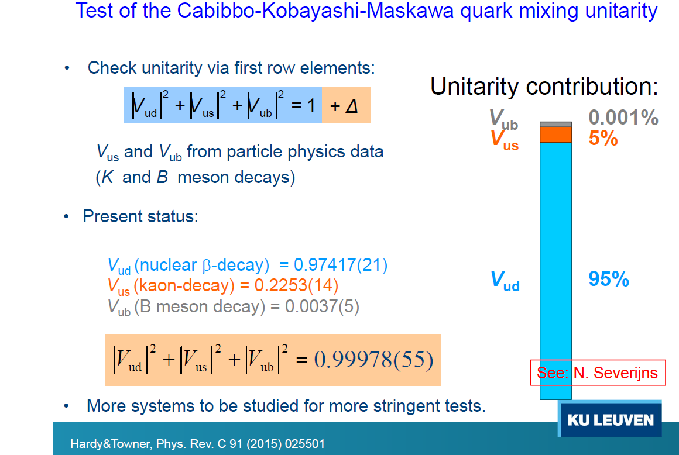
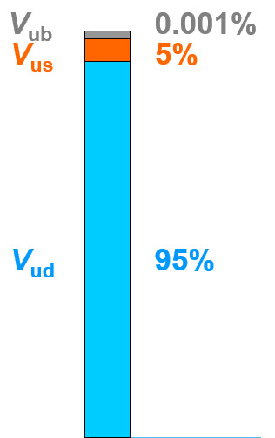
0.97420(21)
0.2243(5)
0.0039(4)
0.99939(47)
Hardy & Towner, arXiv 1807.01146 and Particle Data Group 2018

Slide 6
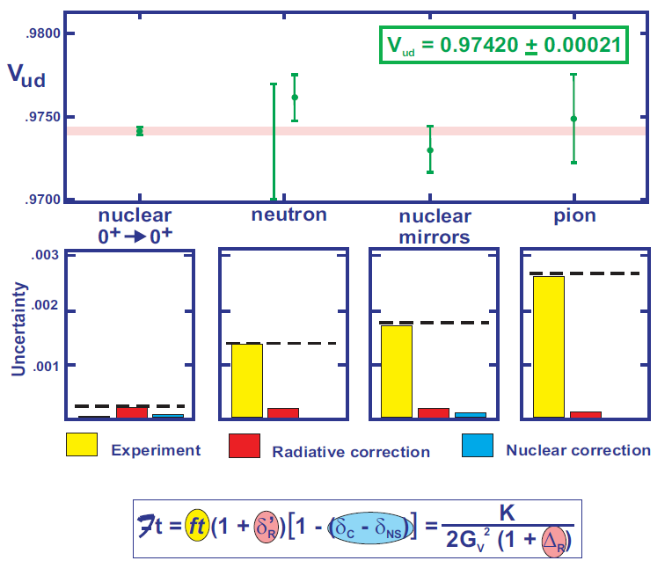
PERKEO III
PERKEO III
Hardy & Towner, arXiv 1807.01146
PERKEO III - B. Markisch et al., PRL 112 (2019) 242501

Slide 7
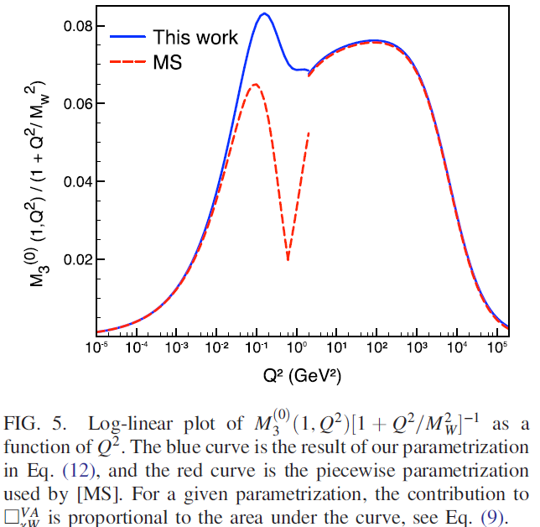


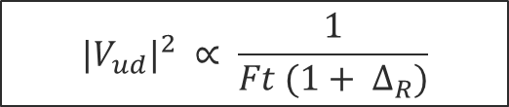

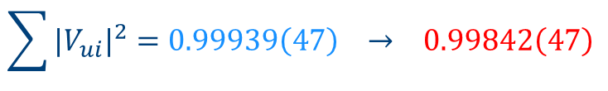
Radiative correction $∆_{R}$
$${|V_{ud}|}^{2} ∝ \frac{1}{Ft (1+ ∆_{R})}$$
(1 + Δ_{R}) = 0.02361(38) - W. J. Marciano and A. Sirlin, Phys. Rev. Lett. 96, 032002 (2006)
$$\sim 3 σ$$
(1 + Δ_{R}) = 0.02467(22) - M. Gorchtein, M. Ramsey-Musolf et al., PRL 121, 241804 (2018)
→ 0.97370(14)
$$\sum{{|V_{ui}|}^{2}=0.99939\left(47\right) → 0.99842\left(47\right) }$$
$$∆_{SM}=1.3 σ → 4.5 σ$$

Slide 8
Outline
- neutron and nuclear beta decay
- V_{ud} and CKM-unitarity
- searches for exotic S and T currents
- searches for Time Reversal Violation
- EDM experiments in search for CP-violation
- testing CPT with anti-matter

Slide 9
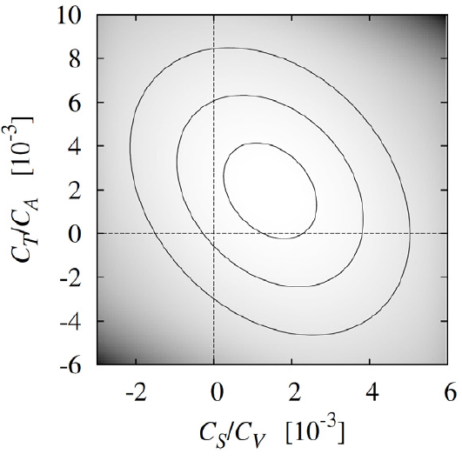
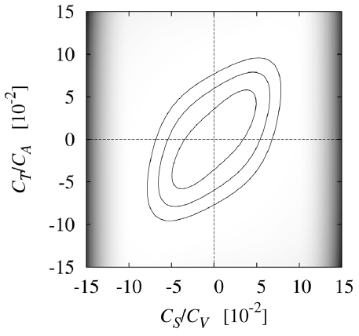
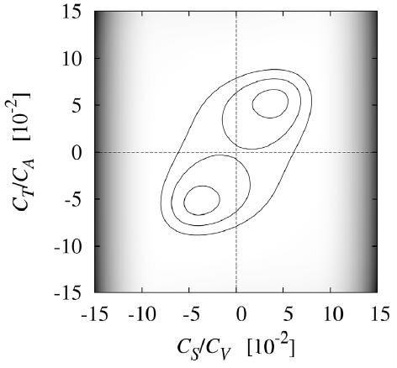

Constraints on (real) scalar and tensor coupling constants
Lee-Yang coupling constants
EFT coupling constants
9
B_{n} omitted
4
Right-handed currents
Left-handed currents
Right-handed currents

Slide 10
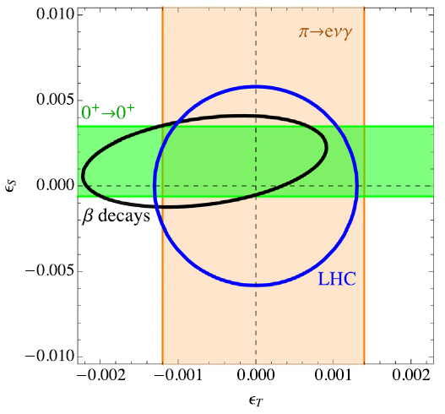
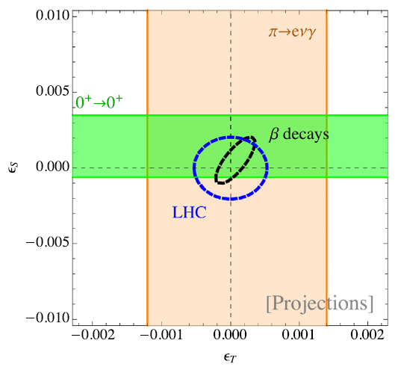



Comparison to Large Hadron Collider
90% C.L. constraints on ε_{S}, ε_{T}
assuming:
Δ(τ_{n}) = 0.1 s
Δ(b) = 0.001
δ(A_{n}) = 0.1 %
δ(a) = 0.1 %
O. Naviliat-Cuncic, M. González-Alonso,
Ann. Phys. (Berl.) 525 (2013) 600
T. Bhattacharya et al.,
Phys. Rev. D 85 (2012) 054512

Slide 11
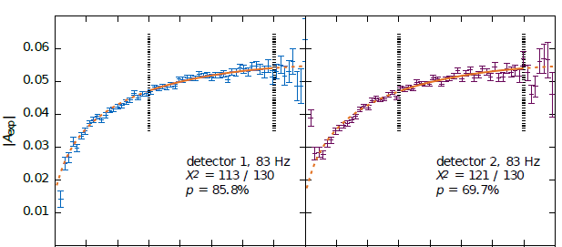
The challenge then is to reach precisions of:
- Δ(τ_{n}) = 0.1 s → current world average τ_{n} = (879.7 ± 0.8) s
- δ(A_{n}) = 0.1 % → PERKEO III - ILL - B. Markisch et al., arXiv:1812.04666
A_{n} = -0.11985(21) → δ(A_{n}) = 0.2 %
(about 2.5 times more precise than any previous measurement)

Slide 12
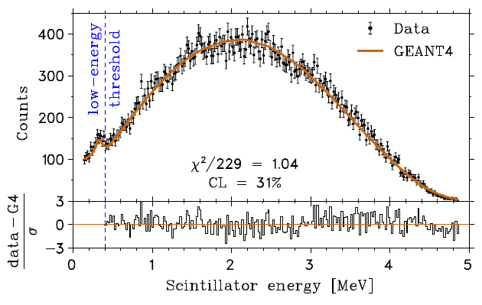
- δ(A_{n}) = 0.1 % → TRINAT - TRIUMF III - B. Fenker et al., PRL 120 (2018) 062502
A_{37K} = -0.5707(19) → δ(A_{n}) = 0.3 %
(about 4 times more precise than any previous measurement)
- δ(a_{n}) = 0.1 % → aSPECT - ILL / FRM II - M. Beck et al., arXiv:1908.04785v1
a_{n} = -0.10430(84) (about 6 times more precise
than any previous measurement)
δ(A_{n}) = 0.8 %

Slide 13
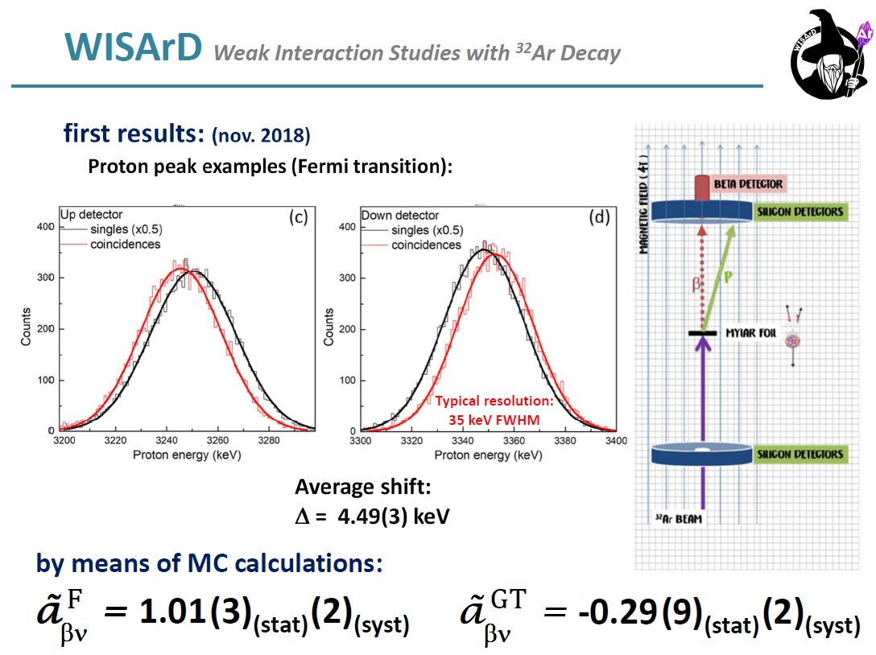
δ(a_{F/GT}) in nuclear beta decays:
δ(a) = 0.1 % within reach with improved setup (in prep.) - ISOLDE
Courtesy: B. Blank
V. Araujo-Escalona, X. Flechard et al., arXiv:1906.05135

Slide 14
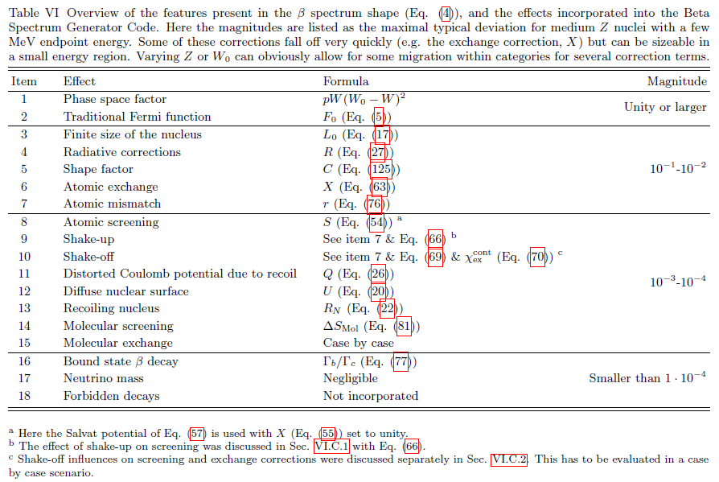
Δ(b_{n,F/GT}) = 0.001
& QCD corrections (weak magnetism) → beta-spectrum shape measurements
Analytical description + code,
accurate to few 10⁻⁴ level
L. Hayen, N. Severijns et al.,
Rev. Mod. Phys. 90 (2018) 015008
e⁺
nucleus
θ
ν_{e}

Slide 15
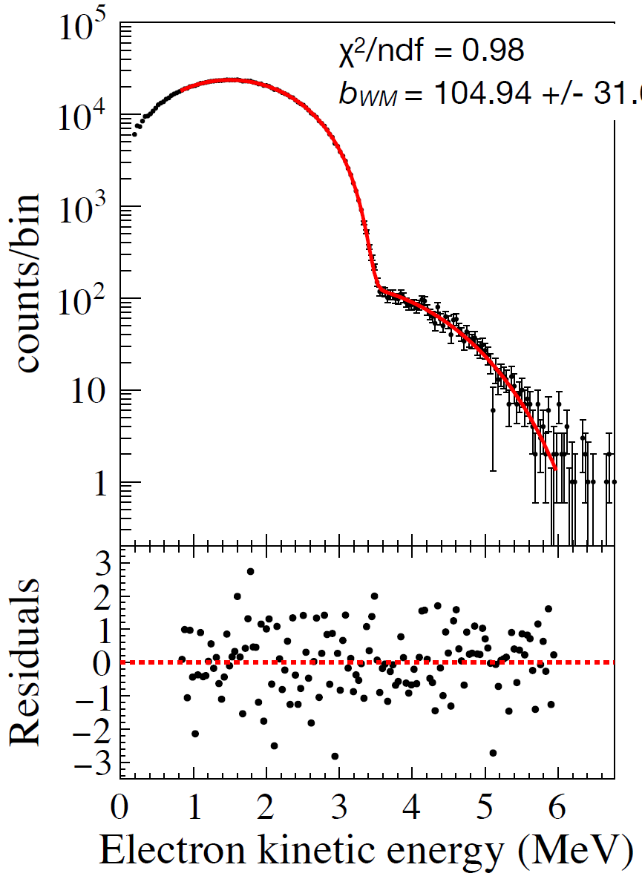
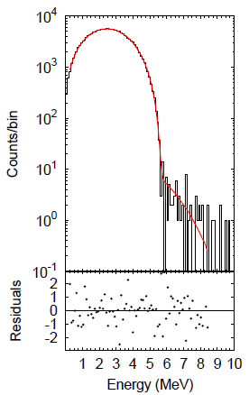
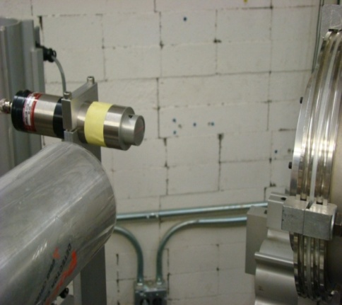


Fit β-spectra over 4 orders of magnitude in rate
Xueying Huyan (PhD, MSU, 2019)
Max Hughes (PhD, MSU, 2019)
⁶He
²⁰F
⁶He
calorimetric technique
(NSCL-MSU) and use
of a radioactive beam,
eliminates the effect of
electron backscattering
on detectors
~100 spectra with CsI(Na) and NaI(Tl)
Expected total sensitivity: 4×10⁻³
~55 spectra collected with CsI(Na)
Expected total sensitivity: 7×10⁻³

Slide 16
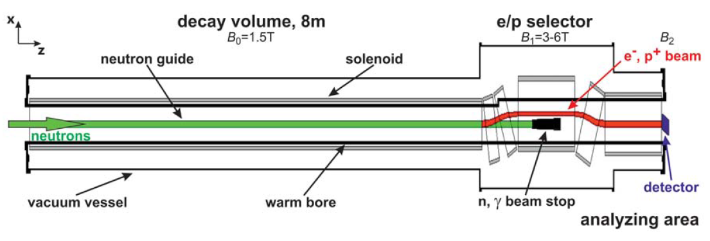
PERC facility - FRM II - ESS
see poster Gertrud Konrad
strong longitudinal magnetic field will collect decay electrons and protons
both polarized and unpolarized neutrons for correlation measurements
detector set ups for specific observables can be installed
specific design to reduce systematic effects
expect order of magnitude increase in measurement precision
Dubbers et al., Nucl. Inst. Meth. A 596 (2008) 238
Konrad et al., Journal of Physics: Conf. Ser. 340 (2012) 012048

Slide 17
Outline
- neutron and nuclear beta decay
- V_{ud} and CKM-unitarity
- searches for exotic S and T currents
- searches for Time Reversal Violation
- EDM experiments in search for CP-violation
- testing CPT with anti-matter

Slide 18


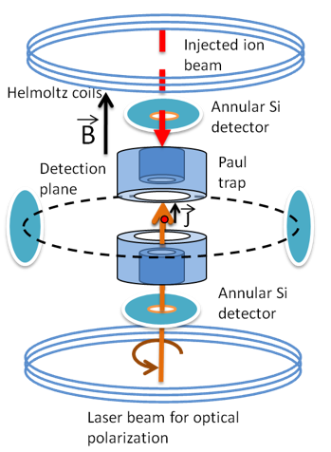
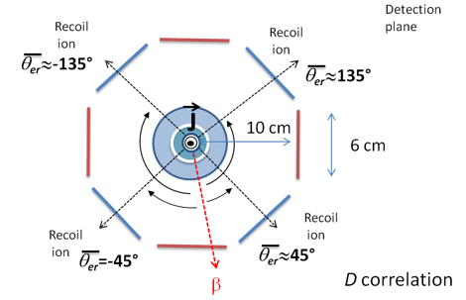
D-correlation: (sensitive to T-violation in V,A interaction)
Today: D_{19Ne} = (-0.9 ± 1.8 ± 1.0) x 10⁻⁴ T.E. Chupp et al., Phys. Rev. C 86 (2012) 035505
D_{n} = (-1 ± 6) x 10⁻⁴ F.C. Calaprice et al., Hyp. Int. 22 (1985) 83)
Coming: σ_{D(23Mg, 39Ca)} < 5 x 10⁻⁵ - MORA experiment
Laser-optical polarization in a Paul trap
β-recoil coincidence measurements
Experiments at JYFL and GANIL
P. Delahaye et al., Hyperfine Interact (2019) 240:63

Slide 19


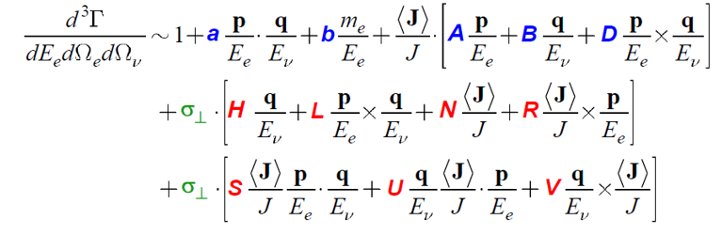
R-correlation: (sensitive to T-violating S,T interactions)
Today: R_{8Li} = 0.0009(22) nTRV Coll, A. Kozela et al., Phys. Rev. C 85 (2012) 045501 R_{n} = 0.004(13) R. Huber et al., Phys. Rev. Lett. 90 (2003) 202301
Coming:
BRAND project
(ILL – ESS)
- measure 11 coerrelations simultaneously → perform gloal analysis
- sensitive to both Time Rev. conserving and violating S and T interactions:
X = X_{SM} + X_{FSI} + c₁ ReS + c₂ ReT + c₃ ImS + c₄ ImT
Courtesy: K. Bodek

Slide 20
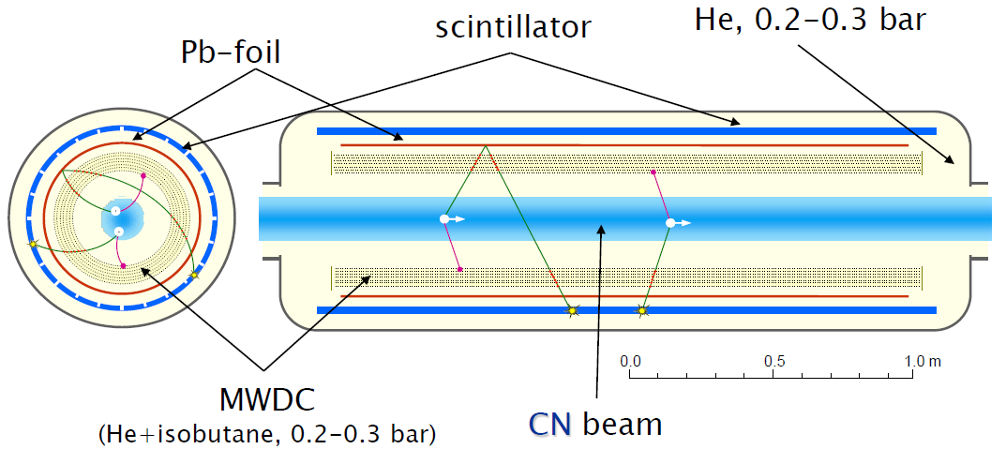
BRAND project
- measure transverse electron polarization
- particle tracking
- vertex reconstruction
- Mott scattering
Courtesy: K. Bodek

Slide 21
Outline
- neutron and nuclear beta decay
- V_{ud} and CKM-unitarity
- searches for exotic S and T currents
- searches for Time Reversal Violation
- EDM experiments in search for CP-violation
- testing CPT with anti-matter

Slide 22
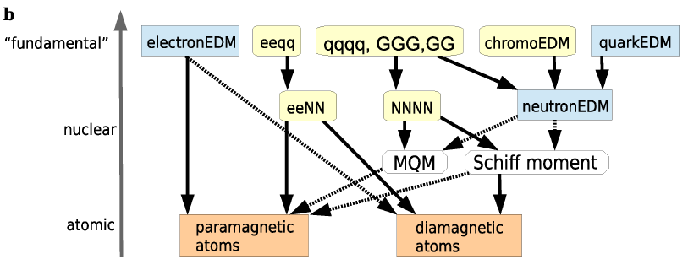
Electric Dipole Moments
see also talk Piet Van Duppen
CP violating sources contribute to EDMs in various systems on different energy scales
F. Kuchler, Universe 2019, 5, 56;
Fundamental particle EDMs (blue boxes) , as wells as
CP-odd interactions between electrons (e) , quarks (q) and gluons (G) (yellow boxes)
lead to
EDMs of complex systems like atoms (orange boxes) .

Slide 23
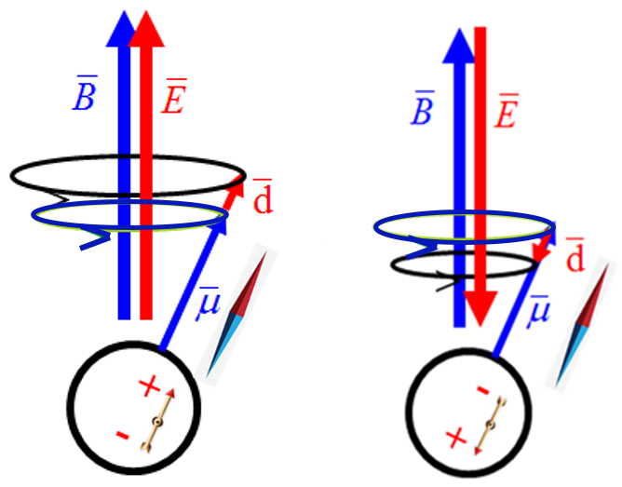
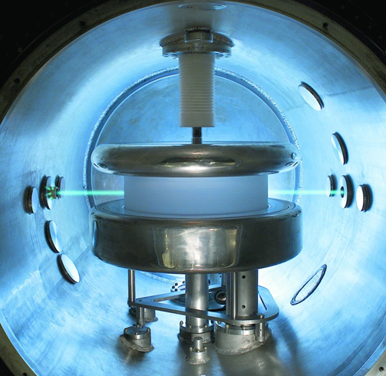

e.g. the nEDM experiment at PSI - testing CP-violation
50 cm
12 cm
B₀ = 1 μT
E = 12 kV/cm
$${sensitivity \left(300 days data taking\right) : σ}_{raw}=0.94×{10}^{−26}e cm$$
(unblinding today …)

Slide 24
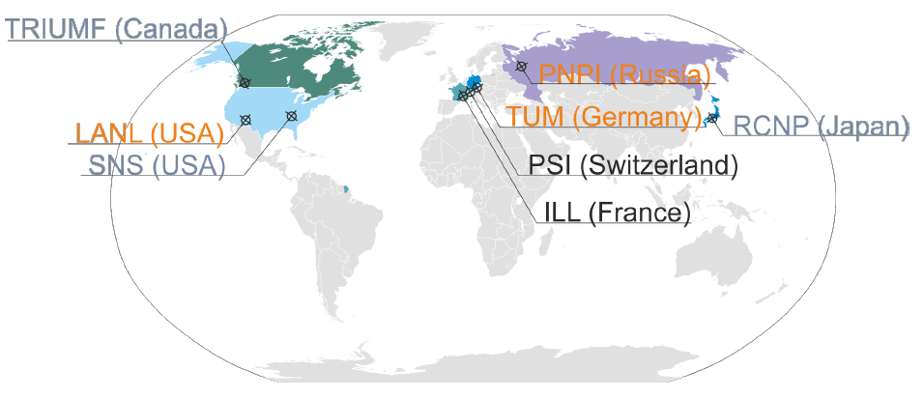
Worldwide neutron EDM efforts

Slide 25
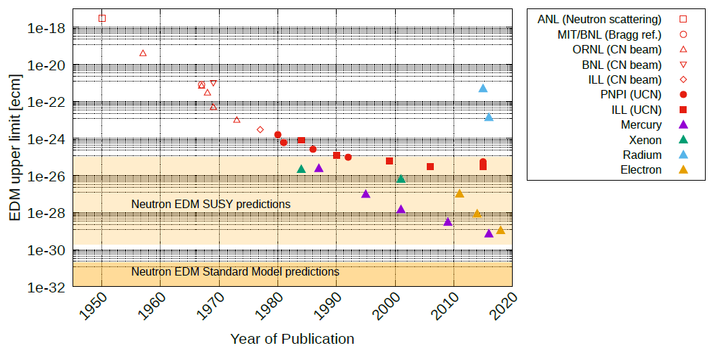
Evolution of EDM searches in different systems
neutron
F. Kuchler, Universe 2019, 5, 56

Slide 26
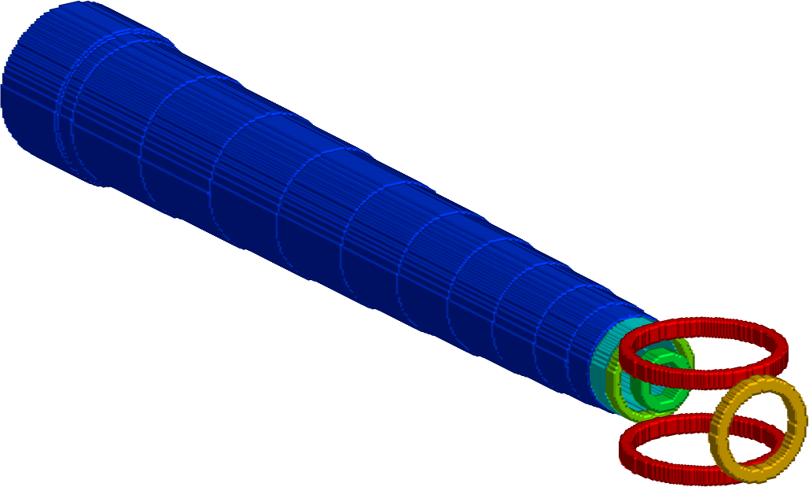
2
EDM measurements on ²²⁵Ra
See: Piet Van Duppen
P. Müller, ANL
Oven:
²²⁵Ra
In addition:
Parity violation measurements
with discovery potential at sin² (θ_{W})
Transverse
cooling
Zeeman
Slower
Why trap ²²⁵Ra atoms
atomic states with opposite parity close in E
→ significant enhancement for electron EDM
octupole deformation
→ enhancement by 10² – 10³ for nucleon EDM
High electric field (> 100 kV/cm)
Long coherence times (~ 100 s)
Negligible “v x E” systematic effect
Magneto-optical
Trap (MOT)
Optical dipole
trap (ODT)
EDM
measurement
Courtesy of Peter Müller

Slide 27
Status and recent progress of EDM limits
Neutron Electron ¹⁹⁹Hg ¹²⁹Xe ²⁵⁵Ra
90% C.L. 90% C.L. 90% C.L. 90% C.L. 90% C.L.
Exp. upper limit (e cm) 3.0 x 10⁻²⁶ 9.4 x 10⁻²⁹ 2.6 x 10⁻²⁹ 6.6 x 10⁻²⁷ 1.4 x 10⁻²⁴
[1] [2] [3] [4] [5]
to appear 1.1 x 10⁻²⁹ 6.1 x 10⁻³⁰ 1.2 x 10⁻²⁷ [6] [7] [8] [9]
SM prediction (e cm) ~10⁻³¹ – 10⁻³² ~10⁻³⁸ ~10⁻³⁴ ~10⁻³⁴ -
molecular
quadr. def.
[1] Pendlebury et al., Phys. Rev. D 92 (2015) 092003 [6] nEDM Collaboration - PSI (2020)
[2] De Mille, Gabrielse et al., Science 343 (2014) 269 [7] De Mille, Gabrielse et al., Nature 562 (2018) 355
[3] Heckel, Fortson et al., Phys. Rev. Lett. 102 (2009) 101601 [8] Heckel, Fortson et al., Phys. Rev. Lett. 116 (2016) 161601
[4] Chupp et al., Phys. Rev. Lett. 86 (2001) 22 [9] Fierlinger et al., Phys. Rev. Lett. 123 (2019) 143003
[5] Mueller et al., Phys. Rev. C 94 (2016) 025501
+ weaker limits on EDM of μ, p, τ, ν_{e},_{μ} , ν_{τ} , Λ (e.g. Jungmann, Nucl.Phys. A 751 (2005) 87c)

Slide 28
Outline
- neutron and nuclear beta decay
- V_{ud} and CKM-unitarity
- searches for exotic S and T currents
- searches for Time Reversal Violation
- EDM experiments in search for CP-violation
- testing CPT with anti-matter
see also talk Klaus Kirch

Slide 29

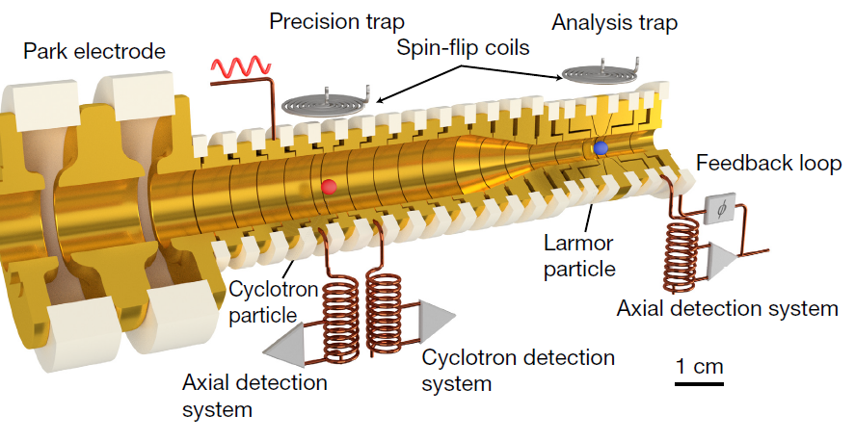



e.g. the BASE experiment at AD-CERN - testing CPT
$$ω_{L}\text{=}\frac{g e}{\text{2} m}\text{B}$$
= -2.792 847 344 1 (42) μ_{N}
$$\frac{ω_{L}}{ω_{C}}=\frac{g }{2 }=\frac{μ_{p} }{μ_{N}}$$
μ_{p} = +2.792 847 344 62 (82) μ_{N}
$$ω_{C}=\frac{e}{m}B$$
relative difference of 2 x 10⁻¹⁰
anti-p: C. Smorra et al., Nature 550 (Oct. 2017) 371
proton: G. Schneider et al., Science 358 (Nov. 2017) 1081

Slide 30
Summary
- neutron and nuclear beta decay
- V_{ud} and CKM-unitarity
- searches for exotic S and T currents
- searches for Time Reversal Violation
- EDM experiments in search for CP-violation
- testing CPT with anti-matter

Slide 32
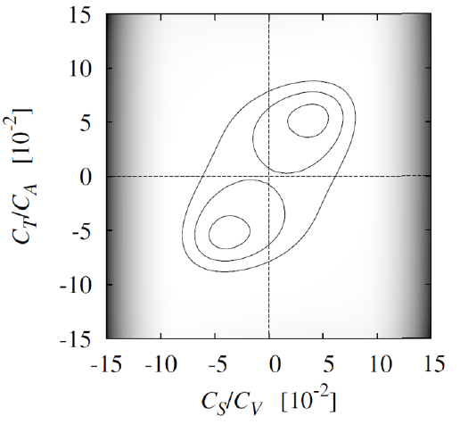
the Standard Model and beyond:
* C_{V} ≡ 1; C_{A} = -1.27 (g_{A}/g_{V} from n-decay)
* C_{V}’ = C_{V} & C_{A}’ = C_{A} (maximal P-violation)
* C_{S} = C_{S}’ = C_{T} = C_{T}’ = C_{P} = C_{P}’ ≡ 0
(only V- and A-currents)
* no time reversal violation (except for the CP-violation
described by the phase in the CKM matrix)
experimental upper limits on
scalar and tensor couplings
involving right-handed neutrinos
are at the 5 to 10 % level
(neutron and nuclear β-decay)
M. Gonzalez-Alonso, O. Naviliat-Cuncic, NS,
arXiv:1803.08732 [hep-ph] (subm. to RMP)
5% level → ~ 350 GeV
per mille level → ~ 2.5 TeV

Slide 33
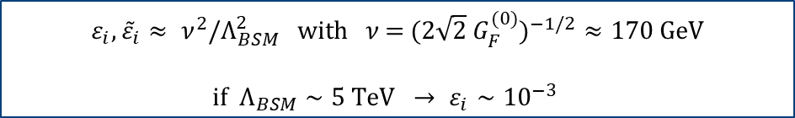
Precision meas^{ts} in nuclear/neutron β decay in the LHC era
if particles that mediate new interactions are above threshold for LHC
→ Effective Field Theory allowing
direct comparison of low-energy and collider constraints
low-scale O(1 GeV) effective Lagrangian for semi-leptonic transitions
(contributions from W-exchange diagrams and four-fermion operators)
link betw. EFT couplings ε_{i} and Lee-Yang nucleon-level effect. couplings C_{i}:
$$ε_{i}, {\tilde{ε}}_{i}≈ ν^{2}/Λ_{BSM}^{2} \text{with} ν\text{ = }(2\sqrt{2} G_{F}^{(0)})^{−1/2}≈170 \text{GeV}$$
$\text{if} Λ_{BSM}∼5 \text{TeV} → ε_{i}∼10^{−3}$
T. Bhattacharya et al., Phys. Rev. D 85 (2012) 054512
V. Cirigliano, et al., J. High. Energ. Phys. 1302 (2013) 046
O. Naviliat-Cuncic and M. Gonzalez-Alonso, Annalen der Physik 525 (2013) 600.
V. Cirigliano, et al., Progr. Part. Nucl. Phys. 71 (2013) 93

Slide 34
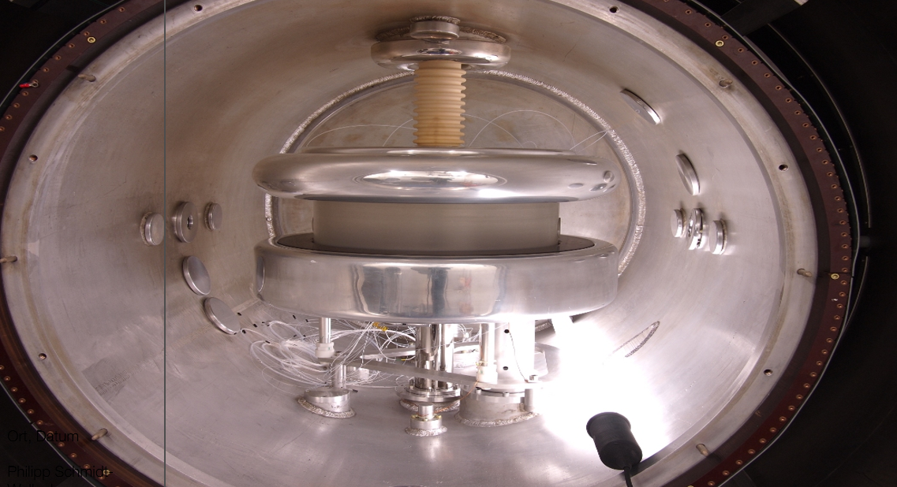

Slide 35
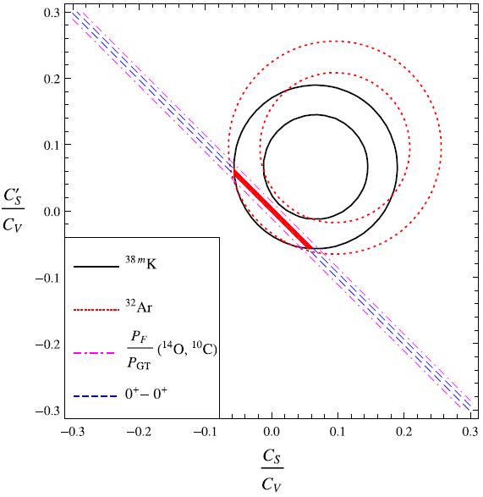


Limits on scalar currents
³²Ar: Adelberger et al., PRL 83 (1999) 1299
^{38m}K: Gorelov, Behr et al., PRL 94 (2005) 142501
with:
Hardy & Towner , Phys. Rev. C 91 (2015) 025501
B. R. Holstein, J. Phys. G 41 (2014) 114001

Slide 36
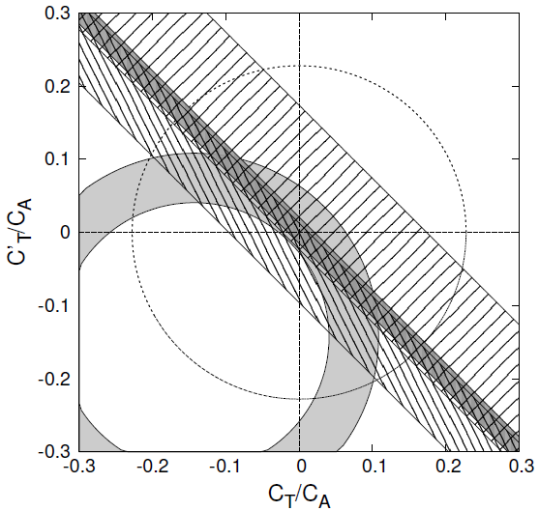
Limits on tensor currents
a(⁶He)
C. Johnston et al.,
PR 132 (1963) 1149
α-β-ν(⁸Li)
M.G. Sternberg, G.Savard et al.,
PRL 115 (2015) 182501
A(⁶⁰Co)
F. Wauters, N.S. et al.,
PR C 82 (2010) 055502
A(⁶⁷Cu)
G. Soti, N.S. et al.,
PR C 90 (2014) 035502
A(⁶⁰Co)
A(⁶⁷Cu)
α-β-ν(⁸Li)
a(⁶He)

