Slide 1
How well are we exploring our synergies in conferences/workshops ?
Barbara Erazmus
Subatech, Nantes

Slide 2
and Beyond …
Conferences (EPS HEP, NPD, QM, INPC)
EPPSU 2020 Open Symposium in Granada
European Actions
Theory Centers (ECT*, EuCAPT)
Integrating Activities (NSAR2, STRONG-2020)
Global efforts
Scientific Unions
International Science Council

Slide 3

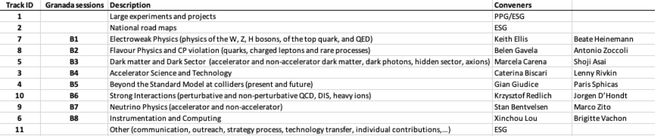
EPPSU 2020
Halina Abramowicz Chairperson
Scientific Input to the Strategy Update
Call for inputs issued February 28, 2018 with deadline for submission December 18, 2018
160 submissions received
40
42
21
27
27
51
20
31
23
35
The Open Symposium in Granada (May 13-16, 2019) aimed to reach a consensus on the scientific goals of the community, based on the provided input, and to assess the proposed projects and technologies to achieve these goals
The ESG needs all this input to propose a realistic update of the Strategy

Slide 4
EPPSU 2020
Open Symposium
Plenary Sessions
2 half-days to review where we stand and what is expected of the European community, also by communities outside Europe
Full day of summaries from the Parallel Session
End product of the Symposium
Briefing Book based on the summaries, compiled by the PPG, assisted by scientific secretaries
is now available on the CERN document server: http://cds.cern.ch/record/2691414.

Slide 5

EPPSU2020
Challenges for the European Strategy Group
Additional aspects to be considered
Ensure adequate dynamism in the particle physics science to remain attractive (long time scales) Many interesting ideas to complement energy frontier with precision measurements (EDMs, rare decays, low energy DM like dark mediators or axions, neutrinos,…, QCD)
Ensure adequate support for theory development and related tools (career path) Difficult to convince Academia – National Labs may help (CERN included)
Ensure preservation of expertise in detector, accelerator and computing sciences See above; enhance the role of National Institutions
Communicate interest of science to other fields of research and to society
Seek synergies with ApPEC, NuPPEC, but also material science, light sources…

Slide 6


Joint session ECFA and EPS-HEPP
Ghent, Belgium July 13, 2019
“Towards an update of the European Particle Physics Strategy”
Overview of the ESPP Open Symposium – Halina Abramowicz
Technology path towards future colliders – Caterina Biscari
Community challenges and opportunities for detector R&D – Ariella Cattai
Higgs at Future Colliders – Christophe Grojean
Physics Beyond Colliders – Claude Vallee
Synergies between astroparticle, particle and nuclear physics – Caterina Doglioni
Computing and Software challenges – Graeme Stewart
1

Slide 7
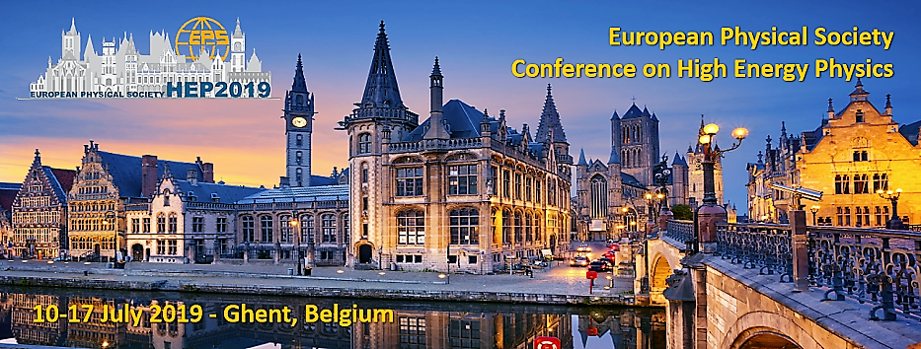
Cosmology
Astroparticle and Gravitational Waves
Dark Matter
Neutrino Physics
Higgs Physics
Top and Electroweak Physics
Flavour Physics and CP Violation
Searches for New Physics
Quantum Field and String Theory
QCD and Hadronic Physics
Heavy Ions Physics
Dense QCD Matter in Heavy Ion collisions and Neutron Stars
Emergence of Quark-Gluon Plasma Phenomena
Detector R&D and Data Handling
Outreach, Education, and Diversity

Slide 8

Parallel Session - QM & nuclear astrophysics
Measurement of the anti-deuteron nuclear inelastic cross section with ALICE and implications for indirect Dark Matter searches
Quarkyonic Matter and Neutron Stars
Continuity from neutron matter to color-superconducting quark matter
Signatures of quark-hadron phase transitions in general-relativistic neutron-star mergers
EOS at high baryon density and neutron star mergers

Slide 9

Parton dynamics and colour condensates
Fundamental Physics with neutrons and muons
Nuclear Astrophysics at LUNA: Status and Perspectives
Nuclear masses for nuclear structure and astrophysics
Nucleosynthesis of heavy elements in the Universe
R-process nucleosynthesis in a double neutron-star merger

Slide 10
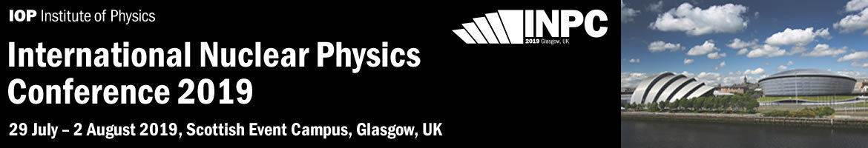
Physics opportunities with reactions induced by relativistic rare beam: Unveiling neutron-star secrets
From Nuclei to the Cosmos: Tracing Heavy-Element Production with the Oldest Stars
The future of neutrino physics and neutrino oscillations
Gravitational waves as Probes for Nuclear Physics
Explosive scenarios in astrophysics: Observations, models and nuclear inputs
Nuclear astrophysics in underground laboratory

Slide 11
European Activities

Slide 12

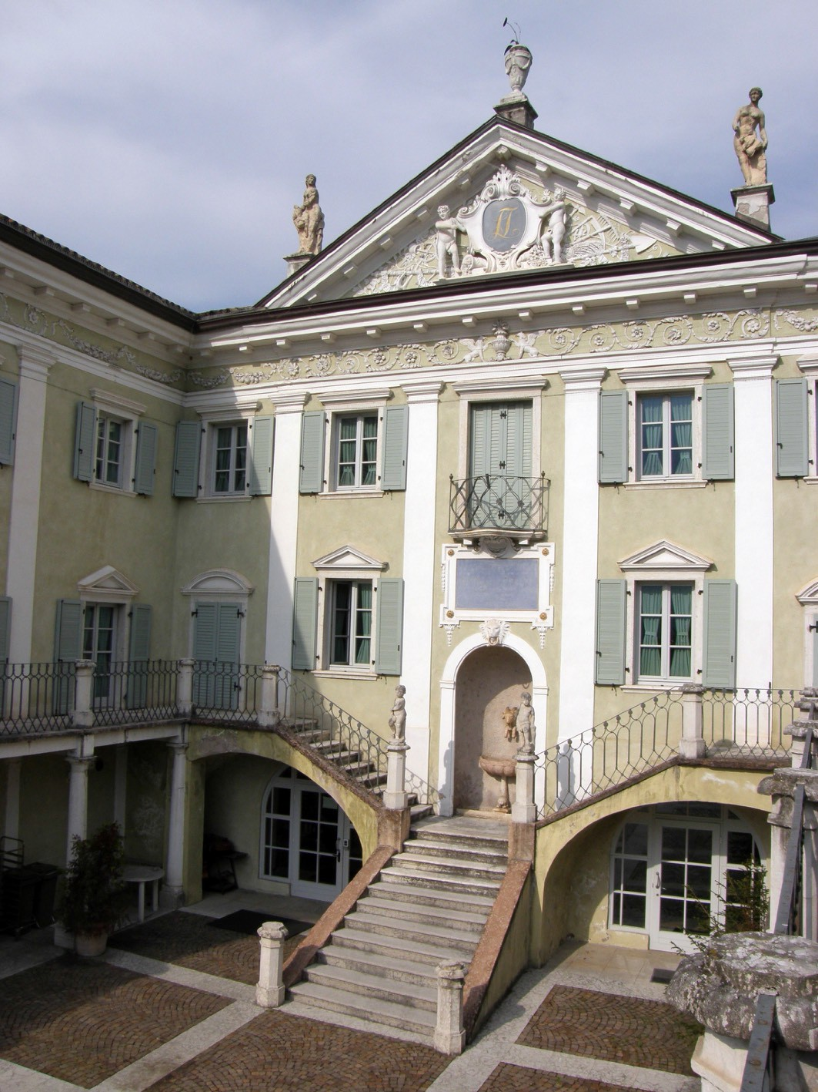


European Centre for Theoretical Studies in Nuclear Physics
and Related Areas
Jochen Wambach
Director

Slide 13


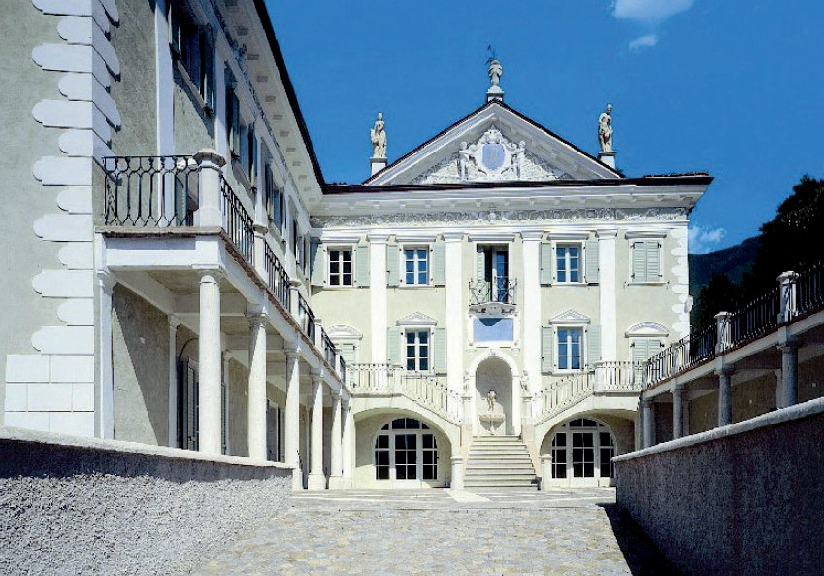



www.ectstar.eu
Established in 1993 . . .
. . . unique in Europe
“Bottom-up” realization supported by large community (ECT* Associates International Scientific Board)
Large influx of international visitors (~ 700 per year)
Strong local support by the Autonomous Province of Trento (PAT)
through the Fondazione Bruno Kessler (FBK)
Multinational Memorandum of Understanding funding agencies of European countries
+ EU Projects: ENSAR2, STRONG-2020

Slide 14
The ECT* Mission
www.ectstar.eu
.To be a center of frontline research
in theoretical nuclear physics
2 senior researchers, 5 junior postdocs
. To promote active contacts between theory and experiments, and to related areas of research
20-25 workshops and coll. meetings

Slide 15










www.ectstar.eu
ECT* Scientific Events 2019
21 accepted workshops + 3 collaboration meetings
distribution of topics
6 6
5
3
Related Areas: Astrophysics & Cosmology
Quantum Many-Body Systems,..
Nuclear Structure and Reactions
2
QCD and Hadron Physics
Nuclear Astrophysics
QCD Matter

Slide 16

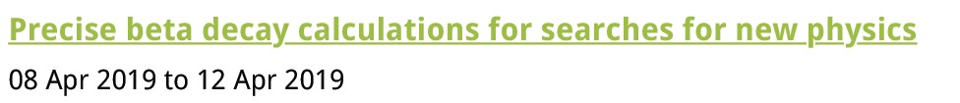
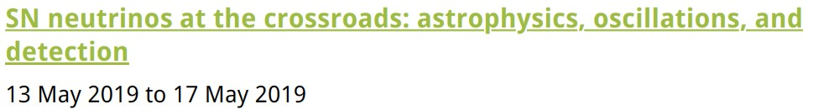
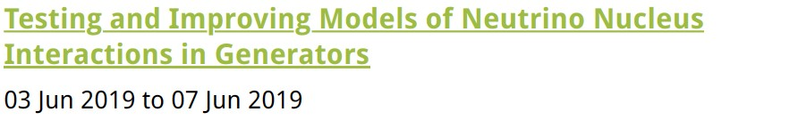

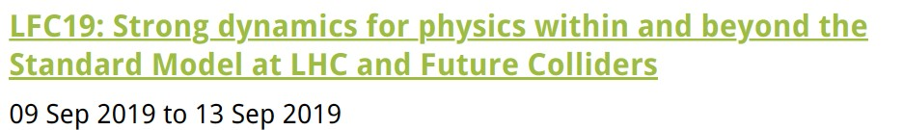
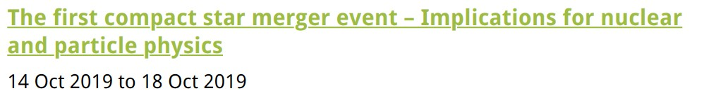
www.ectstar.eu
At the crossroad with particle- and astro-particle physics
selected examples from the 2019 workshop program

Slide 17



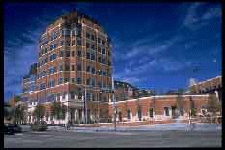














INTERNATIONAL COOPERATIONS
INT
INSTITUTE for NUCLEAR THEORY
www.ectstar.eu
USA
National Astronomical Observatory
of Japan
Japan
JINR Dubna
Russia
Korea
China
Germany
ITP
Chinese Academy of Sciences

Slide 18
EuCAPT European Centre for Astroparticle Theory
was launched on 10 July, 2019 at CERN
Organisation: a central Hub (first 5 years: CERN) and distributed centres governed by
a Director and Steering Committee including supporting Institutes
Activities:
Annual general meeting; Thematic workshops
2. Dedicated meetings to consolidate/finalize collaborative projects and common proposals
3. Coordination of existing/planned activities of the participating institutions
4. Contacts/coordination with ApP theorists from all over the world
5. Advice, referee support, training concerning funding proposals
6. EuCAPT website, activity calendar, news

Slide 19
“European Nuclear Science and Applications Research 2”
(ENSAR2)
Integrating activity (IA) for European nuclear scientists performing research in three of the major subfields defined by NuPECC: Nuclear Structure and Dynamics, Nuclear Astrophysics and Nuclear Physics Tools and Applications.
Its core aim is to provide access to nine of the complementary world-class large-scale facilities.
Muhsin N. Harakeh
Coordinator

Slide 20
Transnational Access
    GANIL-SPIRAL2 (France)
    LNL-LNS (INFN, Italy)
    ISOLDE (CERN, Switzerland)
    JYFL (Finland)
    ALTO (CNRS, France)
    GSI (Germany)
    KVI-CART (The Netherlands)
    NLC (HIL/IFJ PAN, Poland)
    IFIN-HH/ELI-NP (Romania)
    ECT* (Italy)
NEW
NEW
NEW

Slide 21
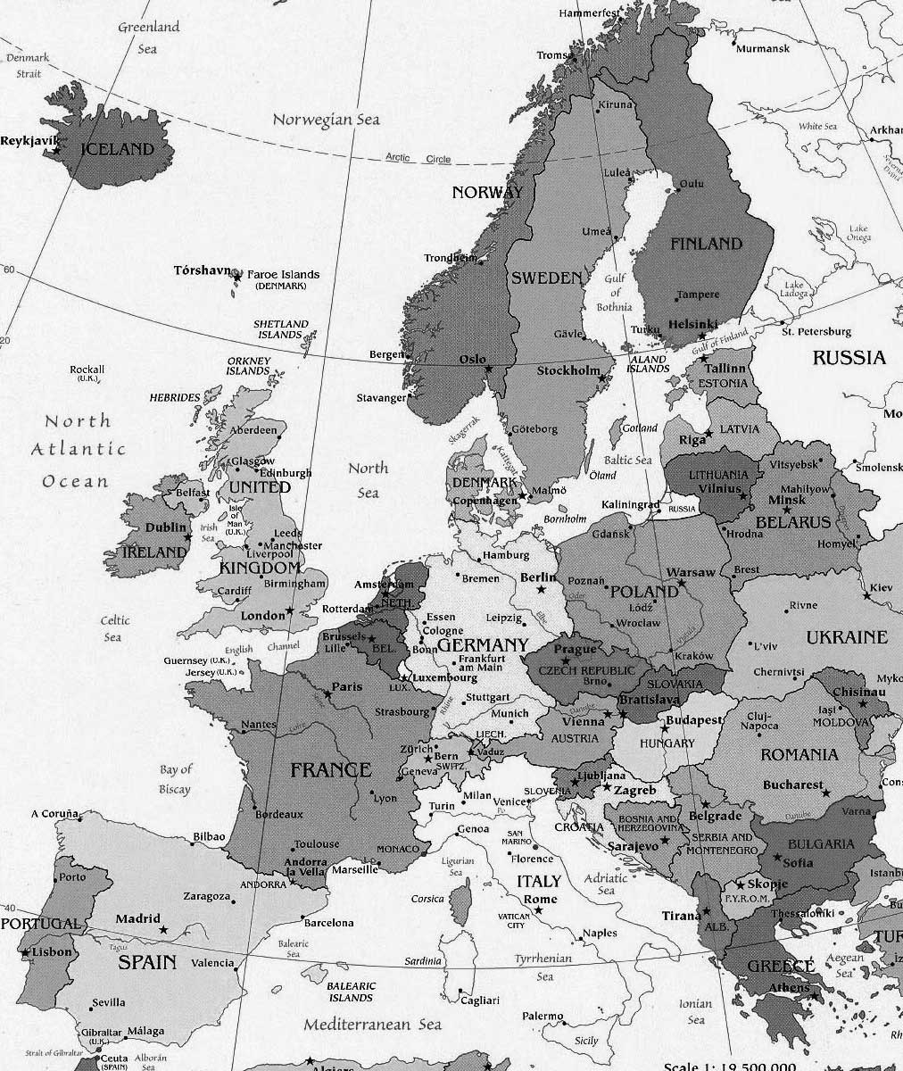
FP8 ENSAR2
Partners of
10 TNA Facilities
JYL
30 beneficiaries
15 countries
UoY
Community: 2700-3000 scientists and highly qualified engineers
UWAR-HIL & IFJ PAN
RUG-KVI
I
ULIV
KUL
JLU
Köln
GSI
GANIL
CEA
ULB
MedAustron
Close collaboration with infrastructures outside Europe:
Canada: TRIUMF
China: IMP Lanzhou
Japan: RIKEN & RCNP
Russia: Dubna/JINR
South Africa: iThemba
United States: NSCL & ANL
ARRONAX
JOGU
ATOMKI-HAS
ALTO-CNRS
LMU
ECT*
ELI-NP / IFIN-HH
USC
ISOLDE-CERN
LNL-INFN
FFCUL
CIEMAT
UMIL
NCSRD
CSIC
Univ. Sevilla
LNS-INFN

Slide 22
Networking Activities
Synergies with particle physics
    NA3-MIDAS: MInimisation of Destructive plASma processes in ECR ion sources
Supports developments of ion sources by academic and industrial (AVS and PANTECHNIK) experts and organise trainings and workshops on this topic for the community.
    NA5-MediNet: Medical Network
    Devoted to nuclear physics for medicine through the developments of beam and detection techniques and of ion-beam therapy.

Slide 23
Joint Research Activities
Synergies with particle and astroparticle physics
    JRA1-PASPAG: Phoswich scintillator assemblies: Application to the Simultaneous detection of PArticle and Gamma radiation
    JRA2-PSeGe: Position-Sensitive Germanium detectors for nuclear structure and applications
    JRA5-SATNuRSE: Simulations and Analysis Tools for Nuclear Reactions and Structure in Europe

Slide 24
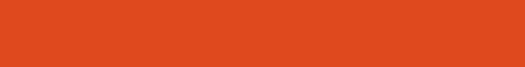
‘The strong interaction at the frontier of knowledge: fundamental research and applications’
The list of fundamental open questions at the frontier of our current knowledge in the strong interaction is very rich and varied including a full understanding of
partonic structure of hadrons
exotic hadronic states
dense quark matter
hot and dense quark-gluon plasma
precision tests of the SM
Barbara Erazmus, Coordinatrice du projet
Paris,08/02/2018

Slide 25
Research topics studied experimentally and theoretically mostly via particle collisions at low (a few tens of GeV) and high (up to 14 TeV) energies
Associated developments
in state-of-the-art detectors/data-acquisition/beams/targets
as well as in theoretical calculations
(lattice, effective field,perturbative)

Slide 26
Start June 2019
Coordinator CNRS/IN2P3 SUBATECH
Budget 10 MEu
32 Work Packages
  7 Transnational Infrastructures (COSY, MAMI, ELSA, GSI, LNF, CERN, ECT*)
  2 Virtual Infrastructures
  Experimental / Theoretical / Instrumentation Activities
    7 Networking Activities (NA)
    14 Joint Research Activities (JRA)
44 participating institutions
  16 countries: Austria, Belgium, Switzerland, Germany, Spain, Finland, France, Croatia, Ireland, Italy, Montenegro, The Netherlands, Poland, Portugal, Sweden and United Kingdom
Barbara Erazmus, Coordinatrice du projet
Paris,08/02/2018

Slide 27
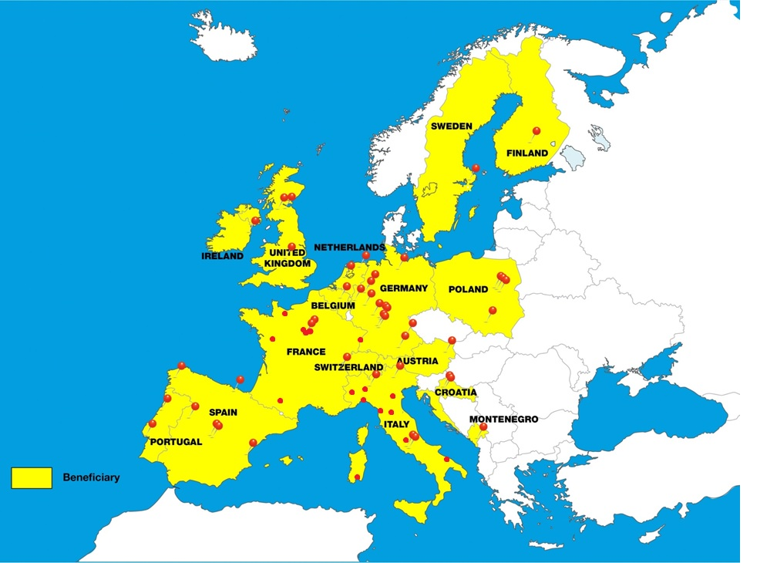

Slide 28
Synergies
(few examples)
    - JRA-PrecisionSM: Precise determination of the muon anomalous magnetic moment (g-2)μ; the CKM matrix element Vud from beta decay, and the weak mixing angle from parity-violating electron scattering.
    - NA-PREN: Address the “proton-radius puzzle” via combined data-theory analyses of new results in atomic spectroscopy (laser spectroscopy of Hydrogen molecules and molecular ions, muonic atoms, He+ ions, positronium, and muonium) and very-low momentum transfer (Q2) lepton-proton elastic scattering at various energies.
    - JRA-HaSP: Development of a common data-theory analysis framework to determine exotic hadrons properties (new mesons and baryons, onia, dibaryon, multi-quark, glueballs, hybrids...) by fitting new experimental data (MAMI, TJNAF, BESIII, COMPASS, LHCb and ALICE at CERN) to lattice QCD and effective-field-theory predictions.
    - NA-THEIA: Address the “neutron stars hyperon puzzle” (contradiction between the observation of 2-solar-masses neutron stars and microscopical predictions of a softening of the nuclear equation-of-state due to the presence of strange-quark hadrons) through combined theoretical and experimental studies of (anti)hypernuclei and bound strange-meson systems produced in hadronic collisions at various c.m. energies.
    - Instrumention and applications Work Packages

Slide 29
Global efforts

Slide 30
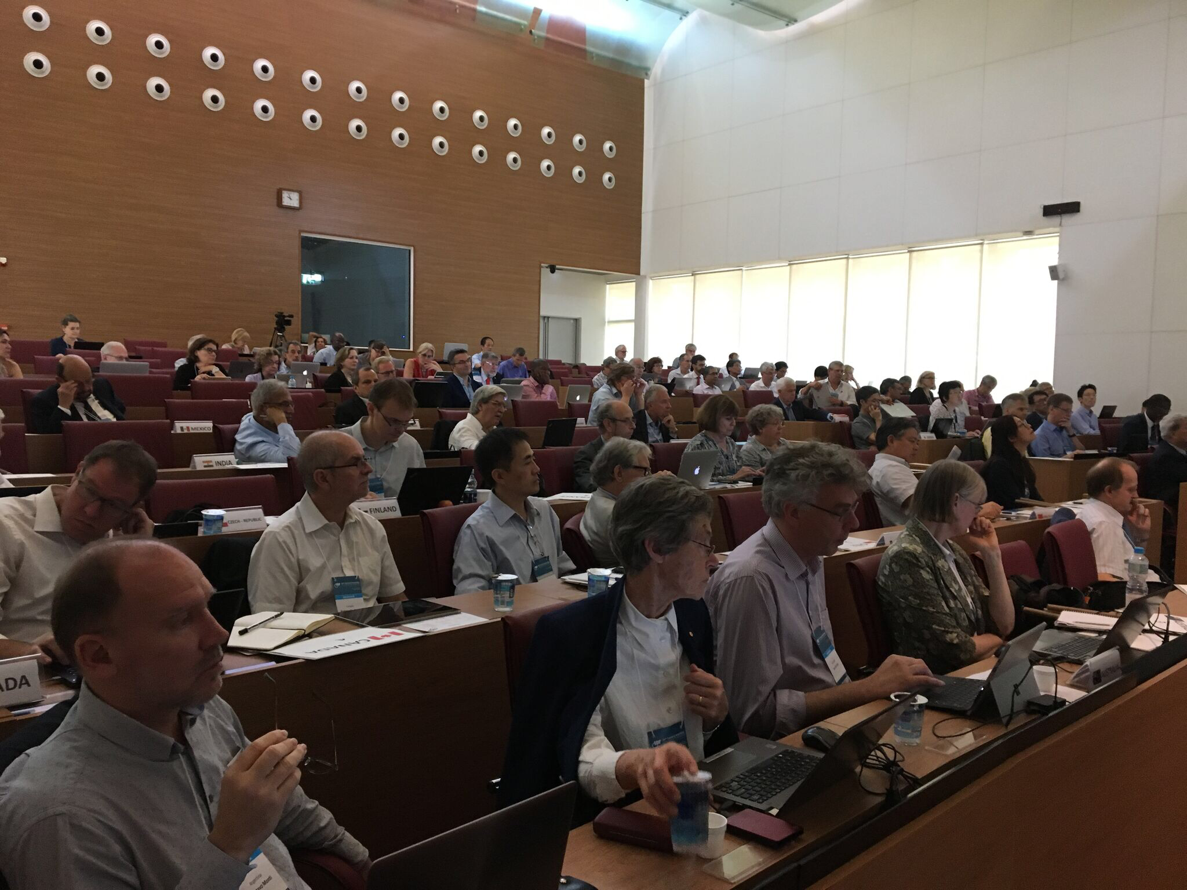
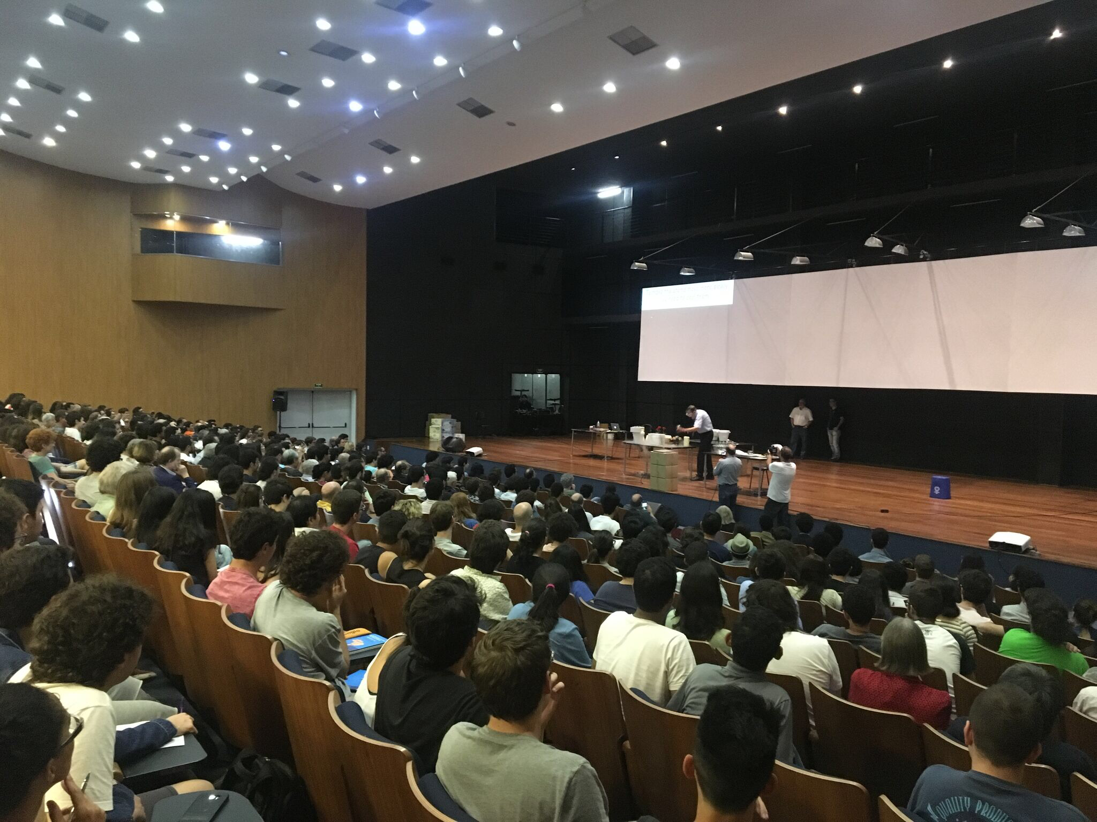
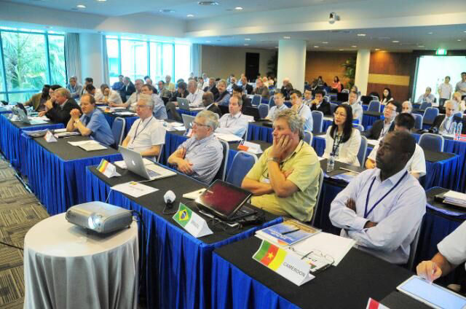
IUPAP
Michel Spiro (President Designate)
Mission:
“To assist in the worldwide development of physics, to foster international cooperation in physics, and to help in the application of physics toward solving problems of concern to humanity”.

Slide 31
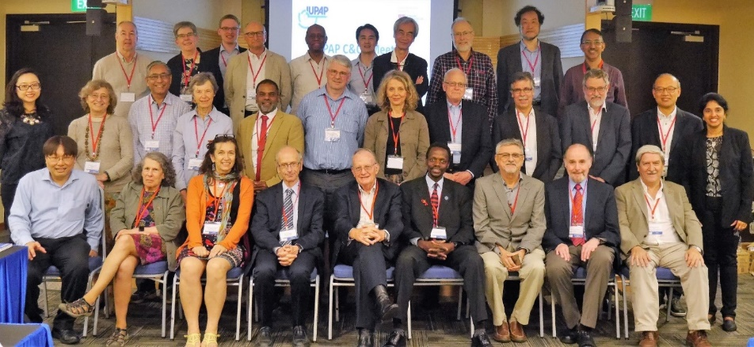
Commissions
• Symbols, Units, etc (C2)
• Statistical Mechanics (C3)
• Astroparticle Physics (C4)
• Low Temperature Physics (C5)
• Biological Physics (C6)
• Semiconductors (C8)
• Magnetism (C9)
• Condensed Matter (C10)
• Particles and Fields (C11)
• Nuclear Physics (C12)
• Physics for Development (C13)
• Physics Education (C14)
• Atomic Molecular and Optical Physics (C15)
• Plasma Physics (C16)
• Laser Physics and Photonics (C17)
• Mathematical Physics (C18)
• Astrophysics (C19)
• Computational Physics (C20)
The first scientific commission, on Units, was established in 1931 at the third General Assembly.
Currently there are 18 Commissions.
Organize the major International conferences in their field; and award Young Scientist Prizes

Slide 32
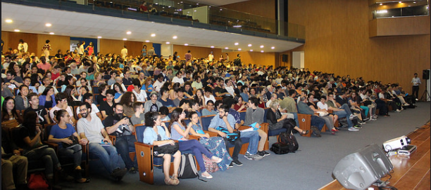
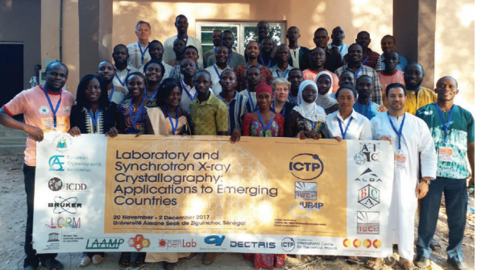
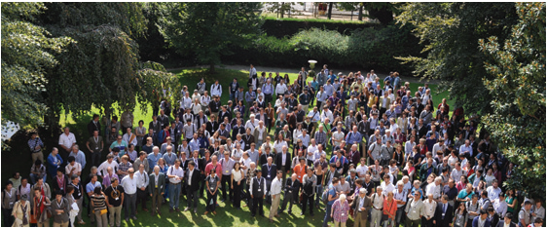
CONFERENCES
IUPAP sponsors and endorses ~50 conferences per year:
Very large, medium size, specialized
everywhere with a special attention to developing countries
Requirements are:
scientific interest
worldwide attendance with no a priori restriction or difficulty to attend
inclusiveness and diversity

Slide 33
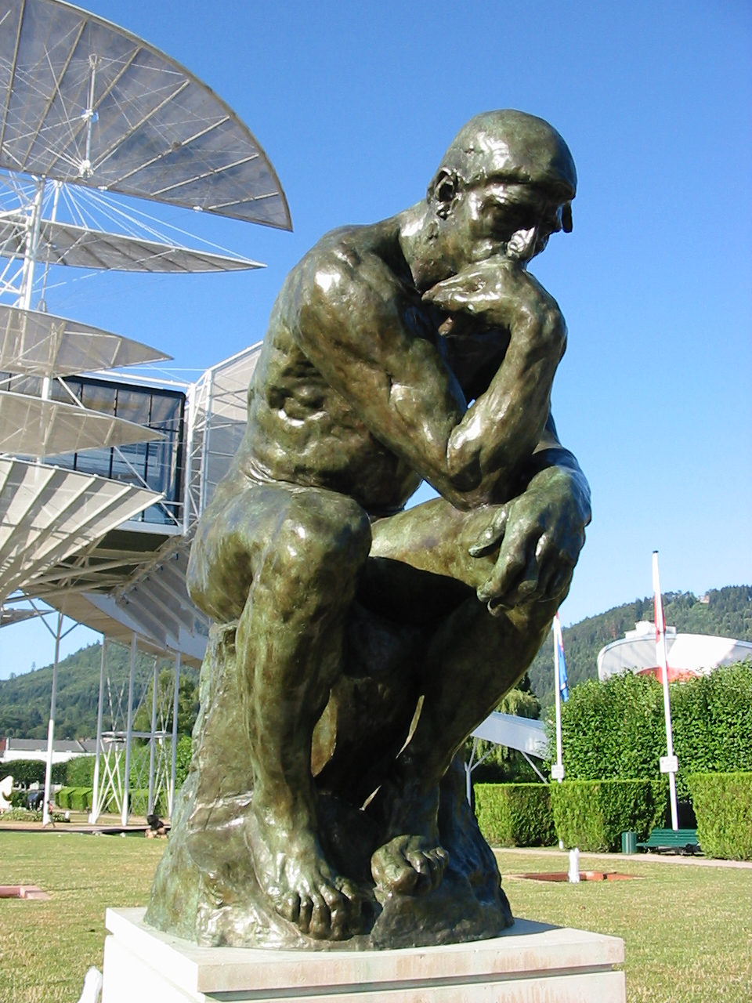











2022
IYBSD
International Year of Basic Sciences for Development
Basic Sciences under the spotlight
Basic Sciences are a key tool to provide a multi-cultural dialogue, with “scientific diplomacy” a known and demonstrated means to contribute to a more peaceful world

Slide 34
The global voice for science
140 National and Regional Scientific Organizations
40 International Scientific Unions and Associations across the natural and social sciences
3 Regional Offices and Social Science Councils in Africa, Asia, Latin America and the Arab world
7 International Research / Funding Programmes focusing on global change and sustainability
11 International Committees and Networks on data, observing systems, science advice
Partnerships with other International Scientific Organizations, incl. IAP, TWAS, WFEO
Formal Relations with the UN, Coordinator of the UN Major Group for S&T

Slide 35
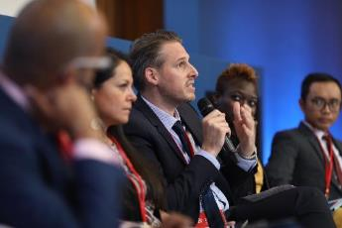
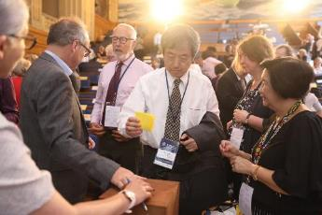
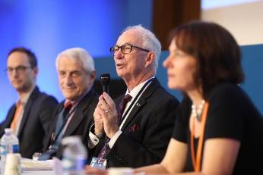
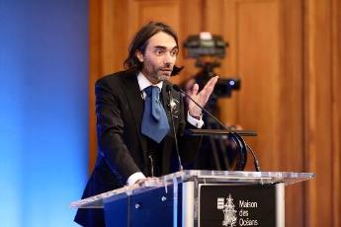
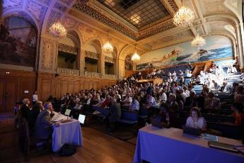
Founding General Assembly and Inauguration of the International Science Council
Paris, France, 3 - 5 July 2018
Photos: Simon Cassanas for ISC

Slide 36
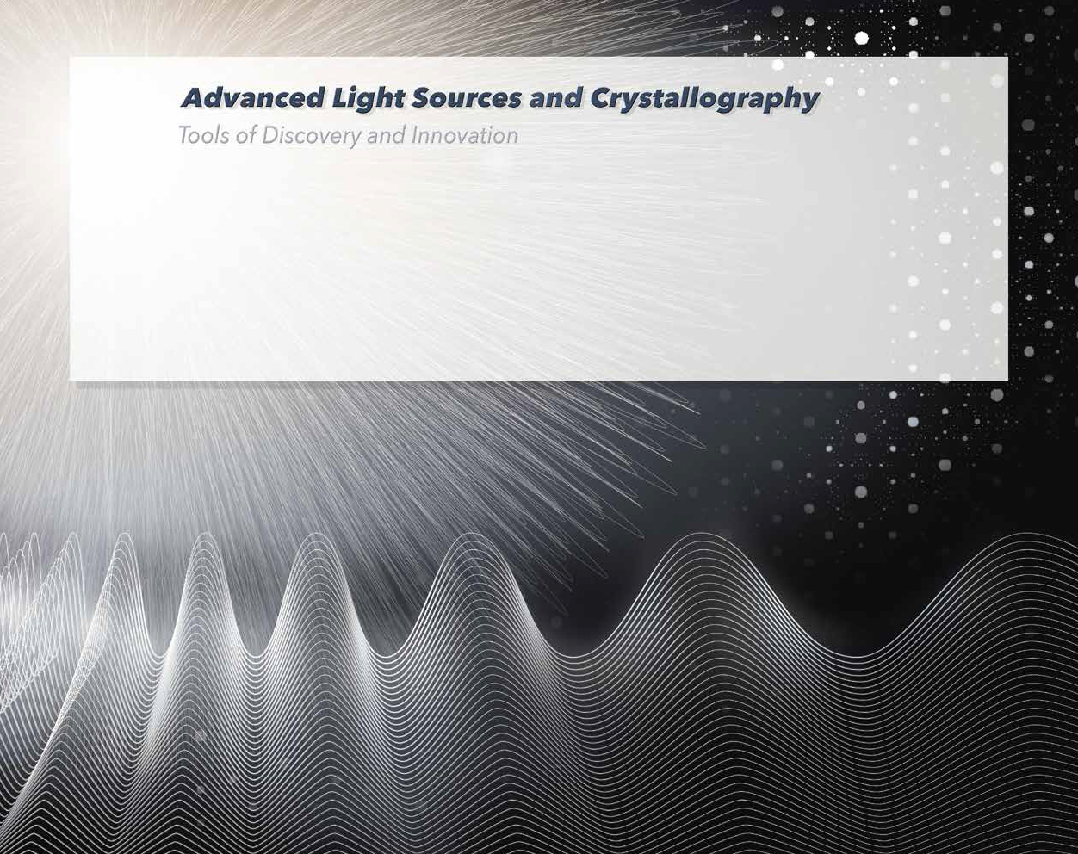






Published by LAAAMP, Lightsources for Africa, Asia, the Americas and Middle East Project,
an International Union of Pure and Applied Physics (IUPAP) and International Union of Crystallography (IUCr) project funded by the International Science Council (ISC)
To learn more about LAAAMP http://laaamp.iucr.org
The IAEA is the world’s centre
OPEN SESAME is supported
for cooperation in the nuclear field and seeks to promote the safe, secure and peaceful use
of nuclear technologies.
by the European Union’s H2020 Research and Innovation programme under Grant Agreement No. 730943
Editor: Ernest Malamud, Fermilab and University of Nevada, Reno
The Editor thanks the many individuals who have contributed to producing this brochure. A list of them is at http://laaamp.iucr.org/tasks/brochure
Design: Atelier Christian Millet, Paris
Initial printing: December 2017. Second printing: July 2018. Revised: March 2019.

Slide 37
Non-exhaustive (personal) overview
EPPSU 2020
Opens oportunities for synergies
European Inititatives
interdisciplinary projects, workshops, networks

Slide 38
Large Conferences
Many topics
particle – astroparticle - nuclear
Do we want to do more ?
Topical conferences/workshops ?
Global efforts
Very strong potential
(interdisciplinary scientific and political/advisory )
Needs to be explored further

Slide 39
Thanks for valuable input
Halina Abramowicz
Muhsin Harakeh
Lucilla Spini (ISC)
Michel Spiro
Jochen Wambach
… and many others

