Slide 1
Perspectives on the route to a multi-TeV muon collider

Slide 2
Contents
Ambition
Muon accelerators for particle physics
Muon collider
nuSTORM
To realise the ambition

Slide 3
Ambition
Perspectives on the route to a multi-TeV muon collider

Slide 4
Outstanding questions …
… for the accelerator-based programme:
  My take on part of P.Hernanez’ excellent introduction to ESPPU

Slide 5
The Higgs as window on new physics
m_{Higgs}= 125.09(24) GeV
  Standard Model: predictive & verified at this level of precision

Slide 6
The Higgs as window on new physics
SM within uncertainty
  Motivates Higgs factory to reduce substantially
    Statistical and systematic uncertainties

Slide 7
Neutrinos as window on origin of flavour
PMNS
Related to physics at very high energy scale
  Motivates high-precision neutrino programme
    Large event samples and low systematic uncertainties

Slide 8
Energy frontier to illuminate limit of SM
Measurement at highest possible energy
  Experimental motivation clear!
    Theorists motivated by ‘meta-stability’ of SM

Slide 9
And so, the ambition
Our ambition is to make measurements:
  Of the properties of the Higgs
    With the highest possible precision
  Of the properties of the neutrino
    With the highest possible precision
  Of the properties of matter
    At the highest possible energies
What is the role of muon beams?

Slide 10
Muon accelerators for Particle Physics
Perspectives on the route to a multi-TeV muon collider

Slide 11
Basis of potential
Muon mass:
  200 m_{e} ~ m_{μ} ~ 0.1 m_{p}
Muon decay:
  ν_{e}, ν_{μ}
  Precisely known energy spectrum
Energy frontier:
  No brem-/beam-sstrahlung
    Rate ∝ m⁻⁴
    [5 × 10⁻¹⁰ cf e]
  Enhanced coupling to Higgs
    Production rate ∝ m²
    [5 × 10⁴ cf e⁺e⁻]
  Efficient acceleration
    Favourable rigidity
Physics of flavour:
  Precision neutrino physics
  Sensitive cLFV searches

Slide 12
Line shape
Standard Model Higgs:
  M = 125 GeV;
  Γ=4.5 MeV
    Exquisite resolution
      R < 0.003%
“Two-state” Higgs:
  Deviation from SM line shape
  Resolve states
    Exquisite resolution!
M.Greco,T.Han,Z.Liu
B.Autin, A.Blondel, J.Ellis;
CERN 99-02, 1999

Slide 13
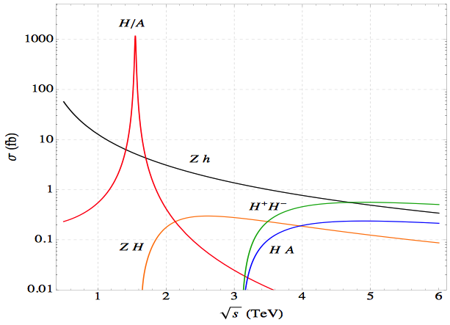
Couplings/branching ratios
Standard Model Higgs
  Accurate threshold measurement
  Exploiting accurate knowledge of (narrow) energy spectrum
Beyond SM Higgs
  Exploit narrow energy spectrum to search for :
    Narrow resonances
    Unexpected thresholds
M.Greco,T.Han,Z.Liu
m_{bb} > 100 GeV
arXiv:1306.2609

Slide 14
The Standard Model and beyond
Energy frontier: big advantage over pp because fundamental fermion
Future study of the Higgs:
  Line width; establish single resonance (?) in s-channel with μ⁺μ⁻
  Couplings; requires > 1 TeV for complete, precise study

Slide 15
Resurgence of interest: Pastrone Panel

Slide 17
Neutrino Factory: sensitivity & precision
Unique:
  Large, high-energy
  ν_{e} (ν_{e}) flux
    Muon-beam cooling
  Favourable rigidity:
    Optimise E for given L

Slide 18
Muon collider
Perspectives on the route to a multi-TeV muon collider

Slide 19
Collider Parameter Examples
From the MAP collaboration: Proton source

Slide 20
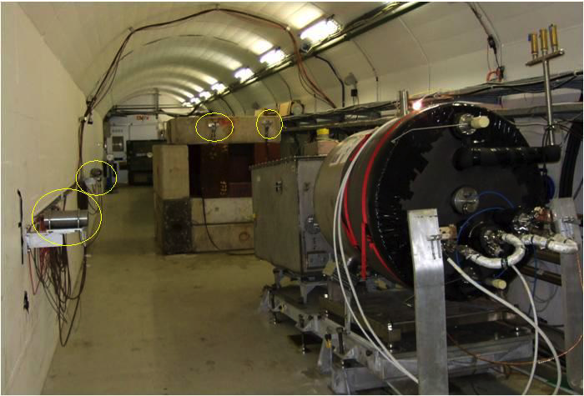

Source
The MERIT Experiment at the CERN PS
  Demonstrated a 20m/s liquid Hg jet injected
  into a 15 T solenoid and hit with a
  115 KJ/pulse beam!
  Jets could operate with beam powers up to
  8 MW with a repetition rate of 70 Hz
Hg jet in a 15 T solenoid: measured disruption length ~28 cm

Slide 21
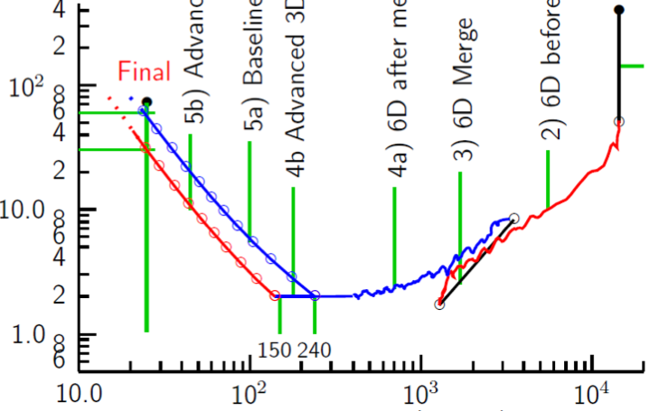
Cooling: the emittance path
Target
Y
Specification Achieved (simulations)
•
•
•
Front End
For acceleration to
multi-TeV collider
For acceleration to NuMAX (325MHz injector acceptance 3mm,24mm)
Phase
Rotator
Final
Exit Front End
(15mm,45mm)
Initial Cooling
Longitudinal Emittance (mm)
Initial
(X)
Initial
(Y)
Final
Cooling
post-merge 6D Cooling
pre-merge
6D Cooling (original design)
For acceleration
to Higgs Factory
HCC
Bunch
Merge
VCC &
Hybrid
Transverse Emittance (microns)

Slide 22
Muon Ionization Cooling Experiment

Slide 23

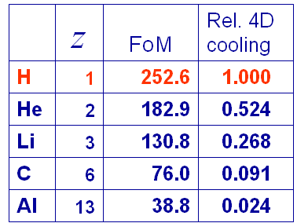
The principle of ionization cooling
Competition between:
  dE/dx [cooling]
  MCS [heating]
Optimum:
  Low Z, large X₀
  Tight focus
  H₂ gives best performance

Slide 24
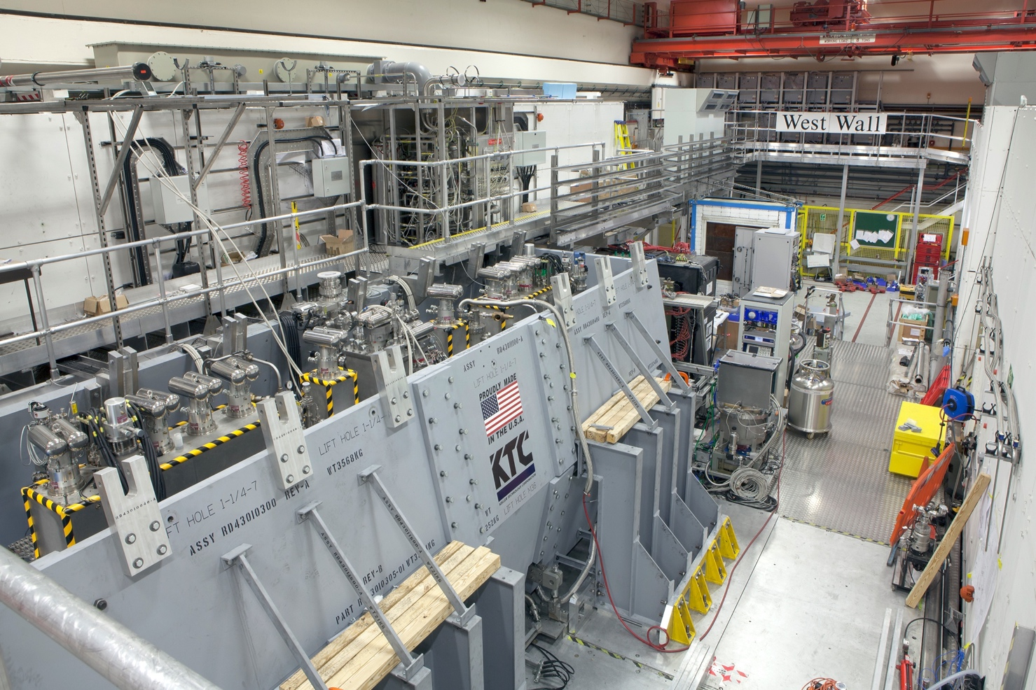
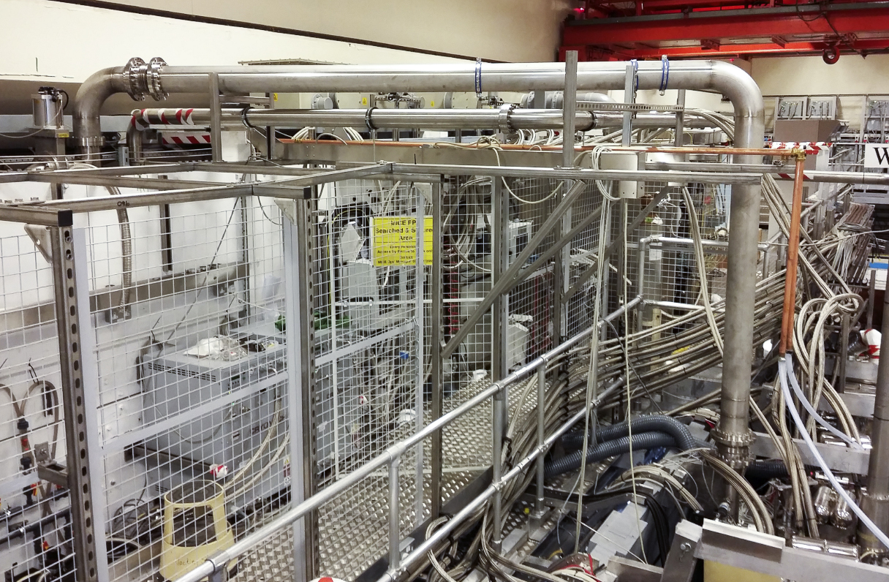

Slide 25
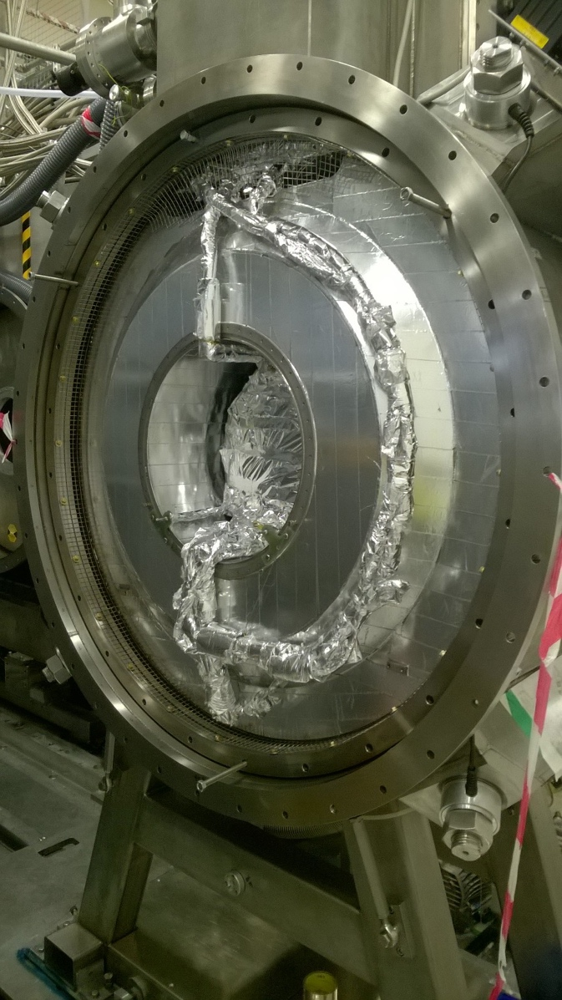
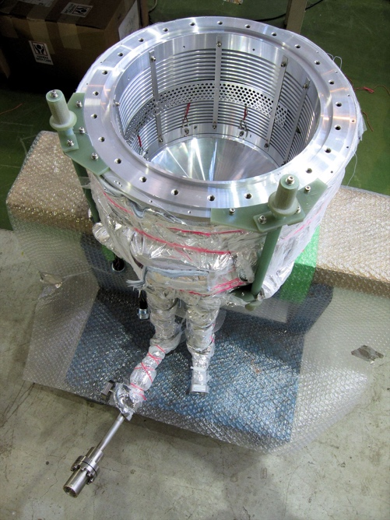
Liquid-hydrogen absorber
Online reconstruction:
Mean momentum lost by muons as they pass through the liquid-hydrogen absorber.
The data were recorded while the absorber was filling.

Slide 26
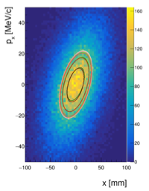
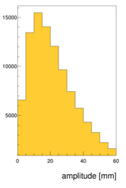
Emittance and amplitude
Emittance:
  Evaluated from RMS beam ellipse
Amplitude:
  Distance from core of beam
Mean amplitude ~ RMS emittance

Slide 27
Effect of lithium-hydride absorber
Upstream
Downstream
Simulation in good agreement with data
  Example:
    ε_{T} = 6 mm
    P = 140 MeV/c
    Notation: P-ε_{T} = 6-140
p_{x}
p_{x}
p_{y}
p_{y}

Slide 28
Core-density change across absorber
Core-density:
  Increases with LiH and LH2 absorbers
  Consistent with ‘no change’ for no absorber
Ionization-cooling signal
Preparing submission
to nature.
R_{amp} = ratio of cumulative density downstream to upstream

Slide 29
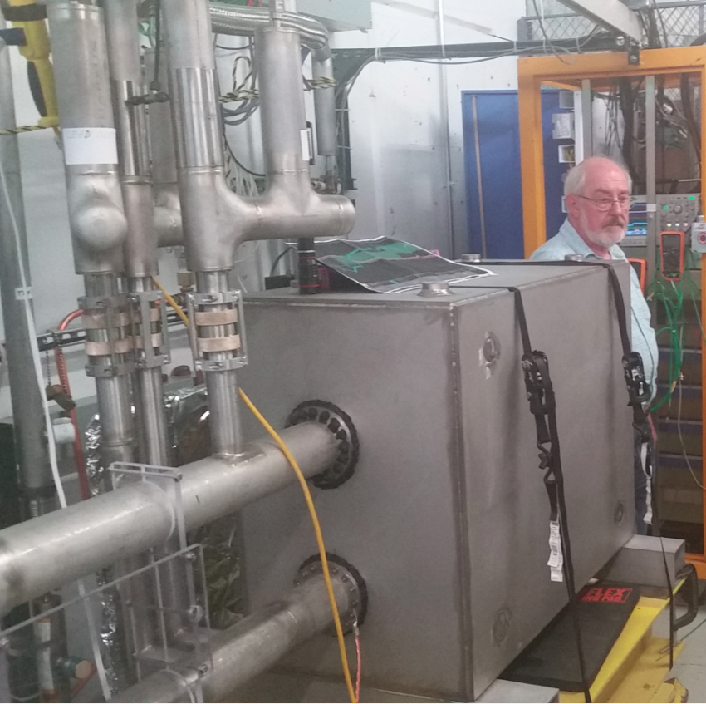
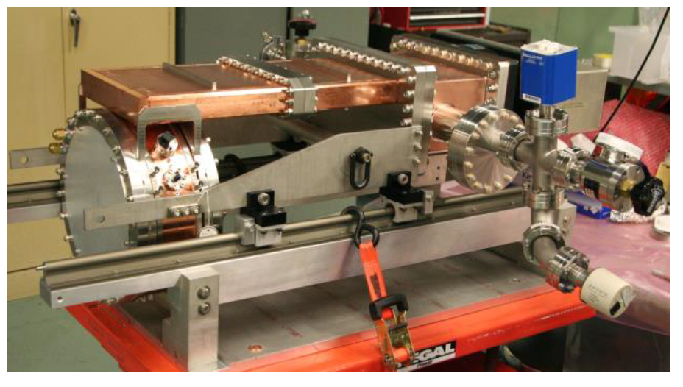
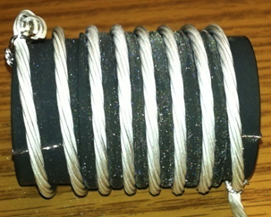
Other Tests
NHFML
32 T solenoid with low-temperature HTS
FNAL
Breakthrough in HTS cables
MuCool: >50MV/m in 5 T field
FNAL
12 T/s HTS
0.6 T max
Mark Palmer
6D Ionization Cooling Designs
  Designs in hand that meet performance targets in simulations with stochastic effects
  Ready to move to engineering design and prototyping
  Able to reach target performance with Nb₃Sn conductors (NO HTS)
RF operation in magnetic field (MTA program)
  Gas-filled cavity solution successful and performance extrapolates to the requirements of the NF and MC
  Vacuum cavity performance now consistent with models
  MICE Test Cavity significantly exceeds specified operating requirements in magnetic field
Final Cooling Designs
  Baseline design meets Higgs Factory specification and performs within factor of 2.2× of required transverse emittance for high energy MC (while keeping magnets within parameters to be demonstrated within the next year at NHMFL).
  Alternative options under study
29

Slide 30
Test Facility Example
Carlo Rubbia: The experimental realization of the presently described μ+μ- Ring Collider may
represent the most attractive addition of the future programs on the Standard Model to
further elucidate the physics of the Ho, requiring however a substantial amount of prior
R&D developments, which must be experimentally confirmed by the help of the Initial
Muon Cooling Experiment(al) program.
6D cooling experiment; example
Use 100 ns ESS pre-pulse with 3x10¹¹ protons
Yields 3x10⁷ μ⁻ and 6x10⁷ μ⁺ around 250 MeV

Slide 31
Potential Approaches
Various options considered:
Recirculating linacs
Fast acceleration but typically only a few passages through RF, hence high RF cost
FFAGs
Static magnets, but only limited increase in energy possible
Rapid cycling synchrotron (RCS)
Potentially larger acceleration range at affordable cost
Could use combination of static superconducting and ramping normal-conducting magnets
But have to deal with energy in fast pulsing magnets

Slide 32
Collider Ring
Strong focusing at IP to maximise luminosity
Becomes harder with increasing energy
High field dipoles to minimise collider ring size and maximise luminosity
Minimise distances with no bending
Proposal to combine last accelerator ring and collider ring (Neuffer/Shiltsev) might reduce cost but creates many specific challenges
Decaying muons impact accelerator components, detector and public
The latter becomes much worse with energy
Radiation to public in case LHC tunnel use
Might be best to use LHC tunnel to house muon accelerator and have dedicated new collider tunnel

Slide 33
The LEMMA Scheme
Muon beams produced with low emittance with positron beam
(40 nm vs. 25 μm in proton scheme)
  No cooling required, use lower muon current
Positron beam:
  45 GeV, 3x10¹¹ particles every 200 ns
  Passes through target and produces muon pairs
Muon bunches circulation O(2000) times muon accumulation (4.5x10⁷)
Every 0.5 ms, the muon bunches are extracted and accelerated

Slide 34
Key Issues
Small efficiency of converting positrons to muon pairs:
  Muon pair production small fraction of overall cross section (O(10-5))
  Most positrons lost with no muon produced
  Have to produce many positrons (difficult)
  O(100MW) synchrotron radiation
  High heat load and stress in target (also difficult)
The multiple scattering of the muons in the target:
  Theoretical best emittance of 600 nm (40nm assumed)
    Reduction of luminosity by factor 15
Small bunches to be accelerated and merged:
  No design for the merger yet
  Combination factor proportional to beam energy

Slide 35
Ongoing LEMMA Effort
Address issues identified:
  Large emittance from target
    Use sequence of thin targets
  Combining bunches at high energy
    Producing bunches in pulses fashion
  Positron ring challenge
    Larger ring
  Positron production
    Improved concepts
  Did not yet reach competitive performance
    Work is ongoing

Slide 36
nuSTORM
Perspectives on the route to a multi-TeV muon collider

Slide 37
Neutrinos from stored muons
Scientific objectives:
  %-level (ν_{e}N)cross sections
    Double differential
  Sterile neutrino search
    Beyond Fermilab SBN
  Muon-accelerator test-bed
    E.g. 6D cooling experiment
Precise neutrino flux:
  Normalisation: < 1%
  Energy (and flavour) precise
π ⇢ μ injection pass:
  “Flash” of muon neutrinos

Slide 38
Neutrino flux
10.1146/annurev-nucl-102014-021930
ν_{μ} flash:
  Pion: 6.3 × 10¹⁶ m⁻² at 50m
  Kaon: 3.8 × 10¹⁴ m⁻² at 50m
    Well separated from pion neutrinos
ν_{e} and ν_{μ} from muon decay:
  ~10 times as many ν_{e} as, e.g. J-PARC beam
  Flavour composition, energy spectrum
    Use for energy calibration

Slide 39
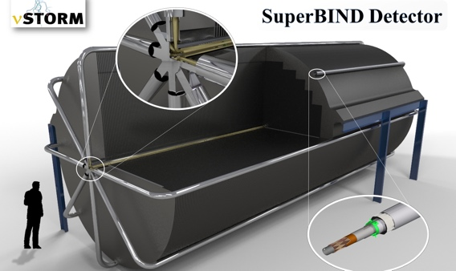
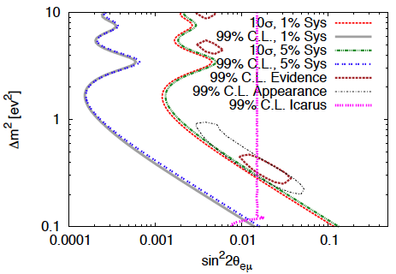
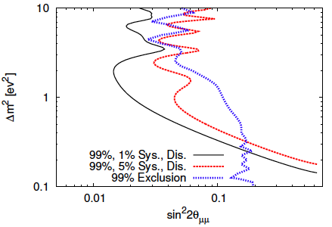
Sterile neutrino search @ FNAL
Adey et al., PRD 89 (2014) 071301

Slide 40
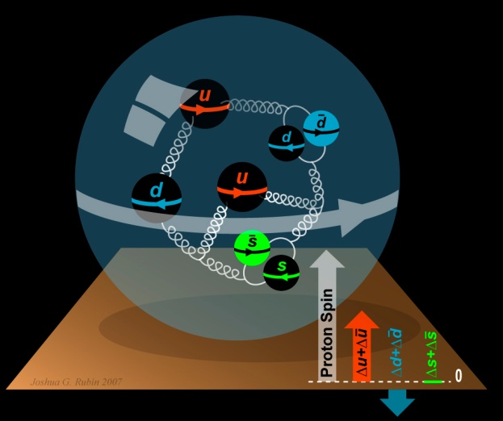
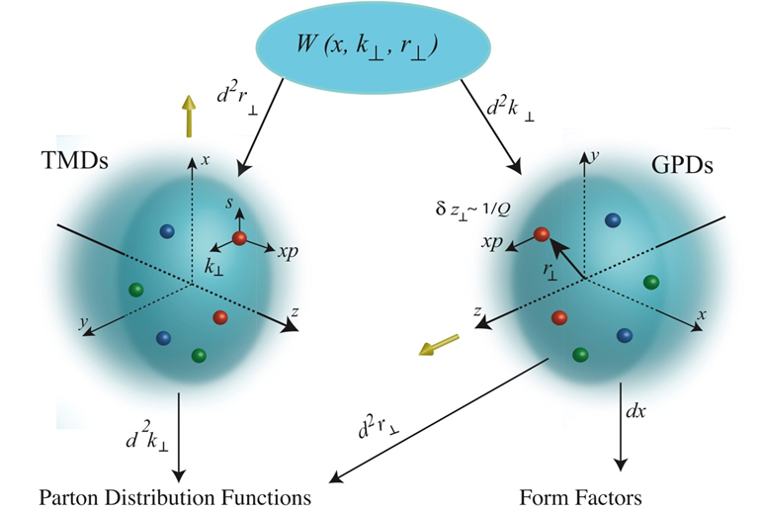
To understand the nucleon and the nucleus
Neutrino unique probe: weak and chiral:
  Sensitive to flavour/isospin and 100% polarised
How could neutrino scattering help?
  Development of understanding of nucleus/nucleon (e.g.):
    Multi-nucleon correlations
    Precise determination of:
      Model parameters or, better,
      Theoretical (ab initio) description
Precise νN scattering measurements to:
  Constrain models of nucleus/nucleon:
    Exploiting isospin dependence, chirality, …
Benefit of nuSTORM:
  Precise flux and energy distribution

Slide 41
Search for CPiV in lbl oscillations
Seek to measure asymmetry:
  P(ν_{μ} ➤ ν_{e}) – P(ν_{μ} ➤ ν_{e})
Event rates convolution of:
  Flux, cross sections, detector mass, efficiency, E-scale
    Measurements at %-level required
  Theoretical description:
    Initial state momentum, nuclear excitations, final-state effects
Lack of knowledge of cross-sections leads to:
  Systematic uncertainties; and
  Biases; pernicious if ν and ν differ

Slide 42
Systematic uncertainty and/or bias
Phys.Rev. D89 (2014) no.7, 073015; Coloma et al
Event mis-classification
Phys.Rev. D92 (2015) no.9, 091301; Ankowski et al
Energy scale mis-calibration
Uncertainty
(cross section
and ratio)
Missing energy (neutrons)

Slide 43
Specification: energy range
Guidance from:
  Models:
    Region of overlap
    0.5—8 GeV
  DUNE/Hyper-K far detector spectra:
    0.3—6 GeV
Cross sections depend on:
  Q² and W:
    Assume (or specify) a detector capable of:
      Measuring exclusive final states
      Reconstructing Q² and W
    → E_{μ} < 6 GeV
So, stored muon energy range:
DUNE
Hyper-K
1 < E_{μ} < 6 GeV

Slide 44
nuSTORM for νN scattering @ CERN — parameters
New specification!
  Design update:
    1 < E_{μ} < 6 GeV
  Challenge for accelerator design!
  Benefit:
    Calibration via energy spectrum
    Statistical ‘mono-energetic beam’
SPS requirements table

Slide 45
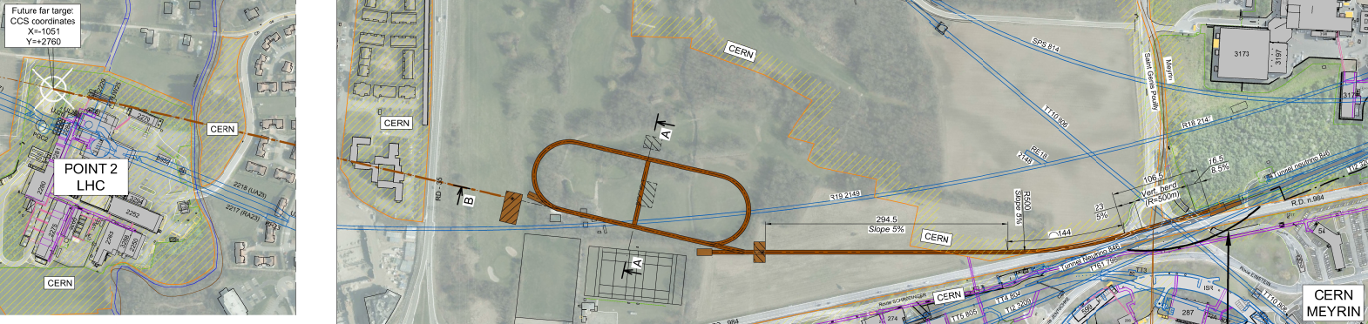
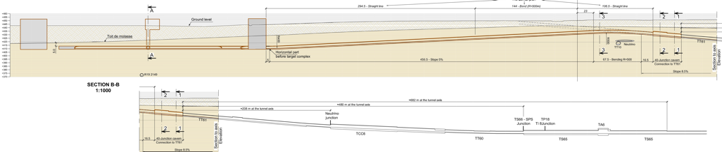
Overview
Extraction from SPS through existing tunnel
Siting of storage ring:
  Allows measurements to be made ‘on or off axis’
  Preserves sterile-neutrino search option

Slide 46
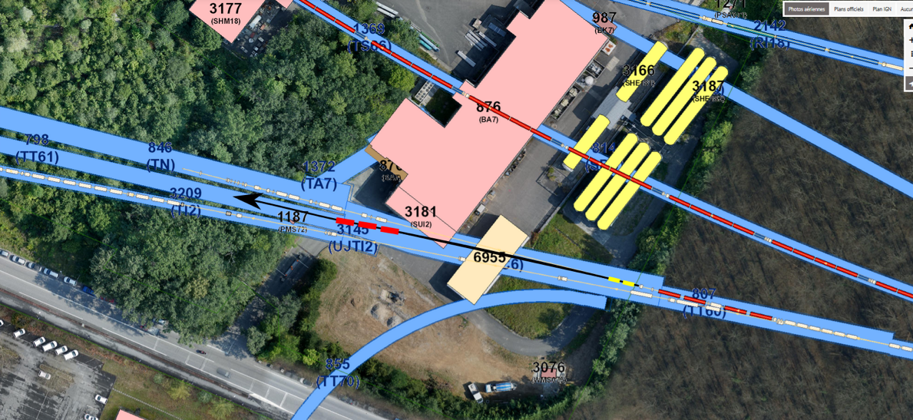
Extraction and p-beam transport to target
Fast extraction at 100 GeV:
  CNGS-like scheme adopted;
    Apertures defined by horizontal and vertical septa reasonable
    Pulse structure (2 x 10.5 ms pulses) requires kicker upgrade
Beam transport to target:
  Extraction into TT60:
    Branch from HiRadMat
    beam line at 230 m (TT61)
  Require to match elevation
  and slope
  New tunnel at junction
  cavern after 290 m
  585 m transport to target

Slide 47
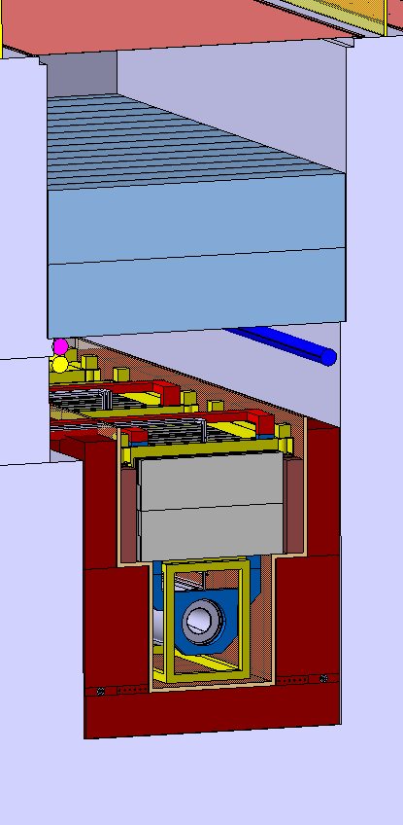
Target and capture
FNAL scheme adopted:
  Low-Z target in magnetic horn
  Pair of quadrupoles collect particles horn focused
  Target and initial focusing contained in inert helium atmosphere
Graphite target, based on CNGS experience:
  Radiation-cooled graphite target embedded in water-cooled vessel
Containment and transport of pion beam with a 10% momentum spread:
  Base on scheme used successfully for AD in PS complex
Target complex design:
  Exploit extensive work done for CENF

Slide 48
Storage ring
New design for decay ring:
  Central momentum between 1 GeV/c and 6 GeV/c;
  Momentum acceptance of up to ±16%
Hybrid FODO/FFA concept developed:
  Maintain large momentum and transverse dynamic acceptance simultaneously
  FODO optics used in the production straight
  Zero-chromaticity FFA cells used in arcs and return straight
Hybrid ring properties:
  Zero dispersion in the quadrupole injection/production straight; and
  Zero chromaticity in the arcs and return straight
    Limits overall chromaticity of ring.
Magnets:
  Superconducting combined-function magnets (B up to 2.6 T) in arcs
  Warm combined-function magnets used in return straight
  Large-aperture warm quadrupoles used in production straight
  Mean betatron functions in production and return straights large:
    Minimise betatron oscillations to minimise spread of the neutrino beam

Slide 49
nuSTORM feasibility
Goal of PBC nuSTORM study:
  “A credible proposal for siting at CERN …”
achieved.
Challenges:
  Muon decay ring:
    FFA concept though feasible
    Require magnet development to allow production at a reasonable cost
  Detailed evaluation of:
    Proton-beam extraction, target and target complex
    Civil engineering studies and radiological implications
“ … the SPS can provide the beam and offers a credible fast extraction location allowing the beam to be
directed towards a green field site at a suitable distance from existing infrastructure. Initial civil engineering
sketches have established a potential footprint and the geology is amenable to an installation at an
appropriate depth.”

Slide 50
To realise the ambition
Perspectives on the route to a multi-TeV muon collider

Slide 51

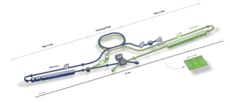

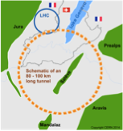
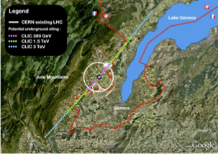

Options

Slide 52
Timescales are long

Slide 53
Muon collider

Slide 54
Neutrinos

Slide 55
Conclusions
Muon accelerators have the potential to:
  Contribute to the study of the Higgs boson
  Deliver multi-TeV lepton-antilepton collisions
    Bringing forward the exploration of the very highest energies
  Revolutionise the study of the neutrino
Energy-frontier R&D programme should therefore:
  Include muon collider R&D:
    A new test facility is an essential part of this effort
      Synergy with front-rank particle-physics should be exploited
nuSTORM:
  A front-rank neutrino facility based on stored muon beams
  A demonstrator for muon beams for particle physics
  Capable of serving the 6D-cooling demonstration crucial for muon collider

