Slide 1


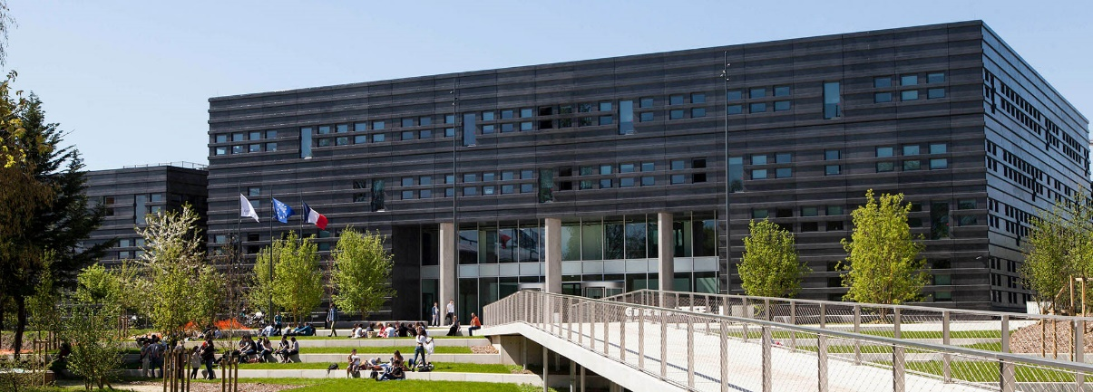





AMICI WP5 INDUSTRIALIZATION
Saclay Centrale Supélec
Oct 9th 2019
P.Fabbricatore as WP5 coordinator

Slide 2
Objectives of AMICI WP5- Industrialization:
Industry for Research’s benefit
The purpose of Work Package 5 ‘Industrialization’ is to propose actions and methods that would benefit to the industrialization of the construction of future European Research Infrastructures (RI), based on Accelerators and Superconducting Magnets. This benefit should be evaluated from the cost, schedule and performance of the products, processes and services provided by Industry.

Slide 3
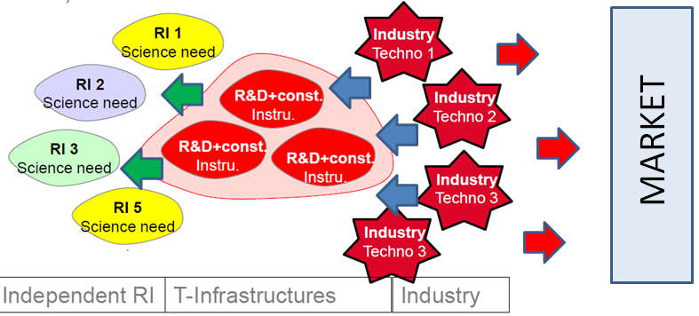
The integrated Technological Infrastructure scheme as envisaged by AMICI at the starting point of the project

Slide 4
The structure of AMICI as developed
  In the AMICI model, the partnership with industry is considered a fundamental element of the AMICI integrated Technological Infrastructure, with a double link: through an Industry Advisory Group and an Industrial Liason Group

Slide 5
The WP5.4 Tasks
T5.1 Professional training and apprenticeship
Task Leader: C. Madec / O.Napoly (CEA)
T5.2 Harmonization- Material and Component References
Task Leader: M.Fouaidy (CNRS)
T5.3 Harmonization - Cryogenic Safety Procedures
Task Leader: S.Grohman (KIT)
T5.4 Requirements and conditions for developing prototypes with the industry
Task Leader: M.Michelato, F. Broggi (INFN)

Slide 6
The today report
For any task I will report on:
1) Recall of the objectives of the task
2) Results of the work performed
3) Perspectives for future activities

Slide 7
The WP5.4 Tasks
T5.1 Professional training and apprenticeship
Task Leader: C. Madec / O.Napoly (CEA)
T5.2 Harmonization- Material and Component References
Task Leader: M.Fouaidy (CNRS)
T5.3 Harmonization - Cryogenic Safety Procedures
Task Leader: S.Grohman (KIT)
T5.4 Requirements and conditions for developing prototypes with the industry
Task Leader: M.Michelato, F. Broggi (INFN)

Slide 8
T5.1 Professional training and apprenticeship
Task Leader: C. Madec /O.Napoly
Participants: CEA, DESY, INFN, STFC
Results in Deliverables D5.2 and D5.4
This task aims at promoting professional skills training and cross improvement between TI and industry. Both training opportunities in TI and in industry have been considered, with the aim to enforce a powerful support mechanism for effective knowledge and technology transfer between TI and Industry:
Training and apprenticeship in TI. It aims at defining the conditions and setting the basis for an apprenticeship pilot program dedicated to train technicians and engineers from industry in hands-on fabrication, assembly or test of accelerator and magnet.
Training and apprenticeship in Industry. This part is mainly dedicated to understand the opportunities and the conditions for secondments of young researchers of TI in industry.

Slide 9
Training and apprenticeship in TI
Supply Chain
Training in TI is needed to bring the supply chain to the challenging performance requirements set by the laboratories in charge of the RI project realization
Sustaining pre-existing know-how in industry entails System-Engineering and Quality-Assurance methodology enforced at the interface between Industry and TI.

Slide 10
Training and apprenticeship in TI
Advantages
Training in the Technology Infrastructure facilities has benefits :
To provide hands-on training to young engineers and technicians from industry, with the possibility of extended interactions within the TI laboratories.
To establish a network between TI and technical universities and technology institutes by hosting apprenticeship programs mostly directed towards the education of highly qualified technicians, with the possibility of exchanges with the TI laboratories.
To disseminate the use of high standards to be followed for the demanding technologies that are emerging.

Slide 11
Training and apprenticeship in TI
Harmonizing System Engineering and QA practices
Sustaining pre-existing expertise and avoiding a loss of know-how in industry over the duration of the RI construction entails System-Engineering (SE) and Quality-Assurance (QA) methodology enforced at the interface between Industry and TI.
Project Management Plan
Production Management Plan (PMP)
ESH Management Plan (ESH)
Systems Engineering Management Plan (SEMP)
Quality Assurance Plan (QAP)
Interface management plan
Configuration management plan
Technical Review plan
Non-conformance management plan
Risk management plan
Sub-contracting plan
Documentation management and control procedure
The common efforts of the industry manufacturers and the technological facilities to follow-up the production should be organized and managed in a contractual framework described by the SE and QA plans

Slide 12
Training and apprenticeship in TI
What to do in future
• Establish apprenticeship programs with Technical Universities and Institutes for high qualification technicians.
• Support common programs and exchanges for apprentices among the TI.
• Propose to industry a continuously updated catalog of information and training sessions to key technologies reaching high TRL soon to be industrialized.
• Include that catalog in the industry-oriented existing public funding schemes, and propose the principle of a training certificate.
For standard competences (e.g. magnetic measurement, vacuum technology, RF technology), training and apprenticeship is already available in the public and private sectors, and no action is required from the TI.

Slide 13
Training and apprenticeship in TI
What to do in future for SE and QA
Although not attractive to scientists, these management methods are now of general use and are inevitable to tackle the extreme systems complexity of Research Infrastructure construction projects. With the aim to uniformize these methods:
• An effort to harmonize the architecture and content of the ‘Systems Engineering Management plan’ and ‘Quality Assurance plan’, for the AMICI institutes both to manage their industrial production contracts and to manage their future RI (in-kind) contributions,
• Educate TI experts (scientists, engineers and technicians) with respect to Systems Engineering and Quality Assurance.

Slide 14
T5.1 Professional training and apprenticeship
Task Leader: C. Madec /O.Napoly
Participants: CEA, DESY, INFN, STFC
Results in Deliverables D5.2 and D5.4
This task aims at promoting professional skills training and cross improvement between TI and industry. Both training opportunities in TI and in industry have been considered, with the aim to enforce a powerful support mechanism for effective knowledge and technology transfer between TI and Industry:
Training and apprenticeship in TI. It aims at defining the conditions and setting the basis for an apprenticeship pilot program dedicated to train technicians and engineers from industry in hands-on fabrication, assembly or test of accelerator and magnet.
Training and apprenticeship in Industry. This part is mainly dedicated to understand the opportunities and the conditions for secondments of young researchers of TI in industry.

Slide 15
Training and apprenticeship in Industry
Secondments of TI personnel in industry appears a powerful tool for facilitating knowledge transfer between industry and TI and enabling the TI personnel to gain direct knowledge of current industry practices, with many positive aspects
However, this practice is not common among the AMICI partners. AMICI should encourage this practice through a definition of general protocol to start secondments on specific programs of general interest for accelerator and superconducting magnets
There are positive examples in Academia which can be followed.

Slide 16
Training and apprenticeship in Industry (issues)
Possible issues for industry are related to the IP management and to the disclosure of patented or reserved industrial methods or, more in general, knowledge. These aspects should be analysed case by case and specific non-disclosure agreements shall be done
For TI staff a possible issue of long secondments in industry is related to the role and the career of the seconded personnel once back to the home institutions. For avoiding possible problems of this kind, the TIs should be encouraged specifying clear rules supporting the seconded personnel.

Slide 17
The WP5.4 Tasks
T5.1 Professional training and apprenticeship
Task Leader: C. Madec / O.Napoly (CEA)
T5.2 Harmonization- Material and Component References
Task Leader: M.Fouaidy (CNRS)
T5.3 Harmonization - Cryogenic Safety Procedures
Task Leader: S.Grohman (KIT)
T5.4 Requirements and conditions for developing prototypes with the industry
Task Leader: M.Michelato, F. Broggi (INFN)

Slide 18
T5.2 Harmonization- Material and Component References
Task Leader: M.Fouaidy
Participants: CNRS, CEA, DESY, IFJ PAN
Results in Deliverable D5.1
One of the action for creating the AMICI ecosystem consists in establishing common knowledges about material and components properties and common standards. The use of design methods and tools common to all integrated TFs allows the industries to face innovative contracts with the same approach and uniformly accepted level of information.

Slide 19
Harmonization- Material and Component References
Main objective:
Create a common reference database dedicated to
Materials and components for accelerators
Large SC magnets.
Start to fill it with relevant data
Three steps approach
Collect an initial set of basic data relevant to Material and Components specifications.
Provide a possible structure for the database
Develop and implement a professional database (next phase of AMICI)

Slide 20
Motivations of a db for Accelerators and large SC magnets
Cost, performances and reliability of accelerators and large SC magnets are determined by: design/engineering and material and/or component choice and specifications.
Material Data and properties of components not easy to find in literature.
Lack of data on materials/ components suited for use accelerator extreme environment (e.g. radiation, cryogenic temperature…).
Easy access common database, with validated material properties, and shared between academia institutions and European industry would improve efficient development/construction of future large scale international projects.
Such database does not exist: its development is an added value for Europe.
NIST-USA database is no more maintained.

Slide 21
Step to step approach to the AMICI Data Base
Creation of a working group - 16 meetings
Concept of database structure
Definition of how to proceed through examples
Survey of existing databases and useful sources of data
Review of databases proposed by other EC projects
Definition of the type of data and/or information to be included in the database
Exhaustive list of sources of data
Development and implementation AMICI database demonstrator
Collect initial data on material
Database proposal

Slide 22
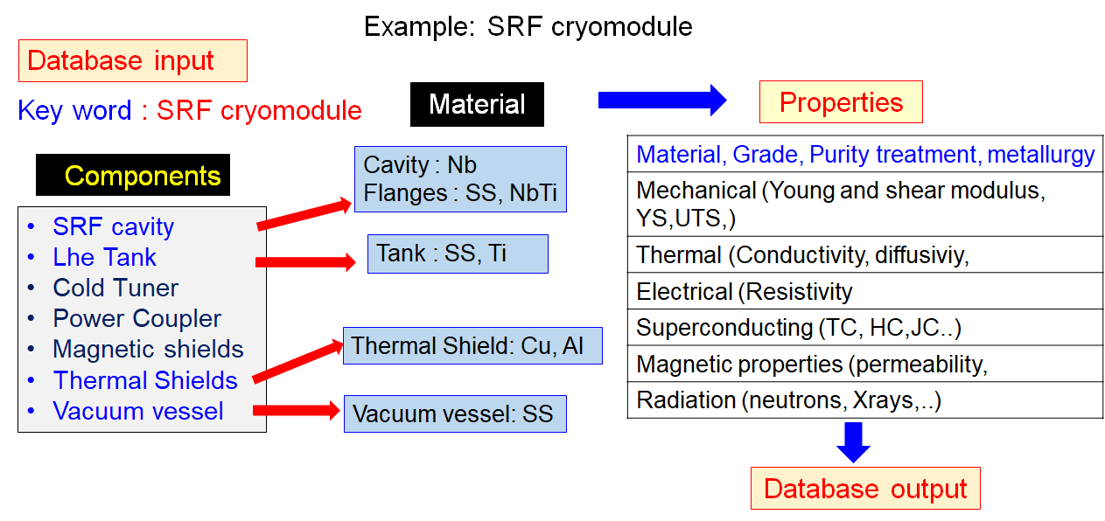
Operating way of the AMICI Data Base

Slide 23
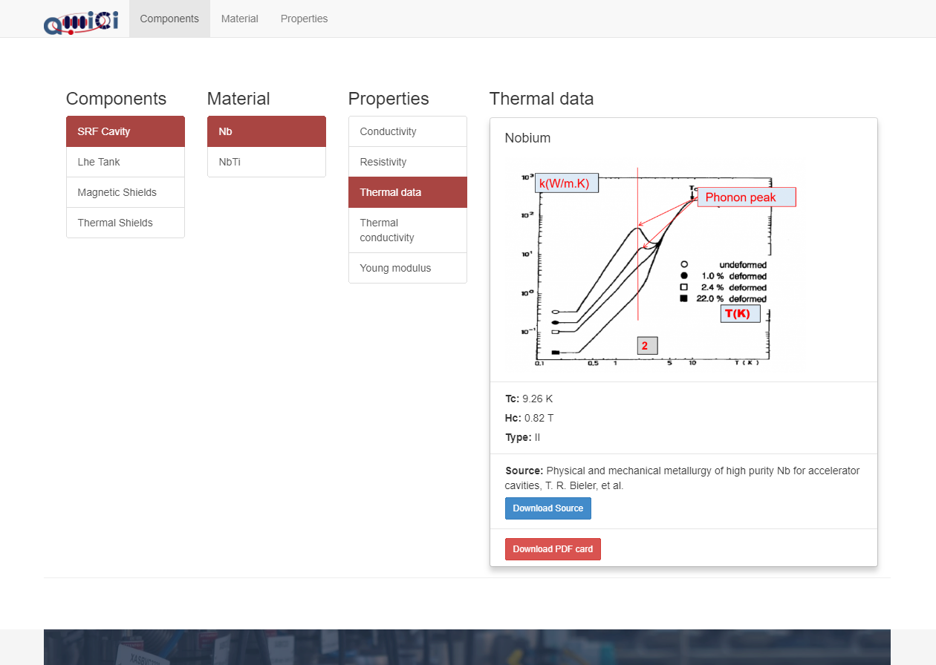
A demonstrator has been developed
Implemented (web application)
https://amici.space/ user: amici pwd: Eegheur5
Example: SRF Niobium (Nb) Accelerating Cavity
effect of plastic deformation on the thermal conductivity of Nb
Strong impact on cavity performance

Slide 24
The WP5.4 Tasks
T5.1 Professional training and apprenticeship
Task Leader: C. Madec / O.Napoly (CEA)
T5.2 Harmonization- Material and Component References
Task Leader: M.Fouaidy (CNRS)
T5.3 Harmonization - Cryogenic Safety Procedures
Task Leader: S.Grohman (KIT)
T5.4 Requirements and conditions for developing prototypes with the industry
Task Leader: M.Michelato, F. Broggi (INFN)

Slide 25
T5.3 Harmonization - Cryogenic Safety Procedures
Task Leader: S.Grohman
Participants: KIT, CEA, CERN
Results in Deliverable D5.3
The second action in the framework of the harmonization has been the standardization of one of the most peculiar aspects of the AMICI field of interest: Cryogenics. A new European Standard “Helium cryostats -- Protection against excessive pressure” has been developed and will be applicable to superconducting magnet cryostats and cryostats for superconducting radio-frequency cavities, to cold-boxes of helium refrigerators and liquefiers, to ultra-low temperature refrigerator systems using 3He and 3He/4He mixtures as well as to helium distribution systems including valve boxes.

Slide 26
Motivations of T5.3

Slide 27
Challenges and organization of work
CEN is the European Committee for Standardization,

Slide 28
Activities performed within T5.3

Slide 29
The organization of CEN/TC 268/WG6

Slide 30
Status of T5.3
Harmonised Standards (HAS) consultants. The HAS consultants’ role is to assess whether the standards drafted by CEN, CENELEC, ETSI comply with the European Commission requests as outlined in the relevant standardisation mandates.

Slide 31
The WP5.4 Tasks
T5.1 Professional training and apprenticeship
Task Leader: C. Madec / O.Napoly (CEA)
T5.2 Harmonization- Material and Component References
Task Leader: M.Fouaidy (CNRS)
T5.3 Harmonization - Cryogenic Safety Procedures
Task Leader: S.Grohman (KIT)
T5.4 Requirements and conditions for developing prototypes with the industry
Task Leader: M.Michelato, F. Broggi (INFN)

Slide 32
T5.4 Requirements and conditions for developing prototypes with the industry
Task Leader: M.Michelato and F.Broggi
Participants: INFN
Results in Deliverable D5.5
The aim of task WP5.4 is the definition, in cooperation with interested companies, of the basic requirements and conditions that can make attractive, feasible and effective to engage companies in developing prototypes of accelerator components (or significant accelerator parts) or large superconducting magnets.
Significant activities on:
Understanding the legal frameworks in EU for innovative projects
The modalities for co-joint developments of models and prototypes
The Intellectual Property

Slide 33
Definitions
Model: A device based on first development of conceptual ideas with a scaled (and many times progressive) approach. Usually tooling is not (fully) available yet. Many models could be necessary before moving to the next step of prototyping. In terms of Technology Readness Level a model stays in the range TRL4-TRL5.
Prototype: An almost mature component, for final assessing and training of tools and manufacturing methods . In principle it could be used in an accelerator. Also in this case more than one prototype could be required before moving to the following step of component production. A prototype can range between TRL6 and TRL8.
Mass Production: Mature components. No more changes applied wrt the last prototype (TRL9)
Industry involvement

Slide 34
The legal frameworks in EU for innovative projects
A Guidance on Innovation Procurement has been issued by the European Commission in May 2018 with the possible administrative public procedures for innovation. We have checked that the identified procedures have been already integrated into the national laws for public contracts:
• Pre-commercial procurement (PCP)
• Innovation Partnership
• Competitive procedure with negotiation
• Competitive dialogue
In an R&D phase the first two procedures looks applicable. In the next two slides these legal procedures will be briefly reviewed with reference to the AMICI fields of interest. As general remark for all procedures: in all cases a public selection of the company/ies shall be done

Slide 35
Pre-commercial procurement (PCP)
Pre-Commercial Procurement (PCP) is the procurement of research and development of new innovative solutions before they are commercially available. PCP involves different suppliers competing through different phases of development. The risks and benefits are shared between the procurers and the suppliers under market conditions.
The spirit of the PCP scheme is to fund companies to perform R&D in a competitive environment. The business case is to engage small/medium industries to work on edge technologies, even if no large market volumes are expected.

Slide 36

An example of PCP: QUACO
A positive Pre-Commercial Procurement (PCP) initiative was funded by EU under the name QUACO (H2020 PCP). The project run in collaborative effort among four partners (two from AMICI): CERN, CEA, CIEMAT, NBCJ coordinated by CERN, around the development of the Q4-MQYY full scale quadrupole magnet prototypes for HL LHC project.
A possible drawback of PCP is related to the IP for the following (construction) phases: Only the involved companies have the needed knowledge and detect part of IP, so holding an advantage wrt possible competitors.

Slide 37
Innovation Partnership
Unlike in the case of Pre-Commercial Procurement, the Innovation Partnership is regarding the development of solutions with a reasonable marketing perspective.
The Partnership for Innovation combines the R&D phase of the PCP and the purchase phase of the developed product in one tender procedure and may involve the involvement of one or more operators in every phase
This procedure looks to be well suitable for developing prototypes for accelerators or superconducting magnets having as following step the mass production. The lock-in* issue is intrinsically excluded by the nature of the procedure based on the choice of the best potential users since the R&D phase.
* The lock-in is a situation in which a customer using a product or service cannot easily transition to a competitor’s product or service.

Slide 38
Developing prototypes with AMICI model
The involvement of the industry in the prototyping shall be done if possible at an early stage of the design unless the component to be developed is highly challenging and not well defined yet.
The role of the industry should not simply cover manufacturing aspects but also design aspects in collaboration with TI. This is important to allow industry set the basis for future products beyond the scopes of the specific prototyping activities.
The industry asks to be timely informed about the need for a prototype development

Slide 39
The subdiary principle
In the WP5 working groups discussion a principle emerged proposed by industry: if industry is interested and has the technical capacity for developing a prototype, this should be favored. TI should be involved only if industry is not able to do it.
From TI point of view, only once the object characteristics have been defined and a preliminary concept developed (Late model or prototype stages), the Industry can be suitably involved. In case of less innovative objects, industry can be involved in an earlier stage and the subsidiary principle be applied.

Slide 40
The Intellectual Property (in general)
IP in Academia. Academia’s requirements for IP generated in a project are primarily to publish results of research and show the impact of the establishment’s research in tangible terms; this can be through licensing IP for royalty income or sale of know-how through consultancy.
IP in Industry. The organisational goals will be to gain a competitive edge from future new products and processes.
IP in R.I. or T.I. A government funded laboratory’s IP requirement for IP generated in a project is generally a hybrid of industry and academia; primarily it requires its IP in order to efficiently operate the laboratories through publication or patenting. Another strategic goal of R.I.s is to transfer their IP to industrial partners for industrial application outside their research field through licensing or selling IP that is not critical

Slide 41

The management of IP in AMICI
All the TIs of AMICI are extremely open to cooperate with industries and negotiate appropriate agreements on a case by case basis with a pragmatic approach
Background knowledge
Each party keeps the ownership of IPR related to pre-existing knowledge/ patents
Foreground knowledge
There are alternative provisions:
In case of collaborative research IPR may be jointly owned; shares are based on the importance of respective contributions
In case of research contract IPR may be jointly owned or exclusively owned by the customer (if so, contract value increases)

Slide 42
Conclusions for the whole WP5
Cooperation with Industry in R&D for accelerators and superconducting magnets is fundamental, specially in the developments of models and prototypes.
AMICI is setting up a model of cooperation for engaging industry in the low TRL phases of development still preserving the ownership by the Technological Facilities of the developed technologies
Activities are already ongoing for constructing a common background TI–Industry of knowledges, quality and standards
The role of the trainings TI←→ Industry is considered among the crucial points and its enforcement will be one of the next actions of the AMICY community

Slide 43
Thank you for your attention

