Slide 1
Generative models uncertainty estimation
Lucio Anderlini¹, Constantine Chimpoesh², Nikita Kazeev^{2,3}, Agata Shishigina²
on behalf of LHCb Simulation Project
¹Universita e INFN, Firenze
²HSE University
³National University of Singapore, Institute for Functional Intelligent Materials (I-FIM)

Slide 2
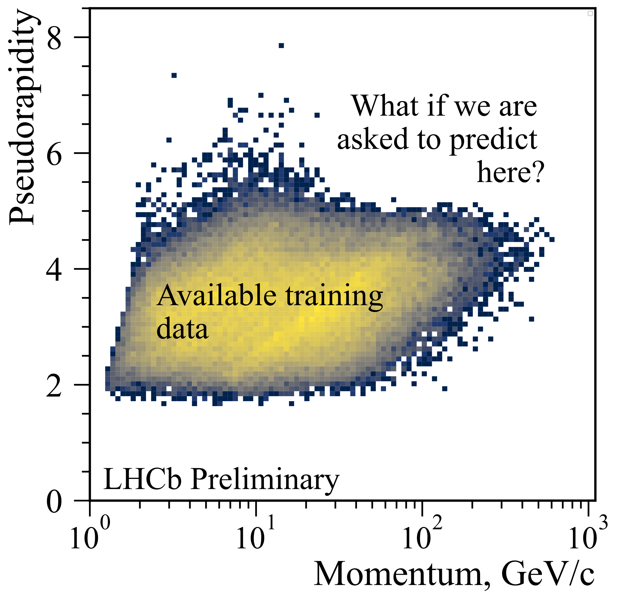
[Physics intro] Generative models are used for fast detector simulation and they are not perfect
Training on MC → max quality is same as MC, needs a lot of CPU
Training on calibration samples → bias from calibration data selection, parametrisation, limited coverage
On any data, an ML model is just a heuristic fit
The question we answer:
For a given input, is the model usable?
Generative models uncertainty estimation, ACAT-2021

Slide 3
ML intro
Uncertainty for Conditional GANs
Same goal as for classification & regression, but more complex
Model quality can only be measured on samples
And even then, comparing two multidimensional distributions is difficult
Formalism: uncertainty of a regression is a generative model (pdf), uncertainty of a generative model is a distribution in the function space

Slide 4
Plan
Model problem (LHCb RICH)
Methods of uncertainty estimation
Ensemble Distillation
Results

Slide 5
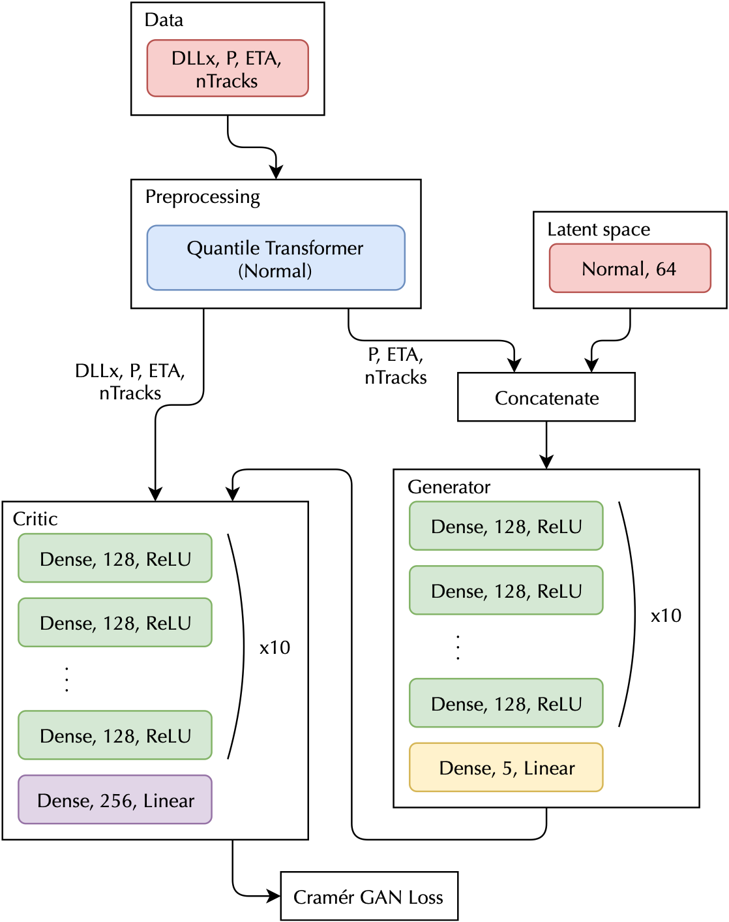
LHCb RICH GAN
Input: $X⊂ℝ^{3}$
Momentum P
Pseudorapidity ETA
Number of tracks nTracks
Output: ​Y $⊂ℝ^{5}$
Particle type hypotheses delta log-likelihoods RichDLLx
For track $i$, $x∈\left\{K,μ,e,p,below threshold\right\}$ $$RichDLL=\log{ℒ\left(type of i is x\right)} −\log{ℒ(type of i is π)}$$
Fast Data-Driven Simulation of Cherenkov Detectors Using Generative Adversarial Networks

Slide 6
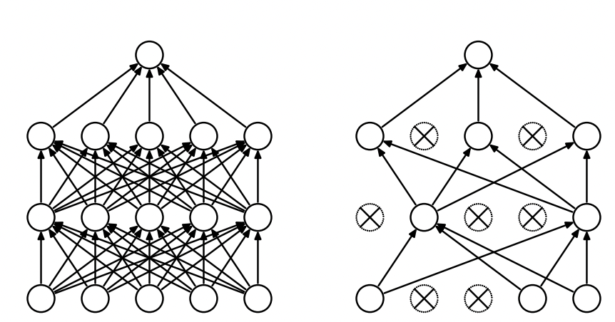
Recap: MC Dropout
Dropout: Randomly drops units (along with their connections) from the neural network during training
MC Dropout: dropout is applied both during training and inference
Standard Neural Net
After applying dropout
Dropout: A Simple Way to Prevent Neural Networks from Overfitting

Slide 7
[Our] Adversarial deep ensembles
Cramér GAN generator loss modification:
$$f\left(y\right)={\left\|D\left(y\right)−D(y_{g}^{′})\right\|}_{2}−{\left\|D\left(y\right)\right\|}_{2}$$
$$L_{G}=f\left(y_{r}\right)−f\left(y_{g}\right)−α{\left\|D\left(y_{g}\right)−D(y_{∪_{g}})\right\|}_{2}$$
$y_{∪_{g}}$is a concatenation of the predictions of the ensemble, corresponding to a model with averaged probability density
Rewards the model for being different from the ensemble average

Slide 8
[Our] Adversarial deep ensembles
$$L_{G}=f\left(y_{r}\right)−f\left(y_{g}\right)−α{\left\|D\left(y_{g}\right)−D(y_{∪_{g}})\right\|}_{2}$$
train Cramér GANs with the classic loss ($α=0$)
train Cramér GANs with the classic loss (𝛼=0)
- retain the critics weights
- reinitialize the generators with random weights
- set $α>0$
- retain the critics weights
- reinitialize the generators with random weights
- set 𝛼>0
- train both the generators and the critics with our loss
- decrease 𝛼 according to a schedule
Training schedule

Slide 9
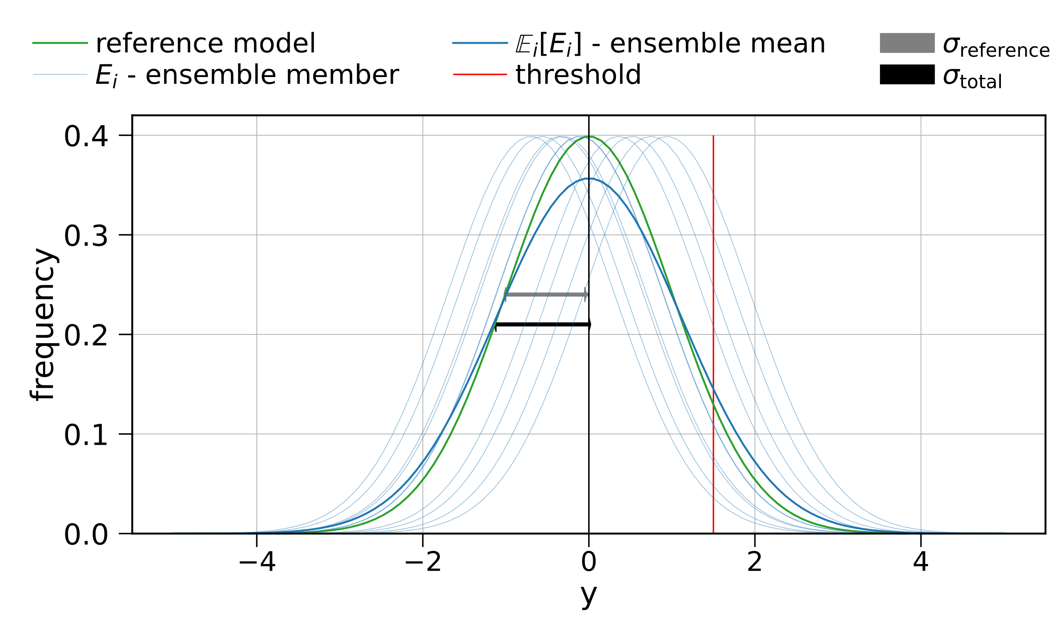
Ensemble distillation
Approximate a computationally complex ensemble with a single lightweight model during inference
Assumptions:
$y$ is an output variable for track $x$, $y \sim 𝒩(μ(x), σ_{reference} (x))$
Ensemble has normally-distributed $μ\left(x\right)$
$σ_{reference}^{2}$ - variance of distribution of $y$ for the reference model
$σ_{systematic}^{2}$ - systematic uncertainty of the training procedure
Toy data
$$σ_{total}= \sqrt{σ_{reference}^{2}+ σ_{systematic}^{2}}$$

Slide 10
Uncertainty estimation with(out) ensembles
$σ_{systematic}= \sqrt{\frac{1}{2}(𝔼_{ens}\left[{\left(y^{(1)} −y^{(2)}\right)}^{2}\right]−𝔼_{ref}\left[{\left(y^{(1)}−y^{(2)}\right)}^{2}\right])}$
$𝔼_{ens}$ and $𝔼_{ref}$ - the average operators computed across data produced by ensemble model or reference models
$y^{(1)}$and $y^{(2)}$ - independently sampled examples from the corresponding model
Train a regression to approximate $σ_{systematic}$ from the ensemble, thus allowing uncertainty computation with just a single model
The training doesn’t use true labels, therefore is not restricted to the available data

Slide 11
Computing efficiency uncertainty with $σ_{systematic}$
Toy data
$$Cut efficiency={refernce efficiency}_{−σ_{eff}^{−}}^{{+σ}_{eff}^{+}}$$

Slide 12
Efficiency with uncertainty, uniform train/test split
Generative models uncertainty estimation, ACAT-2021
Kaons
Muons
Pion efficiency at 90% overall signal efficiency as a function of momentum. The data are uniformly split into training and testing parts
For most of the bins, efficiency on the test data lies inside the error bounds of the efficiency of the model

Slide 13
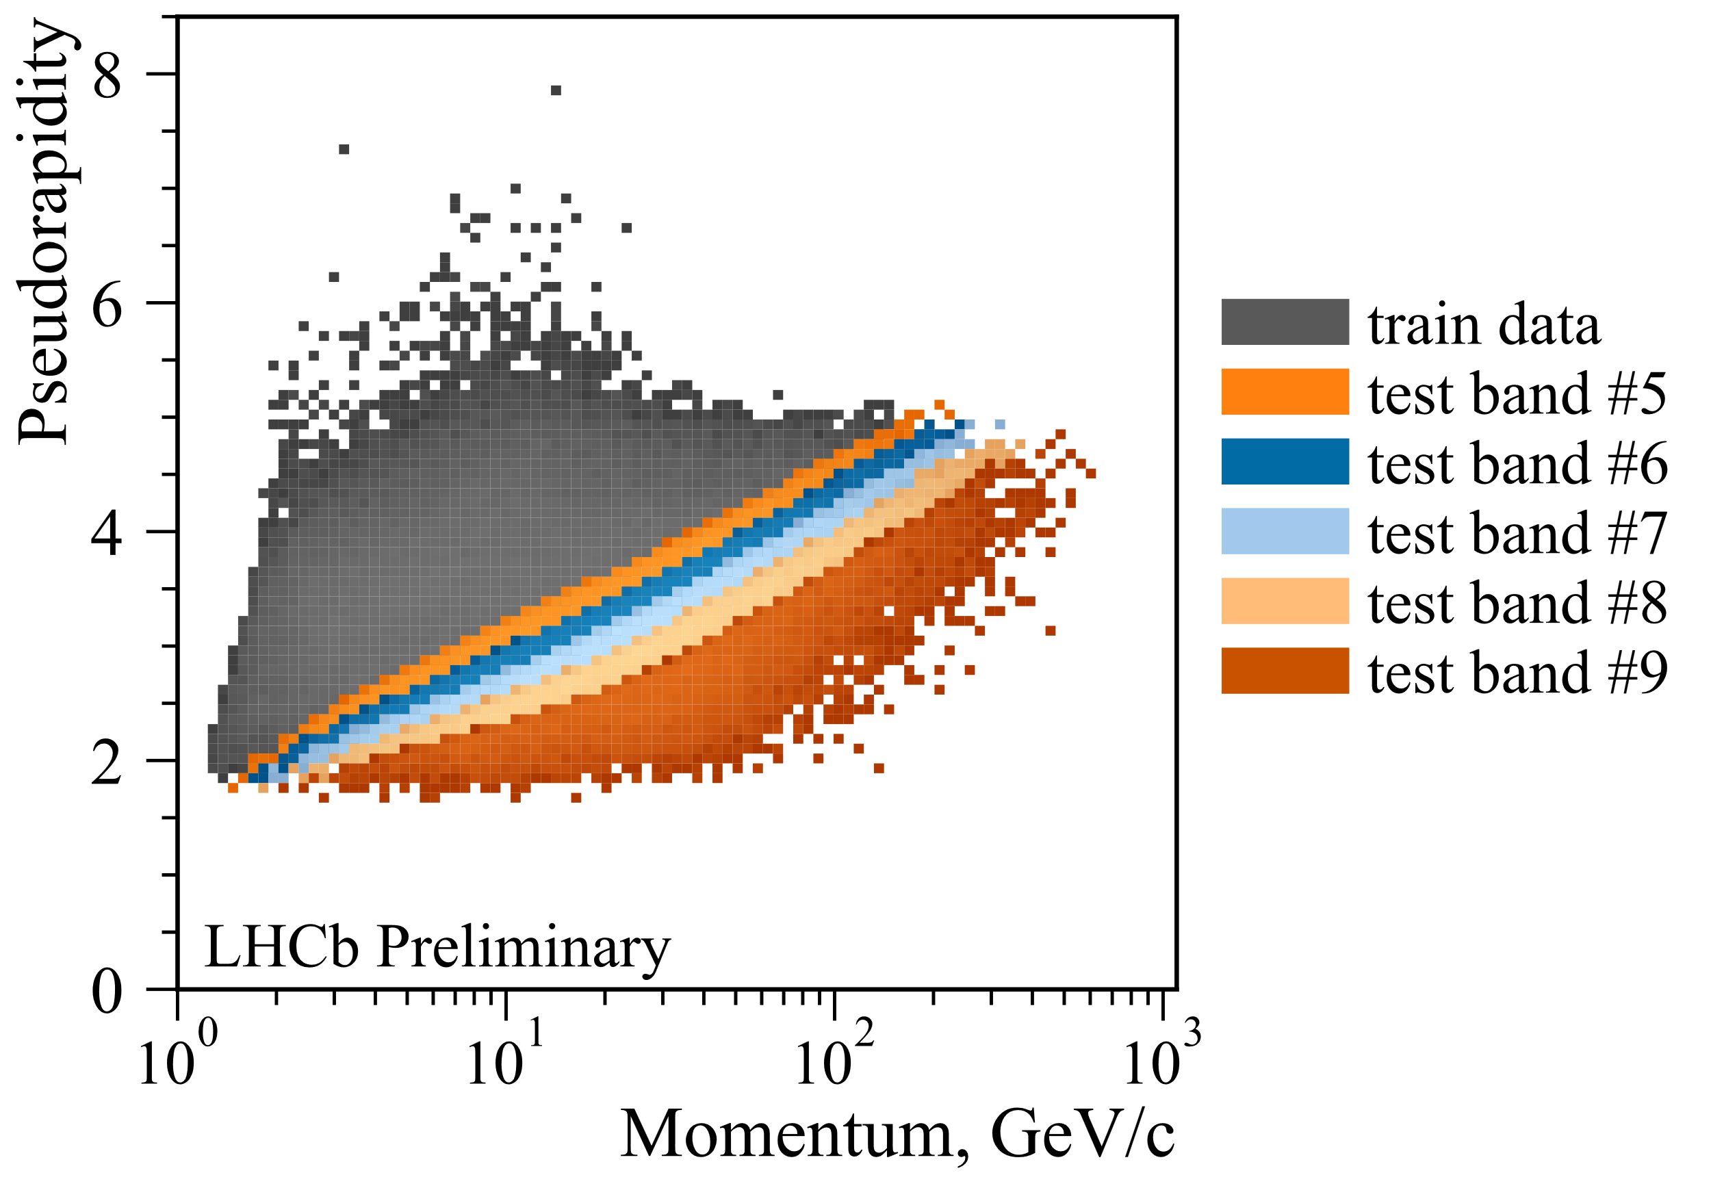
Extrapolation scan
The dataset is split into train and test subsets by a line in equal proportions.
Each subset is divided into bands, where one band contains the same number of samples
Generative models uncertainty estimation, ACAT-2021

Slide 14
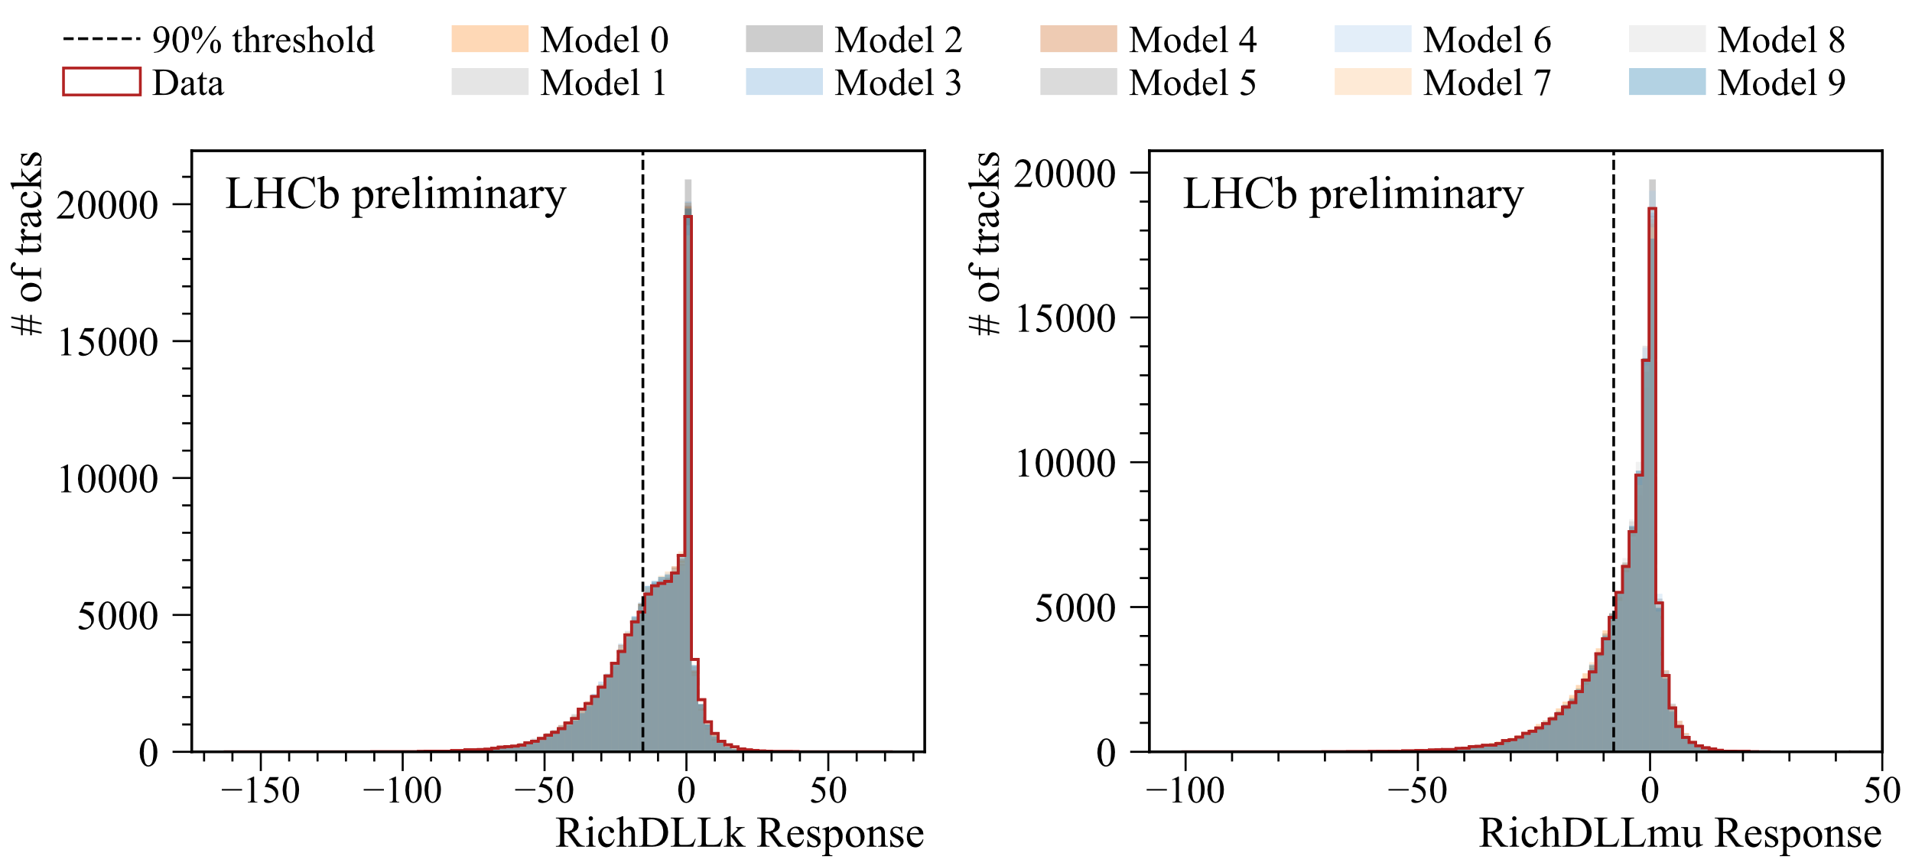
Distribution of the RichDLLs in a region with training data
Generative models uncertainty estimation, ACAT-2021

Slide 15
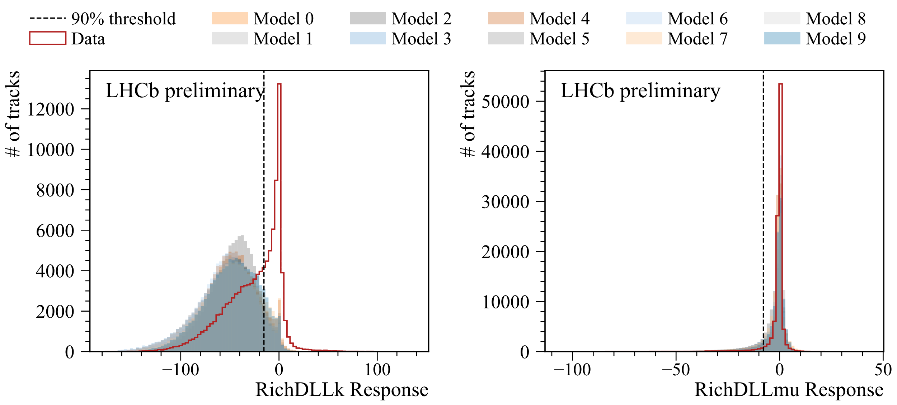
Distribution of the RichDLLs in a region without training data
Generative models uncertainty estimation, ACAT-2021

Slide 16
Efficiency with uncertainty, extrapolation scan
Generative models uncertainty estimation, ACAT-2021
Kaons
Muons
Pion efficiency at 90% overall signal efficiency as a function of band index. Bands 0-4 are training parts 5-9 are testing parts
The uncertainly increases while getting further from the training region. However, the uncertainty does not increase sufficiently to account for the discrepancy in the furthest test regions

Slide 17
Instead of conclusion
With some adaptation, ensemble and Bayesian methods can be used for generative model uncertainty estimation
Ideally we want to get an uncertainty estimate to be plugged into an analysis
Realistically, we are at the stage "can we use this model with these input data?"
We propose an uncertainty estimation method, and evaluate it on LHCb RICH
For most of the bins, efficiency on the test data lies inside the error bounds of the efficiency of the model
In the extrapolation case, the uncertainly increases while getting further from the training region, but not sufficiently to account for the discrepancy in the furthest test regions
Thanks!

Slide 18
Backup

Slide 19
LHCb RICH fast simulation. Figure of merit
RichDLL common use is classification – tracks are filtered by a condition RichDLLx > threshold
We choose a threshold for RichDLLx so that 90% of tracks with type x pass it
Of course, not only particles of type x pass the selection, but there are also false positives
We plot the pion efficiency: the fraction of pions for which RichDLLx > threshold
Ideally, it should match for data and GAN

