Slide 1
Institut Pascal Learning to Discover introduction

Slide 2
3rd of a series
15-26 Jul 2019: Real time analysis workshop
14-25 Oct 2019: Advanced Pattern recognition
Learning to discover : Jul 2020, Feb 2021, Feb 2022, April 2022!

Slide 3
Program
19-20 : Representation Workshop
21-22 : Dealing with uncertainties workshop
25-26 : Generators workshop
27-29 : final conference
Each workshop : ~55 on-site participants + ~75 remote
Final conference : 110 on-site + 80 remote

Slide 4
Social Events
Tuesday
Lunch buffet
Dinner 6:30 at Brass & co (20’ walk from here on the plateau, see map on indico). We would leave « en masse » from Institut Pascal at 6PM
Please fill asap the Google Form you should have received from Sabrina
Wednesday
Lunch cafeteria

Slide 5
Premices
The whole Institut Pascal (half-building) is yours
Two amphitheaters the big 120 one and the small 70 one (we use the big for plenary for social distancing)
40 offices (« Learning to Discover ») pick yours (possibly shared).
You can write your name on the sheet outside
Small meeting rooms, free coffee machines…

Slide 6
Spirit
Long talks, do not hesitate to ask questions during the talk:
On zoom raise your hand
Long coffee breaks
Break-out sessions
Un-organised spontaneous discussions

Slide 7
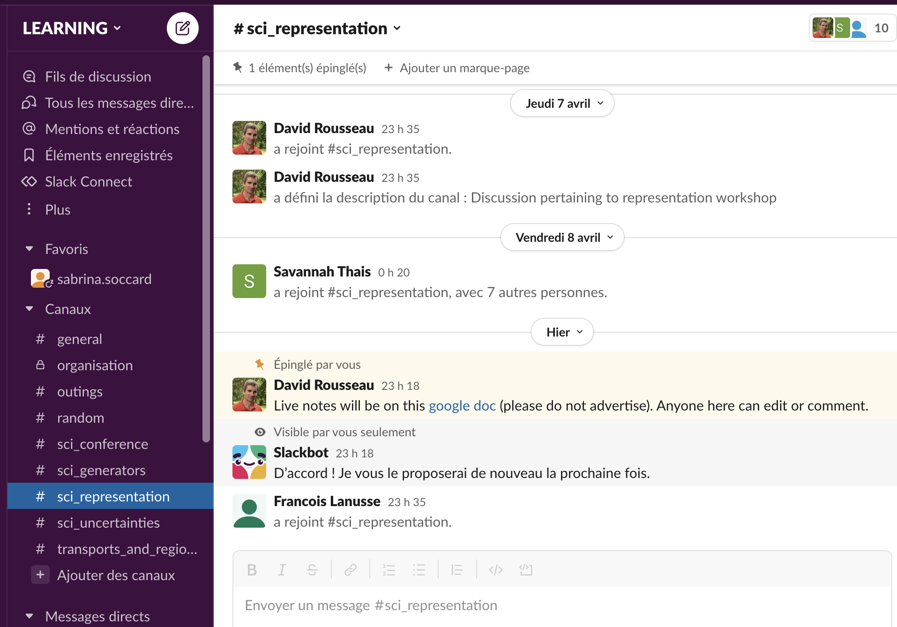
slack
Primary channel of communication
140 participants as of this morning. Make sure you’re connected (ask your neighbour)

Slide 8
Zoom
Zoom in meeting mode (no waiting room, everyone sees every one else connection)
Link, meeting ID and code distributed on slack
Please do not adverstise beyond workshop and conference
Anyone of you can start zoom in amphi and meeting rooms : « join » room number + code
Do not hesitate to exercise it yourself
6 break out room created. Anyone can navigate between these rooms and the main.
Zoom chat (volatile) only to be used for connection issues
Use slack for scientific exchanges : #sci_representation for this workshop (other specific channel can be created on request)

Slide 9
Live Document
Google doc link posted in slack #sci_representation (please do not advertise beyond workshop attendees)
Live notes
Break-out sessions proposed themes
Anyone can edit / comment. Feel free to add info. Propose break-out sessions.

Slide 10
Break-out sessions
Semi auto organised
Theme added in google doc, you can add your own and vote
Org committee will assign physical and zoom room
You take it from there
(sketchy) report Tuesday end of afternoon

Slide 11
(not) Facebook
List of participants on indico lists who is here or remote for which workshop and conference
Google sheet with one page per participant (to be) shared on slack
Please duplicate first (dummy) page and briefly introduce yourself, recent work, interest

Slide 12
Workshop summary at the final conference
Each workshop will be summarised in 30’ at the final conference
Savannah Thais kindly volunteered for this one
She might ask for your inputs

Slide 13
Outcome
Work started or continued from collaboration enriched in these workshops may be published in special edition of Computing and Software for the Big Science.
If interested, talk to one of the organiser

Slide 14
Organising committee
Sabrina Soccard, Program Manager at Institut Pascal
Peter Battaglia, senior scientist at Google Deepmind
Anja Butter, ITP Heidelberg : generator models and uncertainties in ML for Particle Physics
Cécile Germain : Emeritus professor (computer science) Université Paris-Saclay, LRI-CNRS, and INRIA TAU team, organiser of the 2014 HiggsML and 2018-2019 TrackML challenge
Tobias Golling, associate professor at Université de Genève, generative models and anomaly detection for particle physics
Vladimir Vava Gligorov, CNRS/IN2P3 LPNHE, leader of the LHCb Real Time analysis project, organiser of the Real Time Analysis Institut Pascal Workshop
Eilam Gross, Weizmann Institute, organiser of the Hammers and Nails 2017 and 2019 workshop
Michael Kagan, SLAC, co-coordinator of CERN Interexperiment Machine Learning group
Danilo Rezende, Researcher on Probabilistic Methods for Decision Making, Senior Staff Researcher and Team Lead at Google Deepmind
David Rousseau, CNRS/IN2P3 IJCLab : former co-coordinator of ATLAS Machine Learning group, co-coordinator of the LHC Interexperiment Machine Learning Group, organiser of the 2014 Higgs Machine Learning challenge, and of the 2018-2019 TrackML challenge
Andreas Salzburger, CERN, coordinator of the ATLAS software upgrade group, organiser of the 2018-2019 TrackML challenge and organiser of the Advanced Pattern Recognition Institut Pascal Workshop
Savannah Thais, Princeton, representation learning for Particle Physics, AI and ethics
Jean-Roch Vlimant, Caltech, co-coordinator of CMS Machine Learning group, organiser of the 2018-2019 TrackML challenge
Slava Voloshynovskiy, head of Stochastic Information Processing group, Université de Genève

Slide 15
Sponsors
Thanks to our sponsors (see indico Menu)
Institut Pascal
Paris Saclay Center for Data Science
TrackML
DataIA
CNRS/IN2P3
Recept
Dark Matter Lab

