Slide 1
?
Druva
Uncertainty quantification in Deep Learning
Geoffrey DANIEL, CEA/DES/ISAS/DM2S/STMF/LGLS

Slide 2
Plan
Uncertainty quantification in Deep Learning
Different levels of uncertainties
Uncertainties estimation in Deep Learning
Validation of uncertainties
Works in collaboration with Jean-Marc MARTINEZ (DES/ISAS/DM2S/STMF/LGLS)
And two interns: Mohamed Bahi YAHIAOUI (Mines St Etienne) and Clément RIBES (IMT Atlantique)

Slide 3
Plan
Uncertainty quantification in Deep Learning
Different levels of uncertainties
Uncertainties estimation in Deep Learning
Validation of uncertainties
Works in collaboration with Jean-Marc MARTINEZ (DES/ISAS/DM2S/STMF/LGLS)
And two interns: Mohamed Bahi YAHIAOUI (Mines St Etienne) and Clément RIBES (IMT Atlantique)

Slide 4
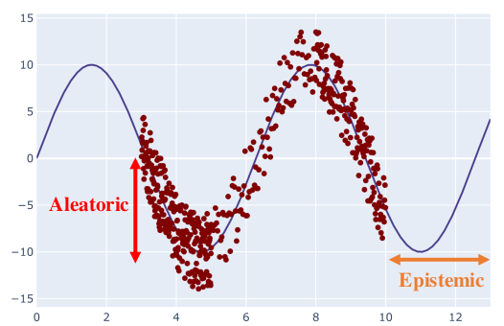
Predictive, aleatoric and epistemic uncertainties
Let $x$ an input point, $f_{ω}$ a predictive model with parameters $ω$
Objective: Quantifying the uncertainty on the prediction $f_{ω}\left(x\right)$
→ Predictive uncertainty
Aleatoric uncertainty
→ Uncertainty related to the data/the phenomenon
Epistemic uncertainty
→ Uncertainty related to the model
Visualisation of the two types of uncertainty
A review of uncertainty quantification in deep learning: Techniques, applications and challenges, M. Abdar et al., https://doi.org/10.1016/j.inffus.2021.05.008

Slide 5
Predictive, aleatoric and epistemic uncertainties
Aleatoric uncertainty
Phenomenon
Observations
Observed data
Randomness in the phenomenon
Missing data
Error and noise in measurements
Statistical and systematical uncertainty (see N. Berger talk)
Uncertainty intrinsic within the data, irreducible by improving the model or increasing the dataset
→ A larger dataset does not reduce aleatoric uncertainty, but it helps to give a better estimation!
We can reduce the aleatoric uncertainty by improving the measurement (reducing the error or noise) for instance.

Slide 6
Predictive, aleatoric and epistemic uncertainties
Epistemic uncertainty
Represents the lack of « knowledge » or « understanding » of a model on a specific input data point
Two main origins of epistemic uncertainty for machine learning models:
Estimation error: the training dataset is just a sample of all the possible observable data
Approximation error: no model can approximate perfectly the unknown « true » function
$$𝔽:𝕏→𝕐$$
Space of all the functions
Estimated model
$$\hat{f}$$
Space of all the possible models with parameters $ω$
$$f^{∗}$$
$$f^{†}$$
$$𝓕_{ω}$$
« True » function
Estimation
error
Approximation error
Optimal model
It can be possible to reduce epistemic uncertainty by using more data and increasing the model complexity

Slide 7
Probabilistic formulation
$x$ : input data point
$ω$ : model parameters
$y^{∗}$ : possible output
$D$ : Training dataset
Representation of the total predictive uncertainty by a probability distribution
$$p\left(y^{∗}\right|x,D)=\int_{ω}{p\left(y^{∗} | x,ω\right)p\left(ω|D\right)dω}$$
Aleatoric part
Epistemic part
Intractable in practice → What quantifications and methods in deep learning?

Slide 8
Plan
Uncertainty quantification in Deep Learning
Different levels of uncertainties
Uncertainties estimation in Deep Learning
Validation of uncertainties
Works in collaboration with Jean-Marc MARTINEZ (DES/ISAS/DM2S/STMF/LGLS)
And two interns: Mohamed Bahi YAHIAOUI (Mines St Etienne) and Clément RIBES (IMT Atlantique)

Slide 9
Uncertainties quantification
Classification problems (basics)
Prediction of a class for an input $x$ among $c$ possible classes, represented by a binary vector ${\left(y^{\left(i\right)}\right)}_{i=1}^{c}$
Conventional representation: a model $f_{ω}$ predicts the probability that $x$ belongs to each class $i$:
$$f_{ω}^{(i)}\left(x\right)=p\left(y^{\left(i\right)}=1 | x\right)$$
Corresponding likelihood: multinoulli distribution (generalized Bernoulli)
$$L\left(ω|x\right)=\prod_{i=1}^{c}{{p\left(y^{\left(i\right)}\right|x;ω)}^{y^{\left(i\right)}}}=\prod_{i=1}^{c}{{f_{ω}^{\left(i\right)}\left(x\right)}^{y^{\left(i\right)}}}$$
Mean negative log-likelihood on the whole dataset: categorical cross-entropy
$l\left(ω\right)=−\frac{1}{N}\sum_{j}{\sum_{i}{y_{j}^{\left(i\right)}\log\left(f_{ω}^{\left(i\right)}\left(x_{j}\right)\right)}}$ → Learning: $ω^{∗}=arg\min_{ω}{l\left(ω\right)}$

Slide 10
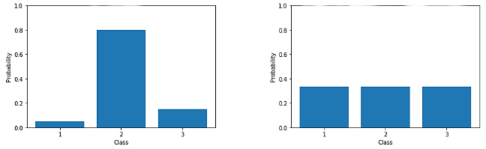
Uncertainties quantification
Classification problems: Aleatoric uncertainty
Let $f_{ω}$, a model with parameters $ω$, $x$ an input data
The aleatoric uncertainty can be interpreted as the uncertainty in the decision between each class.
Example with 3 classes:
High uncertainty
(fully random)
Low uncertainty
Quantity to synthetise this knowledge?

Slide 11
Uncertainties quantification
Classification problems: Aleatoric uncertainty
Quantification from information theory: Shannon entropy
$$ℋ\left(p\left(y | x;ω\right)\right)=−\sum_{i}{p\left(y^{\left(i\right)} | x;ω\right)\log\left(p\left(y^{\left(i\right)} | x;ω\right)\right)=−\sum_{i}{f_{ω}^{\left(i\right)}\left(x\right)\log\left(f_{ω}^{\left(i\right)}\left(x\right)\right)}}$$
Example with 3 classes:
High uncertainty
(fully random)
Low uncertainty
Shannon entropy:
$$0,61$$
$1,1=\log\left(3\right)$ (maximal entropy)

Slide 12
Uncertainties quantification
Example
Generated dataset
Expected entropy (Bayes theorem)
Predicted entropy by a neural network
Toy dataset generated by four 2D gaussian distributions
Separated classes
Overlapped classes

Slide 13
Uncertainties quantification
Example with MNIST
?

Slide 14
Uncertainties quantification
Example with MNIST

Slide 15
Uncertainties quantification
Example with MNIST
?

Slide 16
Uncertainties quantification
Example with MNIST

Slide 17
Uncertainties quantification
Classifcation problems: epistemic uncertainty
Epistemic uncertainty can be interpreted as the part of uncertainty related to the paramaters of the model.
The network parameters $ω$ (weights) are represented by random variables, following a (unknown) probability distribution $p\left(ω\right|D)$, with the training dataset $D$.
Quantification of the epistemic uncertainty using the mutual information between the outputs $y$ and the network parameters $ω$, conditionned by the input $x$ and the training set $D$ :
$$𝓘\left(y;ω\right|x;D)=𝓗\left(𝔼_{ω ∽ p\left(ω | D\right)}\left(p\left(y | x;ω\right)\right)\right)−𝔼_{ω ∽ p\left(ω | D\right)}\left(𝓗\left(p\left(y | x;ω\right)\right)\right)$$
Epistemic uncertainty
Total uncertainty
Aleatoric uncertainty
Mutual information
Entropy of the mean prediction
_
Mean entropy of the predictions
=

Slide 18
Uncertainties quantification
Classification problems: epistemic uncertainty, in practice
Main difficulty: estimation of $p\left(ω | D\right)$ → still an open problem in Deep (and Machine) Learning, numerous methods are proposed that we will present later
Let suppose that $p\left(ω | D\right)$ is known (or estimated at least)
Mutual information is still analytically intractable → use Monte-Carlo sampling
Drawing $T$ samples $\{ω_{1},ω_{2},…,ω_{T}\}$ from $p\left(ω | D\right)$
Mean prediction approximation:
Total entropy approximation:
Aleatoric entropy approximation:
Mutual information approximation:
$$𝔼_{ω ∽ p\left(ω | D\right)}\left(p\left(y^{\left(i\right)} | x;ω\right)\right)≅\hat{p}\left(y^{\left(i\right)}\right|x)=\frac{1}{T}\sum_{t}{p\left(y^{\left(i\right)} | x;ω_{t}\right)}$$
$$ℋ\left(\hat{p}\left(y | x\right)\right)=−\sum_{i}{\hat{p}\left(y^{\left(i\right)}\right|x)\log\left(\hat{p}\left(y^{\left(i\right)}\right|x)\right)}$$
$$\hat{ℋ}\left(p\left(y | x;ω\right)\right)=−\frac{1}{T}\sum_{t}{\sum_{i}{p\left(y^{\left(i\right)} | x;ω_{t}\right)\log\left(p\left(y^{\left(i\right)} | x;ω_{t}\right)\right)}}$$
$$\hat{ℐ}\left(y;ω|x,D\right)=ℋ\left(\hat{p}\left(y | x\right)\right)−\hat{ℋ}\left(p\left(y | x;ω\right)\right)$$

Slide 19
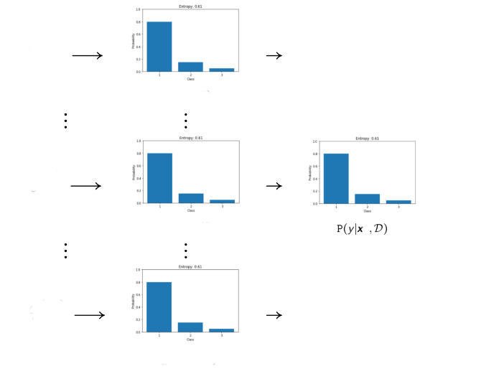
Uncertainties quantification
Intuition
Low variability between each model
→ Low epistemic uncertainty
Different samples $ω_{i}$
$$p\left(y | x;ω_{1}\right)$$
High mean probability for one class
→ Low total uncertainty
$$p\left(y | x;ω_{t}\right)$$
High probability for one class in each model
→ Low aleatoric uncertainty
$$p\left(y | x;ω_{T}\right)$$
19

Slide 20
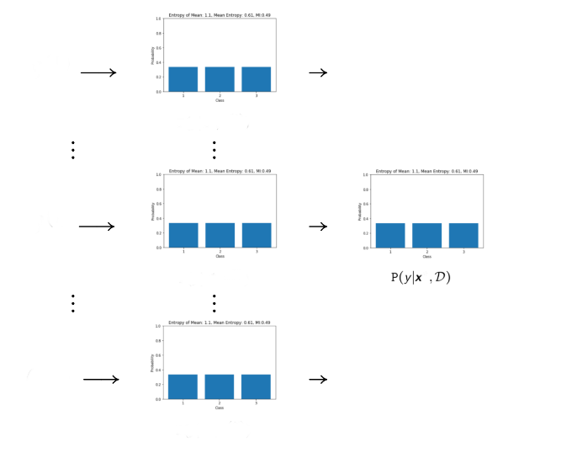
Uncertainties quantification
Intuition
Low variability between each model
→ Low epistemic uncertainty
Different samples $ω_{i}$
$$p\left(y | x;ω_{1}\right)$$
Low mean probability for each class
→ High total uncertainty
$$p\left(y | x;ω_{t}\right)$$
Low probability for each class in each model
→ High aleatoric uncertainty
$$p\left(y | x;ω_{T}\right)$$
20

Slide 21
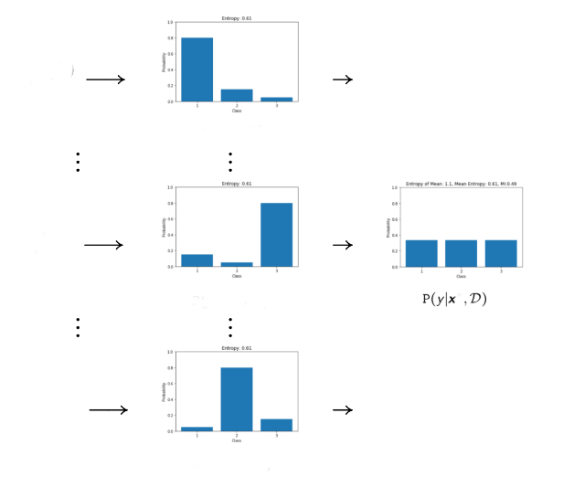
Uncertainties quantification
Intuition
High variability between each model
→ High epistemic uncertainty
Différents paramètres tirés
$$p\left(y | x;ω_{1}\right)$$
Low mean probability for each class
→ High total uncertainty
$$p\left(y | x;ω_{t}\right)$$
High probability for one class in each model
→ Low aleatoric uncertainty
$$p\left(y | x;ω_{T}\right)$$
21

Slide 22
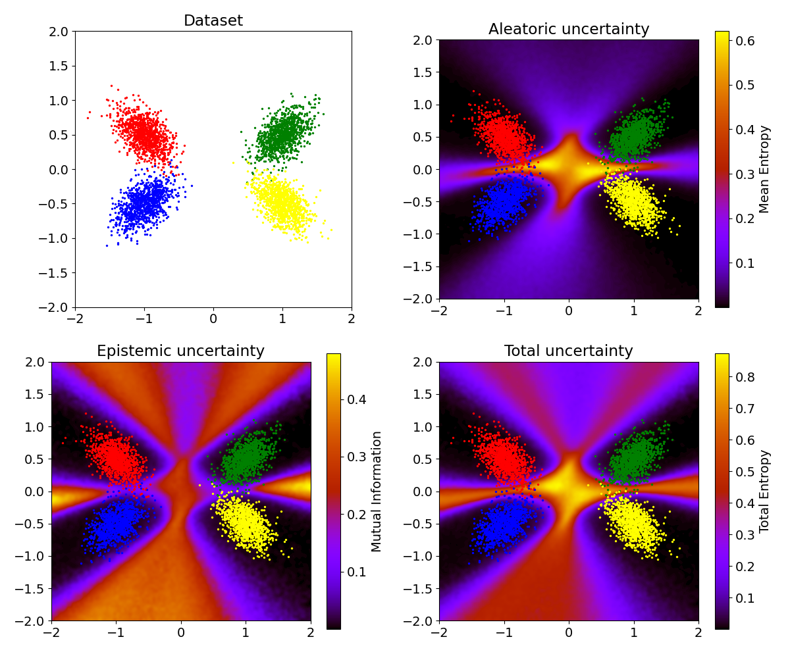
Uncertainties quantification
Example
Back to the toy dataset (four 2D gaussian distributions)
Predicted aleatoric uncertainty
Use of Monte-Carlo Dropout as approximation of bayesian Neural Network
Predicted epistemic uncertainty
Predicted total uncertainty
22

Slide 23
Uncertainties quantification
Regression problems: conventional approach
Let $f_{ω}$ a model with parameters $ω$, ${\left(x_{j},y_{j}\right)}_{j}$ training data.
Loss function: Mean Squared Error
$$ω^{∗}=\underset{ω}{argmin}{\frac{1}{N}{\left\|y_{j}−f_{ω}\left(x_{j}\right)\right\|}_{2}^{2}}$$
Implicit hypothesis:
The output data follow a normal distribution $y_{j} ∼𝒩\left(μ_{j},σ_{j}^{2}𝕀\right)$
Data noise is homoscedastic, $σ_{j}$ is uniform for every example $j$
These hypothesis lead to the following likelihood ($d$ is the output dimension) :
$$L\left(ω\right)=\prod_{j}{\frac{1}{{\left(2πσ_{j}^{2}\right)}^{\frac{d}{2}}}\exp\left(−\frac{{\left\|y_{j}−f_{ω}\left(x_{j}\right)\right\|}_{2}^{2}}{2σ_{j}^{2}}\right)}$$
Negative log-likelihood + $σ_{j}$ constant
The estimated mean $\hat{μ}$ is the output of the model $f_{ω}$
Direct estimation of $\hat{μ}$ presented yesterday (N. Berger talk)
23

Slide 24
Uncertainties quantification
Regression problems: aleatoric uncertainty
Density neural networks
We model the aleatoric uncertainty using a distribution $p\left(y | θ\left(x\right)\right)$ with parameters $θ\left(x\right)$.
The outputs of the neural network correspond to these parameters $θ$ : $f_{ω}\left(x\right)=θ\left(x\right)$
Remark: we can use one dedicated model (neural network) for each parameter
Objective : minimization of the negative log-likelihood
$$ω^{∗}=\underset{ω}{argmin}{−\sum_{j}{log⁡(p\left(y_{j} | f_{ω}\left(x_{j}\right)\right)}}$$
Example: 1D gaussian distribution, $θ(x)=\left(μ(x),σ(x) \right).$
The homoscedasticity hypothesis is no longer required, $σ$ depends on $x$!
$$p\left(y | f_{ω}\left(x\right)\right)=\frac{1}{\sqrt{2π}f_{ω}^{\left(2\right)}\left(x\right)}\exp\left(−\frac{1}{2}\frac{{\left(y−f_{ω}^{\left(1\right)}\left(x\right)\right)}^{2}}{f_{ω}^{\left(2\right)}{\left(x\right)}^{2}}\right)$$
Negative log-likelihood:
Remarks:
The « real » standard deviation is not required in the training dataset
Other distributions can be considered, but could raise convergence problems (such as divergence of the likelihood)
$$l\left(ω\right)=\sum_{j}{\log\left(\sqrt{2π}f_{ω}^{\left(2\right)}\left(x_{j}\right)\right)+\frac{1}{2}\frac{{\left(y_{j}−f_{ω}^{\left(1\right)}\left(x_{j}\right)\right)}^{2}}{f_{ω}^{\left(2\right)}{\left(x_{j}\right)}^{2}} }$$
24

Slide 25
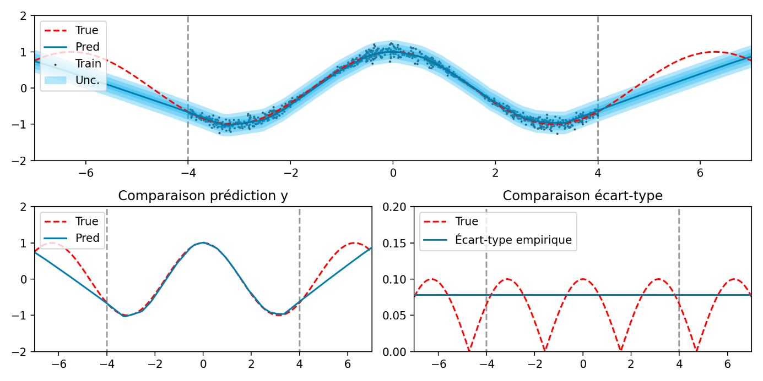
Uncertainties quantification
Regression problem: aleatoric uncertainty
Density neural networks: example
Generated data with heteroscedastic gaussian noise
Conventional appraoch:
Least squares estimation
Empirical estimation of the standard deviation, uniform regardless the input
25

Slide 26
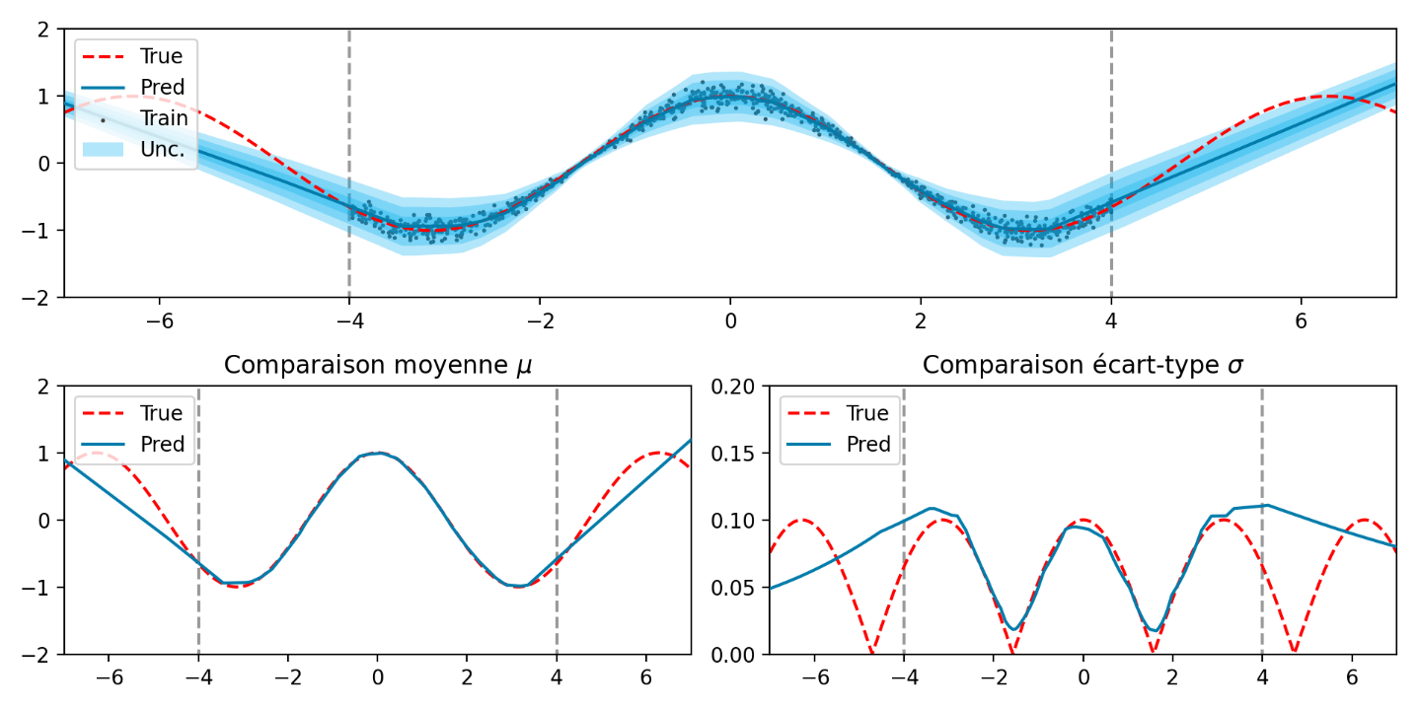
Uncertainties quantification
Regression problems: aleatoric uncertainty
Density neural networks: example
Generated data with heteroscedastic gaussian noise
Density neural networks
26

Slide 27
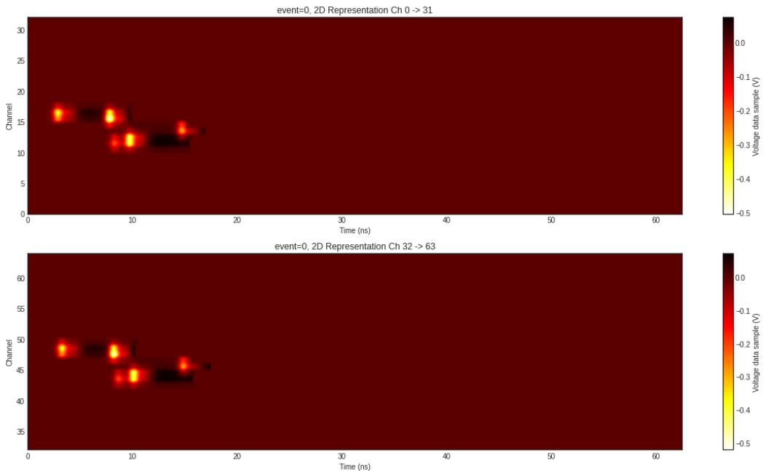
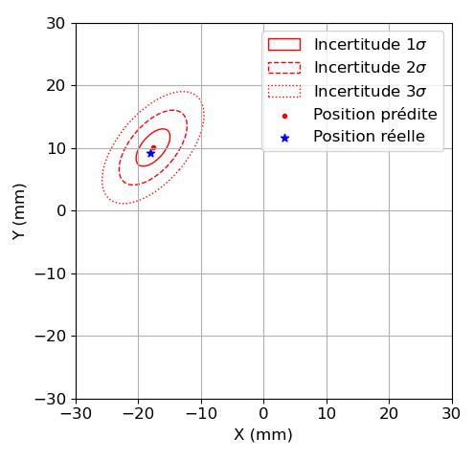
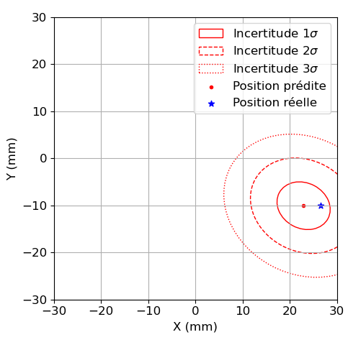
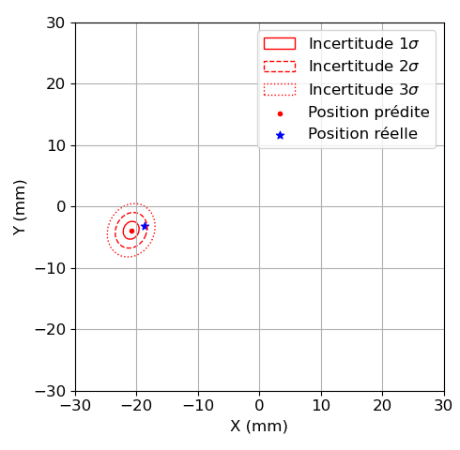
Uncertainties quantification
Input example
Regression problems: aleatoric uncertainty
Density neural networks: application to a detector for medical imaging
Transverse project (DRF/Irfu, DRF/SHFJ, DES/LGLS) within the ClearMind project
Input: Electrical impulse shapes recorded by the detector (high dimension 400x64)
Output: Gamma interaction position
Density neural network with a 2D gaussian distribution (with a correlation factor)
27

Slide 28
Uncertainties quantification
Regression problems: aleatoric uncertainty
Quantile regression: a non-parametric approach
Introduced yesterday with MAPIE talk
For an expected output $y\left(x\right)$, the quantile $q_{α}(x)$ with probability $α$ is the value such as:
$$p\left(q_{α}\left(x\right)≥y\left(x\right)\right)=α$$
Quantile regression: prediction of the quantile, agnostically to the density of $y$
Loss function: Pinball loss, for a probability level $α$ and $f_{ω}\left(x\right)$ is trained to represent $q_{α}\left(x\right)$
$$ω^{∗}=\underset{ω}{argmin}{\frac{1}{N}\sum_{x∈D}{max\left(α\left(y\left(x\right)−f_{ω}\left(x\right)\right),\left(1−α\right)\left(f_{ω}\left(x\right)−y\left(x\right)\right)\right)}}$$
Advantage:
No model of the expected noise (aleatoric uncertainty) is necessary
Multi-modal distributions can be approximated
Limitations:
Large amount of data required for a correct estimation of extreme quantiles
Local or global interpretation of quantiles?
28

Slide 29
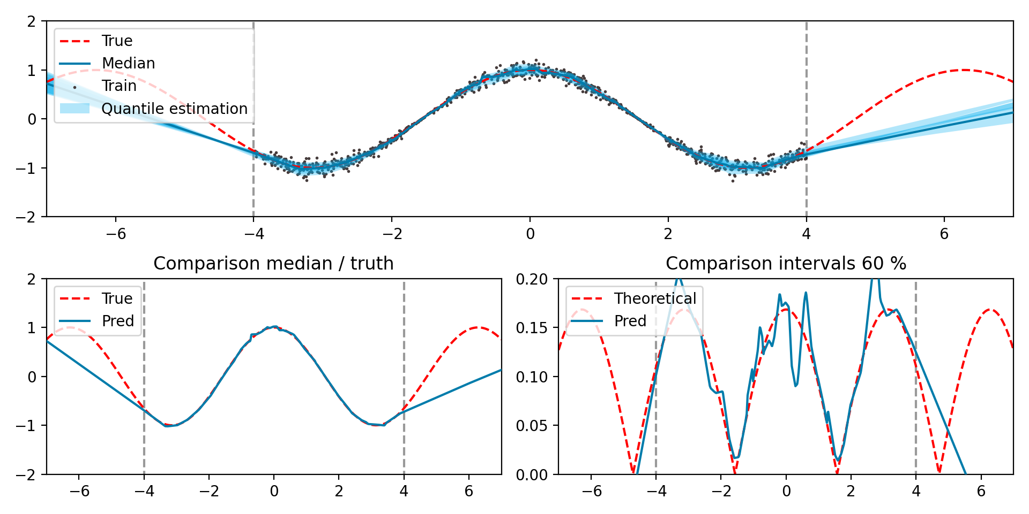
Uncertainties quantification
Regression problems: aleatoric uncertainty
Quantile regression: Example
Generated data with heteroscedastic gaussian noise
29

Slide 30
Uncertainties quantification
Regression problems: epistemic uncertainty
Same interpretation as classification: dependance of the output on the parameters $ω$ with a distribution $p\left(ω | D\right)$
Same main difficulty as classification: estimation of $p\left(ω | D\right)$
Quantity to characterize the epistemic uncertainty in regression: variance
$$𝕍\left(y | x,D\right)=𝕍_{ω ∼ p\left(ω | D\right)}\left(𝔼_{y ∼ p\left(y | f_{ω}\left(x\right)\right)}\left(y\right)\right)+𝔼_{ω ∼ p\left(ω | D\right)}\left(𝕍_{y ∼ p\left(y | f_{ω}\left(x\right)\right)}\left(y\right)\right)$$
Total uncertainty
Epistemic uncertainty
Aleatoric uncertainty
Differential entropy (extension of Shannon entropy to continuous cases) instead of variance?
30

Slide 31
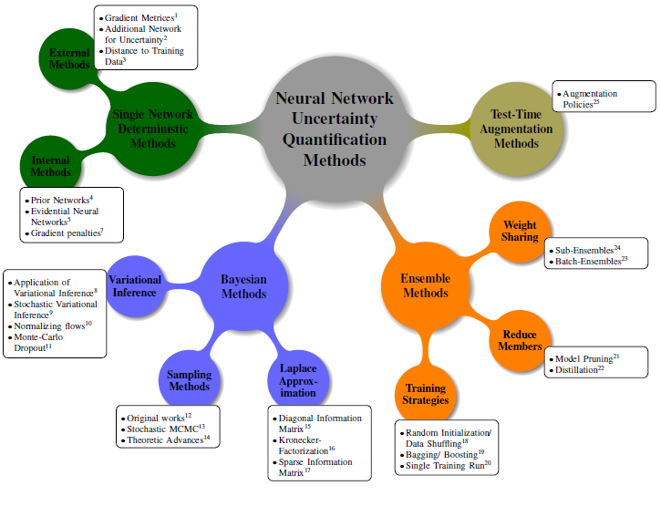
Numerous approaches in Deep Learning
A Survey of Uncertainty in Deep Neural Networks, J. Gawlikowski et al,, arXiv:2107.03342
31

Slide 32
Numerous approaches in Deep Learning
A Survey of Uncertainty in Deep Neural Networks, J. Gawlikowski et al,, arXiv:2107.03342
32

Slide 33
Numerous approaches in Deep Learning
Single Network Deterministic methods :
The name is explicit: using one single neural network with a deterministic prediction
Examples:
Additionnal Network for Uncertainty: in classification problems, we have several answers for a single input point. For instance, several doctors give possibly different diagnostics for a same image, we compute the corresponding frequency of positive and negative answers and the networks is trained on these frequencies.
Evidential Neural Network: extension of Density Neural Networks with a probability distribution on the parameters of the probability distribution
Example :
Gaussian distribution on the output: $y \sim 𝒩\left(μ,σ^{2}\right)$
The parameters $μ$ et $σ$ are considered as random variables:
$μ \sim 𝒩\left(γ,v^{−1}σ\right)$
$σ \sim Γ^{−1}\left(α,β\right)$
The neural network estimates the four parameters $\left(γ,v,α,β\right)$
The direct prediction is given by $𝔼\left(μ\right)=γ$
The aleatoric uncertainty is given by $𝔼\left(σ^{2}\right)=\frac{β}{α−1}$ and the epistemic uncertatinty $𝕍\left(μ\right)=\frac{β}{v\left(α−1\right)}$
Interesting formalism but some issues in practice, especially for Out-of-distribution points
33

Slide 34
Numerous approaches in Deep Learning
A Survey of Uncertainty in Deep Neural Networks, J. Gawlikowski et al,, arXiv:2107.03342
34

Slide 35
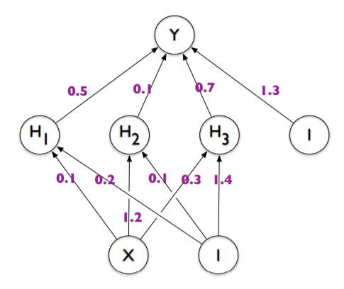
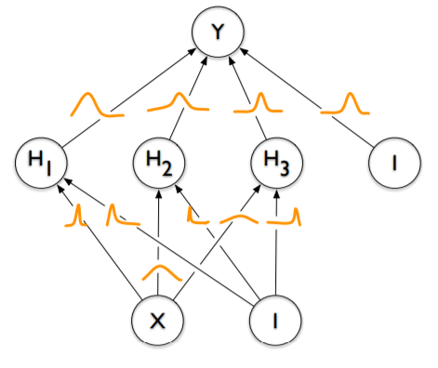
Numerous approaches in Deep Learning
Bayesian approaches:
Main idea: achieving a sampling of $ω$ according to the unknown distribution $p\left(ω | D\right)$
Several approaches:
Bayes by backprop: variational inference
$p\left(ω | D\right)$ is intractable
Approximation by a distribution $q\left(ω\right|Θ)$
For instance : $Θ_{l}=(μ_{l},σ_{l})$ parameters of a gaussian
Objective function:
$$Θ^{∗}=\underset{Θ}{argmin}{KL[q\left(ω | Θ\right)|\left|p\left(ω | D\right)\right]}$$
$⇔Θ^{∗}=\underset{Θ}{argmin}{KL[q\left(ω | Θ\right)|\left|p\left(ω\right)\right]−𝔼_{q\left(ω | Θ\right)}[\log\left(p\left(D | ω\right)\right)]}$
Weight Uncertainty in Neural Networks, Blundell et al.
KL: Kullback-Leibler divergence
ELBO : Evidence Lower Bound
Regularization term
Prior $p\left(ω\right)$ to be defined
→ Limitation?
Likelihood maximization
Monte-Carlo sampling for estimation
→ Limitations in the training procedure
35

Slide 36
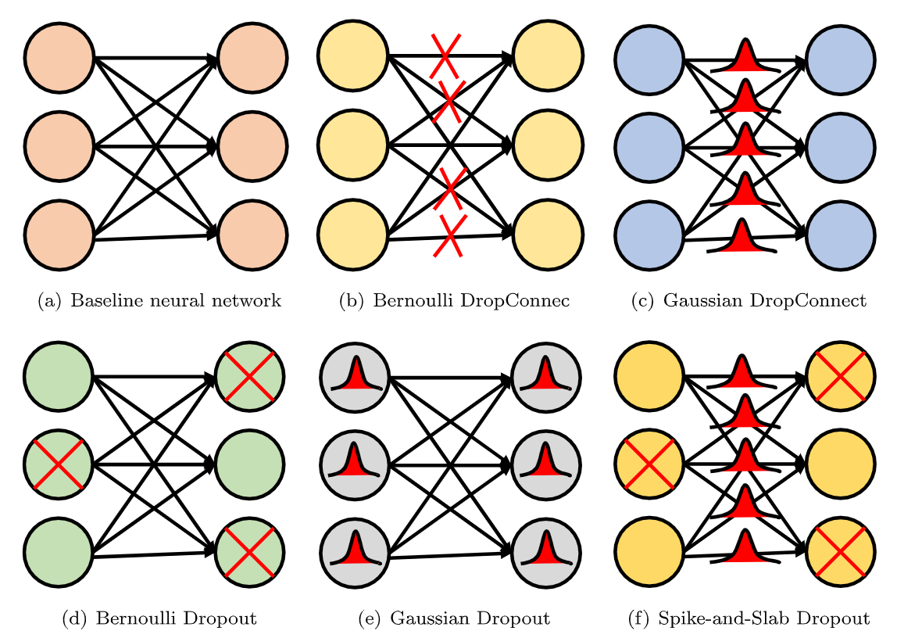
Numerous approaches in Deep Learning
Bayesian approaches :
Main idea: achieving a sampling of $ω$ according to the unknown distribution $p\left(ω | D\right)$
Several approaches:
Monte-Carlo Dropout
Deactivation or noise on neurons or weights
Conventional method for regularization
Applied at test time
Deactivation of weights: each component of $ω$ follows a Bernoulli distribution
Gaussian noise: each componant of $ω$ follow a gaussian distribution, we optimize the mean (variance is fixed)
Prior $p\left(ω\right)$ chosen as $𝒩\left(0,l\right)$ → $L_{2}$-regularization
Limitations:
Weak theoretical guarantees
Dropout rate/Variance of the gaussian noise?
36

Slide 37
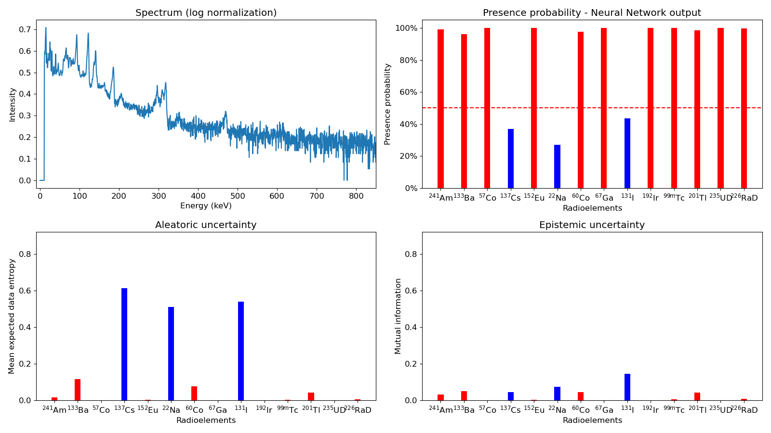
Numerous approaches in Deep Learning
Example: application to gamma spectroscopy
True present elements
True absent elements
37

Slide 38
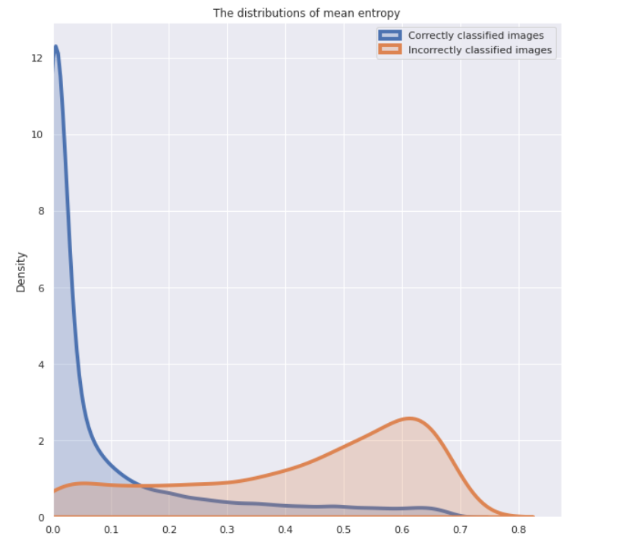
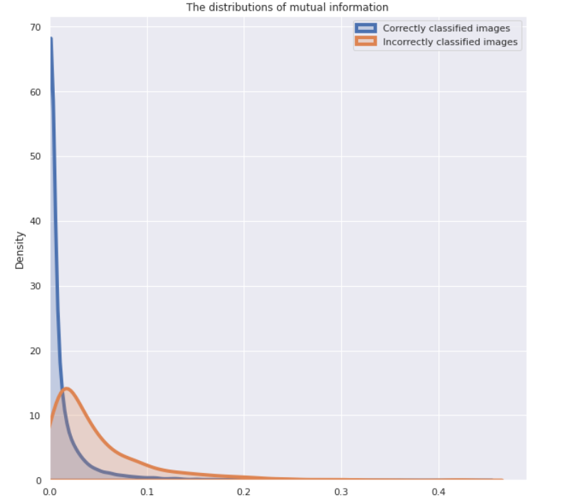
Numerous approaches in Deep Learning
Use uncertainty to « identify » wrong prediction ?
Correctly classified spectra
Incorrectly classified spectra
Correctly classified spectra
Incorrectly classified spectra
Mean entropy = Aleatoric uncertainty
Mutual information
= Epistemic uncertainty
Wrong predictions: high aleatoric uncertainty
Correct predictions: low aleatoric uncertainty
Wrong prediction: slightly higher uncertainty than correct predictions

Slide 39
Numerous approaches in Deep Learning
A Survey of Uncertainty in Deep Neural Networks, J. Gawlikowski et al,, arXiv:2107.03342
39

Slide 40
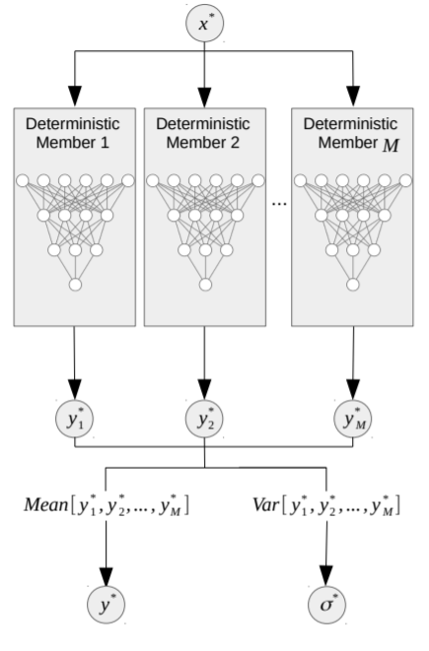
Numerous approaches in Deep Learning
A Survey of Uncertainty in Deep Neural Networks, J. Gawlikowski et al,, arXiv:2107.03342
Ensemble methods :
Main idea: train several neural networks in order to provide a variability on the output
Several approaches:
Random initialization of the network parameters
Database shuffling
Random noise in the gradient descent
Limitations:
Requires the learning of several models
Storing several models
40

Slide 41
Numerous approaches in Deep Learning
A Survey of Uncertainty in Deep Neural Networks, J. Gawlikowski et al,, arXiv:2107.03342
41

Slide 42
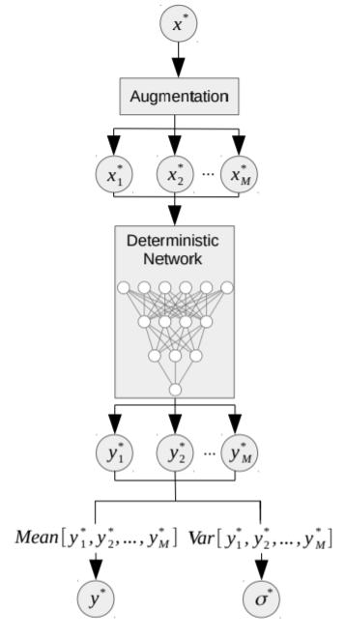
Numerous approaches in Deep Learning
A Survey of Uncertainty in Deep Neural Networks, J. Gawlikowski et al,, arXiv:2107.03342
Test-time augmentation methods:
Main idea: Introducing noise or distortion in the input in order to obtain a variability in the prediction
Several distortions:
Gaussian noise or other noises
For images: zoom, rotations, deactivate pixels in the image…
Limitations:
Selection of the noise level, the type of distortions
Real representation of uncertainties?
42

Slide 43
Plan
Uncertainty quantification in Deep Learning
Different levels of uncertainties
Uncertainties estimation in Deep Learning
Validation of uncertainties
Works in collaboration with Jean-Marc MARTINEZ (DES/ISAS/DM2S/STMF/LGLS)
And two interns: Mohamed Bahi YAHIAOUI (Mines St Etienne) and Clément RIBES (IMT Atlantique)

Slide 44
Validation of uncertainties
Calibration curves in classification
Similar concept introduced yesterday with MAPIE talk
Main idea: probabilistic interpretation of the neural network output:
$$f_{ω}^{\left(i\right)}=p\left(y^{\left(i\right)} | x\right)$$
Comparison in the test set between the frequency of correct answers and the associated probabilities
Example: the frequency of correct classifications with a predicted probability 40% should be 40%
A Survey of Uncertainty in Deep Neural Networks, J. Gawlikowski et al,, arXiv:2107.03342

Slide 45
Validation of uncertainties
Calibration curves in classification
A Survey of Uncertainty in Deep Neural Networks, J. Gawlikowski et al,, arXiv:2107.03342
Recalibration technics:
Regularization methods at training time
Post-processing with a temperature factor (temperature scaling)
$$f_{ω}^{\left(i\right)}\left(x\right)=p\left(y^{\left(i\right)} | x\right)=σ\left(\frac{z^{\left(i\right)}}{T}\right)$$
Calibration of hyperparameters: Dropout rate for MC-Dropout, for instance
Conformal prediction (MAPIE)

Slide 46
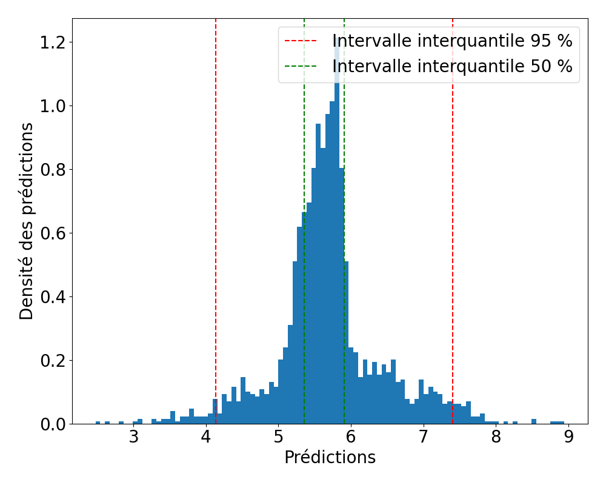
Validation of uncertainties
Calibration curves in regression
Prediction interval $I_{α}\left(x\right)$ for a data point $x$ with a probability $α$ :
$P\left(I_{α}\left(x\right)∋y\left(x\right)\right)=α$, where $y\left(x\right)$ is the expected output for $x$
By using methods for un certainty quantification, we can estimate interquantile intervals ${\hat{I}}_{α}$:
Analytically in the case of Density Neural Networks:
Direct estimation of the probability density $p\left(y | θ\right)$ where $θ=f_{ω}\left(x\right)$
Direct computation by using Monte-Carlo sampling of the output
46
Notes:
Slide clé: prendre du temps, présenter courbes de calibration + MSE
Dans certains cas, grande incertitude

Slide 47
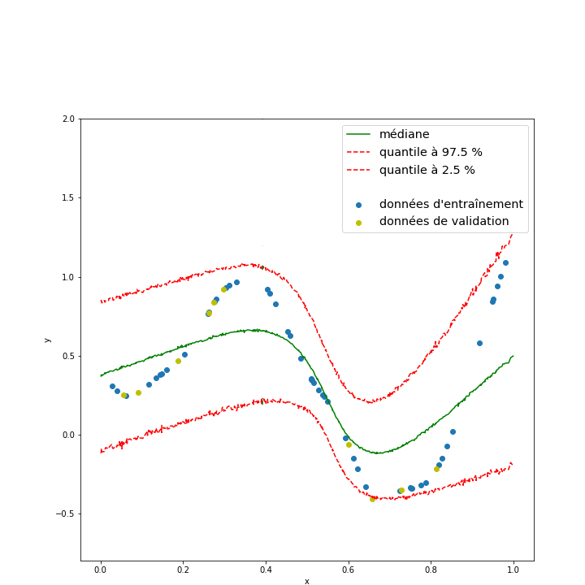
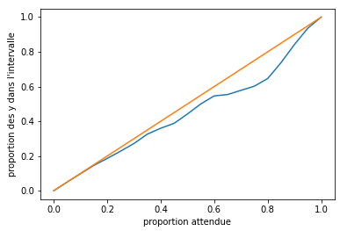
Validation of uncertainties
Calibration curves in regression
Introduced yesterday with MAPIE talk
Does estimated interquantile intervals ${\hat{I}}_{α}$ with probability $α$correspond to prediction intervals $I_{α}$ with probability $α$?
Verification procedure: mean evaluation on the test set
If the uncertainties are well calibrated, it does not imply that the model has good predictive performance
$$𝔼_{x}\left[P\left({\hat{I}}_{α}\left(x\right)∋y\left(x\right)\right)\right]=\int_{x}{P\left({\hat{I}}_{α}\left(x\right)∋y\left(x\right)\right)}p\left(x\right)dx \underset{?}{=}{α}$$
Calibration curve: frequency of exepected output in the predicted interquantile interval ${\hat{I}}_{α}$ compared to the probability $α$
Recalibration :
Modification of the density model in Density Neural Networks
Hyperparameters tuning (Dropout rate in MC-Dropout, prior for Bayesian Neural Networks…)
Conformal prediction (MAPIE)
47
Notes:
Slide clé: prendre du temps, présenter courbes de calibration + MSE
Dans certains cas, grande incertitude

Slide 48
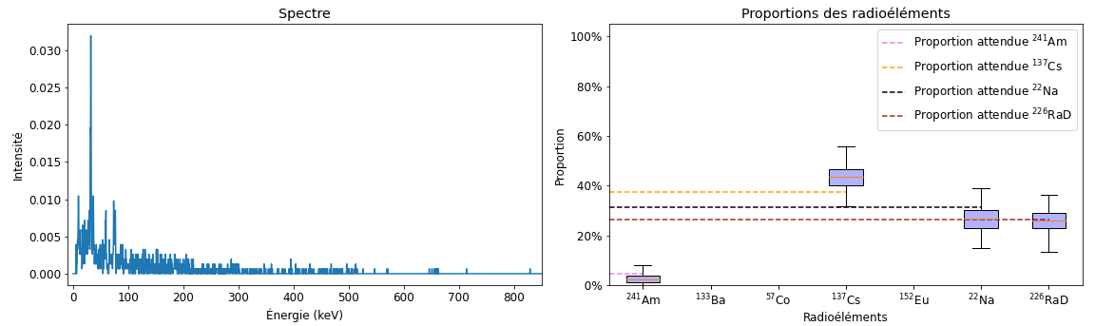
Validation of uncertainties
Calibration curves in regression
Application: examples for gamma spectroscopy
Pay attention: prediction of the proportions for each radioelement (not their presence)
→ Regression problem
→ Uncertainty prediction by MC-Dropout
Example:
48

Slide 49
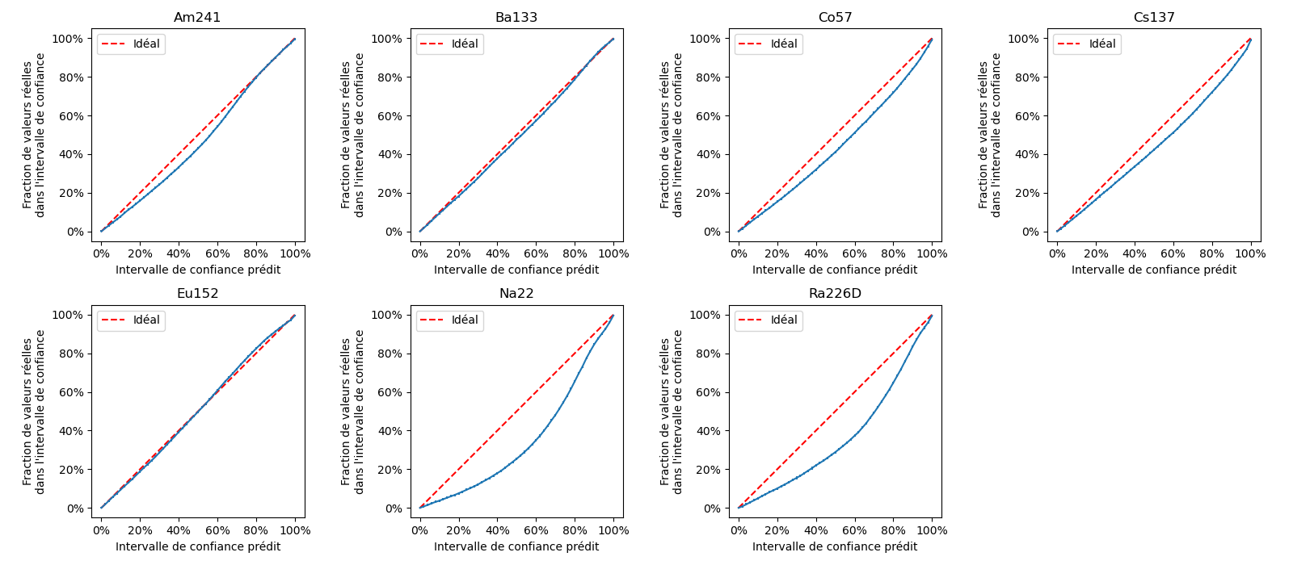
Validation of uncertainties
Calibration curves in regression
Application: examples for gamma spectroscopy
Calibration curves for a Dropout rate of 0,25
Size of the interquantile interval at 95 %: 5 %
49

Slide 50
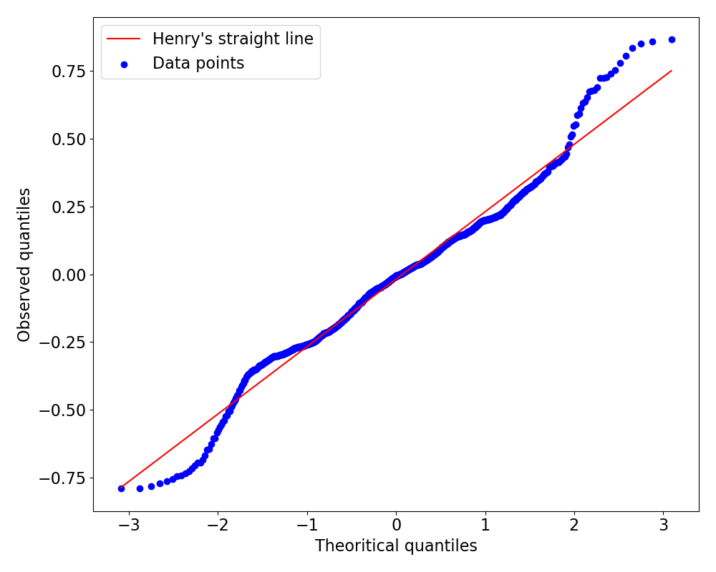
Validation of uncertainties
Q-Q plots
Example of Q-Q plot
Other method to validate uncertainties in the case of Density Neural Networks
Example: we consider a model that estimates, for each input $x$, the mean $\hat{μ}\left(x\right)$ and the standard deviation $\hat{σ}\left(x\right)$
We compute the normalized error for each data point $\left(x_{i},y_{i}\right)$:
$$t_{i}=\frac{\left(y_{i}−\hat{μ}\left(x_{i}\right)\right)}{\hat{σ}\left(x_{i}\right)}$$
If $y_{i}$ follows a normal distribution $𝒩\left(\hat{μ}\left(x_{i}\right),\hat{σ}\left(x_{i}\right)\right)$, then $t_{i}$ follows a normal distribution $𝒩\left(0,1\right)$.
We can compute the quantile-quantile plot of ${\left(t_{i}\right)}_{i}$ on the dataset.
Observed quantiles: sorted values of $t_{i}$
Theoritical quantiles: $Φ^{−1}\left(\frac{j}{N}\right)$ where $j$ is the j-th sorted index and $N$ is the size of the dataset
50

Slide 51
Conclusion
Methods for uncertainties quantification in Deep Learning:
New state-of-the-art
Rapid evolution in the literature
Be cautious with the interpretation → Estimated uncertainties must be validated
Simplified implementation thanks to dedicated libraries and frameworks : Tensorflow Probabilities, MAPIE…
Importance to consider uncertainties notions in scientific applications of Deep (Machine) Learning algorithms
Connections to notions of robustness (sensibility of neural networks to small perturbations), out-of-distribution detection…
Thanks for your attention!
Questions?

Slide 52
References
Reviews on uncertainties in Deep Learning
A Survey of Uncertainty in Deep Neural Networks, J. Gawlikowski et al. (2021) arXiv:2107.03342
A review of uncertainty quantification in deep learning: Techniques, applications and challenges, M. Abdar et al. (2020), Information Fusion https://doi.org/10.1016/j.inffus.2021.05.008
Mixture Density Network (extension of Density Neural Networks)
Mixture Density Networks, Christopher M. Bishop (1994), NCRG/94/004 https://publications.aston.ac.uk/id/eprint/373/1/NCRG_94_004.pdf
Bayes by backprop
Weight Uncertainty in Neural Networks, Blundell et al. (2015), Proceedings of the 32 nd International Conference on Machine Learning arXiv:1505.05424v2
Monte-Carlo Dropout
Dropout as a Bayesian Approximation: Representing Model Uncertainty in Deep Learning, Gal & Ghahramani (2016), Proceedings of the 33 rd International Conference on Machine Learning arXiv:1506.02142v6

